Slide 1
Develop a Robust User Community
Sarah Fisher
STFC

Slide 2
Overview
Introduction
RAL LabVIEW User Group
  Setup
  Successes
  Challenges
Team Based Development
  Source code control
  Code sharing
  Code reviews, LabVIEW Version Control

Slide 3
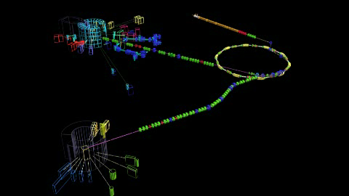
The ISIS Pulsed Neutron and Muon Source
Notes:
ISIS produces beams of neutrons and muons that allow scientists to study materials at the atomic level using a suite of instruments.

Slide 4
Diagnostics at ISIS
19 PXI and 2 cRIO systems for DAQ and logging from ~ 250 diagnostics monitors
  Position
  Profile
  Loss
  Intensity
Essential to run ISIS safely and efficiently.

Slide 5
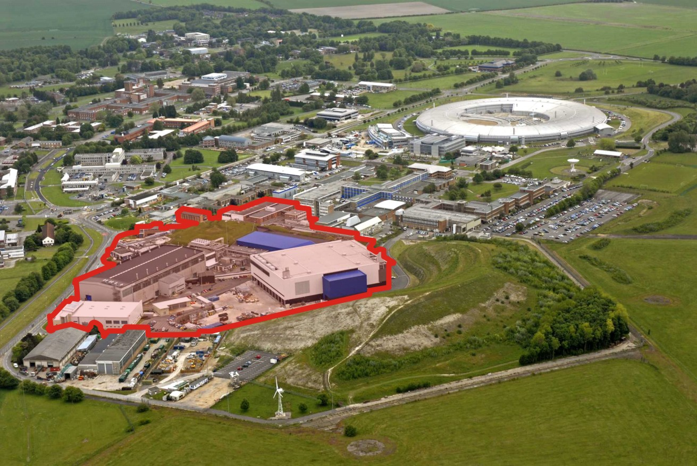
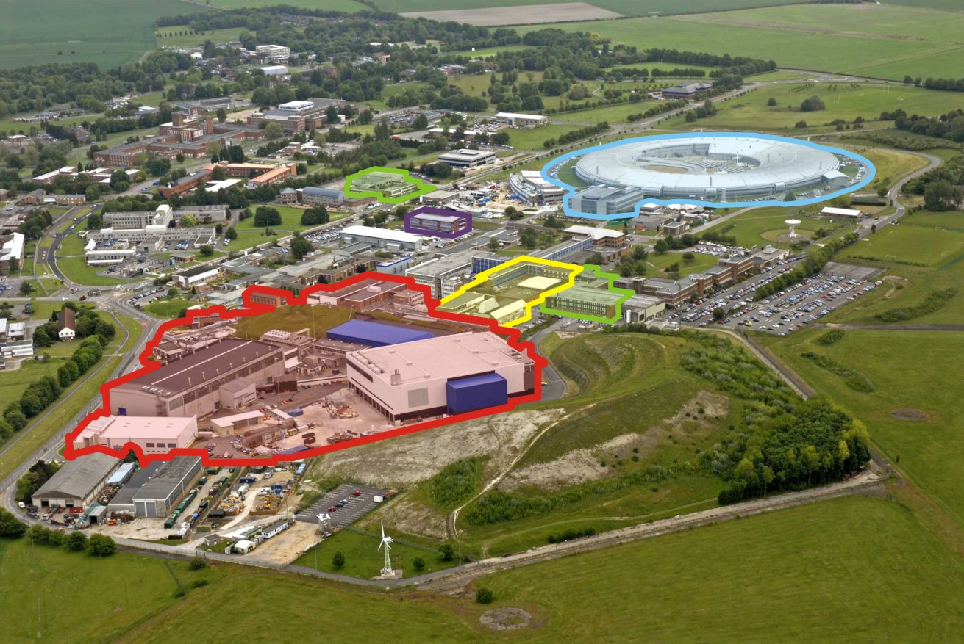

Rutherford Appleton Laboratory
Operated by STFC
Harwell Science and Innovation Campus,
Oxfordshire
Diamond LS
eScience
CLF
RAL Space
ISIS
Notes:
Science and Technology Facilities Council, one of the UKs 7 research councils.
Other facilities at RAL – CLF, RAL Space & DLS – the UKs national synchrotron radiation facility.

Slide 6
RAL LabVIEW User Group
First meeting – March 2009
Held quarterly
Between ~ 10-20 attendees
Currently 172 names on distribution list
Open to anyone, not just RAL
Supported by NI
Lunch

Slide 7
Ensuring success
Familiarity – regular, same time, same place.
Short calendar bookings
Supported, not run, by NI.
Varied agenda, mix of user talks, technical/NI talks and discussion.
Feedback
Food
Fun!

Slide 8
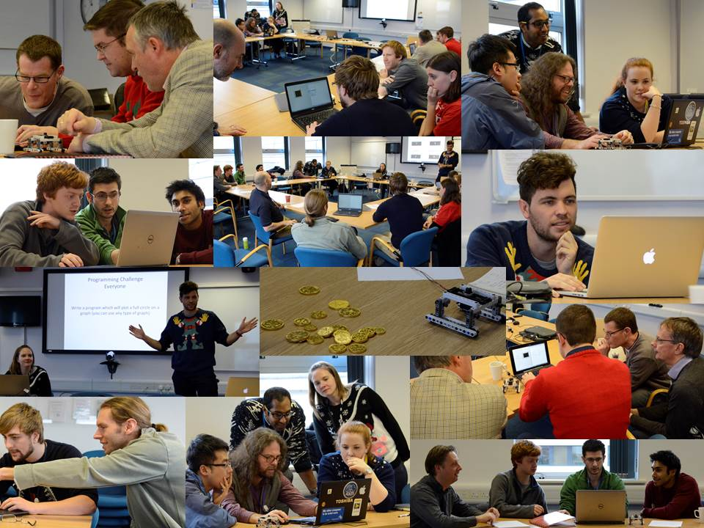
Fun!

Slide 9
Challenges
Volunteers for talks
Group discussion
Technical Level

Slide 10
Enterprise Agreement
Discussions began at an early user group
  RCUK wide agreement
  Unlimited access to LabVIEW all inclusive
  Training credits
  Support
  NIWeek conference passes

Slide 11
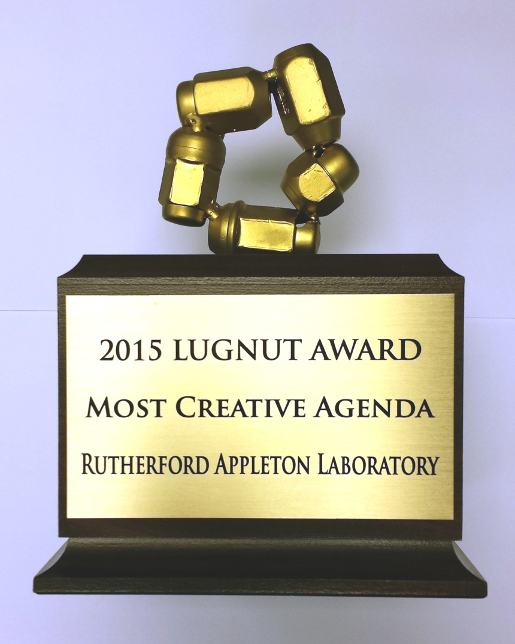
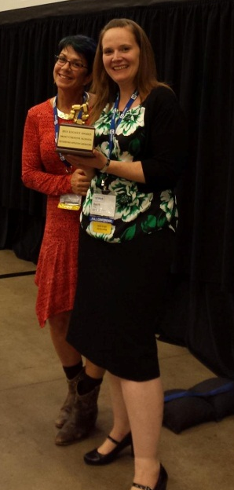
Award Winning

Slide 12
Team Based Development
Source code control
Sharing code
Code reviews
LabVIEW version control
LabVIEW Centre of Excellence

Slide 13
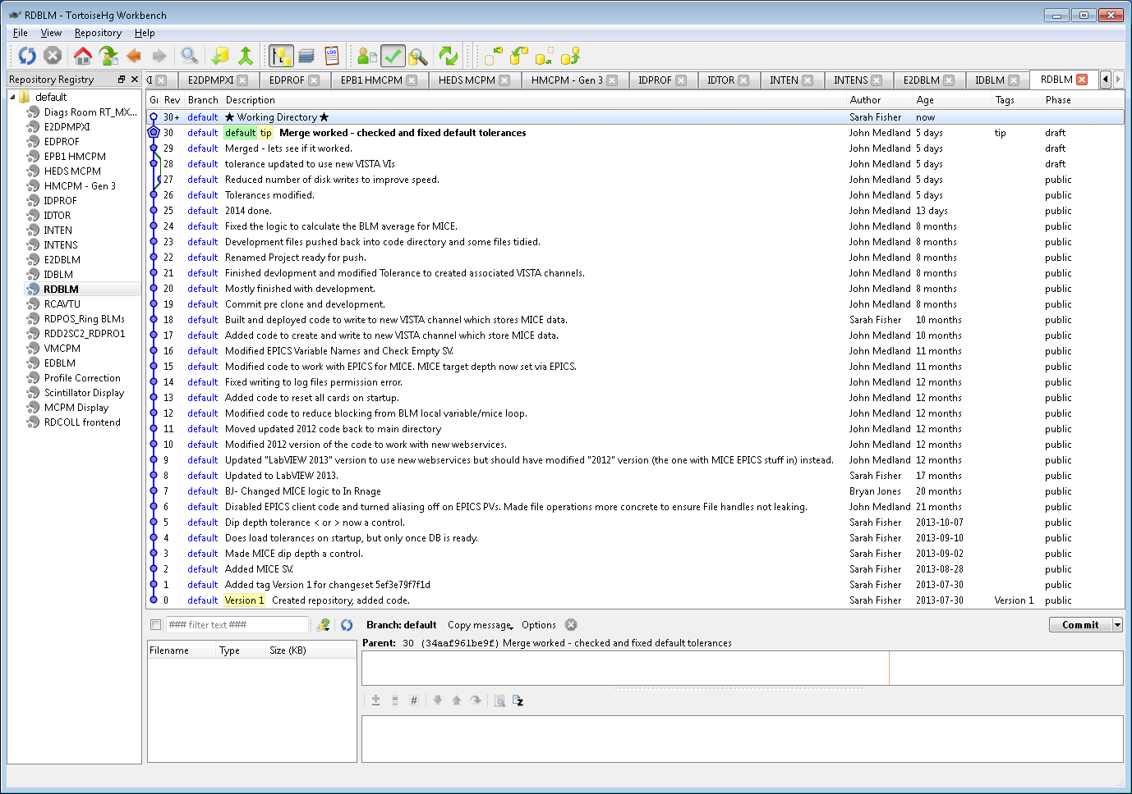

Source Code Control
Mercurial via Tortoise HG Graphical User Interface
  Open source
  Distributed

Slide 14
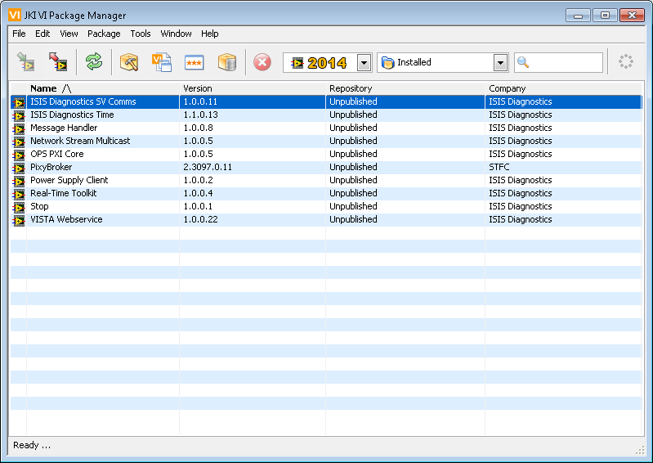
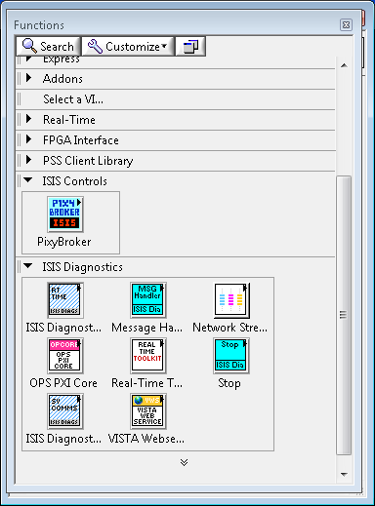
Sharing Code
JKI’s VI Package Manager (VIPM)
  Build reuse code into packages

Slide 15
Other Best Practices
Code Reviews
  Forces readable code
  Bugs are found quicker
  Not just one individual knowledgeable about code
  Learn tips and tricks from each other
Version Control
  All developers developing in the same version
  All exes built in that version
  Thoroughly tested before upgraded
Training and certification

Slide 16
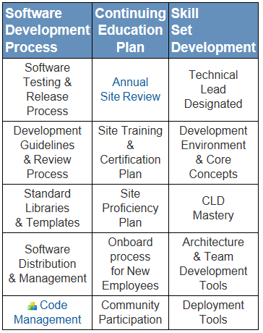
LabVIEW Centre of Excellence
Technical
Knowledge
1 CLA
Development Process
SCC
Continuous Learning
2 CLDs*
Coding Standards
Code Review
Templates and Libraries
NIWeek (optional)
Events (User Groups and Dev Days)
Internal Training Plan
Internal User Group*

Slide 17
Summary
https://decibel.ni.com/content/groups/rutherford-appleton-laboratory
sarah.fisher@stfc.ac.uk

