Slide 1
Actor Framework at GSI
Dr. Holger Brand
GSI Helmholtzzentrum für Schwerionenforschung GmbH
Dieses Material steht unter der Creative-Commons-Lizenz Namensnennung - Nicht-kommerziell - Weitergabe unter gleichen Bedingungen 4.0 International.
Um eine Kopie dieser Lizenz zu sehen, besuchen Sie http://creativecommons.org/licenses/by-nc-sa/4.0/.
Copyright 2015 GSI Helmholtzzentrum für Schwerionenforschung GmbH,
Dr. H. Brand, Dr. D. Neidherr, RBEE, Planckstraße 1, 64291 Darmstadt, Germany

Slide 2
Agenda
Motivation
Crash Course: LVOOP
Actor Design Pattern:
  Classic: Queued State Maschine
  Object-oriented: Actor Framework
CS++ Classes
Communication
  Local: Actor-Messages
  Distributed:
    Linked Network Actor
      Network-Stream
    Shared Variable
    PV Monitor
CS++ Message-Maker
Summary

Slide 3
Motivation I
CS Framework → CS++
CS Framework
  CS is a multi-threaded, event driven, object oriented and distributed framework with SCADA functionality. An experiment control system can be developed by combining the CS framework with experiment specific add-ons. CS is supported on MS-Windows and on Linux (real-time OS Pharlap, LabVIEW RT)
  Artificial object-oriented approach started with LabVIEW 6i
    Reference based (VI-Server), Multiple Inheritance like C++
    Complex with many recommendations which cannot be enforced.
  Network layer: Distributed Information Management (DIM)
  Mainly used with Laser (PHELIX, POLARIS) and many Iontraps

Slide 4
Motivation II
CS Framework → CS++
CS++ Class Library
  Integrate non LabVIEW experts like short term Bachelor & Master students
    CLAD level implementing derived classes
  Plan: Similar feature set as CS Framework based on LVOOP & Dataflow
  Successful Feasability Study: Mobile Agent based on LVOOP (LabVIEW 8.5)
  NI Actor Framework released with LV 2012
  provides simple and efficient design
    First application: Gasflow Control for the COMPACT Detector
  Profit from NI maintenance and community developments
  Network Layer: Abstract Process Variable Base Classes.
    Default: Shared Variables or DataSocket on Linux/Mac
  Use as much NI Tools as possible
    Distributed System Manager, Data Logging & Supervisory Control Module, TDMS & DIAdem
  Future user: APPA community @ FAIR

Slide 5
Crash Course: LVOOP
{

Slide 6
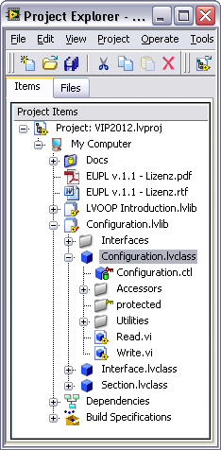
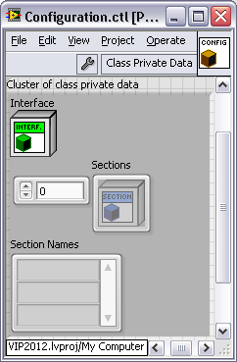
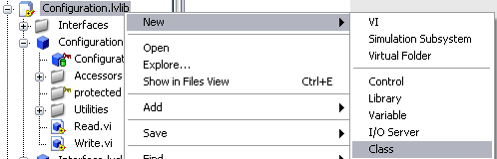

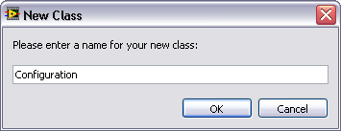
LVOOP Objects and Classes
A Object is an Instance of a class.
  Comparisson: Class: Recipe -> Object: Real Meal
A LabVIEW Class has following properties:
  Attributes are defined in Cluster of Class Private Data.
  Methods are VIs, that read or modifies attribute values.
    Data access VIs (Accessors): simple read or write attribute values.
    Other VIs, that may modify attribute values.
    Access scope: (Who is allowed to call a VI?)
      Private (Community): Only VIs of classe itself (and friends)
      Protected: Only VIs of classe itself and its derived classes
      Public: All other VIs. These are the public interface!

Slide 7
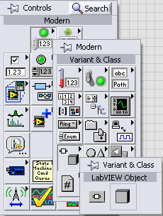
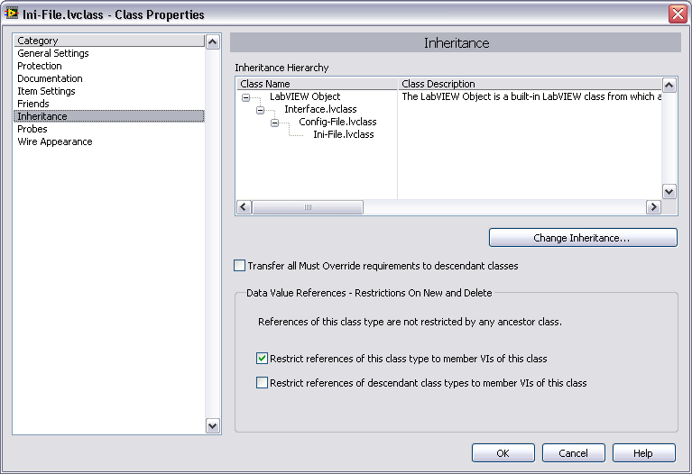
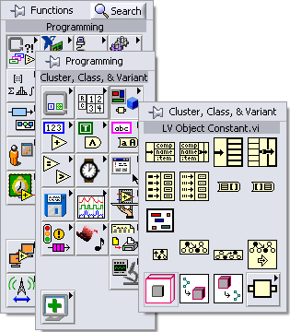
LVOOP Inheritance
User-Classe is derived from ancester class
  LabVIEW Object is the ultimate ancestor class
    Empty Cluster of class private data
    No Methods
  A Class
    inherits properties of der base class
      Attributes: Access via accessor-VIs
      Methodd: protected und public
    extends base class
      new Attributes
      new Methods
    spezializes methods of base classe
      Overrides Dynamic Dispatch-VIs.

Slide 8
Advantages of LVOOP Classes
(with respect to type definition)
Encapsulation
  Attribute data is always private. It can be modified by member-VIs only.
  Interne data structure is hidden.
  Access: Public, Protected, Private, Community (friend)
Modularity
  Each class has a specified responsibility.
  Public interface should be well defined.
    It shouldn‘d be modifies without really good reason.
  Simplyfies testability.
Extensibility
  Derived classes extend the attributes and behaviour of their ancestor class.
Spezialization
  Derived classes spezialize the behaviour of their ancestor class.
  → Override-VI overrides Dynamic-Dispatch-VI
LabVIEW Objects behave exactly like other Datentypes!
  They respect LabVIEW‘s dataflow paradigm!

Slide 9
Crash Course: LVOOP
}

Slide 10
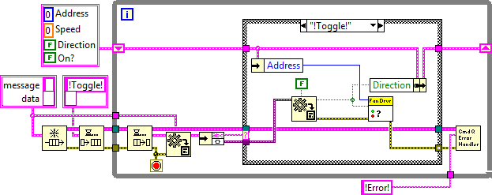
Design Pattern classic: Queued State Maschine
Three Sources of Code Replication
Override the handling of one message
Extend the set of handled messages
Decorate the machine with additional behavior
State
Extend
Override
Decorate
Notes:
Decorate: we want to add behaviors that are not part of the state machine, but are part of the process it models.
All three typically require saving a copy of the state machine and modifying the copy.

Slide 11
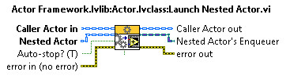
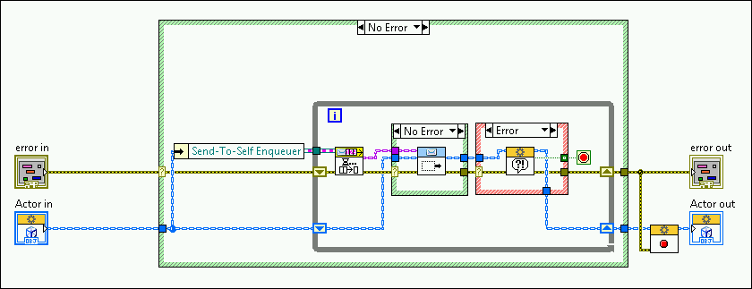
Design Pattern object-oriented
Actor Framework
QSM.vi → Actor Core.vi
  State Cluster → Actor Class
  Command Cluster → Message Class
  Case Structure → Message:Do.vi
  Error-Handling → Handle Error.vi
  Stop → Stop Core.vi
Launch
(uses VI-Server)
Dynamic-Dispatch & Override
Message
State

Slide 12
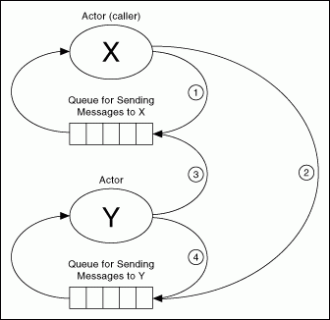
Local Actor Communication
Message.lvclass
Each Actor has a Message-Queue.
Message classes are the public interface.
Communication pathes:
  Actor to Self (1,4)
  Caller-Actor to Nested-Actor (2)
  Nested-Actor to Caller (3)

Slide 13
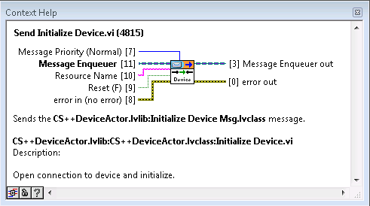
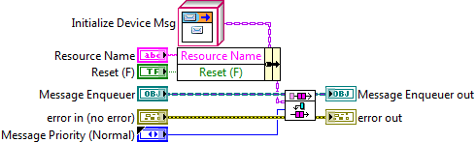
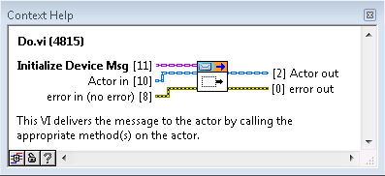
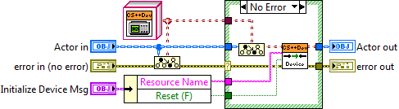
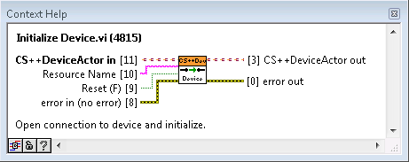
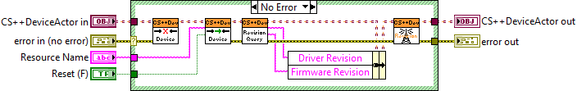
Local Actor Communication
Message.lvclass
Example: Initialize Device.vi
Message.lvclass
  Message:Do.vi is executed in context of Actor Core.vi
Actor.lvclass

Slide 14
CS++ Requirements
Similar feature set as CS Framework
based on LVOOP & Dataflow
CS++ Actor classes should be usable by wire
  Option for deterministic dataflow
    To be used in Timed Loop on LV-RealTime or
    Providing Sequence-Steps for an Sequencer
Simple Configuration Database
  Default ini-files; extendable for relational database
Abstract Network Layer
  Default implementation is Shared Variable
  DataSocket for heterogenious LV-Systems with Linux/Mac
  DIM support for smooth migration from CS Framework
Focus
  Easy Implementation (just LabVIEW), enforcement of design rules
  Easy commissioning & reconfiguration and
  Stable runtime behaviour

Slide 15
CS++ Architecture
Shared Variable Engine, DSC,
or other SCADA System
GUI Layer
Control Layer
Device Layer
Network
Message
Linked Network Actor

Slide 16

CS++ Classes
CS++Factory can create initialized objects at runtime
  Parameters are read from ini-file as default implementation
  Derived clases could read from database etc.
Objects of derived classes of CS++Base can be used as entities; A CS++Reference contains exactly one object.
CS++BaseActor is the ancestor class of all CS++ Actors and adds following (dynamic-dispatch) methods:
  Initialize Attibute.vi: Parse initialization data to attributes.
  After Launch Init Core.vi: Acquire resources after launch of Actor.
  (This should be the first messaged to be received after launch.)
  Polling Core.vi: pseudo periodic polling.
  Introspection Core.vi: returns public messages.
  Open/close Frontpanel of own Actor Core.vi
  Launch associated actor, e.g. GUI-Actor.
CS++BaseGUI: Ancestor class for all GUI classes (Template).
CS++DeviceBase: Ancestor class for all device classes.

Slide 17
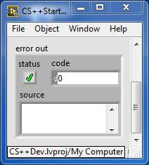
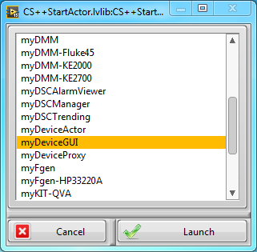
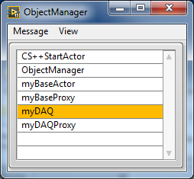
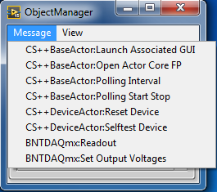
CS++ StartActor & MessageLogger ObjectManager
CS++ StartActor
  Provides default Launch-VI
    Supports command line parameters
  Initializes Message Logger
  Launch StartActors at first action
  User can launch Actors from menue at runtime
MessageLogger
  Syslog and DSC are supported
  DSC: Error severity is mapped to alarm priority
Object Manager
  Displays a list of active actors
  Dispatch standard messages to actors from context menue
  Dispatch Message registered via Introspection Core.vi to actor from menu
[CS++StartActor]
LVClassPath="CS++StartActor.lvlib:CS++StartActor.lvclass"
CS++StartActor:CS++StartActor.Open_ActorCore=True
CS++BaseActor:CS++BaseActor.ErrorDialog=True
CS++StartActor:CS++StartActor.MessageLogger=""
CS++StartActor:CS++StartActor.StartActors=CS++StartActor.StartActors
CS++StartActor:CS++StartActor.ActorList=CS++StartActor.ActorList
[CS++StartActor.StartActors]
#Actor Object to start with option to open its Actor Core.vi.
ObjectManager=True
#myBaseActor=False
[CS++StartActor.ActorList]
List of Actor object to be started manually, with option to open its Actor Core.vi.
myBaseActor=False
myBaseProxy=True
myDeviceActor=False
myDeviceProxy=False
myDeviceGUI=False
[Syslog]
LVClassPath="CS++Syslog.lvlib:CS++Syslog.lvclass"
CS++Syslog:CS++Syslog.IP="140.181.78.202"
CS++Syslog:CS++Syslog.Port=514
CS++Syslog.CS++Syslog.Debug=True
[DSClog]
LVClassPath="CS++DSCMsgLogger.lvlib:CS++DSCMsgLogger.lvclass"
CS++DSCMsgLogger:CS++DSCMsgLogger.Process="CSPP-MsgLogger"
CS++DSCMsgLogger:CS++DSCMsgLogger.Error= "Alarm“
[ObjectManager]
LVClassPath="CS++ObjectManager.lvlib:CS++ObjectManager.lvclass"
CS++BaseActor:CS++BaseActor.ErrorDialog=True
CS++BaseActor:CS++BaseActor.PollingInterval_s=1.

Slide 18
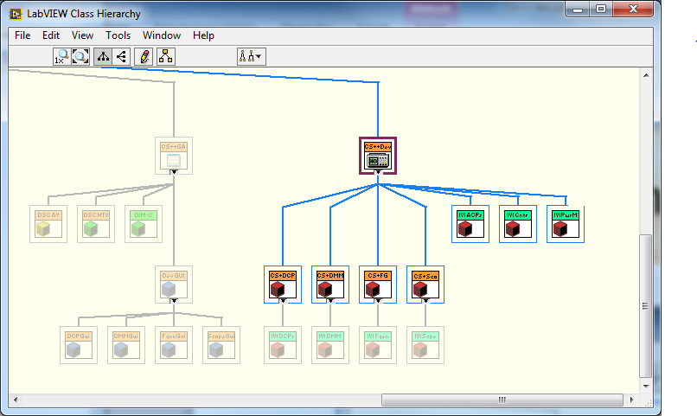
CS++ Device Classes
CS++DCPwr, CS++DMM, CS++Fgen, CS++Scope & GUI
  IVI Implementation available
CS++Motor, CS++MCS & GUI
  Concrete implementation examples are available.
CS++DCPwr
CS++DMM
CS++Fgen
CS++Scope
AlarmViewer
TrendViewer
Corresponding
GUIs
Need for help!
IVI Implementation

Slide 19

Distributed Actor Communication I
Linked Network Actor
  uses Network-Streams
  https://decibel.ni.com/content/docs/DOC-43921
  One-to-One Communication
  Extension: CS++LNA
    enables complete decoupling (no dependencies in .lvproj)
Process Variables (especially: Shared Variables)
  Decoupling of application layers (Model, View, Controler)
  One-to-Many and Many-To-One communication patterns
  Prefered mechanism in CS++
  Advantages:
    Integration of heterogenous environments with other communication protocolls, e.g. DIM
    Shared Variables:
      DSM, DSC: Historical Trending, Alarming and Security (access permission)

Slide 20
CS++ Process Variable Classes
Alarm&Event, ProcessVariable, PVConnection,
PVMonitor, PVProxy
  Encapsulates the network communication
  Connects PV to AF Messages (Observer Pattern)
    DataSocket: DSConnection & CS++DSMonitor
    Shared Variable: DVConnection & CS++SVMonitor
    DIM: DIMConnection & DIMMonitor
Data Logging & Supervisory Control (DSC)
  DSCMonitor (event-driven), DSCAlarmViewer, DSCTrendViewer
  DSCManager dealing with configuration and deployment of Shared Variables and processes.
  Shared Variables can be bound to OPC-Items
  OPC-UA-Interface Actor maps process variables to OPC-UA-Items

Slide 21
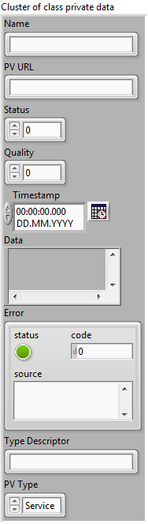
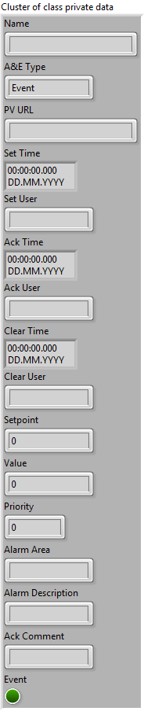

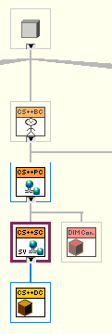
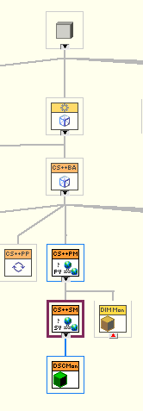
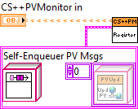
Distributed Actor Communication II
CS++ Classes
PV.lvclass & AE.lvclass
  passive PV and Alarm data
PVConnection.lvclass
  DSConnection, SVConnection, DSCConnection, DIMConnection
  Connection to Variable (open / close)
  Provides read and write access
An Actor publish its status using PV‘s
Another Actor can subscribe to PV‘s oder AE‘s
  PVMonitor.lvclass
  DSMonitor, SVMonitor, DSCMonitor, DIMMonitor
Use Cases
  Display or usage of PV & AE
  React on Commands or change of Set-Values

Slide 22
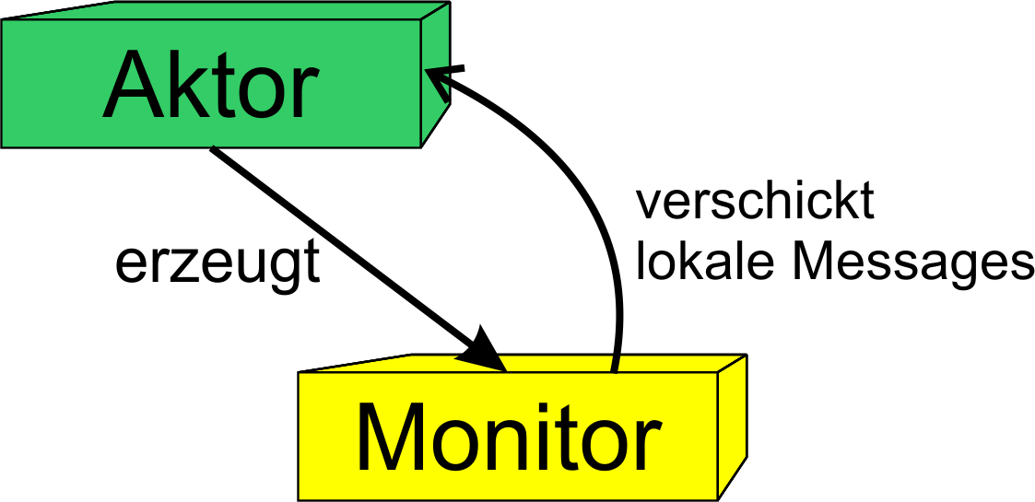
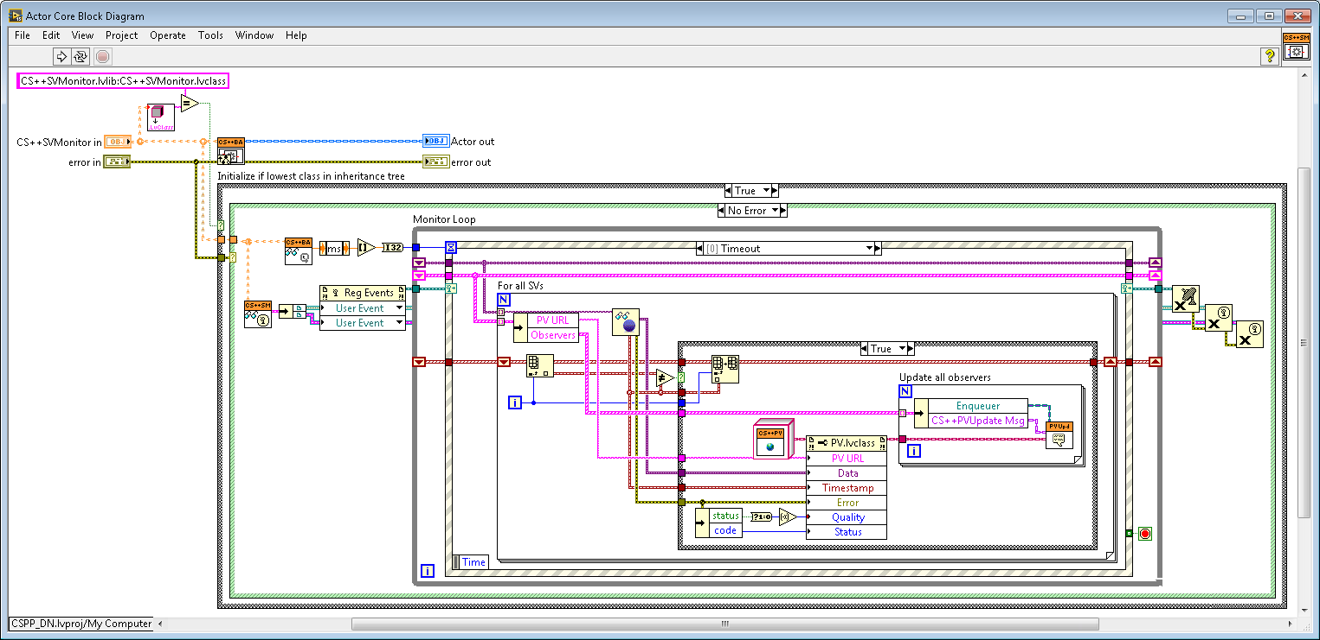
SVMonitor.lvclass:Actor Core.vi
Monitor-Actors react on changes of PVs and dispatch Messages to registered Observers.

Slide 23
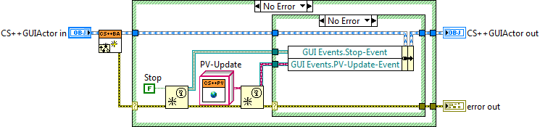
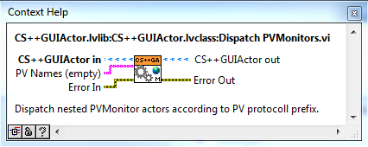
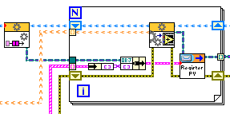
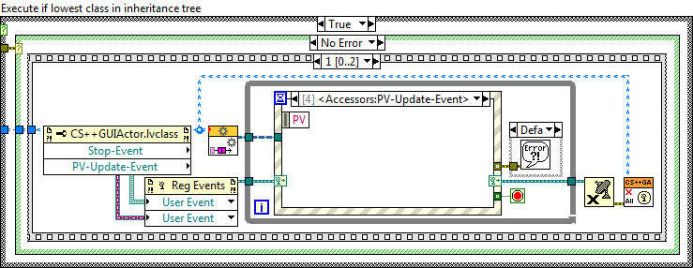
  Use Case: Display/Usage PV & AE
  Example: GUI
Create PV-Update-Event:
Start Monitor Actor and register Messages:
React on PV-Update-Event
in GUI-loop:
Display on FP

Slide 24
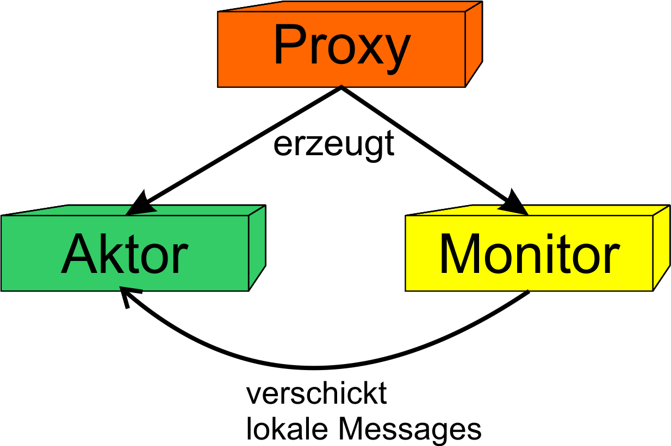
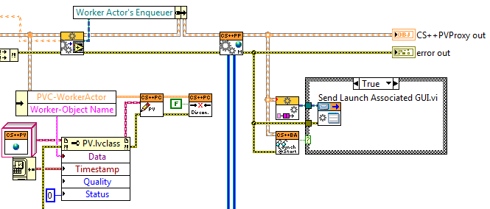
  Use Case:
  Commands / Set-Value changes
  Example: DeviceActor
PVProxy Actor initializing collaboration of Device- and Monitor-Actor.
Separate PV-Subscription from Device-Aktor.
Register Messages, to be sent directly to the
associated „Worker Actor“.

Slide 25
CS++ Configuration
[PV_Protocols]
ni.var.psp=DSCConnection
[DSCConnection]
LVClassPath="CS++DSCConnection.lvlib:DSCConnection.lvclass"
#_p:Polling; _e:Events
[PV_Monitors]
ni.var.psp_p=DSCMonitor
ni.var.psp_e=DSCMonitor
[DSCMonitor]
LVClassPath="CS++DSCMonitor.lvlib:CS++DSCMonitor.lvclass"
[myBaseActor]
LVClassPath="CS++BaseActor.lvlib:CS++BaseActor.lvclass"
CS++BaseActor:CS++BaseActor.DefaultGUI=""
CS++BaseActor:CS++BaseActor.LaunchDefaultGUI=False
CS++BaseActor:CS++BaseActor.ErrorDialog=True
CS++BaseActor:CS++BaseActor.PollingInterval_s=-1.
[myBaseActor.URLs]
PollingMode="ni.var.psp://localhost/CSPP_Core_SV/myBaseActor_PollingMode?.1"
PollingTime="ni.var.psp://localhost/CSPP_Core_SV/myBaseActor_PollingTime?.1"
PollingInterval="ni.var.psp://localhost/CSPP_Core_SV/myBaseActor_PollingInterval?.1"
[myBaseProxy]
LVClassPath="CS++PVProxy.lvlib:CS++PVProxy.lvclass"
CS++BaseActor:CS++BaseActor.DefaultGUI=""
CS++BaseActor:CS++BaseActor.LaunchDefaultGUI=False
CS++BaseActor:CS++BaseActor.ErrorDialog=True
CS++BaseActor:CS++BaseActor.PollingInterval_s=-1.
CS++PVProxy:CS++PVProxy.WorkerActor="myBaseActor"
CS++PVProxy:CS++PVProxy.DelayedActivation=True
[myBaseProxy.URLs]
Activate="ni.var.psp://localhost/CSPP_Core_SV/myBaseProxy_Activate?.1"
WorkerActor="ni.var.psp://localhost04/CSPP_Core_SV/myBaseProxy_WorkerActor|1024?.1"
Polling_Interval_Msg="ni.var.psp://localhost/CSPP_Core_SV/myBaseActor_PollingInterval?.1"
Polling_Start_Stop_Msg="ni.var.psp://localhost4/CSPP_Core_SV/myBaseActor_PollingStartStop?.1"

Slide 26
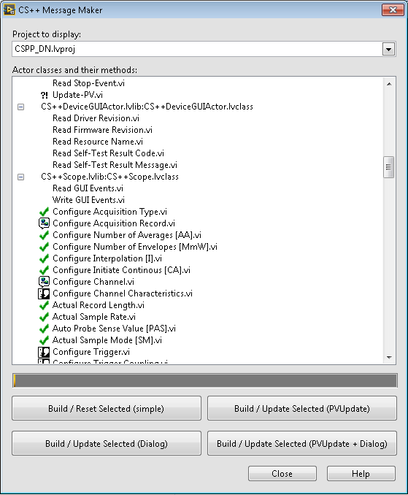
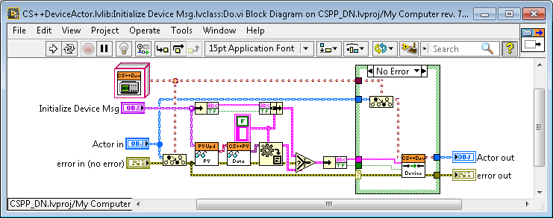
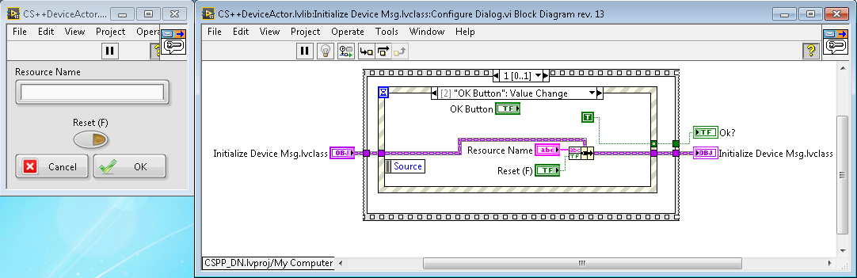
CS++ Message Maker I
Extend Massage Maker for
CS++ Messages
Developed from scratch.
Current version adds two additional features:
  Inherit from PVUpdate Msg and modify parameter extraction from PV in Do.vi:
  Create Dialog.vi

Slide 27


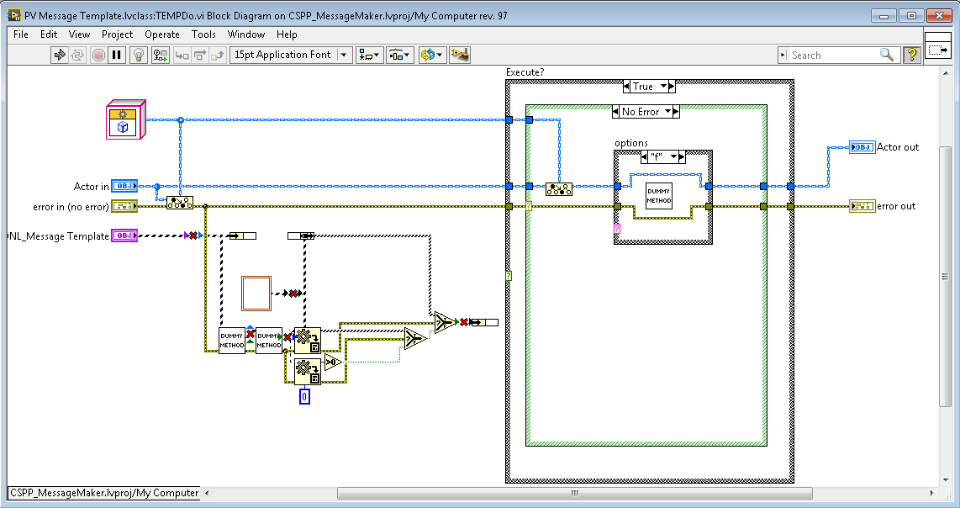
CS++ Message Maker II
More Features of CS++ Massage Maker:
  Focus on simple Extensibility:
    For each VI in Message, 2 Step-Preparation:
      Copy from Template-Folder (easy, butr can lead to errors, s.u.)
      Modify using VI-Scripting-Methods

Slide 28
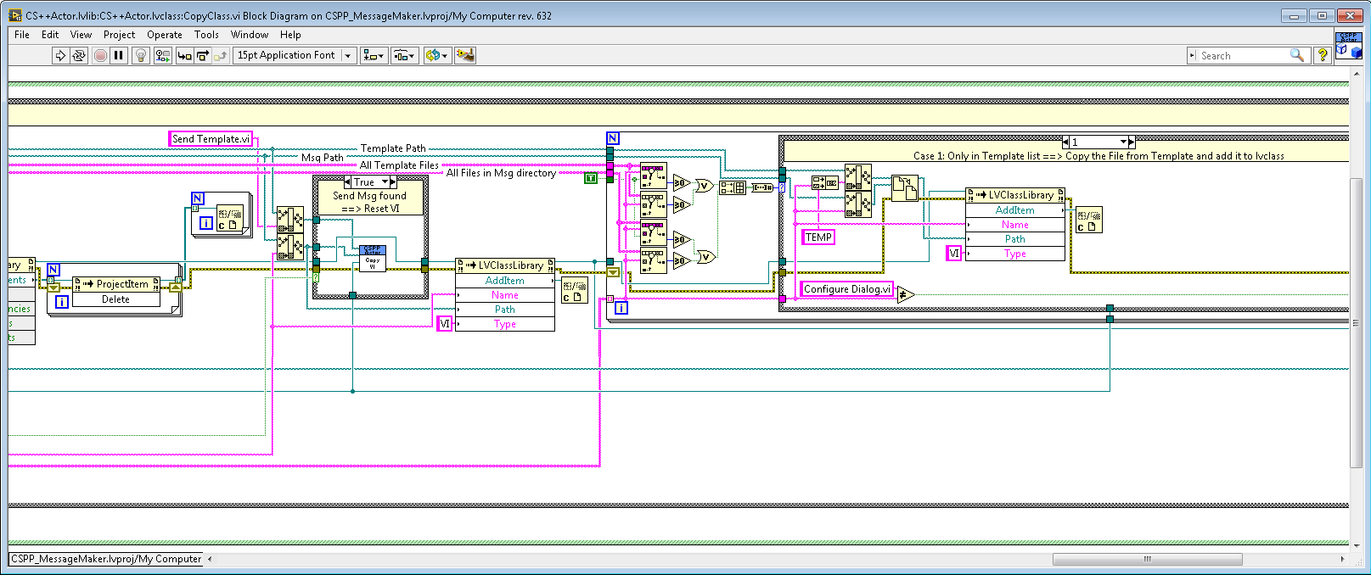
CS++ Message Maker II
More Features of CS++ Massage Makers:
  Focus on Usability:
    Tool designed for „Part time“-developer
    Clear error messages if not avoidable
    User should have the option to switch between different „Message-Types“:
      Durch das Kopieren / Löschen von Dateien und Hinzufügen / Entfernen von VIs zu Bibliotheken erzeugt LabVIEW hierbei im Normalfall viele Fehler
      Mehrere Fälle abzuarbeiten, je nachdem ob File schon im Zielverzeichnis und/oder in der Zielklasse vorhanden

Slide 29
Summary
Aktor Framework is a very flexible Design-Model
Communication within AF:
  Direct dispatching of message objects
  Communication with Actors in distributed Systems (LNA)
CS++ provides base classes with some default implementation for
  Entity, Device- & GUI-Actor
  PV Interface
    PVConnection class
    Subscription to PVs using PVMonitor Actors
  MessageLogger, Introspection & ObjectManager
  CS++RT actors supporting health and watchdog monitoring
CS++ Message Maker for creation of new derived Messages
CS++ Applications
  Motion Control 16 axes at Cave A
  Serial Teststand for SIS-100 supraconducting dipole magnets
Thanks for your Attention!
https://github.com/HB-GSI/CSPP

Slide 30
Referenzen
LabVIEW Menue>Help>LabVIEW Help... -> Contents -> Fundamentals -> LabVIEW Object-Oriented Programming
LabVIEW Menue>Help> Find Examples -> Browse by Task -> Fundamentals -> Object-Oriented
LabVIEW Object-Oriented Programming: The Decisions Behind the Design
LabVIEW Object-Oriented Programming FAQ
Applying Common OO Design Patterns to LabVIEW
HGF Baseclass Library
Mobile Agent System
Actor Framework
Measurement Abstraction and Model-View-Controller (MVC) Project with Actor Framework in LabVIEW
Status of the CS framework and its successor CS++
  GSI Annual Report 2014
  https://repository.gsi.de/record/183651/files/SR2014-Contents-Main-Part.pdf
Thanks to Stephen Mercer for his contributions to web documents & discussions

Slide 31
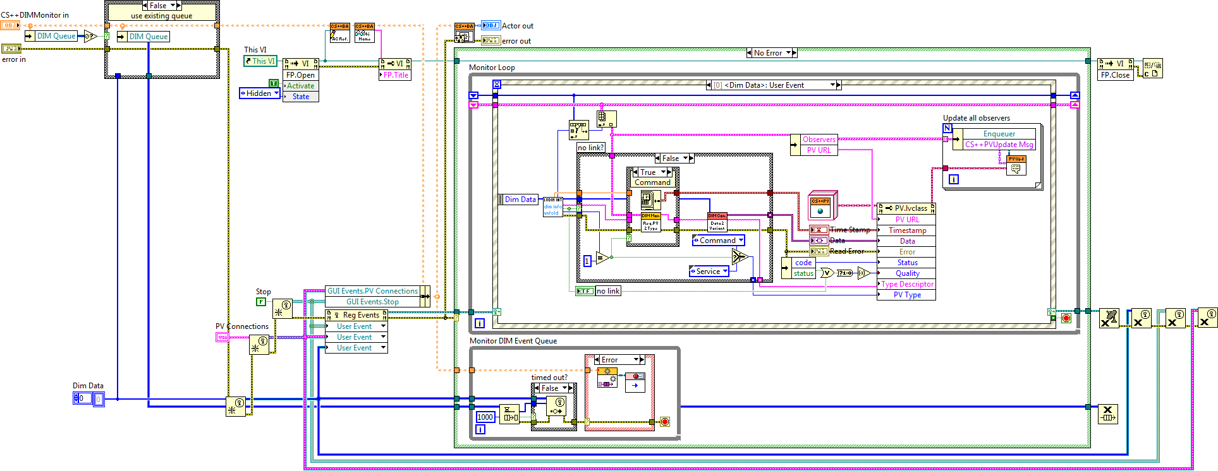
DIMMonitor.lvclass:Actor Core.vi

