Slide 2
Personnel Protection Systems at CERN
BE/ICS-CSE
NI Big Physics Summit @ CERN - 11-12 February 2016
Authors: P. Ninin, F. Valentini
Edms: 1580195

Slide 3
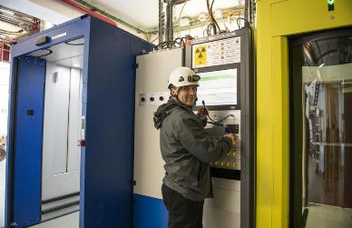
Outline
Personnel Protection Systems @ CERN
Development process (iec-61511)
Evaluation of NI Technology
Conclusions
Edms: 1580195

Slide 4

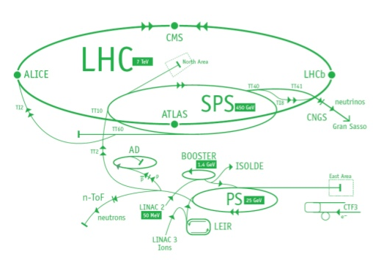





What a PPS is?
Ionizing radiations hazards
Cryogenic (ODH) hazards
Electrical hazards
Magnetic field hazards
Laser hazards
Mechanical hazards
BEAM ON
NO ACCESS
ACCESS ON
NO BEAM
Edms: 1580195

Slide 5
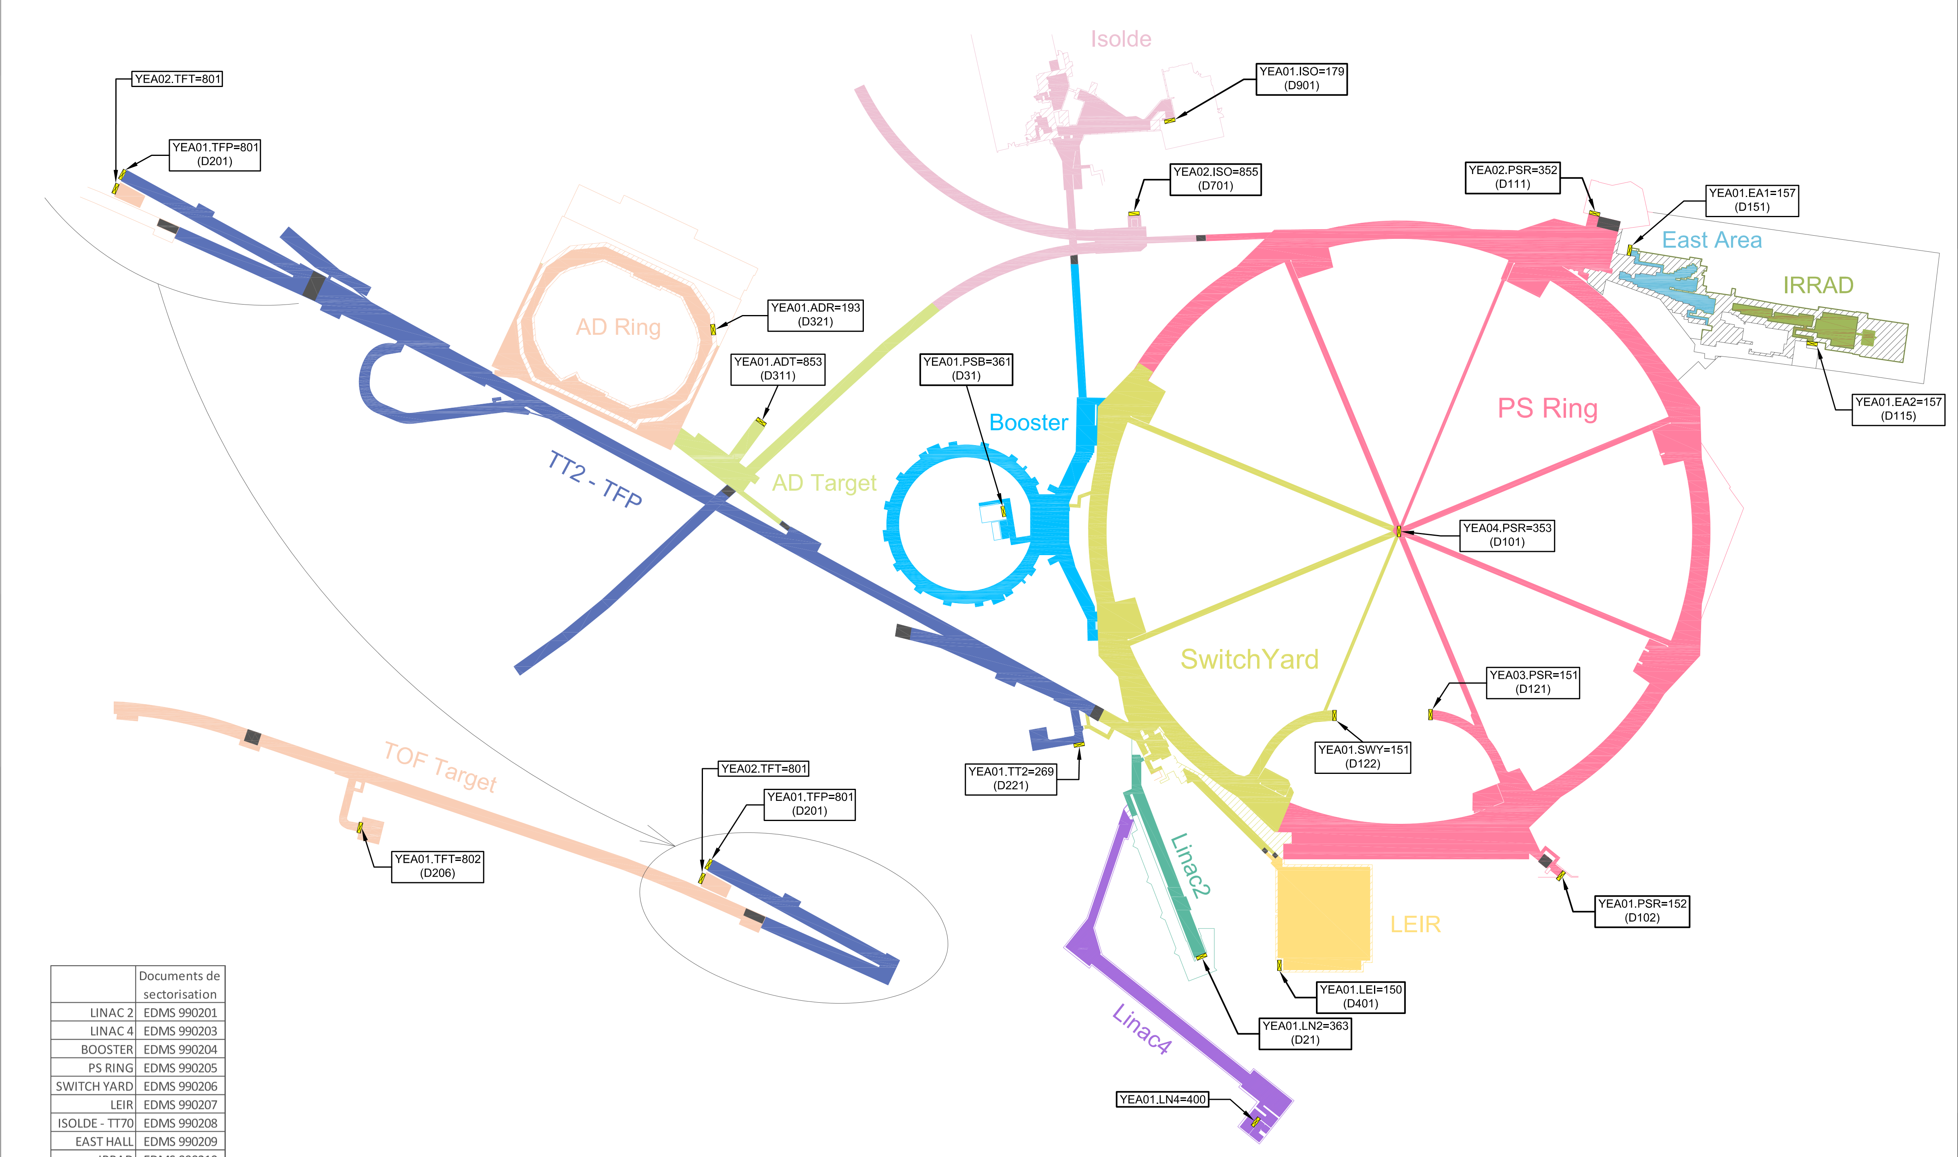

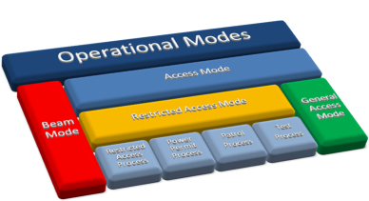
Primary Zones - PPS
Edms: 1580195

Slide 6
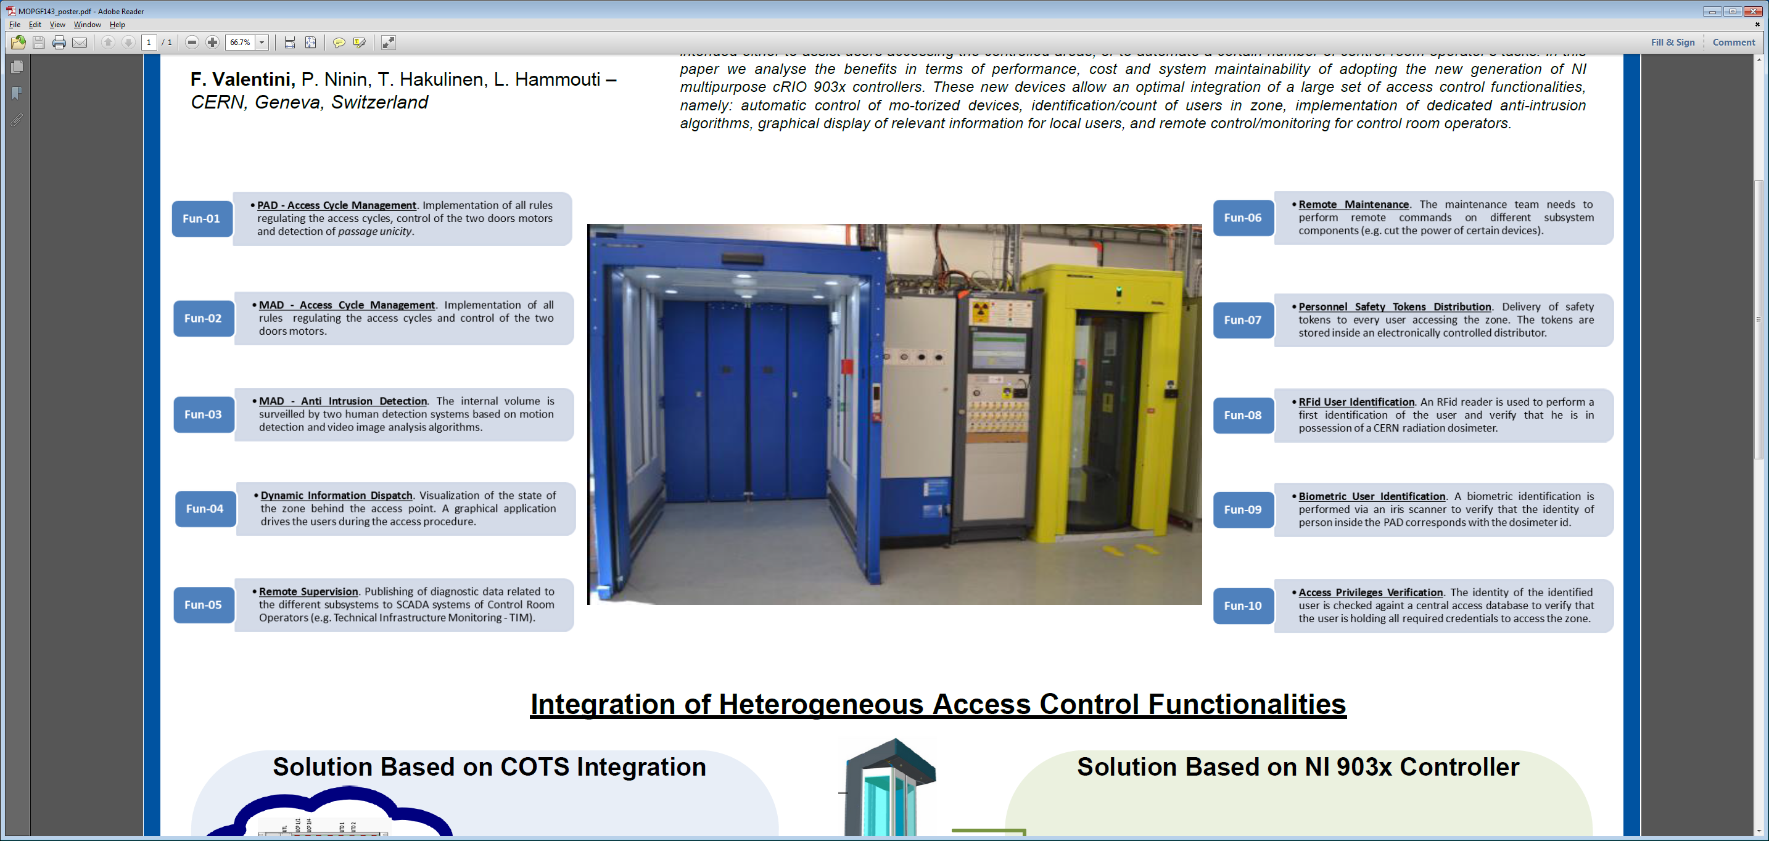
Primary Zones - PPS
Edms: 1580195

Slide 7
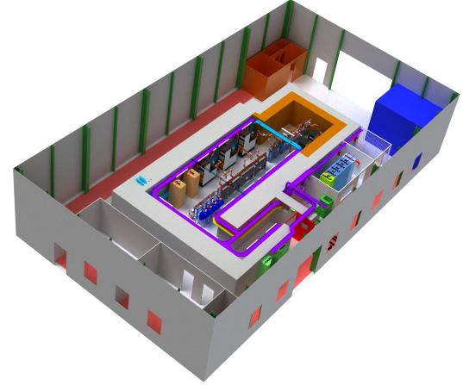
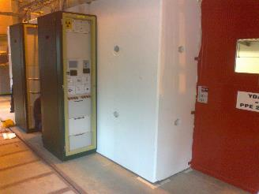
Experimental Zones - PPS
Particularities:
Lower risks than in primary areas.
Reduced facility size.
Reduced number of I/O signals.
Small population of trained users.
Local operation of the system.
Low realization cost requirements.
Edms: 1580195

Slide 8
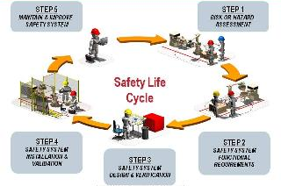
Outline
Personnel Protection Systems @ CERN
Development process (iec-61511)
Evaluation of NI Technology
Conclusions
Edms: 1580195

Slide 9
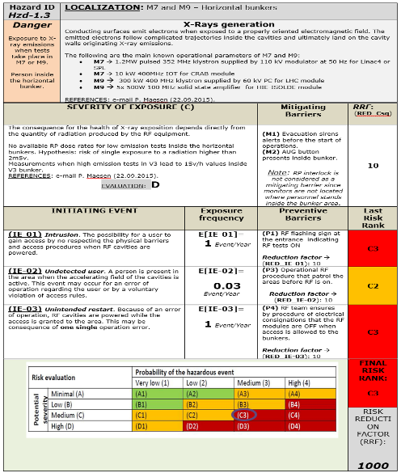
Development Process (IEC-61511)
(1) Hazard Identification & Risks Assessment
Edms: 1580195

Slide 10
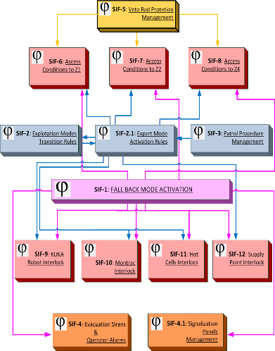
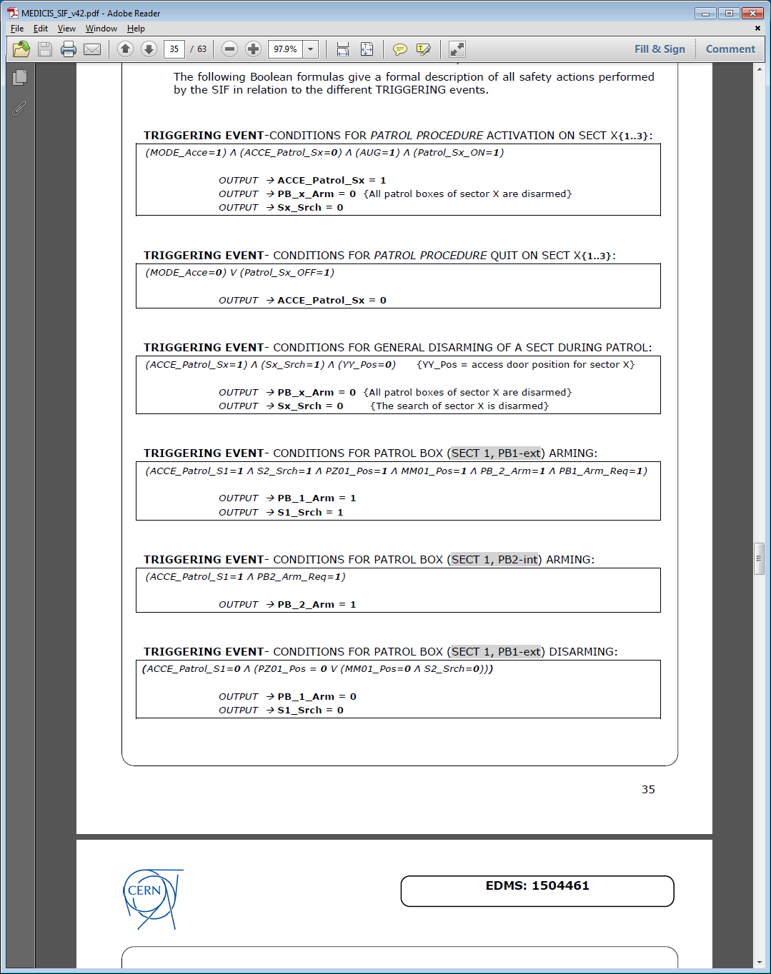
Development Process (IEC-61511)
(2) System formal specification by Safety Instrumented Functions (SIF)
Edms: 1580195

Slide 11
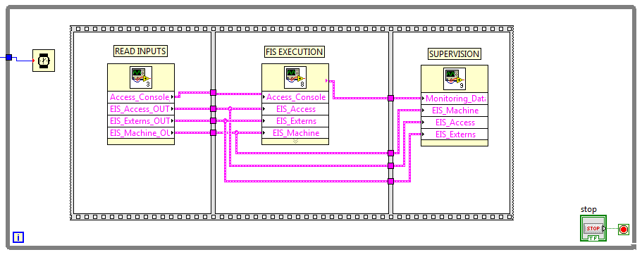
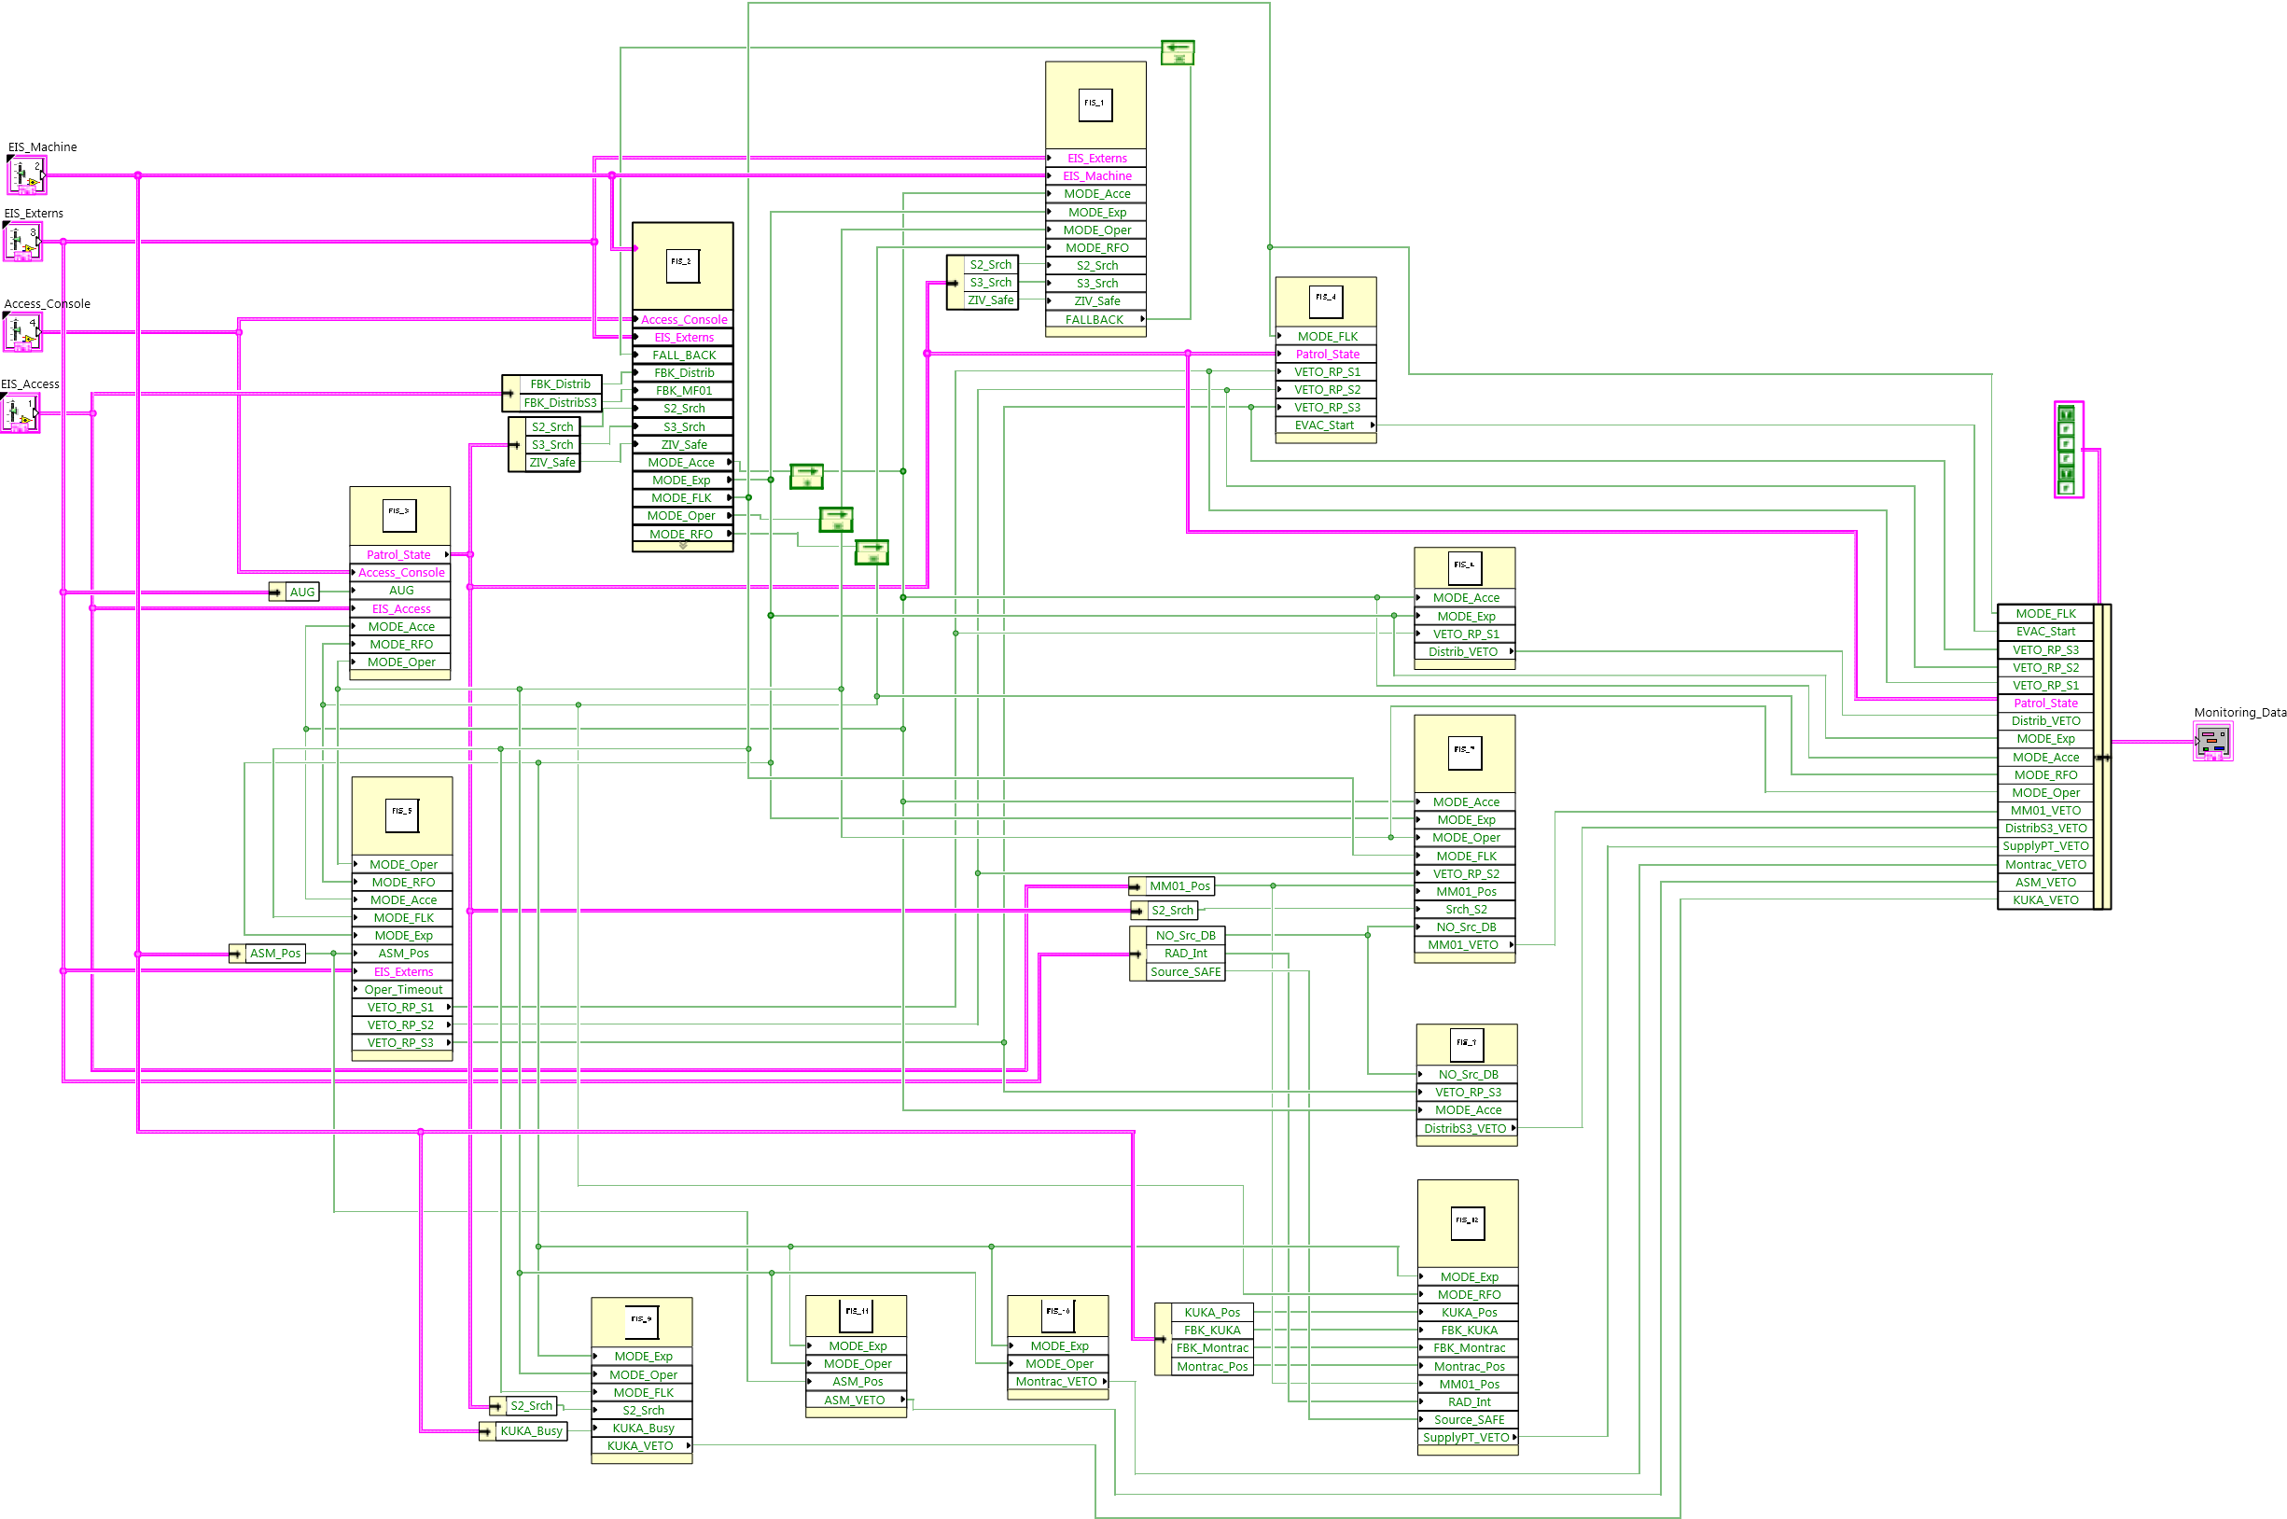
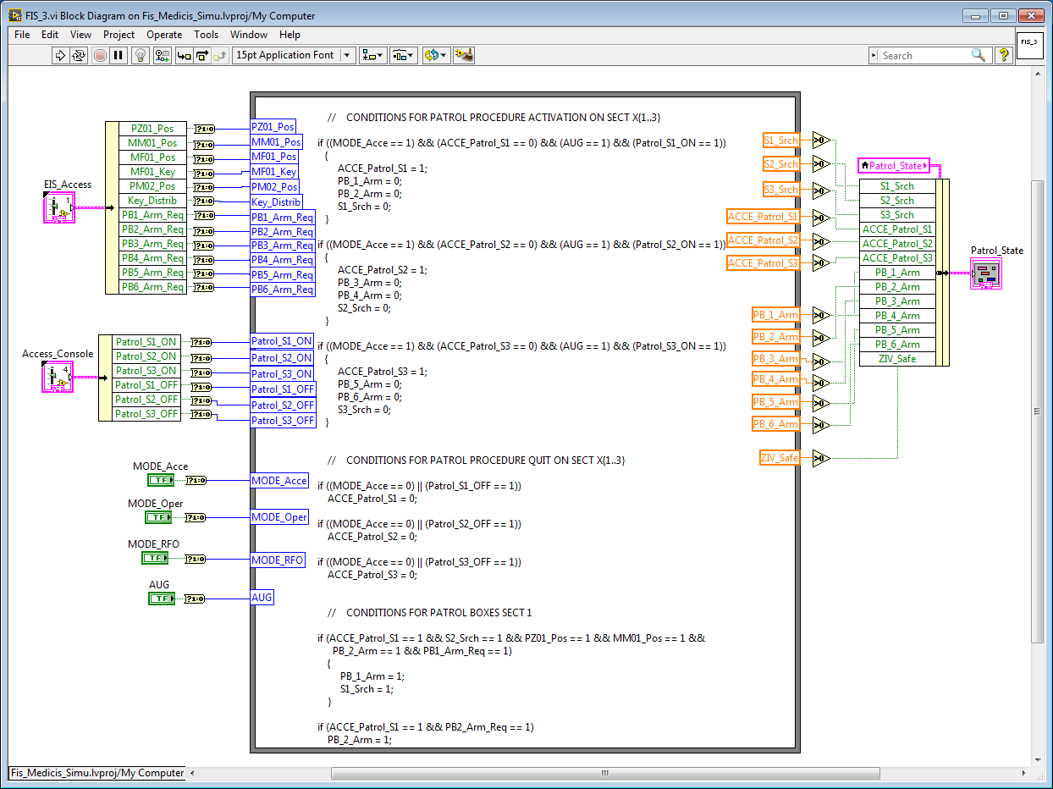
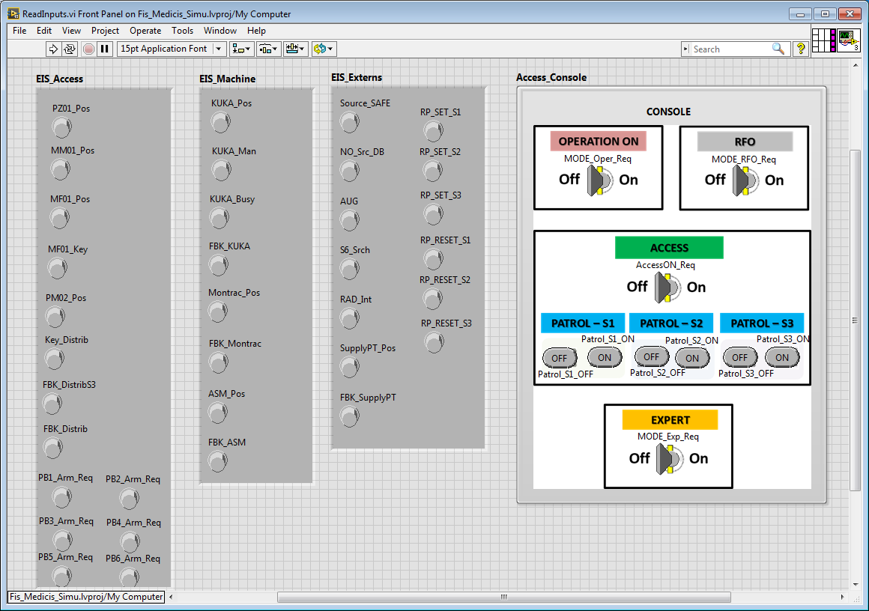
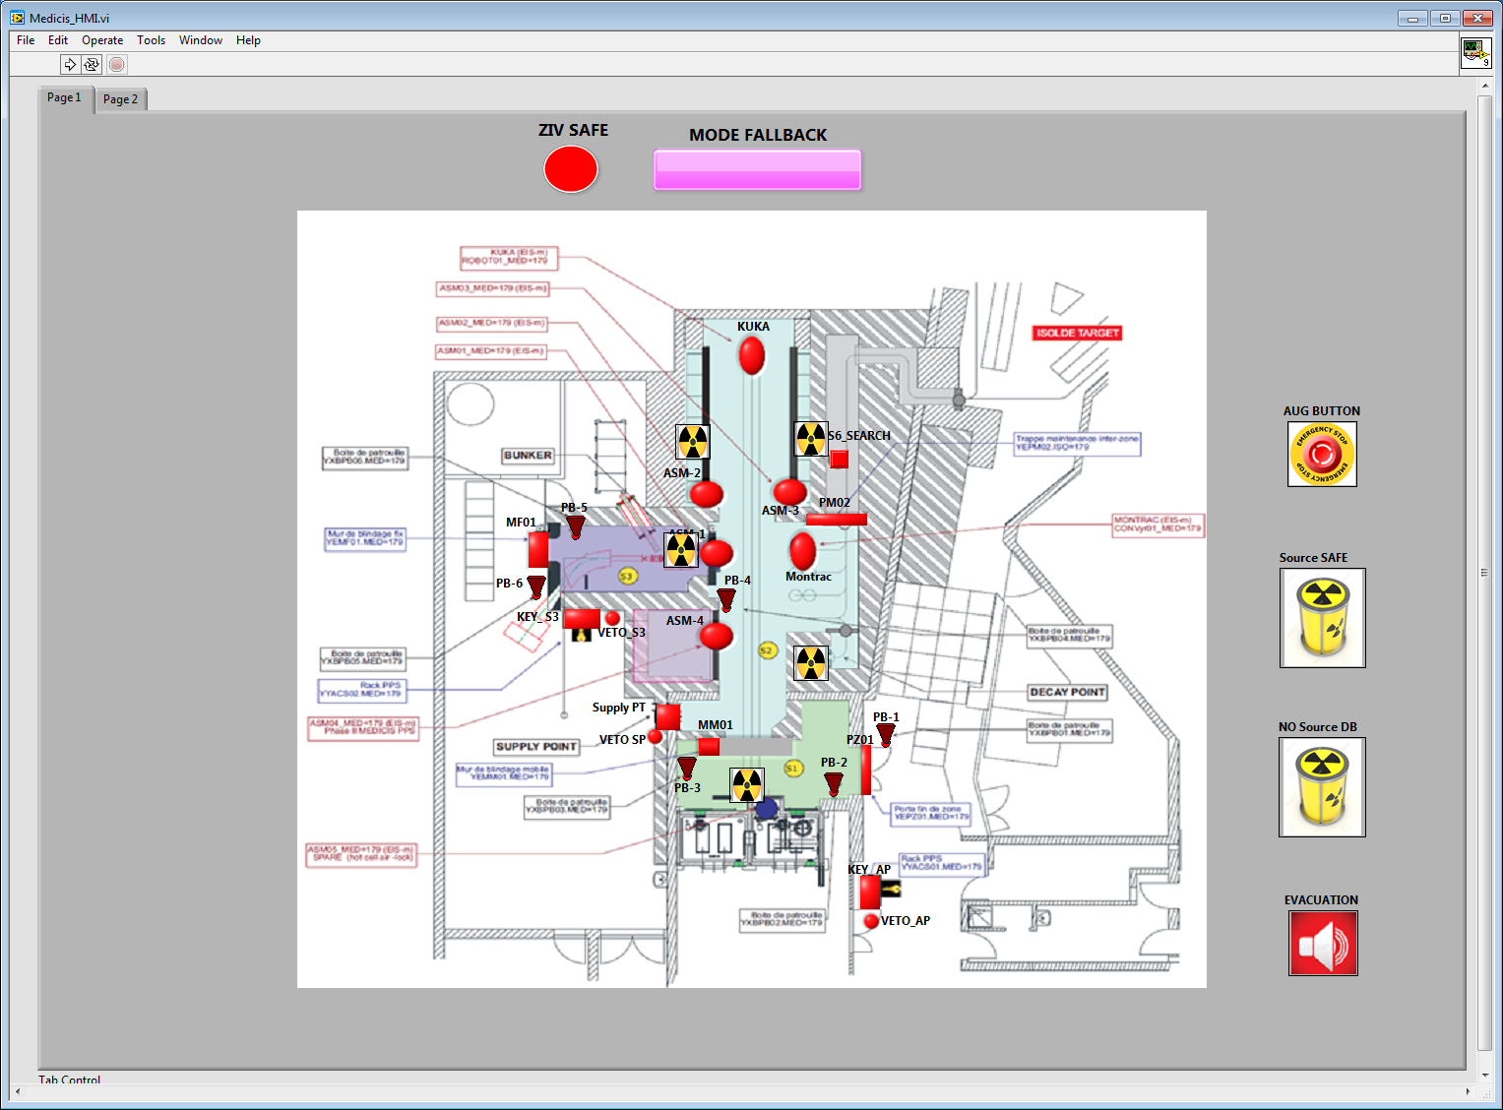
Development Process (IEC-61511)
(3) Formal Verification of Safety Functions
14 SIF / 70 Boolean Variables / 121 Boolean operators
Edms: 1580195

Slide 12
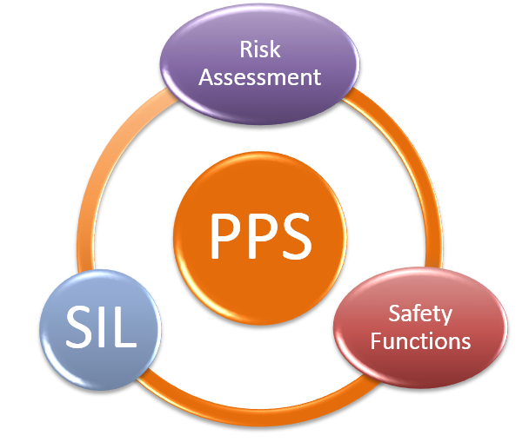

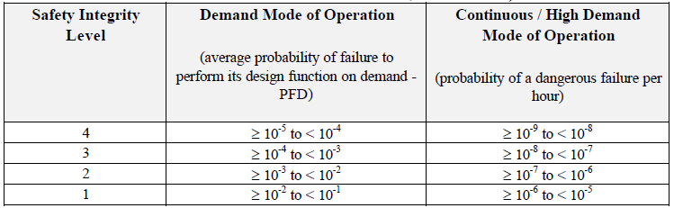
Development Process (IEC-61511)
(4) Safety Integrity Level (SIL) Allocation to SIF
Residual risk
Safety Instrumented
Function
Probability of failure of the SIF in ensuring its mission.
SIL Interpretation
Factor of risk reduction to be provided by the SIF.
Edms: 1580195

Slide 13
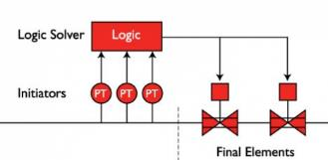

Development Process (IEC-61511)
(5) SIL Demonstration
Failure Rate:
SIF Architecture:
Safe Failure Fraction (SFF):
The percentage of failures that do not prevent the safety function to ensure its mission.
Mission Time (T):
It is the period of time after which the device is fully verified and all undetected faults can be revealed.
Statistical Model:
$$F\left(t\right)=1 − e^{−λ_{DU}t}$$
Edms: 1580195

Slide 14
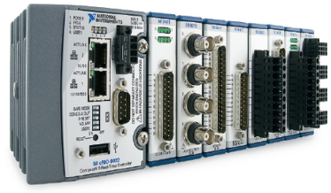
Outline
Personnel Protection Systems @ CERN
Development process (iec-61511)
Evaluation of NI Technology
Conclusions
Edms: 1580195

Slide 15
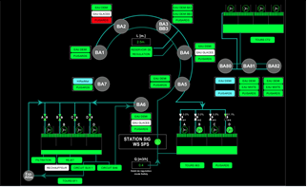
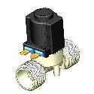

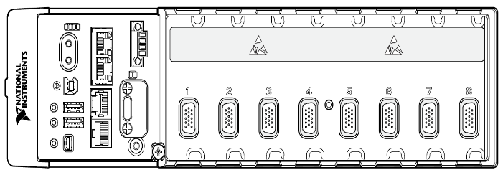


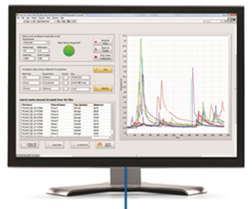

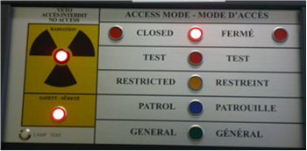


Evaluation of NI cRIO 903x
Standard Program
Safety Program (SIF execution)
Linux RT
FPGA
Edms: 1580195

Slide 16
Conclusions
Possible improvements of NI technology for safety related applications:
Provide mechanisms to easy handle I/O channels redundancy.
Provide automatic auto-diagnostic functionalities at level of I/O modules and at level of FPGA in order to increase SFF.
Provide more precise reliability data, estimation of dangerous failures (FMEA study).
TUV certification it is not mandatory but it is required by systems integrators and it is a good way to ensure a qualitative development process.
Edms: 1580195

Slide 18
Fast PIS – Hardware Architecture
Slide from Luis Fernandez-Hernando (ITER)

Slide 19
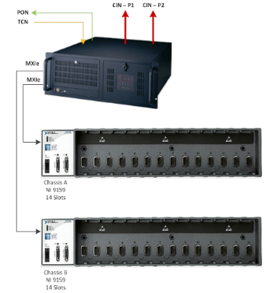
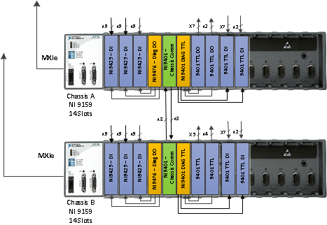
CCPS architecture
Slide from Luis Fernandez-Hernando (ITER)
HOST
Red Hat linux CODAC compliant
Connected to CODAC and to CIS

