Slide 1
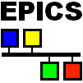


LabIOC
EPICS-LabVIEW Interface
Alan Greer
Presented by Philip Taylor
Observatory Sciences Ltd, Cambridge UK
ajg@observatorysciences.co.uk
NI Big Physics Summit CERN 11-12 February 2016

Slide 2


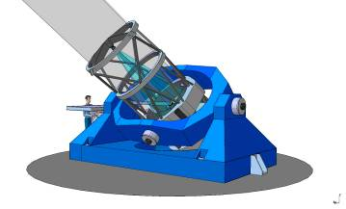
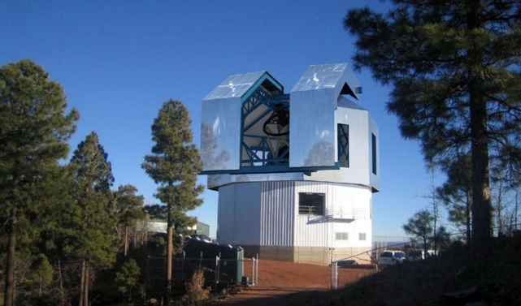
Observatory Sciences: LabVIEW Telescope
Control Systems
The Multi-Application Solar Telescope (MAST) is a 0.5m advanced solar telescope, commissioning 2013-14 in Udaipur, India.
The ARIES telescope will be a 3.6 meter diameter optical telescope, the largest in Asia. It will be sited at Devesthal Peak, India. On-site commissioning 2015.
The Magdalena Ridge Optical Interferometer (MROI) will be sited on Magdalena Ridge in New Mexico, USA. Awaiting completion.
The Discovery Channel Telescope is a 4.2 meter optical telescope built in Arizona, USA by the Lowell Observatory. Completed in 2012, now in full operation.
Observatory Astrofisico de Javalambre includes a 2.5m wide-field survey telescope sited in the Aragon region of Spain. Factory Commissioning on-site 2014-15

Slide 3
Introduction to EPICS
Experimental Physics and Industrial Control System (EPICS).
Control System Architecture and Software Toolkit.
Open source software used by hundreds of sites, with many collaborators including
  The Advanced Photon Source at Argonne National Laboratory
  Australian Synchrotron
  Berlin Electron Synchrotron (BESSY II)
  Deutches Elektronen Synchrotron (DESY)
  Diamond Light Source
  European Spallation Source (ESS)
  Extreme Light Infrastructure (ELI)
  Fermilab (FNAL)
  ITER
  Jefferson Laboratory (JLAB)
  Keck Observatory
  Laboratori Nazionali di Legnaro (INFN-LNL)
  Lawrence Berkeley National Laboratory (LBL)
  Los Alamos National Laboratory (LANL)
  Swiss Light Source (SNS)
  Stanford Linear Accelerator Center (SLAC)
See NI whitepaper for introduction to EPICS and current NI implementation of EPICS/LabVIEW interface:
  http://www.ni.com/white-paper/14144/en/

Slide 4
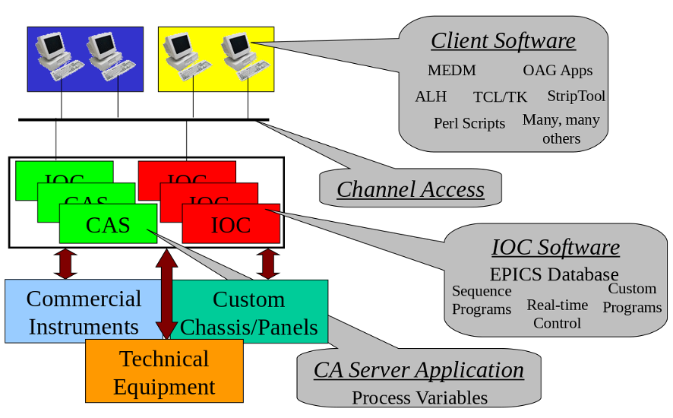
EPICS Control System

Slide 5
EPICS IOC
IOC = Input Output Controller.
The computer running the IOC can be:
    PC running Windows, Linux
    VME based CPU, running vxWorks, RTEMS, Linux
    Mac running OSX
    Embedded processor running Linux, RTEMS
    Raspberry Pi
Usually has Input and/or Output devices attached
An EPICS control system must consist of at least on Channel Access Server (usually an IOC).
An IOC has one or more databases loaded. The database tells the IOC what to do.

Slide 6
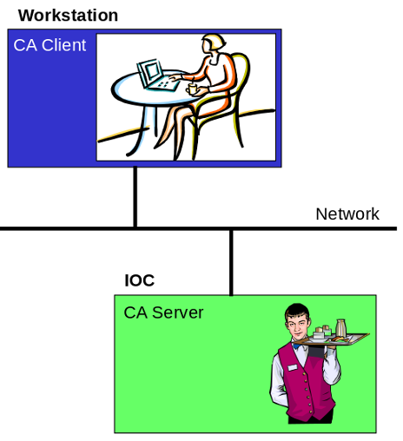
EPICS Channel Access
Allows other programs (CA Clients) to see and change values of Process Variables in an IOC (CA Server)
CA Clients may:
      Put (write)
      Get (read)
      Monitor (wait for event)
  data of Process Variables
IOCs are both CA clients and CA servers. They can interact with data in other IOCs
A CA Client can connect to many servers
A CA Server may serve many clients
A very efficient and reliable protocol in operational use for over 25 years

Slide 7
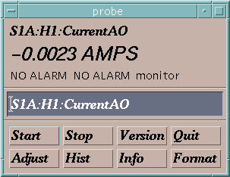
EPICS Channel Access in One Slide
“connection request” or “search request”
“get” or
“caGet”
“put” or
“caPut”
“set a monitor”
Who has a PV named “S1A:H1:CurrentAO”?
Change its value to 30.5
Notify me when the value changes
What is its value?
Channel Access Client
CA Client
CA Server
Channel Access Server
I do.
25.5 AMPS
OK, it is now 30.5
It is now 20.5 AMPS
It is now 10.5 AMPS
It is now -0.0023 AMPS
Process Variables:
S1A:H1:CurrentAO
S1:P1:x
S1:P1:y
S1:G1:vacuum
“put complete”
“post an event”
or
“post a monitor”
30.5 is too high. It is now set to the maximum value of 27.5.
or
You are not authorized to change this value
or

Slide 8
EPICS Databases
Use common, proven, objects (records) to collect, process and distribute data
Provide a common toolkit for creating applications
They contain a collection of EPICS records, including processing and data links between records.
Interface to process instrumentation
Distributed processing
Provide external access to all process information

Slide 9
What are EPICS records?
A record is an object with...
        A unique name e.g. BL:V5:MVM1:Current
        Controllable properties (fields) e.g. EGU
        A behaviour – defined by its record type
        Optional associated hardware I/O (device support)
        Links to other records
Each field can be accessed individually by name e.g. BL:V5:MVM1:Current.EGU
A record name and field name combine to give the name of a process variable
A process variable name is what Channel Access needs to access data

Slide 10
Where does LabVIEW fit?
LabVIEW is a tool for producing applications faster and more effectively
LabVIEW offers integration with unprecedented quantities of hardware
Many hardware manufacturers provide LabVIEW drivers and LabVIEW test applications
LabVIEW offers multi-platform support, inherent parallel programming, many pre-existing libraries for data acquisition, processing, analysis...

Slide 11
LabVIEW – EPICS Integration
Many solutions exist with various advantages and disadvantages*
Shared memory on VxWorks (LANL)
Hypervisor shared memory – Hyppie (LNLS)
ActiveX CA (ORNL-SNS)
CaLab Win DLL (HZB-BESSYII)
DCOM Win API via EPICS driver (STFC-ISIS)
DIM Interface (GSI + CERN)
LV – native EPICS implementation (ORNL-SNS)
DSC Module via Shared Variables (NI)
LV-native CA (LabIOC – Observatory Sciences)
* surveyed 2014 – not an exhaustive list. Credit goes to: various presentations at EPICS collaborations and NIWeek by Alexander Zhukov, ORNL; GSI wiki summary; Tech Talk [http://www.aps.anl.gov/epics/tech-talk/]

Slide 12

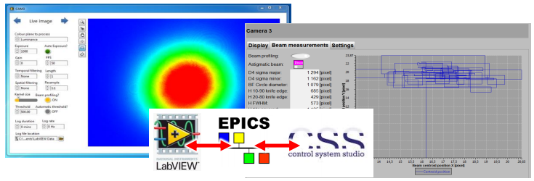
Testing by ELI Beamlines
Early testing of NI EPICS module carried out by ELI Beamlines.
Basically works, but...
Project has been put on ice (NI's unofficial warning in 2013)
Network SVs must be used (slow, unstable, poor scalability)
Not a full implementation (PVs on server-side have only few fields)
Missing fields confuse clients (e.g. Control System Studio)
Type-casting bugs (string and integer)
Courtesy of Eli-Beamlines
Demonstration of LabVIEW camera server on RMC-8354 using NI EPICS module to link to a Control System Studio secondary display (developed 2012-2013)

Slide 13
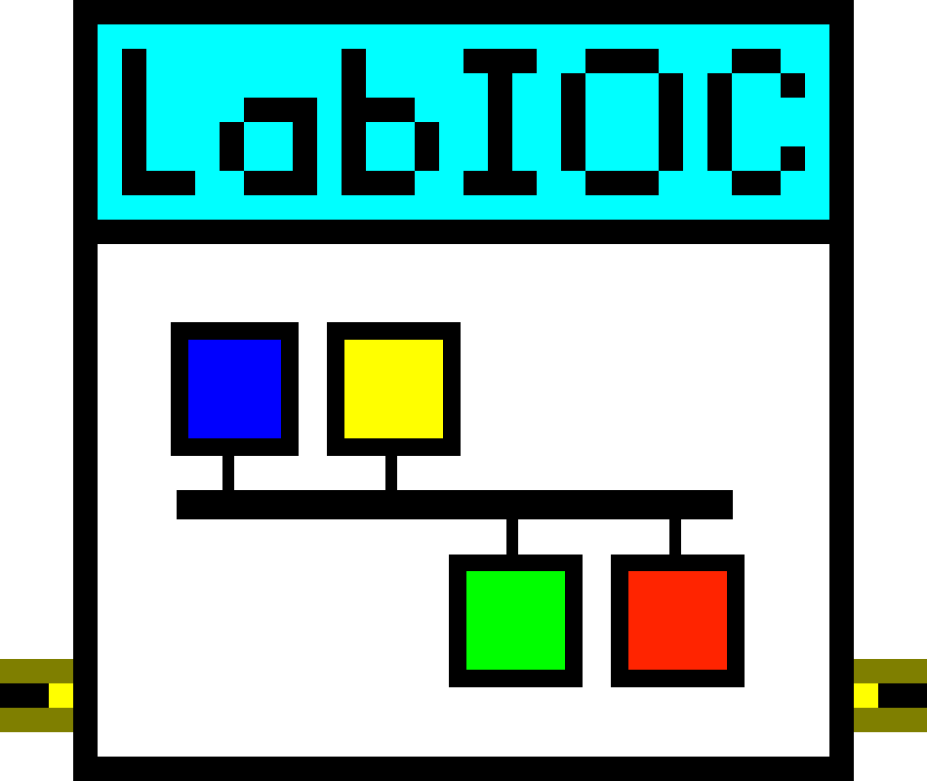
Observatory Sciences & LabIOC
Observatory Sciences was contracted by ELI Beamlines (Prague) in 2014 to produce a library to bridge the gap between LabVIEW and EPICS.
The first version of LabIOC was made available in 2015.
LabIOC was described in a paper at the ICALEPCS conference in Melbourne, Australia, October 2015:
  Extreme Light Infrastructure, Beamlines - Control System Architecture for the L1 Laser, Jack Naylon et al
  http://icalepcs.synchrotron.org.au/talks/tud3o02_talk.pdf

Slide 14
LabIOC Goals
Goals for LabIOC:
Offer an easy way for non-EPICS experienced LabVIEW developers to interface to EPICS applications/facilities
Offer good performance and reliability
Ensure the library will continue to work as future versions of LabVIEW are released
Portable: ensure library will work identically on all NI LabVIEW.
Keep the library interface simple
Provide more than just the Channel Access communications protocol for PVs

Slide 15
LabIOC
Implemented as a LabVIEW library consisting of over 700 VIs
Works on all LabVIEW supported platforms, including Windows, Linux and LabVIEW Real-Time
Implemented EPICS Channel Access communications protocol using only native LabVIEW nodes (TCP, UDP, Queues, Notifiers)
Implemented most common EPICS record structures
Works seamlessly with current EPICS tools (caget, caput, camonitor, EDM, CSS, etc)
Designed with input from users at ELI Beamlines & National Energetics to ensure product works as expected
Concentrated on performance of library
Designed for LabVIEW engineers, no EPICS experience required (no EPICS installation or EPICS libraries required)

Slide 16
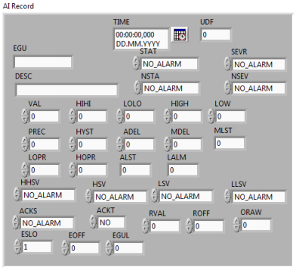
LabIOC
LabIOC has full support for basic EPICS record types:
  ai/ao
  bi/bo
  longin/longout
  mbbi/mbbo
  stringin/stringout
  waveform
Polymorphic VIs used for standard LabVIEW types:
  I8
  I16
  I32
  SGL
  DBL
  STR
  Boolean
  Arrays of all types above – typecasting as appropriate
Example LabVIEW Control for EPICS AI record

Slide 17
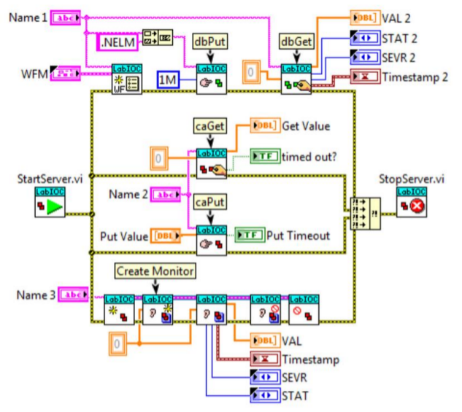
Example LabIOC VI Set
Courtesy of Eli-Beamlines

Slide 18
LabIOC Server Capabilities
Start and stop server with VIs
EPICS records supported with
    Limits
    Engineering units
    Display limits
    Enumerated names
    Display precision
    Alarm status
    Alarm severity
Write to record fields (dbPut) with polymorphic VIs
Read from record fields (dbGet) using polymorphic VIs
Channel access communication complexities are removed from the program

Slide 19
LabIOC Client Capabilities
Very simple interface
    Create channel
    Read channel
    Write channel
    Monitor channel
    Delete channel
Channel Access handled by the library
Created channels share TCP connections where appropriate
Works with all EPICS servers (LabVIEW or native EPICS)
LabVIEW standard types are supported (polymorphic VIs)

Slide 20
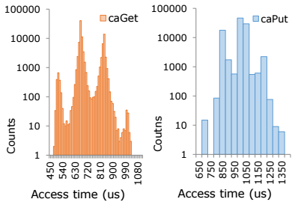
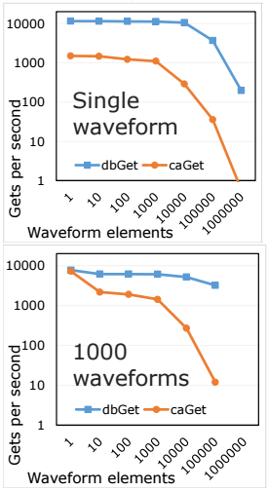
LabIOC ELI Testing Results
Courtesy of Eli-Beamlines
Testing carried out by ELI and National Energetics
Performance is good. Work will continue on streamlining library

Slide 21
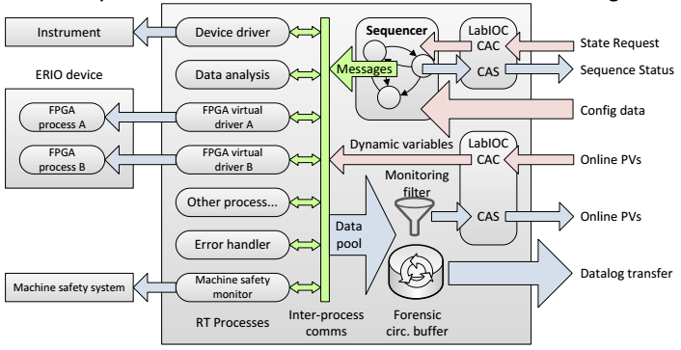
LabIOC In Use
ELI Framework
Courtesy of Eli-Beamlines
Device Layer
LabVIEW Virtual IOC
Integration Layer

Slide 22
Acknowledgements
APS (EPICS Introduction Presentation)
ELI Beamlines (Dr Jack Naylon)

