Slide 1
LabVIEW
Accelerator Device Control in
Matjaž Slak and Samo Tuma, Cosylab

Slide 2
Sounds familiar?
Want to do a new experiment
Want a running machine
Want to do your work!
but you’re
Stuck implementing the same old core functions
  Communication between processes
  Saving the Data
  Timestamping
  Logging Events
  Managing Configurations
and SUPPORTING
and DEBUGGING

Slide 3
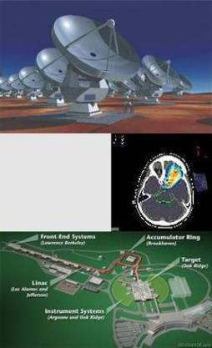
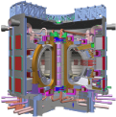
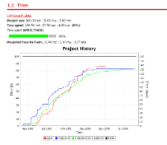
The Company Cosylab
Worldwide leader for control system integration of nuclear accelerators and large physics facilities, chosen by the majority of projects.
  We offer services and develop products where expert knowledge is required.
  We know how to use and develop state-of-the-art electronics and software.
  We integrate them into mankind‘s most complex systems.

Slide 4
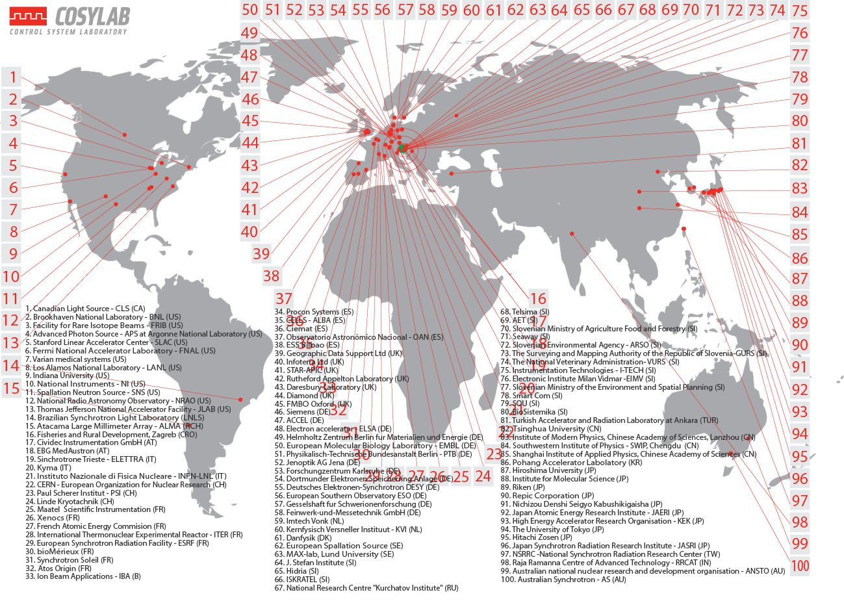
Customers From Nearly All Major Labs Worldwide

Slide 5
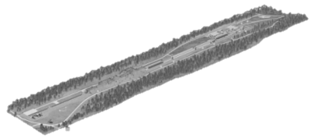
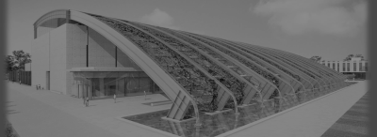
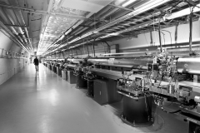
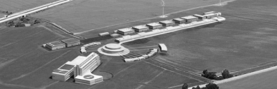
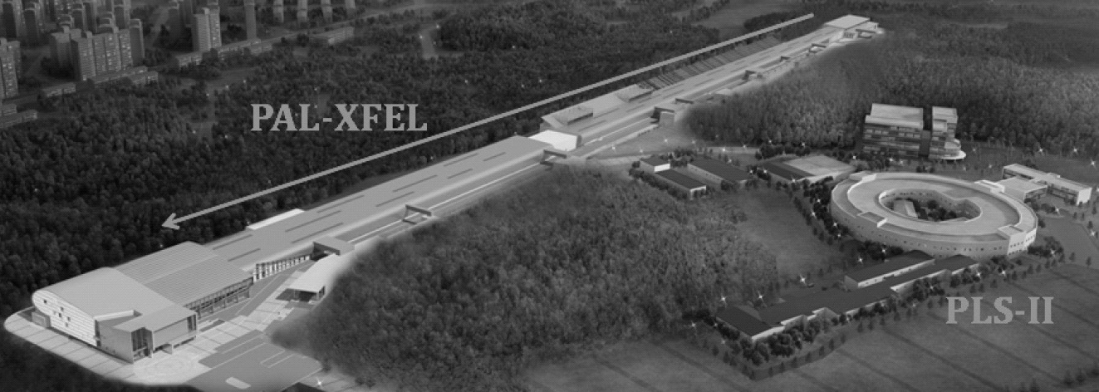
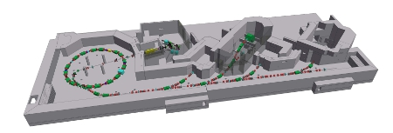
Cosylab Key References (1/2)
Reference | Description
PSI SwissFEL & Swiss Light Source | SwissFEL –Free electron laser SLS – Synchrotron radiation light source
ELI-NP | Laser and gamma beam facility
SLAC LCLS/LCLS-II | Free electron laser
European Spallation Source (ESS) | Neutron source based on high-power proton linac
PAL XFEL (South Korea) | 10 GeV FEL
MedAustron | Carbon-ion synchrotron for cancer therapy

Slide 6
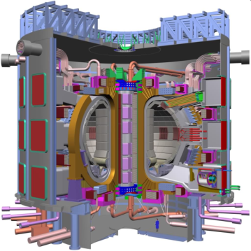
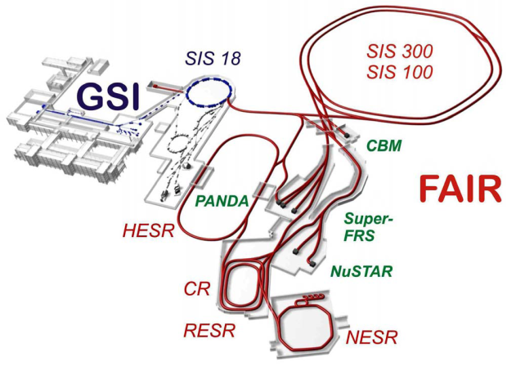
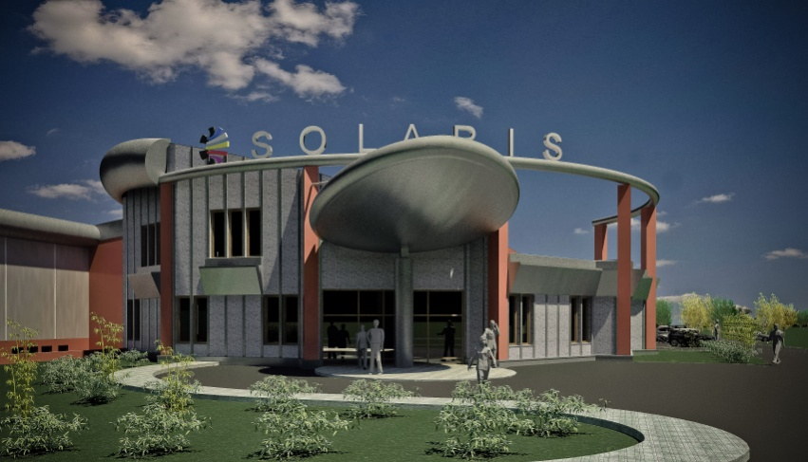
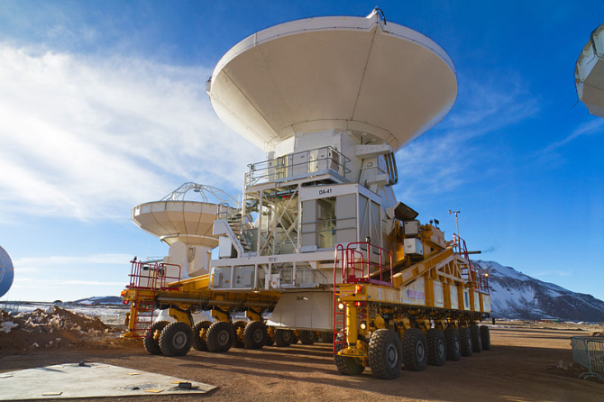
Cosylab Key References (2/2)
Reference | Description
ITER IO | Biggest scientific project, international collaboration, collaborating since 2008
USITER | US contribution to ITER
In-kind contribution to FAIR | In-kind project in Darmstadt, Germany FESA CS
SOLARIS | 3rd generation light source in Krakow, Poland Tango CS
ALMA | Radio telescope in milimeter/submilimeter wavelengths Largest astronomical project in existence

Slide 7
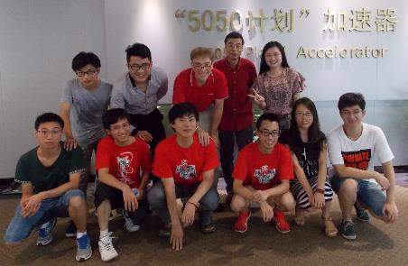
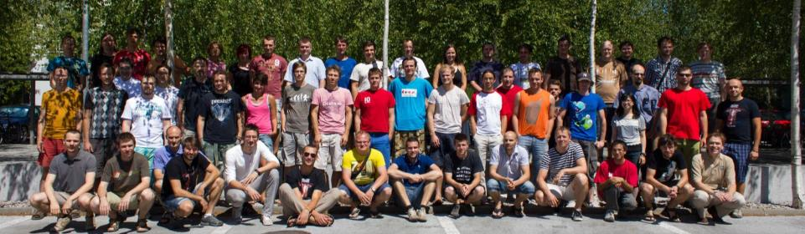
Who are we?
>120 employees worldwide
  95 „developer/engineer“ FTEs effectively
  Always ~30 students in the pipeline
Branches: Sweden, USA, Japan, China, Switzerland

Slide 8
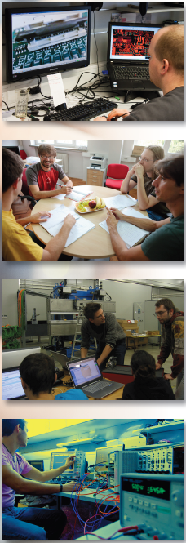
WE OFFER: Quality Service, Support And Extended Maintenance That Takes The Risk Out Of Control at a Fair Price
Turnkey control system adapted to your project – with open source components
Integration of subsystems and equipment into your control system
Outsourcing – we provide experts
EPICS, TANGO training - worldwide

Slide 9
Cosylab
Specialized in all Software and Hardware technologies used in accelerators:
  EPICS, CSS, TANGO, PLC, Timing, MPS, LabVIEW,
  National Instruments, PCIe,
  PXI, VME, xTCA,
  Linux, RTEMS,
  FPGA, Matlab,…
Combining System Integration know-how with Big Physics domain expertise.
  Architects and Programmers that understand you!
FPGA
EPICS
Lab
VIEW
.net
TANGO
WinCC
FESA

Slide 10
What do we really do?
Selected projects

Slide 11
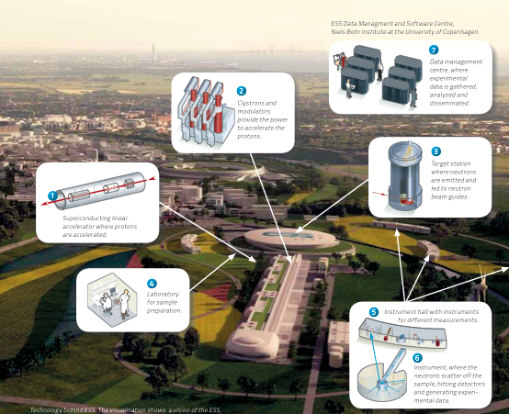

We help humanity get a better look at the molecular level
1 million Process Variables
Total budget: 1.8 B EUR
subsystems of various nature (target = nuclear system)
15-20 engineers from Cosylab

Slide 12
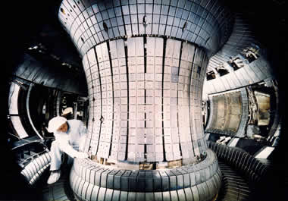


We help create unlimited energy
ITER – International Thermonuclear Experimental Reactor
  Experimental fusion reactor (spherical tokamak)
  Fusion of Deuterium and Tritium into Helium
  Design power: 500 MW Collaborators are EU, USA, India, Japan, China, Rusia and Korea
  Operational in „2027“

Slide 13
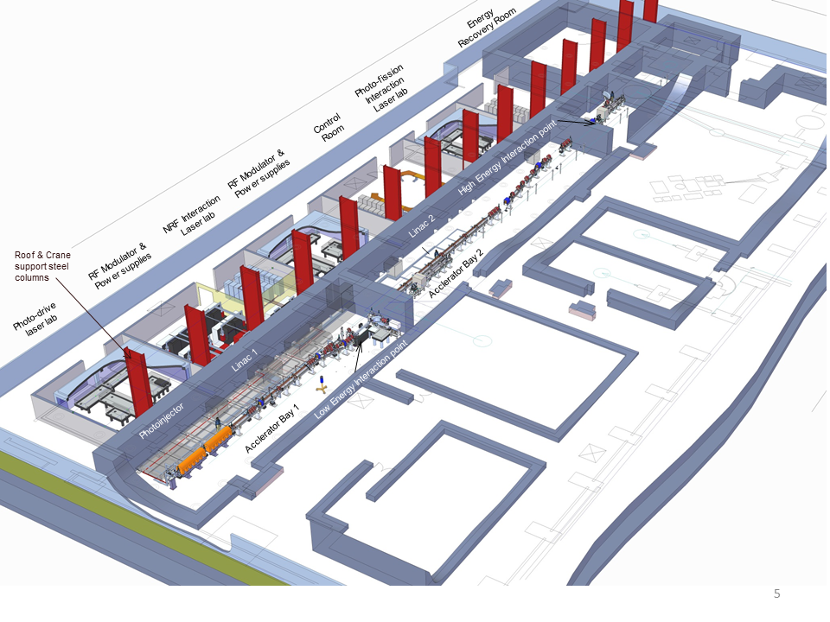

We keep cost down and speed up
    Provide all major aspects of the control system
    EPICS SW and HW
    Reuse of Software
    Turnkey Control System
      Lower costs and development time

Slide 14
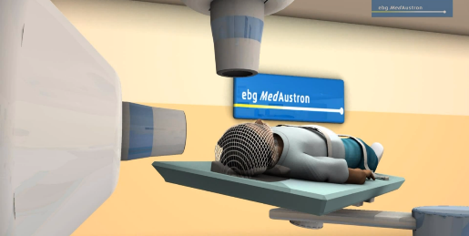
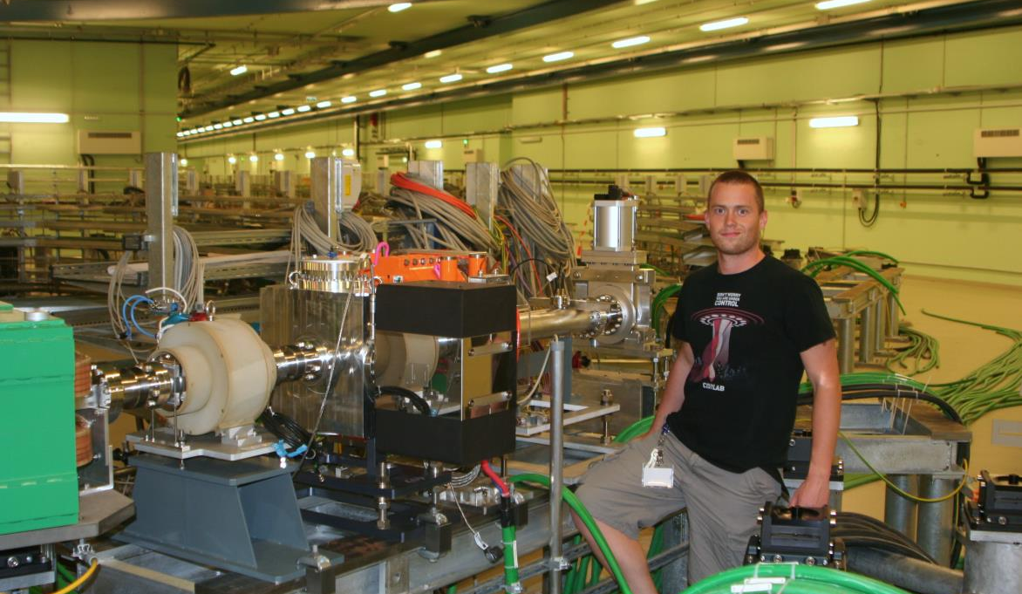


We help treat cancer
Ion Beam Therapy: Cancer treatment with Carbon
Wiener Neustadt, Austria
First patient treatment planned in end 2016
Cosylab did the development of control system for medical synchrotron accelerator since 2010
  main timing system, power converter control, front-end controller, LV RT communication framework, injector and synchrotron LLRF integration, FPGA programming, LV RT drivers
  now: dose delivery system (medical part)

Slide 15
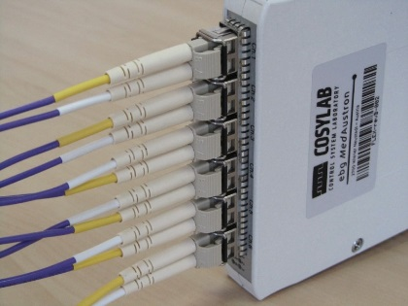
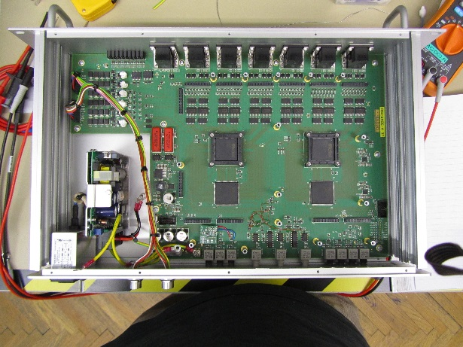
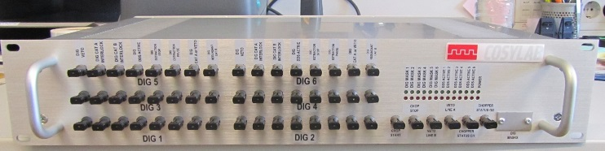
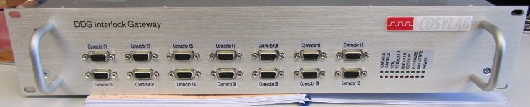
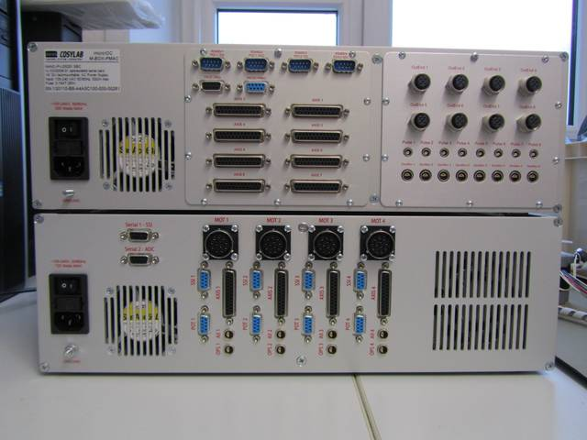
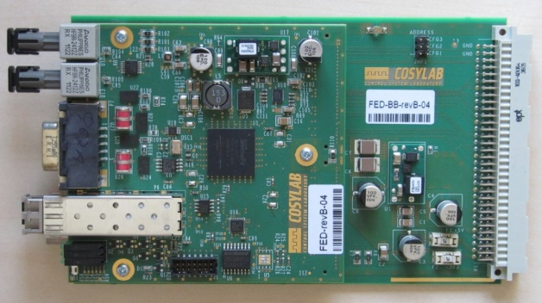
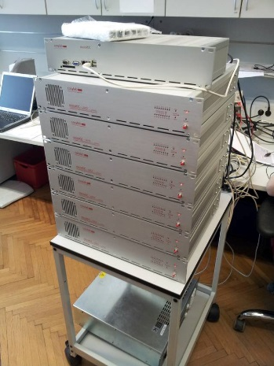
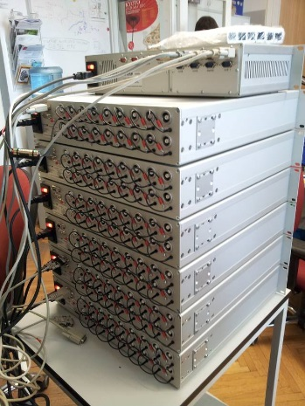
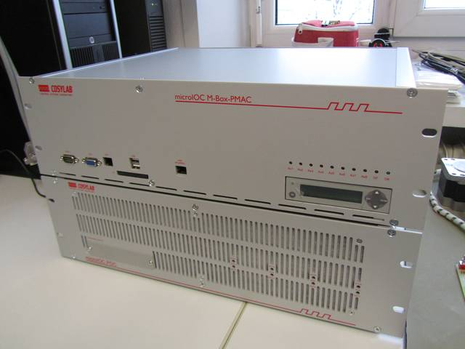
We do Hardware Development
  Developing SW is important, but just as important is the HW
    FPGA, LabVIEW, EPICS, FESA
    TS, MPS/MIS, 5GSps digitizers
    medical products
    microIOC
    PXI, PXIe, MTCA
    magnet power supplies, ion sources, commissioning, dose/beam delivery systems

Slide 16
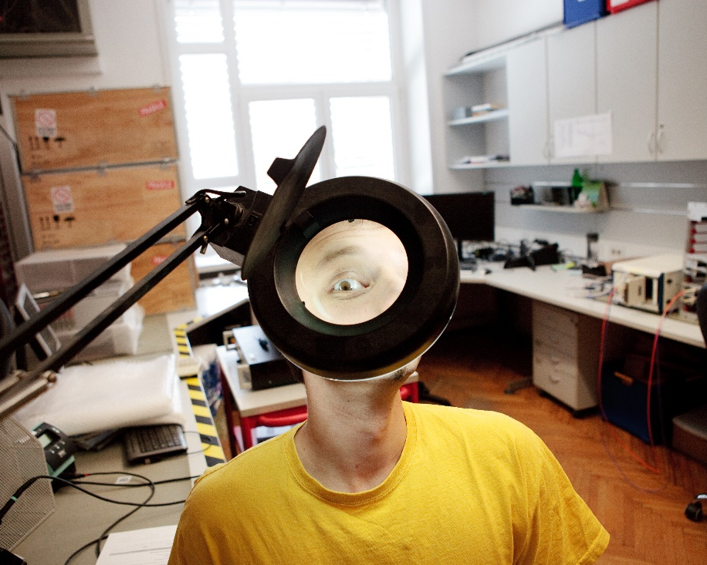
Our solution
Accelerator control system framework
LabVIEW based software framework
  based on decades of accumulated domain knowledge in the field
= Solid software foundation

Slide 17

M.A.D.I.E.
Modular Accelerator Device Integration Environment
Samo Tuma

Slide 18
What is MADIE?
Modular Accelerator Device Integration Environment (MADIE) is a LabVIEW based software framework, which is designed based on decades of accumulated domain knowledge in the field.
MADIE is a solid software foundation maximizing performance and reliability of the system while also minimizing the commissioning time of the accelerator.
It is the integrators API, which significantly accelerates device integration and at the same time promotes a state-of-the art software architecture.

Slide 19
How MADIE fits in the CS
SCADA
DDS
TCS
HDDS Widget
OPC UA Client
Remote log
client
Configuration server
HDDS server
Accelerator Allocator
MADIE
Plugin (IS)
Plugin (PS)
RF HW
BD HW
Power HW
etc...

Slide 20


Essential Common Services
Launcher
Intraproces communication service
OPC UA manager service
High Speed Data Distribution Service (HDDS)
Request-Response service
Watchdog service
Local & Remote Logging service
Configuration managment service
File (Parsing) Service

Slide 21
The Launcher
LVOOP design
There is a “parent” service responsible for:
  instantiation of all other MADIE plugins and services
  Initial configuration of the runtime parameters of MADIE plugins
  Parallel execution of MADIE plugins
  Intraprocess communication management
Running on LV 2014 and Windows 7
  Looking forward to running in on Linux ☺

Slide 23

Interproces communication service
Coordinate activities among different plugins and services that run concurrently
Direct access (No broker required)

Slide 24
OPC UA Manager service
standard control and monitoring interface between SCADA system and device layer
Internal or external OPC UA server support
EPICS CA currently under development

Slide 25
HDDS service
High speed data distribution service for BIG DATA.
Publisher-subscriber messaging pattern
Highly customizable (TCP based)
Tag based messaging
Multiple tag support!
Clients currently exist for:
  C++,
  LabVIEW,
  .net
  C#

Slide 26

Request Response service
Used where reliability is a big factor (medical)
Zero-MQ based
Libraries currently exist for:
  C++,
  LabVIEW,
  .net
  C#

Slide 27
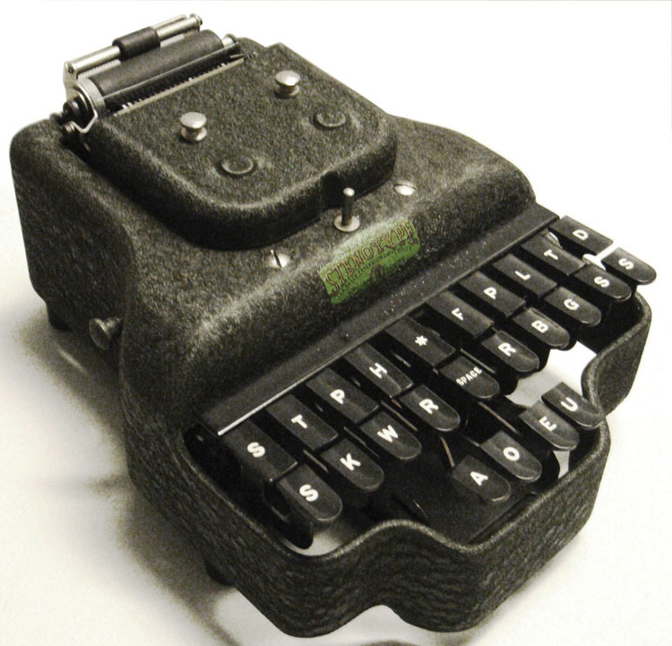
Logging services
Local
  Tab delimited log format for easy filtering (.csv)
  Multiple log levels support (debug, info, warning, error..)
Remote
  HDDS communication to transfer logs from local controllers to remote clients
  This reduces network load since only messages that the client subscribes to are sent
Localization
  total language independance when reporting errors to the user
  developer simply defines error codes, the rest is defined in a .txt file

Slide 28
File service
File parsing
  JSON
  XML
  INI
File loading/storing
  Non-blocking, used for loading/storing big files from/to HD to/from memory
Supports fetching and parsing
  a single file
  a folder content
  or a custom list of files

Slide 29
Configuration manager service
Monitoring of HTTP Configuration server contents
Selection, verification and download of apropriate
  Binaries
  Local configuration files
  Language localization definition files
Watchdog service
Monitors the responsiveness and health of plugins and services

Slide 30
Conclusions

Slide 31
Advantages of MADIE
Lightweight and modular design
Easy to develop and include new services, if needed
Highly customizable
  deploy only services which are needed on a target
Seamless integration with other Cosylab products:
  Data distribution service (finishedrunning)
  Central Timing System (finished, running)
  Configuration management tools (in progress)
  Remote log viewer clients (in progress)
  Device Allocator application (in progress)
Built for easy integration with a wide range of SCADA systems and EPICS CA
Stadardized interfaces for efficient medical software integration

Slide 32

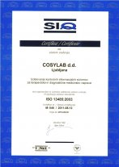
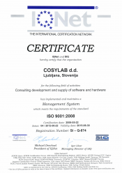
Well documented
Developed according to industrial development process (ISO 9001) and comes with all necessary documentation and traceability in place!
  Requirements and test plans
  Architecture and design
  User documentation
Ready to connect with
medical systems, e.g.:
  DDS
  TCS

Slide 33

Why MADIE?
Provides the LabVIEW integrator with essential common services for integration of accelerator control system devices
Enforces a unified architecture and communication protocols for all device integrations
Offers the integrator of specific devices a higher level API for better more cost-efficient implementation
Strong architectural foundations
mean simplifed debugging,
which cuts down commisioning time!

Slide 34
Thank you!
samo.tuma@cosylab.com
www.cosylab.com

Slide 35
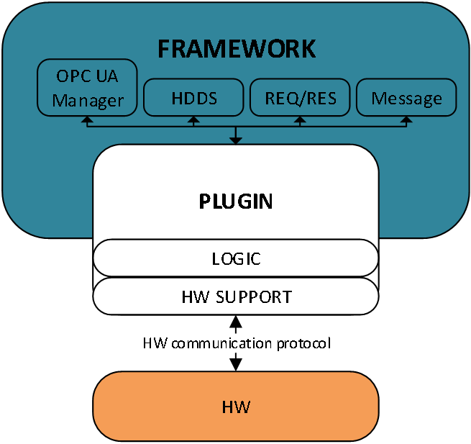
Plugin integration

