Slide 1
FCC
— RF —
Considerations
FCC-RF-Working Group
S. Aull, O. Brunner, A. Butterworth, N. Schwerg, M. Therasse

Slide 2
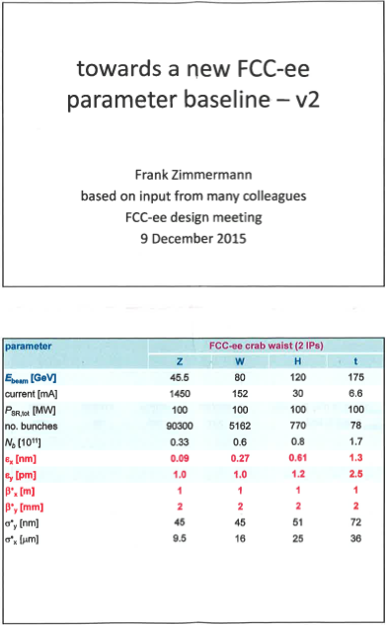
Input
 | V_tot | n_bunch | I_beam | E_turnloss
Z | 0.08 | 90300 | 1450 | 0.034
W | 0.8 | 5162 | 152 | 0.33
H | 5.5 | 770 | 30 | 1.67
t | 10 | 78 | 6.6 | 7.55
Machine Parameters

Slide 3
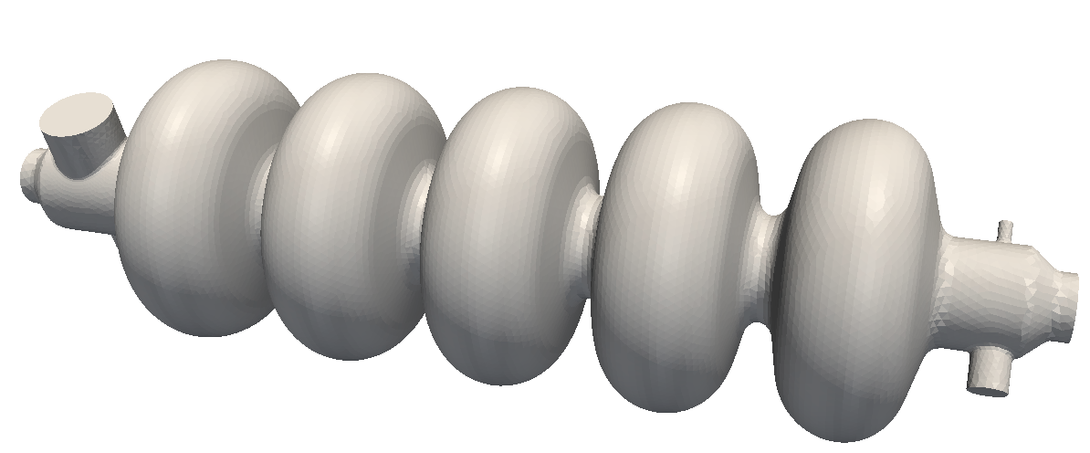
Design and Technology
G : Geometry factor
R_s : Surface Resistivity
f : Frequency
k_0 : Loss factor
E_acc : Accelerating gradient
n_cells : Number of cells
Choices

Slide 4
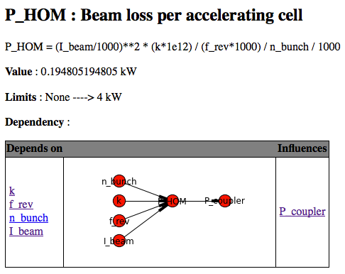
Interrelationships
and
Limits

Slide 5
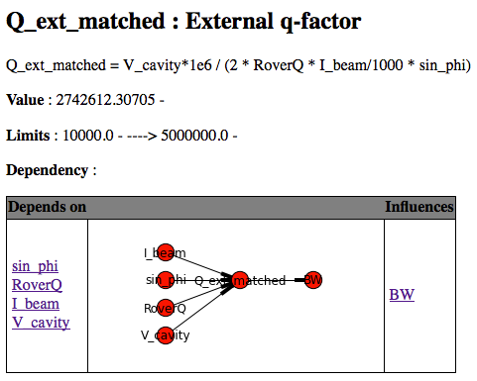
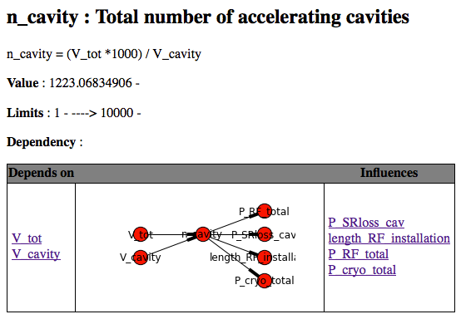
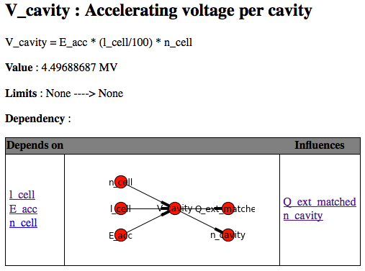
Interrelationships
Collection of Quantities

Slide 6
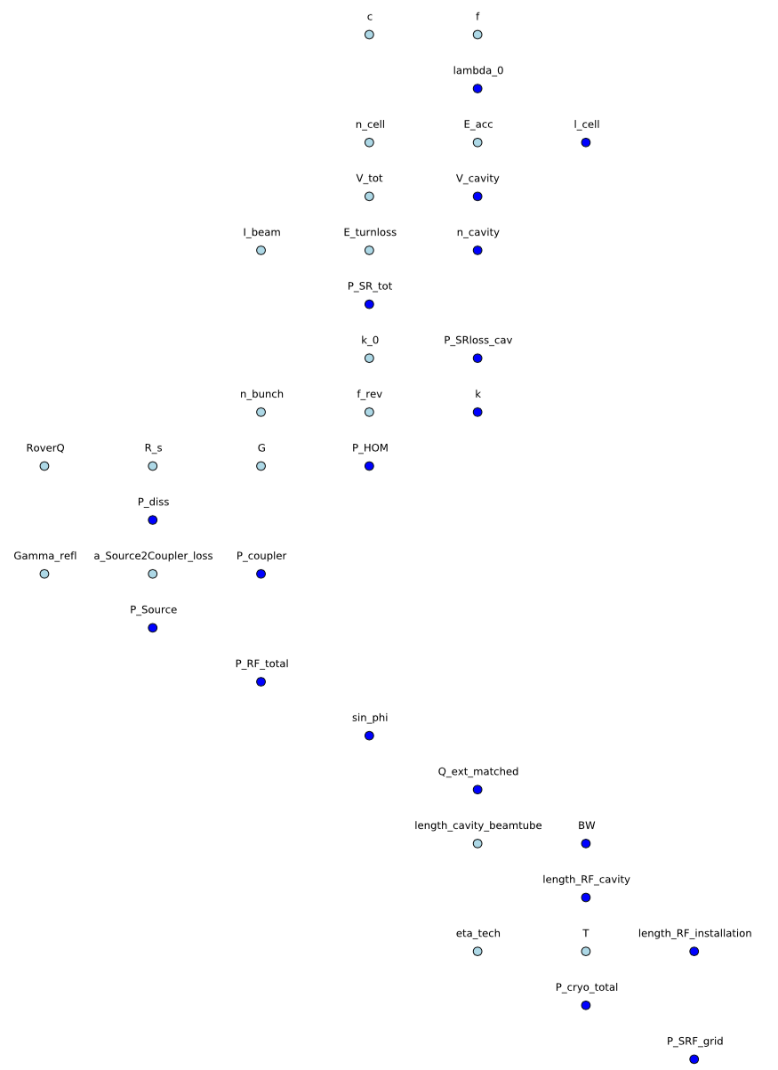
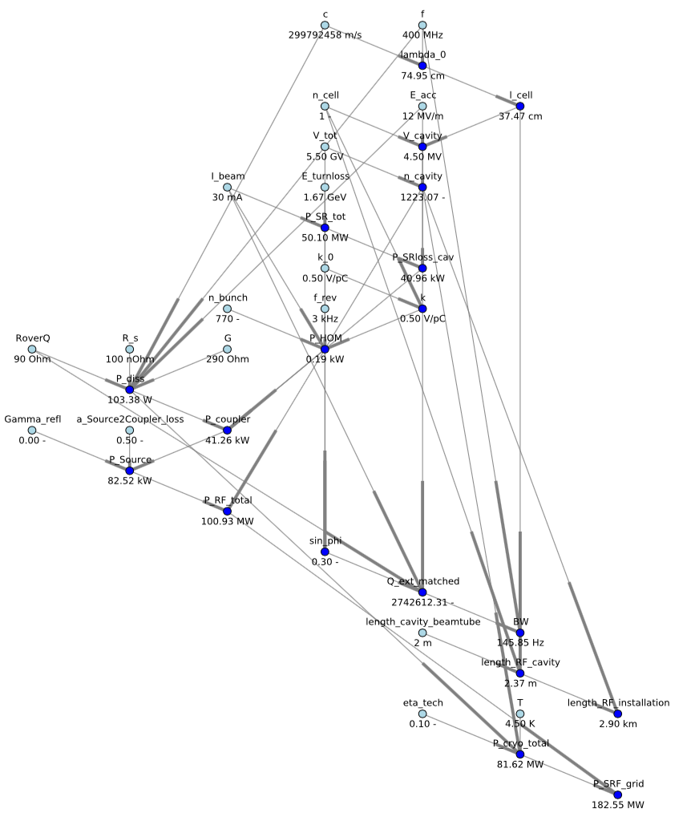
Interrelationship Network

Slide 7
Machine Related
Design and
Technology Choices
Critical Values

Slide 8
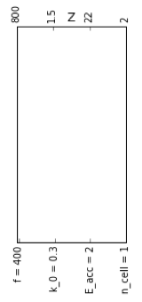
Design and Technology
f : Frequency
k_0 : Loss factor
Test all possible combinations
E_acc : Accelerating gradient
n_cell : Number of cells
Parameter Variation

Slide 9
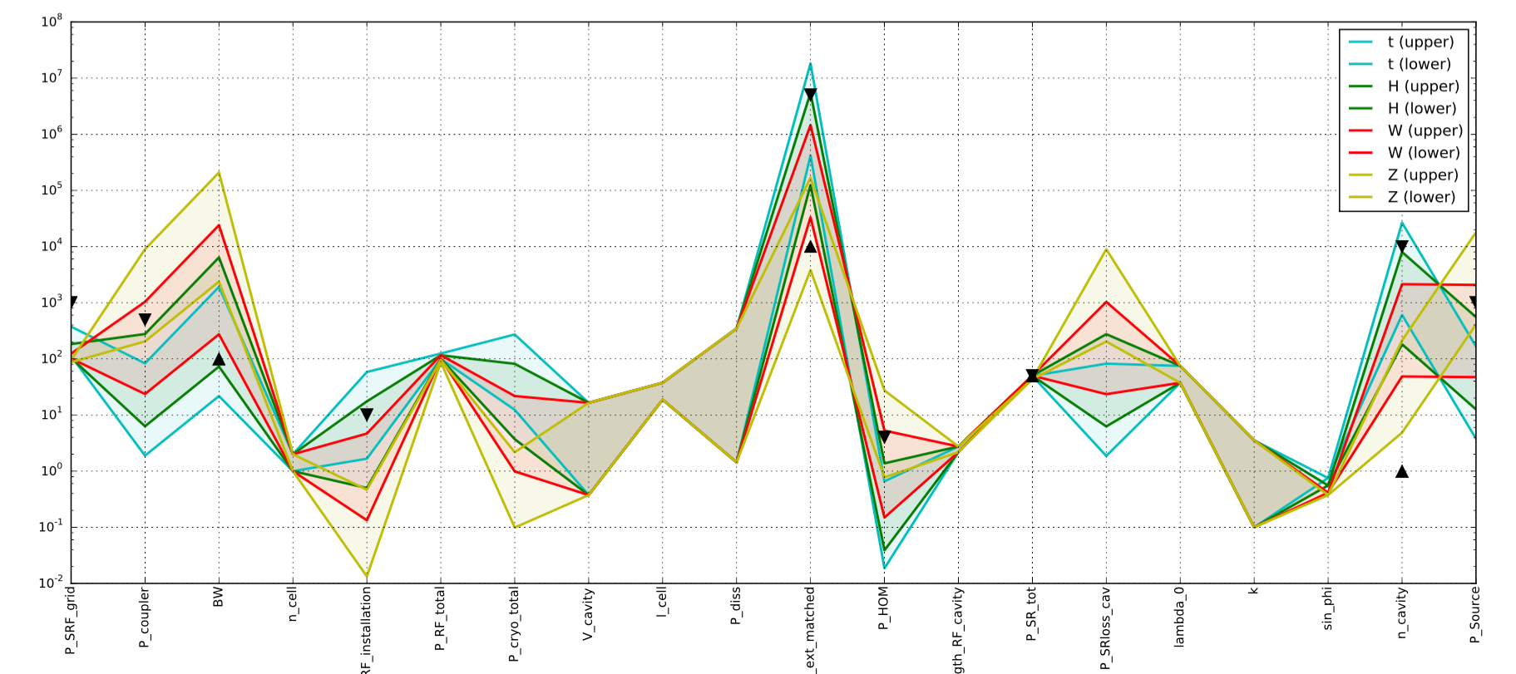
Machine Parameters
Design and Technology Choices
 | V_tot | n_bunch | I_beam | E_turnloss
Z | 0.08 | 90300 | 1450 | 0.034
W | 0.8 | 5162 | 152 | 0.33
H | 5.5 | 770 | 30 | 1.67
t | 10 | 78 | 6.6 | 7.55

Slide 10
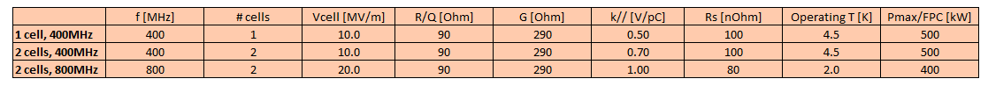
Design and Technology
Testing 3 Different Designs

Slide 11
Design and Technology
3 Different Designs
4 Machines
 | Z |  |  | W |  |  | H |  |  | t
Technology&design
cavity choice | 1 cell, 400MHz | 2 cells, 400MHz | 2 cells, 800MHz | 1 cell, 400MHz | 2 cells, 400MHz | 2 cells, 800MHz | 1 cell, 400MHz | 2 cells, 400MHz | 2 cells, 800MHz | 1 cell, 400MHz | 2 cells, 400MHz | 2 cells, 800MHz
frequency [MHz] | 400 | 400 | 800 | 400 | 400 | 800 | 400 | 400 | 800 | 400 | 400 | 800
Nb cells/cavity | 1 | 2 | 2 | 1 | 2 | 2 | 1 | 2 | 2 | 1 | 2 | 2
Eacc [MV/m] | 2.1 | 1.05 | 1.65 | 10.0 | 10.0 | 20.0 | 10.0 | 10.0 | 20.0 | 10.0 | 10.0 | 20.0
R/Q [Ohm] | 90 | 90 | 90 | 90 | 90 | 90 | 90 | 90 | 90 | 90 | 90 | 90
k// [V/pC] | 0.50 | 0.70 | 1.00 | 0.50 | 0.70 | 1.00 | 0.50 | 0.70 | 1.00 | 0.50 | 0.70 | 1.00
Pfpc max [kW] | 0.50 | 0.70 | 1.00 | 0.50 | 0.70 | 1.00 | 0.50 | 0.70 | 1.00 | 0.50 | 0.70 | 1.00
G [Ohm] | 290 | 290 | 290 | 290 | 290 | 290 | 290 | 290 | 290 | 290 | 290 | 290
Rs [nOhm] | 100 | 100 | 80 | 100 | 100 | 80 | 100 | 100 | 80 | 100 | 100 | 80
Operating Temp [K] | 4.5 | 4.5 | 2.0 | 4.5 | 4.5 | 2.0 | 4.5 | 4.5 | 2.0 | 4.5 | 4.5 | 2.0
RF system parameters
Cell length [m] | 0.375 | 0.375 | 0.1875 | 0.375 | 0.375 | 0.1875 | 0.375 | 0.375 | 0.1875 | 0.375 | 0.375 | 0.1875
Active length/cavity [m] | 0.375 | 0.75 | 0.375 | 0.375 | 0.75 | 0.375 | 0.375 | 0.75 | 0.375 | 0.375 | 0.75 | 0.375
Vcell [MV] | 0.79 | 0.39 | 0.31 | 3.75 | 3.75 | 3.75 | 3.75 | 3.75 | 3.75 | 3.75 | 3.75 | 3.75
Pbeam loss [MW] | 49.3 | 49.3 | 49.3 | 50.16 | 50.16 | 50.16 | 50.1 | 50.1 | 50.1 | 49.83 | 49.83 | 49.83
Qext matched | 7.1E+03 | 7.1E+03 | 5.6E+03 | 3.3E+05 | 6.6E+05 | 6.6E+05 | 2.3E+06 | 4.6E+06 | 4.6E+06 | 4.2E+06 | 8.4E+06 | 8.4E+06
BW | 56343 | 56343 | 143418 | 1204 | 602 | 1204 | 175 | 87 | 175 | 96 | 48 | 96
Nb cells | 102 | 203 | 259 | 213 | 213 | 213 | 1467 | 1467 | 1467 | 2667 | 2667 | 2667
Nb cavities | 102 | 102 | 129 | 213 | 107 | 107 | 1467 | 733 | 733 | 1333 | 667 | 667
Pdiss/cav [W] | 3 | 1 | 1 | 72 | 72 | 115 | 72 | 72 | 115 | 72 | 72 | 115
RF system active length [m] | 38 | 76 | 48 | 80 | 80 | 40 | 550 | 550 | 275 | 500 | 500 | 250
RF system length [m] | 180 | 218 | 165 | 379 | 229 | 136 | 2603 | 1577 | 935 | 1183 | 717 | 850
Pcryo tot [MW] | 0 | 0 | 0 | 10 | 5 | 18 | 68 | 34 | 123 | 62 | 31 | 112
PRF/cell [kW] | 485 | 485 | 381 | 235 | 470 | 470 | 34 | 68 | 68 | 37 | 75 | 75
Phom [kW] | 3.9 | 5.4 | 7.8 | 0.7 | 1.0 | 1.5 | 0.2 | 0.3 | 0.4 | 0.1 | 0.1 | 0.2
max "allowable" k// [V/pC] | 0.52 |  |  | 2.68 |  |  | 10.27 |  |  | 21.49
Cavity choices
 |  | f [MHz] | # cells | Vcell [MV/m] | R/Q [Ohm] | G [Ohm] | k// [V/pC] | Rs [nOhm] | Operating T [K] | Pmax/FPC [kW]
 | 1 cell, 400MHz | 400 | 1 | 10.0 | 90 | 290 | 0.50 | 100 | 4.5 | 500
 | 2 cells, 400MHz | 400 | 2 | 10.0 | 90 | 290 | 0.70 | 100 | 4.5 | 500
 | 2 cells, 800MHz | 800 | 2 | 20.0 | 90 | 290 | 1.00 | 80 | 2.0 | 400
Fixed values/limits
 | min | val | max | note
Frev [kHz] | 3
Phom[kW] | -- |  | 4 | state_of_the_art for 4 "hook" couplers
RF system length [m] | -- |  | 4000 | FCC_ee layout: 2 x 2000m RF LSS
Qext matched | ? |  | 5.00E+06 | BW > 100Hz
Cryo efficiency |  | 0.10
both beams

Slide 12
R’n’D Topics
Z
W
400 MHz (1 cell) x 90
RF Power up to 500 kW
HOM Power up to 4 kW
Niobium on Copper @ 4.5 K
Fundamental Power
Coupler
Loss factor
HOM Damping
H
400/800 MHz (2 cells) x 700
RF Power below 80 kW
Cryo Losses 170 kW
Niobium on Copper @ 4.5 K
Bulk Niobium @ 2 K
t
Solid-State Amplifier
R_s and E_acc

Slide 13
End
— Discussion and Comments —

Slide 14
Interrelationship Table
NAME | TITLE | MATH | VALUE | UNIT | LOWER_LIMIT | UPPER_LIMIT | SOURCE
f | frequency | - | 400 | MHz | - | - | -
c | speed of light | - | 299792458 | m/s | - | - | https://en.wikipedia.org/wiki/Speed_of_light
lambda_0 | wave length | c/(f*1e6) * 100 | 74.95 | cm | - | - | -
l_cell | RF cell length | lambda_0/2 | 37.47 | cm | - | - | -
E_acc | maximum accelerating gradient | - | 12 | MV/m | - | - | -
n_cell | number of cells per cavity | - | 1 | - | - | - | -
V_cavity | accelerating voltage per cavity | E_acc * (l_cell/100) * n_cell | 4.50 | MV | - | - | -
V_tot | total RF voltage for the machine | - | 5.50 | GV | - | - | Machine type specific
n_cavity | total number of accelerating cavities | (V_tot *1000) / V_cavity | 1223.07 | - | 1 | 10000 | -
E_turnloss | synchrotron loss per turn OR WHAT EVER | - | 1.67 | GeV | - | - | -
I_beam | beam current | - | 30 | mA | - | - | -
P_SR_tot | power loss due to synchrotron radiation | (E_turnloss * 1e9) * (I_beam / 1000) / 1e6 | 50.10 | MW | 49.50 | 50.50 | -
P_SRloss_cav | beam loss per accelerating cavity | P_SR_tot / n_cavity * 1000 | 40.96 | kW | - | - | -
k_0 | HOM loss factor constant | - | 0.50 | V/pC | - | - | Plot by Rama Calaga
k | HOM loss factor | k_0 * n_cell**0.5 | 0.50 | V/pC | - | - | Plot by Rama Calaga
f_rev | revolution frequency | - | 3 | kHz | - | - | -
n_bunch | number of bunches | - | 770 | - | - | - | -
P_HOM | beam loss per accelerating cell | (I_beam/1000)**2 * (k*1e12) / (f_rev*1000) / n_bunch / 1000 | 0.19 | kW | - | 4 | -
G | Geometry factor | - | 290 | Ohm | - | - | [Padamsee, pp. XX]
R_s | surface resistance | - | 100 | nOhm | - | - | [Padamsee und Sarah, pp. XX]
RoverQ | R upon Q | - | 90 | Ohm | - | - | LHC standard
P_diss | dissipated power per cell | (E_acc*1e6)**2 * c * (R_s*1e-9) / ((4 * f*1e6) * G * RoverQ) | 103.38 | W | - | - | [Padamsee, pp. XX]
P_coupler | total RF power per cavity going through the power coupler FPC | P_HOM + P_SRloss_cav + P_diss/1000 | 41.26 | kW | - | 500 | -
a_Source2Coupler_loss | Loss factor between power source and coupler | - | 0.50 | - | - | - | -
Gamma_refl | Reflection coefficient at coupler input | - | 0.00 | - | - | - | -
P_Source | Total power per RF source | P_coupler / a_Source2Coupler_loss / (1- Gamma_refl**2) | 82.52 | kW | - | 1000 | -
P_RF_total | overall required RF power for the machine | P_Source * n_cavity/1000 | 100.93 | MW | - | - | -
sin_phi | - | E_turnloss / V_tot | 0.30 | - | - | - | -
Q_ext_matched | external Q-factor | V_cavity*1e6 / (2 * RoverQ * I_beam/1000 * sin_phi) | 2742612.31 | - | 10000.00 | 5000000.00 | -
BW | bandwidth | f * 1e6 / Q_ext_matched | 145.85 | Hz | 100 | - | -
length_cavity_beamtube | extra cavity length | - | 2 | m | - | - | -
length_RF_cavity | overall length of one cavity | length_cavity_beamtube + (l_cell/100) * n_cell | 2.37 | m | - | - | -
length_RF_installation | length of the entire RF installation | length_RF_cavity * n_cavity / 1000 | 2.90 | km | - | 10 | -
T | Operating temperature | - | 4.50 | K | - | - | -
eta_tech | Technical efficiency for cryo plant | - | 0.10 | - | - | - | -
P_cryo_total | overall length of one cavity | P_diss * n_cavity / (T/(295 - T)) / eta_tech / 1000000 | 81.62 | MW | - | - | -
P_SRF_grid | overall required power for the SRF installation | P_cryo_total + P_RF_total | 182.55 | MW | - | 1000 | -

