Slide 1


Longitudinal Halo from NEA and PEA Photocathodes
ERL 2017 – 19.06.2017 Geneva
Monika Dehn
K. Aulenbacher, V. Bechthold, F. Fichtner
FKZ 05K12UM1

Slide 2
Motivation
intensity
acceptance
laser pulse
unwanted beam
(longitudinal halo)
pulse response
time
Knowledge of shape, structure, and length of electron bunches out of a photoemission gun under different photo excitation conditions
Beginning of the project as a collaboration between HZB, HZDR, JGU, MSU, and SPSPU
Now collaboration between HZB, HZDR, DESY, University of Siegen, JGU, and the additional support through University of Rostock, University of Wuppertal, and TU Darmstadt

Slide 3
Outline
Some fundamentals
  Semiconducting photocathodes
  Photoemission process
Time response measurements
  Experimental setup
  Measuring principles
  Measuring results
Conclusion and Outlook

Slide 4
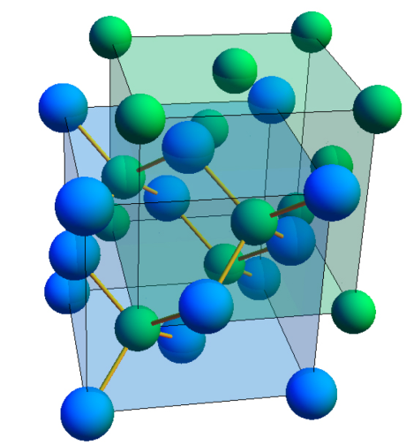

Fundamentals
Semiconducting photocathodes
E
e⁻
thermalization
CsO:GaAs
  Single crystalline structure
  Negative electron affinity (NEA)
K₂CsSb
  Multi crystalline structure
  Positive electron affinity (PEA)
e⁻
transport
tunneling
E_{C}
χ
optical pumping
E_{V}
E_{Val}
valence band
solid
vacuum
x
E
e⁻
thermalization
emission
e⁻
no emission
E_{V}
E_{C}
χ
optical pumping
E_{Val}
valence band
solid
vacuum
x

Slide 5
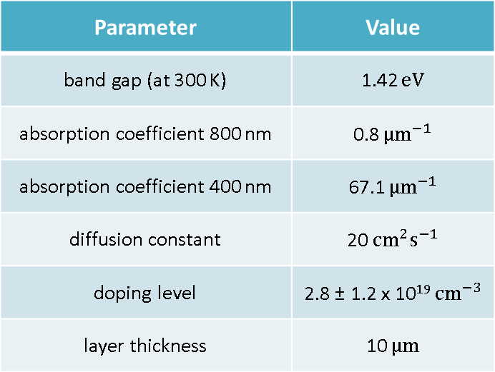
Fundamentals
CsO:GaAs – Influences of the Photon Energy
Penetration depth
  ca. 1250 nm @ 800 nm (E_{γ} = 1.55 eV)
  ca. 15 nm @ 400 nm (E_{γ} = 3.10 eV)
Band bending region (BBR) causes an electric field
  Electrons near the surface get accelerated
E
BBR
conducting band
E_{C}
E_{V}
Parameter | Value
band gap (at 300 K) | 1.42 $eV$
absorption coefficient 800 nm | 0.8 ${µm}^{−1}$
absorption coefficient 400 nm | 67.1 ${µm}^{−1}$
diffusion constant | 20${ cm}^{2}s^{−1}$
doping level | 2.8 ± 1.2 x 10¹⁹${ cm}^{−3}$
layer thickness | 10 $µm$
E_{F}
valence band
x
p-doped solid
vacuum
5 nm

Slide 6

Time Response Measurements
Principles
RF Master
Solid State Amplifier
Phase Shifter
Freq. Divider
DBM
≈
ϕ
Active Phase Stabilization
:32
76MHz-Filter/
Photodetector
Detector/
Channeltron
Slit
CCD Camera
YAG Screen
Deflector
Cavity
Cathode
Beamsplitter
Laser
Conversion of the longitudinal profile into transverse profile by TM₁₁₀ RF Deflector Cavity
Electron bunches must be emitted synchronously to RF Master
Longitudinal profile directly visible on the screen (intensity) or can be sampled by a Channeltron Detector

Slide 7
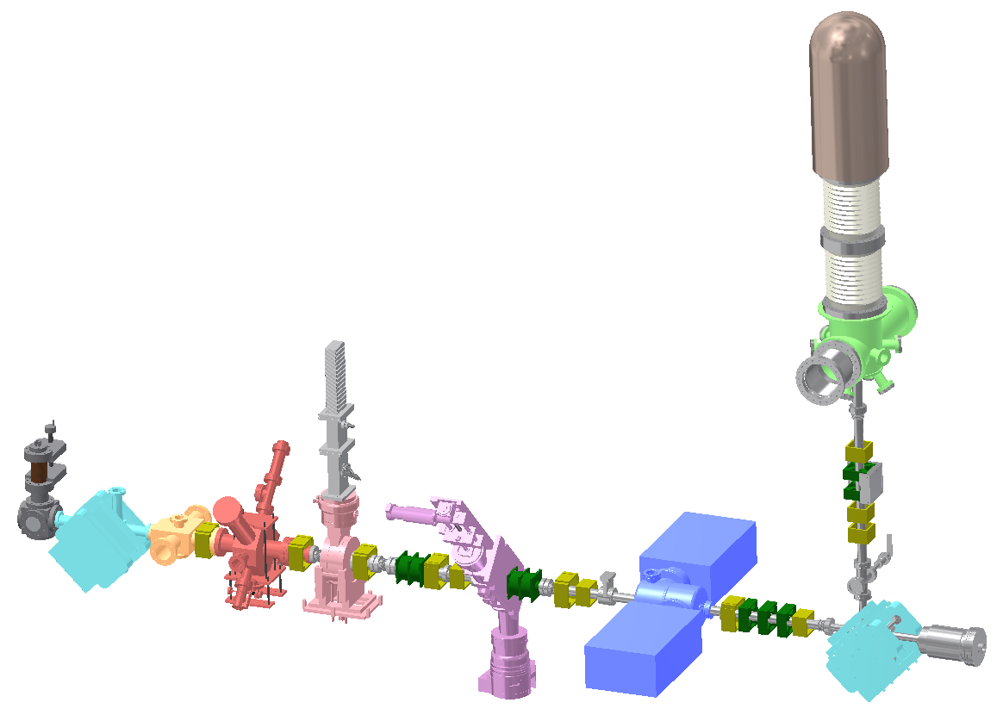

Time Response Measurements
Experimental Setup at PKAT
Generation of short electron bunches:
Laser pulse (red), Electron bunch (green), synchronous with RF
Electron Gun
100 keV DC
YAG Screen/
Slit
Deflector Cavity
Channeltron
Double Solenoid
e⁻ Bunch
RF Deflection
700 mm
Laser

Slide 8
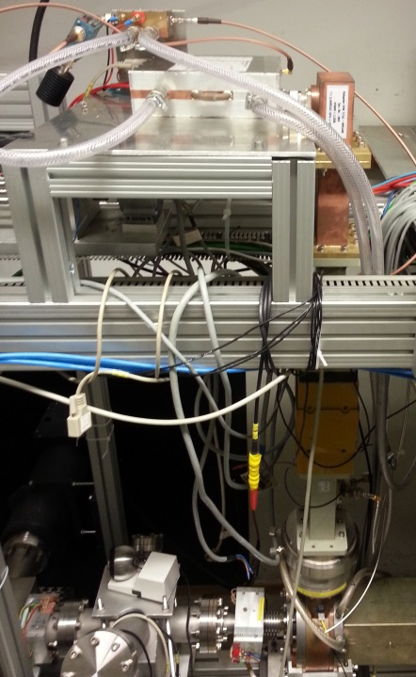
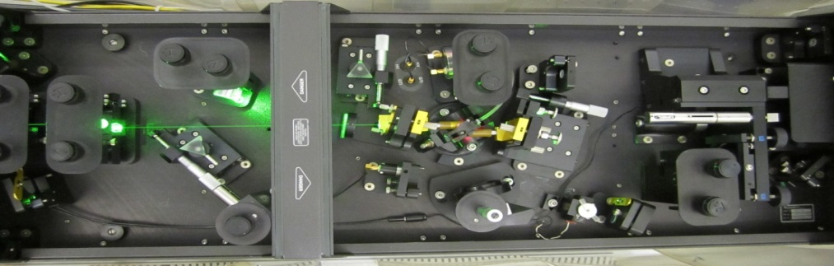
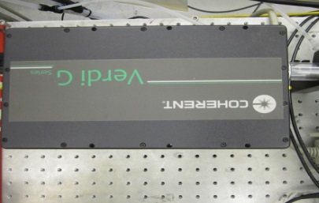
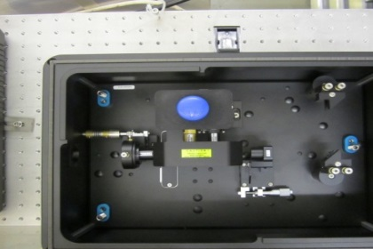
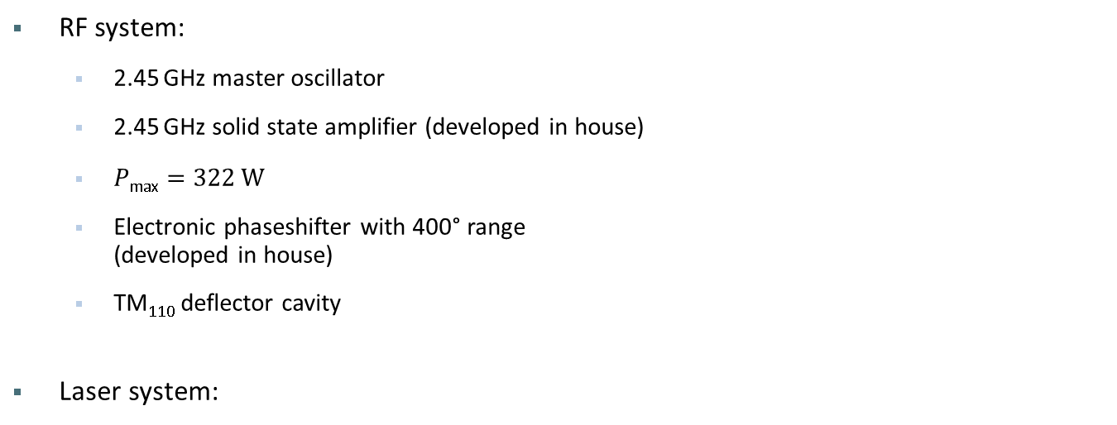
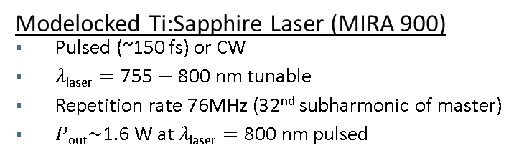
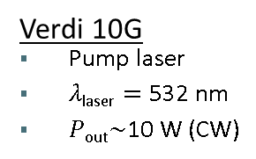
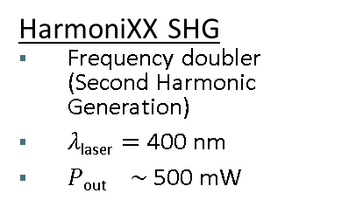
Time Response Measurements
Some Technical Details
RF system:
  2.45 GHz master oscillator
  2.45 GHz solid state amplifier (developed in house)
  $P\text{max}=\text{322} \text{W}$
  Electronic phaseshifter with 400° range
  (developed in house)
  TM₁₁₀ deflector cavity
Laser system:
400 mm
Verdi 10G
Pump laser
$λ\text{laser}=\text{532} \text{nm}$
$P\text{out}\sim \text{10} \text{W}$ (CW)
Modelocked Ti:Sapphire Laser (MIRA 900)
Pulsed (~150 fs) or CW
$λ\text{laser}=\text{755}−\text{800} \text{nm}$ tunable
Repetition rate $\text{76}\text{MHz}$ (32nd subharmonic of master)
$P\text{out}\sim \text{1}\text{.}\text{6} \text{W}$ at $λ\text{laser}=\text{800} \text{nm}$pulsed
HarmoniXX SHG
Frequency doubler (Second Harmonic Generation)
$λ\text{laser}=\text{400} \text{nm}$
$P\text{out} \sim \text{500} \text{mW}$

Slide 9
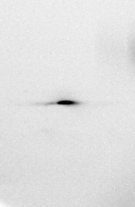

Time Response Measurements
Measurements with CsO:GaAs
Beam profile YAG-screen
CW-beam (integrated over 25 x 10⁶ bunches)
Bunch charge < 0.01 fC
Intensity distribution equals the convolution of
  the transverse beam profile of deflection plane and the time response
  time of flight effects because of energy distribution within the bunch
  laser pulse length
  laser spot size
Transverse structure
Time structure
Without RF
With RF

Slide 10
Time Response Measurements
Results at 400 nm and 800 nm with CsO:GaAs
Measurements
Simulations with the diffusion model
After 10 ps the intensity at 400 nm is about 2 orders of magnitudes smaller.
Quantum efficiency
    QE₈₀₀ = 0.05%
    QE₄₀₀ = 0.5%
Simulation with a diffusion model
Describes the pulse response only qualitatively not quantitatively
The signals do not fall as fast as in the measurements
  E.g. unknown doping level
  Electrons at 400 nm do not follow a diffusion

Slide 11
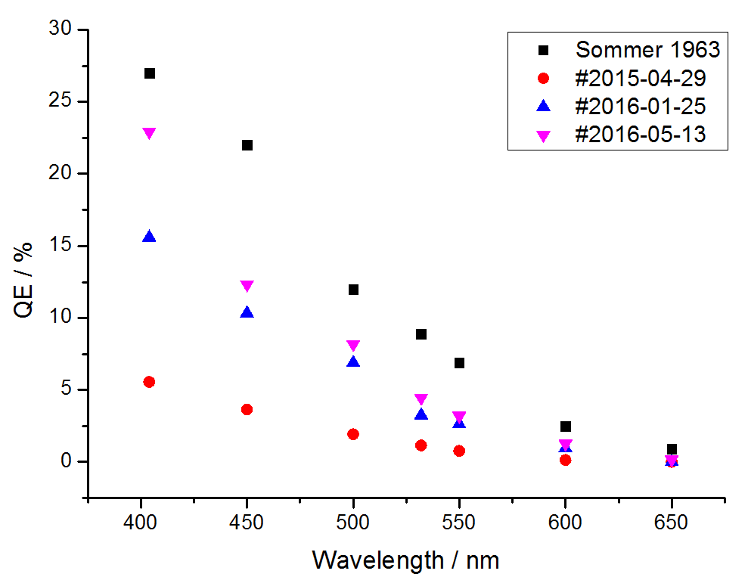
Time Response Measurements
Production of K₂CsSb Photocathodes
Used for measurements
Further information:
Poster
Victor Bechthold
MOPSPP004
Victor Bechthold, DPG spring meeting 2017, Dresden

Slide 12
Time Response Measurements
Comparison of CsO:GaAs and K₂CsSb
Red and blue line: NEA
Black line: PEA
  Pulse response faster than NEA
  Variation of the intensity in the tail: between a factor of 2 (left) and 10 (right)
  QE = 1 %

Slide 13
Conclusion and Outlook
Conclusion
  Pulse response measurements with CsO:GaAs photocathodes at 800 nm and 400 nm
  Lower contribution to unwanted beam at 400 nm due to higher concentration to electrons at the surface
  Pulse response measurements with K₂CsSb photocathodes at 400 nm
  Pulse response of K₂CsSb is faster than CsO:GaAs, and lower contribution to unwanted beam even to CsO:GaAs
  Actually, the measurements with K₂CsSb show the lowest limit of our time resolution with σ = 0.9 ps
Outlook
  Analysis of the different types of jitter during the measurements
  Time resolved measurements with other types of GaAs photocathodes (thin layers)
  Investigations in the differences of the tail intensities of K₂CsSb

Slide 14
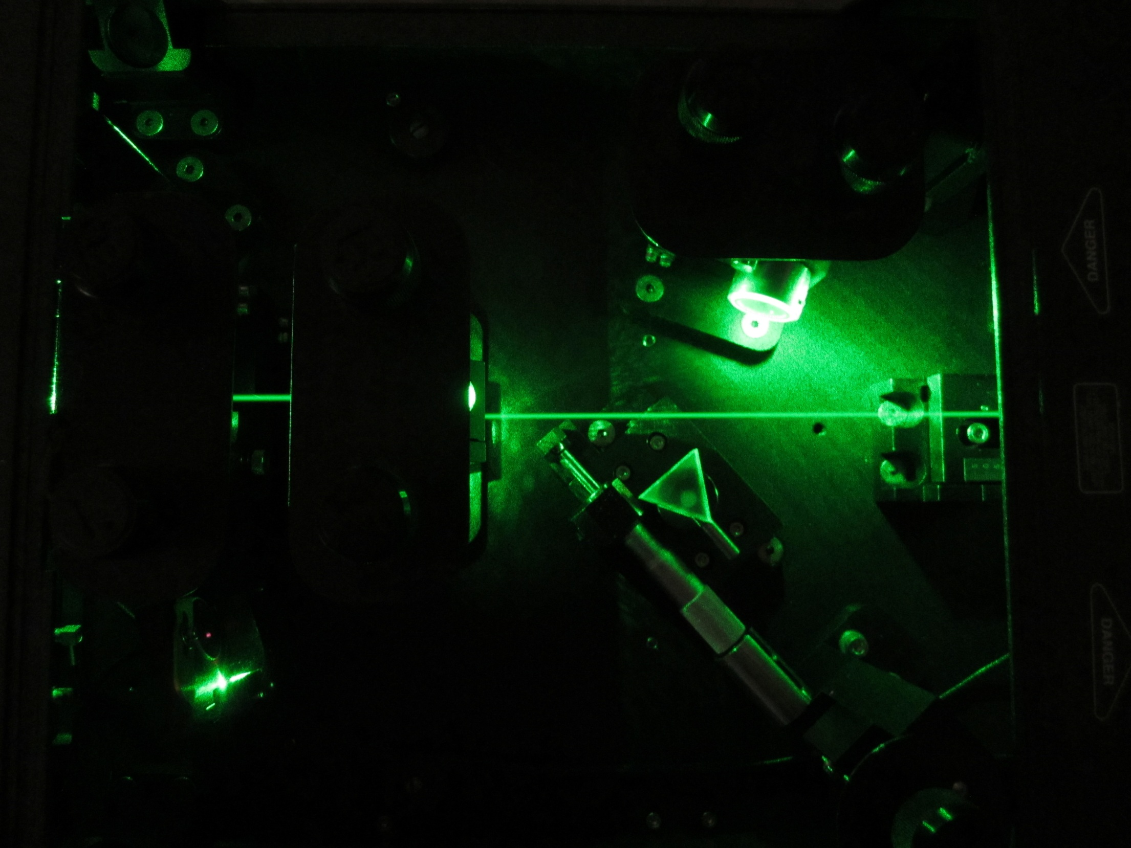
Thank you
for your
attention.

Slide 15
Time Response Measurements
Limits of the Resolution
Different effects
  Real transverse spot size only by the emittance
  High voltage power supply: jitter
  Beam spot: jitter
  RF phase: jitter
  Laser bunch length: jitter
  Electrons: different starting energies
  Electrons: different transverse momenta
  Channeltron: hum of the mains
  Water cooling: drifts

Slide 16
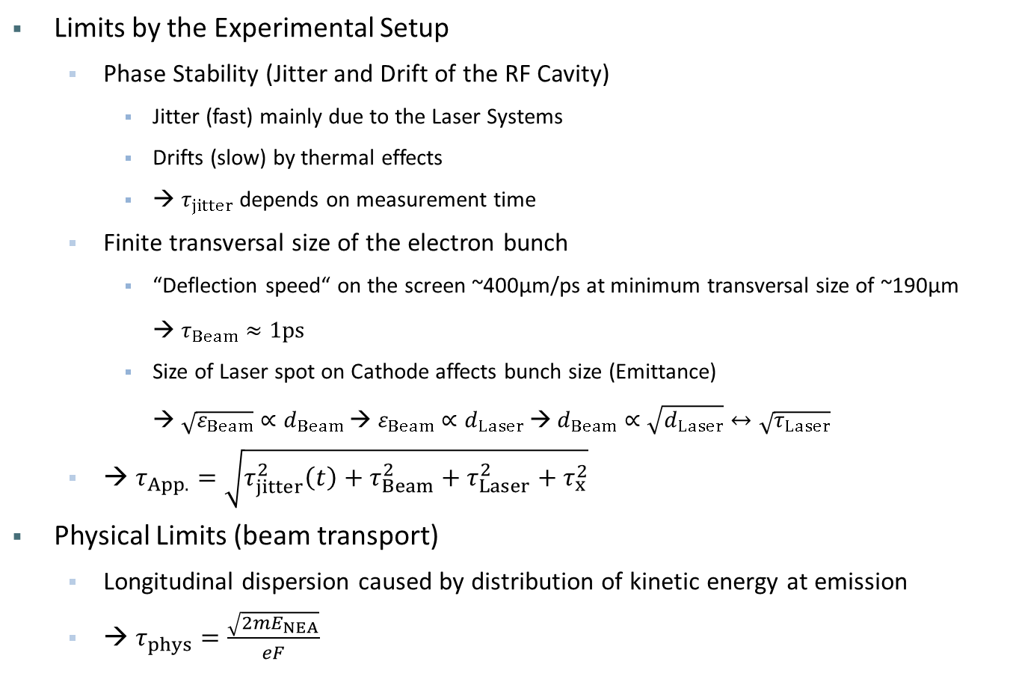
Time Response Measurements
Limits of the Resolution
Limits by the Experimental Setup
  Phase Stability (Jitter and Drift of the RF Cavity)
    Jitter (fast) mainly due to the Laser Systems
    Drifts (slow) by thermal effects
    → $τ_{jitter}$ depends on measurement time
  Finite transversal size of the electron bunch
    “Deflection speed“ on the screen ~400µm/ps at minimum transversal size of ~190µm
    → $τ_{Beam}≈1\text{ps}$
    Size of Laser spot on Cathode affects bunch size (Emittance)
    → $\sqrt{ε_{Beam}}∝d_{Beam}$ → $ε_{Beam}∝d_{Laser}$ → $d_{Beam}∝\sqrt{d_{Laser}}↔\sqrt{τ_{Laser}}$
  → $τ_{App.}=\sqrt{τ_{jitter}^{2}\left(t\right)+τ_{Beam}^{2}+τ_{Laser}^{2}+τ_{x}^{2}}$
Physical Limits (beam transport)
  Longitudinal dispersion caused by distribution of kinetic energy at emission
  → $τ_{phys}=\frac{\sqrt{2{mE}_{NEA}}}{eF}$

Slide 17
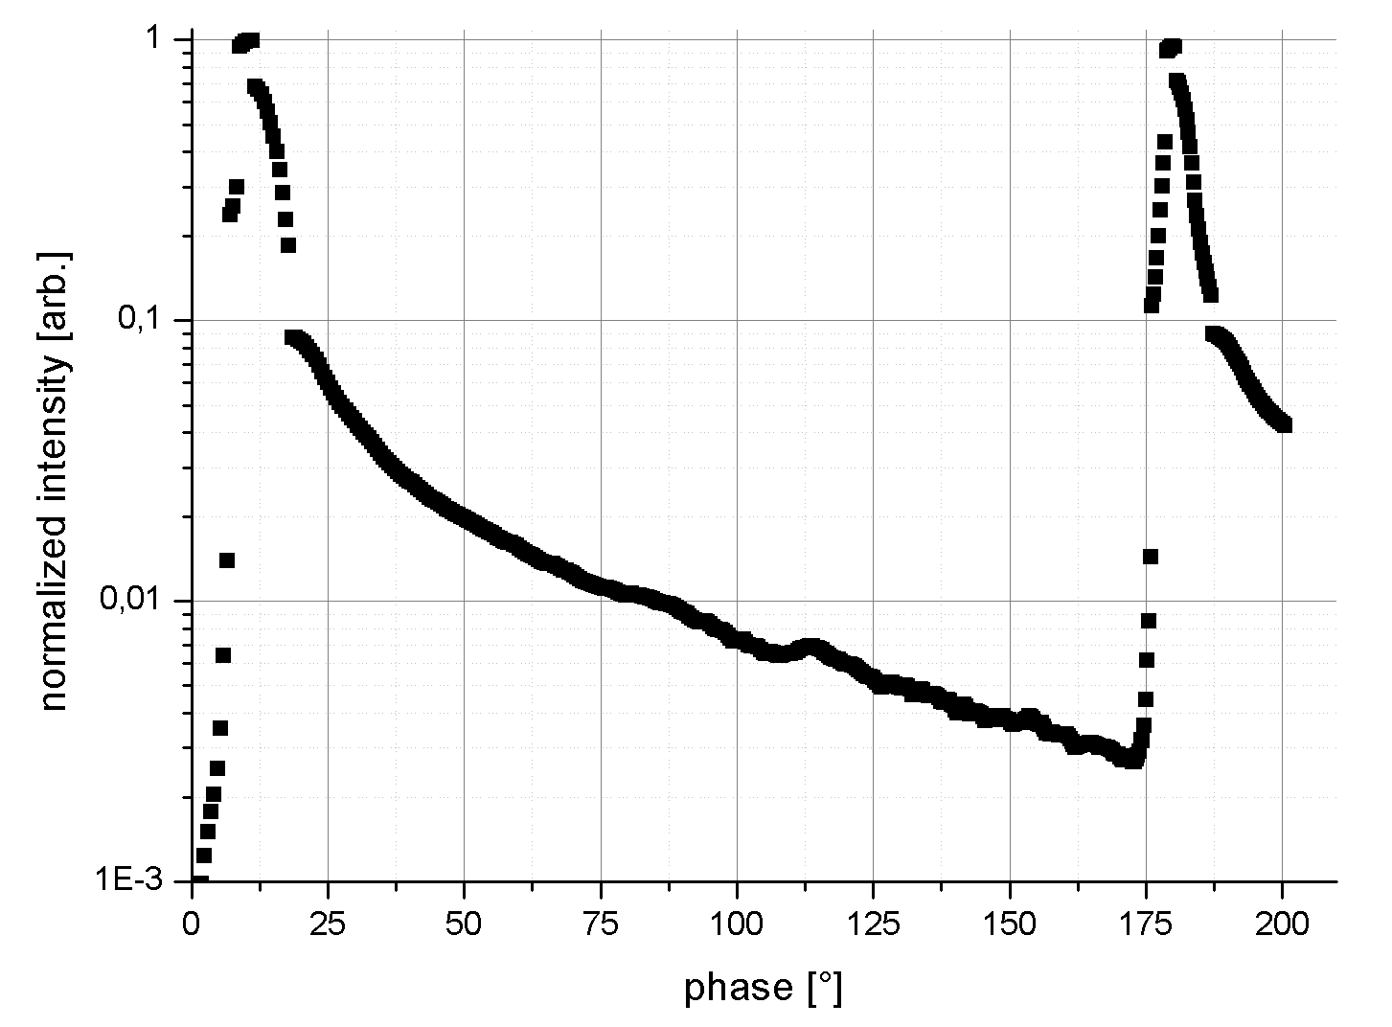
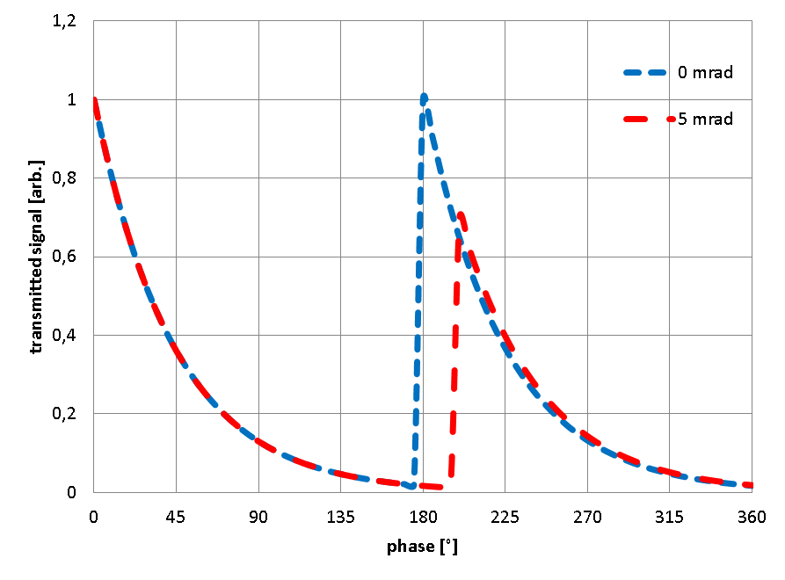
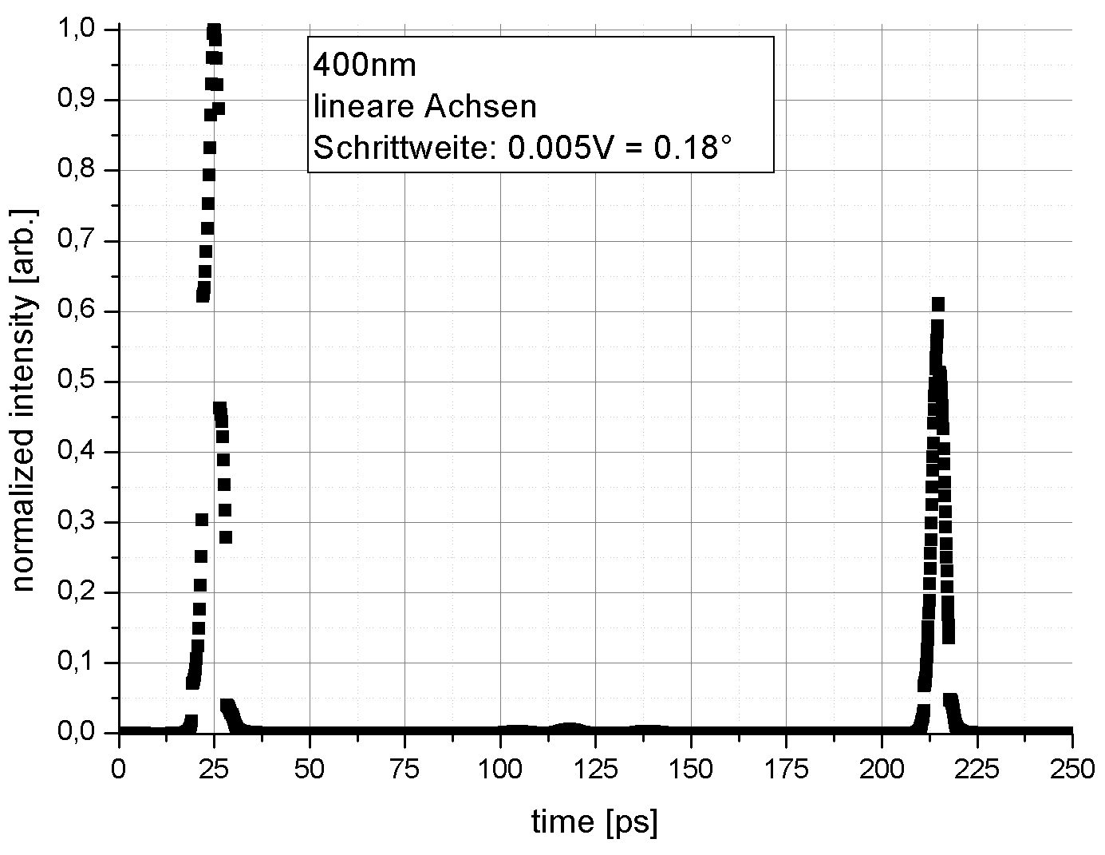
Time Response Measurements
Long Phaseshift
11°
180°
Phase shift: 200°
Pulse repeats after 169°
Cavity simulation
  E.g. a beam deviation of 5mrad through the cavity shows an additional phase shift and an intensity modulation.
Source: Kirsch, E.: Johannes Gutenberg Universität Mainz, Diplomarbeit, 2014

Slide 18
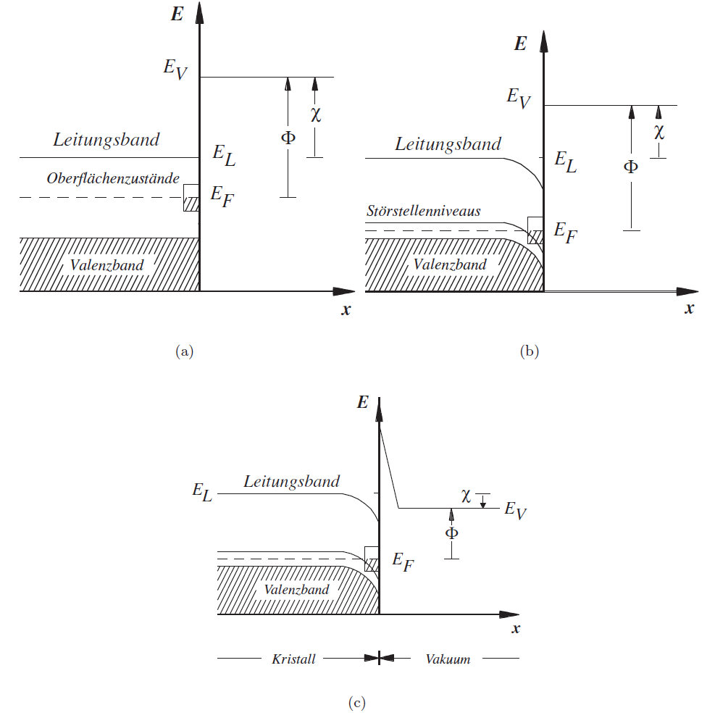
Fundamentals
Semiconducting photocathode GaAs
undotiert
p-dotiert
CsO₂ Schicht (NEA)

Slide 19
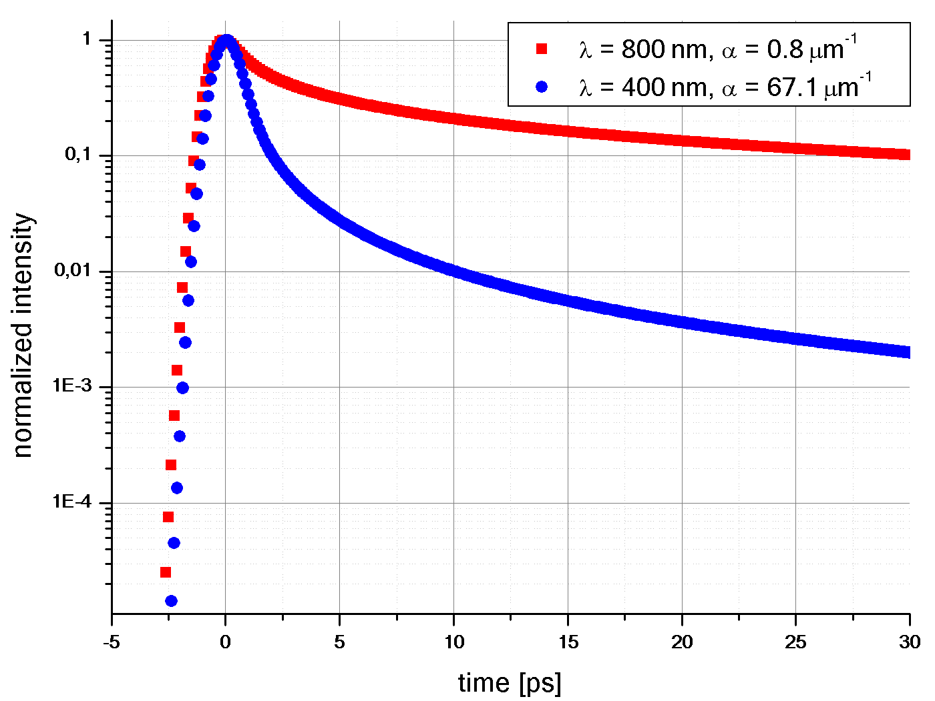
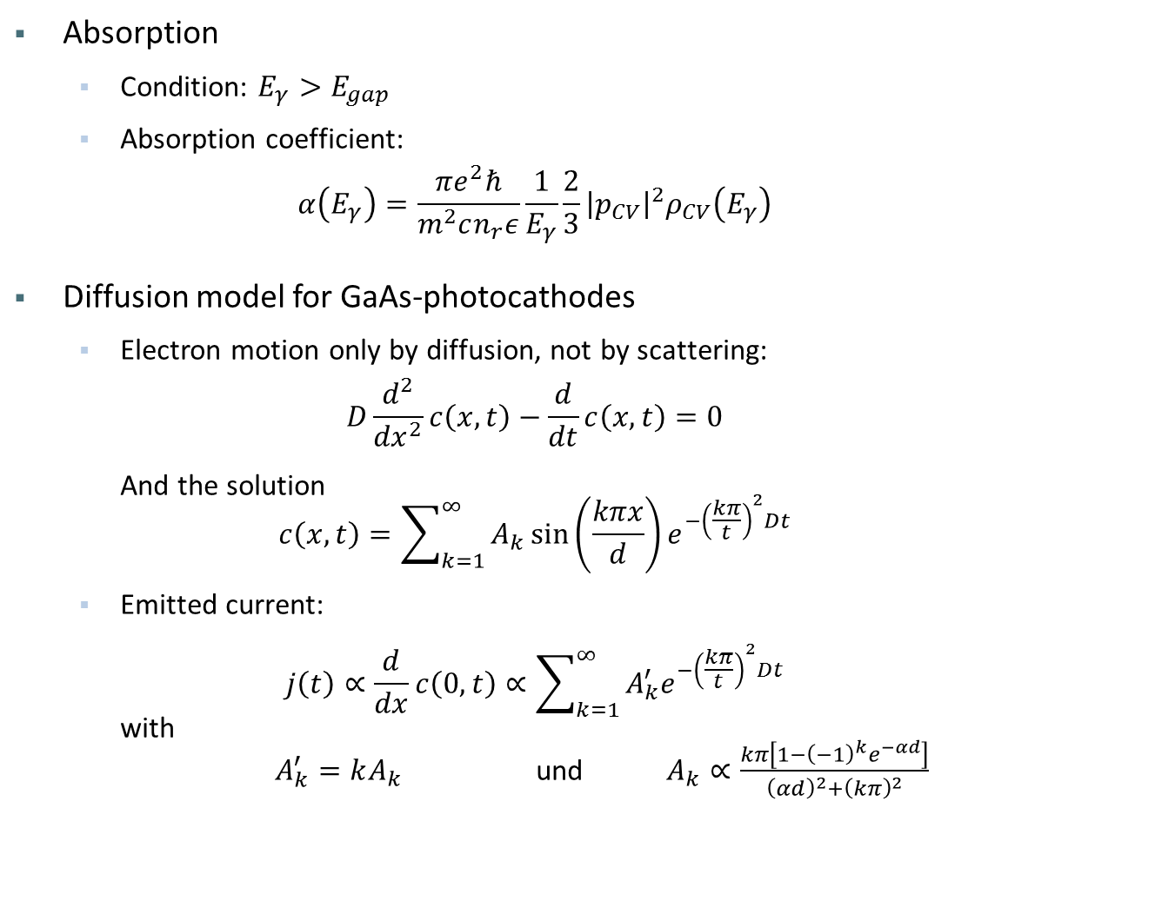
Fundamentals
Photoemission from Semiconductors
Absorption
  Condition: $E_{γ}>E_{gap}$
  Absorption coefficient:
  $α\left(E_{γ}\right)=\frac{πe^{2}ℏ}{m^{2}cn_{r}ε}\frac{1}{E_{γ}}\frac{2}{3}{\left|p_{CV}\right|}^{2}ρ_{CV}\left(E_{γ}\right)$
Diffusion model for GaAs-photocathodes
  Electron motion only by diffusion, not by scattering:
  $D\frac{d^{2}}{{dx}^{2}}c\left(x,t\right)−\frac{d}{dt}c\left(x,t\right)=0$
  And the solution
  $c\left(x,t\right)=\sum_{k=1}^{∞}{A_{k}\sin\left(\frac{kπx}{d}\right)e^{−{\left(\frac{kπ}{t}\right)}^{2}Dt}}$
  Emitted current:
  $j\left(t\right)∝\frac{d}{dx}c\left(0,t\right)∝\sum_{k=1}^{∞}{A_{k}^{′}e^{−{\left(\frac{kπ}{t}\right)}^{2}Dt}}$
  with
  $A_{k}^{′}=kA_{k}$ und $A_{k}∝\frac{kπ\left[1−{\left(−1\right)}^{k}e^{−αd}\right]}{{\left(αd\right)}^{2}+{\left(kπ\right)}^{2}}$

Slide 20
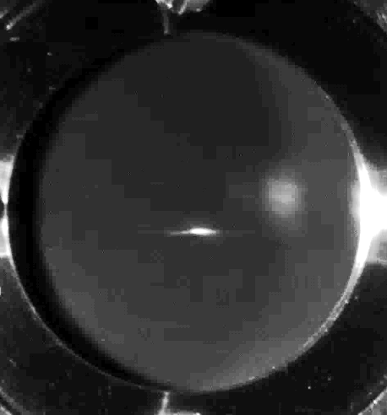
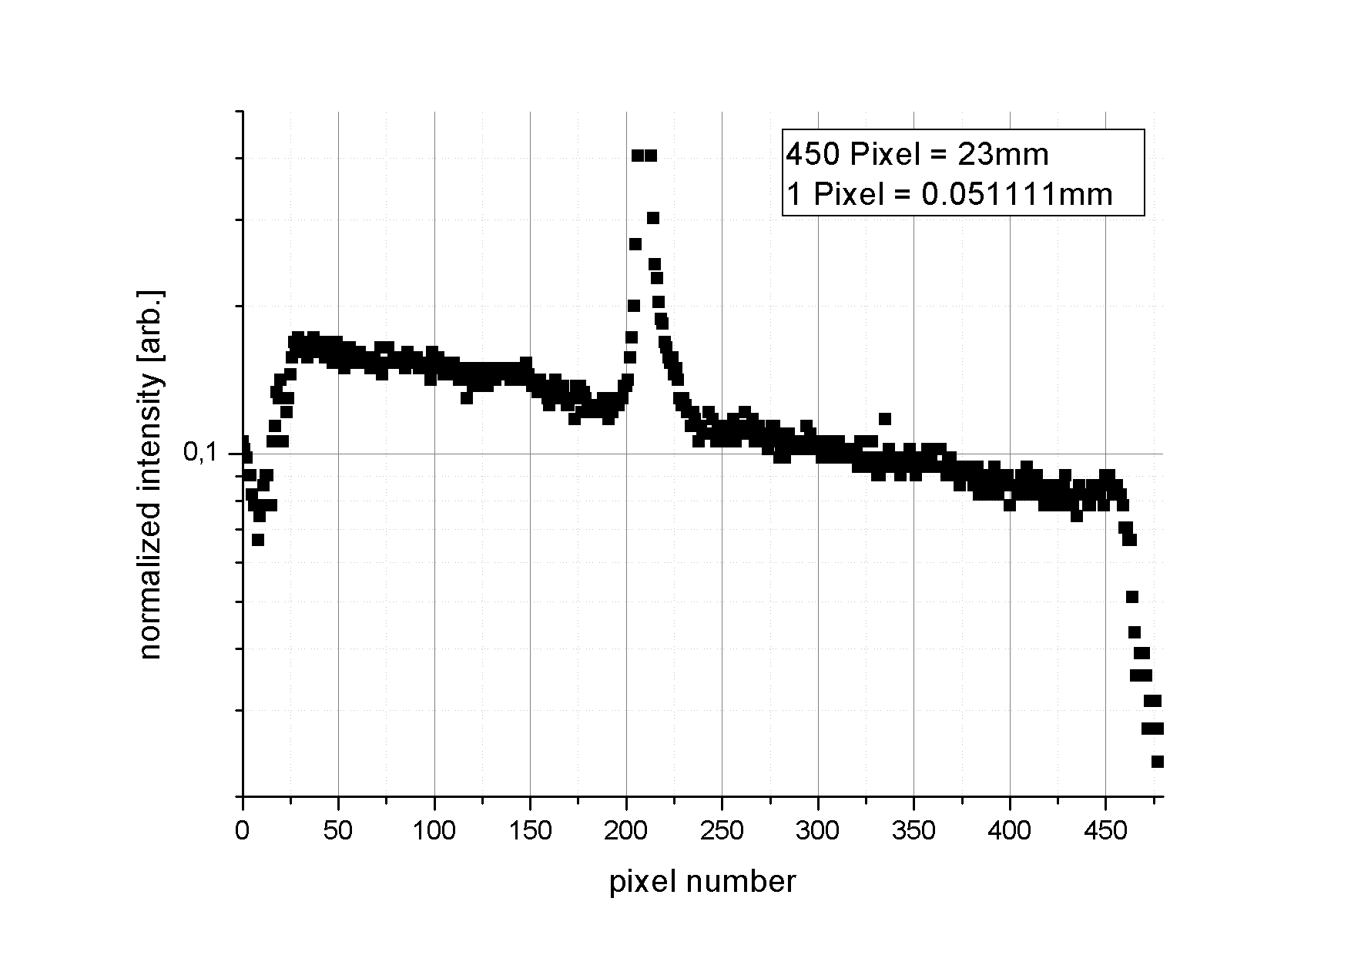
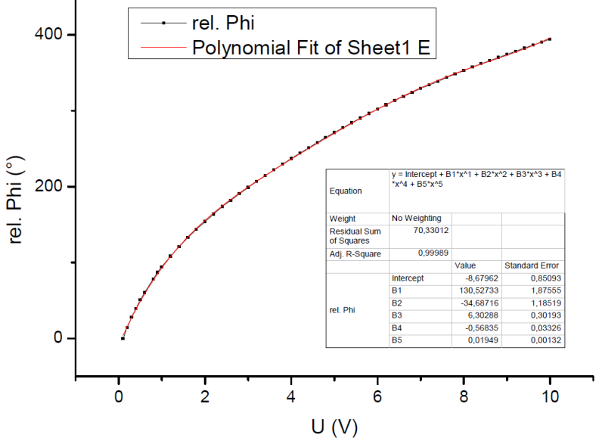
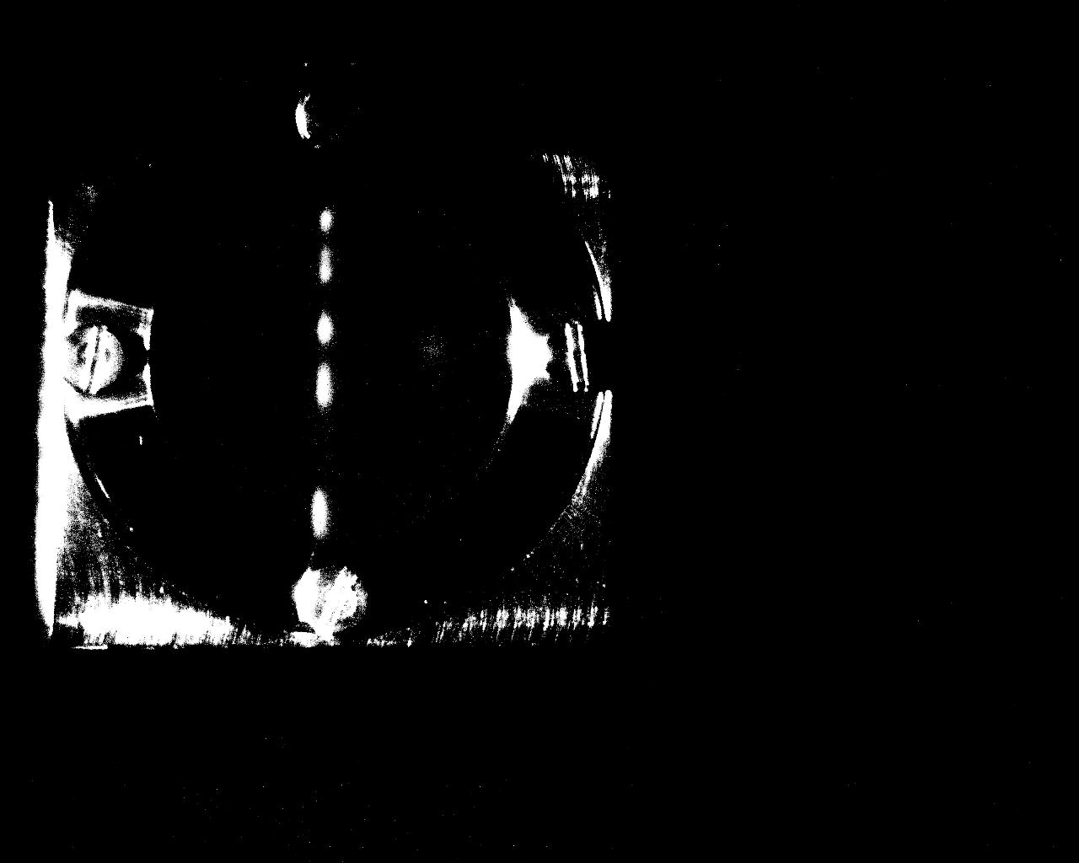
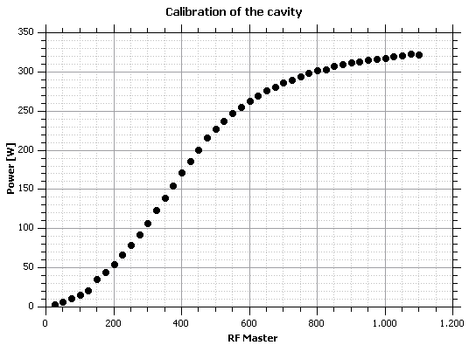
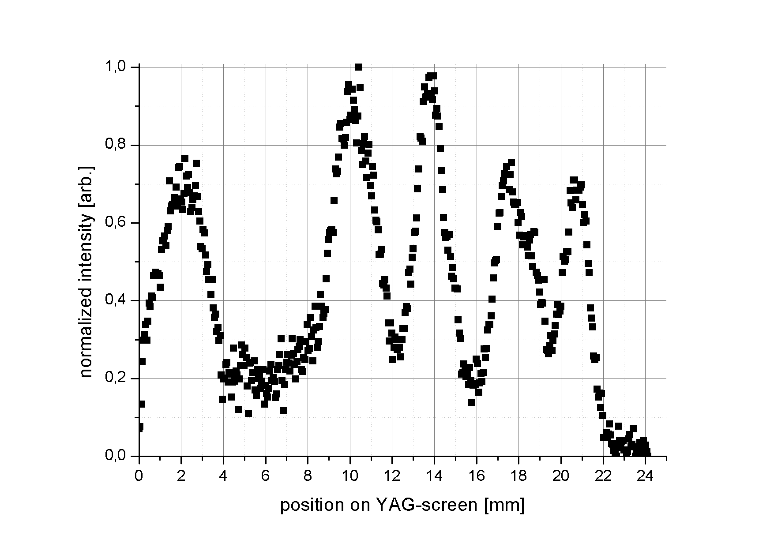
Time Response Measurements
Some Calibrations
Electronical phaseshifter
450 Pixel = 23 mm
23mm
Source: Bechthold, V.: Johannes Gutenberg Universität Mainz, internal notes, 2016
18.617mm
Phase modulation
37.906° = 18.617 mm

