Slide 1
Multialkali Cathode for High Current Electron Injector-
Fabrication, Installation and Testing
T. Rao, E. Wang. Kayran. I. Pinayev,
Brookhaven National Laboratory
On behalf of CeC and LEReC groups

Slide 2
Outline of the Talk
Introduction
K-Cs-Sb cathode for CeC
  Cathode preparation
  Transfer to CeC
  Performance in SRF gun
Na-K-Sb cathode for LEReC
  Sequential evaporation
    Fabrication
    Performance
  Co-evaporation
    Cathode preparation
    Transfer to LEReC
    Performance in DC gun

Slide 3
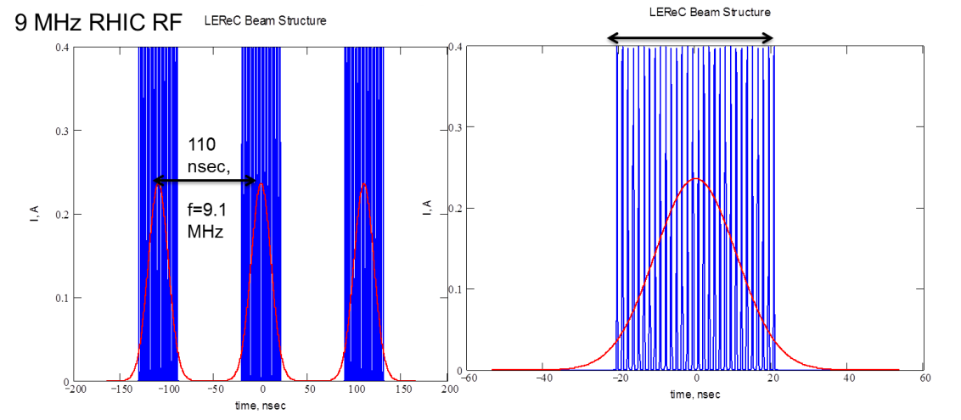
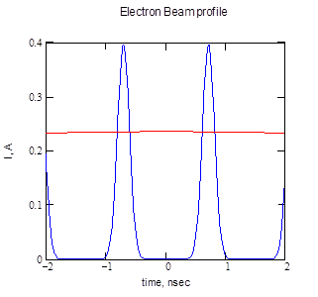
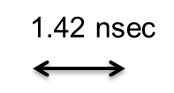
e beam Goals for CeC and LEReC
Parameters for LEReC
Charge/bunch: 100 pC
Pulse duration: ~ 100 ps RMS
Average current for 2 MeV beam: 30 mA
Average current for 5 MeV beam: 50 mA
Parameters for CeC
Charge per bunch, nC | 1.4
Initial bunch full length, ps | 100-500
Initial radius, mm | 2.5
Bunch rep-rate, kHz | 78.2
Average beam current, mA | 0.3
Injection kinetic energy, MeV | 2.0
Maximum beam energy, MeV | 21.8

Slide 4
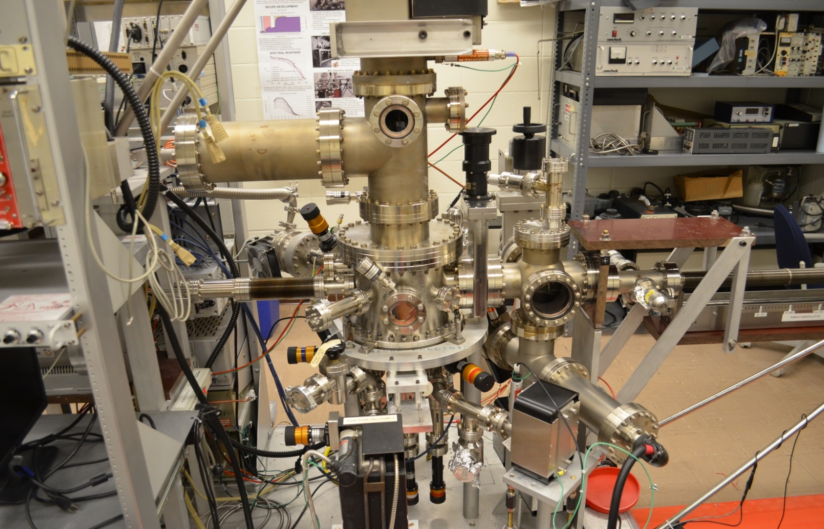
Fabrication Chamber for CeC cathode K-Cs-Sb cathode
Main Chamber Base pressure ~ 1x 10 ⁻¹¹ Torr, dominant residual gas H₂
Manipulator Arm
Crystal monitor
Windows for QE measurement
3 Sources, isolated from main chamber & each other

Slide 5
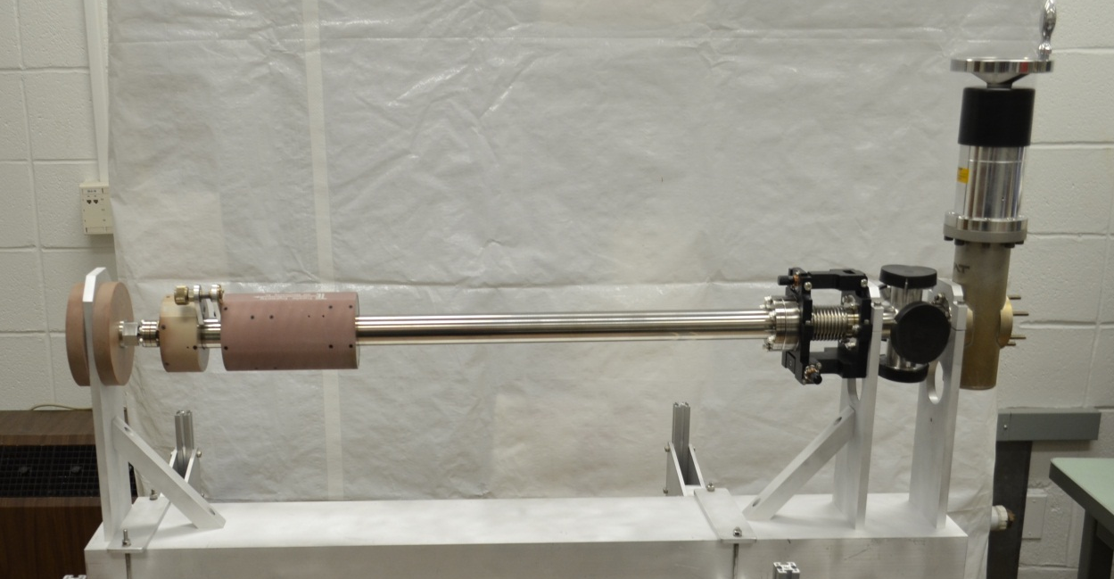
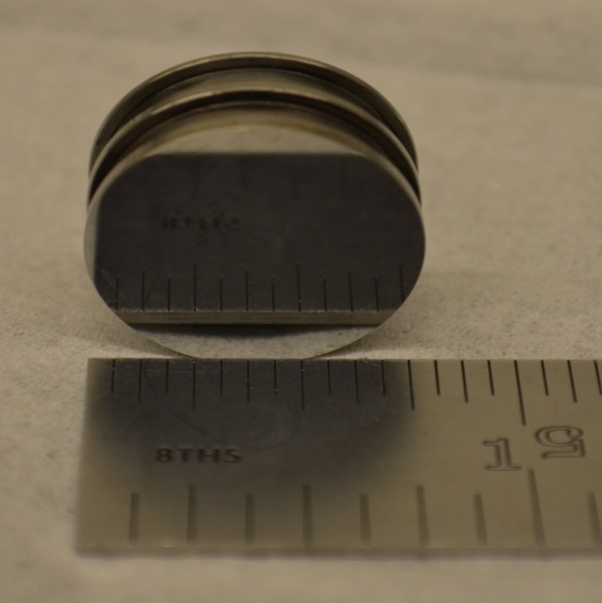
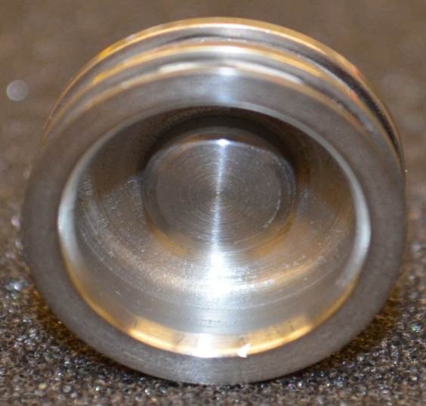
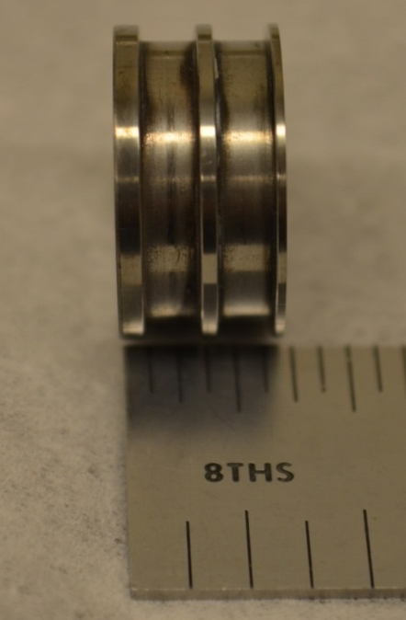
Transport Suitcase
Moly Puck, polished to optical finish
Rinsed in Hexane, cleaned in ultrasonic bath
Transport Suitcase
Front view
Back view
Side view

Slide 6
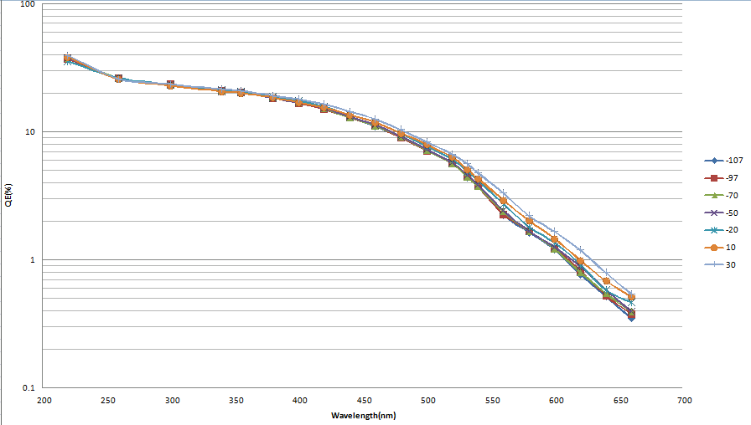
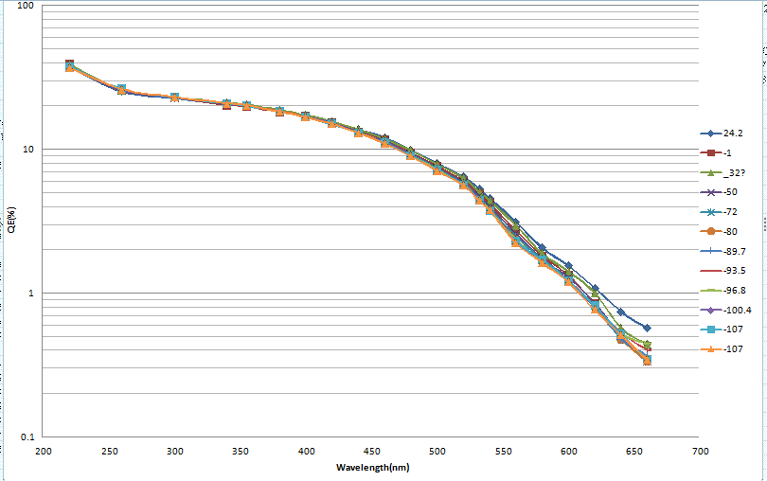
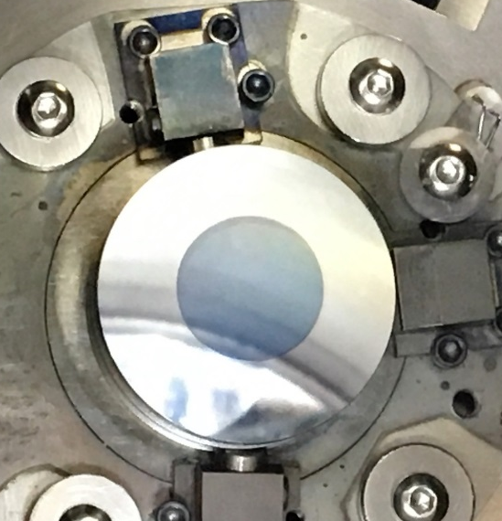
Cathode Performance
Procedure
  100 Å of Sb with the substrate @ ~ 100 °C
  200 Å of K with substrate @ 125 °C
  Evaporate Cs @ 130 °C for max. QE
Cooling to – 120 C
Warming from – 120 C

Slide 7
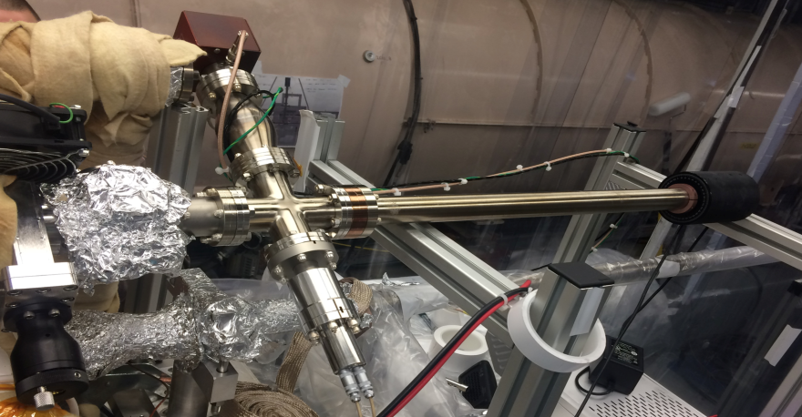
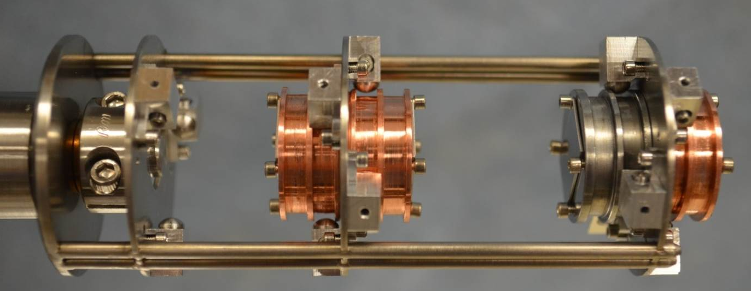
Cathode Transfer
The cathode is prepared in a dedicated cathode preparation system in Instrumentation Div..
The cathode is moved into transport cart which has low-10⁻¹⁰ torr scale vacuum.
Transport cart moved to RHIC tunnel in this vacuum
Cart connected to the SRF gun in a class-100 clean enclosure.
The load lock section is baked about 2 days and reach 10⁻⁹ torr scale Vacuum.
QE evolution monitored inside the transport cart during bake. We make sure that the cathode still has a good QE before moving it into the SRF gun.
112 MHz gun cathode transferring chamber
cathode stack

Slide 8
Photocathode transfer
Cathode transfer
In garage, the QE dropped about 2% in transferring due to load-lock bake. Then the QE is almost stabilized with the lifetime more than months.

Slide 9
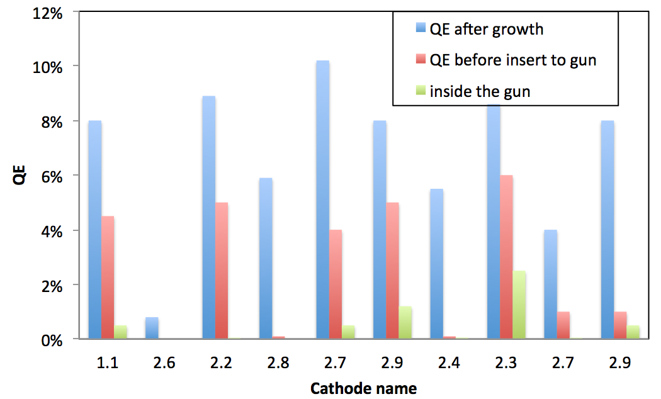
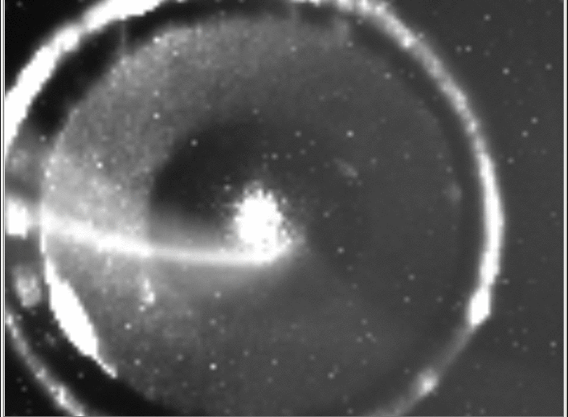
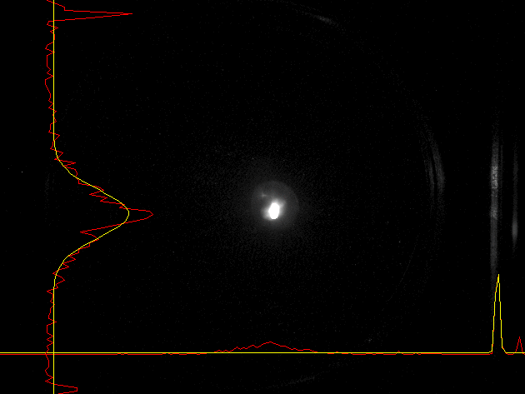
Insert cathode into gun
Laser on the cathode
Total of ten cathodes delivered in to 112 MHz gun from 2015 to 2016.
Seven cathodes survived during cathode transfer from preparation chamber to RHIC tunnel and keeping in storage chamber for a week.
Three cathodes lost QE due to either power outage to ion pump or garage misassembly.
Beam spot on YAG

Slide 10
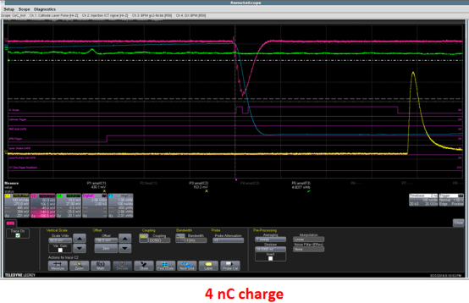
Start the gun with cathode
With Multi-alkali cathode, the gun has strong multipacting when ramping up the power power.
The gun could operate with a gap voltage in the range of 0.8 MV to 1.3 MV.
In stable operation, cathode preserved 1.2% QE without decay. However, it is very sensitive to vacuum spikes. the QE will significantly degrade orders of magnitude.
Maximum 3.7 nC bunch generated from gun

Slide 11
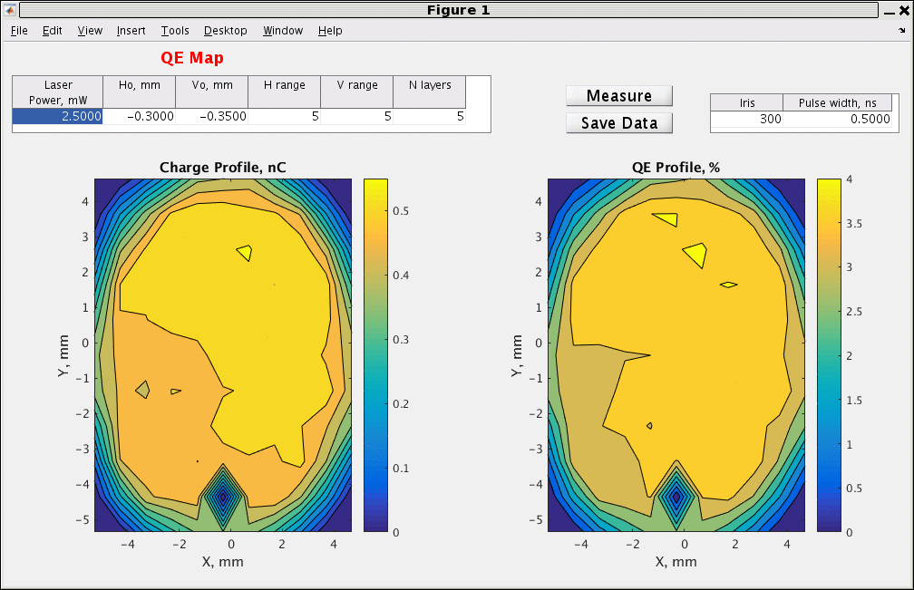
QE map of the latest cathode in SRF gun
Cathode has been in the gun for months
Multipacting is the main reason for degradation of high QE. Fine tuning of the RF start procedure could avoid the degradation.
Cover all the view-ports on the gun to make sure no ambient light could leak into the gun.
Move the main coupler to strong coupling position and off set the center frequency to break the multipacting resonance.
Use pulse mode to boost gun voltage to desired range.

Slide 12
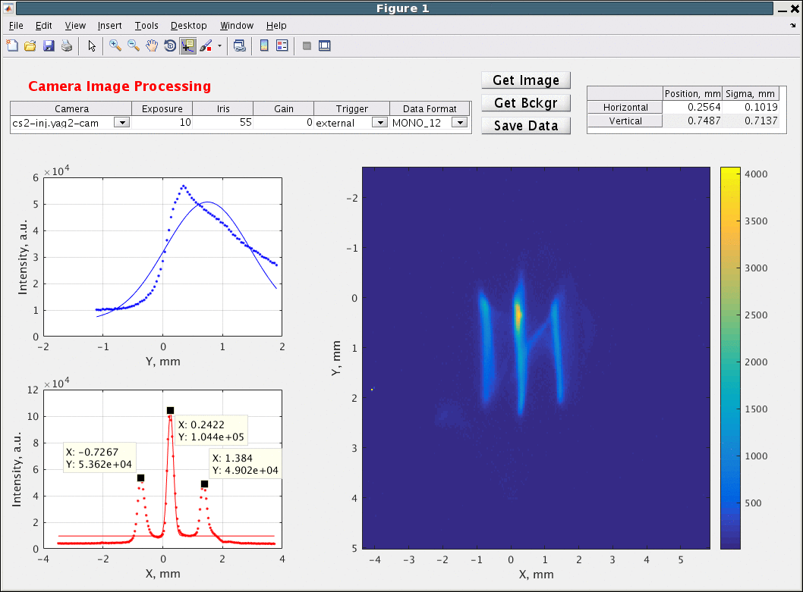
Beam Emittance
Charge 640 pC
Beam size 1.3 mm
Divergence 0.29 mrad
R.m.s. emittance 0.37 mm mrad
Normalized 1.2 mm mrad

Slide 13
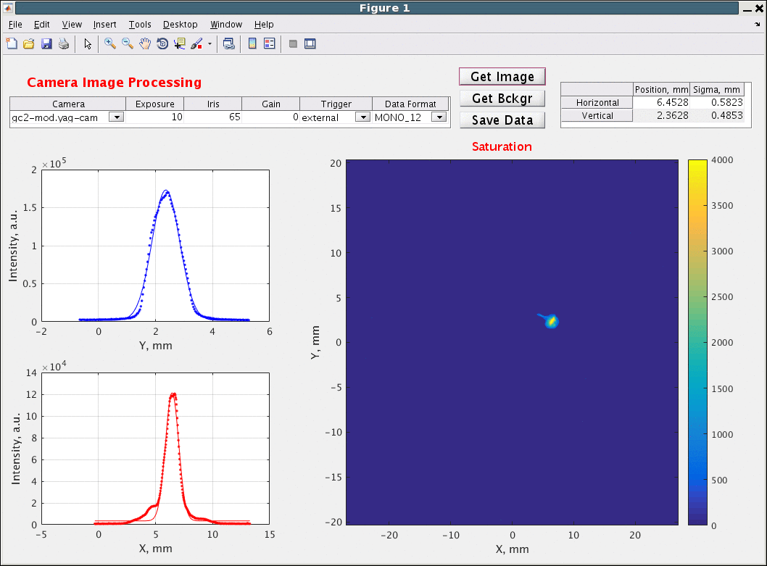
Beam Image

Slide 14
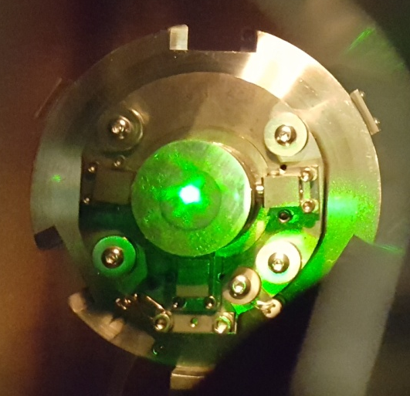
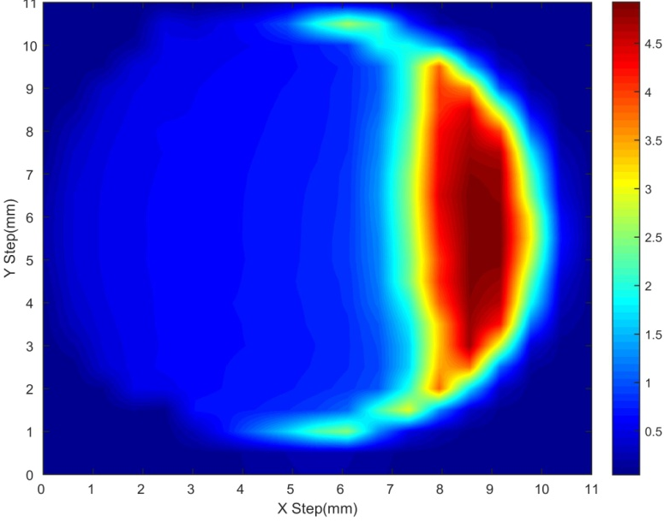
NA-K-Sb cathode for LEReC.
Sequential evaporation using dispenser sources
Procedure
  100 Å of Sb with the substrate @ ~ 100 °C
  200 Å of K with substrate @ 140 °C
  Alternate evaporation of Na and K with substrate at ~200 °C

Slide 15
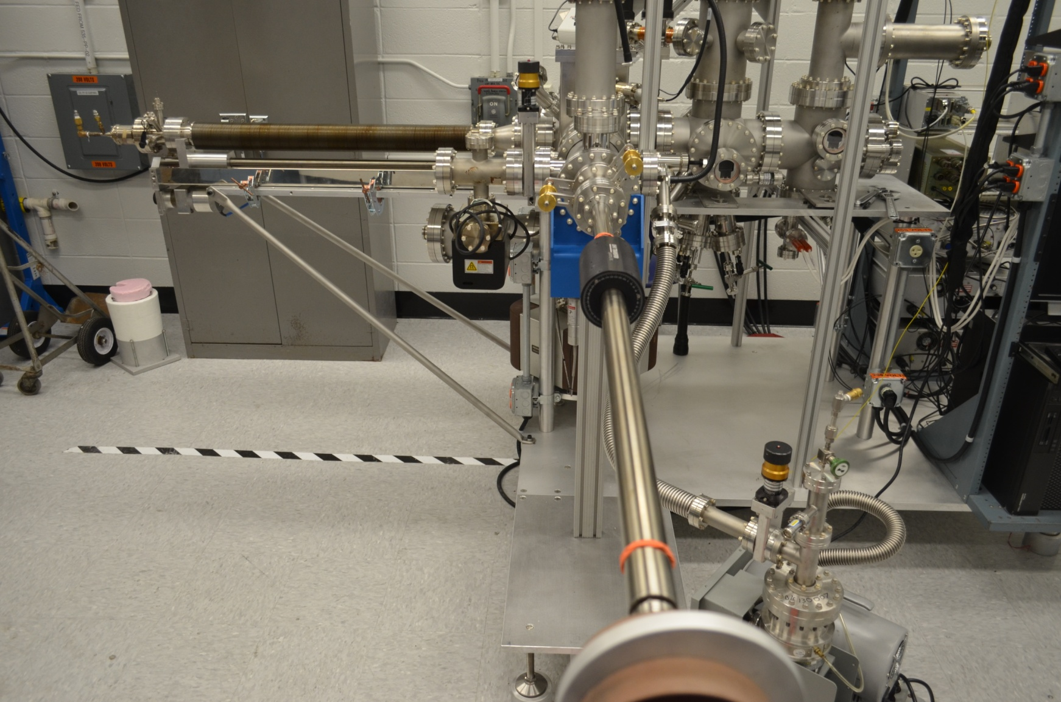
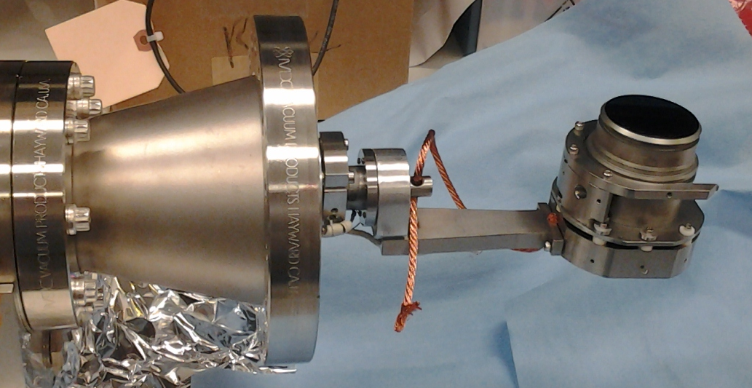
Co-evaporation with effusion cell
Depo. Chamber
Substrate

Slide 16
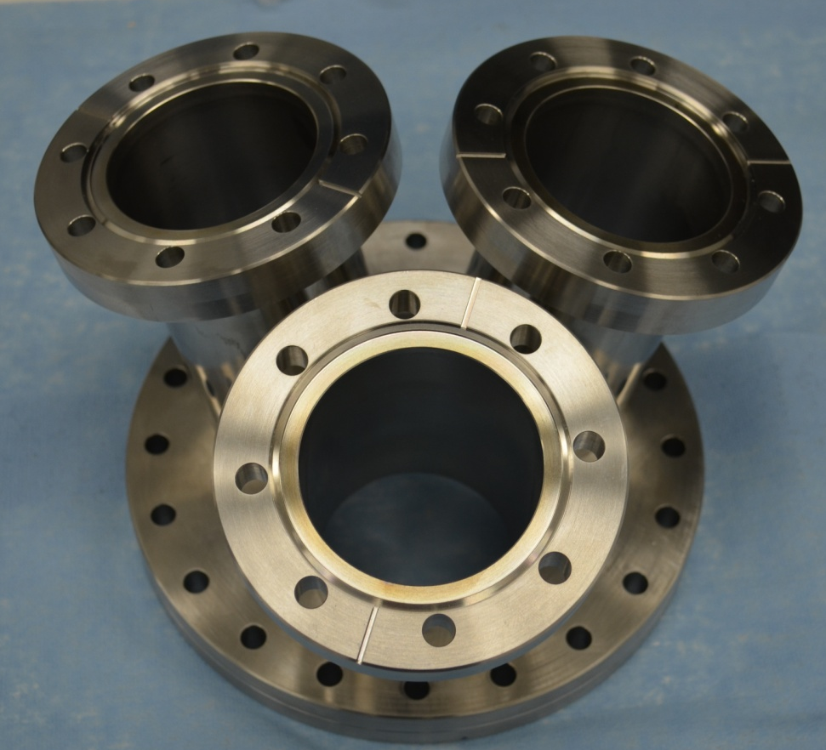
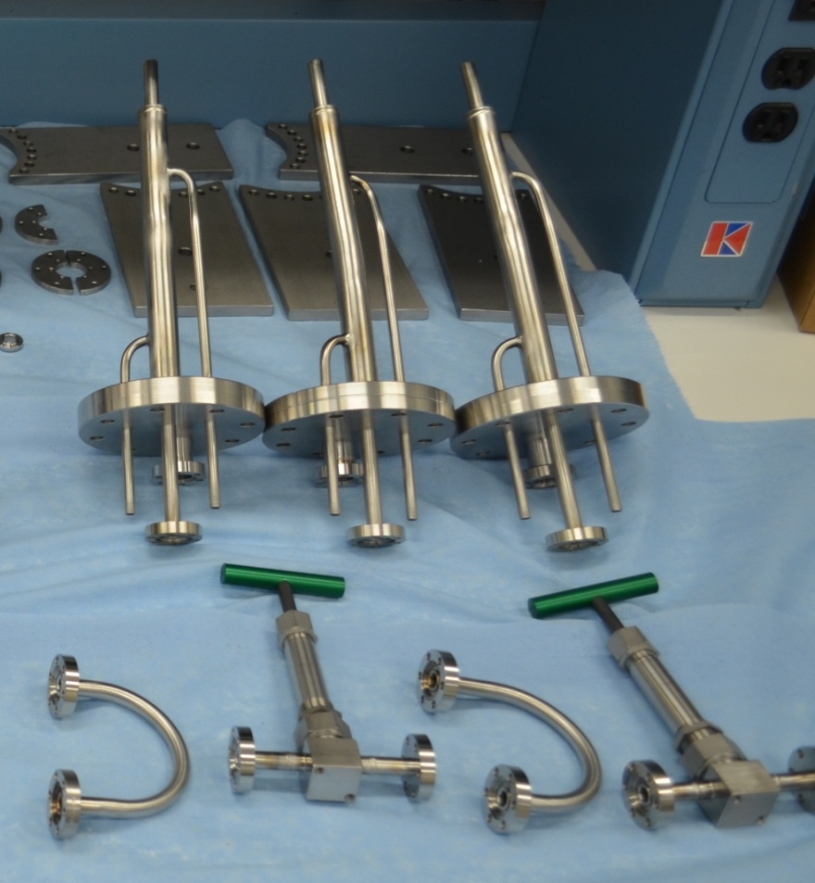
Effusion Cell design
Cluster flange for 3 effusion cells
Components of effusion cell

Slide 17
Fabrication process and performance
Tentative procedure:
Evaporate 100 Å of Sb with substrate at ~ 100°C at a rate of 20 Å/minute
Set the evaporation rate of K of 3 Å/minute
Evaporate at 125 °C till QE maximizes
Heat to 200 °C
Co-evaporate K and Na till QE maximizes
Turn off heater, lower effusion cell temperature
Continue till QE stabilizes and substrate at room temperature

Slide 18
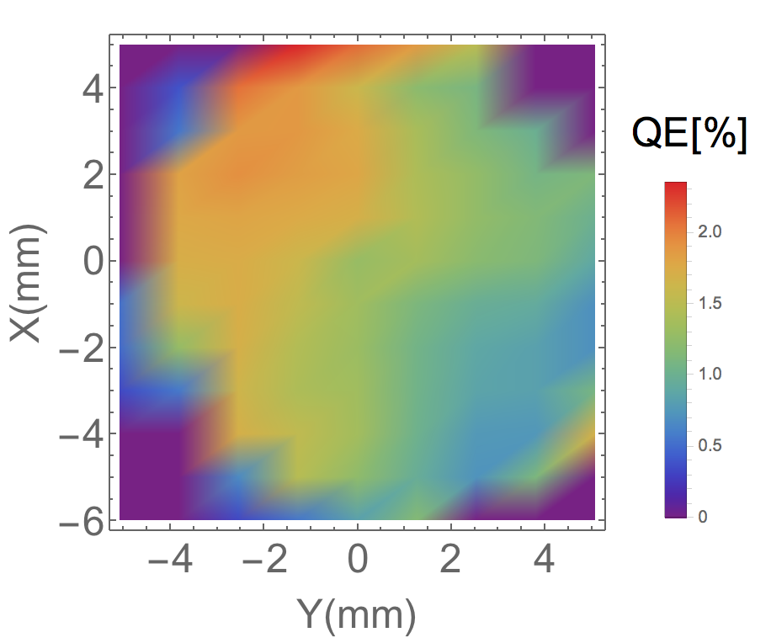
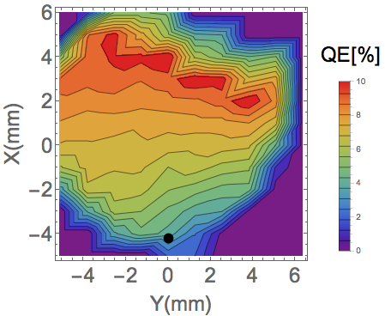
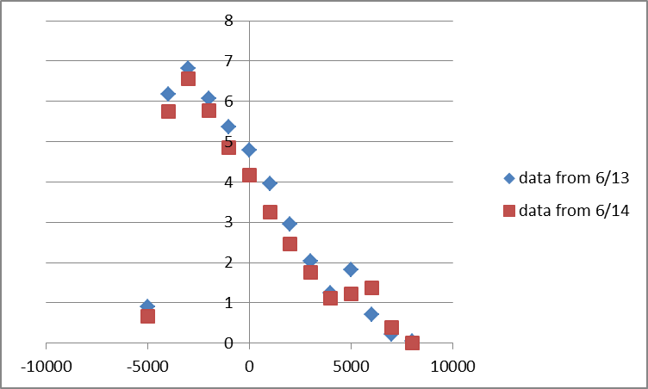
Cathodes QE map (measured at the cathode lab)
#1
#2b
The cathode QE center check:
in lab: 1.8 %
The cathode QE center check:
in lab: 7%
before bake: 6.3%.
after load-lock baking: 0.35%.
#3
The cathode QE center check:
in lab: 4 %

Slide 19
QE Evolution in Deposition Chamber
QE changes over time: Increases in the beginning, decreases over longer time scale
Changes in QE map as well
Preliminary analysis indicates exponential decay, higher QE material with smaller decay constant
Possible causes:
  Temperature effect
  Migration of constituent elements
  Contaminants
Working towards systematic study

Slide 20
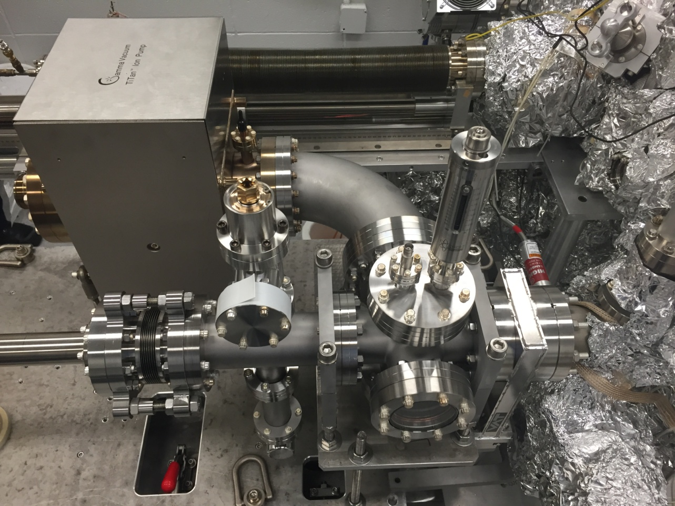
Single Puck Transporter
Weighs 400 lb
Low 10⁻⁹ torr vacuum
Ability to measure QE
Data log for pressure

Slide 21
Video of the transport process

Slide 22
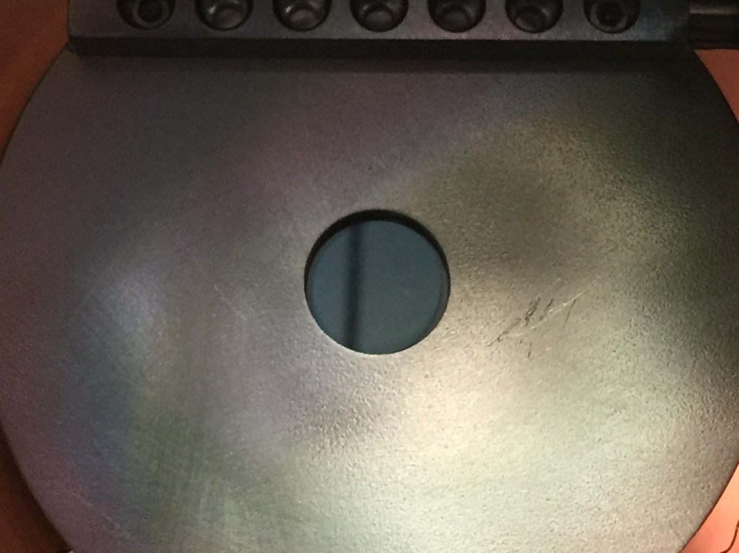
Photograph of the first cathode transported to LEReC

Slide 23
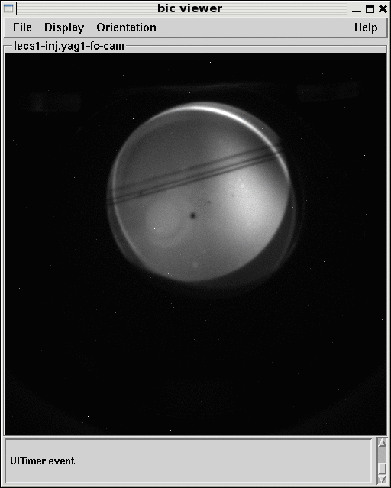
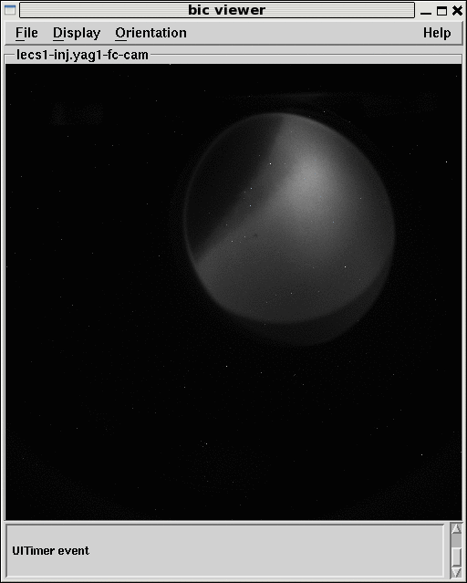
Lamp Beam
Cath #1
Cath #2

Slide 24
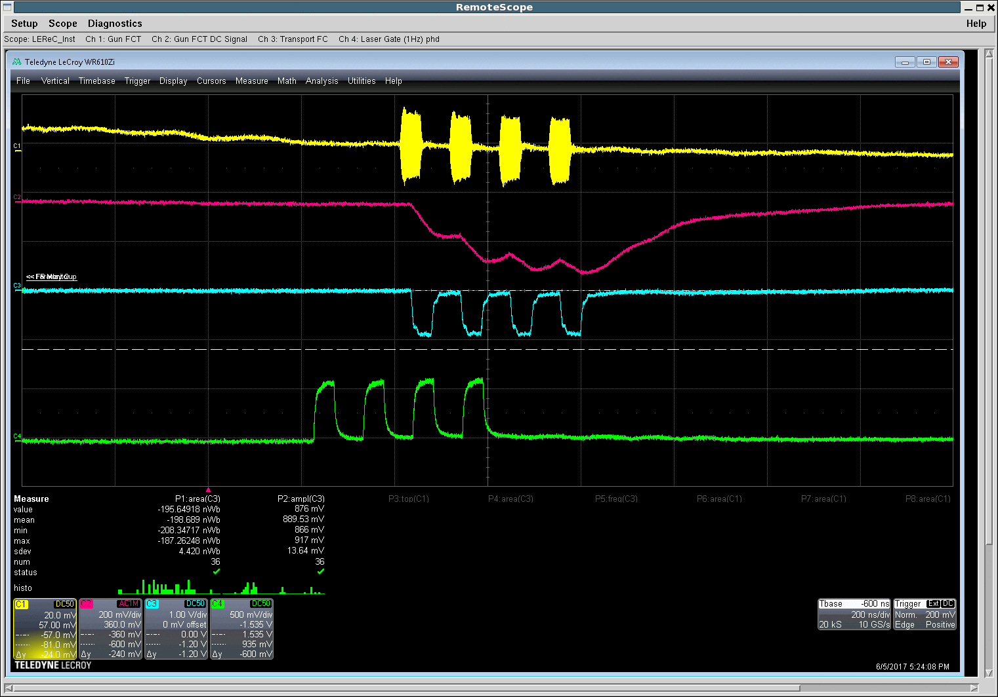
4 Macrobunches operation
FCT signal
FCT detected signal
FC signal
Laser pulse structure

Slide 25
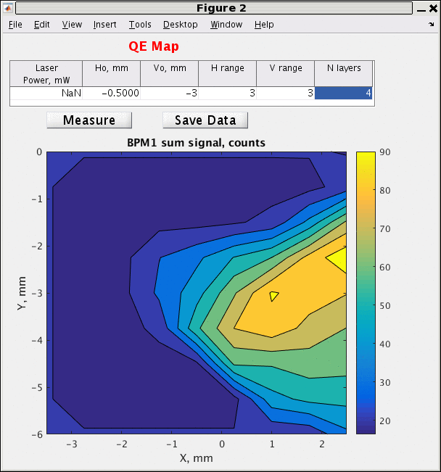
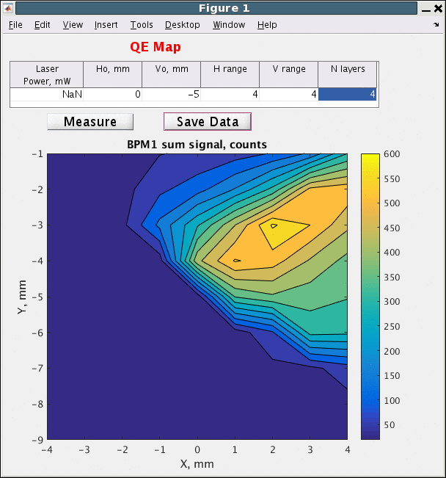
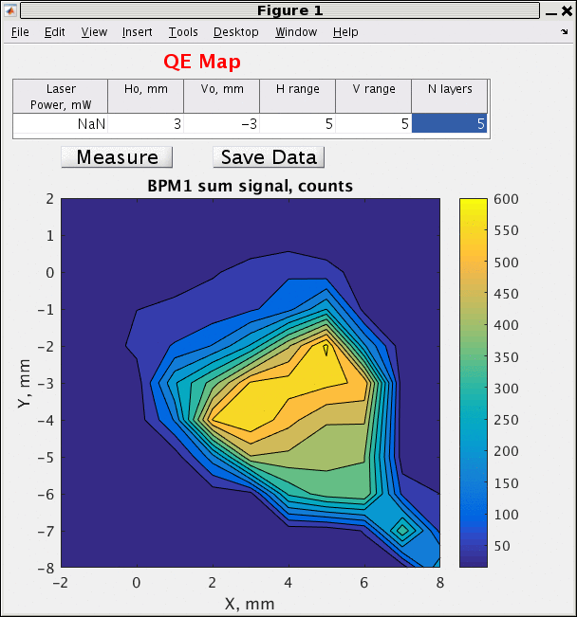
QE scans.( same cathode different initial position based on readings)
QE in the gun has not been calculated- laser power measurement yet to be done

Slide 26
 | Suitcase | Grow | Lab QE | Inserted | Removed | Lamp DC (POF) | Bunch Charge
Cath#1 | #2 | Jan 30 | 1.7% | Apr 17 | May 30 | 40 nA | 25 pC
Cath#2b | #1 | May 17 | 7% | June 2 | June 14 | 40 nA | 33 pc
Cath#3 | #2 | June 13 | 7% | June 16? |  | ?? | 130 pC
QE of cath. #1 in gun was ~0.1%- 8 hour exposure to 9 scale vacuum during bake of load-lock
QE of cath. #2 dropped to 0.8 after baking load-lock, even though valve temperature was not increased- pressure log was not connected
QE of cath. #3 estimated to be > 2% in the gun (~ factor of 2-3 reduction in QE)
-modifications : Better base pressure, cooled flange, retracted puck, no latency in transfer
Ion pump turned off for ~ 20 s when ion pump power supply was changed

Slide 27
Conclusions
CeC
  Cathode fabrication for CeC experiments is mature
  E beam expectations mostly met
LEReC
  3 cathodes delivered to DC gun
  ~40 mA produced in 4 macrobunches
  Commissioning is in progress
  More research needed for 24/7 operation

