Slide 1

Resonance Control
at the Compact ERL in KEK
Takako Miura (KEK)
on behalf of LLRF and SRF Cavity Group
LLRF Group
Takako Miura, Shinichiro Michizono, Feng Qiu, Toshihiro Matsumoto, Hiroaki Katagiri, Dai Arakawa (KEK),
Liu Na (Sokendai Univ.)
SRF Cavity Group
Eiji Kako, Takaaki Furuya, Hiroshi Sakai, Kensei Umemori, Taro Konomi, Masato Egi, Kazuhiro Enami (KEK),
Masaru Sawamura (QST)

Slide 2
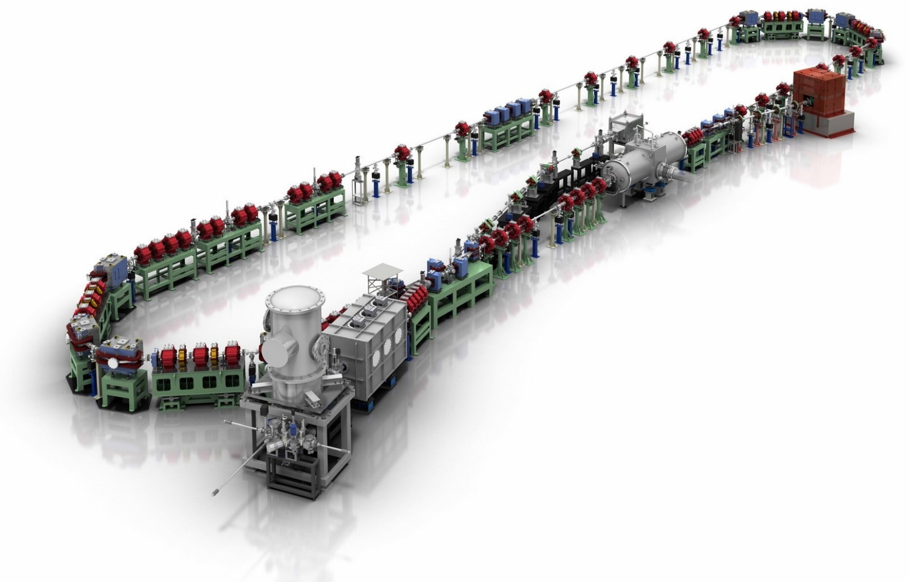
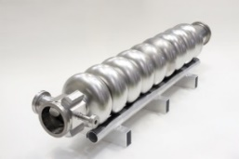
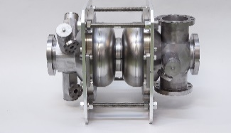
Introduction of cERL
Compact ERL (cERL) is a test facility of 3-GeV ERL as a future light source.
Beam Dump
Circumference ~ 90m
Main LINAC
9-cell SRF cavity x 2
Q_{L} = 1× 10⁷
Marger
Injector LINAC
RF = 1.3 GHz CW
Design parameters of the cERL
©Rey.Hori/KEK
Nominal beam energy | 35 MeV
Nominal Injector energy | 5 MeV
Beam current | 10 mA (initial goal)
Normalized emittance | 0.1 ‒ 1 mm⋅mrad
Bunch length | 1-3ps (usual) 100fs (short bunch)
2-cell SRF cavity x 3
Photocathode DC gun
Q_{L} = 5×10⁵
Buncher
Requirements of RF stabilities for 3GeV-ERL
0.01%rms,0.01deg.rms

Slide 3
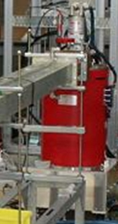
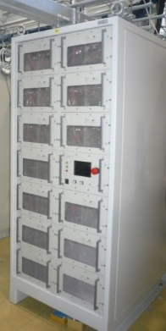
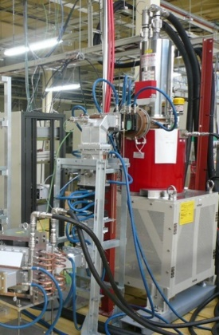
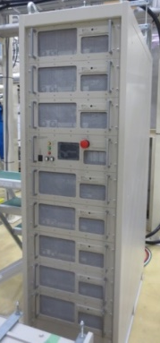
Current status of high power RF sources
 | Buncher | Inj-1 | Inj-2 | Inj-3 | ML-1 | ML-2
Cavity | NC | 2cell-SC | 2cell-SC | 2cell-SC | 9cell-SC | 9cell-SC
Cavity Voltage | 114 kV | 0.7 MV | 0.7 MV | 0.7 MV | 8.6 MV | 8.6 MV
Field Gradient (Desgin) |  | 3 MV/m (7.5MV/m) | 3MV/m (7.5MV/m) | 3MV/m (7.5 MV/m) | 8.6 MV/m (15MV/m) | 8.6 MV/m (15MV/m)
Q_{L} | 1.1× 10⁵ | 1.2 × 10⁶ | 5.8 × 10⁵ | 4.8 × 10⁵ | 1.3 × 10⁷ | 1.0 × 10⁷
Cavity Length | 0.068 m | 0.23 m | 0.23 m | 0.23 m | 1.036 m | 1.036 m
RF Power @Low beam current | 3 kW | 0.53 kW | 2.6 kW |  | 1.6 kW | 2 kW
BUN
Inj1
Inj2
Inj3
ML1
ML2
Vector-sum
The "vector-sum" operation in low energy region, β<1, has some difficulties.
-> transit time change
-> RF phase change
8 kW SSA
25kW Klystron
16 kW SSA
8 kW SSA
300kW Klystron

Slide 4
Digital LLRF System at cERL
Mechanical tuner : coarse tuning
Resonance Tuning
Fast Interlock
(Arc, Pref, etc.)
0 ~ 500V
Pieso Tuner : fine tuning
1.3 GHz
KLY/SSA
Cavity pick-up signal
Kly Pf
RF SW
Pc
Pf
LO (1.3GHz(1+1/128)≈1310MHz)
LO
LO
IF (10MHz)
IF (10MHz)
I
Tuner board
RF FB board
Q
DAC
Digital I/O
Baseband
MO(1.3 GHz)
(CW/CCW pulse output)
Offset
+250V
Motor driver
-250V~250V
Requirements of RF stabilities for 3GeV-ERL
0.01%rms,0.01deg.rms
Piezo driver

Slide 5
Tuner System

Slide 6
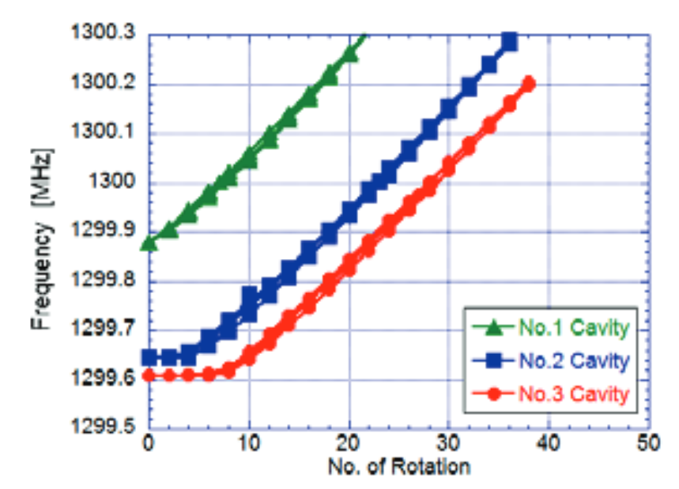
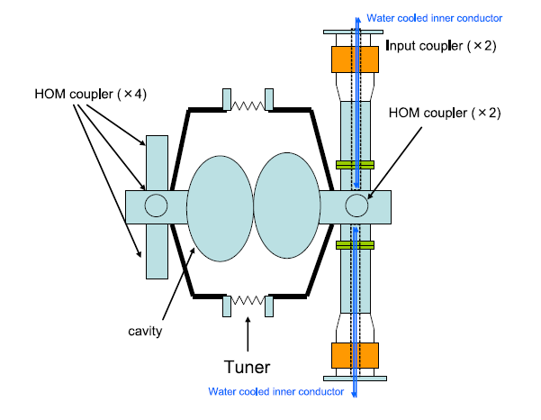
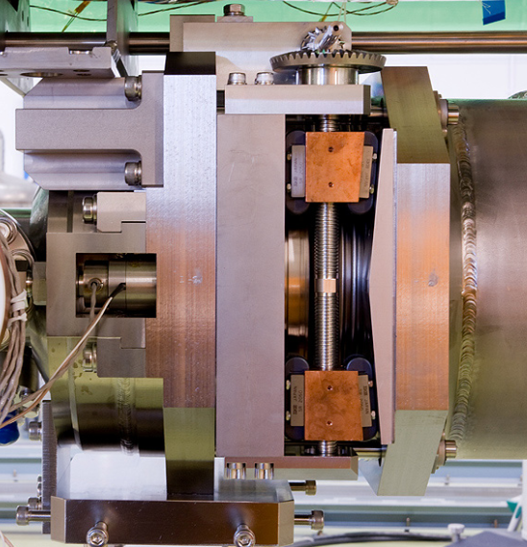
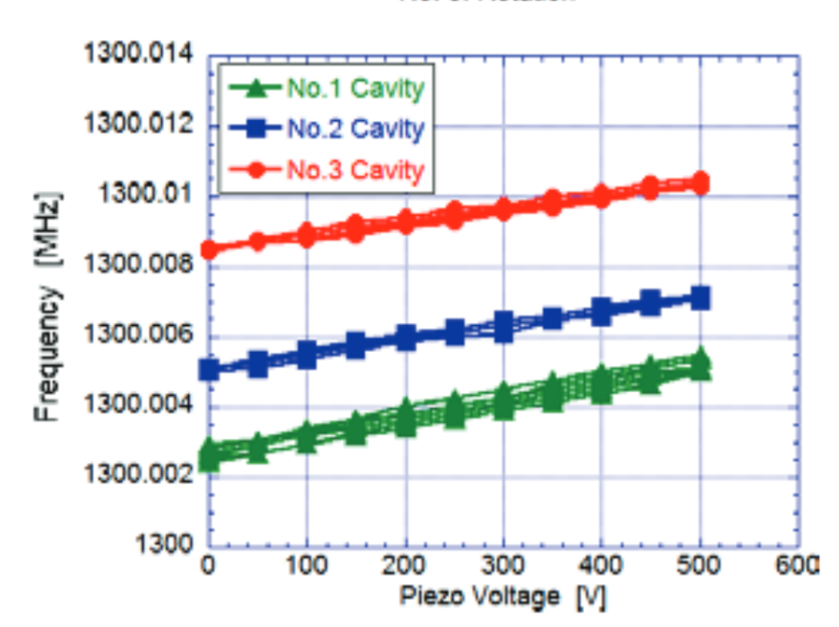
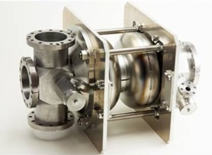
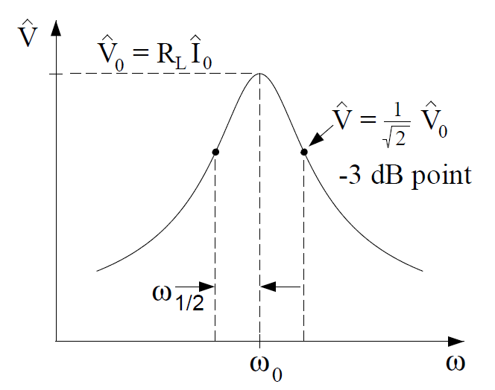
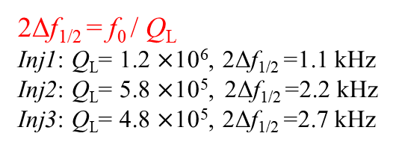
Tuner system of Injector Linac
Slide-Jack tuner
E. Kako, IPAC2013
20 kHz/rotation
Drive Shaft
He jacket
600 kHz
Piezo tuner
0-500V
stroke= 4 μm@2K
performance of slide-jack tuner
Piezo: 0-500V => 2 kHz
Taper
The same as KEK-STF tuner system
2Δf_{1/2} = f₀ / Q_{L}
Inj1: Q_{L}= 1.2 $×$10⁶, 2Δf_{1/2} =1.1 kHz
Inj2: Q_{L}= 5.8 $×$10⁵, 2Δf_{1/2} =2.2 kHz
Inj3: Q_{L}= 4.8 $×$10⁵, 2Δf_{1/2} =2.7 kHz
2kHz
Piezo tuner can cover the band width.
performance of piezo tuner
f_{1/2}
f₀
f

Slide 7
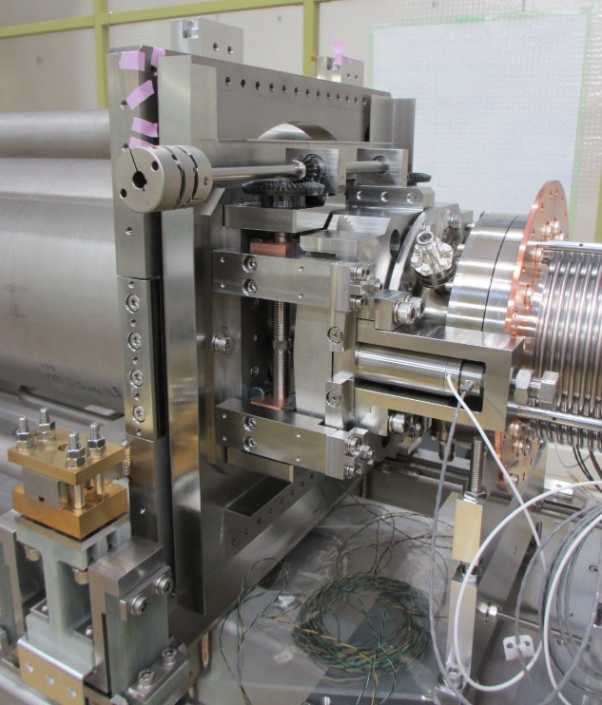
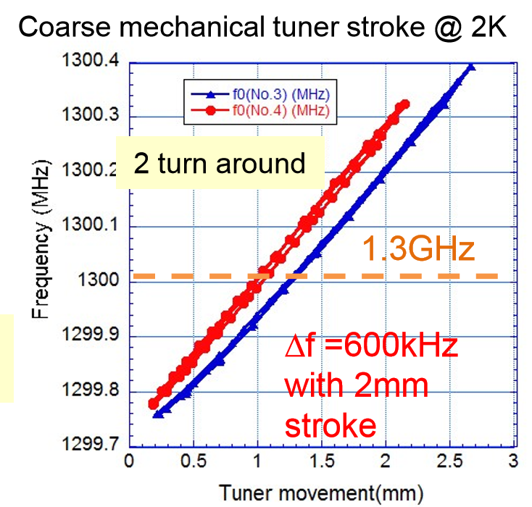
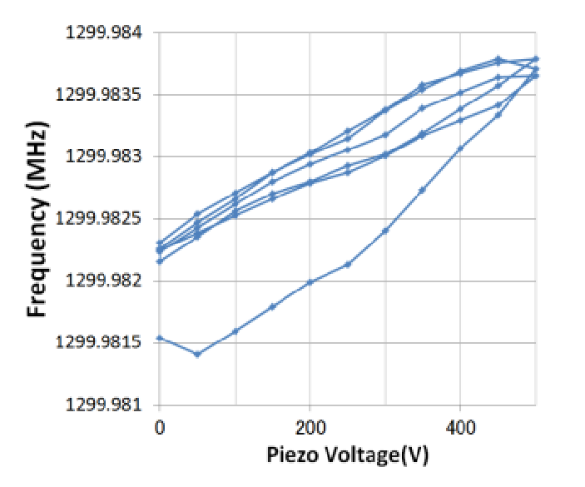
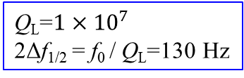
Tuner system of Main Linac
Shaft of slide-jack tuner
H. Sakai, SRF2013 @Paris
Cavity flange is fixed here
Piezo tuner
0V - 500V (offset=250V)
Stroke= 4 μm @ 2K
40 μm @ 300K
(1 μm: 300Hz)
He jacket
Slide-jack tuner
Q_{L}=$1×{10}^{7}$
2Δf_{1/2} = f₀ / Q_{L}=130 Hz
1kHz
Screw

Slide 8
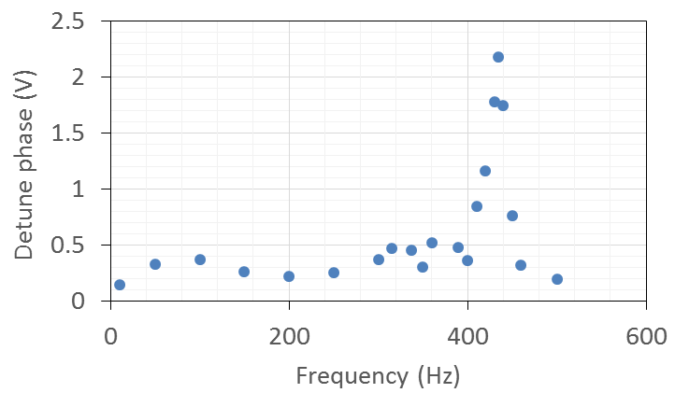
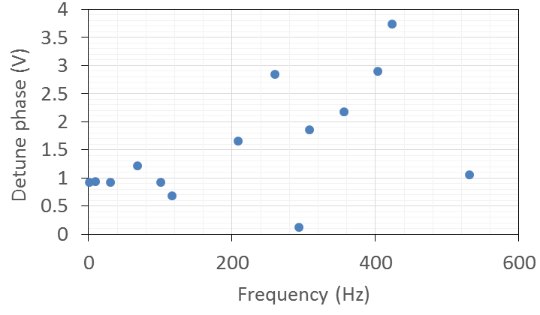
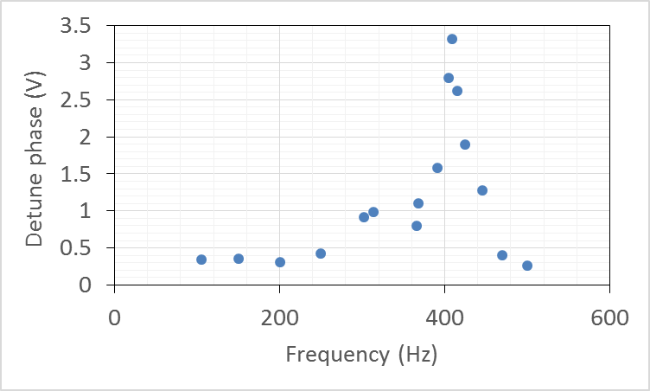
Mechanical Resonance of Inj Cav
<Injector>
Eacc: 1MV/m
Sinusoidal wave (40V_{pp}) was fed to piezo tuner.
Mechanical resonance is scanned by sweeping the input frequency.
INJ2
409Hz
Phase detector : 20 mV/deg
INJ1
423Hz
435Hz
260Hz
INJ3
68Hz
Large mechanical resonance exists around 400 Hz.

Slide 9
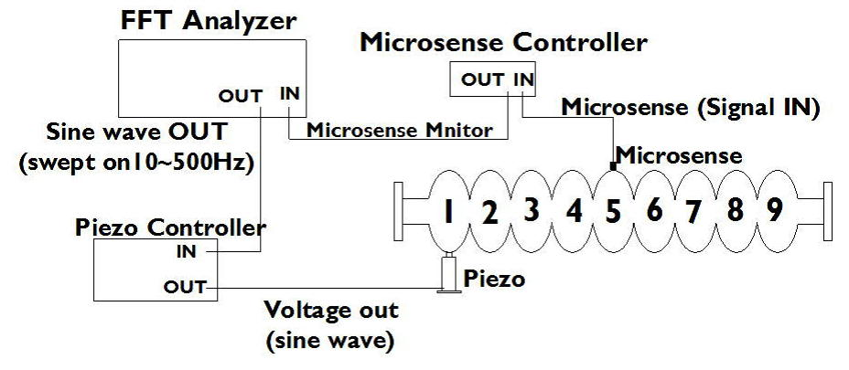
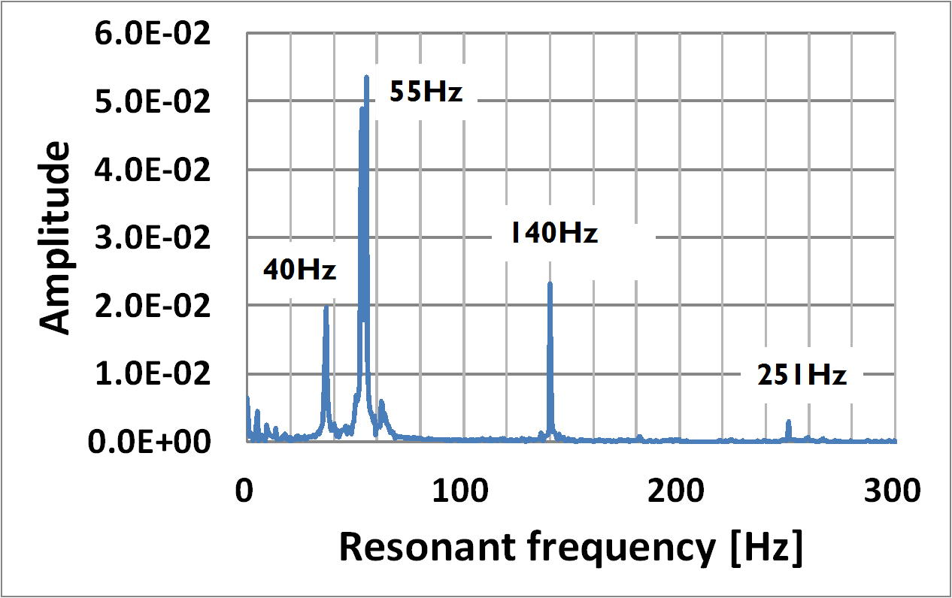
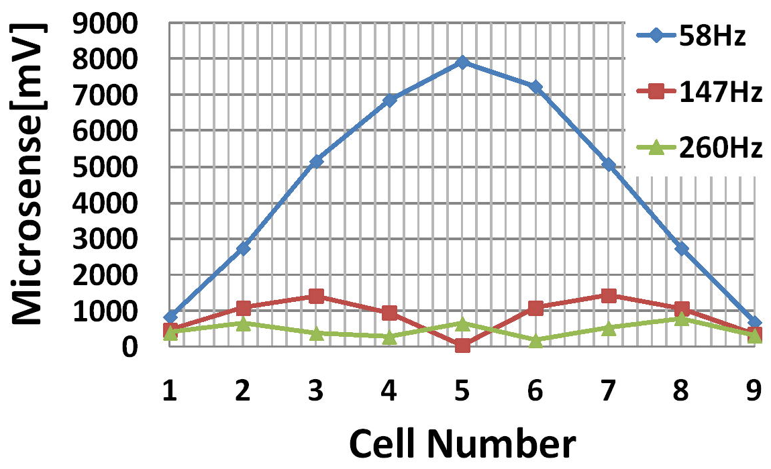
Mechanical Resonance of ML Cav
M. Satoh, IPAC2014
Impulse hammer response
Large mechanical resonance exist near 50 Hz.

Slide 10
LLRF System

Slide 11
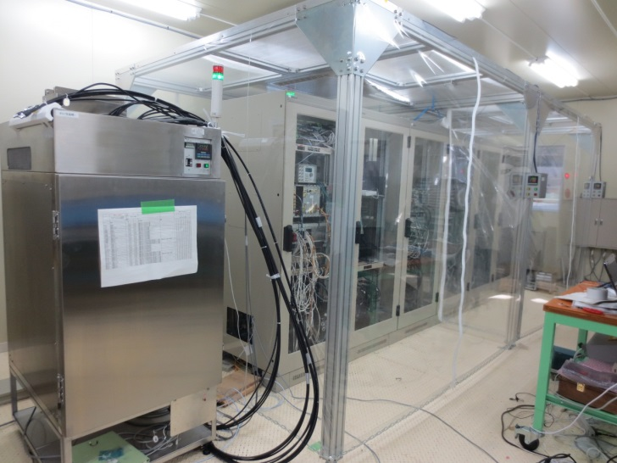
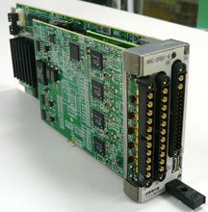
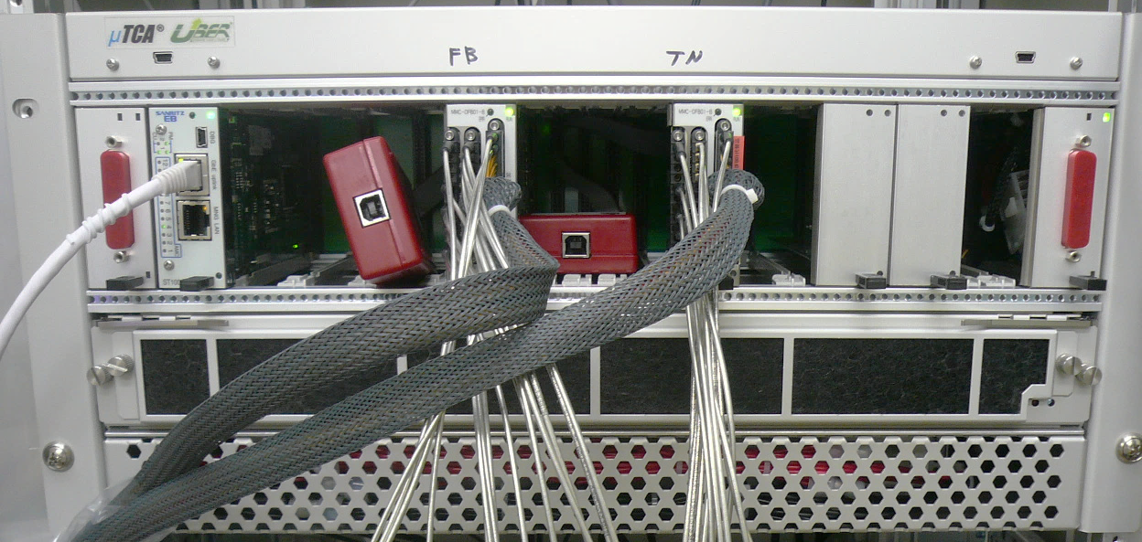
Digital LLRF Boards
16-bit ADC x 4
(LTC2208)
16-bit DAC x 4
(AD9783)
FPGA
Virtex5-FX
RF FB Control
Tuner Control
Digital I/O
MicroTCA
AMC(Advanced Mezzanine Card)
(Mitsubishi Electric TOKKI Systems Co.,Ltd.)
Total 11 boards are used for operation.
Embedded Linux is working in the PowerPC on FPGA.
Each board acts as an EPICS IOC.
Data acquisition is performed through GbE bus on the backplane.
 | BUN | Inj1 | Inj2 | Inj 3 | ML1 | ML2
RF FB board | FB0 | FB1 | FB2 (Vec-sum) |  | FB4 | FB5
Tuner board | TN0 | TN1 | TN2 | TN3 | TN4 | TN5

Slide 12

Field Feedback Control
LPF:100kHz
Q
A
θ
I

Slide 13



Cavity Resonance
2Δf_{1/2}
Δf_{1/2} =65 Hz for ML cavities (Q_{L}=10⁷)
Narrow bandwidth for f₀=1.3 GHz
-3dB
Amplitude (dB)
f₀
$∆θ=θ_{f} − θ_{c}$
: The phase difference between the input
RF and the cavity pickup signal
45deg
$$tan∆θ≈2Q_{L}\frac{∆f}{f}$$
-45deg
To keep resonance frequency,
tuner should be controlled to maintain Δθ at zero.
Detuning Δf=f_{c}-f₀
For constant acceleration field,
double input power is necessary at Δf = Δf_{1/2}

Slide 14

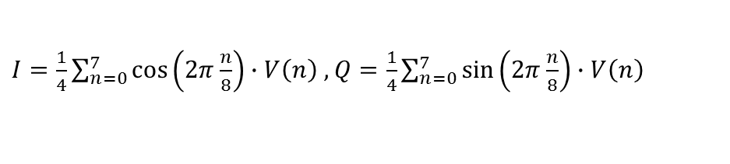
Block Diagram of Resonance Control
Feedback Control:
Δθ = θ_{f} (Pf) − θ_{c} (cav) => 0
DAC
Piezo Tuner
CW
Digital I/O
Mechanical Tuner
CCW
Stepper motor
FPGA Board
CLK
Amplitude
Level judge
offset
θ_{offset}
FB on/off
Offset
80MHz
Ki
LPF
for protection
Cav
ADC
I
Q
ROT1
-
Σ
IIR LPF
+
DAC
Δθ
Δθ'
Pf
ADC
I
Q
ROT2
0 <
0 >
CW
IIR LPF
Digital I/O
fc=20Hz
Polarity
change
Kp
CCW
Q
$I=\frac{1}{4}\sum_{n=0}^{7}{\cos\left(2π\frac{n}{8}\right)∙V\left(n\right) ,}$ $Q=\frac{1}{4}\sum_{n=0}^{7}{\sin\left(2π\frac{n}{8}\right)∙V\left(n\right) }$
A
θ
I

Slide 15
Cavity field Stability & Microphonics

Slide 16
Waveform of ML Cavities
T. Miura, IPAC2014 @Dresden
ML1
Amplitude
Phase
ΔA = 0.012% rms
Δθ = 0.014° rms
ΔA = 0.035% rms
Δθ = 0.3° rms
1.4deg
Vc: w RF Feedback
Vc: w/o RF Feedback
Amplitude
Phase
ML2
ΔA = 0.013% rms
Δθ = 0.015° rms
50Hz
Microphonics
ΔA = 0.15% rms
Δθ = 0.6° rms
4deg
Field fluctuation by Michrophonics is stabilized by RF Feedback
Notes:
If detuning is seriously large, tuner FB control should be improve.

Slide 17
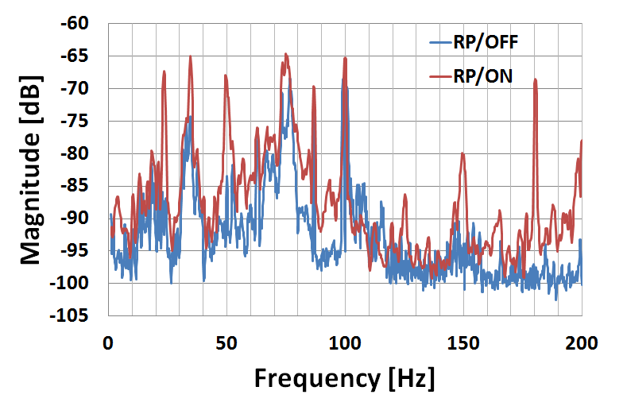
Phase noise jitter measurement
using Signal Source Analyzer
Agilent E5052B
M.Egi, PASJ2016 (MOP025)
T. Miura, IPAC2014 @Dresden
Vibrational state of "ﬂoor" around Main Linac
50Hz
RP: Rotally pump
dBc/Hz
ML2
Hz
Vc Phase Noise with RF FB (10Hz-1MHz)=0.017deg
Vc Phase Noise w/o RF FB (10Hz- 1MHz)=0.73 deg
Microphonics is observed at 10 Hz - 400Hz.
Phase noise by Microphonics was suppressed well by RF FB.
Phase noise of Vc with FB was almost the same as that of Master Oscillator.

Slide 18
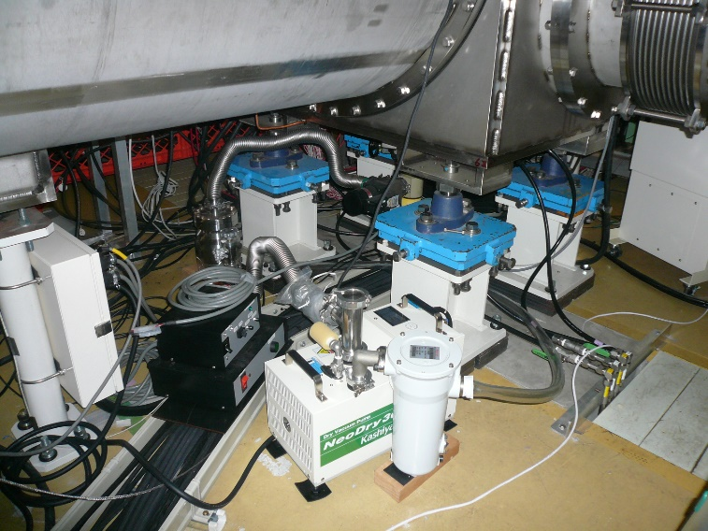
Countermeasure against Scroll Pump Vibration
9-cell SC cavity: Q_{L}=10⁷
For constant input RF power
Before
50 Hz
vibration by scroll pumps
Field gradient
8.3 MV/m : Operation point
(15 MV/m : Design)
After
The rubber sheet was inserted
under the scroll pump.
The 50 Hz vibration is suppressed.

Slide 19
Momentum Error due to Vector-sum Error
&
Improvement by tuner feedback parameter

Slide 20
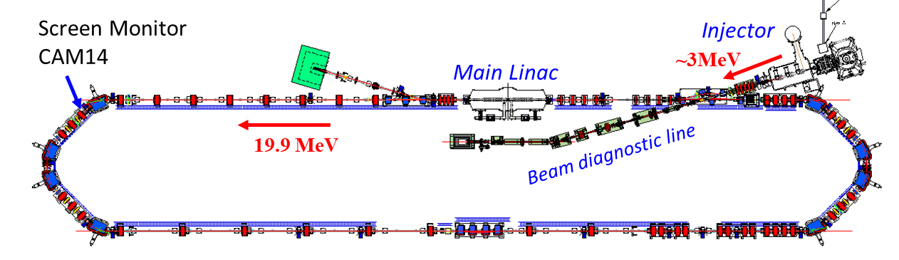
RF Performance
RF Stabilities for Short Time
 | Inj1 | Inj2 & Inj3 | ML1 | ML2
Amplitude | 0.006% rms | 0.012% rms | 0.003% rms | 0.003% rms
Phase | 0.009° rms | 0.022° rms | 0.010° rms | 0.009° rms
Almost satisfied the requirement of 3-GeV ERL
Measurement of Beam Momentum Stability
for confirmation of RF stability
36 min.
<Measurement condition>
Beam: 5Hz, 3ps rms, 23 fC, total Energy=19.9 MeV
Momentum stability = 0.013% rms
Momentum drift of ~15 minutes period was observed.

Slide 21
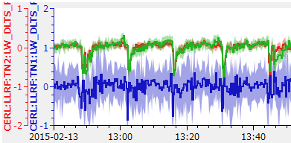
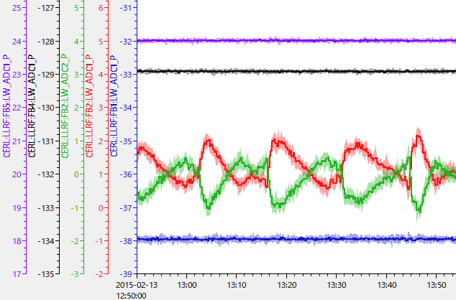
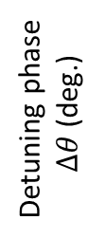
What causes Energy Drift ?
Time interval of detuning is similar to the interval of energy drift.
Inj2
Inj3
~15 min.
Large ripple depends on valve control for liquid N₂.
Detuning phase
$∆θ$ (deg.)
Input-couplers of injector are cooled
by liquid N₂.
Inj1
Time
Cavity Phase
ML2
<RF source : cavity =1:1 >
Cavity phase is stabilized by RF FB.
<Vector-sum operation>
Vector-sum is constant,
but each cavity phase fluctuates.
ML1
Cavity Phase(deg.)
Inj2
10deg
Inj3
Inj1
Vector-sum error may cause energy drift.

Slide 22
Vector-sum Error
Possibility of momentum drift caused by vector-sum error
Vector-sum calibration error
Amplitude & Phase calibration error
(2) for low beam energy (β < 1),
transit time is affected by cavity field.
Injection energy : 1.63MeV@Inj2, 2.36 MeV@Inj3
Cavity fields changes => Beam phase changes.
In order to minimize the momentum fluctuation due to the vector-sum error,
“detuning” should be stabilized.

Slide 23
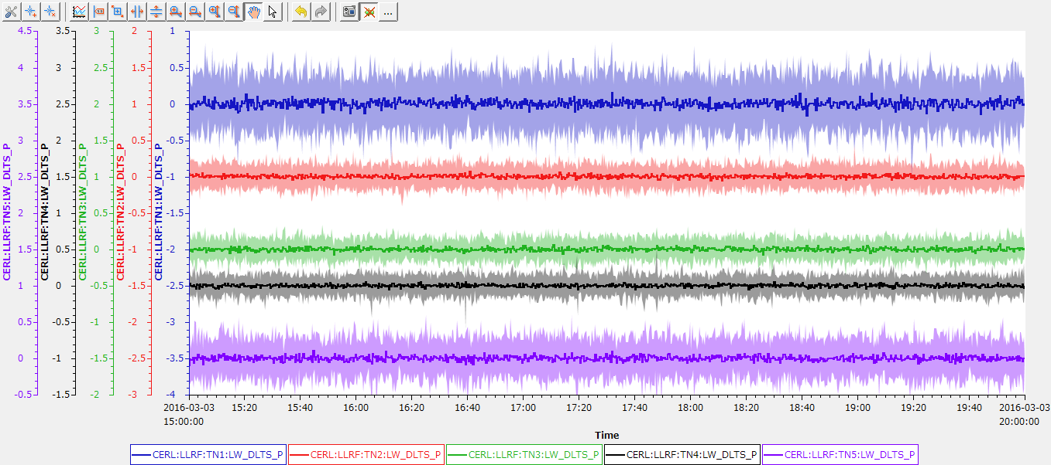
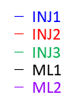
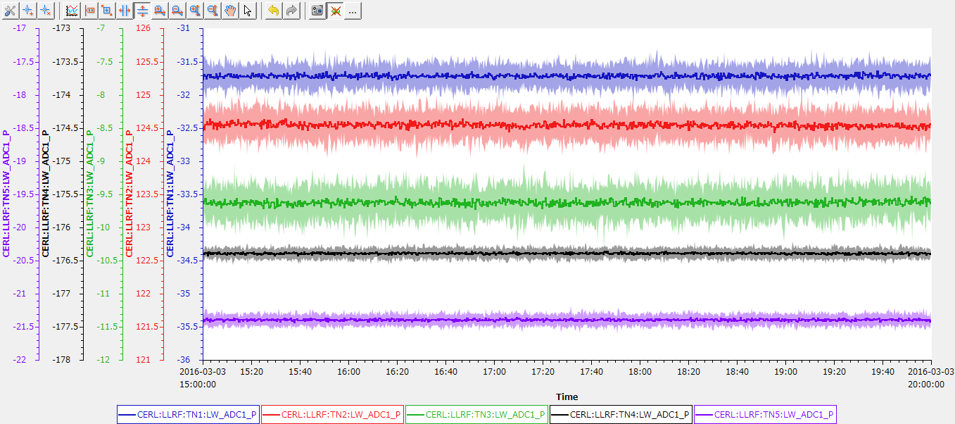
Result of Resonance FB Control Improvement
Higher FB gain in resonance control is adopted for small detuning.
Detuning Phase
Cav | Δθ deg (rms) | Δf Hz (rms)
INJ1 | 0.23 | 2.2
INJ2 | 0.10 | 2.0
INJ3 | 0.09 | 2.1
ML1 | 0.09 | 0.08
ML2 | 0.16 | 0.18
Detuning phase
Δθ (deg)
5 h
Detuning due to liquid N₂ flow has been compensated.
Cavity Phase
Inj2&Inj3 cavity phase
become stable.
Cavity phase
θc (deg)

Slide 24
Stability of Beam Momentum (2)
Measurement after modification of tuner feedback gain
for Inj2 & Inj3 only
FB gain is optimized
Momentum Jitter= 0.0064% rms
The latest result
ΔP/P = 0.003% rms
30 min.
50 min.
Large momentum drift disappeared.
=> Beam momentum jitter ΔP/P =0.003% is achieved.

Slide 25
Summary
Digital control boards are applied to RF feedback and tuner control.
Owing to the stiff cavity structure, so detuning by Michrophonics does not influence to the operation.
The field fluctuation due to Michrophonics is well suppressed by RF feedback.
Vector-sum operation has some difficulty for low beam energy due to different transit time.
By applying high FB gain for piezo tuning, the detuning fluctuation due to liquid N₂ flow rate has been suppressed.
=> Beam energy drift caused by vector-sum error has become small.
0.003% momentum stability is achieved.

