Slide 1

Novosibirsk ERL facility
G.N. Kulipanov and NovoFEL team
Budker INP, Novosibirsk, Russia
The 59th ICFA Advanced Beam Dynamics Workshop on Energy Recovery Linacs
CERN, 18-23 June 2017

Slide 2
NovoFEL Team
N.A. Vinokurov, V.M. Borin, I.V. Davidyuk, E.N.Dementyev, V.I. Dorokhov, Ya.V.Getmanov, B.A.Knyazev, E.I.Kolobanov, A.A.Kondakov, E.V.Kozyrev, V.V.Kubarev, G.N.Kulipanov, I.V.Kuptsov, G.Ya.Kurkin, O.I. Meshkov, S.V.Motygin, V.N.Osipov, V.M.Petrov, L.E.Medvedev, V.K.Ovchar, V.M.Popik, V.V.Repkov, T.V.Salikova, M.A.Scheglov, I.K.Sedlyarov, S.S.Serednyakov, O.A.Shevchenko, A.N.Skrinsky, S.V.Tararyshkin, V.G.Tcheskidov, A.G. Tribendis, V.N. Volkov.

Slide 3
1. Introduction.
History of ERL activity in Novosibirsk
The Energy Recovery Linac concept for the FEL was proposed at Budker INP by N. Vinokurov and A. Skrinsky (Preprint BINP 78-88, Novosibirsk, 1978; Proceedings of the 6th Soviet Union Accelerator Conference, Dubna, 11-13 October 1978, V II, p.233-236).
The first project of the four-turn race-track microtron-recuperator for the free electron laser NovoFEL was proposed at FEL’90 Conference, which took place in Paris (September 1990).
Gavrilov N.G., Gorniker E.I., Kulipanov G.N., …, Vinokurov N.A., NIM A304 (1991), P.228-229

Slide 4
Later the project was modified, the base lines kept:
A four-turn normal conductance linac with energy recovery;
Low RF cavities (180 MHz)
A grid-controlled DC gun with Q~ 1nC, t=1nsec, and f_{rep}=10kHz÷22.5 MHz;
The ERL can operate in three modes, providing an electron beam for the three different FELs, from 5 µm up to 240 µm
Advantages of the low frequency (180 MHz) RF system
High threshold currents for instabilities
Operation with long electron bunches (for narrow FEL linewidth)
Large longitudinal acceptance (good for operation with large energy spread of used beam)
Relaxed tolerances for orbit lengths and longitudinal dispersion

Slide 5
Low RF frequency (180 MHz) allows to use normal-conducting RF
Advantage: high beam current.
Disadvantage: high RF power consumption.
Indeed, the characteristic stability parameter is
Therefore, the “critical” beam current is

Slide 6
Construction and commissioning four track ERL was divided on three stages;
The first stage of Novosibirsk high power free electron laser (NovoFEL) working in spectral range (90 ÷ 240) μm, based on one track energy recovery linac (ERL) with energy 12 MeV, was commissioned in 2003.
The second stage of NovoFEL working in spectral range (35 ÷ 80) μm, based on two track energy recovery linac with energy 22 MeV, was commissioned in 2009.
The third stage of NovoFEL working in spectral range (8 ÷ 15) μm, based on four track energy recovery linac with energy 42 MeV, was commissioned in 2015.

Slide 7
2. Status of NovoFEL - First stage
τ = 100 ps
Q = 1.5 nQ
E = 2 MeV
Gun
τ = 1 ns
Q = 1.5 nQ
E = 300 keV
E = 2 MeV
E = 2 MeV
Main acceleration structure
ΔE = 10 ÷ 12 MeV
Buncher
0.5 kW
Electron beam from the gun passes through the buncher (a bunching RF cavity), drift section, 2 MeV accelerating cavities, the main accelerating structure and the undulator, where a fraction of its energy is converted to radiation.
After that, the beam returns to the main accelerating structure in a decelerating RF phase, decreases its energy to its injection value (2 MeV) and is absorbed in the beam dump.

Slide 8
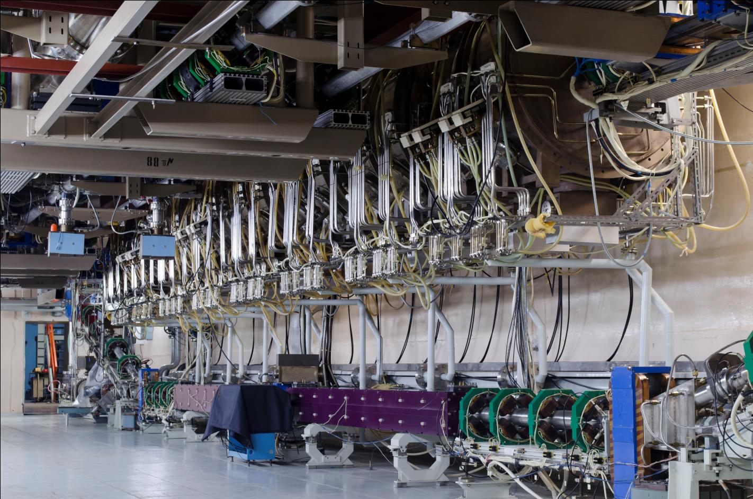
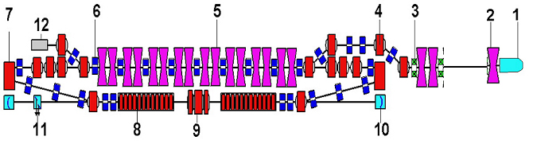
Main linac

Slide 9
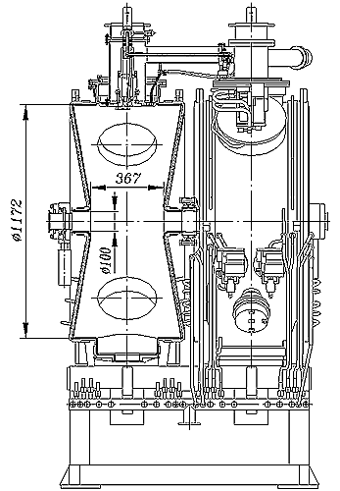
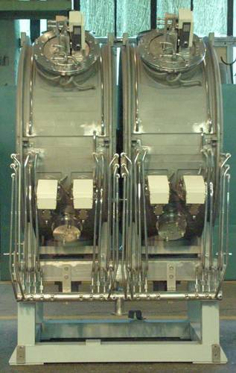
RF cavities of main linac
F₀ = 180 MHz, Δf₀ = 320 kHz, U_{max} = 950 kV,
U_{eff} = 850 kV, P_{dis} = 85 kW

Slide 10
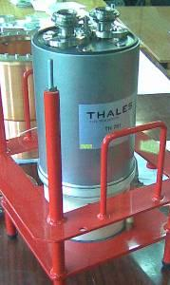
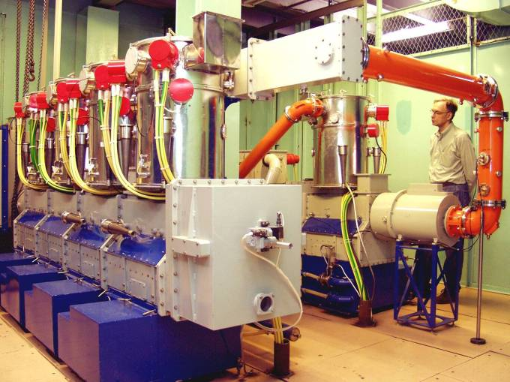
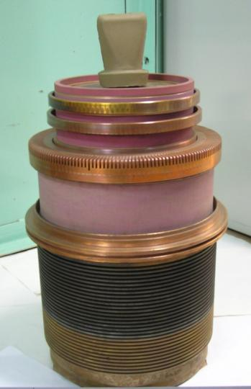
RF power amplifier
Frequency, MHz | 180.4
Power, MW | 2 x 0.6

Slide 11
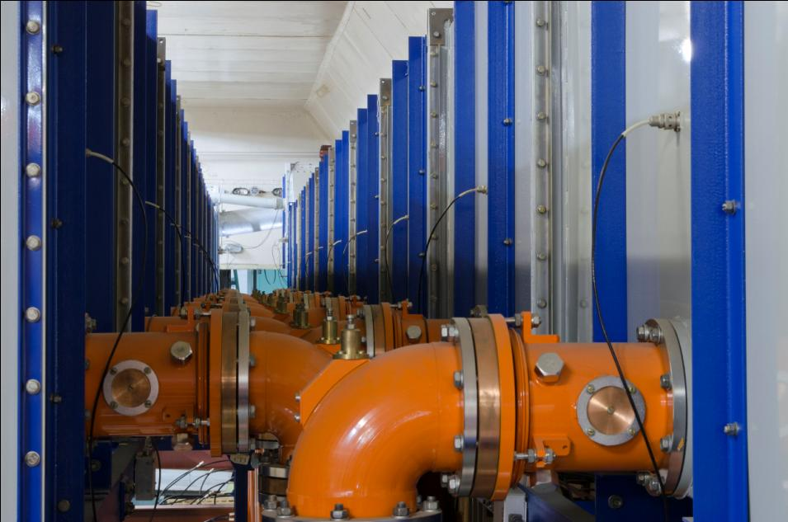
RF waveguides and feeders

Slide 12
3. Second and third stages of NovoFEL design and commissioning
Novosibirsk energy recovery linac has rather complicated magnetic system. First stage of NovoFEL with 12-MeV electron energy lies in vertical plane.
Other four orbits lie in the horizontal plane.
The beam is directed to these orbits by switching on of two round magnets. In this case electrons pass four times through acceleration RF cavities, obtaining 43-MeV energy. Than, (at the fourth orbit) the beam is used in FEL and decelerated four times.

Slide 13
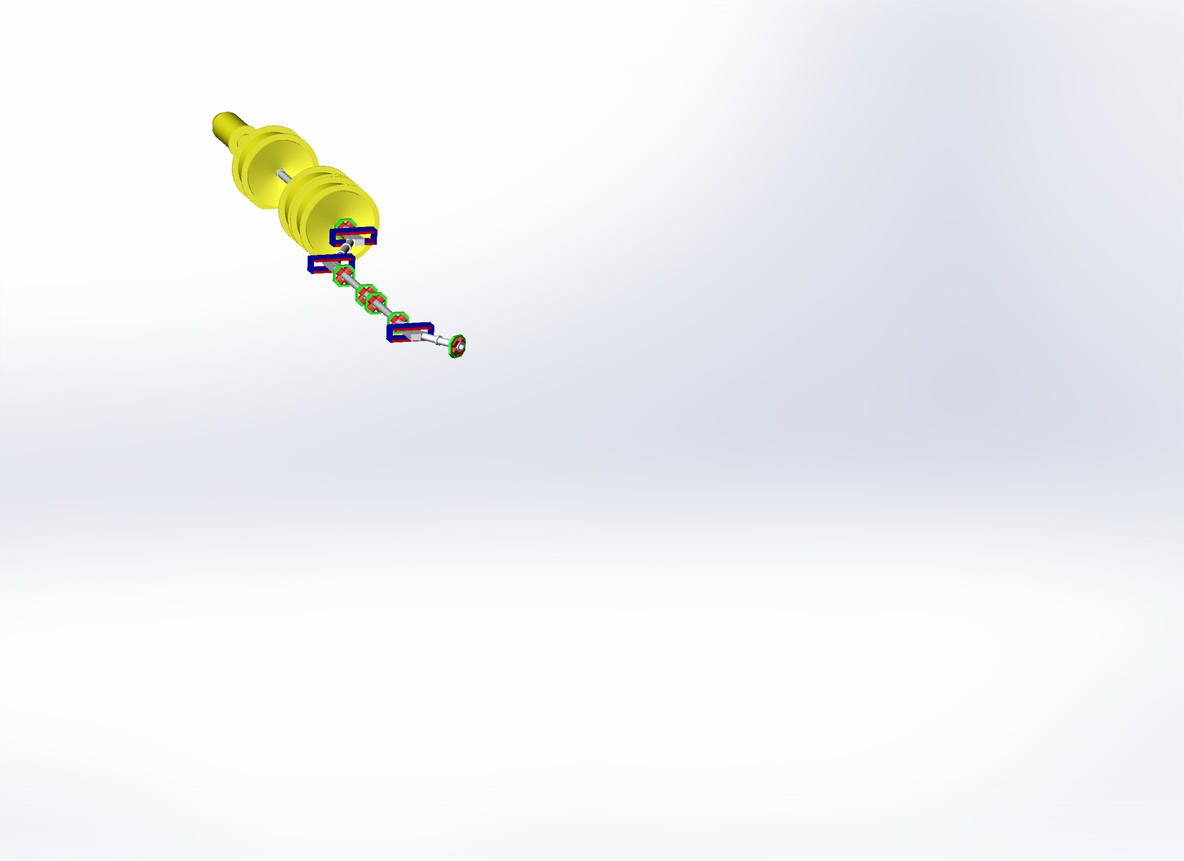
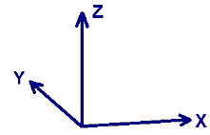
NovoFEL Accelerator Design and status
Gun
Injector

Slide 14
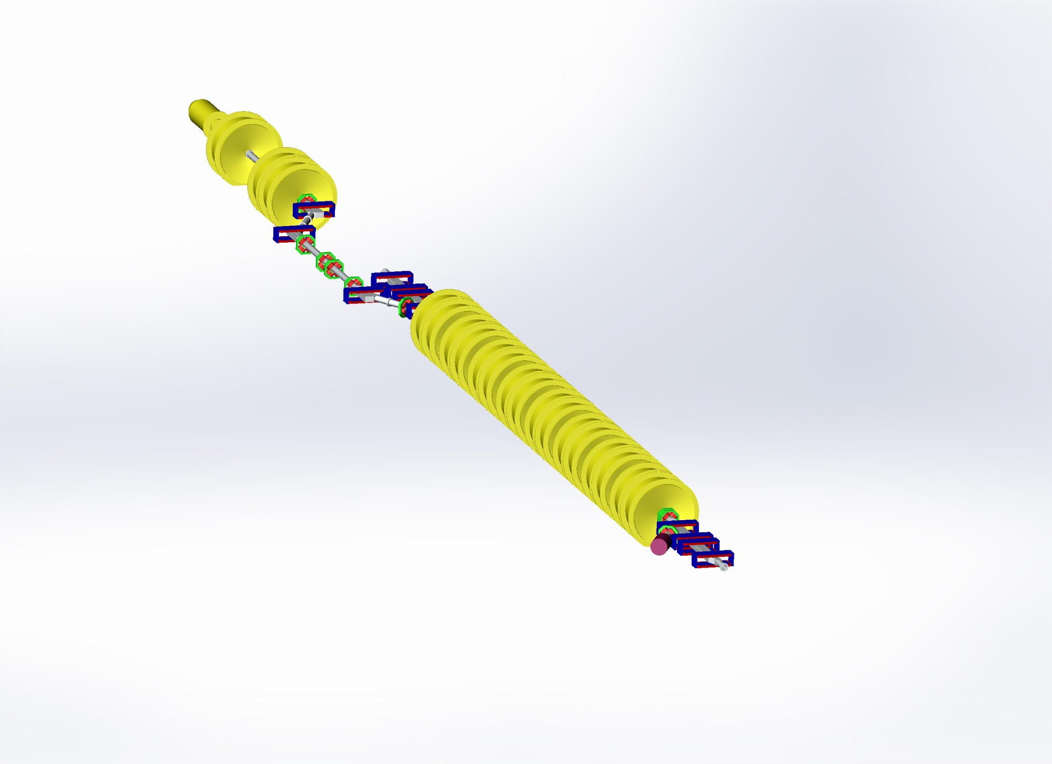
NovoFEL Accelerator Design and status
Gun
Injector
Main linac
Dump

Slide 15
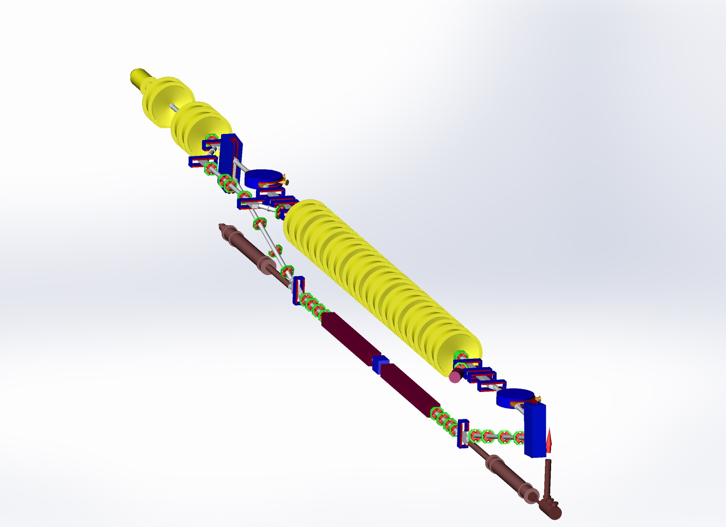
NovoFEL Accelerator Design and status
Gun
Injector
Main linac
The first THz FEL
undulator sections
Dump

Slide 16
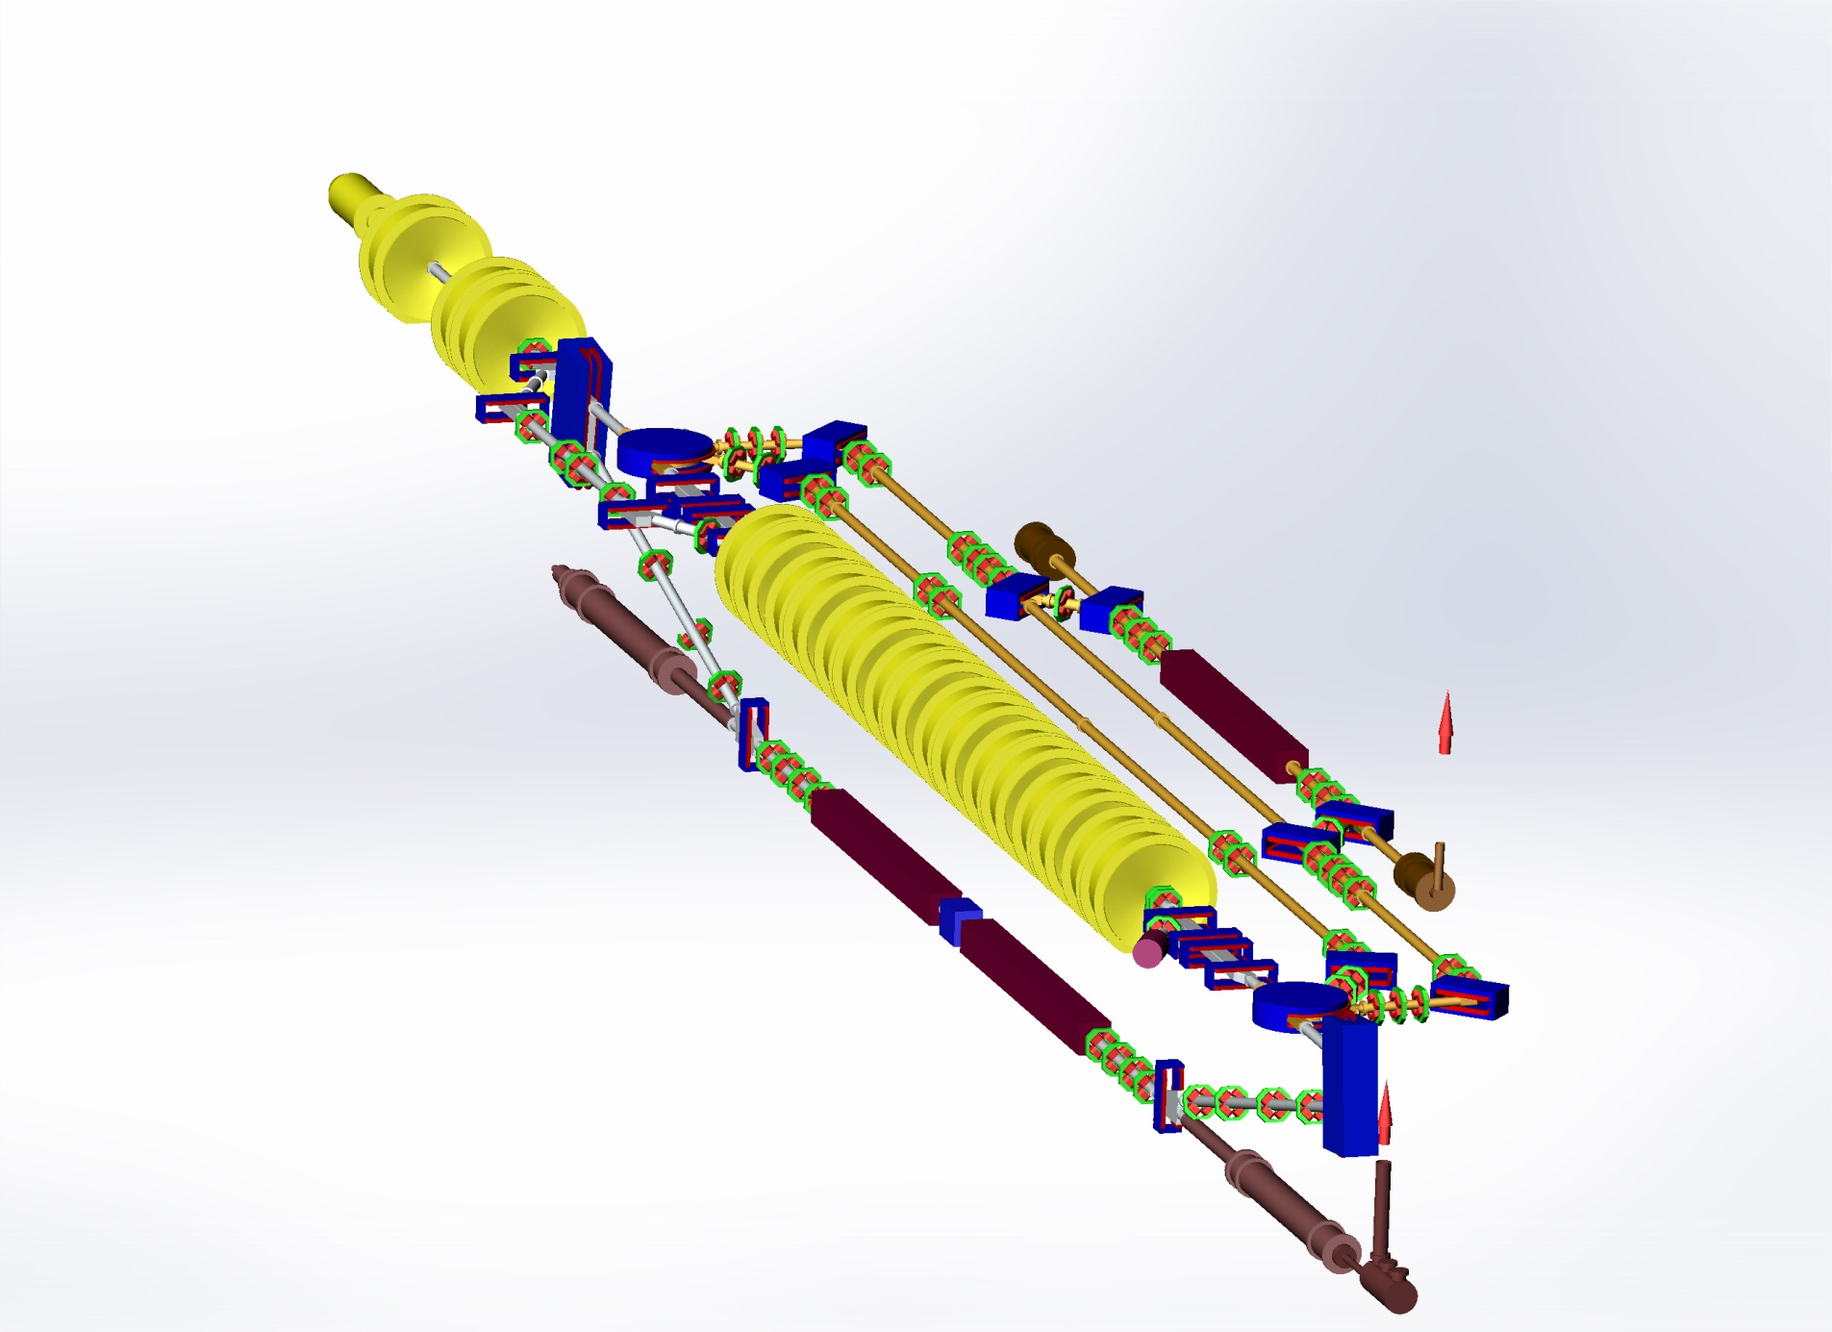
NovoFEL Accelerator Design and status
Gun
The second FEL
undulator
Injector
Main linac
The first THz FEL
undulator sections
Dump

Slide 17
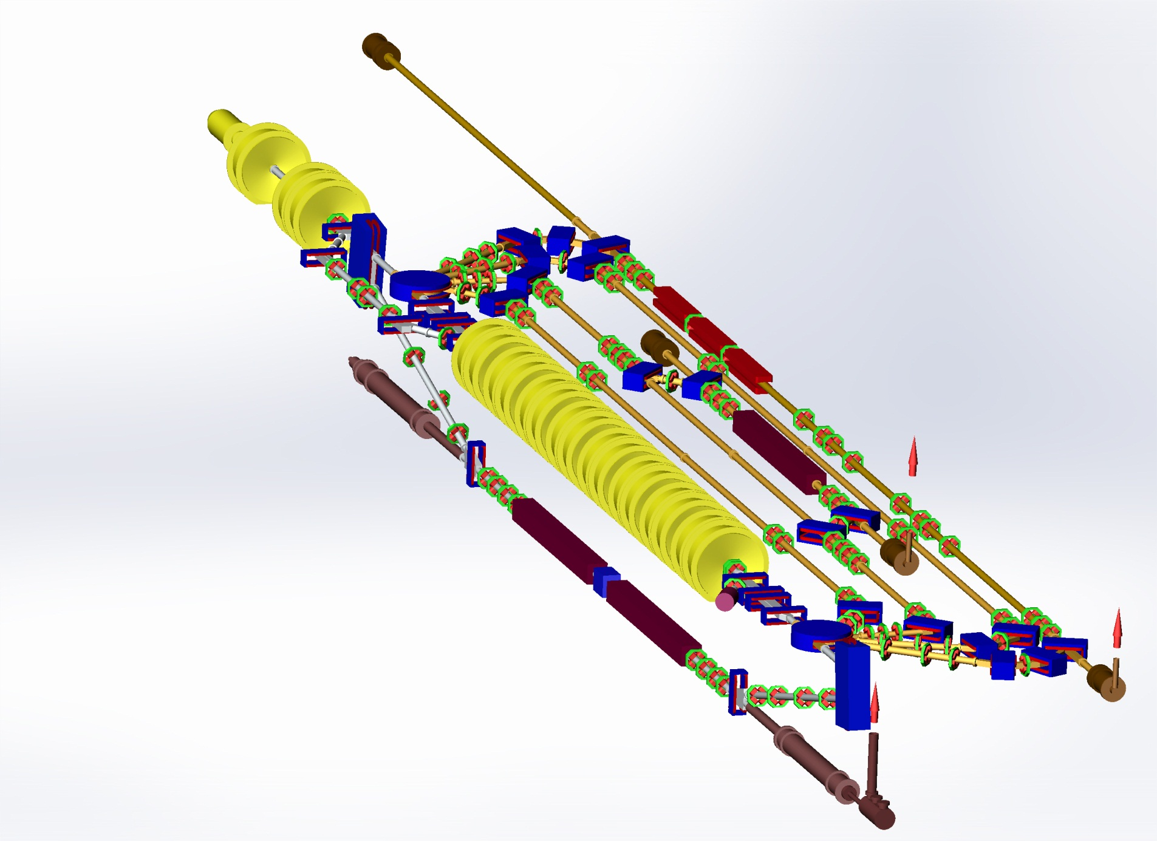
NovoFEL Accelerator Design and status
Gun
The third IR FEL
undulator sections
The second FEL
undulator
Injector
Main linac
The first THz FEL
undulator sections
Dump

Slide 18
Second and third stages beamlines
12 MeV
22 MeV
32 MeV
42 MeV
(horizontal plane)

Slide 19
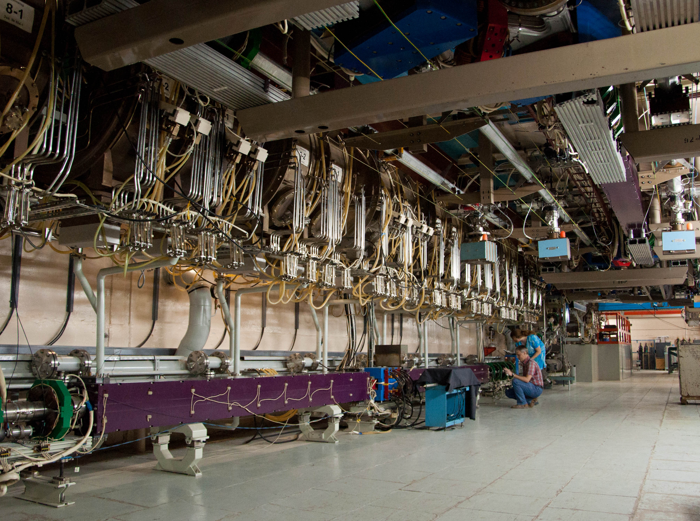
Horizontal tracks
1st stage FEL
undulator
2nd stage FEL
undulator
Main linac

Slide 20
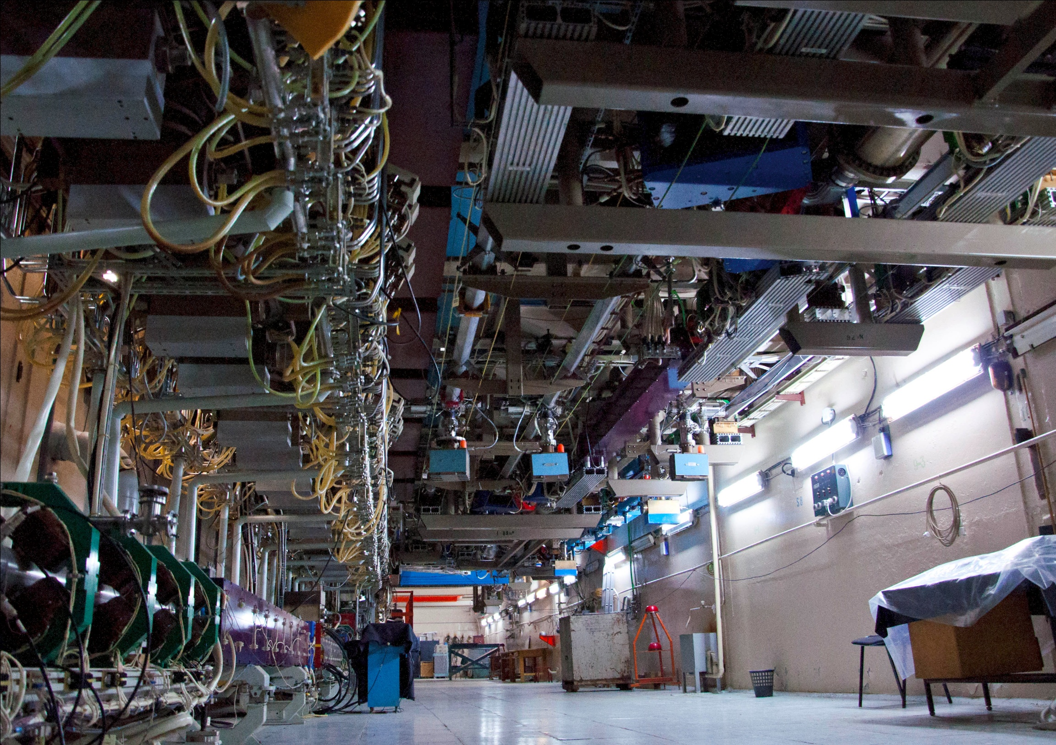
3rd stage FEL
undulator

Slide 21
Electron beam and radiation parameters (1)
 | 1st E=12 MeV |  |  | 2nd E=22 MeV |  | 3rd E=42 MeV
 | lasing | working | max | lasing | max | lasing | max
Current, mA | 5.5 | 11 | 30 | 7.0 | 7.5 | 3.0 | 5
Rep. rate, MHz | 5.6 | 11.2 | 22.4 | 7.52 | 7.52 | 3.76 | 5.64
Q nQ | 1 | 1 | 1.4 | 0.9 |  | 0.8
P, W | 300 | 500 | 1000 | 500 |  | 100

Slide 22
Electron beam and radiation parameters (2)
 | 1st | 2nd | 3rd
Energy, MeV | 12 | 22 | 42 | 46
Current, mA | 30 | 7.5 | 5 | 50
Wavelength, μm | 90-240 | 40-90 | 8-11 | 5-20
Radiation power, kW | 0.5 | 0.5 | 0.1 | 5
Electron efficiency, % | 0.6 | 0.3 | 0.2 | 0.5

Slide 23
4. Nearest and far future plans
Install optical (SR) diagnostics of electron beam parameters
Install undulator with variation of period
Install RF gun
Improve x-ray and neutron radiation shielding

Slide 24
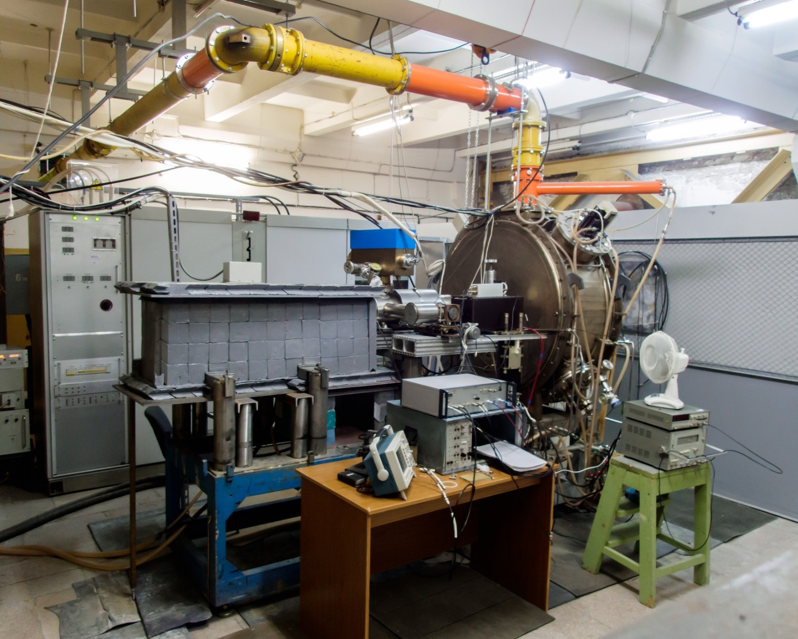
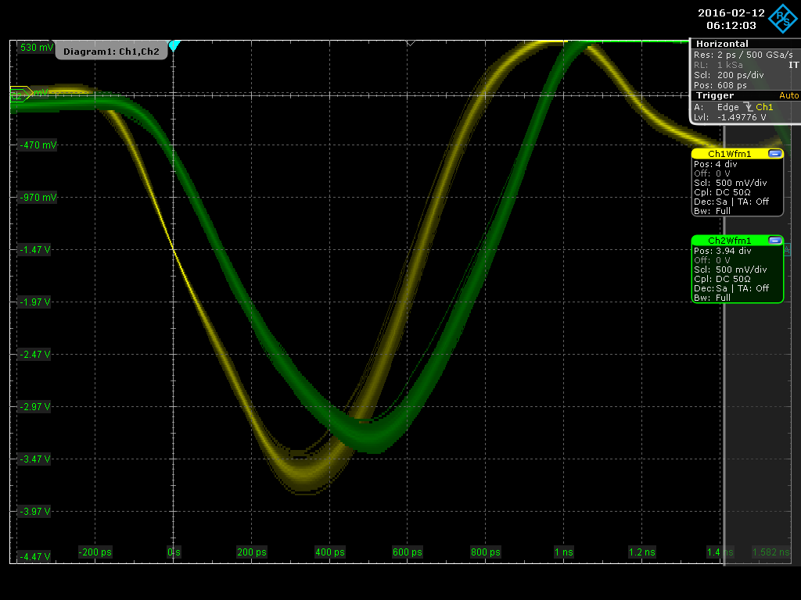
RF Gun Test Setup
575 пс
Measured beam parameters
Energy, keV | 100 ÷ 320
Pulse duration(FWHM), ns | ≤ 0.6
Bunch charge, nQ | 0.3 ÷ 1.5
Repetition rate, MHz | 0.01 ÷ 90
Average current, mA | 102 max
Vladimir N. Volkov CW 100 mA Electron RF Gun for Novosibirsk ERL FEL (RUPAC2016)
http://accelconf.web.cern.ch/AccelConf/rupac2016/papers/tucamh02.pdf

Slide 25
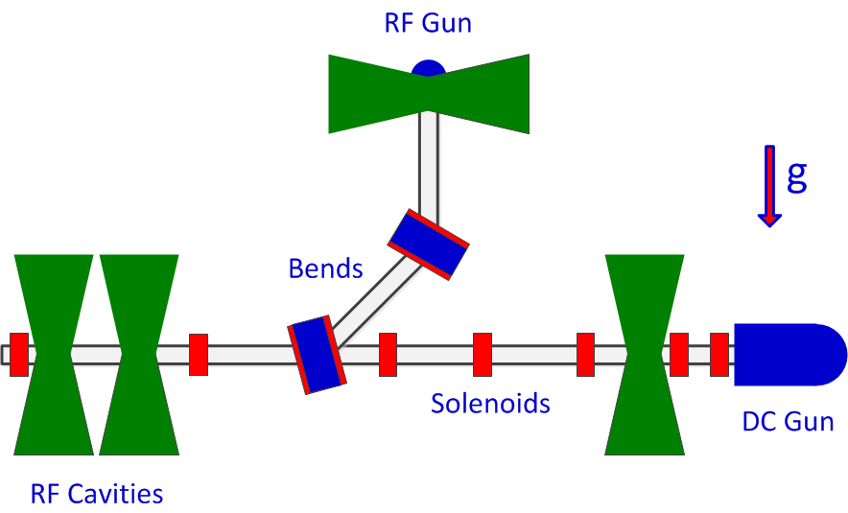
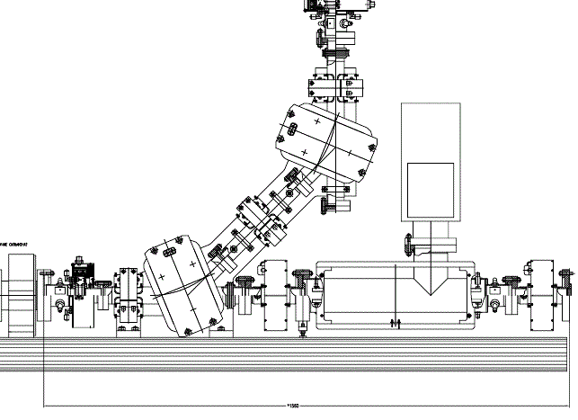
RF Gun Installation Layout

Slide 26
Undulator with variation of period
One of the main FEL
advantages is the ability to
adjust the wavelength
Variation of magnetic field
Electromagnetic
undulator
Variable gap
undulator
K ~ 0…1.5
K ~ 0.4…2.5
E1 ~ 10…13 MeV
E2 ~ 20…24 MeV
E3 ~ 40…46 MeV
Variation of beam energy
Variable period
undulator
Variation of undulator period
(N. Vinokurov)
K ~ 0.42…1.79

Slide 27
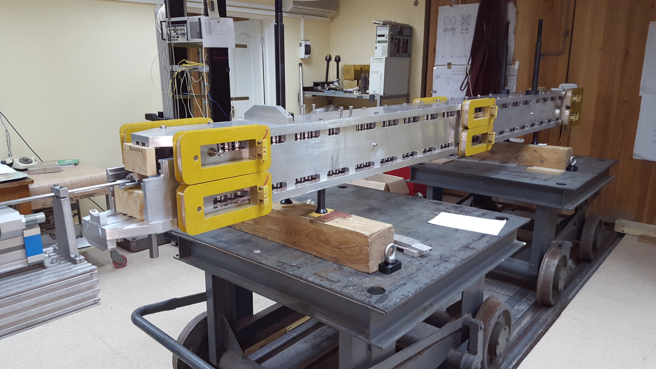
Variable period undulator at magnetic measurements

Slide 28
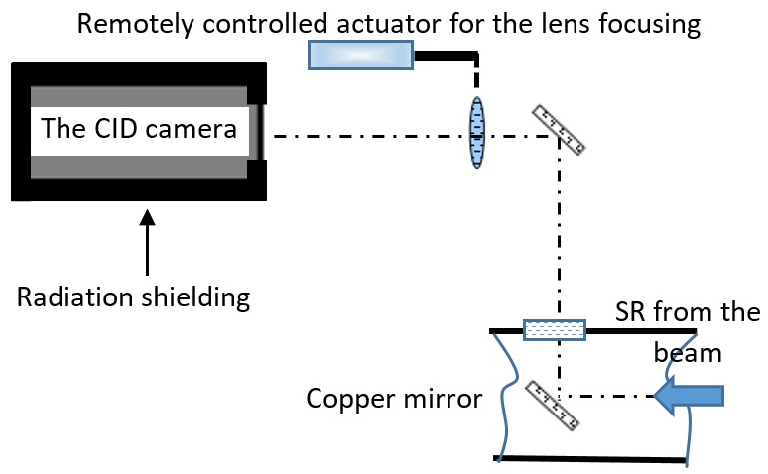
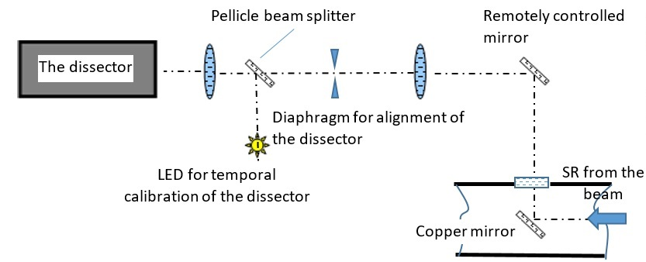
Optical diagnostic of electron beam parameters
Layout of the diagnostics for acquisition of the transverse profile of the beam
Layout of the diagnostics for acquisition of the longitudinal profile of the beam

Slide 29
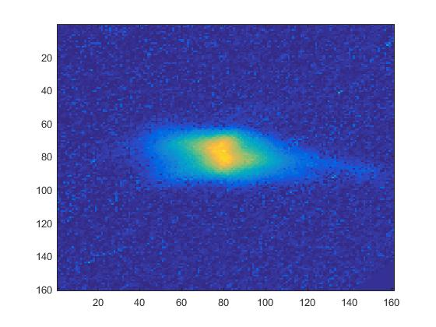
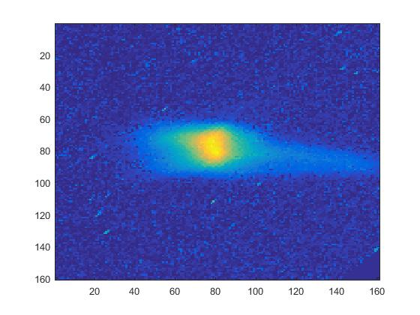
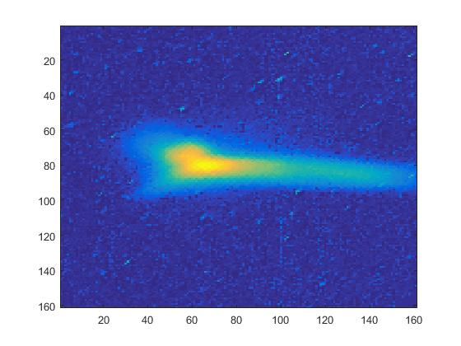
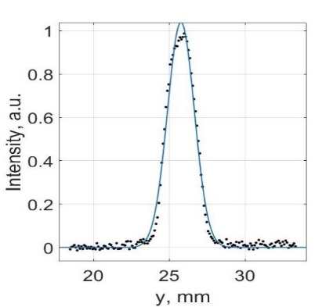
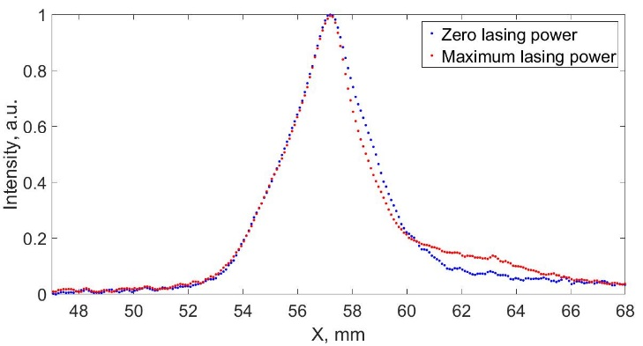
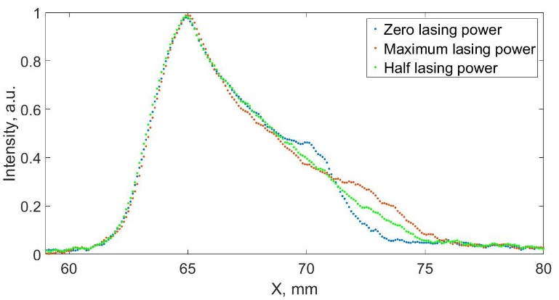
Optical diagnostic of electron beam parameters
Examples of acquired transverse beam profiles
Vertical beam profile
Horizontal profiles acquired during the 2nd run
Horizontal profiles acquired during the 1st run

Slide 30
5. Perspective of ERL with SC cavities at Budker INP
5.1 MARS –Multiturn Accelerator Recuperator Source
At SRI-97 conference for realization of a fully spatially coherent X-ray source was proposed by Kulipanov G., Skrinsky A., Vinokurov N. using of accelerators-recirculators with energy recuperation (SRI-97)
See: [1] MARS - recirculator-based diffraction limited X-ray source. // Budker
INP preprint No 97-103 (1997);
[2] Kulipanov G., Skrinsky A., Vinokurov N. Synchorton light sources and
recent development of accelerator technology. // J. of Synchrotron
Radiation –1998 V.5 pt.3 P.176).
After SRI-2000, the idea of using the accelerators-recuperators for creation of 4th generation of SR sources has been actively discussed at Jefferson Lab, Cornell Uni., KEK, BNL, LBL, Erlangen Uni., Daresbury Lab.

Slide 31
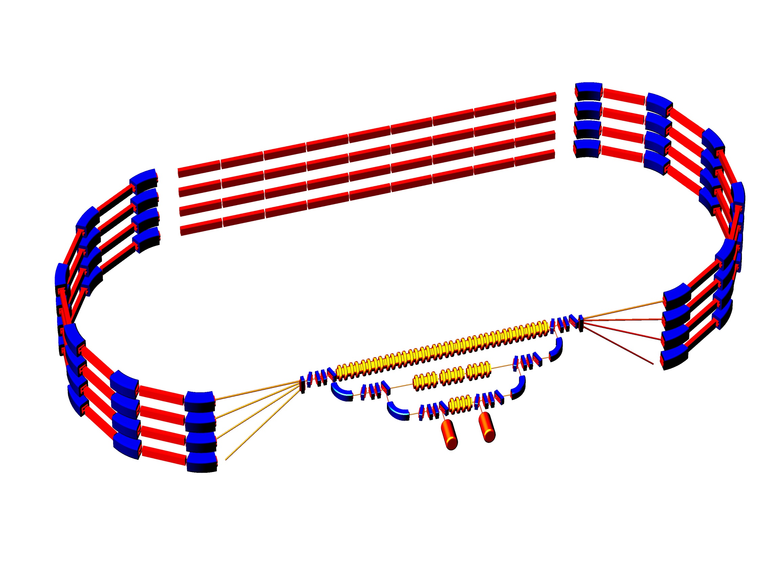
Layout of 5.7 GeV four-pass accelerator-recuperator
Basic overall dimensions of ERL and MARS (E_{max} = 6 GeV)
λ~1Å
At “SRI-2000” (Berlin, Germany)
5.76 GeV
λ~12Å
1.8 GeV 3.12 GeV 4.44 GeV 5.76 GeV
ΔE = 1.32 GeV, L_{acc} = 144 m
ΔE = 440 MeV
ΔE = 40 MeV
Injector
5-8 MeV
Beam
dump
R=100 m

Slide 32
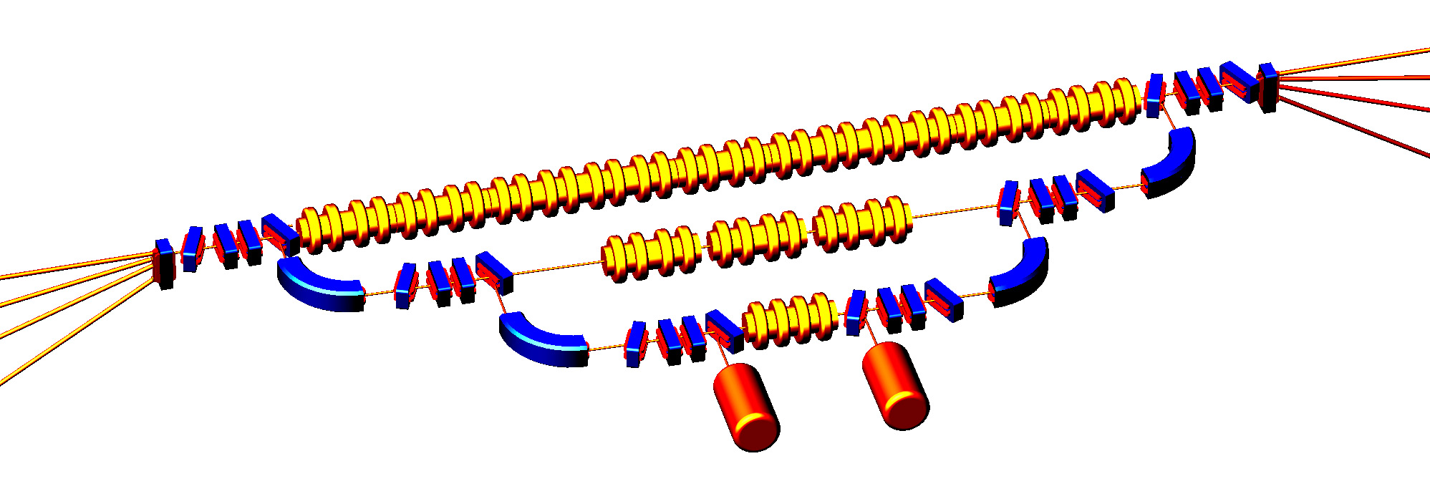
Cascade injection – effective solution of important problems of ERL
Decrease in radiation hazard and limitation of induced radioactivity due to low energy of electrons at dump (5-8 MeV).
Reduction in the cost of construction and RF power system for the injector
Simplification the problem of focusing particles of different energies travelling simultaneously in the accelerating structure, because the cascade scheme enables injection of electrons into all accelerating structures with energies of no less than Emax/10 (Emax is the maximum energy of electrons traveling in the accelerating structure).
E_{max}
3/4E_{max}
1/10 E_{max}
1/2E_{max}
1/4E_{max}
Injector
dump
1/100 E_{max}
5-8 MeV
5-15 kW
5-8 MeV
1-3 mA
First linac has 5-8 MeV energy and does not use energy recovery.
For booster linacs (30 MeV and 330 MeV energy gain) energy recovery is used.

Slide 33
5.2. ERL with separated tracks for accelerated and decelerated beams
It was suggested at ERL-2011 (G. Kulipanov, Ya. Getmanov, O. Shevchenko, A. Skrinsky, A. Tribendis, N. Vinokurov,
V. Volkov, “Multiturn ERL X-ray Source(MARS) Feasibility study,” ERL-2011, October 2011, KEK) to turn to an accelerator-recuperator scheme with two acceleration sections, similar to the scheme of the US accelerator CEBAF. Such schemes are considered below.

Slide 34
The simplest scheme of ERL (for understanding) with separated tracks
0.7 GeV
350 MeV
42 MeV
8 MeV
8 MeV
6
1
1.9 GeV
1 – injector, 2 – preliminary accelerating system, 3 – main accelerating RF structure, 4 – magnets, 5 – undulator, 6 – dump.
red arrows – accelerating bunch
black arrows – used decelerating bunch

Slide 35
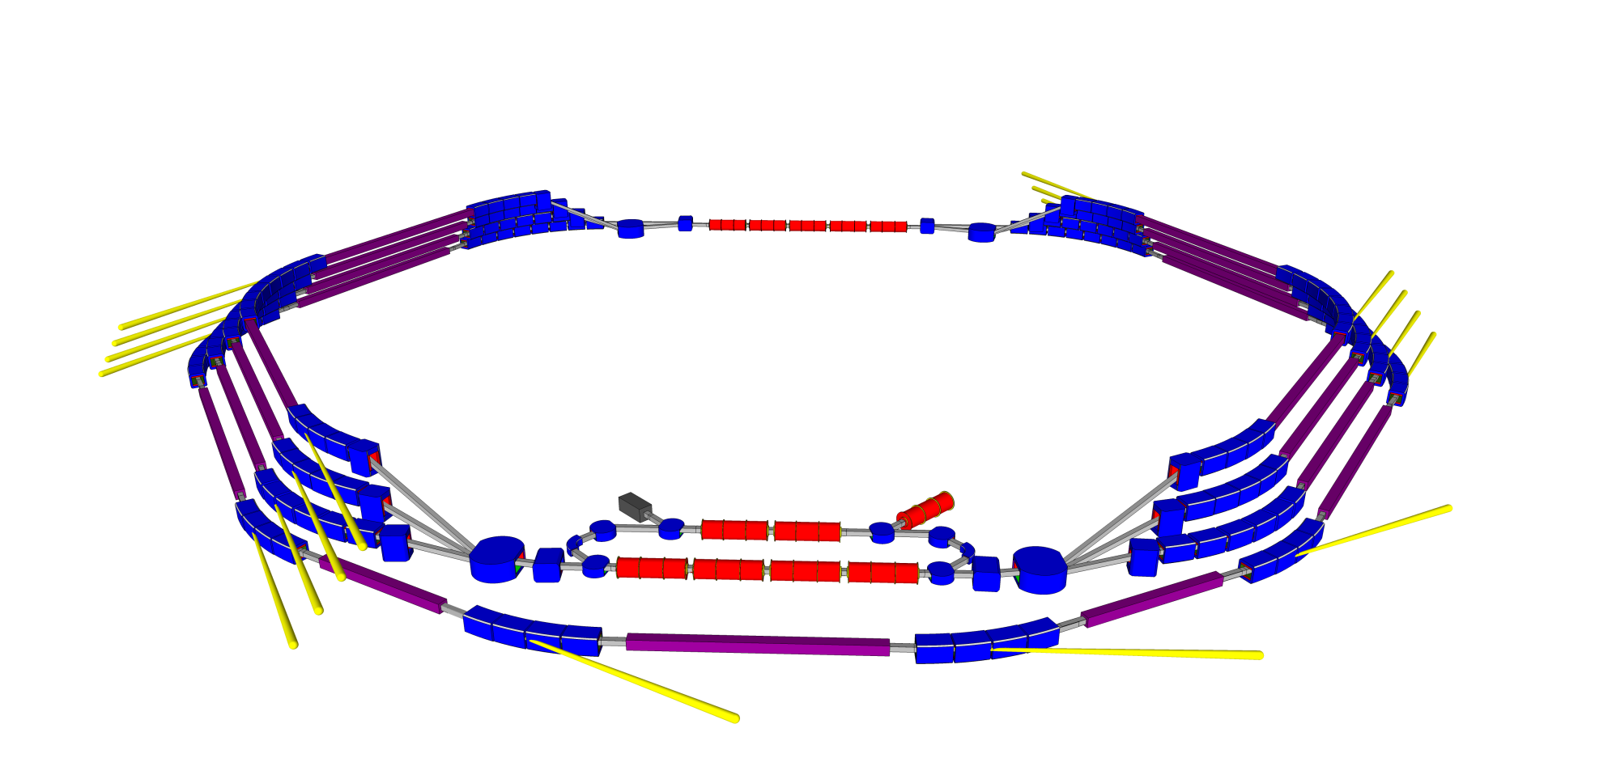
Full Spatial Coherent multiturn ERL
X-Ray Source MARS
MULTIPASS ACCELERATOR-RECUPERATORS SOURCE
linac-2
undulators
~1km
undulators
injector
linac-1
undulators
Energy range | 5.6, 3.8, 3, 1.2 GeV | Bunch length | 0.1 – 1 ps
Average current | 10 mA | 7 undulators for | 5.6 GeV
Peak current | 10 A | 4 undulators for | 3.8 GeV
Normalized Emittance | 10⁻⁷ m·rad | 4 undulators for | 3 GeV
Bunch charge | 10⁻¹¹ Cl | 4 undulators for | 1.2 GeV

Slide 36
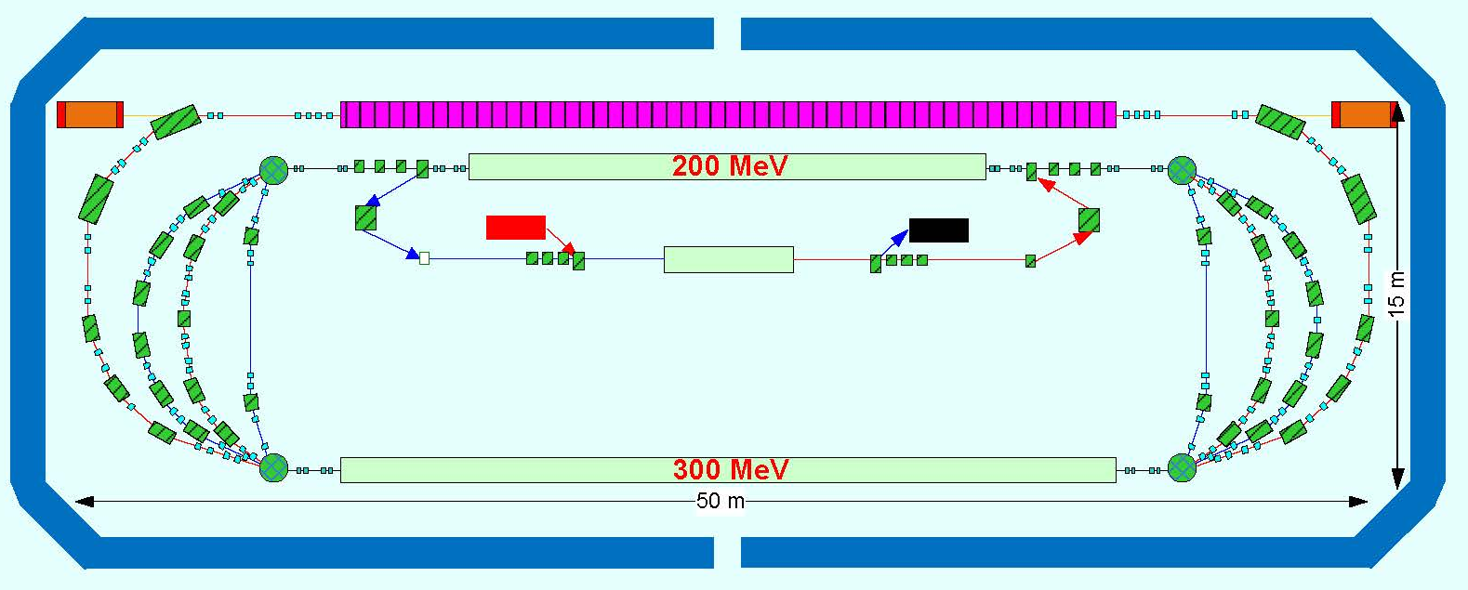
Project of FEL for EUV Lithography
(compact 13.5-nm free-electron laser for extreme ultraviolet lithography,
Y. Socol, G.N. Kulipanov, A.N. Matveenko, O.A. Shevchenko, and N.A. Vinokurov,
Phys. Rev. ST AB, Vol. 14, No 4. – 040702-1 – 040702-7, 2011).
Undulator
10 МэВ
10 МэВ
30 МэВ
λ | 13.5 nm
E_{e} | 1 GeV
P_{av} | 10 kW
I | 10-20 mA
λ_{u} | 3 cm
accelerated beam
decelerated beam

Slide 37
Thank you for your attention!

