Slide 1

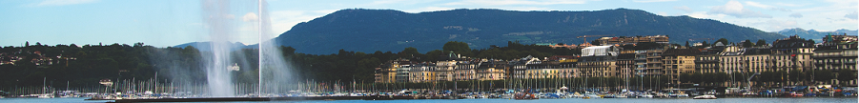
EUV ERLs for Semiconductor Integrated Circuits Lithography
Norio Nakamura
High Energy Accelerator Research Organization(KEK)
ERL17, 18-23 June 2017, CERN, Geneva, Switzerland

Slide 2



EUV-ERL Design Group
(KEK) T. Furuya, K. Haga, I. Hanyu, K. Harada,
T. Honda, Y. Honda, E. Kako, Y. Kamiya, R. Kato,
H. Kawata, Y. Kobayashi, T. Konomi, T. Kubo,
S. Michizono, T. Miura, T. Miyajima, H. Nakai,
N. Nakamura, T. Obina, K. Oide, H. Sakai, M. Shimada,
R. Takai, Y. Tanimoto, K. Tsuchiya, K. Umemori,
S. Yamaguchi, M. Yamamoto
(QST) R. Hajima
(Tohoku Unv.) N. Nishimori
The design study has been done under collaboration with a Japanese company.

Slide 3
Outline
Introduction
Design of EUV ERL Source
S2E Simulation
Activities and Considerations for Industrialization
Summary

Slide 4
Outline
Introduction
Design of EUV ERL Source
S2E Simulation
Activities and Considerations for Industrialization
Summary

Slide 5
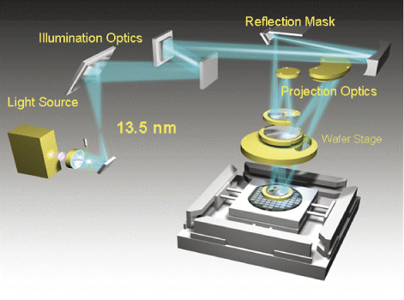
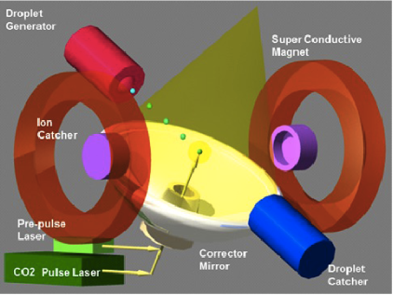
EUV Lithography
EUV Lithography :
・ Next generation lithography using extreme ultraviolet light (13.5 nm)
・ Allows exposure of fine circuit pattern with a half-pitch below 20 nm
・ Laser-produced plasma(LPP) source is under development for ≥ 250 W
Schematic of EUV exposure tool
Concept of LPP EUV source
H. Mizoguchi et al., Komatsu Technical Report 59-166 (2013)
H. Mizoguchi et al., Proc. of SPIE 10143, 101431J (2017)
EUV ERLs (EUV FEL sources based on ERLs)
・ Meet future demand for 1 kW EUV power or more
・ Distribute 1-kW class power to multiple scanners → more economical
・ Produce no debris contaminating the EUV optics
・ Reduce dumped beam power and activation drastically

Slide 6
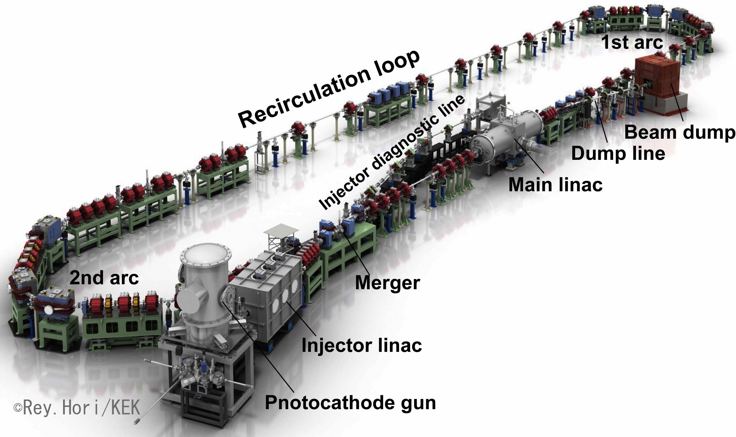
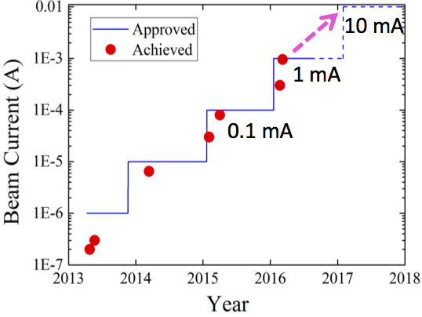
Compact ERL(cERL)
in operation at KEK since 2013
Beam Energy: 20 MeV
RF Frequency: 1.3 GHz
plan of kW-class IR FEL
History of achieved beam current
cERL technologies and resources are available for EUV ERLs.

Slide 7
Outline
Introduction
Design of EUV ERL Source
S2E Simulation
Activities and Considerations for Industrialization
Summary

Slide 8
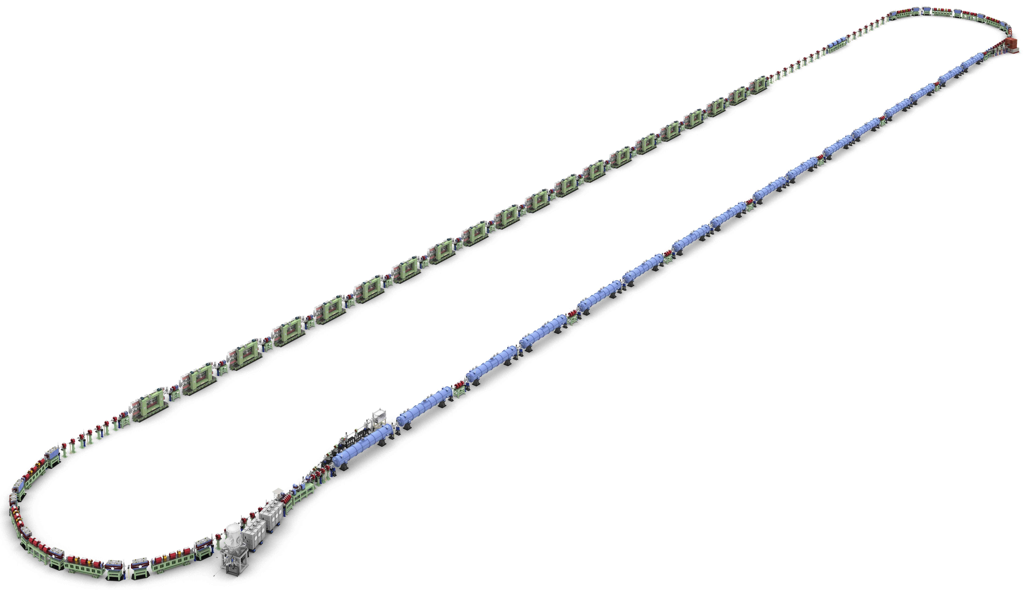
Image of EUV-ERL Source
1st Arc
Beam energy: 800 MeV
RF frequency: 1.3 GHz
Chicane
Beam Dump
~200 m
Undulators(FEL)
Main SC Linac
Parameter | Design value
Injection Energy | 10.5 MeV
Beam Energy | 800 MeV
Bunch Charge | 60 pC
Repetition Rate | 162.5 MHz
Ave. Current | ~10 mA
Acc. field | 12.5 MV/m
EUV Wavelength | 13.5 nm
EUV power | > 10 kW
Injector Diagnostic Line
EUV Light
2nd Arc
Merger
Injector Linac
~20 m
Gun
©Rey.Hori/KEK

Slide 9
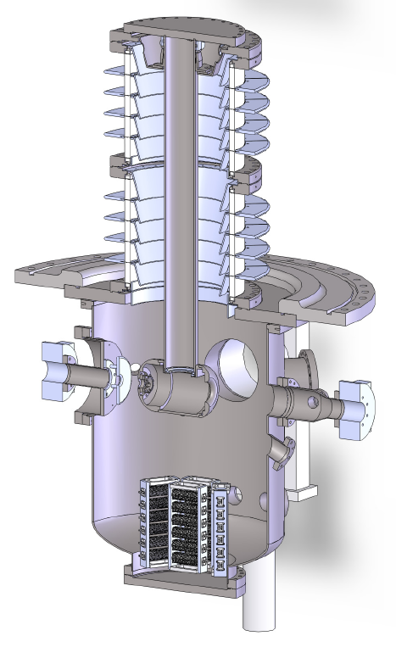
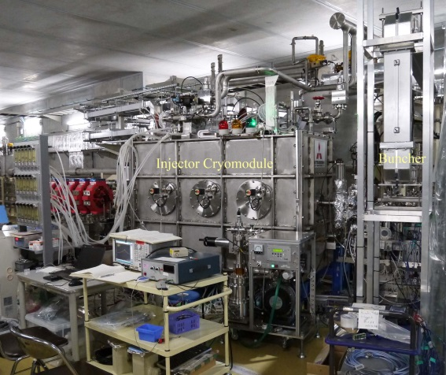
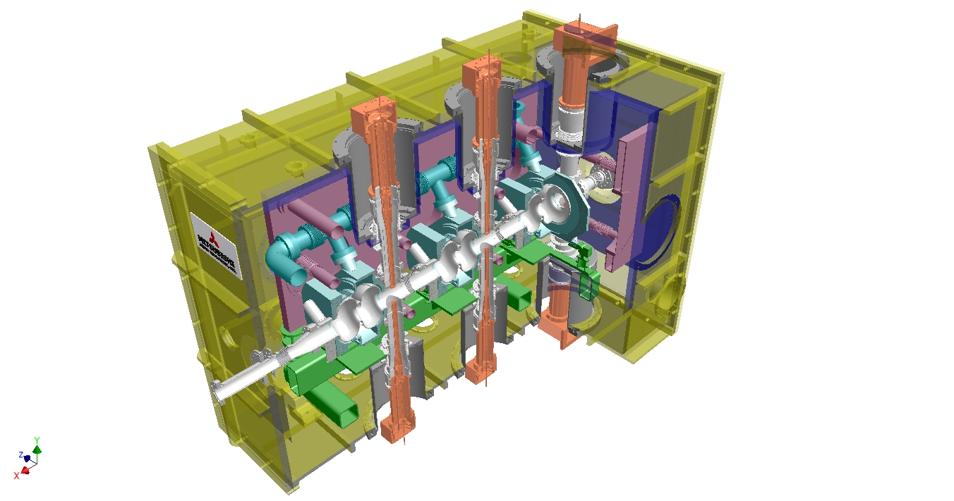
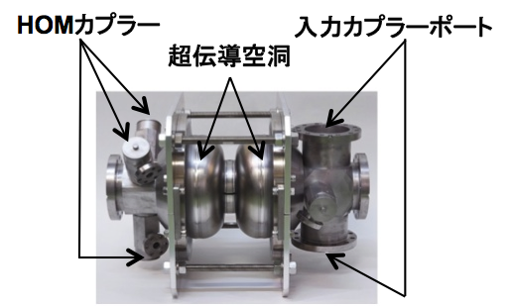
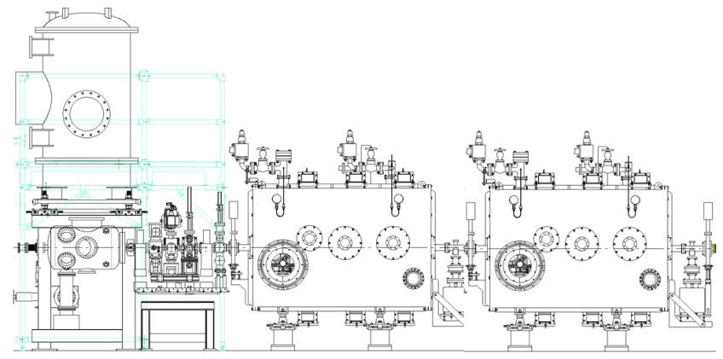

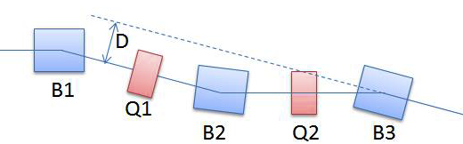
Injector & Merger
Segmented
ceramic duct
Vacuum Vessel
5K Duct
5K Panel
5K Panel
80K Shield
Electron
beam
2K He Jacket
2K Gas
Return Pipe
5K Support
Anode
(0V)
80K Base-plate
Cathode
(-500kV)
cERL Injector cryomodule
e⁻
Input Coupler
2-cell Cavity
Ti chamber
NEG pump
HOM coupler
Input coupler
HOM Coupler
Photocathode DC gun
cavity cells
Cryomodule design
Solenoid magnets
Buncher cavity
2-cell SC cavity
B : Bending magnets（θ=15°, ρ=1m）
Q : Quadrupole magnet
recirculation loop
injection point
electron beam
E_{inj}~10.5 MeV
Injector section (side view)
matching section
Merger section (top view)

Slide 10
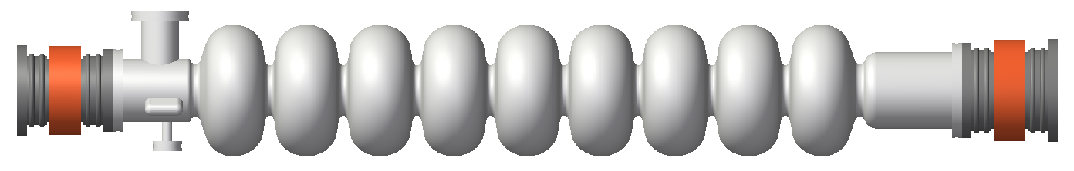
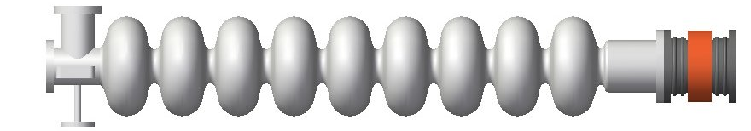
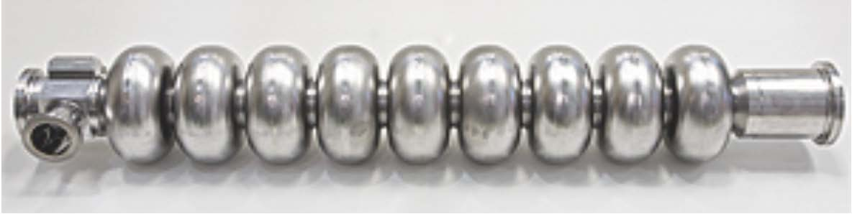
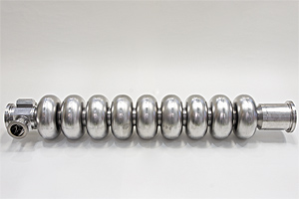
Main Linac
Main linac (9-cell cavities × 64 in 16 cryomodules)
Cryomodule(4 cavities)×２
Quadrupole
triplet
Basic unit of main linac structure
Quadrupole
triplet
cERL cavity
EUV ERL cavity
Under design. A large-aperture pipe will be also applied to the left side.
 | cERL | EUV ERL |  | cERL | EUV ERL
Frequency | 1.3 GHz | 1.3 GHz | Iris diameter | 80 mm | 70 mm
R_{sh}/Q | 897 Ω | 1007 Ω | Q_{o}×R_{s} | 289 Ω | 272 Ω
E_{p}/E_{acc} | 3.0 | 2.0 | H_{p}/E_{acc} | 42.5 Oe/(MV/m) | 42.0 Oe/(MV/m)
Stable operation at 8.5 MV/m (cERL) ➔ 12.5 MV/m (EUV-ERL)

Slide 11
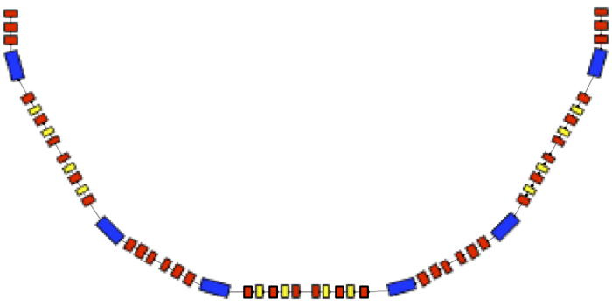
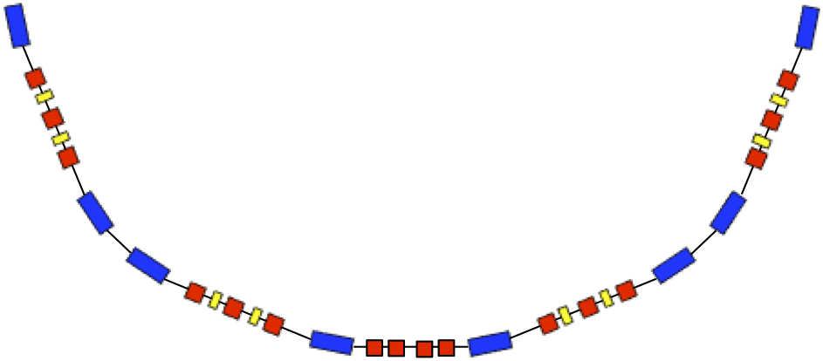
Arc Sections
p
1st arc lattice
p
e-
21.3 m
t
3 DBA cells
t
ρ =2.2 m, θ =π/6 rad,
L_{B}=1.15 m, L_{Q1}=L_{Q6}=0.2 m
L_{Q2-Q5}=0.3 m, L_{S}=0.2 m
R₅₆= 6ρ (θ − sinθ ) =0.3115 m
Bunch compression
(1st arc, R₅₆ > 0）
Blue：Bending magnet
Red： Quadrupole magnet
Yellow：Sextupole magnet
2nd arc lattice
p
e-
p
21.3 m
2 TBA cells
t
ρ =3 m, θ =π/8 rad,
L_{B}=1.178 m, L_{Q}=0.4 m,
L_{S}=0.2 m
R₅₆: -0.25 m (tunable)
t
Bunch decompression
(2nd arc, R₅₆ < 0）
Optics are optimized for bunch compression and decompression.

Slide 12

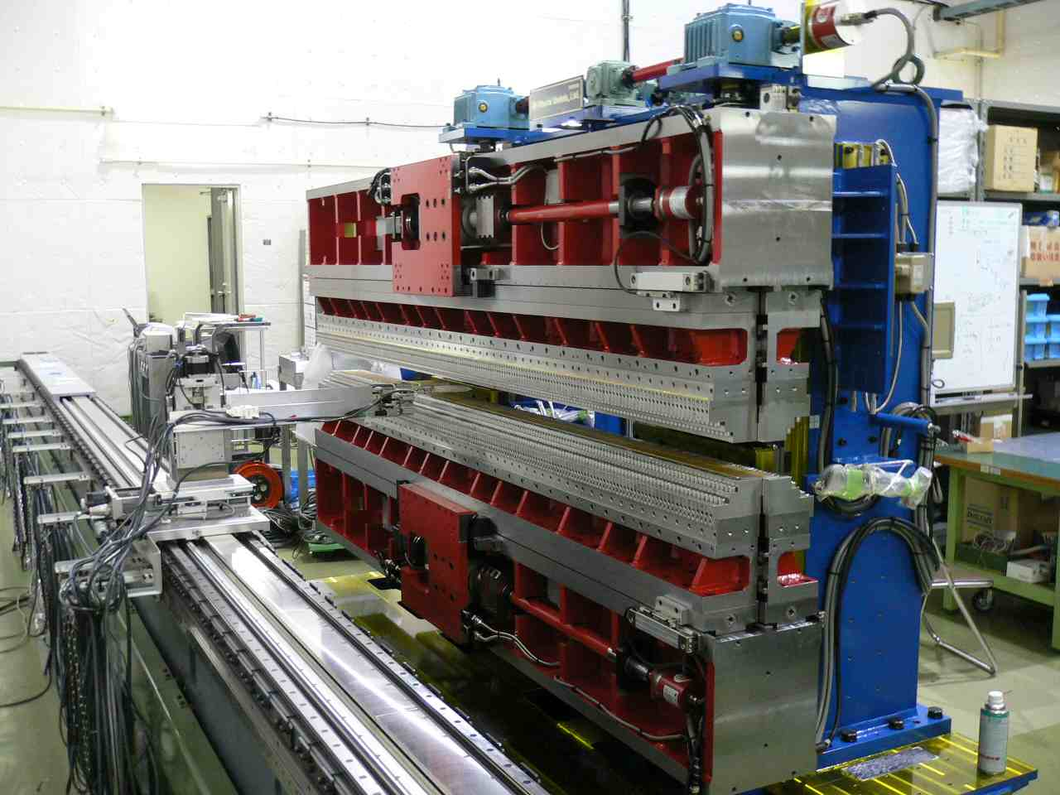
Undulator System for FEL
Undulator System（including matching section）
Undulator System（FEL）
Undulator segment
(K=1.652, λ_{u}=28 mm)
QMs for focusing
QMs for optics matching
18 units
….
….
e⁻ beam
Exit of 1st arc
4.9m
1.12m
Matching Section
Adjustment of Twiss parameters β_{x,y},α_{x,y}@ FEL entrance
for maximizing FEL output power
Parameters of undulator system to be optimized
（１）Undulator period and K-value (magnetic gap)
（２）Segment length and gap between segments
（３）Magnetic strength of QMs for focusing
（４）Undulator tapering
Circularly-polarizing undulator
developed at KEK

Slide 13
Outline
Introduction
Design of EUV ERL Source
S2E Simulation
Activities and Considerations for Industrialization
Summary

Slide 14
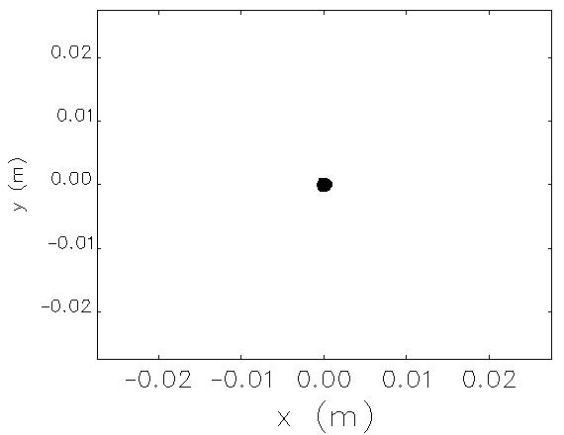
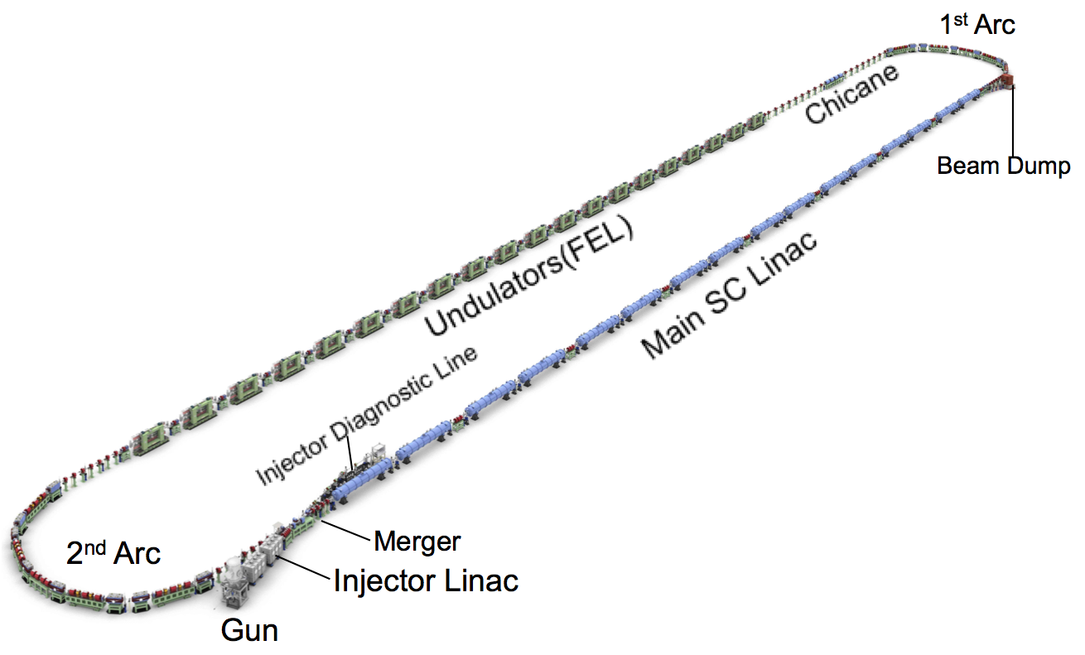
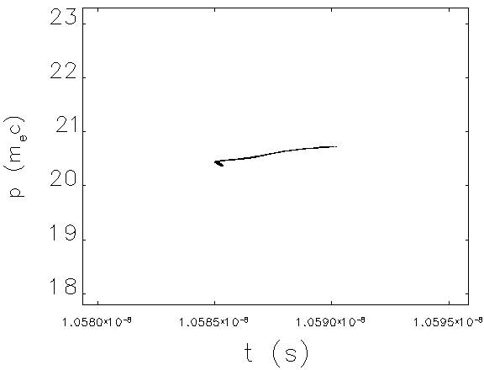
Injector & Merger
Injection beam optimization by GPT and genetic algorithm
Bunch charge: Q_{b}=60 pC, Injection energy: E_{inj}=10.5 MeV, Bunch length: σ_{t} ~ 1 ps
entrance of main linac
20
10
0
y[mm]
-10
ε_{nx}=0.65 mm mrad
ε_{ny}=0.73 mm mrad
-20
-20
-10
0
10
20
x[mm]
23.0
22.0
e⁻
21.0
p/mc
20.0
19.0
σ_{t}=1.08 ps
σ_{p}/p=0.347 %
18.0
-5.0
-2.5
2.5
5.0
t[ps]

Slide 15
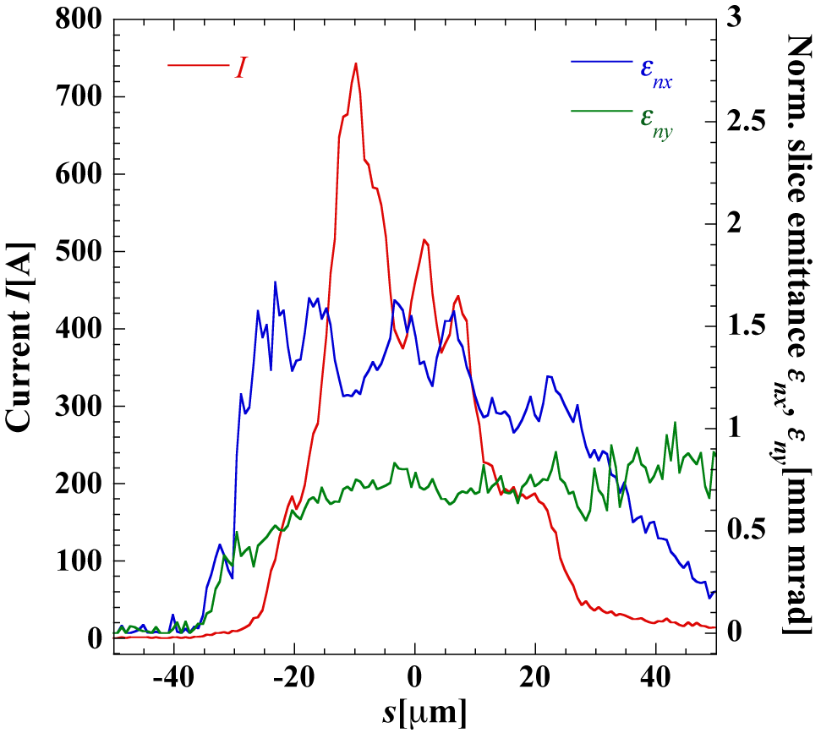
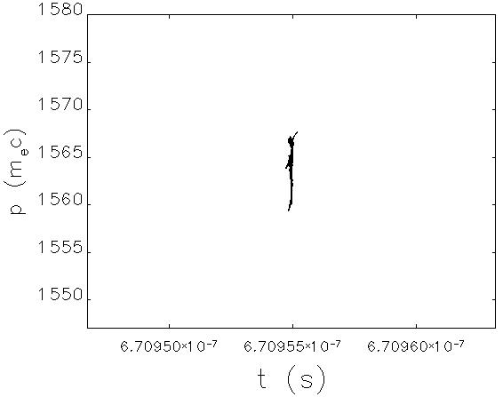
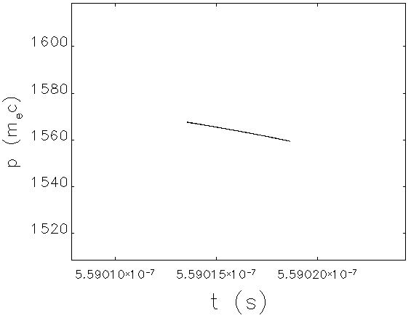
Bunch Compression
Current&slice emittance
exit of 1st arc
σ_{t}=47.4 fs
σ_{p}/p=0.112 %
entrance of 1st arc
5ps
σ_{t}=1.04 ps
σ_{p}/p=0.103 %
ε_{nx}=2.02 mm mrad
ε_{ny}=0.72 mm mrad
ε_{nx}=0.66 mm mrad
ε_{ny}=0.72 mm mrad
Peak current I_{p} > 700 A
Slice ε_{nx}/ε_{ny} ≈ 1.2/0.7 mm mrad at I=I_{p}
e⁻
E=800 MeV
entrance of main linac
simulation by elegant
σ_{t}=1.08 ps
σ_{p}/p=0.347 %
E=10.5 MeV
ε_{nx}=0.65 mm mrad
ε_{ny}=0.73 mm mrad

Slide 16
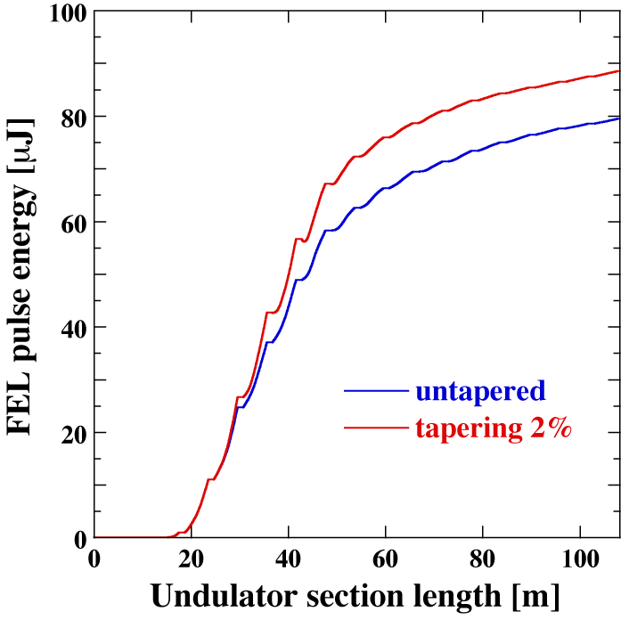
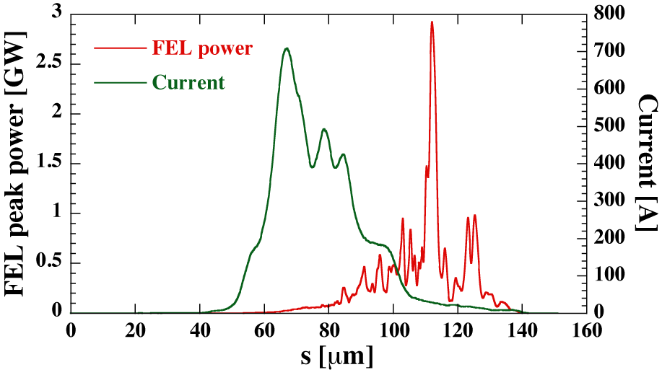
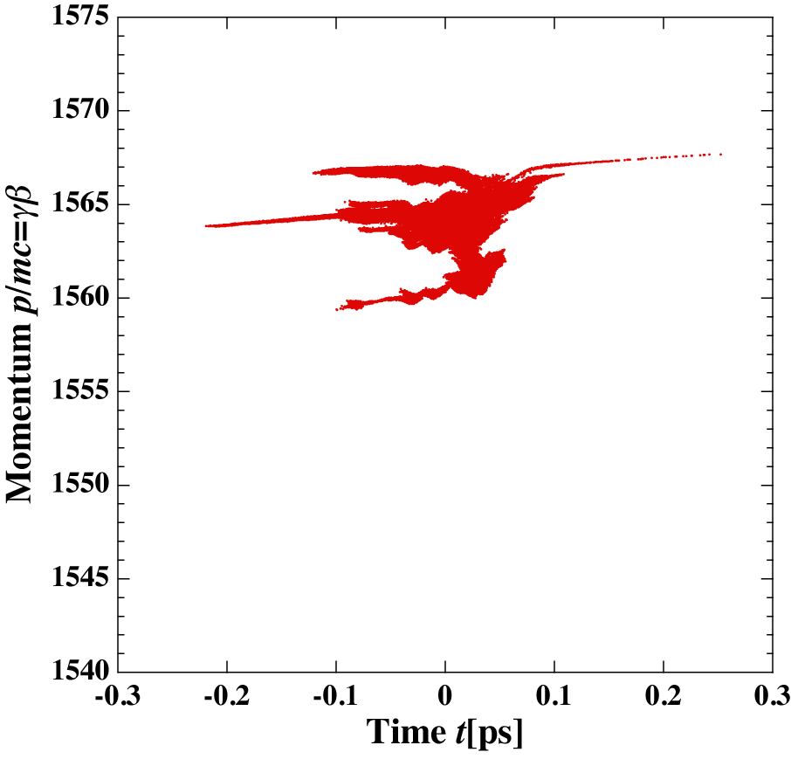
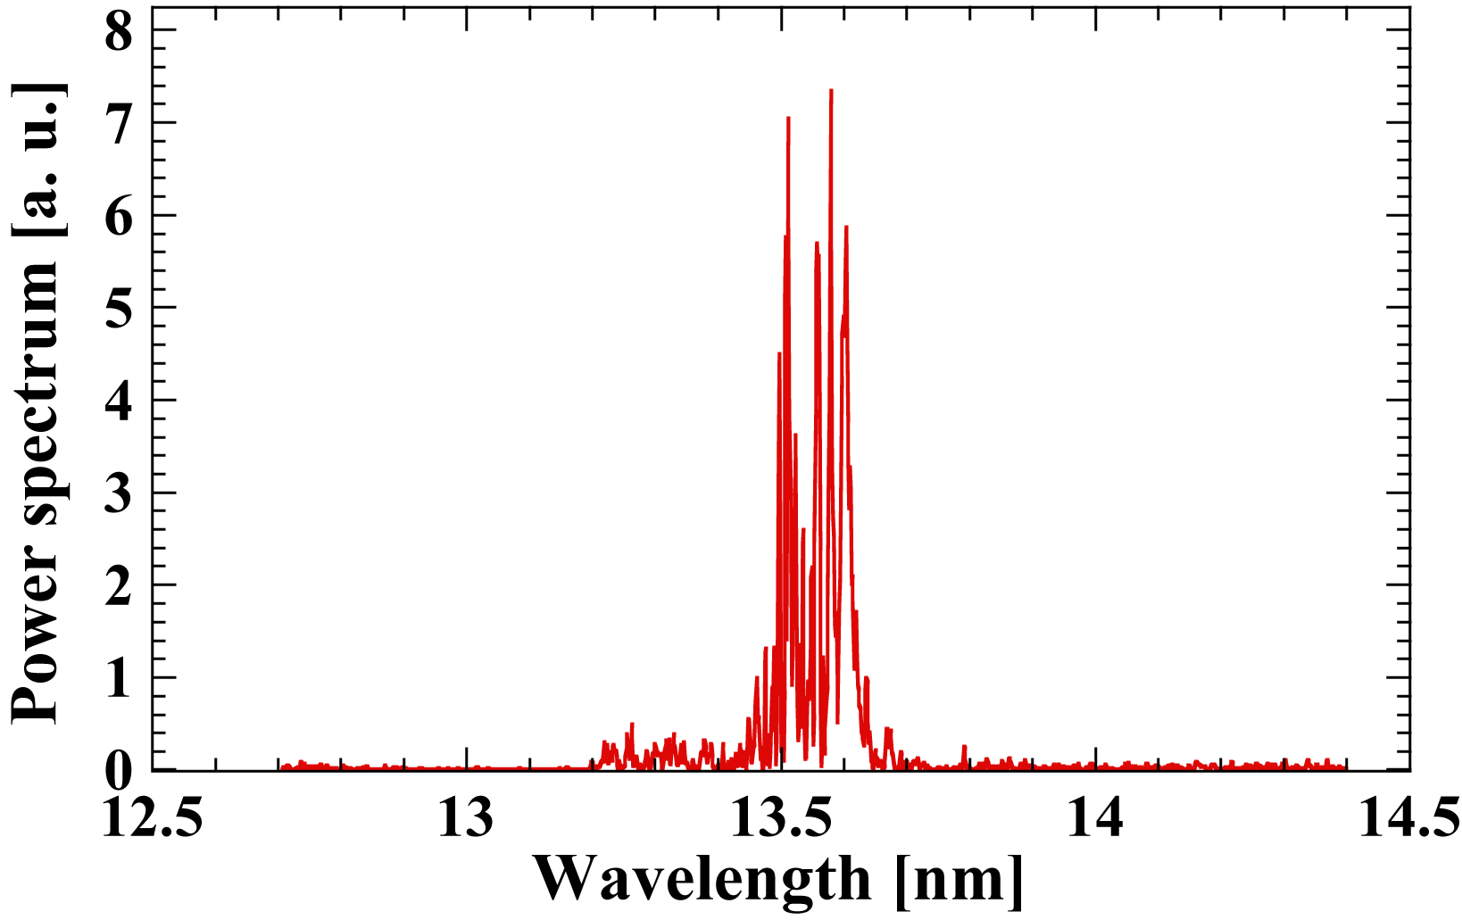
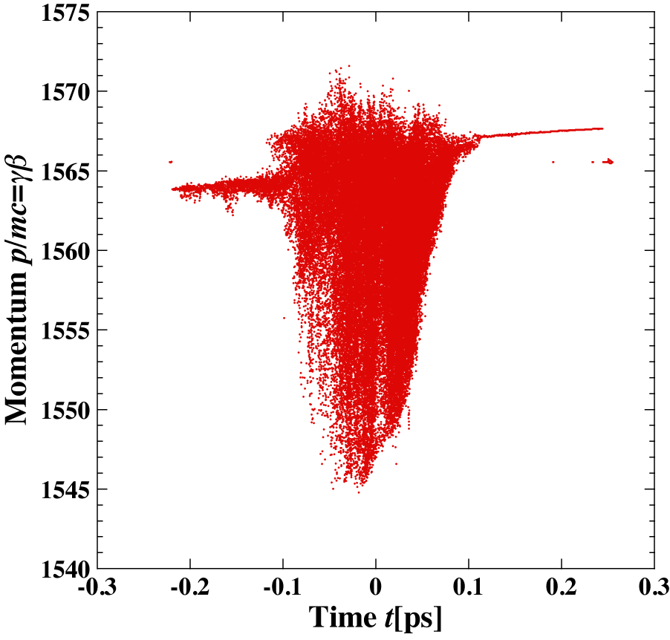
FEL
88.5μJ
79.5 μJ
<γβ>=1564.0
σ_{t}=47.4 fs
σ_{p}/p=0.113 %
ε_{nx}=2.00 mm·mrad
ε_{ny}=0.72 mm·mrad
bandwidth of
Mo/Si reflectivity
FEL power without tapering: 12.9/25.8 kW @ 9.75/19.5 mA (162.5/325 MHz)
FEL power with 2% tapering: 14.4/28.8 kW @ 9.75/19.5 mA (162.5/325 MHz)
(P_{FEL}=88.5 μJ x 162.5 MHz =14.4 kW, I_{av}=60pC x 162.5 MHz=9.75 mA)
Energy spread is increased.
simulation by Genesis
e⁻
<γβ>=1561.1
σ_{t}=48.5 fs
σ_{p}/p=0.299 %
ε_{nx}=1.98 mm·mrad
ε_{ny}=0.71 mm·mrad
P_{FEL} > 10 kW is achieved.

Slide 17
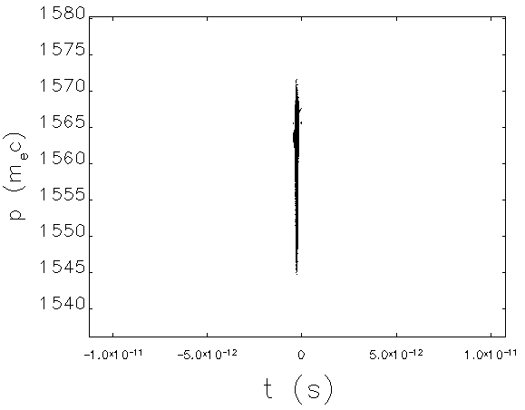
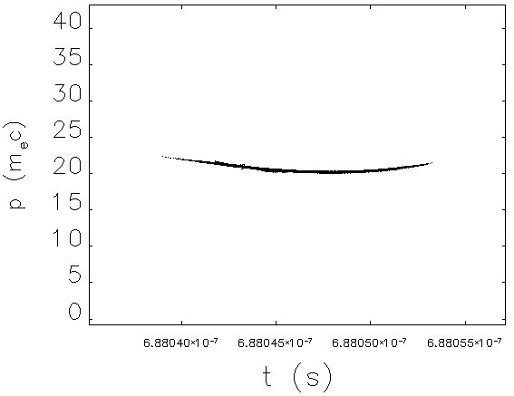

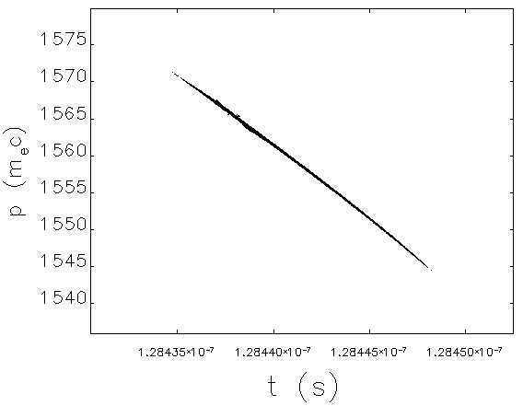
Bunch Decompression
exit of FEL
Electron beam is transported without beam loss.
σ_{t}=48.5 fs, σ_{p}/p=0.299 %
simulation by elegant
e⁻
E=10.5 MeV
ε_{nx}/ε_{ny}=1.98/0.71 mm mrad
exit of main linac
σ_{t}=2.51 ps
σ_{p}/p=1.55 %
5ps
E=800 MeV
ε_{nx}=6.52 mm mrad
ε_{ny}=0.70 mm mrad
point of maximum beam size
exit of 2nd arc
σ_{x}=3.10 mm
σ_{y}=0.034 mm
σ_{t}=2.35 ps
σ_{p}/p=0.295 %
2cm
ε_{nx}=7.68mm mrad
ε_{ny}=0.70 mm mrad
pipe aperture of cERL arc

Slide 18
Outline
Introduction
Design of EUV ERL Source
S2E Simulation
Activities and Considerations for Industrialization
Summary

Slide 19
EUV-FEL Light Source Study Group for Industrialization
since 2015

Slide 20

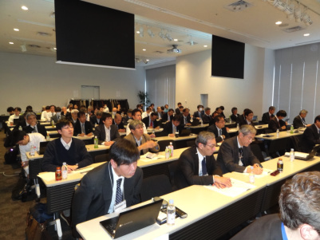
EUV-FEL Workshop
Date: 13 Dec 2016 10:00-17:00
Site: Akihabara UDX 4F NEXT-1
Participants : > 100
(Source group, tool and material venders, end users etc.)
URL: http://pfwww.kek.jp/PEARL/EUV-FEL_Workshop/

Slide 21
Availability Issues
Required availability for industrialization: ≥ 98 %
( non-operation time ≤ ~ 1 week per year)
Electron gun
  Short photocathode lifetime ( one week for ~10 mA )
  Remote control of photocathode exchange
SC Cavity
  Reduction of trip rate
  Pulse processing time for suppression of field emission increase
Undulator
  Demagnetization of permanent magnets
Cryoplant
  High pressure gas safety law
  Safety inspection (once per year in Japan)

Slide 22
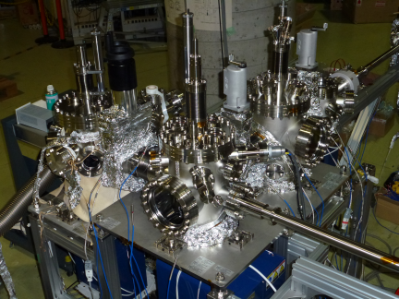
Cathode Preparation System
Courtesy of M. Yamamoto
Short dead time for
exchange cathode
during gun operation.
Vacuum
Suitcase
(Option)
Cathode
Storage
Cleaning
chamber
Storage
chamber
Activation
chamber
Gun chamber
Cathode Cleaning
Cathode-container
Loading
Atomic H
Activate & storage
6~9 cathodes per day.
Cs & O₂
Heating
Gate
valve
NEA
Activation
cathode preparation system at KEK

Slide 23
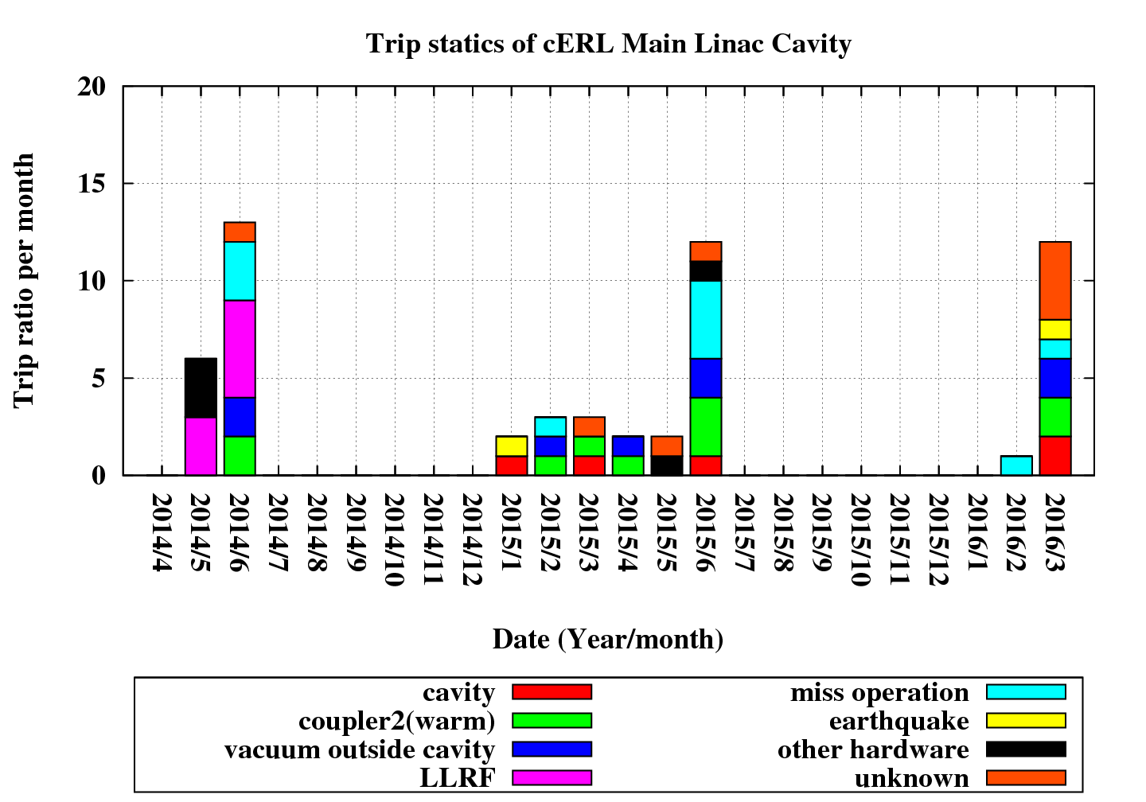
Trip of SC Cavities
Trips of cERL Main Linac Cavities
Courtesy of H. Sakai
8.57MV×2
ML1:10MV, ML2: 7.16MV
8.57MV×2
3rd run（5 weeks）
(2014/5/20-6/20)
4th run（9.5 weeks）
(2015/1/26-4/4)
5th run（5 weeks）
(2015/5/25-6/27)
6th run（7 weeks）
(2016/2/15-3/31)
Number of trips
No trip
(2/9～3/23)
LLRF change
High gain
→ Medium gain
Date(year/month)

Slide 24
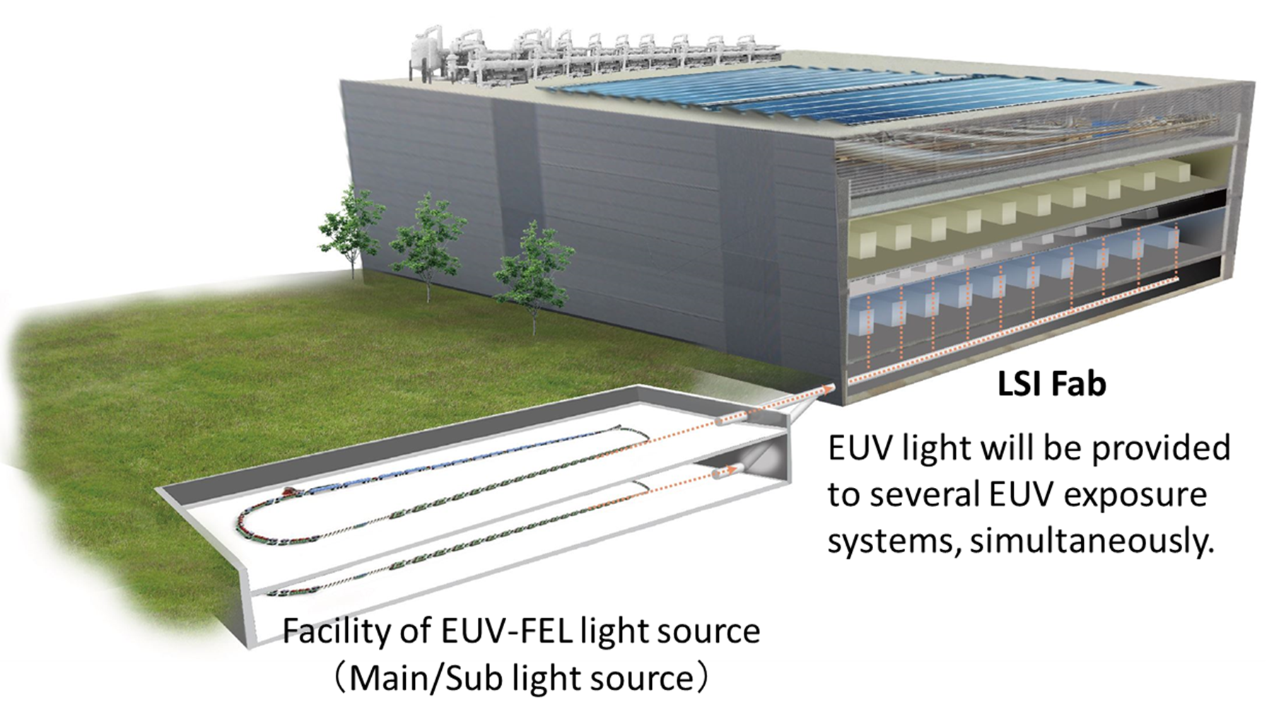
Redundant System
Redundant System for ensuring high availability
  Critical parts (Cryoplant, Injector, Main Linac, Undulator, … )
  Entire light source system

Slide 25
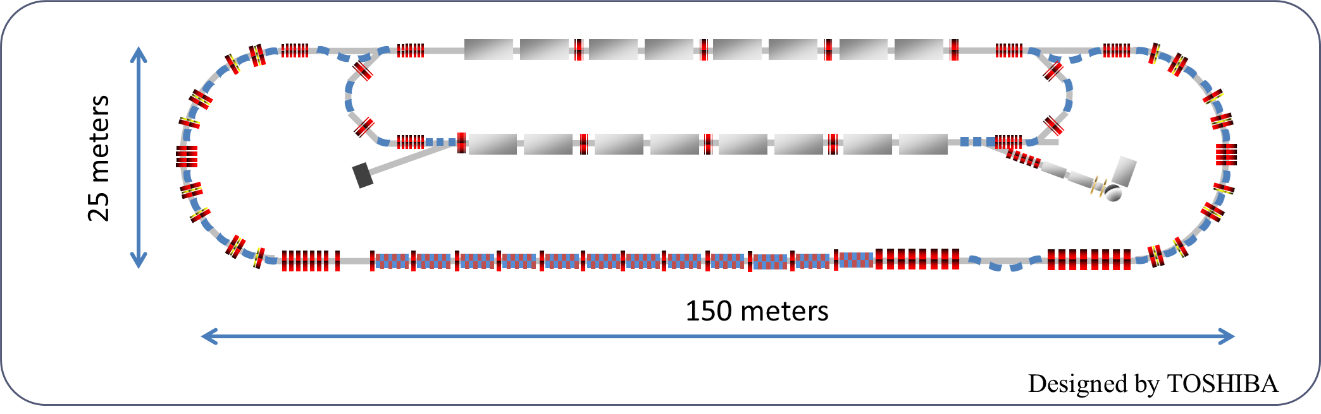
Reduction of Source Size
Higher field gradient of Main SC cavities
  Increase of power consumption ∝ E_{acc}²/Q
  High-Q SC cavity (Nitrogen doping etc.)
Lower Beam Energy
  Shorter-period undulator with strong magnetic field
  Increase of current or energy conversion efficiency for the same FEL power
2-loop/2-turn ERL
  Optics design for CSR effect suppression
  Increase of current for the same FEL power

Slide 26
Outline
Introduction
Design of EUV ERL Source
S2E Simulation
Activities and Considerations for Industrialization
Summary

Slide 27
Summary
EUV ERLs are expected to be high-power EUV sources for lithography that meet future demand.
An EUV ERL source has been designed with available technologies and resources and its performance has been checked by S2E simulation.
  Generation of FEL power more than 10 kW at 10 mA in the designed EUV-ERL source
  Successful transportation of electron beams throughout the EUV-ERL source without any beam loss
We established the source group for industrialization and organized the EUV-FEL workshop. R&D efforts are required for industrialization to achieve high availability, size reduction and so on.

Slide 28
Thank you for your attention!

Slide 29
Backup Slides

Slide 30
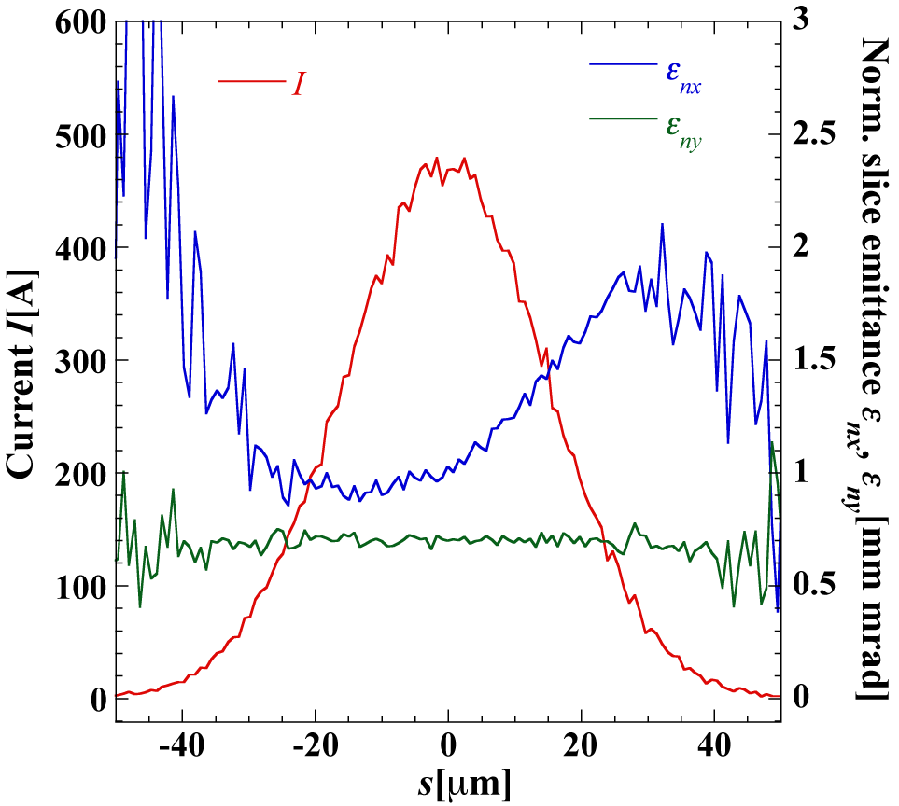
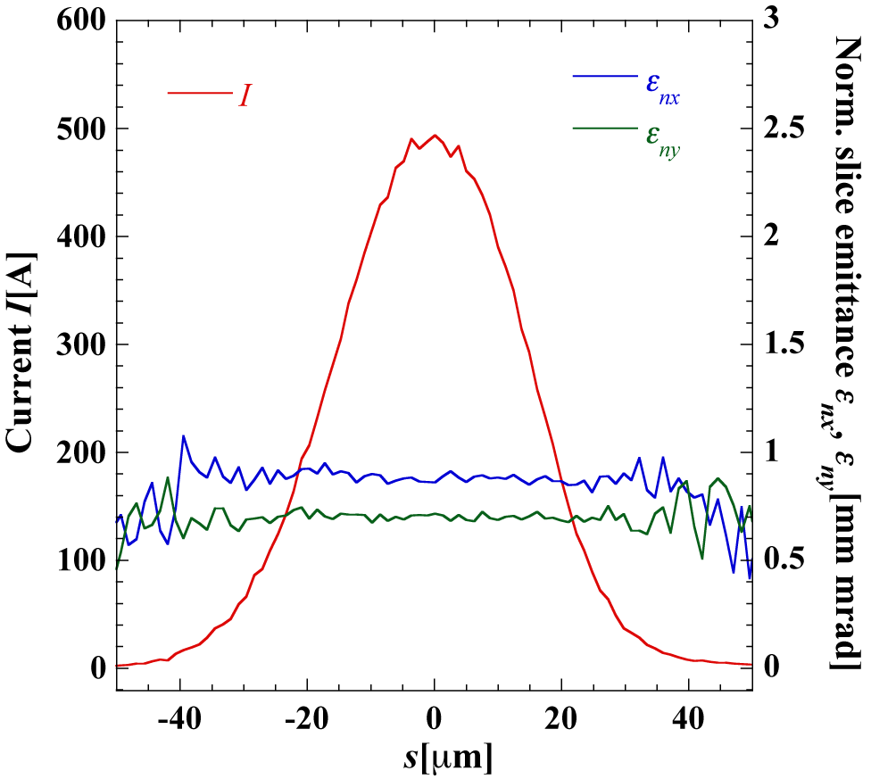
Suppression of CSR effects
Electron distribution after bunch compression
Initial parameters: Q_{b}=60 pC, ε_{nx}=ε_{ny}= 0.7 mm mrad, σ_{p}/p=0.31 %, σ_{t,inj}=1 ps (Gaussian beam)
TBA arc + chicane (R₅₆=-0.15/-0.15 m)
DBA arc (R₅₆=0.31 m, β_{x2}=0.5 m, α_{x2}=1.9)
Projected normalized horizontal emittance
DBA lattice can well suppress CSR effects on ERL beam.

Slide 31
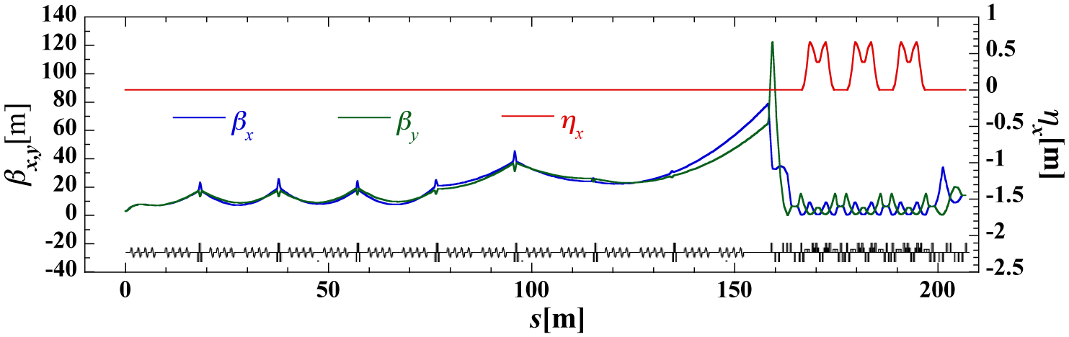
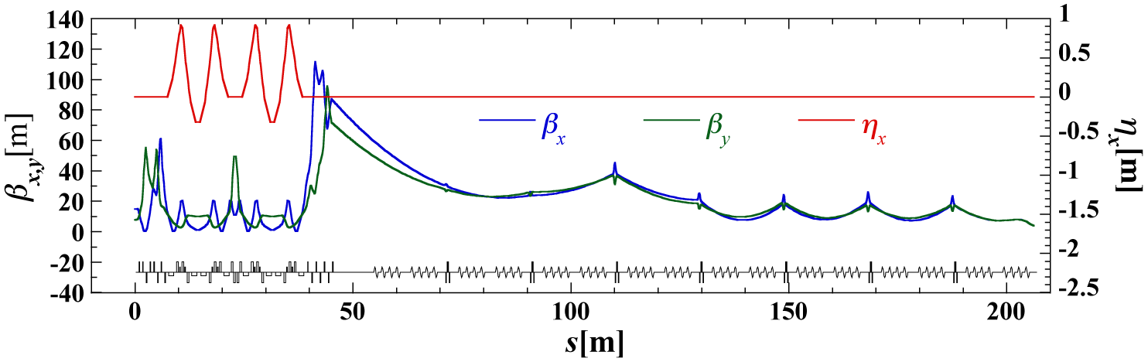
Optics of Recirculation Loop
(1) Bunch compression (before FEL)
Betatron function [m]
Dispersion function[m]
E=10.5 MeV
E=800 MeV
Main linac
M1
1st arc
M2
(2) Bunch decompression (after FEL)
Betatron function [m]
Dispersion function[m]
E=10.5 MeV
E=800 MeV
M3
2nd arc
M4
Main linac（deceleration）

Slide 32
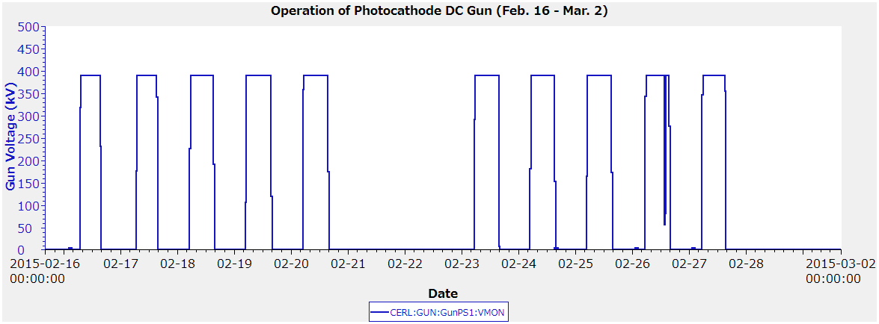
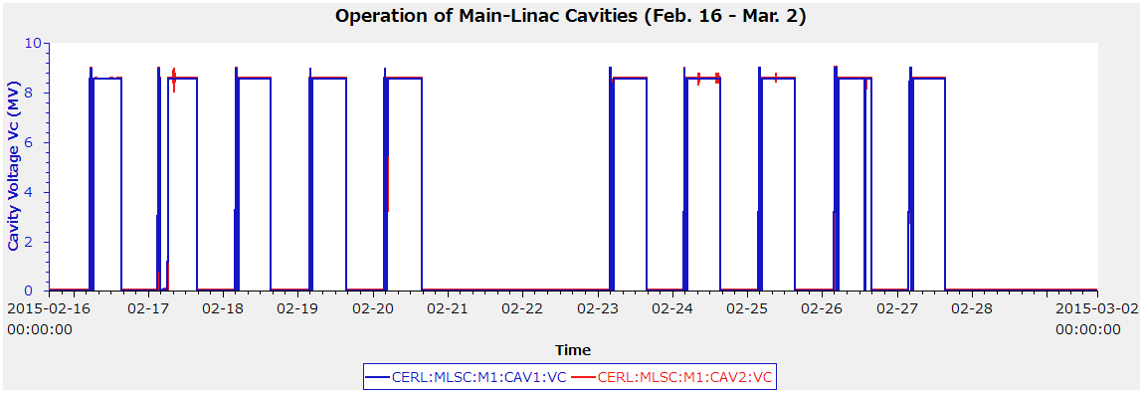
Operation of Gun & ML Cavities
Gun
Gun operation (2015/2/16-2015/3/2)
in 2015
2 weeks
No trip
Entering
acc. room
Gun voltage
( kV)
Conditioning
Dispersion measurement
Main cavities
(ML-1, ML-2)
ML operation (2015/2/16-2015/3/2)
2 weeks
in 2015
No trip
Entering
acc. room
RF voltage
(MV)
32

