Slide 1

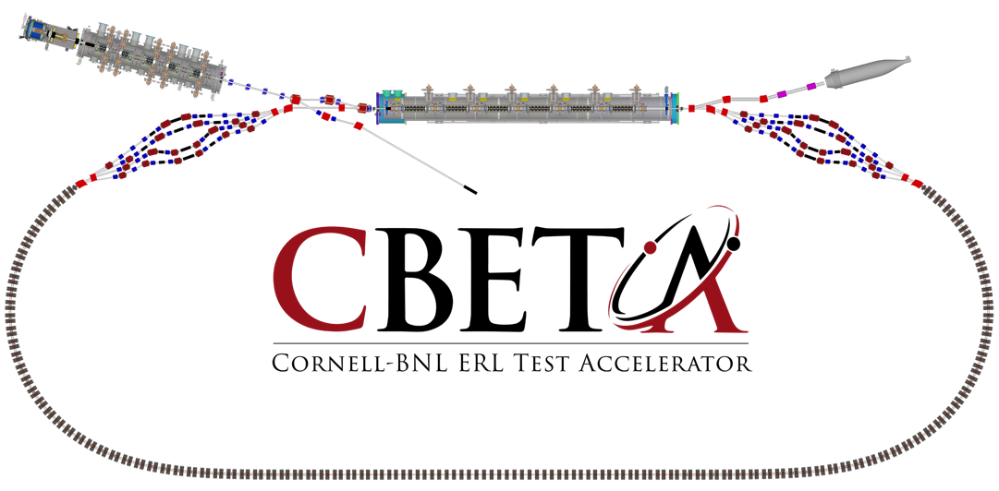



Applications for CBETA at Cornell
ERL workshop 07/19/2017
Georg Hoffstaetter (Cornell)

Slide 2
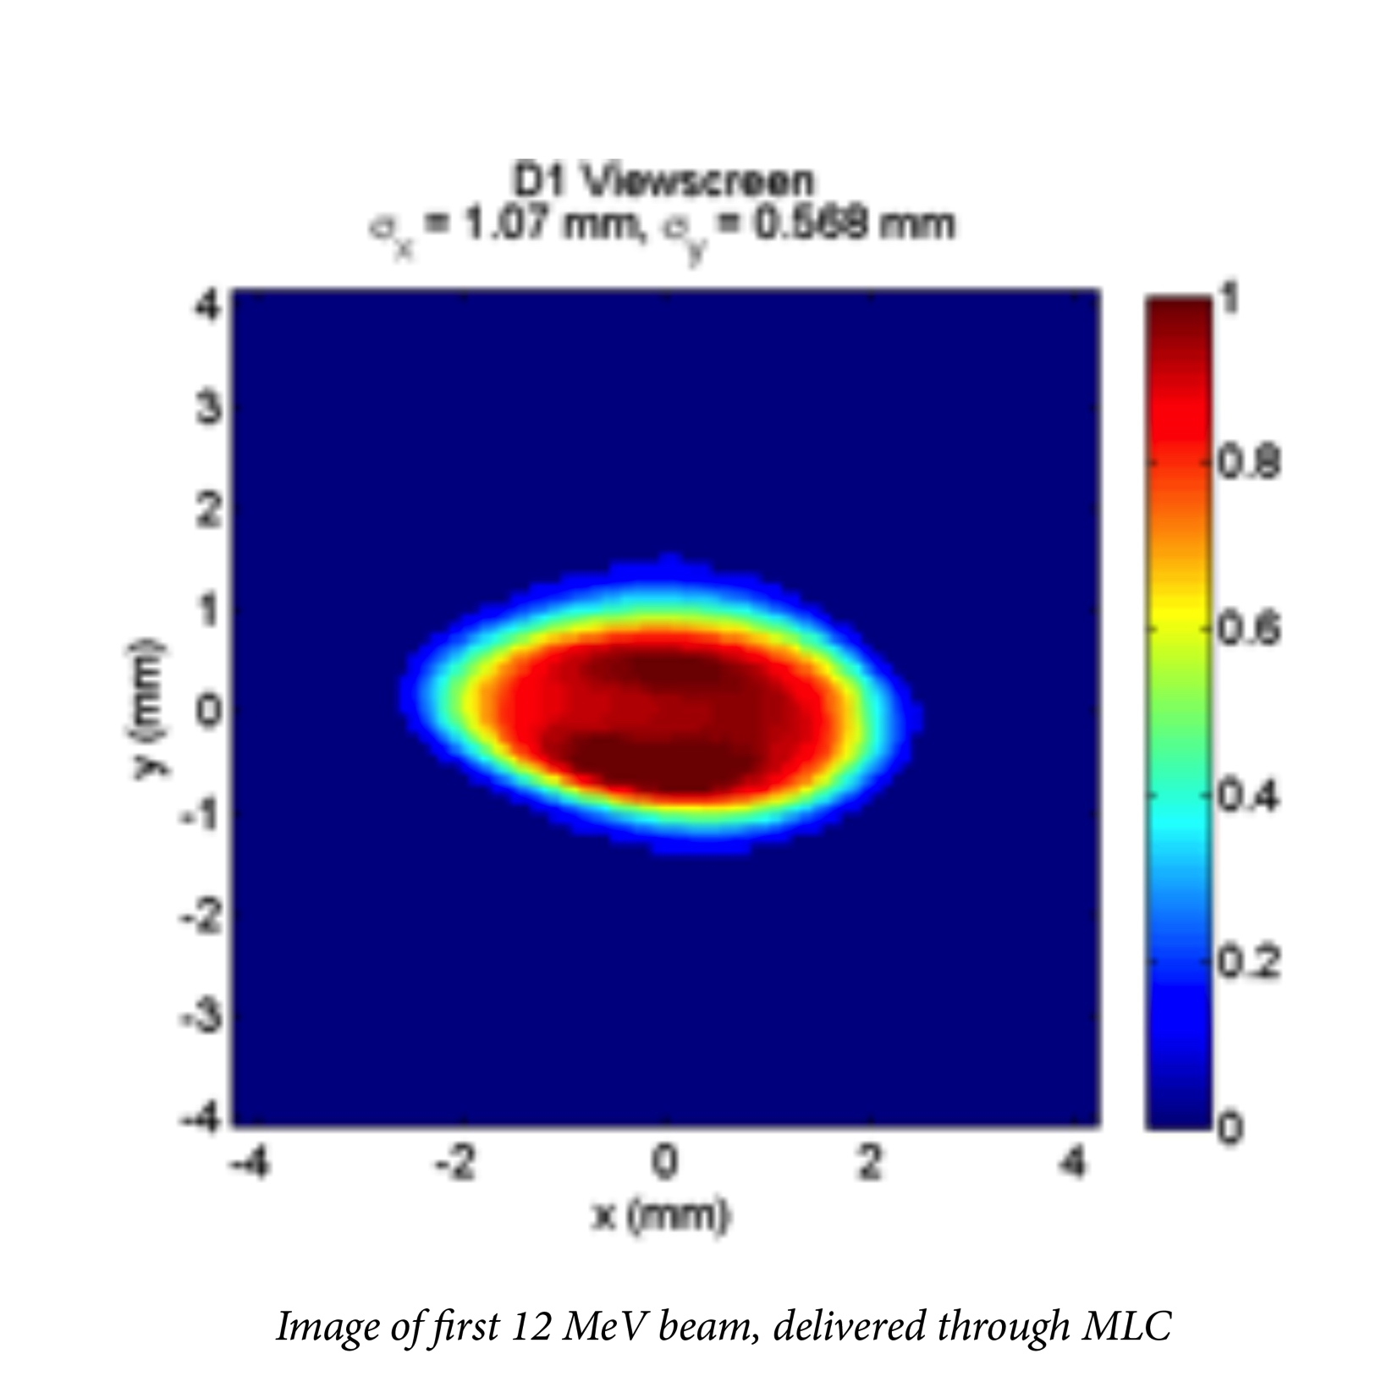
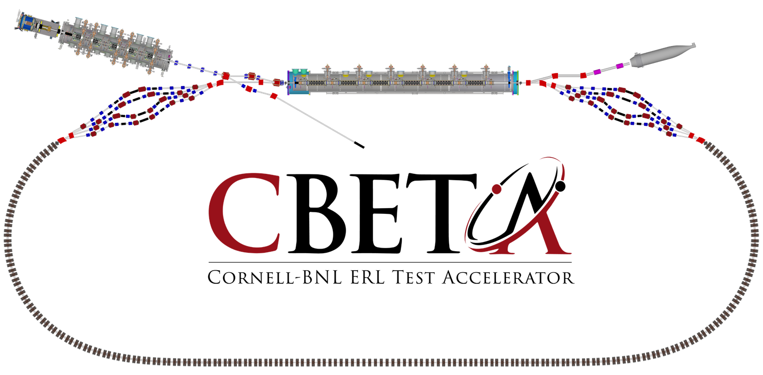
Beam through accelerator test
Cornell DC gun
100mA, 6MeV SRF injector (ICM)
600kW beam dump
100mA, 6-cavity SRF CW Linac (MLC)
Tested
6 MeV
6 MeV
+/- 36 MeV
Electron Current up to 320mA in the linac
Bunch charge Q of up to 2nC
Bunch repetition rate 1.3GHz/N
Beams of 100mA for 1 turn and 40mA for 4 turns
42, 78, 114, 150 MeV

Slide 3
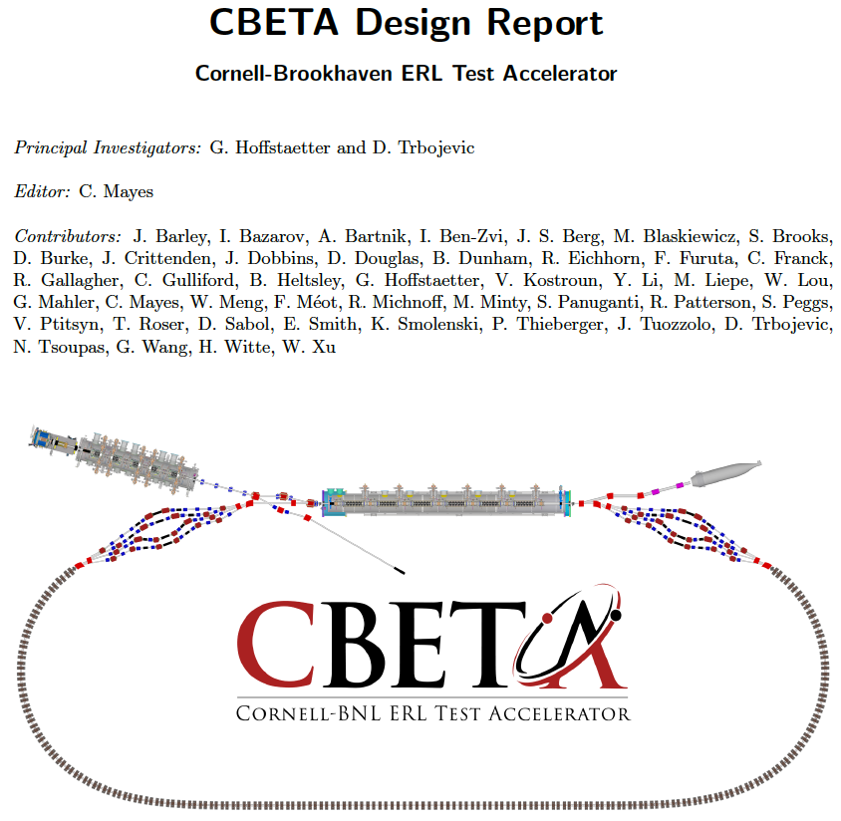
The CBETA CDR
The CBETA Collaboration
Background for CDR
Wrote PDDR for hard X-ray ERL at Cornell in 2012.
Start of CBETA July 2014 White paper December 2014
Defined CBETA in a white paper in December 2014.
CDR for CBETA in with Hybrid permanent magnets in July 2016.
Secured funding October 2016
DR for CBETA with Halbach magnets in February 2017
Past first technical (Jan 31st) and financial (Feb 6) review!

Slide 4
The path is free for CBETA
# | Milestone (at the end of months) | Baseline | Actual
 | Funding start date |  | Oct-16
1 | Engineering design documentation complete | Jan-17
2 | Prototype girder assembled | Apr-17
3 | Magnet production approved | Jun-17
4 | Beam through Main Linac Cryomodule | Aug-17
5 | First production hybrid magnet tested | Dec-17
6 | Fractional Arc Test: beam through MLC & girder | Apr-18
7 | Girder production run complete | Nov-18
8 | Final assembly & pre-beam commissioning complete | Feb-19
9 | Single pass beam with factor of 2 energy scan | Jun-19
10 | Single pass beam with energy recovery | Oct-19
11 | Four pass beam with energy recovery (low current) | Dec-19
12 | Project complete | Apr-20

Slide 5
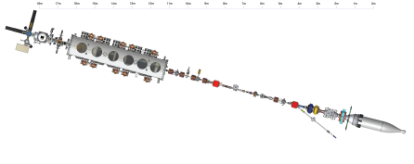
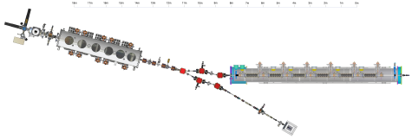
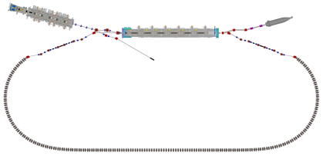

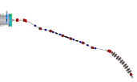
Beam Commissioning
Last beam run
August 2017
April 2018
August 2019
Push toward 4-tunr ERL thereafter (April 2020)

Slide 6
Applications of CBETA
DarkLight – an experiment to find dark matter particles
Compact Compton source for hard x-rays – complementing CHESS’ range
THz laser – complementing CHESS’ range
Beam for time-resolved electron diffraction from 1-6MeV
Beam for Plasma Wakefield Acceleration with High Transformer Ratio
eRHIC accelerator testing – more detailed eRHIC R&D
eRHIC cavity testing with beam
ASML medical isotope cavity testing with beam
Generic ERL accelerator physics
Electron cooler tests – ERL tests for JLEIC
Preparations for Perle
Preparations for LHeC
High-Power beam dynamics testing
Permanent magnet and FFAG test bed for future accelerators

Slide 7
ERL – a new beam regime
Synchrotron: Repetitive acceleration to high energy, low repetition rate and therefore low current.
Fixed target experiments, high energy, low current, relatively large beam size.
Storage rings: Rare filling at high energy and storage for millions of turns, high current, requires very low loss rates.
➔ Internal target experiments, high energy, high current, relatively large beam size.
Linacs: Linear acceleration to moderately high energies that are limited by the available length. Current*Energy is limited by the available power.
➔ Fixed target experiments, moderately high energies, low current, small beam size.
ERLs: Linear acceleration and deceleration to capture the energy of spent beam, like a linac but without the power limit on beam current, as spent beam provides the power. Loss rates have to be limited.
Dense internal targets, moderately high energies, high currents, small beam size.
ERLs provide a new niche of beam parameters: What physics can they be used for?

Slide 8
ERL - Internal target colliders
ERLs: Linear acceleration and deceleration to capture the energy of spent beam, like a linac but without the power limit on beam current, as spent beam provides the power. Loss rates have to be limited.
Dense internal targets, moderately high energies, high currents, small beam size.
ERLs provide a new niche of beam parameters: What physics can they be used for?
Lost beam power has to be available from power sources.
Target has length L, nuclei with charge Z.
Coulomb scattering and particle optics determine beam loss (at an aperture a with a maximal optical beta function)
ERL Target and luminosity limits:
Courtesy Chris Mayes

Slide 9
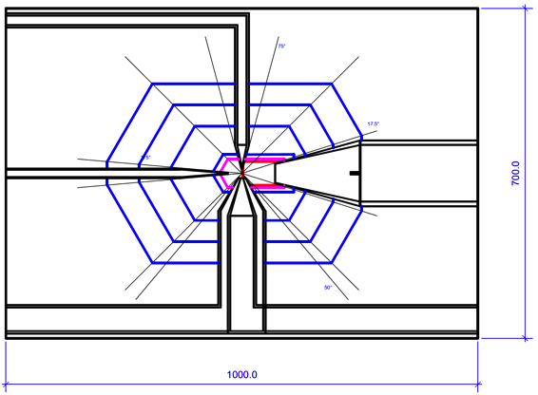
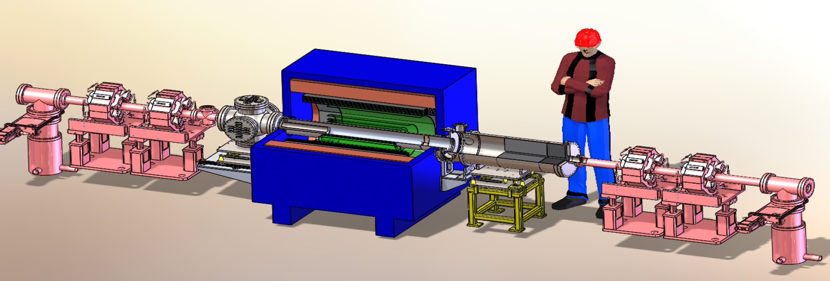
DarkLight
DarkLight – an experiment to find dark matter particles
DarkLight @ Cornell
Does CBETA have advantage over the JLAB-FEL?
=> by a factor of 10 for full CBETA performance (40mA vs 5mA and smaller emittances for smaller gas cells).
Detector R&D; can the JLAB Darklight detector be used?
Gas jet collision experiment.
Darklight detector @ JLAB

Slide 10
DarkLight
DarkLight – an experiment to find dark matter particles
DarkLight @ JLAB test the possibility of a dark photon in the mass range 10 to 100 MeV coupling the dark sector to the Standard Model.
DarkLight precisely measures electron proton scattering using the 100 MeV electron beam of intensity 5 mA at the JLAB ERL incident on a windowless gas target of molecular hydrogen.
The complete initial state including scattered electron, recoil proton, and e+/e- pair that could come from the decay of a dark photon will be detected.
The DarkLight experiment drives development of new technology for beam, target, and detector and provides a new means to carry out electron scattering experiments at low momentum transfers. This technology would be ready to be applied at CBETA.

Slide 11
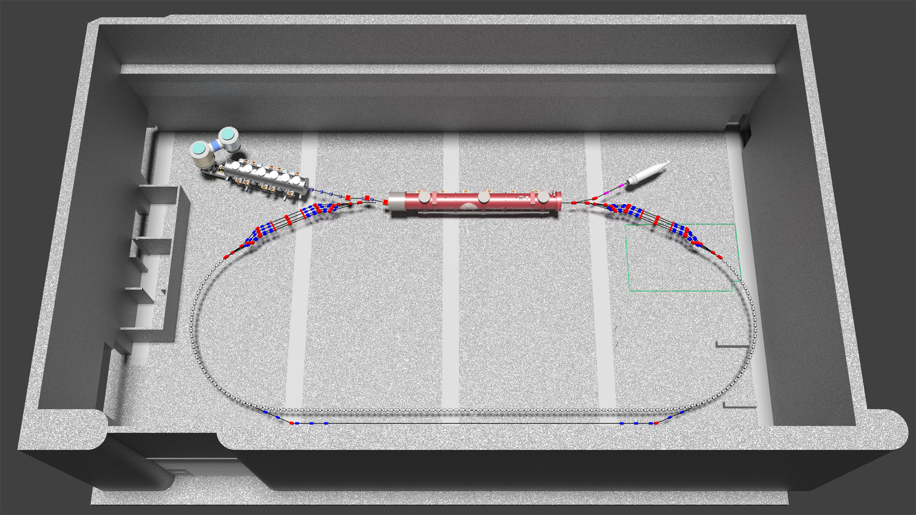
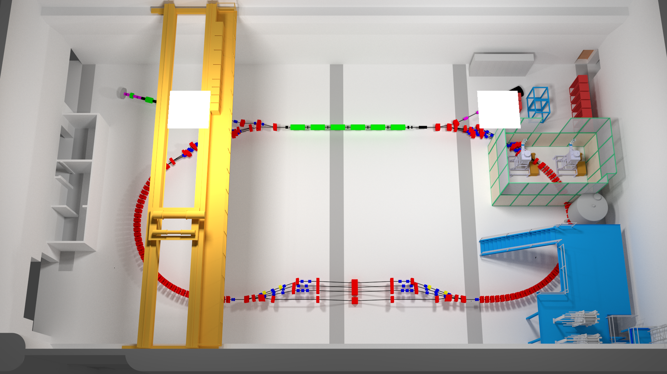
Resonantly extracted beam
Resonant extraction:
Use correctors that cancel for three energies but add for the highest energy.
Beam separation:
Use septa magnets to separate each energy.

Slide 12
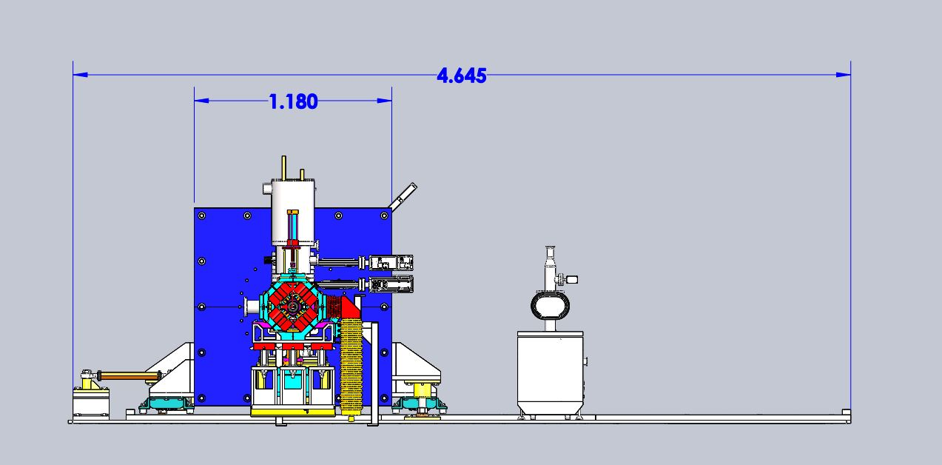
DarkLight
DarkLight – an experiment to find dark matter particles
The Darklight detector at JLAB
Movable support
Movable support
Pump station for the gas jet.

Slide 13
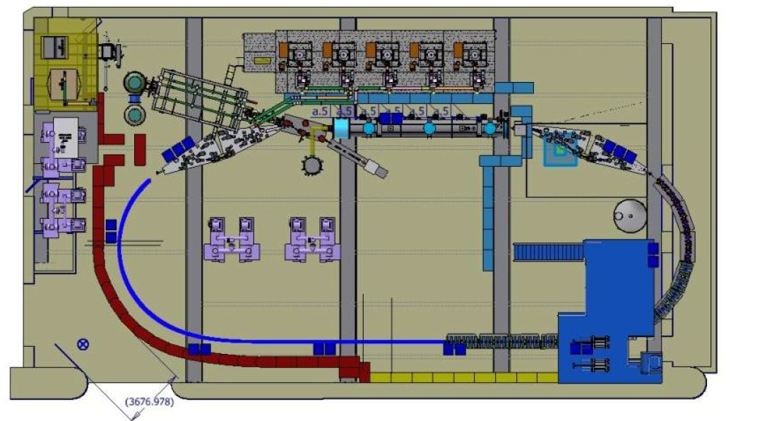
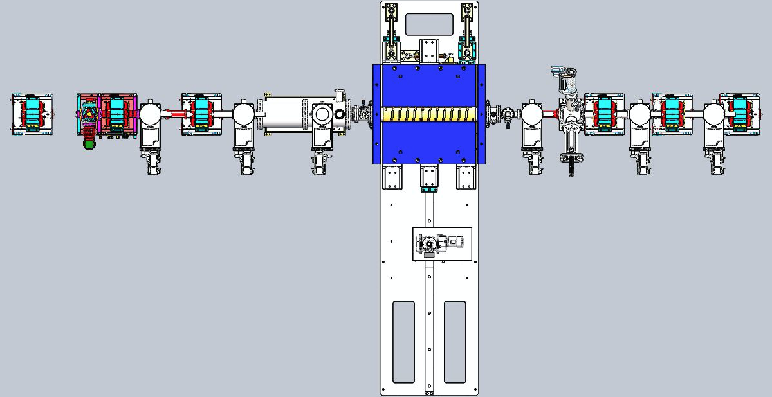

(A) DarkLight
The Darklight detector will fit around the resonantly extracted CBETA beam, if the movable support is redesigned.
Cornell is in contact with the DarkLight collaboration to submit a joint proposal.

Slide 14
(B) Compact Compton Source
Compact Compton source for hard x-rays – complementing CHESS’ range
Extrapolating from the recent demonstration of an ERL-based laser Compton source by T. Akagi et al., Phy. Rev. Accelerators and Beams 19, 114701 (2016). Assuming the same laser source and photon pulse – electron bunch collider
Expected maximum X-ray energy: 412 keV with 0.4% bandwidth, 0.14 mrad divergence
Anticipated flux on sample of 2x10¹⁰ photons/ sec
This is 13 times more than at a 3rd generation synchrotron radiation source: the current Cornell wiggler at CHESS’s F2 line with the upgraded CESR storage ring (to be completed in the next few years)
From a collaboration with Carl Franck (Cornell)
The electron/photon collisions would occur within an optical cavity that intensifies the optical bunch intensity. The base design is due to Akagi et al. (2016)

Slide 15
(B) Compact Compton Source
Compact Compton source for hard x-rays – complementing CHESS’ range
A proposal is envisioned for
Develop laser storage cell
Establish collisions in CBETA
Develop an x-ray beamline
For after commissioning of CBETA with current funding by summer 2020 and possible stage II accelerator R&D.

Slide 16

THz Laser
THz laser – complementing CHESS’ range

Slide 17
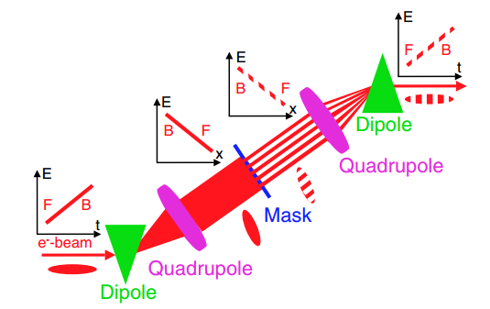
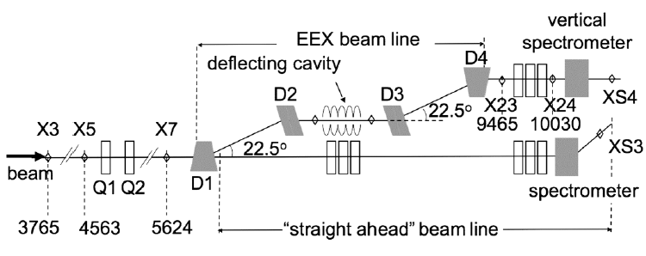
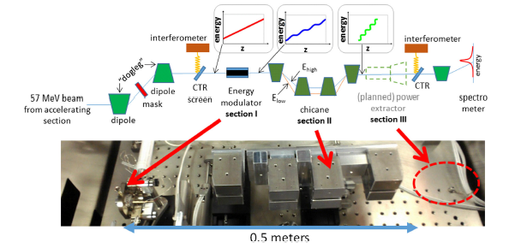
Accelerator based narrow-band THz schemes
Exchange transverse modulation to longitudinal distribution
P. Muggli et al., PRL 101, 054801 (2008)
Y. E. Sun et al., PRL 105, 234801 (2010)
Exchange wake-induced energy modulation to density bunching
K. Bane and G. Stupakov, NIM-A 677, 67 (2012)
S. Antipov et al., PRL 108, 144801 (2012)
S. Antipov et al., PRL 111, 134802 (2013)
G. Stupakov, PRST-AB 18, 030709 (2015)
Curtsey Zhirong Huang
K. Bane et al., NIMA 844, 121 (2017)

Slide 18
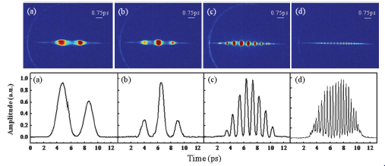
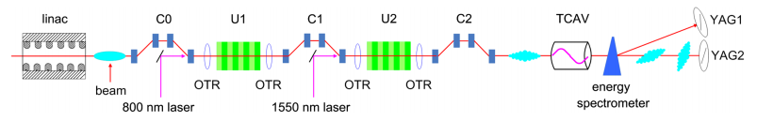
Accelerator based narrow-band THz schemes
Direct modulate the drive laser of the gun
Y. Li et al., APL 92, 014101 (2008)
P. Musumeci et al., PRL 106, 184801 (2011)
Y. Shen et al., PRL 107, 204801 (2011)
P. Musumeci et al., PRST-AB 16, 100701 (2013)
Z. Zhang et al., PRL 116, 184801 (2016)
Frequency beating of laser-induced density bunching
Curtsey Zhirong Huang
D. Xiang et al., PRST-AB 12, 080701 (2009)
M. Dunning et al., PRL 109, 074801 (2009)

Slide 19
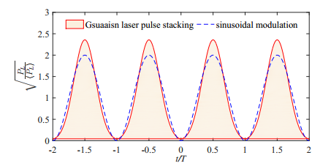
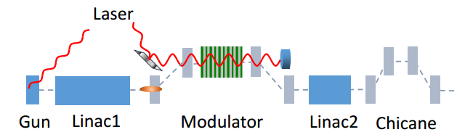

New method
(Z. Zhang et al., Phys. Rev. AB 20, 050701, 2017)
We propose a method based on the slice energy spread modulation to generate density bunching in a relativistic electron beam (a la laser heater setup)
Modulated laser pulse
Similar method has been used in storage ring and FERMI FEL (for two-color FEL).
Curtsey Zhirong Huang
S. Bielawski et al. Nature Physics, 4(5), 390-393 (2008)
E. Roussel et al. Phys. Rev. Lett. 115, 214801(2015).

Slide 20
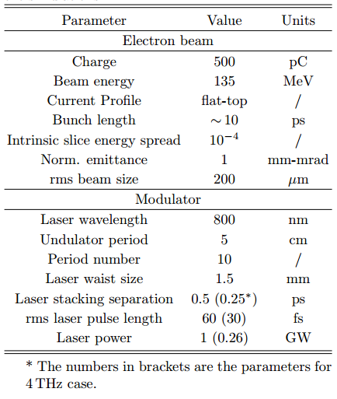
Simulation parameters fit very well to CBETA
Curtsey Zhirong Huang

Slide 21
High-rep. Rate Stand-alone THz source
A stand alone THz source has been designed for the LCLS-II are
Stand-alone THz source at the experimental area (XFEL, LCLS-II)
Use LCLS-II spare gun + accel. cryomodule (50 MeV) for a high-rep. rate compact accelerator
E-beam power is similar to LCLS-I (5-10 kW) and requires LCLS-I type of shielding
Leverage OPCPA laser at LCLS-II R&D (800 nm, 0.1 -1 MHz, 100 W)
Expect good synchronization with hutch lasers (both through OPCPA)
Strong THz field may be used in the LCLS(-II) TimeTool to cross-correlate with optical signals (and X-rays) for jitter corrections
THz pulse form can be controlled by both laser and e-beam techniques (narrowband, chirped, a few cycle pulses, all possible)
Flexible, powerful, high-rep. rate THz, well-synchronized with X-rays.
Similar parameters could be achieved at CBETA.
This application is under discussion, no planning has been started.
Curtsey Zhirong Huang

Slide 22
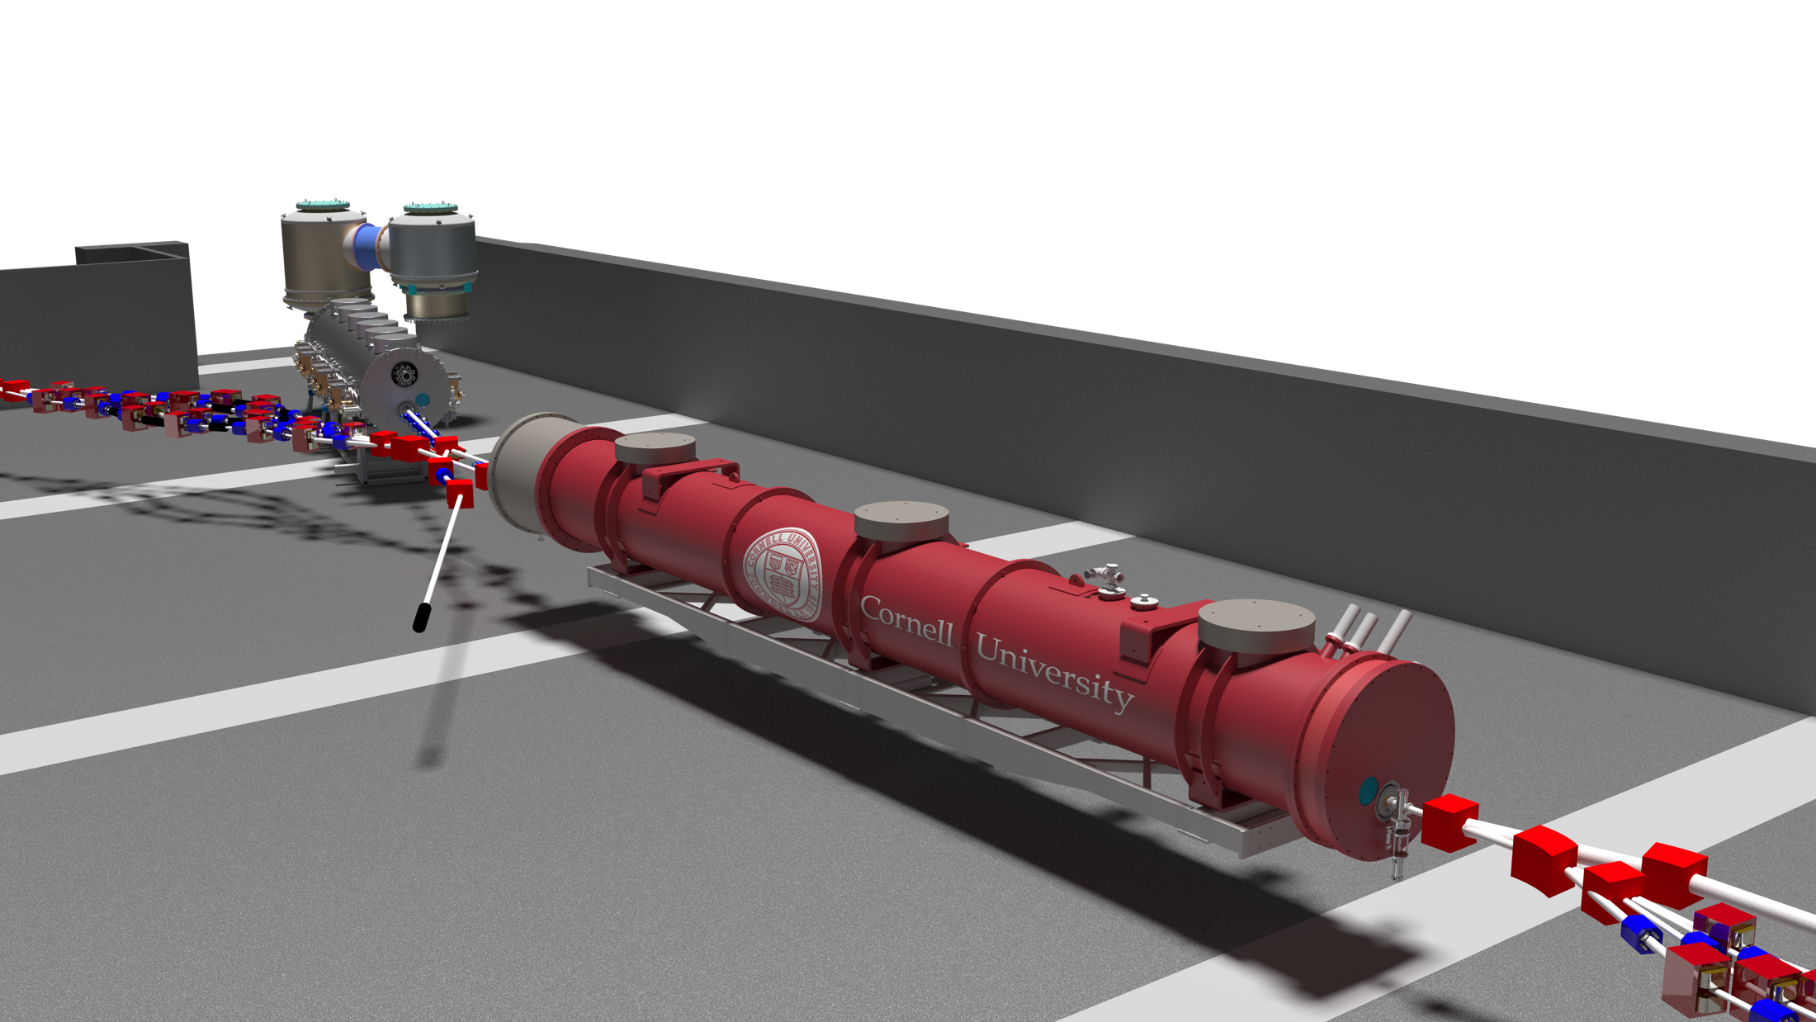
Fast electron diffraction
Beam for time-resolved electron diffraction from 1-6MeV
CBETA has a 6MeV line that is mirror symmetric to the line that leads into the Main Linac Cryomodule (MLC). It is for injector optimization, because optimization in the MLC lacks detectors.
The full beam brightness can be optimized in this region between 1 and 6 MeV and can be used for various beam applications.
Together with David Muller (Cornell) an application for fast electron diffraction is being prepared.

Slide 23
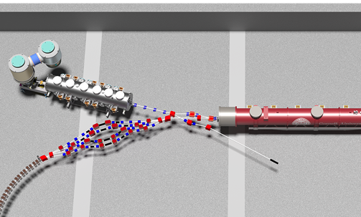
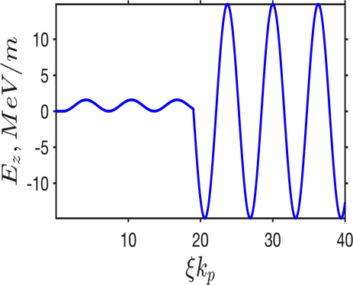


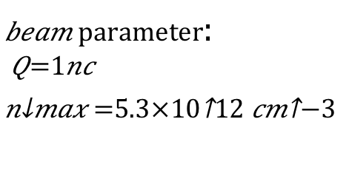
Plasma Wakefield Acceleration
Beam for Plasma Wakefield Acceleration
with High Transformer Ratio
$beam parameter$:
$$Q=1nc$$
$$n_{max}=5.3×{10}^{12}cm^{−3}$$
$$1mm$$
$$3mm$$
Decelerating field
Accelerating field
Key challenge for PWFA: low transformer ratio
A Gaussian driver bunch is experiencing a decelerating field that is ½ of the peak accelerating field experienced by the witness bunch
Shaped bunches → large transformer ratio → never demonstrated before
CBETA could generate triangular shaped driver bunches and time-delayed witness bunches (Collaboration with Gennady Shvets)

Slide 24
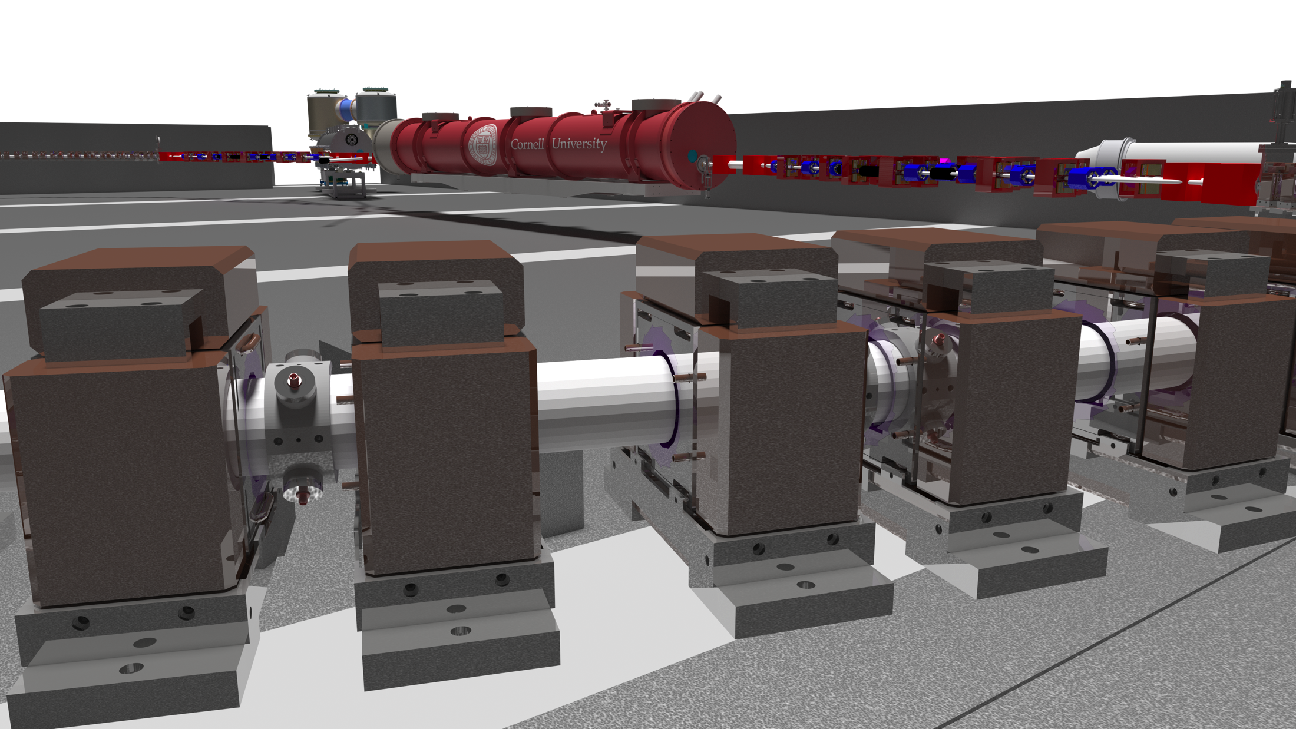
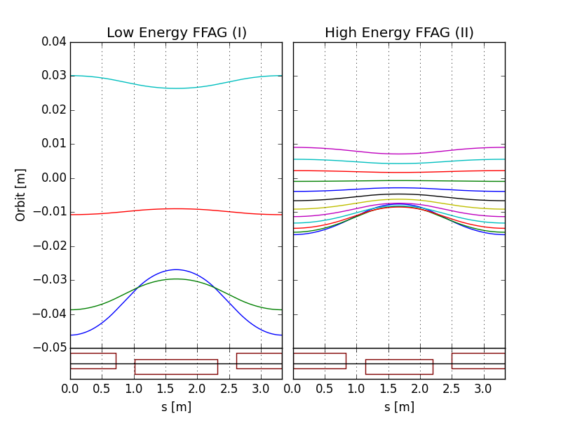
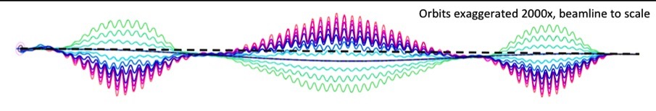
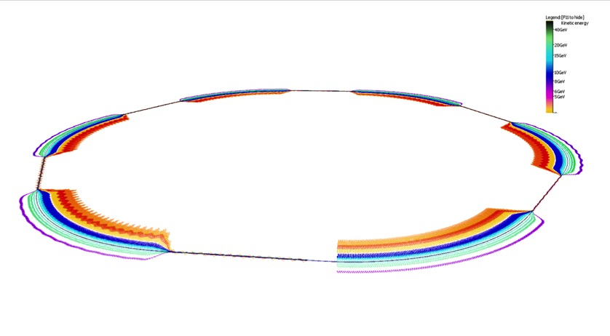
Continued eRHIC prototyping
eRHIC accelerator testing – more detailed eRHIC R&D
E=5.0 GeV
E=18.3 GeV
E=6.7 GeV
E=1.7 GeV
BD
QF
@S.Brooks, D.Trbojevic
Orbits in Detector bypass section
Quad offsets evolve adiabatically
Orbits in Transition section
Each of two eRHIC FFAGs contain 1066 FFAG cells

Slide 25
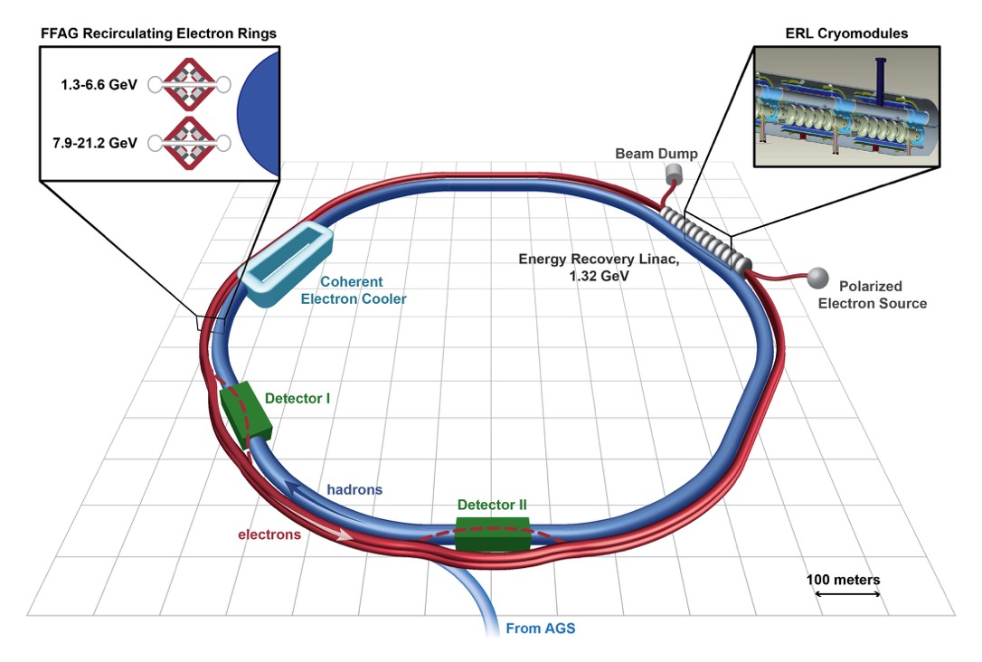
Cavity testing with beam
eRHIC cavity testing with beam
ASML medical isotope cavity testing with beam
eRHIC’s first test cavity has 650MHz and can be tested in CBETA setup with beam:
Remove MLC, adjust cryo and RF systems
Insert eRHIC test-cryomodule with 2 5-cell cavities
The company ASML has a grant for electron-beam production of medical isotopes with an CW SRF linac. Interest in beam test of the linac (650MHz or 1.3GHz) in CBETA has been discussed.

Slide 26
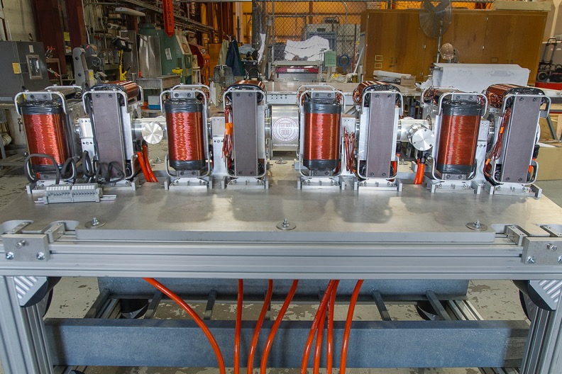
ERL accelerator physics
Generic ERL accelerator physics
Electron cooler tests – ERL tests for JLEIC
Preparations for Perle @ ORSAY
Preparations for LHeC
High-Power beam dynamics testing
Permanent magnets for future accelerators
FFAG test bed for future accelerators
CBETA’s prototype girder with 4 FFAG cells of permanent Halbach magnets.

Slide 27
Questions?

