Slide 1
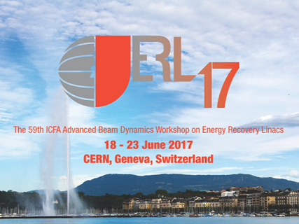
High-Q R&D at FNAL
Mattia Checchin
Performance frontier group, SRF sector, TD
ERL 2017
20 June 2017

Slide 2
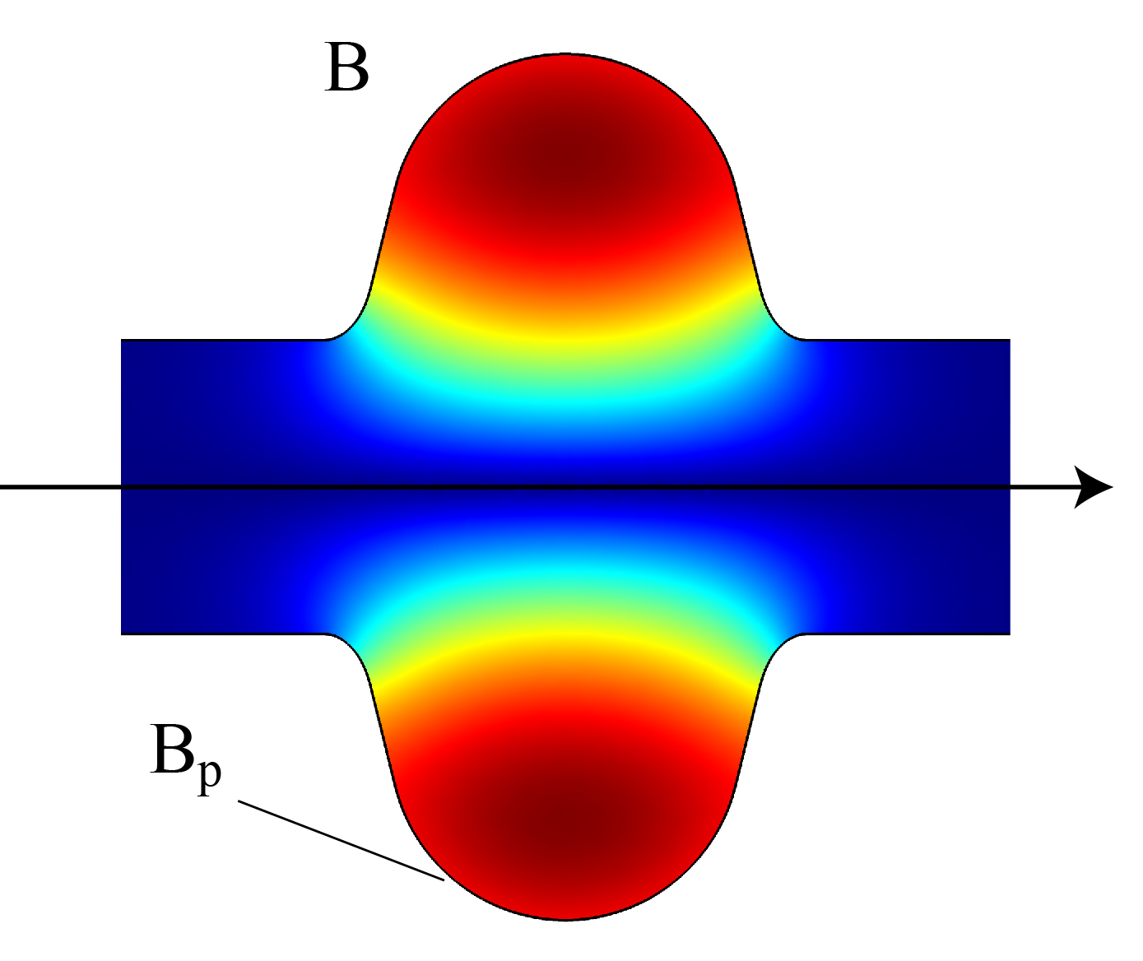
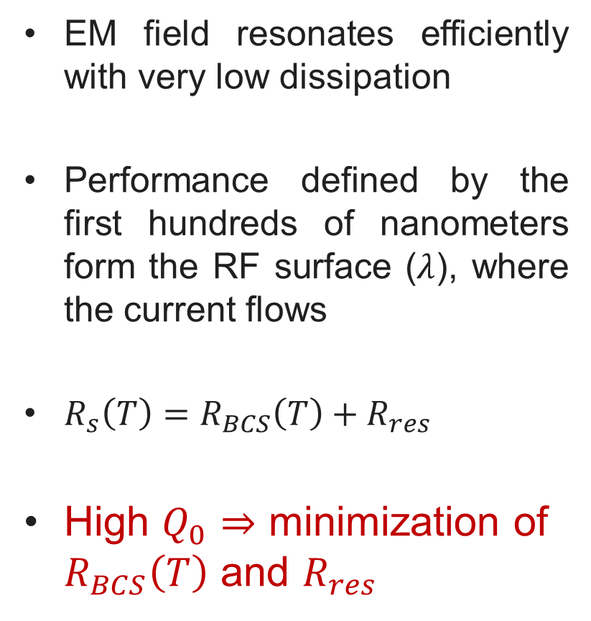


Superconducting RF resonators
EM field resonates efficiently with very low dissipation
Performance defined by the first hundreds of nanometers form the RF surface ($λ$), where the current flows
$R_{s}\left(T\right)=R_{BCS}\left(T\right)+R_{res}$
High $Q_{0}$ $⇒$ minimization of $R_{BCS}\left(T\right)$ and $R_{res}$
$$j(t)$$
$$\sim λ$$

Slide 3
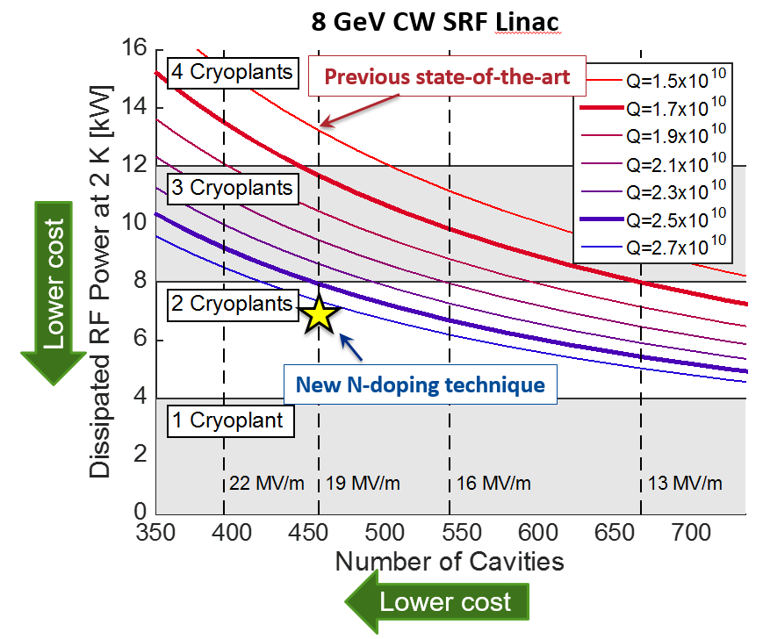
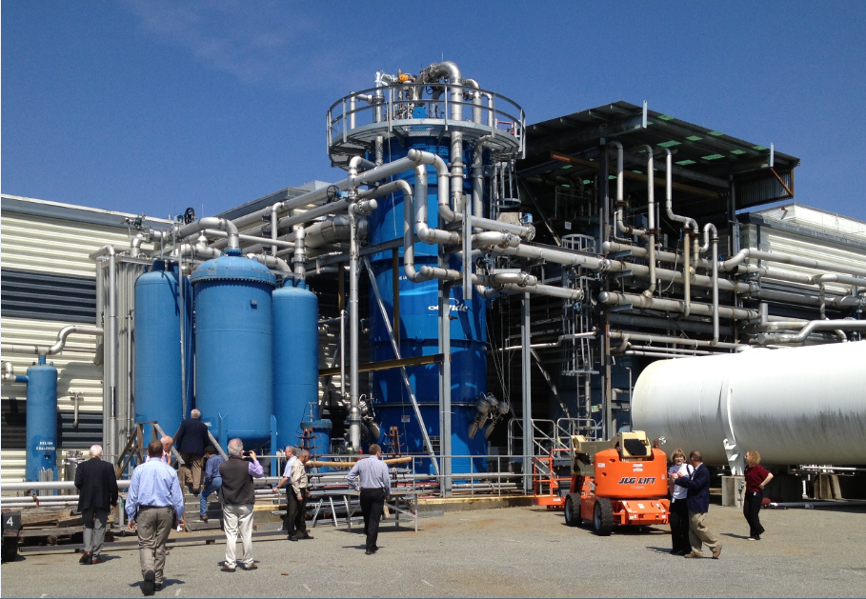




Why high-Q?
8 GeV CW SRF Linac
$$P_{diss}\sim {E_{acc}}/{Q_{0}}$$
$$12 kW$$
$$8 kW$$
$$4 kW$$
courtesy of A. Grassellino

Slide 4

High $Q_{0}$ studies at FNAL
N-doping & N-infusion

Slide 5
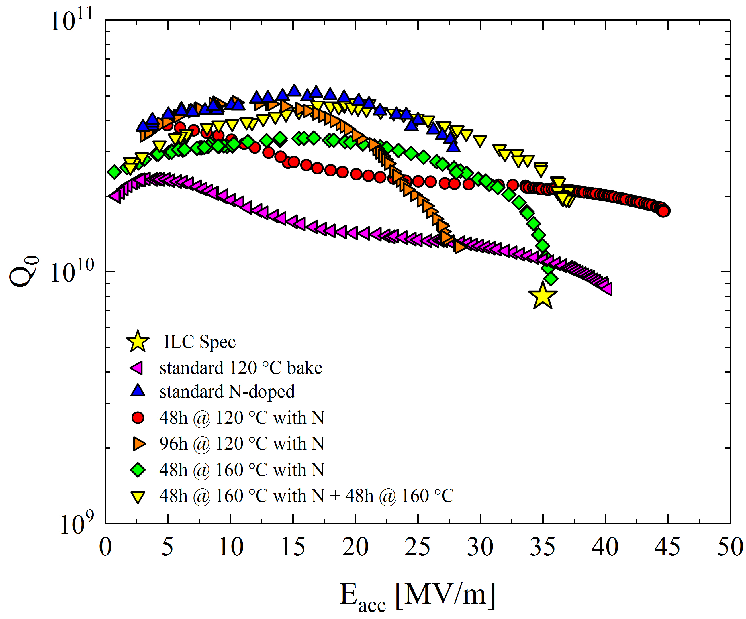
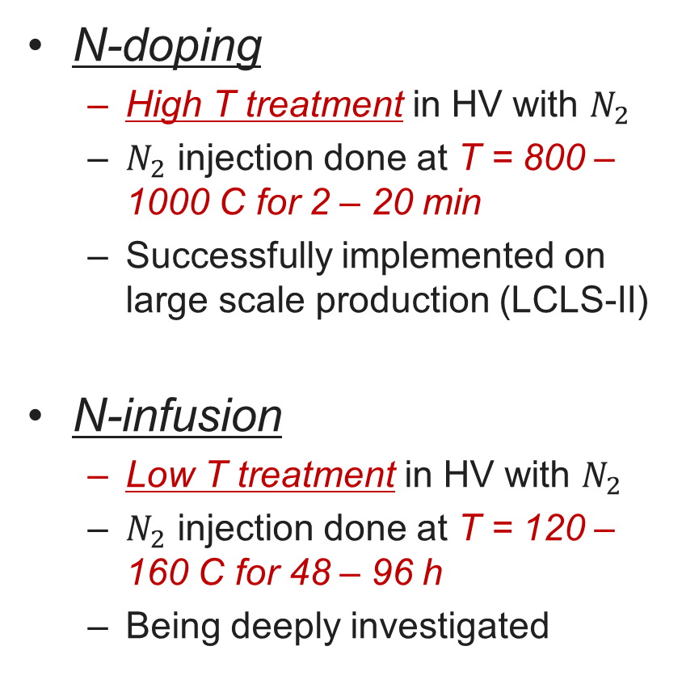
High $Q_{0}$ treatments studied at FNAL
N-doping
N-doping
  High T treatment in HV with $N_{2}$
  $N_{2}$ injection done at T = 800 – 1000 C for 2 – 20 min
  Successfully implemented on large scale production (LCLS-II)
N-infusion
  Low T treatment in HV with $N_{2}$
  $N_{2}$ injection done at T = 120 – 160 C for 48 – 96 h
  Being deeply investigated
N-infusion

Slide 6
High $Q_{0}$ treatments studied at FNAL
N-doping
N-doping
  High T treatment in HV with $N_{2}$
  $N_{2}$ injection done at T = 800 – 1000 C for 2 – 20 min
  Successfully implemented on large scale production (LCLS-II)
N-infusion
  Low T treatment in HV with $N_{2}$
  $N_{2}$ injection done at T = 120 – 160 C for 48 – 96 h
  Being deeply investigated
N-infusion

Slide 7
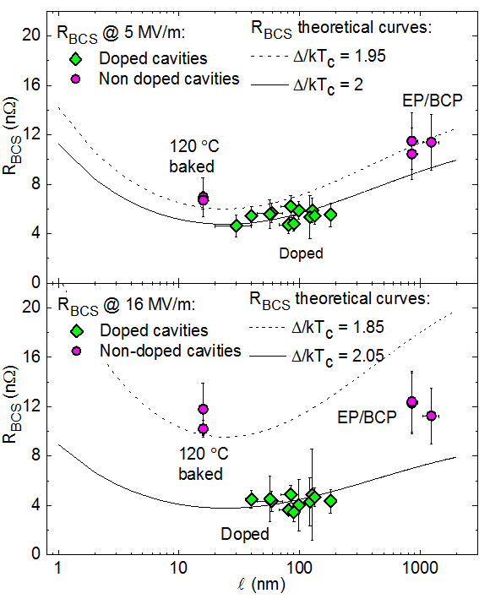
N-doping: reversal of BCS surface resistance
$$R_{s}\left(T\right)=R_{BCS}\left(T\right)+R_{res}$$
Anti-Q-slope emerges from the BCS surface resistance decreasing with RF field
A. Grassellino et al., Supercond. Sci. Technol. 26 102001 (2013) - Rapid Communications
A. Romanenko and A. Grassellino, Appl. Phys. Lett. 102, 252603 (2013)
M. Martinello et al., App. Phys. Lett. 109, 062601 (2016)

Slide 8
High $Q_{0}$ treatments studied at FNAL
N-doping
N-doping
  High T treatment in HV with $N_{2}$
  $N_{2}$ injection done at T = 800 – 1000 C for 2 – 20 min
  Successfully implemented on large scale production (LCLS-II)
N-infusion
  Low T treatment in HV with $N_{2}$
  $N_{2}$ injection done at T = 120 – 160 C for 48 – 96 h
  Being deeply investigated
N-infusion

Slide 9
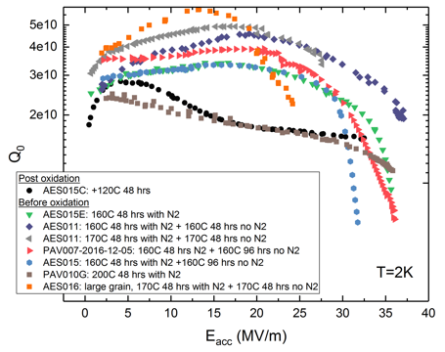
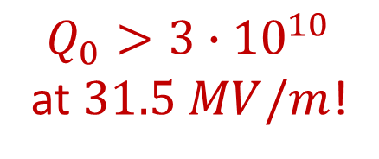
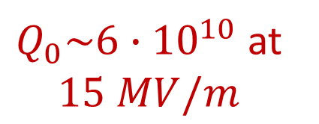
N-infusion: a larger parameter space to be explored
$Q_{0}>3∙{10}^{10}$ at $31.5 MV/m$!
$Q_{0}\sim 6∙{10}^{10}$ at $15 MV/m$
A. Grassellino et al., arXiv:1701.06077 (submitted to SUST)

Slide 10
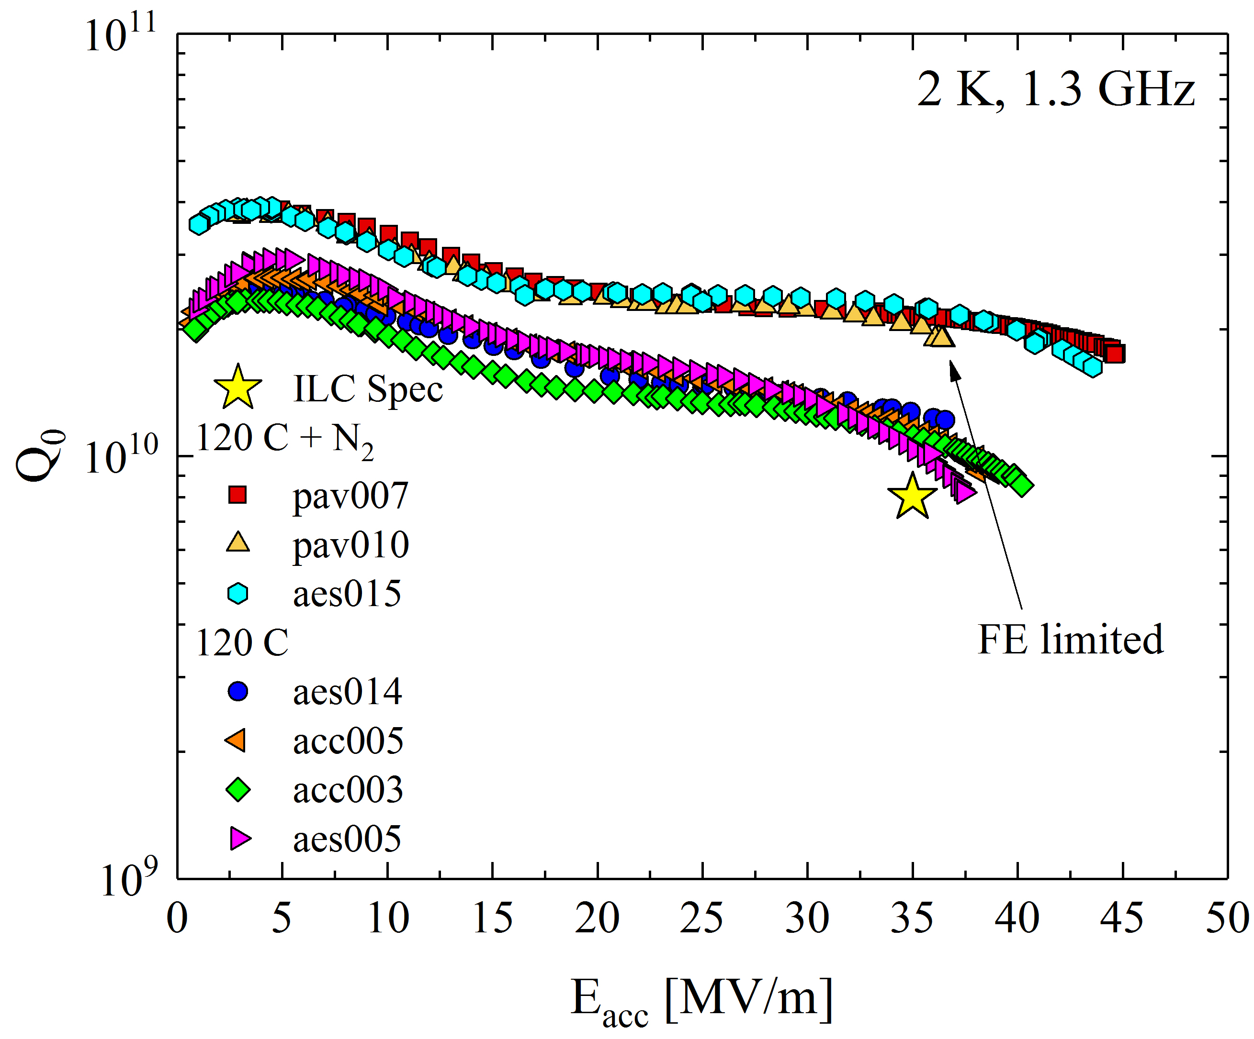
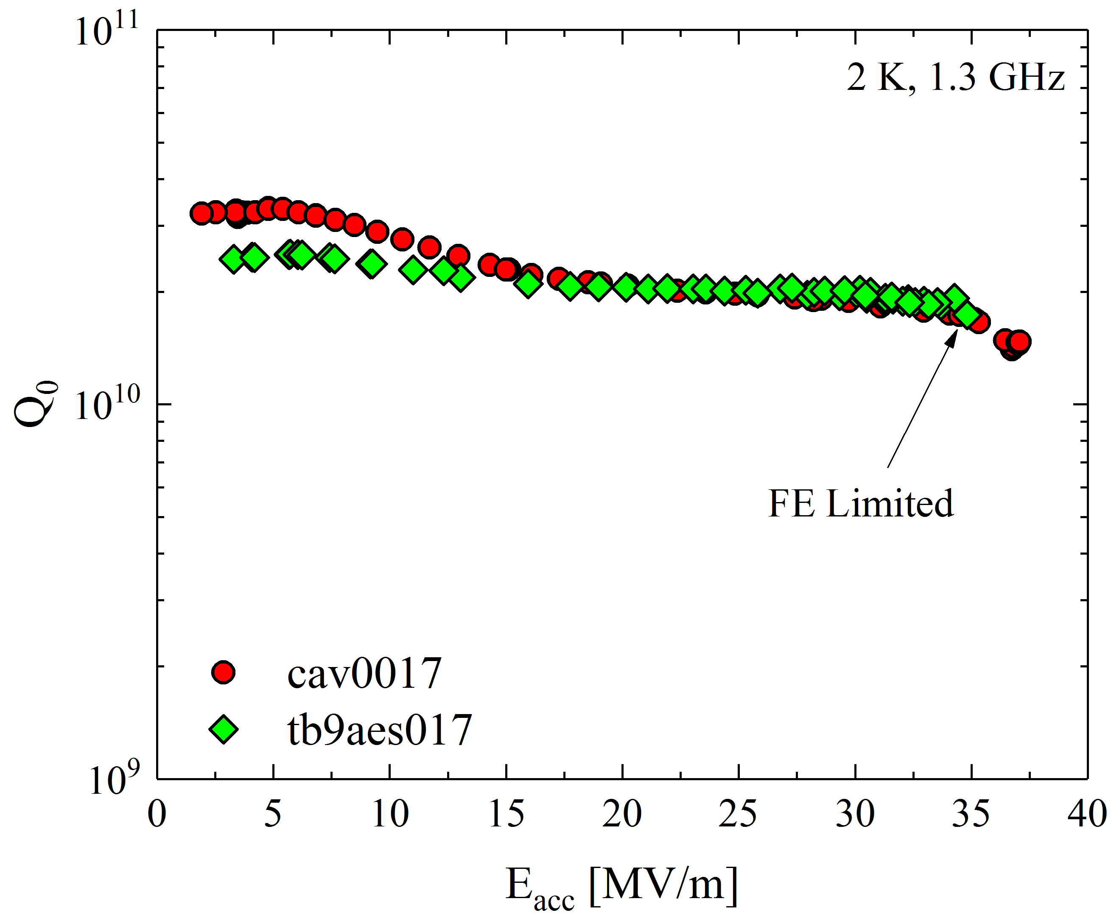
120 C N-infusion: high $Q_{0}$ at high gradients
Single-cell
9-cells
2 times higher!
Higher Q-factor at higher field may allow for higher duty-cycles and therefore higher luminosity!
A. Grassellino et al., arXiv:1701.06077 (submitted to SUST)

Slide 11
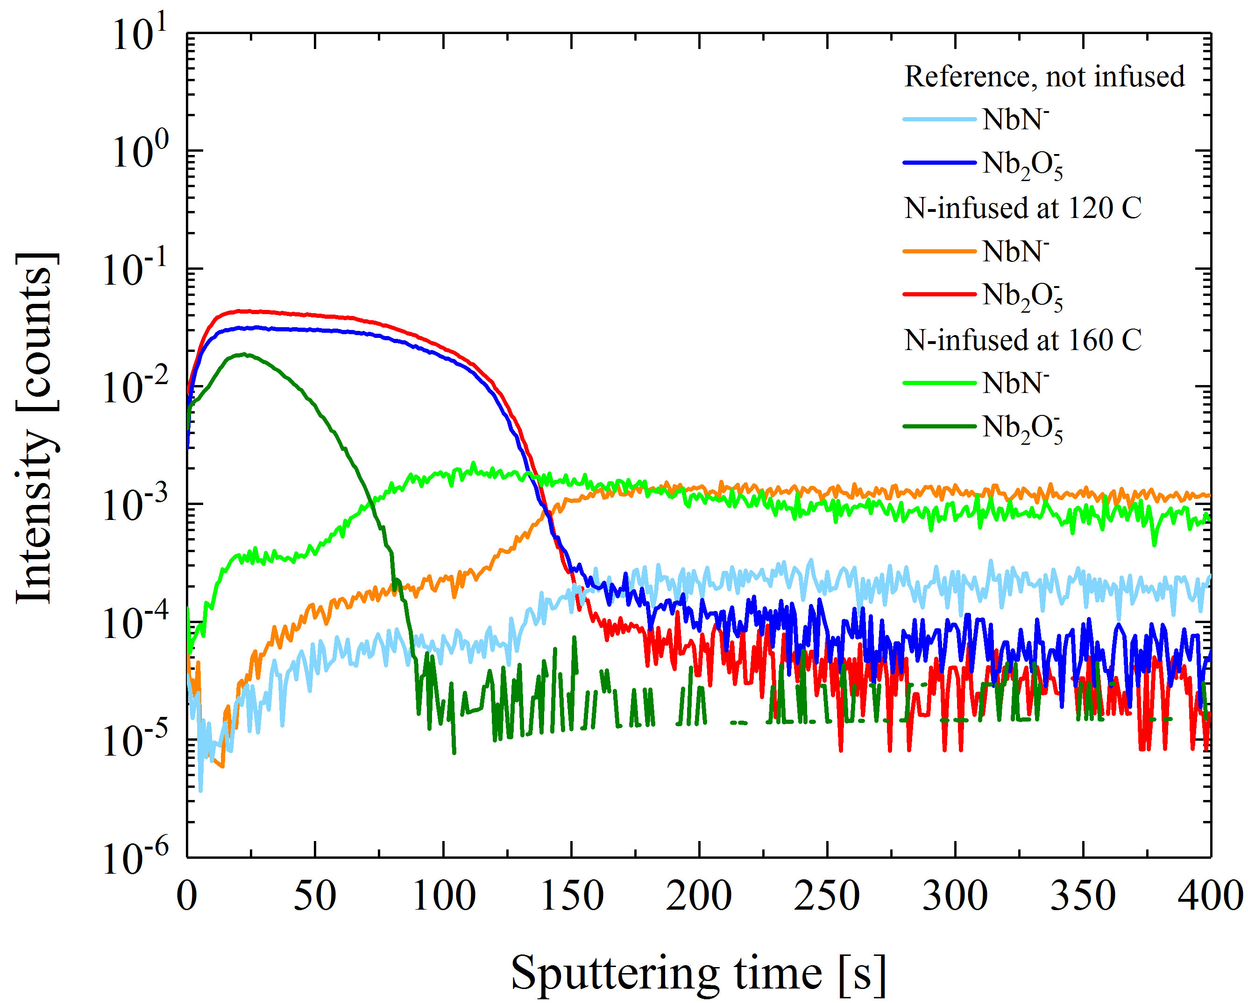

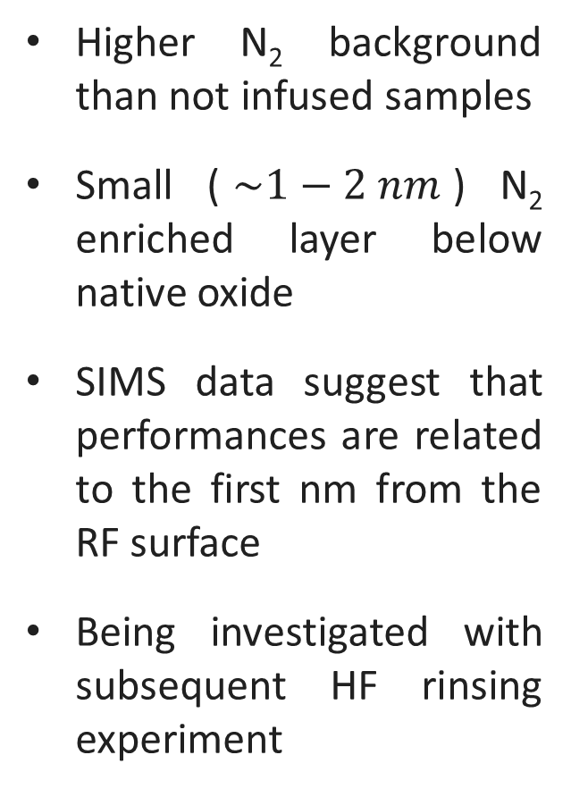
Nitrogen role in N-infusion
Higher N₂ background than not infused samples
Small ($\sim 1−2 nm$) N₂ enriched layer below native oxide
SIMS data suggest that performances are related to the first nm from the RF surface
Being investigated with subsequent HF rinsing experiment
$$\sim 5 nm$$
data courtesy of Y. Trenikhina
No nitrides formation at the RF surface
A. Grassellino et al., arXiv:1701.06077 (submitted to SUST)

Slide 12

$Q_{0}$ preservation
Understanding the trapped flux
surface resistance

Slide 13
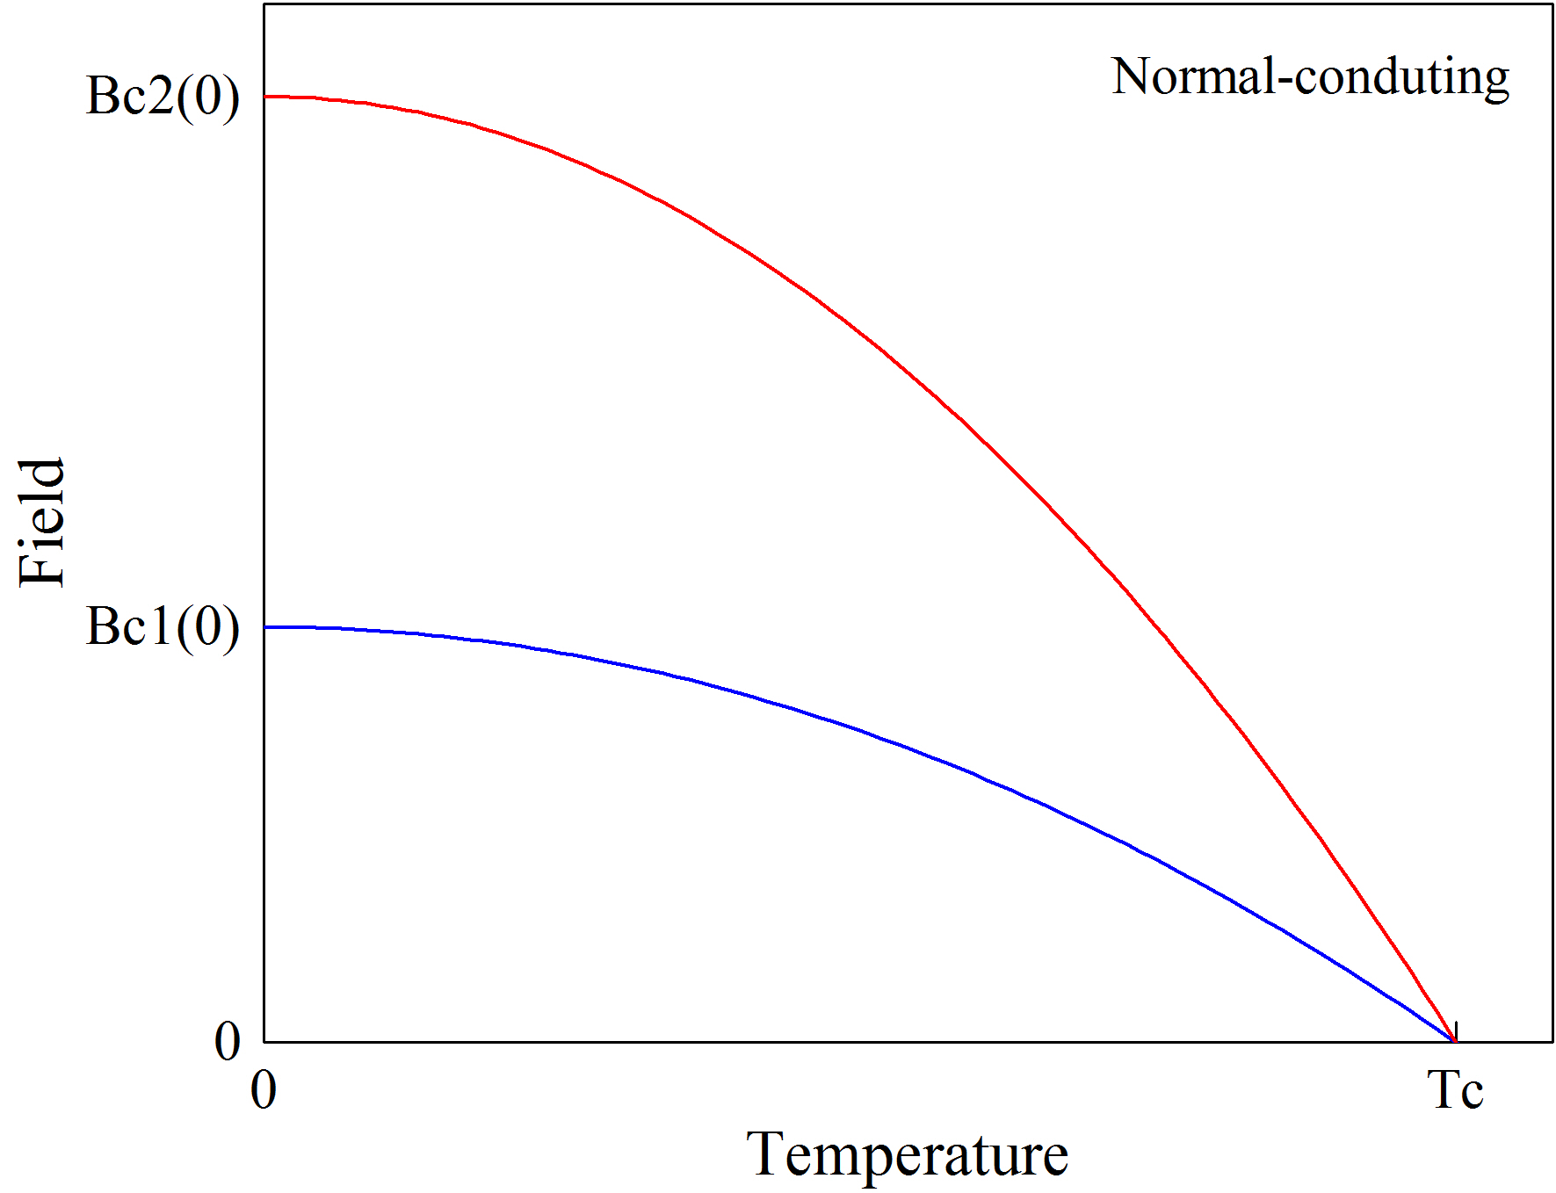
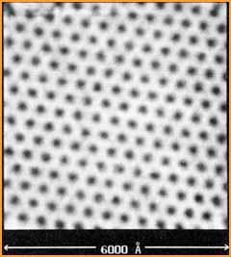

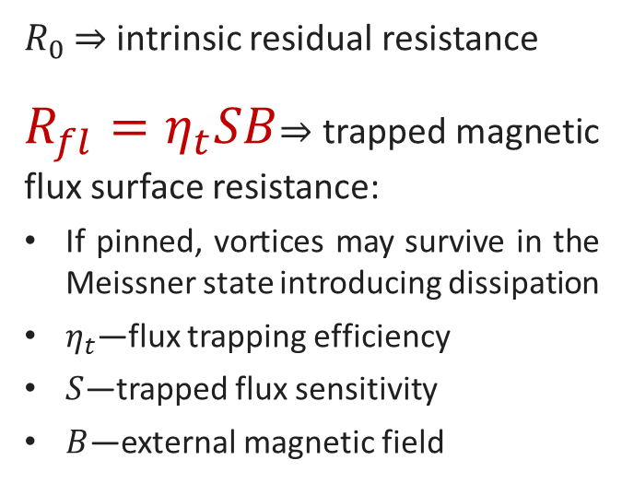






Trapped flux surface resistance
$$R_{res}$$
Normal conducting
$$R_{s}\left(T, B\right)=R_{BCS}\left(T\right)+R_{fl}\left(B\right)+R_{0}$$
H. F. Hess et al., Phys. Rev. Lett. 62, 214 (1989)
$R_{0}$ ⇒ intrinsic residual resistance
$R_{fl}=η_{t}SB$⇒ trapped magnetic flux surface resistance:
If pinned, vortices may survive in the Meissner state introducing dissipation
$η_{t}$—flux trapping efficiency
$S$—trapped flux sensitivity
$B$—external magnetic field
Cooldown
$$B$$
$$y$$
Pinning points
$$T_{c_{1}}$$
$$T_{c_{2}}$$
$$x$$
Trapped vortices

Slide 14
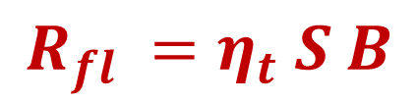
Trapped flux surface resistance contributions
$$R_{fl} =η_{t} S B$$
$R_{fl}$ can be reduced by minimizing these contributions:
External Magnetic Field
$$B$$
𝐵
Magnetic shielding and hygiene
$$η_{t}$$
𝜂_𝑡
Fast cooling / pinning
$$S$$
𝑆
Optimizing mean free path
Flux Trapping Efficiency
Trapped Flux Sensitivity

Slide 15
Trapped flux surface resistance contributions
$$R_{fl} =η_{t} S B$$
$R_{fl}$ can be reduced by minimizing these contributions:
External Magnetic Field
$$B$$
𝐵
Magnetic shielding and hygiene
$$η_{t}$$
𝜂_𝑡
Fast cooling / pinning
$$S$$
𝑆
Optimizing mean free path
Flux Trapping Efficiency
Trapped Flux Sensitivity

Slide 16
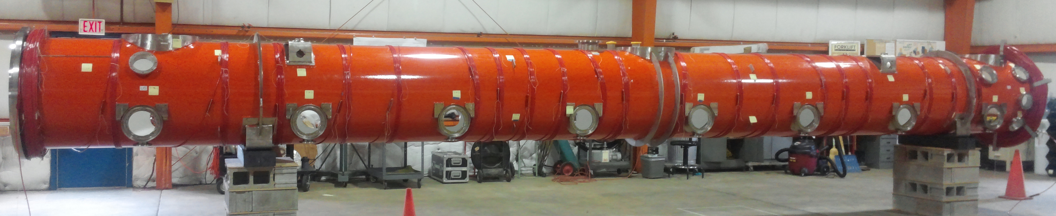
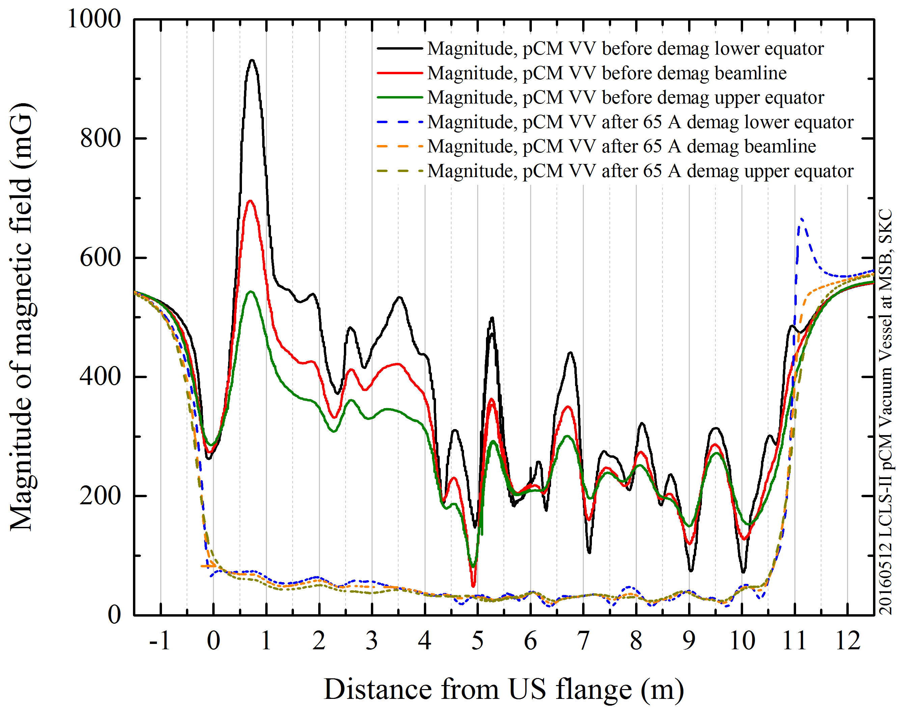
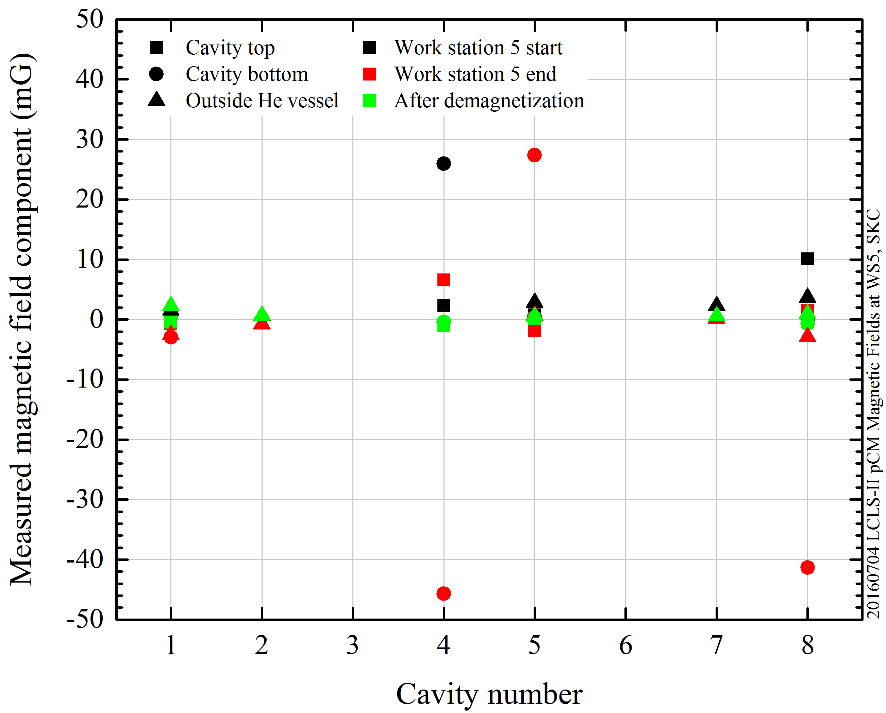
Minimization of remnant field in the cryomodule
Coils for magnetic field demagnetization
Empty vacuum vessel
Assembled Cryomodule
Demagnetization
Demagnetization
data courtesy of S. Chandrasekaran

Slide 17
Trapped flux surface resistance contributions
$$R_{fl} =η_{t} S B$$
$R_{fl}$ can be reduced by minimizing these contributions:
External Magnetic Field
$$B$$
𝐵
Magnetic shielding and hygiene
$$η_{t}$$
𝜂_𝑡
Fast cooling / pinning
$$S$$
𝑆
Optimizing mean free path
Flux Trapping Efficiency
Trapped Flux Sensitivity

Slide 18
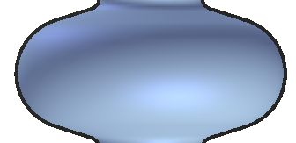
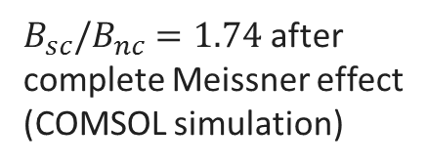
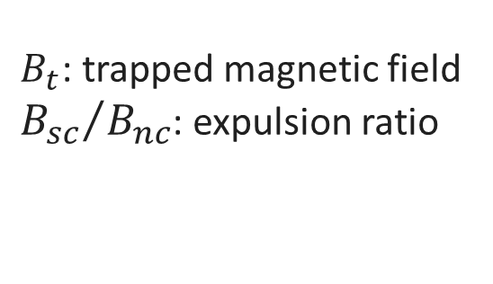

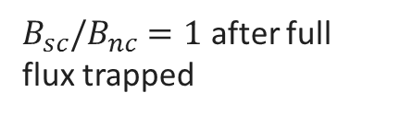
Magnetic field redistribution after SC transition
$$η_{t}={B_{t}}/B=f({B_{sc}}/{B_{nc}})$$
$B_{t}$: trapped magnetic field
${B_{sc}}/{B_{nc}}$: expulsion ratio
Before the SC transition:
B = B_{nc}
fluxgate magnetometers to measure external field
After the SC transition:
$B_{sc}/B_{nc}=1.74$ after complete Meissner effect
(COMSOL simulation)
Field completely expelled
B_{sc}
Field completely trapped
B_{sc}
$B_{sc}/B_{nc}=1$ after full flux trapped

Slide 19
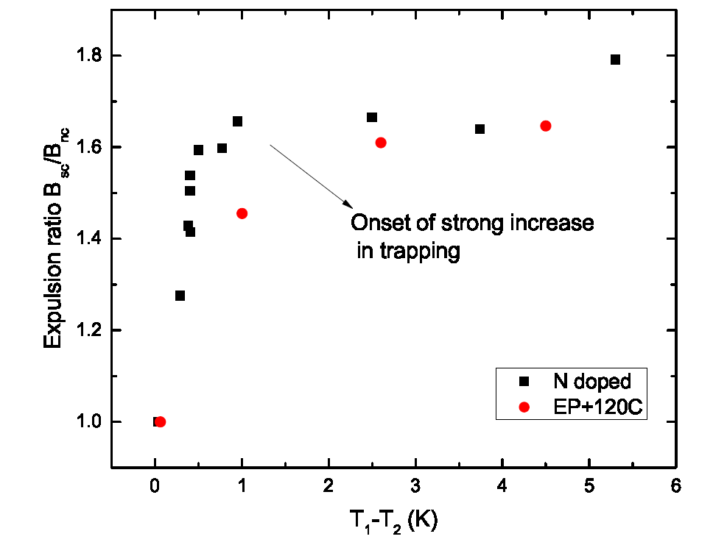
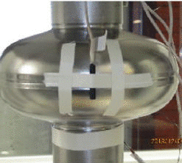
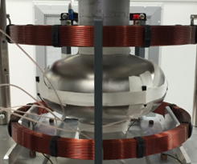
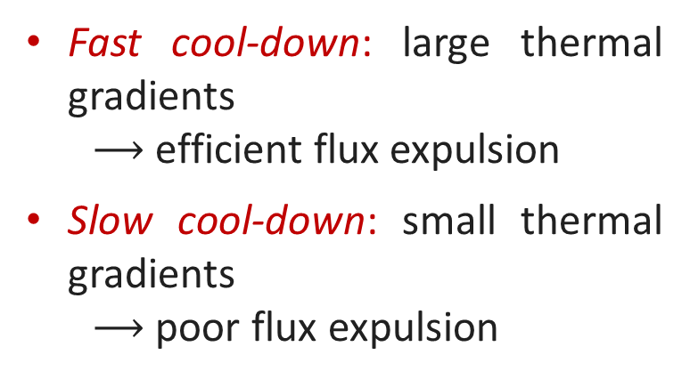
Fast cooldown helps flux expulsion
Fast cool-down: large thermal gradients
  $⟶$efficient flux expulsion
Slow cool-down: small thermal gradients
  $⟶$ poor flux expulsion
B_{sc}/B_{nc}
T₁
T₂
A. Romanenko et al., Appl. Phys. Lett. 105, 234103 (2014)
A. Romanenko et al., J. Appl. Phys. 115, 184903 (2014)
D. Gonnella et al., J. Appl. Phys. 117, 023908 (2015)
M. Martinello et al., J. Appl. Phys. 118, 044505 (2015)
S. Posen et al., J. Appl. Phys. 119, 213903 (2016)
S. Huang et al., Phys. Rev. Accel. Beams 19, 082001 (2016)

Slide 20
Thermodynamic force during cooldown
The Gibbs free energy density defines the stability of vortices in the SC:
$$g(H)$$
Meissner State
Mixed
State
$$g=B(H_{c_{1}}(T)−H)$$
$$0$$
$$H$$
$$H_{c_{1}}(T)$$
We can define the thermodynamic force acting on the vortex as:
$$f=−\frac{∂g}{∂x}=−\frac{∂g}{∂T}\frac{∂T}{∂x}$$
$$y$$
$$g(x)$$
$$f$$
$$f=\frac{2BH_{c_{1}}\left(0\right)T}{T_{c}^{2}}∇T$$
$$f$$
Meissner State
Mixed State
$$x$$
$$T_{c_{1}}$$
  M. Martinello, M. Checchin et al., to be published

Slide 21
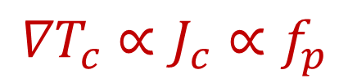
Critical thermal gradient
The pinning force acting against the expulsion is defined in terms of critical current density $J_{c}$:
$$f_{p}=\left|{ \overline{J}}_{c}×n{\overline{Φ}}_{0}\right|=J_{c}B$$
The minimum thermal gradient needed to expel vortices is the critical thermal gradient ${∇T}_{c}$ :
Pinning point
$$y$$
$$g(x)$$
$${∇T}_{c}=\frac{J_{c}T_{c}^{2}}{2H_{c_{1}}\left(0\right)T}$$
$$f_{p}$$
$$f$$
Meissner State
Mixed State
$$x$$
$${∇T}_{c}∝J_{c}∝f_{p}$$
$$T_{c_{1}}$$
  M. Martinello, M. Checchin et al., to be published

Slide 22
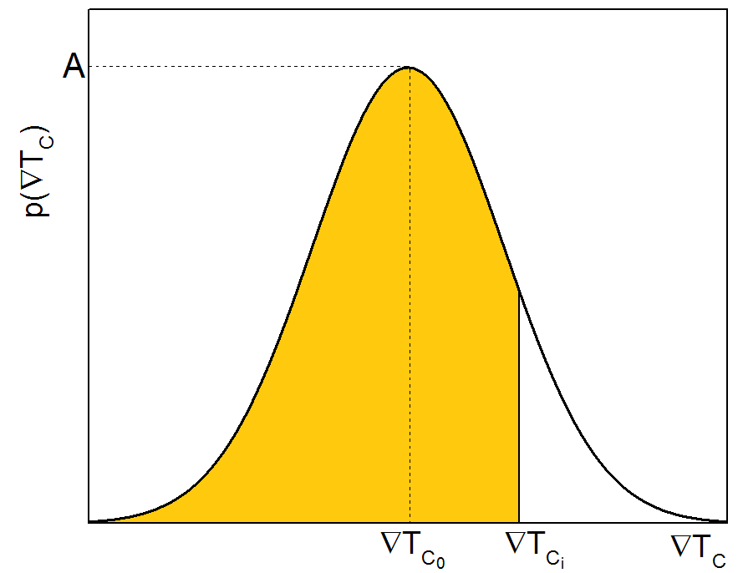
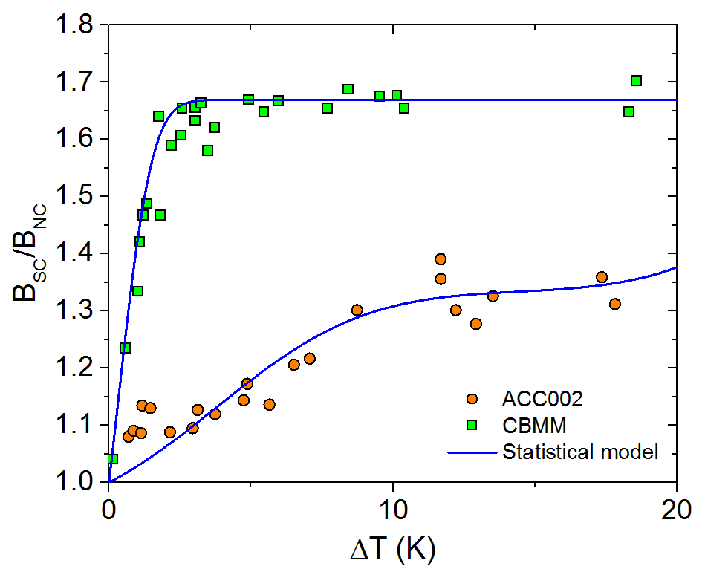
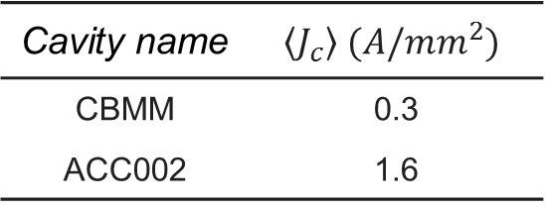
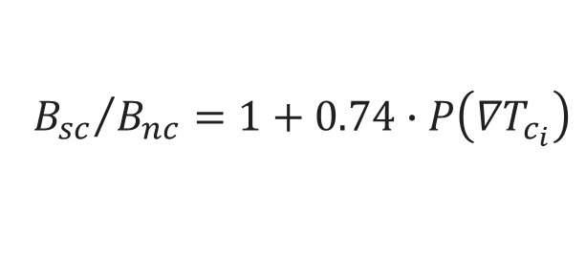
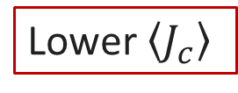
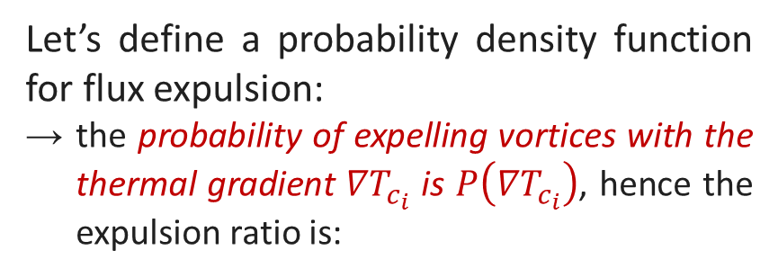
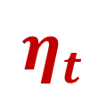
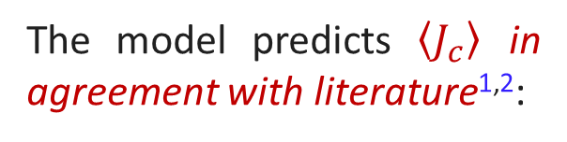

Statistical model for the expulsion ratio
Let’s define a probability density function for flux expulsion:
the probability of expelling vortices with the thermal gradient ${∇T}_{c_{i}}$ is $P\left({∇T}_{c_{i}}\right)$, hence the expulsion ratio is:
$$P\left({∇T}_{c_{i}}\right)$$
$$η_{t}$$
For TESLA shape
$${B_{sc}}/{B_{nc}}=1+0.74∙P\left({∇T}_{c_{i}}\right)$$
The model predicts $\left\langle J_{c}\right\rangle$ in agreement with literature^{1,2}:
Lower $\left\langle J_{c}\right\rangle$
Cavity name | $$\left\langle J_{c}\right\rangle (A/{mm}^{2})$$
CBMM | 0.3
ACC002 | 1.6
M. Martinello, M. Checchin et al., to be published
Data: S. Posen et al., J. Appl. Phys. 119, 213903 (2016)
¹ G. Park et al., Phys. Rev. Lett. 68, 12 (1992)
² L. H. Allen and J. H. Claassen, Phys. Rev. B 39, 4 (1989)

Slide 23
Trapped flux surface resistance contributions
$$R_{fl} =η_{t} S B$$
$R_{fl}$ can be reduced by minimizing these contributions:
External Magnetic Field
$$B$$
𝐵
Magnetic shielding and hygiene
$$η_{t}$$
𝜂_𝑡
Fast cooling / pinning
$$S$$
𝑆
Optimizing mean free path
Flux Trapping Efficiency
Trapped Flux Sensitivity

Slide 24
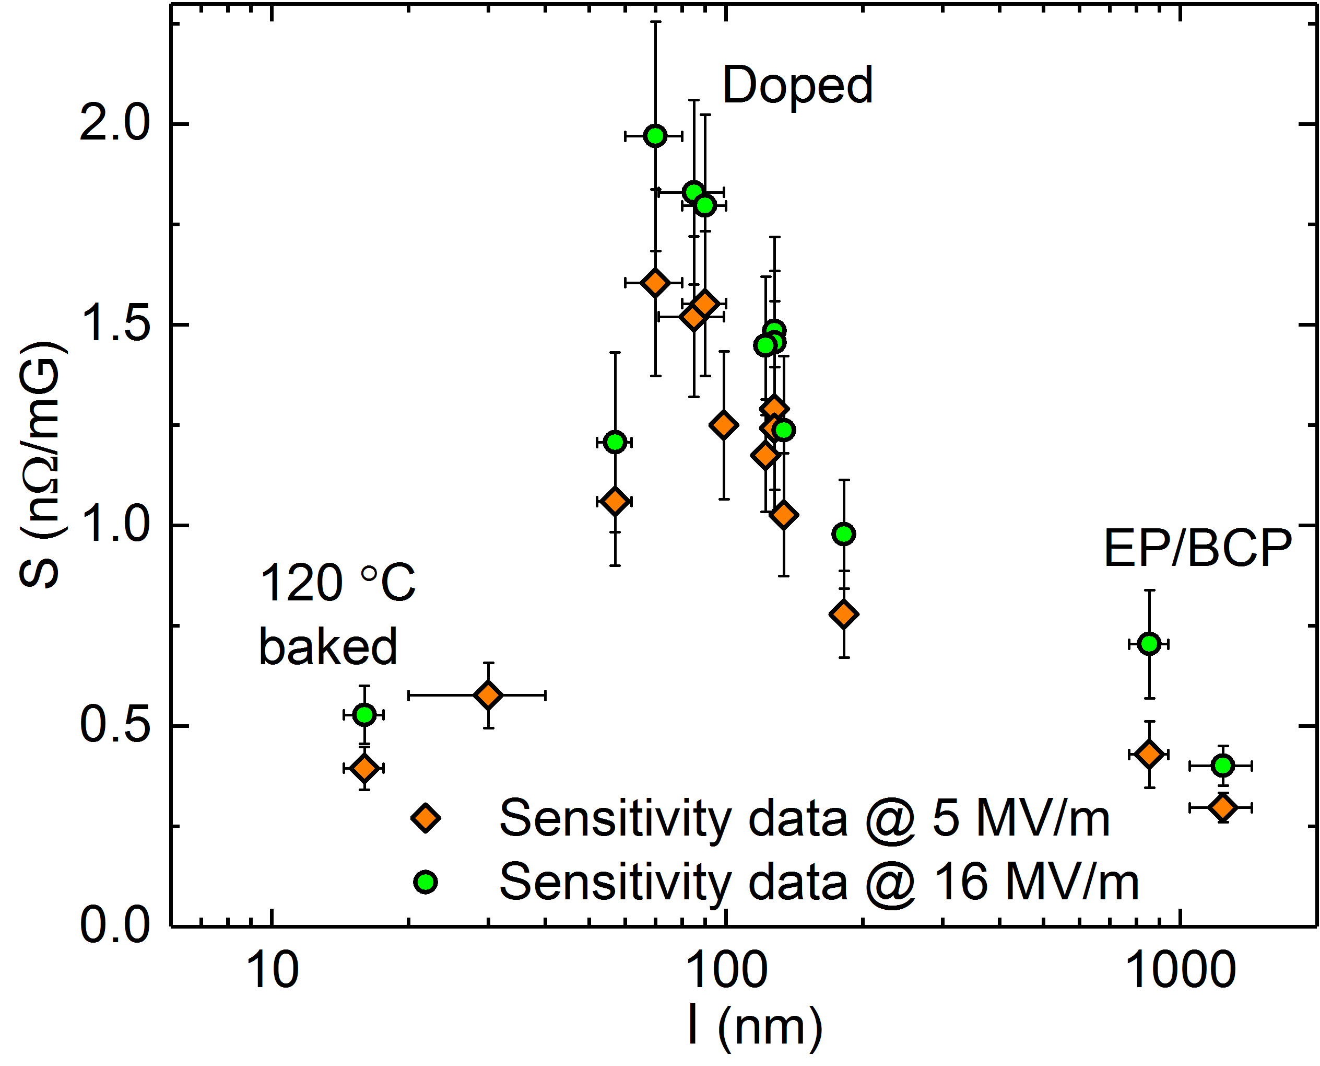
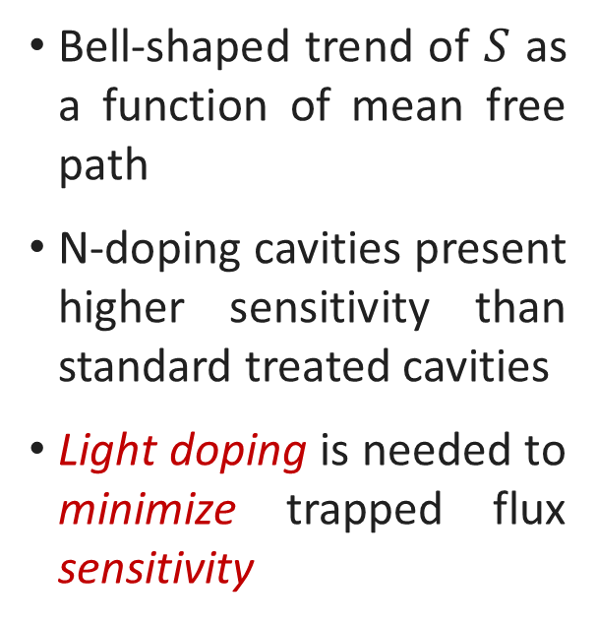
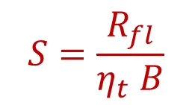
Light doping to minimize trapped flux sensitivity
Trapped flux sensitivity:
$$S=\frac{R_{fl}}{η_{t} B}$$
Bell-shaped trend of $S$ as a function of mean free path
N-doping cavities present higher sensitivity than standard treated cavities
Light doping is needed to minimize trapped flux sensitivity
2/6 N-doping
M. Martinello et al., App. Phys. Lett. 109, 062601 (2016)
D. Gonnella et al., J. Appl. Phys. 119, 073904 (2016)

Slide 25
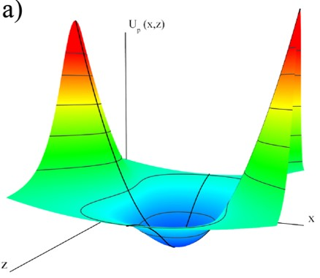
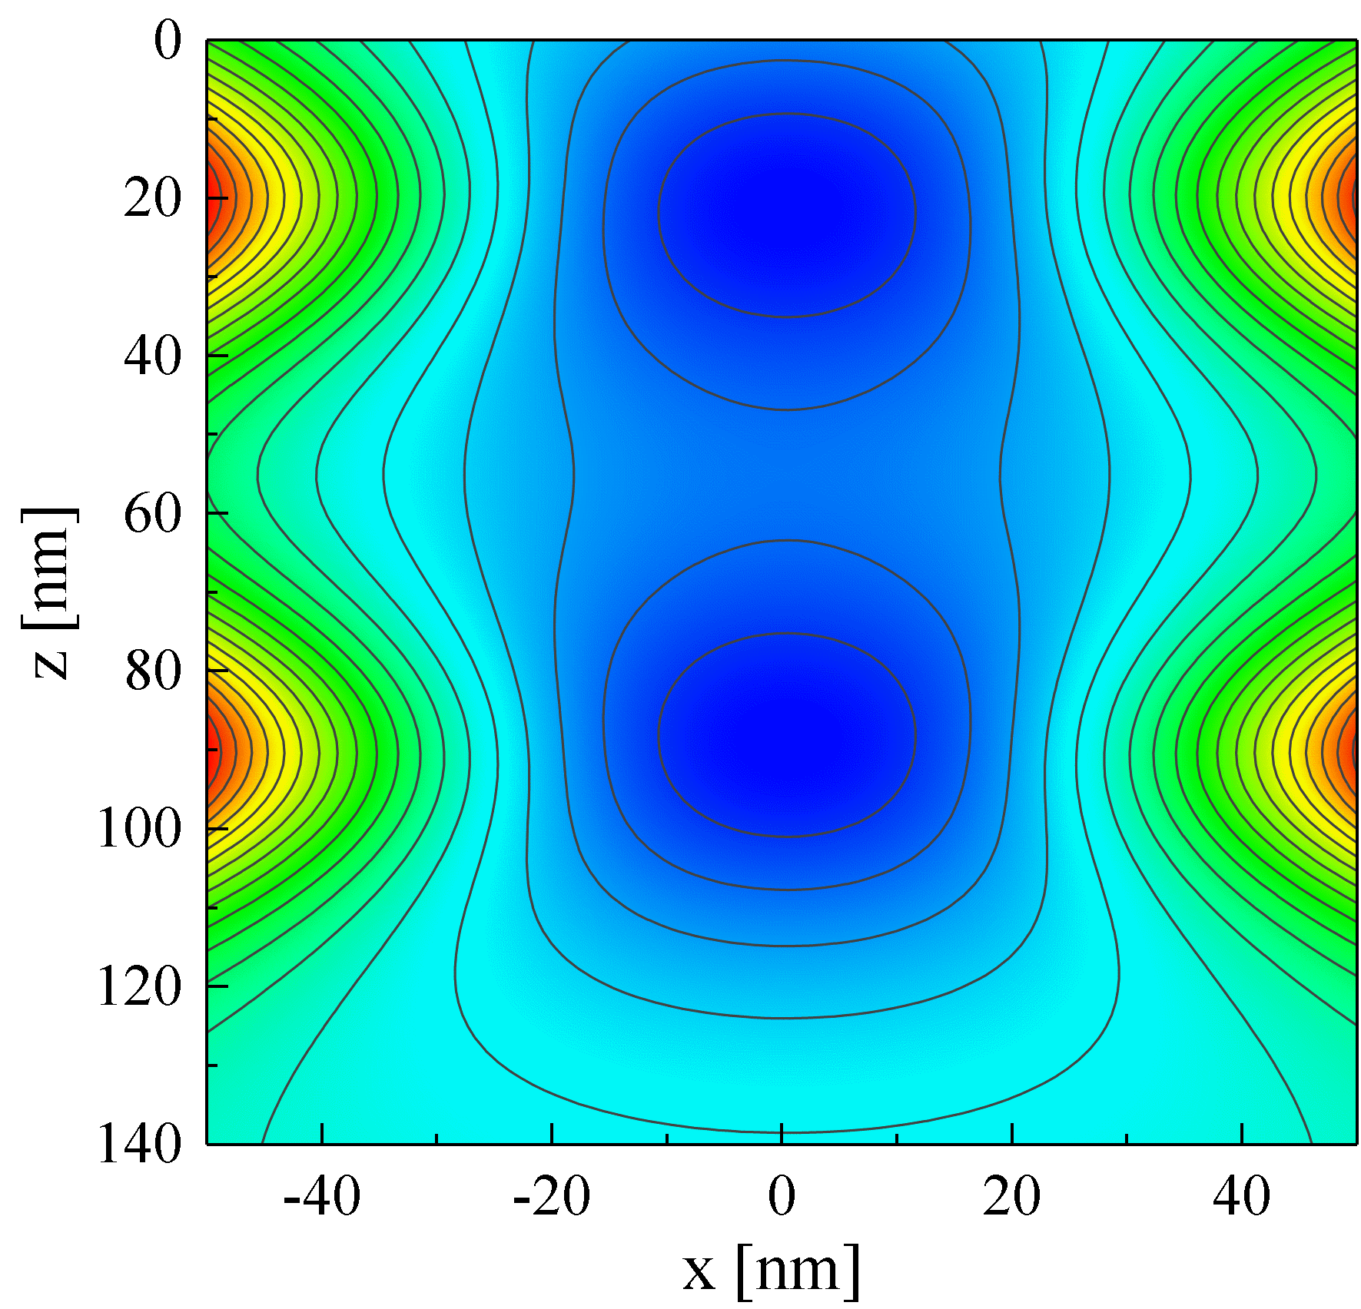
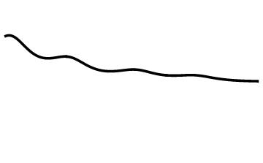

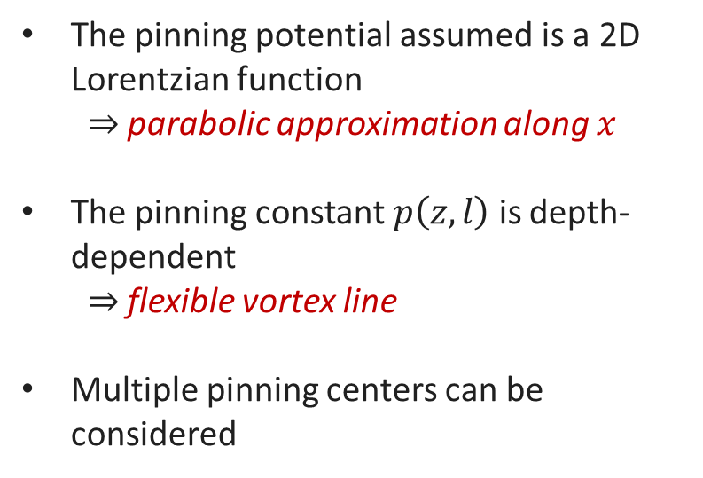
Single vortex equation of motion
The motion equation has form:
$$M\left(l\right)\ddot{x}+η\left(l\right)\dot{x}+p\left(z,l\right)x=j_{0}φ_{0}sin\left(θ\right)e^{iωt−z/{λ\left(l\right)}}$$
The solution is valid from $z=0$ to $z→∞$
The pinning potential assumed is a 2D Lorentzian function
  $⇒$ parabolic approximation along $x$
The pinning constant $p\left(z,l\right)$ is depth-dependent
  $⇒$ flexible vortex line
Multiple pinning centers can be considered
Pinning Center
Pinning Center
  M. Checchin et al., Supercond. Sci. Technol. 30, 034003 (2017)

Slide 26
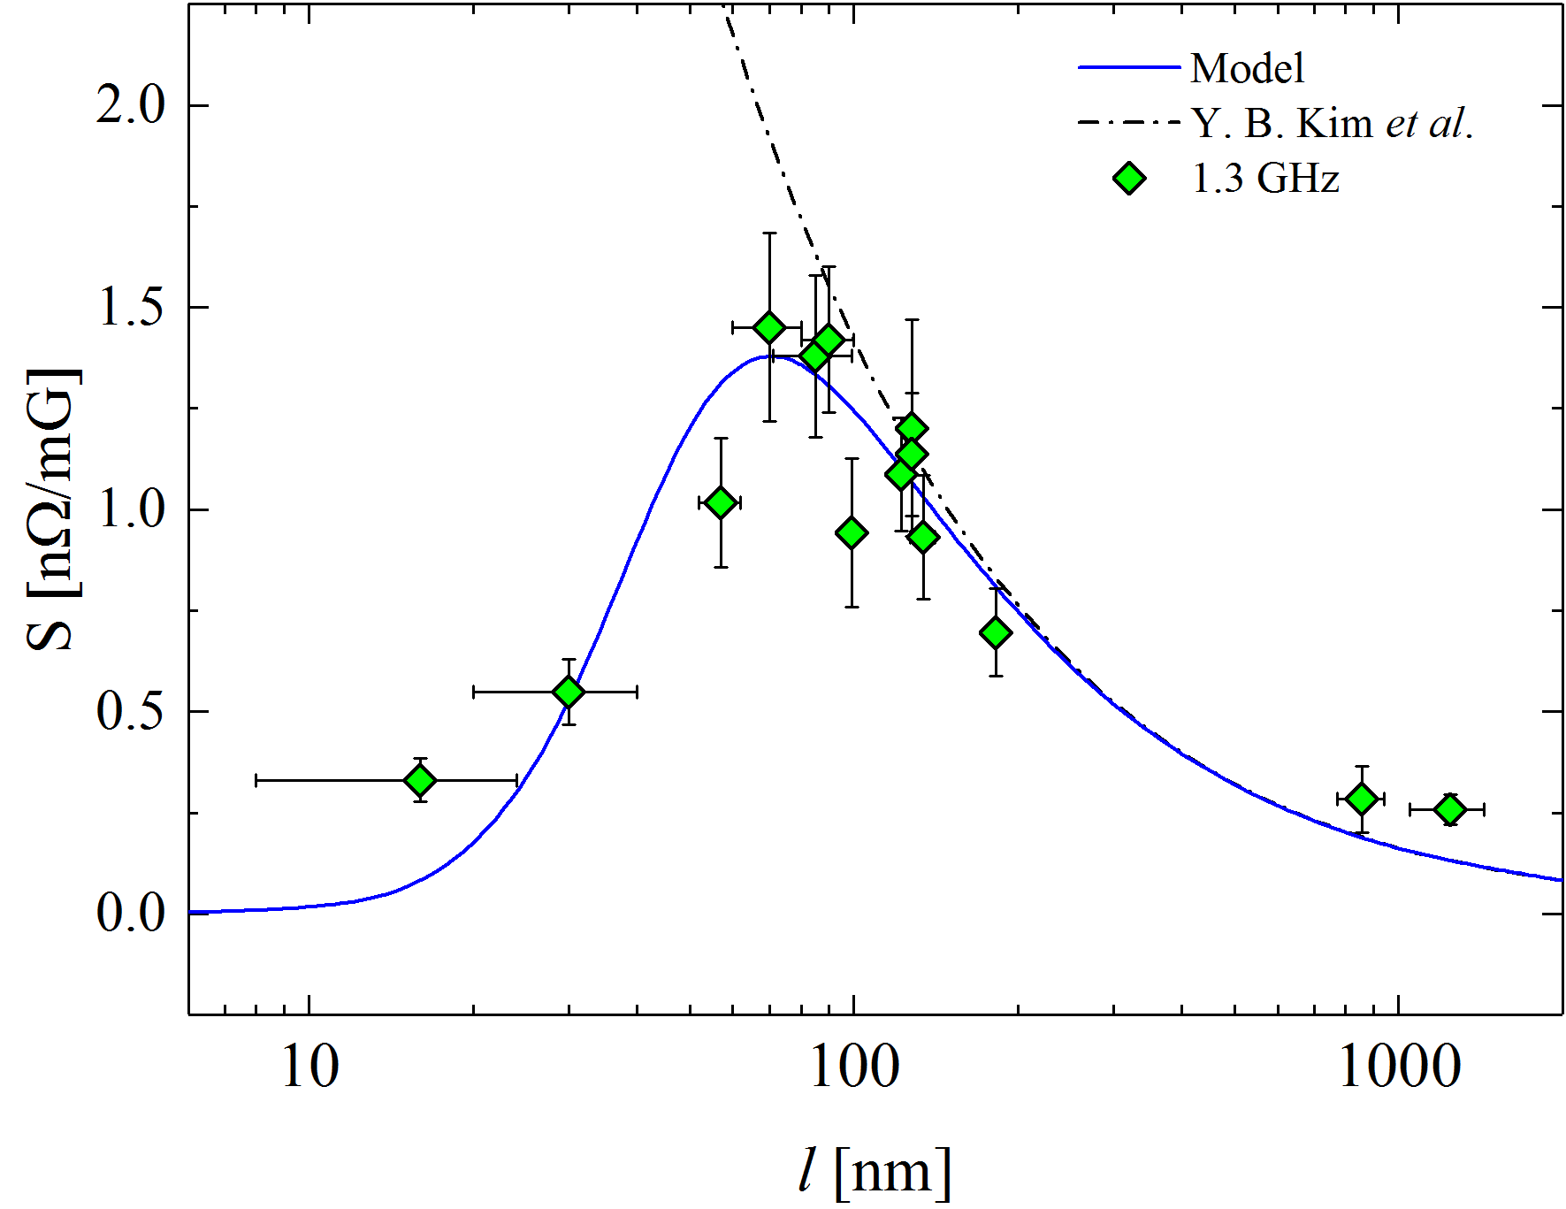
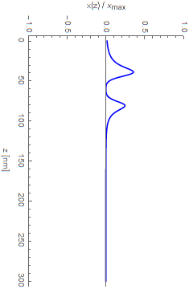
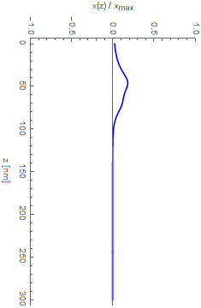
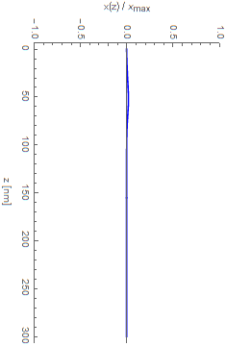




Sensitivity vs mean-free-path
Small $l$– pinning regime $η≪p$:
$$ρ_{1}\left(l,U_{0}\right)≈\frac{η(l) }{{p(l,U_{0})}^{2}}$$
  $ρ_{1}$ increases with $l$ and $ω^{2}$, decreases with the increasing of $U_{0}$
Large $l$– flux-flow regime $η≫p$:
$$ρ_{1}\left(l\right)≈\frac{1}{η(l)}$$
  $ρ_{1}$ decreases with $l$, independent on $ω$ and $U_{0}$
Pinning
regime
Flux-flow
regime
$$l = 5 nm$$
$$l = 70 nm$$
$$l = 500 nm$$
Pinning
  M. Checchin et al., Supercond. Sci. Technol. 30, 034003 (2017)
  Data: M. Martinello et al., App. Phys. Lett. 109, 062601 (2016)

Slide 27



Sensitivity vs frequency
Small $l$– pinning regime $η≪p$:
$$ρ_{1}\left(ω\right)≈ω^{2}$$
  $ρ_{1}$ increases with $ω^{2}$
Large $l$– flux-flow regime $η≫p$:
$$ρ_{1}=constant$$
  $ρ_{1}$ independent on $ω$
The higher $f$ the higher the sensitivity peak
Lower frequencies are favorable to minimize the sensitivity
Pinning
regime
Flux-flow
regime
Increasing
frequency
  M. Checchin et al., Supercond. Sci. Technol. 30, 034003 (2017)

Slide 28

Summary
State-of-the-art surface treatment for
high $Q_{0}$ at 1.3 GHz

Slide 29


$Q_{0}$ in condition of full flux-trapping @ 1.3 GHz
12
15
M. Martinello et al., App. Phys. Lett. 109, 062601 (2016)

Slide 30

$Q_{0}$ in condition of full flux-trapping @ 1.3 GHz
12
LCLS-II N-doping is better than standard treatments as long as the field trapped is $<10 mG$
15
M. Martinello et al., App. Phys. Lett. 109, 062601 (2016)

Slide 31


LCLS-II prototype cryomodule test at FNAL
LCLS-II spec: $2.7×{10}^{10}$ at $16 MV/m$
Cavity | Usable Gradient* [MV/m] | Cryomodule Q₀ @16MV/m** Fast Cool Down
TB9AES021 | 18.2 | 2.6e10
TB9AES019 | 18.8 | 3.1e10
TB9AES026 | 19.8 | 3.6e10
TB9AES024 | 20.5 | 3.1e10
TB9AES028 | 14.2 | 2.6e10
TB9AES016 | 16.9 | 3.3e10
TB9AES022 | 19.4 | 3.3e10
TB9AES027 | 17.5 | 2.3e10
Average | 18.2 | 3.0e10
Total Voltage | 148.1 MV
Acceptance = 128 MV
* Radiation <50 mR/h
** TB9AES028 Q₀ was at 14 MV/m
courtesy of G. Wu

Slide 32

Frequency dependence study
We are now extending the same study to different frequencies and many surface treatments (EP, 120 C bake, N-doping and N-infusion)….
The initial results are extremely interesting….STAY TUNED!

Slide 33
Conclusions

Slide 34

Conclusions
N-doping and N-infusion both increases $Q_{0}$
$R_{fl}=η_{t} S B$ can be minimized by:
  Efficient magnetic field shielding (low $B$)
  Fast cooling, minimize pinning (low $η_{t}$)
  Decreasing as much as possible the sensitivity (low $S$)
Two different regimes of vortex dissipation
  Small $l$, pinning regime: $ρ_{1}$ increases if $l↑$, $ω^{2}↑$ and $U_{0}↓$
  Large $l$, flux-flow regime: $ρ_{1}$ decreases if $l↑$, but independent on $ω$ and $U_{0}$
Only by understanding $R_{fl}$ N-doping could be successfully implemented to mass production
  LCLS-II cryomodule specification exceeded
Thank you for the attention

Slide 35
Back-up slides

Slide 36

N-infusion thermal process
Bulk electro-polishing
High T furnace with caps to avoid furnace contamination:
  3h @ 800C in HV
  48h @ 120-160 C with N₂ (25 mTorr)
  Optional annealing 48h @ 120-160 C
NO chemistry post furnace
HPR, VT assembly
800 C
25 mTorr
120 C
Protective caps and foils are BCP’d prior to every furnace cycle and assembled in clean room, prior to transporting the cavity to furnace area
A. Grassellino et al., arXiv:1701.06077 (submitted to SUST)

Slide 37


Statistical definition of trapping efficiency
The probability of expelling vortices with the thermal gradient ${∇T}_{c_{i}}$ is $P\left({∇T}_{c_{i}}\right)$
The trapping efficiency $η_{t}$ is function of ${∇T}_{c_{i}}$:
The trapped field is then:
$$P\left({∇T}_{c_{i}}\right)$$
$$η_{t}=\left[1−P\left({∇T}_{c_{i}}\right)\right]$$
$$P\left({∇T}_{c_{i}}\right)=\int_{0}^{{∇T}_{c_{i}}}{p\left({∇T}_{c}\right)}d{∇T}_{c }$$
For TESLA shape
$$\frac{B_{sc}}{B_{nc}}=1+0.74∙P\left({∇T}_{c_{i}}\right)$$
$$B_{t}=η_{t}B=B\left[1−P\left({∇T}_{c_{i}}\right)\right]$$
  M. Martinello, M. Checchin et al., to be published

Slide 38


Double-peaked probability density function
Double distribution of pinning centers (e.g. dislocations + grain boundaries)
$p\left({ΔT}_{c}→0\right)≠0$ $⇒$ finite probability that vortices are not pinned
First plateau defined by the ratio of the two peaks’ area
Complete flux expulsion reached when ${ΔT}_{c}$ is larger enough so that $P\left({ΔT}_{c}\right)=1$
  M. Martinello, M. Checchin et al., to be published

Slide 39



High T baking effects
High T baking effects:
Decreases the number of pinning points
  pdf narrowing
Smaller $J_{c}$
After 1000 C
baking
M. Martinello, M. Checchin et al., to be published
Data: S. Posen et al., J. Appl. Phys. 119, 213903 (2016)

Slide 40

Pdf before/after 1000 C annealing example
  M. Martinello, M. Checchin et al., to be published

Slide 41



Pinning potential
The smaller $l$, the steeper the potential:
$$U_{p}\left(z\right)=−\sum_{i=0}^{n}{\frac{U_{0_{i}}ξ^{2}}{ξ^{2}+x^{2}+{\left(z−q_{i}\right)}^{2}}}$$
$$≈−\sum_{i=0}^{n}{\frac{U_{0_{i}}ξ^{2}}{ξ^{2}+{\left(z−q_{i}\right)}^{2}}}+\sum_{i=0}^{n}{\frac{U_{0_{i}}ξ^{2}}{{\left[ξ^{2}+{\left(z−q_{i}\right)}^{2}\right]}^{2}}x^{2}}$$
  M. Checchin et al., Supercond. Sci. Technol. 30, 034003 (2017)

Slide 42




Vortex surface impedance
The complex resistivity of the vortex line follows from the calculation of the apparent power (active plus reactive power) :
The vortex surface impedance (using the classic definition of $Z$) is then:
$$ρ\left(z,l\right)=ρ_{1}+iρ_{2}=\frac{φ_{0}^{2}\sin^{2}\left(θ\right)}{πξ_{0}^{2}\left[{\left(p−Mω^{2}\right)}^{2}+{\left(ηω\right)}^{2}\right]}\left[ηω+i\left(p−Mω^{2}\right)\right]$$
$$Z\left(l\right)=\frac{πξ_{0}^{2}B}{φ_{0}}\int_{0}^{q_{0}^{∨}}{\int_{U_{0_{0}}^{∧}}^{U_{0_{0}}^{∨}}{⋯}}\int_{0}^{q_{n}^{∨}}{\int_{U_{0_{n}}^{∧}}^{U_{0_{n}}^{∨}}{\frac{\prod_{i=0}^{n}{Γ\left(q_{i}\right)Λ\left(U_{0_{i}}\right)}}{\int_{0}^{L}{\frac{e^{−z/λ}}{ρ\left(z,l\right)}}dz}}dU_{0_{0}}dq_{0}⋯dU_{0_{n}}dq_{n}}$$
Number of vortices $B/{B_{vortex}}$
Vortex impedance weighted over normal distributions of pinning positions and strengths
  M. Checchin et al., Supercond. Sci. Technol. 30, 034003 (2017)

Slide 43




Pinning strength dependence
The higher the pinning force, the more constrained the oscillation
Dirtier or more defective materials (e.g. thin films) have larger pining strength
Lower sensitivity!
By increasing the pinning force of one order of magnitude the sensitivity is 7 times smaller!
1.4 nΩ/mG
0.2 nΩ/mG
Lower pinning strength
Higher pinning strength
M. Checchin et al., Supercond. Sci. Technol. 30, 034003 (2017)

Slide 44






Sensitivity vs pinning site depth
Vortex dissipation is a near-surface property
The pinning site distance from the surface $q_{0}$ determines the resistance
For instance, if $l = 70 nm$:
    $q_{0}≅15 nm$ $⇒$ sensitivity is the lowest
    $q_{0}>400 nm$ $⇒$constant sensitivity
    bulk pinning does not affect the vortex oscillation!
Pinning
Pinning
$⇒$ $S$ is a near surface property!
  M. Checchin et al., Supercond. Sci. Technol. 30, 034003 (2017)

