Slide 1




Twin-Axis Elliptical Cavity
Frank Marhauser, Andrew Hutton
Jefferson Laboratory (JLab), Newport News
Jean Delayen, HyeKyoung Park, Subashini De Silva, Laura Sweat
Center for Accelerator Science (CAS), Old Dominium University, Norfolk
ERL Workshop, 18-23 June 2017, CERN

Slide 2
Principle Idea
Twin-axis elliptical cavity can accelerate and decelerate beams in two separate beam pipes
  Energy recovery feasible of physically separated beams traversing the same cavity
Primary idea of proposal for twin-axis cavity was that the low energy (vulnerable) beam from the electron source has to be merged with high-energy (spent) beam
  Twin-axis cavity allows injecting the beam without requiring bends (no complex
  merger magnet) as beams are separated physically
  Allows maintaining small emittance from source (high brightness)
Second idea related to the ability to dump beam without an intervening bend thus containing beam size (otherwise large energy spread and emittance of decelerated beam)
  Improve feasibility of recovering energy of otherwise fully dumped beam
  → out-couple RF power, e.g. feed back to injector
  Ease dump design, i.e. energy can be lowered to minimize activation
Usable for high-current, low energy electron beams for bunched beam cooling of high-energy protons or ions (JLEIC cooler ERL)
Notes:
Red Interior Page Design 1

Slide 3

Funding Opportunity
Funding for this project provided by the US DoE Office of High Energy
Physics as part of an Accelerator Stewardship Test Facility Pilot
Program (“ASTFPP”) initiated in 2015
Mission of long-term accelerator R&D stewardship program is to
  Support fundamental accelerator science and technology R&D
  Disseminate accelerator knowledge and training
The new ASTFPP specifically endorses access to the Office of Science
accelerator R&D infrastructure
Pre-requisite of the stewardship program was partnering with a university (in our case ODU/CAS) and engaging a graduate student in the research
Our proposal was award in August 2015 for a one-year duration
Work effort required beyond the one year period is based on no-cost extension
No follow-up phase was permitted through same stewardship program
Notes:
Red Interior Page Design 1

Slide 4
Objective
Design, optimize, and build a novel twin-beam axis superconductive RF
cavity prototype (single-cell) for ERLs
Prototype is proof-of-principle of technical feasibility
To our knowledge this is the first twin-axis cavity built despite past, similar proposals and conceptual design studies
Operational mode conceived is a dipole HOM (TM₁₁₀-like)
  Requires to symmetrize RF fields in beam tubes by design
  Minimization of higher order multipole components of operating mode needed that can cause residual kick to electrons even when beams traverse on ideal tube axis
Further design/practical goals:
  Target a rather large separation of the beam tubes
  Limit surface field enhancement ratios (E_{acc}/E_{pk}, B_{pk}/E_{acc}) to acceptable values
  Achieve acceptable R/Q and R/Q·G (cryogenic losses)
  Assess (to some extent) potential multipacting barriers and structural integrity
  Gain fabrication experience while using conventional, readily applicable techniques,
  i.e. forming of Nb sheets into half cells, rolling of beam tubes and join all components by electron-beam welding (EBW)
  Frequency chosen is 1.5 GHz (JLab/CEBAF), but design scalable to any frequency
Notes:
Red Interior Page Design 1

Slide 5
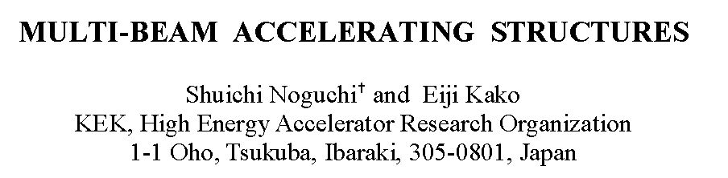
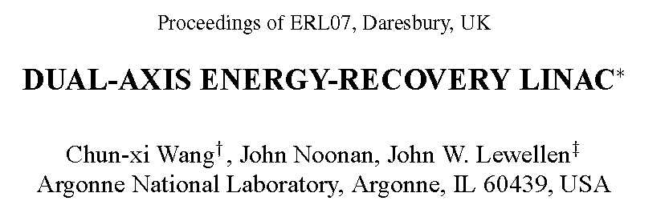
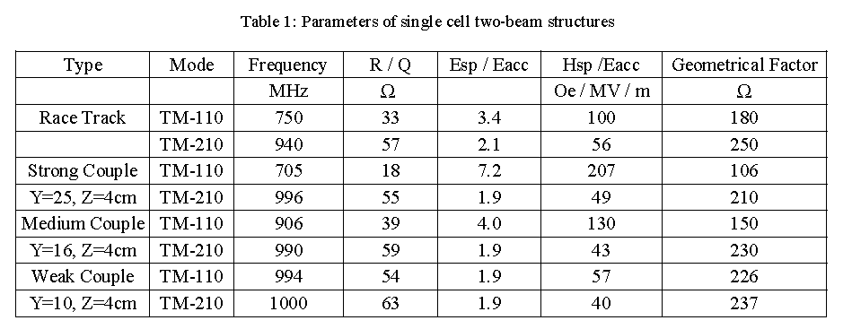
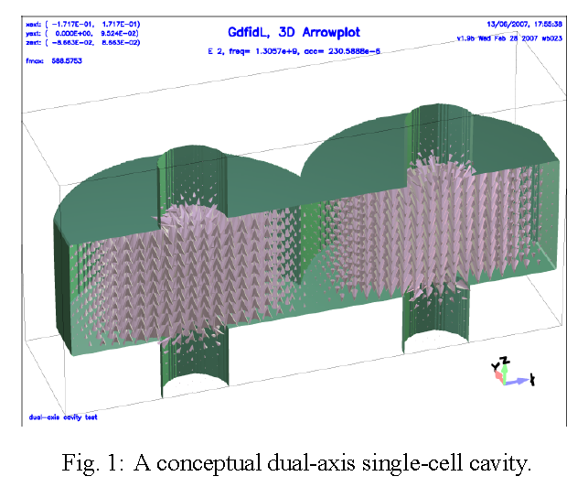
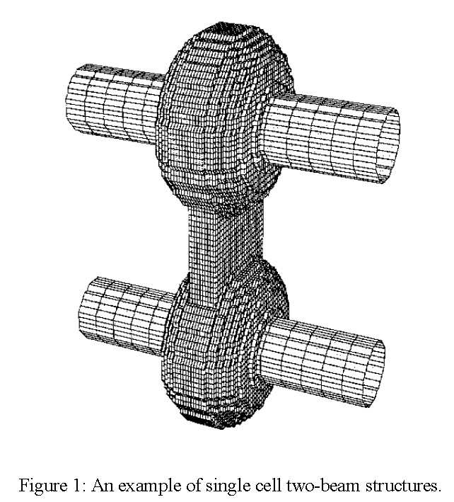
Past Proposals
Potential of multi-beam axis cavities for ERLs identified early (KEK - SRF 2003)
  Lower the beam energy in the injector
  Avoid a complex injection beam line and optics
  May allow to increase charge/current maintaining low beam emittance
  Deliver beam to ERL and FEL simultaneously
Squeezing the center of twin-axis cavity provides better balance of RF fields around two beam axes (favors weakly coupled structure, but not simple to press)
Later conceptual design (ANL - ERL 2007) using two more interleaved cavities
TM-110 mode is monopole mode (TM010-like)
TM-210 mode is operational mode (TM110-like)
Notes:
Red Interior Page Design 1

Slide 6
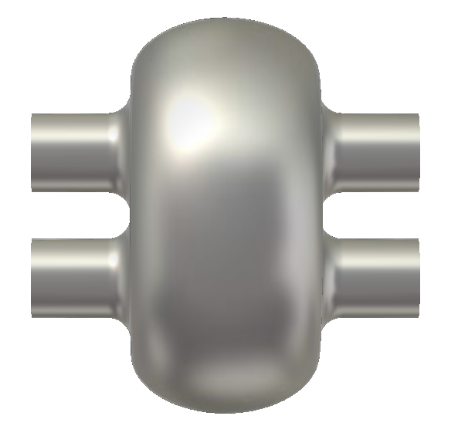
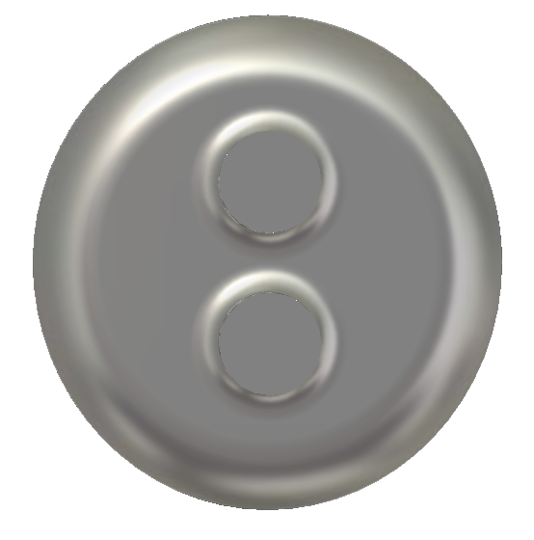
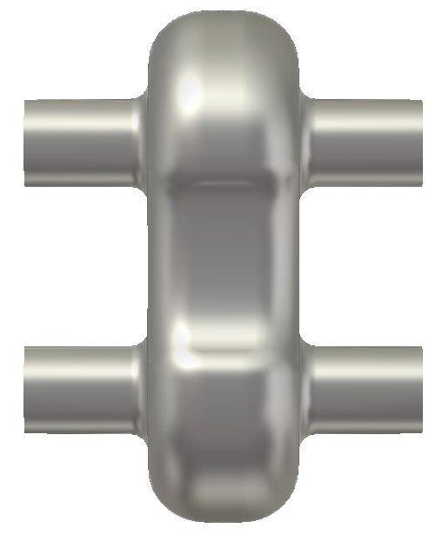
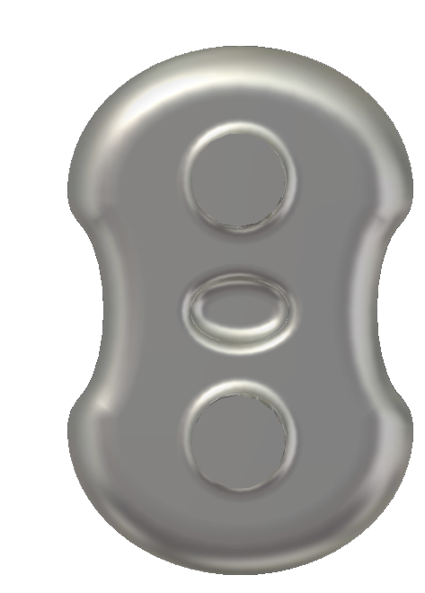
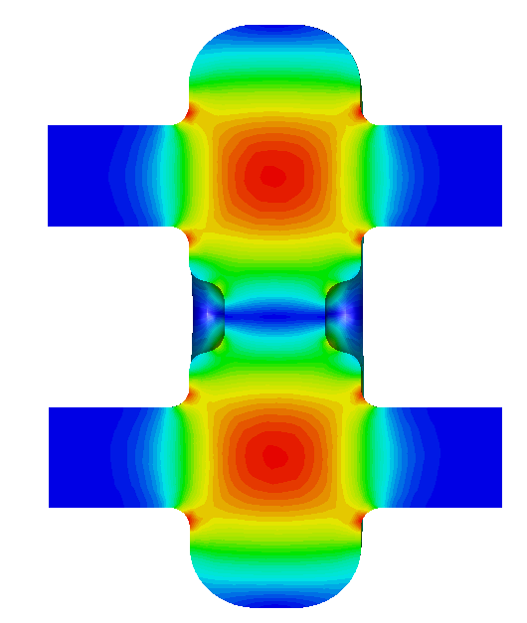
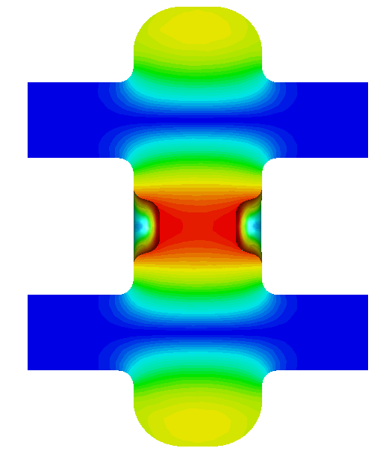
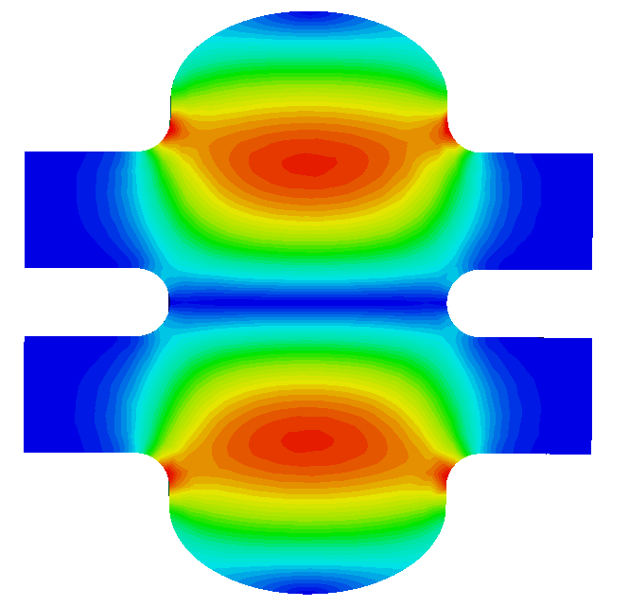
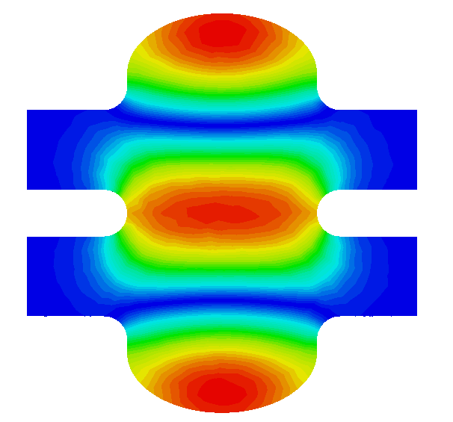
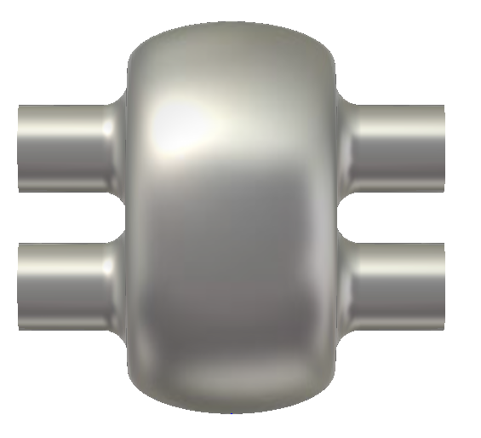
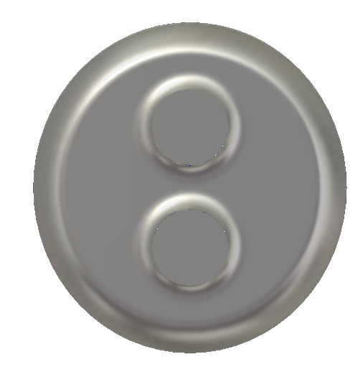
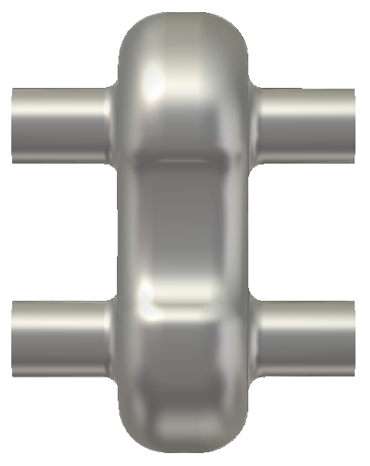
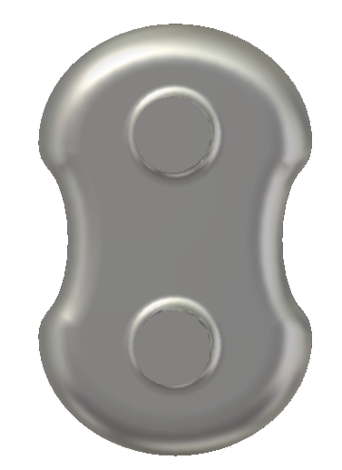
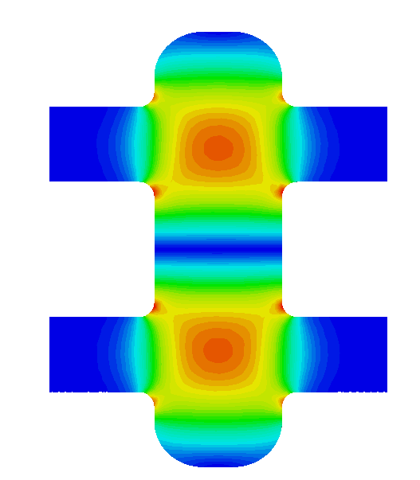
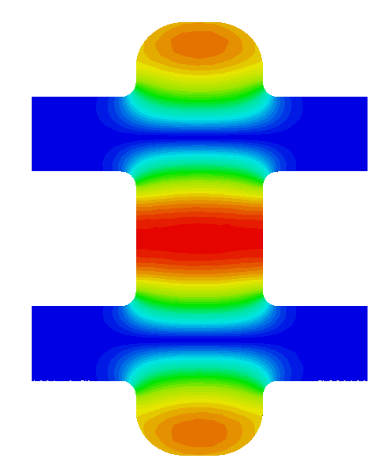
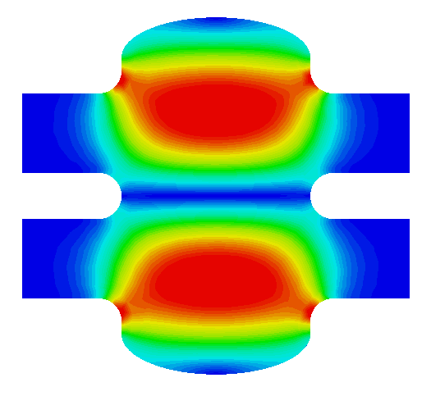
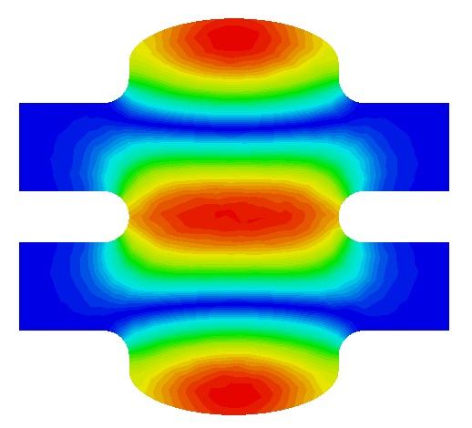
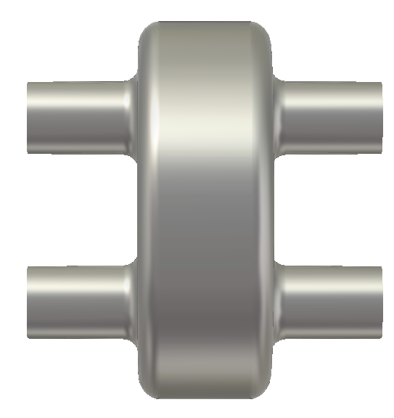
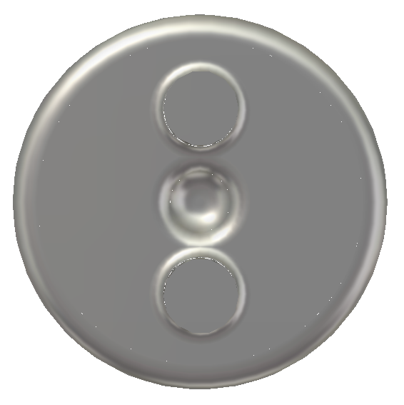
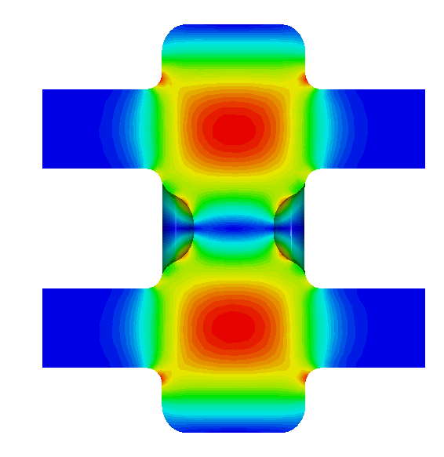
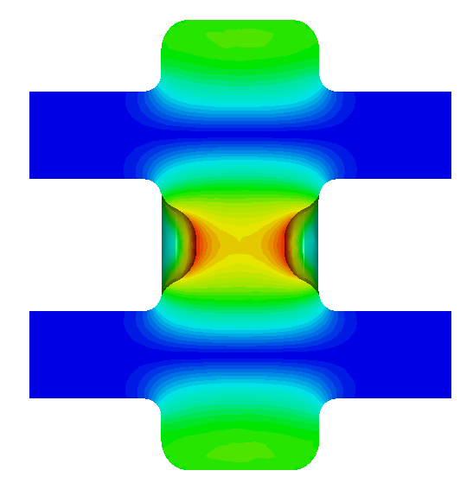
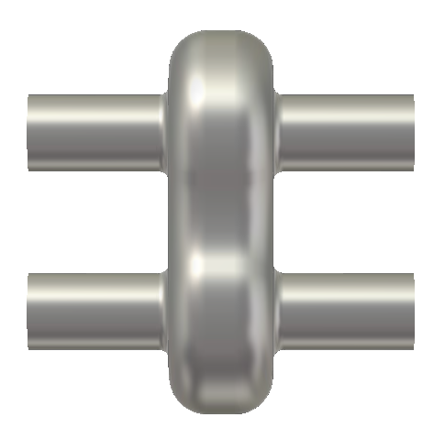
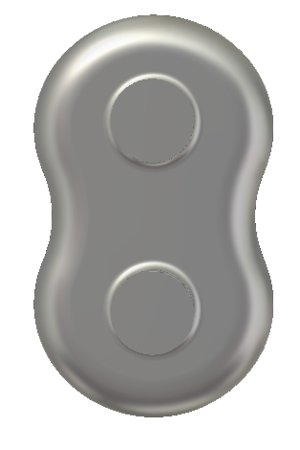
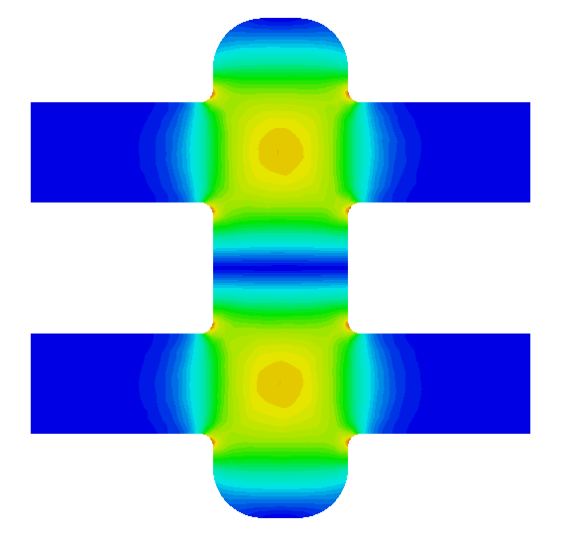
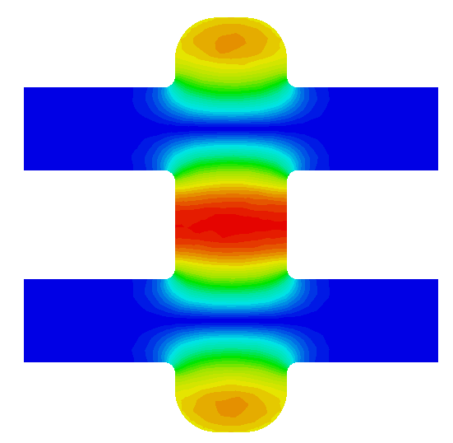
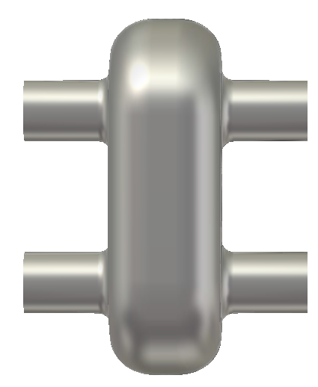
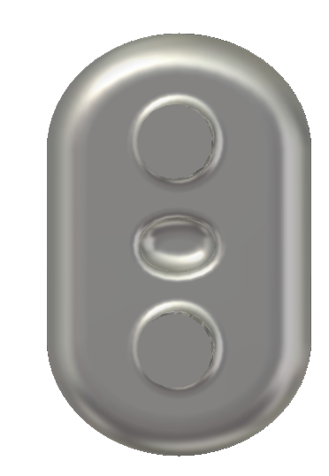
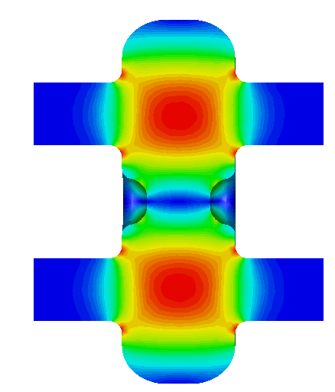
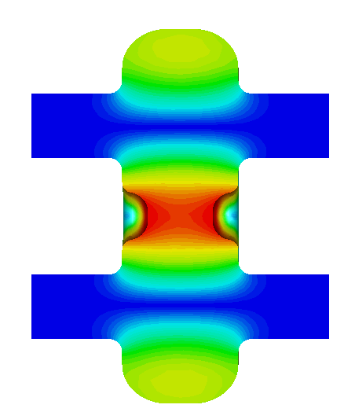
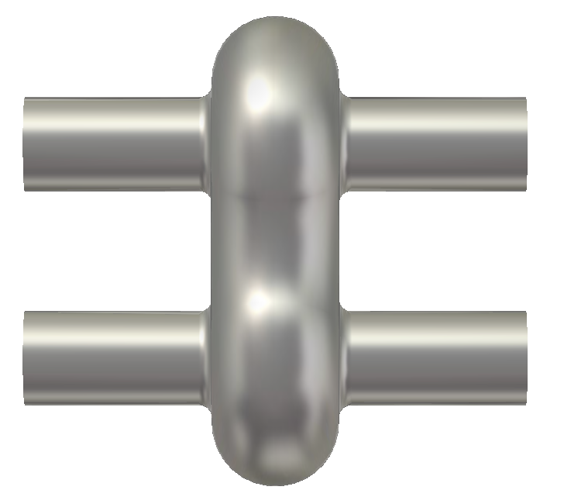
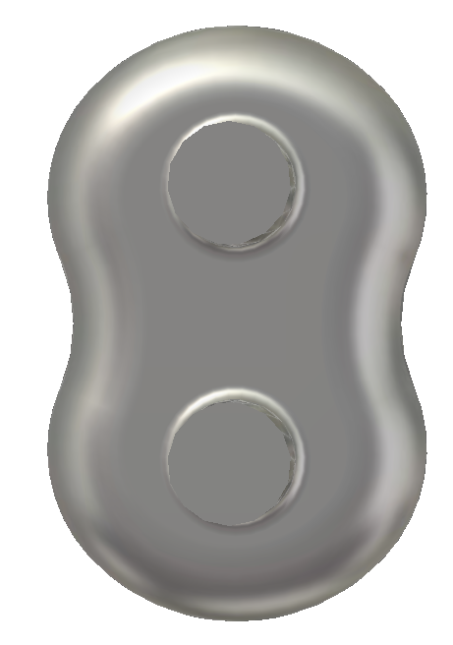
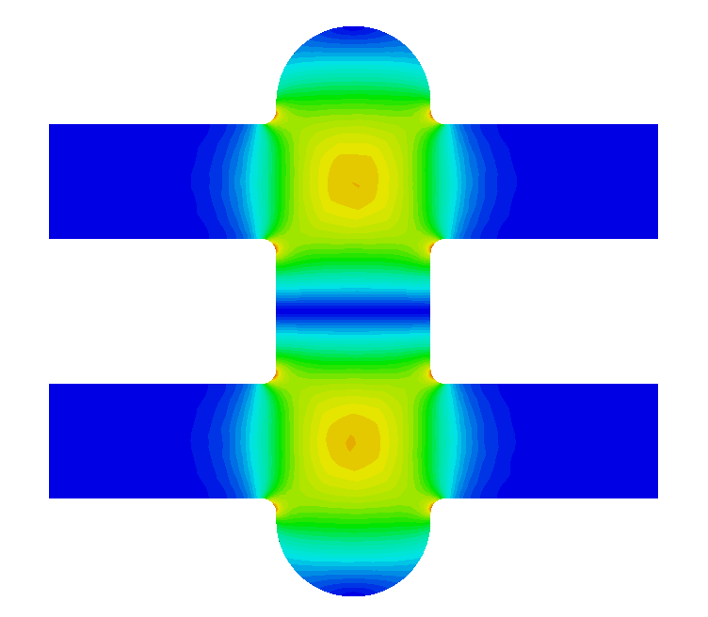
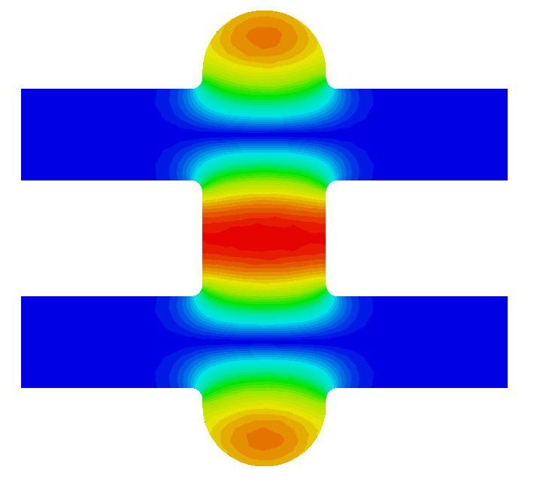




Design Evolution
$$\left|\vec{E} \right|$$
$$\left|\vec{H} \right|$$
$$\left|\vec{E} \right|$$
$$\left|\vec{H} \right|$$
Notes:
Red Interior Page Design 1

Slide 7
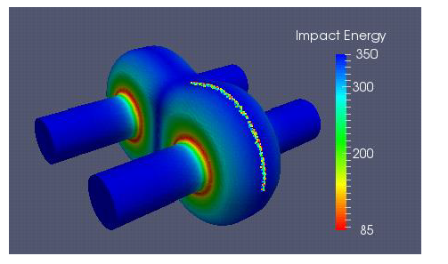
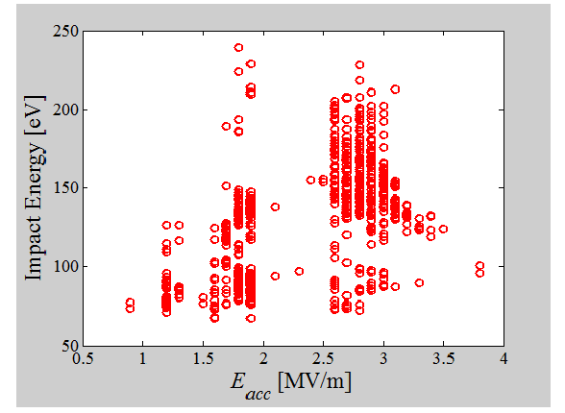
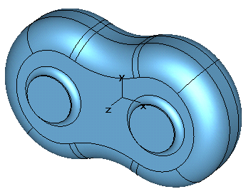
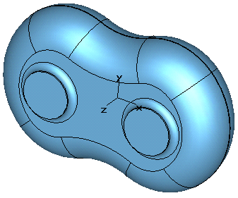
Multipacting (MP) Studies
E_{acc} = 15 MV/m is an envisioned operating field
3D ACE3P/Track3P resonant MP studies performed up to E_{acc} = 16 MV/m
  Electron impact energy range of 50-2000 eV considered
Electrons with resonant MP trajectories
at cell equator (impact energy in eV)
Impact energy of electrons surviving 50 RF cycles. MP barrier below E_{acc} = 4 MV/m
final design (increase equator axis)
MP barrier below 4 MV/m vanished (MP barrier beyond
16 MV/m still possible)
Notes:
Red Interior Page Design 1

Slide 8
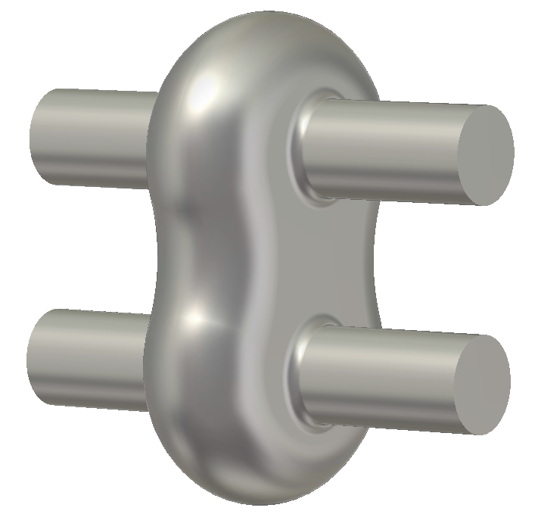
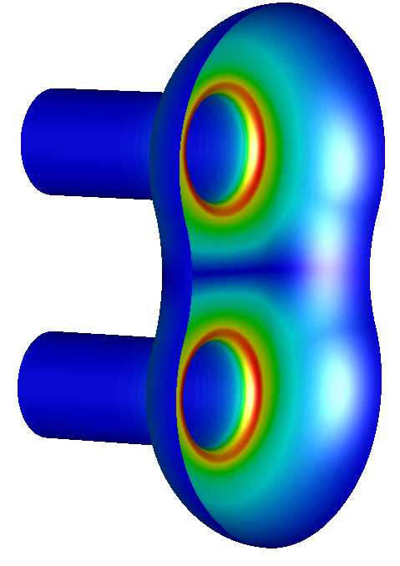
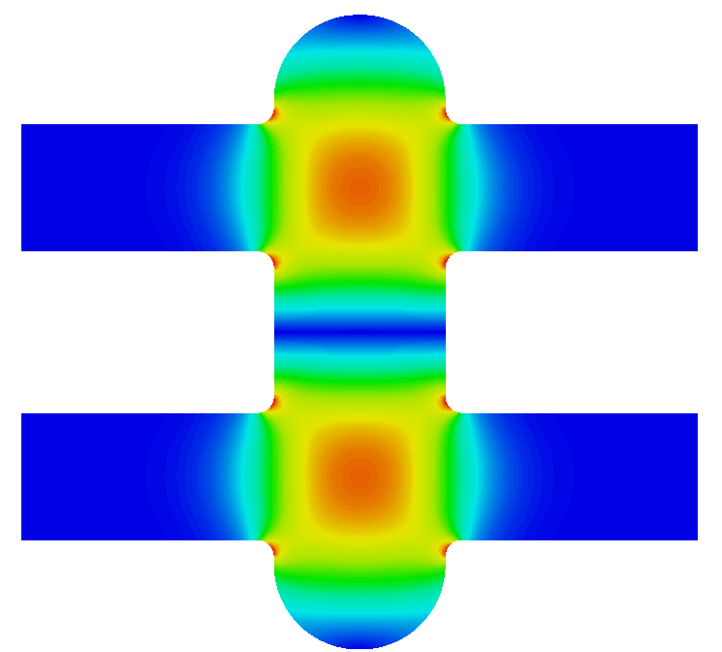
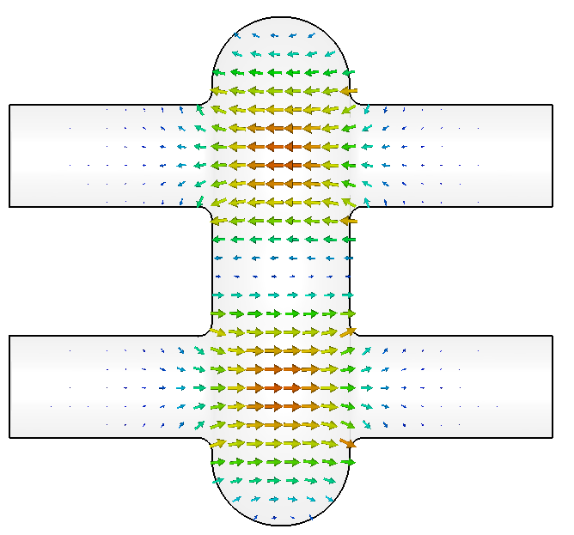
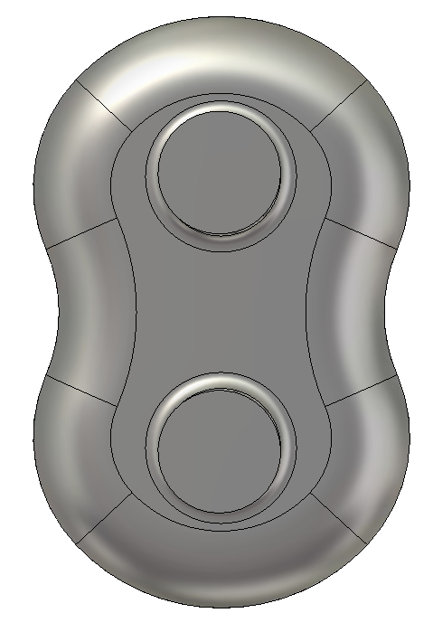
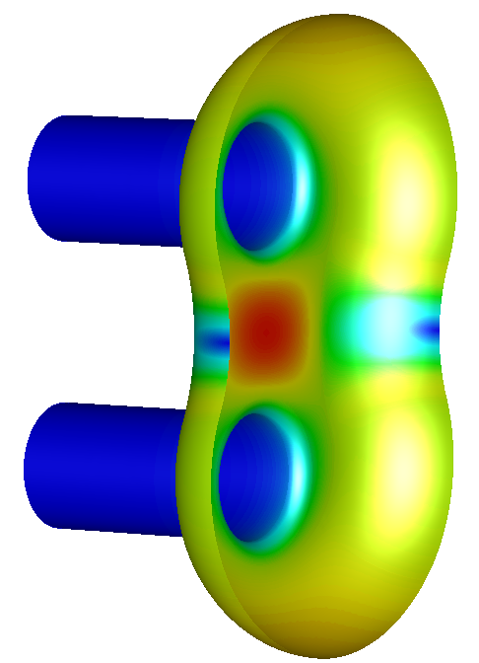
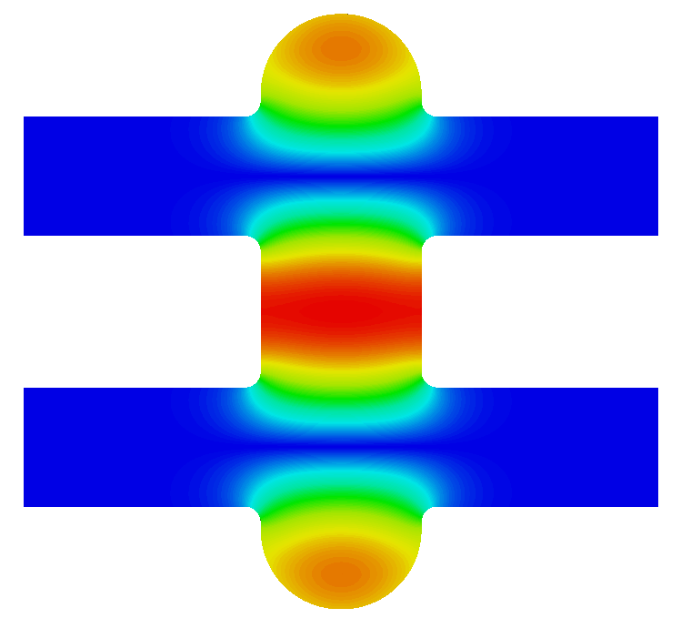
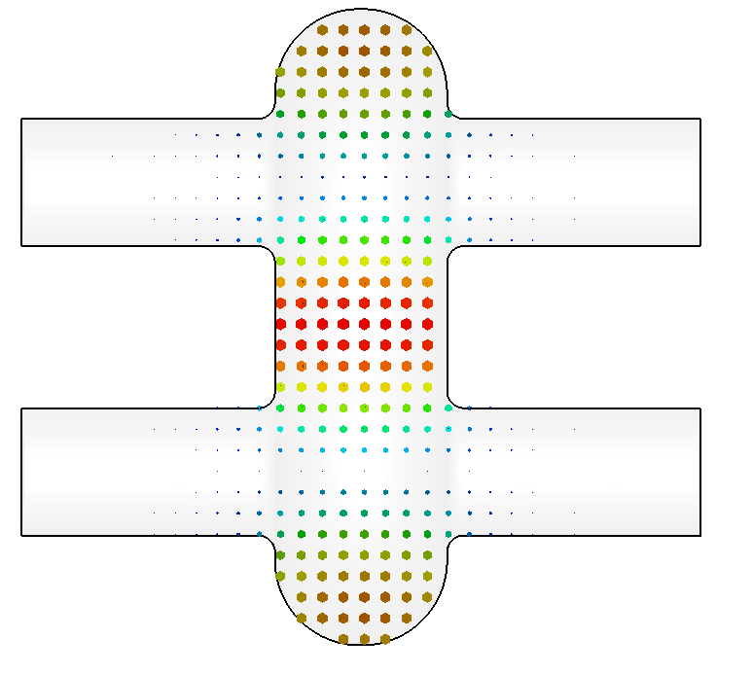
Final RF Design
Transverse field components of operating mode minimized at beam tube centers
Beam tubes slightly shifted off the peak electric field to cancel dipole effect
RF electric field plots
1.5 GHz design
RF magnetic field plots
∅ = 60 mm
136.44mm
B_{pk}
@ E_{acc} = 15 MV/m → B_{pk} = 78.9 mT
Notes:
Red Interior Page Design 1

Slide 9
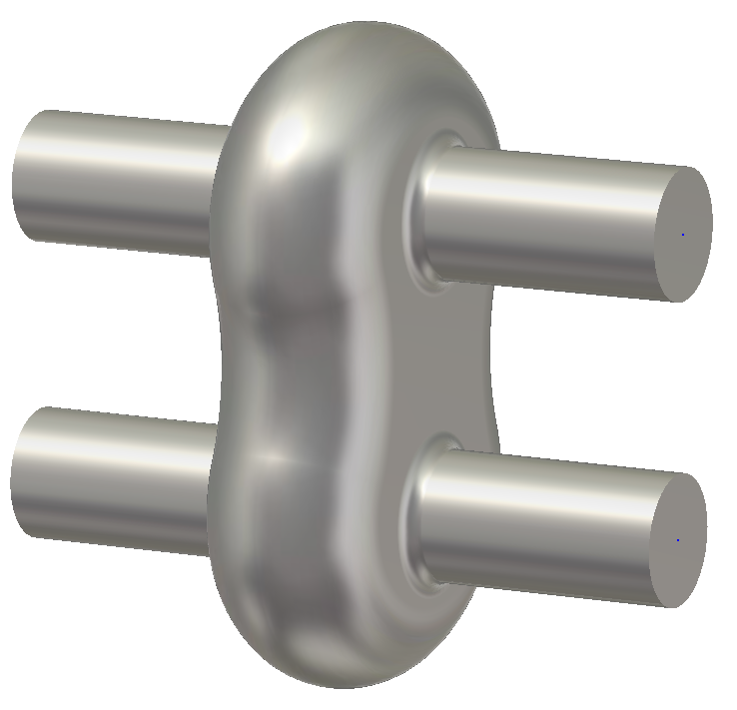


















Design Parameters - Comparison
$$\left|\vec{E} \right|$$
$$\left|\vec{H} \right|$$
KEK design
$$\left|\vec{E} \right|$$
$$\left|\vec{H} \right|$$
$$\left|\vec{E} \right|$$
$$\left|\vec{H} \right|$$
JLab/ODU design
strong coupling
weak coupling
Parameter |  | New JLab/ODU Design | KEK Design (2003) weak to strong coupling | JLab (KEK-type) Strong coupling | JLab (KEK-type) Weak coupling | Single-Tube Standard Cavity (C100 LL)
Operational mode |  | TM110 | TM110 | TM110 | TM110 | TM010
E_{pk}/E_{acc} |  | 2.33 | 1.9-2.1 | 2.26 | 2.20 | 2.17
B_{pk}/E_{acc} | mT·(MV/m)⁻¹ | 5.26 | 4.0-5.6 | 6.13 | 5.87 | 3.74
R/Q – US def. | Ohm | 61.8 | 57-63 | 62.9 | 62.5 | 103.71
G | Ohm | 313.8 | 210-250 | 266.5 | 270 | 282
R/Q·G | Ohm² | 19377 | 11550-14931 | 16773 | 16875 | 29270
Notes:
Red Interior Page Design 1

Slide 10











Deep-Drawing of Half Cells
Deep-drawing study done with Al and Cu discs (1/8” = 3.175 mm thick material)
male die
blank holder
hole punch die
female die
coining ring
blank shape for studies
final Nb blank shape (wire EDMed)
Al
Cu
Notes:
Red Interior Page Design 1

Slide 11







Fabrication Flow Chart
1st prototype twin-axis cavity
made from high RRR Nb (cavity #1)
after rolling
Notes:
Red Interior Page Design 1

Slide 12





Mechanical Fabrication Completed
We actually have built 2 prototype cavities concurrently
One concern was that electron beam welding (EBW) requires full penetration weld
along a rather complex curvature with varying beam current
cavity in EBW chamber
Cavity #1
Cavity #2
outside machining on half cells for full penetration weld
equator weld prep
after rolling
Notes:
Red Interior Page Design 1

Slide 13



















EBW Experience – 1st Prototype
Outside machining of equator done based on ideal cavity contour
Does not take into account spring-back effect of cell material after forming
Equator thickness variations along perimeter was actually on the order of ~1 mm
Welder decided to weld, but faced issues:
  1) Few blow-thru holes → needed to be patched by local re-weld
  2) No full penetration weld achieved on narrow sides after 1st weld pass
  → 2nd weld pass conducted all around perimeter for repair (twice the weld shrinkage)
Deep patches likely limit performance
  Attempt will be made to locally grind blemishes with grinding tool
Centrifugal barrel polishing is an option depending on outcome
Cell 1: 0.076-0.112” [1.93-2.82 mm]
Cell 2: 0.068-0.108” [1.73-2.74 mm]
Kyoto camera inspection
after rolling
Notes:
Red Interior Page Design 1

Slide 14










EBW Experience – 2nd Prototype
Lessons learned applied to 2nd prototype
Outer contour of half cells as pressed has been recorded with CMM
Inner contour machined with reference to actual outer profile to provide better
uniformity of equator thickness around perimeter (0.07” ± ~0.01”)
Full penetration weld achieved on 1st pass, overall cleaner weld seam
However: still few holes blown thru, needed local patches
outer cell contour as measured with CMM
Endgroup equators machined
at interior to achieve nearly
uniform thickness
endgroups after final
machining
2nd prototype cavity after equator welding
clean weld seam
Irregularity, varying e⁻
(this is not a patch)
Notes:
Red Interior Page Design 1

Slide 15
Summary
Design and fabrication of new twin-axis single-cell cavity completed
First proof-of-principle, while using standard fabrication techniques
Actually delivered 2 prototypes (extra cavity beyond scope, but within budget)
No major feasibility issues concerning production, but several lessons learned as part of prototyping:
  Equatorial electron beam weld of curved perimeter is not standard, full penetration weld needed (riskier than outside/inside weld)
  Weld parameter/current changes, JLab welding machine is mature and programming did not allow to vary parameters smoothly, but stepwise
  Few holes were blown thru and needed local re-welding
  Equatorial weld preparation improved for 2nd prototype by proper machining based on measured contour after forming → full penetration achieved without 2nd weld pass, overall improved quality of weld seam
  Welding issues likely avoidable if more time would have been available for practicing welds
Notes:
Red Interior Page Design 1

Slide 16



Summary
One design benefit:
$$\frac{B_{pk,eq.}}{B_{pk}}=80 \%$$
B_{pk} = 0
B_{pk}
So what’s next?
  Cavity #1 interior will be grinded, CBP considered
  But cavity #2 will proceed to vertical RF baseline test as-is in parallel
Chemical post-processing (bulk BCP) is panned for cavity #2
  High pressure rinse hardware under development
Vertical test coming soon (all still within budget)…
Notes:
Red Interior Page Design 1

Slide 17
In Memory of My Beloved Brother
Jost Marhauser
24. Aug. 1973 – 23. July 2016
Notes:
Red Interior Page Design 1

Slide 18
Back-Up Slides and Additions

Slide 19


Target Frequency
Target frequency is 1497 MHz at 2K under vacuum, but exact frequency not important for vertical testing (large RF bandwidth)
For this reason we did not trim half cell equators based on frequency measurements (would need dedicated RF fixture), but aimed for nominal length (incl. weld shrinkage)
Unfortunately, all (4) endgroups were inadvertently trimmed considerably too short
Based on length shortage, the expected frequency (warm, air) is 1499.64 MHz
  Cavity #1 measured: 1506.03 MHz
  Cavity #2 measured: 1501.27 MHz
  Discrepancy is Δf = 4.73 MHz, double weld-shrinkage for cavity #2 only accounts for 1 MHz
  Rest are fabrication tolerances, note: spring-back effect can be large (several MHz)
TM110 trimming sensitivity for
endgroup is 4.16 MHz/mm
Notes:
Red Interior Page Design 1

Slide 20








Mechanical Stiffening of Cavity
Heat treatment for H2-degassing (typically at 800 °C) reduces Young’s modulus (YM) of high RRR Nb material (100 GPa to ~30 GPa)
  Chemical vapor-deposition of Nb3Sn considered at later stage (T = 1200°C)
  Need to consider worst case when YM ~ 30 GPa and yield strength ~ 30 MPa
Beam tubes deflect when cavity evacuated
  Added minimal stiffening between tubes to stay within the elastic range
no stiffener
1 ksi ~ 6.895 MPa
VTA setup with gravity and outside pressure of 0.133 MPa considered
with stiffener
  SSR = Slow Strain Rate is 5.561e-5 s⁻¹
  FSR = Fast Strain Rate is 2e-4 s⁻¹ up to yield point
  and 1e-3 s⁻¹ until break
Stress linearization along thickness
(Membrane stress) resulted in only 11.8 MPa
G.R. Myneni et al., Proc. of SRF 2003
after rolling
Notes:
Red Interior Page Design 1

Slide 21


2-Beam Excitation Scheme
Drawback: In twin-axis cavity monopole modes may have dipole components to kick the beam away from tube axis and transverse HOMs can be excited on tube axis since long. field components may exist
How to quantify drawback without specific ERL design and optics?
Beam excitation can be resembled numerically with 2-beam excitation scheme
to calculate broadband coupling impedance or loss factor
  Accelerating and decelerating beam in cavity cell at the same time
acc. beam
acc. beam
dec. beam
e⁻
e⁻
e⁻
dec. beam
e⁻
Conventional TM010 cavity
2 beams counter-propagating
(ERL mode)
Twin-axis TM110 cavity
- 2 beams co-moving (ERL mode)

Slide 22

2-Beam Loss Factor
Expect larger energy deposition in parasitic modes for twin-axis cavity compared to standard single-axis cavity
Machine and beam-pattern dependent BBU impedance instability threshold must be considered
Avoid beam spectral lines by design
HOM-damping necessary

Slide 23


2-Beam Coupling Impedance
Unresolved (bare cavity) broadband coupling impedance on tube axes
Operating mode - zero beam loading
Bare cavity
TE11 cutoff

Slide 24



2-Beam Coupling Impedance
Preliminary study – add HOM couplers (beyond scope funded project)
TESLA-type coaxial couplers (scaled), no further optimization
Critical HOM impedance can be damped further with adequate
coupler design – up to 4 beam tubes available
TE11 cutoff
TESLA-type coaxial
couplers (scaled – no
optimization)

Slide 25



Prospect for Multi-Cell
Single-die design built in consideration of fabrication of a multi-cell cavity
HOM-damping studies beyond scope of funded project
Notes:
Red Interior Page Design 1

Slide 26




Alternative
Two independent cavities, one resonant coupling cell for
TM010 operational mode (only)
Mitigate regenerative BBU with cavities of slightly different shape and decoupled HOMs
  Threshold current for instabilities increase by factor ~5 compared to symmetric cavities

