Slide 1
eRHIC Multi-Pass ERL
eRHIC – future electron-ion collider at BNL
Two eRHIC design options
ERL-based eRHIC design Features
SRF Linac
Two variants of recirculation passes
R&D efforts for polarized electron gun
Summary
Vadim Ptitsyn
on behalf of eRHIC design team

Slide 2
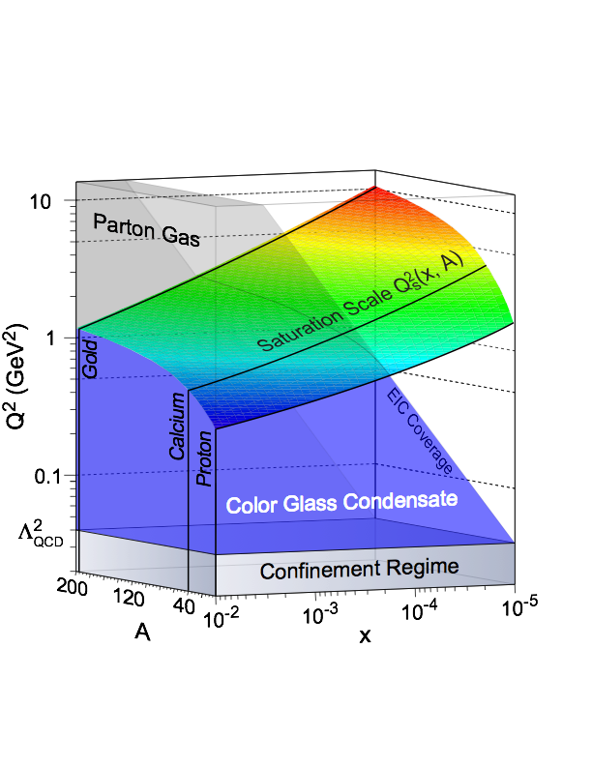
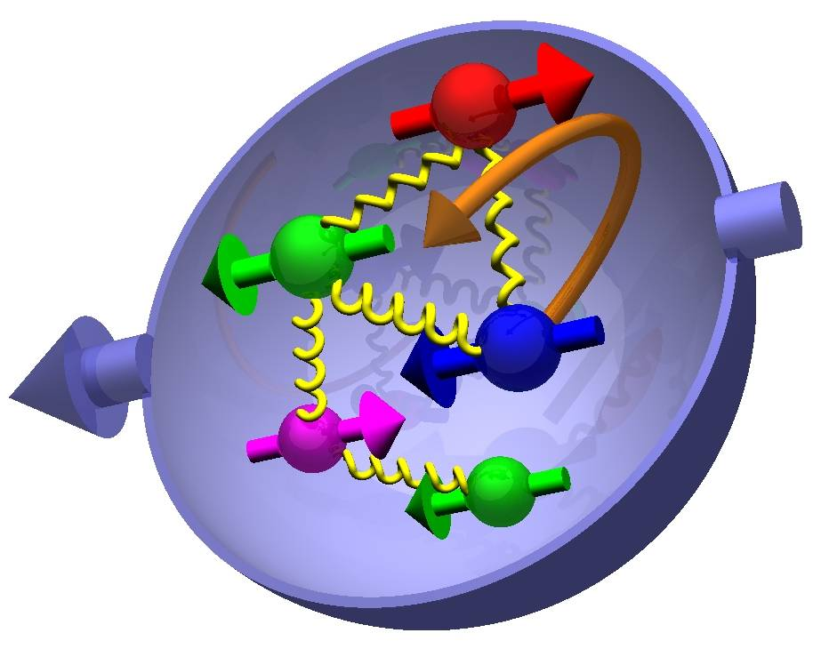
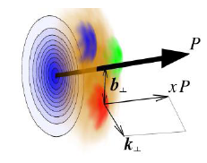
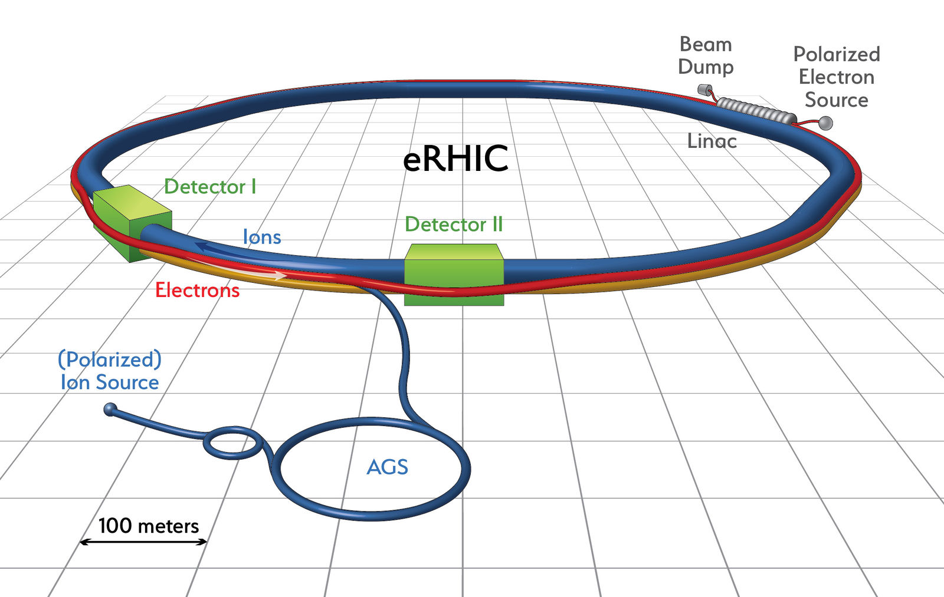
Electron-Ion Collider at BNL, eRHIC
US Nuclear Physics Long Range Plan recommended a high-energy high-luminosity polarized EIC as the highest priority for new NP facility construction.
Study of gluon dominated matter,
Discovery of color-glass condensate
(high CME , e-A)
3D nucleon imaging,
nucleon spin origin
(high L, polarized e-p)
  Add an 18 GeV electron accelerator to the existing $2.5B RHIC complex
  In addition to the hadron machine eRHIC will re-use the existing infrastructure: RHIC tunnel and buildings, detector halls and cryo facility
  Take full advantage of existing polarized proton capability
  Take full advantage of existing heavy ion capability and large energy reach for gluon saturation studies

Slide 3
Two eRHIC Design Options
Main goals (and challenges) of eRHIC accelerator design:
  L ~10³³-10³⁴ cm⁻²s⁻¹ (exceeding HERA luminosity by 2 orders of magnitude)
  High electron and proton polarization (>70%); Realizing complex spin pattern
  Satisfying large acceptance detector, with detector elements integrated in the accelerator IR for forward particle detection
  Minimizing the construction and operational cost of accelerator
To realize the goals two design options have been evaluated
ERL-Ring
Electron linear
Accelerator (ERL)
Ring-Ring
Electron storage ring
Ion ring
Ion ring
  High luminosity is based on small beam size in IP
  L ~ E_{p}
  Cost efficient; straightforward staging
  Requires some accelerator technology beyond present state-of-the-art
  Main challenge: polarized electron source. Presently addressed by corresponding R&D effort.
  High luminosity is based on high current of electron and proton beams
  L ~ E_{e}*E_{p} = 0.5*E_{CM}²
  Less technological challenges than in ERL-Ring
  Challenges: High electron beam current and synchrotron radiation; Polarization
  Present design efforts are concentrated on this option towards a pre-conceptual design report at middle 2018.

Slide 4
ERL-Ring Design Features
Based on re-circulaitng electron linac (12 GeV CEBAF) and high current Energy-recovery linac technologies.
Beyond present state-of-the-art: 50 mA polarized electron source and high-energy high-power ERL.
Single collision of each electron bunch. No limit of electron beam-beam effect on luminosity.
Small electron beam emittance.
Maximum electron energy: 18 GeV
50 mA polarized electron source employing merging electron current produced by multiple electron guns
Main ERL SRF linac(s): 647 MHz cavities, 3 GeV/turn
Six individual re-circulation beamlines based on electromagnets
For very high luminosity (~10³⁴ cm⁻² s⁻¹) with hadron cooling system (CeC)
Interaction region design with crab-crossing satisfying detector acceptance requirements
I_{e}=50 mA
More in V. Litvinenko’s talk on Friday

Slide 5
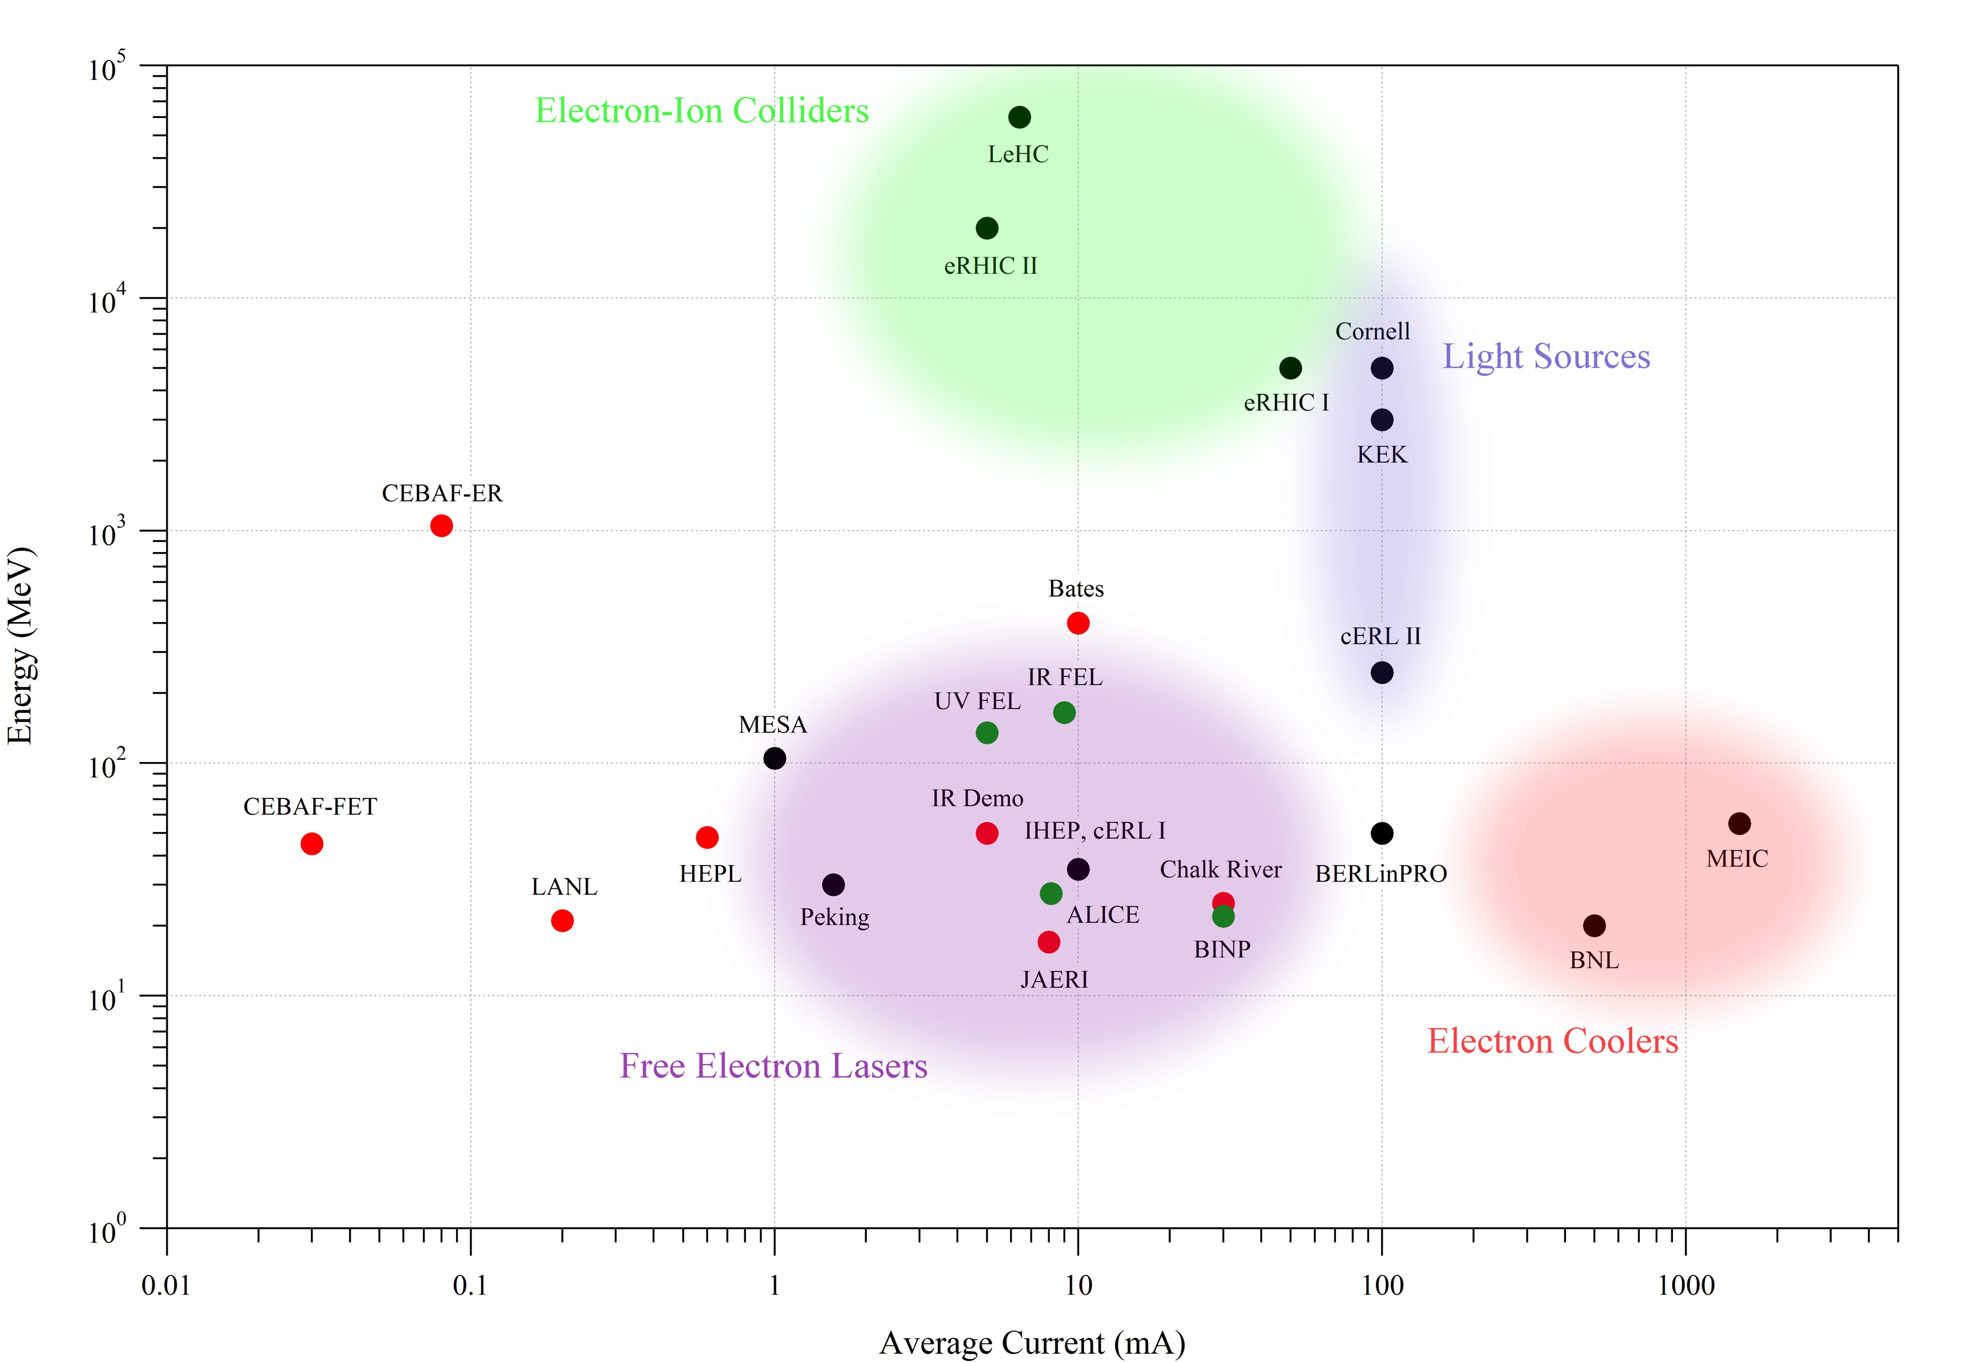
Energy Recovery Linacs
Red-past
Green-present
Black- designed or constructed
eRHIC
ERL@CEBAF
4pass CBeta
2pass MESA
4pass BINP

Slide 6
eRHIC ERL: Stepping up in beam current and beam power
Major issues related with stepping up in the beam current and the beam power:
Multi-pass Beam Break Up Instability
  the cavity design and proper HOM damping to minimize HOM impedances
  straightforward simulations to ensure that the instability threshold is large enough
  machine lattice incorporating specific tools like betatron phase adjuster, and betatron coupling and/or large chromaticity (if needed)
Beam losses control/prevention:
    Accounting and evaluating all possible beam halo sources
    Proper choice of magnet apertures
    Collimation system
    Adequate beam current and beam loss diagnostics

Slide 7
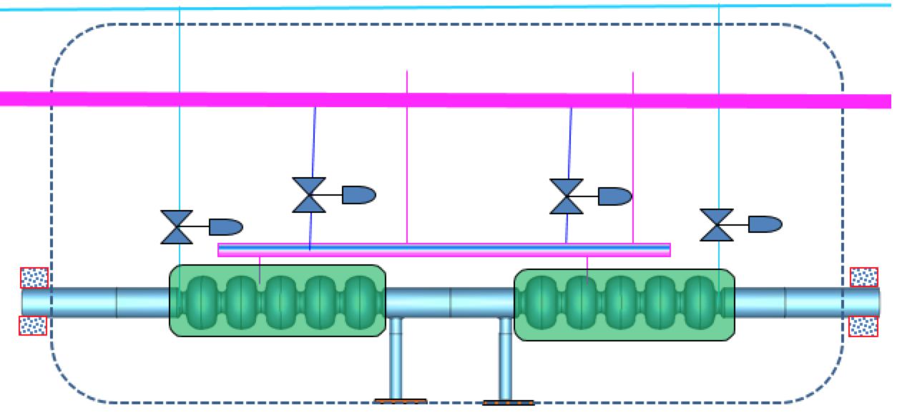
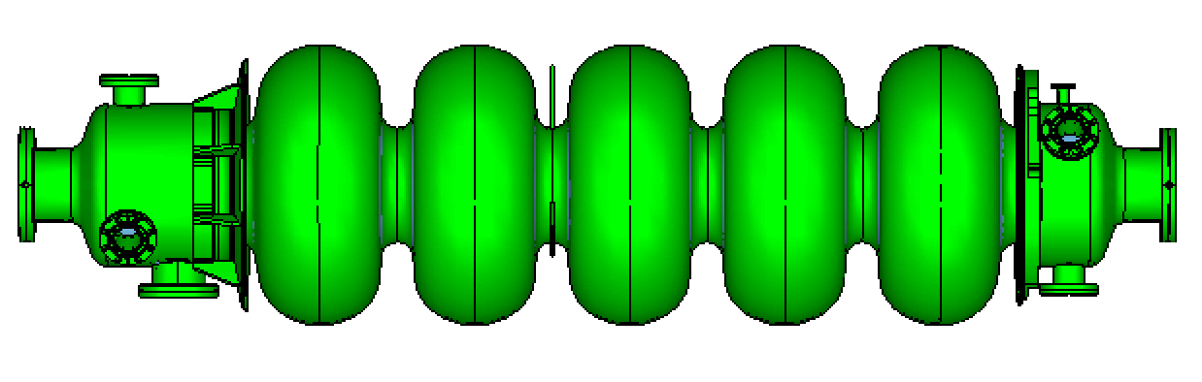
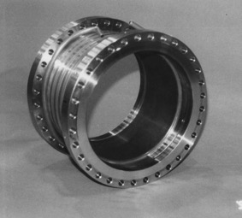
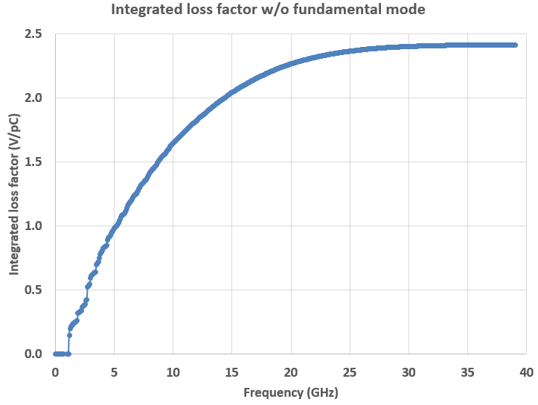
Main Linac SRF
Cryomodule
647 MHz 5-cell cavity
Gradient: 18 MV/m@Q0=3e10.
FPC power: 30 kW, Qext: 1.7e7
Cooling 1.9K LHe
Total amount: 144 cavities in 72 cryostats
Frequency of main linac accelerating cavities is benefitting from the 650 MHz SRF development program for the Fermilab PIP II project.
Room temperature
SiC

Slide 8
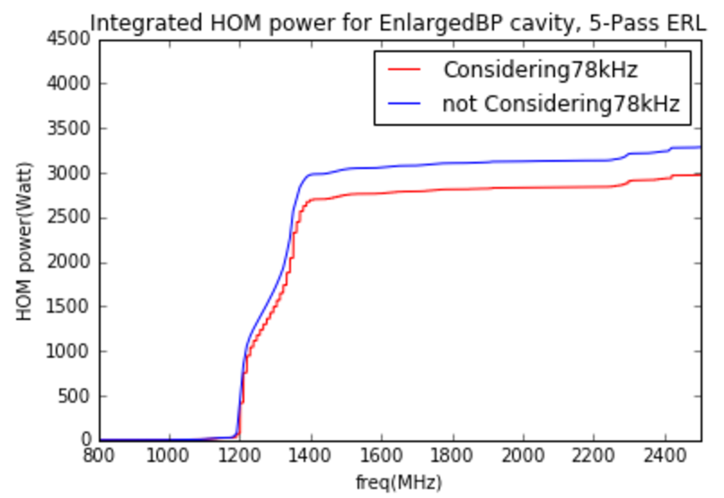
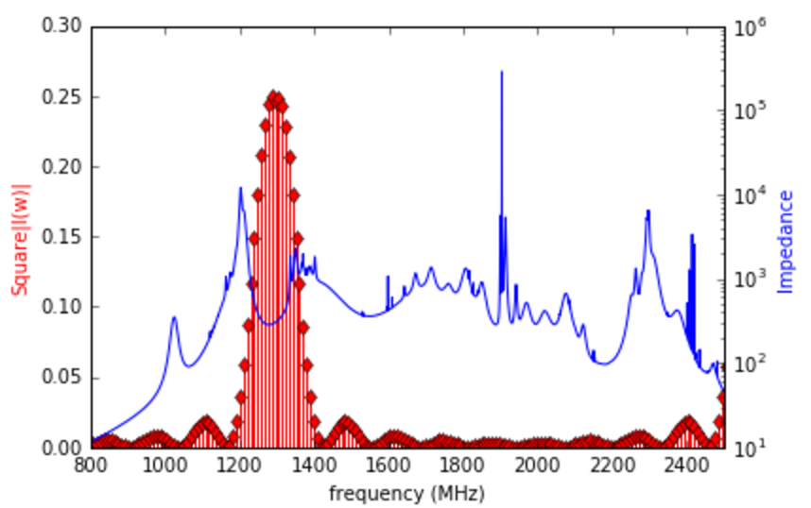
HOM power
© W. Xu
with ion clearing gap
This is an example of HOM power calculated with a bunch pattern corresponding to completely interleaved accelerating and decelerating bunches
Several hundreds mA of total beam current in the Linac -> HOM power up to 7 kW per cavity.
  This is similar to circulating beam in storage rings at KEKB and Cornell where up to 10 kW of HOM power is absorbed with Ferrite or SiC beam- pipe dampers
Low risk solution: room temperature SiC absorbers
Ideal solution: combination of SiC and ridged waveguide absorbers

Slide 9
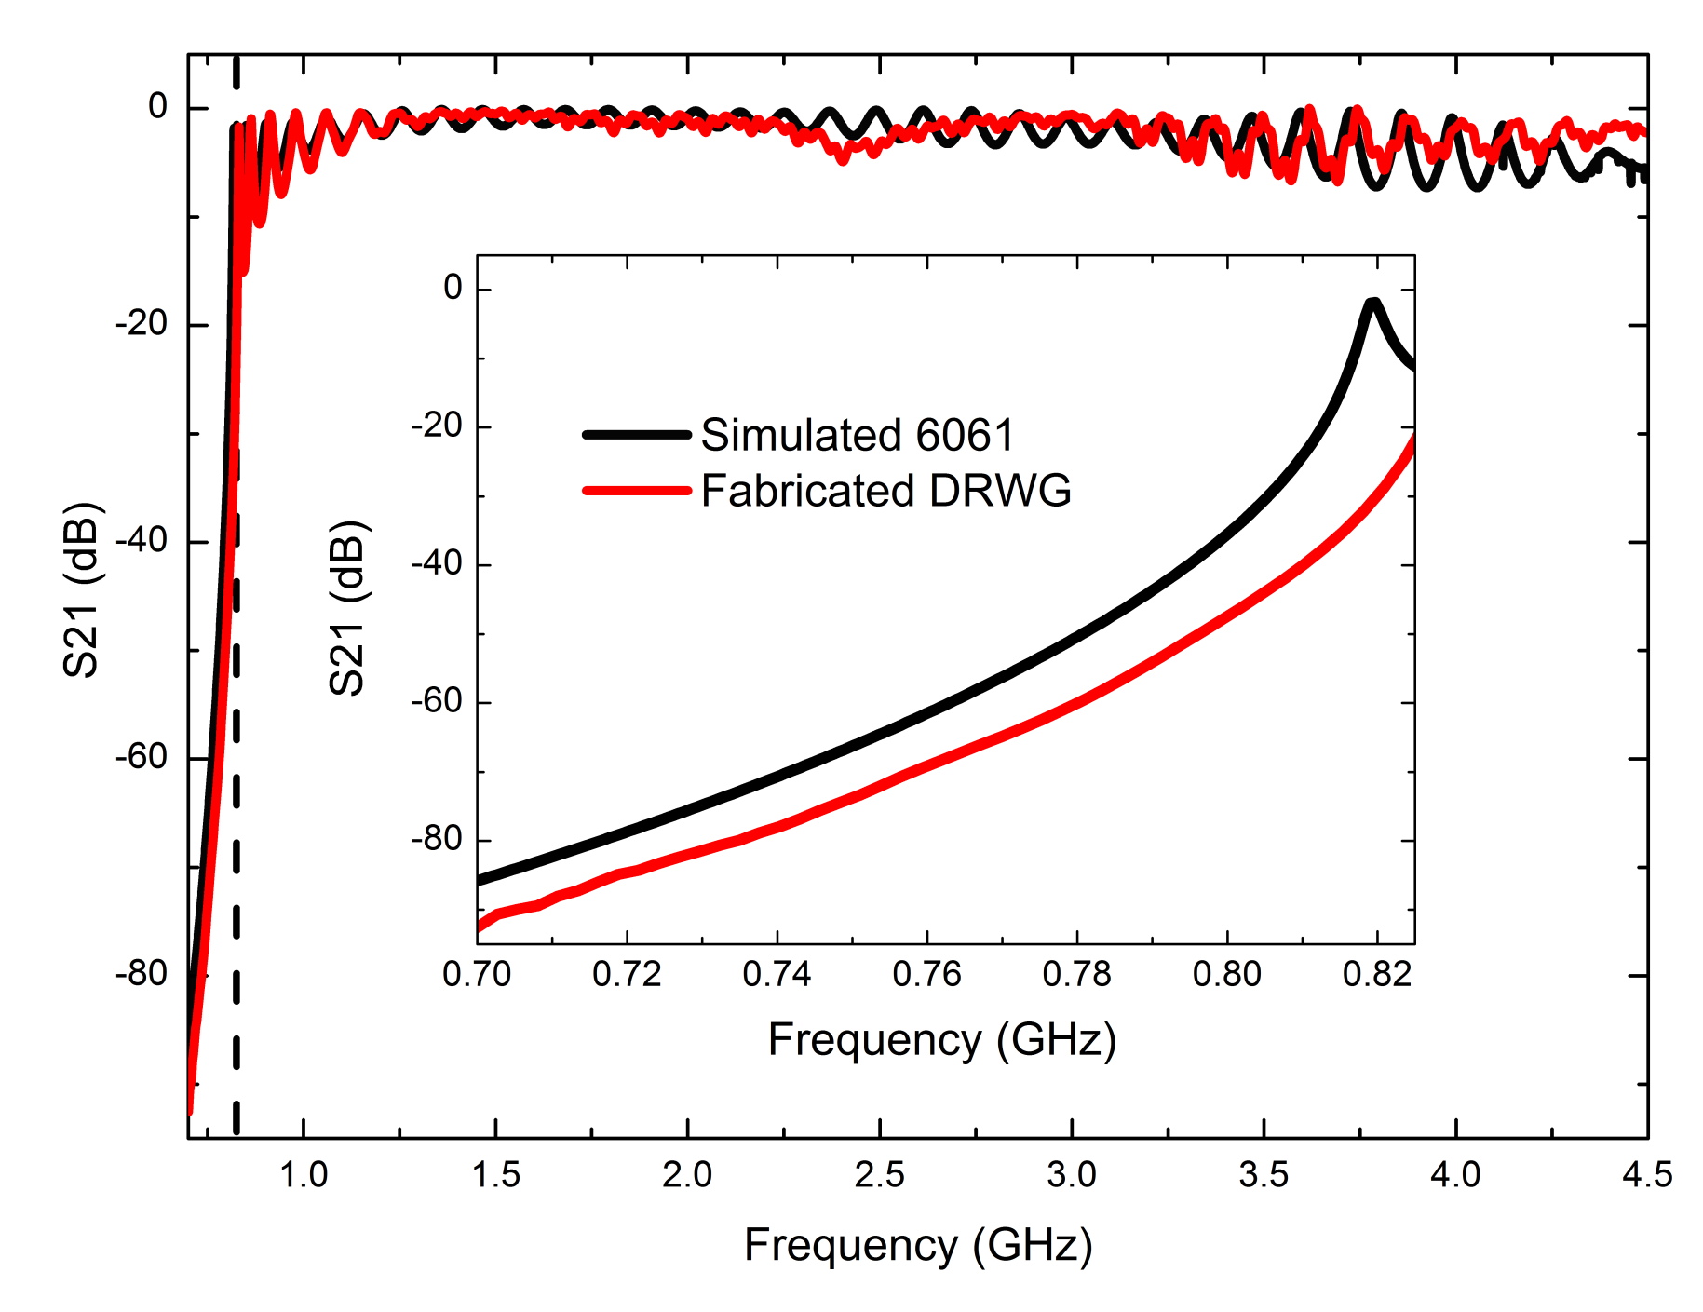
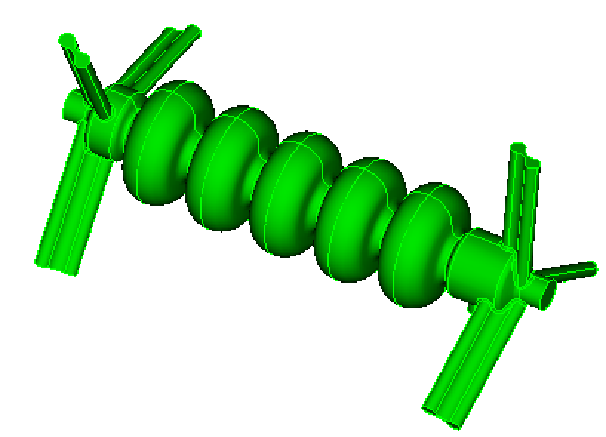
R&D for 650 MHz Cavity and HOM Damping
The R&D effort is underway:
  Copper prototype of 650 MHz 5-cell cavity has been recently fabricated.
  HOM measurements are ongoing.
  Superconducting prototype is being fabricated by RI. Expected delivery in fall 2017.
    HOM damping technology using both ridge waveguide dampers and beam pipe absorbers will be tested with cavity prototypes (2017-2018).
650 MHz cavity with ridge waveguide dampers
Ridge WG is a natural high pass filter with higher bandwidth, smaller size than regular WG.

Slide 10
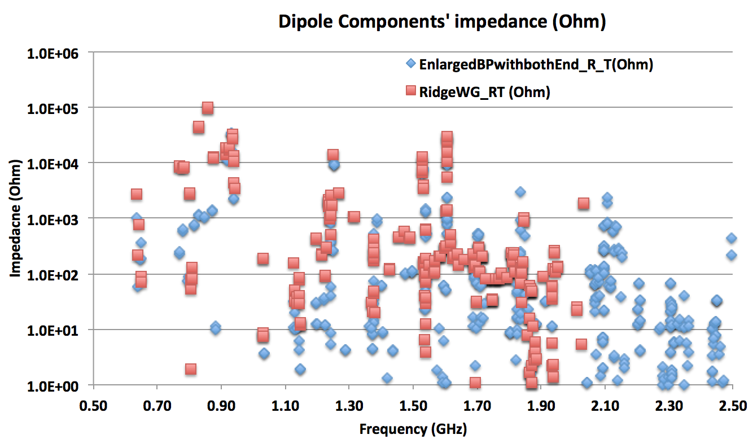
Dipole HOMs
@W. Xu
Beam pipe absorbers (Ohm)
Ridge waveguide absorbers (Ohm)
These data were used as an input to the MBBU simulations
From simulations with 12-recirculation pass lattice the MBBU threshold is expected to be above 100 mA

Slide 11
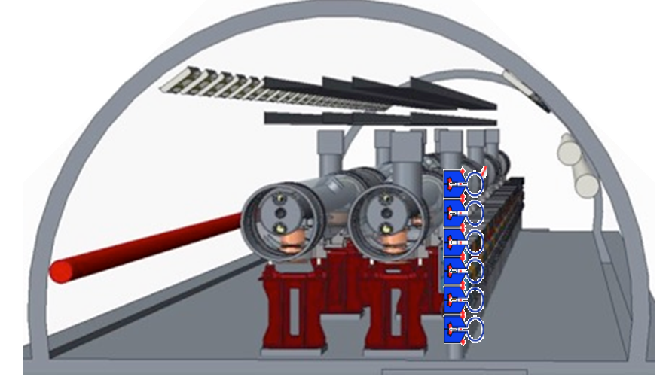
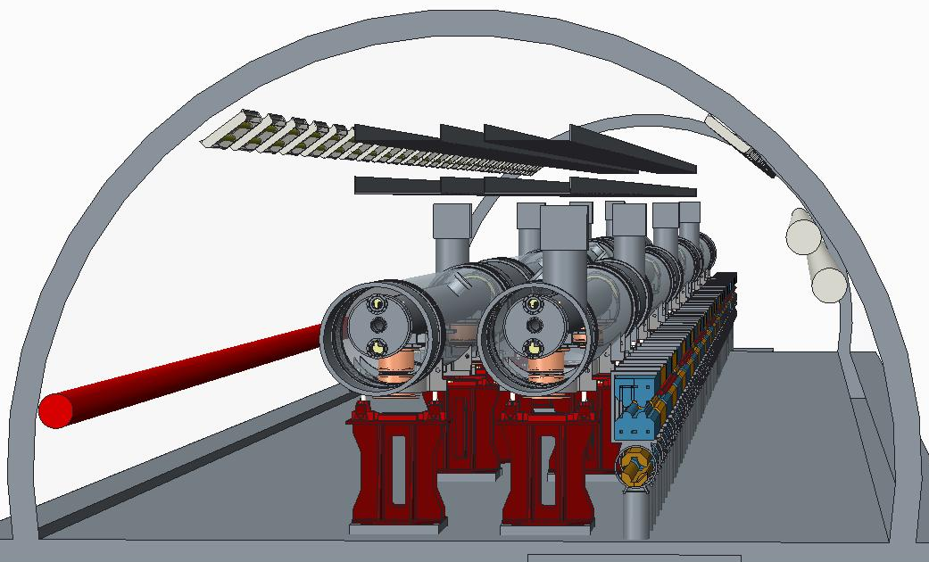
Recirculation passes
Two options for recirculating passes have been considered.
For both options lattice design has been developed.
Standard approach:
Up to 6 vertically stacked return loops
Novel approach:
Using 2 FFAG beamlines
Accelerating up to 18 GeV requires 2 linacs placed in two 200 m straight sections of RHIC tunnel
Accelerating up to 21 GeV requires one linac placed in one 200 m straight section of RHIC tunnel. Up to 16 recirculations are possible. Number of re-circulations is limted by HOM consideration (power and MBBU)

Slide 12
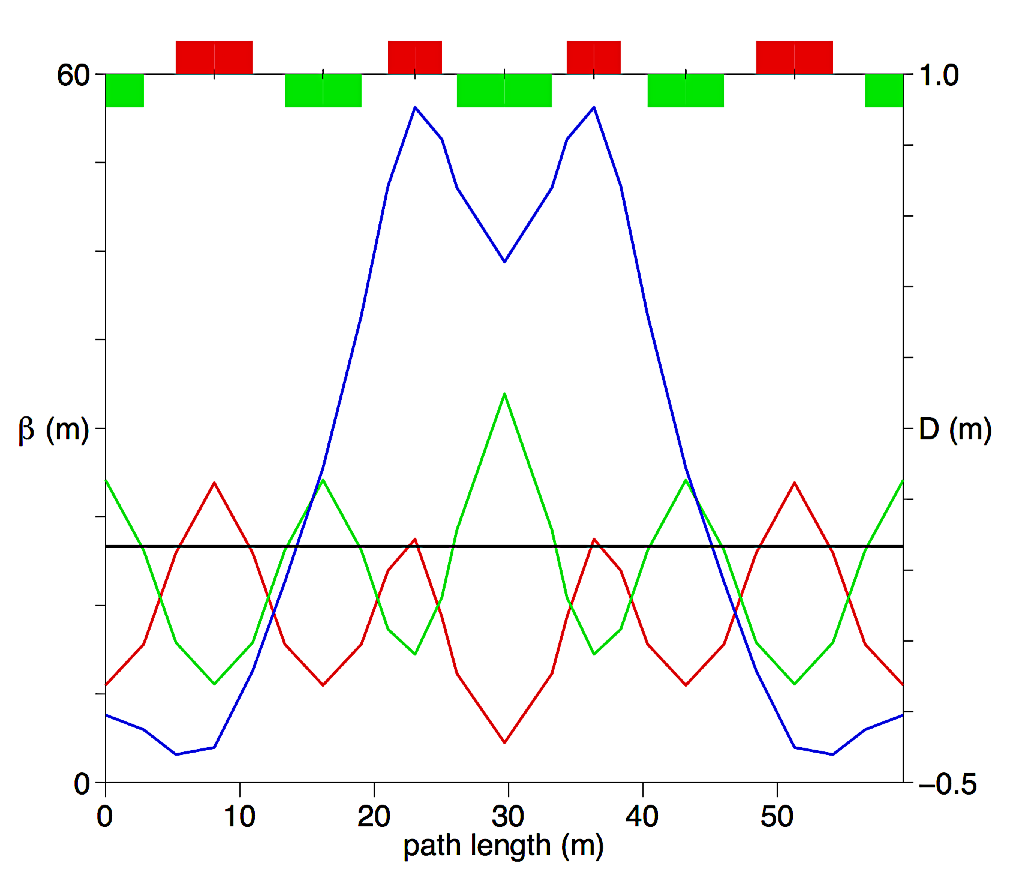
Individual recirculation pass lattice
The lattice has been optimized to the number of magnets and synchrotron radiation effect.
Lattice basic cell:
Isochronous cell based on combined function magnets
Synchrotron radiation for 12-18 GeV operation with 50 mA current ~1 MW
R₅₆ tuning done by adjusting cell quads.
© D. Trbojevic
D_{x}
β_{y}
β_{x}

Slide 13
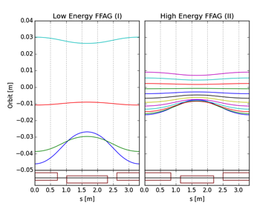
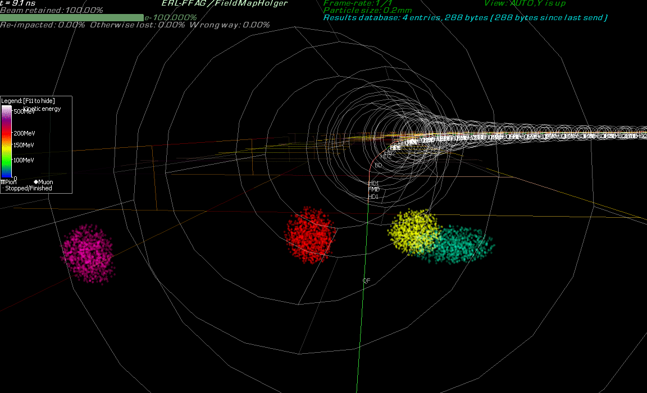
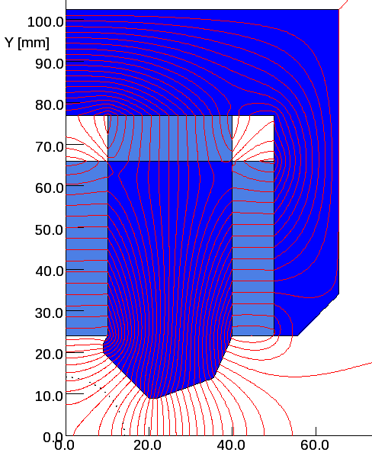
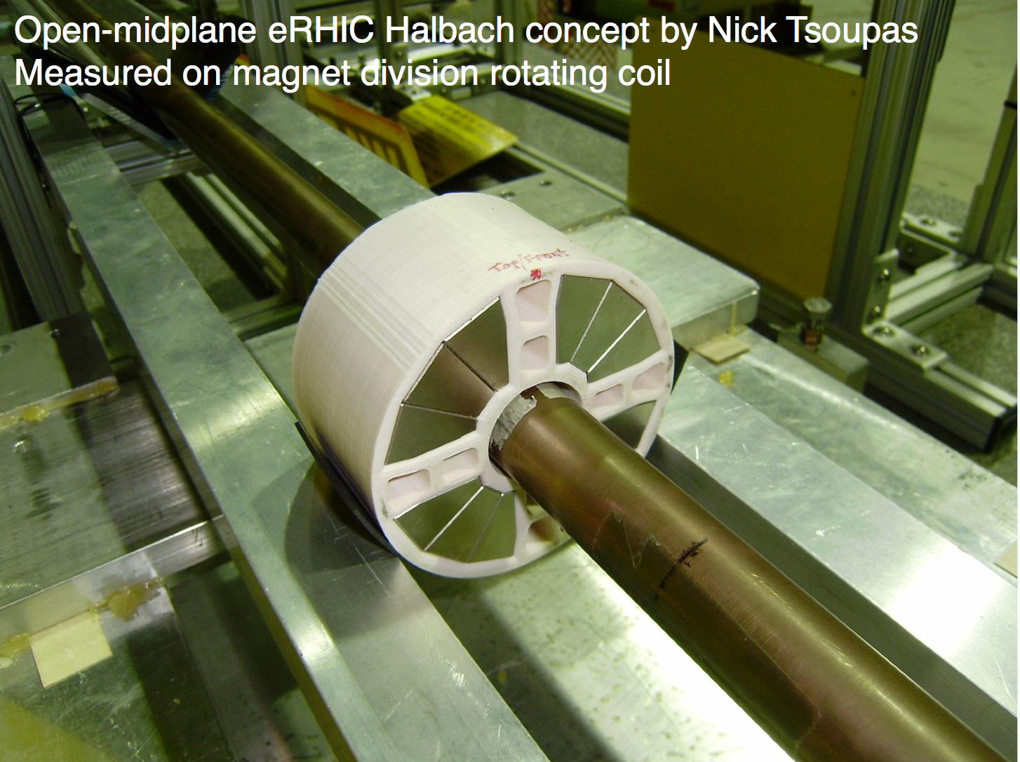
FFAG Recirculation Passes Based on Permanent Magnets
FFAG beamline
  Capable to transport beams in wide energy range (E_{f}/E_{in} ~3-4)
  Used mostly for sub-GeV proton accelerators; only one test electron accelerator (EMMA)
  Not isochronous; thus spreader/merger is more complex incorporating pathlength and R₅₆ correction
  Considerable cost saving
Permanent magnets
  Cost saving: no need for power supplies, cables and cooling.
  Fermilab has built a permanent magnet based recycler ring.
  Technological challenges are related with satisfying eRHIC magnet field tolerance requirements and thermal stabilization
  Permanent magnet prototypes (Hybrid-type and Halbach-type) has been bulit and measured.
© D. Trbojevic, S. Brooks
E=5.3 GeV
E=21.2 GeV
E=6.6 GeV
E=1.3 GeV
BD
QF
  CBETA facility, under construction in Cornell University, utilizes the FFAG beamline with permanent magnets for multipass ERL.

Slide 14
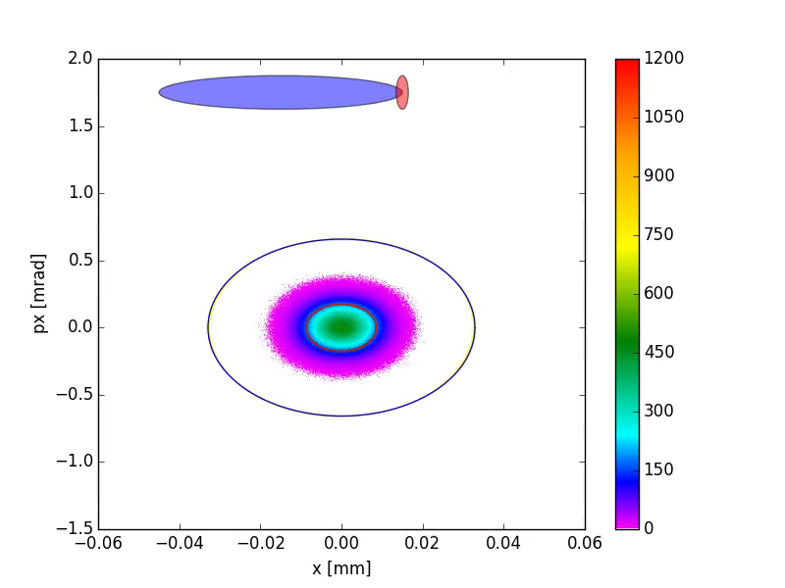
Beam dynamic study highlights
Electron beam disruption by proton beam
during the collision in the detector
Using gap in electron bunch pattern
to facilitate electron beam blow-up by
accumulated ions
© Y. Hao
© G.Wang
Electron beam bunch pattern, with bunch gap
Major source of beam halo in decelerated electron beam.
Simulations helped to define adequate magnet apertures of recirculating loops.

Slide 15
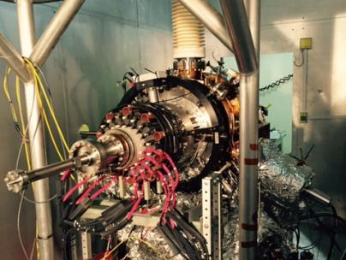
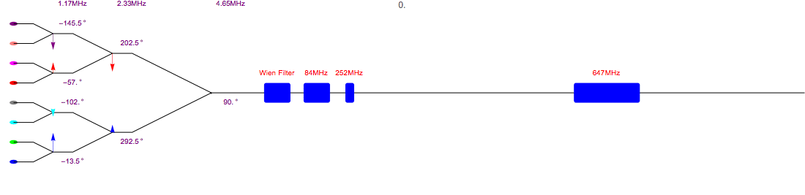
ERL-Ring Polarized Source Using Merging Scheme
50 mA polarized electron current required for ERL-based eRHIC
4 mA polarized electron beam current was demonstrated in dedicated experiments in JLab
Although the Jlab gun design is not optimal for high bunch charge mA scale operation: small cathode size, no cathode cooling
R&D is underway for various approaches to
high current polarized source:
  Gatling Gun using multiple cathodes in the same vacuum volume.
  Prototype has been built.
  Studies are underway (BNL- Stony Brook University collaboration).
  Large cathode gun prototype is being built by BNL (2017-2018)
  Similar gun prototype program is underway in MIT (Boston)
  Polarized source using longitudinal stacking from multiple guns has been also explored
1.17 MHz
The 20 MeV injector includes the eight beam combining scheme, spin rotator, buncher and pre-accelerator.
The frequency of the combiner and phase of the RF are listed.
2.33 MHz
4.65 MHz
Buncher cavities
20 MeV pre-accelerator
Polarized guns
©E. Wang

Slide 16
Summary
ERL-based eRHIC design has been developed to cover the complete EIC White Paper science case and combine high performance with energy efficiency.
Main design components:
  Linac(s) based on 647 MHz cavities with strong HOM damping
  Two possible solutions for recirculating passes:
    Return loops for individual energies
    FFAG beam lines capable of multi-energy transport
R&D efforts are underway on major technological risk of ERL-based eRHIC, high current polarized electron source, as well as on 647 MHz SRF cavity and its HOM dampers.
CBETA facility, constructed in Cornell University, is expected to provide a demonstration of multi-pass ERL with FFAG-type recirculation loop.
My acknowledgments to the ERL-based eRHIC design team:
E. Aschenauer, J. Beebe-Wang, I. Ben-Zvi, J.S. Berg, M. Blaskiewicz,
S. Brooks, A. Fedotov, Y. Hao, A. Hershkovitch, H. Huang, Y. Jing, D. Kayran, P. Kolb, V.N. Litvinenko, C. Liu, Y. Luo, F. Meot, M. Minty, B. Parker, R. Petty, I. Pinayev, V. Ptitsyn, T. Rao, T. Roser, J. Skaritka, K. Smith, S. Tepikian, R. Than ,D. Trbojevic, N. Tsoupas, J. Tuozzolo, E. Wang, G. Wang, F. Willeke, H. Witte, Q. Wu, C. Xu,
W. Xu, A. Zaltsman, W. Zhang

