Slide 1




Beam Dynamics and Optics Challenges of
the Berlin Energy Recovery Linac Project
Michael Abo-Bakr
Institute for Accelerator Physics
Helmholtz-Zentrum Berlin
ERL17: 59th ICFA Advanced Beam Dynamics Workshop on Energy Recovery Linacs – CERN, Geneva, 20.06.2017

Slide 2
Outline
Introduction: bERLinPro
ERL Beam Dynamics & Beam Optics
  Goal Beam Parameter & Energy Recovery Issues
  Linear Beam Optics
  Nonlinear Beam Optics
  Collective Effects
    space charge effects
    CSR – coherent synchrotron radiation
    BBU – beam break up

Slide 3
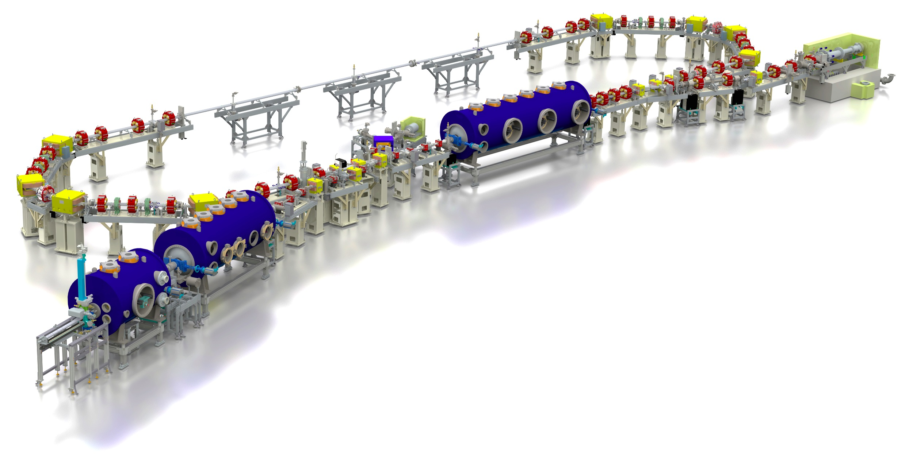

bERLinPro – Berlin Energy Recovery Linac Project
beam dump
6.5 MeV, 100 mA
→ 650 kW
linac module
3 x 7 cell srf cavities
44 MeV
modified Cornell booster
3 x 2 cell srf cavities
4.5 MeV
srf-gun
1.4 cell srf cavities
1.5-2.3 MeV, single solenoid,
Basic Parameter | value
maximum beam energy | 50 MeV
maximum current | 100 mA (77 pC/bunch)
normalized emittance | < 1 mm mrad
bunch length | 2 ps (~100 fs)
repetition rate | 1.3 GHz
relative losses per turn | < 10⁻⁵

Slide 4
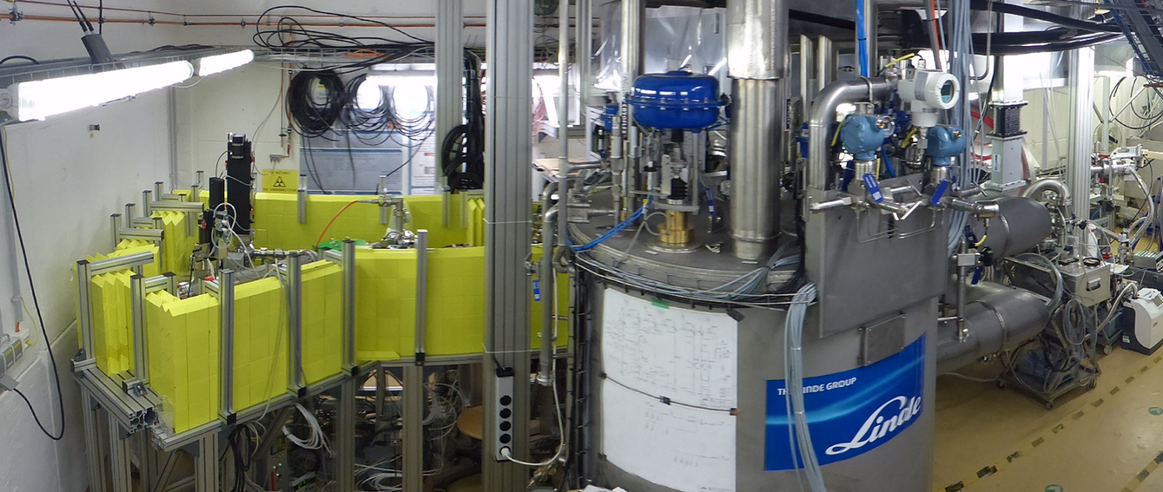
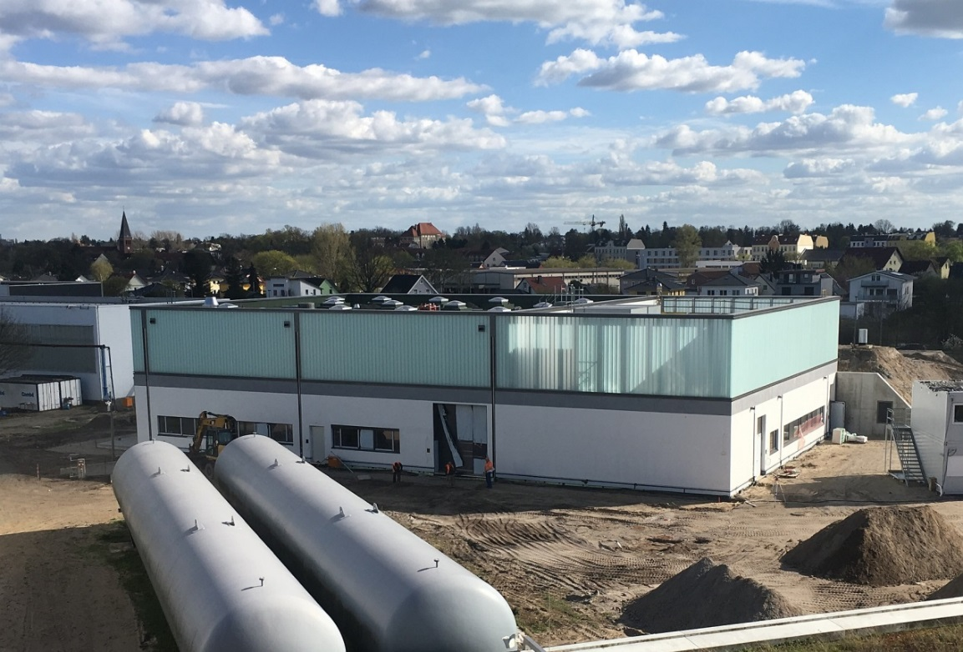
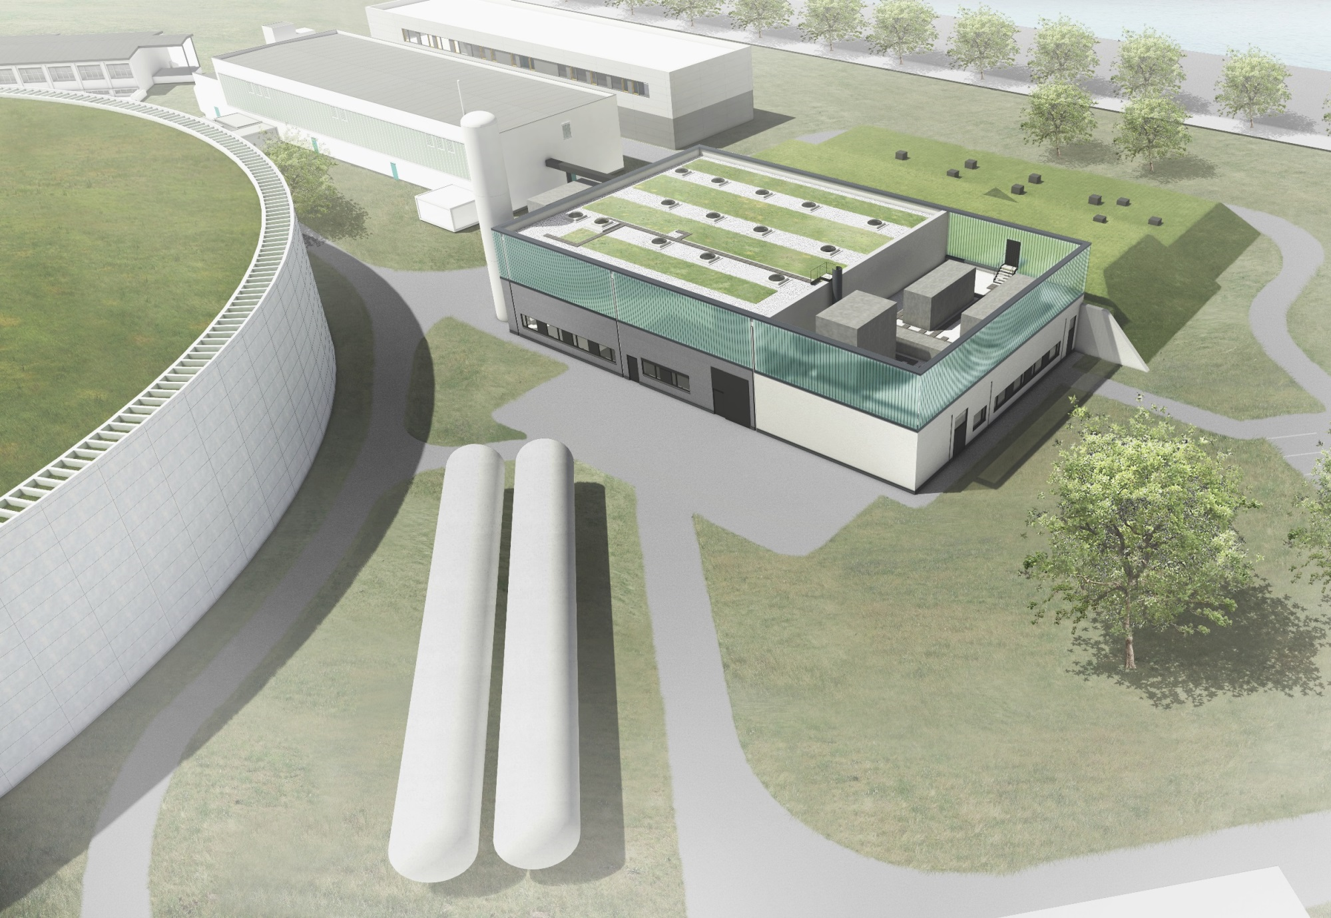


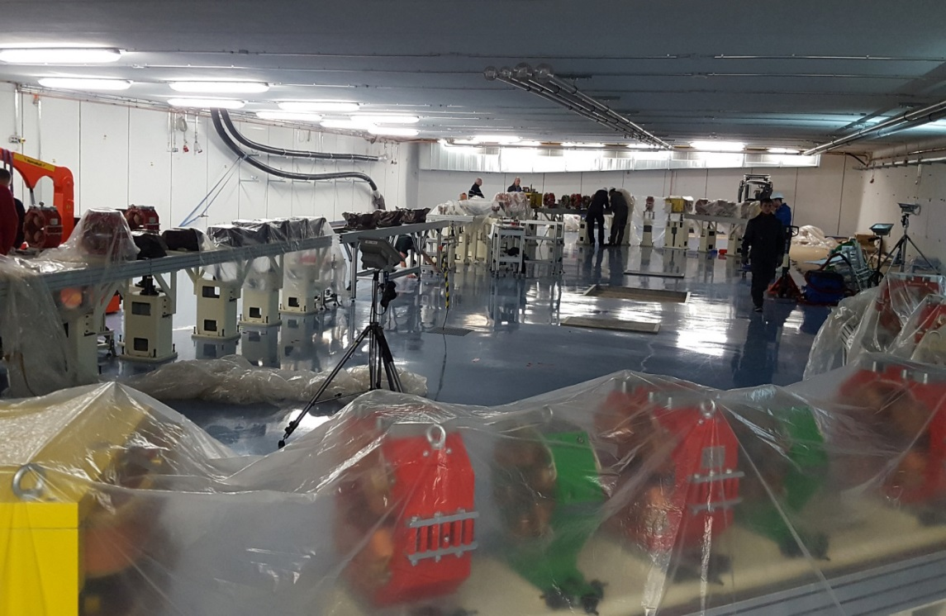
bERLinPro – building: technics and accelerator hall
From an artists view to …
GunLab
J. Kühn:
“Semiconductor Photocathode development for the bERLinPro photo injector”, Mon 11:15
A. Neumann:
“The bERLinPro SRF Photoinjector system”
Wed 17:25
accelerator hall
A. Jankowiak:
“Status of bERLinPro”
Wed 08:55

Slide 5
bERLinPro Beam Dynamics: Goal Parameter & ERL Issues
Goal Beam Parameter:
  efficient “Energy Recovery”
    adjust recovery conditions: rf phase advance & path length
    minimize losses of high current beam:
      small transverse beam size, dispersive regions → small E-spread
      halo: avoid, remove, transport
      instabilities: maximize threshold currents
  maintain beam quality from source
    transport beam preserving the emittance
  bunch manipulation: compression
    increase longitudinal bunch density as far as energy spread and transverse emittance degradation allow → user experiment
many issues known from SRs and/or Linacs
Notes:
RF power, machine damages

Slide 6
Linear and Nonlinear Beam Optics
  energy recovery → phase advance tuning
  beam manipulation → short pulses in ERLs
  beam transport without emittance degradation & losses
  high power beam dump & MPS
  requirements for beam diagnostics & commissioning
  error studies → misalignments effects of magnets and cavities
  tolerance & acceptance studies → hardware specification
  halo & dark current → low losses
    McAteer: “Dark Current and Halo Tracking in ERLs”, Thu 8:55
Notes:
RF power, machine damages

Slide 7
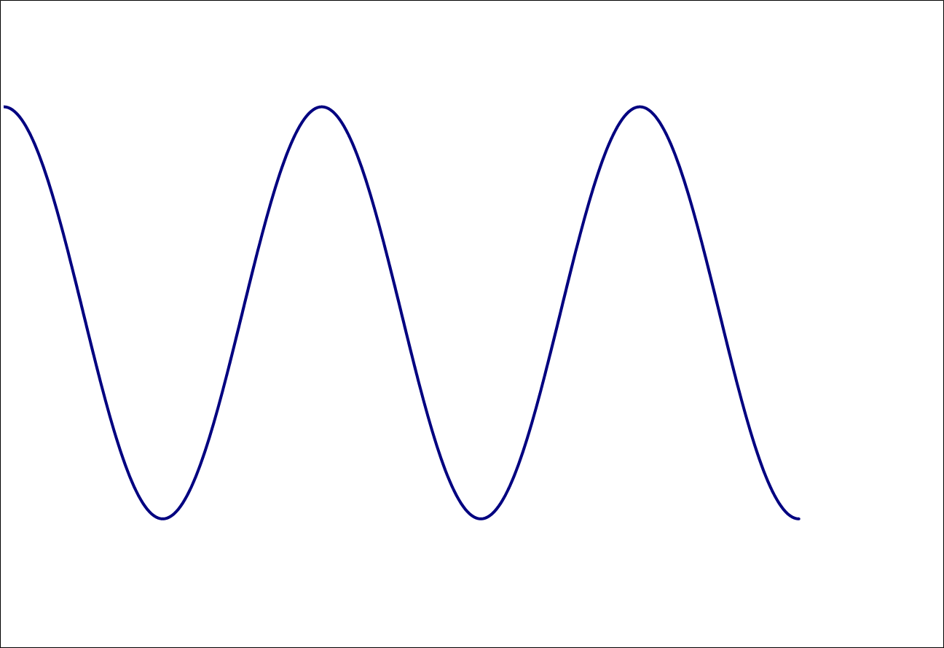
Linear Beam Optics: recovery phase & path length
options: - extra chicane
- inside arc
- moveable arc
1
(Linear) Beam Optics: recovery of energy by passing the linac @ dec. phase
1
2
V
of crest
acc
on crest
acc
3
on crest: ϕ_{dec} = ϕ_{acc} + 180°
of crest: ϕ_{dec} = 180° + ϕ_{acc}
ϕ_{dec} = 180° – ϕ_{acc}
2a
☹
Arc 2
2
t
2b
1
3
bERLinPro
recirculator passage time: L_{Rec} / (βc) = (n + ½) T_{rf} (½ T_{rf} = 180° rf phase advance)
path length may change: v = f(E), misalignments & field offsets → orbit oscillations, switch between acceleration & deceleration (n ↔ n+ ½, multi-turn ERLs)
→ adjust RF frequency: f_{rf} , T_{rf} ☹
→ adjust recirculator length L_{rec}

Slide 8
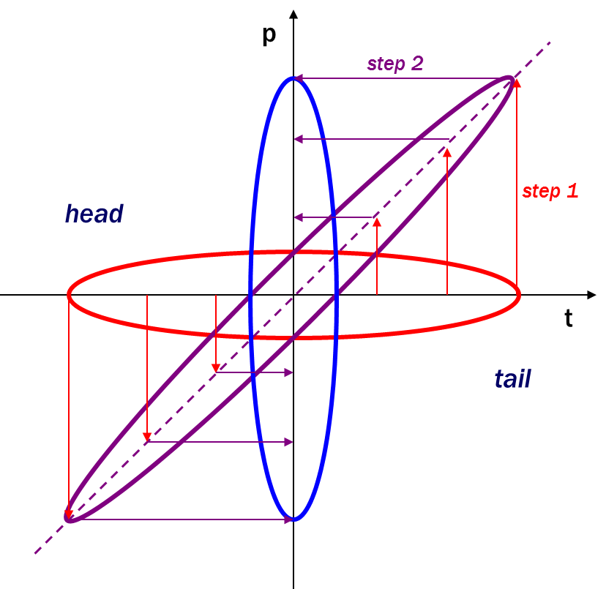
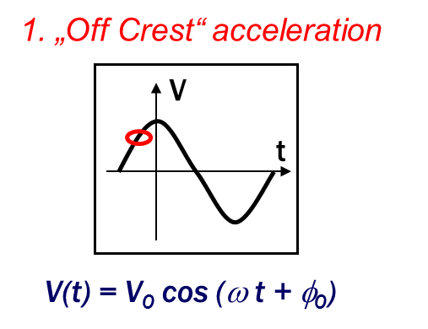
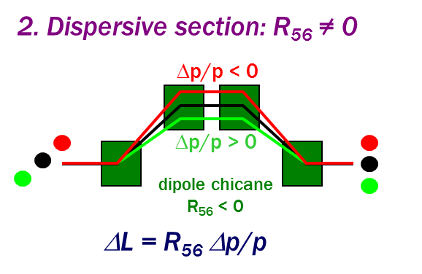
Linear Beam Optics: beam manipulation
many techniques: bunch compression, emittance exchange, laser heater, …
choice of bunch length / compression?
  injector, merger: long → reduced SC effects, short → minimize rf curvature
  linac: long → reduced beam loading to HOMs, short → minimize rf curvature
  recirculator: long → reduce SC, CSR, wakes, short → experiment / project goal
bERLinPro: 6-8 ps (laser/cath.) → 4-5 ps (merger/linac) → 2 ps (~100 fs) (recirc.)
Before deceleration: decompress bunch to restore chirp & minimize σ_{E} → R_{56,Arc2} = -R_{56,Arc1}
R_{56,Arc2} = R_{56,Arc1} → inverted chirp → ϕ_{dec} = 180° – ϕ_{acc} with unbalanced beam loading

Slide 9
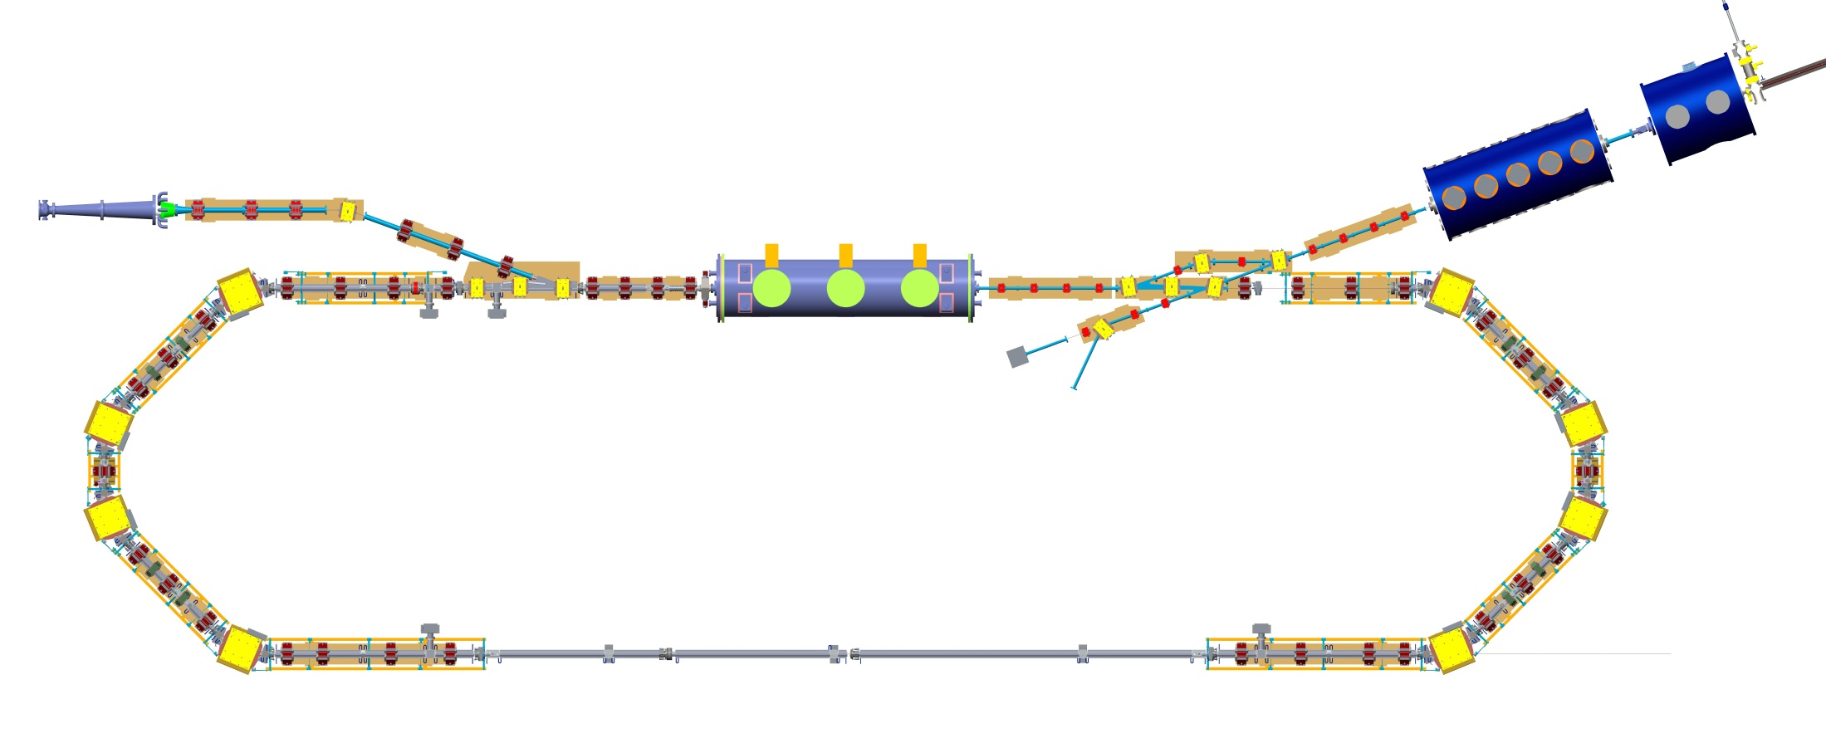

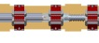
Linear Beam Optics: bERLinPro
bERLinPro = one stage ERL:
Injector → Merger → Linac(acc) → Arc1 → Straight Section →
Arc2 → Linac(dec) → Splitter → Dumpline & Dump
section requirements:
injector: gun & booster
injectior / merger / splitter / dumpline:
  low energy beam transport
  merge / separate low & high energy beams
  first stage of bunch compression
linac section:
  merger / splitter chicanes
  matching to injection line, arcs and dump line
recirculator arcs & straight section:
  2 x 180° total bending angle
  final bunch compression
  sufficient space for user experiments in the straight section
beam dump & dump line
linac
merger
splitter
recirculation
arc 1
recirculation
arc 2
straight section

Slide 10
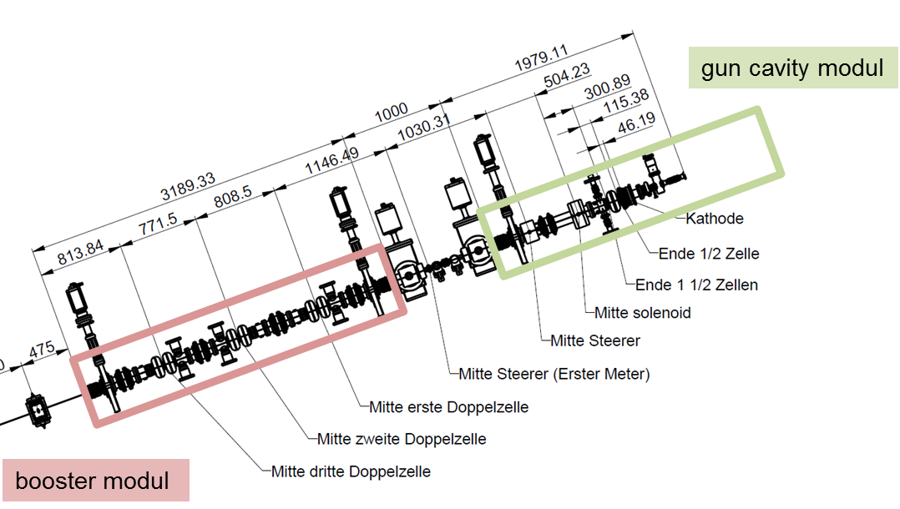
Linear Beam Optics: bERLinPro Injector
only one magnetic element: solenoid
beam dynamics dominated by SC
  → emittance compensation
energy
rms beam size
Twiss parameter
emittance: ε_{n,xy} < 1 mm mrad

Slide 11
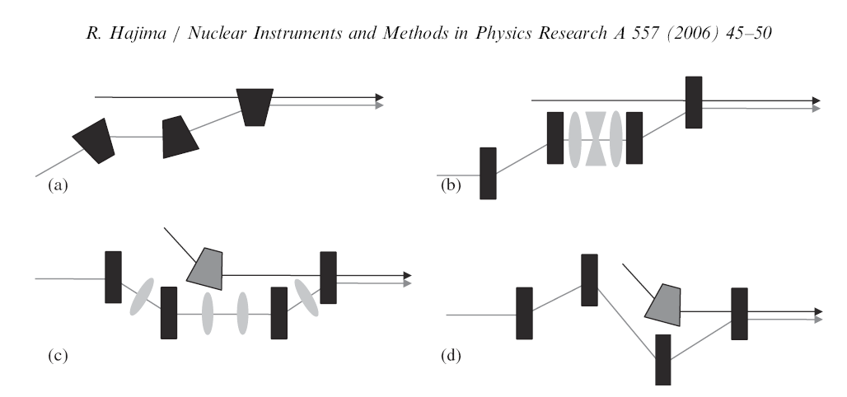
Linear Beam Optics: Merger / Splitter
bERLinPro
Mergers for existing and proposed ERLs:
  (a) JLAB IR-demo, IR-upgrade,
  Cornell ERL, Daresbury ERLP
  (b) JAERI-ERL
  (c) BINP-ERL
  (d) BNL-ERL (proposed)
design considerations:
  length & hardware
  chromatic properties, R₅₆ range
  SC sensitivity / ε compensation

Slide 12
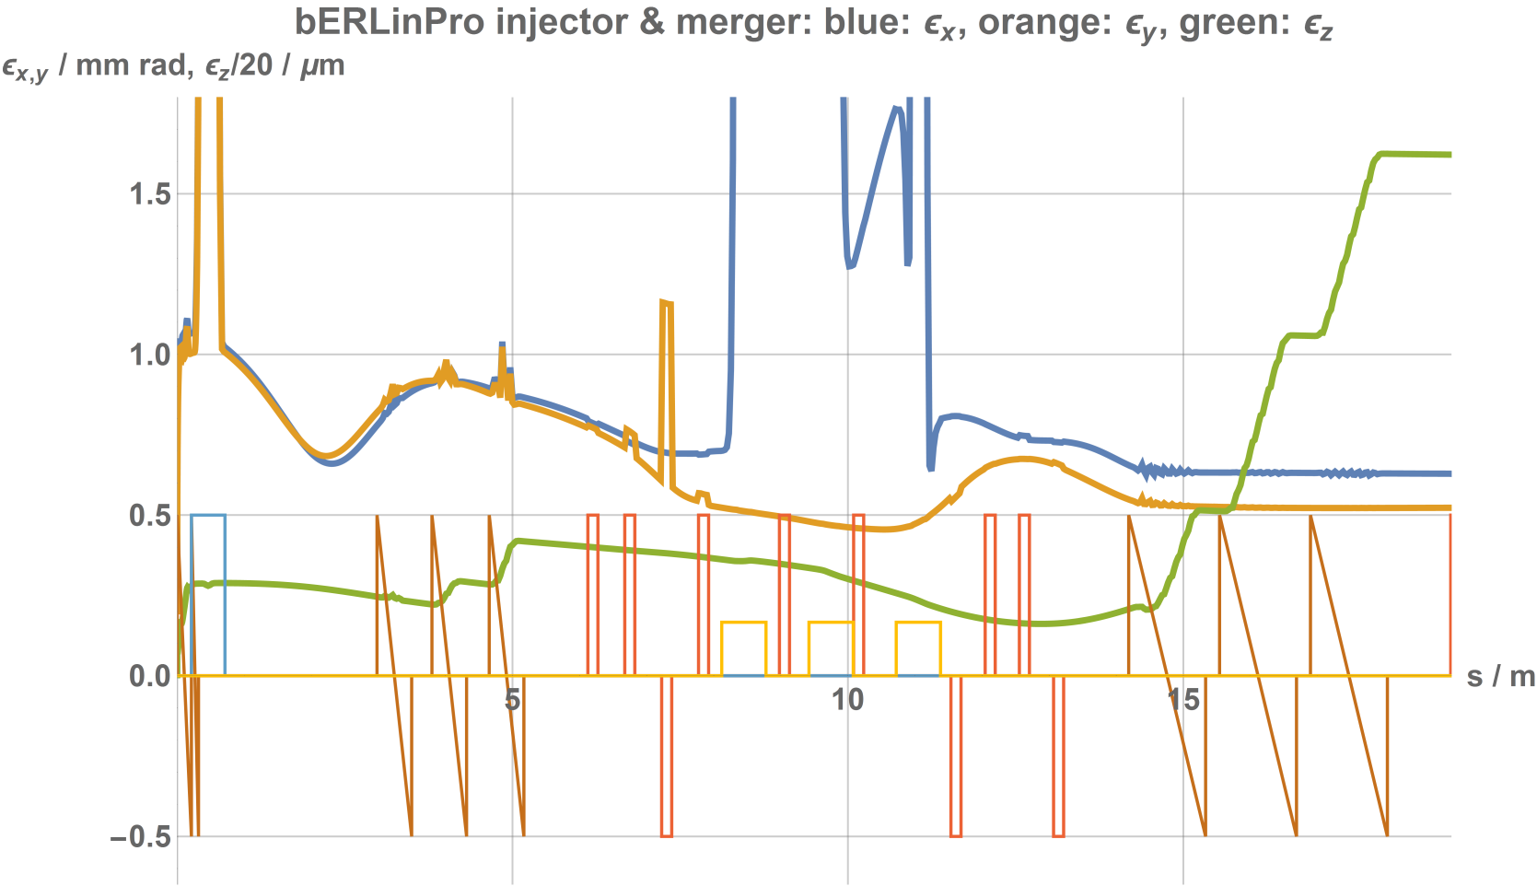
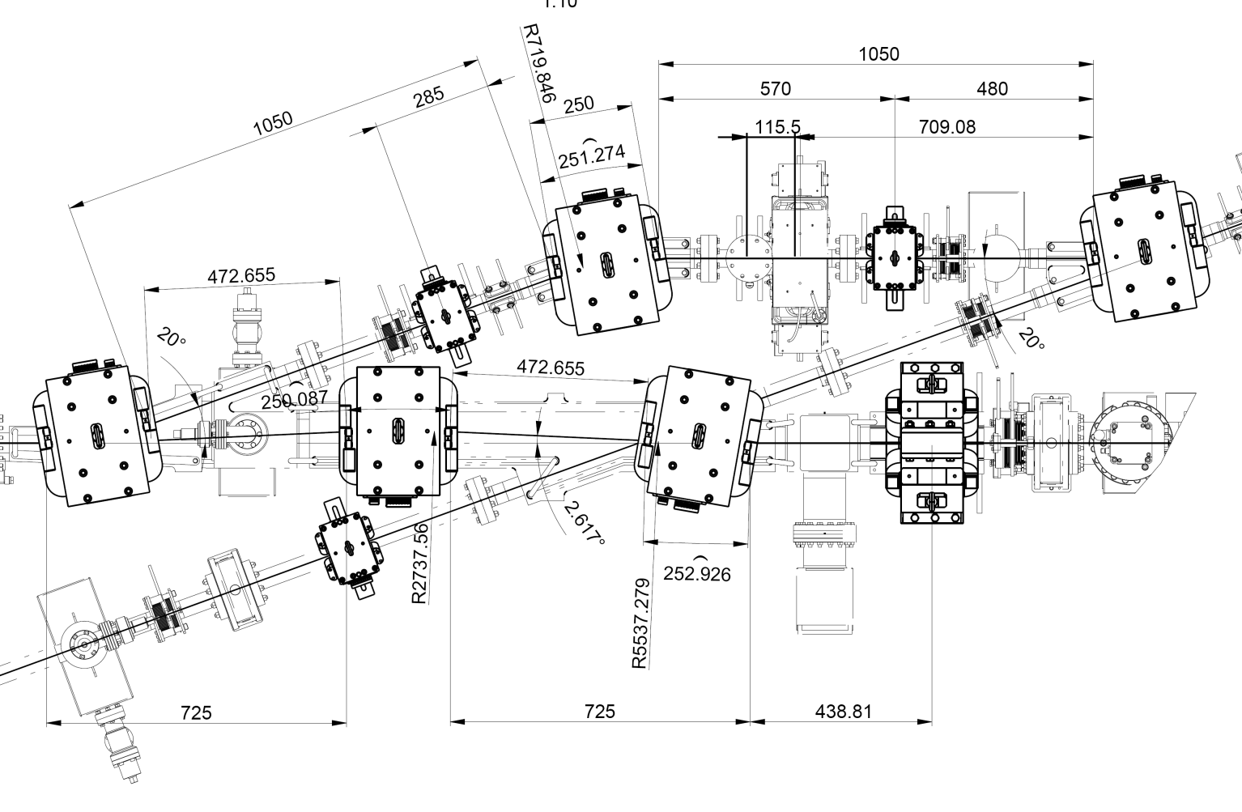
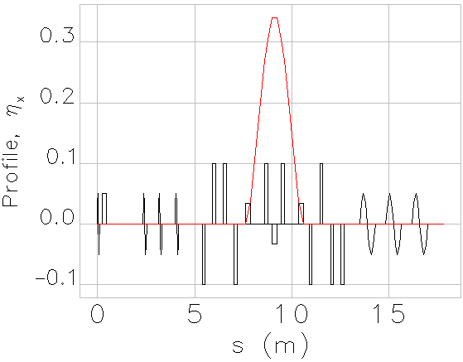
Linear Beam Optics: Merger / Splitter
bERLinPro: merger
beam dynamics dominated by SC
  emittance compensation continued
  beam transport in dispersive section: ε−growth (“space charge dispersion”)
first stage of compression
  → rf curvature limits R₅₆
bERLinPro: merger
ϕ_{bend} = 20°
R₅₆ = 10 cm
Q_{b} = 77 pC
ε_{x} = 0.63 mm mrad
ε_{y} = 0.52 mm mrad
gun
booster
merger
linac

Slide 13
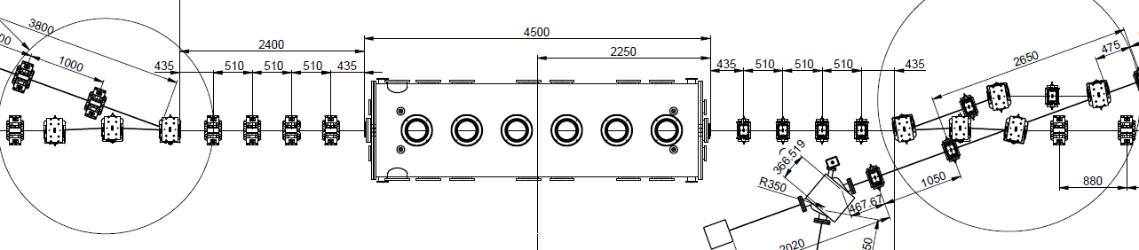
Linear Beam Optics: Linac Section
rf focusing in the linac (with few/no quads)
two (or multi) energy beam optics: matching beam optics from merger (LE) & Arc2 (HE) and into Arc1 (HE) & Dumpline (LE)
adjust β-function in the linac cavities for maximum BBU threshold current
include merger and splitter chicanes for the HE beam
splitter
beam
merger
main linac
splitter
chicane
merger
chicane
matching quads
low energy: 2nd turn
matching quads
low energy: 1st turn

Slide 14
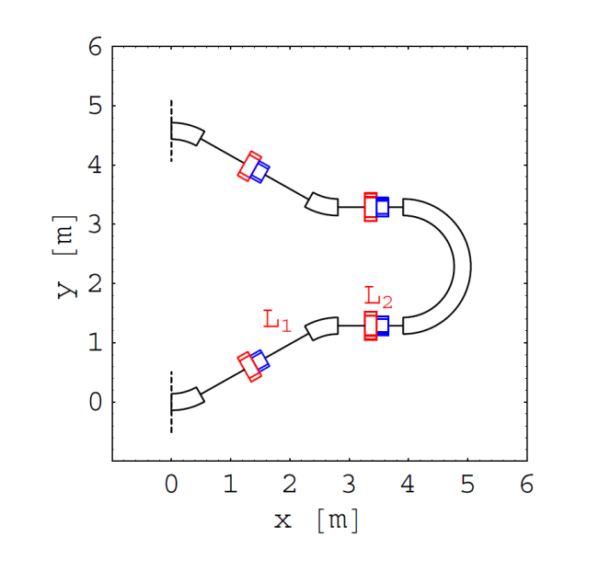
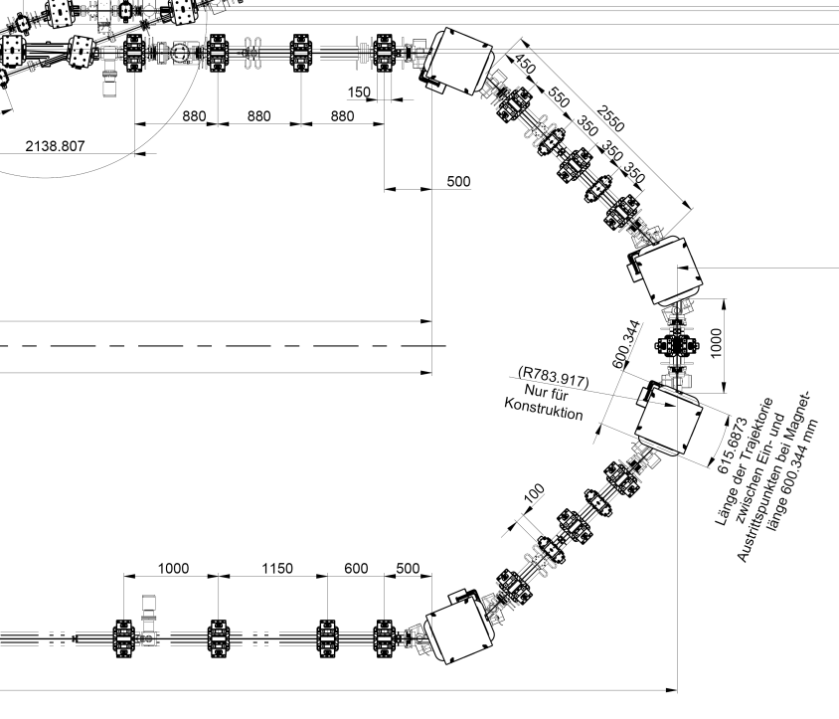
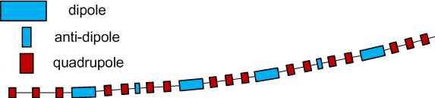
Linear Beam Optics: Recirculator
arc optics: various option also known from SR’s
→ DBA, TBA, MBA (achromatic closed FODO)
→ Bates Arc
design considerations:
  length & hardware
  flexibility / tunability
  chromatic properties, R₅₆ range
  ISR / CSR properties
Bates Arc
TBA
bERLinPro:
4 (2 x double) bend achromat
MBA with antibend
FSF: A. Matveenko, et al., ERL WS, 2013.
H.L. Owen et al., “Choice of Arc Design for the ERL Prototype at Daresbury Laboratory”, EPAC, Lucerne, Switzerland 2004.

Slide 15
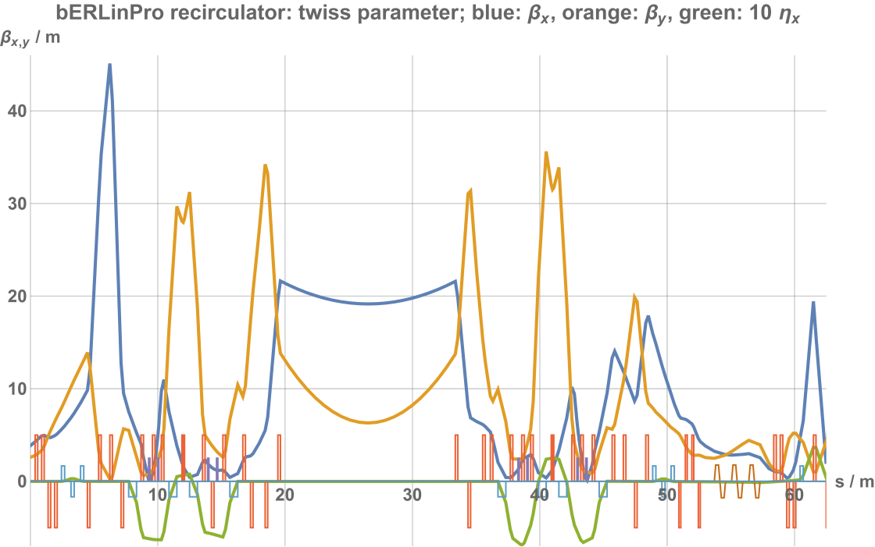
Linear Beam Optics: Recirculator
Lattice design: various demands → difficult to meet all simultaneously
High transmission:
  moderate β-functions around the recirculator
  matching to the linac section
  closed and small dispersion function in the arcs
splitter chicane
merger chicane
Variable R₅₆:
  tunable ‑0.25 m < R₅₆ < 0.25 m
  standard mode R₅₆ = +/- 0.14 m
  recirculator in total isochronous
Betatron phase advance:
  minimize CSR induced emittance growth
  maximize BBU limited current threshold (tune & chromaticity)
linac
(dec)
arc1
rec. straight
arc2

Slide 16
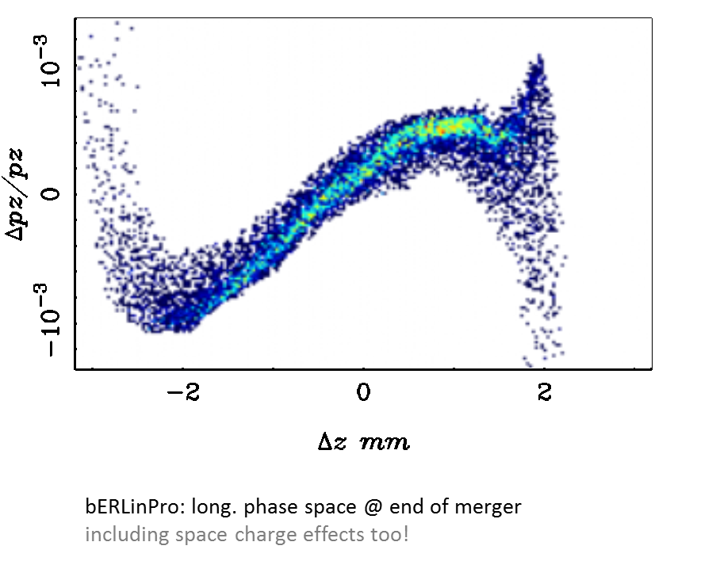
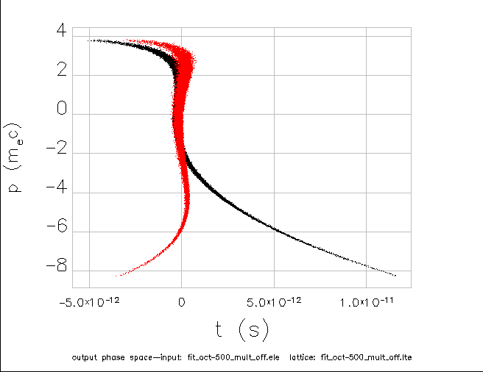
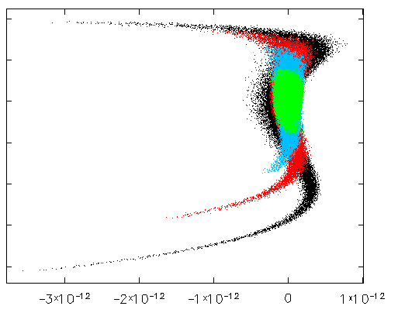
Nonlinear Beam Optics
  RF curvature: E(t)=E₀ cos(ωt + ϕ₀)
  aberrations: geometric & chromatic:
  counteracted by nonlinear fields → multipole magnets
Example: bunch compression E(s_{i}) = E₀ cos(s 2π/λ - ϕ₀) → δ_{i} = δ(s_{i}) : rel. energy dev. ΔL_{i} = R₅₆ δ_{i} + T₅₆₆ δ_{i}² + U₅₆₆₆ δ_{i}³ + …
with MP / without
σ_{s,start} = 2.0 mm
→ σ_{s,end} = 73 μm
σ_{s,start} = 0.5 mm
σ_{s,start} = 1.0 mm
σ_{s,start} = 1.5 mm
σ_{s,start} = 2.0 mm
Δ
Δ
bERLinPro recirculator: bunch compression test with and without multipole (sextupole and octupole) magnets
bERLinPro recirculator: bunch compression test with varying initial bunch length indicating the influence of the the rf curvature

Slide 17
Nonlinear Beam Optics
bERLinPro: two modes of operation - both require multipole magnets for nonlinear corrections
→ four sextupole magnets per arc (each individually powered)
Low Emittance Mode (LEM): high current, emittance ≤ 1 mm mrad, σ_{t} = 2 ps
  sextupoles first arc → counteract chromatic effects causing emittance growth
  sextupoles second arc → restore longitudinal phase space before deceleration to minimize the downstream energy spread
Short Pulse Mode (SPM): σ_{t} ≤ 100 fs @ reduced current & degraded emittance
  sextupoles in first arc → linearize long. phase space / optimize T₅₆₆ for shortest bunches
  sextupoles in second arc → restore long. phase space (like in LEM)
optimization procedure:
numerical optimization (Elegant) → minimize goal function from tracked bunch:
  @ experiment (recirculator straight section): ε, σ_{s}
  after deceleration: phase space optimized to dump the beam → low ε, σ_{E} & no linear / nonlinear chirp

Slide 18
ERL Beam Dynamics: Collective Effects
Collective Effects:
  Space Charge
  Coherent Synchrotron Radiation
  Beam Break Up
  Geometric & other wakes
  Ion Trapping

Slide 19
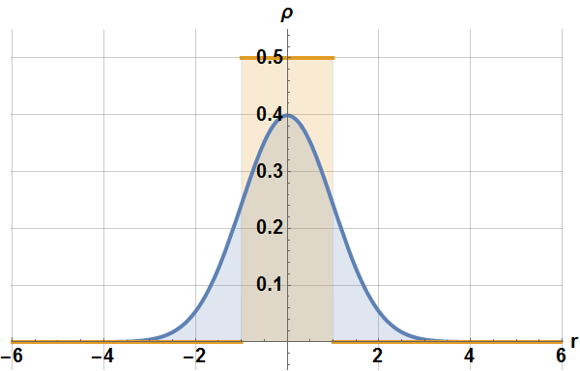
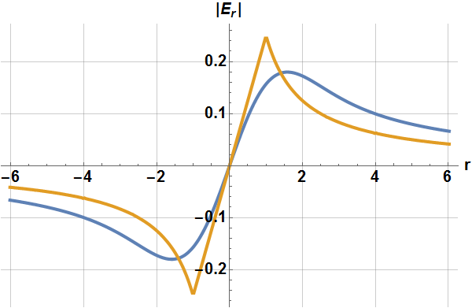

Collective Effects: Space Charge
Fields & Forces
eqn. of motion:
$$r^{′′}+κ\left(s\right) r −K(s)/a^{2} r=0$$
distrib.:
Gaussian
uniform
SC: perveance K=f(I,γ), a: (round) beam size
ext. focusing: κ(s)
→ SC: defocusing forces in the bunch
least degradation due to SC:
  radial force as linear as possible → uniform radial charge density distribution
  no variation of K(s) along bunch → K = const → flat top, long. charge density distribution
nonlinear
force
linear force
within bunch

Slide 20
Collective Effects: Space Charge
SC Effects in ERLs
(moderate) tune shift: minor issue in ERLs
emittance growth
  nonlinear SC forces → phase space nonlinearities (x-x’, y-y’, t-p)
  varying strength of SC effects along bunch
x’, y’
r
charge density
x, y
z
bunch: longitudinally sliced
each slice with individual
  charge & charge density
  transverse size & divergence → ε
  energy & energy spread
→ individual SC forces
effective (projected)
emittance
emittance compensation:
realign slices to minimize projected emittance

Slide 21
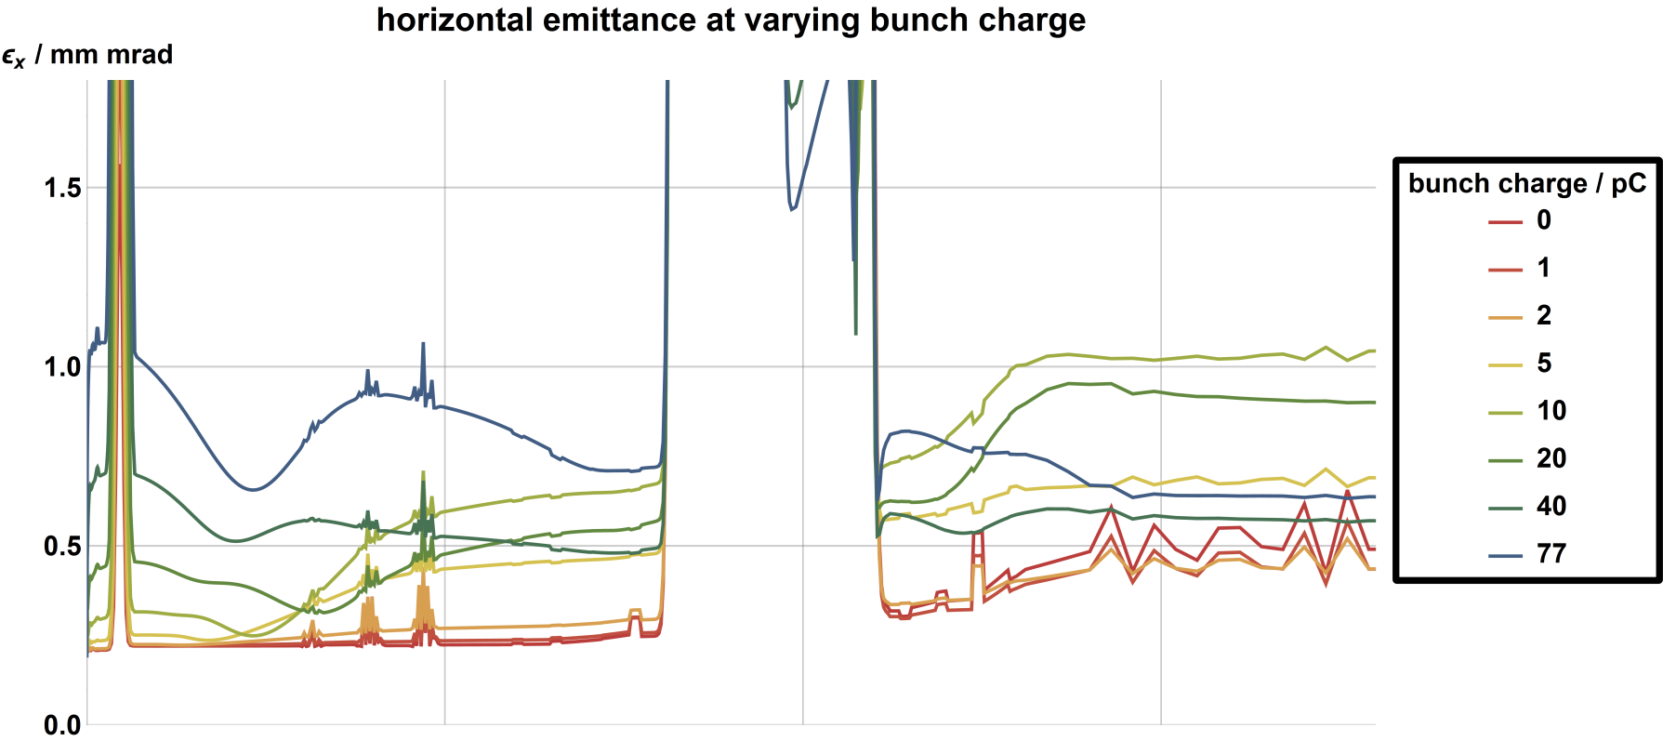
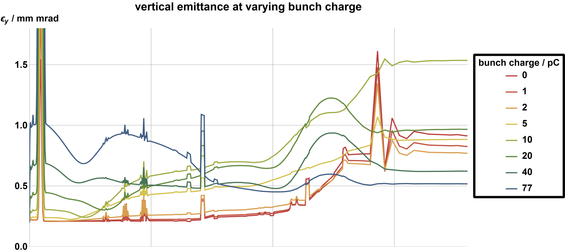
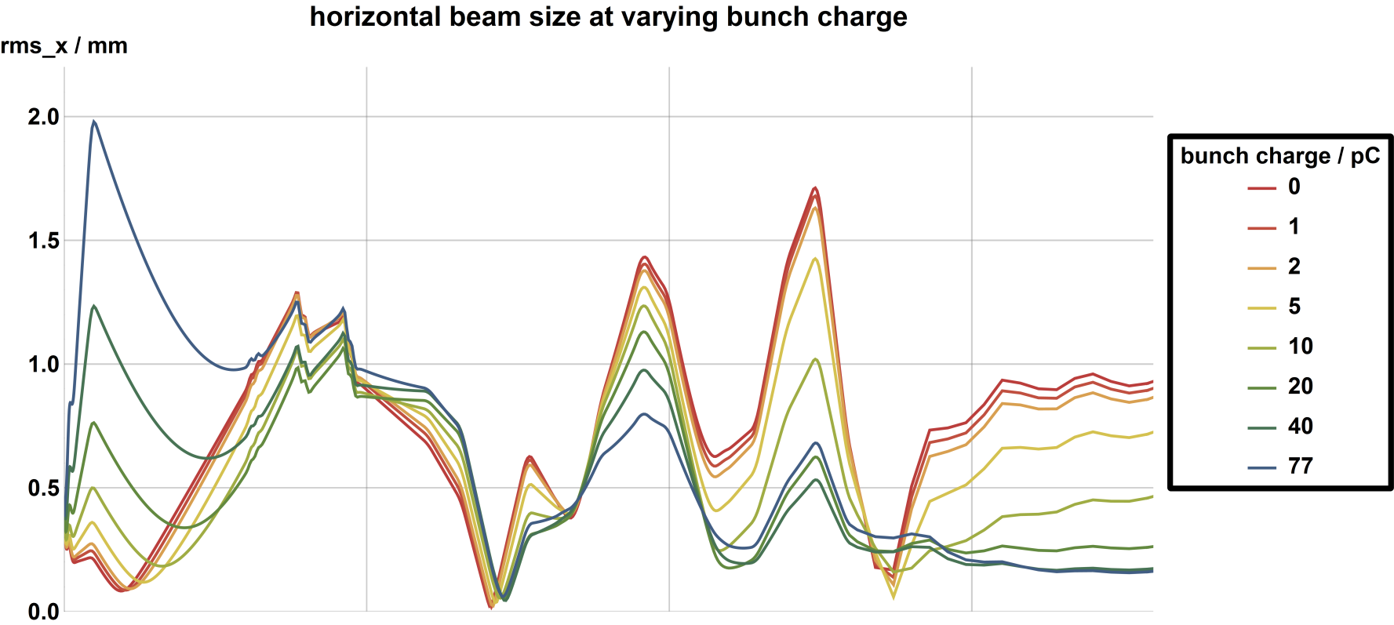
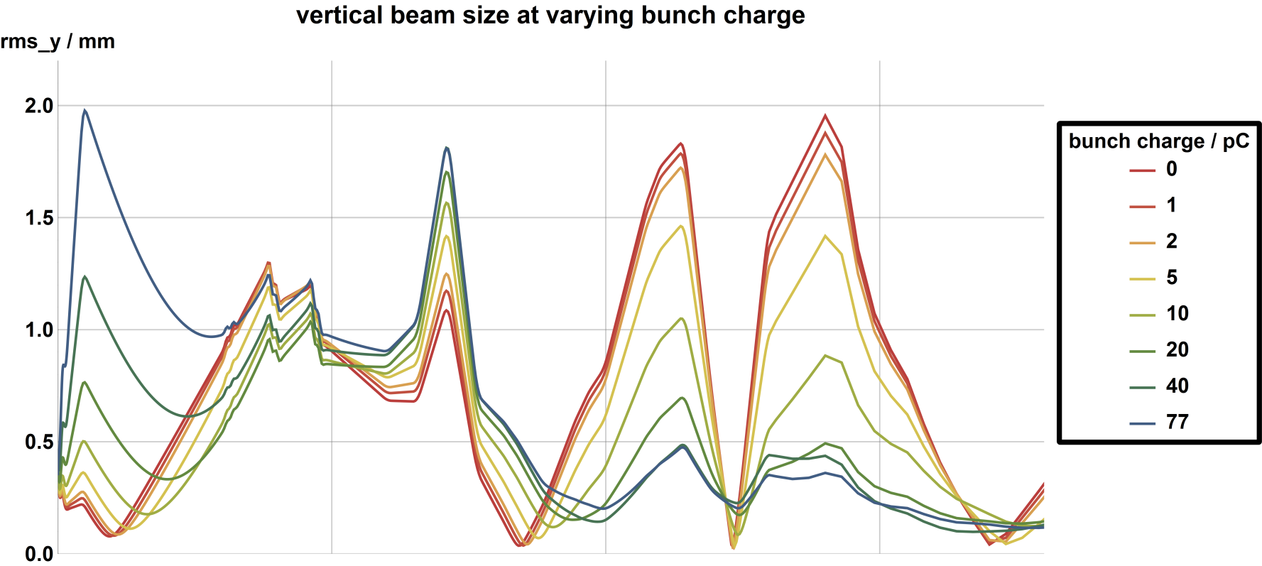
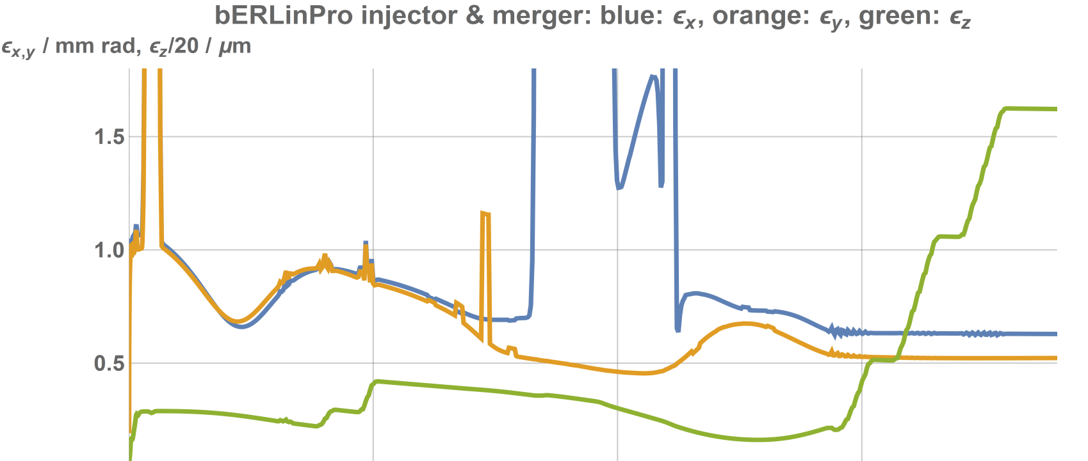
Collective Effects: Space Charge
bERLinPro: simulations & optimization of SC dominated beam transport → ASTRA, OPAL
for 2D - emittance compensation: SCO*
*SCO: A. Bondarenko, A. Matveenko, “Emittance Compensation Scheme for the BERLinPro Injector”,IPAC 2011, San Sebastian
space charge at current ramping = increase of bunch charges at 1.3 GHz bunch rep-rate
Q_{B} = 77pC
ε_{x} = 0.63 mm mrad
ε_{y} = 0.52 mm mrad
SRF
Solenoid
Bends
Quads
2.3 MeV
6.5 MeV
50 MeV
s / m

Slide 22


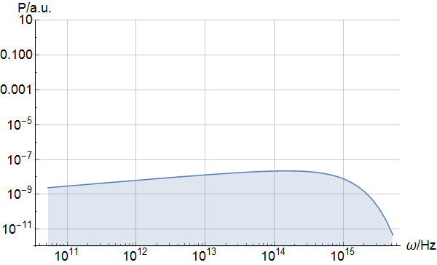
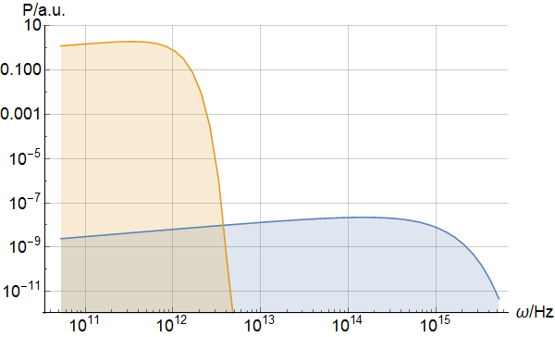
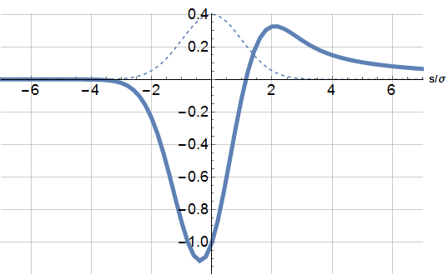
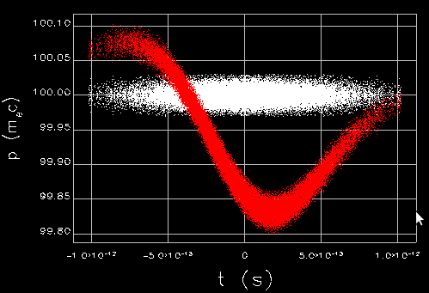
Collective Effects: Coherent Synchrotron Radiation
incoherent emission of
Synchrotron Radiation
coherent emission of
Synchrotron Radiation
→ CSR
charge density
distribution
g: form factor
coherent
CSR steady
wake potential
incoherent

Slide 23
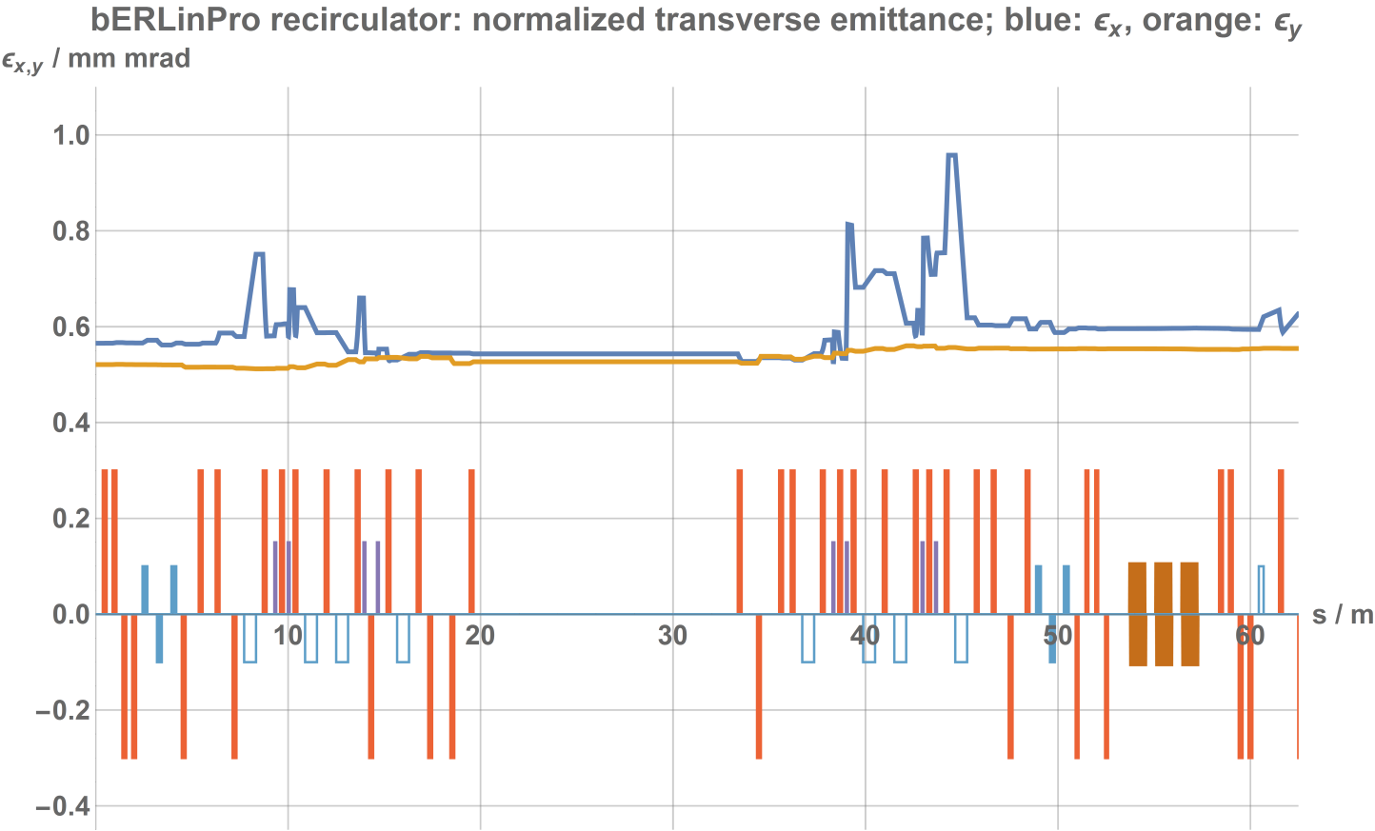
Collective Effects: Coherent Synchrotron Radiation
bERLinPro: LEM (σ_{s} = 2 ps, Q = 77 pC, N = 8, E = 50 MeV) → P_{CSR} ~ 4.4 kW
SPM → CSR power (4.4 kW from LEM) limits bunch charge:
→ Q_{SPM} ~ 10 pC @ 100 fs
CSR: energy variation in dispersive sections → betatron oscillation → emittance growth
Countermeasures:
Shielding: suppression of long wavelength CSR → reduced aperture & increased losses
Beam Optics: cancel out energy modulation by long. beam flipping s → -s:, requires crossing of full compression → more CSR & large R₅₆, unbalanced beam loading ☹
Beam Optics: reduce emittance growth by adjusting phase advance in bending plane → cancel out excited betatron oscillations from previous CSR kick(s)
bERLinPro: 1D-simulations → CSR no major issue
limited tune adjustment range → optics not optimized with respect to CSR
rec. straight
linac
(dec)
arc1
arc2

Slide 24
ERL Beam Dynamics: Beam Break Up
Beam Break Up: resonant interaction of short & long range cavity wake fields with the generating bunch or subsequent bunches
  if HOM excitation exceeds HOM damping → kick strength rapidly increases → instability & beam loss
x
z
various BBU variants: single bunch BBU, multi bunch BBU (cumulative / regenerative, transverse / longitudinal, single-/multi-cavity, single-/multiple-turn)

Slide 25
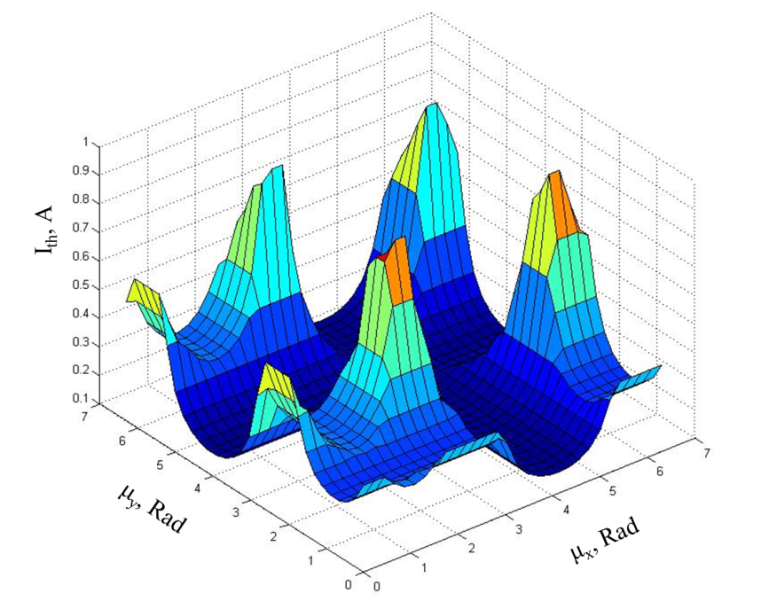
ERL Beam Dynamics: Beam Break Up
regenerative transverse BBU
(single cavity, single turn, one mode):
Countermeasures:
cavity design:
  HOMs: small R/Q, varying ω_{λ} at fixed ω₀ → multi cavity BBU thresholds increase
  no HOM on a fundamental’s harmonics: ω_{λ} ≠ n*ω_{rf}
  low Q for HOM → HOM dampers (ferrites, waveguides, …)
recirculator beam optics:
  for α=0 & uncoupled beam transport
  → m* = m₁₂ = (β₁β₂)^{1/2} sin(Δϕ_{x}) =0 for Δϕ = nπ
  adjust sin(ω_{λ} T_{rec}) = 0 for the worst HOM large path length change → inpractical ☹
  large chromaticity → similar to Landau damping
  strong sextupoles
PhD: Y. Petenev
BBU thesholds
@ bERlinPro
Vladimir N. Litvinenko, “Chromaticity of the lattice and beam stability in energy recovery linacs”, PRST-AB 15, 074401 (2012)

Slide 26
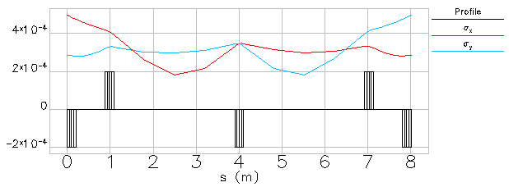
ERL Beam Dynamics: Beam Break Up
regenerative transverse BBU
(single cavity, single turn, one mode):
Countermeasures:
recirculator beam optics (continued):
  coupled beam transport: switching of planes X↔Y: m₁₂=0 → horizontal HOM kick transforms to vertical offset → polarized HOM not further excited,
  two options: solenoid (low energy) or skew quadrupole based rotator
bERLinPro:
rotator concept
with 5 skew quads prepared

Slide 27

Thanks …
… to the bERLinPro Optics & Theory group:
J. Knedel, B. Kuske, D. Malyutin, A. Matveenko, M. McAteer & C. Metzger-Krauss
… to the bERLinPro team
M. Abo-Bakr, W. Anders, A. Büchel, K. Bürkmann-Gehrlein, P. Echevarria, A. Frahm, H.-W. Glock, F. Glöckner, F. Göbel, B. Hall, S. Heling, H.-G. Hoberg, A. Jankowiak, C. Kalus, T. Kamps, G. Klemz, J. Knedel, J. Knobloch, J. Kolbe, G. Kourkafas, J. Kühn, B. Kuske, J. Kuszynski, D. Malyutin, A. Matveenko, M. McAteer, A. Meseck, C. Metzger-Kraus, R. Müller, A. Neumann, N. Ohm-Krafft, K. Ott, E. Panofski, F. Pflocksch, J. Rahn, M. Schmeißer, O. Schüler, M. Schuster, J. Ullrich, A. Ushakov, J. Völker
… to all supporting colleagues @ HZB and from other Accelerator-Laboratories
… for your attention!

