Slide 1

Development of a multialkali photocathode DC gun
for high current operation
Tohoku Univ. N. Nishimori
QST R. Nagai, M. Sawamura, R. Hajima

Slide 2
Outline
Development of a photoemission DC gun at QST
Fabrication of Cs₃Sb photocathode with QE of 5%
mA beam generation from the gun
Summary

Slide 3
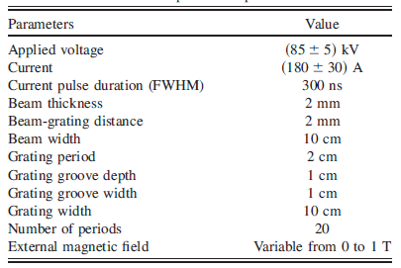
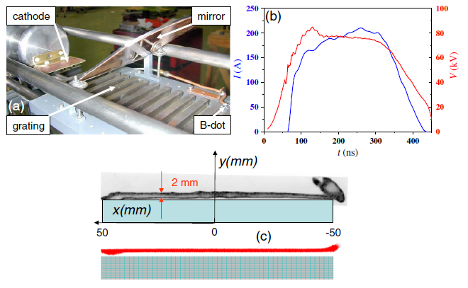
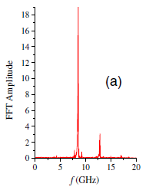
Application of high current DC gun
J. Gardelle et al., PRSTAB12, 110701 (2012)
800MeV ERL-FEL
10kW EUV light sources
Smith-Purcell FEL
Compact THz light source
N. Nakamura, Tudesday Talk
CEA-CESTA, France
Injector specifications after merger
Charge | ε_{n} (μm) | I_{peak} (A) | I_{ave.} (mA)
60 pC | 0.60 | 30 | 10

Slide 4
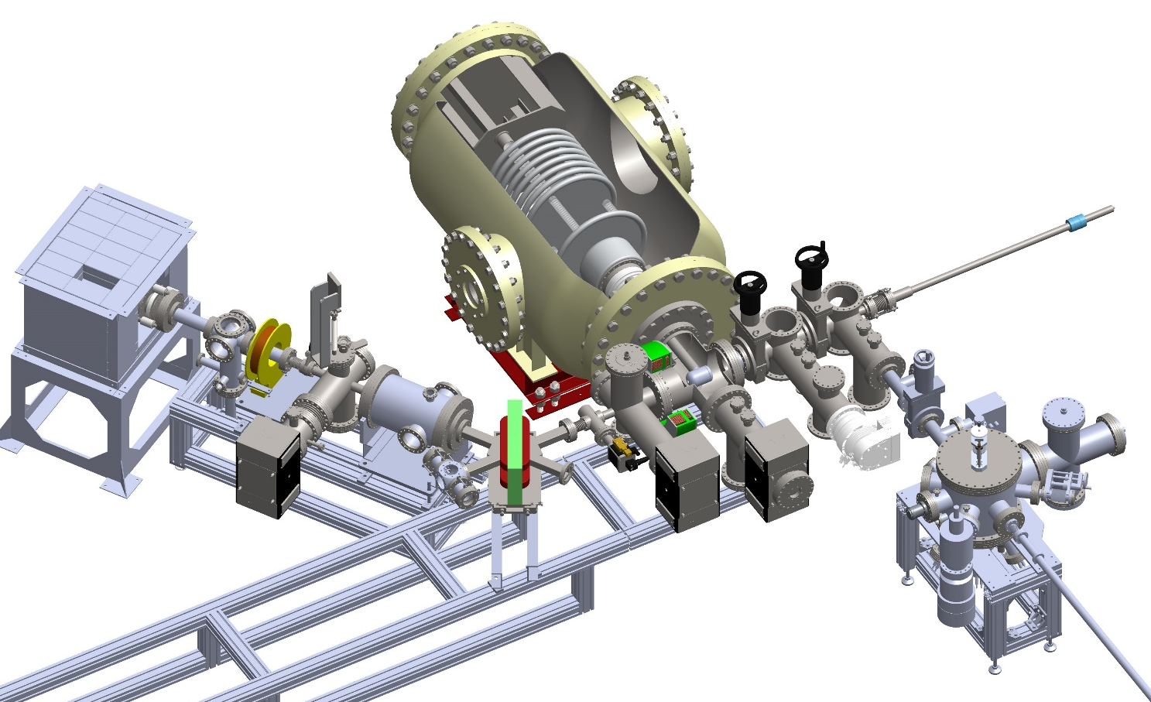
Development of a photoemission DC gun at QST
3. beamline
2. photoemission DC gun (250kV-50mA max.)
beam profile
monitor
drive laser
beding magnet
cathode electrode
3m
1. alkali photocathode preparation chamber

Slide 5
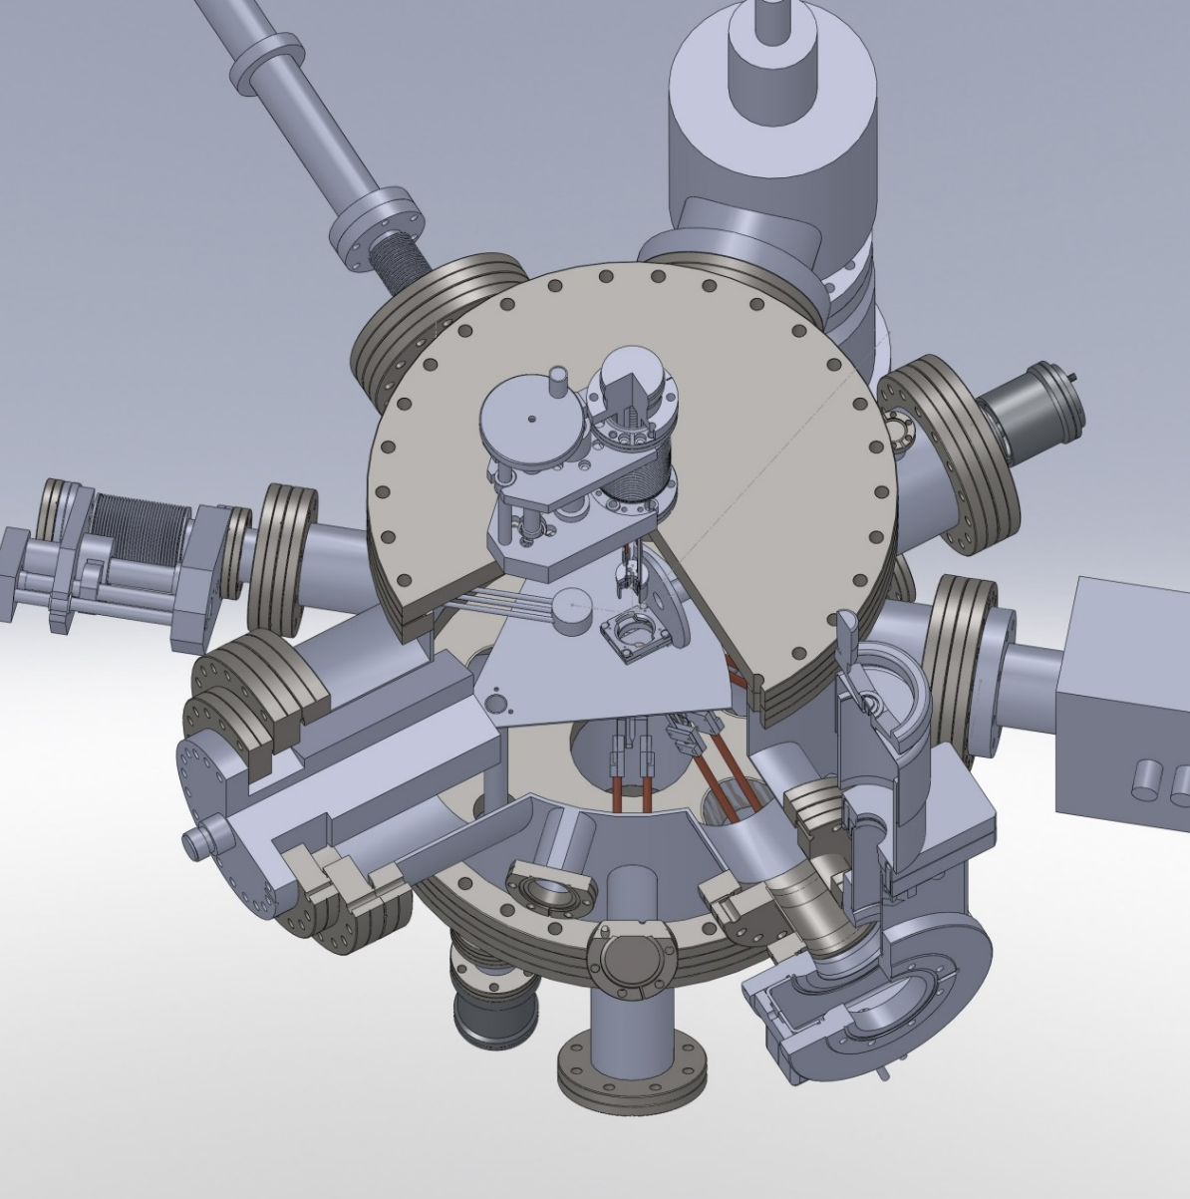
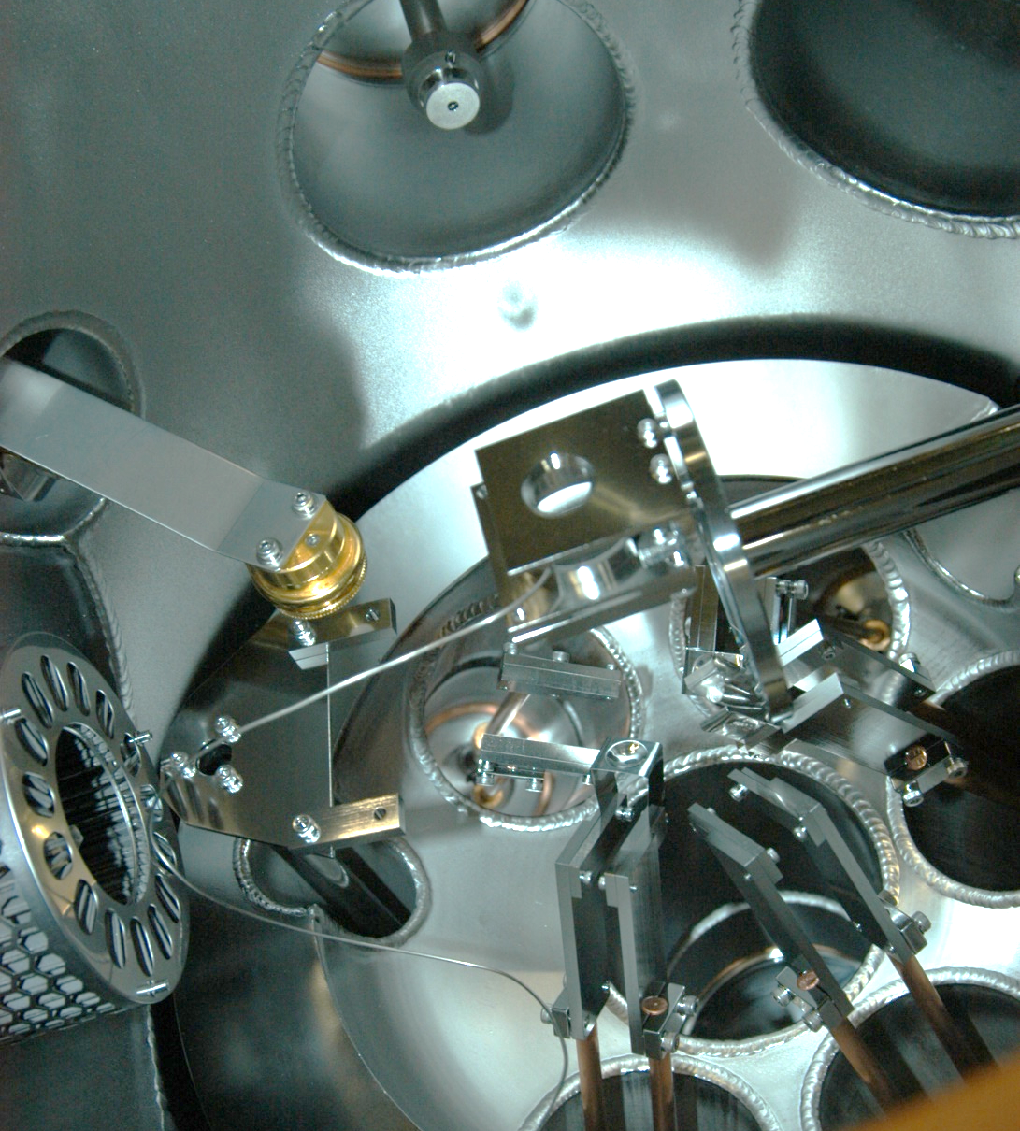
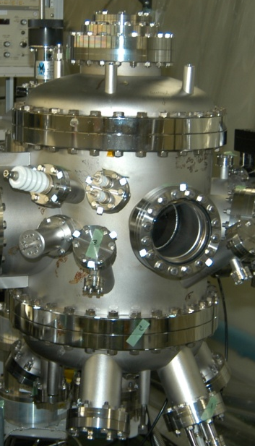
1. Development of an alkali photocathode preparation chamber (2013~)
Follow Cornell’s system,
L. Cultera, “Fabrication, characterization and use of alkali antimonides in a dc gun”, P3 Workshop 2012.
a)
a) transfer rod
c) puck holder
on ratating table
f) tungsten heater
b) thickness monitor
CRTS-4 (ULVAC)
c)
b)
d)
e)
e) AS-6-Cs-415-V
(ALVATEC)
Mo boat
Sb 99.9999%
d) NEG pump
MBE chamber
Alkali photocathode preparation chamber

Slide 6
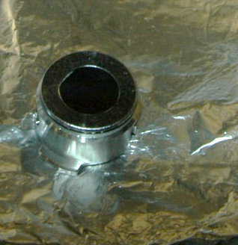
Fabrication of Cs₃Sb photocathode
QE increased
2 days later.
Sb
Cs evaporation
2.0
200
10⁻⁵
4
10⁻⁵
Mo puck
(cERL compatible)
Si(100) substrate
1.5
150
10⁻⁶
3
10⁻⁶
15 mm
in height
QE (%)
T(degC)
vacuum (Pa)
vacuum (Pa)
1.0
10⁻⁷
QE (%)
10⁻⁷
2
33 mm in diam.
0.5
50
10⁻⁸
1
10⁻⁸
0
0
10⁻⁹
0
10⁻⁹
0
1
2
3
4
0
4
8
time (hrs.)
time (min.)

Slide 7
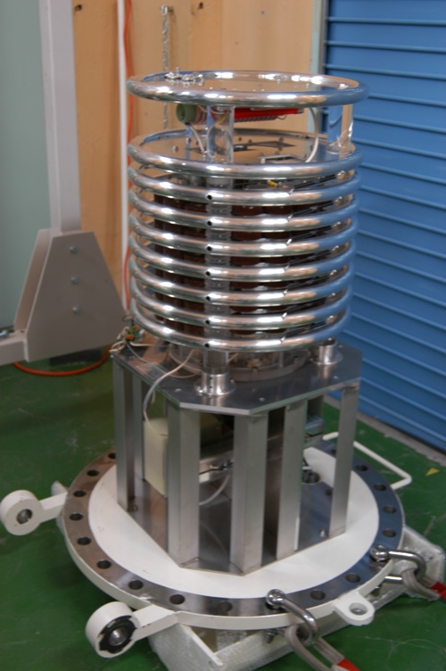
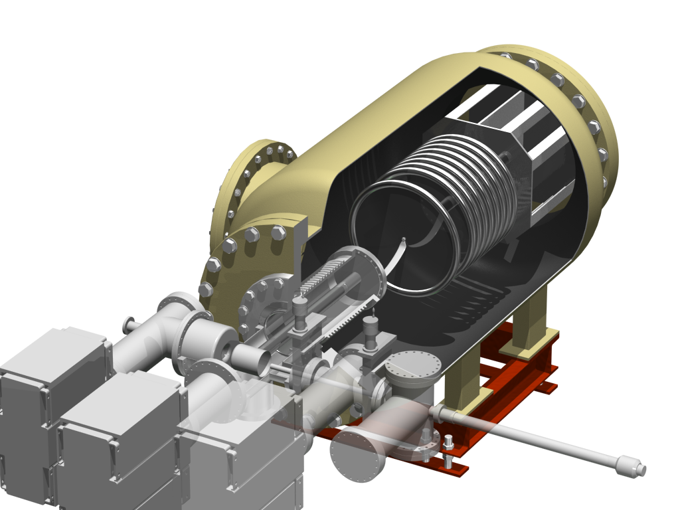
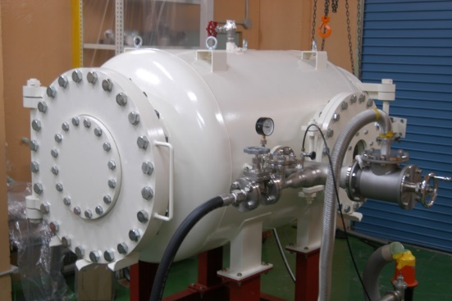
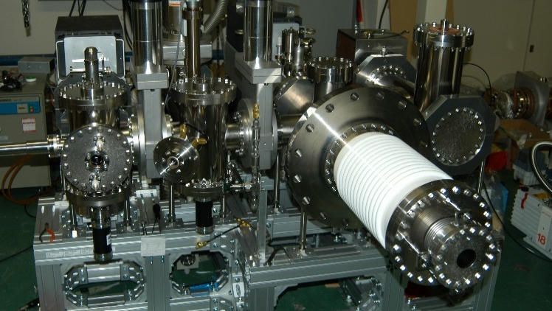
2. Development of a photoemission DC gun
250kV-50 mA HV power supply
Gun development started in 2006.
180kV-1μA beam generation
with GaAs photocathode
R. Nagai et al., Proc. Of PAC09, 545 (2009)
R. Nagai et al., RSI 83, 123303 (2012)
SF6 insulator gas tank
GaAs preparation system

Slide 8
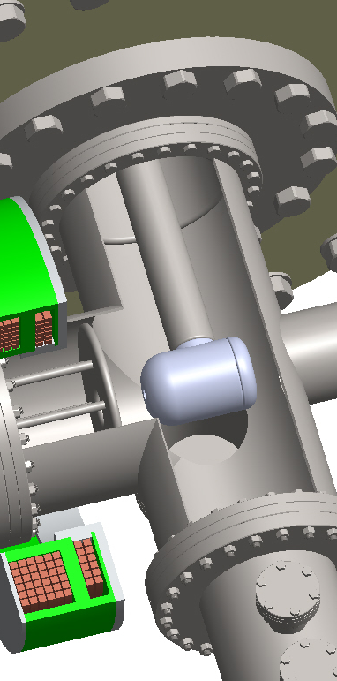
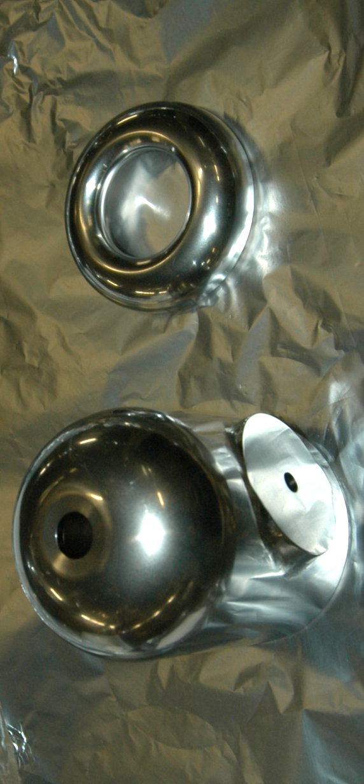
HV test with cathode electrode in place
250
200
200
150
150
HV (kV)
HVPS current (uA)
100
100
cathode electrode
50
50
0
0
10⁻⁸
0.5
0.4
0.3
vacuum (Pa)
radiation (uSv/h)
0.2
0.1
10⁻⁹
0.0
0
4
8
12
time (hrs.)

Slide 9
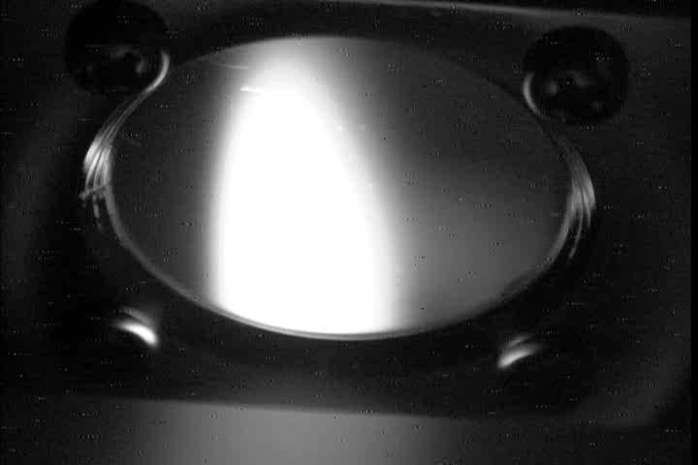
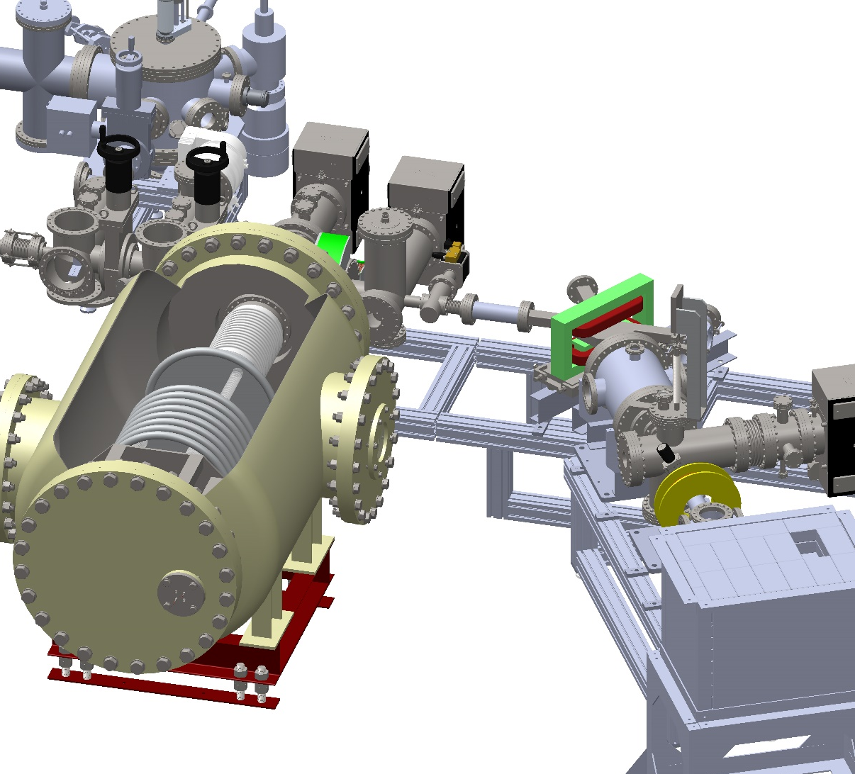
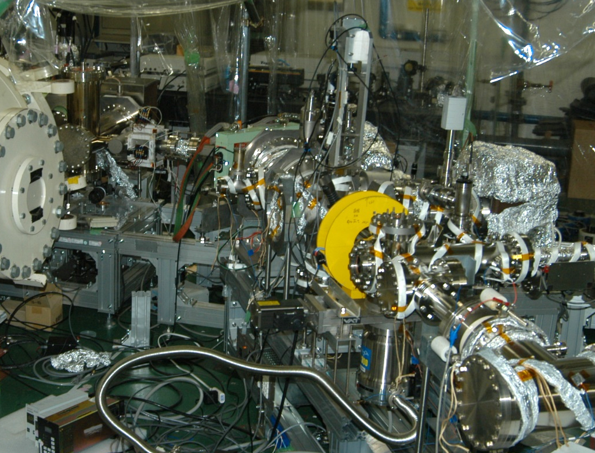
3. Beamline
beam profile
solenoid
beding magnet
differential pump
beam profile
monitor
beam dump

Slide 10
μA beam generation
250
50
10⁻⁴
50
10
200
40
10⁻⁵
40
8
150
30
10⁻⁶
30
6
Beam dump current (μA)
HV (kV)
Gun, beam dump vacuum (Pa)
Beam dump current (μA)
QE (%)
100
20
10⁻⁷
20
4
50
10
10⁻⁸
10
2
0
0
10⁻⁹
0
0
0
0.2
0.4
0.6
0
1.0
2.0
time (hrs.)
532nm laser power (mW)

Slide 11
mA beam generation
300
6
10⁺²
5
5
1.8mA with 200 mW laser
4.3mA with 500 mW laser
250
5
10⁰
4
4
200
4
10⁻²
3
3
Gun, beam dump vacuum (Pa)
Beam dump current (mA)
QE (%)
150
3
10⁻⁴
HV (kV)
Beam dump current (mA)
2
2
100
2
10⁻⁶
1
1
50
1
10⁻⁸
0
0
10⁻¹⁰
0
0
0
0.2
0.4
0.6
0.8
0
200
400
600
time (hrs.)
532nm laser power (mW)

Slide 12
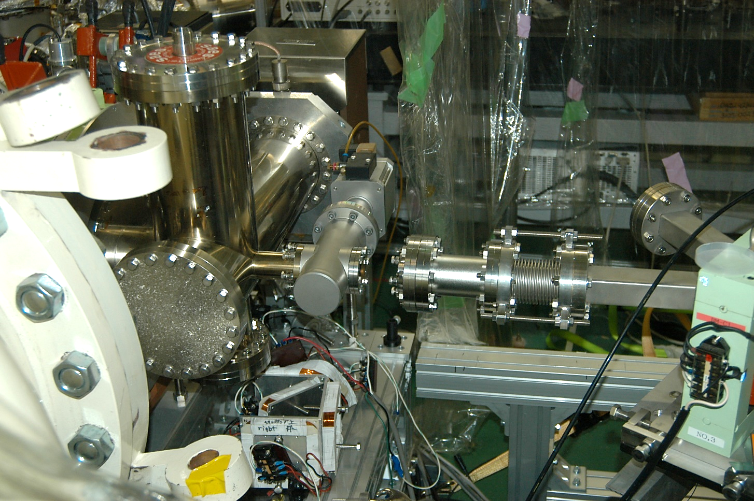
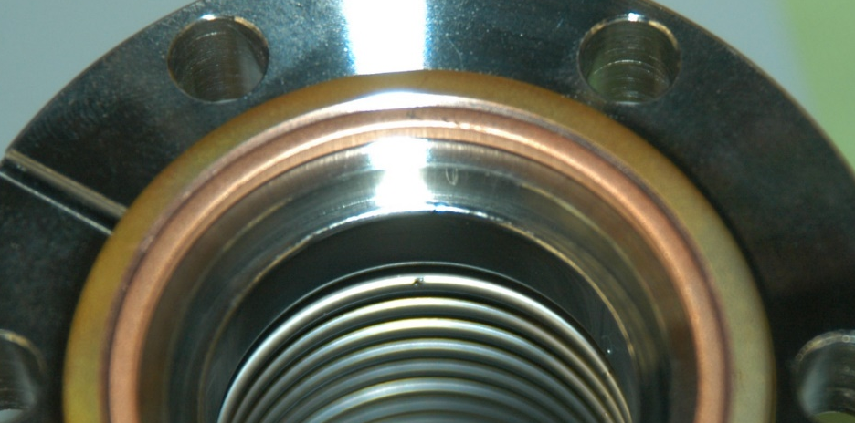
Vacuum incident during beam transport
300
6
10⁺²
vacuum incident
250
5
10⁰
1.5mA with 200 mW laser
3.6mA with 500 mW laser
200
4
10⁻²
Gun, beam dump vacuum (Pa)
150
3
10⁻⁴
HV (kV)
Beam dump current (mA)
100
2
10⁻⁶
50
1
10⁻⁸
0
0
10⁻¹⁰
0
0.2
0.4
0.6
0.8
time (hrs.)

Slide 13
Summary
Fabricated Cs₃Sb photocathode with QE of 5 %.
Generated 150kV - 4.3 mA beam from the photocathode.
Future work
Fix the vacuum issue and perform baking, HV conditioning,
photocathode fabrication to restart the gun development.
Acknowledgement
This work is partially supported by
JSPS Grants-in-Aid for Scientific Research in Japan (15K13412).

