Slide 1
Graphene – Quantum dot Hybrid photodetector technology for CMOS compatible high performance photodetectors from the UV to Short-wave Infrared
G. Navickaite¹, S. Goossens¹, I. Nikitskiy¹, E. Puma ¹, T. Galan¹, S. Gupta¹, M. Montagut¹, C. Monasterio¹, F. H. L. Koppens^{1,2} , G. Konstantatos^{1,2}
¹ ICFO - Institut de Ciències Fotòniques, Mediterranean Technology Park, 08860 Castelldefels, Barcelona, Spain
² ICREA – Institució Catalana de Reçerca i Estudis Avançats, Barcelona, Spain
Gerasimos.Konstantatos@icfo.es, Frank.koppens@icfo.es

Slide 2
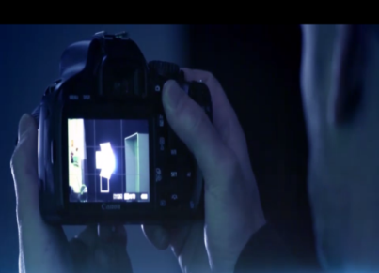
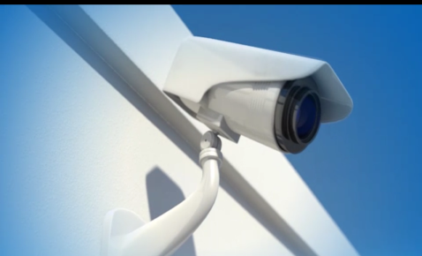
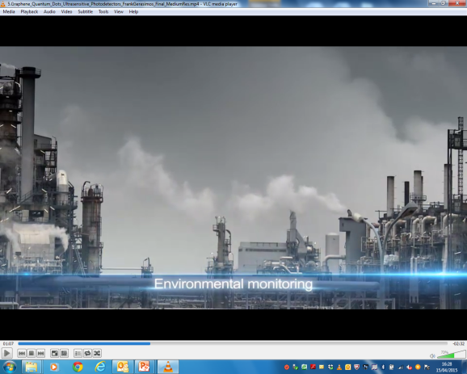
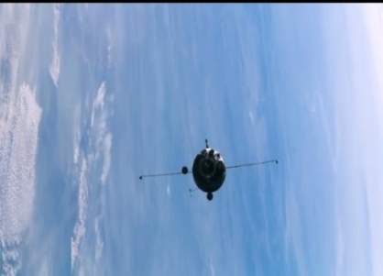
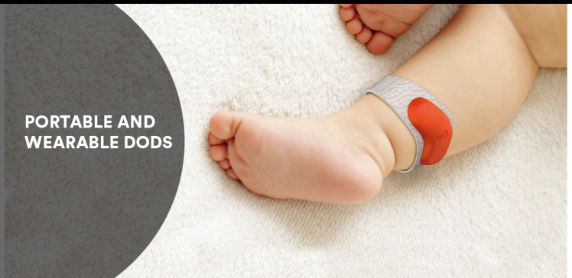
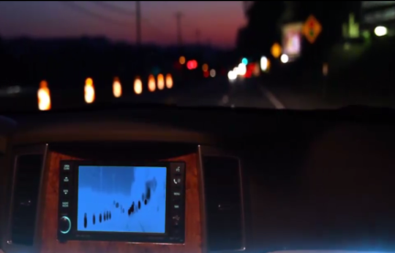
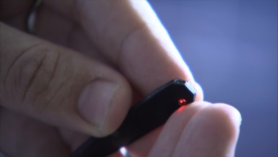
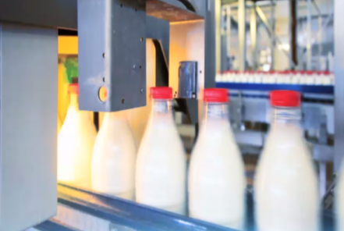
^{Market Applications}
^{Consumer market:} digital imaging, surveillance, remote sensing
The automotive industry (thermal, passive night vision)
The biomedical industry (x-ray imaging, NIR biomedical imaging and diagnostics),
Environmental monitoring (Infrared, UV and multispectral imaging),
Safety (x-ray imaging, explosives and threat detection),
Metrology (scientific metrology, space applications etc.)
Wearable devices (pulse- oxymetry, and other kinds of health monitoring).
Process Monitoring (agro-, food- pharmaceutical inspection)
Machine vision (industrial manufacturing, AUVs, Drones)

Slide 3
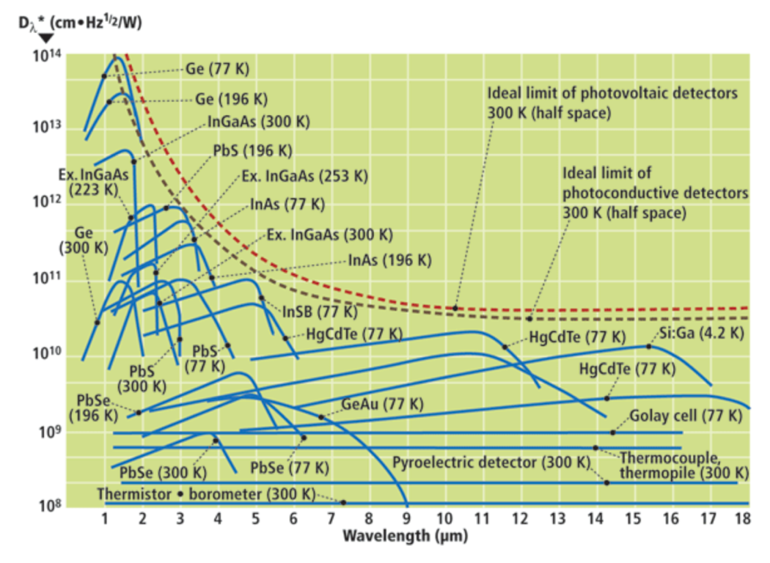
^{Existing technology} ^{roadblocks}
Technology Fragmentation
Non Monolithic Solutions
InP
InGaAs Photodiode
Array Chip
Si
Si ROIC Chip
Dramatically High cost beyond Si-coverage:
in SWIR (>20K€)
In FLIR (>50K€)
Low Pixel Resolution
Complex and High cost multispectral systems
Non-flexible platforms (rigid substrates)

Slide 4
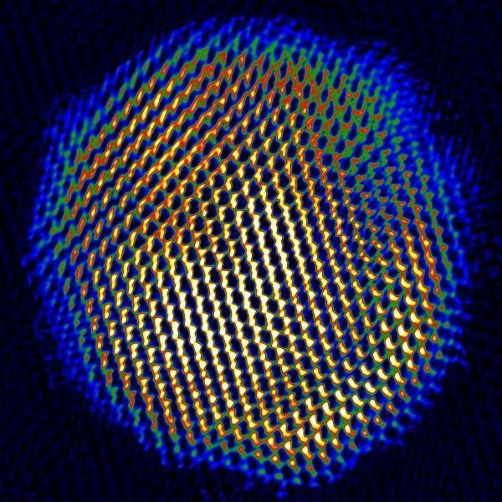
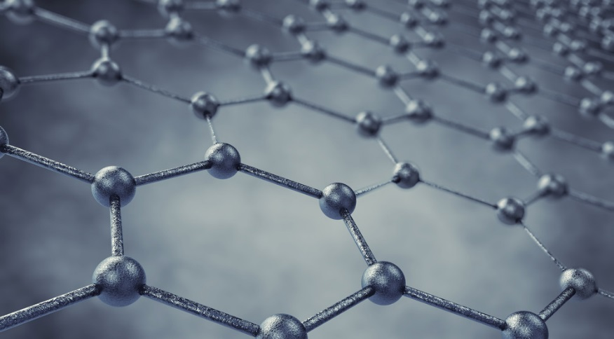
^{ICFO´s Approach}
+
Colloidal Quantum Dots
Graphene

Slide 5
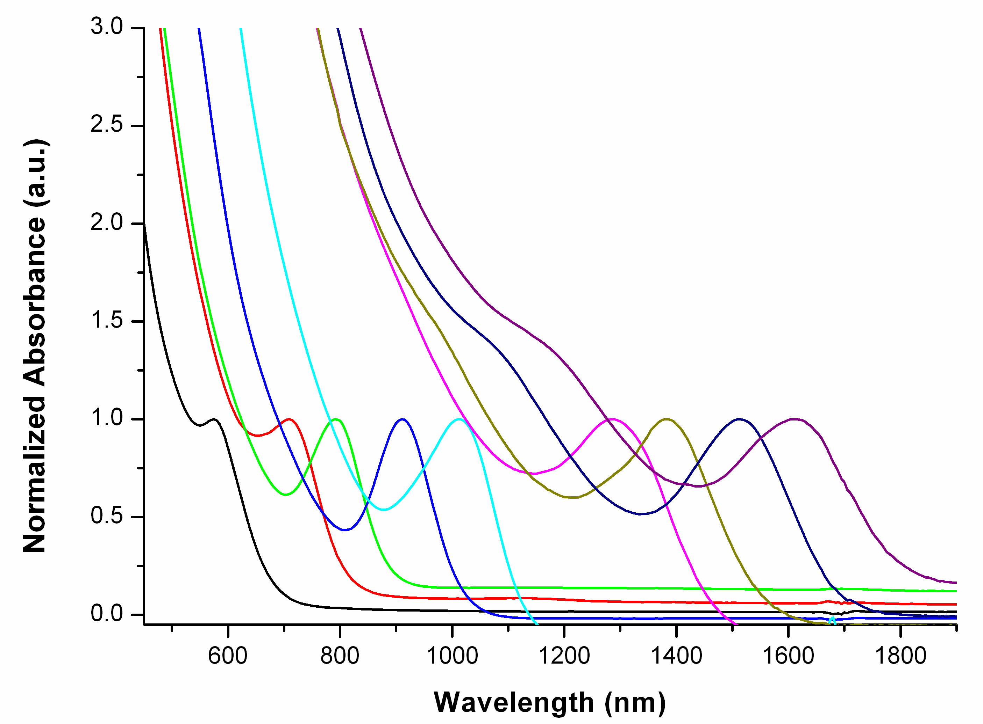
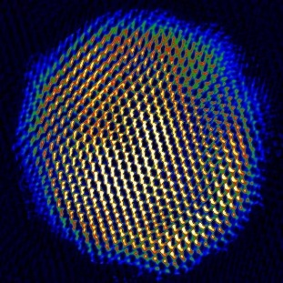
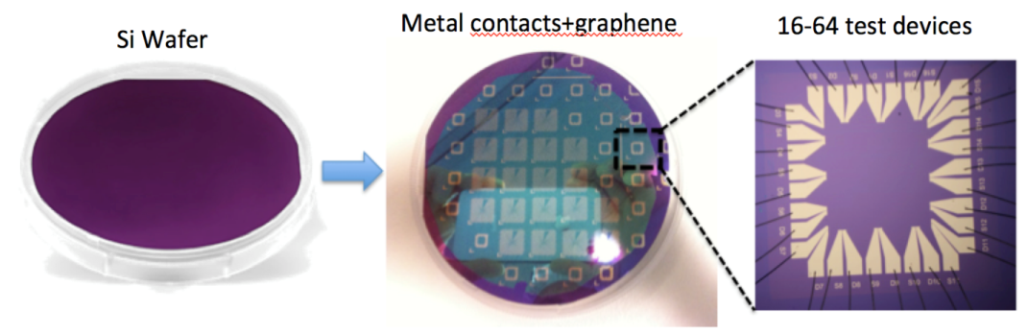
^{ICFO´s Approach}
+
Colloidal Quantum Dots
Graphene
Vary diameter
Ultra small nanocrystals based on PbS
Absorption wavelengths tunable by changing size, exciton peak 600 nm – 2000 nm
Strong light absorber
Solution processed
CMOS Compatible
Atomically thin carbon layer
High mobility
Low 1/f noise
Transparent and flexible
Grown by chemical vapour deposition (CVD)
CMOS Compatible

Slide 6
First Generation of a Graphene-QD photodetector
Gain 10⁶ - 10⁷
EQE 25%
Time response 10 – 100 ms
Linear Dynamic Range 60 dB
G. Konstantatos et al., Nature Nanotech. 7, 363-368 (2012) .

Slide 7
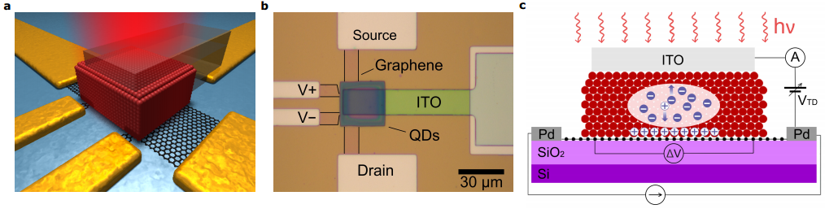
Second Generation of a Graphene-QD photodetector
Gain 10⁵ - 10⁶
EQE 80%
Time response 0.1 – 1 ms
Linear Dynamic Range 110 dB
Nikitskiy et al., Nature Comm. (2016)

Slide 8
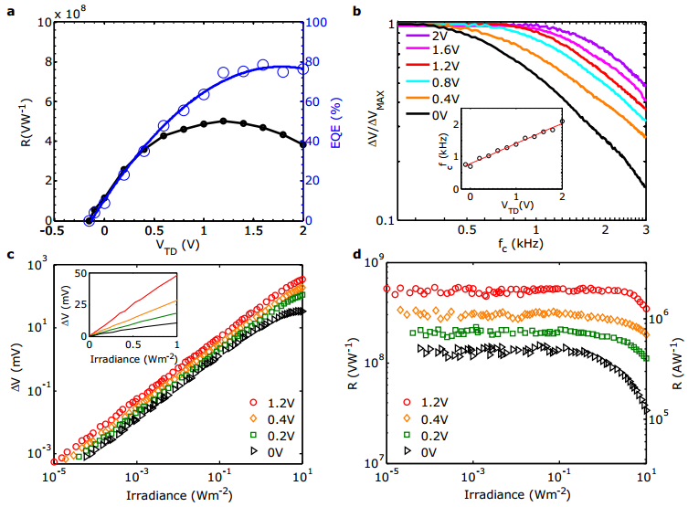
Second Generation of a Graphene-QD photodetector
Gain 10⁵ - 10⁶
EQE 80%
Time response 0.1 – 1 ms
Linear Dynamic Range 110 dB
Nikitskiy et al., Nature Comm. (2016)

Slide 9
2D (MoS2)-QD photodetector
Kufer et al., Adv. Materials. (2014)
Kufer et al. ACS Photonics (2016)

