Slide 1
Avalanche Pixelated Detectors for Time Resolved Experiments
NICOLA TARTONI
Diamond Light Source

Slide 2
Techniques requiring time resolving detectors
Crystallography
Powder diffraction
Small angle scattering
Spectroscopy
…

Slide 3
Timepix3
Time stamp per pixel 1.56ns resolution
Data-driven Zero-suppressed Sparse readout
Pixel size 55 μm x 55 μm
Pixel matrix array 256 x 256

Slide 4
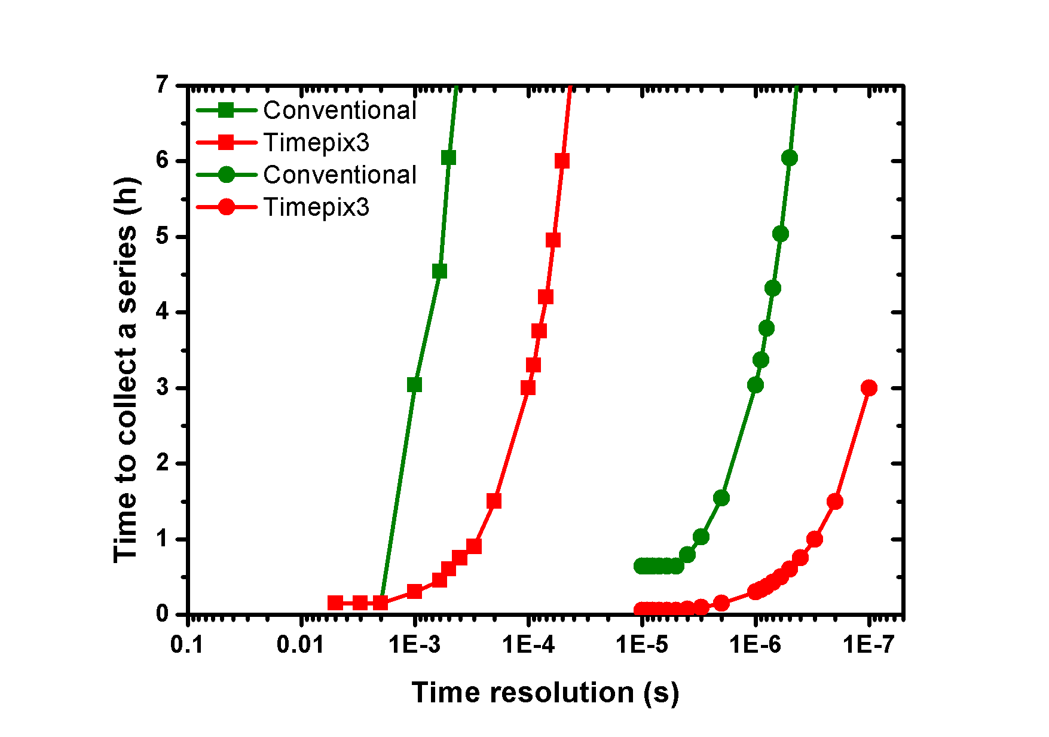
Small molecule crystallography
10 Hz
Laser
10 kHz
Laser
Courtesy Mark Warren

Slide 5
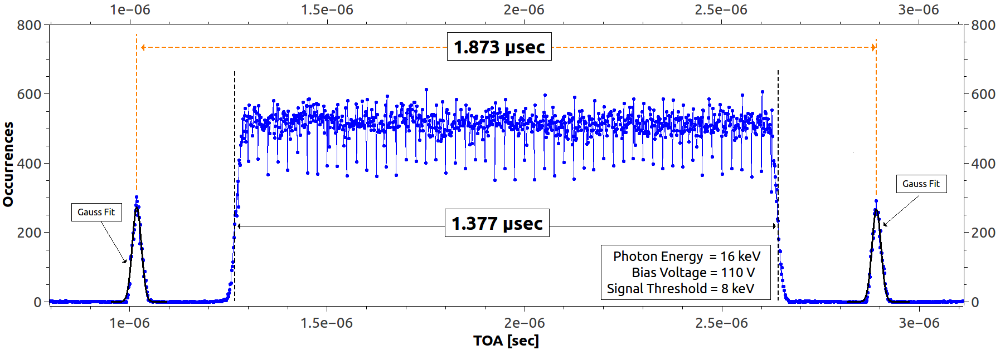
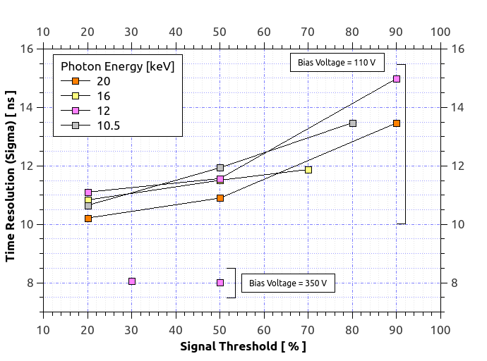
Hystogram of ToAs
Best achieved resolution:
8 ns (sigma)
Measurements taken in Hybrid and Low-Alpha modes

Slide 6
Limitations
DEAD TIME: Time Over Threshold + 475ns
MAX GLOBAL COUNTING RATE: 80 Mhits/s/chip

Slide 7
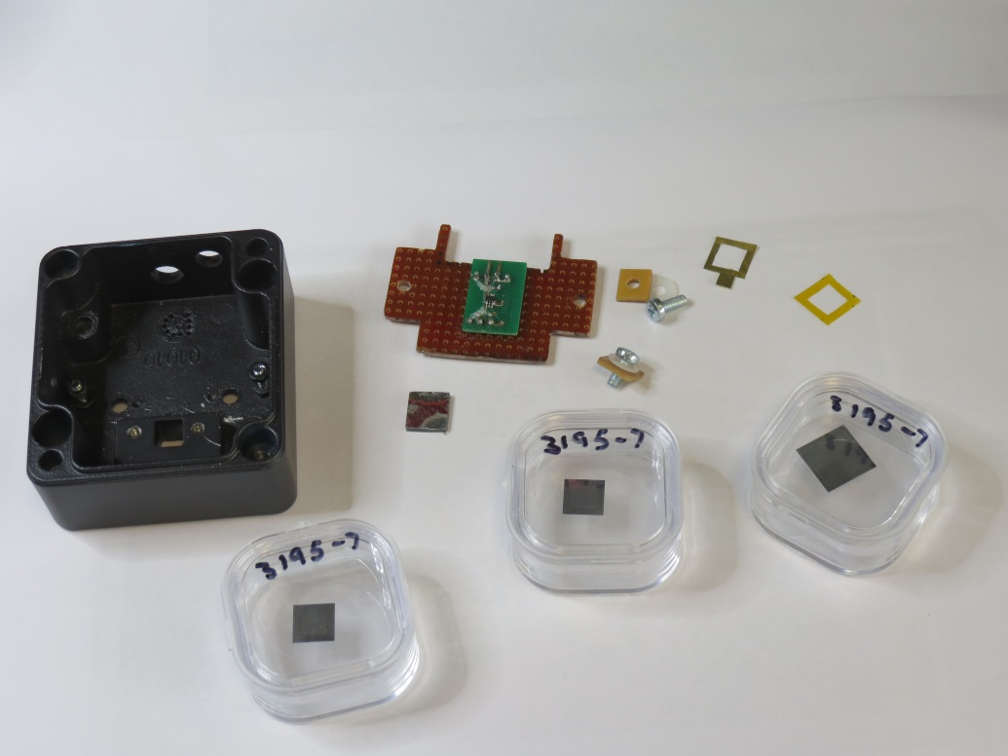
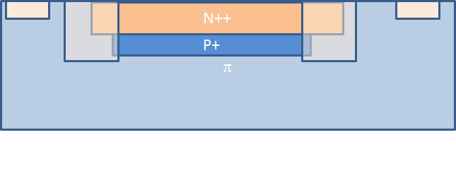
Avalanche Pixelated Sensors Hi-Res Silicon
Structures fabricated by Micron Semiconductor and
Glasgow University

Slide 8
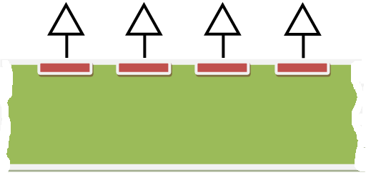
Issues to be addressed
Uniformity of gain

Slide 9
Issues to be addressed
Dedicated front-end electronics

Slide 10
Mini-Attract Project
Development of front-end electronics with 55 micron pitch dedicated to Avalanche Detectors
Development of Avalanche Pixelated Sensors suitable to build large area detectors

Slide 11
Possible Attract Project
Full detector system development
  Avalanche sensor
  ASIC (4-side buttable with high performance digital section)
  Interconnections (board-level optical interconnections)
  DAQ

Slide 12
Potential Impact
Enhancement of hybrid detector technology
Much more efficient Time Resolved Experiments
Effective operation in 1 keV – 4 keV range

