Slide 1
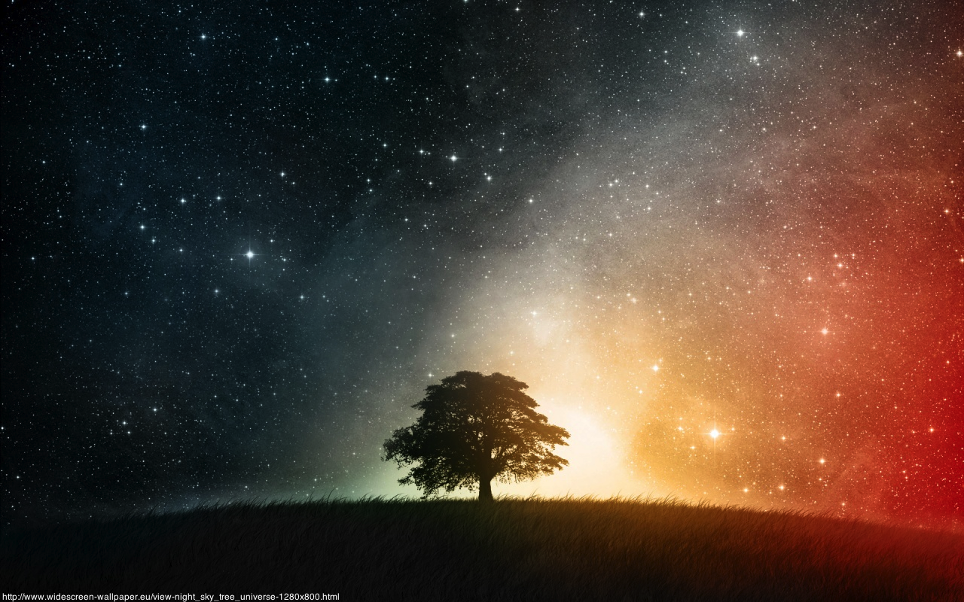
Cosmology
A short introduction
Sarah Aretz
CERN

Slide 2
What is cosmology all about?
Κοσμολογία = study of the world
description of the origin, evolution and eventual fate of the Universe by physical laws

Slide 3
Cosmological Questions:
What is the Universe made of?
How does it’s structure look like?
What is it’s origin?
Can we reconstruct the history of the Universe?

Slide 4
Contents
Dimensions of our Universe
Dynamics of the Universe
A Journey through Time
Mysteries of the Universe

Slide 5
Dimensions of our Universe

Slide 6
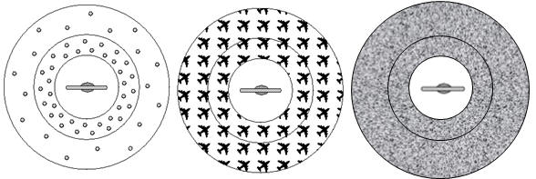
The Cosmological Principle
“On large scales the Universe is
homogeneous and isotropic”
We don’t find ourselves in a special place.
isotropic, but not homogeneous
homogeneous, but not isotropic
Homogeneous and isotropic

Slide 7
The Universe
Before the 20th century the Universe seemed to be a quiet place.
It was not very busy.
Most of the physicists believed the Universe being infinte in space and time.
But there was a strange observation:
At night it is dark
This couldn‘t be explained with an infinitely large and old Universe.

Slide 8
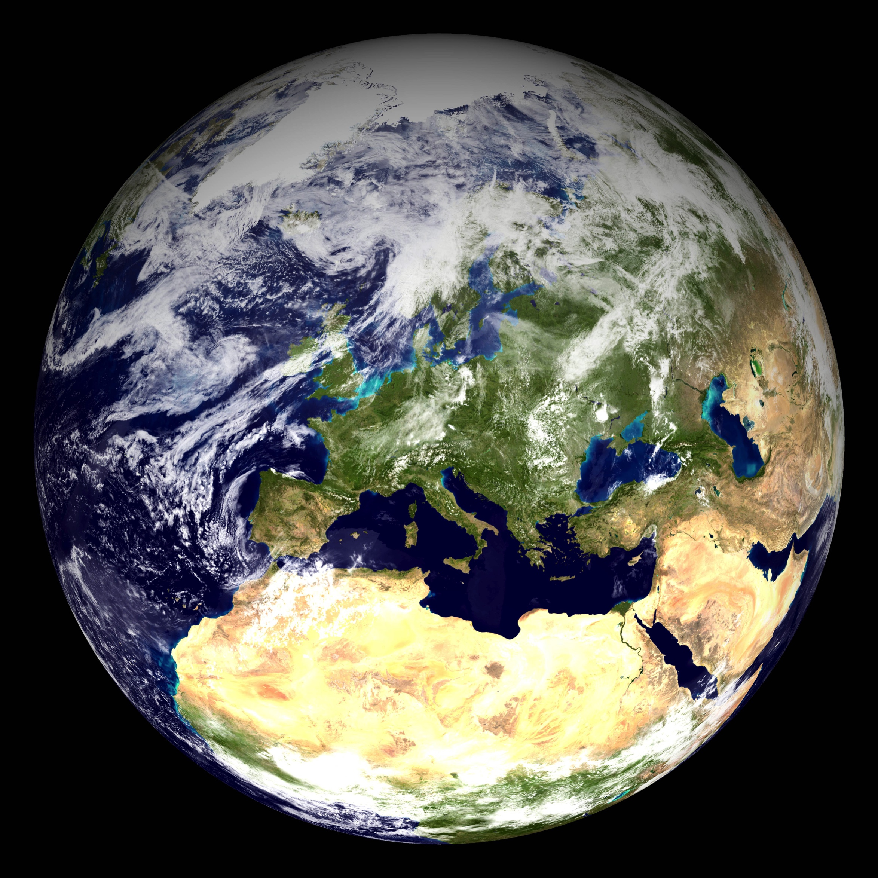
The Earth: ≈13000 km in diameter

Slide 9
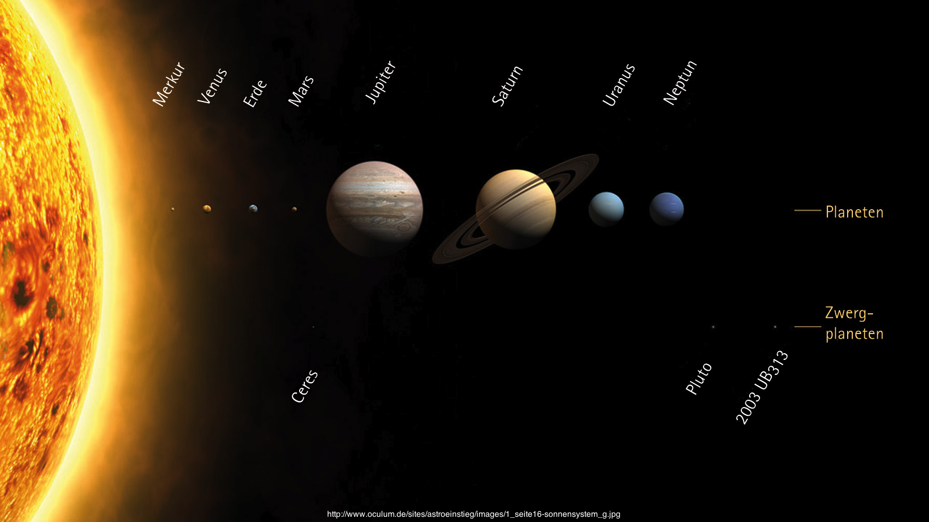
The Solar System:
≈10 billion km in diameter

Slide 10
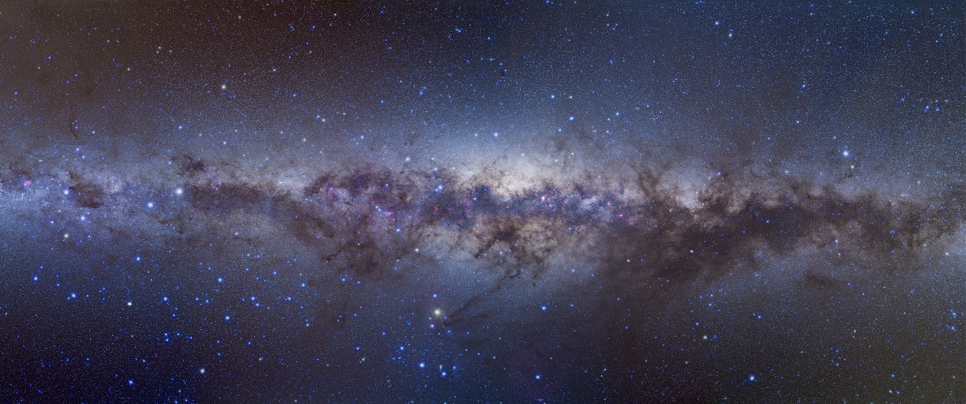
Our Milky Way:
10¹⁸ km = 100000 light years in diameter

Slide 11
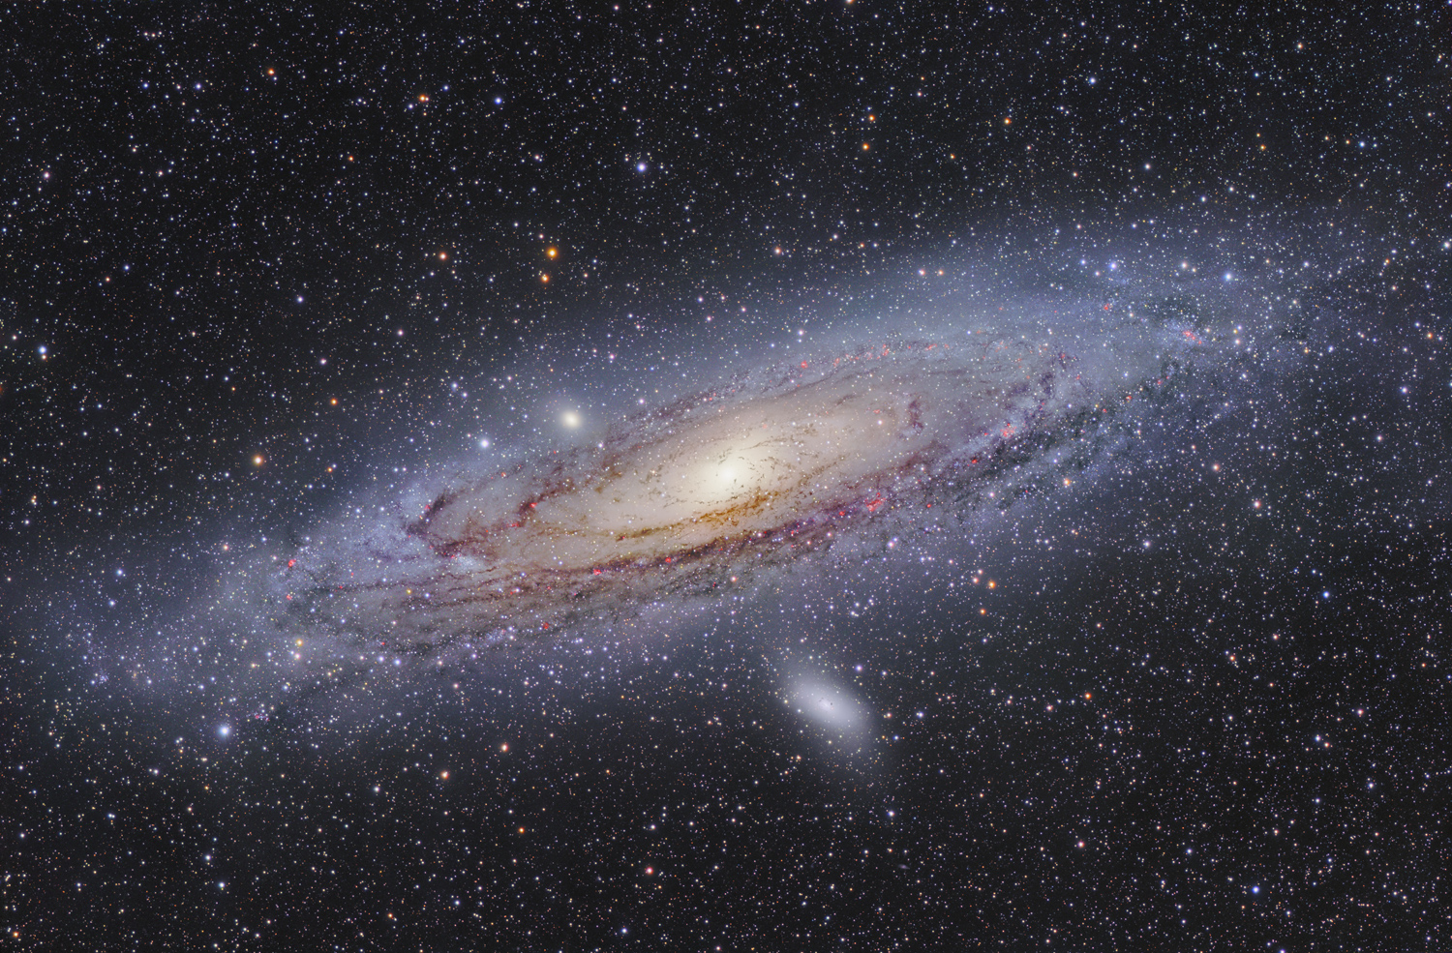
Andromeda Galaxy:
2.5 million light years distance

Slide 12
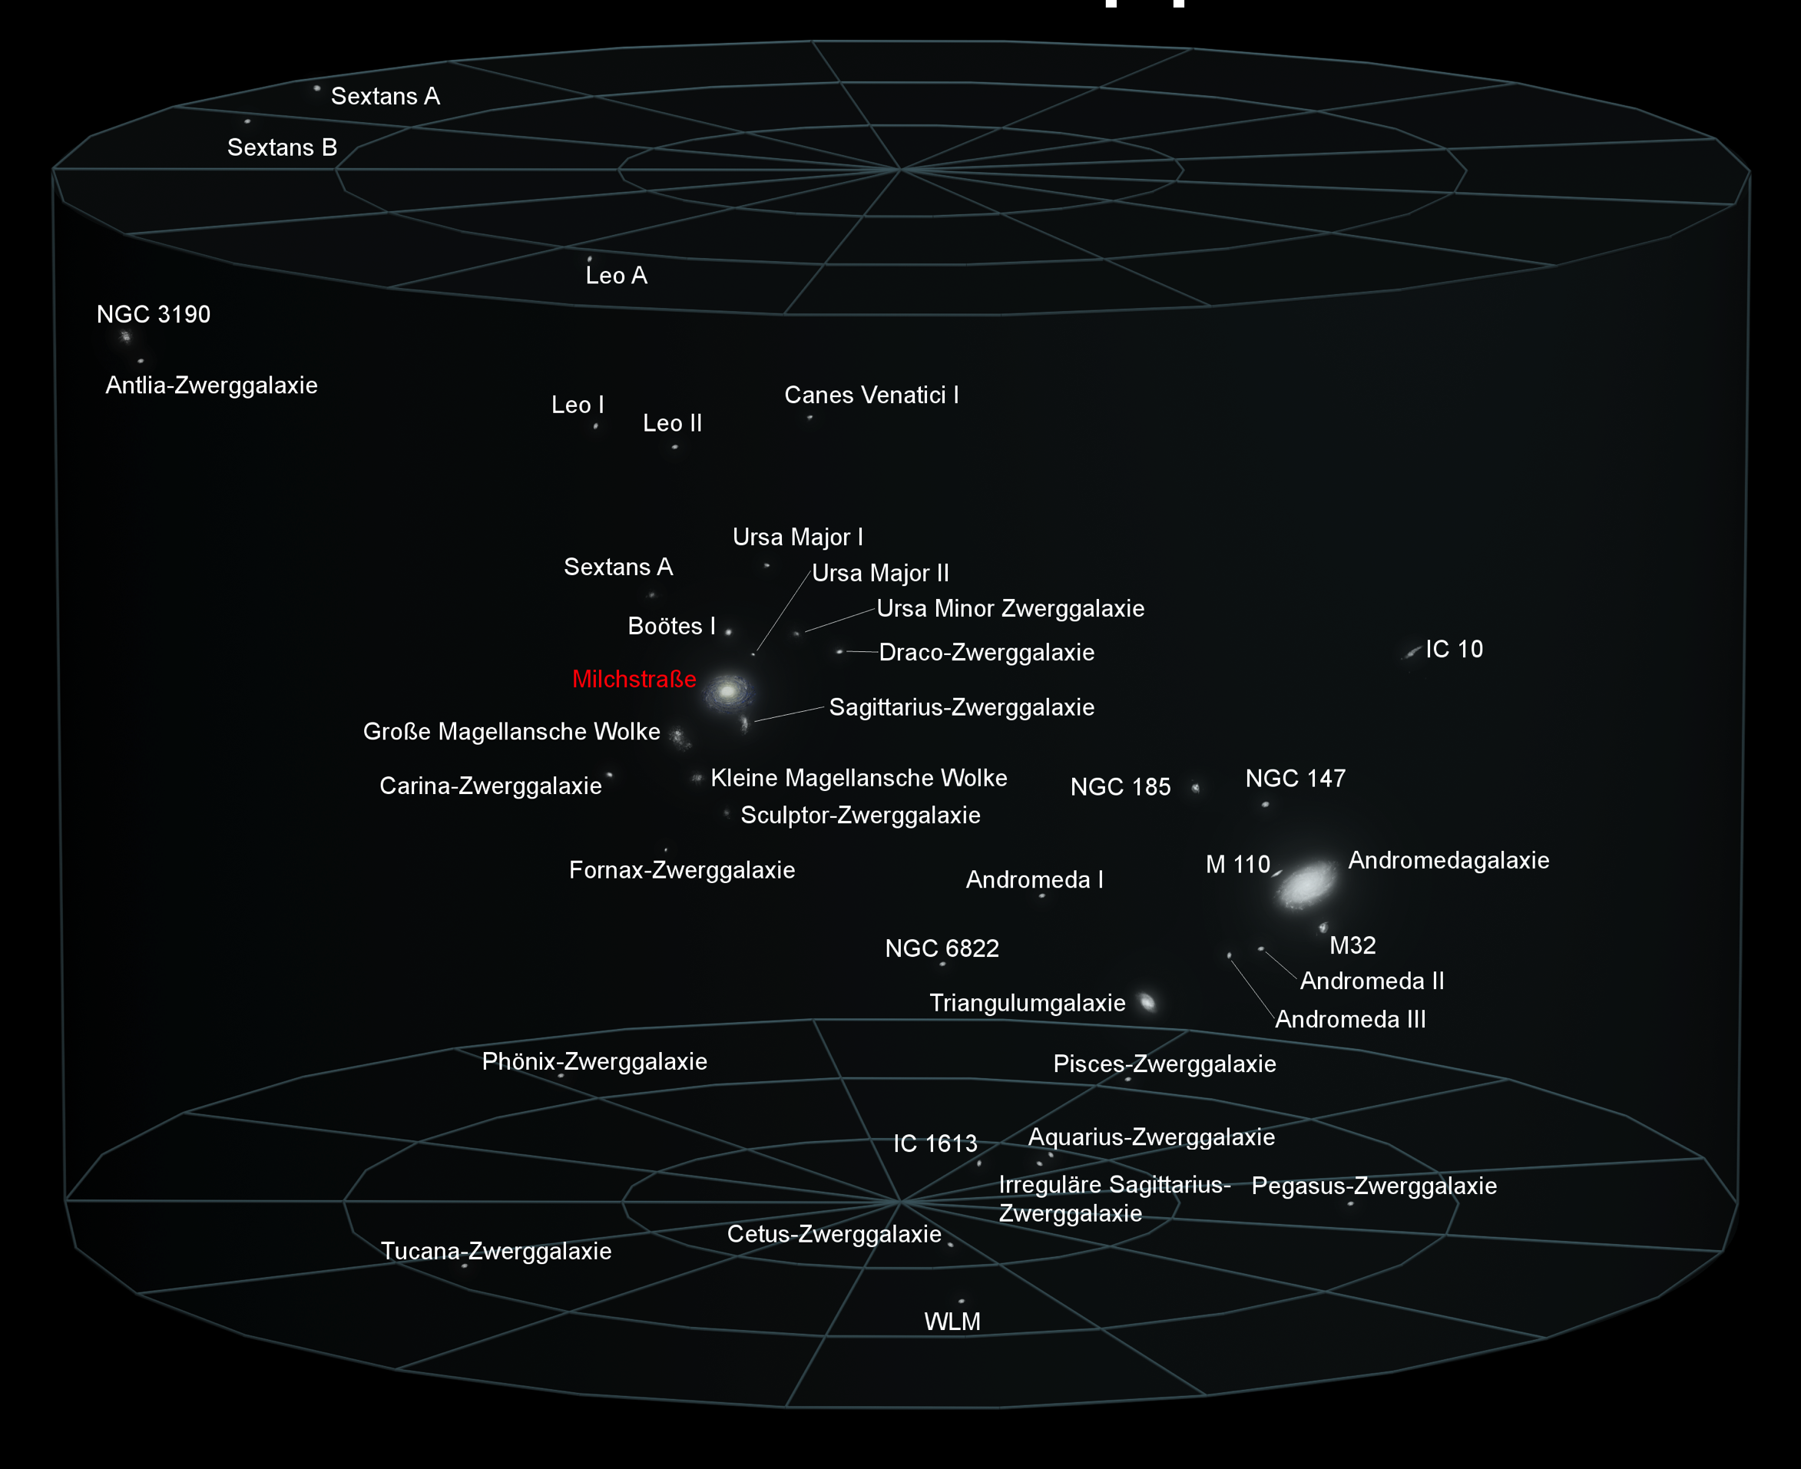
Local Group:
8 million light years in diameter

Slide 13
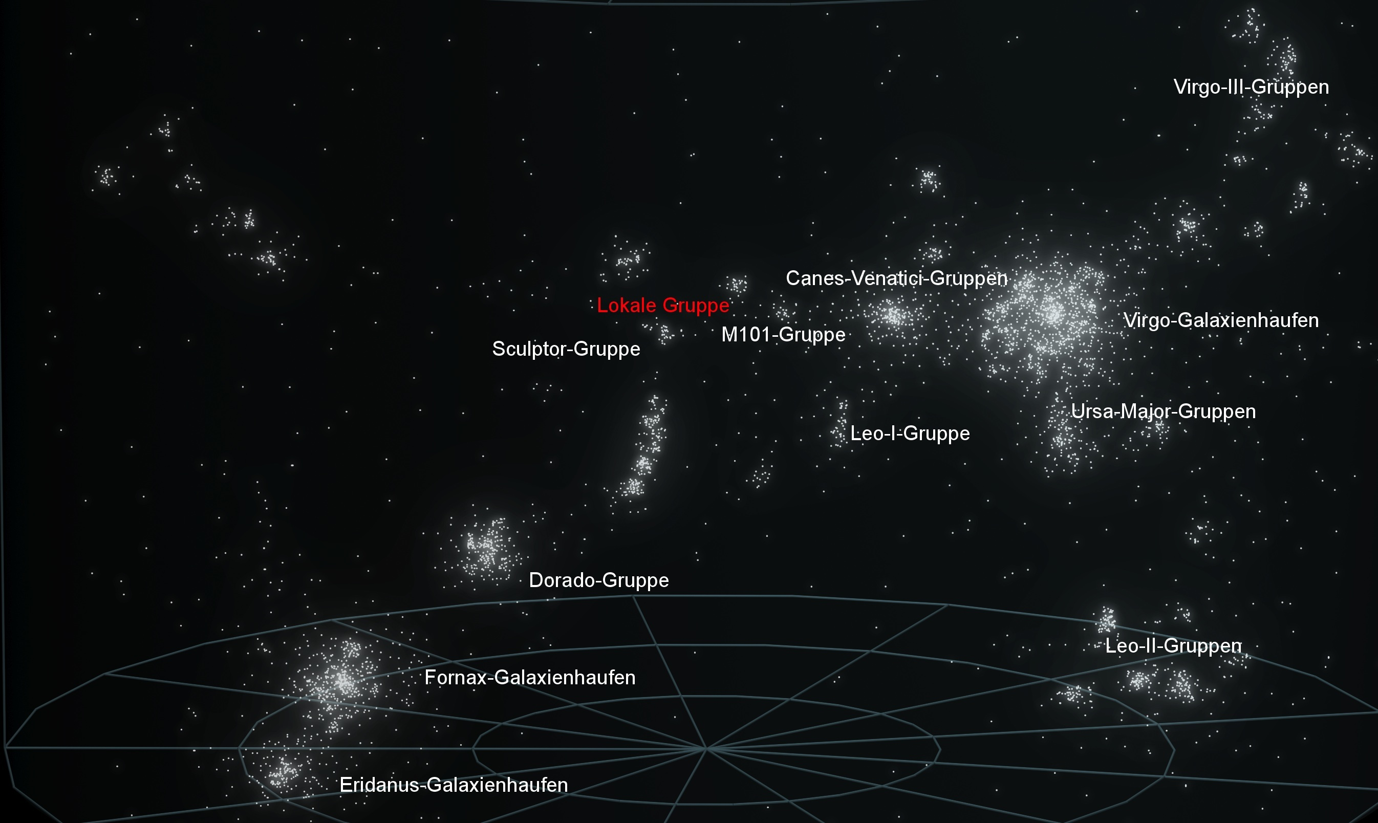
Virgo Supercluster: 100-200 million light years in diameter

Slide 14
Hubble Extreme Deep Field

Slide 15
Dynamics of the Universe

Slide 16

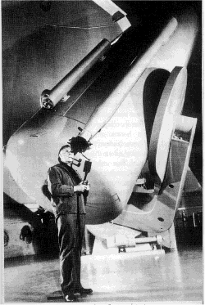
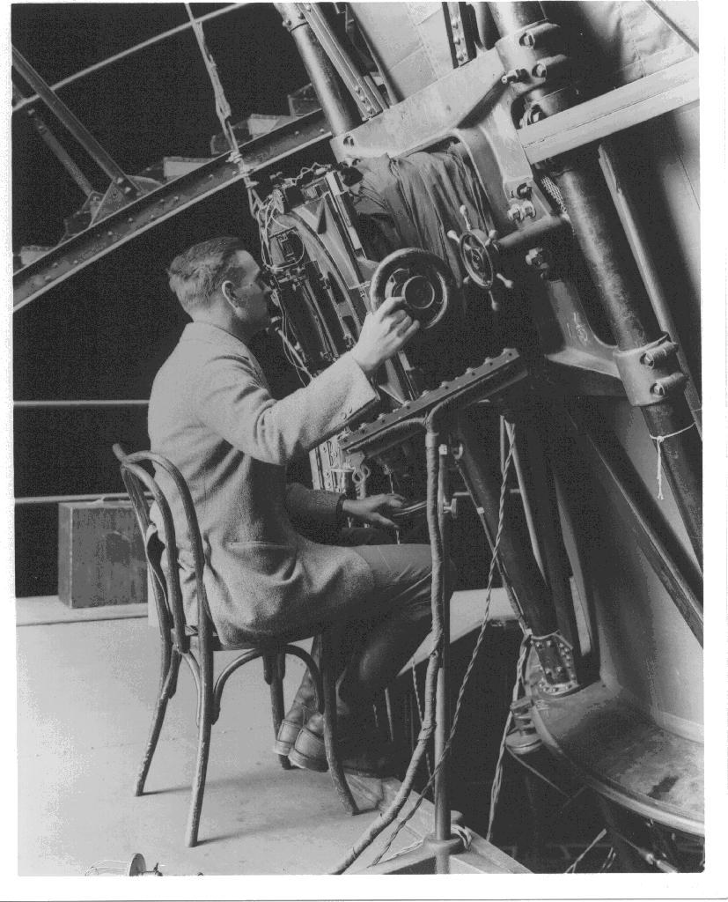
The Universe is bigger than we thought!
1924
Edwin Hubble
Mt. Palomar telescope
Observation of „nebulas“
Proof of the existence of galaxies outside the
Milky Way

Slide 17
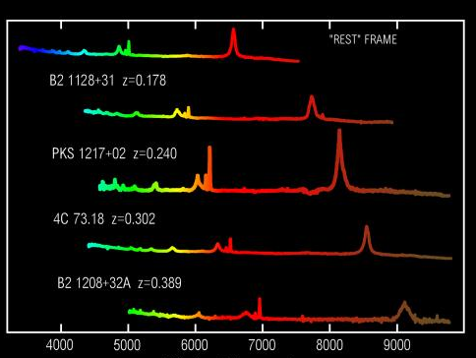
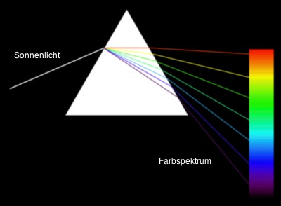
Measuring of the Redshift
Emission lines
Spectroscopy
in the lab
Wavelength [Å]

Slide 18
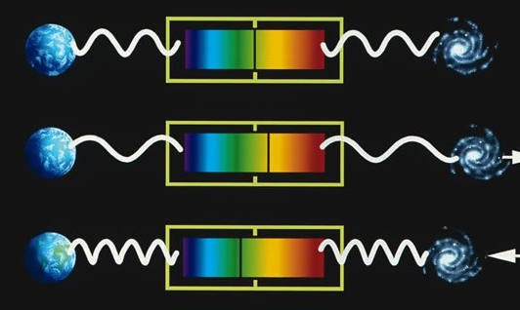
Cosmological Redshift vs.
Doppler Effect
The cosmological redshift is comparable with a redshift caused by a relative movement of source and observer

Slide 19
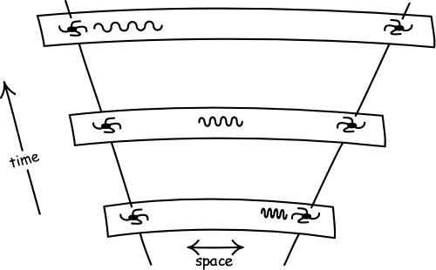
Cosmological Redshift
Space itself expands and “stretches” the wavelength of the photons.

Slide 20
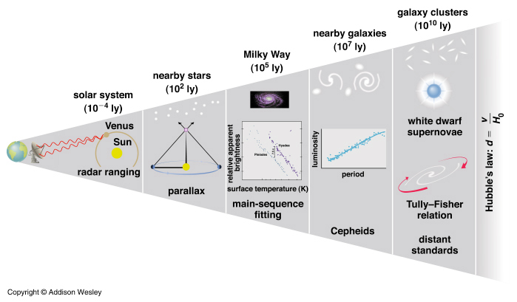
Distance Ladder

Slide 21
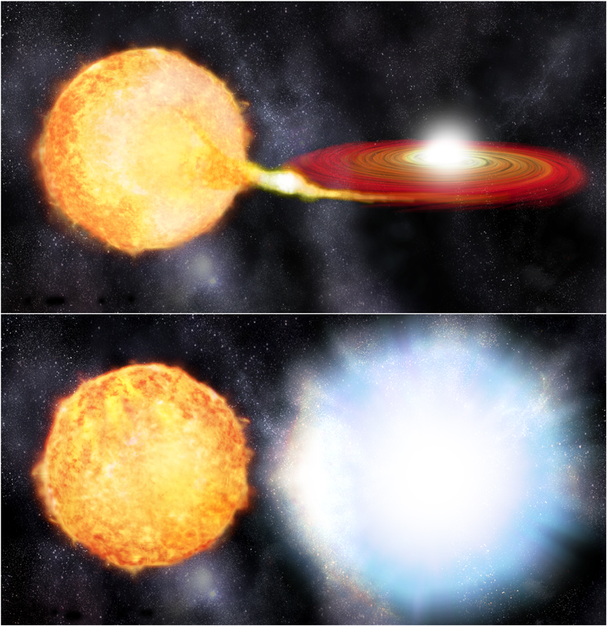
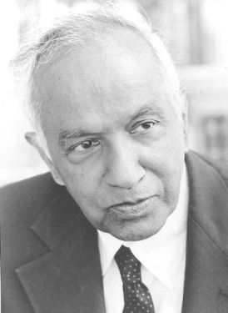
Type Ia Supernova
white dwarf
Chandrasekhar limit:
M ≈ 1.4 M_{sun}

Slide 22
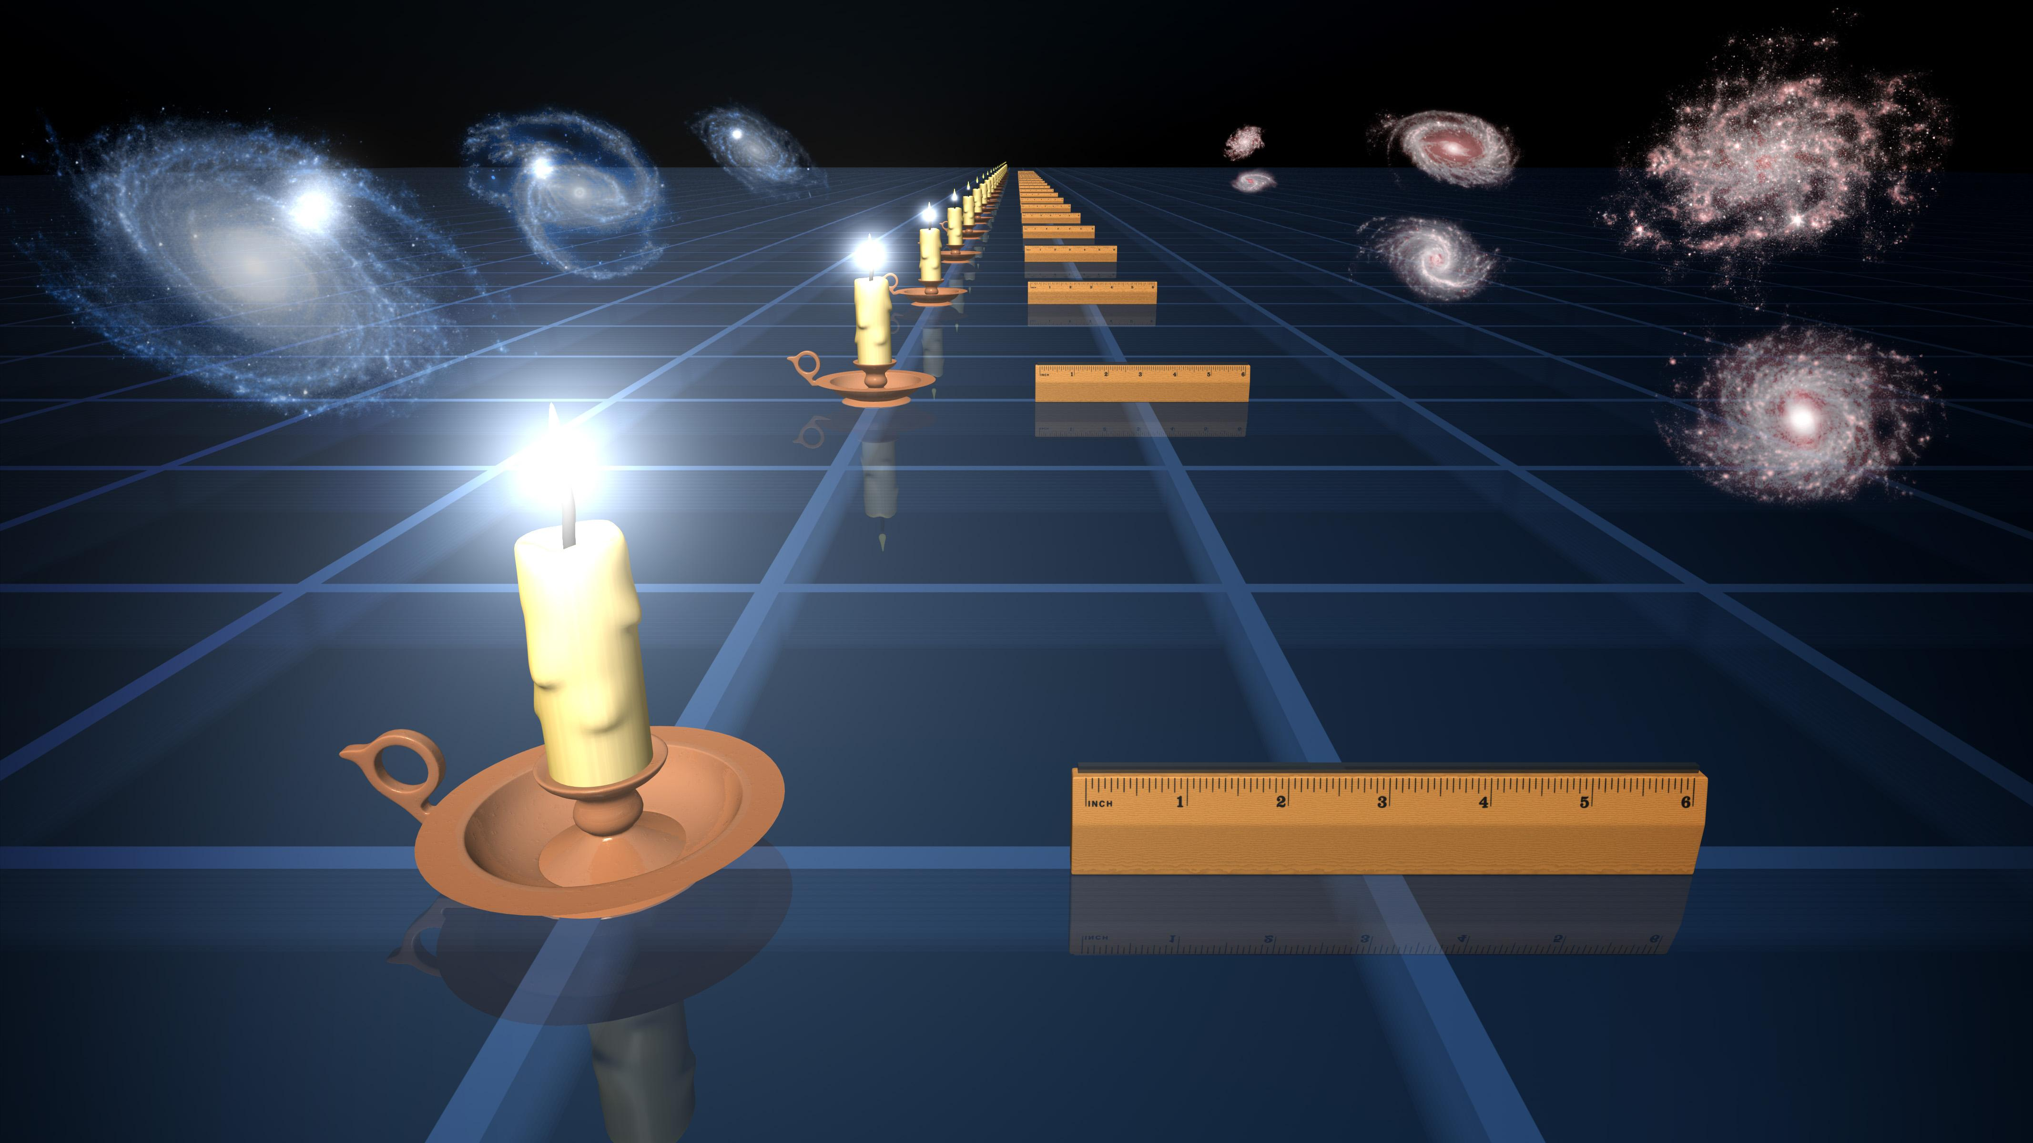
Standard Candles and Brightness

Slide 23
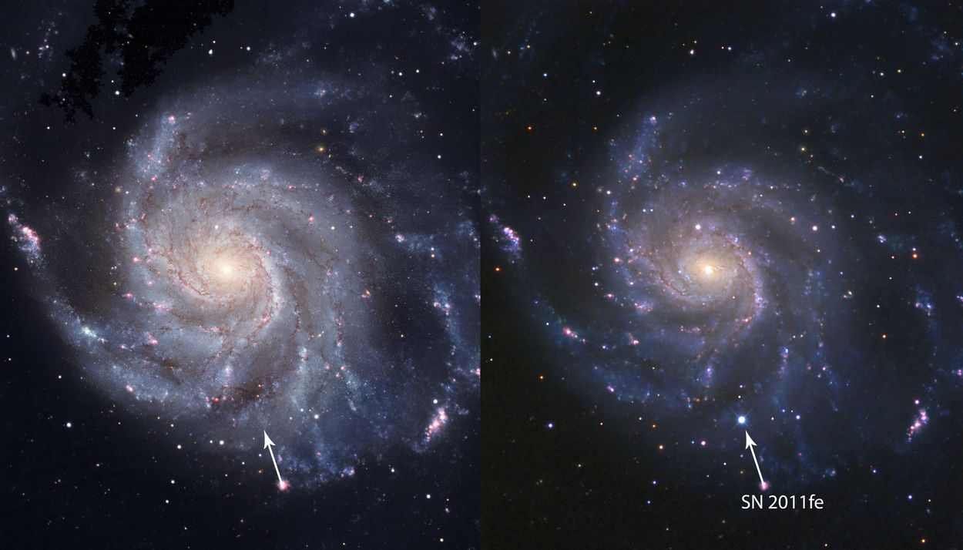
Example of a Supernova from 2011
Supernovae can temporarily release as much energy
as a whole galaxy!

Slide 24
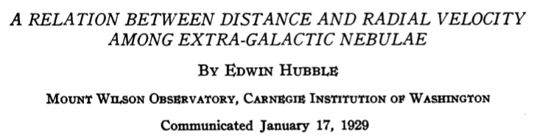
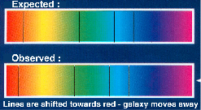
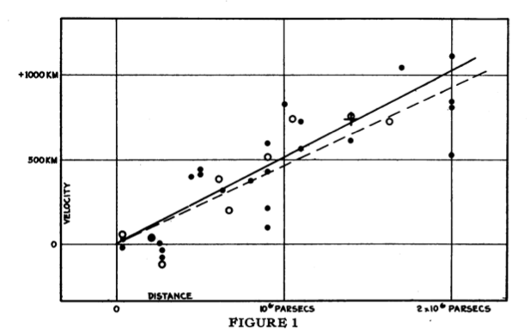
The Universe is expanding
1929
redshift is proportional to the distance of the galaxies
(galaxy escape)
Hubble‘s law: v = Ho d
Ho = 530 km/s / Mpc !!

Slide 25
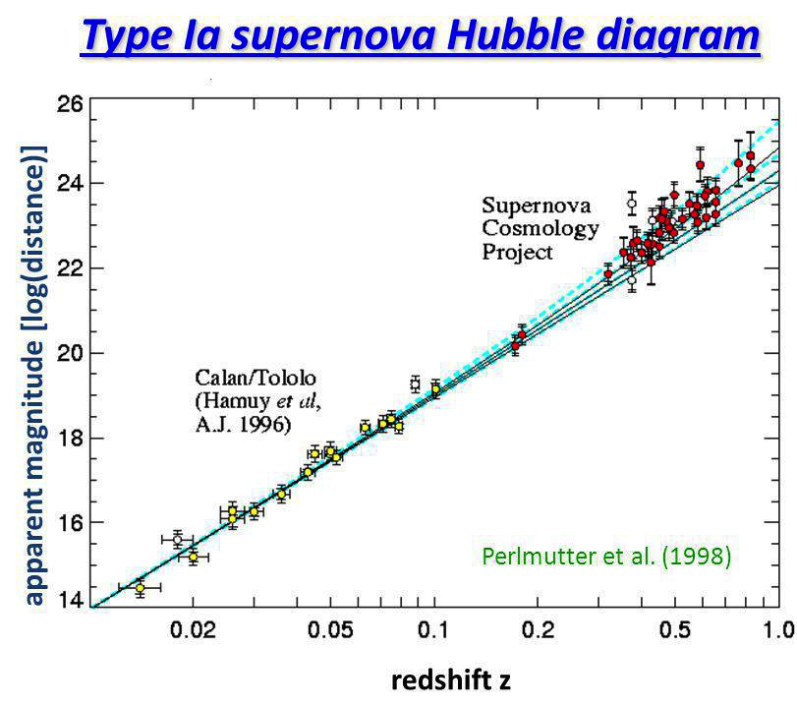
The present value of the Hubble ”constant”
Today: H = 70±3 km s⁻¹ Mpc ⁻¹

Slide 26

The further we look back into the past, the smaller was the Universe. conclusion about the Big Bang
Consequences of the Cosmological Expansion

Slide 27
A Journey through Time

Slide 28
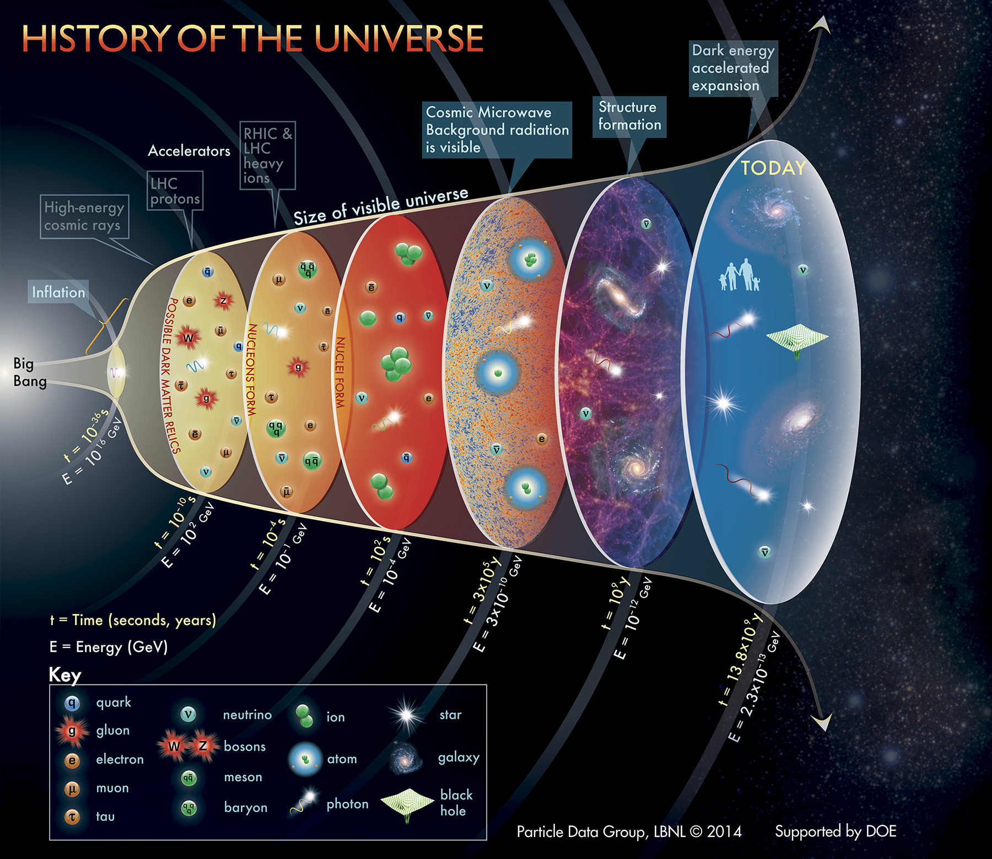

Slide 29
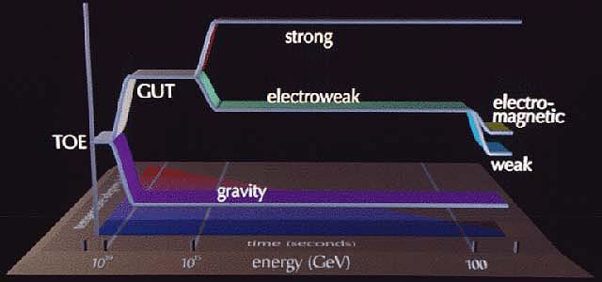
Unification of the Forces
age 10⁻³⁶ s: strong and electroweak force get separated

Slide 30
inflation

Slide 31
destruction battle

Slide 32
nucleosynthesis

Slide 33
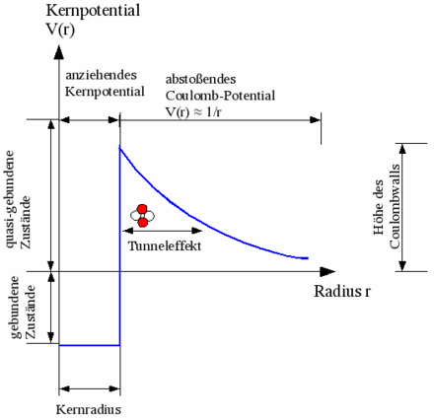
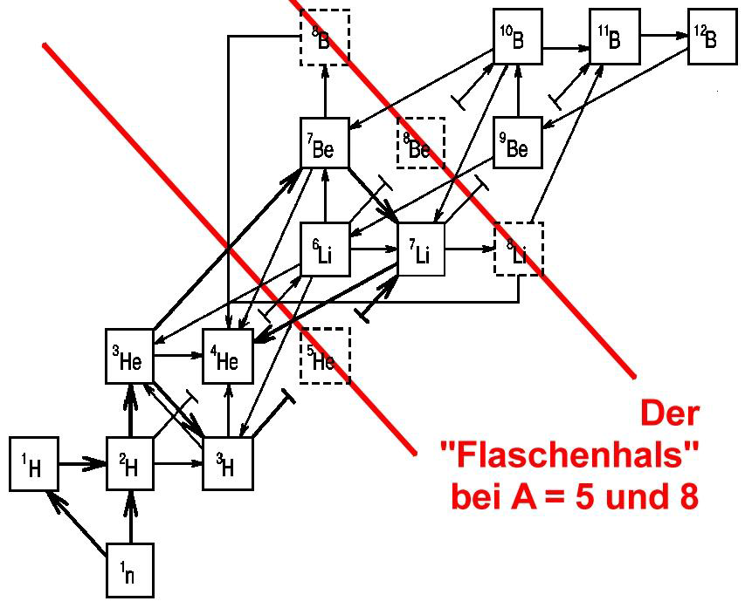
Nuclear Fusion
fusion in particle collisions
fusion needs high temperatures
and high particle densities

Slide 34
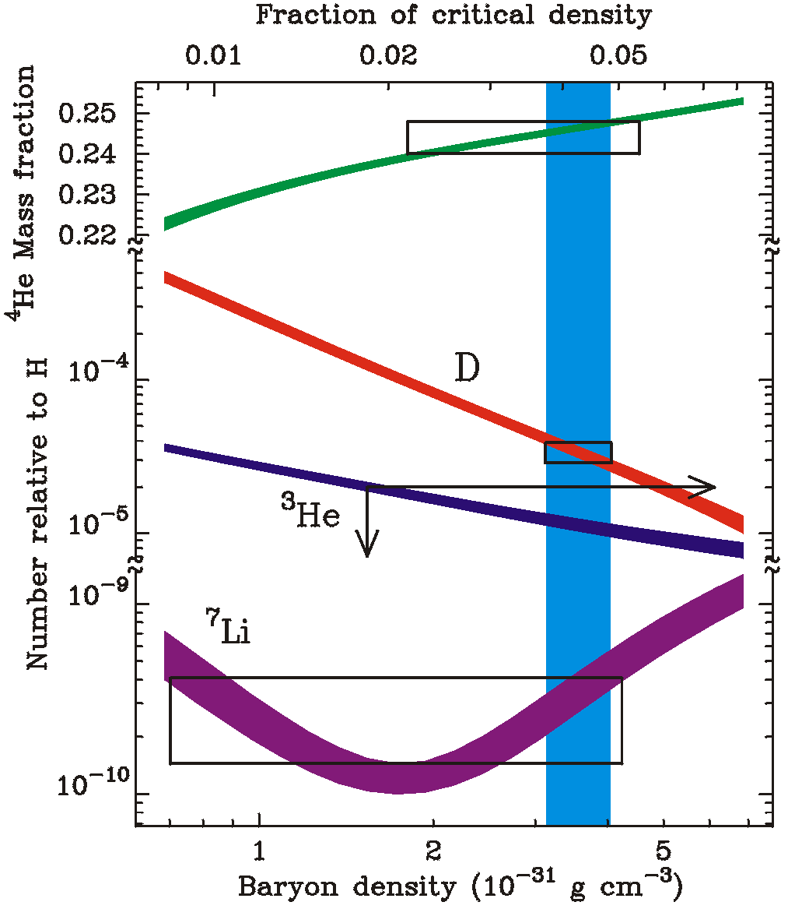
Primordial Nucleosynthesis
explains the abundances
of light elements
74 % hydrogen
25 % helium
1 % rest
baryon density
3,5 10⁻³¹ g/cm³ or
0,2 hydrogen atoms/m³
baryons contribute about 4-5% to the critical density

Slide 35
recombination

Slide 36
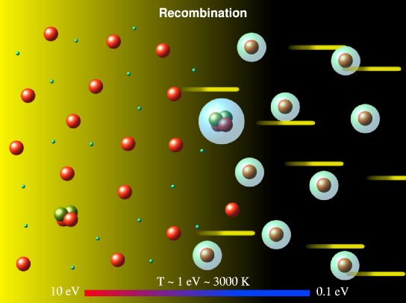
Recombination
below T = 3000 K (t = 380000 a) neutral atoms can form
afterwards photons don’t scatter any more on free electrons
The Universe becomes transparent!

Slide 37
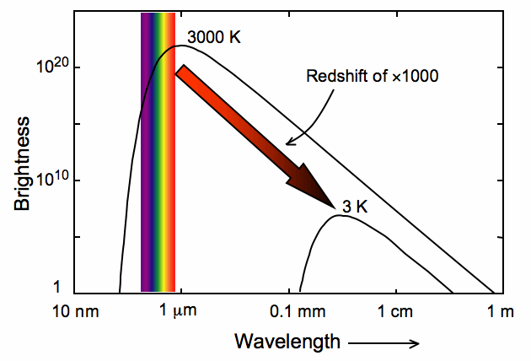
The Cosmic Microwave Background (CMB)
During recombination the photons are in thermic equilibrium with the electrons and atomic nuclei.
Their energy spectrum is the one of a black body (“Planck spectrum”)

Slide 38
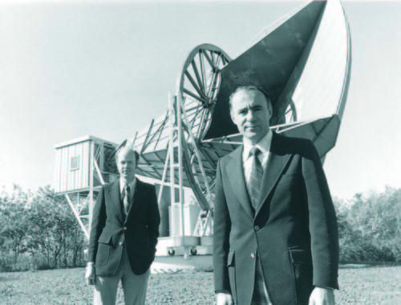
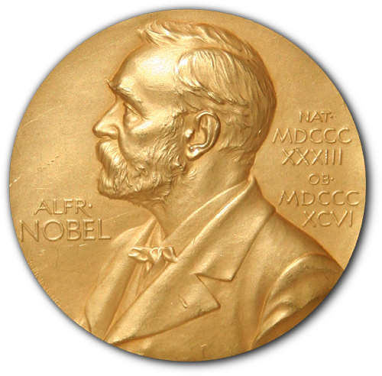
Discovery of the CMB
1964 Penzias und Wilson discovered a noise, which they couldn’t explain
(1978)

Slide 39
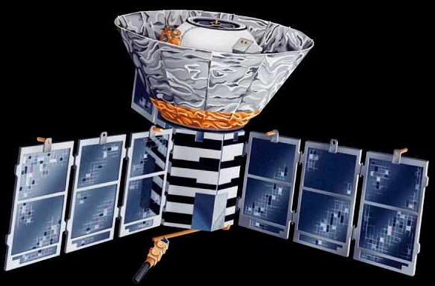
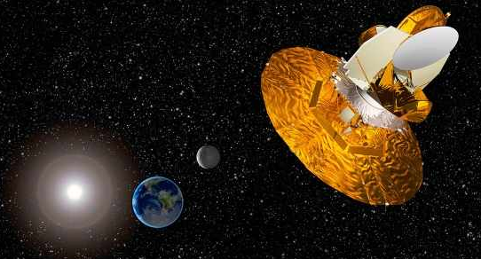
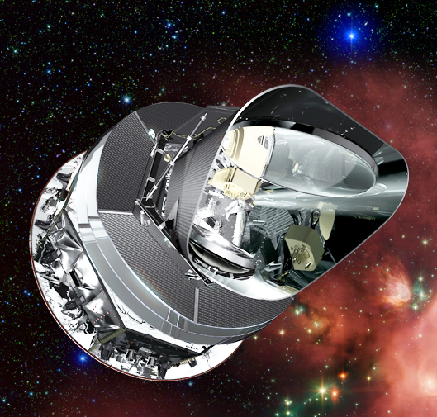
Satellites for the investigation of the CMB
COBE
Cosmic Background Explorer
1989-1993
Nobel Prize 2006
(Smoot & Mather)
WMAP
Wilkinson Microwave Anisotropy Probe
2001-2010
Planck
2009-2013

Slide 40
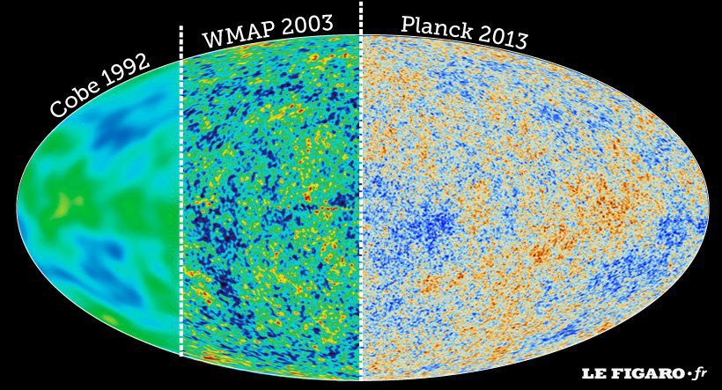
The Echo of the Big Bang

Slide 41
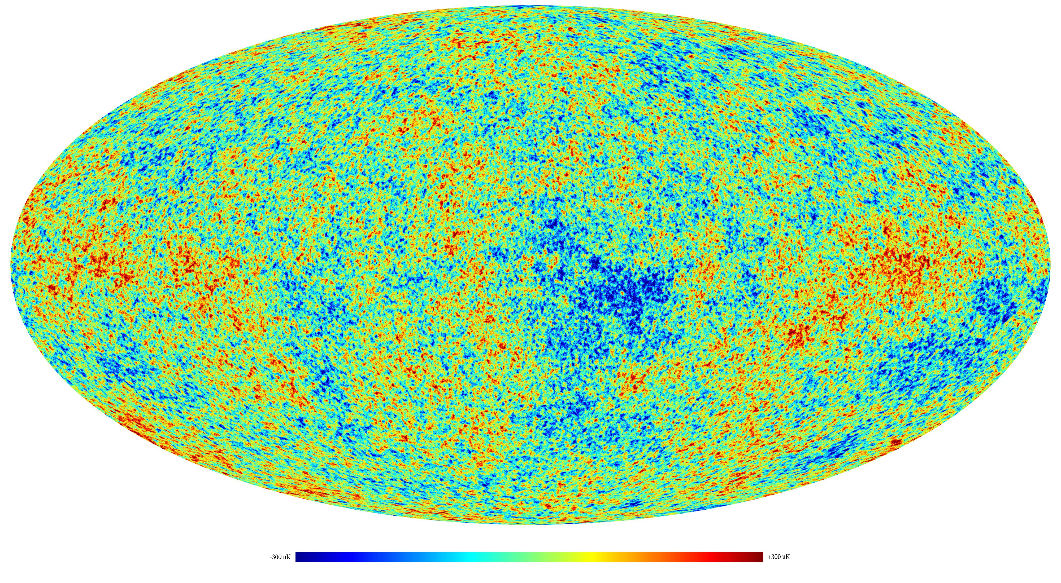
The Echo of the Big Bang
The CMB is extremely isotropic with a temperature of T_{CMB} = 2,725 K.
The temperature differences are in the range of microkelvin!
Planck

Slide 42
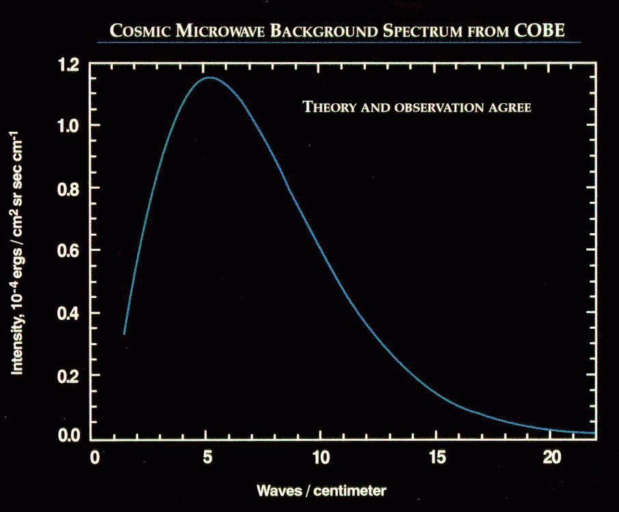
The spectrum of the CMB

Slide 43
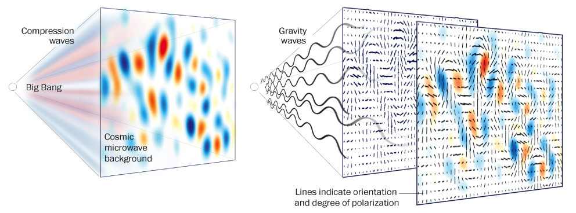
Gravitational Waves as a Proof of Inflation
could be indirectly seen in the polarization of the CMB

Slide 44
structure building

Slide 45
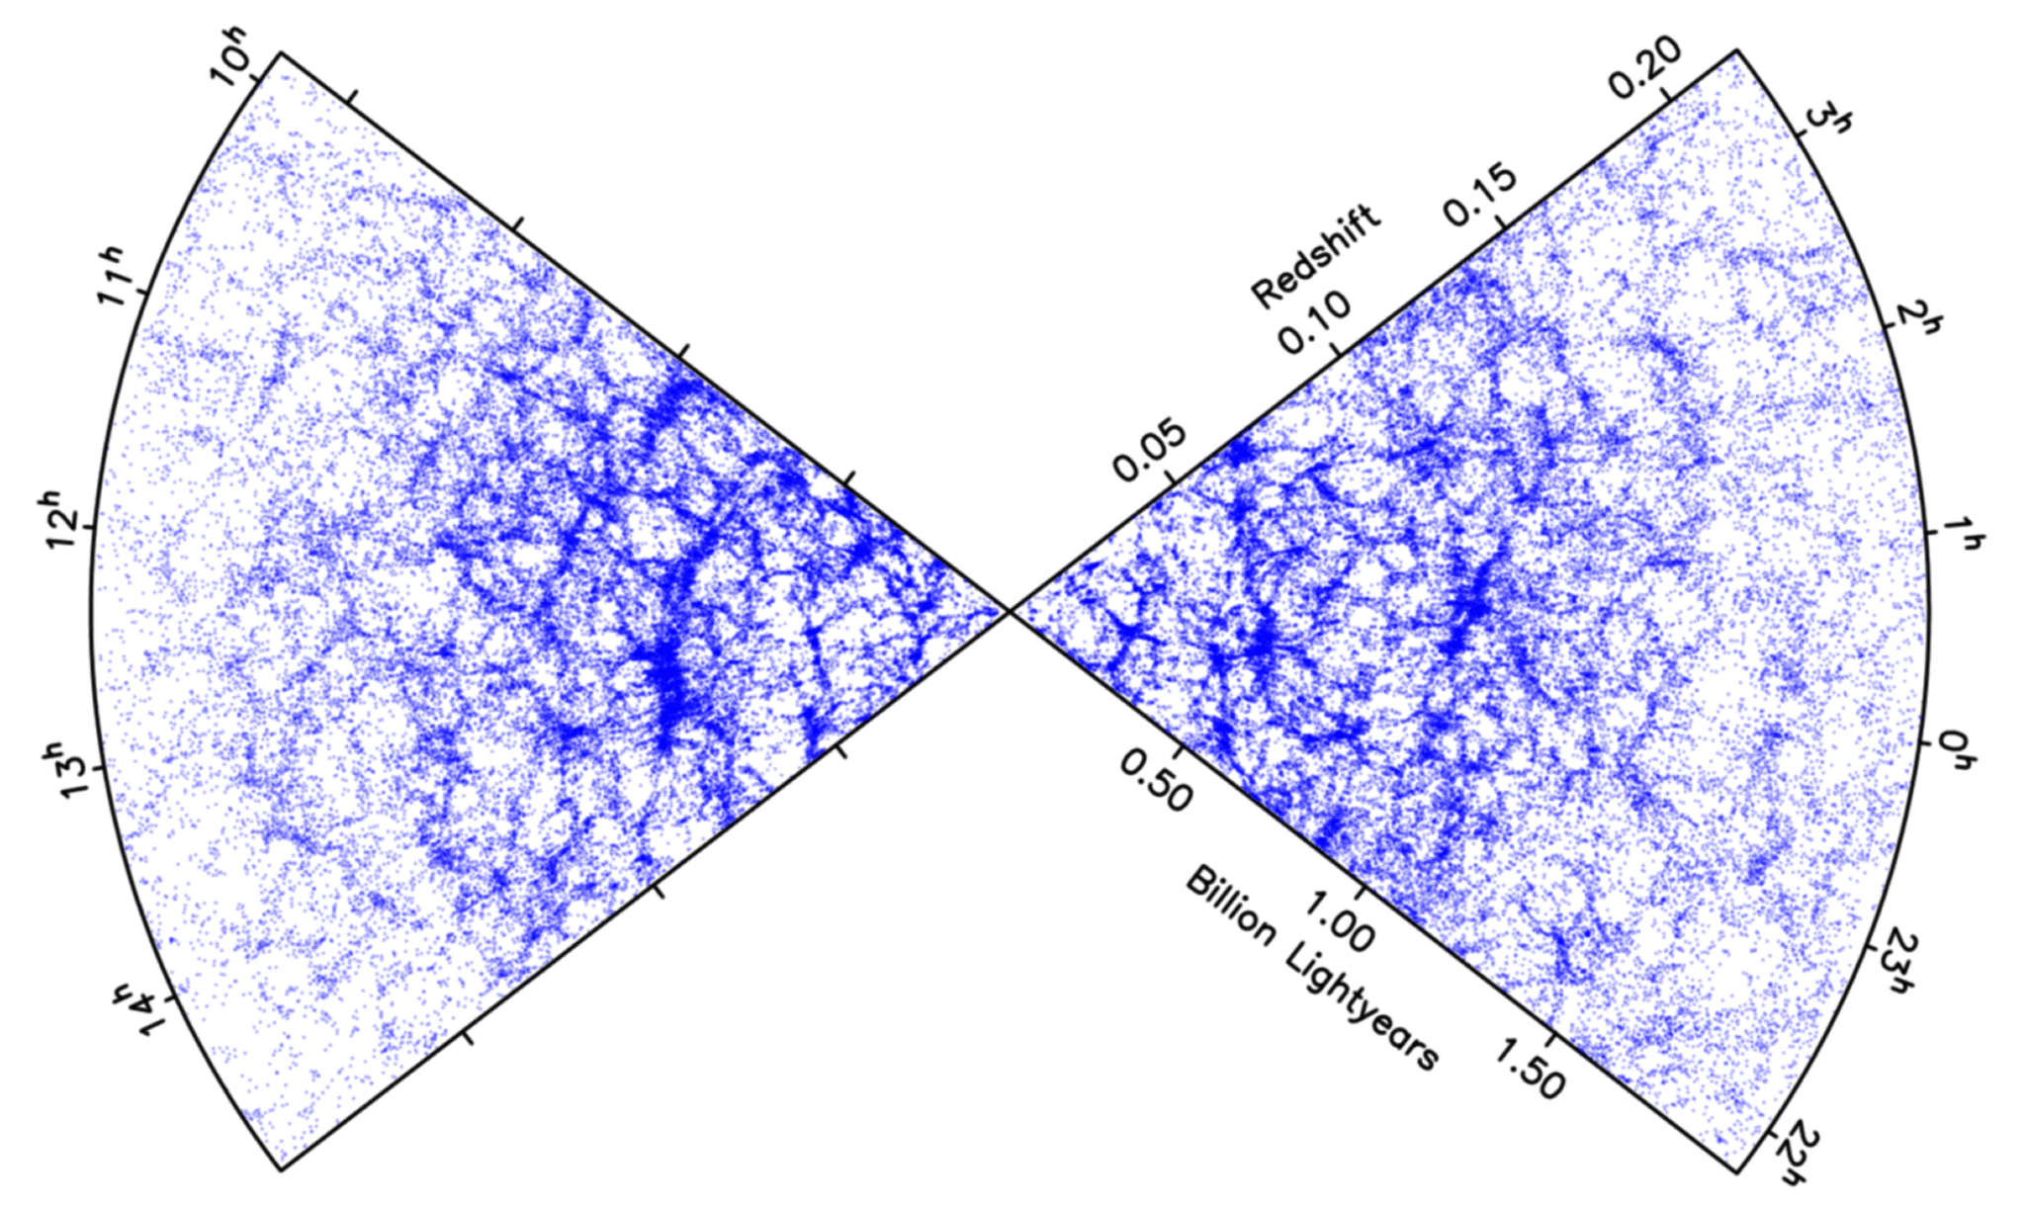

Galaxy Distribution
In the past the Universe was much more homogeneous than today:
Each single point is a galaxy!

Slide 46
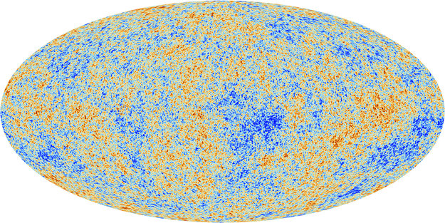
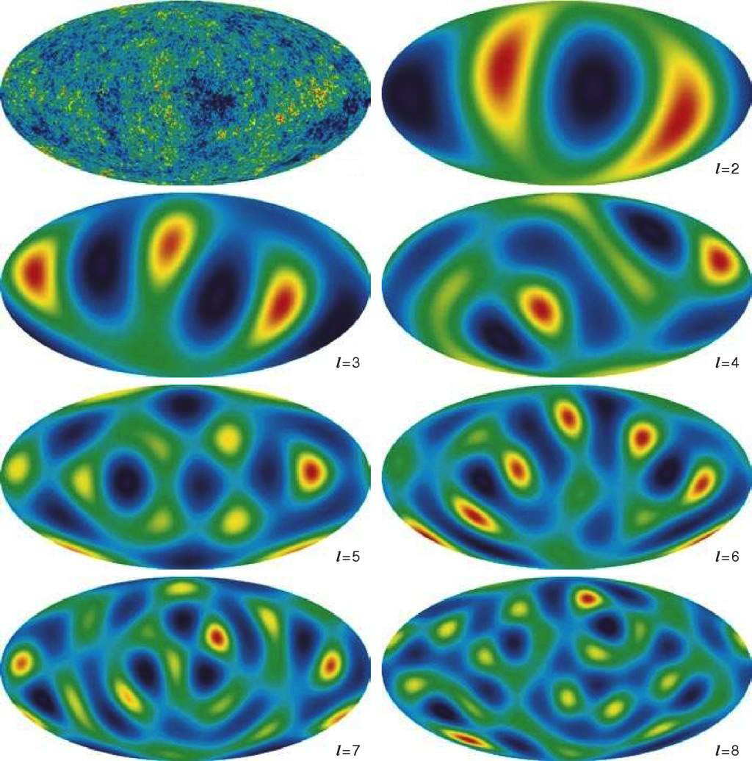
From the map to the spectrum…
theory is not able to predict the exact position of individual hot or cool spots
instead: prediction of statistical properties of the temperature map (for example mean value, variance, correlations,…)

Slide 47
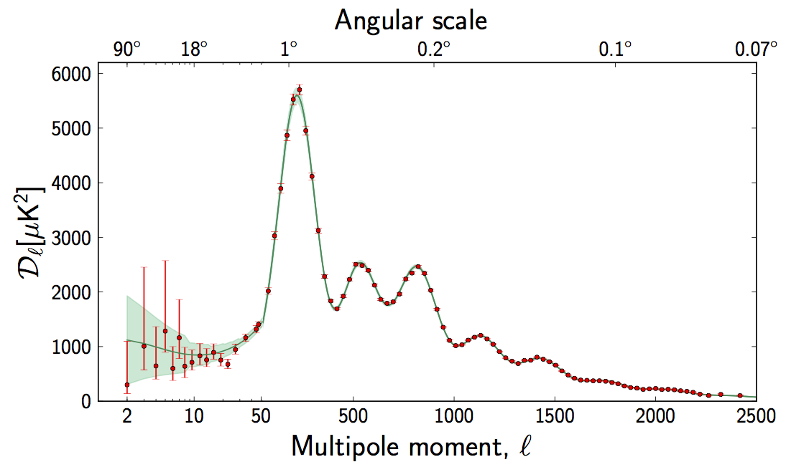
The Angular Power Spectrum of the CMB
typical size of the hot
and cool spots

Slide 48
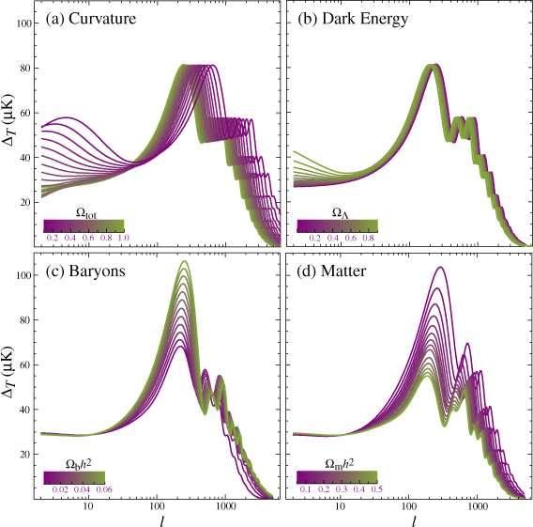
Theoretical Predictions of the
CMB Spectrum
spatial
curvature
vacuum energy density
The theoretical CMB spectrum is depending on values of certain cosmological parameters
Comparison with the measured spectrum allows to distinguish between the models and to determine the values of the unknown parameters
baryon density
matter energy density

Slide 49
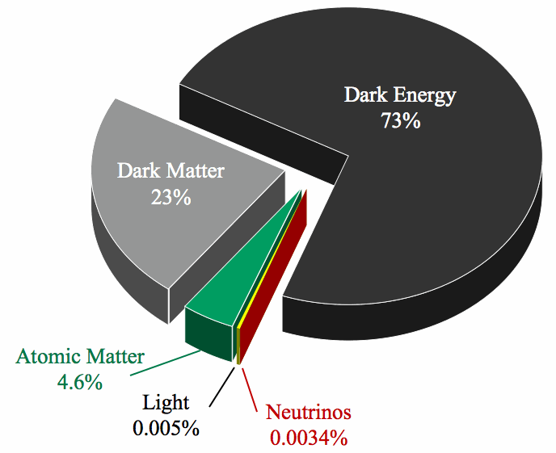
The Standard Cosmological Model
The simplest model, with which the data can be explained (Ockham’s Razor!)
dark energy?!?!
(vacuum energy)
dark matter?!
About 95% of the Universe is still unknown…
“normal” matter

Slide 50
Mysteries of the Universe
What is dark matter?

Slide 51
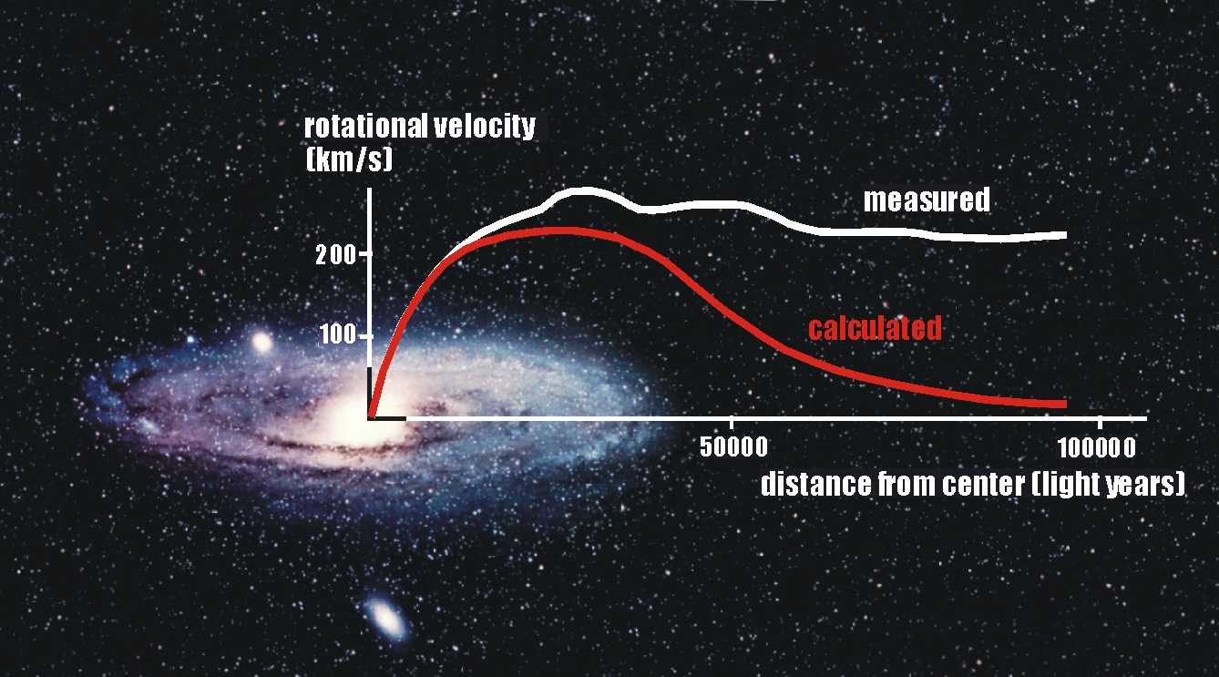
Rotation Curves of Galaxies

Slide 52
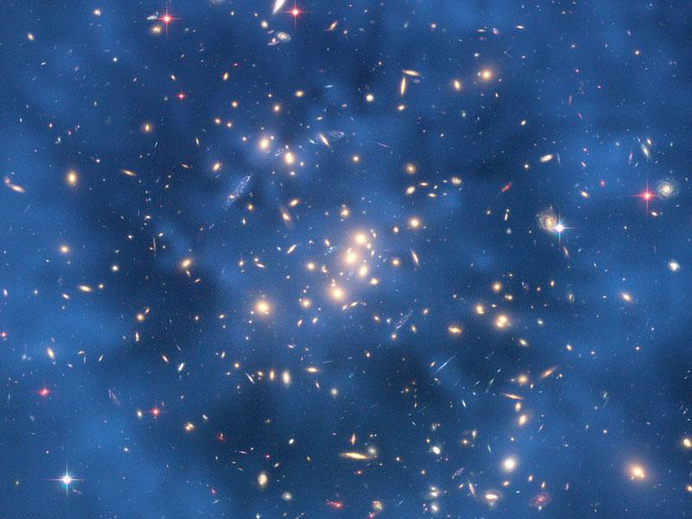
Galaxy Cluster CL0024+17

Slide 53
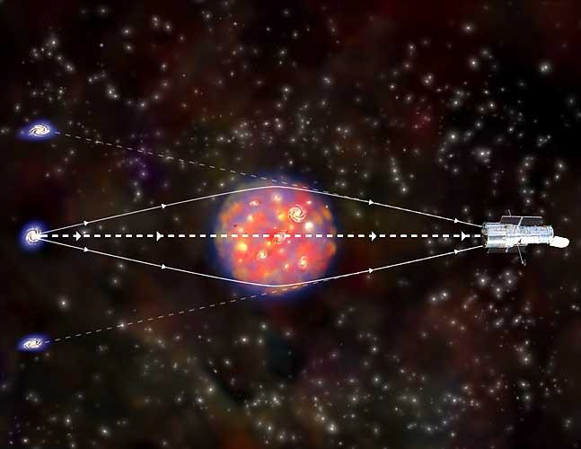
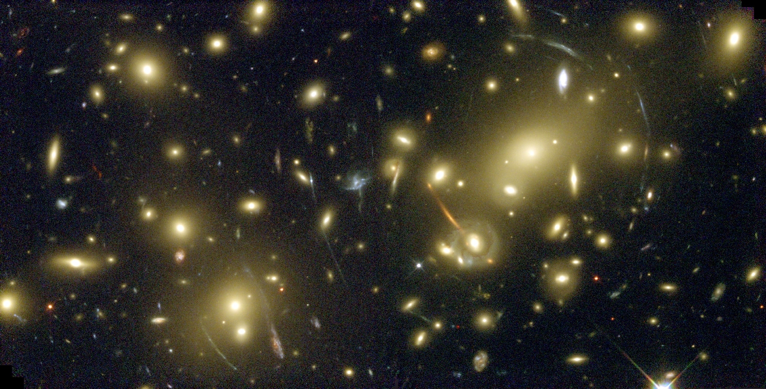
Gravitational Lenses
Massive objects curve space-time and therefore distort the light of the objects behind.

Slide 54
Gravitational Lenses
galaxy cluster Abell 2218
Thereby light arcs of the objects behind are visible.

Slide 55
era of the dark energy

Slide 56
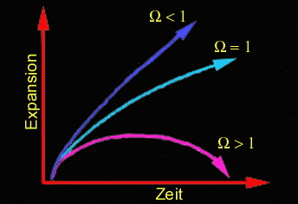
The Fate of the Universe...
... depends on the balance between contraction and expansion
Ω = ρ/ρ_{krit}
ρ_{krit} is the critical density, which is necessary to stop the expansion:
Ρ_{krit} = 10⁻²⁹g/cm³ = 5 protons/m³
Ω > 1
gravitation wins, the Universe collapses
Ω = 1
expansion reaches “saturation” and ultimately stops
Ω < 1
expansion wins, the Universe will expand forever

Slide 57
Cosmology of the 21st century
Dark Matter
What is it made of, what are its properties?
Or another model (e.g. MOND)?
Dark Energy
What kind of energy is it? How does it influence the expansion of the Universe?
Inflation
Can we find experimental confirmation? If yes, what caused it?
Matter-Antimatter Asymmetry
Where is the tiny surplus of matter coming from, from which everything around us is made of?
The Moment of the Big Bang
Will we find a unified theory, which describes the beginning of the Universe?
The Fate of the Universe...

Slide 58

Many thanks for your attention!

Slide 59

Are there any questions?

