Slide 1

The ATLAS Tile Calorimeter hybrid demonstrator and test-beam activities at CERN
Chamunorwa Oscar Kureba
oscar.kureba@cern.ch | Chamunorwa.Kureba@wits.ac.za
University of the Witwatersrand
High Energy Particle Physics workshop, 10 February 2016
Oscar

Slide 2
Introduction
In the Large Hadron Collider’s Phase II upgrade, there will be a complete re-design of the read-out electronics in the Tile Calorimeter of the ATLAS detector
The completed new read-out architecture is expected to have the front-end electronics transmit fully digitized information of the detector to the back-end electronics system
The back-end system will, thus, provide digital calibrated information with greater precision and granularity to the first level trigger, thereby resulting in improved trigger efficiencies
A hybrid demonstrator has been built and tested under beam conditions

Slide 3
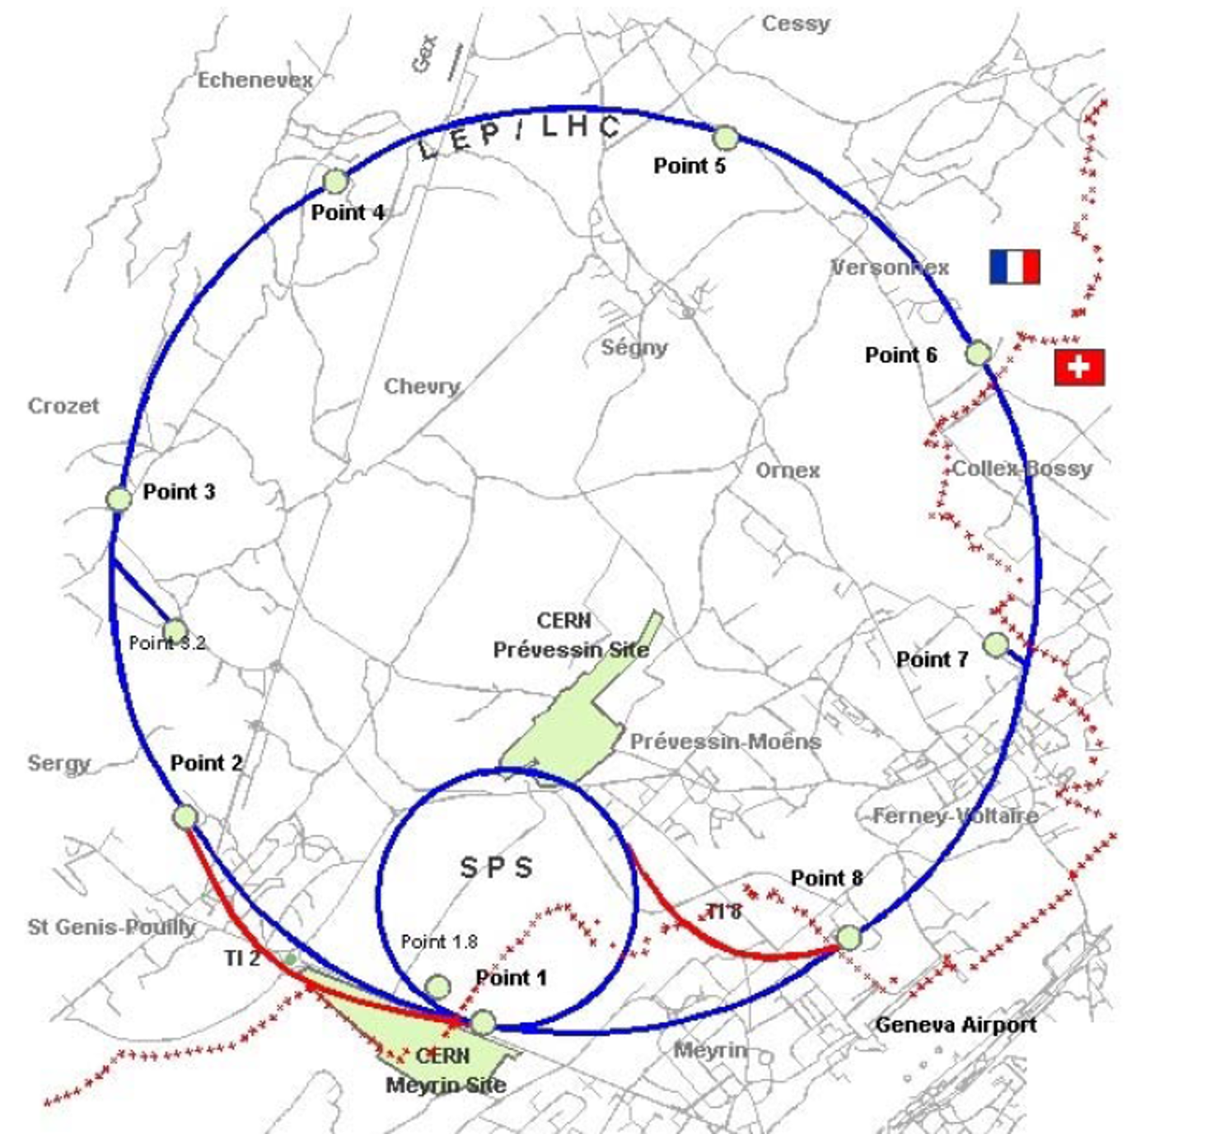
Large Hadron Collider
Located at the France-Switzerland boarder
Site for test-beam
Oscar Kureba, Wits
test-beam activities at CERN

Slide 4
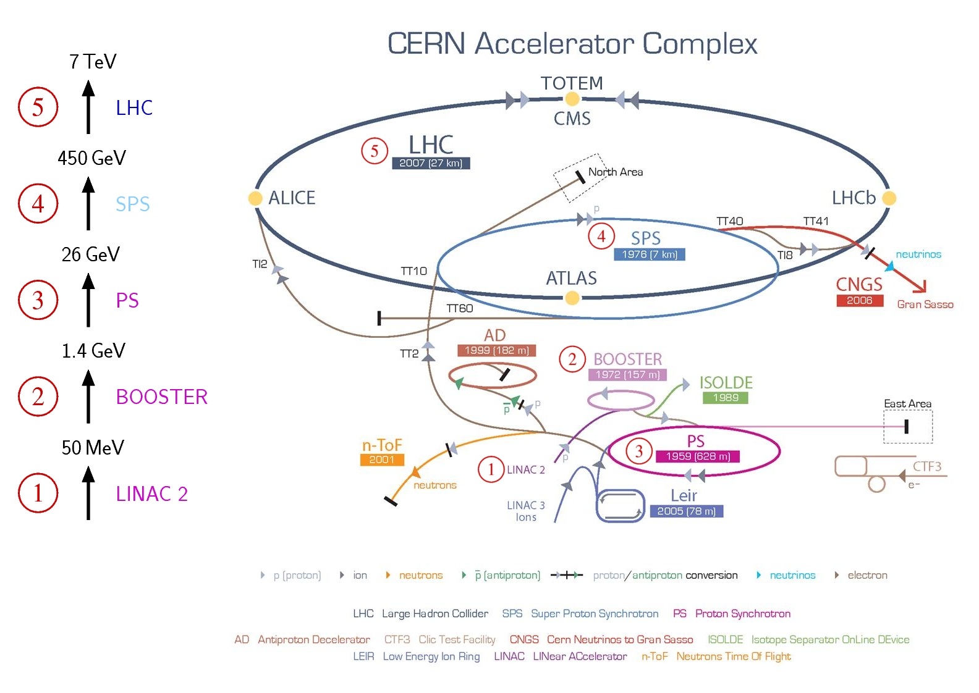
CERN accelerator complex
Site for test-beam
Oscar Kureba, Wits
test-beam activities at CERN

Slide 5
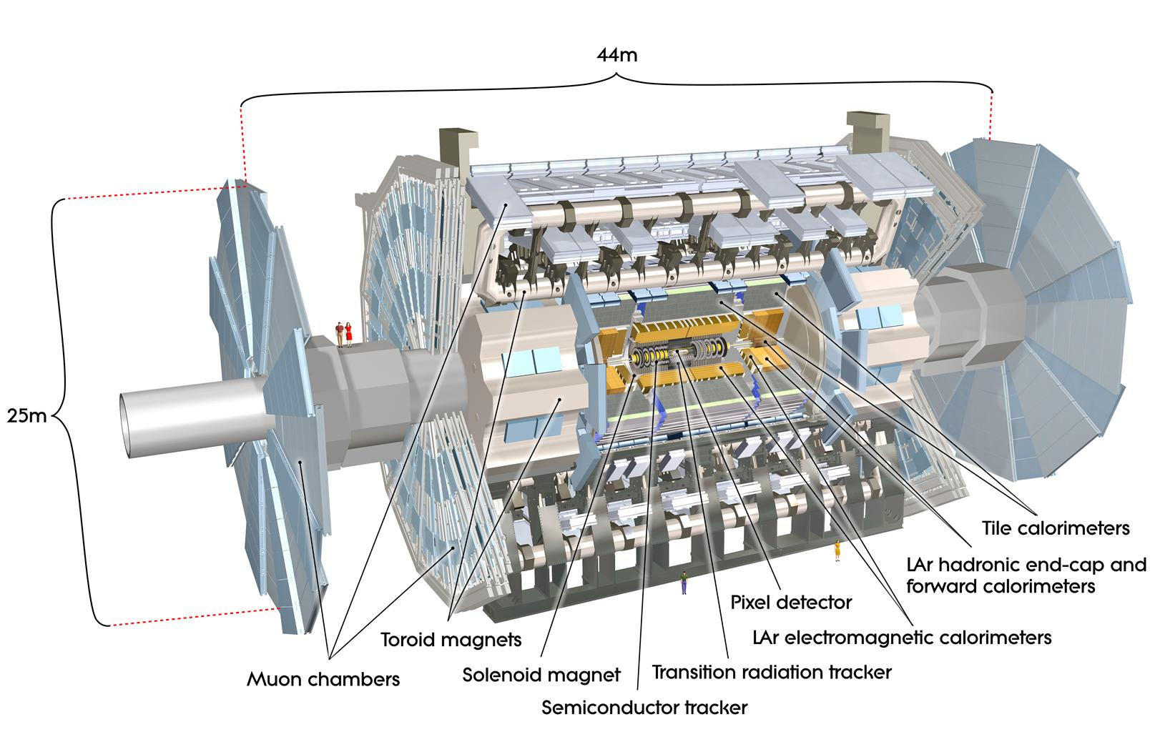
ATLAS detector
Largest of all detectors at the LHC (25 m high, 44 m wide)
All purpose detector of pp collision products

Slide 6
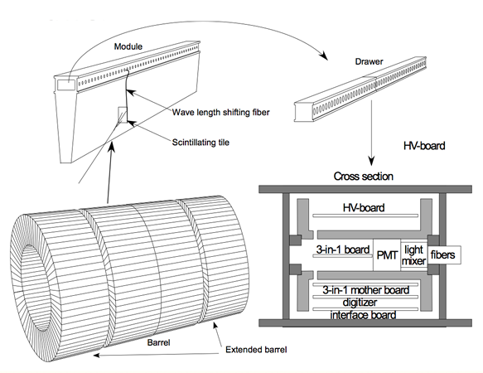
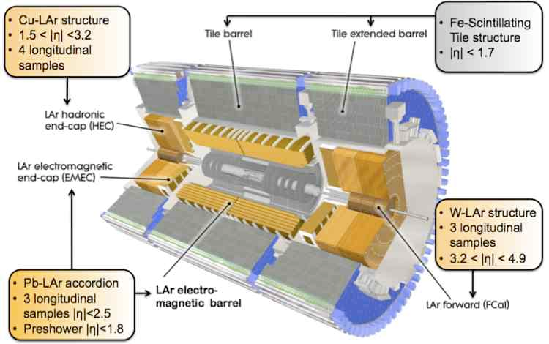
ATLAS Tile Calorimeter
TileCal measures energy and direction of hadrons, jets and tau leptons
Made of Absorber (steel) + Scintillator (plastic) materials
Super-drawers contain front-end electronics which process signals
Undergoing upgrade to meet HL-LHC conditions

Slide 7
Tile Calorimeter upgrade for Phase II:
Hybrid Demonstrator
Aim to cope with luminosity increase (5-7x) and reduce single point failures (improve reliability)
Fewer failure-prone connectors with the challenge of routing more fiber optic and LV cables
Smaller DAQ elements by introduction of mini-drawers
Increase the redundancy in the read-out path from the cell to the backend
Similar redundancy in the power distribution and introduction of Point-Of-Load regulators

Slide 8
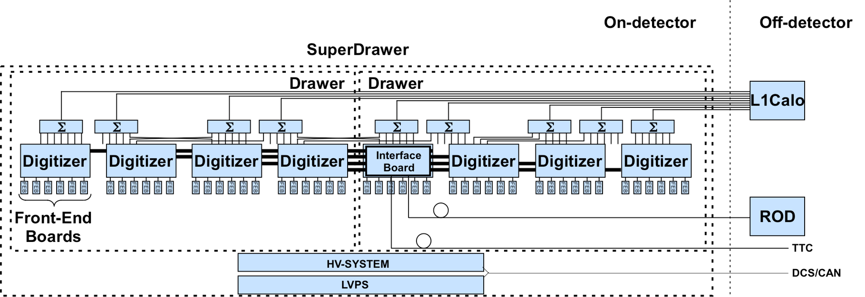
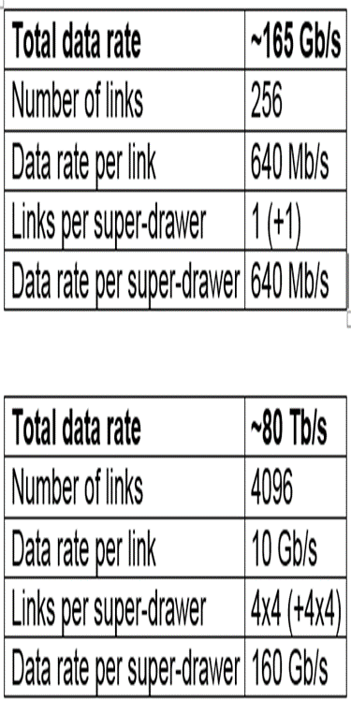
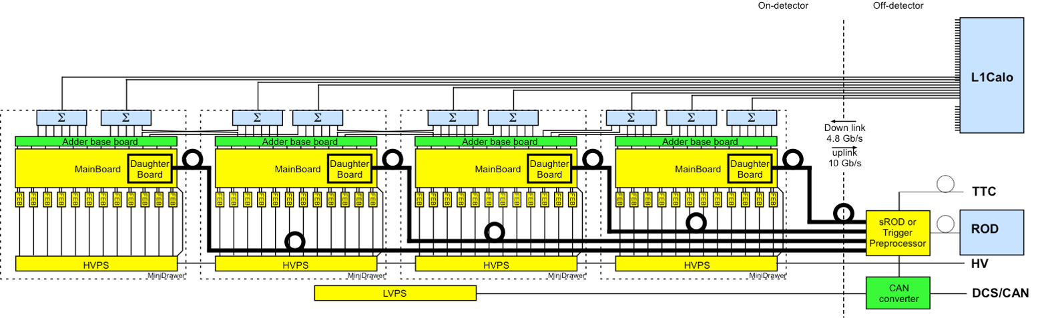
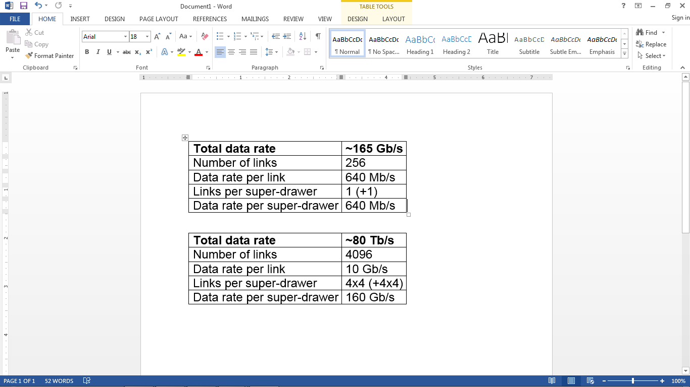
Tile upgrade for Phase II
Present electronics
Hybrid demonstrator with analog output for phase-II upgrade

Slide 9
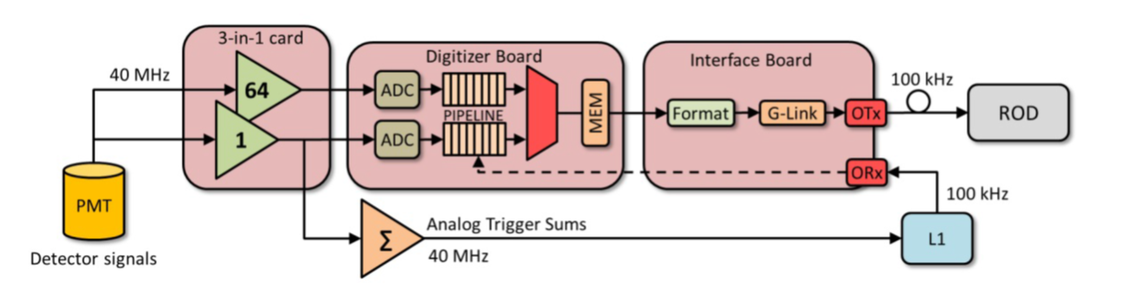
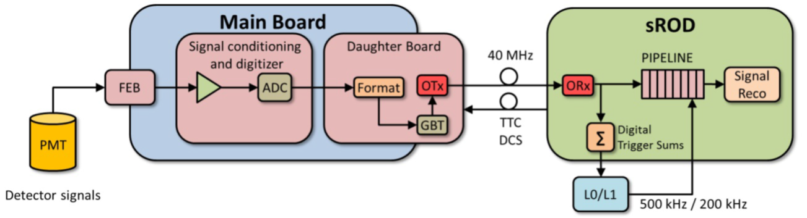
Front-end electronics: present and future
On-detector
Off-detector
Present
On-detector
Off-detector
TilePPr
Future
To ROD

Slide 10
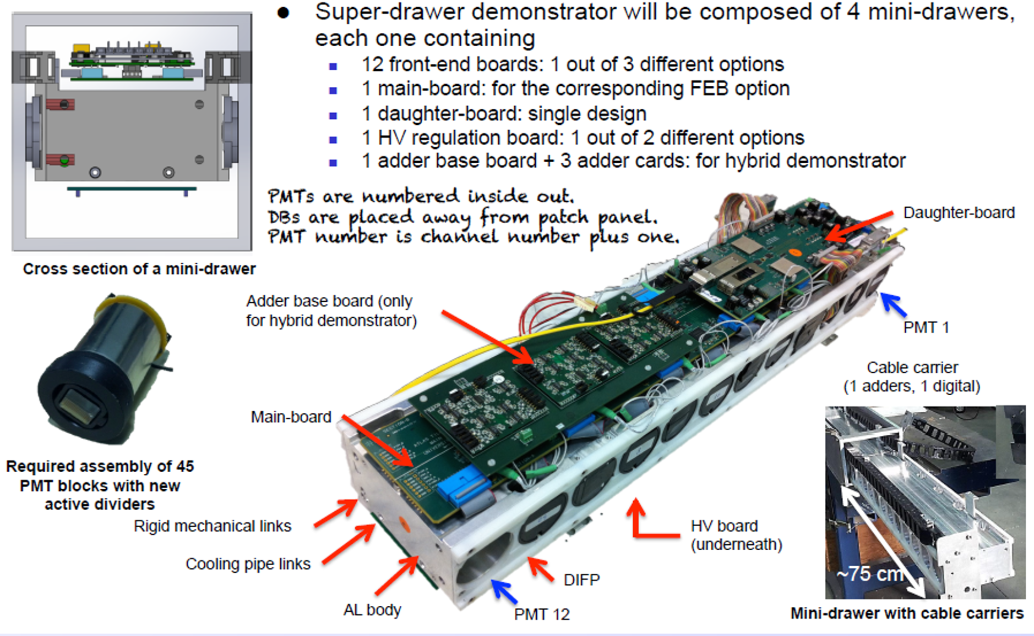
Mini-drawers

Slide 11
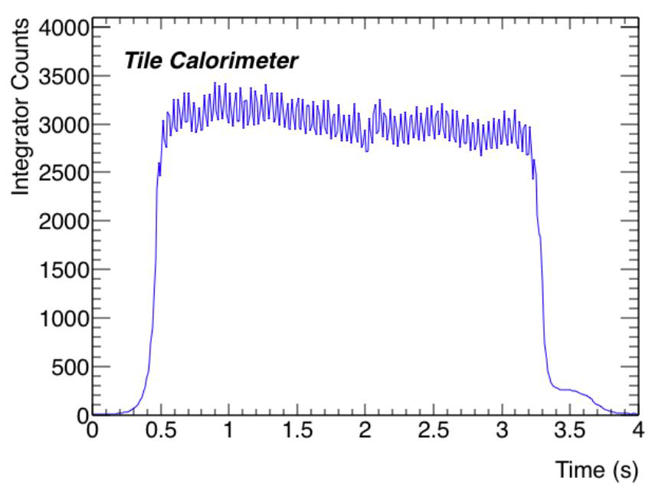
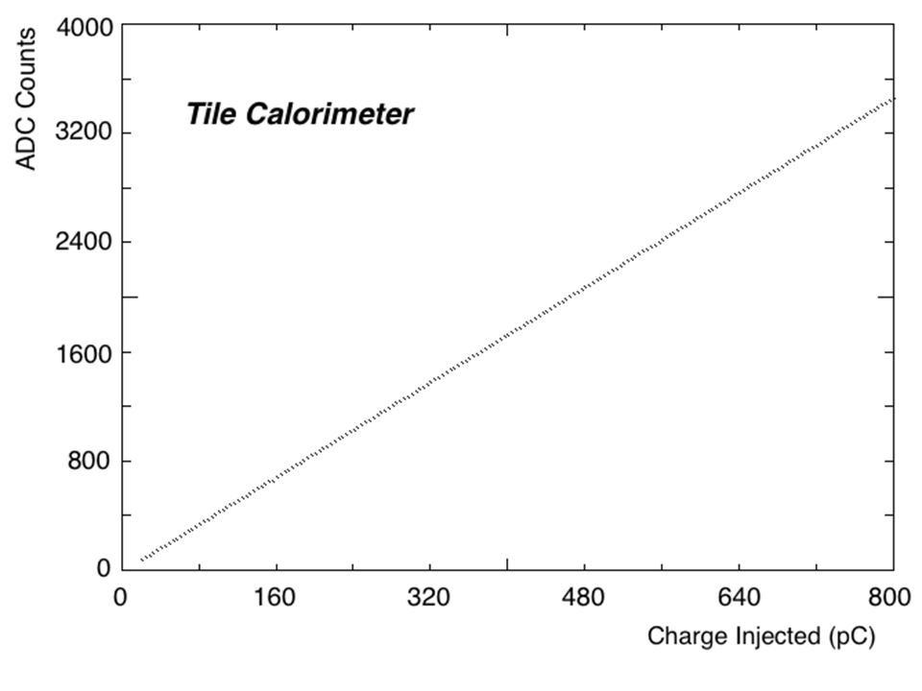
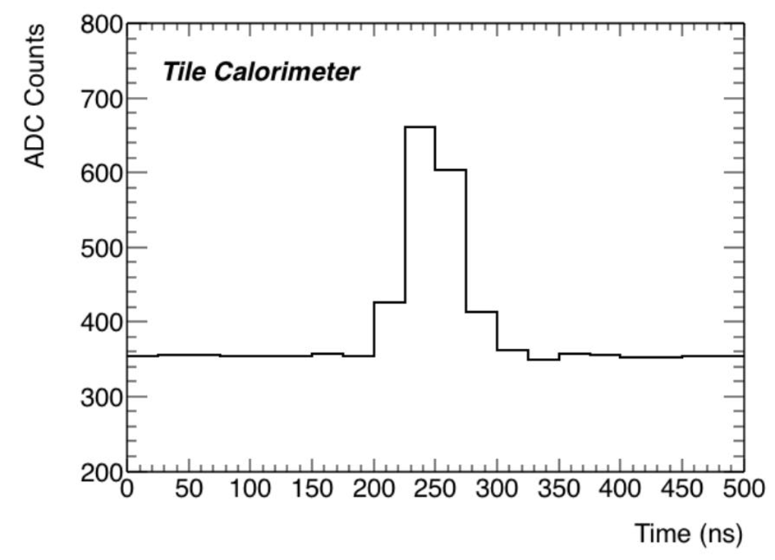
Demonstrator calibration results
Average Low Gain response of a 3in1 card to an injected charge
Integrator response for Extended Barrel Cell D-6 to a passing Caesium source
Low Gain response to a LASER pulse in the hundreds of GeVs, sampled at 40 MHz.

Slide 12
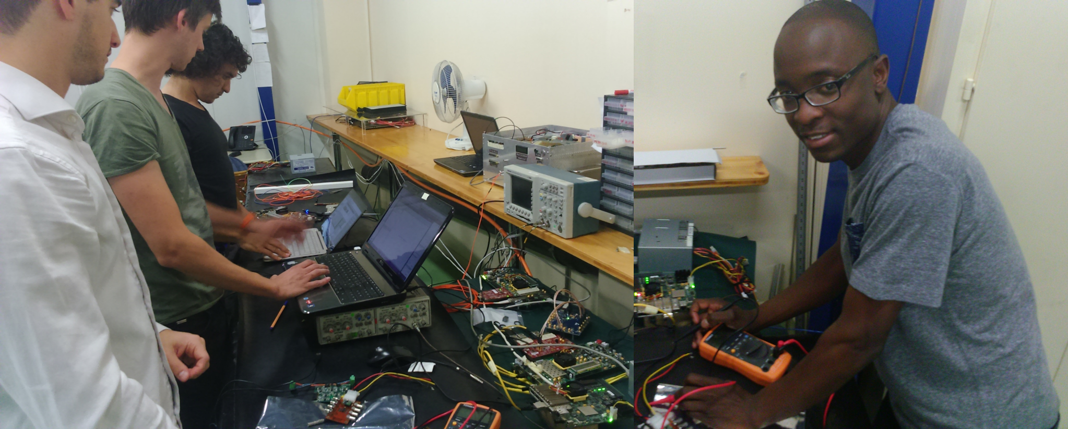
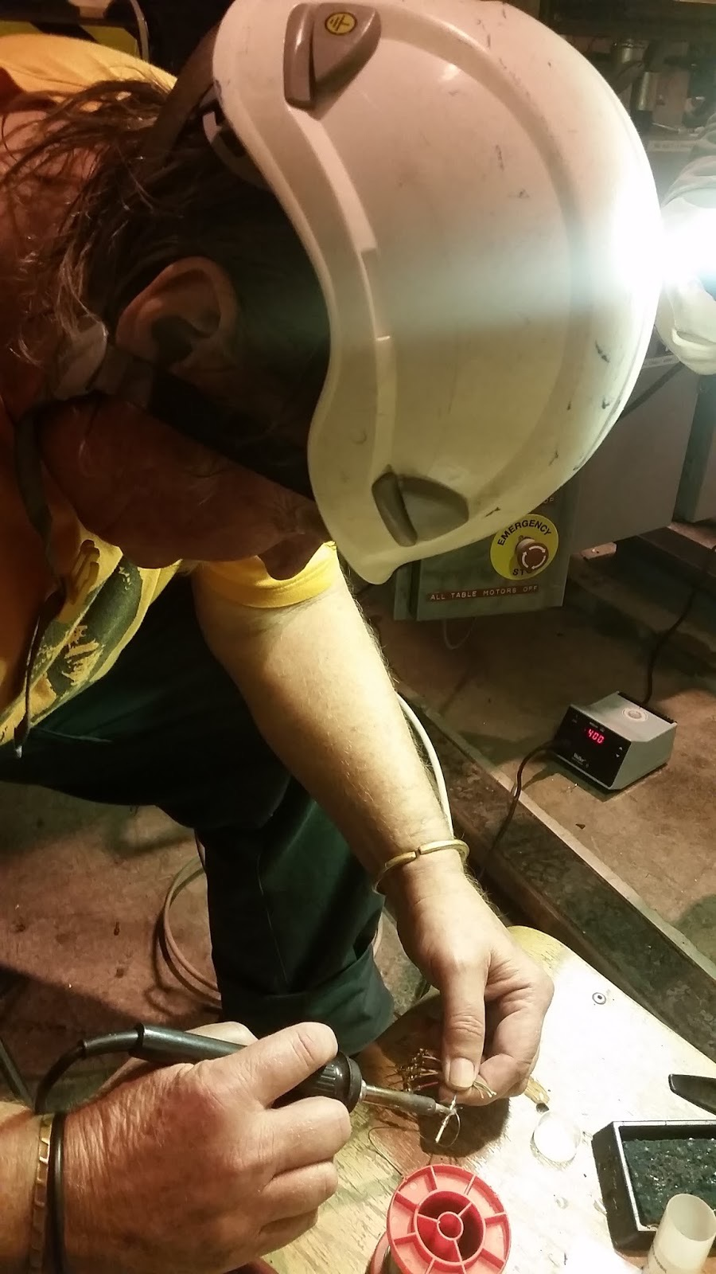
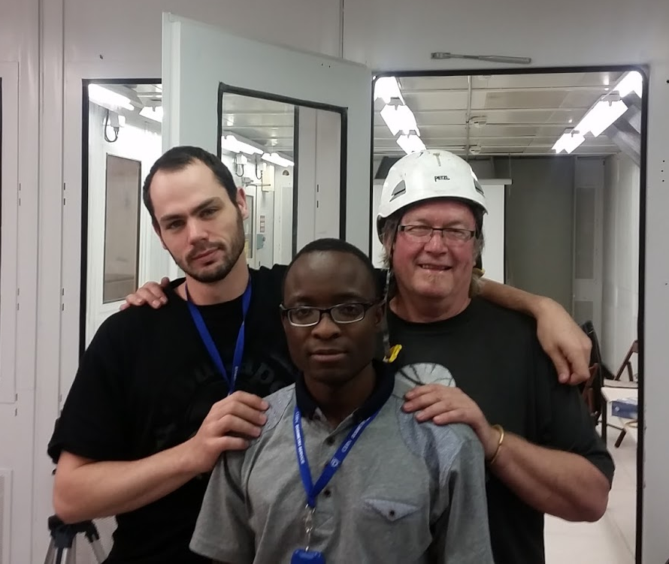
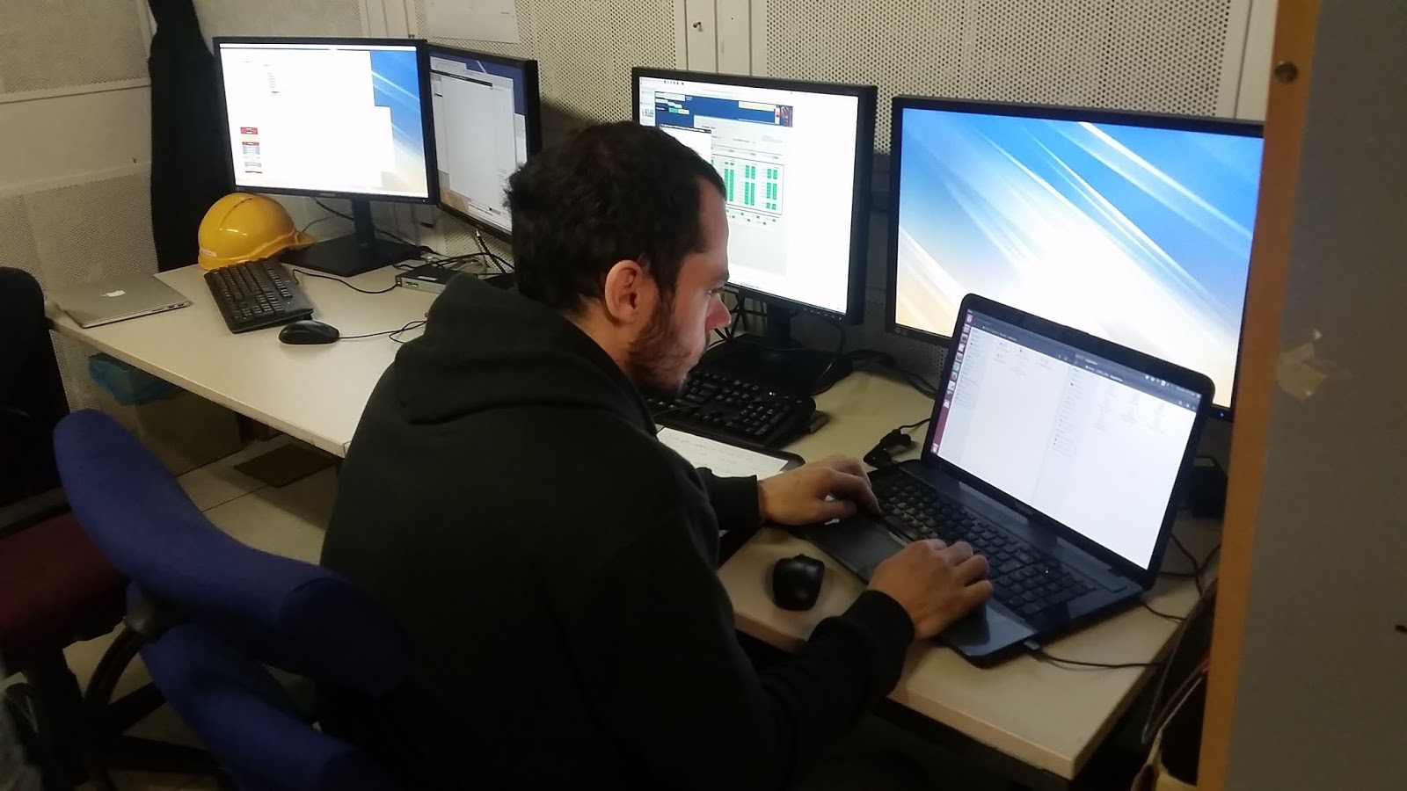
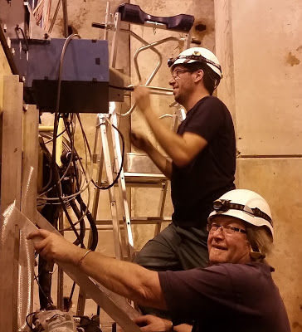
Test-beam activities
ATLAS TileCal electronics upgrade team got test-beam from 7-21 October 2015
Previous test beam was 10 years ago
Lots of work in run up to- and during test beam period
Members from Wits: Oscar Kureba, Roman Hartmann and Charles Sandrock
Oscar et al, testing hardware & firmware for the TilePPr
Charles, soldering
Roman, working on software

Slide 13
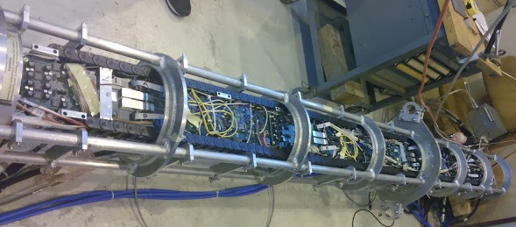
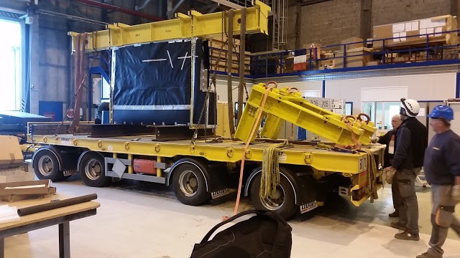
Demonstrator, before insertion into hadronic module
Module on truck ready
for transport from
Meyrin to Prevesin

Slide 14
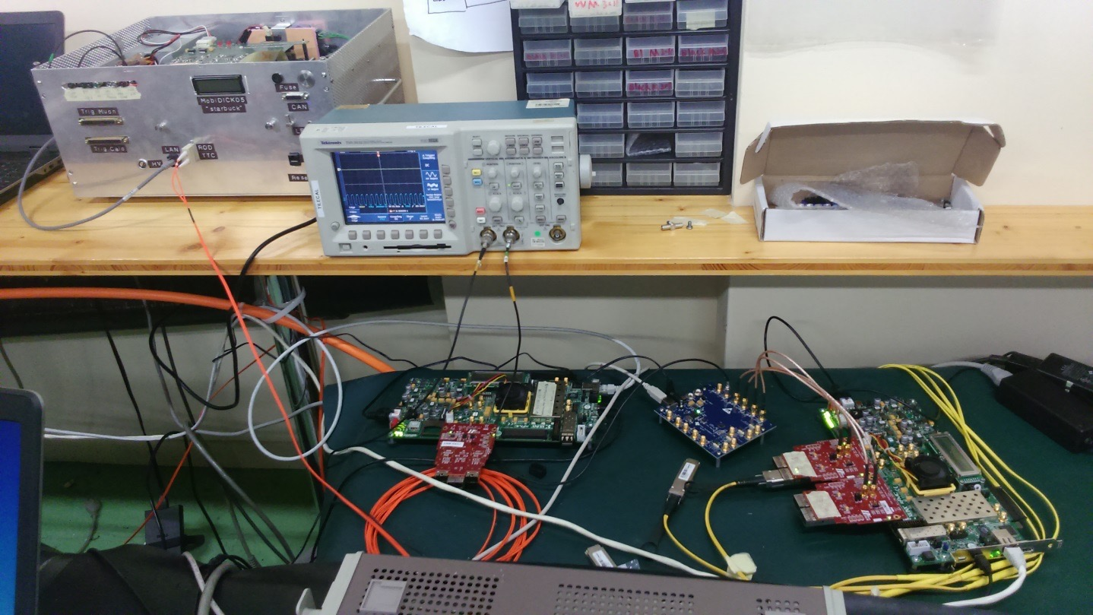
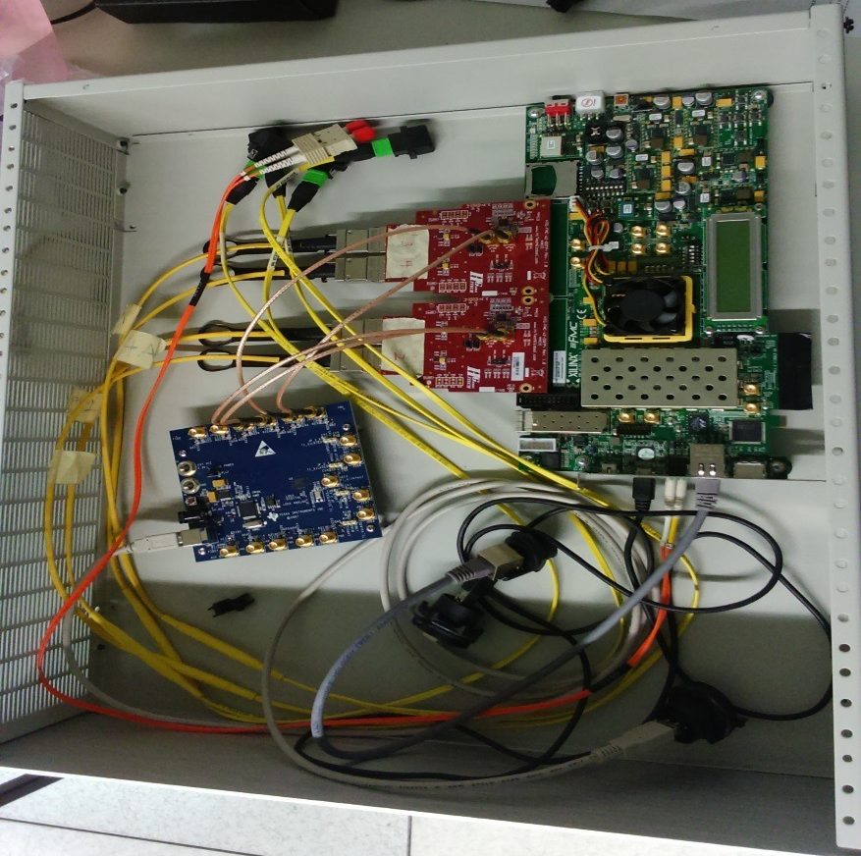
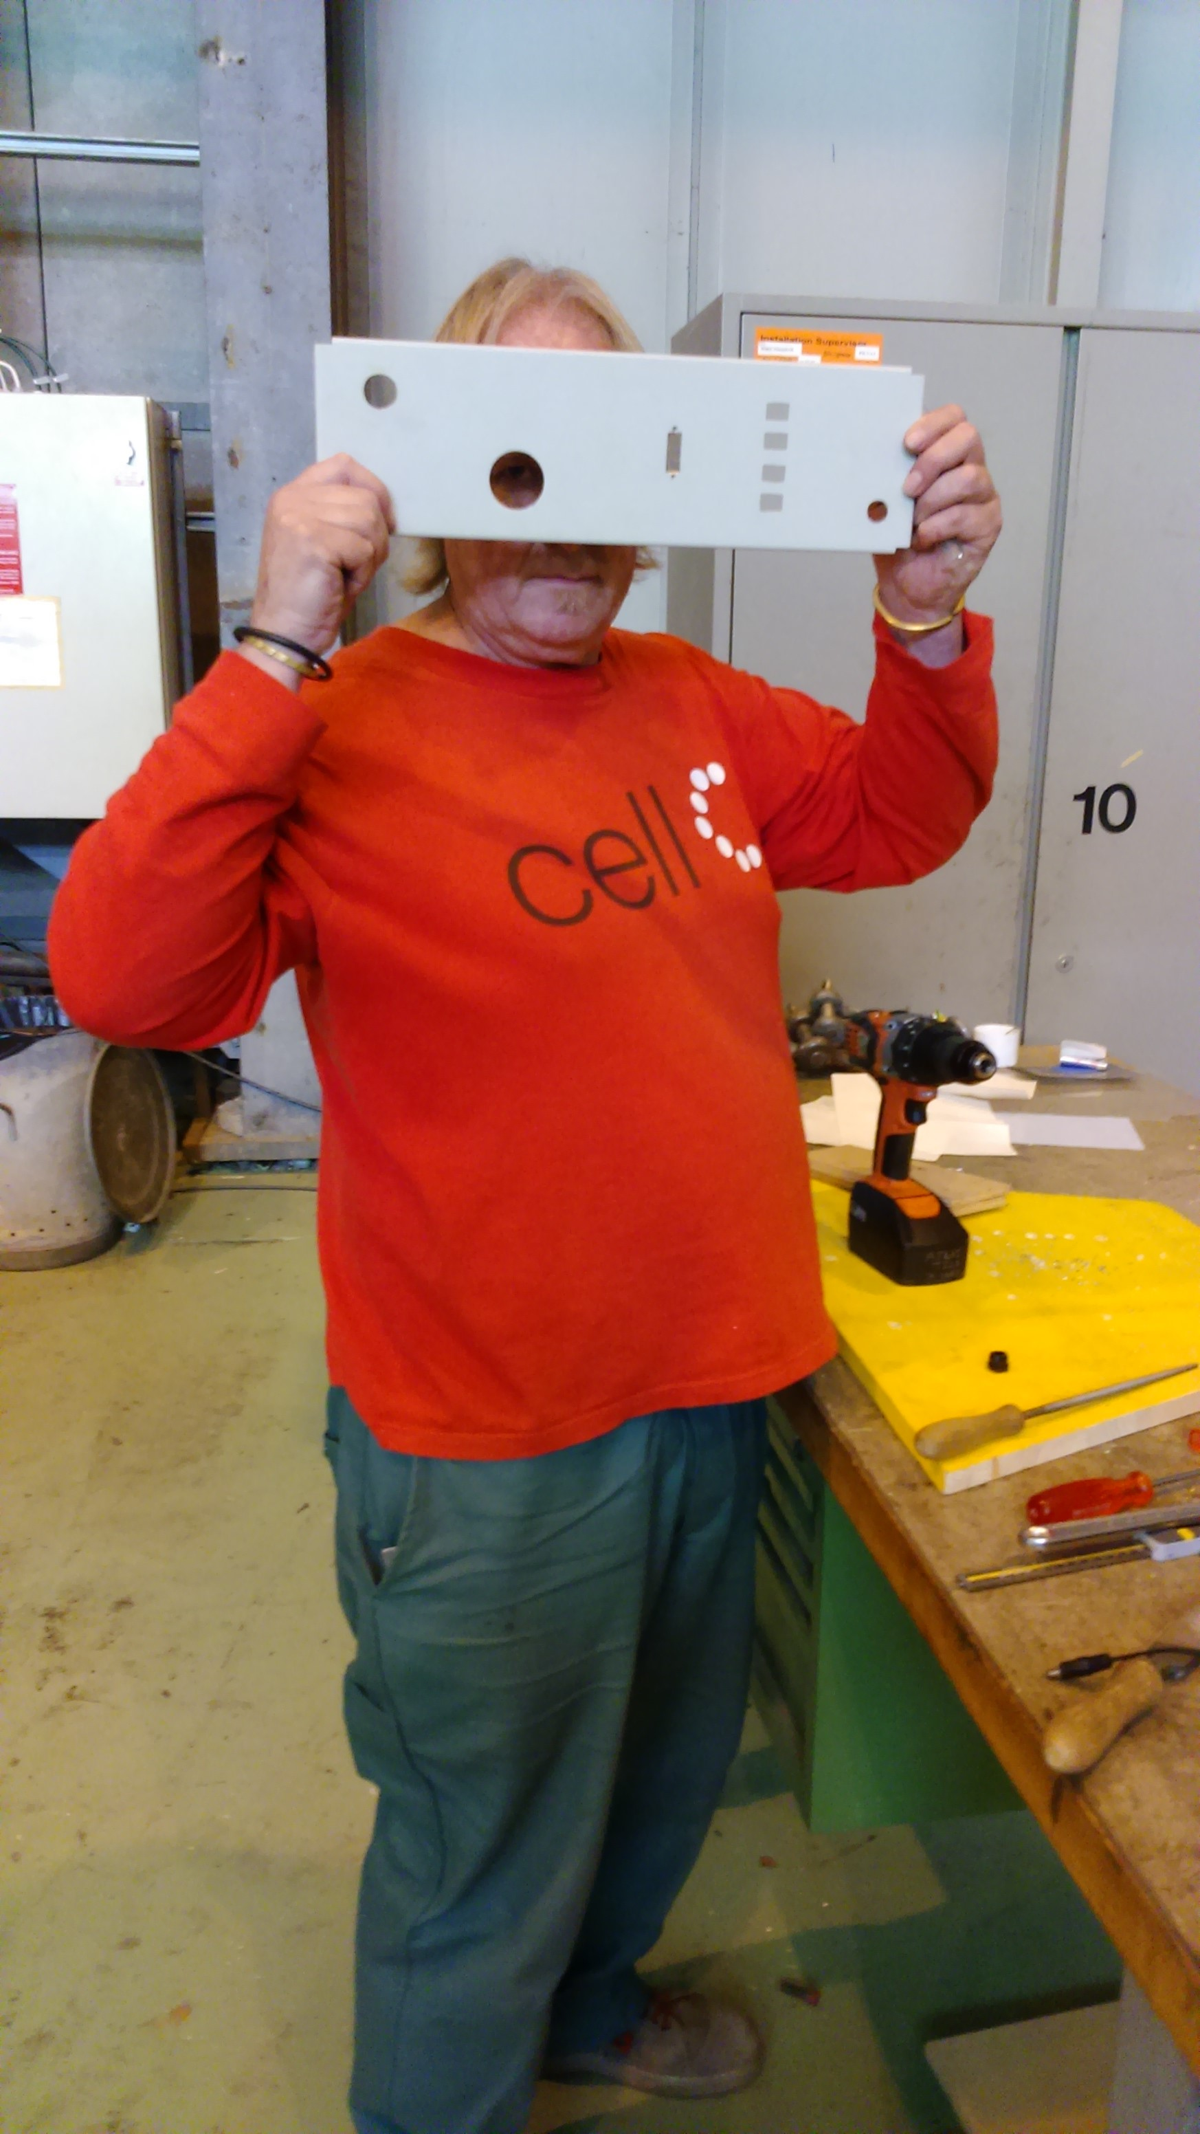
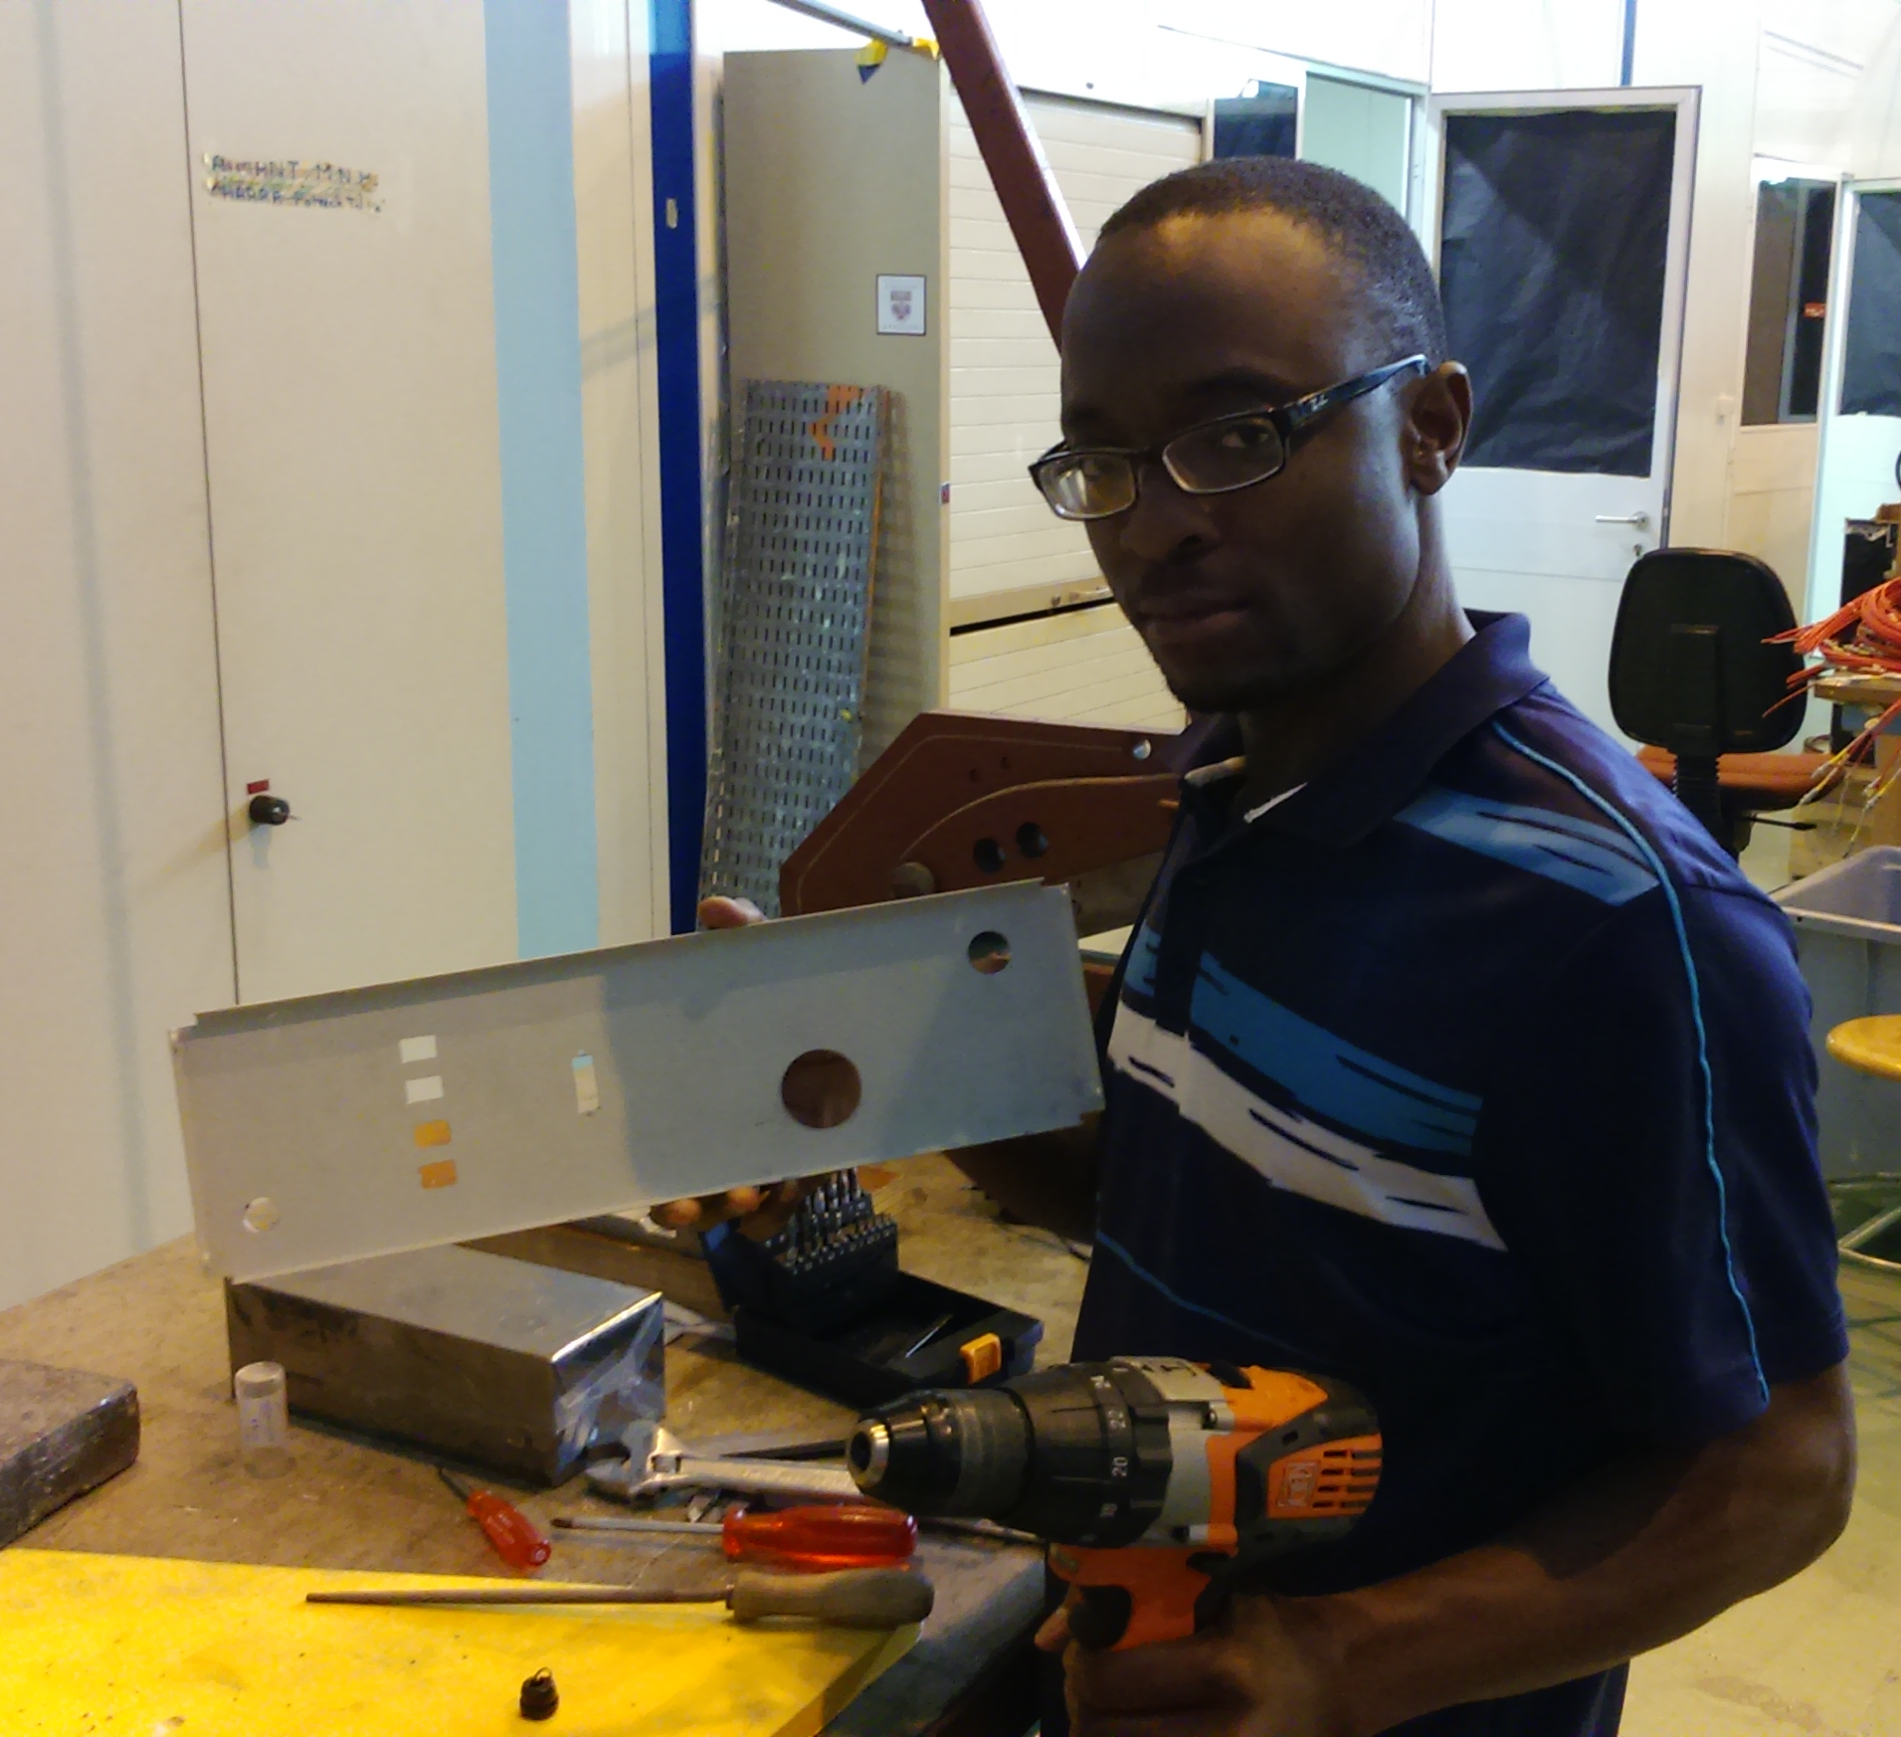
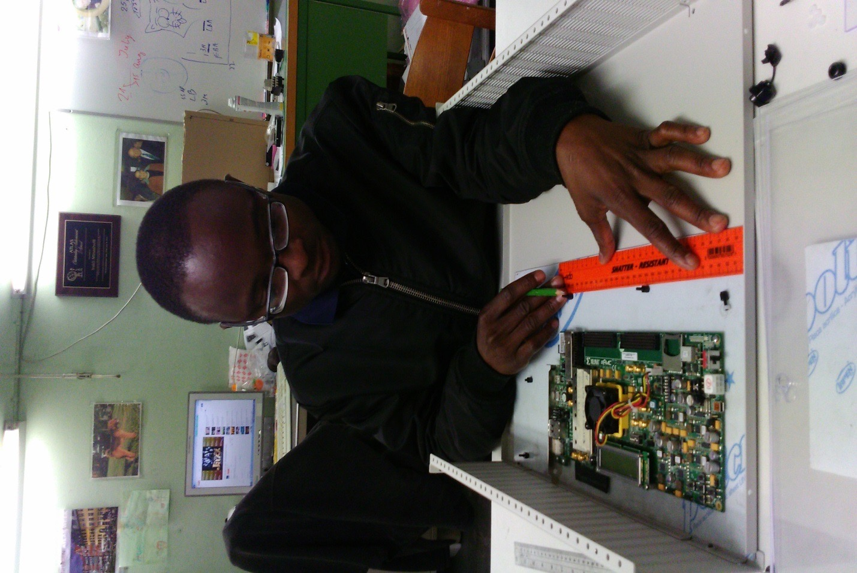
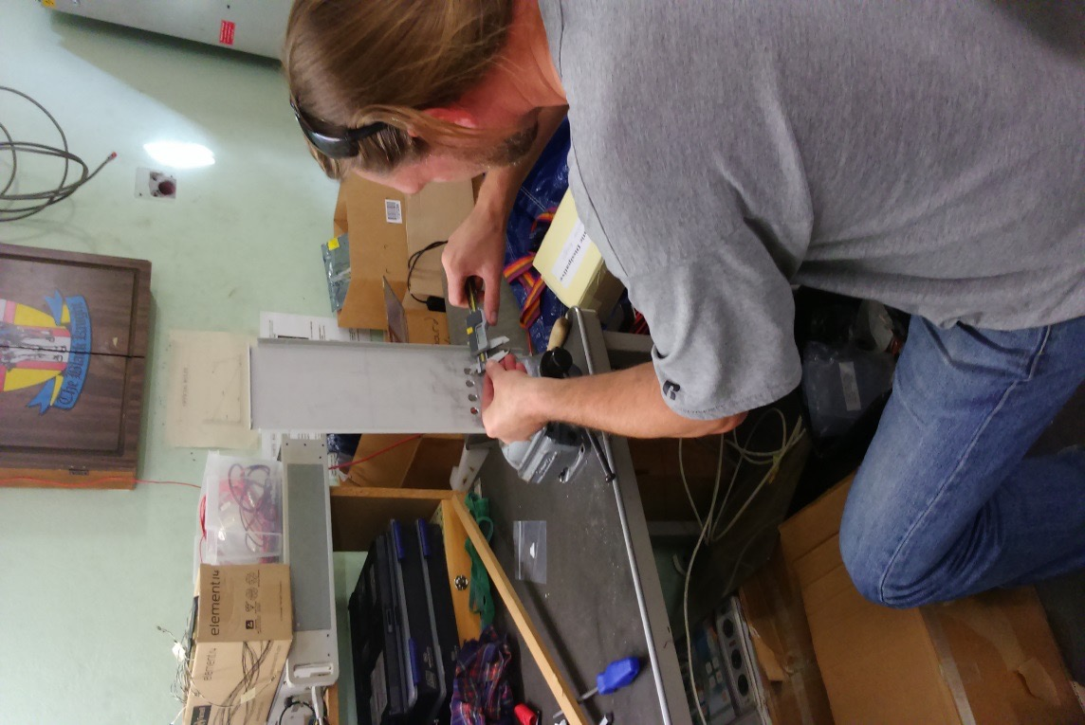
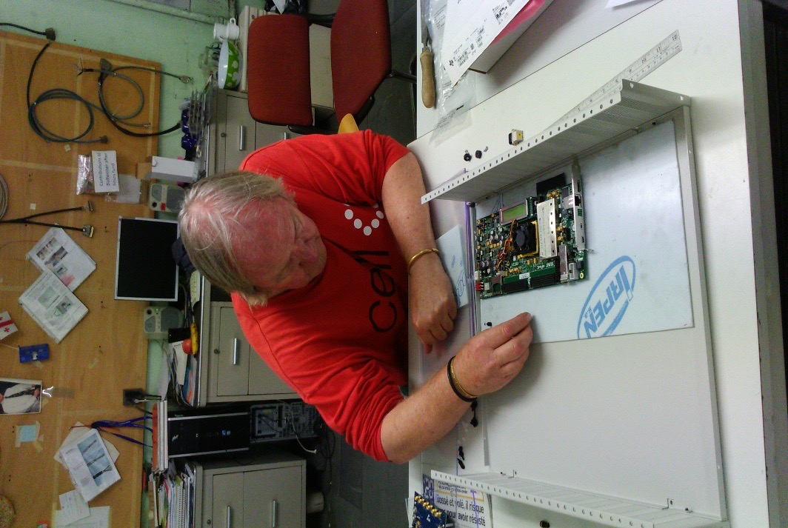
Casing for TilePPr for test-beam
Before test-beam , operation of the TilePPr emulator used to take place from an open table top
Prone to accidental bumping and a lot of uncontrollable shifting about the place
Hence the need to have the TilePPr system inside a casing/box
Very little or no physical interfearance with the PPR hardware during testbeam
Open system
Boxed system

Slide 15
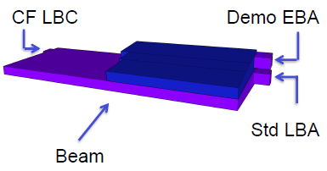
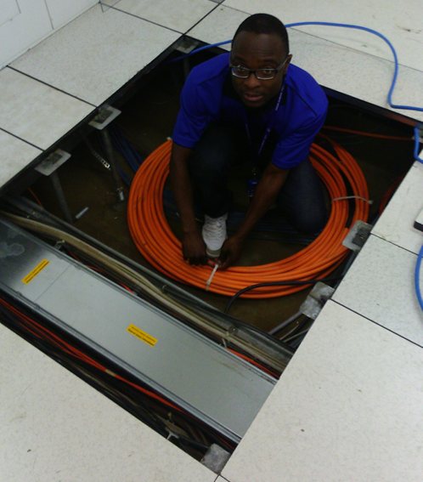
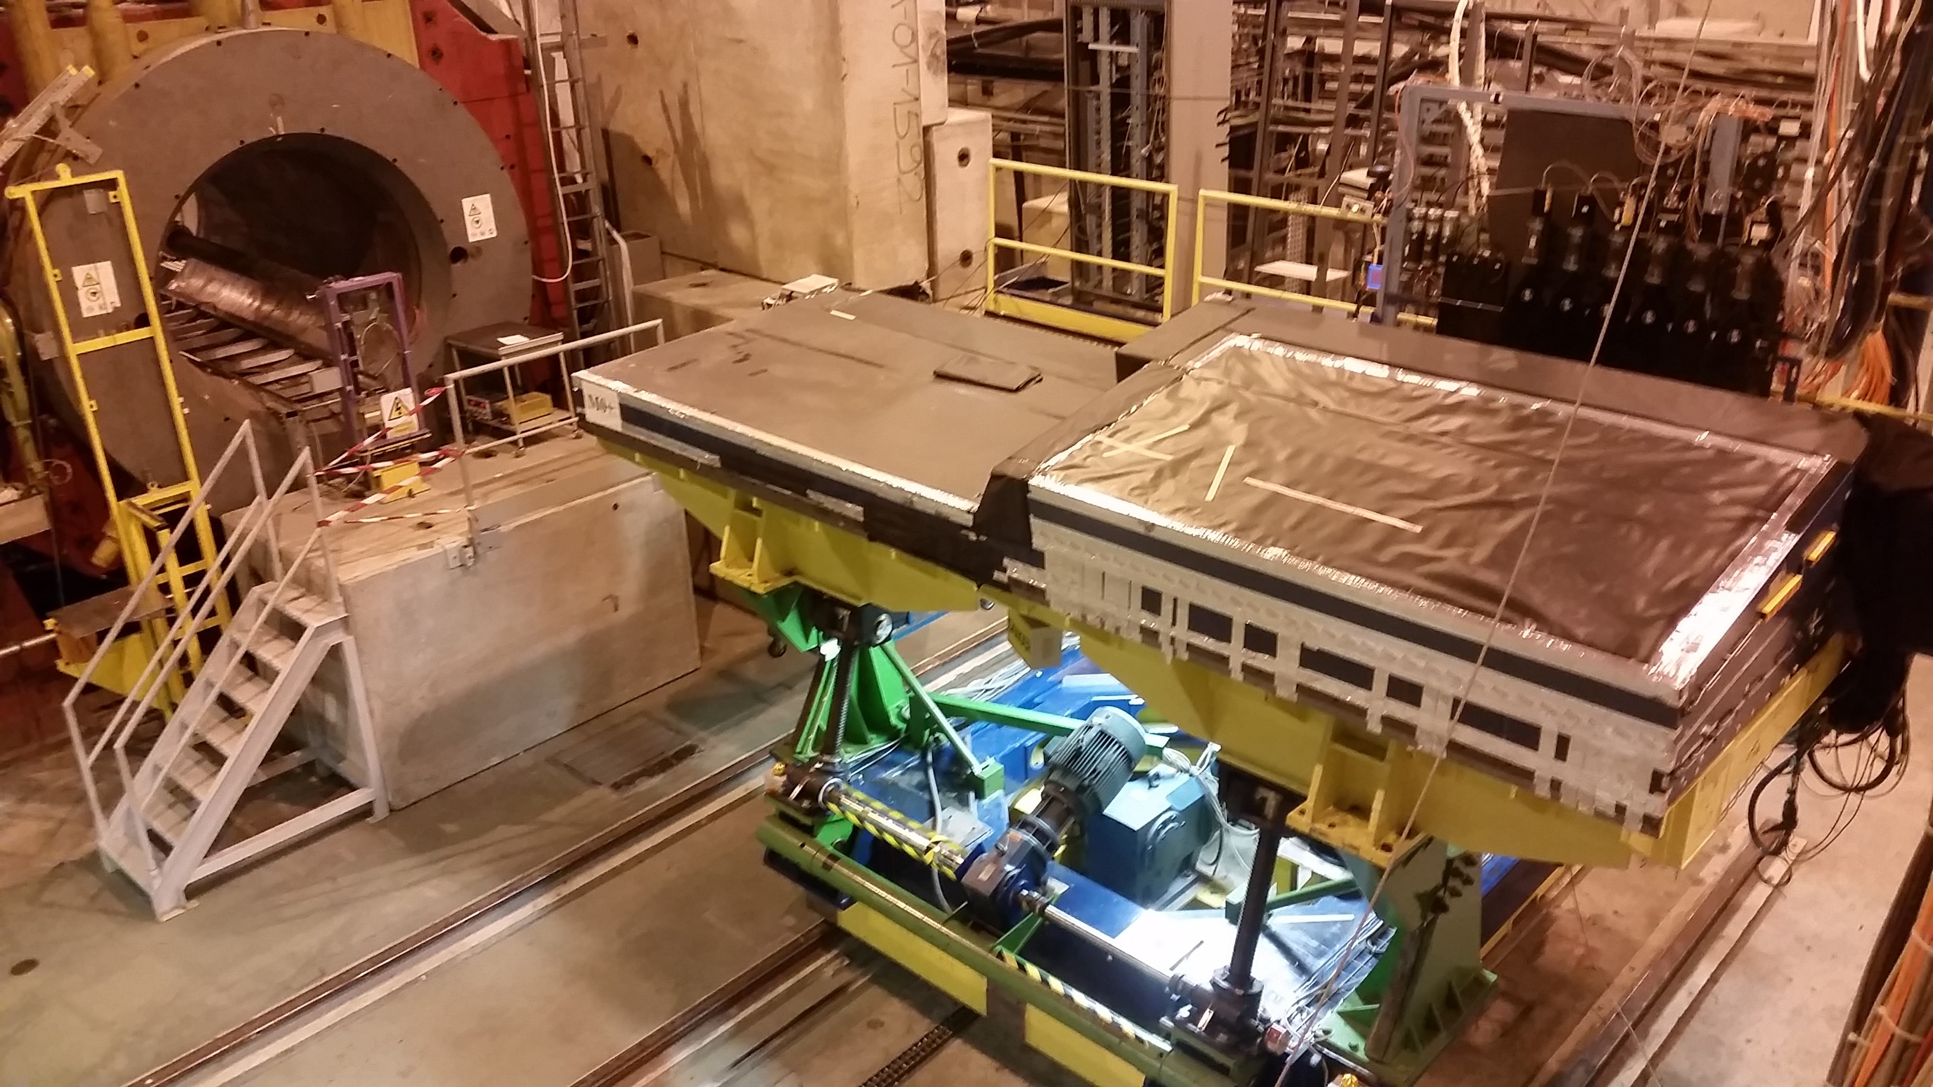
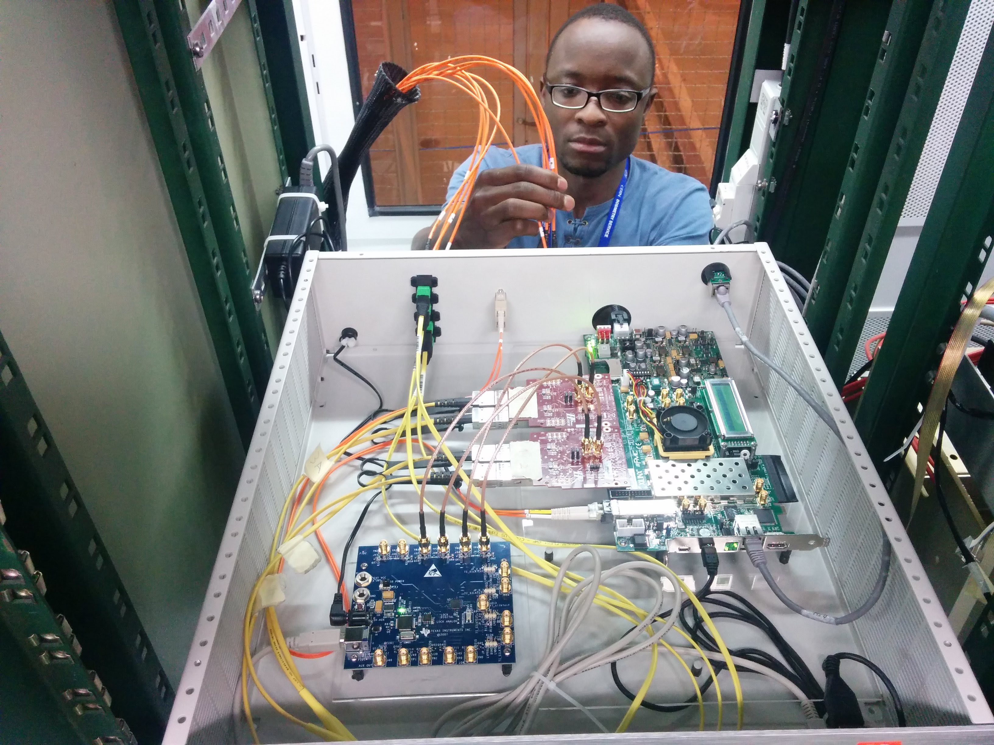
Test-beam activities
Routing of fibre optic cables
Cable connection onto boxed TilePPr system

Slide 16
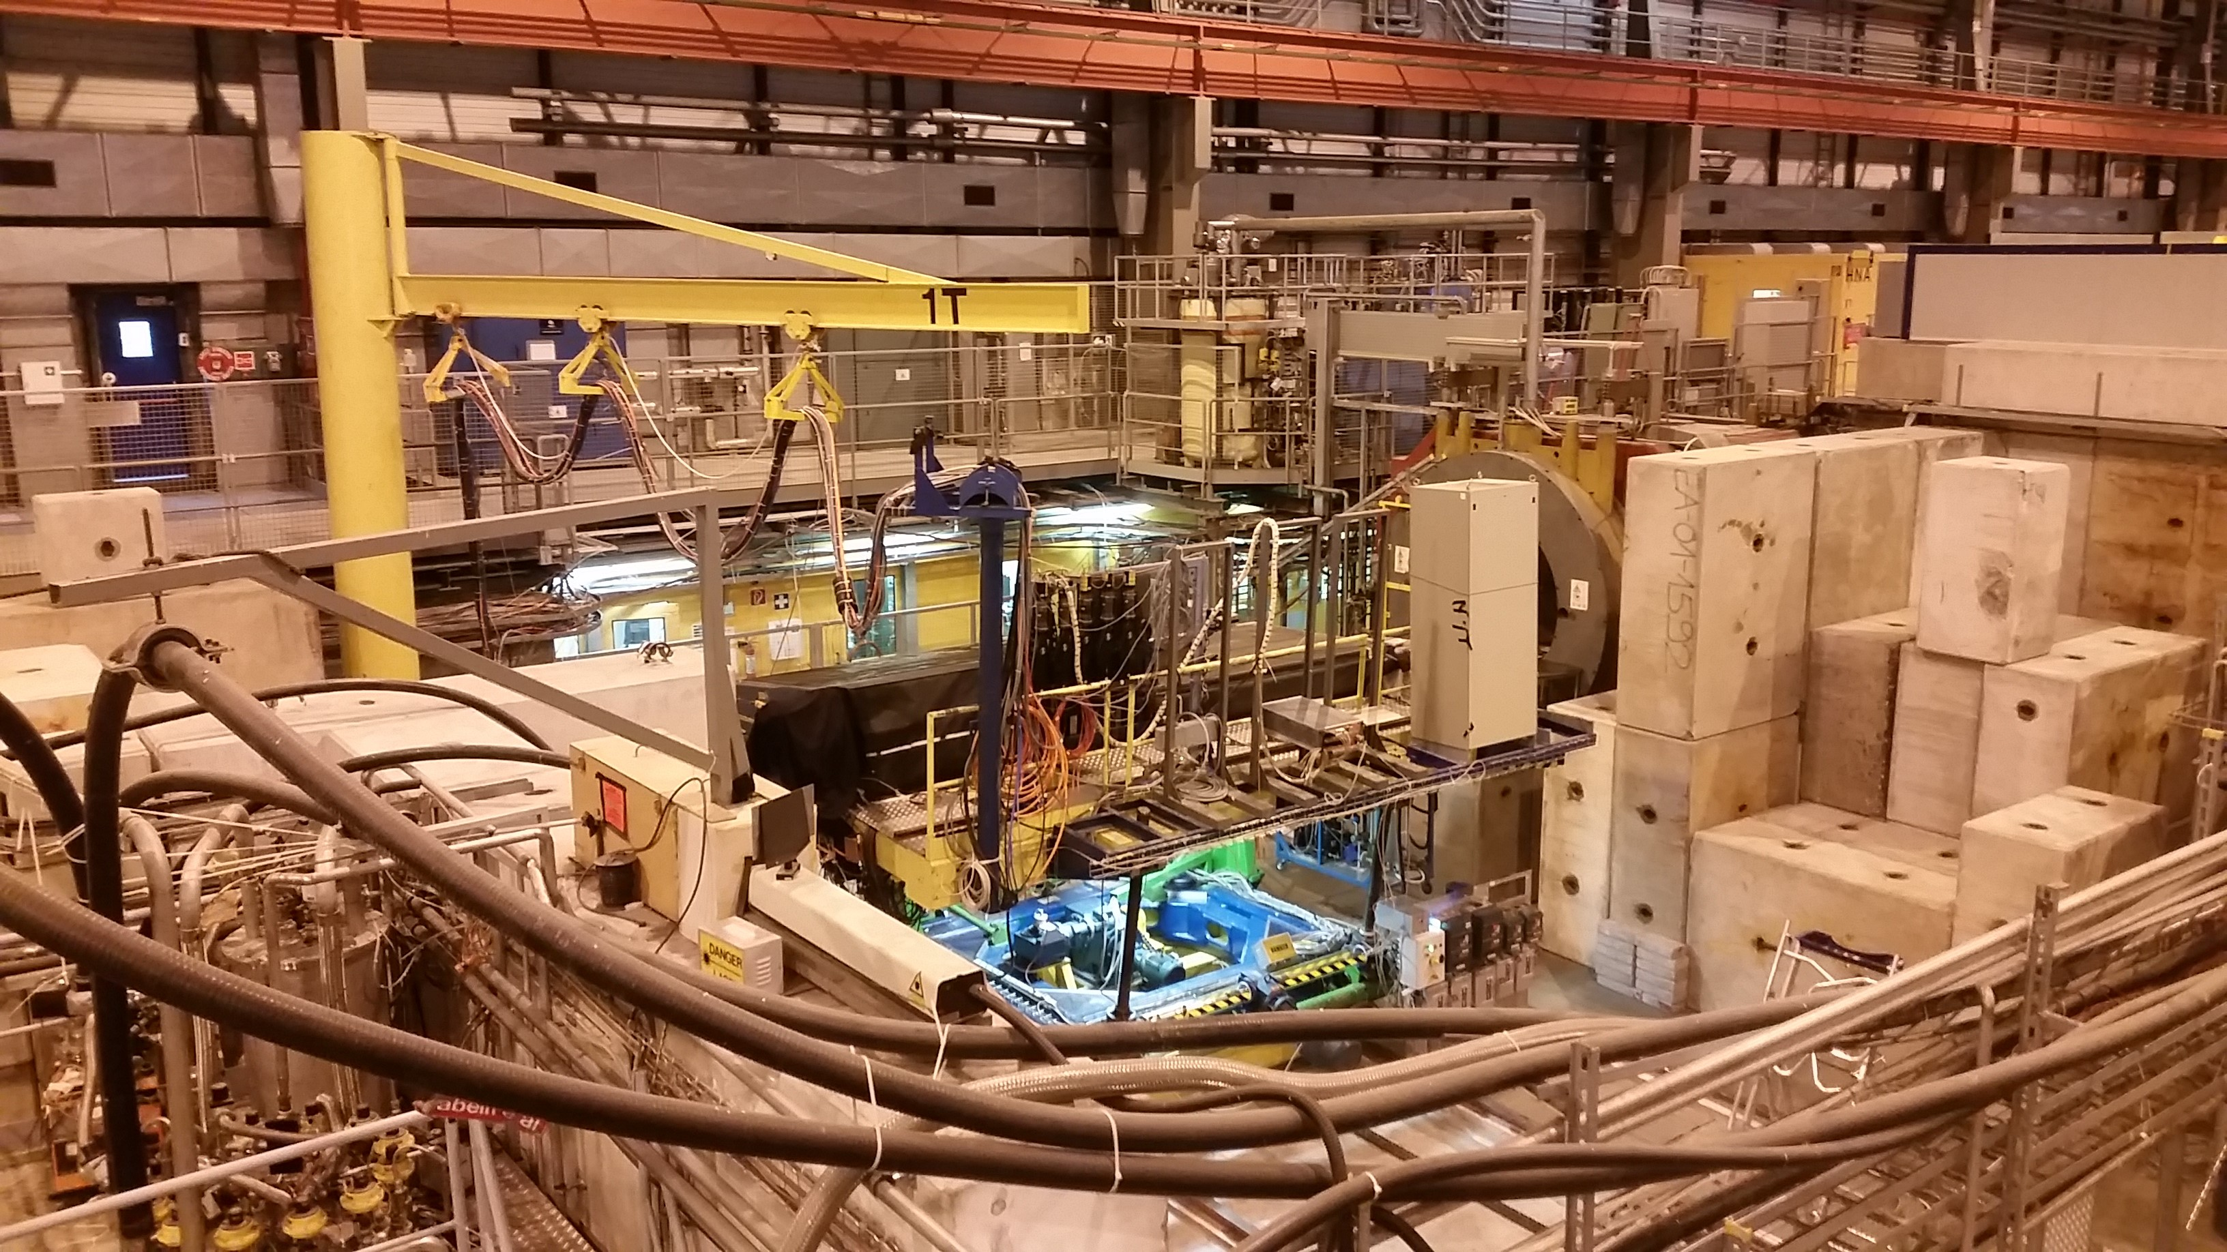
Test-beam facility
Warehouse contains several beam lines
Beam could be:
  180 GeV proton
  180 GeV muon
  150 GeV electron
  100 GeV electron
  50 GeV electron
Modules placed on
top of automatically
movable table

Slide 17
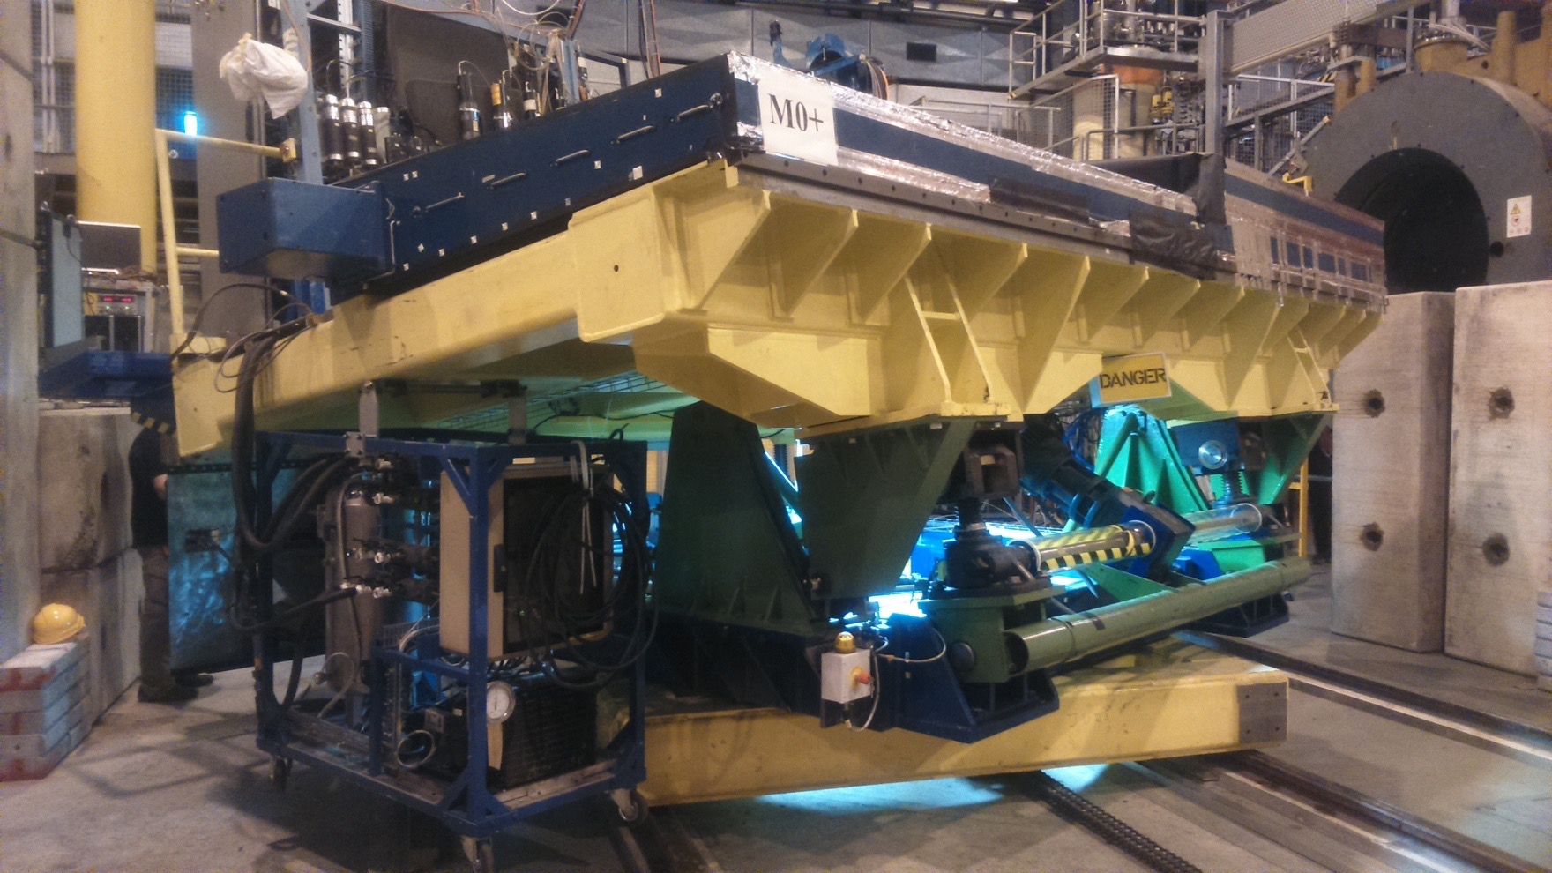
Test Bench
Two modules on test bench:
  Long barrel – legacy electronics
  Extended barrel – Demonstrator
Longer module is a standard legacy module, used to make
sure the system is working
Shorter module is extended barrel sitting on top, holds the demonstrator electronics

Slide 18
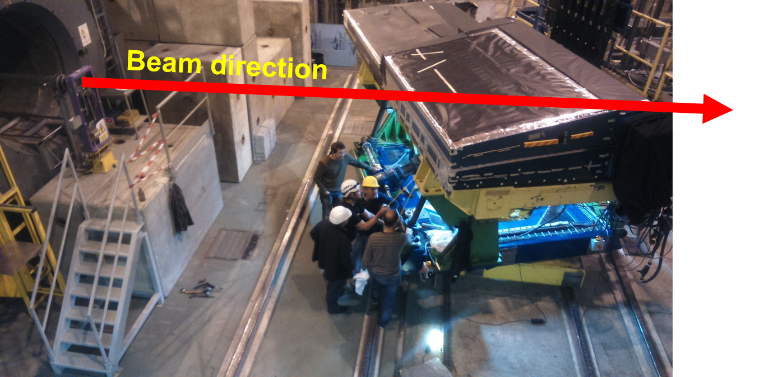
Test-bench
Beam Path:
The module captures all of the energy of the beam and its interactions via scintillation tiles
Legacy/Demonstrator electronics processes the signals

Slide 19
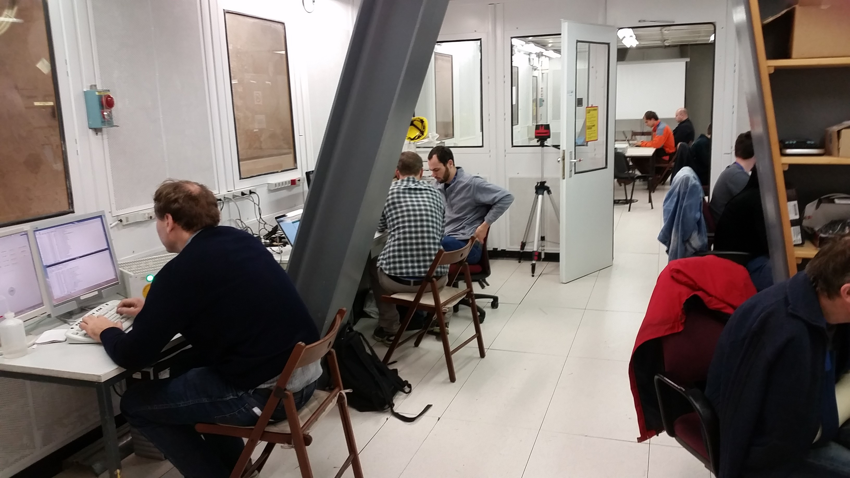
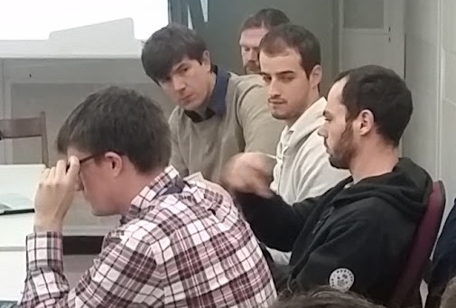
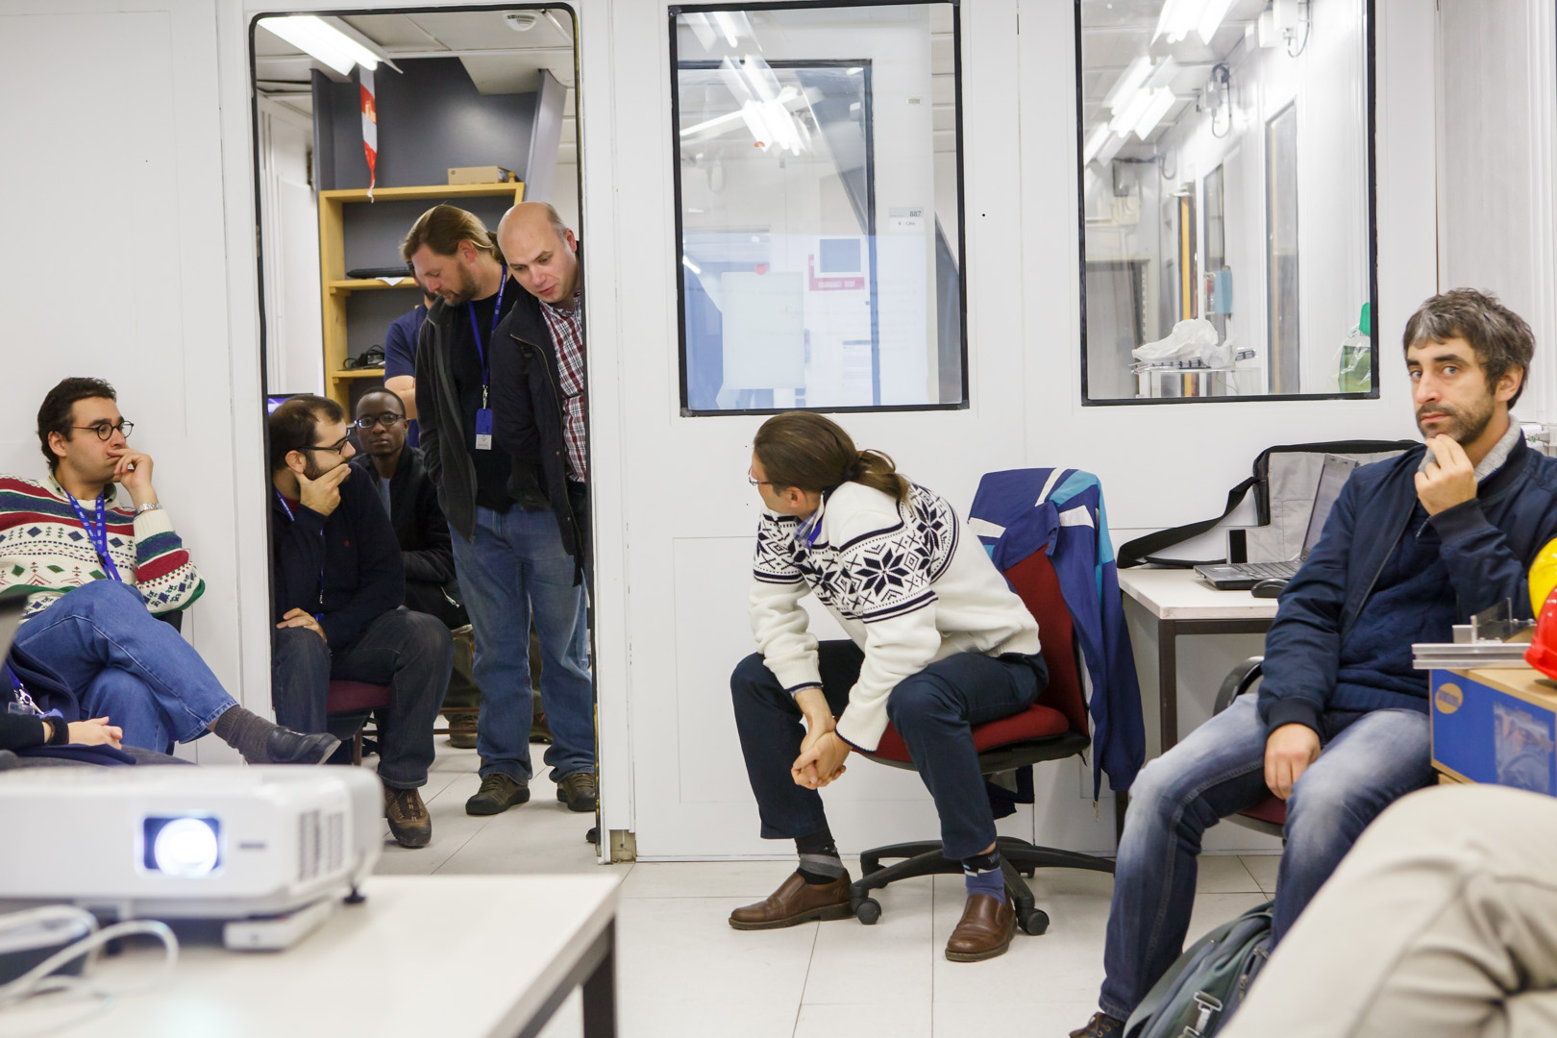
Daily operations
9 am meeting daily
  Description of progress and challenges
  Setting and allocation of the day’s priorities
  Many small teams working on different elements in parallel
Massive expertise and helpful mindset in all involved members ensures that work progresses quickly

Slide 20
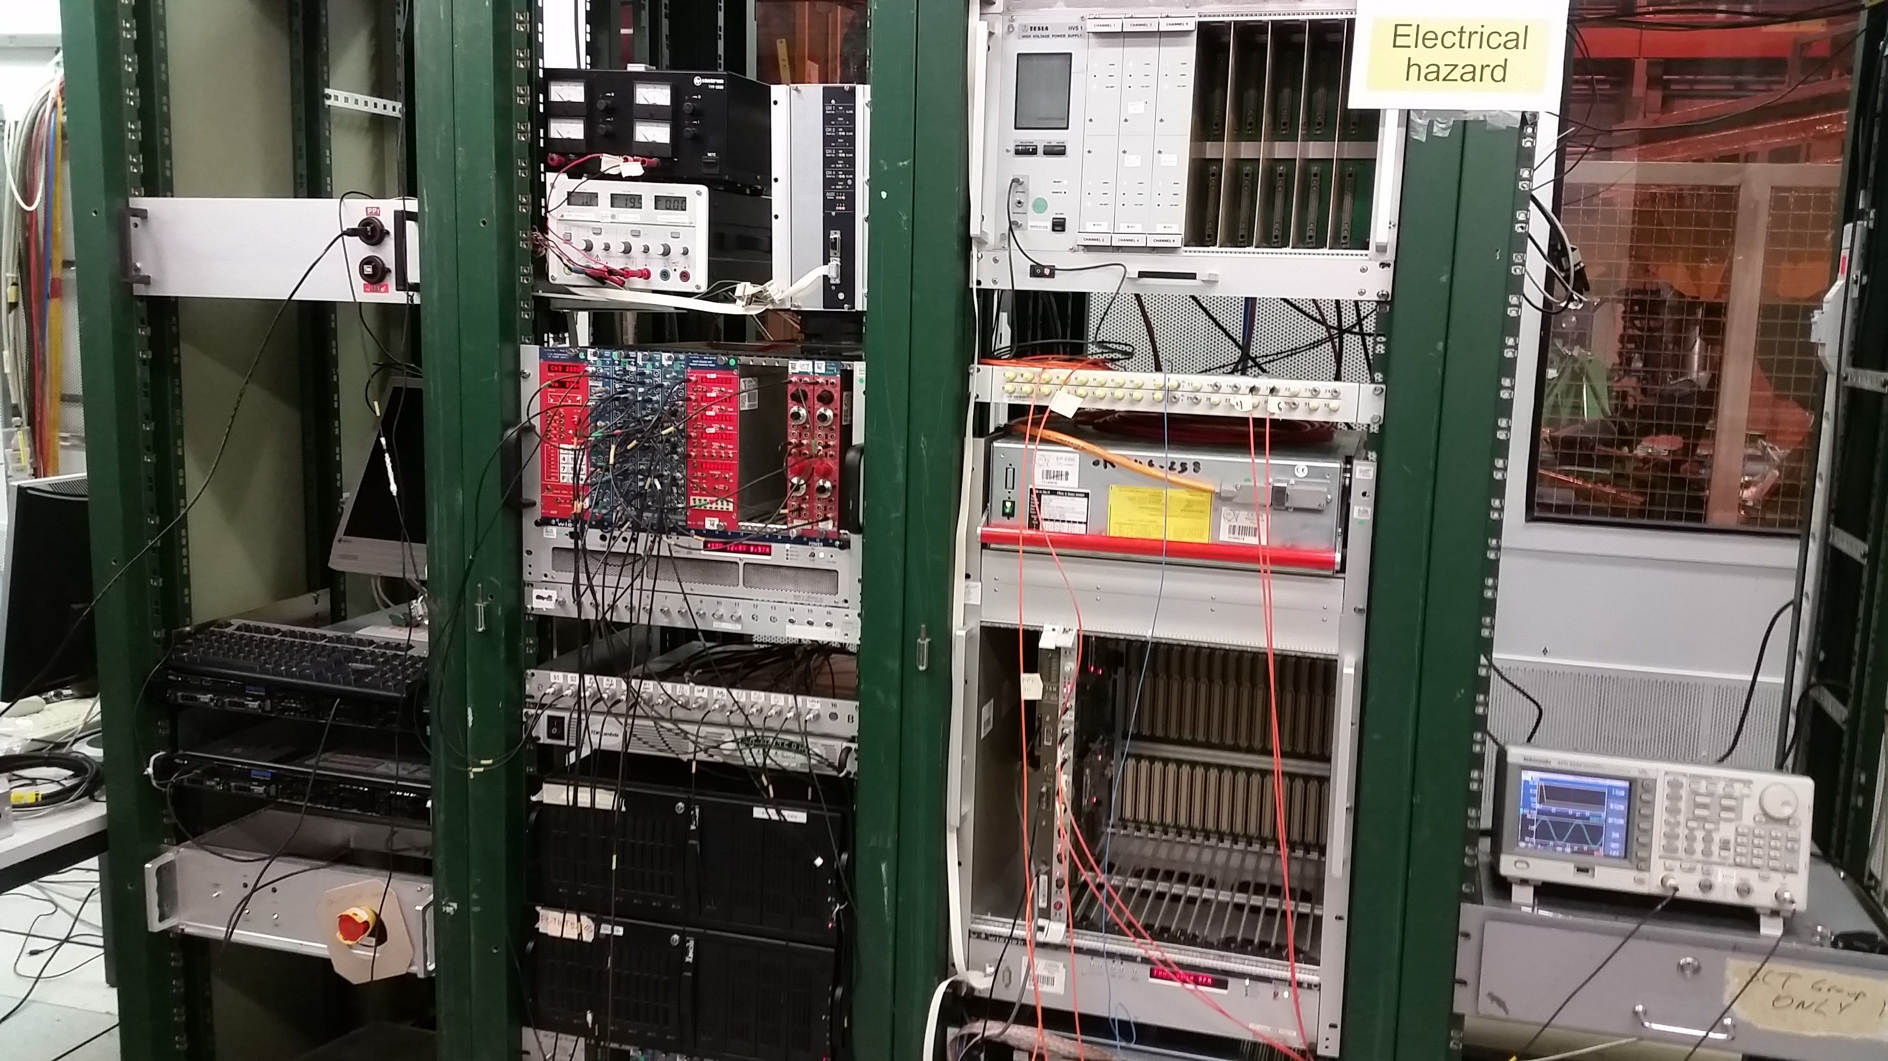
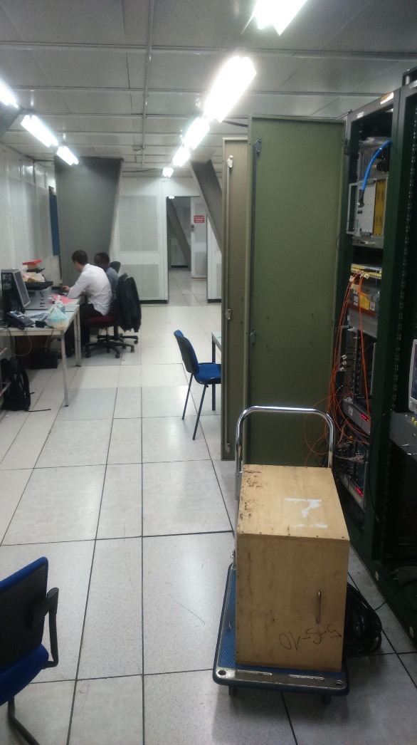
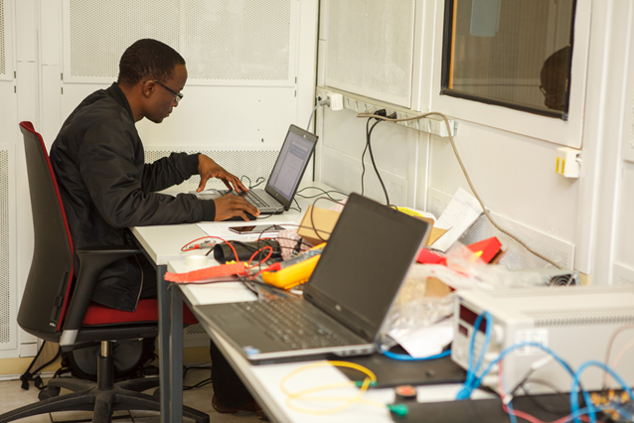
Control room
Houses back end electronics racks
  New and old electronics
Has enough floor space for the whole test beam crew to work in
Also houses computers for:
  Beam control
  Table control
  Shifters stations

Slide 21
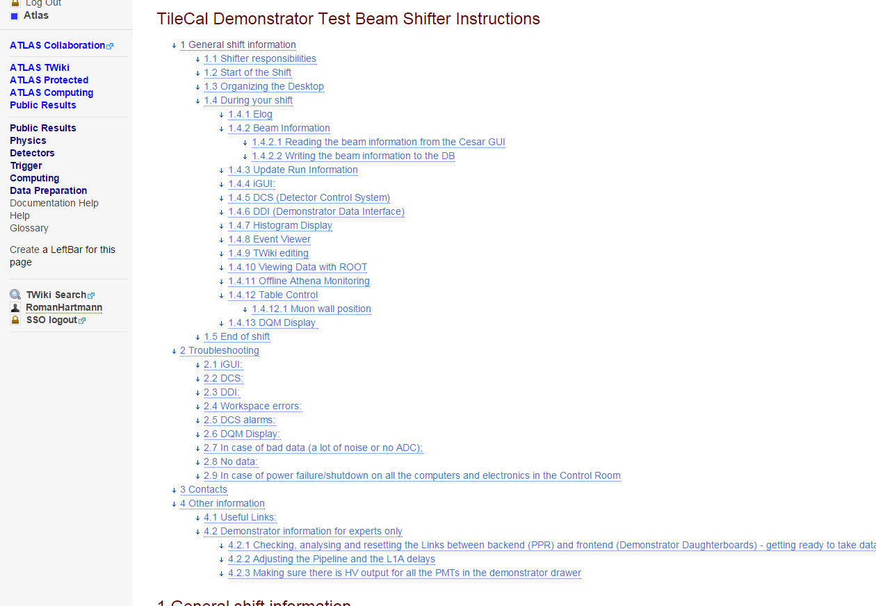
Shift activities
Shift: Two members work in 8 hour shifts around the clock to manage and assist in the data taking process
Shifters need to monitor the DCS for system faults (and fix them if able, call for help if not), manage data taking runs, check the data, update the data DB, make sure beam information is correct etc
If unoccupied, shifters continue with their previous work – or new work. There is always something to do
https://twiki.cern.ch/twiki/bin/viewauth/Atlas/TileCalDemonstratorTestBeamShifterInstructions

Slide 22
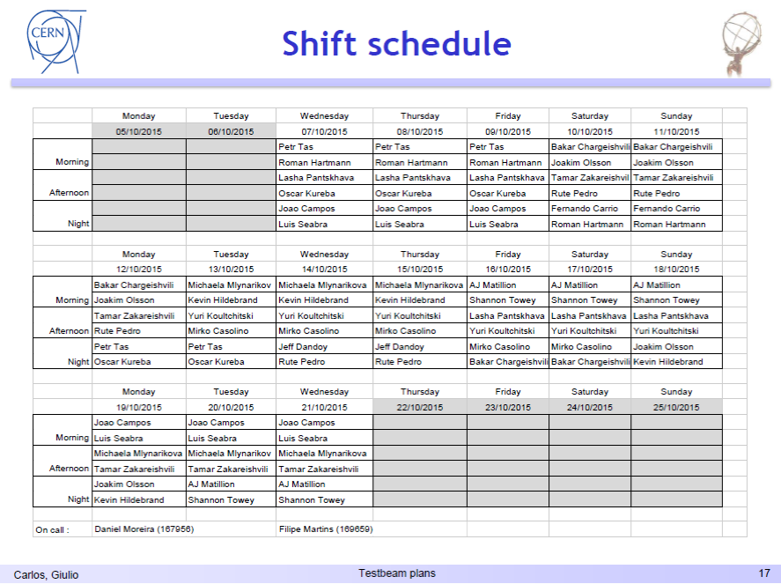
Shifts taken by Witsies marked with

Slide 23
Run summary from test-beam
Module 0 [Legacy electronics]
90°, muons, 180 GeV, all tiles
20°, electrons, 50-100-150 GeV, all cells
Module EB [Demonstrator electronics]
+/- 90°, muons, 180 GeV, all tiles
20°, electrons, 50-100-150 GeV, all cells
Projective, muons, 180 GeV, all cells
+/- 90°, electrons, 50 GeV, all tiles
90°, muons, 180 GeV, z-scan
20°, electrons, 50 GeV, z-scan
20°, hadrons, 50-100-150 GeV

Slide 24
Pre-analysis
Cleaning/beam properties
Establish a set of cleaning cuts (reject multi particle events, empty events, off-axis particles, …)
Study of the beam composition : how to select electrons, muons, hadrons, estimate contamination
Extract beam energy and its uncertainty
Precise computation of the beam impact point using the survey measurements of TileCal table and beam chambers

Slide 25
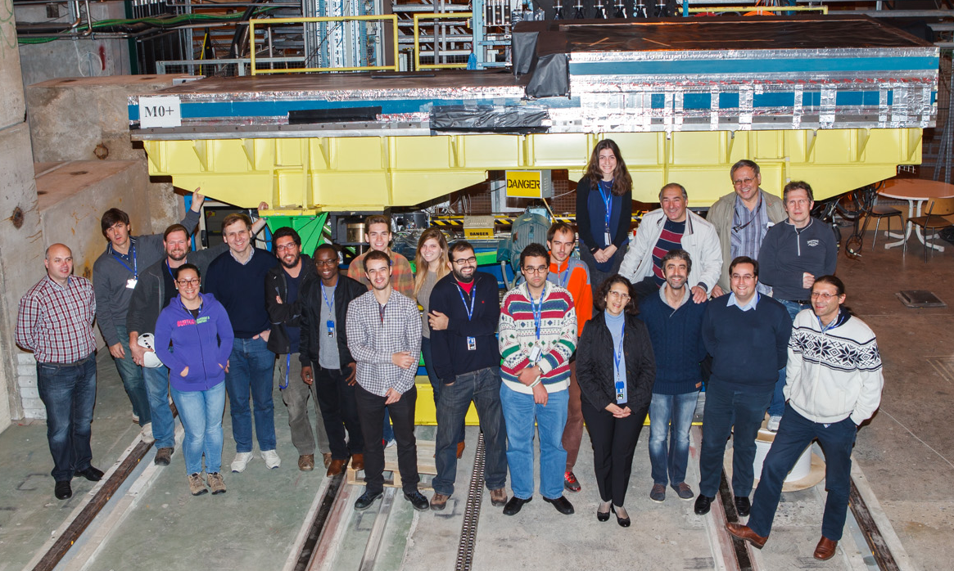
Group photo taken at the end of test-beam

Slide 26
Summary and outlook
The goal of the October 2015 test-beam was to verify if the ATLAS TileCal Demonstrator electronics can take meaningful data in ATLAS-like environment and yes it can
The data was taken with the aim to uncover the EM scale (pC/GeV ratio) already set in the Demonstrator by the Cs scan
Priceless experience was gained in operating the new TileCal readout electronics in close to real operational conditions
Mainly muons (180GeV) and electrons (50-150GeV) were taken in different conditions. Both data types can independently lead to the EM scale measurement.
Some important data sets were also taken with the legacy electronics readout path
Data analysis is on-going

Slide 27
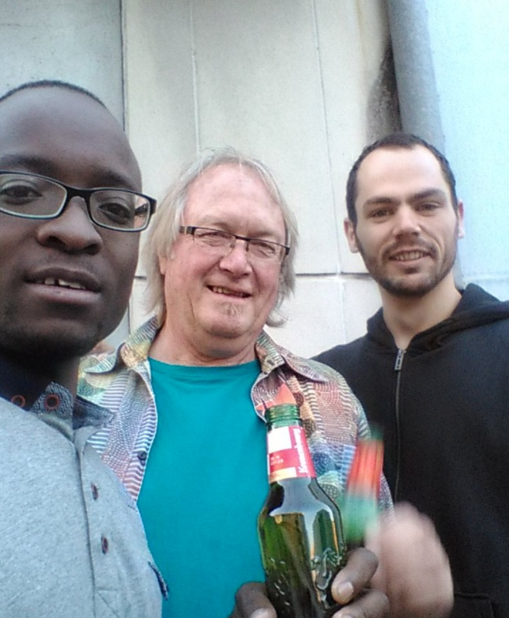
Thank you!

Slide 28
The backup plan

Slide 29
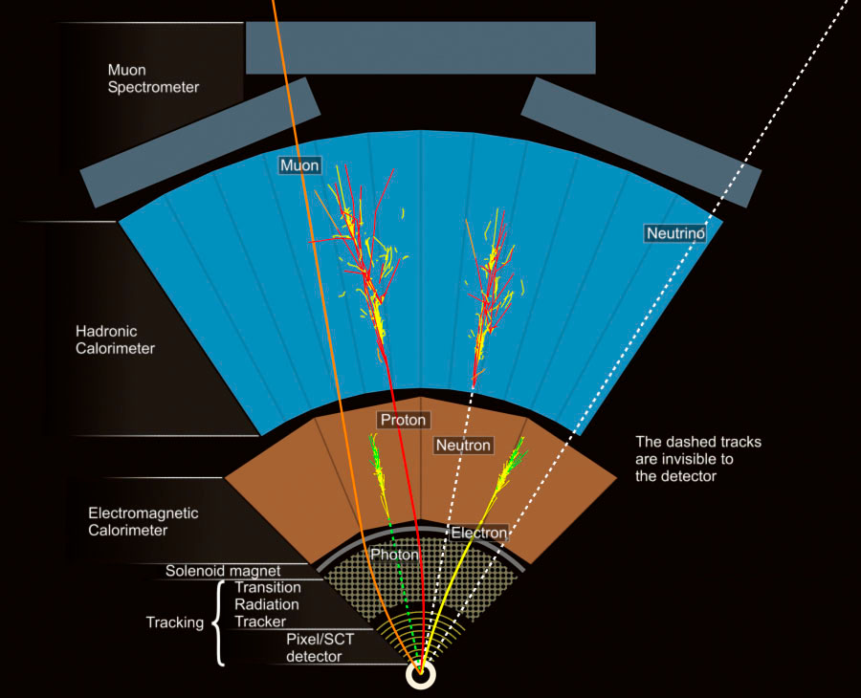

Slide 30
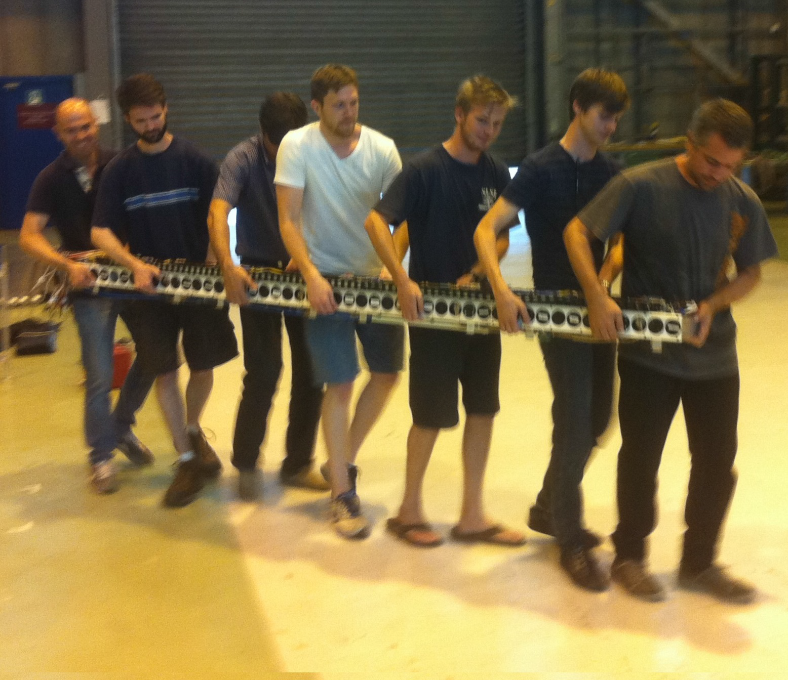
Super-drawer
The Hybrid Demonstrator is fully compatible with the current electronics and acts as a
validation for the new read-out architecture
4 mini-drawers make up a
super-drawer

Slide 31
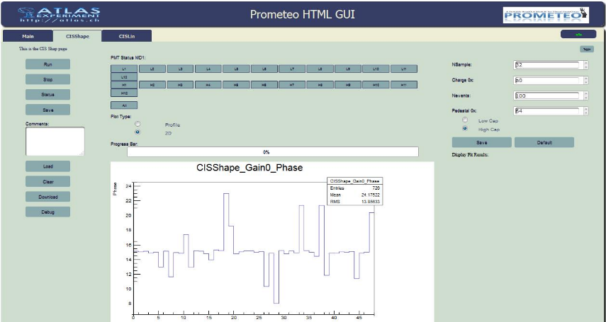
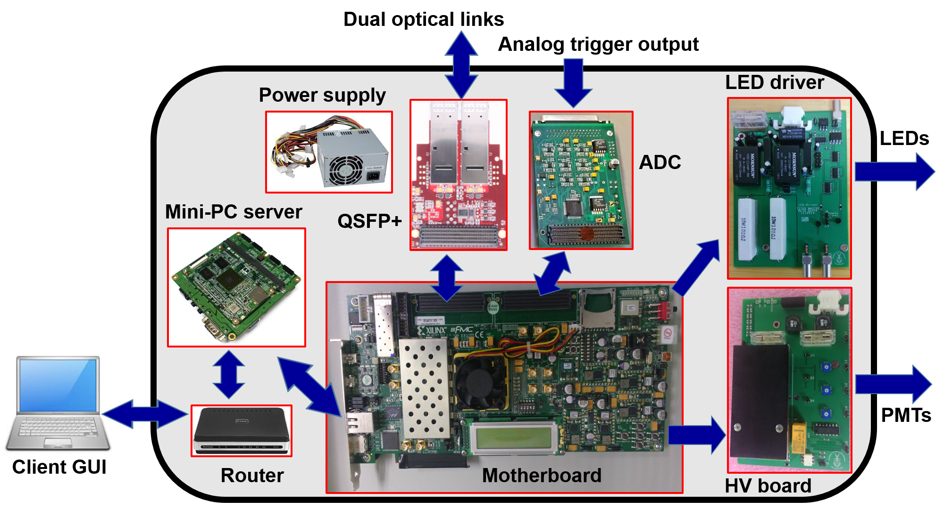

Wits contributions to the Demonstrator
Wits is responsible for the conceptual design and manufacture of
the next generation front-end electronics test-bench
Portable ReadOut ModulE for TileCal ElectrOnics (PROMETEO)
Used for the certification of the new electronics design for Phase II upgrade
All custom-designed modules were manufactured in South Africa
PROMETEO

Slide 32

ADC Board (For PROMETEO)
Project Aim: Develop, test and validate a new ADC board
  Manufactured in South Africa
Used to test adder cards on TileCal front end electronics
  16 analog signals digitised
  from the TileCal and Muon Triggers
7.68 Gb/s Data to FPGA
  Xilinx Virtex7 on VC707 Dev Board
  Two 8 channel, 12 bit, 50 MSample/s
  ADCs
Developing VHDL Firmware for
Control and Readout
Integration with TilePPR Firmware

Slide 33






TilePPr
Formerly known as the sROD, this 16 layer board is the most complex manufactured so far in South Africa
In production at Trax company, Cape Town
It is able to process a total throughput of 290 GB/s
Main functionality: Main data read out,
Trigger and Timing Control distribution, DCS commands
to front-end
TilePPr
1st ptototype

Slide 34




ATCA Framework
(Advanced Telecommunications Computing Architecture)
ATCA will replace current VME Crates ATLAS-wide
  Modern and High Data Throughput
Wits-developed framework allows easy
integration into ATLAS Detector Control System
  Wits HTEL has an ATCA chassis for R&D and Validation

Slide 35




Processing Unit (To be installed in ATCA Chassis)
Wits is developing a general purpose co-processing unit for offloading complex algorithms from TilePPr FPGA
  PCI-Express via ATCA for high data throughput using energy efficient and cost effective ARM System on Chips found in mobile devices
  Will make use of RDMA over PCIe with a shared memory space for easier application development and higher performance.
Potential for generic use for
example in SKA

Slide 36


GPU Research for Processing Unit
(Low cost, high performance for ATLAS Trigger or SKA)
Cluster of 11 NVIDIA Tegra-K1 GPUs in Wits HTEL
Currently researching the feasibility of TileCal front end energy reconstruction algorithms on GPU
  Redistribute the massively parallel implementation of the TileCal front-end from FPGA to GPU
High Performance Computing with GPU and 64 bit X-Gene system

Slide 37

General Purpose Processing Unit
GPU
Re-purpose the co-PU for the TileCal into a general purpose PU
Cox M, Reed R, Mellado B 2015 JINST 10 C01007
Notes:
sROD is a key link between the detector front-end and back-end
Performs, amongst other things, online energy reconstruction and quality factor checks
Because it is FPGA-based it is difficult to implement high-level signal-processing algorithms
Solution: ARM-GPU based co-processing unit (PU)

Slide 38


Ipbus protocol
An implementation of the IPbus protocol in
few kilobytes of code, available in
C++, Java and python
IP bus hub enables multiple clients to
connect to the same host with a low impact
on transaction speed
IP bus hub program logic

Slide 39

Long term commitments:

