Slide 1
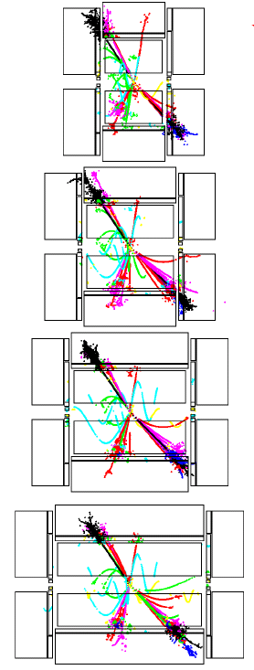
Thoughts on detector optimization: aspect ratio
F. Teubert (CERN PH Department)

Slide 2

Introduction
The size of the Barrel vs EndCap region is one
of the critical factors in the detector
optimization → Cost!
Given the fact that the production mechanisms
for many interesting physics in the multi TeV
range are quite different from the 0.5 TeV
region, maybe is worth to have an independent
look from the CLIC side. Example,
σ∝1/s
σ∝log(s)

Slide 3
Introduction
Several detector characteristics to be considered:
- Barrel length
- Overlaps
- Calorimeters EndCap Resolution: Segmentation
- Tracking resolution: B field.
- …
In this talk I will look at what we know from the
ILD optimization studies: see for instance: http://ilcagenda.linearcollider.org/conferenceDisplay.py?confId=2813
And suggest some possible benchmark channels.

Slide 4
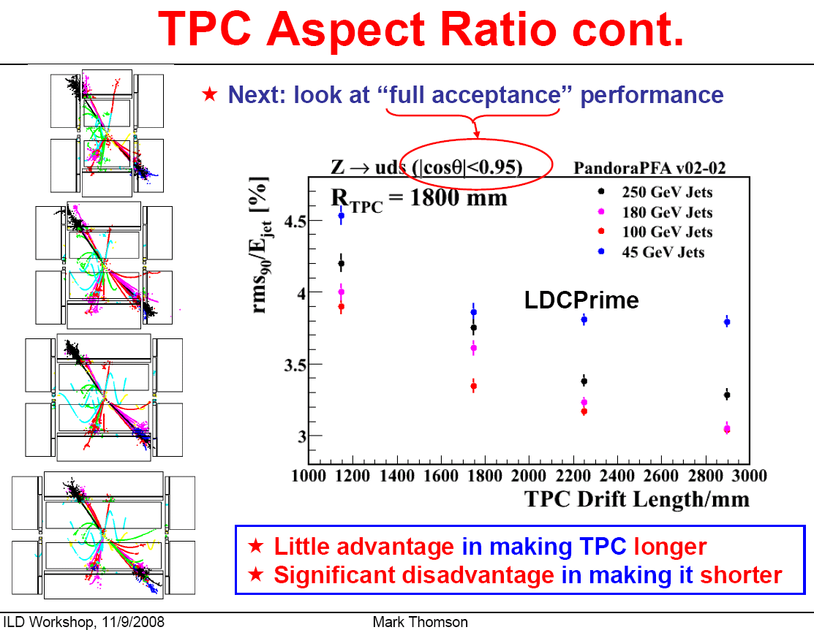
Generic Studies for ILD

Slide 5
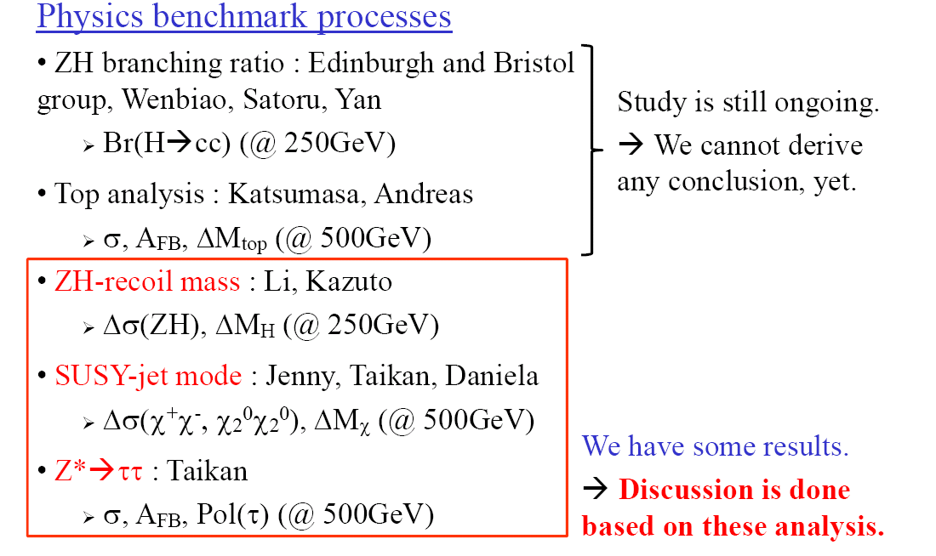
Benchmark Channels for ILD Optimization

Slide 6
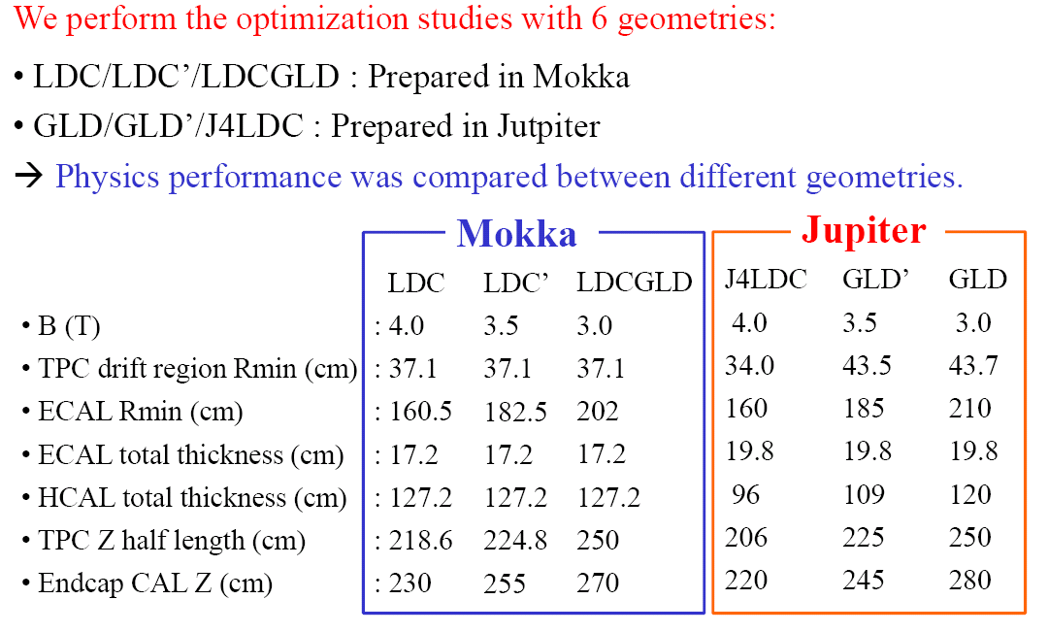
Detector options for ILD

Slide 7
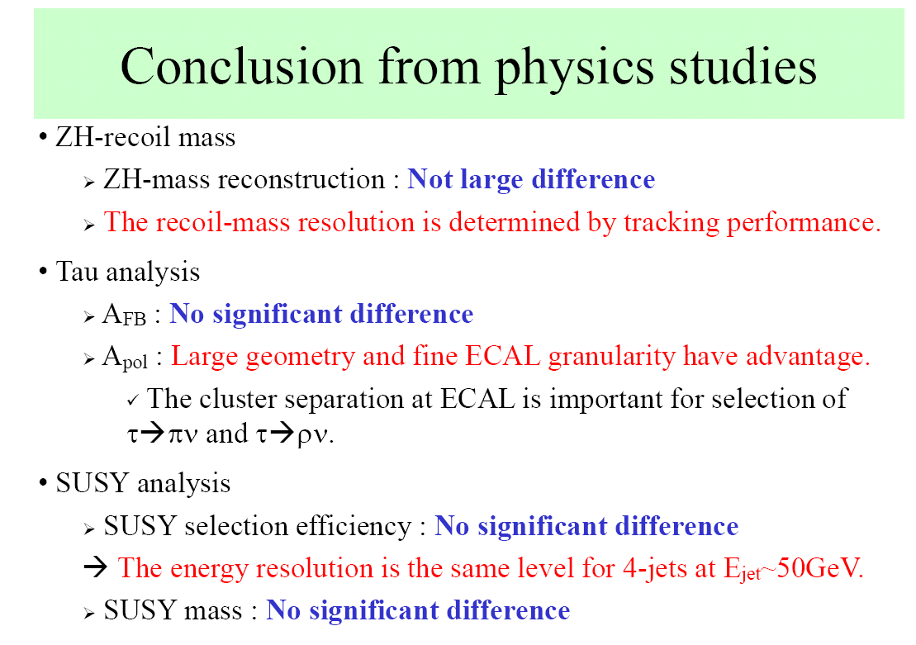
September 08 Conclusions for ILD Optimization

Slide 8
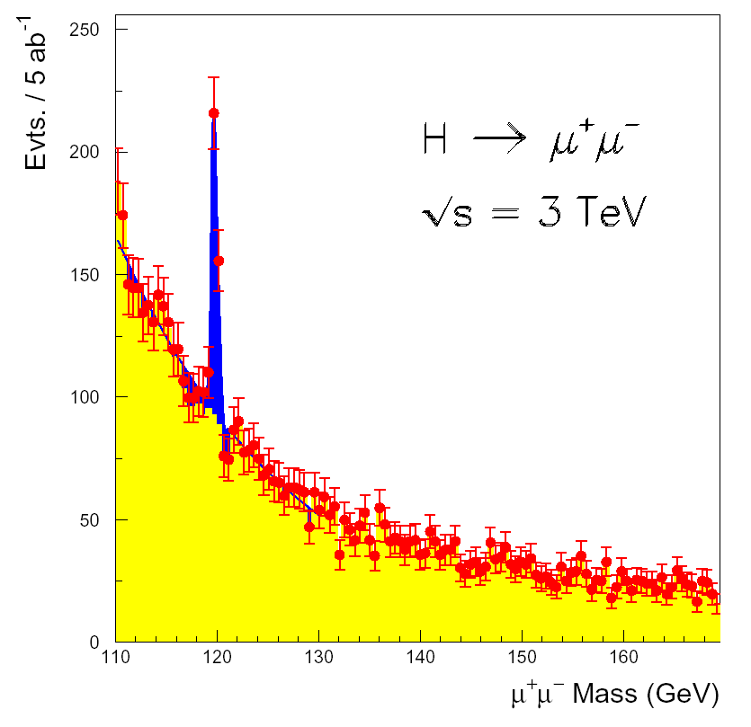
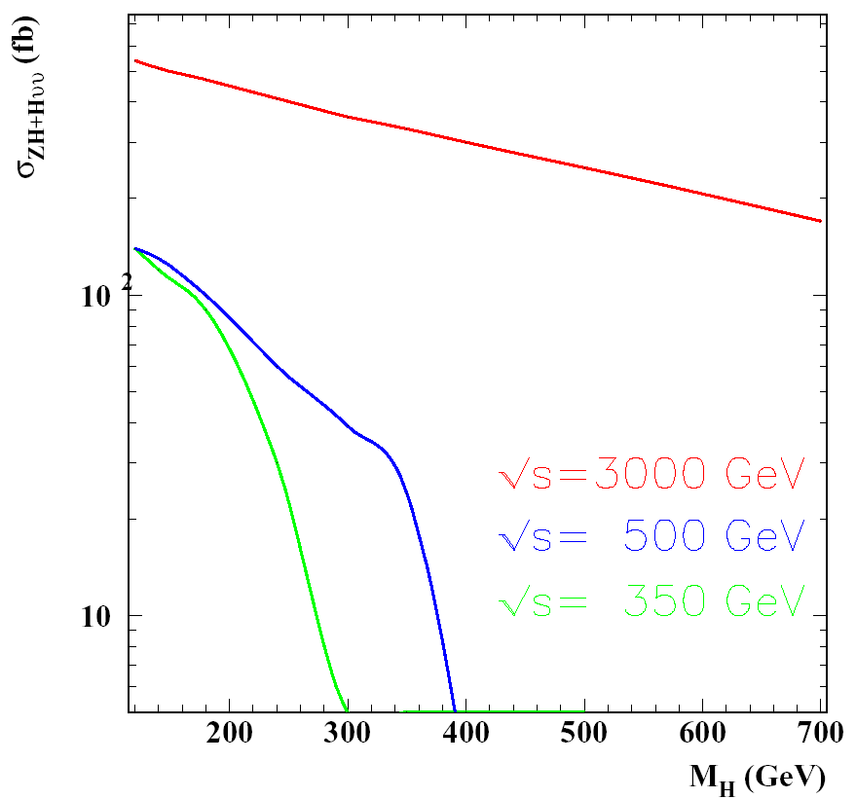
What about CLIC?: If there is a light SM-like Higgs…
The cross-section at ~3TeV is enormous
→ access to very rare decays (BR~10⁻⁴).
Measure Higgs couplings to leptons, for
instance with 0.5 ab⁻¹, we expect ~70 H→μ+μ⁻
decays for M_{h}=120 GeV/c², and measure the
couplings with ~4% precision.
σ∝1/s
σ∝log(s)
Should we test the tracking performance on these muons for different aspect ratios?

Slide 9
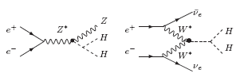
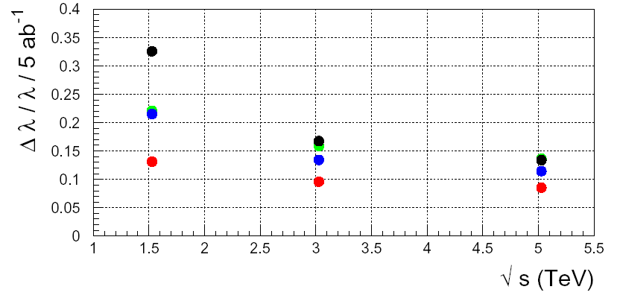
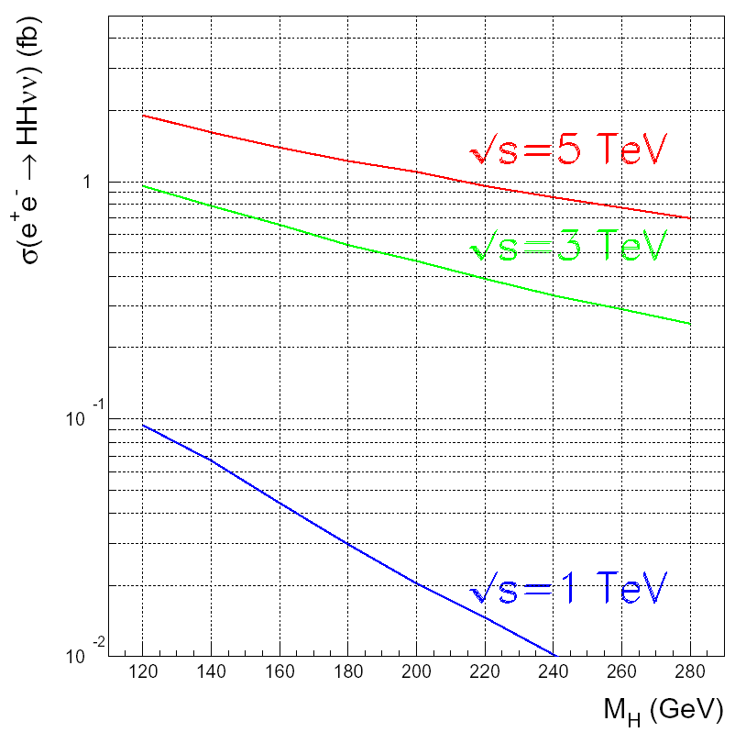
What about CLIC?: If there is a light SM-like Higgs…
The double Higgs cross-section at ~3TeV is big
→ access to HHH self coupling, hence Higgs potential!
For instance with 5 ab⁻¹, we expect to measure
the triple HHH coupling with ~10% precision for
M_{h}=120 GeV/c².
σ∝1/s
~0.2 fb @ 0.5 TeV
σ∝log(s)
~1 fb @ 3 TeV
M_{H} = 240 GeV/c²
180 GeV/c²
140 GeV/c²
120 GeV/c²
Should we test b-jet resolution for different aspect ratios?

Slide 10
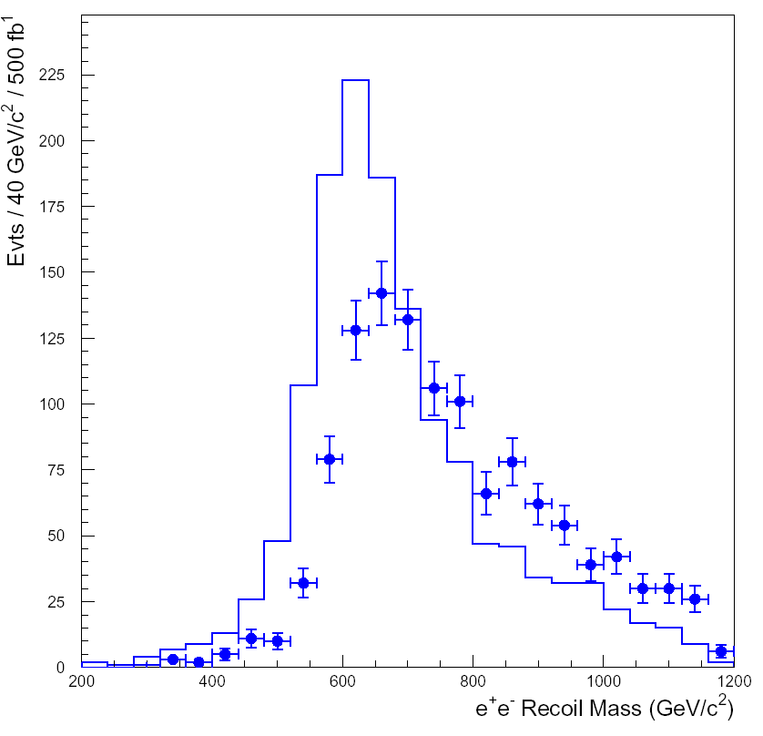
What about CLIC: If there is NP the Higgs may not be light…
The presence of New Physics may partially cancel the virtual
effects of a heavy Higgs and still be in agreement with precision
measurements.
Indeed LHC should have discovered a heavy Higgs, and roughly
measure its properties. However a precise determination of its
mass, width and couplings will require a LC.
The fusion process ZZ→e⁺e⁻H can be used as
the Higgs-strahlung process at low energies to
determine its mass independent of the decay mode
using the recoil mass.
However the electrons are at very low angles,
where backgrounds are worse. Nevertheless, it
seems possible to extract a clear signal up to
M_{H}<900 GeV/c².
σ∝1/s
σ∝log(s)
0.5 ab⁻¹
It may be relevant to define EndCaps vs Forward regions?

Slide 11
Conclusions
Given the fact that the production mechanisms are
so different in the Multi-TeV region is probably
worth to simulate:
- e⁺e⁻ → e⁺e⁻H(μ⁺μ⁻) (check tracking vs Barrel length)
- e⁺e⁻ → ννH(bb)H(bb) (check b-jet reconstruction vs length/overlaps/endcap resolution)
- e⁺e⁻ → e⁺e⁻H(X) (check very forward tracking)

