Slide 1

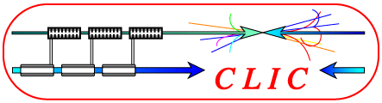
Updates on Hcal Material Choice
16. March 2009
P. Speckmayer & C. Grefe
CERN

Slide 2
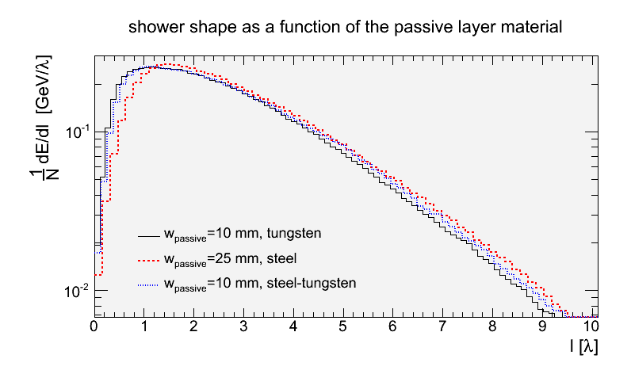
Shower shapes tungsten & steel

Slide 3
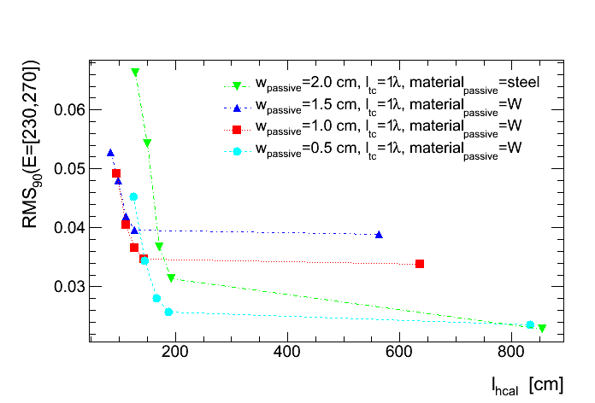
Sampling fraction optimization

Slide 4
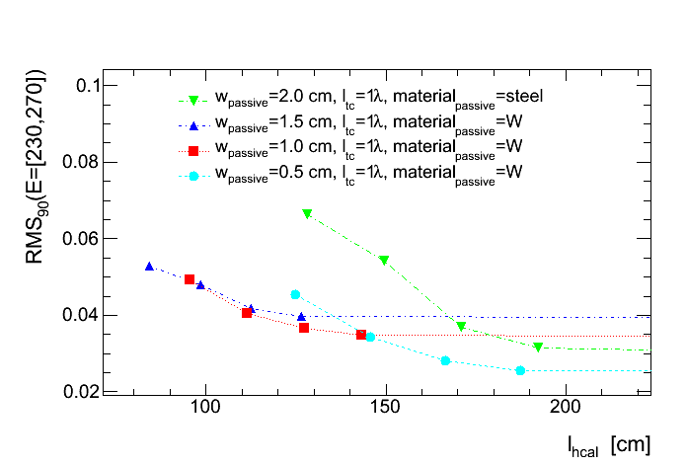
Sampling fraction optimization

