Slide 1
HL_LHC, WP17.2 -
Electrical distribution
Review of EN-EL cooling and ventilation equipment needs (not included DC cabling)
17 Dec 2015 – EDMS xx
N. Dos Santos (on behalf of EN-EL group)

Slide 2
Presentation content:
Equipment inventory per building
Thermal loads and temperature needs per building
Thermal loads and temperature-humidity parameters update
Conclusions
  For DC cabling needs, please refer to JC. Guillaume presentation

Slide 3
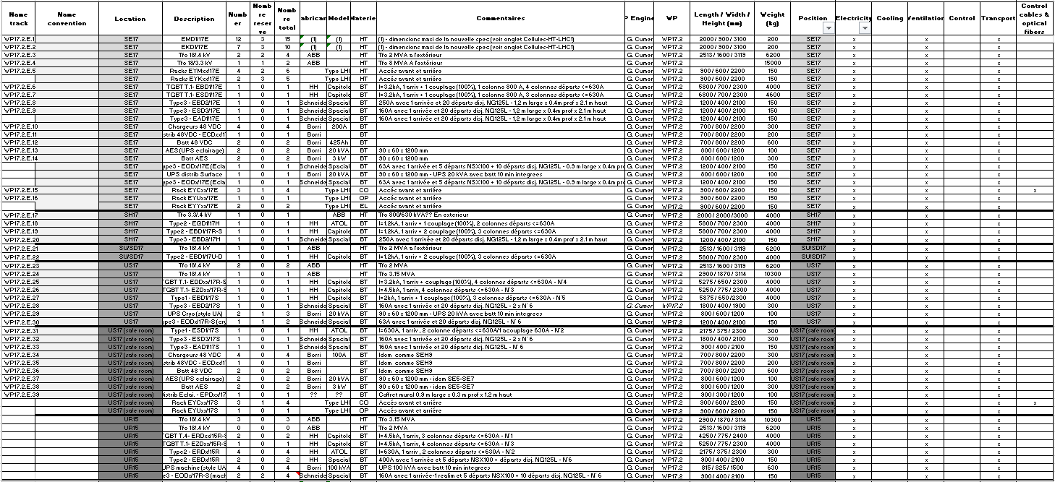
Equipment inventory per building (LHC1 = LHC5)
WP17 Equipment characteristics and the technical needs - Technical infrastructure - https://edms.cern.ch/document/1516703/0.2

Slide 4
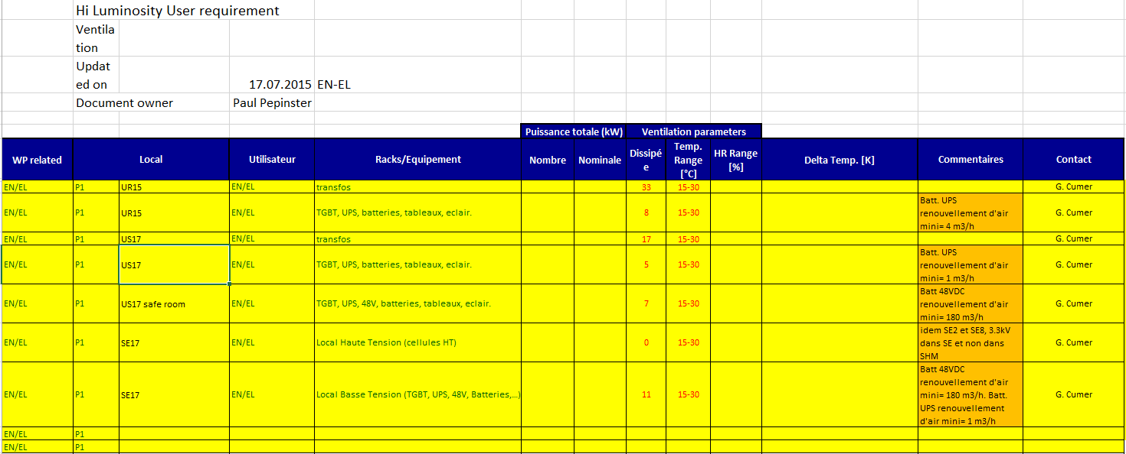
Thermal loads and temperature needs per building (LHC1 = LHC5)
EL requirements on 17 July 2015
EL thermal loads per building
Min/Max Temperature per building
Minimum air flow renovation for batteries (NF C 58-311 and EN 50272-2)

Slide 5
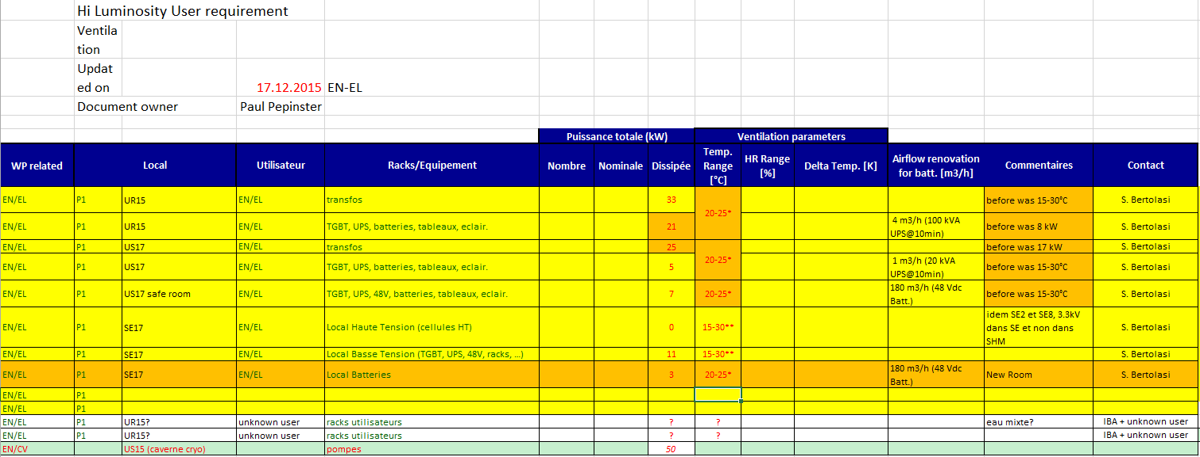
Thermal loads and temperature-humidity parameters update
update of 17 Dec 2015
Orange cells → update
* - batteries presence
** - parameters to be confirmed
Temperature range and humidity parameters for EL equipment are under revision (on going discussions inside EL group) → parameters will be fixed in 2016

Slide 6
Conclusions
New batteries room inside SE17/57 to be foreseen → layout to be defined, hopefully no impact in SEs’ building dimensions
Final temperature and humidity parameters to be accorded between EL and CV

Slide 7
Thank you for attention.

