Slide 1
Power converter integration
Power converters for HL-LHC
WP 6b : Warm powering
Jean-Paul Burnet, CERN TE-EPC

Slide 2
Content
Introduction
List of circuits
Power converter types
Power converter integration
Infrastructure needed

Slide 3
Infrastructure for Power Converters
All new power converters for HL-LHC (inner triplet and matching section) will be installed in new UR gallery.
Power converters transform electricity from AC to DC to power magnets.
Power converters are placed between the mains and the DFHM.
Power converters needs:
Electricity
Cooling-water
control
Air conditioning
Power converters shall be close to electrical switchboard and DHFM to minimized the cabling and limit the losses.

Slide 4
List of circuits for HL-LHC
List of circuits for one IP side for inner triplet and matching section magnets.
All IP side are identical.

Slide 5
List of power converters for HL-LHC
List of power converters needed for the inner triplet and matching section magnets:

Slide 6
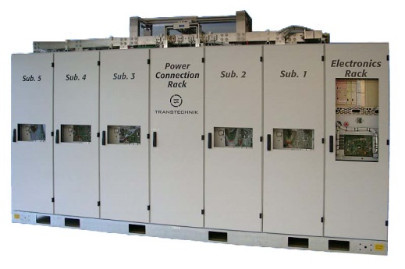
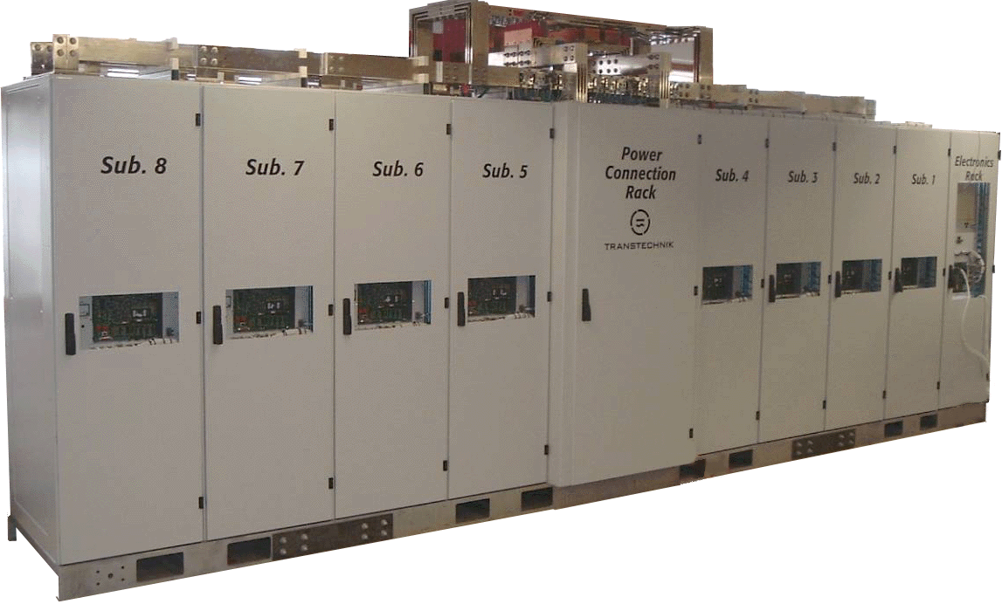
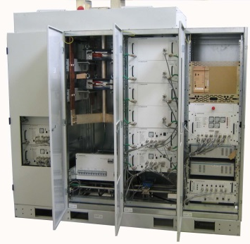
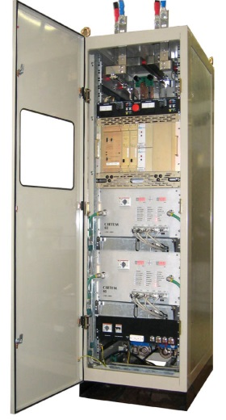
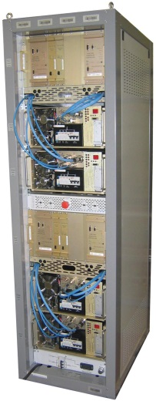
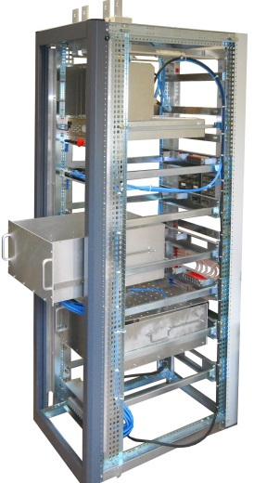
Power converter types
The power converters will be of the same type as the present one.
2 new types will be developed but based on the same technology.
Main Quadrupoles: 13kA/18V
Atlas Toroid: 20.5kA/18V
Individual Quadrupoles: 6kA/8V
Same family
4-quadrant for correctors : ±600A/±10V
4-quadrant for correctors : ±120A/±10V
4-quadrant for correctors : ±200A/±10V
±2kA/±10V
New types

Slide 7
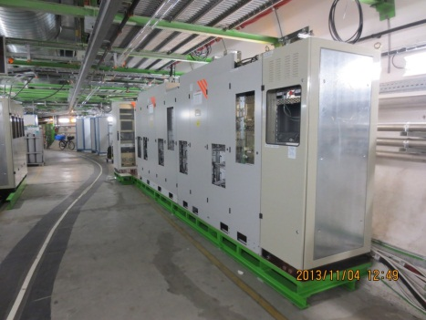
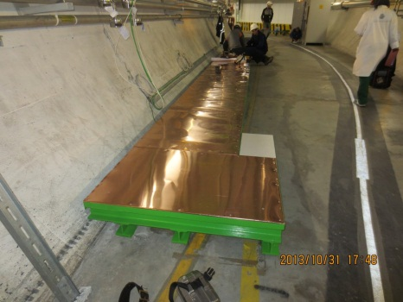
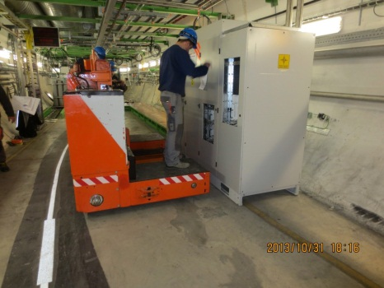
Power converter underground integration
The installation should be similar to a present UA.
No mezzanine.
Space for transport and installation.
No rear access to racks.

Slide 8
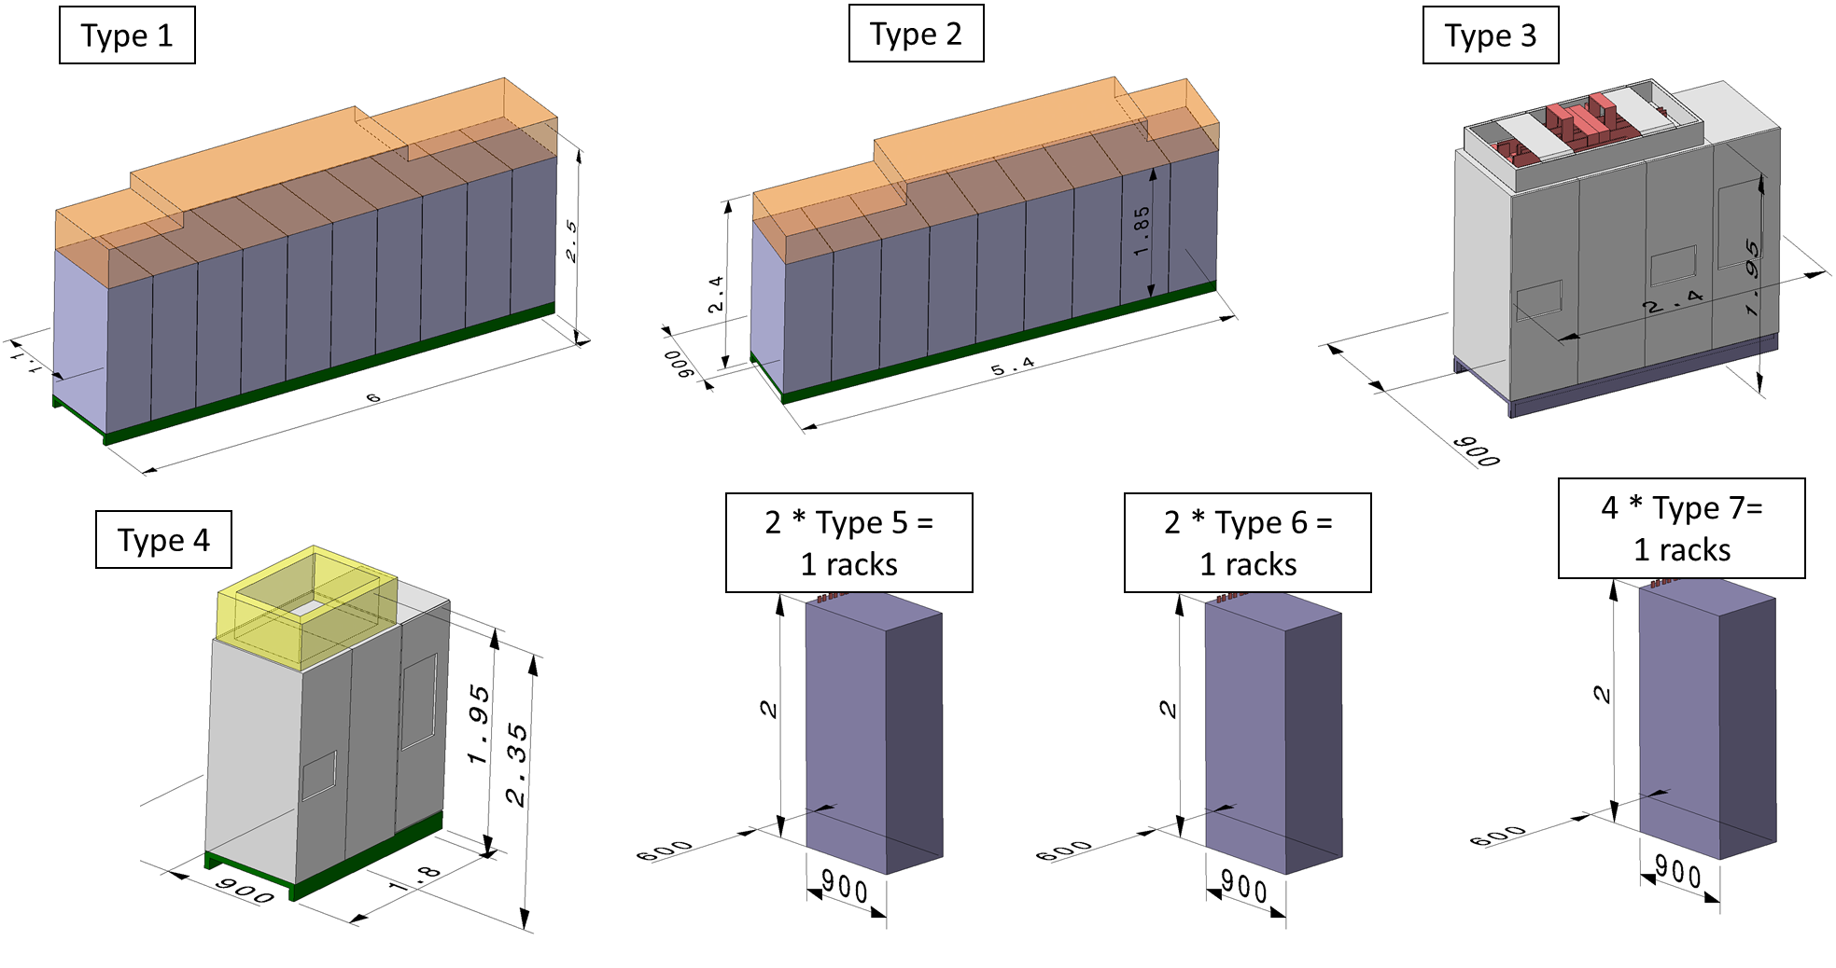
Power converter size

Slide 9
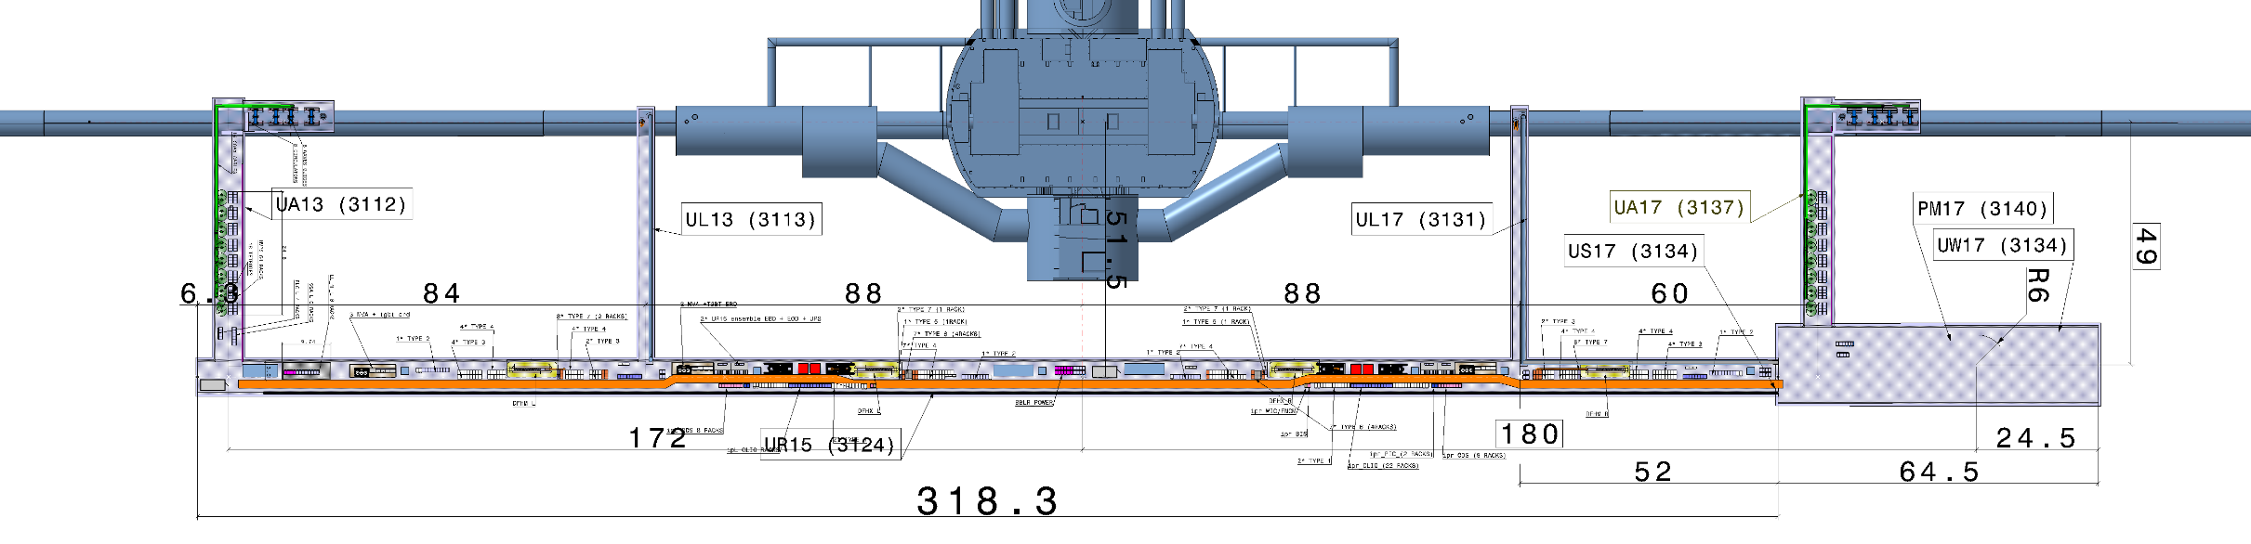
Power converter integration
All power converters will be installed in underground galleries, UR.
The UR contains the power converters for both IP side. In total 86 power converters will be installed in this gallery.

Slide 10
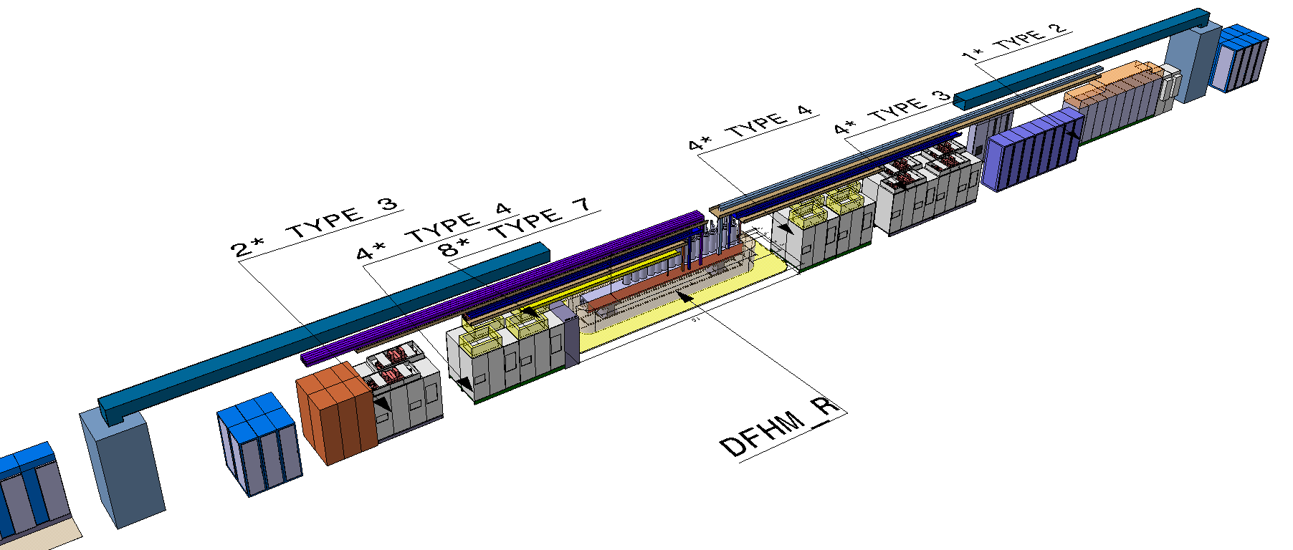
Power converter underground integration
Layout of the UR15, arrangement around the DFHM

Slide 11
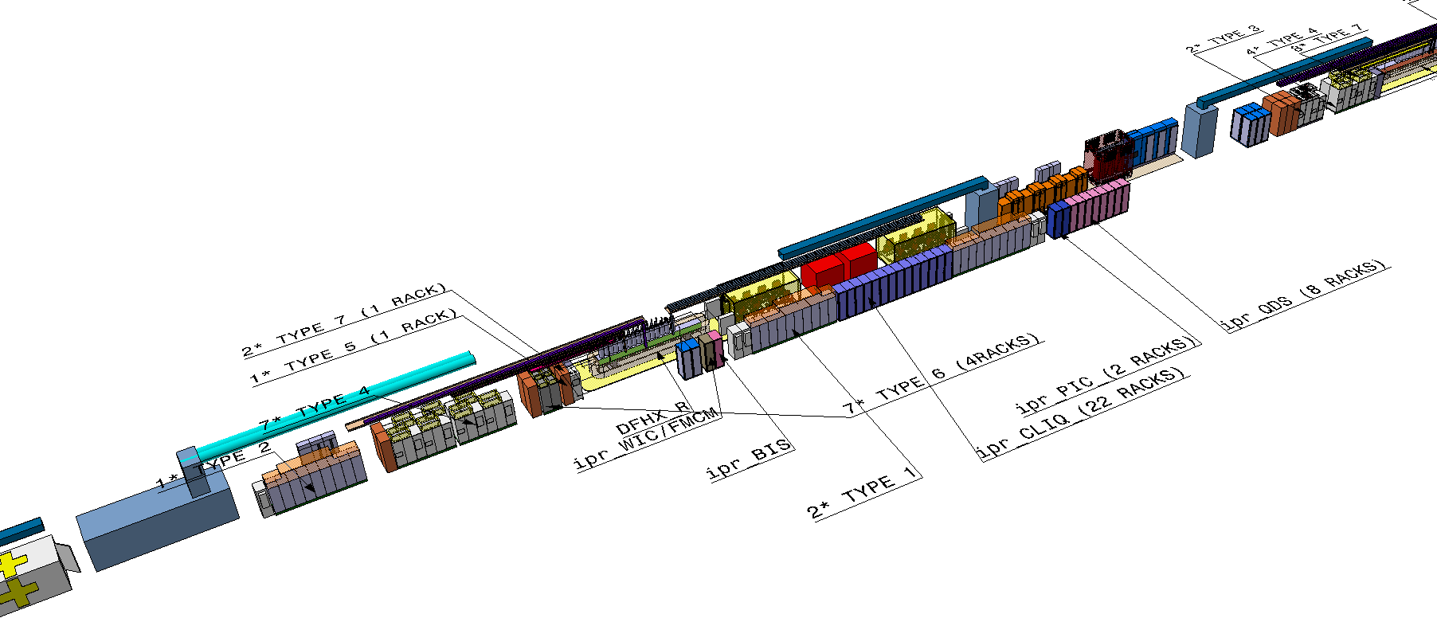
Power converter underground integration
Layout of the UR gallery.

Slide 12
Infrastructure needed
Electricity (400V)
UPS (400V) for control electronics
Classical DC cables (<1kA)
Water cooled cables (>1kA)
Water cooling for power converters and DC cables
Air conditioning
Ethernet (technical network)
Gateway for control FGC2 or FGC3 (worldfip or Ethernet)
PIC
BIC
WIFI

Slide 13
Power converter size
The size of the power converter is based on the present one.
Corresponding to 215 equivalent rack 19’’ inside the UR.

Slide 14
Electricity
The list of AC sockets is presented below for one UR.

Slide 15
Water cooling for power converters
The water flow needed for the power converter for one UR.
without the water-cooled cables.

Slide 16
Losses in Air for power converters
The air losses are presented below for one IP side.

Slide 17
Control infrastructure
Additional racks are needed for the control infrastructure.
Gateway racks, 2 racks 19’’
Calibration rack for high-precision measurement, 4 racks 19’’

Slide 18
High voltage power supplies for crab cavities
To power the crab-cavities, two options are possible depending of the power needed.
Option 1: tetrode
Option 2: IOT

Slide 19
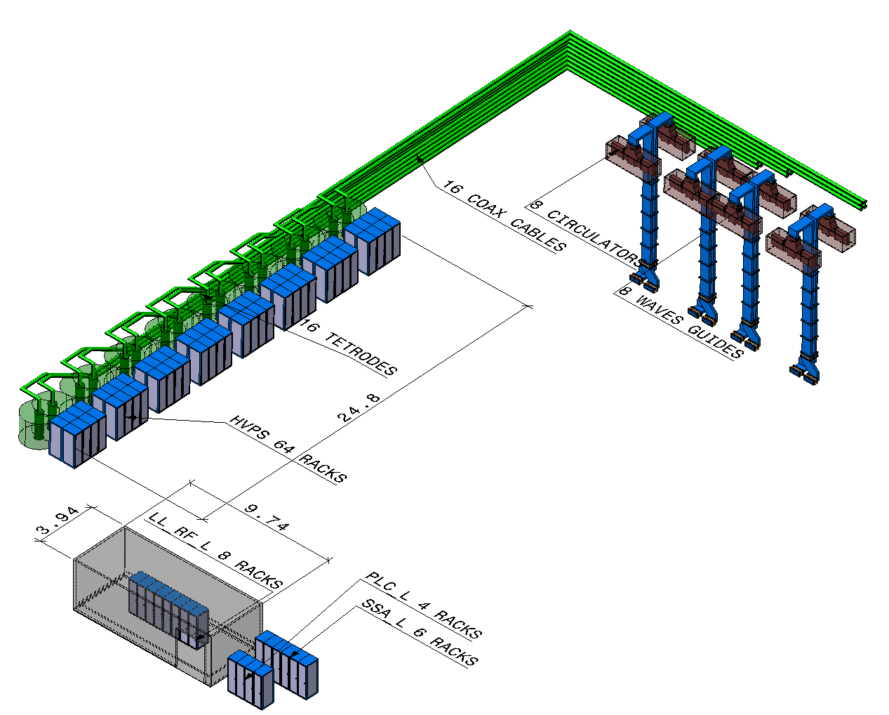
High voltage power supplies for crab cavities
Option tetrode:
Each tetrode needs an HVPS. 8 tetrodes are placed in UA with its associated HVPS.
HVPS rating:
200kVA, 10kV DC
4 racks 19’’
Water cooled
Total power is 3.2 MW per IP.

Slide 20
High voltage power supplies for crab cavities
Option tetrode: SR17
18 HVPS placed in SR17. 16 + 2 spare converters.
4 racks 19’’ / HVPS
Water cooled
AC socket : 400A * 18
DC cable: 10kV / 10A * 18
UPS: 1kVA * 18
Air losses : 16 * 20kW + 40kW for test
Water losses: 16 * 10kW + 40kW for test

Slide 21
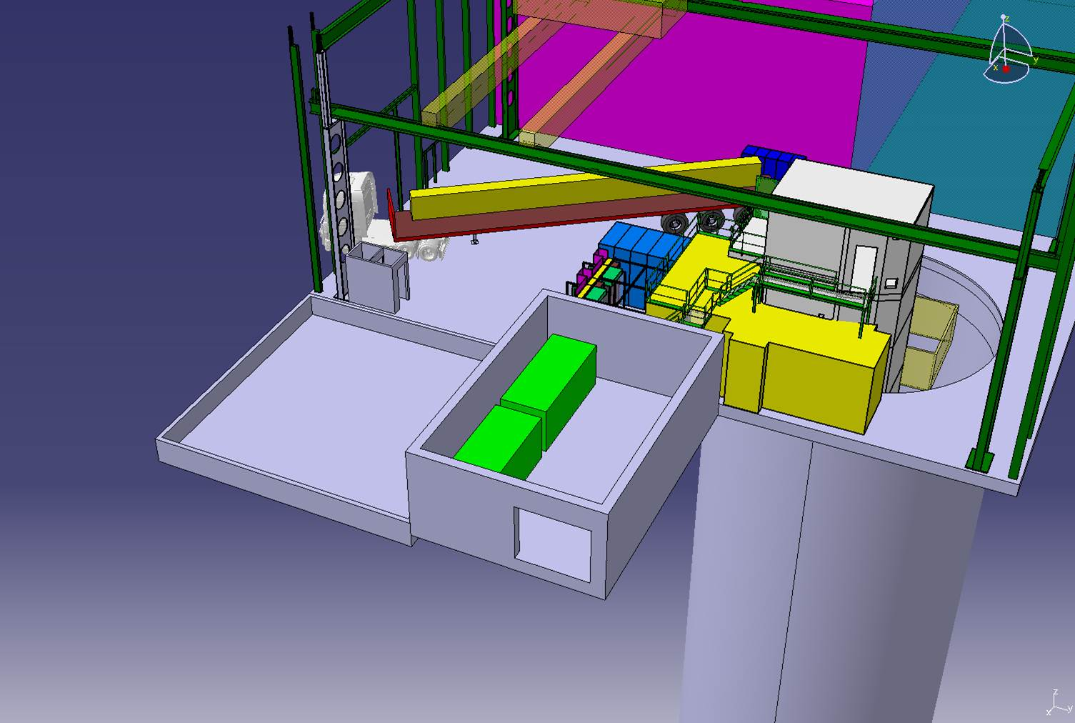
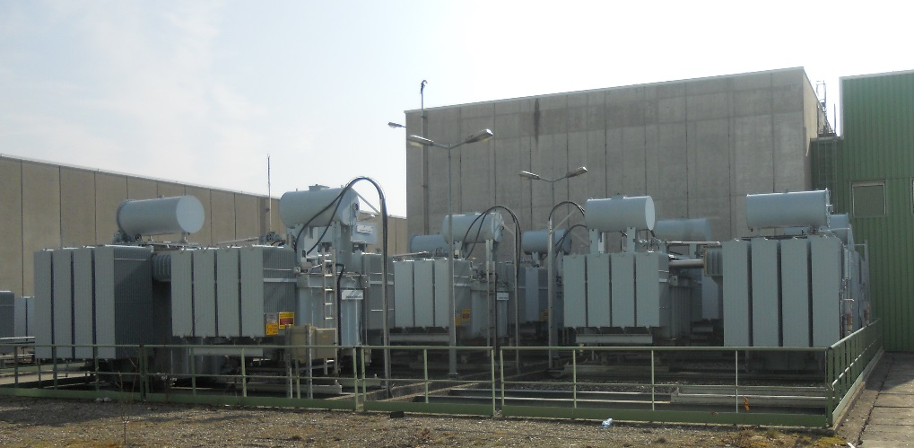
High voltage power supplies for crab cavities
Option IOT:
IOT need 50kV DC power. The power converter technology is completely different and oil is need for insulation. In this case, the solution is to place the HVPS in surface. One HVPS for one IP side.
HVPS rating:
2MVW, 50kV DC
Total power is 4 MW per IP.
Need surface building for racks
and outdoor platform for oil transformers.

Slide 22
Summary
  All needs were communicated for the integration works and service groups.
  All is inside the model.

