Slide 1
HL_LHC, WP17.2,
DC cables
Review of CV loads
JC. Guillaume
17 Dec 2015 – EDMS xxxxx

Slide 2
Contents
Minimum geometric constraints of DC lines HL-LHC
Principle of distance calculation
DC links (Version DC-ST0689858_01 A02-V2)
DC links (Proposition EL: long. optimisée)
Summary: Values for one IP.
17-12-2015

Slide 3
Minimum geometric constraints of DC lines HL-LHC
Cables for circuits 13 & 18kA
Cables for circuits 6kA
r
Cables for circuits 2kA
Cables for circuits 400A
1300 mm
1200 mm
Cables for circuits 200/120A
1000 mm
h
600 mm
400 mm
1000mm
Access
needed.
17-12-2015

Slide 4
Principle of distance calculation
Currently, no attribution of the electrical circuit to the current leads,
Position of the cable trays/convertors not exactly defined.
d2
d2
c.trays
Conv.
Conv.
d2= 4m
L. Cable = d1 + 2xd2
L. Circuit= 2L. câble
DFH
(Axis)
d1= linear
(Axis)
d1= linear
17-12-2015

Slide 5
DC links (Version DC-ST0689858_01 A02-V2 ; 30-11-2015)
DC cables: Based on the datas given by TE-EPC.
EN-EL studies and integration are in progress.
Losses/IP sides:
I Operating I Max
RI2: 652 kW 825 kW
Air: 73 kW 89 kW
- Correctors Q4 MCBR & Q5 MCBY: 2kA -> 600A
- Correctors MCO/MCQ/MCT/MCD/MCS: 200A -> 120 A
05-10-2015

Slide 6
DC links (Version DC-ST0689858_01 A02-V2 ; 17-12-2015)
Main modifications:
- Modification of calculation of Qair: 10% -> using of Q= q x DT x Surface cable hoses
with the following parameters: q= 10; DT= 12K
Other parameters:
- Using of Max current.
- Temp. (inl) water: 27 °C
- Delta T water (between inlet-outlet): 10 °C
- Max velocity in inlet/outlet connections: 2.5 m/s
- Air temparature in the tunnel: 20 C°
Results: Losses/IP sides: I Max I Operating
RI2 825 kW (825) (652)
Water: 778 kW (736) (579)
Air: 47 kW (89) (73)
(Prev. Version)
17-12-2015

Slide 7
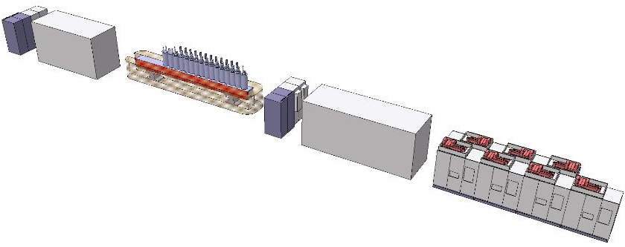
DC links (Proposition EL: long. optimisée + convertisseurs 2 cadrans) (1)
(DFHX)
3 Correct. MCQ/MCT
4 Correct. MCD/MCS
2 Racks Calibration
1 Correct. Trim Q2
2 Correct. MCO
2 Racks Calibration
D1
DFHX
600 mm
14.3m
10.3m
MCBXFB
7.5m
Q1-Q3
MCBXFB
MCBXFA
11.7m
600 mm
TRIM Q3
16.4m
MCBXFA
18.2m
MCBXFA
20m
MCBXFA
21.8m
17-12-2015

Slide 8
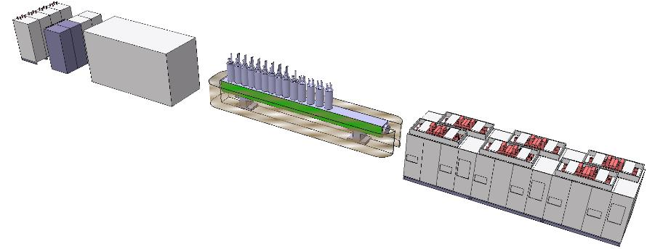
DC links (Proposition EL: long. optimisée + convertisseurs 2 cadrans) (1)
(DFHM)
2 Correct. MCBRD
2 Correct. MCBRD
2 Correct. MCBYY
2 Correct. MCBYY
4 Correct. MCBY
4 Correct. MCBY+MCBC
2 Racks Calibration
D2
DFHM
600 mm
14.1m
12.3m
Q4
Q5
8.3m
Q6
600 mm
9.1m
Q4
11.5m
Q5
13.9m
Q6
17-12-2015

Slide 9
DC links (Version DC-long-optimisées; 17-12-2015)
Losses/IP sides:
RI2: 414 kW
Q Water: 381 kW
Q Air: 34 kW
17-12-2015

Slide 10
Summary: Values for one IP
Main parameters:
- Using of Max current.
- Temp. (inl) water: 27 °C
- Delta T water (between inlet-outlet): 10 °C
- Max velocity in inlet/outlet connections: 2.5 m/s
Type of convertors ‘2 cadrans’ to be confirm.
Integration for ‘long-optimisée’ version to be confirm !
17-12-2015

Slide 11
Thanks for your attention

