Slide 1
WP4
RF equipment volume needs
06 November 2015
Eric Montesinos

Slide 2
RF System Bloc Diagram per IP side
Tetrode or IOT or SSPA

Slide 3
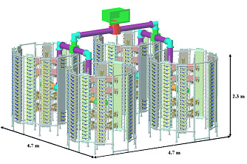
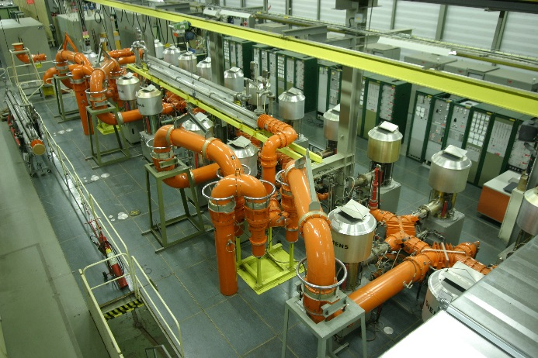
RF power density
Soleil 4 x 45 kW unit
Tower density = 0.8 kW/m³
Whatever the power system in this range of frequency and this range of power the power density of an amplifier is approximately 1.4 kW/m³
(not including combiners, circulators, RF loads, cable trays, water piping, …)
Per LHC IP side, we need 8 x 100 kW (maximum), i.e. 800 kW / (1.0 kW/m³) =
total 800 m³
Ideal requested UA gallery for amplifiers and services is about 1000 m³
Allocated UA volume for amplifiers and services is R3 x 25 =
550 m³ (Cannot be reduced)
CERN SPS 4 x 500 kW unit
One transmitter density = 1.1 kW/m³
Previously wrongly calculated 850 m3

Slide 4
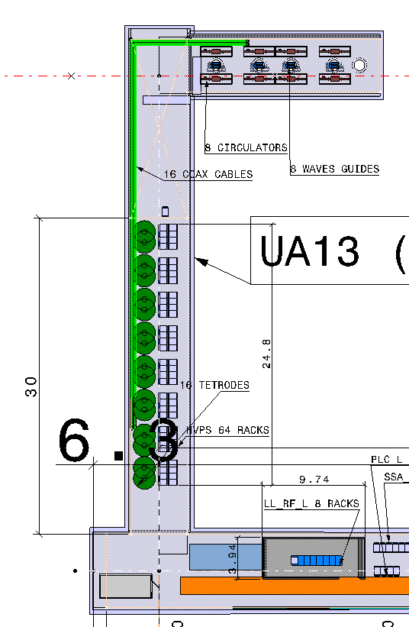
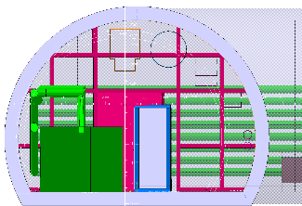
RF power density
Ideal Gallery
Ideal volume for 8 x 100 kW
Technology | 100 kW Amplifiers + lines kW/m³ | Total m³
SSPA | 0.7 | 1150
IOT | 0.8 | 1000
Tetrode | 0.8 | 1000
Current proposal
  R3 m x 25 m = 553 m³
    [R²(Pi[1-α/360]+1/2 sin α)] avec ici α = 125 degrés
Already compressed by 50 % compared to any other power stations (with same frequency and same power level per unit) with a unfavourable shape (tubular gallery instead of parallelepiped gallery)
Already too much squeezed !
  Trying to squeeze it even more would prevent the possibility of (promising) SSPA

Slide 5
Services requirements per IP side
Equipment | Location | Qty | Electricity | Water | Air | Handling
HVPS | Surface (or UA ?) | 1 (or 8) | 2 MVA in case of IOTs (800 kW) 1 MVA in case of Tetrodes (400 kW) | TE-EPC | TE-EPC | Yes
SSPA | UR and UW | 16 | 64 KVA | 30 kW | 5 kW | Yes
PLC | UR and UW | 4 | 230 V – 6 KVA (UPS) | - | 6 KW | -
LLRF | UR and UW | 8 | 230 V – 12 KVA (UPS) | - | 12 kW | -
Faraday Cage | UR and UW | 1 | Lights | - | T° and humidity | Yes
LVPS | UA | 64 | 400 V – 16 KVA | - | 16 KW | -
Amplifiers | UA | 8 | - | 800 kW | 80 kW | Yes
Combiners | UA | 8 | - | - | - | Yes
Circulators | UA | 8 | - | - | - | Yes
Loads | UA | 16 | - | (800 kW) | - | Yes
WG | UA & ring | 8 | - | - | - | Yes
Blowers | UA & Ring | 24 | 400 V – 25 KVA | - | 25 KW | -
FPC | Ring | 8 | 400 V – 8 KVA | 8 kW | 8 kW | -
Cavities | Ring | 8 | tbd | tbd | tbd | Yes
No change with HVPS on surface
As with HVPS in the gallery all HVPS losses would be in water
Initially 50 kW,
Corrected to
MINIMUM 80 kW
All data extracted from the Conceptual Specification

