Slide 1
HL-LHC
CERN 17th Dec 2015
Tunnel heat transfer estimate
M. Battistin, M. Gomez, P. Pepinster, F. Borralho

Slide 2
Agenda
Surface measurement
Heat transfer problem
Convective heat transfer estimate
Radiation heat transfer estimate
Conclusions

Slide 3
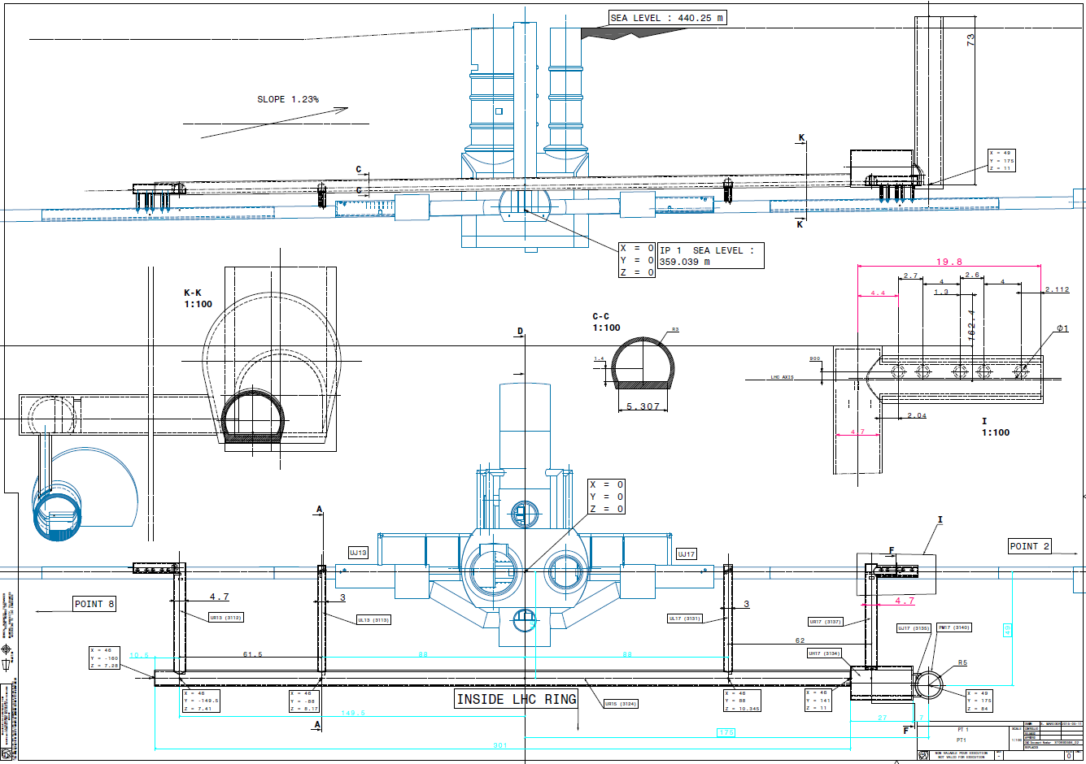
410 m²
410 m²
632 m²
632 m²
4570 m²
1945 m²
UA13:
SS= 275m2
S.parois= 632m2
Vol=1140m3
UL13:
SS= 153m2
S.parois= 410m2
Vol=408m3
UL17:
SS= 153m2
S.parois= 410m2
Vol=408m3
UA17:
SS= 275m2
S.parois= 632m2
Vol=1140m3
UR15:
SS= 1903m2
S.parois= 4570m2
Vol=9800m3
US17:
SS= 882m2
S.parois= 1950m2
Vol=9900m3

Slide 4
Heat Transfer Problem
Stable temperature
8600 m²
h_{convection}
20 m
14°C
25°C
R_{rock}
R_{concrete}
Q???

Slide 5
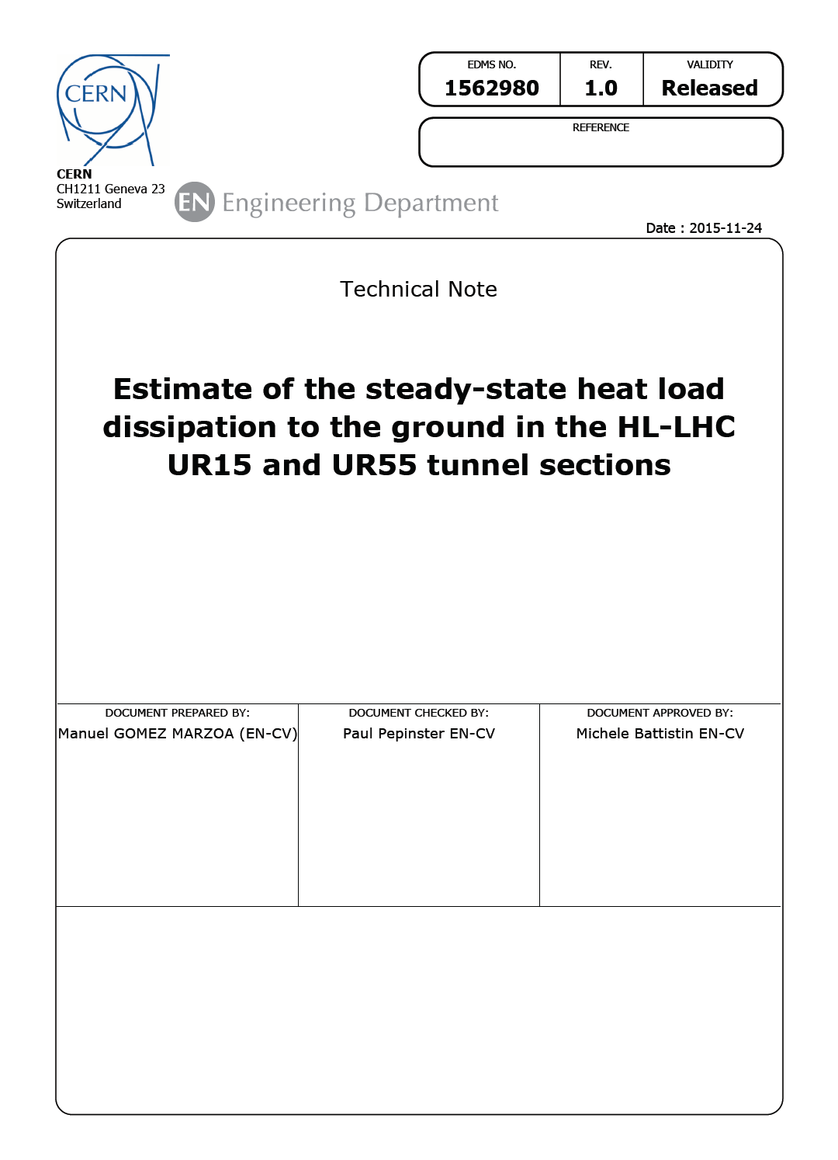
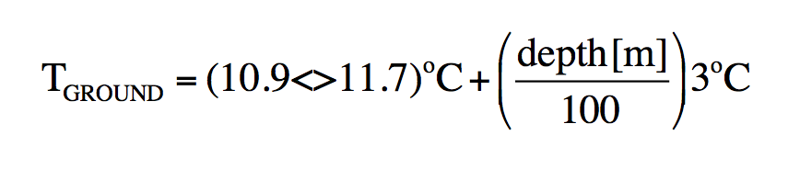
Technical note
100 m depth -> ≈14°C

Slide 6
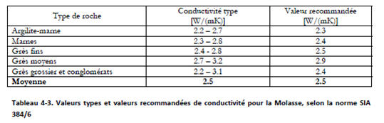
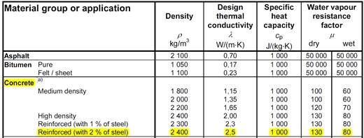
Thermal Resistance Parameters
SOIL
SIA Standard Soil conductivity ≈ 2.5 W m⁻¹ K⁻¹
Concrete
EN 12524 Concrete conductivity ≈ 2.5 W m⁻¹ K⁻¹

Slide 7
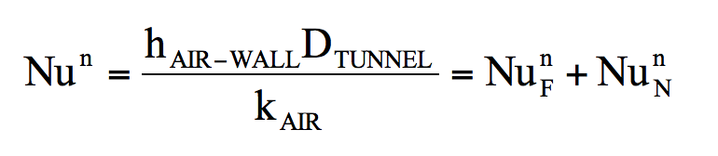
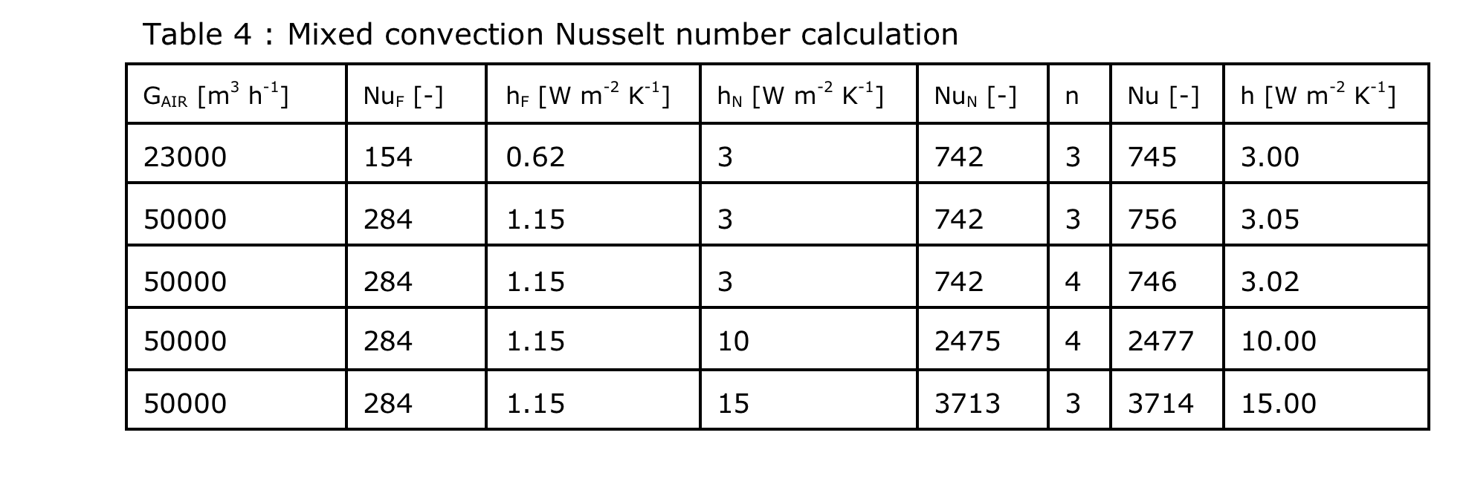
Mixed Convective Heat Transfer
Nu ≈ Nu_{N} -> the natural convection is dominating the heat transfer process
The expected heat tranfert coefficient at the wall is about 3÷15 W m⁻² K⁻¹

Slide 8
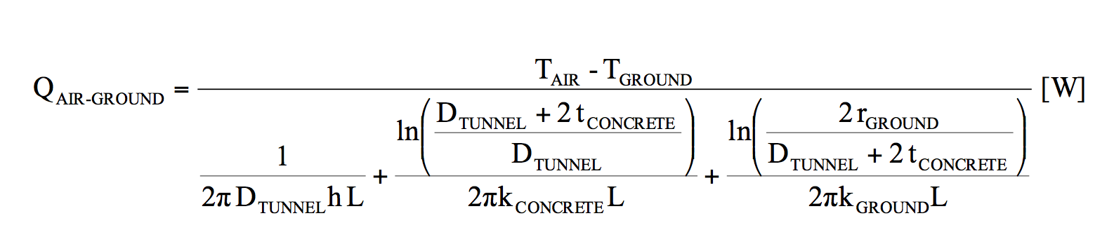
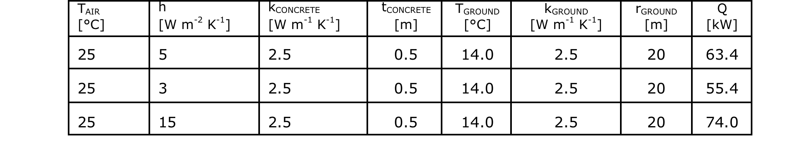
Convective Heat Load Estimate
The maximum expected convective heat load to the ground will be 74 kW

Slide 9
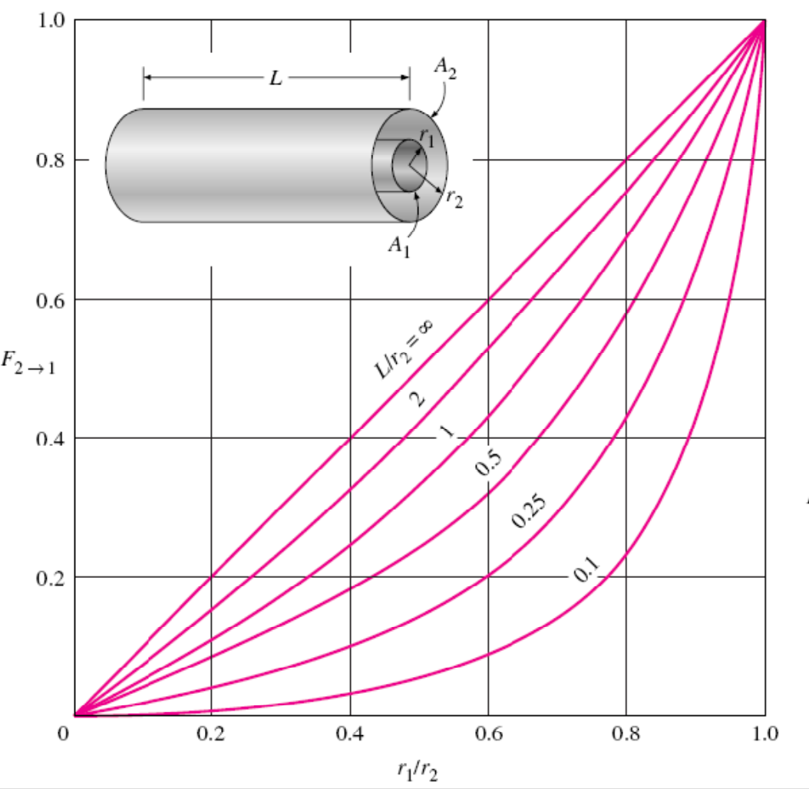
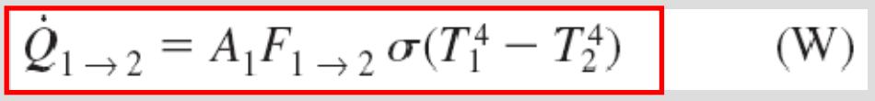
Radiation Heat Load Estimate
D = 3.2 m; d = 1 m
D/d ≈ 0.31 -> View Factor = 0.31
Surface = 8600 m²
T1 = 25 °C = 297 K
T2 = 14 °C = 286 K
S = 5.67*10⁻⁸ W m² K⁻⁴
Emissivity both surfaces = 1.0
Q ≈ 80 kW
The radiation heat transfer is similar to the convective one

Slide 10
Conclusions
The heat transfer between HL-LHC structure and the ground is mainly dominated by the natural convection and radiation
Considering a tunnel air temperature of 25°C…
...the expected heat load is around 150 kW

Slide 11
Any question?

