Slide 1

Gentner Programme
Started October 2007
    after CERN visit of State Secretary Meyer-Krahmer from German BMBF (Federal Ministry of Education and Research)
  special German Doctoral Student Programme
    in addition to the existing CERN Doctoral Student Programme
    (almost) identical conditions
    basic difference: funding (subsistence) by BMBF, also extra funds for travel to Germany
  mid- and long term goals
    better usage of CERN resources by Germany
    better connection between German Universities and CERN
    more German staff at CERN (long-term)
      presently only ~7.1% German staff (180/2529), but 20.5% contribution of DE to CERN budget
3 parties involved: CERN – BMBF – DESY
    Programme Coordination by DESY (Manfred Fleischer)
    + local Coordinator at CERN (MH)

Slide 2
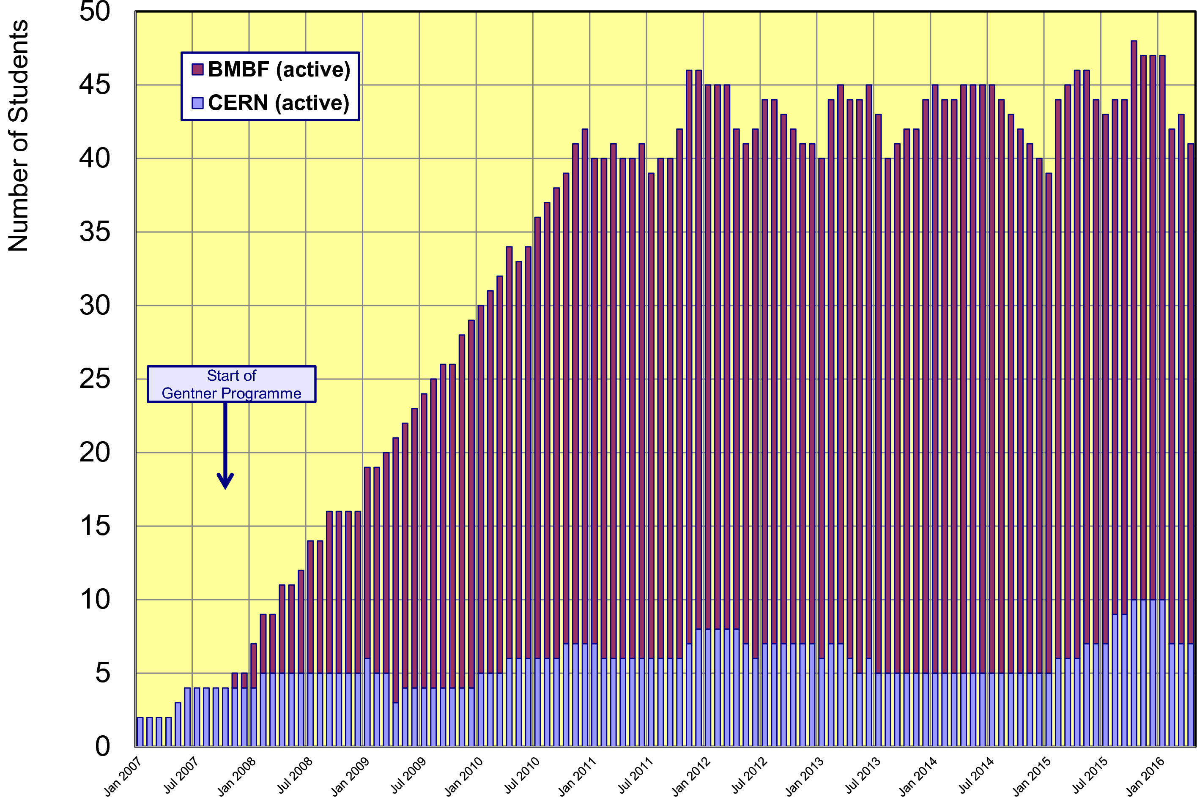
Status Gentner Programme
Presently 34 active Gentner Students (11 female = 32%)
    + 7 Germans in regular CERN Programme
    Number of Students ~stable since 2011

Slide 3
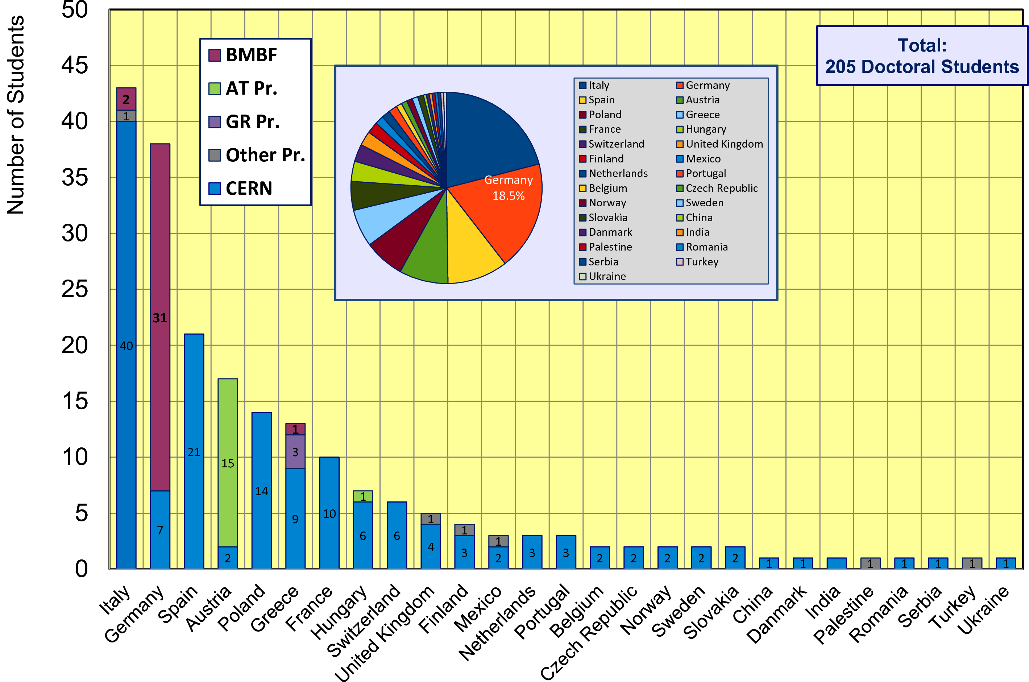
CERN Doctoral Students
Nationalities of all Doctoral Students at CERN
  Italians (43 Students) + Germans (38 Students) are dominating

Slide 4
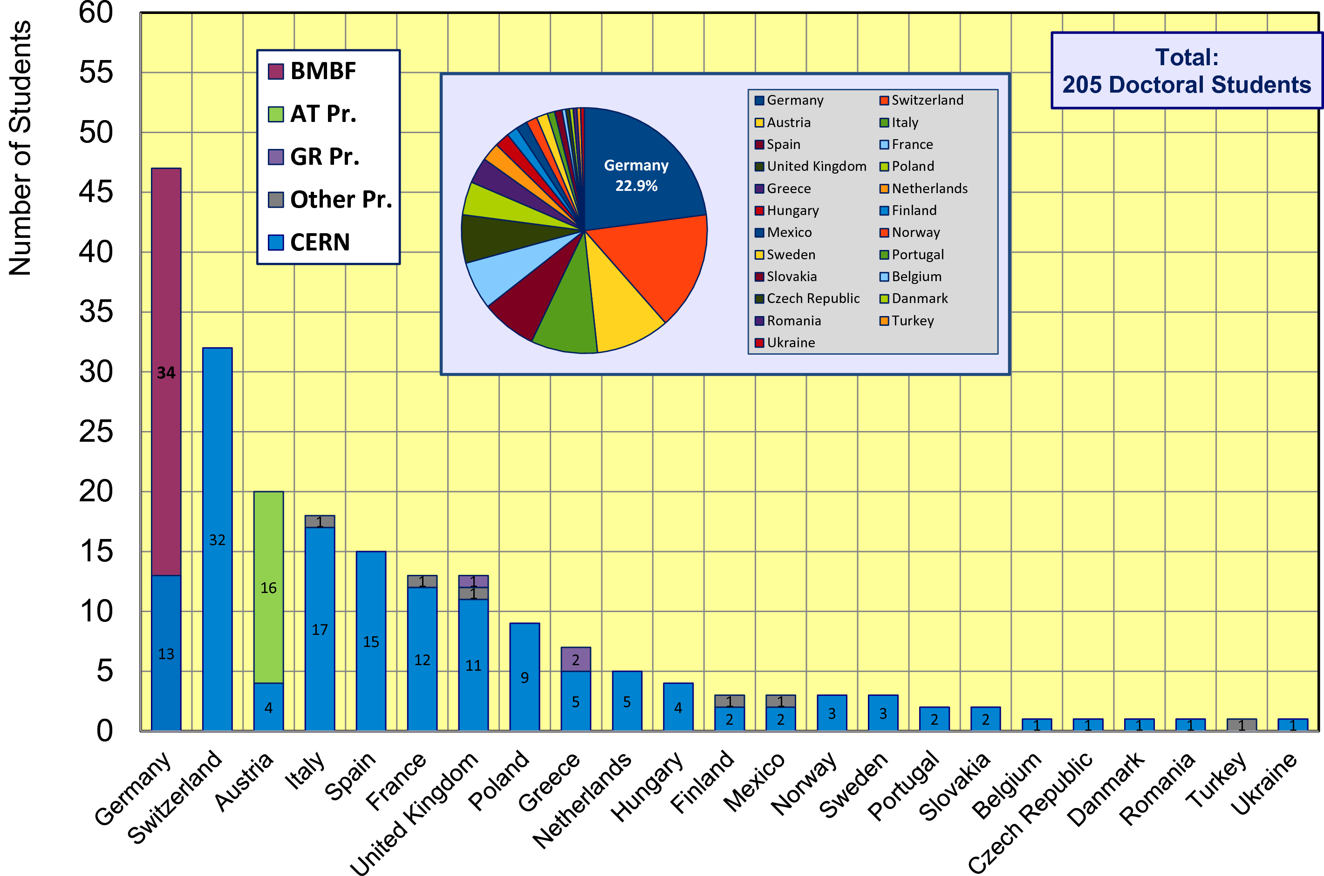
CERN Doctoral Students
Institute Country of all Doctoral Students
  47 Students enrolled at a German University (~23%)

Slide 5
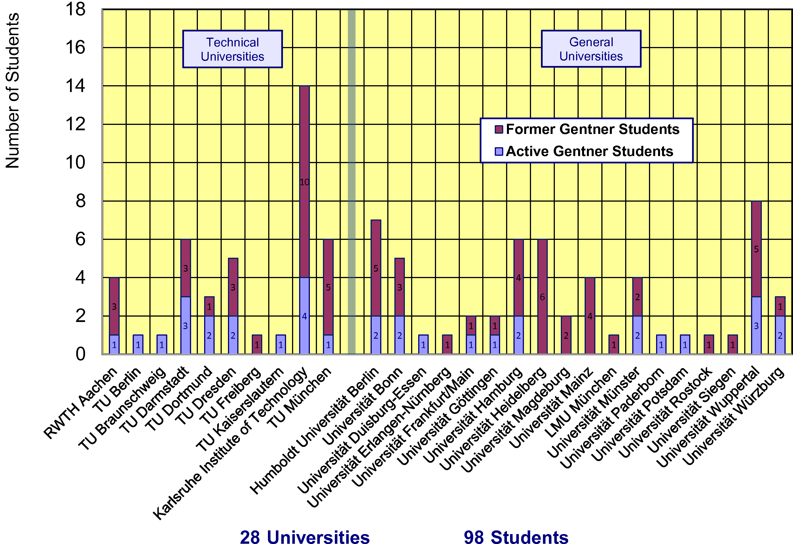
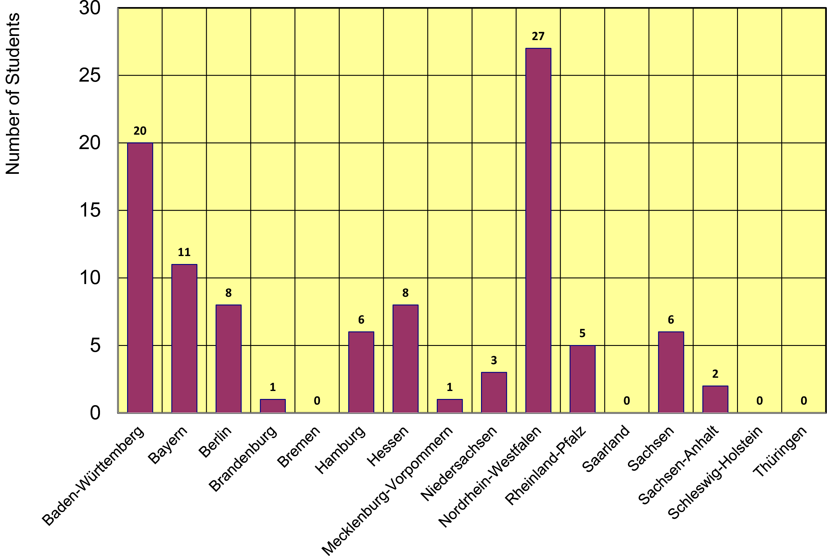
Gentner Students
  coming from 28 different Universities in DE
    also from university groups without or with little CERN contacts beforehand
  43% of Gentner Students from Technical Universities
  12 German States
    NRW and BW are dominating
    only a few small(er) States are missing

Slide 6
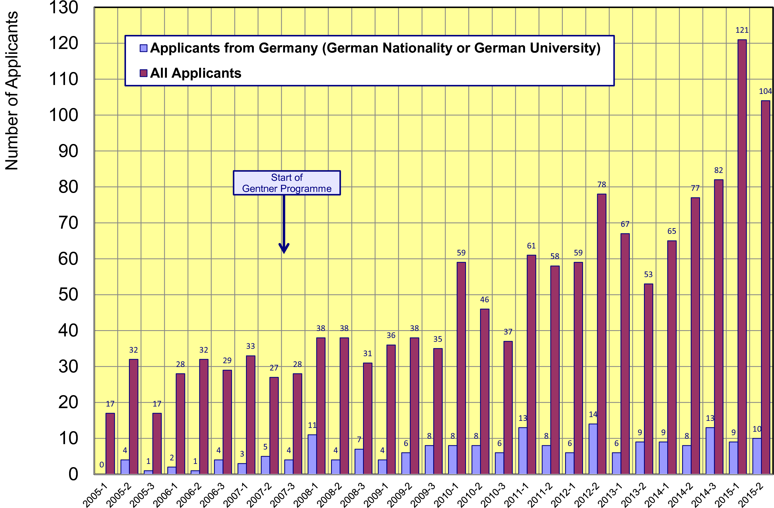
Doctoral Student Applications
Typically ~21 applicants/year from Germany (~stable)
    but overall number of applications is raising → fraction of DE applications goes down

Slide 7
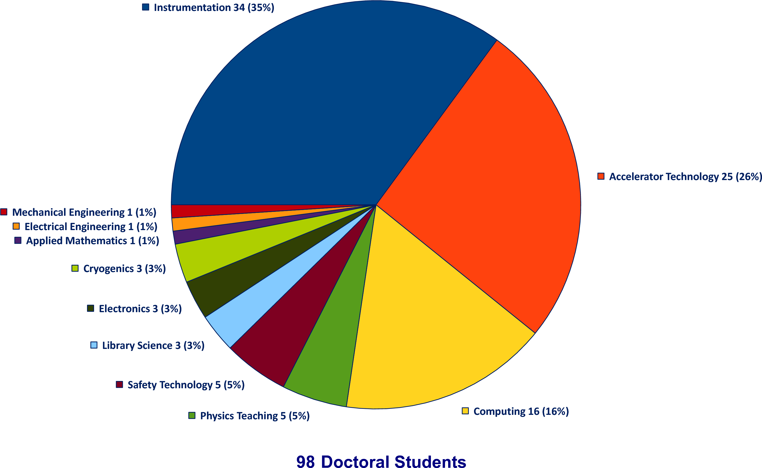
Thesis Topics of Gentner Students
(active + former)
Majority of topics in Instrumentation (35%), Accelerator Technology (26%), Computing (16%), stable since years
100th Student
expected in June!

Slide 8
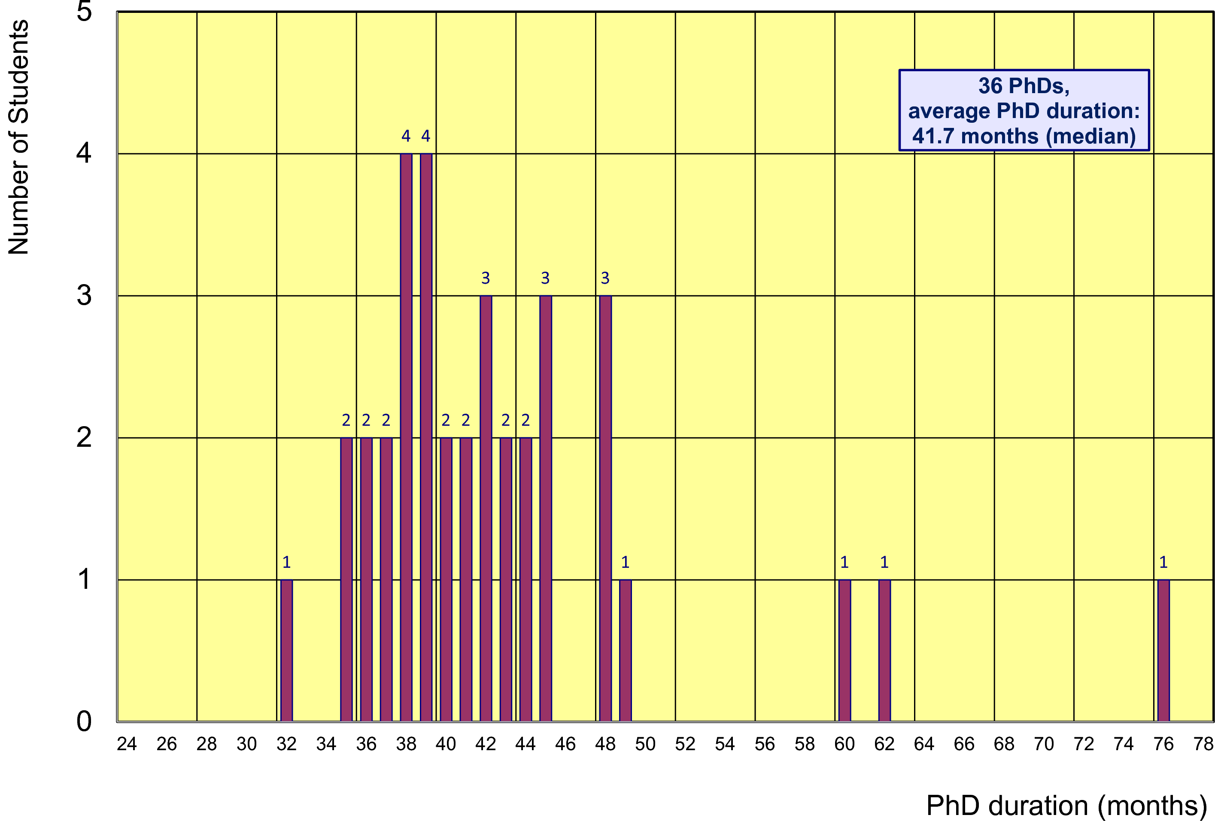
Former Gentner Students
36 PhDs so far (10 female = 28%), 5 Students have cancelled their PhD
    average age at PhD (defense): 30.7 years (median)
    average duration of PhD: 41.7 months (median) = 5.7 months after end of CERN 3-years contract
Physics PhDs in Germany (2014)
20% female PhDs students
30.7 years (median) at PhD
50.4 months (median) duration of PhD

Slide 9
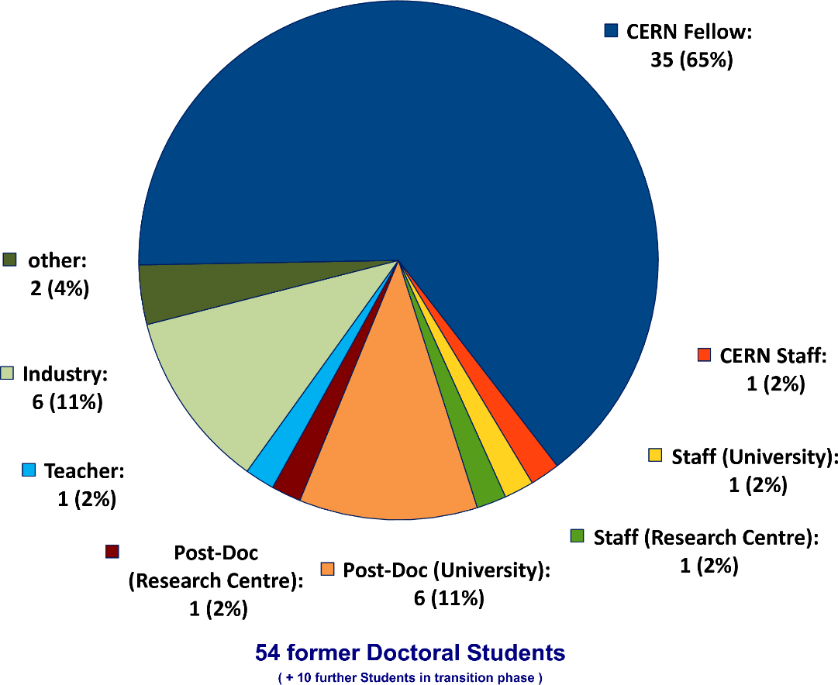
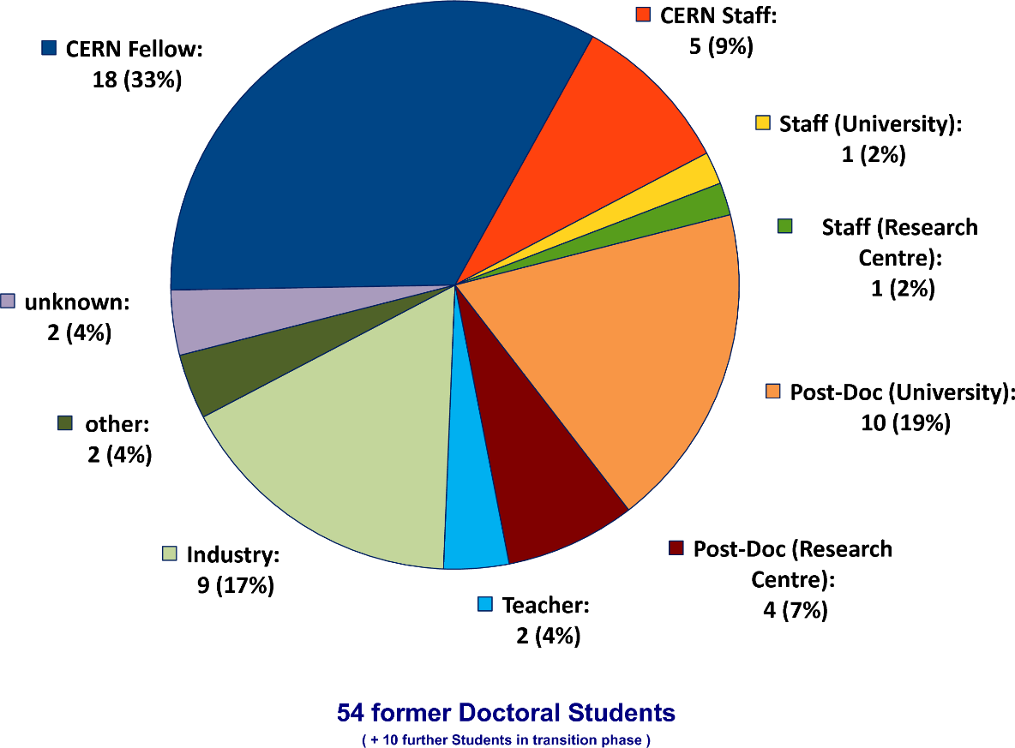
Whereabouts of Gentner Students
  First employment of ~2/3 of the Gentner Students: CERN Fellow(!)
First Employment
Present Employment
presently 5 CERN Staff Members (+1 more starting 1 June),
1 with indefinite contract (since 1 April)

Slide 10
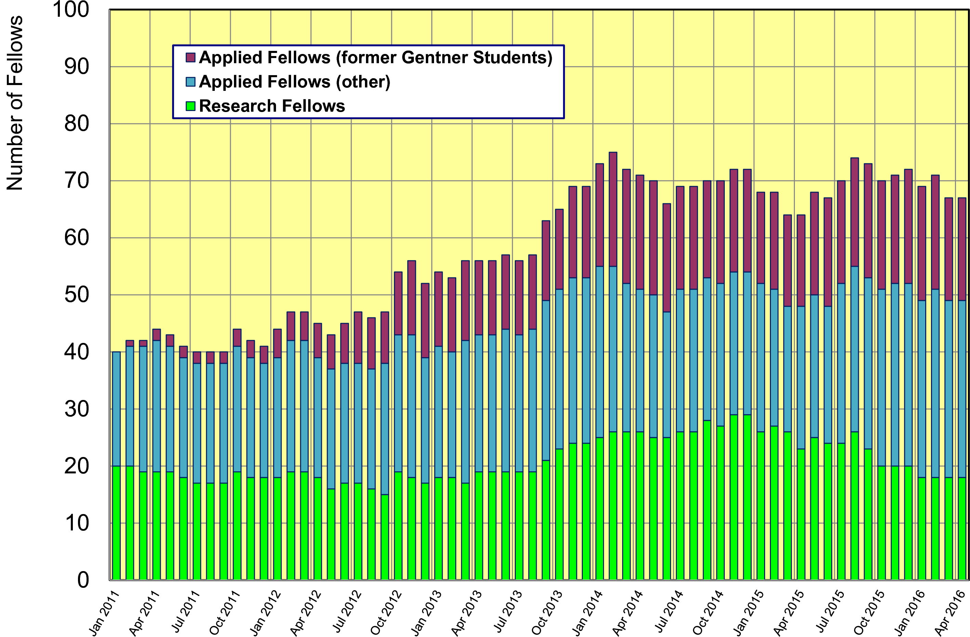
Gentner Students → Fellows
  significant increase of DE Fellows by former Gentner Students
    about 40% of German Applied Fellows are former Gentner Students

Slide 11
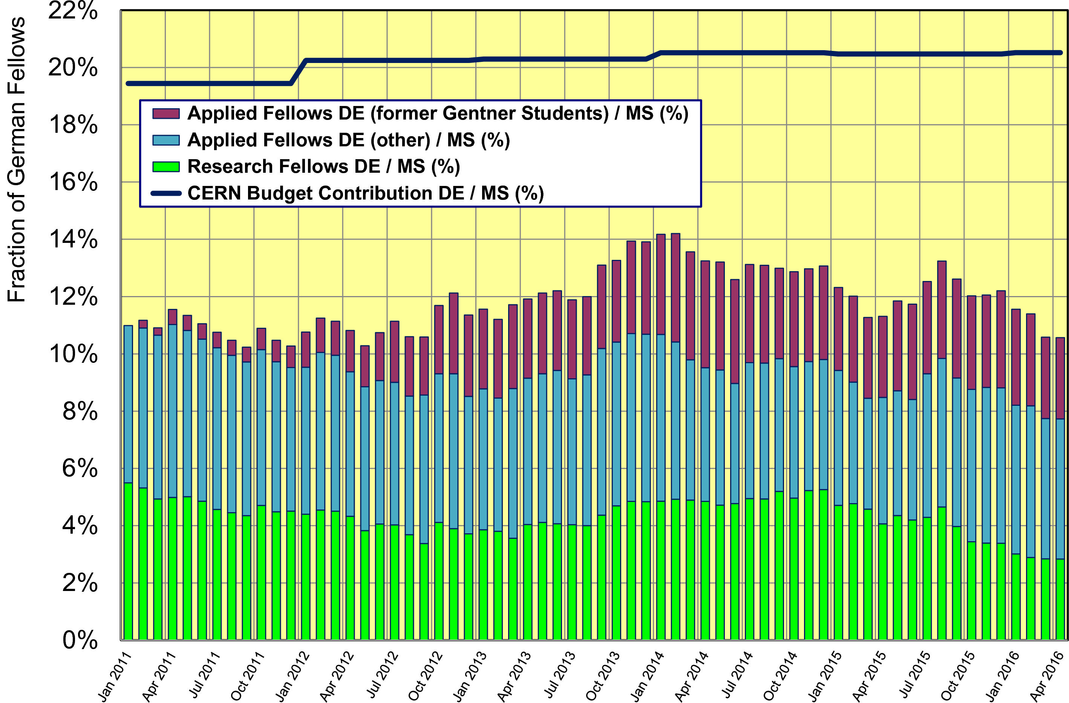
Gentner Doktoranden → Fellows
  without additional former Gentner Students → fraction of German Fellows w.r.t. to all Member States would be < 8% now

Slide 12
Gentner Programme Continuation
Funding secured until end of 2017
  funding in 2015 - 2017: 5.15 M€ (1.72 M€/year)
  funding was based on 1 € = 1.20 CHF, sufficient for (on average) 39 Students
Contract renewal needed after 2017
  renewal process to be started in fall 2016
      no consequences to present Students if Programme would terminate end-2017: noone will be “fired”, support for present students continues beyond end of 2017
Problem in 2015: discontinuation of CHF–EUR minimum exchange rate by Swiss National Bank
  no extra funding from BMBF to mitigate impact
  had to adapt/reduce average number of Students (39 → 35)
    will carefully follow situation depending on future development of CHF–EUR exchange rate

Slide 13
General News and Remarks
Travel
  fewer Students travelled to DPG Physical Society Spring Meetings
    please make use of these opportunites
Advertisement
    no. of applicants from Germany ~stable, but more applicants welcome
  distribute brochures + posters when travelling to home university
    pick-up in my office
  possible Gentner information event in Dresden in July (tbc)
Students’ Delve-In (started after last Gentner Day)
    informal topical evenings of Students (more details in discussion)
Very important
  when finishing → please keep me informed on your further whereabouts + upload your thesis to CDS
  key figures needed for BMBF indicating the Programme success!

Slide 14
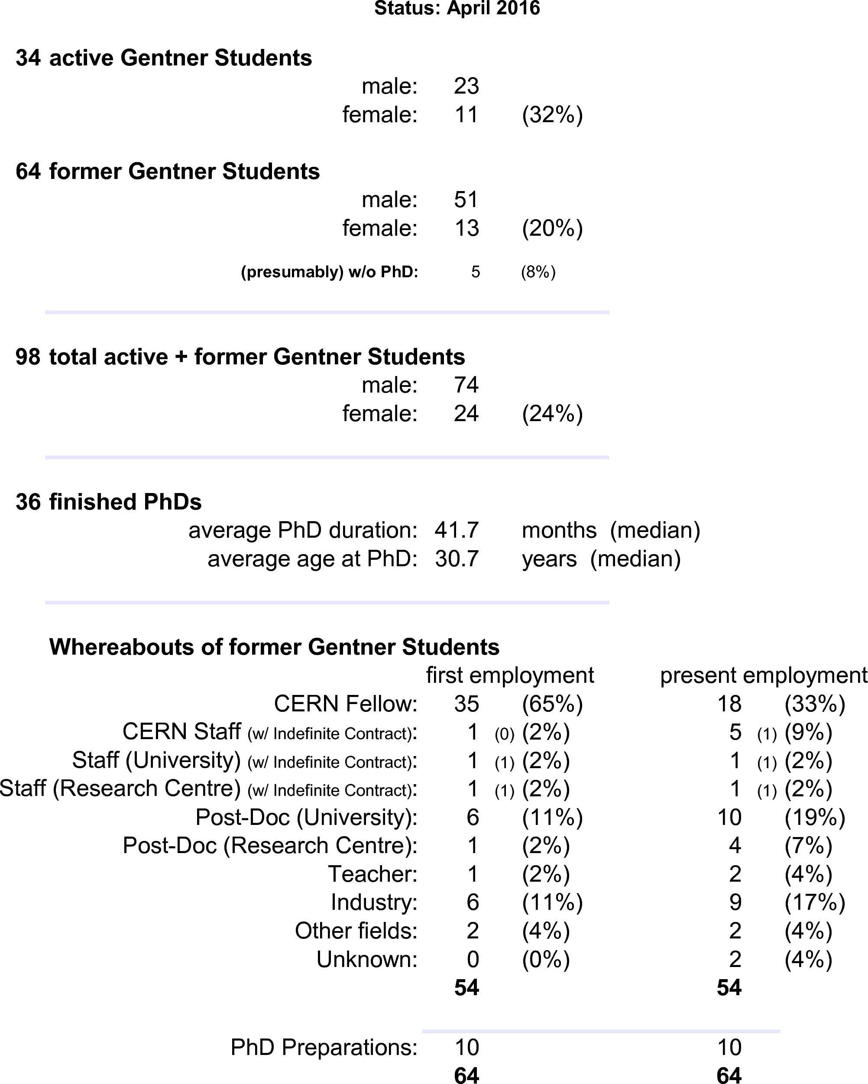
Summary Gentner Programme
Next Gentner Day:
26 October 2016
Physics PhDs in Germany (2014)
20% of PhDs students female
30.7 years (median) at PhD
50.4 months (median) duration of PhD
CERN Fellows
≈ 40% of German Applied Fellows
are former Gentner Students

