Slide 1



Introduction to the Future Circular Collider Study
Michael Benedikt
CERN Academic Training
Filtration Plant, 2 February 2016
On behalf of the FCC Coordination Group
Work supported by the European Commission under the HORIZON 2020 project EuroCirCol, grant agreement 654305

Slide 2
Outline
Motivation
FCC Study Scope
Main Machine Parameters
Timeline
FCC Organisation & Collaboration Status

Slide 3

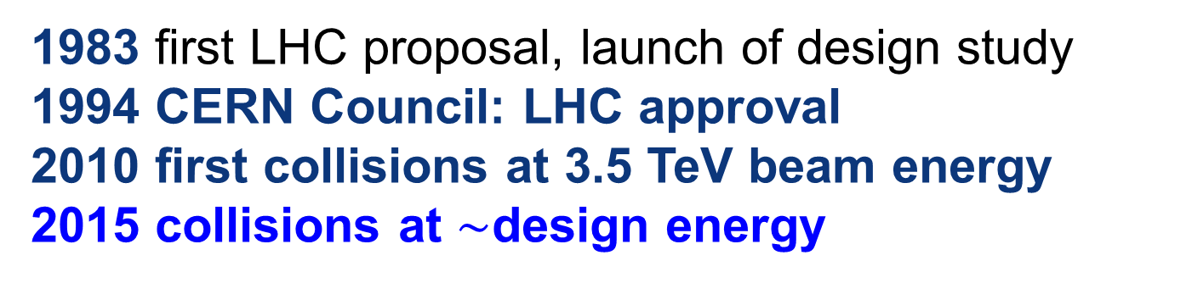
LHC evolution
LHC history
1983 first LHC proposal, launch of design study
1994 CERN Council: LHC approval
2010 first collisions at 3.5 TeV beam energy
2015 collisions at $\sim$design energy
now is the time to plan for ~2040!

Slide 4
FCC Strategic Motivation
European Strategy for Particle Physics 2013:
  “…to propose an ambitious post-LHC accelerator project….., CERN should undertake design studies for accelerator projects in a global context,…with emphasis on proton-proton and electron-positron high-energy frontier machines….coupled to a vigorous accelerator R&D programme, including high-field magnets and high-gradient accelerating structures,….”
ICFA statement 2014:
  ”…. ICFA supports studies of energy frontier circular colliders and encourages global coordination.….”
US P5 recommendation 2014:
  ”….A very high-energy proton-proton collider is the most powerful tool for direct discovery of new particles and interactions under any scenario of physics results that can be acquired in the P5 time window….”

Slide 5

FCC motivation:
pushing the energy frontier
A very large circular hadron collider seems the only approach to reach 100 TeV c.m. collision energy in coming decades
Access to new particles (direct production) in the few TeV to 30 TeV mass range, far beyond LHC reach.
Much-increased rates for phenomena in the sub-TeV mass range →increased precision w.r.t. LHC and possibly ILC
The name of the game of a hadron collider is energy reach
Cf. LHC: factor ~4 in radius, factor ~2 in field → O(10) in E_{cms}
$$E∝B_{dipole}{×ρ}_{bending}$$

Slide 6
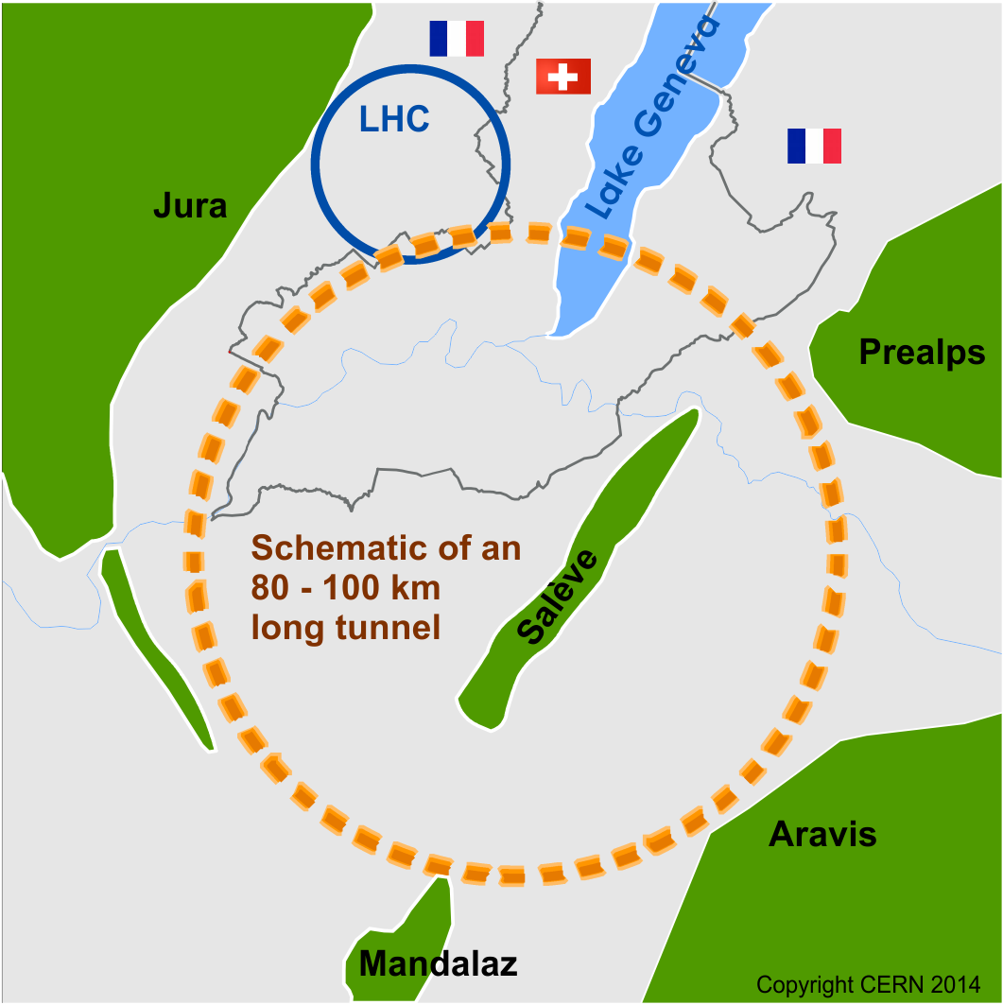
Future Circular Collider Study
GOAL: CDR and cost review for the next ESU (2018)
International FCC collaboration (CERN as host lab) to study:
pp-collider (FCC-hh) → main emphasis, defining infrastructure requirements
80-100 km tunnel infrastructure in Geneva area
e⁺e⁻ collider (FCC-ee) as potential intermediate step
p-e (FCC-he) option
HE-LHC with FCC-hh technology
~16 T ⇒ 100 TeV pp in 100 km

Slide 7
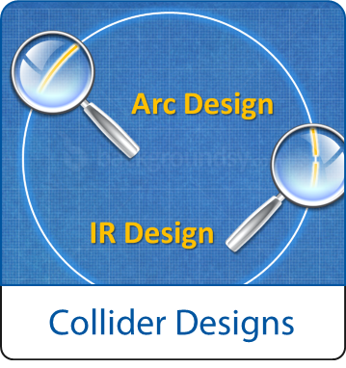

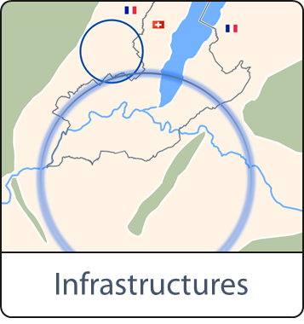
FCC Scope:
Accelerator and Infrastructure
FCC-hh: 100 TeV pp collider as long-term goal
→ defines infrastructure needs
FCC-ee: e⁺e⁻ collider, potential intermediate step
FCC-he: integration aspects of pe collisions
key technologies
pushed in dedicated R&D programmes, e.g.
16 Tesla magnets for 100 TeV pp in 100 km
SRF technologies and RF power sources
tunnel infrastructure in Geneva area, linked to CERN accelerator complex;
site-specific, as requested by European strategy

Slide 8

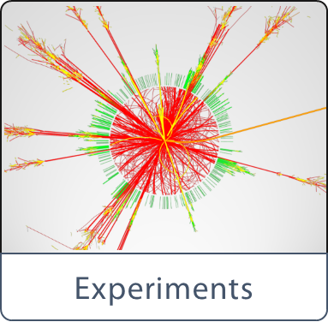

FCC Scope:
Physics & Experiments
physics opportunities
discovery potentials
experiment concepts for hh, ee and he
machine Detector Interface studies
concepts for worldwide data services
overall cost model ;
cost scenarios for collider options
including infrastructure and injectors ;
implementation and governance models

Slide 9
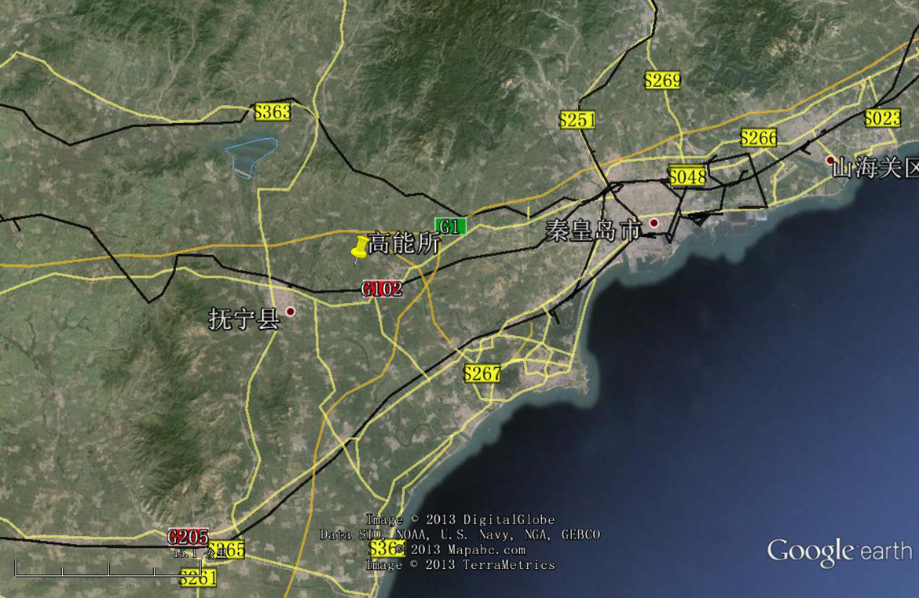
CepC/SppC study (CAS-IHEP) 54 km (baseline)
e⁺e⁻ collisions ~2028; pp collisions ~2042
Qinhuangdao (秦皇岛）
CepC, SppC
50 km
100 km
easy access
300 km east
from Beijing
3 h by car
1 h by train
“Chinese Toscana”
Yifang Wang

Slide 10
hadron collider parameters
Parameter | FCC-hh |  | SPPC | LHC | HL LHC
collision energy cms [TeV] | 100 |  | 71.2 | 14
dipole field [T] | 16 |  | 20 | 8.3
# IP | 2 main & 2 |  | 2 | 2 main & 2
bunch intensity [10¹¹] | 1 | 1 (0.2) | 2 | 1.1 |  | 2.2
bunch spacing [ns] | 25 | 25 (5) | 25 | 25 |  | 25
luminosity/Ip [10³⁴ cm⁻²s⁻¹] | 5 | ~25 | 12 | 1 |  | 5
events/bunch crossing | 170 | ~850 (170) | 400 | 27 |  | 135
stored energy/beam [GJ] | 8.4 |  | 6.6 | 0.36 |  | 0.7
synchrotron radiation [W/m/aperture] | 30 |  | 58 | 0.2 |  | 0.35

Slide 11
lepton collider parameters
parameter | FCC-ee |  |  | CEPC | LEP2
energy/beam [GeV] | 45 | 120 | 175 | 120 | 105
bunches/beam | 90000 | 770 | 78 | 50 | 4
beam current [mA] | 1450 | 30 | 6.6 | 16.6 | 3
luminosity/IP x 10³⁴ cm⁻²s⁻¹ | 70 | 5 | 1.3 | 2.0 | 0.0012
energy loss/turn [GeV] | 0.03 | 1.67 | 7.55 | 3.1 | 3.34
synchrotron power [MW] | 100 |  |  | 103 | 22
RF voltage [GV] | 0.08 | 3.0 | 10 | 6.9 | 3.5
FCC-ee: 2 separate rings CEPC baseline: single beam pipe like LEP

Slide 12
CERN Circular Colliders and FCC
1980
1985
1990
1995
2000
2005
2010
2015
2020
2025
2030
2035
Constr.
Physics
LEP
Design
Proto
Construction
Physics
LHC
Design
Construction
Physics
HL-LHC
20 years
FCC
Design
Proto
Construction
Physics
CDR by end 2018 for next strategy update

Slide 13



CDR Study Time Line
2014 |  |  |  | 2015 |  |  |  | 2016 |  |  |  | 2017 |  |  |  | 2018
Q1 | Q2 | Q3 | Q4 | Q1 | Q2 | Q3 | Q4 | Q1 | Q2 | Q3 | Q4 | Q1 | Q2 | Q3 | Q4 | Q1 | Q2 | Q3 | Q4
Study plan, scope definition
Explore options
“weak interaction”
conceptual study of baseline “strong interact.”
FCC Week 2015:
work towards baseline
FCC Week 17 & Review
Cost model, LHC results
→ study re-scoping?
FCC Week 2016
Progress review
Elaboration,
consolidation
FCC Week 2018
→ contents of CDR
Report
CDR ready

Slide 14
Overall FCC Study Setup
Geographically
Balanced
Topically
Complementary
Worldwide
Excellence
carried out by global collaboration
universities, laboratories & industry worldwide
hosted by CERN

Slide 15
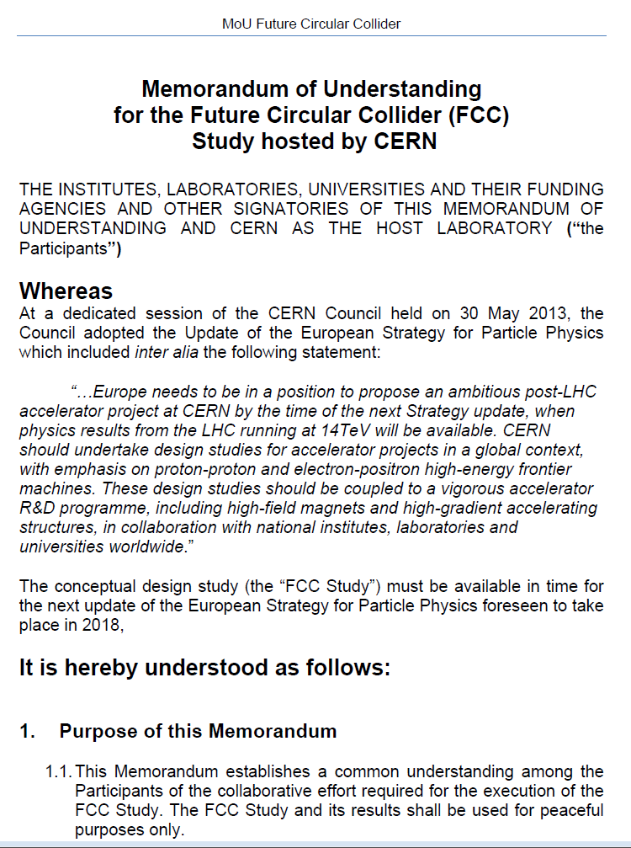
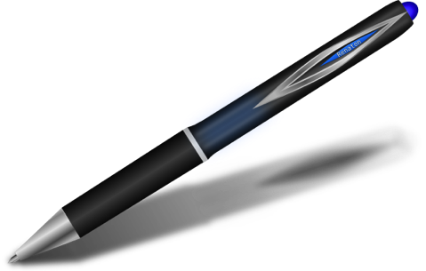
FCC Collaboration
A consortium of partners based on a
Memorandum Of Understanding (MoU)
Working together on a
best effort basis
Pursuing the same
common goal
Self governed
Incremental & open to
academia and industry

Slide 16
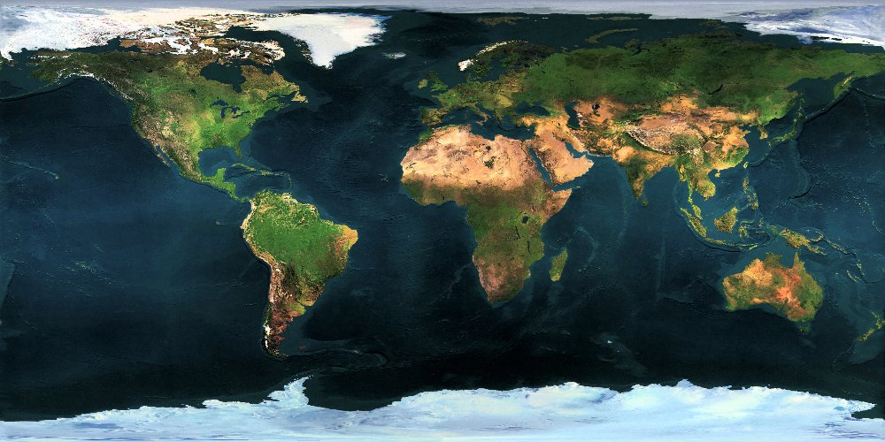



























Collaboration Status
FCC International Collaboration
72 institutes
26 countries + EC
Status: 1 February 2016

Slide 17
FCC Collaboration Status
72 collaboration members & CERN as host institute, 1 Feb. 2016
ALBA/CELLS, Spain
Ankara U., Turkey
U Belgrade, Serbia
U Bern, Switzerland
BINP, Russia
CASE (SUNY/BNL), USA
CBPF, Brazil
CEA Grenoble, France
CEA Saclay, France
CIEMAT, Spain
Cinvestav, Mexico
CNRS, France
CNR-SPIN, Italy
Cockcroft Institute, UK
U Colima, Mexico
UCPH Copenhagen, Denmark
CSIC/IFIC, Spain
TU Darmstadt, Germany
TU Delft, Netherlands
DESY, Germany
DOE, Washington, USA
TU Dresden, Germany
Duke U, USA
EPFL, Switzerland
KIT Karlsruhe, Germany
KU, Seoul, Korea
Korea U Sejong, Korea
U. Liverpool, UK
MAX IV, Lund, Sweden
MEPhI, Russia
UNIMI, Milan, Italy
MIT, USA
Northern Illinois U, USA
NC PHEP Minsk, Belarus
U Oxford, UK
PSI, Switzerland
U. Rostock, Germany
RTU, Riga, Latvia
UC Santa Barbara, USA
Sapienza/Roma, Italy
U Siegen, Germany
U Silesia, Poland
TU Tampere, Finland
TOBB, Turkey
U Twente, Netherlands
TU Vienna, Austria
Wigner RCP, Budapest, Hungary
Wroclaw UT, Poland
UT Enschede, Netherlands
U Geneva, Switzerland
Goethe U Frankfurt, Germany
GSI, Germany
GWNU, Korea
U. Guanajuato, Mexico
Hellenic Open U, Greece
HEPHY, Austria
U Houston, USA
IIT Kanpur, India
IFJ PAN Krakow, Poland
INFN, Italy
INP Minsk, Belarus
U Iowa, USA
IPM, Iran
UC Irvine, USA
Istanbul Aydin U., Turkey
JAI, UK
JINR Dubna, Russia
FZ Jülich, Germany
KAIST, Korea
KEK, Japan
KIAS, Korea
King’s College London, UK

Slide 18
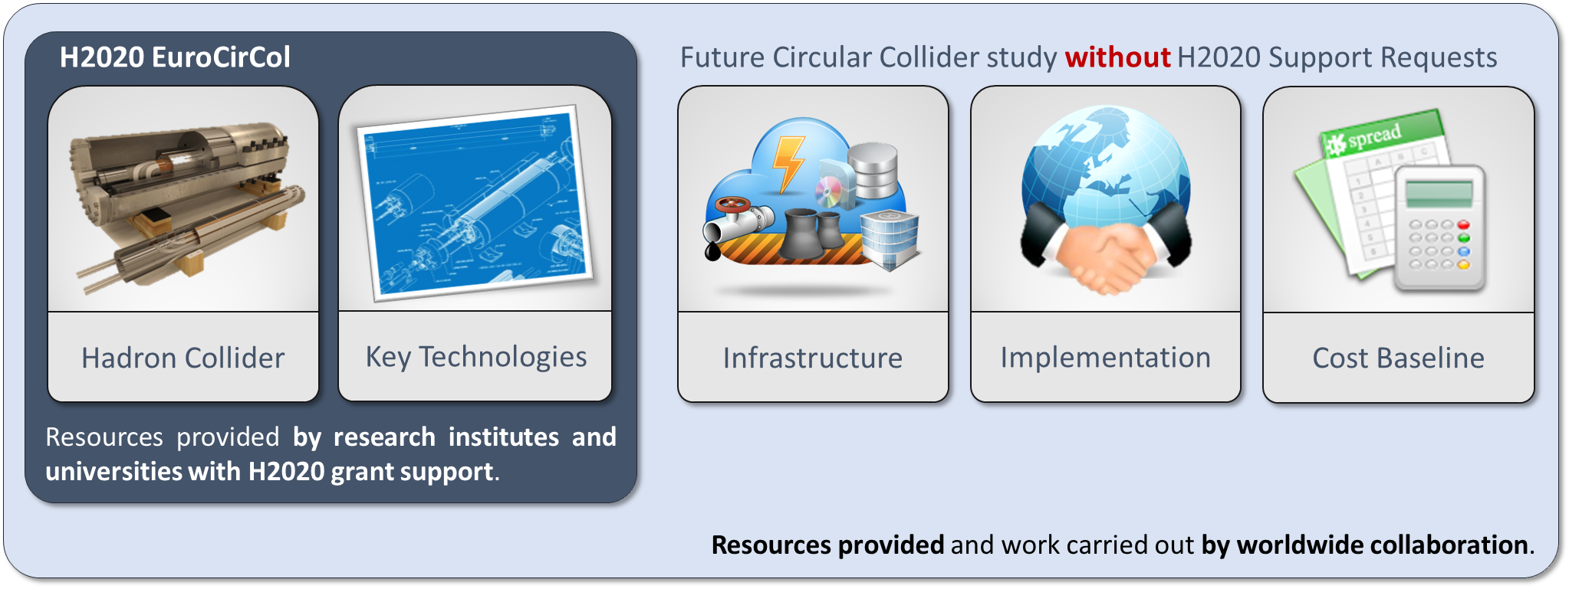
EuroCirCol EU Horizon 2020 Grant
EC contributes with funding to FCC-hh study
Main aspects of hadron collider design: arc & IR optics design, 16 T magnet program, cryogenic beam vacuum system
Recognition of FCC Study by European Commission.

Slide 19
EuroCirCol Consortium + Associates
CERN | IEIO
TUT | Finland
CEA | France
CNRS | France
KIT | Germany
TUD | Germany
INFN | Italy
UT | Netherlands
ALBA | Spain
CIEMAT | Spain
STFC | United Kingdom
UNILIV | United Kingdom
UOXF | United Kingdom
KEK | Japan
EPFL | Switzerland
UNIGE | Switzerland
NHFML-FSU | USA
BNL | USA
FNAL | USA
LBNL | USA
Japan
KEK
Finland
TUT
United Kingdom
STFC, UNILIV, UOXF
Netherlands
UT
Germany
KIT, TUD
France
CEA, CNRS
CERN
Switzerland
EPFL, UNIGE
Italy
INFN
Spain
ALBA, CIEMAT
Consortium Beneficiaries, signing the Grant Agreement

Slide 20
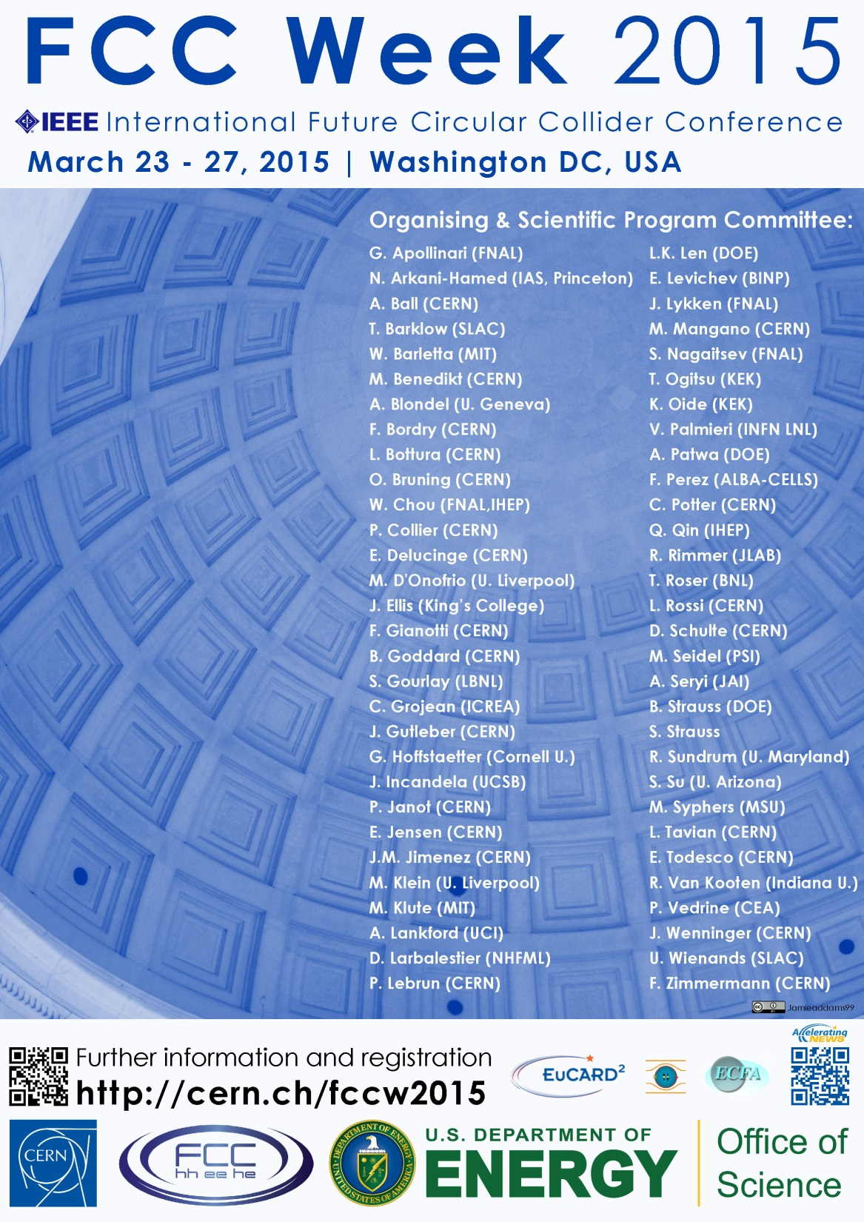
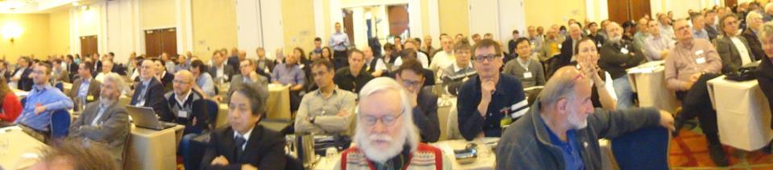
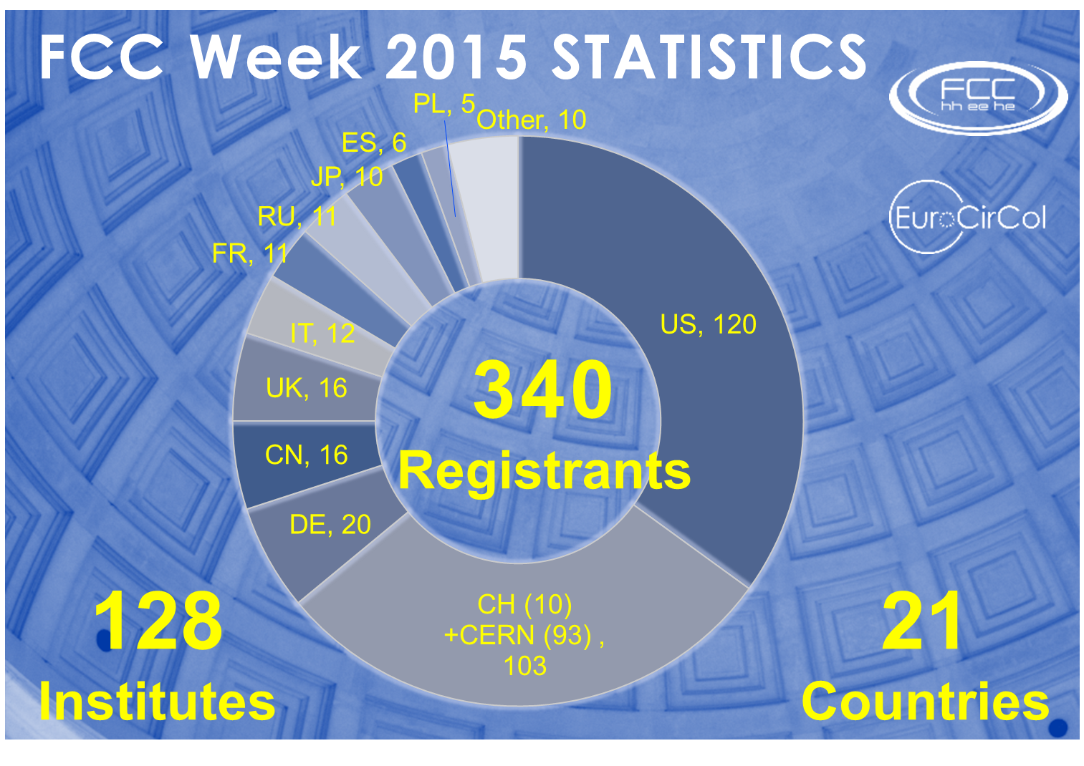
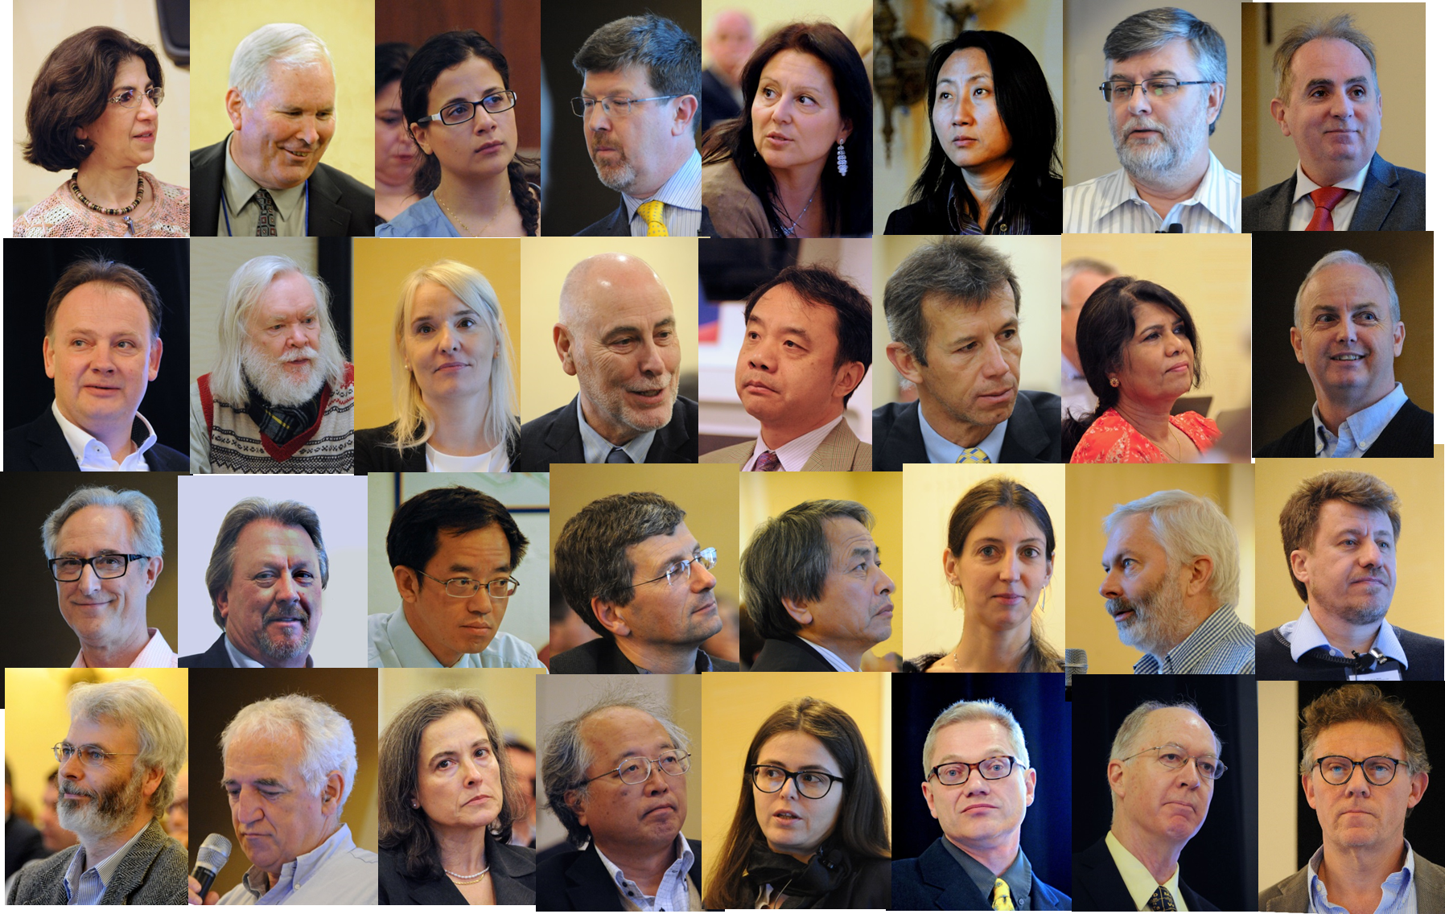
First FCC Week
Conference
Washington DC
23-27 March 2015
http://cern.ch/fccw2015
“head shots” from Bob Palmer (BNL)

Slide 21
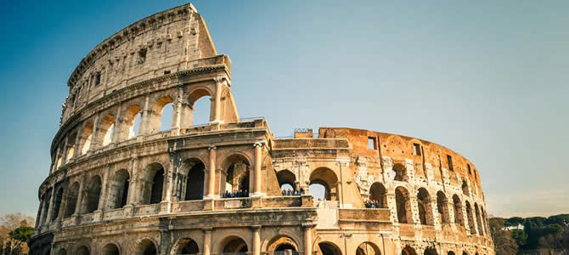







FCC Week 2016
Rome, 11-15 April 2016
http://cern.ch/fccw2016

