Slide 1

FCC-hh
Daniel Schulte
CERN, February 2016

Slide 2
Basic Parameters
 | LHC | HL-LHC | FCC-hh Baseline Ultimate
Cms energy [TeV] | 14 | 14 | 100 | 100
Luminosity [10³⁴cm⁻²s⁻¹] | 1 | 5 | 5 | <30
Machine circumference | 27 | 27 | 100 | 100
Arc dipole field [T] | 8 | 8 | 16 | 16
Bunch distance [ns] | 25 | 25 | 25 | 25 (5)
Background events/bx | 27 | 135 | 170 | 1020 (204)
Bunch length [cm] | 7.5 | 7.5 | 8 | 8
Baseline 1250fb⁻² per 5 year cycle (considering shutdowns, stops, MDs, … )
= 2fb⁻² per day with no problems
Ultimate 5000fb⁻² per 5 year cycle
= 8fb⁻² per day
Total 17.5ab⁻²

Slide 3
FCC-hh Layout
Two high-luminosity experiments (A and G)
Two other experiments (F and H)
Two collimation and extraction insertions
  Exact layout being developed
Two injection insertions
Insertion lengths (1.4km, 4.2km for J and D) will be reviewed as optics designs are optimised

Slide 4
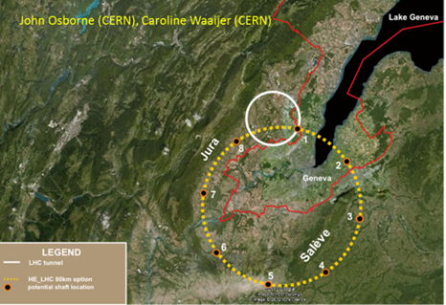
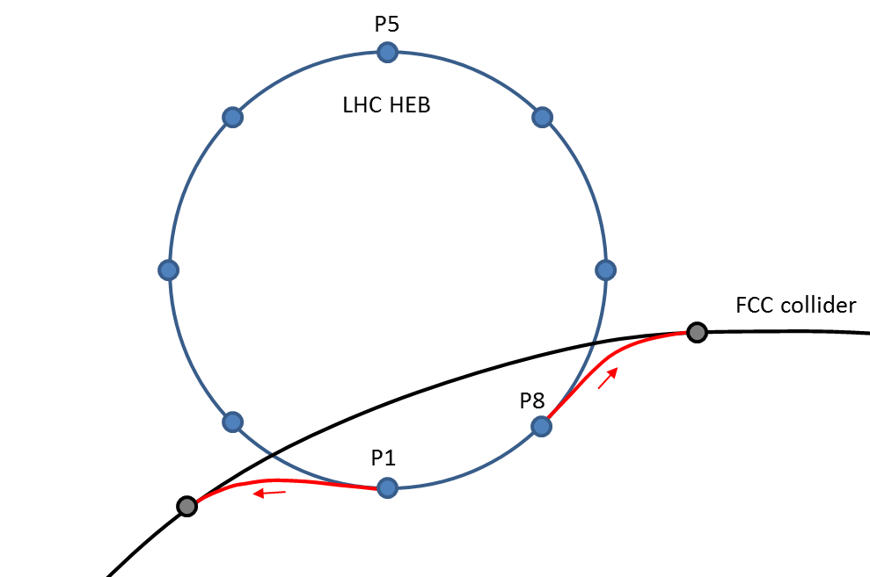
FCC Injection and Site Study
V. Mertens, tomorrow
Detailed site studies are ongoing
Geology
Surface buildings
…
100km ring fits well into the Geneva area
LHC can be used as injector
Small changes on LHC
The two tunnels would match nicely
Energy and beam quality are sufficient
Also consider SPS and FCC tunnel for injector
SPS located at the right place

Slide 5
Arc Cell Layout
B. Dalena, A. Chance, J. Payet
Longer cell
fewer and shorter quadrupoles
better dipole filling factor
Shorter cells
more stable beam
smaller beam
12 dipoles with L=14.3m
L_{cell}=214.755m
to be reviewed with update magnet design
Fill factor about 80%
Field (100km ring): (16-ε)T

Slide 6
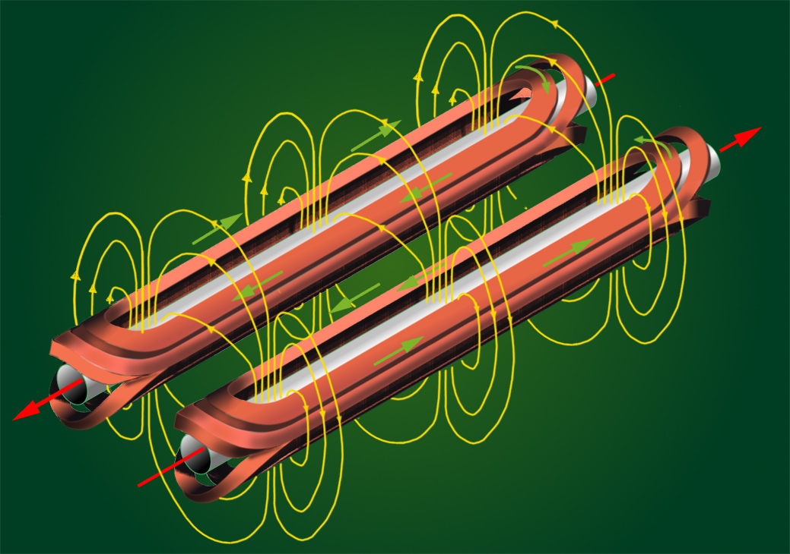
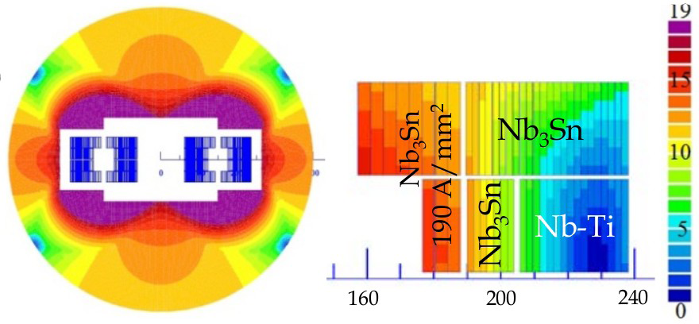
Magnets
L. Bottura, tomorrow
FCC goal is 16T operating field
Requires to use Nb₃Sn technology
At lower field levels used for HL-LHC
Also potential for 20T is being explored
Requires use of HTS
Also field quality is important
at injection energy
At top energy
Important parameter is the required aperture of the coils
Larger is more expensive

Slide 7
Initial Beam Parameters
 | FCC-hh Baseline | FCC-hh Ultimate
Luminosity L [10³⁴cm⁻²s⁻¹] | 5 | 20
Background events/bx | 170 (34) | 680 (136)
Bunch distance Δt [ns] | 25 (5)
Bunch charge N [10¹¹] | 1 (0.2)
Fract. of ring filled η_{fill} [%] | 80
Norm. emitt. [μm] | 2.2(0.44)
Max ξ for 2 IPs | 0.01 (0.02) | 0.03
IP beta-function β [m] | 1.1 | 0.3
IP beam size σ [μm] | 6.8 (3) | 3.5 (1.6)
RMS bunch length σ_{z} [cm] | 8
Crossing angle [σ’] | 12 | Crab. Cav.
Turn-around time [h] | 5 | 4

Slide 8
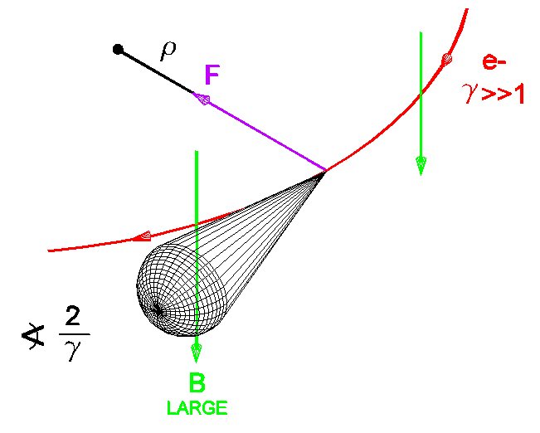
Synchrotron Radiation
At 100 TeV even protons radiate significantly
Total power of 5 MW
Needs to be cooled away
Equivalent to 30W/m /beam in the arcs
Protons loose energy
They are damped
Emittance improves with time
Typical damping time 1 hour

Slide 9
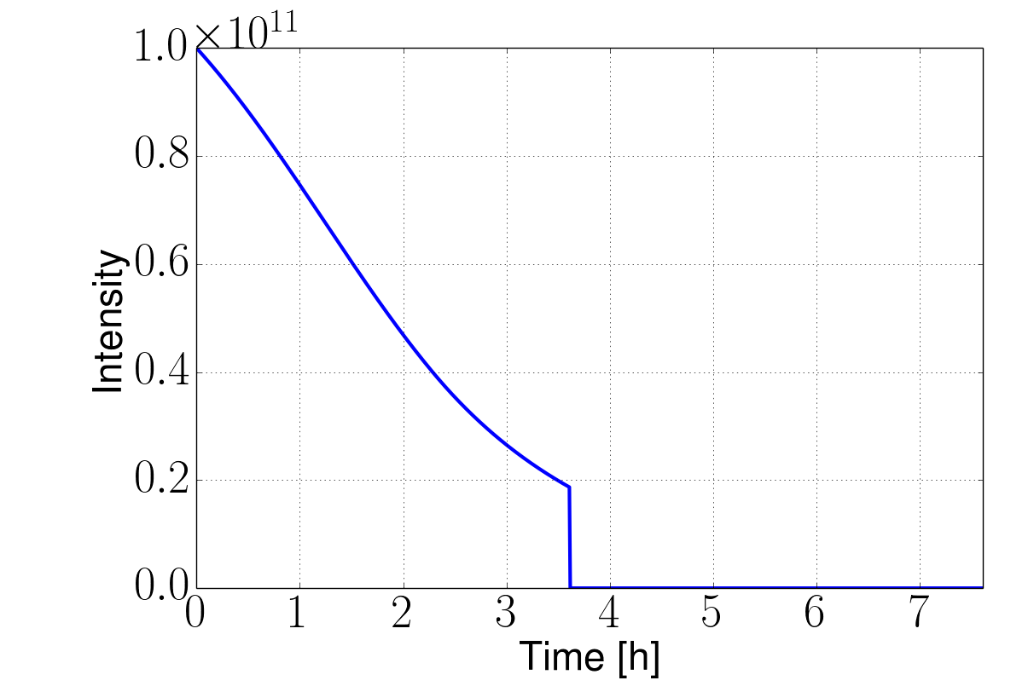
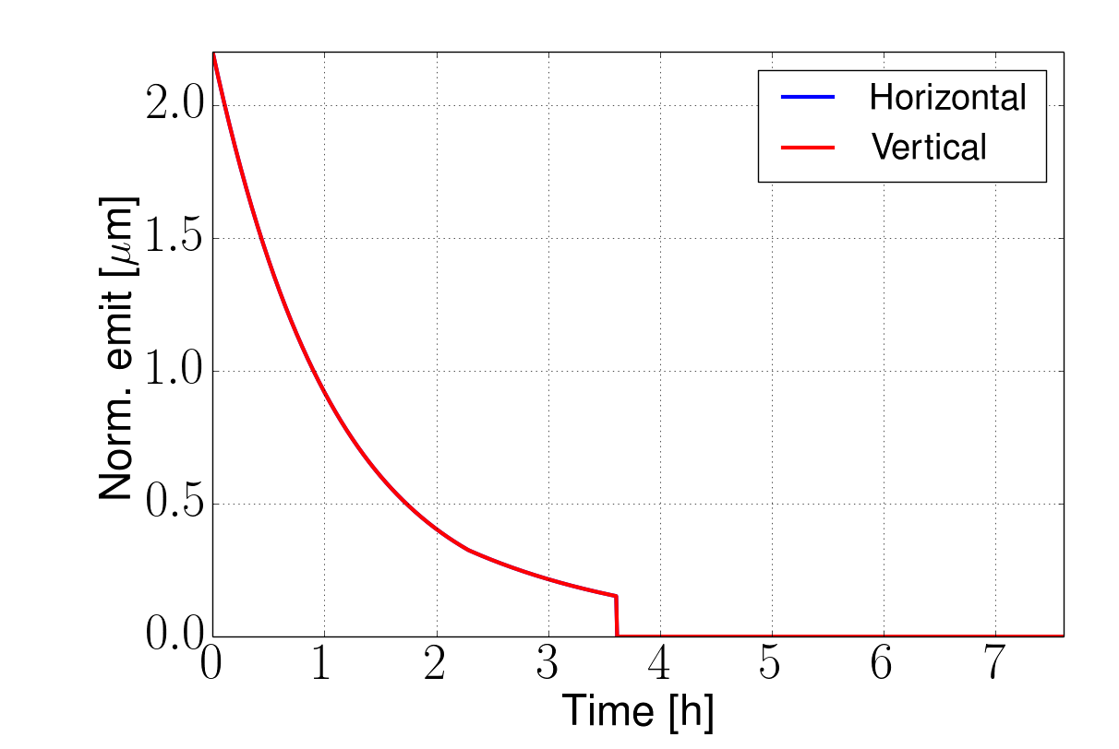
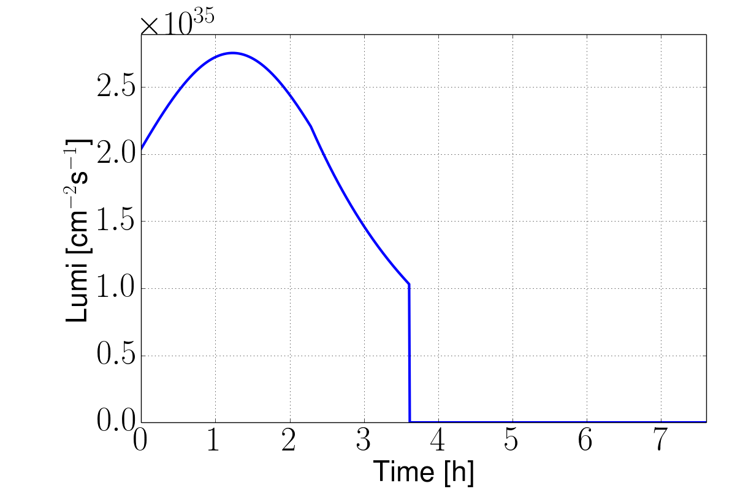
Luminosity Run Example
X. Buffat, D.S.
Example with ultimate parameters shown
Burn beam quickly
But emittance shrinks
Can reach 8fb⁻¹/day
    5000fb⁻¹ per 5 year cycle
Ultimate example, 25ns, no luminosity levelling
8fb⁻¹/day
Turn-around time

Slide 10
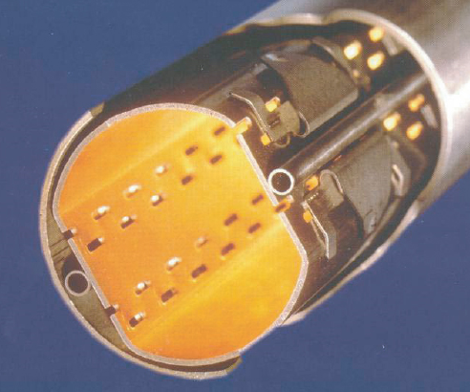
Beam Screen Design
Space for support:
O(1mm)
Total magnet aperture 50mm
Cold bore + space for helium 1.5mm+1.5mm
LHC screen
Impedance:
Aperture >26mm
Stress in quench:
1.25mm steel
Cooling:
O(5mm) outer diameter
Impedance:
0.3mm copper coating

Slide 11
Cooling
L. Tavian, C. König,
Ph. Lebrun
Cross section determines length that can be cooled
16K beamscreen would require 300MW for cooling
50K requires 100MW => current baseline
For 4K magnets would prefer T>100K
But more impedance

Slide 12
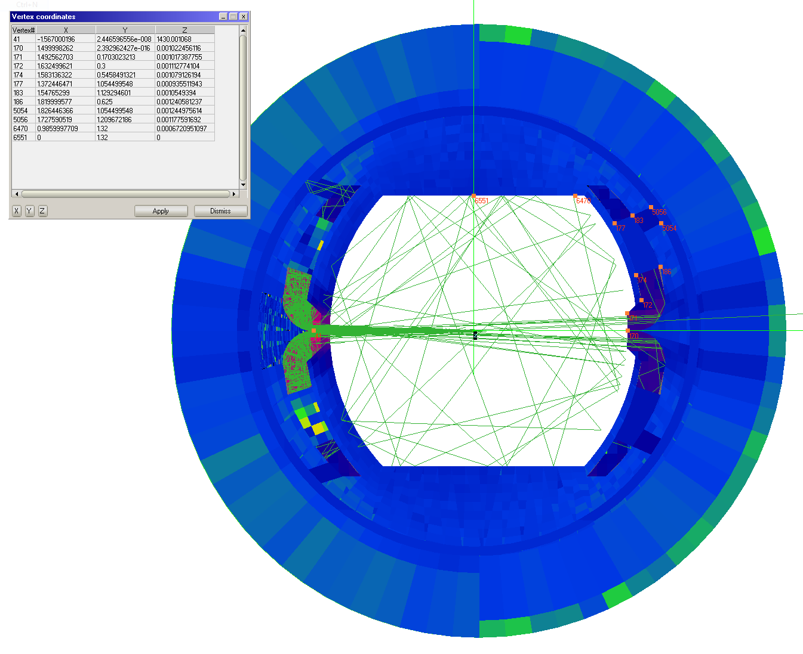
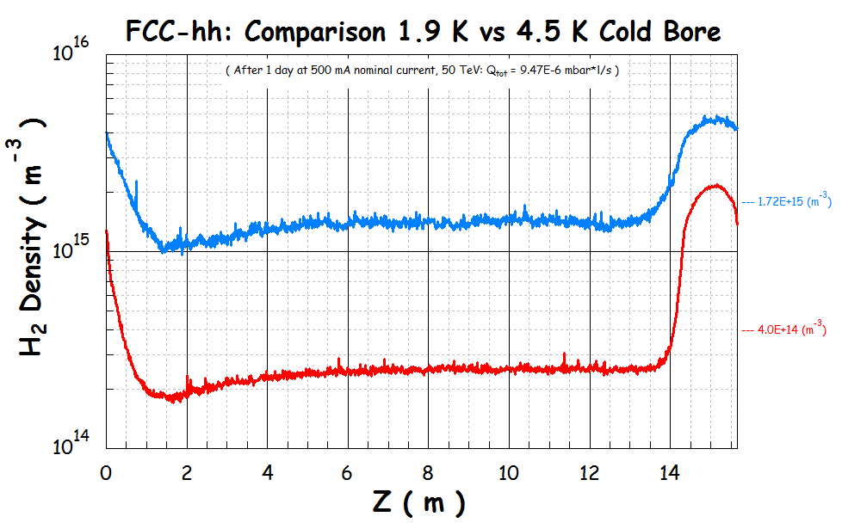
Vacuum Quality
R. Kersevan
For 2K cold bore meet target after 1 day
twice better than LHC design
but need to work on connections
Cryo absorbers required for 4K cold bore

Slide 13
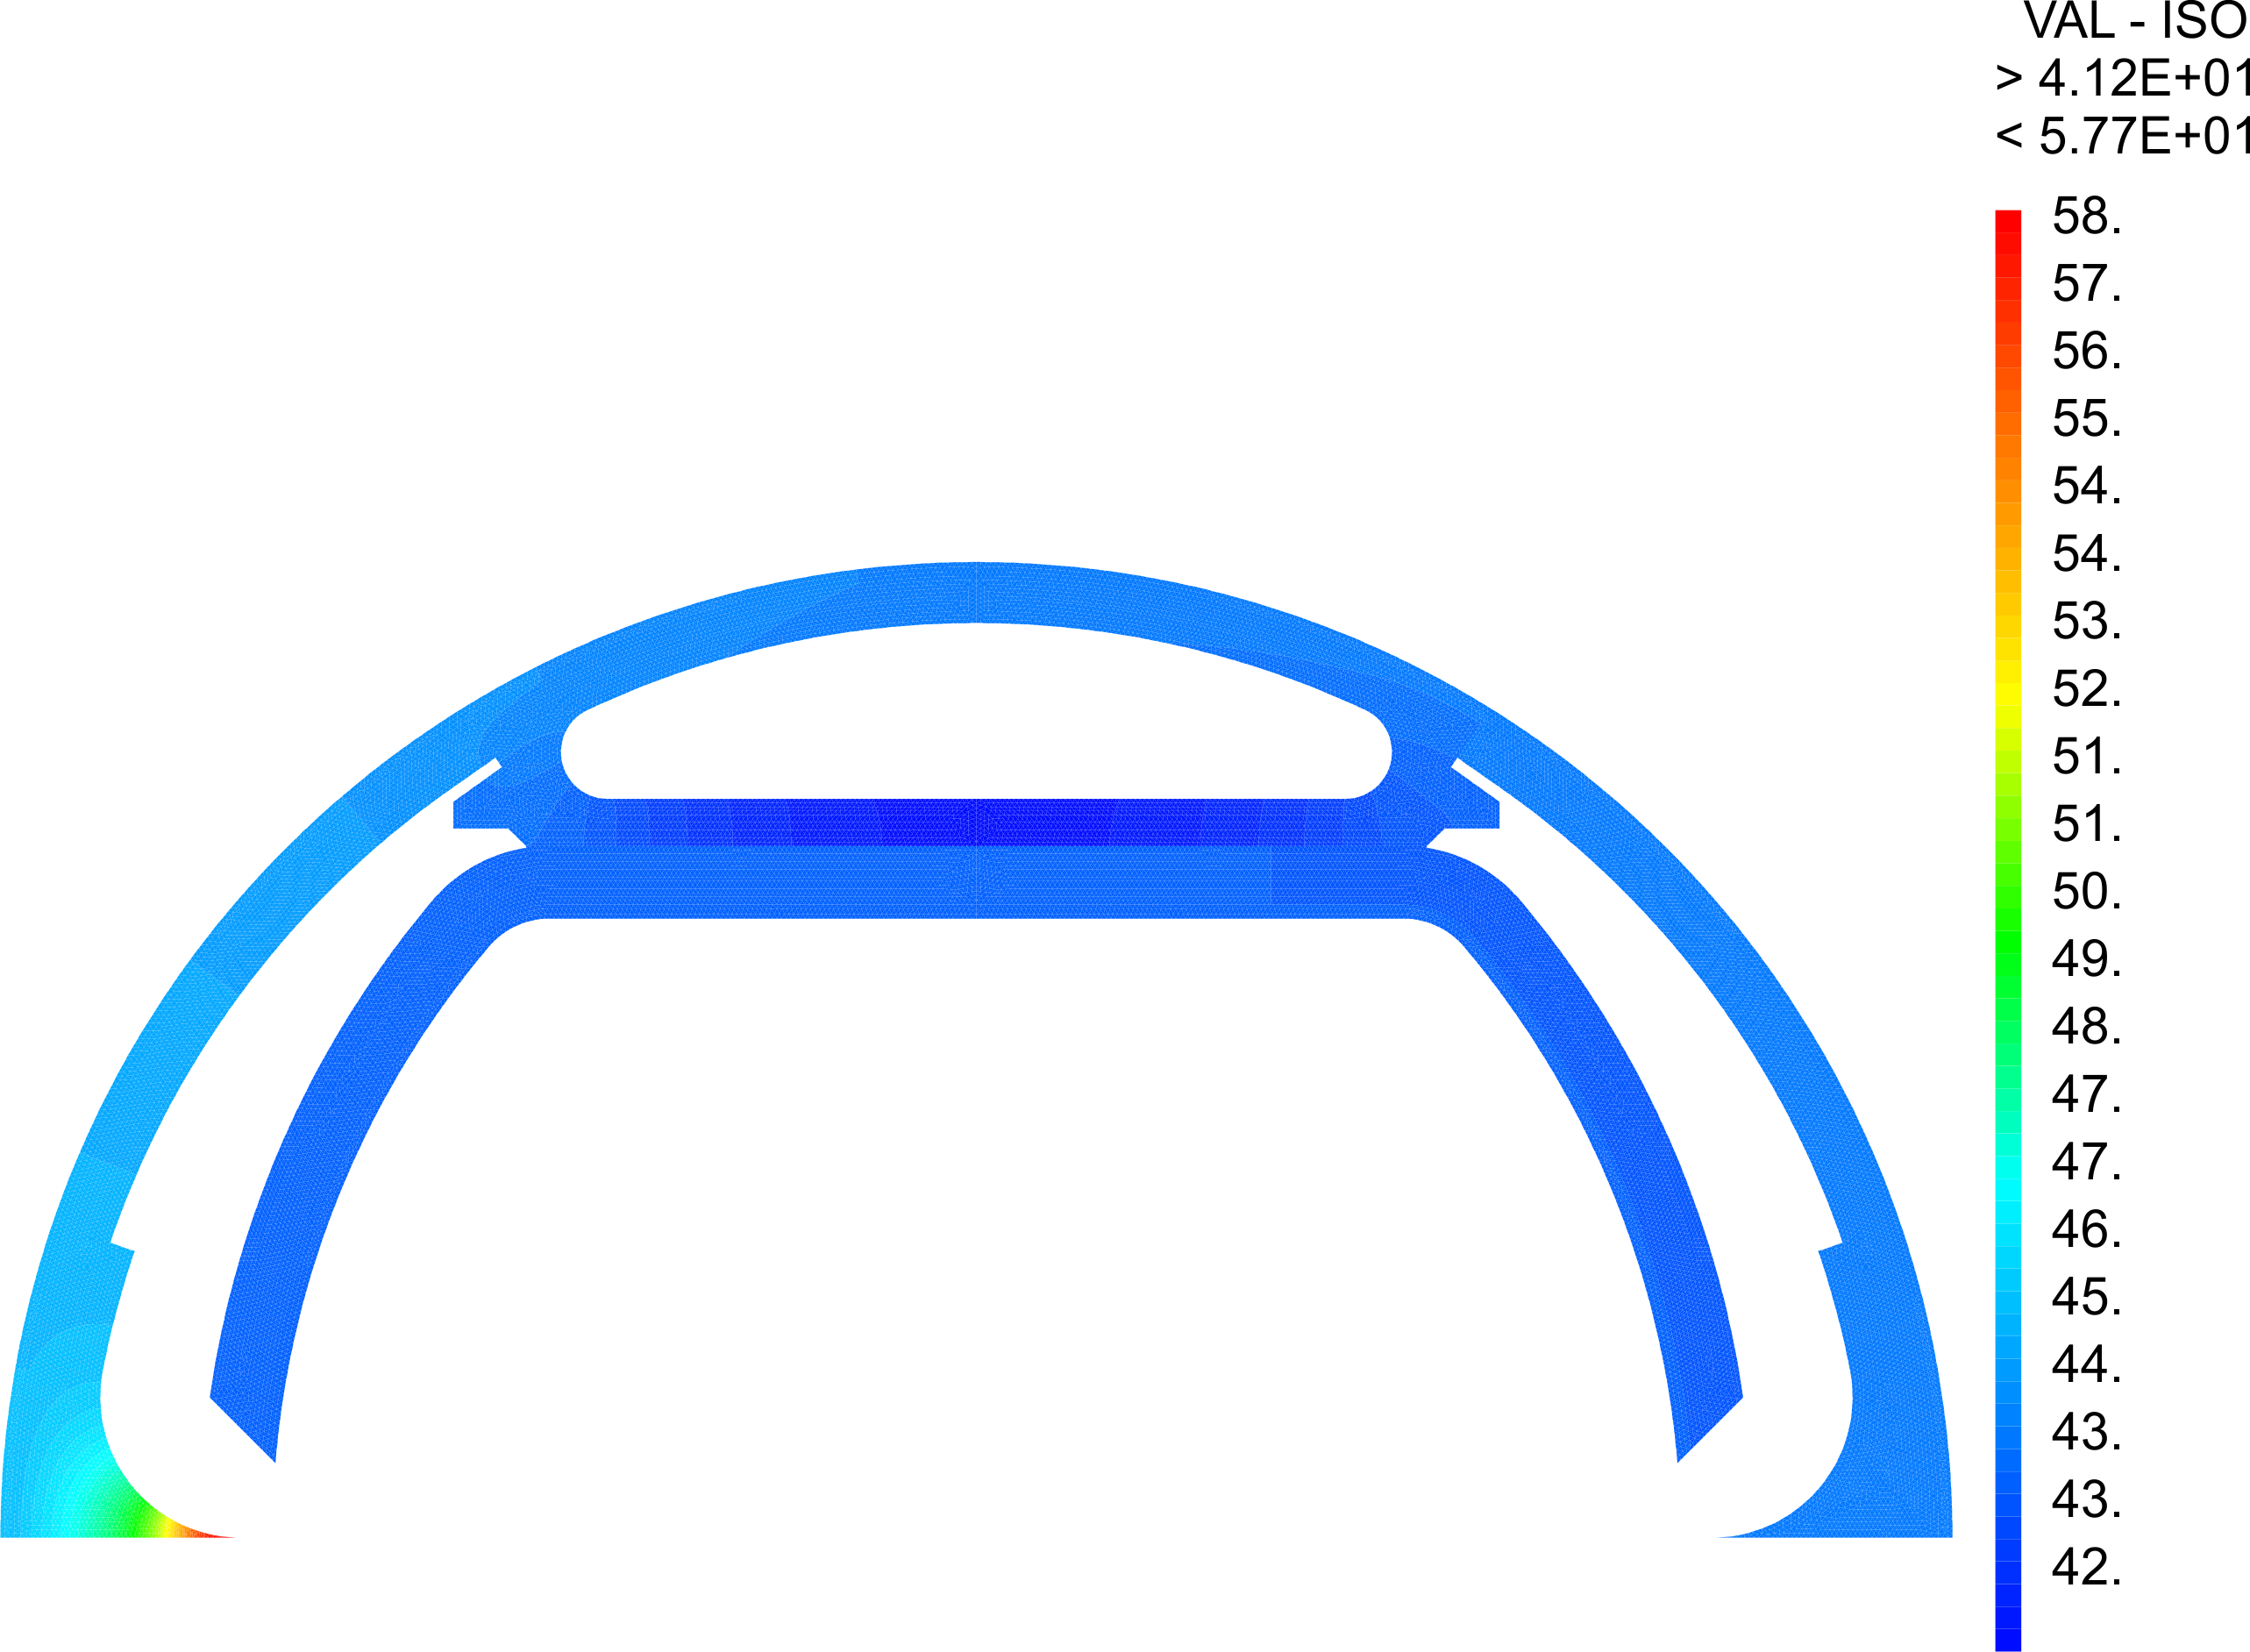
FCC Beam Screen Mechanical Design
C. Garion
Beam screen remains relatively cool
Stress is acceptable from heat
Worry about sheer stress in quench
attachment copper steel

Slide 14
Low Frequency Impedances
At injection multi-bunch instability is driven by resistivity of arc beam screen
Resistivity increases with temperature
Minimium radius is defined by strong dependence of impedance
2b=26mm
Multi-bunch instability O(10) worse than in LHC
Assumes fast feedback
N. Mounet, G. Rumolo, O. Boine-Frankeheim, U. Niedermayer, F. Petrov, B. Salvant, X. Buffat, E. Metral, D.S.

Slide 15
High Frequency Impedance
In LHC pumping holes are important contribution to high frequency impedance at injection
Pumping holes in LHC-like design would lead to instability (TMCI) at 1.5x10¹¹
Way to little margin for charge of 1x10¹¹
        In FCC holes are shielded
        Removes impedance
        Other sources need to be studied (e.g. collimation system, …)
X. Buffat, O. Boine-Frankeheim, U. Niedermayer, F. Petrov, B. Salvant, D.S.

Slide 16
Feedback
BPM
W. Höfle, J. D. Fox et al.
Kicker
Beam
Active closed loop
Feedback
Analog
Front
End
ADC
Signal
Processing
DAC
Analog Back
End
Power Amp
pre-processed
pre-distortion
drive signal
Higher bandwidth than in LHC (5ns bunch spacing)
Faster feedback allows to rise beam screen temperature
Even intra-bunch feedback is considered

Slide 17
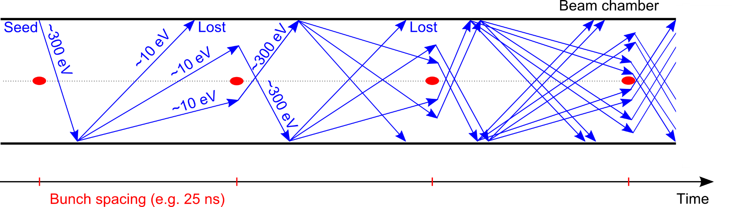
Electron Cloud Effects
Still a potential performance limitation for LHC
Heat load
Beam instability
Twice as many photons as in LHC
At 100 times the energy (4.3keV vs. 44eV)
Similar to B-factories
Surface properties important like photoelectron yield, secondary emission yield, reflectivity, …
Experimental input critical

Slide 18
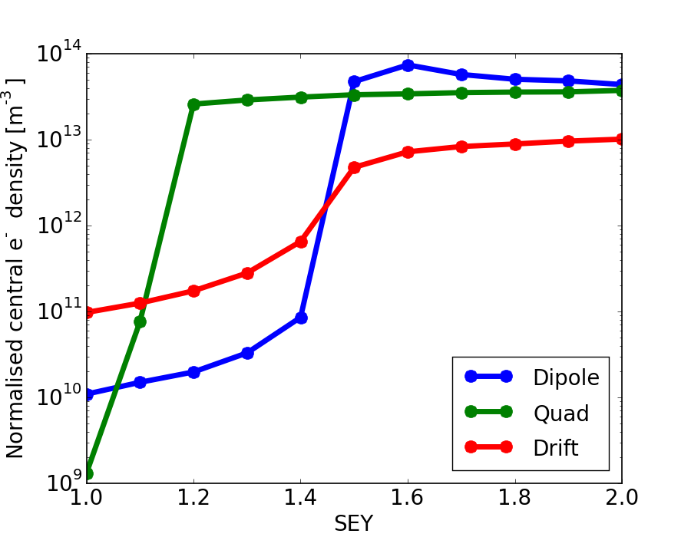
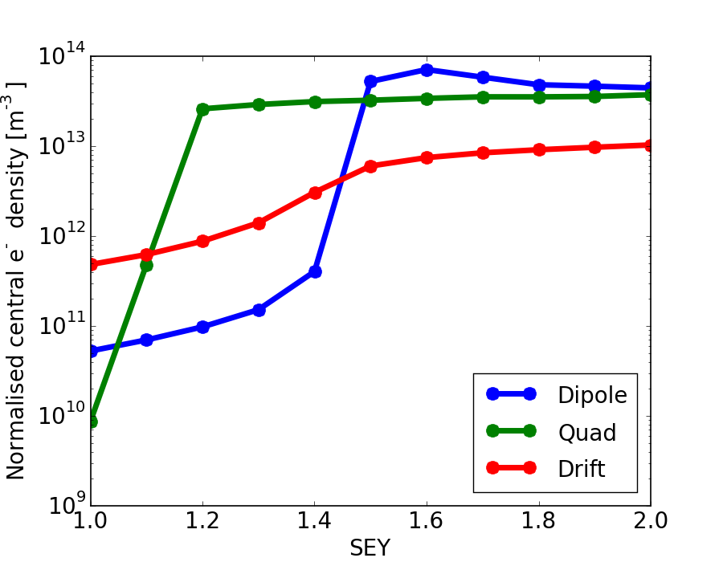
Electron Cloud Effects
Simulations for 5ns shown
Required:
Photoelectron yield <0.02
Secondary emission yield δ_{m}<1.2
Not much margin
25ns is better
Photoelectron yield 0.02
L. Mether,
G. Rumolo, K. Ohmi
Photoelectron yield 0.1
Need mitigation methods
Need to measure surface properties

Slide 19
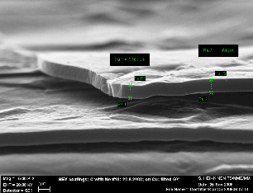
Mitigation Methods
P. Costa Pinto et al.
Developments for LHC are critical
Carbon coating
Laser treatment of surface
Can also learn from B-factories
a-C
LESS
Simulation of exact geometry is important, may help
Prototype and experiments in EuroCirCol WP 4
Cryo Beam Vacuum

Slide 20
Alignment
Good alignment required for beam quality
good pre-alignment
good beam-based alignment
Alignment beam vs. slit is also important
M. Jones, N. Ibarrola Subiza
First system is based on wire and hydrostatic leveling

Slide 21
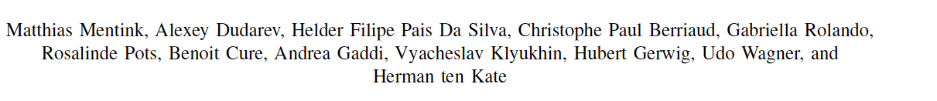
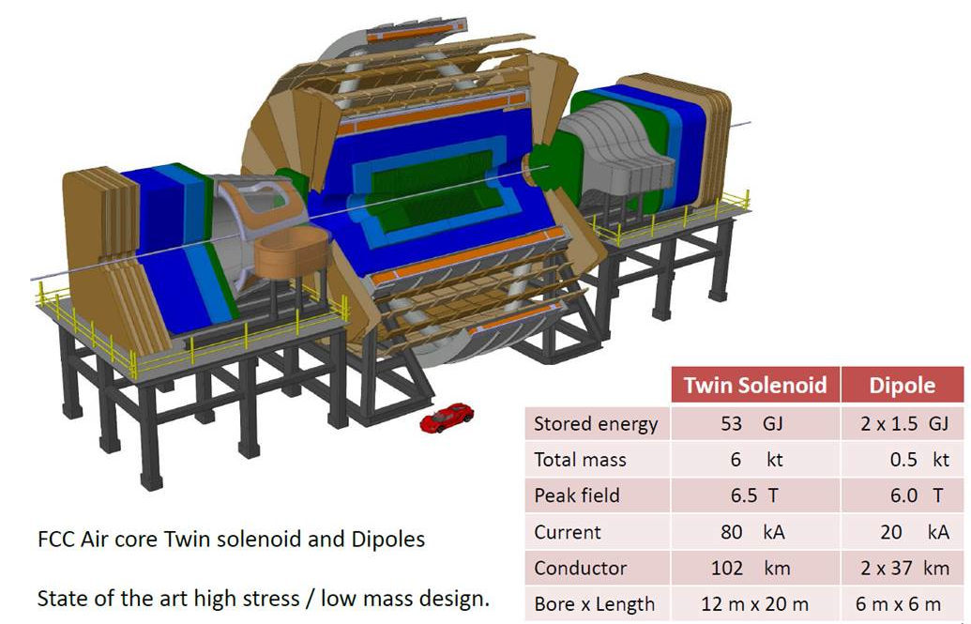
Current FCC Detector Model
W. Riegler et al.

Slide 22
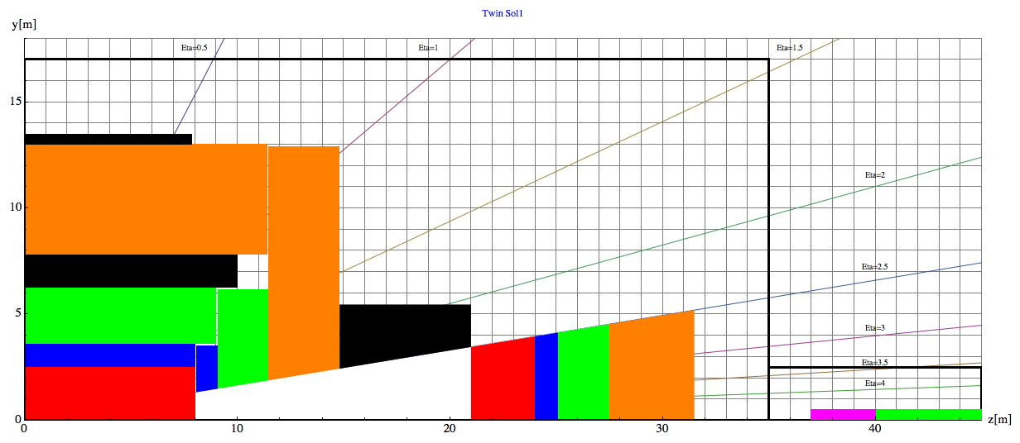
Space for FCC Detector
Modified from W. Riegler et al.
W. Riedler
Tracking
Ecal
HCAL
Magnets and cryostat
Muons
35m
L*=45 m
Have iterated on L*

Slide 23
High-luminosity Insertions
High-luminosity Insertions
R. Martin, R. Tomas et al.
Squeezes the beam to few microns
Have designs for L*=36m and L*=61m to explore
Now will go for L*=45m

Slide 24
High-luminosity Insertions
R. Martin, R. Tomas et al.
Small beam in interaction point leads to large beam in triplets
For given triplet, aperture is limited due to required field gradient
Beam stay clear >15σ
Can reach enough beam stay clear for target beta-function

Slide 25
Radiation from Beam-beam
Total power of background events 100-500kW per experiment
Car or truck engine
Already limit in LHC and HL-LHC
Magnet lifetime, heat load
Study of 3000fb⁻¹ in older FCC-hh detector design
Goal: survive at least 5000fb⁻¹
One 5-year run
Magnets
Shield (TAS)
Shielding
5mm
10mm
15mm
20mm
Dose for
3000fb⁻¹
30MGy=
Current limit
M. I. Besana, F. Cerutti, et al.

Slide 26
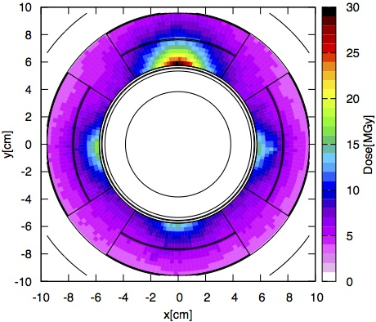
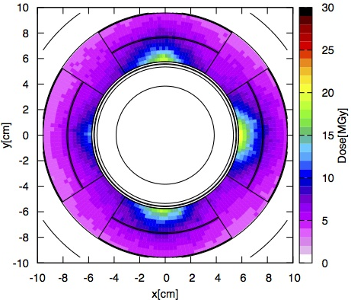
Countermeasures
Split magnets
Vary crossing scheme to distribute damage (S. Fartoukh)
R. Martin et al.
M. I. Besana, F. Cerutti, et al.
Longer triplet with more aperture to better shield/spread radiation
Improvements in radiation hardness
Need to push hard to gain small factors
A. Langner et al.

Slide 27
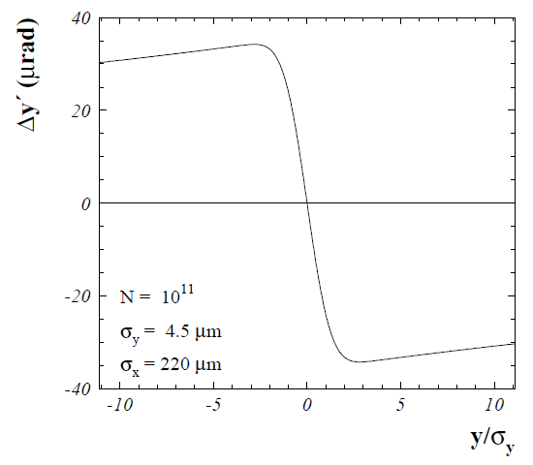
Beam-beam Effects
Emittance growth
Beam loss

Slide 28
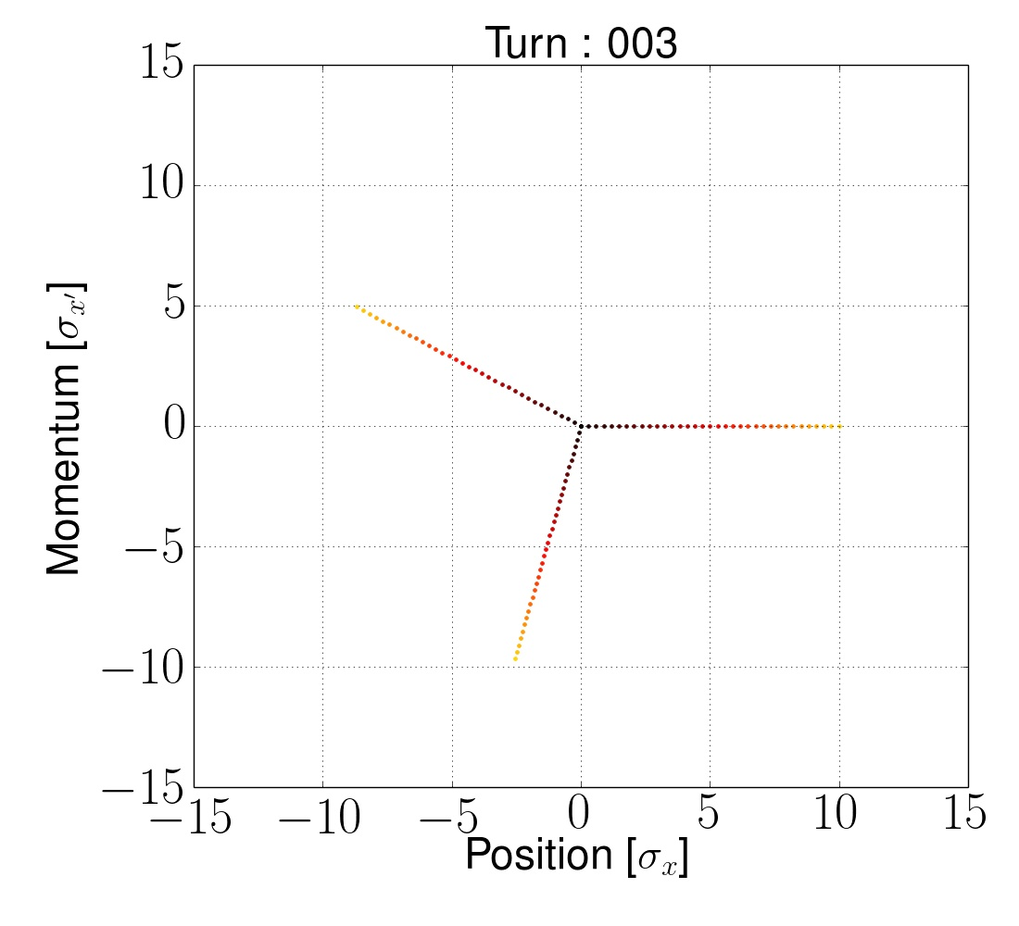
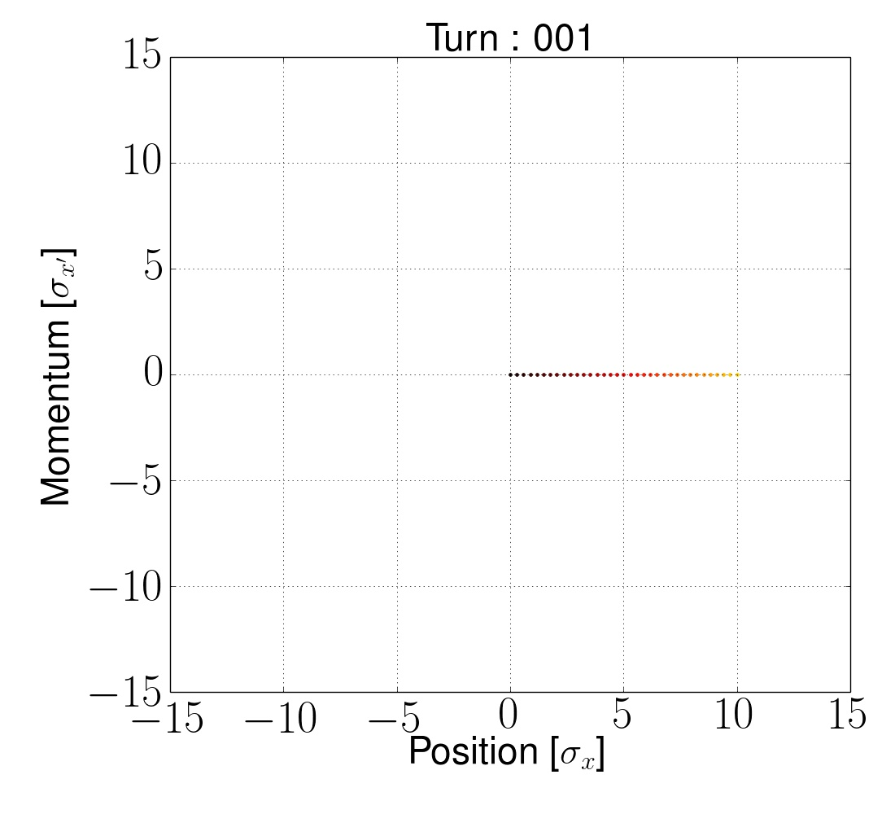
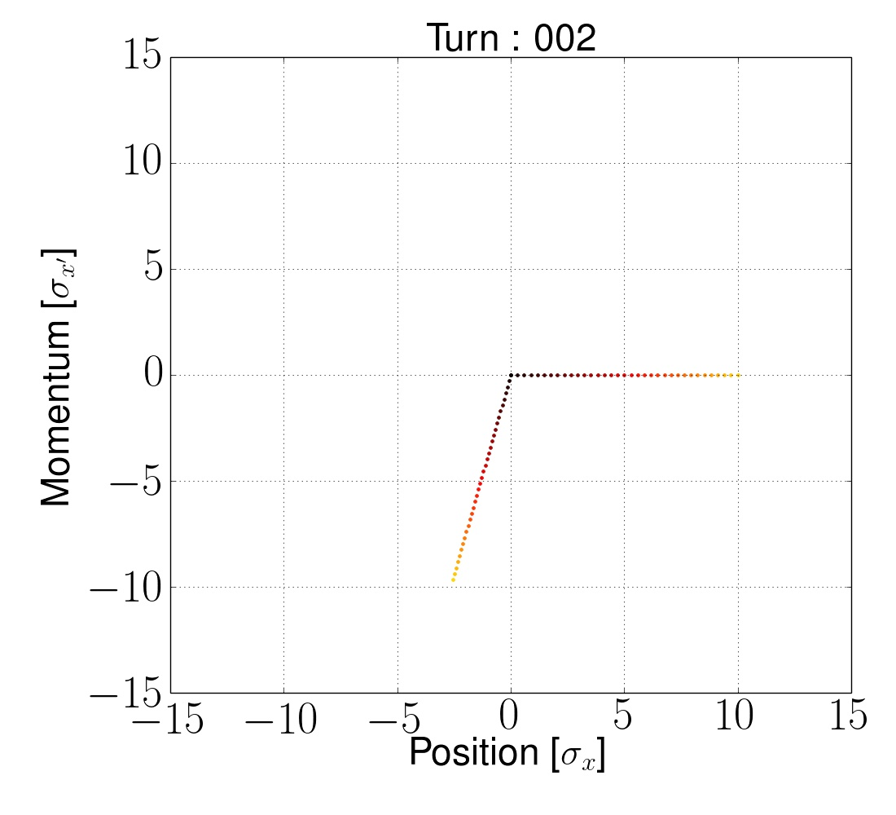
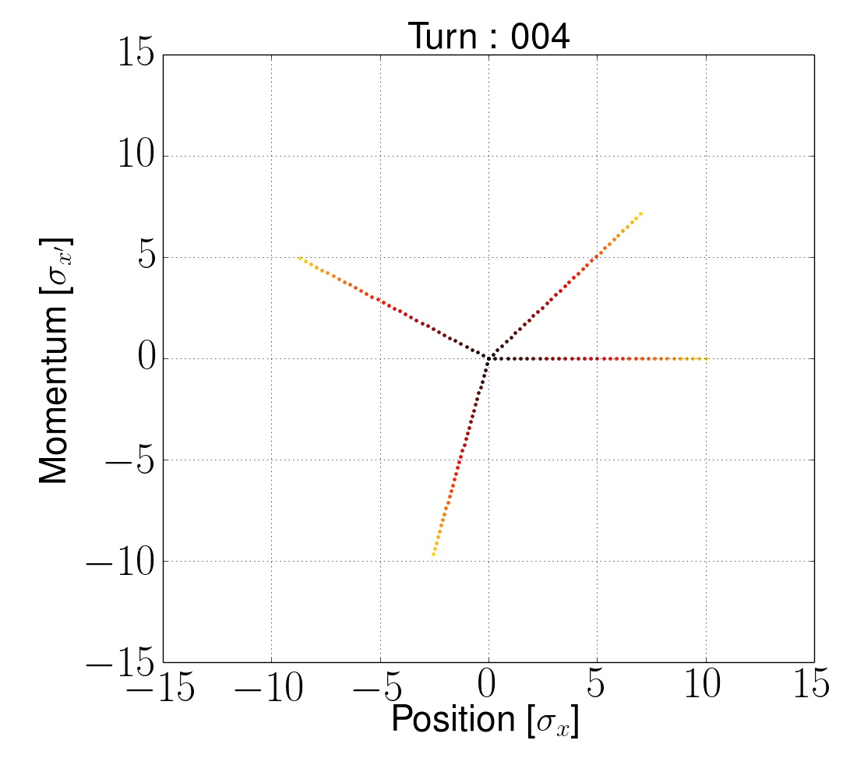
Beam-beam Effects
X. Buffat

Slide 29

Beam-beam Effects
X. Buffat

Slide 30
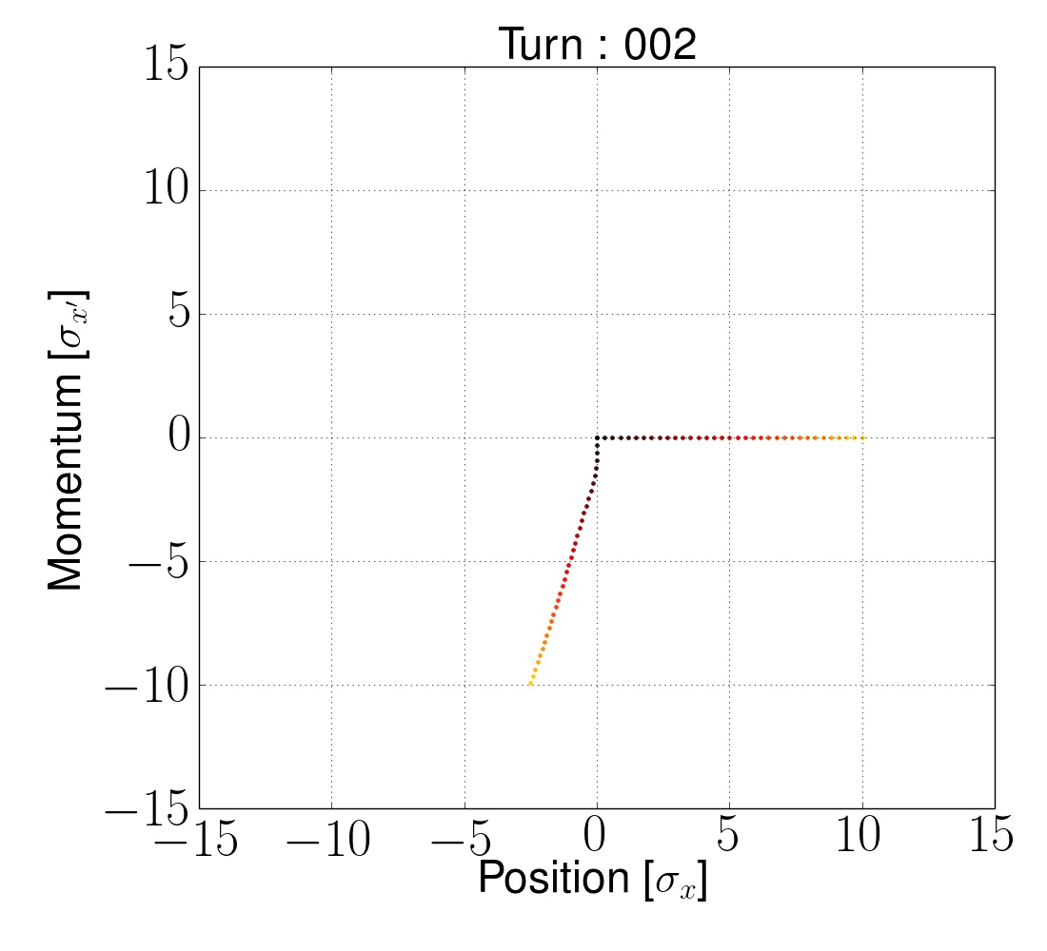
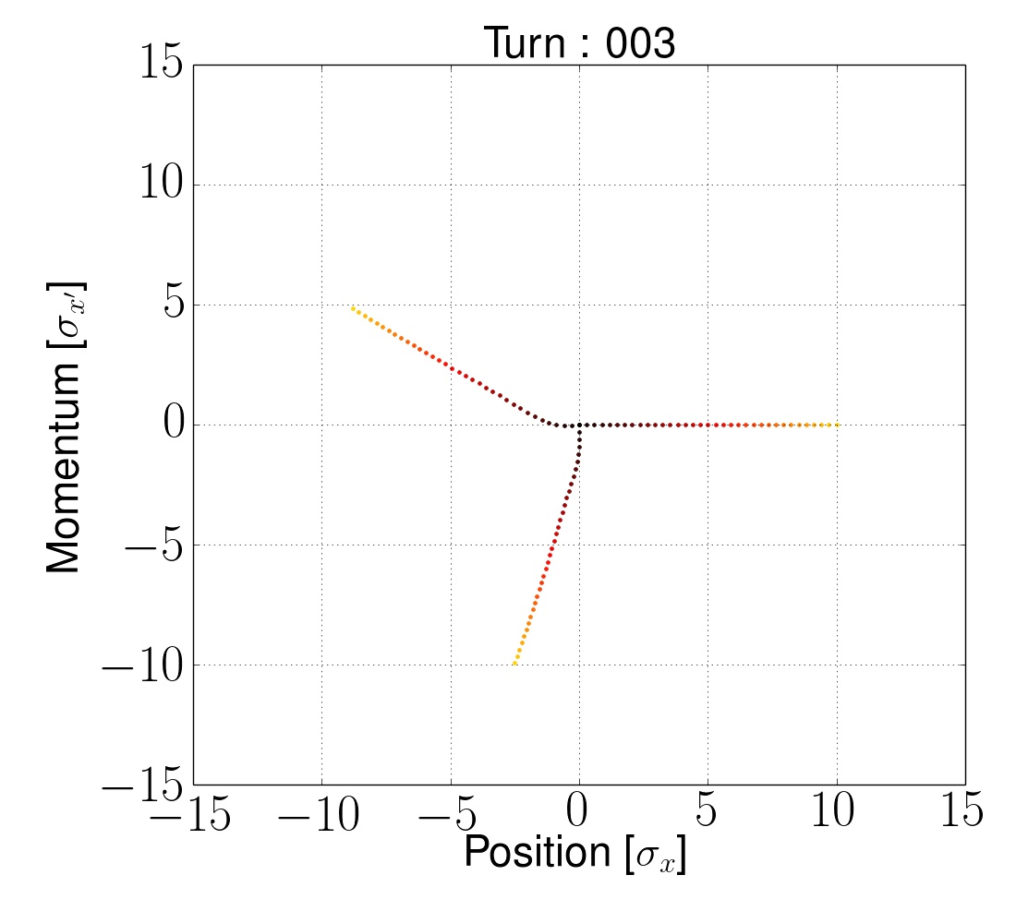
Beam-beam Effects
X. Buffat

Slide 31
Beam-beam Effects
X. Buffat

Slide 32
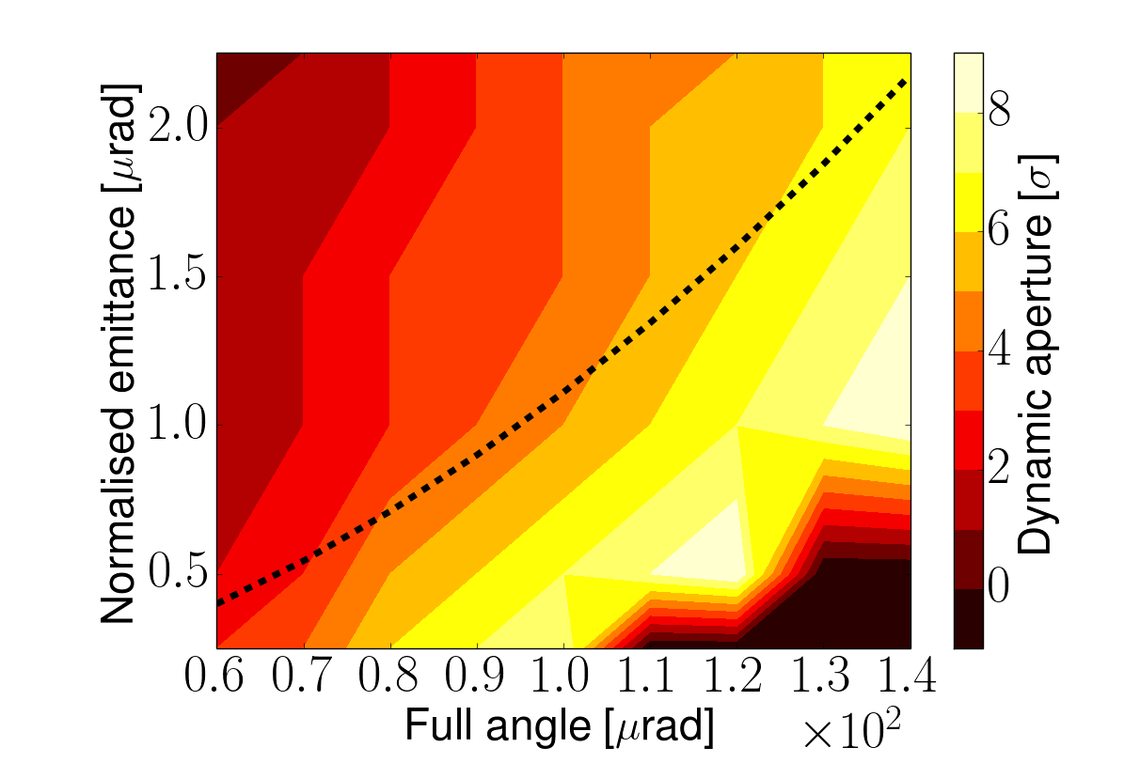
Limit and Mitigation
X. Buffat
Crossing scheme and angle determined by beam-beam
Effect is about OK for baseline
But would like to have margin and to push further
Mitigation technique examples:
Larger crossing angle (and crab crossing)
Mitigation technique examples:
Larger crossing angle (and crab crossing)
Compensating wire (to be tested for HL-LHC)
Wires

Slide 33
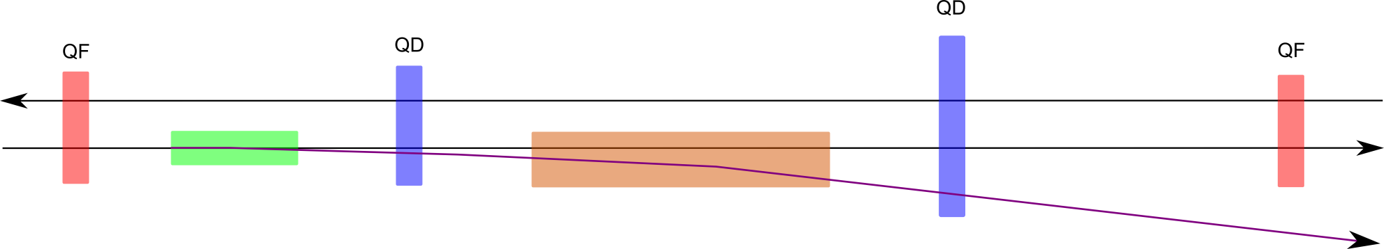
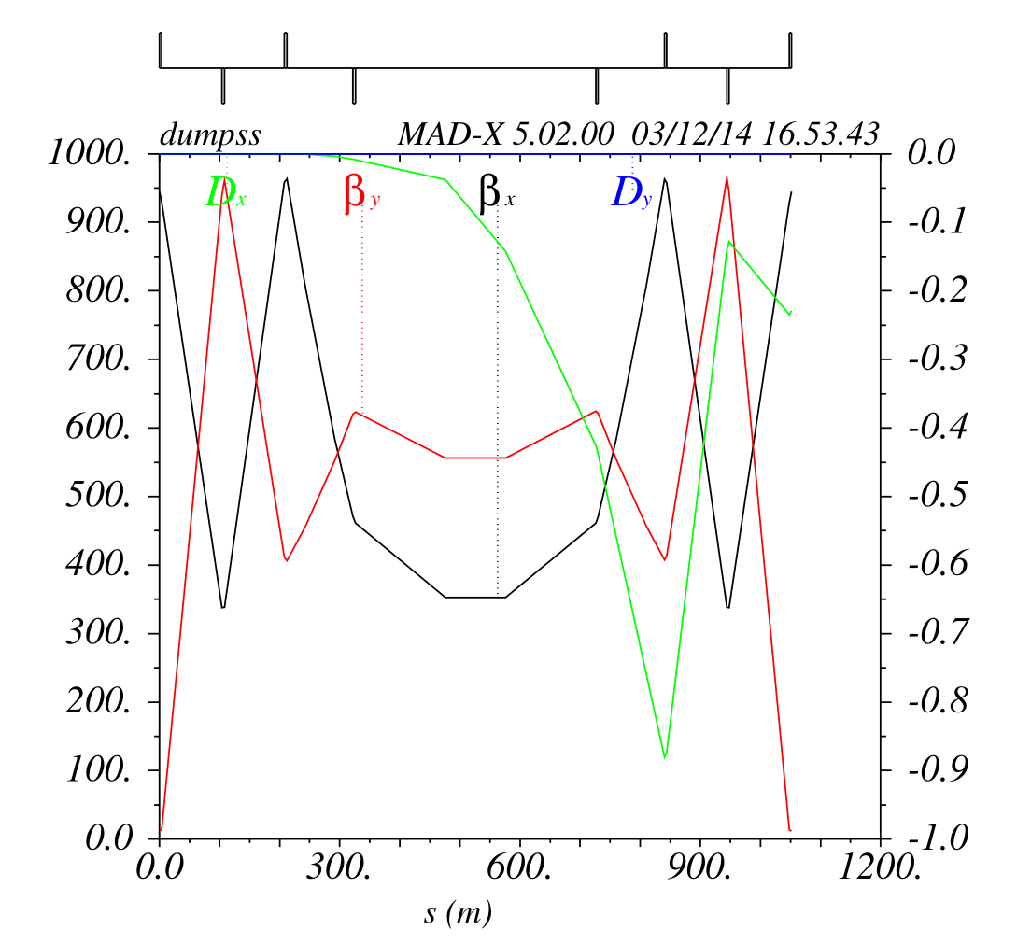
Extraction
MKBH
MKBV
Kicker
0.13mrad
Septum
1.7 mrad, 1.42 T
Triple chamber quadrupole?
(Enlarged quadrupole)
Normally fire kickers in the abort gap of the beam
But kicker can fire on its own
In LHC fire all and sweep beam out
  Does the extraction line survive?
Can we segment kicker such that we can leave beam circulating until abort gap?
  Is this safe?
Design based on LHC design
Alternatives studied
W. Bartmann, B. Goddard, F. Burkart, …

Slide 34
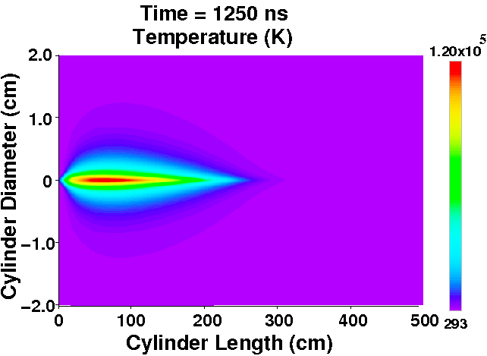
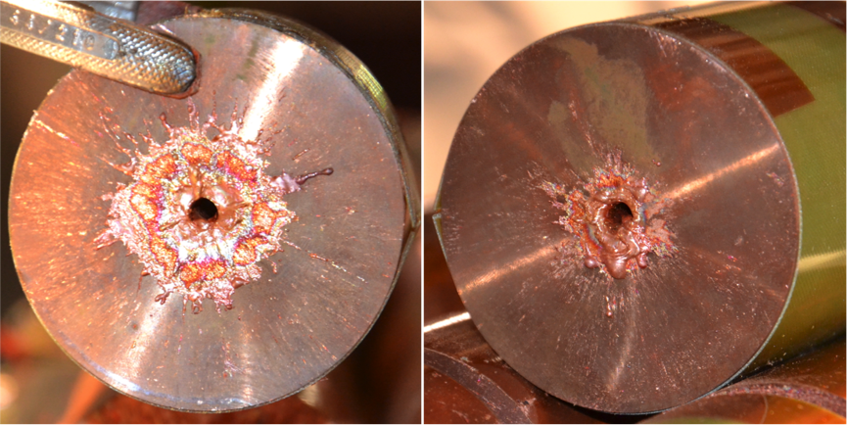
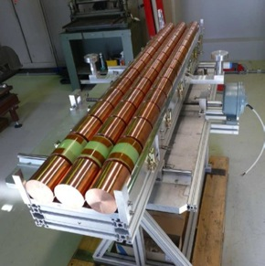
Beam Dump Considerations
8GJ kinetic energy per beam
Airbus A380 at 720km/h
2000kg TNT
400kg of chocolate
  Run 25,000km to spent calories
O(20) times LHC
Hydrodynamic tunneling
F. Burkart et al.
Simulation show beam will penetrate ~ 300 m in Copper, assuming no dilution.
→ Dilution required!

Slide 35
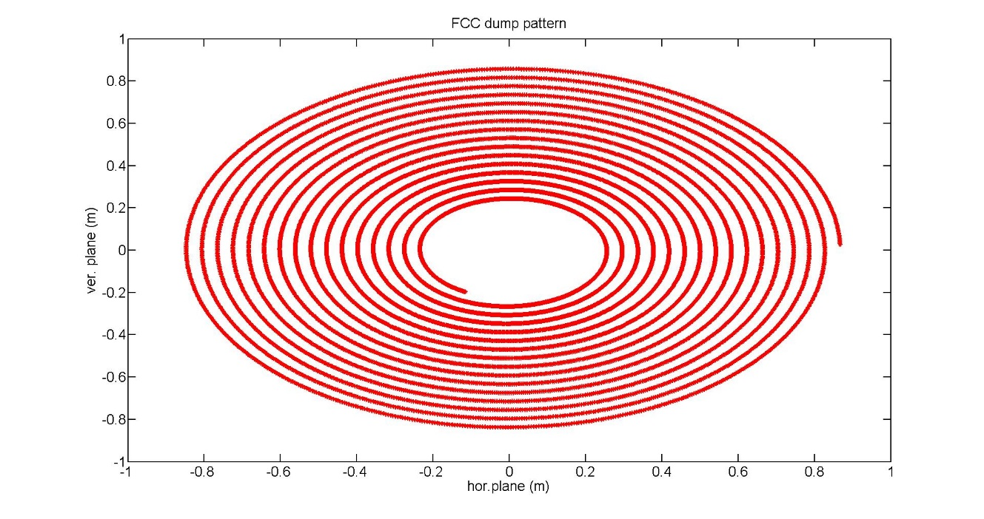
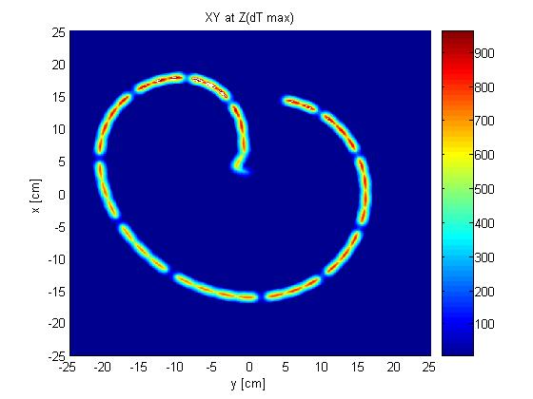
Dilution System
F. Burkart et al.
2.5 km dump line
1.4 km dump insertion
2.8 km collimation insertion
Kicker
Septum
10 mrad bend
Dilution
Absorber
2m
A. Lechner, P. Garcia
Fluka studies of required pattern:
Bunch separation > 1.8 mm
Branch separation: 4 cm
Keeps T<1500°C
Horizontal and vertical kicker system as in the LHC
~ 300 m, ~150kickers, to be optimized
Large magnet apertures required towards dump
Different solutions studied
Require up to 80cm radius
LHC pattern (same scale)

Slide 36
Collimation
S. Redaelli et al.
To protect machine and experiments
At injection tightest part is arcs
At collision energy triplets at experiments

Slide 37
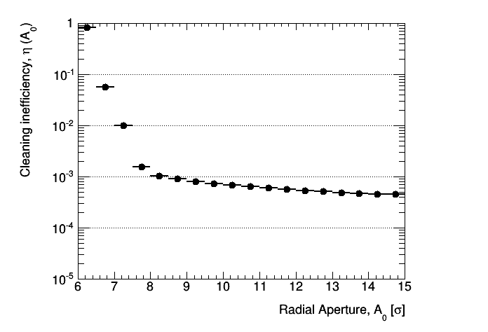
First Collimation Studies
First collimation system lattice designs exist
Based on LHC designs
Starting point for exploration
Fix issues from LHC design
Betatron collimation
R. Tomas
LHC
M. Fiascari,
S. Redaelli

Slide 38
Collimation
First performance studies are ongoing
Collimation efficiency
Power losses
Many studies to be performed
Protection of machine from experiments
Background from one experiment to the next
…
Have to review FLUKA at FCC energies
A complex long-term optimisation

Slide 39
Injection Insertion
Have to limit injected batch
With LHC limits can inject O(100) bunches
Very fast kicker (O(300ns)) for beam filling factor of 80%
W. Bartmann, B. Goddard, F. Burkart, …

Slide 40
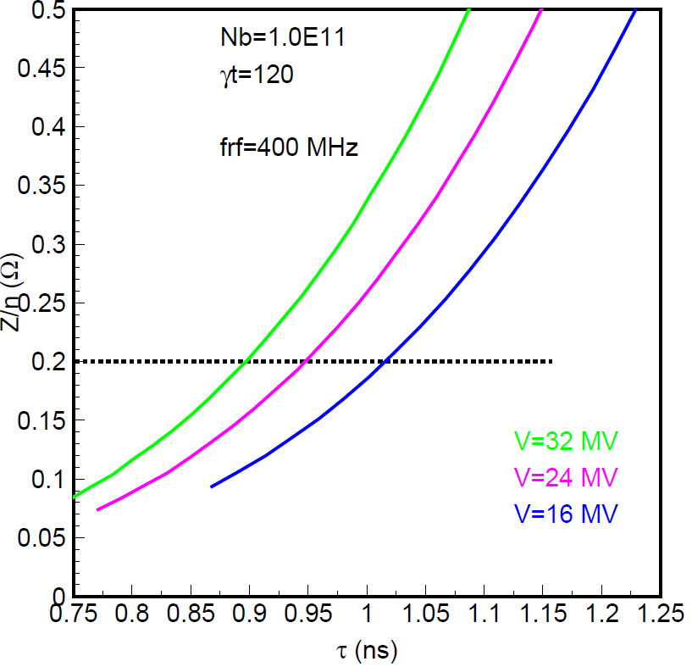
RF Design Considerations
E. Shaposhnikova
RF integrated in injection insertion
Limited radiation
400.8 MHz seems a good baseline
16MV minimum with no margin
32MV seems fine
Higher voltage helps for other instabilities as well
To accelerate beam in 1000s require 16MV and 8MW
Assumed impedance (x2)
32MV
24MV
16MV
Bunch length

Slide 41
Turn-around Time
Integrated luminosity is strong affected by turn-around time
Higher luminosity would not help a lot
Turn-around time in LHC larger than theoretical limit
Need to understand in more detail
Ultimate example, 25ns, no luminosity levelling
8fb⁻¹/day
Turn-around time
Ensure we are not too optimistic
Explore options to speed it up
Magnets need >640s (linear ramp)

Slide 42
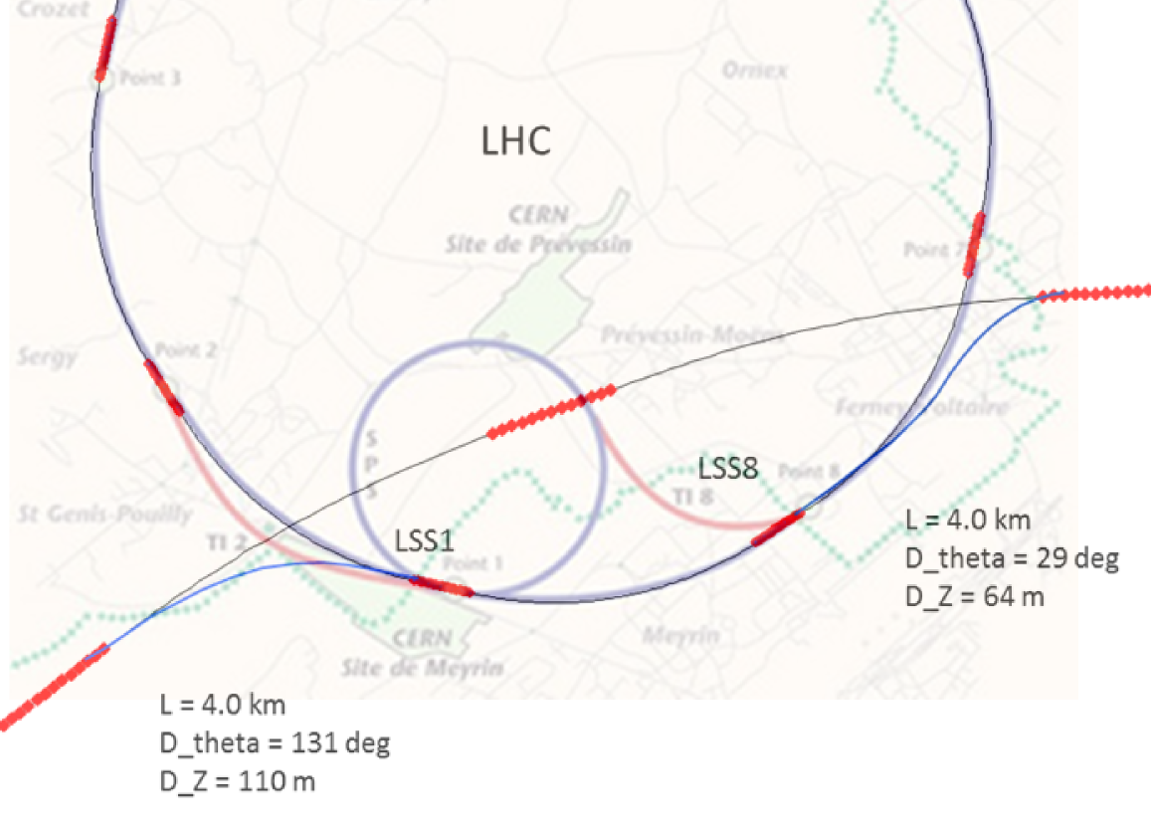
Injector Considerations
Many choices
SPS -> LHC -> FCC
SPS -> FCC
SPS -> FCC booster -> FCC
100 km intersecting
Current baseline injection energy is 3.3TeV
B. Goddard at al.

Slide 43
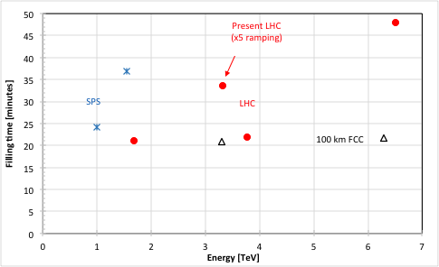
Filling Time
LHC-type Nb-Ti
B. Goddard, L. Stoel, et al.
SPS -> FCC
Higher fields lead to long ramp times
LHC with 5x faster ramping
LHC high field
LHC-type Nb-Ti
*
SPS -> LHC -> FCC
Single layer Nb-Ti
Single layer Nb-Ti
*
SPS -> FCC booster -> FCC
*
1 T
Superferric
Overhead to accelerate all p+ to 450 GeV
LHC-type Nb-Ti
LHC would work as injector
Will study other options in more detail
Study effects of lower energy in collider ring

Slide 44
LHC as Injector
The LHC is basically suited as injector
Some modifications required
Faster ramping of magnets is required
Need four fillings into FCC
In total roughly 1.5h ramping up and down
Realistic goal seems a factor 5 improvement
  Better ramp shape
  Upgrade of power converters
4TeV
0.46TeV
800s
Many studies to come
5ns bunch spacing
Injection into LHC
…
Develop the other options
B. Goddard, A. Milanese et al.

Slide 45
Dynamic Aperture
Example table: Need to consider many errors
Magnets have field errors
Random and systematic
Non-linear fields can lead to chaotic motion
particle loss over many turns
Need to also work at low field at injection
Critical limit for magnet design
E. Todesco, S. I. Bermudez et al.

Slide 46
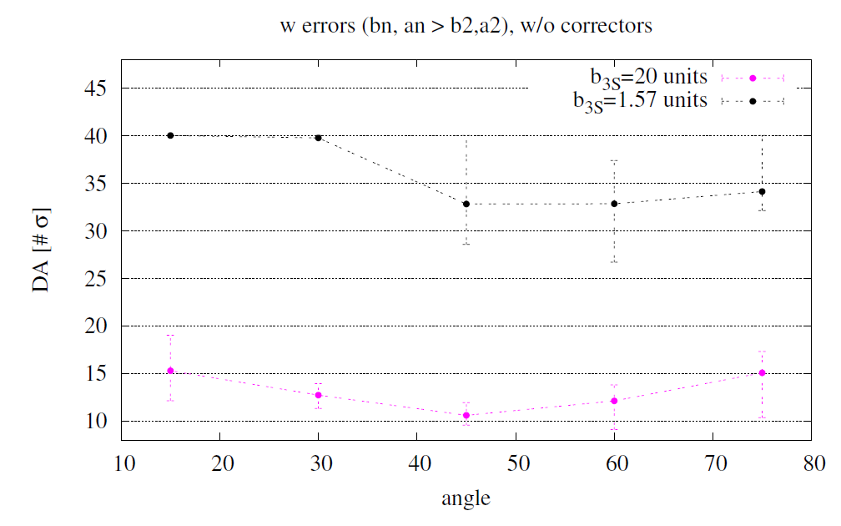
Example Estimate
Collision energy
Design to have B3 mainly at full energy
Design to have B3 mainly at injection
Conclusion:
Dynamic aperture too small
Would need very strong correctors (10xLHC)
2) Dynamic aperture looks fine
Need to work on dynamic aperture at injection
B. Dalena, A. Chance,
D. Boutin, J. Payet,

Slide 47
LHC Experiments
Field error depends on injection energy
Uncertain about reproducibility and stability at low fields
Experiment is important
D. Tommasini et al.
Inject beam into LHC at 225GeV
Or decelerate injected beam to 225GeV
Many changes are required and need to be undone
Best at the end of a run
Important for FCC as well:
Faster ramping
Profit from LHC and HL-LHC MDs
Impedances
Beam-beam
…
http://indico.cern.ch/event/469656/
B. Goddard et al.

Slide 48
If You Want to Contribute
Work/meeting structures established based on INDICO, see:
FCC Study: https://indico.cern.ch/category/5153/
In particular:
FCC-hh Hadron Collider VIDYO meetings
  https://indico.cern.ch/category/5263/
  Contacts: daniel.schulte@cern.ch
FCC-hadron injector meetings
  https://indico.cern.ch/category/5262/
  Contacts: brennan.goddard@cern.ch

Slide 49
Conclusion
FCC-hh developed as option for future flagship project at CERN
  Goal is to have CDR ready for European strategy update (2018)
  https://indico.cern.ch/category/5153/
  Workshop in Rome April 11-15, 2016
Work is progressing
More work to be done
  Exciting technological challenges
  Exciting beam physics
  Exciting physics
Your contributions are most welcome

Slide 50
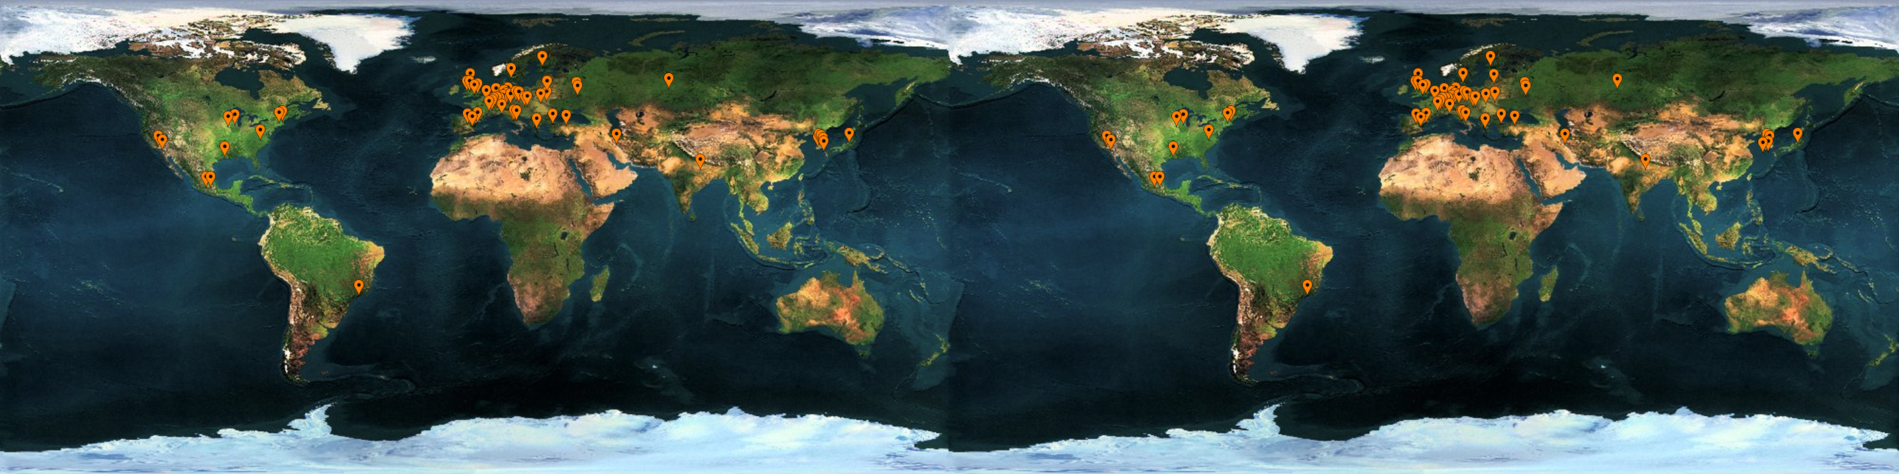



























Many thanks to FCC Collaboration
70 institutes
26 countries + EC
Status: November, 2015

Slide 51
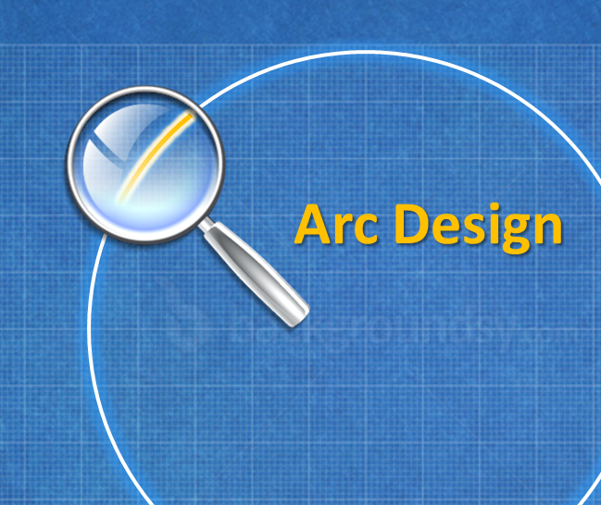
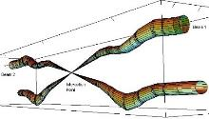
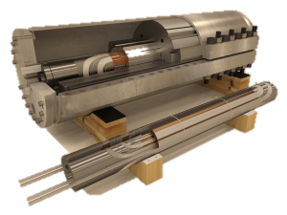
And EuroCirCol
Arc Design
EIR Design
Cryo Beam Vacuum
High Field Magnet
CERN | IEIO
TUT | Finland
CEA | France
CNRS | France
KIT | Germany
TUD | Germany
INFN | Italy
UT | Netherlands
ALBA | Spain
CIEMAT | Spain
STFC | United Kingdom
UNILIV | United Kingdom
UOXF | United Kingdom
KEK | Japan
EPFL | Switzerland
UNIGE | Switzerland
NHFML-FSU | USA
BNL | USA
FNAL | USA
LBNL | USA
Japan
KEK
EU co-funded design study for FCC-hh, focus on core activities
Accepted in 2015
Finland
TUT
United Kingdom
STFC, UNILIV, UOXF
Netherlands
UT
Germany
KIT, TUD
France
CEA, CNRS
CERN
Switzerland
EPFL, UNIGE
Italy
INFN
Spain
ALBA, CIEMAT

Slide 52
Reserve Slides

Slide 53
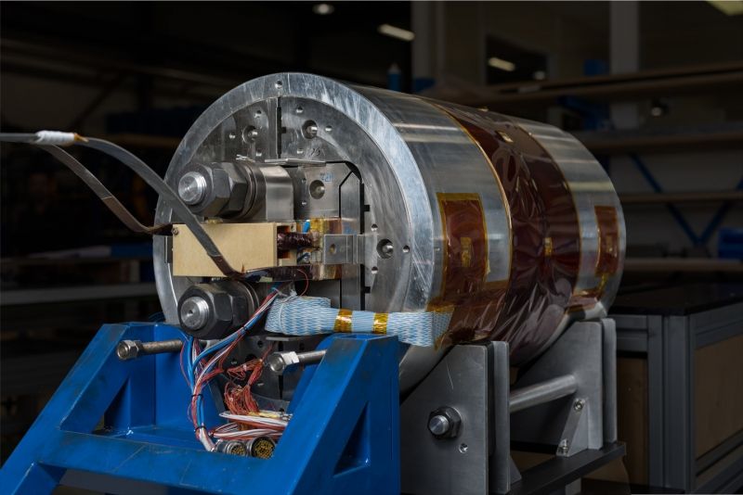
Magnets
Older example designs (one quarter)
(L. Rossi, E. Todesdco, P. MacIntyre )
Combination of materials used to reduce cost
Different designs are being explored for FCC
A recent test AT CERN has achieved world record of 16.2T
But a short racetrack magnet

Slide 54

Limits for the Field
The cable can quench (superconductivity breaks down)
if the current is too high
If the magnetic field is too high
This limits the achievable field
  In theory
  Even lower limit in practice (shown)
Can use different materials
  Nb-Ti is used for LHC
  Nb₃Sn is used for high luminosity upgrade

Slide 55
Cost Effective Magnet Design
Nb₃Sn is much more costly than Nb-Ti
Use both materials
Coil sketch of a 15 T magnet with grading, E. Todesco

Slide 56
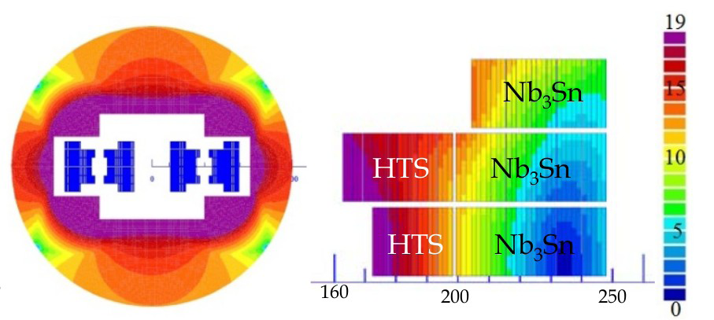
Cost Effective Magnet Design II
HTS is even more expensive than Nb₃Sn
Even more complex design
Coil sketch of a 20 T magnet with grading, E. Todesco

Slide 57
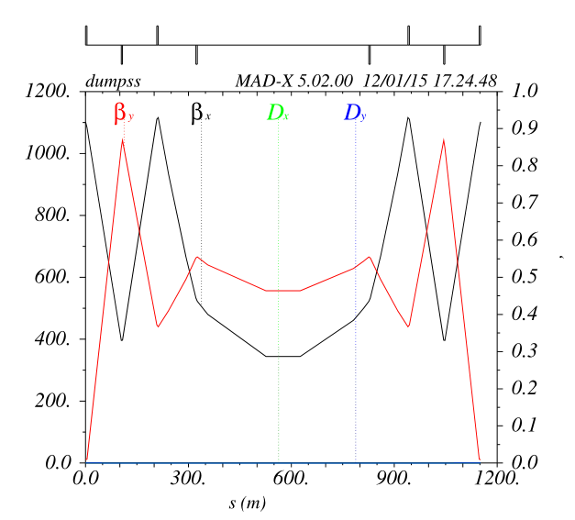
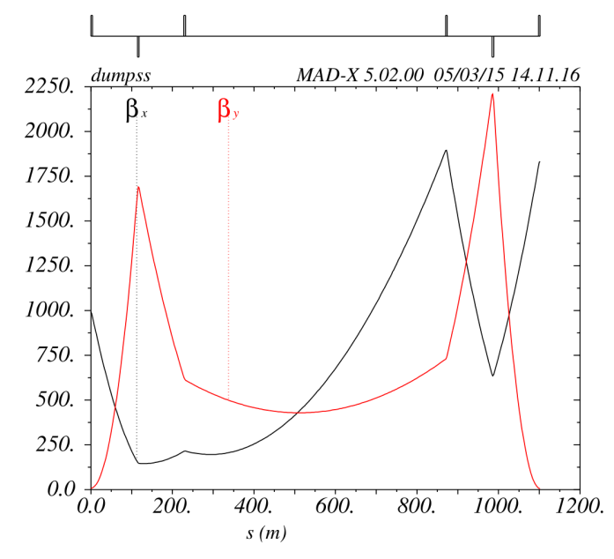
Dump Insertion Alternatives
SSC like
  Septum is part of extraction bump
  Use field free channel of septum to extract
  Need strong, good field quality septum
Asymmetric insertion optics
Avoid asynchronous dumps by accepting single kicker erratic
High segmentation of kicker system (200-300 modules)
Asymmetric optics
  to reduce oscillation from single kicker failure
  (small hor beta)
  to reduce kicker strength and dilute beam at absorbers (high betas at septum)

Slide 58
Beam Dump Dilution
Dilution pattern was evaluated as a function of dilution kicker magnet MKB parameters and energy deposition on the TDE.
Energy deposition studies by FLUKA (A.Lechner & P. Garcia)
Max. temperature below ~ 1500 °C.
Fixed dilution frequency:
f = 50.9 kHz
Maximum amplitude at the dump block: 80 cm
Bunch separation > 1.8 mm
Branch separation: 4 cm
Max deflection: 0.32 mrad
B.dl = 53 T.m
Alternative with frequency change:
f = 20.4 kHz – 42.9 kHz
Bunch separation = 1.9 mm constant
Branch separation = 4 cm
Max deflection = 0.24 mrad
Max amplitude = 0.59 m
Bdl = 39 Tm (2.5 km dump line)

Slide 59
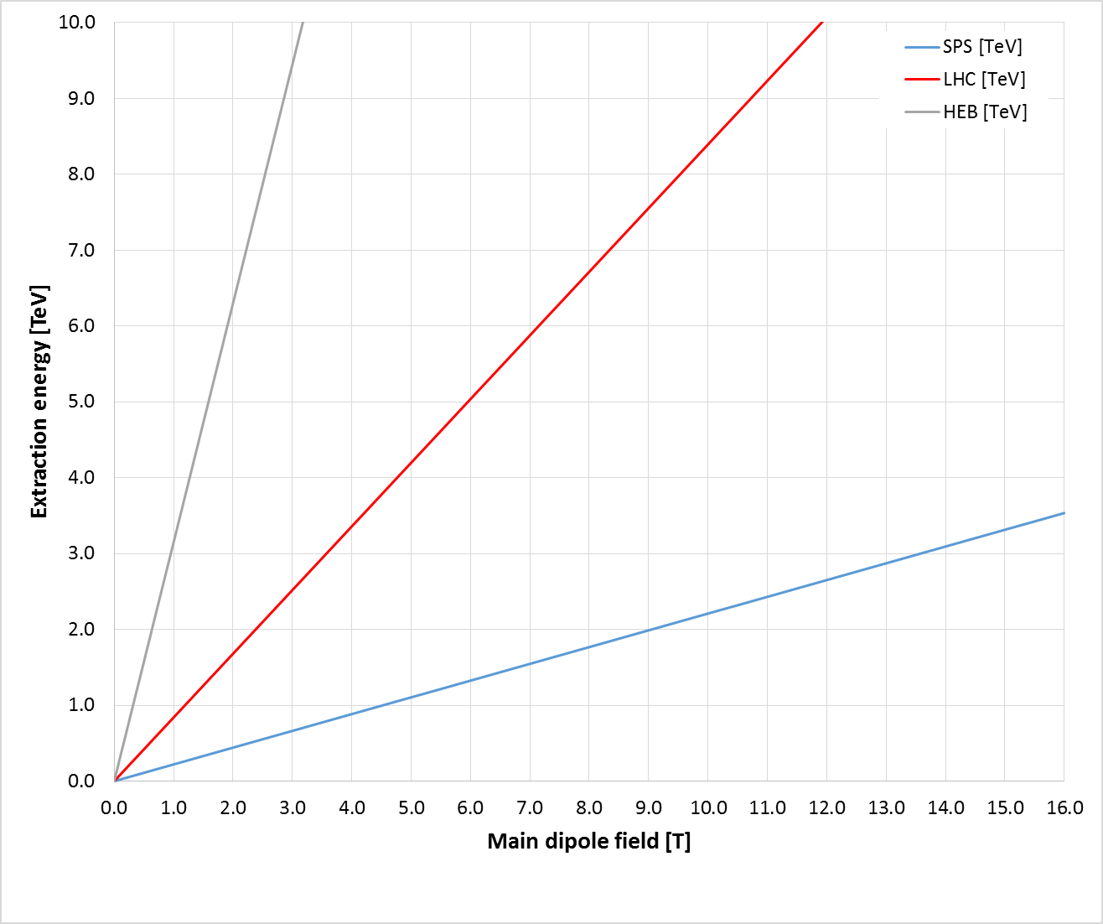
Injection from SPS Tunnel
B. Goddard at al.
low
high
NC / SF
SC Nb-Ti
SC Nb₃-Sn
3.3 TeV
Interesting upgrades
X
X
X
X
Probably slow to ramp
X
Exists

Slide 60
Injection from LHC Tunnel
B. Goddard at al.
low
high
NC / SF
SC Nb-Ti
SC Nb₃-Sn
X
New magnets
Maximum for existing LHC
3.3 TeV
X
X
Faster ramping of existing magnets
X

Slide 61
Injection from FCC Tunnel
B. Goddard at al.
low
high
NC / SF
SC Nb-Ti
SC Nb₃-Sn
Superferric
X
3.3 TeV
NC magnets
X

Slide 62

Thickness of Copper Coating
N. Mounet, G. Rumolo
ΔQ=0.5, can probably assume this upper limit on working point
Coating has some effect
Need maybe 300μm of copper coating
Difficult because of eddy currents in quench
Induces stress on beam pipe
LHC has 50μm
HTS coating? Lots of work
Impedance, coating technology, ecloud, …
Coating is very thin
Has hardly any effect
Coating is very thick
Material on the outside is hardly seen

Slide 63
Example for Loss Mechanism
Beam-gas scattering goal
>100h beam lifetime
<O(10¹⁵m⁻³) H₂ (σ≈100mb)
45kW proton losses
power for cooling
  @2K <30MW
  @4K <15MW
  some part is lost in collimation system
F. Cerutti, I. Besana
First studies indicate peak power density O(1mW/cm⁻³) and 3.5W/beam/dipole in cold
Seems very acceptable but need to define margin
Work in progress

Slide 64
Estimates of Beamipe Impedance Effects
N. Mounet, G. Rumolo
Growth rate of multi-bunch instability
10 turns
Noise growths every 20-30 turns by factor e
50 turns
Need feedback within 10 turns
Challenge for RF and instrumentation
Or increase the beam screen radius
Or decrease beam current
100 turns
Many more impedance studies required
Multi-bunch effect at 50K and injection (worst case)
Only resistive wall (infinite copper layer assumed)

Slide 65

Low Frequency Impedances
* www.copper.org
FCC
LHC
At injection multi-bunch instability is driven by resistivity of arc beam screen
Impedance more critical than in LHC
2b=26mm
50
Strong dependence on radius
Defines minimum b
Multi-bunch instability O(10) worse than in LHC
N. Mounet, G: Rumolo, O. Boine-Frankeheim, U. Niedermayer, F. Petrov, B. Salvant, X. Buffat, D.S.

Slide 66
FCC-hh Layout
Two main experiments on opposite sides of the collider
All bunches collide in main experiments
  independent of filling pattern
  Highest luminosity
Each bunch collides with the same bunch in both experiments
  Compensation of beam-beam effects

Slide 67
FCC-hh Layout
The injection insertion position is determined by LHC/SPS, if used as injector
Best place for RF

Slide 68
FCC-hh Layout
Additional experiments close to one main experiment
Separation to suppress background from one to the next
Symmetric to injection (could be changed)
Short arcs should allow for enough tuning

Slide 69
FCC-hh Layout
Foresee two collimation and extraction insertions
Insertions with largest risk
Scheme provides flexibility
Current baseline
betatron-collimation after extract to protect machine
Energy collimation

