Slide 1

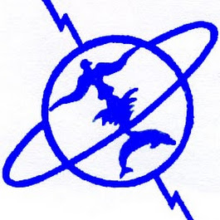

Mohamed V University
Faculty of Sciences
Rabat
The ATLAS Forward Calorimeter Analysis
The S-shape correction in the FCAL ATLAS Electromagnetic module "FCal1"
Prepared by :
DAHBI Salah-Eddine
Professor:
Prof. TAYALATI Yahya

Slide 2
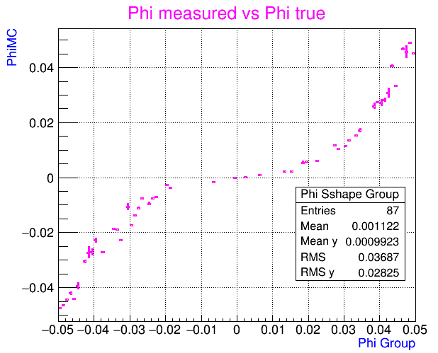
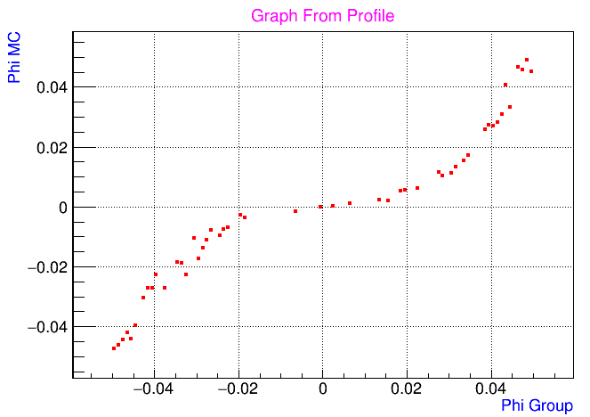
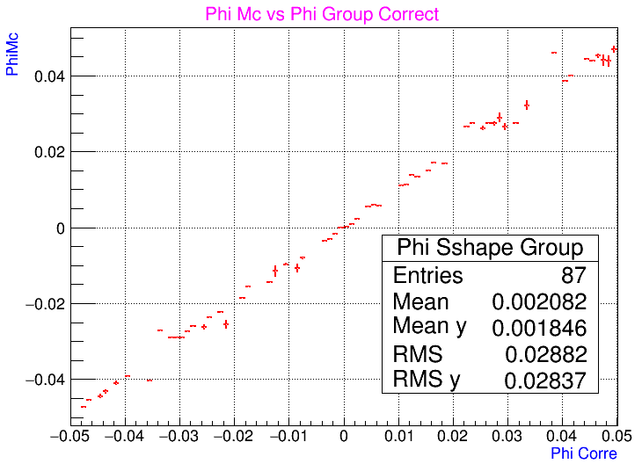
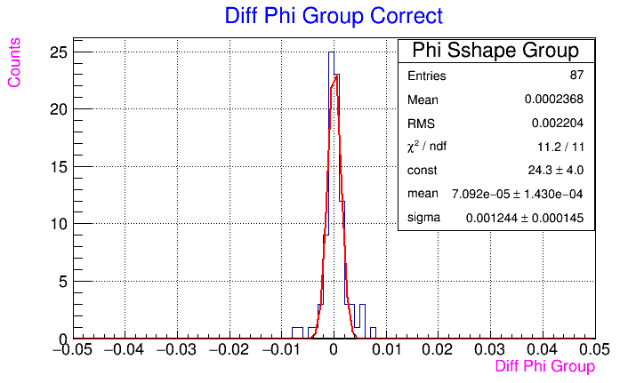
Group S-Shape Correction
φ between -0.05 rad to 0.05 rad .
η between 3.5 to 3.6 .
100 GeV e- .

Slide 3
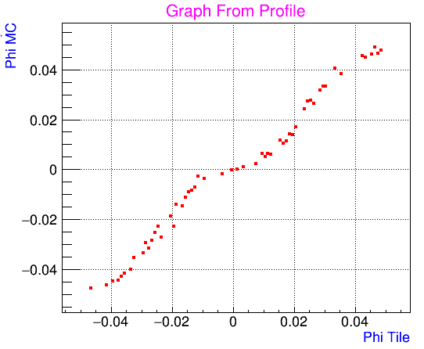
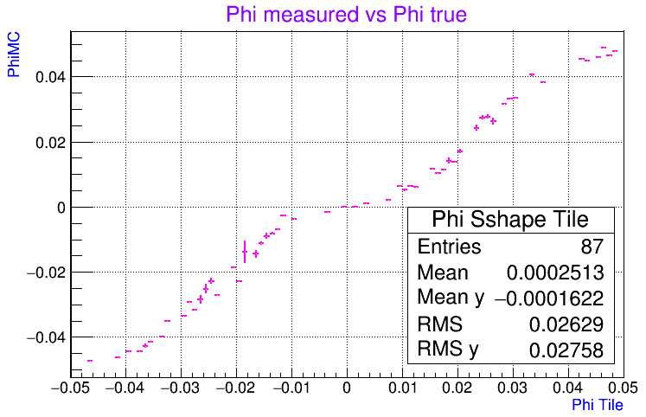
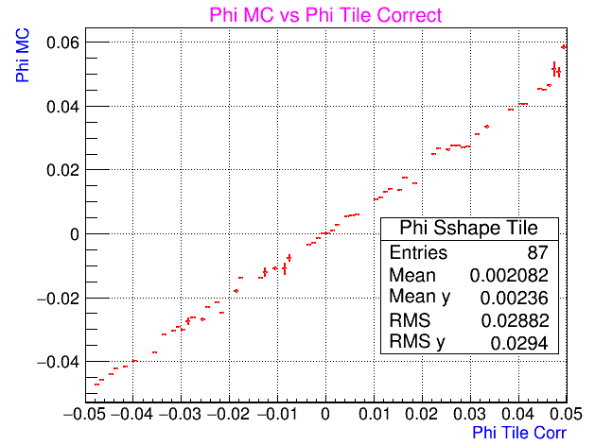
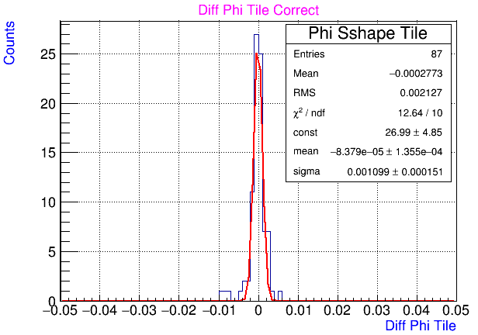
Tile S-Shape Correction
φ between -0.05 rad to 0.05 rad .
η between 3.5 to 3.6 .
100 GeV e- .

Slide 4
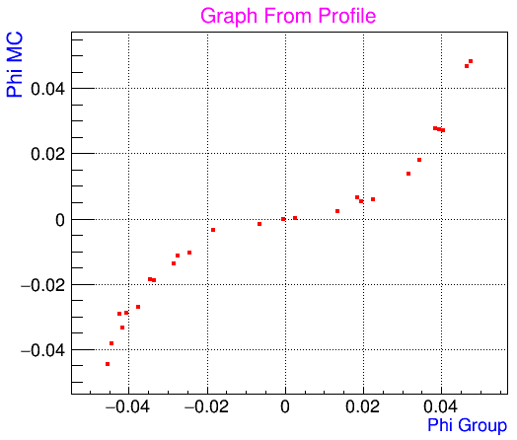
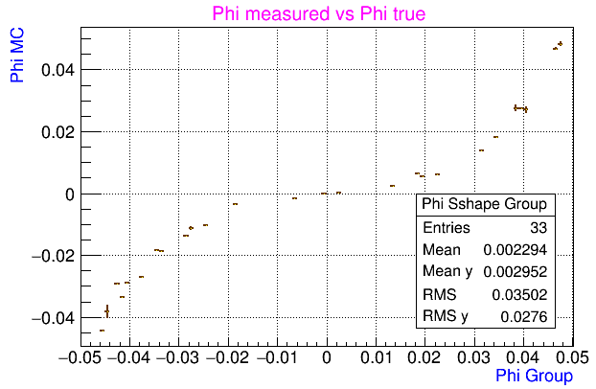
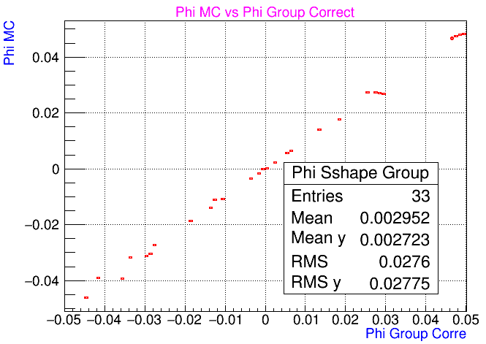
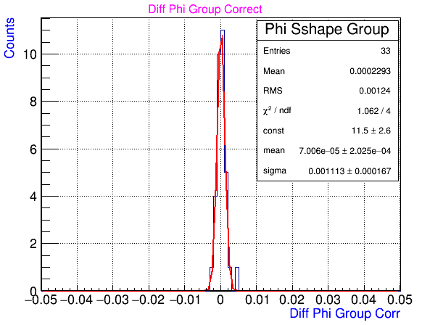
Group S-Shape Correction
φ between -0.05 rad to 0.05 rad .
η between 3.5 to 3.55 .
100 GeV e- .

Slide 5
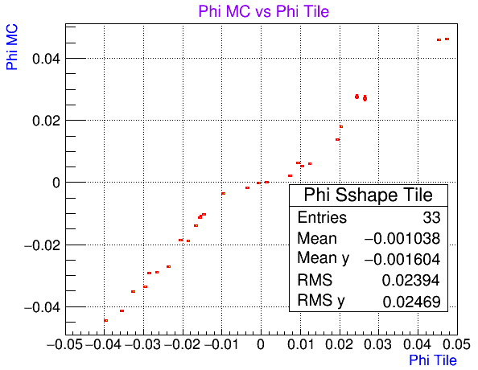
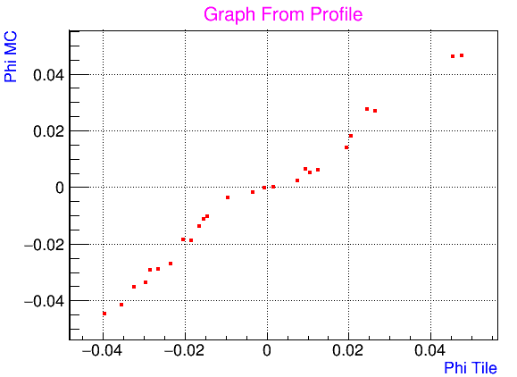
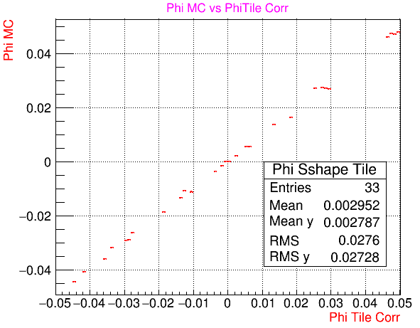
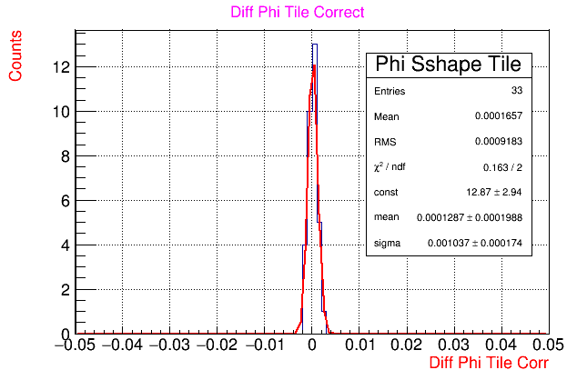
Tile S-Shape Correction
φ between -0.05 rad to 0.05 rad .
η between 3.5 to 3.55 .
100 GeV e- .

Slide 6
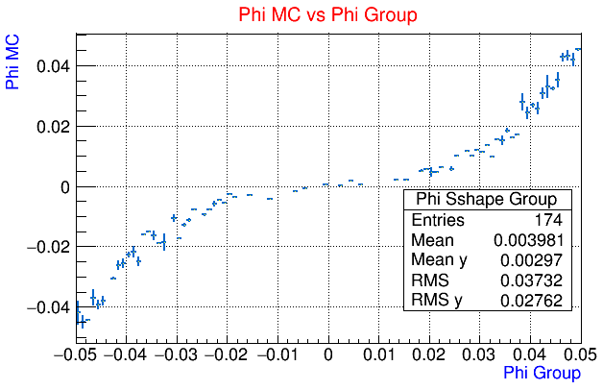
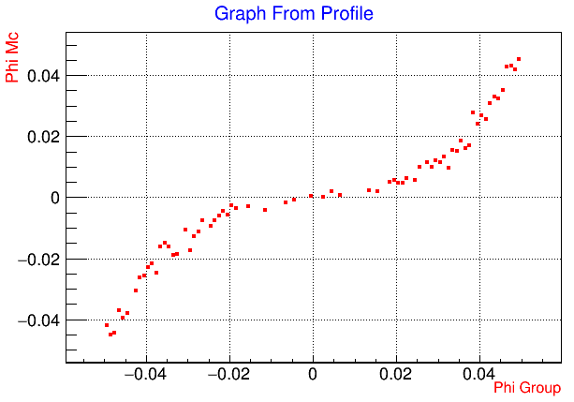
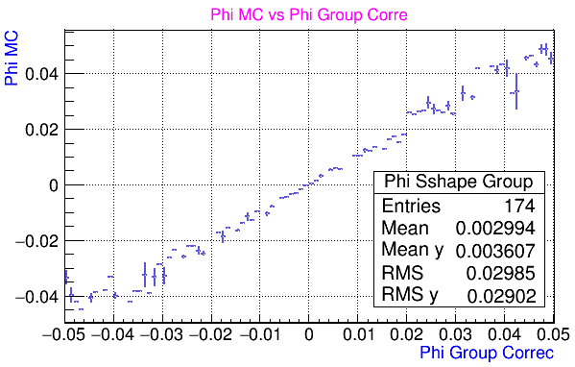
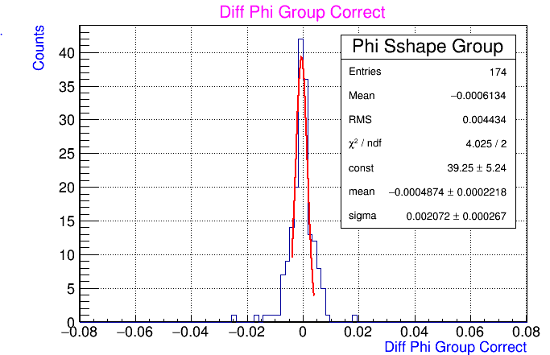
Group S-Shape Correction
φ between -0.05 rad to 0.05 rad .
η between 3.5 to 3.7
100 GeV e- .

Slide 7
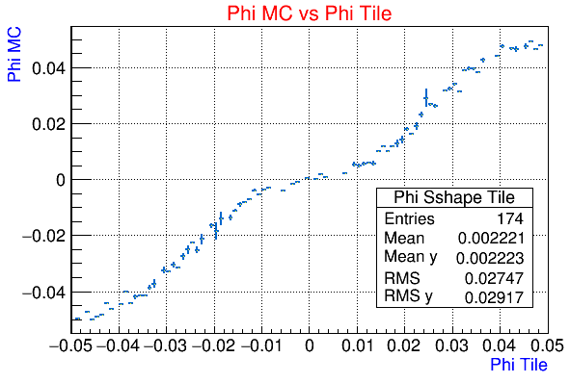
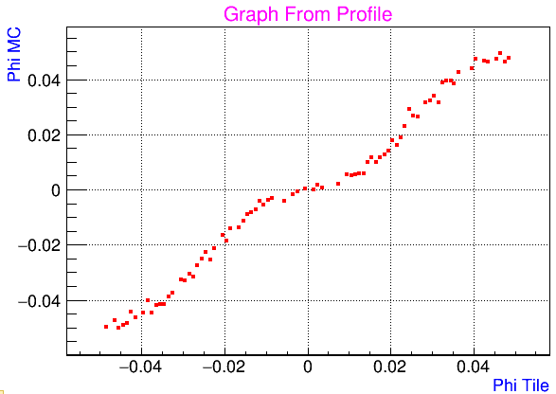
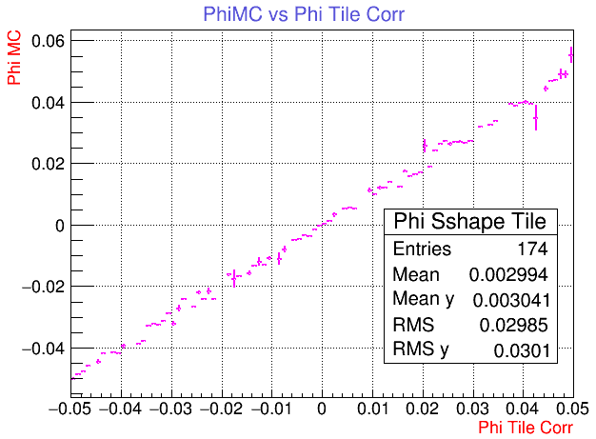
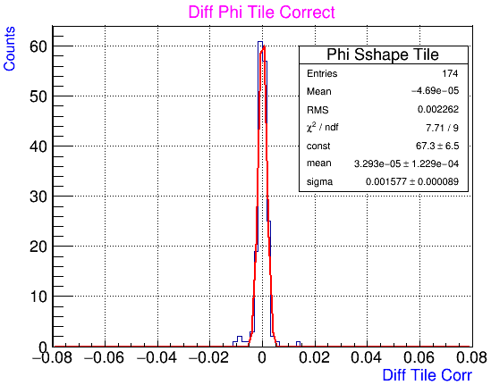
Tile S-Shape Correction
φ between -0.05 rad to 0.05 rad .
η between 3.5 to 3.7 .
100 GeV e- .

Slide 8
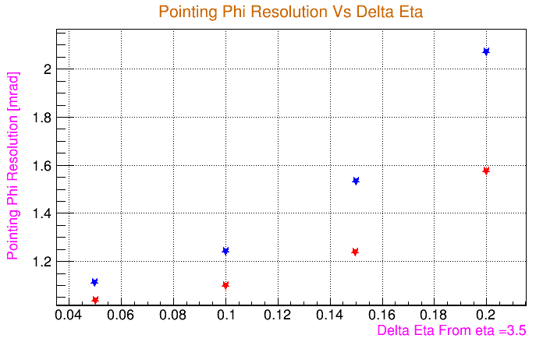
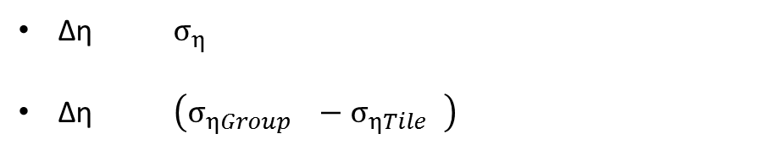
Group
Tile
Δη $σ_{η }$
Δη $\left(σ_{ηGroup }−σ_{ηTile }\right)$

