Slide 1



ATLAS Forward Calorimeter Electrons-Sshape
University
Mohammed I
Physics of Matter and Radiation Laboratory
Faculty of Sciences
Oujda
KTH/ FSO meeting
16/ 12/ 2015
Malika TOUIL – Yahya TAYALATI

Slide 2

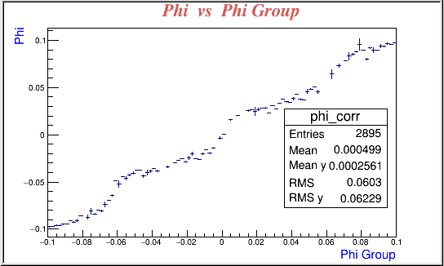
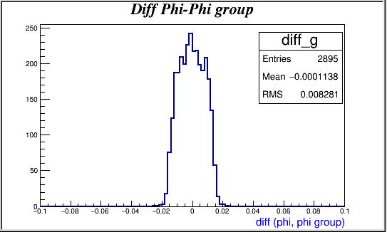
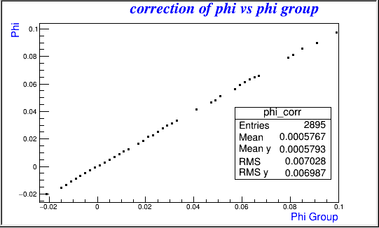
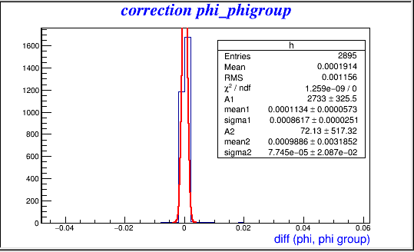


Electrons 100 GeV
$\text{3.1} \text{< }{\text{η}}_{ truth}$ < 3.2
$σ_{φ}=0.86$ mrad
2

Slide 3
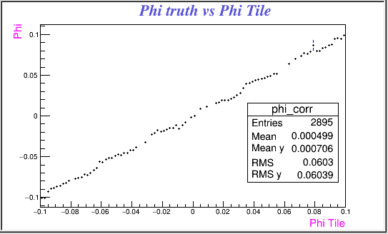
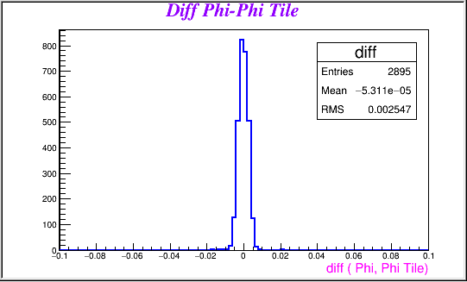
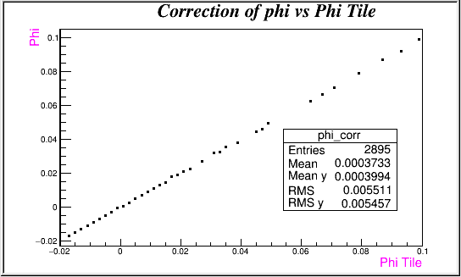
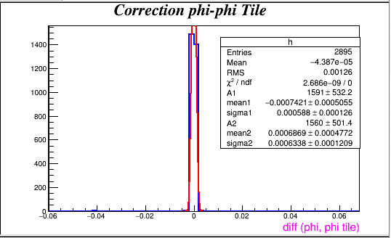


Electrons 100 GeV
$\text{3.1} \text{< }{\text{η}}_{ truth}$ < 3.2
$σ_{φ}=0.94$ mrad
3

Slide 4
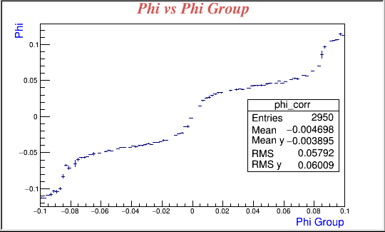
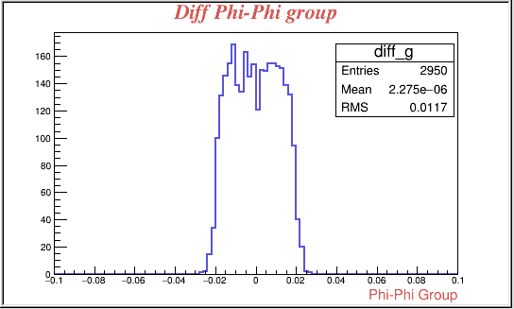
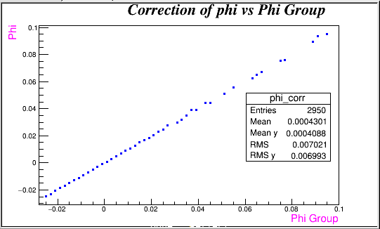
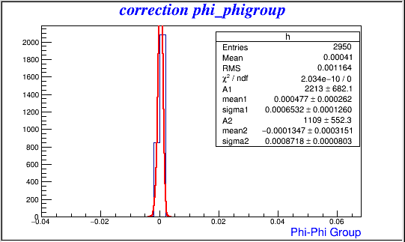


Electrons 100 GeV
$\text{3.4} \text{< }{\text{η}}_{ truth}$ < 3.5
$σ_{φ}=0.8$ mrad
4

Slide 5
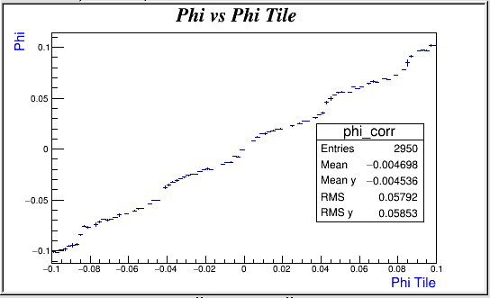
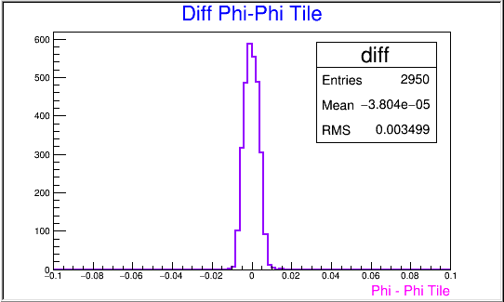
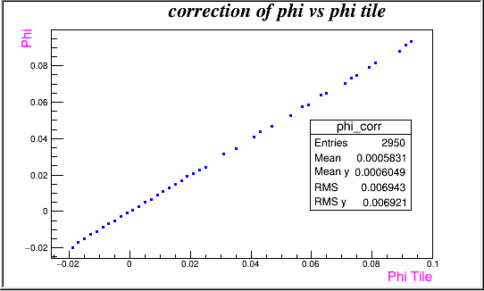
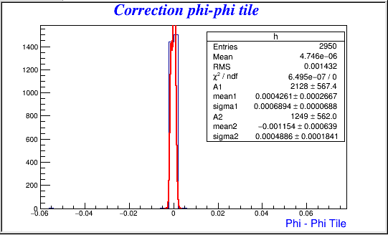

Electrons 100 GeV
$\text{3.4} \text{< }{\text{η}}_{ truth}$ < 3.5
$σ_{φ}=0.69$ mrad
5

Slide 6
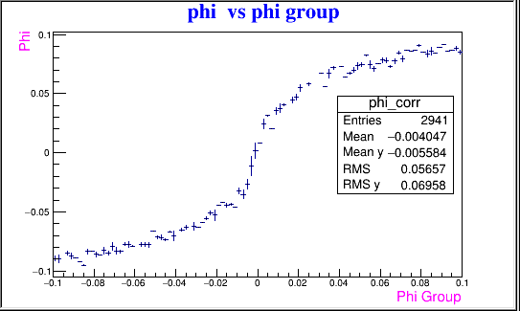
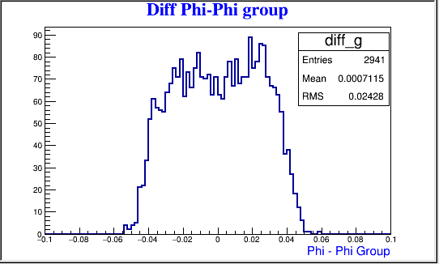
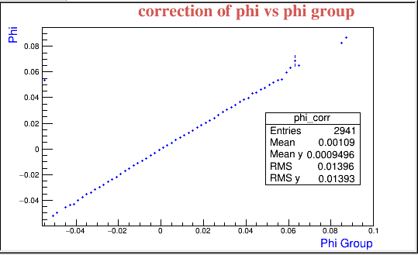
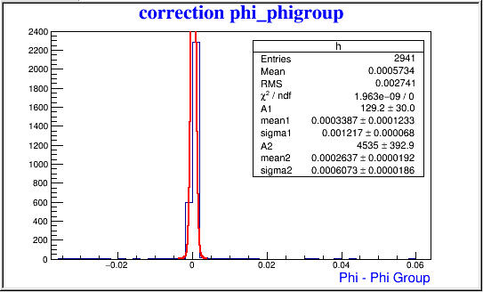


Electrons 100 GeV
$\text{ 4 }\text{.}\text{1}\text{< }{\text{η}}_{ truth}$ < 4.2
$σ_{φ}=0.66$ mrad
6

Slide 7
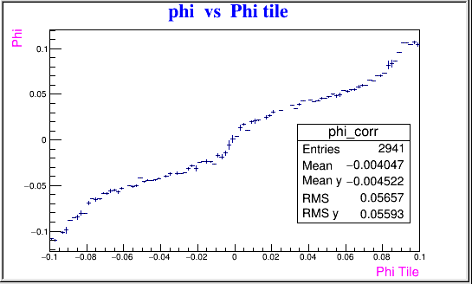
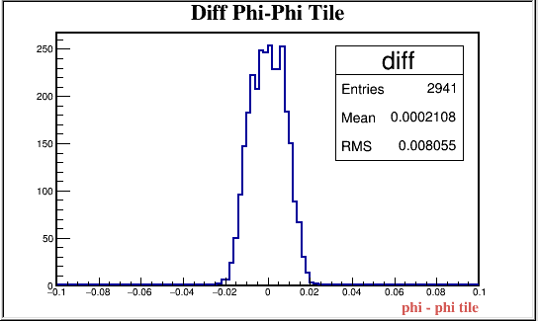
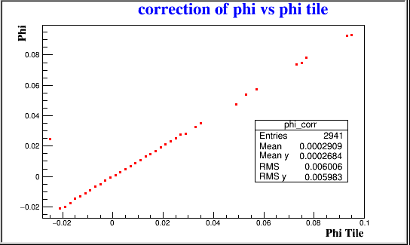
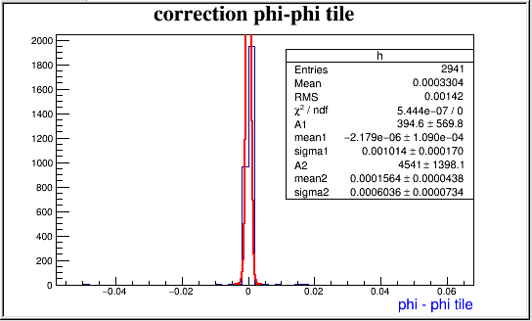

Electrons 100 GeV
$\text{ 4 }\text{.}\text{1}\text{< }{\text{η}}_{ truth}$ < 4.2
$σ_{φ}=0.67$ mrad
7

Slide 8
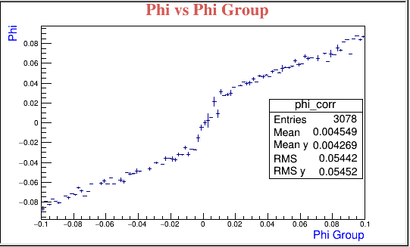
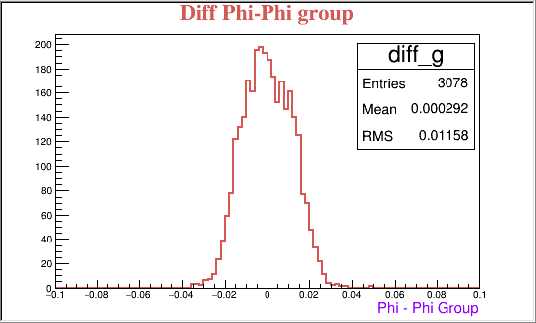
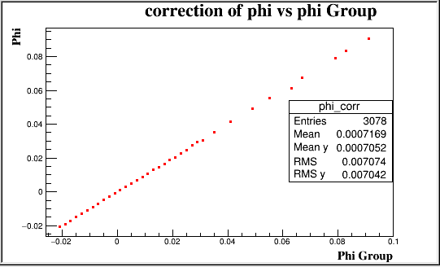
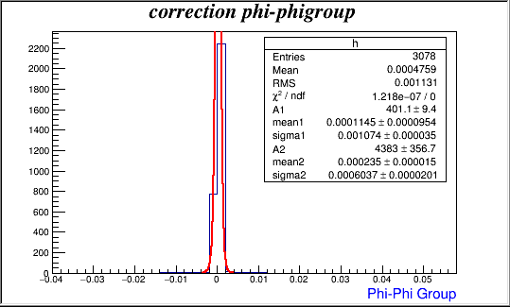

Electrons 100 GeV
$\text{4}\text{.4} \text{< }{\text{η}}_{ truth}$ < 4.5
$σ_{φ}=0.69$ mrad
8

Slide 9
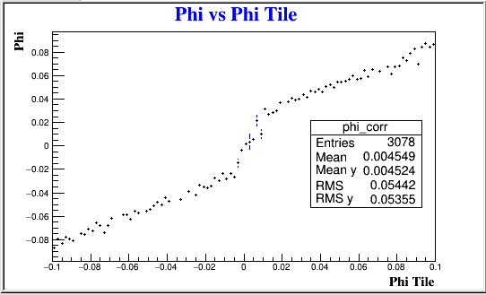
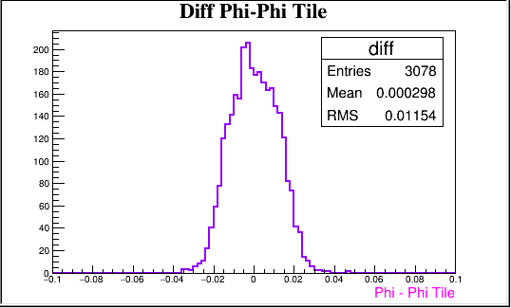
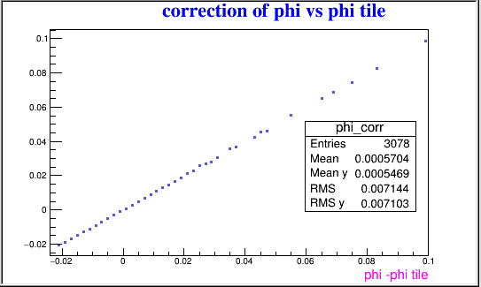
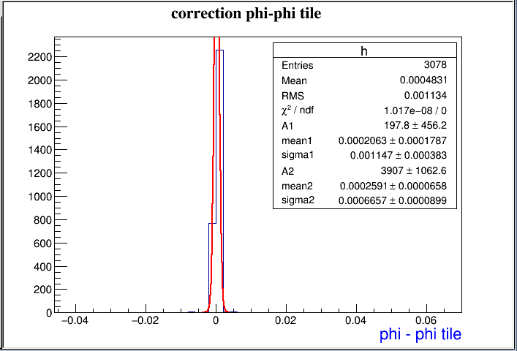

Electrons 100 GeV
$\text{4}\text{.4} \text{< }{\text{η}}_{ truth}$ < 4.5
$σ_{φ}=0.71$ mrad
9

