Slide 1
Non-Equilibrium Dynamics in Nuclear Collisions
Paul Romatschke
CU Boulder & CTQM Boulder

Slide 2
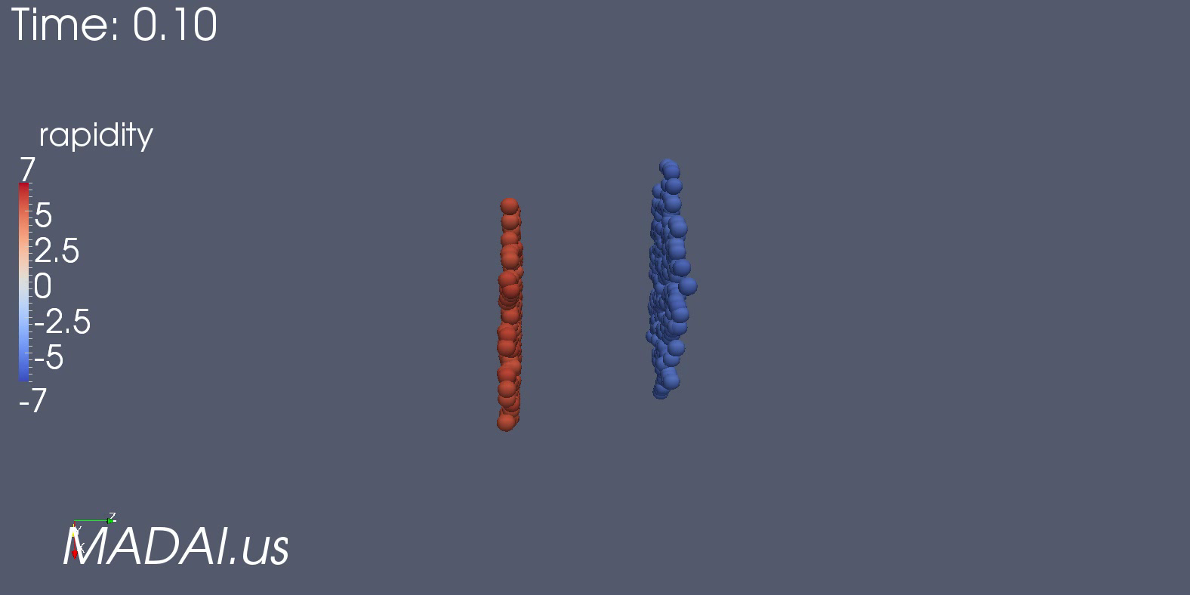
Heavy-Ion Collisions and Elliptic flow

Slide 3
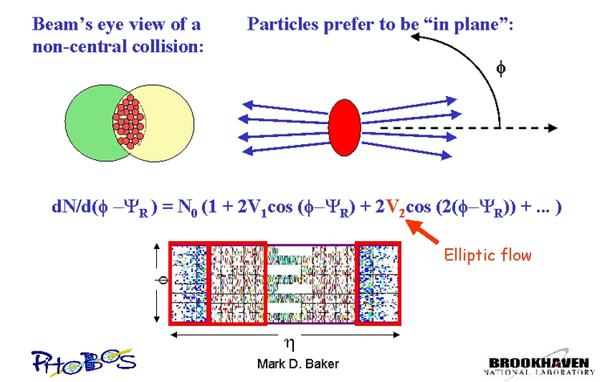
Heavy-Ion Collisions and Elliptic flow V₂

Slide 4
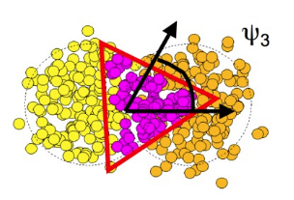
Heavy-Ion Collisions and Triangular flow V₃
dN/dφ ∼V₃cos(3φ)

Slide 5
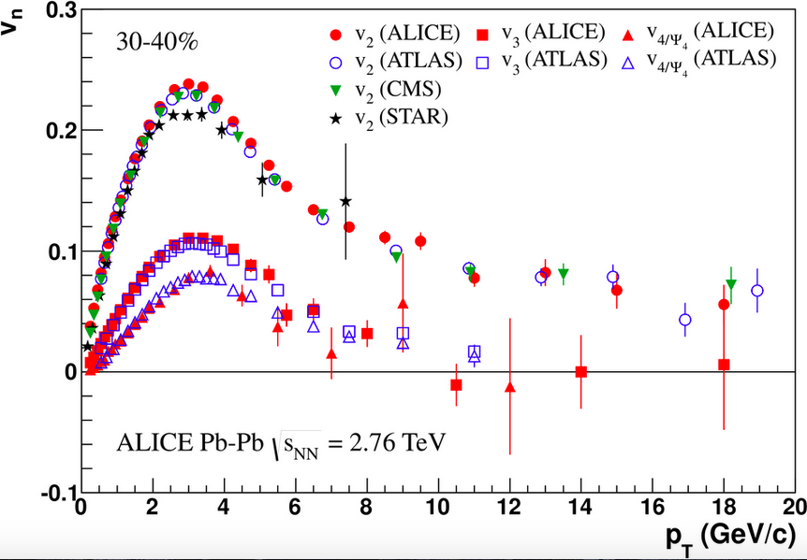
In Heavy-Ion collisions (e.g. Au+Au, P+Pb), V₂, V₃, V_{4,} …are all measured experimentally

Slide 6
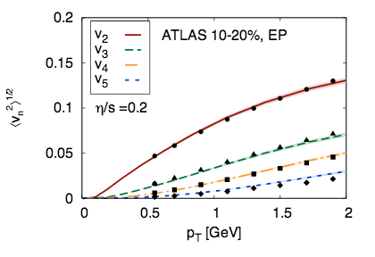
Hydro well describes A-A collisions
Contitutes major piece of evidence for formation of Quark-Gluon Plasma in the laboratory!
[Gale et al. 2012]

Slide 7
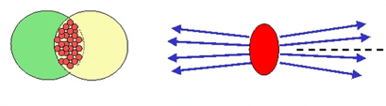
Hydrodynamics

Slide 8
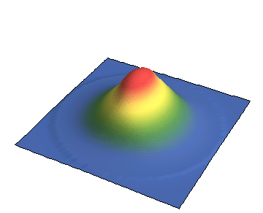

Hydrodynamics
Hydrodynamics converts gradients into velocities

Slide 9

Hydrodynamics
Hydrodynamics converts gradients into velocities
~
p

Slide 10
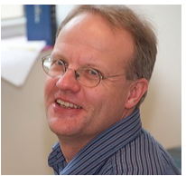

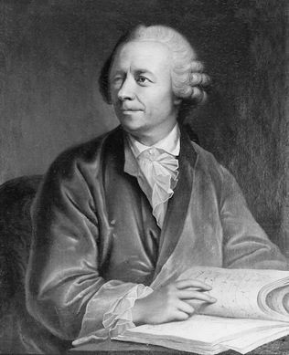
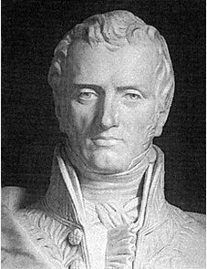
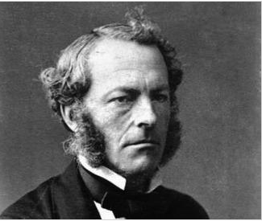
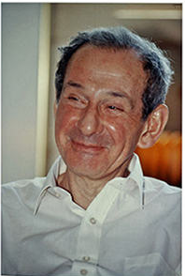
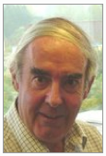








(Relativistic) Hydro History
Hydro (gradient) order
0th
1st
2nd
Navier & Stokes
Euler
& many others!

Slide 11
(Relativistic) Hydro Equations: Transport coefficients
Hydro (gradient) order
0th
1st
2nd
Speed of sound c_{s}
Shear and bulk viscosities η & ς
Second order coefficients: τ_{π}, λ₁, λ₂, λ₃, κ, κ*, ξ₁, ξ₂, ξ₃,…
Equilibrium
Non-equilibrium, but “close” to equilibrium
“Far” from Equilibrium

Slide 12
Example: Effective Pressure in Hydro
Ideal Hydrodynamics: T^{ab}=T^{ab}₍₀₎=diag(-ε,P,P,P)
Just equilibrium pressure
Navier-Stokes: T^{ab}=T^{ab}₍₀₎+π^{ab} ; π^{ab}=-η σ^{ab}; so Peff=P-η u
Equilibrium pressure+ “small” corrections
2nd order hydro (BRSSS) : T^{ab}=T^{ab}₍₀₎+π^{ab} ; D_{t} π^{ab}=-(π^{ab}+ η σ^{ab})/τ_{R}
Non-equilibrium pressure; OK as long as close to NS

Slide 13

Can this be checked?
Simple setup for equilibration: space-time initially at rest starts to expand in one dimension (“Bjorken flow”); matter reacts to ST
t<<0: g(t)=1 (Minkowski)
t>>0: g(t)=t² (Bjorken)
g(t) interpolating between Minkowski and Bjorken
ST flat except for small region around t=0
[Keegan et al, 1512.05347]

Slide 14


Can this be checked?
Simple setup for equilibration: space-time initially at rest starts to expand in one dimension (“Bjorken flow”); matter reacts to ST
Simulate solution exactly (using AdS/CFT & kinetic theory) and compare to hydrodynamics
Pressure anisotropy: “how far from equilibrium”
Navier-Stokes
[Keegan et al, 1512.05347]

Slide 15
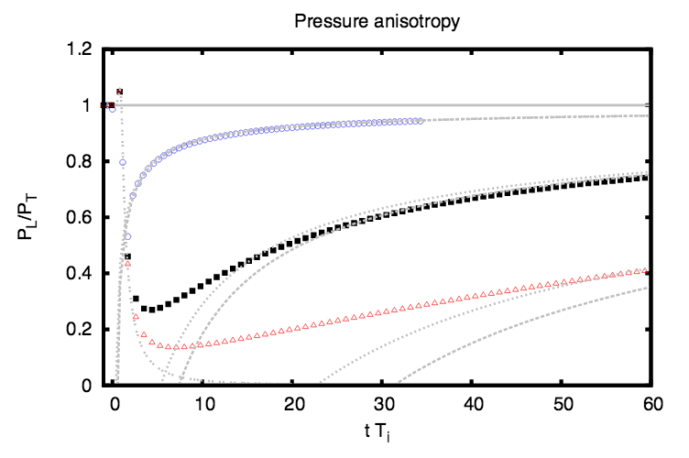

[Keegan et al, 1512.05347]

Slide 16
“Unreasonable” Effectiveness of Hydro
Hydrodynamics describes exact result when non-equilibrium corrections are 50-80%
Order unity deviation from Equilibrium Dynamics!
(2nd order) Hydro works for non-equilibrium situations!

Slide 17
Is this relevant for Heavy-Ion Physics?

Slide 18
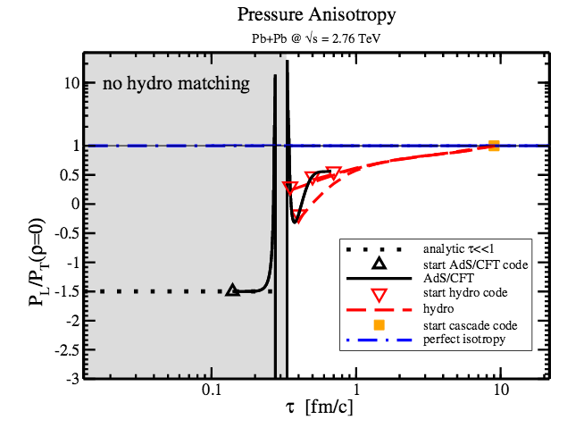
Simulating Pb+Pb using AdS+hydro+cascade
[van der Schee et al., 1307.2539]

Slide 19
Simulating Pb+Pb using AdS+hydro+cascade
[van der Schee et al., 1307.2539]

Slide 20
Reality-check: comparison to exp’ data
[Habich, et al., EPJ 2015]

Slide 21
Non-equilibrium dynamics in Pb+Pb
Pressure anisotropy O(1) in hydro simulations of HIC (all hydro groups)
Clear non-equilbrium phenomena!
Nevertheless, can be described by (2nd order) hydro!
Applicability of hydro not obvious from “standard” mean-free path argument (mean free path ~ system size)
Needed first-principles strong-coupling dynamics (e.g AdS/CFT) to verify
Why does it work? When does hydro break down?

Slide 22
Why does it work?
I do not know...
...but I have an argument!

Slide 23
Hydro vs. Non-hydro modes
Hydro modes: genuine low energy degrees of freedom (EFT)
Non-hydro modes: everything else
As long as non-hydro modes are not (strongly) excited, hydro offers a good description!
This criterion is not (trivially) related to “usual” mean free path vs. system size. Thus hydro may work in non-equilibrium situations.

Slide 24
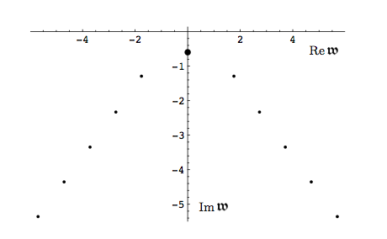
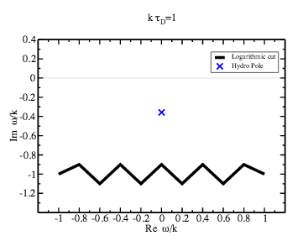
What are non-hydro modes?
Non-hydro QNMs in black holes
Branch cuts in kinetic theory
[Kovtun, Starinets, hep-th/0506184]
[PR, 1512.02641]

Slide 25
New criterion for applicability of hydro
Hydrodynamics good approximation of non-equilibrium dynamics as long as non-hydro modes not excited

Slide 26
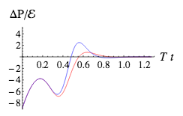
What happens if non-hydro modes excited?
Non-hydrodynamic transport
Example: pressure anisotropy in homogeneous system, e.g.
T^{ab}=diag(-ε,P_{T},P_{T},P_{T}+ΔP)
Hydrodynamics: no change of initial state (no flow in hom’ system)
Actual QFT evolution
[Heller et al, 1304.5172]
Pure non-hydro transport!

Slide 27
How to test if non-hydro modes excited?
2nd order hydro has non-hydro mode controlled by τ_{R}
Can test sensitivity of final results on τ_{R}
Practical criterion: vary τ_{R} by factor 2, see how much results change
Large variations: strong non-hydro contribution, hydro has broken down
Small variations: weak non-hydro contribution, hydro is in good shape

Slide 28
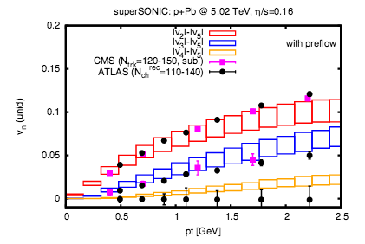
Testing Hydro for light-heavy ion collisions
[PR, 1502.04745]
Notes:
Uncertainty increasing as pT increases -> hydro breaks down at large pT; here effect is smaller because of particular freezeout prescription used.

Slide 29
Testing Hydro for light-heavy ion collisions
Non-equilibrium dynamics
Sensitivity to non-hydro modes small
Hydro reliable!
Can make predictions!

Slide 30
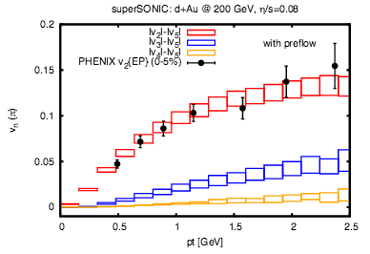
Hydro for d-Au @ 200 GeV
Prediction (to be tested): small but non-vanishing v₃ in central d+Au @ 200 GeV
[PR, 1502.04745]

Slide 31
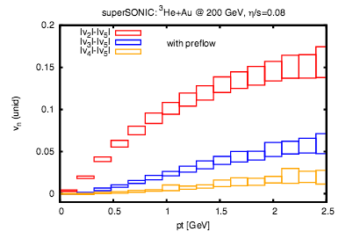
Hydro for ³He-Au @ 200 GeV
Prediction (tested): v₂, v₃ in central ³He+Au @ 200 GeV
[PR, 1502.04745]

Slide 32
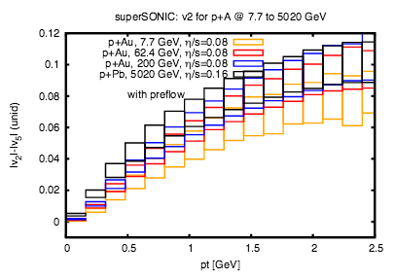
Hydro for p-A from 7.7 GeV to 2760 GeV
Prediction (tested): v₂ for central pAu @ 200 GeV
[PR, 1502.04745]

Slide 33
How do predictions hold up to experimental tests?

Slide 34
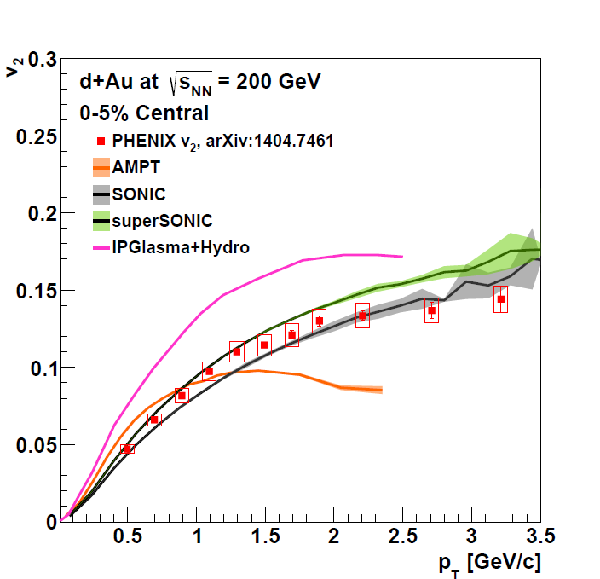
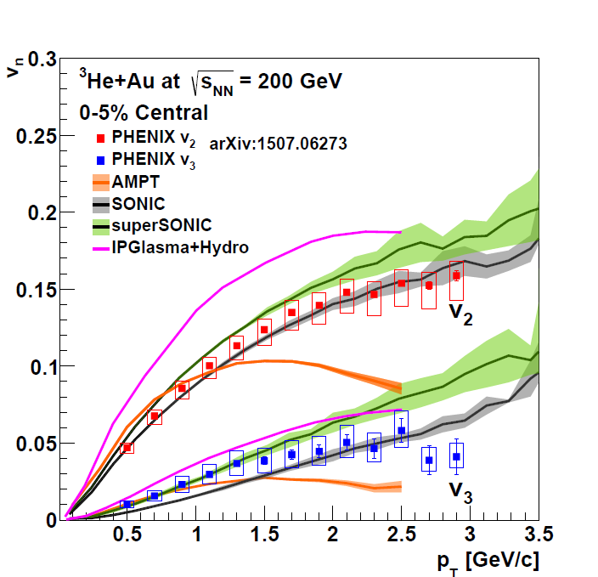
QM15: ³He+Au @ 200 GeV
AMPT: arXiv:1501.06880 SONIC: arXiv:1502.04745 IP+Hydro:arXiv:1407:7557
Several models can reproduce the v_{n} measurements in d+Au and ³He+Au collisions simultaneously

Slide 35
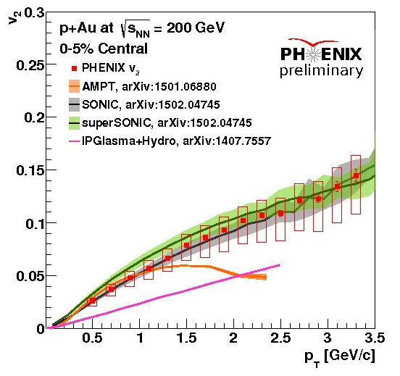
QM15: p+Au @ 200 GeV
"SONIC and superSONIC with Glauber initial conditions agrees with data within uncertainties"
"Hydrodynamics with IPGlasma initial conditions underpredicts v2 by x2."
"AMPT agrees up to pT ~ 1 GeV/c, then underpredicts"

Slide 36
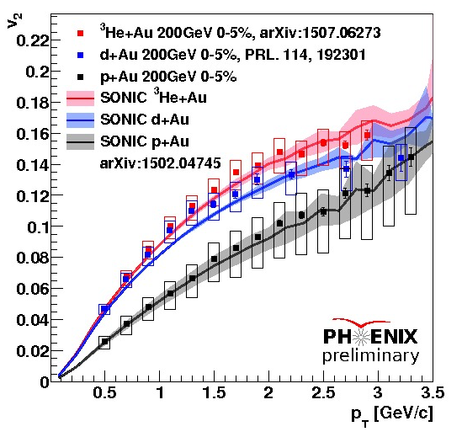
QM 15: p+Au, d+Au, 3He+Au @ 200 GeV
Glauber-like initial condition hydro + hadronic cascade
SONIC Calculations reproduce v₂ for p+Au, d+Au, ³He+Au within systematic errors.

Slide 37
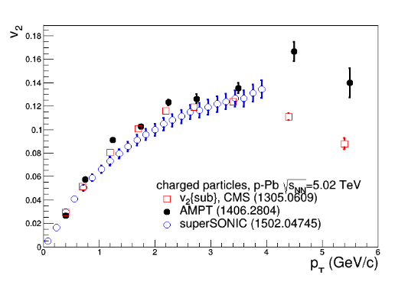
QM15: p+Pb @ 2760 GeV
[Slide by Constantin Loizides, QM15]

Slide 38

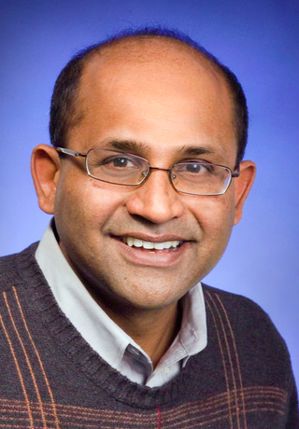
Comparison of hydro predictions to experimental data
Predictions from Hydro in small systems verified
Reaction from colleagues?
Blind Luck.

Slide 39
Beware of models that never fail!

Slide 40
Hydro in p+p collisions

Slide 41
Dn/dy~5 for p-p
Handful of particles
Would not expect so few particles to behave as a fluid
For “rare” high-multiplicity events P. Bozek [0911.2392]; Casalderrey-Solana & Wiedemann [0911.4400] conjecture:
Collective flow in pp collisions
Notes:
..and I said, as I often do: this has to be wrong. There surely cannot be flow in pp. I even wrote papers saying that there cannot be flow in pp.

Slide 42
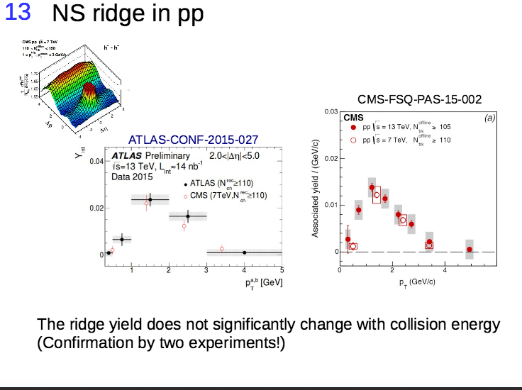
[Loizides, QM15]

Slide 43
Testing Hydrodynamics in pp collisions

Slide 44
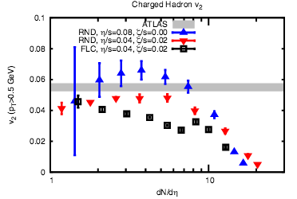
Hydro for p-p collisions
Hydro breaks down for peripheral pp, but seems OK for min-bias!
Naïve min-bias result for round protons matches exp’ data!!!
[Miller et al., 1512.05345]

Slide 45
Hydro with <5 particles
Hydro with 5 particles does not make sense
If system is strongly coupled, there are no good quasiparticles, just (quantum) fields
It is possible to derive hydrodynamics without ever using particle concepts
It is irrelevant how many particles there are in final state!
It is only marginally relevant that system is non-equilibrium
Hydro can apply to small systems if strongly coupled
Hydro for p-A !
Hydro for p-p !
Hydro for e⁺-e⁻ ???

Slide 46
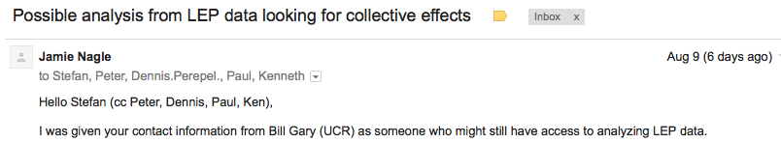
Looking for Hydro in e⁺ e⁻
Use modern analysis techniques on “old” LEP data
Hunt for the same type of signatures as found in pp
Need “raw” data, cannot do with published results
[…]

Slide 47
Hydrodynamics as Non-equilibrium Tool
Hydrodynamics describes (and predicts) non-equilibrium systems
Works when non-equilibrium corrections are O(1) “Large”
This “unreasonable” success continues to be surprising to some
Hydrodynamics does break down when non-hydro modes become important
I would argue that we understand hydro and have it under control!
Let’s use hydrodynamics to study non-equilibrium properties of QCD experiments!

Slide 48
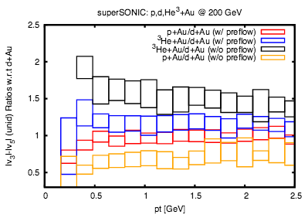
Small systems as QCD laboratory
Small systems retain memory about initial conditions (Saturation?)
Small systems retain memory about pre-equilibrium conditions (Pre-eq flow?)
[PR, 1502.04745]

Slide 49
Conclusions
(2nd order) Hydro is genuine non-equilibrium tool
Hydro reliable as long as non-hydro modes unimportant
Can test importance of non-hydro modes in practice
Nuclear Collisions offer experimental probe of non-eq’ effects
The smaller the collision system, the larger the non-eq effects
Predictions for QCD non-eq’ effects in light-heavy ion collisions
Maybe there are some gems still in e+ e- data!

Slide 50
Thank you!

Slide 51
Conclusions
(2nd order) Hydro is a tool for genuine non-equilibrium dynamics
Hydro gives reliable results even is non-equilibrium corrections are O(1)
Hydro Breaks down when non-hydro modes dominate evolution (early times, far from equilibrium)

Slide 52
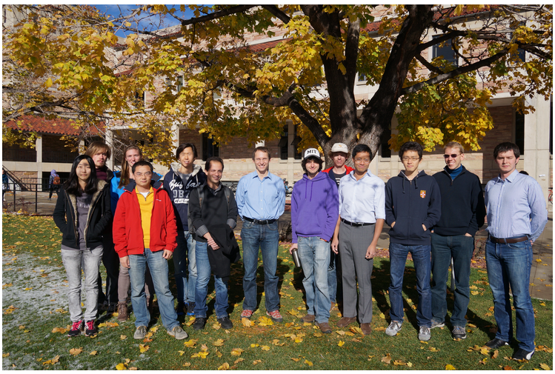
Thank you for your attention!
Strongly Coupled Fluids Group @ CU Boulder

Slide 53
Bonus Material

Slide 54
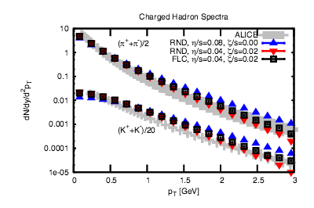
[Miller et al., 1512.05345]

Slide 55
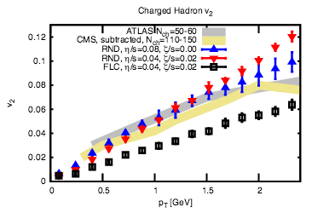
[Miller et al., 1512.05345]

Slide 56
[van der Schee, Romatschke, Pratt, PRL2013]

Slide 57
[Habich, Nagle, Romatschke, EPJ 2015]

