Slide 1
QUANTUM SCALAR CORRECTIONS TO THE GRAVITATIONAL POTENTIALS ON DE SITTER
˚ 1˚
Tomislav Prokopec, ITP Utrecht University
S. Park, T. Prokopec, R.P. Woodard, ``Quantum Scalar Corrections to the Gravitational Potentials on de Sitter Background,'' arXiv:1510.03352 [gr-qc]
Leonard, Park, Prokopec, Woodard, Phys.Rev. D90 (2014) 2, 024032 [arXiv:1403.0896 [gr-qc]]
Marunovic, Prokopec, Phys.Rev. D83 (2011) 104039 [arXiv:1101.5059 [gr-qc]]
Marunovic, Prokopec, Phys.Rev. D87 (2013) 10, 104027 [arXiv:1209.4779 [hep-th]]
D. Glavan, S.P. Miao, T. Prokopec and R.P. Woodard, ``Graviton Loop Corrections to Vacuum Polarization in de Sitter in a General Covariant Gauge,” arxiv:1504.00894, Class.Quant.Grav. 32 (2015) 19, 195014
D. Glavan S.P. Miao, T. Prokopec and R.P. Woodard, Class.Quant.Grav 31 (2014) 175002,
[arXiv:1308.3453 [gr-qc]]
CERN, 18 Aug 2016

Slide 2
CONTENTS
˚ 2˚
1) QUANTUM GRAVITY IS AN EFFECTIVE THEORY
2) QUANTUM GRAVITATIONAL EFFECTS ON FLAT MINKOWSKI SPACE
3) QUANTUM EFFECTS DURING INFLATION (DE SITTER AS TOY MODEL)
4A) AT BOUNDARY OF STABILITY: MASSLESS SCALAR ON DE SITTER
4B) STABLE THEORY: SCALAR ELECTRODYNAMICS
4C) WHEN STABILITY FAILS.. YUKAWA THEORY
4D) PERTURBATIVE GRAVITY ON DE SITTER: VACUUM POLARIZATION
4) GRAVITON SELF-ENERGY FROM SCALAR FIELDS
5A) DYNAMICAL GRAVITONS
5B) GRAVITATIONAL POTENTIALS ON DE SITTER
5) CONCLUSIONS AND OUTLOOK
Notes:
2

Slide 3
˚ 3˚
QUANTUM GRAVITY IS
AN EFFECTIVE THEORY

Slide 4

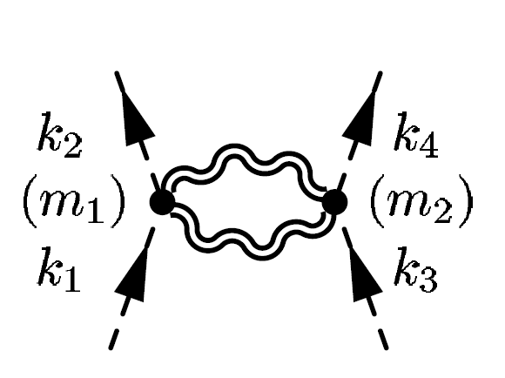
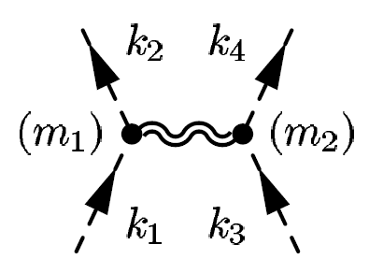

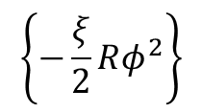
GRAVITY AS EFFECTIVE THEORY
˚ 4˚
● GRAVITY BECOMES STRONGLY COUPLED AT THE PLANCK SCALE
● AT PLANCK ENERGY ALL LOOPS CONTRIBUTE EQUALLY. For example
κ²=16πG
IN COMPARISON TO TREE LEVEL EXCHANGE: SUPPRESSED AS
● EFFECTIVE THEORY IS OF THE FORM (κ²=16πG)
$$\left\{−\frac{ξ}{2}Rφ^{2}\right\}$$
● THIS THEORY CAN BE PERT QUANTIZED. AS LONG AS ci‘s ARE NOT
HUMANGOUSLY LARGE, THE FIRST TWO TERMS DETERMINE
LOW ENERGY GRAVITY
John F. Donaghue, Phys.Rev. D50 (1994) 3874-3888 [gr-qc/9405057]

Slide 5
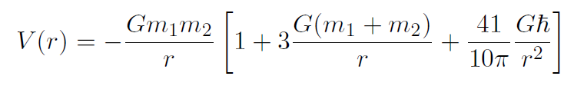
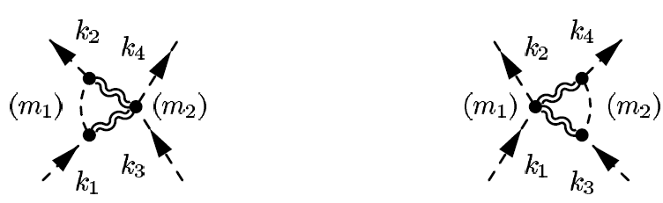
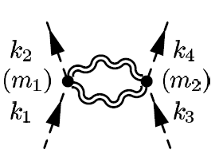
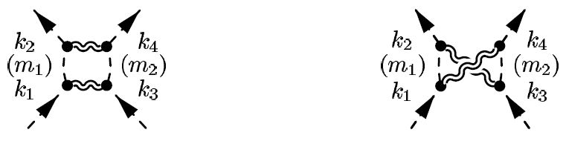
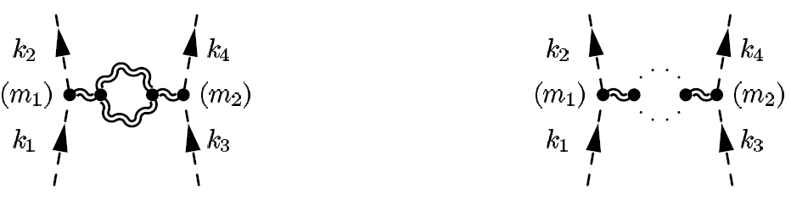
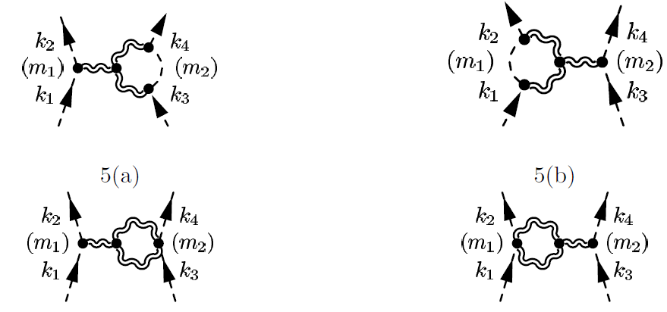
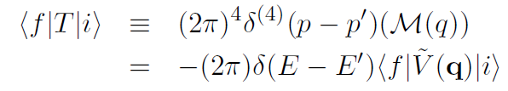
GRAVITY AS EFFECTIVE THEORY 2
˚ 5˚
● E.G. AT ONE LOOP, TWO HEAVY MASSES (in nonrel limit) ATTRACT
EACH OTHER BY A FORCE DETERMINED BY THE POTENTIAL
Bjerrum-Bohr, Donaghue, Holstein, Phys.Rev. D67 (2003) 084033 [hep-th/0211072]
CONTRIBUTING DIAGRAMS:
BOX & CROSSED BOX
TRIANGLE DIAGRAMS
DOUBLE SEAGULL
VACUUM POLARIZATION DIAGRAMS
VERTEX CORRECTIONS
TECHNIQUE: IN-OUT SCATTERING AMPLITUDE.

Slide 6
˚ 6˚
QUANTUM GRAVITATIONAL EFFECTS ON MINKOWSKI

Slide 7
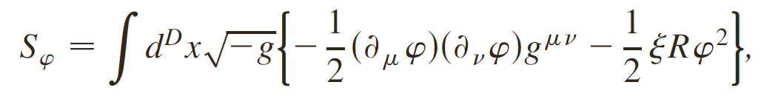
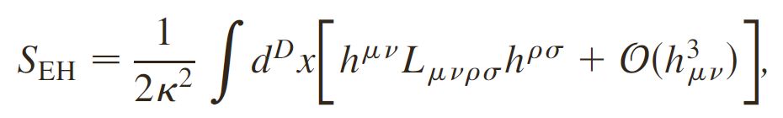
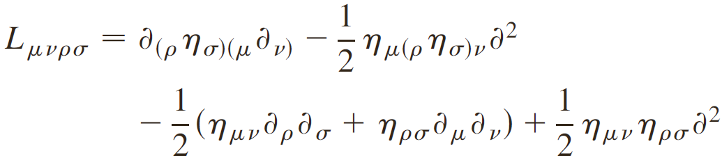
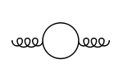
1 LOOP GRAVITON SELF-ENERGY: MINKOWSKI
˚ 7˚
Marunovic, Prokopec, Phys.Rev. D83 (2011) 104039 [arXiv:1101.5059 [gr-qc]]
● ALL MATTER COUPLES TO GRAVITY: SCALARS, VECTORS, FERMIONS
● CONSIDER MASSLESS NONMINIMALLY COUPLED SCALARS
● ACTION:
● GRAVITATIONAL ACTION (quadratic in perturbations around Minkowski):
κ²=16πG
- LICHNEROWICZ OPERATOR (on Minkowski):
- CONTRIBUTING 1 LOOP DIAGRAMS

Slide 8
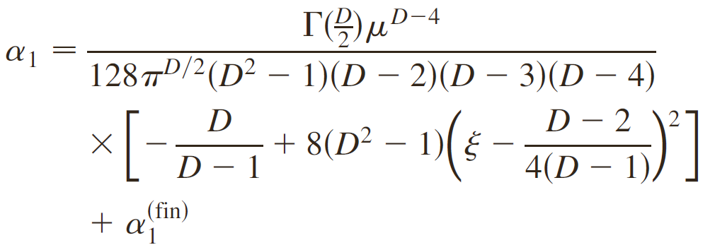
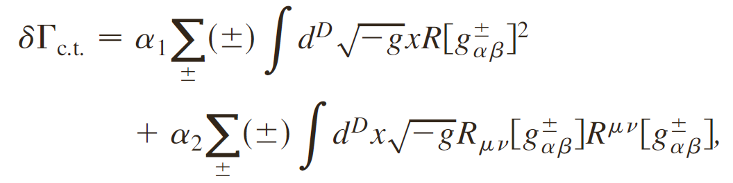
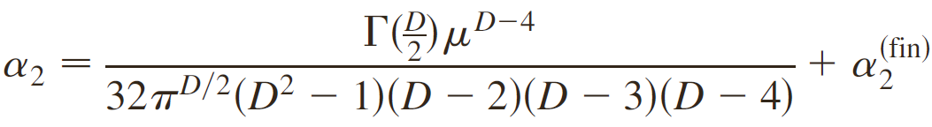
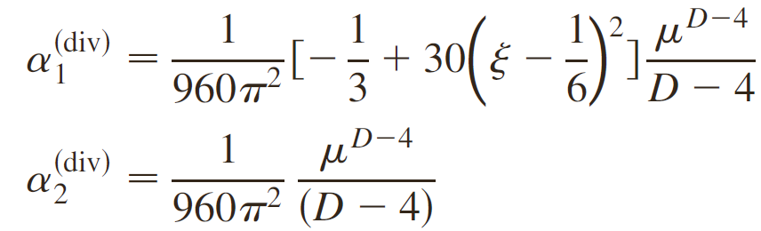
RENORMALIZATION
˚ 8˚
● DIM REG REQUIRES 2 COUNTERTERMS:
Minimal subtraction scheme [when ξ=0 agrees with ‘t Hooft, Veltman 1974]:

Slide 9
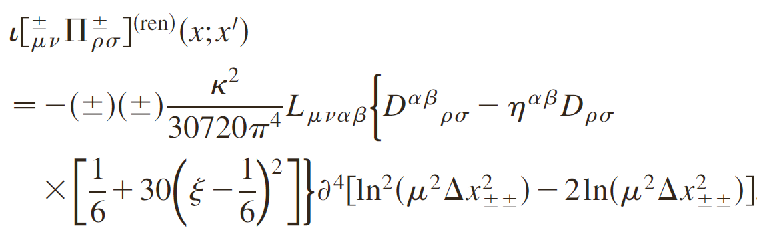

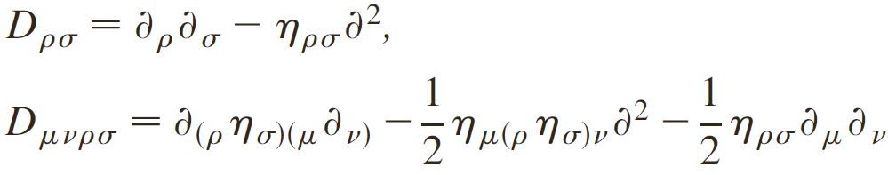
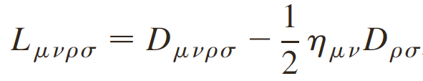
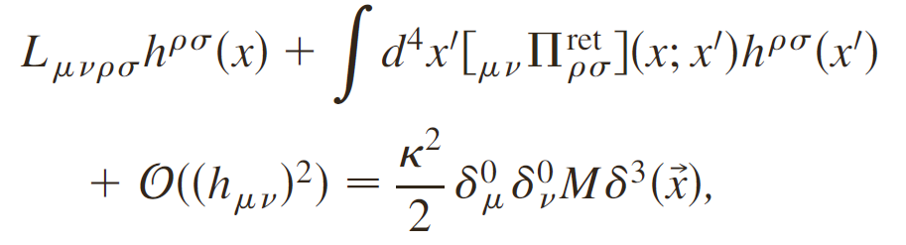
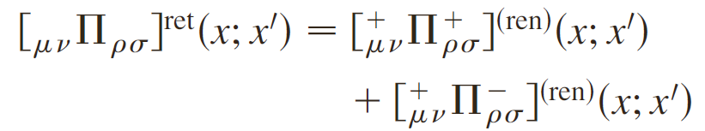
RENORMALIZED SELF-ENERGY
˚ 9˚
● we work in Schwinger-Keldysh formalism, suitable for non-equil. problems
● PERTURBING THE METRIC AROUND MINKOWSKI
● 1PI EFFECTIVE EQUATION OF MOTION FOR THE GRAVITON:
RETARDED SELF-ENERGY: CAUSAL

Slide 10
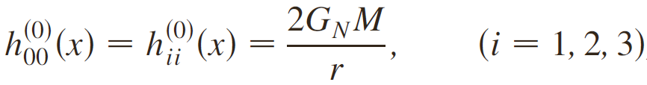


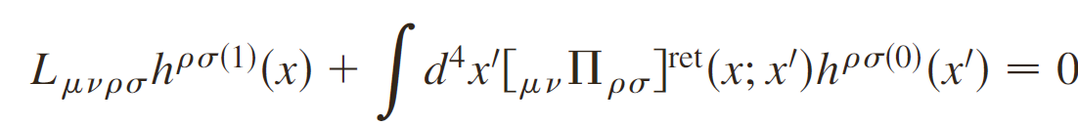
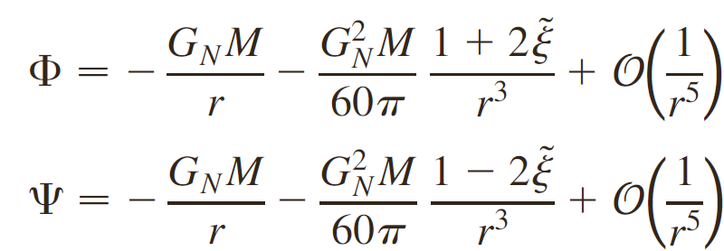

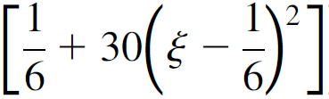
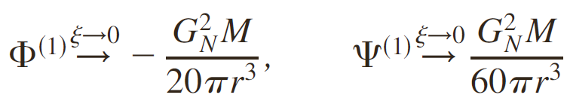
PERTURBATIVE SOLUTION TO 1PI EFFECTIVE EOM
˚10˚
● TREE LEVEL SOLUTION FOR POINT PARTICLE MASS M at r=0:
NEWTONIAN POTENTIALS
● METRIC PERTURBATION:
where κ²=16πGN IS LOOP COUNT. PARAMETER OF QG
● PERTURBED 1PI EOM
● SOLUTION: PERT CORRECTED BARDEEN POTENTIALS
- agrees with Park+Woodard (2010) in their gauge

Slide 11

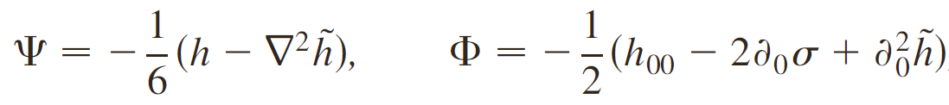
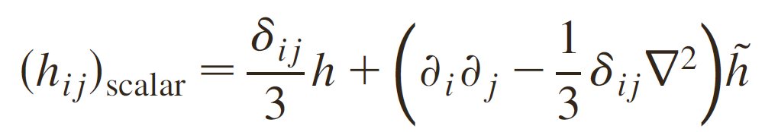
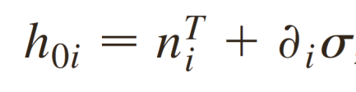

BARDEEN POTENTIALS
˚11˚
● GAUGE INV SCALAR POTENTIALS: inv. under infinitesimal coord. transforms
ARE BARDEEN POTENTIALS
WHERE
NB: Φ,Ψ REDUCE TO USUAL GRAV POTENTIALS φN, ψN IN LONGITUDINAL GAUGE

Slide 12
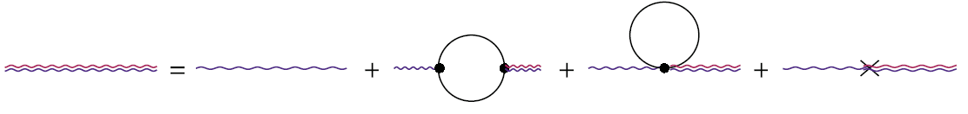
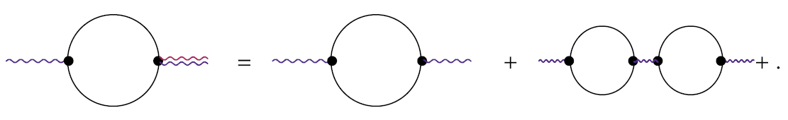
RESUMMATION
˚12˚
● SOLVING 1PI EQ RESUMS 1 LOOP
(BUBBLE & DAISY) DIAGRAMS
● SCHWINGER-DYSON EQUATION:
RESUMMED DIAGRAMS INCLUDE..
RECALL: GAP EQUATIONS IN COND MATTER PRODUCED FAMOUS RESULTS: SC,..

Slide 13
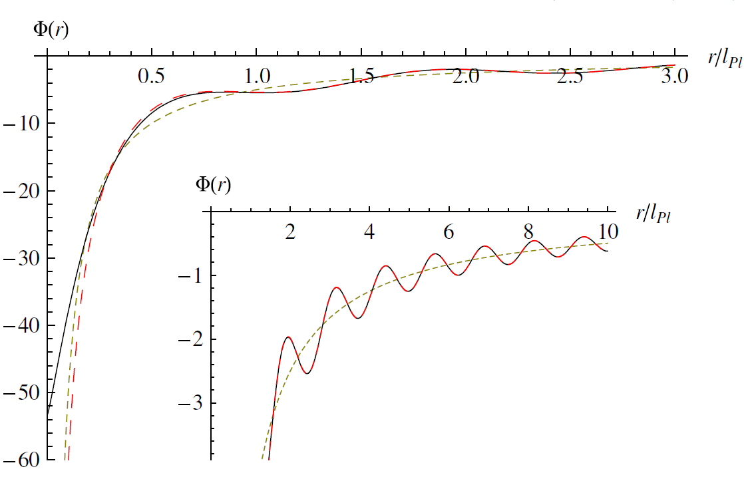
RESUMMED 1LOOP POTENTIALS
˚13˚
● TIME-LIKE BARDEEN POTENTIAL Φ (ξ=0, 1/3, rs/lp=10): LARGE MASS

Slide 14
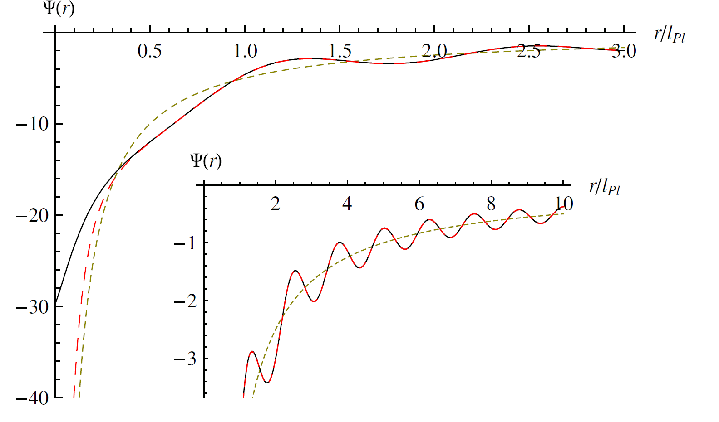
RESUMMED 1LOOP POTENTIALS 2
˚14˚
● SPATIAL BARDEEN POTENTIAL Ψ (ξ=0, 1/3, rs/lp=10): LARGE MASS
● RESUMMATION TELLS US THAT AT SMALL DISTANCES QUANTUM
SCALAR PERTURBATIONS ANTISCREEN NEWTONIAN POTENTIALS

Slide 15
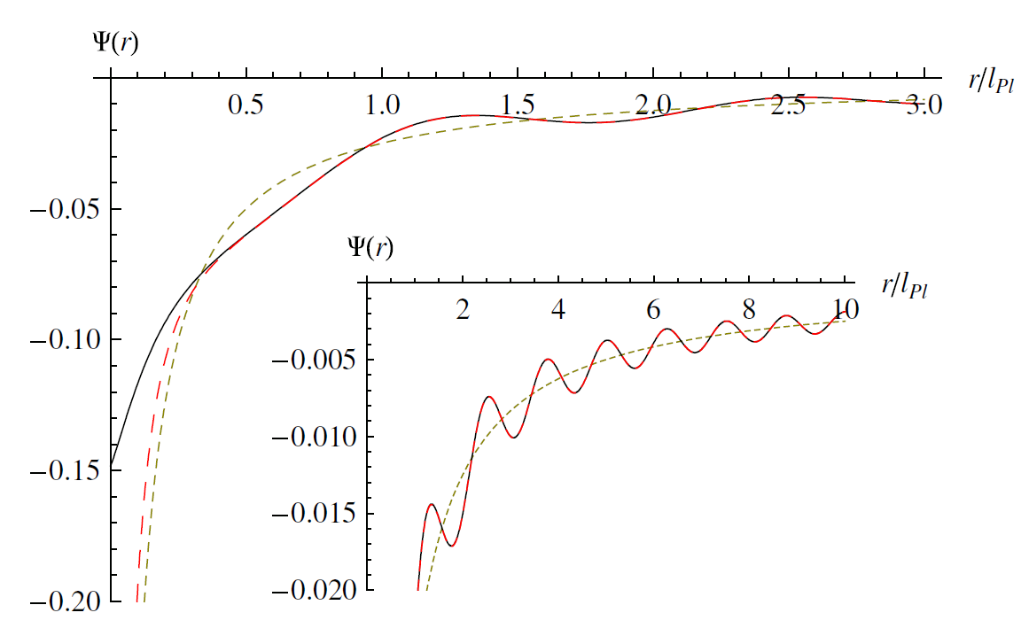
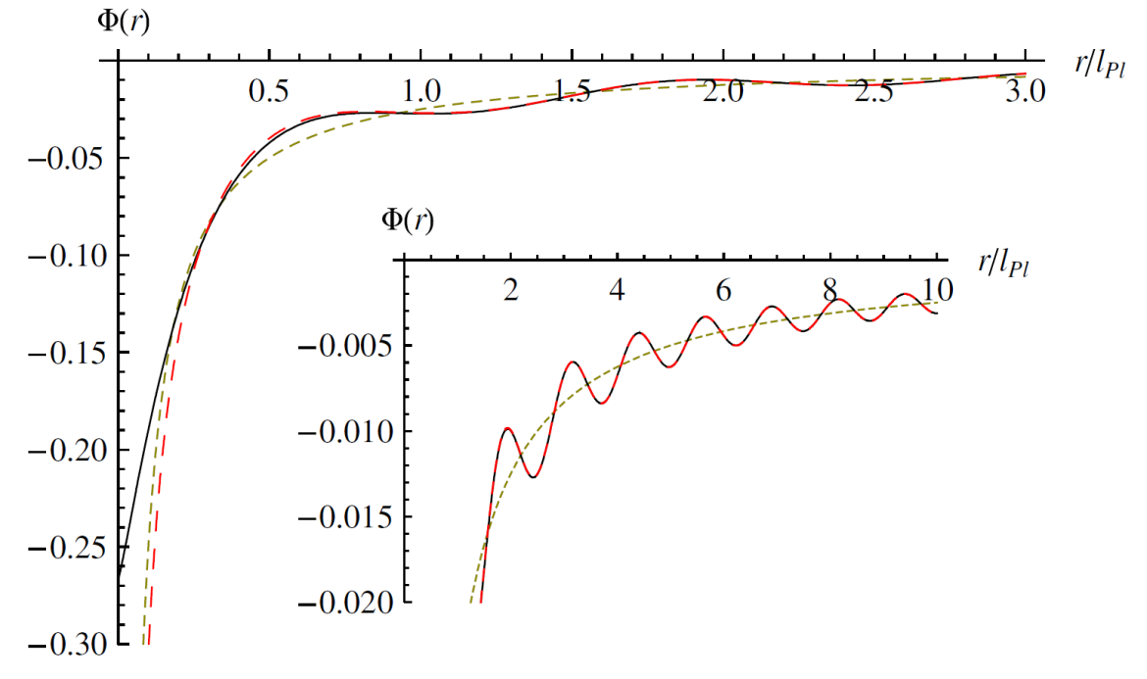
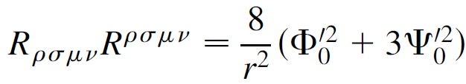
RESUMMED 1LOOP POTENTIALS 3
˚15˚
● TIME-LIKE & SPATIAL BARDEEN POTENTIALS Φ, Ψ (ξ=0,1/3 rs/lp=0.05),
SMALL MASS:
● RESUMMATION TELLS US THAT AT SMALL DISTANCES QUANTUM
SCALAR PERTURBATIONS SCREEN NEWTONIAN POTENTIALS
● SMALL MASS→ FIELDS ARE WEAK EVERYWHERE,
NB: CURVATURE STILL DIVERGES at r→0: Kretchmann:

Slide 16

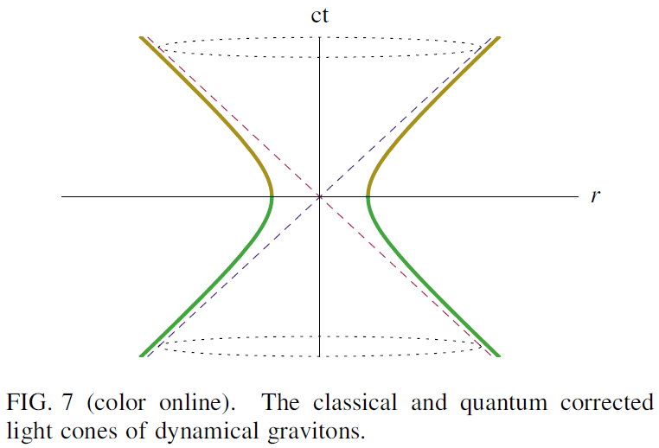
GRAVITON LIGHT CONE
˚16˚
● ONE-LOOP SCALAR QUANTUM FLUCTUATIONS AFFECT
PROPAGATION OF GRAVITONS ON MINKOWSKI
● LIGHT CONE GETS MODIFIED AS:
● PROPAGATION VELOCITY OF GRAVITONS→ ∞ AS ct→0.

Slide 17
˚17˚
QUANTUM EFFECTS
DURING INFLATION

Slide 18
˚18˚
AT BOUNDARY OF STABILITY: MASSLESS SCALARS ON DE SITTER

Slide 19
MASSLESS SCALARS ON DE SITTER
˚19˚
● EXAMPLE 1: MASSLESS SCALAR ON DE SITTER (D=4):
ACTION:
• EOM for φ:
• In a dS invariant state, the propagator must be a function of dS inv distance l(x;x’):
⇒ then the propagator obeys a dS inv equation (in D dim):
⇒ This equation has no solution!
Allen, Folacci, PRD35 (1987)
Notes:
19

Slide 20
˚20˚
MASSLESS SCALAR ON DE SITTER 2
● MASSLESS MINIMALLY COUPLED SCALAR (MMCS) D=4:
● THE NAIVE SOLUTION (in D=4) is (up to an irrelevant constant C):
• This UNIQUE dS inv solution solves the wrong equation:
⇒ Here denotes the antipodal point of :
From it follows that the terms in 2nd square brackets [.]
source the second δ-function in Eq. (**).
The solution (**) follows from:
Notes:
20

Slide 21
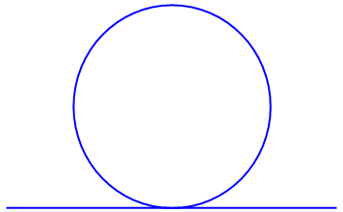
˚21˚
MASSLESS SCALAR ON DE SITTER 3
● CONCLUSION: MMCS cannot be quatized in a dS inv way.
● ONE POSSIBLE SOLUTION (that breaks dS sym, respects spatial homogeneity, but solves the right equation) is:
This dS breaking solution solves the right equation, but
(when dim reg is applied) the coincident propagator grows (linearly) with time.
This has physical consequences. For example, when one introduces a quartic
interaction at one loop one generates a Hartree mass:
In a self-interacting scalar theory, the mass squared thus grows linearly in time.
This is a consequence of abundant particle creation in dS. Precisely this type
of particle creation generates scalar cosmological perturbations, which in turn
induce CMB temperature fluctuations and seed the Universe’s large scale structure.
☺ QUESTION: IS THERE A dS INV SCALAR MASS?
Notes:
21

Slide 22
˚22˚
MASSIVE SCALAR PROPAGATOR ON dS
● dS INVARIANT SCALAR FIELD PROPAGATOR
Chernikov, Tagirov, Annales Poincaré Phys.Theor. A9 (1968)
● COINCIDENT SCALAR PROPAGATOR
⇒The m→0 LIMIT IS SINGULAR;
EXPLAINS WHY THERE IS NO dS INV SOLUTION.
Notes:
22

Slide 23
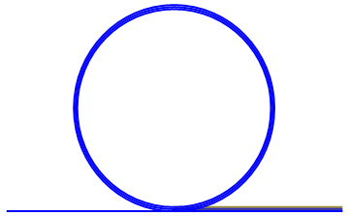
˚23˚
SCALAR FIELD: MASS GENERATION
● in a self-interacting scalar theory, scalar has a growing mass.
Is there a dS inv late time limit?
● RESUMMATION: SELF-CONSISTENT HARTREE:
● ACTION
● GAP EQUATION
● SOLUTION
Ford,Vilenkin, PRD 26 (1982); Serreau; Garbrecht, Rigopoulos (2011+)
Prokopec; Prokopec, Lazzari (2012+)
● THERE ARE STUDIES OF 2 and 3 LOOPS
(primarily to check Stochastic inflation; also w<-1 found)
Kahya, Onemli, Woodard (2010);
Onemli, Woodard (2004)
Notes:
23

Slide 24
˚24˚
SCALAR FIELD: MASS GENERATION
● STOCHASTIC INFLATION RESULT
Starobinsky, Yokoyama 1996
⇒ QUALITATIVELY THE SAME AS THE GAP EQUATION,
BUT QUANTITATIVE DIFFERENCE:
Notes:
24

Slide 25
˚25˚
STABLE THEORY:
SCALAR QED ON DE SITTER

Slide 26
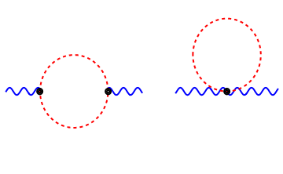
SCALAR ELECTRODYNAMICS
˚26˚
● (BARE) LAGRANGIAN
● ONE RELEASES SYSTEM FROM A FREE VACUUM STATE
Initial boundary divergences lead to exponentially decaying tails,
can be removed by chosing a suitable (pertubative) interacting state
● THE PHOTON GAINS A (PERTURBATIVE) MASS
Prokopec, Tornkvist, Woodard (2002,2003); Prokopec, Puchwein, (2004)
● THE SCALAR CAN BE KEPT (PERTURBATIVELY) MASSLESS
● QUANTUM BACKREACTION: 2 LOOP STRESS-ENERGY TENSOR
Prokopec, Tsamis, Woodard (2007,2008)

Slide 27
● SOME OF THE CONTRIBUTING DIAGRAMS
˚27˚

Slide 28
˚28˚
WHAT HAPPENS AT LATE TIMES?
DOES ONE REACH A DE SITTER INVARIANT STATE?
IF YES, WHICH ONE?
TO ANSWER THESE QUESTIONS WE NEED NON-PERTURBATIVE METHOD ⇒ STOCHASTIC INFLATION

Slide 29
STOCHASTIC SCALAR QED
˚29˚
Prokopec, Tsamis, Woodard, Ann.Phys.323 (2008) [0707.0847 [gr-qc]]
STRATEGY: identify active and passive fields.
Active fields are amplified in IR and can produce leading log(a).
Passive fields (gauge fields, fermions): NEED TO BE INTEGRATED OUT
Stochasticize the resulting EFFECTIVE SCALAR THEORY, with Veff(Φ).
☺ RESULTS:
♣ the scalar and photon acquire a (nonperturbative) mass:
NB: AGREE WITH
♣ fluctuations give constant contributions to the density invariants & c.c.:
NB: These results are fully nonperturbative (not suppressed by the coupling const. e)
CONCLUSION: IN SQED ASYMPTOTICALLY ONE REACHES A dS INVARIANT, STABLE STATE OF LOWER ENERGY
Notes:
29

Slide 30
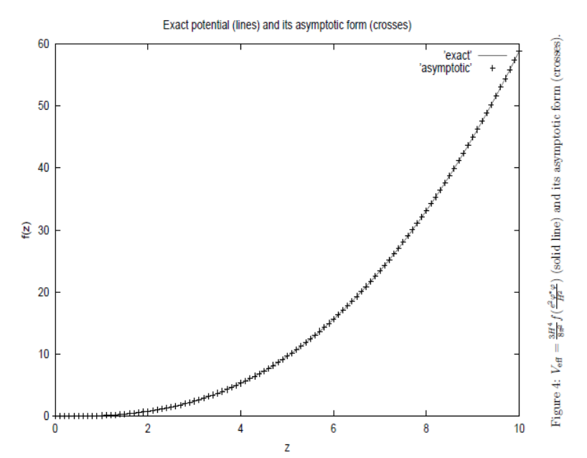
˚30˚
AFTER INTEGRATING THE (PASSIVE) PHOTONS
ONE GETS THE EFFECTIVE SCALAR POTENTIAL
Veff SMALL FIELD

Slide 31
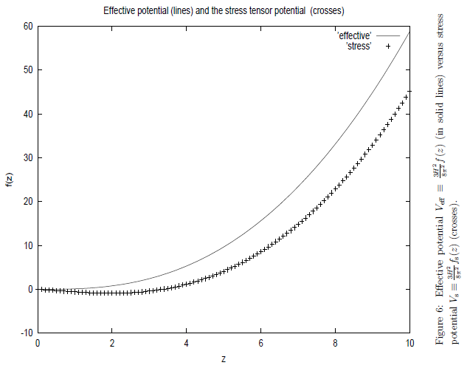
˚31˚
CONTRIBUTION TO ENERGY DENSITY FROM THE EFFECTIVE SCALAR THEORY

Slide 32
˚32˚
WHEN STABILITY FAILS:
YUKAWA ON DE SITTER

Slide 33
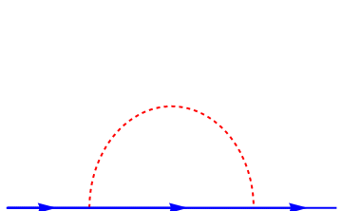
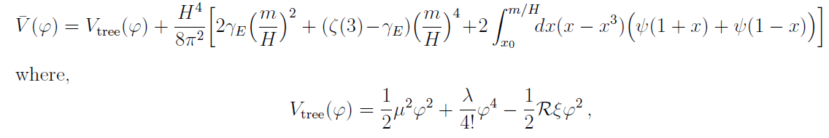
FERMIONS IN YUKAWA
˚33˚
● AT ONE LOOP IN YUKAWA THEORY
PHOTONS ACQUIRE A MASS:
Garbrecht, Prokopec, PRD73 (2006)
► m=scalar mass; y=Yukawa, ξ=nonminimal coupling, R=Ricci scalar
STOCHASTIC THEORY IS OBTAINED BY INTEGRATING OUT
THE FERMIONS. ONE OBTAINS THE FOLLOWING EFFECTIVE POTENTIAL:
Miao, Woodard, PRD (2006), gr-qc/0602110
..AND THE CONTRIBUTION TO THE ENERGY DENSITY IS:
Notes:
33

Slide 34
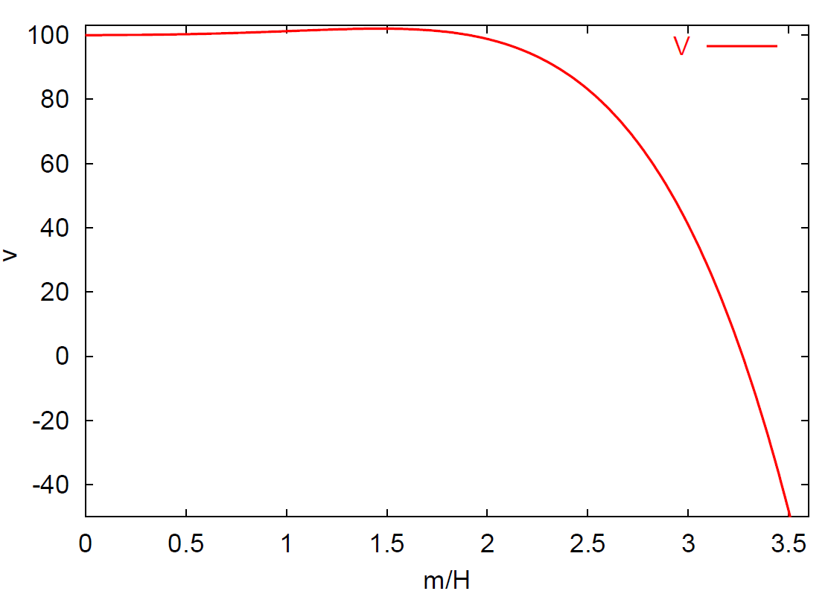
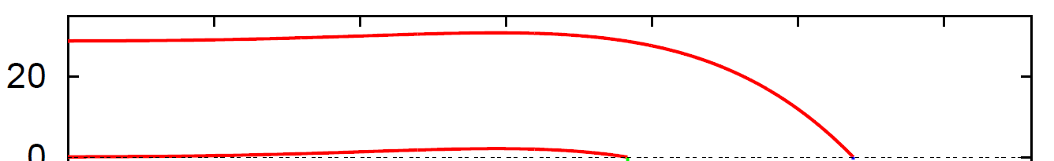
˚34˚
EFFECTIVE POTENTIAL IS UNSTABLE
● EFFECTIVE POTENTIAL
CONTRIBUTION TO
THE ENERGY DENSITY ⇒ unstable evolution
TWO DIFFERENT VALUES OF V0
Notes:
34

Slide 35
˚35˚
PERTURBATIVE GRAVITY ON DE SITTER:
VACUUM POLARIZATION

Slide 36
GRAVITONS ON DE SITTER NON-COVARIANT APPROACH
˚36˚
● WHEN ONE FULLY FIXES THE GAUGE, GRAVITONS ON dS
CAN BE THOUGHT AS TWO POLARIZATIONS OF A MMCS:
• EOM for GRAVITONS :
● IDENTICAL PROBLEM AS MMCS: NO dS INV PROPAGATOR!?
• LHS: THE SAME OPERATOR AS FOR MCMS! ⇒ no solution!
BUT the RHS PROJECTORS Pij BREAK dS INV!
No general proof as yet whether dS inv propagator exist!
We do have now graviton propagator in a covariant exact (de Donder) gauge!
Mora, Tsamis, Woodard, J.Math.Phys.53(2012); Miao, Tsamis, Woodard, J.Math.Phys.52 (2011)
Non-cov propagator cannot be used to study de Sitter breaking
(gauge dependence?) of physical quantities.
Notes:
36

Slide 37
˚37˚
COVARIANT GRAVITON PROPAGATOR
Mora, Tsamis, Woodard, J.Math.Phys.53(2012); Miao, Tsamis, Woodard, J.Math.Phys.52 (2011)
• THE GRAVITON PROPAGATOR CONTAINS SPIN 2 AND SPIN 0 PARTS
● EXACT COVARIANT DE DONDER GAUGE (operator):
{b=gauge parameter)
● SPIN 2 PART (TT on both index groups)
MMCS: EXPECT dS BREAKING
Notes:
37

Slide 38
˚38˚
COVARIANT GRAVITON PROPAGATOR 2
● GAUGE PARAMETER
● SPIN 0 PART (spin 0 projectors)
TACHYONIC WHEN β<D (b<2,D>1)
TACHYONIC WHEN Re[D]>0
• FOR SIMPLICITY WE CONSIDER A CLASS OF GAUGES b>2,
(β>D) FOR WHICH THE N-PROPAGATOR IS dS INVARIANT
● APPLICATIONS: coinc. graviton propagator (in de Donder gauge): dS breaking
Kahya, Miao Woodard (2011), 1112.4442
Notes:
38

Slide 39
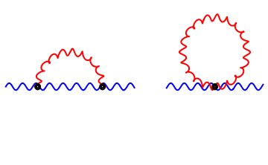
˚39˚
ONE-LOOP VACUUM POLARIZATION
Glavan, Miao, TP, Woodard (2015)
• WE USED THE COVARIANT GRAVITON AND PHOTON PROPAGATORS
DIAGRAMS
+ counter-terms
MIAO & WOODARD CALCULATED SPIN=2 CONTRIBUTION
(in a heroic calculation they included the dS breaking contribution)
GLAVAN & TP CALCULATED THE SPIN=0 CONTRIBUTION
(sheepishly they studied only the b>2 (β>D) CASE, when
the gauge dependent part of the s=0 propagator is dS invariant)
Miao & Woodard found a v=dependence in vac polarisation
v=ln[a(η)/a(η’)]
not present in the vac pol from Leondard & Woodard paper.
Suggests a gauge dependence.
Notes:
39

Slide 40
˚40˚
VACUUM POLARIZATION ON DE SITTER
Glavan, Miao, TP, Woodard (2015)
• USE THE COVARIANT GRAVITON AND PHOTON PROPAGATORS TO CALC
GRAVITON INDUCED 1 LOOP VAC POL:
+ COUNTER-TERMS
• USEFUL (F-G/EL-MAG) REPRESENTATION:
Prokopec, Tornkvist, Woodard; Leonard, Prokopec, Woodard 1304.7265, 1210.6968
• ON MINKOWSKI: LORENTZ INVARIANT (G=0) BUT GAUGE DEPENDENT RESULT
NEGATIVE SEMIDEFINITE FOR b>2:
Notes:
40

Slide 41
˚41˚
VACUUM POLARIZATION: SPIN 2
• SPIN 2 PART:
CONTAINS QUALITATIVELY DIFFERENT TERMS when compared with the vac pol
of Leonard & Woodard obtained in a fixed (de Donder) gauge.
Notes:
41

Slide 42
VACUUM POLARIZATION: SPIN 0
˚42˚
• SPIN 0 PART:
COMPLICATED FUNCTIONS CONTAINING GENERALISED
HYPERGEOMETRIC FUNCTIONS AND THEIR DERIVATIVES
YOU DO NOT WANT TO SEE THEM! THEY STRONGLY DEPEND ON b.
• THE SPIN 0 & 2 STRUCTURE FUNCTIONS CAN BE USED TO CALCULATE
THE 1-LOOP EFFECT ON DYNAMICAL PHOTONS AND COULOMB POTENTIAL
ON DE SITTER IN PRESENCE OF GRAVITON LOOPS. UNLIKE Leonard, Woodard,
WE CAN STUDY GAUGE DEPENDENCE (we have a gauge parameter b) [in progress]
Notes:
42

Slide 43
RENORMALIZATION
˚43˚
• WE USE DIM REG (RESPECTS ALL SYMMETRIES)
• SURPRISING RESULT: NEED A NON-COVARIANT COUNTER TERM ∝ΔC
(THAT ALSO VIOLATES dS SYMMETRY)
• FROM FLAT SPACE RESULT:
Notes:
43

Slide 44
˚44˚
RENORMALIZATION 2
• THE NONCOVARIANT COUNTER TERM:
Notes:
44

Slide 45
THE ORIGIN OF NON-COVARIANT
RENORMALIZATION
˚45˚
• THE ORIGIN OF THE NONCOVARIANT (dS BREAKING) COUNTER TERM:
☼ GRAVITATIONAL INTERACTIONS HAVE TWO DERIVATIVES:
- increases superficial degree of divergence (gravity non-renormalizable)
☼ THE COINCIDENT GRAVITON PROPAGATOR DIVERGES ON dS AS:
∝1/(D-4) [fluctuations at all scales contribute: primarily UV effect]
☼ IN LORENTZIAN SIGNATURE: INTERACTIONS TIME ORDERED,
[exemplified by the Θ(t-t’) and Θ(t’-t) functions in the propagator]
IS THERE ANY WAY OF GETTING RID OF IT?
☼ INCOMPLETE (albeit covariant) GAUGE FIXING, thus an average gauge.
SINCE THE PHOTON AND GRAVITON ARE NOT GAUGE INVARIANT,
WRITING THE ACTION FOR A GAUGE INV COMBINATION MIGHT CANCEL
THE NON-COV CT. CRITICISM: CAN BE REALLY DONE ONLY AT
LINEAR ORDER IN GRAVITATIONAL PERTURBATIONS.
Notes:
45

Slide 46
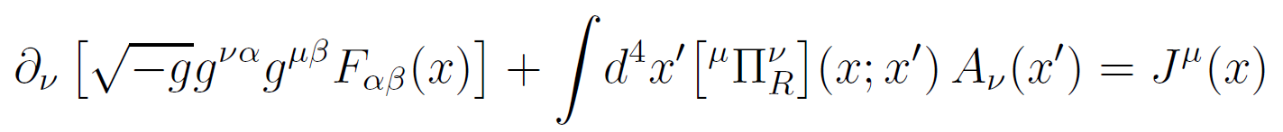





˚46˚
DYNAMICAL PHOTONS
• 1LOOP EQUATION FOR DYNAMICAL PHOTONS:
• 1 LOOP RETARDED RENORMALIZED VACUUM POLARIZATION INDUCED BY 1 LOOP GRAVITONS
=
SOLVE THE ABOVE EQUATION PERTURBATIVELY [J=0]:
$A_{0}=0,{ A}_{i}={\text{ε}}_{i}(\vec{k}){u(η,k)e}^{i\vec{k}∙ \vec{x}}$,
$u(η,k)$= $u_{(0)}(η,k)$+$u_{(1)}(η,k)$,
$u_{(0)}(η,k)$=$\frac{1}{\sqrt{2k}}e^{−ikη}$
• RESULT (to leading order at late times, a→∞):
Leonard, Woodard (2012,13)
$u_{\left(1\right)}\left(η,k\right)=u_{\left(0\right)}\left(η,k\right)×\frac{GH^{2}}{3π}$ $\frac{ik\ln{a}}{Ha}×\left[6\right]$
♦ NONCOVARIANT GRAV.PROP.:
$u_{\left(1\right)}\left(η,k\right)=u_{\left(0\right)}\left(η,k\right)×\frac{GH^{2}}{3π}$ $\frac{ik\ln{a}}{Ha}×\left[45−\frac{2ik}{H}+5e^{2ik/H}\right]$
♦ COVARIANT GRAV.PROP.:
Glavan, Miao, Prokopec, Woodard (16)
UNEXPECTED: RESULT DEPENDS ON GRAVITON GAUGE!?:
Notes:
46

Slide 47

˚47˚
PHYSICAL EFFECTS: POINT CHARGE
Glavan, Prokopec, Miao, Woodard 1308.3453(2013)
• RESPONSE TO POINT CHARGE q (at the origin) ON dS
→ CLASSICAL
→ ONE LOOP
NB: SAME RESULTS
OBTAINED IN PHYSICAL
RADIAL COORDINATES
NB2: EFFECT GROWS
WITH DISTANCE
PHYSICAL DISTANCE/RH
NB3: POINT MAGNETIC DIPOLE: GIVES ANALOGOUS RESULTS

Slide 48
˚48˚
GRAVITON SELFENERGY FROM MMC SCALARS ON DE SITTER

Slide 49







GRAVITON SELF-ENERGY: SCALARS
˚49˚
S. Park and R.P. Woodard (2011)
• AT 1 LOOP ON DE SITTER WE HAVE
COUNTER-TERMS
=
• AT 1 LOOP ON DE SITTER WE HAVE (F0,2: spin=0, 2 structure functions)
where:
LINEARISED WEYL
TENSOR:

Slide 50


SPIN 0 STRUCTURE FUNCTION
˚50˚
• DE SITTER INVARIANT SPIN=0 STRUCUTRE FUNCTION:
- here Li2 is dilogarithm function:

Slide 51

SPIN 2 STRUCTURE FUNCTION
˚51˚
• DE SITTER INVARIANT SPIN=2 STRUCUTRE FUNCTION:
MESSAGE: DE SITTER
INVARIANT, BUT COMPLICATED!

Slide 52

˚52˚
EFFECT ON DYNAMICAL GRAVITONS
Park, Woodard, PRD, arXiv:1101.5804, 1109.4187 (2011)
Leonard, Park, Prokopec, Woodard, PRD, 1403.0896 (2014)
RESULT: AT 1 LOOP SCALARS DO NOT AFFECT DYNAMICAL GRAVITONS, i.e. NO TERMS THAT GROW SECULARLY IN TIME.
LICHNEROWICZ ON DE SITTER
ᴥ PARK&WOODARD [in 1109.4187] SHOWED THAT THE EFFECT CAN BE REDUCED TO A TIME-LIKE BD TERM. IS IT UNPHYSICAL?!?
ᴥ IT IS MORE CONVENIENT TO RECAST THE SELF-ENERGY IN THE
NON-COV. REPR. ANALOGOUS TO THE E-F REP FOR QED [Prokopec et al]
Leonard, Park, Prokopec, Woodard, PRD, 1403.0896 (2014)
Notes:
52

Slide 53



˚53˚
GRAVITON SELF-ENERGY:
NON-COVARIANT REPRESENTATION
Leonard, Park, Prokopec, Woodard, PRD, 1403.0896 (2014)
GENERAL STRUCTURE ON DE FLRW SPACES:
ᴥ where:
-SPIN=0 OBEY CONSERVATION IDENT’s:
-SPIN=2 STRUCTURE FUNCTIONS ARE TRANSVERSE AND TRACELESS:
AND CAN BE OBTAINED e.g. BY CONTRACTING LINEARIZED WEYL TENSORS:
Notes:
53

Slide 54



˚54˚
NON-COV. STRUCTURE FUNCTIONS
Leonard, Park, Prokopec, Woodard, PRD, 1403.0896 (2014)
RENORMALIZED SPIN 0 & 2 STRUCTURE FUNCTIONS (G0=0) :
NOTE: THE NON DS INVARIANT REPRESENTATION IS MUCH SIMPLER!

Slide 55




˚55˚
EFFECT ON DYNAMICAL GRAVITONS 2
SOLVE THE 1PI 1 LOOP EQUATION PERTURBATIVELY:
GRAVITON PLANE WAVE ON DE SITTER:
POLARIZATION TENSOR IS TRANSV. &TRACELESS (in Lifshitz gauge):
PERTURBED METRIC HAS THE SAME FORM,

Slide 56






˚56˚
EFFECT ON DYNAMICAL GRAVITONS 3
ONE LOOP DE SITTER CONTRIBUTION TO THE RHS [ ]
SINCE NO TERM GROWS
AS a², THERE ARE NO GROWING SECULAR
TERMS IN TIME,
CONFIRMING THE
RESULT OF
PARK&WOODARD

Slide 57



PERTURBATIVE SOLUTION TO 1PI EFFECTIVE EOM
˚57˚
Park, Prokopec, Woodard, 1510.03352 [gr-qc]
● TREE LEVEL SOLUTION FOR POINT PARTICLE MASS M at r=0:
NEWTONIAN POTENTIALS
● METRIC PERTURBATION:
● PERTURBED 1PI EOM
$D_{μνρσ}h^{ρσ(1)}$(x)
● LICHNEROVICZ OPERATOR ON DE SITTER:
● SOLUTION: PERT CORRECTED GRAVITAT. POTENTIALS (long. gauge):

Slide 58



CONCLUSIONS AND OUTLOOK
˚58˚
MMC SCALARS DO NOT CAUSE SECULAR GROWTH OF DYNAMICAL GRAVITON WAVE FUNCTION ON DE SITTER SPACE.
- PROBABLE REASON IS DERIVATIVE COUPLING OF GRAVITONS TO MMC SCALARS. NON-MINIMAL COUPLING OR MASS COULD CHANGE THAT.
MMC SCALARS DO GENERATE SECULAR GROWTH (~ln(a)) OF GRAVITATIONAL POTENTIALS ON DE SITTER.
CONFORMAL CONTR
NON-CONFORMAL CONTRIBUTIONS:CAN BE REINTERPRETED AS TIME-DEPENDENT RESCALING OF MASS OR EQUIV NEWTON CONST. (CORRESPONDING TO SCREENING)

Slide 59
OUTLOOK
˚59˚
WHAT WE WOULD REALLY LIKE TO KNOW IS HOW MATTER AND GRAVITATIONAL LOOPS AFFECT DYNAMICAL TENSOR AND SCALAR GRAVITON PERTURBS IN INFLATION. FOR THAT WE NEED GRAVITON PROPAGATOR ON QUASI-DE SITTER (ACCEL.) SPACES, ε=d[1/H]/dt≠0.
STILL A LOT OF WORK TO BE DONE ON PERTURBATIVE QUANTUM GRAVITY ON DE SITTER, EVEN AT 1 LOOP LEVEL!
.. LET ALONE RESUMMATIONS..
LATE TIME EFFECTS FROM QUANTUM INFLATIONARY PERTURB.: DE
D. Glavan, T. Takahashi, T. Prokopec (2016)

