Slide 1

Cosmological constraints on the Higgs-gravity coupling
Arttu Rajantie
CERN TH Institute
24 August 2016
Herranen, Markkanen, Nurmi & AR, PRL113(2014)211102
Herranen, Markkanen, Nurmi & AR, PRL115(2015)241301
AR & Stopyra, arXiv:1606.00849
Figueroa, AR & Torrenti, in progress

Slide 2
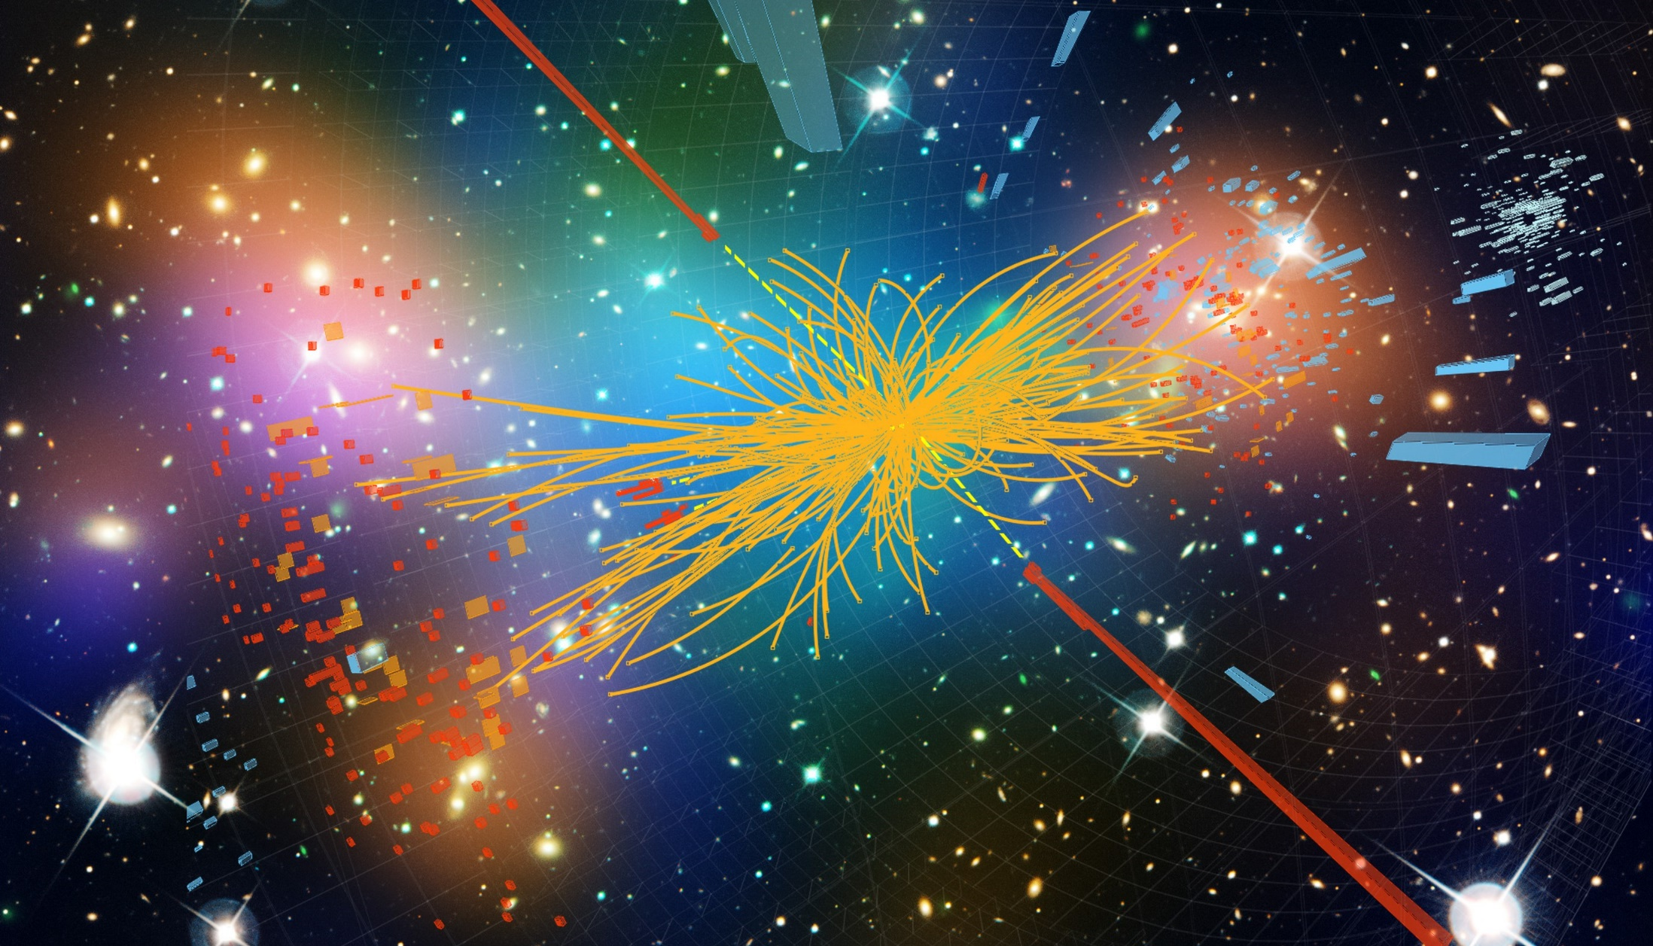

Higgs cosmology
27 – 28 March 2017
The Royal Society at Chicheley Hall, Buckinghamshire
Organised by Professor Arttu Rajantie, Dr Malcolm Fairbairn, Dr Tommi Markkanen and Dr Astrid Eichhorn
For further details, or to request an invitation, please visit
royalsociety.org/events
For enquiries contact kavli.events@royalsociety.org

Slide 3
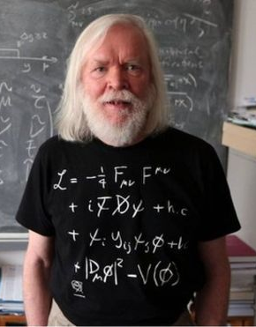

The Standard Model
Six leptons, six quarks,
three gauge fields
+ Higgs scalar $φ$
19 parameters –
all have been measured
All renormalisable terms
allowed by symmetries
in Minkowski space

Slide 4

The Standard Model
Six leptons, six quarks,
three gauge fields
+ Higgs scalar $φ$
19 parameters –
all have been measured
All renormalisable terms
allowed by symmetries
in Minkowski space
Can be extrapolated all the way to the Planck scale
(Buttazzo et al 2013)

Slide 5
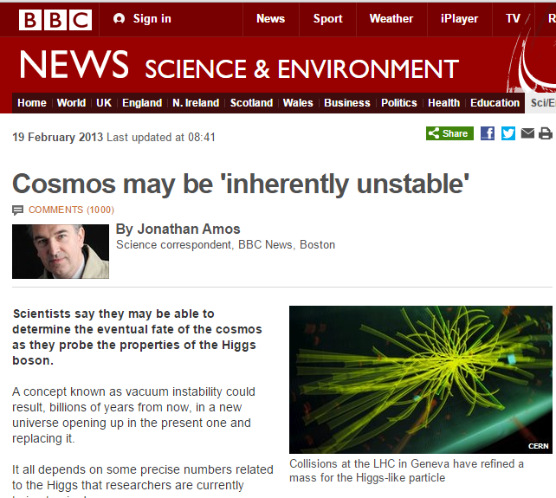
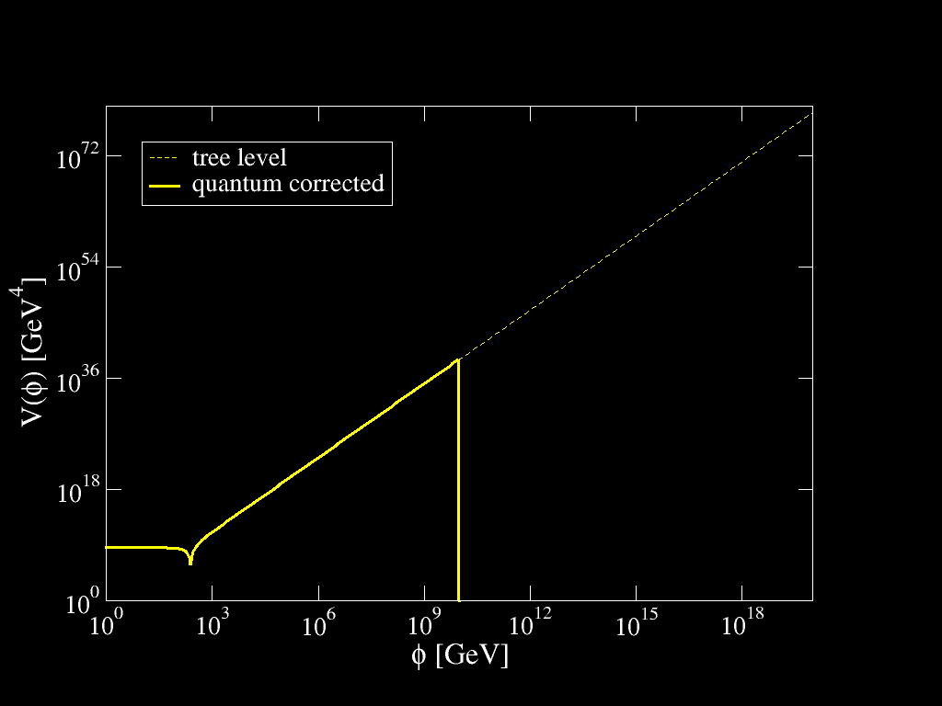

Vacuum Instability
RG improved effective potential
$V\left(φ\right)≈λ\left(φ\right)φ^{4}$
Becomes negative
at $φ>φ_{c}≈{10}^{10}GeV$
True vacuum at
Planck scale?
Current vacuum
metastable against
quantum tunneling

Slide 6

Instability Bounds
Vacuum lifetime $\sim \exp\left(S_{bounce}\right)∼\exp\left(\frac{8π^{2}}{3\left|λ\right|}\right)$
Longer than the age of the Universe – We are safe!
(Buttazzo et al. 2013)

Slide 7

The Standard Model
Six leptons, six quarks,
three gauge fields
+ Higgs scalar $φ$
19 parameters –
all have been measured
All renormalisable terms
allowed by symmetries
in Minkowski space

Slide 8


Higgs-Gravity Coupling
Curved spacetime:
$$ℒ=ℒ_{SM}+ξRφ^{†}φ$$
$\text{(}\text{Chernikov}\text{\&}\text{Tagirov}\text{ 1968)}$
One more renormalisable term:
Higgs-curvature coupling $ξ$
Required for renormalisability,
runs with energy –
Cannot be set to zero!
Last unknown parameter
in the Standard Model
$$+ξRφ^{2}$$

Slide 9
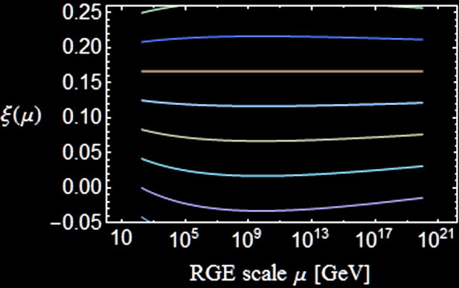


Running $ξ$
$$μ\frac{dξ}{dμ}=\left(ξ−\frac{1}{6}\right)\frac{12λ+6y_{t}^{2}−\frac{3}{2}g^{′2}−\frac{9}{2}g^{2}}{16π^{2}}$$
Becomes negative
if $ξ_{EW}=0$
Conformal value
$ξ=1/6$
RG invariant at 1 loop

Slide 10


Vacuum Instability and $ξ$
Tunneling rate: $Γ∼e^{−B}$, where
$B=$action of the Euclidean “bounce” solution (Coleman 1977)
Coupled field and Einstein equations
Perturbative gravitational correction (Isidori et al 2007)
$ΔB=\frac{32π^{2}}{45M_{Pl}^{2}ρ^{2}{\left|λ\right|}^{2}}$, where $ρ=$ radius of the instanton
AR & Stopyra, arXiv:1606.00849:
Full numerical solution including $ξ$

Slide 11

Vacuum Instability and $ξ$
Tunneling rate $Γ∼e^{−B}$: Larger $\left|ξ\right|$  more stable vacuum
Perturbative $ΔB=\frac{32π^{2}{\left(1−6ξ\right)}^{2}}{45M_{Pl}^{2}ρ^{2}λ^{2}}$ (Salvio et al, arXiv:1608:02555)
AR & Stopyra, arXiv:1606.00849

Slide 12

Vacuum Instability Today
Fastest at $ξ≈1/6$, where almost the same as Minkowski
AR & Stopyra, arXiv:1606.00849

Slide 13
Effect on Stability
AR & Stopyra, arXiv:1606.00849

Slide 14


Measuring $ξ$
Curved spacetime:
$$ℒ=ℒ_{SM}+ξRφ^{†}φ$$
Ricci scalar $R$ very small today – Difficult to measure
Colliders: Suppresses Higgs couplings (Atkins&Calmet 2012)
  LHC Bound $\left|ξ\right|≲2.6×{10}^{15}$
  Future (?) ILC: $\left|ξ\right|≲4×{10}^{14}$
In contrast, $R$ was high in the early Universe:
Cosmological effects?

Slide 15

Example: Higgs Inflation (Bezrukov&Shaposhnikov 2008)
Higgs as inflaton: Dominates energy density
Jordan → Einstein frame: $φ∼\frac{M_{Pl}}{\sqrt{ξ}}\exp\left(\frac{χ}{\sqrt{6}M_{Pl}}\right)$
$V\left(φ\right)=\frac{λφ^{4}}{4} → U\left(χ\right)∼\frac{λM_{Pl}^{4}}{4ξ^{2}}\left[1−\exp\left(−\sqrt{\frac{2}{3}}\frac{χ}{M_{Pl}}\right)\right]$
During inflation
$φ≳M_{Pl}/\sqrt{ξ}$

Slide 16

Example: Higgs Inflation (Bezrukov&Shaposhnikov 2008)
Higgs as inflaton: Dominates energy density
Jordan → Einstein frame: $φ∼\frac{M_{Pl}}{\sqrt{ξ}}\exp\left(\frac{χ}{\sqrt{6}M_{Pl}}\right)$
$V\left(φ\right)=\frac{λφ^{4}}{4} → U\left(χ\right)∼\frac{λM_{Pl}^{4}}{4ξ^{2}}\left[1−\exp\left(−\sqrt{\frac{2}{3}}\frac{χ}{M_{Pl}}\right)\right]$
CMB amplitude
 $ξ∼−49000\sqrt{λ}$
Spectral index
$n_{s}≈0.97$
Tensor/scalar ratio:
$r≈0.003$
(Bezrukov&Shaposhnikov 2015)

Slide 17

Example: Higgs Inflation (Bezrukov&Shaposhnikov 2008)
Higgs as inflaton: Dominates energy density
Jordan → Einstein frame: $φ∼\frac{M_{Pl}}{\sqrt{ξ}}\exp\left(\frac{χ}{\sqrt{6}M_{Pl}}\right)$
$V\left(φ\right)=\frac{λφ^{4}}{4} → U\left(χ\right)∼\frac{λM_{Pl}^{4}}{4ξ^{2}}\left[1−\exp\left(−\sqrt{\frac{2}{3}}\frac{χ}{M_{Pl}}\right)\right]$
Problem: Eff. potential
$V_{eff}\left(φ\right)≈\frac{1}{4}λ\left(φ\right)φ^{4}<0$
for $φ≳{10}^{10}GeV$
(Buttazzo et al 2013)

Slide 18

Higgs During Inflation
Instead of Higgs inflation,
assume inflaton sector decoupled from the Higgs:
Higgs dynamics in expanding background
Ricci scalar in FRW spacetime:
$$R=6\left(\frac{{\dot{a}}^{2}}{a^{2}}+\frac{\ddot{a}}{a}\right)=3\left(1−3w\right)H^{2}$$
  Radiation dominated ($w=1/3$): $R=0$
  Matter dominated ($w=0$): $R=3H^{2}$
  Inflation / de Sitter ($w=−1$): $R=12H^{2}$
Effective Higgs mass term $m_{eff}^{2}=m_{H}^{2}+ξR$:
Time-dependent and very high in the early Universe

Slide 19

Higgs During Inflation
Let us consider $ξ=0$ first
Inflation: $H≲9×{10}^{13} GeV$ (Planck+BICEP2 2015)
Higgs mass $m_{H}≈125 GeV≪H$:
Light scalar field – nearly scale invariant fluctuations
Fokker-Planck equation (Starobinsky&Yokoyama 1994)
$\frac{∂P[φ]}{∂t}=\frac{∂}{∂φ}\left[\frac{H^{3}}{8π^{2}}\frac{∂P}{∂φ}+\frac{V^{′}\left(φ\right)}{3H}P\right]$
Equilibrium distribution
$P\left(φ\right)∝exp\left[−\frac{8π^{2}}{3H^{4}}V\left(φ\right)\right]$

Slide 20
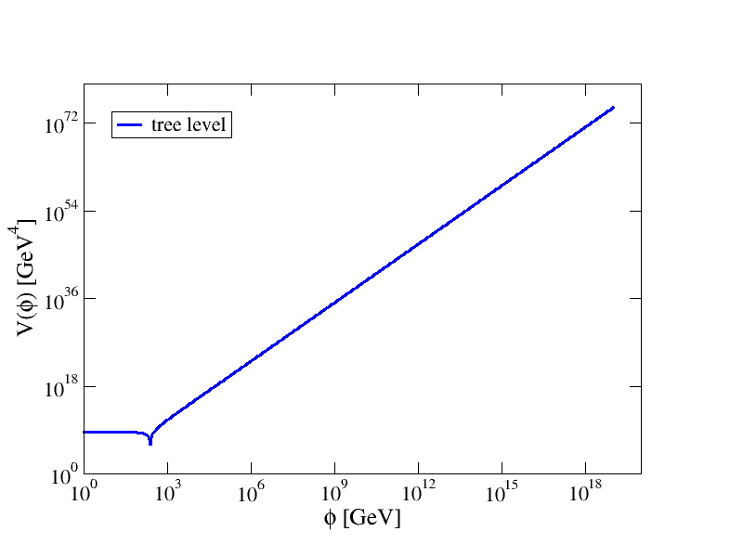

Higgs Fluctuations
Equilibrium $P\left(φ\right)∝exp\left[−\frac{8π^{2}}{3H^{4}}V\left(φ\right)\right]$
Tree-level potential
$V\left(φ\right)=λ{\left(φ^{2}−v^{2}\right)}^{2}$
Nearly scale-invariant
fluctuations with
amplitude $φ∼λ^{1/4}H$
Higgs fluctuations

Slide 21

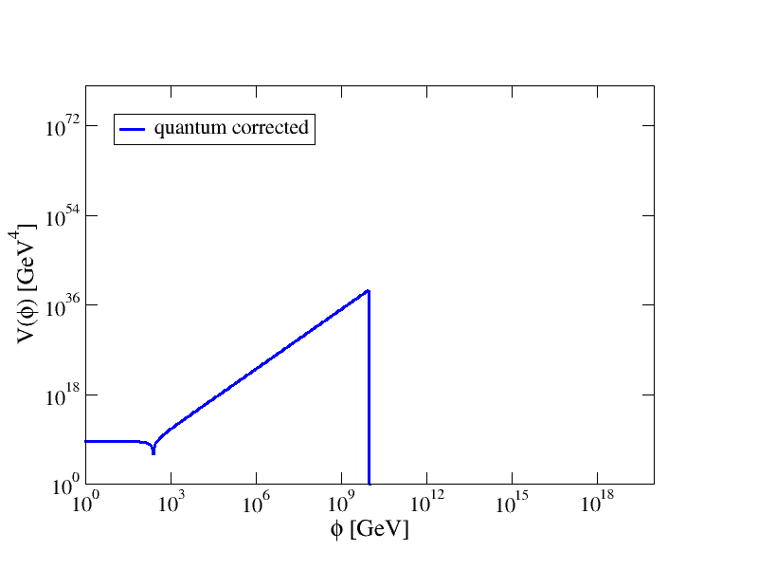

Vacuum Instability During Inflation
Equilibrium $P\left(φ\right)∝exp\left[−\frac{8π^{2}}{3H^{4}}V\left(φ\right)\right]$
Fluctuations take the
Higgs over the barrier
if $H≳φ_{c}≈{10}^{10}GeV$
(Espinosa et al. 2008;
Lebedev&Westphal 2013;
Kobakhidze&Spencer-Smith 2013;
Fairbairn&Hogan 2014;
Hook et al. 2014)
Higgs fluctuations

Slide 22

Gravity to the Rescue
Inflation: Constant $R=12H^{2}$
Effective mass term
$$m_{eff}^{2}=m_{H}^{2}+ξR=m_{H}^{2}+12ξH^{2}$$
Tree level: (Espinosa et al 2008)
  $ξ>0$: Increases barrier height
  Makes the low-energy vacuum more stable
  $ξ<0$: Decreases barrier height
  Makes the low energy vacuum less stable
Also contributes to loop corrections

Slide 23
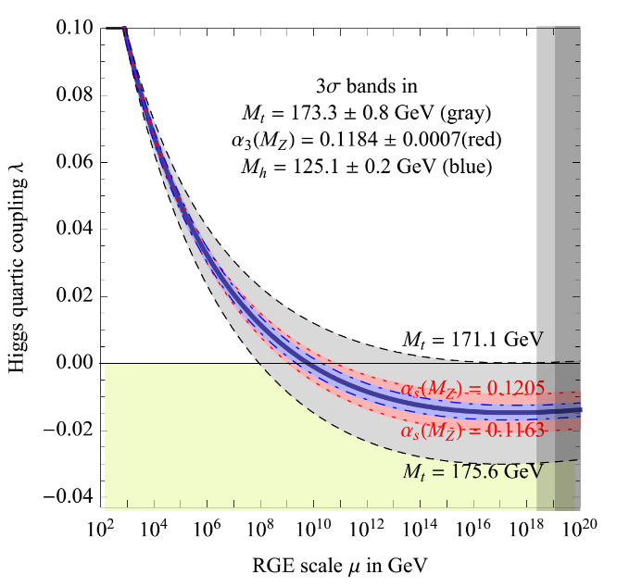

One-Loop Potential
Note: For $R≫φ$,
there are $\log{R/μ^{2}}$ terms
RG improved potential becomes
$V\left(φ\right)≈λ\left(R^{1/2}\right)φ^{4}$
Negative for all $φ$,
no barrier if $ξ=0$
(HMNR 2014)
(Buttazzo et al 2013)

Slide 24




(De-)Stabilising the Potential
$$ξ≳0.06$$
$$V_{max}∼\frac{36ξ^{2}H^{4}}{|λ|}$$
$$V\left(φ\right)$$
Minkowski
$$φ$$
$$ξ≲0.02$$

Slide 25
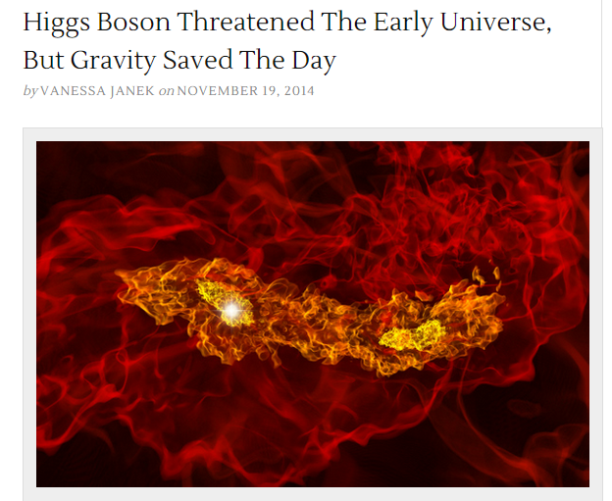
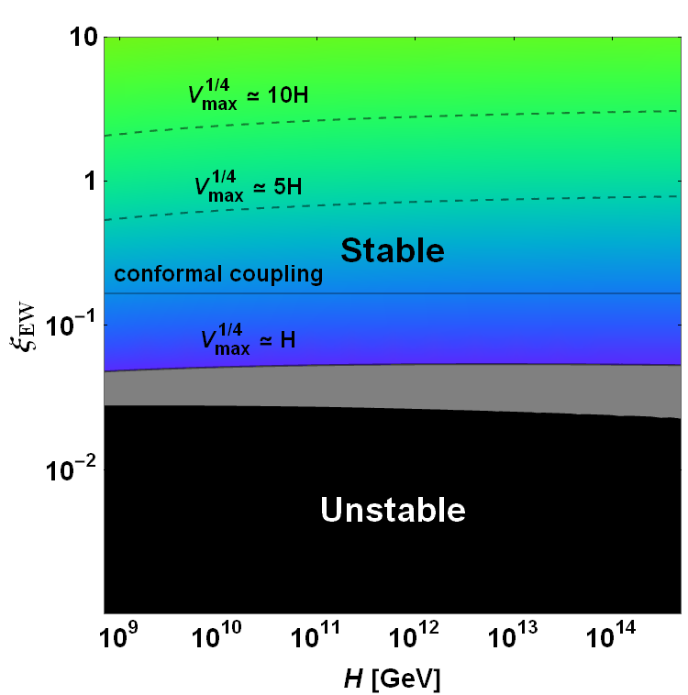

(De)Stabilising the Potential
If $H≳{10}^{10}GeV$ and
there is no new physics,
vacuum stability during
inflation requires
$ξ≳0.06$
(HMNR 2014)

Slide 26

End of Inflation
Reheating:
Inflation ($R=12H^{2}$) → radiation domination ($R=0$)
Effective Higgs mass $m_{eff}^{2}=m_{H}^{2}+ξR$ changes rapidly:
  Excites the Higgs field
  “Geometric preheating” (Bassett&Liberati 1998, Tsujikawa et al. 1999)
Could this throw it over the barrier,
triggering the instability?

Slide 27
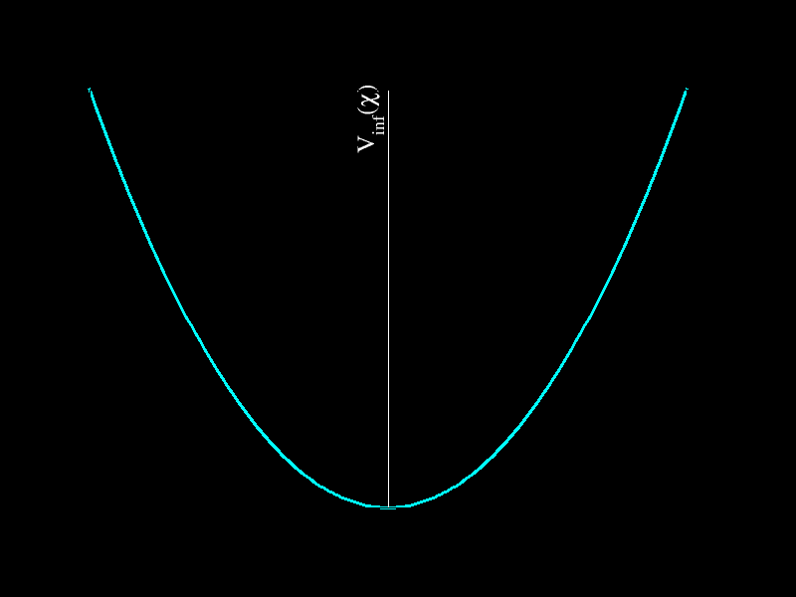

Inflaton Oscillations
After inflation, Universe is dominated by an almost uniform inflaton field $χ$ oscillating in its potential $V_{inf}\left(χ\right)$
Ricci scalar
$R=\frac{1}{M_{Pl}^{2}}\left[4V_{inf}\left(χ\right)−{\dot{χ}}^{2}\right]$
At the minimum
$R∼−\frac{V_{inf}\left(χ_{ini}\right)}{M_{Pl}^{2}}<0$
Tachyonic Higgs mass $m_{eff}^{2}<0$
if $ξ>0$ (HMNR 2015)

Slide 28
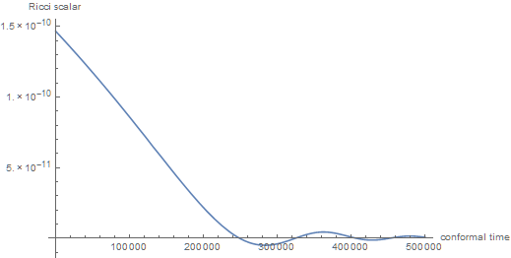

Inflaton Oscillations
Example: $m^{2}χ^{2}$ chaotic inflation
tachyonic

Slide 29

Tachyonic Growth
Tachyonic growth rate $μ∼\sqrt{ξ\left|R\right|}\sim ξ^{1/2}mχ_{ini}/M_{Pl}$
Duration in time
$Δt∼1/m$
Growth during
first oscillation
$e^{μΔt} ∼e^{ξ^{1/2}χ_{ini}/M_{Pl}}$
Higgs variance at
horizon scale:
${\left\langle φ^{2}\right\rangle }_{H}∼\frac{2}{3\sqrt{3}ξ}{\left(\frac{H}{2π}\right)}^{2}e^{\frac{2\sqrt{ξ}χ_{ini}}{M_{Pl}}}∼\frac{H^{2}}{ξ}e^{2\sqrt{ξ}}$ (HMNR 2015)

Slide 30
Vacuum Instability
Not enough
growth
Instability!
?
Becomes
nonlinear
Field backreaction
(HMNR 2015)

Slide 31
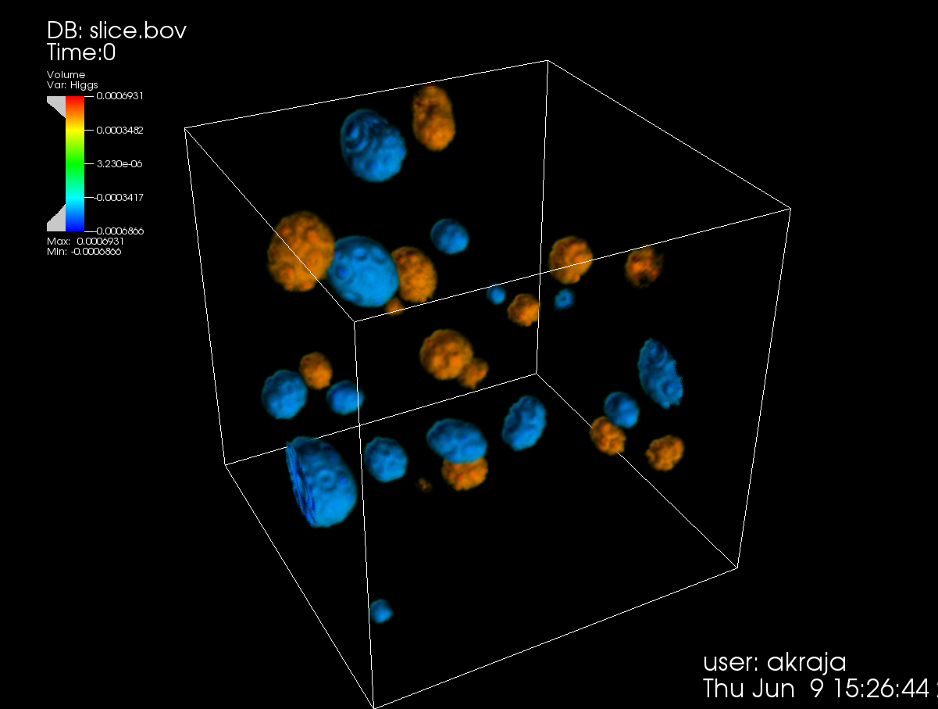

Detailed Calculations
Ema et al,
arXiv:1602:00483
  Lattice simulation
  $ξ≲20$
Kohri et al, arXiv:1602.02100
  Linearised calculation
  $ξ≲40$
Figueroa, AR & Torrenti, in progress:
  Lattice simulations

Slide 32

Lattice Simulations: $m^{2}χ^{2}$
true
vacuum
Figueroa, AR & Torrenti, in progress

Slide 33






Instability Time
$$M_{t}=174.56 GeV$$
$$M_{t}=173.95 GeV$$
Stability depends on speed of reheating, top mass
$M_{t}=173.34 GeV:$ vacuum decays before $mt=100$if $ξ≳9$
$$M_{t}=173.34 GeV$$
$$M_{t}=172.73 GeV$$
$$M_{t}=172.12 GeV$$
Figueroa, AR & Torrenti, in progress

Slide 34


Constraints on $ξ$
Minimal scenario:
Standard Model + $m^{2}φ^{2}$ chaotic inflation,
no direct coupling to inflaton
$$0.06≲ξ≲9$$
15 orders of magnitude stronger than the LHC bound
$\left|ξ\right|≲2.6×{10}^{15}$
Caveats:
  Inflaton coupling – Would still need $|ξ|≲O(1)$
  New physics – Could stabilise potential altogether
Future work: Standard Model couplings, de Sitter tunneling

Slide 35

Summary
Last unknown parameter in the Standard Model:
Higgs-gravity coupling $ξ$
  Required for renormalisability in curved spacetime
Assuming no new physics except inflation:
  Triggers vacuum decay during inflation unless $ξ≳0.06$
  Triggers vacuum decay after inflation unless $ξ≲9$
  Gravitational effects slow down vacuum decay today –
  Fastest rate for near-conformal coupling $ξ≈0.16676$

Slide 36


Running Coupling
$λ$ becomes negative at $μ≳{10}^{10} GeV$
Buttazzo et al., JHEP 2013

