Slide 1


Resonance and exotics production from heavy ion collisions
Su Houng Lee
1. Few words on Multiquark configurations
2. Particle production in heavy ion collision
3. Exotics from heavy ion collisions
4. Summary
+T. Song, K. Morita, Maeda
S. Cho, SHL, arXiv:1509.04092; S. Cho, T. Song, SHL, arXiv:1511.08019

Slide 2
I: Few words on “Multiquark states”
X(3872), Zc(3900), … Zb(10610), Zb(10650)
+ LHCb J/ψ p PRL 115, 072001 (2015)

Slide 3


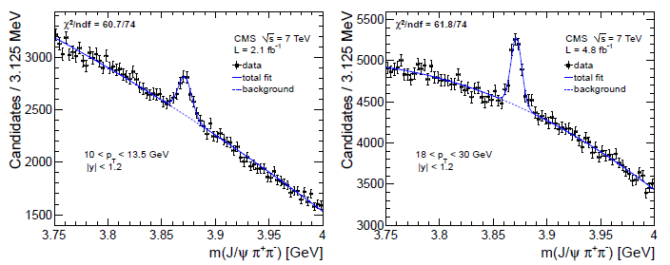

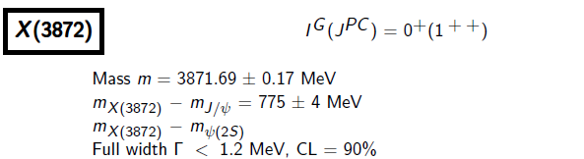
X(3872)
- 2003 -
- 2013 -

Slide 4
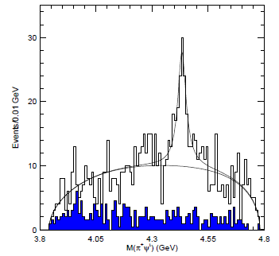
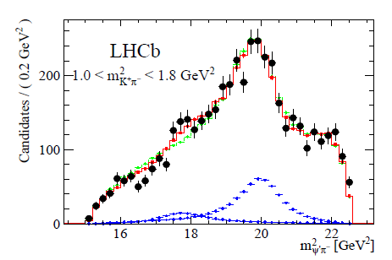

Z(4430)
- 2007 -
- 2014 -
Spin parity = 1+
G=+ → will look at C=-

Slide 5
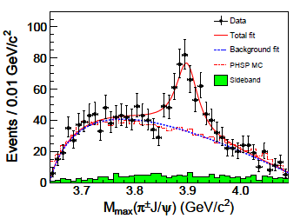
Z(3900)
- 2013 -
BESIII
(Belle)
Probably the same Quantum Number as Z(4430)
Hence,

Slide 6
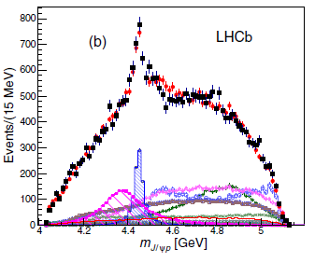
Pentaquark - Pc
- 2015 -

Slide 7

Comact multiquark configuration? Not so easy
c
q
quark
c
q
antiquark
- Color singlet configuration: or
- Spin 1 configuration from : where
C=+
Color
Spin
C=-

Slide 8
Comact multiquark configuration? Not so easy
:
c
q
c
q
:
Favors over
c
q
c
q
: should be strong enough to overcome repulsion from kinetic term
Otherwise can form molecular configuration

Slide 9
H dibaryon
H
Λ
Λ
u
d
u
s
vs
u
u
u
d
s
s
d
s
Park, Park, SHL (PRD2016)

Slide 10
C=+ state
(Woosung Park, SHL 14)
Or (Tornqvist 94)
C=- state
Or is molecular states
Or is 2s of in diquark picture (Maiani, Polosa, Riquer)

Slide 11
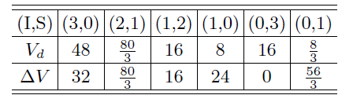
d*(2380)
- WASA-at-COSY-
d*
Δ
Δ
u
d
u
u
→
u
u
d
d
u
d
d
d
 | Color | Spin | Favor | V
(QQ)₁ | 3bar | 0 | 3bar | -2
(QQ)₂ |  | 1 | 6 | 2/3
(QQ)₃ | 6 | 0 | 6 | 1
(QQ)₄ |  | 1 | 3bar | -1/3
W.Park, A. Park, SHL, (PRD 15)

Slide 12
Real compact multiquark states
A 3-body or 4 body force could favor
and lead to compact 4 quark state
or artificially increase diquark correlation
1
2
3
4
Color Spin force
1
2
3
4
→ T_{cc} T_{cb} : real compact flavor exotic tetraquarks

Slide 13
II: Particle production in Heavy Ion Collision

Slide 14
Hadron production in ( p+π→C+X ) collision
c
C
u
β
d
G_{b/π}
D_{C/c}
π
c
u
b
dσ
γ
a
d
d
G_{a/p}
p
c
u
α
X

Slide 15
Particle production in heavy ion collision
Hadron
Multiquark formation
Light nuclei
Molecular structure formation
T
T_{C}
T_{μ}
T_{F}
τ
QGP
Hadron phase
1 fm/c
5 fm/c
7 fm/c
17 fm/c

Slide 16
Normal meson, compact multiquark, molecules, resonances
 | Normal meson | Compact multiquark | Molecules | Resonance
Geometrical configuration
Examples | Nucleon, pion, kaon | ? | Deuteron, light nuclei | K*, rho meson
u
u
d
u
u
u
u
d
d
u
u
d
d
d

Slide 17
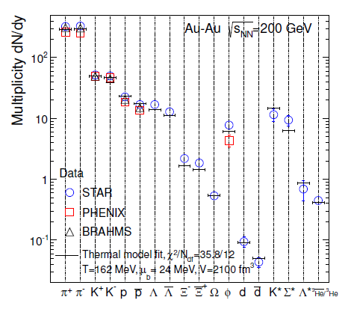
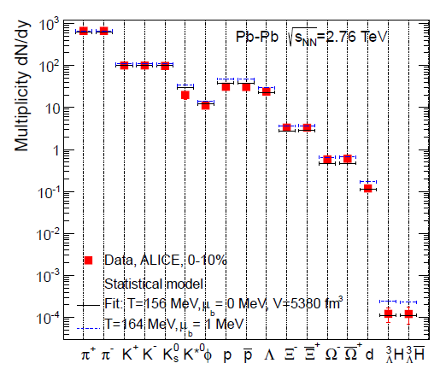
Production of hadrons near Tc
RHIC – Statistical model (PBM ..)
ALICE – Statistical model
resonance

Slide 18
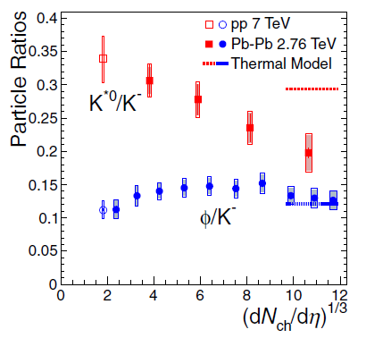
Production of resonances
ALICE (2015 prc)
Reconstruction

Slide 19
Rate equation for K* (resonance) production
Destruction:
Creation
Thermal Equilibrium

Slide 20
Freeze out condition for a particle
Two time scale (=cosmology)
Freeze out condition
T
T_{H}
Freeze out density
T_{F}
τ
Hadron phase
7 fm/c
17 fm/c

Slide 21
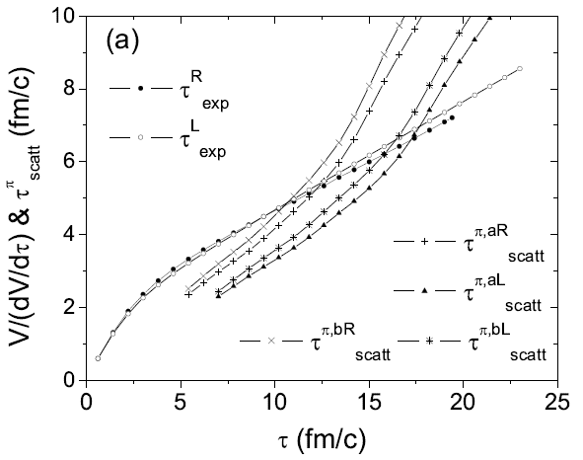
Detailed hydrodynamic calculation - 1
S. Cho, SHL, arXiv:1509.04092; S. Cho, T. Song, SHL, arXiv:1511.08019
Later time
Low density

Slide 22
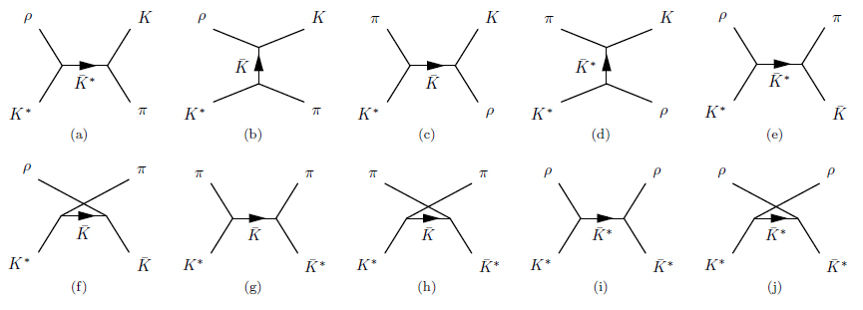
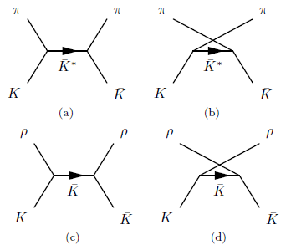
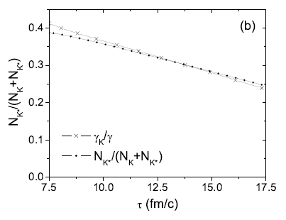
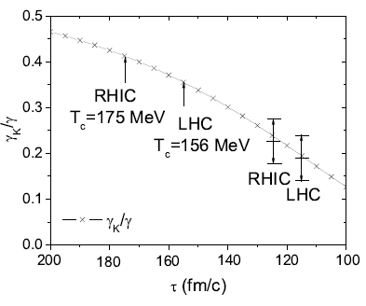
Detailed calculation - 2
S. Cho, SHL, arXiv:1509.04092; S. Cho, T. Song, SHL, arXiv:1511.08019

Slide 23
Detailed calculation
Two time scale (=cosmology)
ALICE (2015 prc)

Slide 24
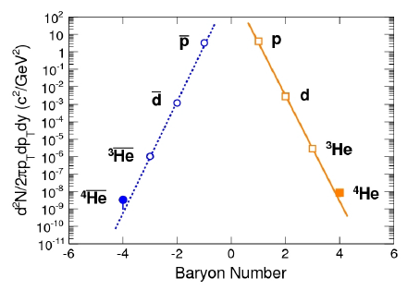
Production of light nuclear
RHIC/STAR (Yugang Ma)
ALICE – Statistical model
S/N i conserved (Siemens, Kapusta 79)

Slide 25
Rate equation for deuteron (bound states) production
Destruction:
Creation
Thermal Equilibrium

Slide 26
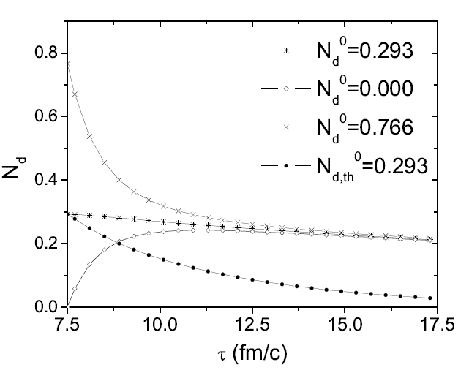
Non equilibrium
Number of Ground state particles remain almost constant
Deuteron

Slide 27
Comparison
K* (Resonance) production
Deuteron (bound state) production

Slide 28
Normal meson, compact multiquark, molecules, resonances
 | Normal meson | Compact multiquark | Molecules | Resonance
Geometrical configuration
Yields /Statistical model | 1 | < 0.1 | ~ 1 | ~ 0.5
u
u
u
u
u
u
d
d
u
u
d
d

Slide 29
Production of resonances
ALICE (2015 prc)
Reconstruction
STAR collaboration (PRL 2006) find

Slide 30
Coalescence model
u
u
u
s
d
M
d
d
c
d
s
u
u
d
c
c
u
c
d
P_{T} dependence of ratio
Quark number scaling of v2
v4
Greco, et al
Greco et al

Slide 31

Hadron production near phase bounday (T_{H} )
Coalescence model = Statistical model + overlap
Suppression of p-wave resonance (Muller and Kadana En’yo)
u
u
u
s
d
M
d
d
s
c
u
d
d
u
c
c
u
c
d

Slide 32
Production of multiquark states are suppressed
Success of Coalescence model
Coalescence model = Statistical model + overlap
u
s
d
u
d
d
u
u
u
u
u
d
s
c
u
d
u
d
u
d
d
u
u
d
c
u
c
Tetraquark configuration [overlap]<<1
Normal meson [overlap]=1
u
c
d

Slide 33
III: Exotics from Heavy Ion Collision

Slide 34
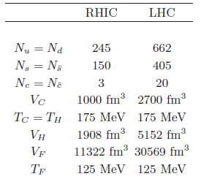
New perspective of Hadron Physics from Heavy Ion Collision
large number of c , b quark production
Vertex detector: weakly decaying exotics : FAIR 10⁴ D⁰ /month,
LHC 10⁵ D⁰/month
T_{cc} production
T_{cc}/D > 0.34 x 10 ⁻⁴ RHIC
> 0.8 x 10 ⁻⁴ LHC

Slide 35
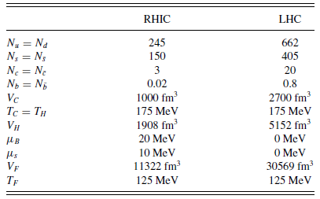



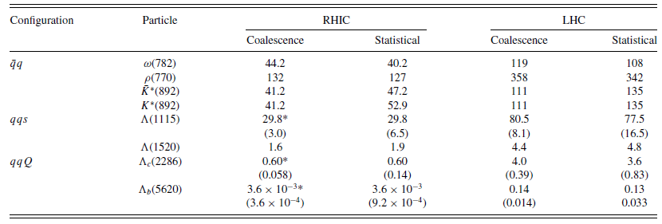
Details of coalescence model calculation (ExHIC PRL, PRC 2011)
Model central rapidity, central collision
Introduce charm fugacity LHC 10⁵ D⁰/month
Coalescence model model and Wigner function
Parameters to fit normal hadron production including resonance feedown from statistical model

Slide 36
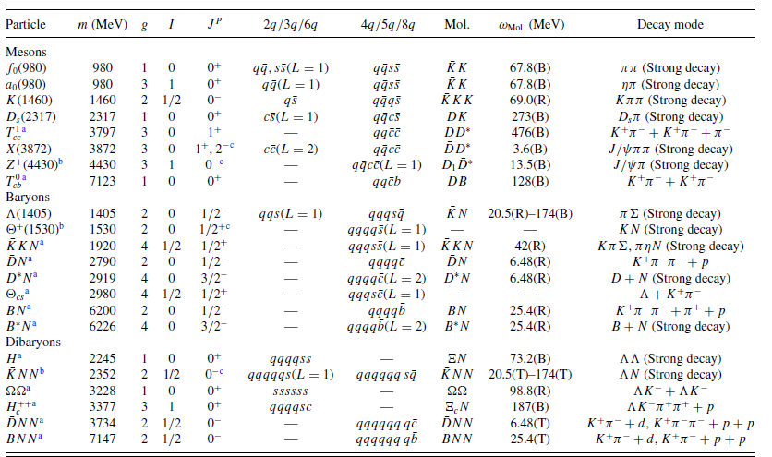
Hadron coalescence

Slide 37
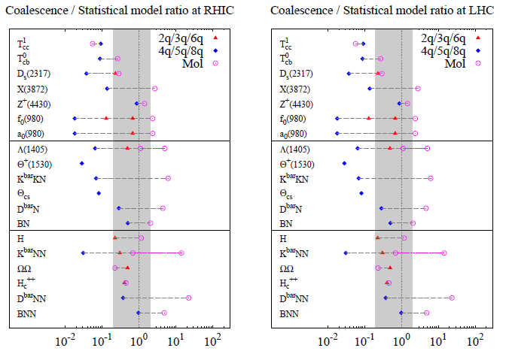
Fachini [STAR]
Expectations [overlap] at LHC

Slide 38
Summary
Whats the difference between compact multiquark states and molecular states
→ Need heavy quarks to enhance diquark correlation
→ Multiquarks will tell us about 3,4-body QCD force
Measurements from Heavy Ion can discriminate the structures
 | Normal meson | Compact multiquark | Molecules | Resonance
Yields /Statistical model | 1 | < 0.1 | 1~ 2 | ~ 0.5
Flavor exotics will involves two heavy quarks→ Heavy ion can easily produce

Slide 39
Suggestions
1. Lambda (1405): two poles?
2. Dibayrons: d*(2323)→ Δ+Δ H, N-Omega, Hc(uuudsc)
3. Light molecules or tetraquarks
4. Heavy Tetraquarks
5. Heavy Pentaquarks

Slide 40
Back up slides

Slide 41
Hadron production through coalescence
u
d
u
d
u
d
u
Normal meson [overlap]=1
s
u
u
d
d
s
d
u
u
s
d
u
d
d
u
s
u
d
u
d
u
d
d
u
d
d
d
d
u
u
u
u
u
s
Molecular configuration: [overlap]=1
d
u
Tetraquark configuration [overlap]<<1
Coalescence model at Tc → ratio of yield

