Slide 1
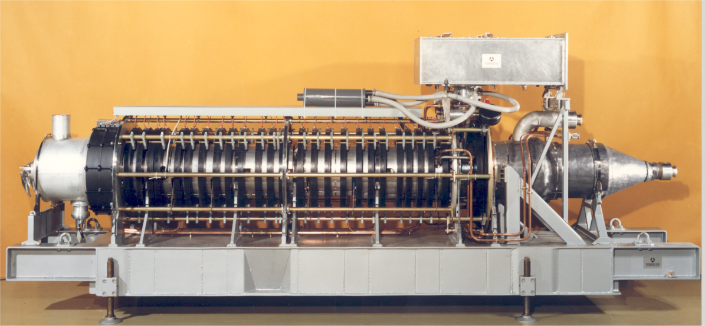
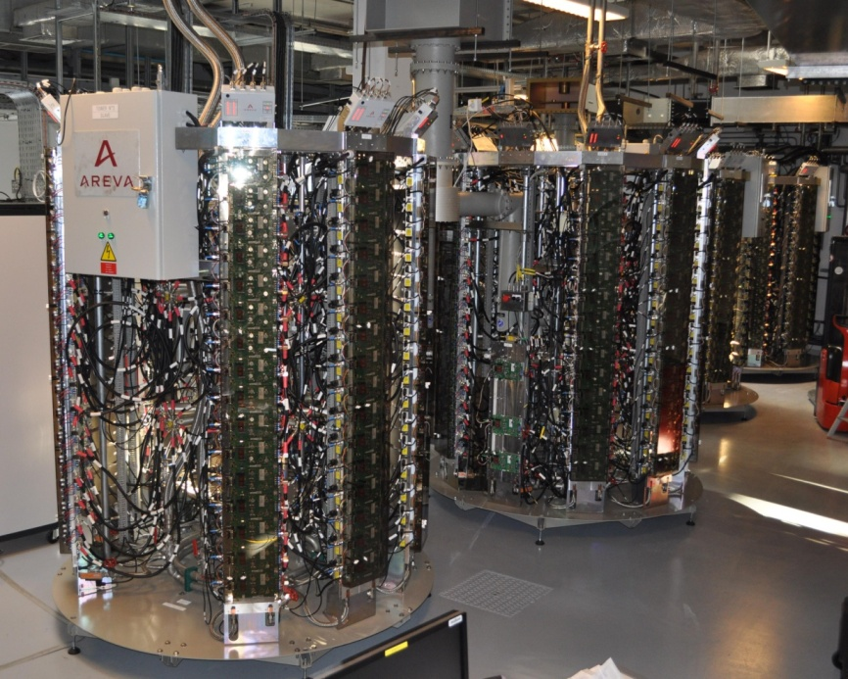
9th CWRF
ESRF/ Grenoble, 20th – 24th June 2016
RF System Upgrade for the New Extremely Brilliant Light Source at the ESRF, Operation Experience with Klystrons and Solid State Amplifiers
J. Jacob, J.-M. Mercier, V. Serrière,
M. Langlois, G. Gautier, A. D’Elia
352 MHz 1.3 MW Klystron
Thales TH 2089
150 kW SSA
SOLEIL / ELTA

Slide 2
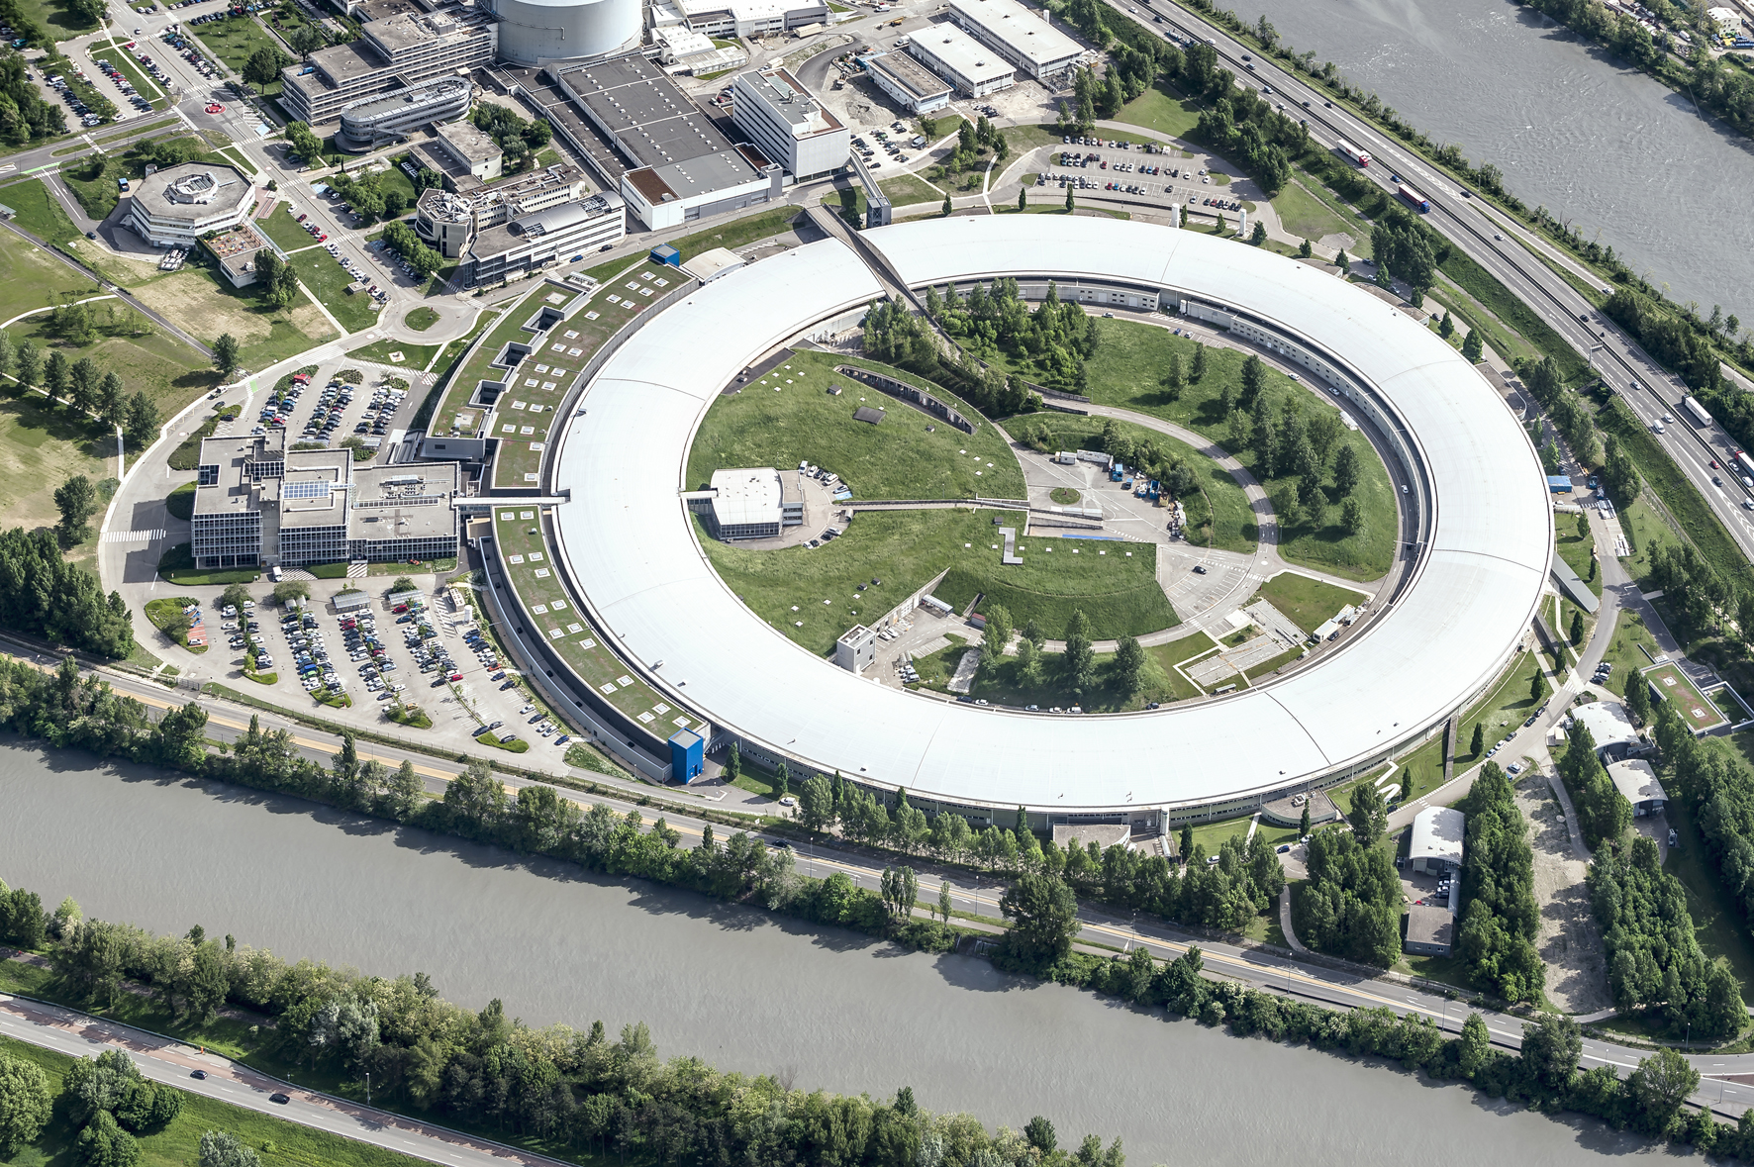

ESRF : First 3rd generation synchrotron light source
Up to 100 keV X-rays
Circ = 844 m
6 GeV Booster
200 MeV Linac
6 GeV Storage Ring
200 mA
Existing Storage Ring
1992: commissioning
1994: external users
since then:
many upgrades
brilliance increase by about a factor 1000
New Extremely Brilliant Source: EBS
further brilliance increase by a factor 40
2019: installation
2020: commissioning
resume user service

Slide 3
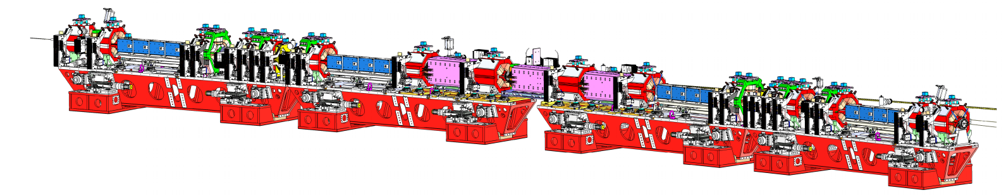
ESRF-EBS: Extremely brilliant source
  Main features:
      2 regions with large dispersion for efficient chromaticity correction
      Rough sextupole compensation by having a ≈π phase advance between the 2 sections
  Performance:
      Natural equilibrium emittance:
        ε_{x0} = 134 pm
      Emittances with 5 pm coupled into the vertical plane and 0.5 MV radiation losses from ID’s:
        ε_{x} = 107 pm
        ε_{z} = 5 pm
[Courtesy: L. Farvacque]

Slide 4
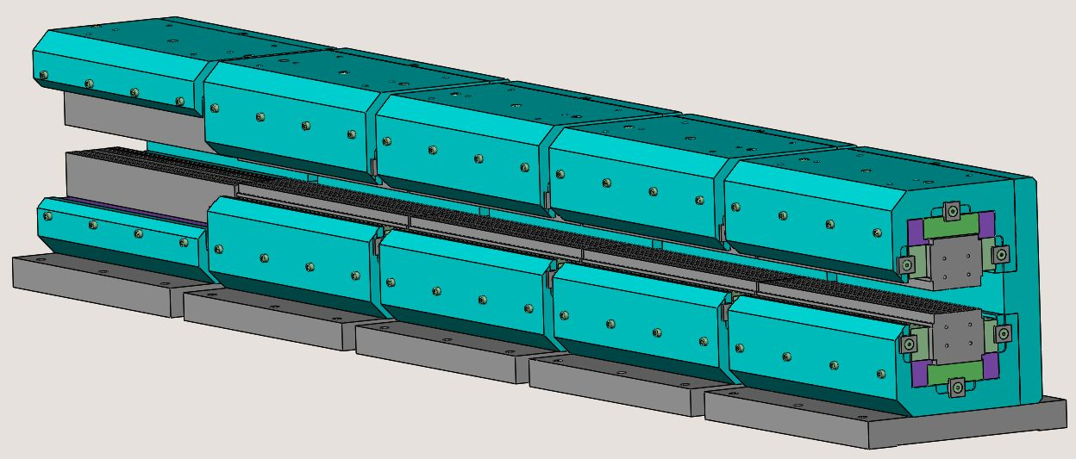
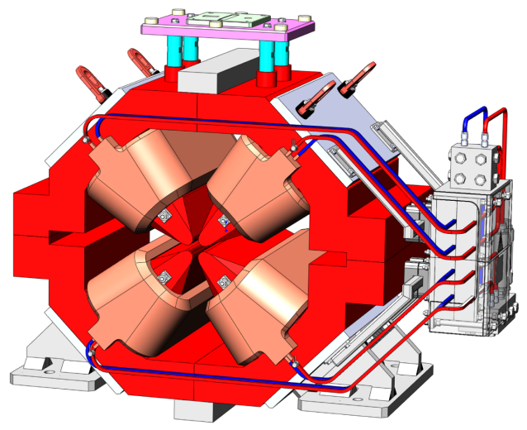
ESRF-EBS magnets
DL
0.17 ➠ 0.67 T
permanent magnets,
5 modules
Quadrupole
91 T/m, ⌀25.4 mm
[Courtesy: Gael Le Bec]

Slide 5
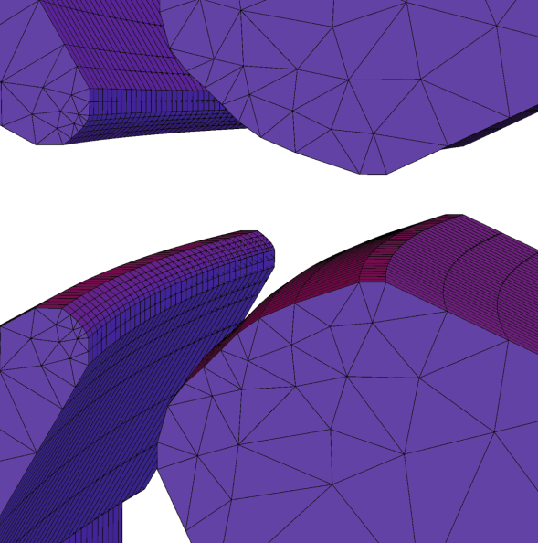
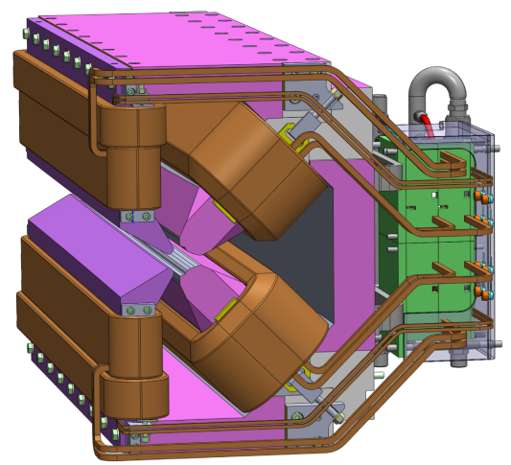
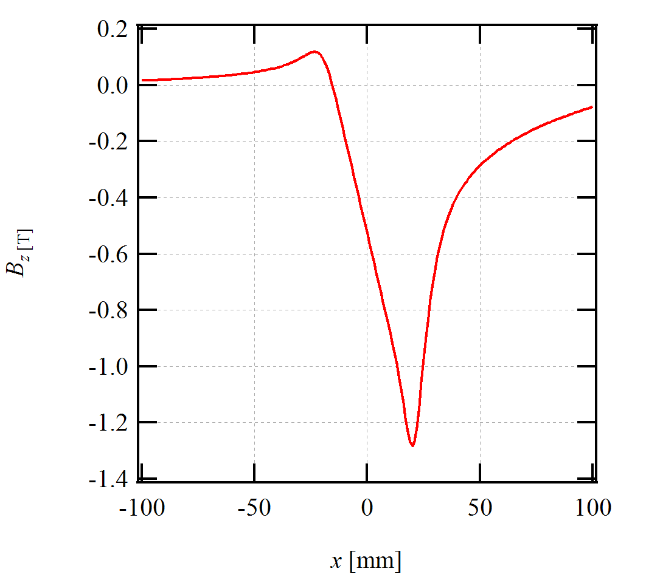
ESRF-EBS magnets
DQ
0.55 T, 37 T/m
[Courtesy: Gael Le Bec]

Slide 6
Main machine parameters
 |  | Existing ESRF | ESRF-EBS
Same energy, current and filling patterns | E, Ibeam | 6 GeV, 200 mA | 6 GeV, 200 mA
Emittance | ε_{x} / ε_{z} | 4000 pm / 5 pm | ≈ 110 pm / 5 pm
Energy loss (incl. 0.5 MeV for ID’s) | U | 5.4 MeV/turn | 3.1 MeV/turn
Same ID position ⇒ Δf_{rf} = + 170 kHz | f_{rf} | 352.20 MHz | 352.37 MHz
Longitudinal damping time | τ_{s} | 3.5 ms | 8.6 ms
Momentum compaction factor | α | 17.8 10⁻⁵ | 8.4 10⁻⁵
Energy spread | σ_{E}/E | 1.06 10⁻³ | 0.948 10⁻³
Nominal RF voltage | V_{acc} | 8 MV (max 12 MV) | 6 MV (max 6.6 MV)
⇒ RF Energy acceptance (incl. ID’s) | ΔE/E | 2.9 % | 4.9 %
Synchrotron frequency | f_{s} | 1.86 kHz | 1.22 kHz
I_{threshold} for HOM driven instabilities (LCBI) [for a given HOM] | ratio | 1.9 to 1 ⇒ HOM damped cavities MANDATORY EBS
Number of cavities | N_{cav} | 5 (five-cell cav’s ⇒ 25 cells) | 13 to 14 (mono-cells, HOM free)
Cavity Coupling | β | 4.4 | 3
Total RF power at 200 mA | P_{tot-200mA} | ≈ 1400 kW | ≈ 1000 kW

Slide 7
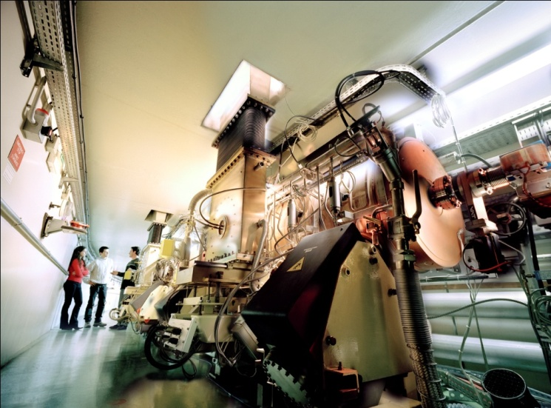
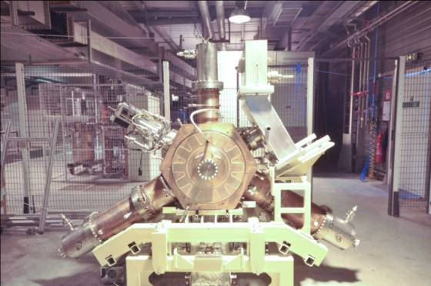
RF DESIGN elements for ESRF-EBS
Total energy loss including ID radiation: 3.1 MeV/turn
Maximum RF Voltage: 6.6 MV
RF transmission losses: 15 %
    including RF losses, spurious mismatches
Stored current with operational margin: 220 mA
RF frequency: 352.371 MHz
15 HOM damped cavities: 3 prototypes validated for 0.6 MV / 150 kW
12 cavities in fabrication
ESRF visit
5-cell cavities: strong HOM !
HOM damped mono-cell cavities developed at ESRF, based on BESSY/ALBA design

Slide 8
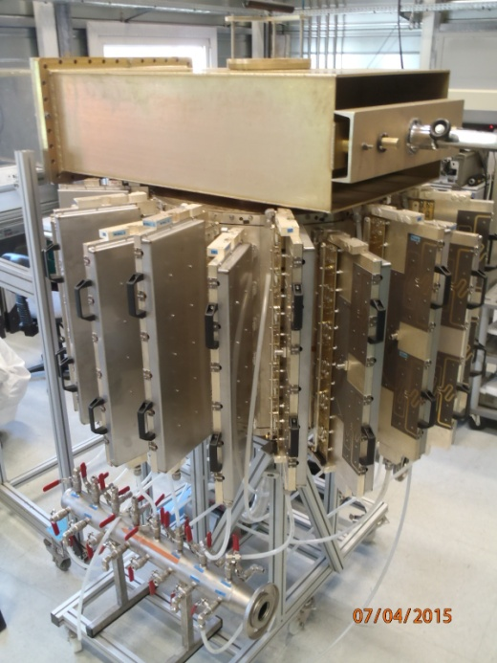
Re-usE of existing RF power sources for ESRF-EBS
ESRF visit
3 x 150 kW SSAs feeding prototype cavities in existing storage ring: re-used for EBS
85 kW SSA with cavity combiner, developed at ESRF [M. Langlois’ talk]
352 MHz 1.3 MW Klystron
2 of 3 existing klystron transmitters: re-used for EBS
Thales TH 2089

Slide 9
Cell 5
Cell 7
Existing klystron transmitters operational for EBS
Will be refurbished
Including full control upgrade
Further SSAs after EBS commissioning
-7 dB
-7 dB
Storage Ring
KLYS 1
KLYS 2
3x existing 150 kW SSAs
Teststand
75 kW
tower
75 kW
tower
75 kW
tower
75 kW
tower
In
house
SSA
Compact 85 kW SSA with cavity combiner
75 kW
tower
75 kW
tower
Base line: 13 cavities
Use only existing RF sources
14th cavity fed by in house SSA
Operating SSA on machine for validation as long term alternative to klystrons
Cell 25
3rd harmonic cavities
  Still under study:
    Passive SC or active NC

Slide 10
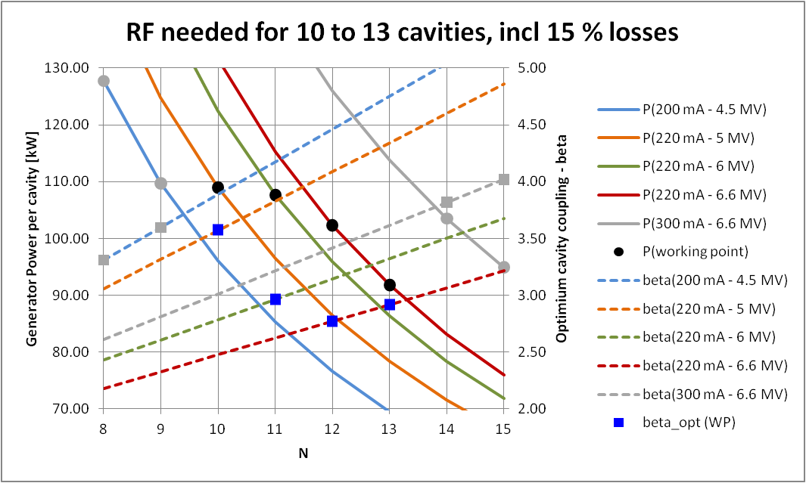
Even with 5 cavities in fault (1 complete cell)  operation at 4.5 MV / 200 mA still possible
Also room left for performance upgrade

Slide 11
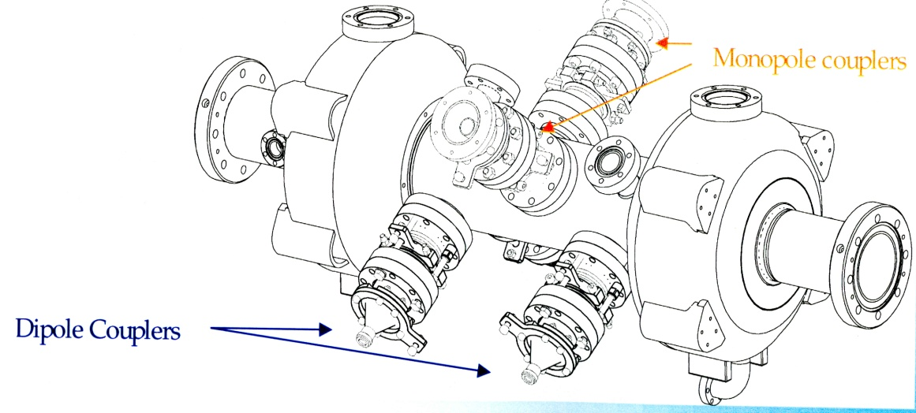

Lifetime in the new machine
New lattice: same operation modes as existing machine:
 | Multibunch | 16-bunches | 4-bunches
Total current | 200 mA | 90 mA | 4 x 10 mA
Nb. Bunches | 868 | 16 | 4
Bunch length | 23 ps | 64 ps | 77 ps
Lifetime for ε_{vert} = 5 pm | 19 h | 1.8 h | 1.2 h
Implementation of 3rd harmonic cavities at 1057.1 MHz for bunch lengthening and increased Touschek lifetime under study.
Alternatives:
  Passive SC cavity, Super3HC type like at Elettra or SLS: collaboration with CEA / IRFU / SACM in Saclay, France
  Active NC cavities: scaling of ESRF HOM damped accelerating cavity

Slide 12
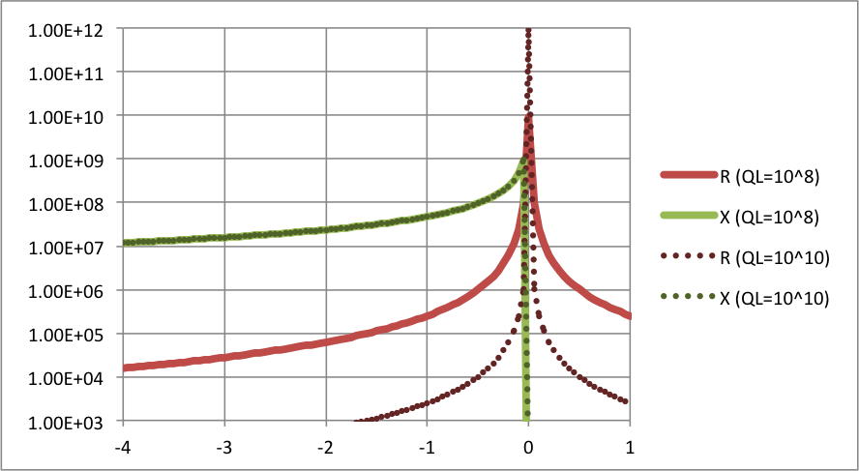
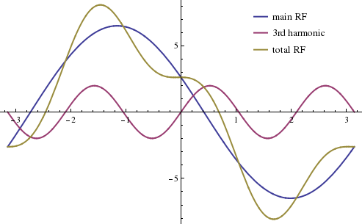
Operation of passive SC harmonic cavity
Z / [Ω]
detuning Δf
f_{s}
R⁺
3f_{rf}
f - 3f_{res} [kHz] ->
Strong detuning Δf of Super3HC like cavity:
  Zcav ≈ jX, with X >> R, X ≠ f(QL)
  Δf such that: 2 I_{beam} X = V_{harm}
  Δf ≈ 3.5 kHz for I_{beam} = 70 mA
Smaller I_{beam} ➔ larger X ➔ smaller Δf ➔ larger R⁺
  => Problem of AC Robinson instability for I_{beam} < 70 mA !
  (off resonance, Φ_{harm} follows rigid bunch motion at f_{s}≠0)
Bunch lengthening:
V_{harm} = 1.7 MV for V_{acc} = 6 MV

Slide 13
Example of AC Robinson instability on 3rd synchrotron satellite
f_{s}
[Multiparticle tracking simulation using AT with beam loading effects in cavities by N. Carmignani in collabopration with B. Nash, ESRF ]
Zoom out
3f_{s}
3f_{s}
Z / [Ω]
SIMULATION:
  Bunch center of mass: unstable oscillation at 3f_{s} for large QL
  Strong Amplitude & phase oscillation of V_{harm} at 3f_{s}
Tentative explanation: beating between
  Nominal harmonic voltage driven by the beam at 3f_{rf}
  Strong voltage from tiny 3f_{s} synchrotron sideband close to SC-cavity resonance
detuning Δf
f_{s}
f_{s}
f_{s}
3f_{rf}
f - 3f_{res} [kHz] ->

Slide 14

Booster RF already upgraded
Initially since 1991:
  1 klystron powered 2 five-cell cavities
  via 2 couplers/cavity
  600 kW in total
  Total V_{acc} up to 8 MV
April 2012 upgrade:
  4 x 150 kW SSAs powered 2 cavities
January 2016 upgrade:
  4 x 150 kW SSAs feed 4 cavities
  1 SSA/cavity via 1 coupler/cavity
  Total V_{acc} up to 11 MV
  Redundancy: 8 MV operation with 3 systems (i.e. if 1 cavity or SSA fails)
Ready for safe frequent top up operation started in 16 bunch in April 2016
5-cell cavities

Slide 15
Operation experience with 7 x 150 kW SSA
Booster → 4 SSA 150 kW each. In operation since January 2012 (4500 hours)
  Top-up since April 2016
SR → 3 x SSA 150 kW each. In operation since October 2013 (17400 hours)
  1 is out of operation because of cavity failure
So far no transistor failure (BLF578 from NXP, now produced by AMPLEON)
Nominal Power Efficiency 58% Gain 63.3 dB – No variation in time (last control March 2016)
Component | Event count | Disturb Operation | Comment
HPA 650W (filter) | SR 10 SY 9 | No No | CMS filters stressed when soldering on the PCB. Youth problem, now fixed with time. Last failure: April 27 2015.
DC/DC Converter 280V/50V | SR 4 SY 3 | No No | Fuse blown. OK after replacing the fuse
Pre-Driver | SR 0 SY 5 | Yes 1 | Conception problems, which have been fixed: Gain loss, bad soldering, bad logic circuitry …
MUXBOX Control Interface | SR 3 SY 4 | Yes 2 No | The SSA trips when the fuse blows because the relays for cooling interlocks are fed by this interface. This is a weakness of the system, which can be improved.
Water Cooling | SR 1 SY 2 | No Yes 1 | Fortunately it happened outside of machine operation
TOTAL | SR 18 SY 23 | 2 2 | 1 in 2014 + 1 in 2015 → Beam loss 2 in 2012 → Refill postponed

Slide 16
Klystron transmitters
STORAGE RING - 3 RF stations with 1.1 MW and 1.3 MW klystrons
RF station #1 feeding 4 five-cell cavities
RF station #2 as backup for #1 or for RF Power Test Stand
RF station #3 feeding 1 five-cell cavity (formerly 2 cavities)
Stations #1 and #2 in operation since 1991, station #3 since 1997
Stations #1 and #2: control refurbished year 2000 following the standard of station #3
Obsolescence of VME / linux computers comprising measurement and digital I/O boards
  New control is under refurbishment using PCI and independent measurements and digital I/O
Klystron EEV2-2 dead at 21770 hours in October 2015
Station #3 will be dismantled end of 2018 for new ESRF-EBS machine
352 MHz 1.3 MW Klystron
Thales TH 2089

Slide 17
Available klystrons - Status March 2016
RF Station | Klystron Id | HV time | Average/year
#1 | EEV4 | 65,087 | 6,100
#2 | EEV1 | 34,121 | 5,000 next 2 years
#3 | PHILIPS | 22,775 | 4,500
Spare Klystrons | EEV3 | 8,374 | Potential time of 110,000 hours assuming a life time of 40,000 hours / klystron corresponding to 11 years of operation (9 years on EBS)
 | TH89022-2 | 18,428
 | TH89018-2 | 36,340
 | EEV5 | 10,631

Slide 18
Klystron versus SSA Failures
Year | Klystrons + ancillaries* |  | SSA
 | Beam losses | % of total RF failures | Beam losses | % of total RF failures
2012 | 2 | 8% | 0 | 0%
2013 | 3 | 14% | 0 | 0%
2014 | 3 | 9% | 1 | 3%
2015 | 1 | 4% | 1 | 4%
* Modulating Anode PS, Focusing PS, Filament PS, IP

Slide 19
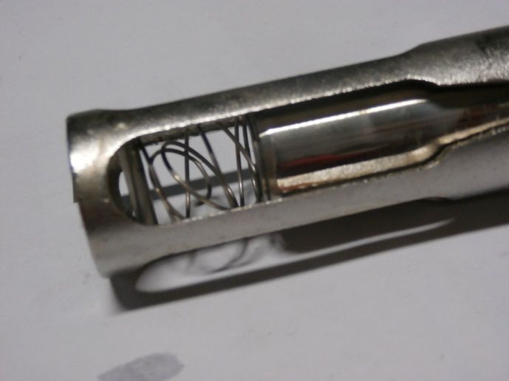
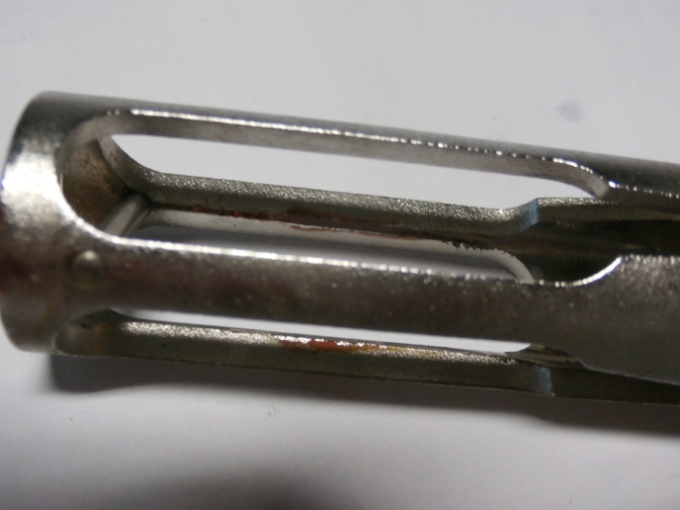
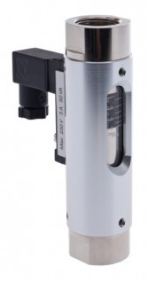
What could be improved on 150 kW SSA
Interlocked cooling water flow controllers:
  1 Kobold flow controller per cooling plate, supporting 16 HPA of 650 W or drivers
  18 cooling plates per SSA
Erosion issue
Design issue
RS 485 BUS
KOBOLD
Data flow
Control Interface
Inner sleeve
relay
Mains
HPA
fuse
Friction area
Broken spring
PLC / interlock
16
Alternative to KOBOLD
7x18 = 126
to be replaced
≈ 40k€
Temp
HPA
Flow controller
Cooling water
Glass sleeve
When the Control Interface fuse is blown the SSA is tripped only because the flow and temperature interlocks are conditioned by this interface (relay).
Interlock should be processes independently.

Slide 20
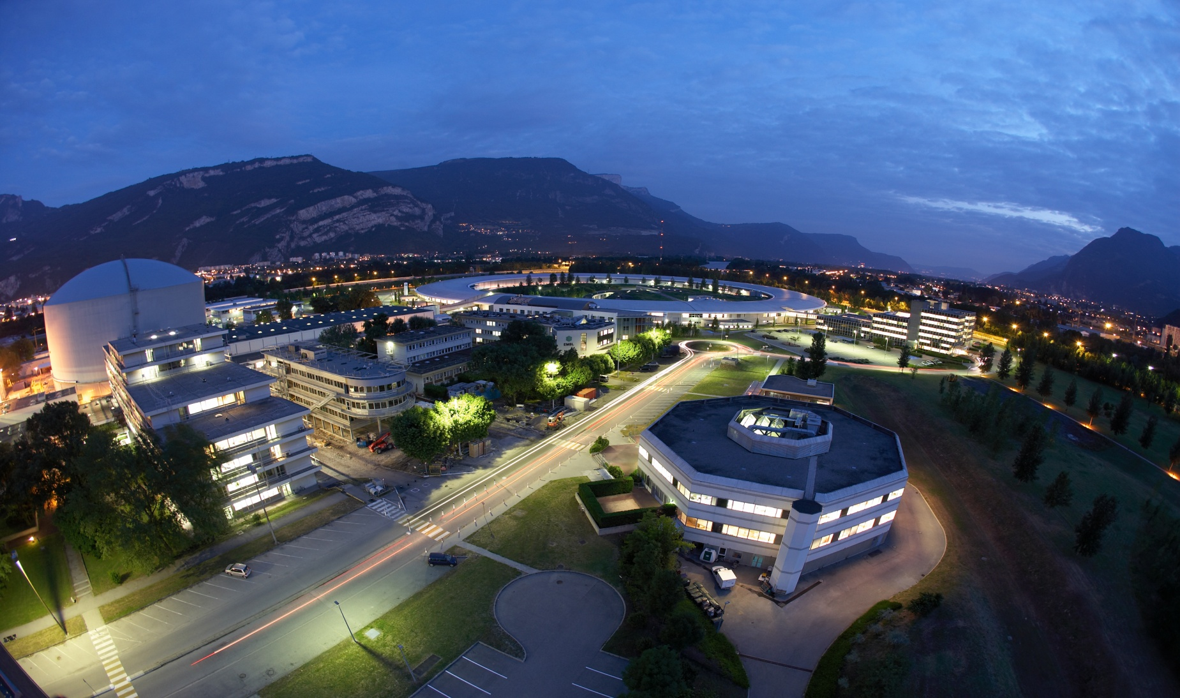
Thank you !!!

