Slide 1
High Efficient Amplifier Design for Accelerator-Applications
Uwe Dalisda
Div. Broadcast and Media
Rohde & Schwarz Munich/Berlin

Slide 2
Index of Contents
Broadcast Transmitter – An Overview
System Architecture
  Broadcast Transmitter
  Amplifier Design
  Feedback Combiner
  Power Combiner
  Reserve Systems
  Common Features
  Examples
Summary

Slide 3
Broadcast Transmitter – An Overview
System Architecture
  Broadcast Transmitter
  Amplifier Design
  Feedback Combiner
  Power Combiner
  Reserve Systems
  Common Features
  Examples
Summary

Slide 4
Broadcast Transmitter – An Overview
Customer Demands |  | Manufacturer Needs
High Availability | ←→ | Robust Design (Designed for 24/7 operation)
Redundant System Components | ←→ | Redundancy concepts
Wide range of output power | ←→ | Output Power cascadable
Efficiency | ←→ | Narrowband/broadband design (transistor matching!)
Low number of spare parts | ←→ | Broadband components
Power Density | ←→ | Compact design Multi-Tx solutions (within one rack)
Service and Serviceability | ←→ | Worldwide Service – „hot plugable modules“ Long term availability for spare parts (10+ years)
Purchasing costs (Capex) | ←→ | Low production costs High degree of automation High volume production Little manual work
Notes:
Designed for signals with high crest factor
Tx should transmit power even with failed components/amplifier – broadcast station not reachable during winter time – (commercials)
Decoupled components, different systems concepts, active/passive/n+1-reserve, dynamic power adaption
RF-Bandwidth up to one octave / baseband up to 20MHz
Compact design to keep the rental low (rental for space)
Service: should be made by non technicians

Slide 5
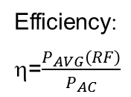
Broadcast Transmitter – An Overview
 | Band 2 | Band 3 | Band IV/V
Frequency range | 87MHz – 108MHz (85MHz – 118MHz) | 170MHz – 254MHz | 470MHz – 862MHz
Channel bandwidth |  | 6/7/8 MHz | 6/7/8 MHz
AVG / CW power Peak power* Multi rack power (AVG) | 5kW – 40kW >80kW | 1.7 – 20kW ~12 – 140kW >60kW | 1.7 – 20kW ~12 – 140kW >100kW
Efficiency OFDM* CW*** | appr. 75%** | ~50% Doherty appr. 65% | ~40% Doherty appr. 55%
Max. amplifier per rack | 8 | 12 | 12
per rack
* related to OFDM modulation (~10dB Crestfactor), min. 34dB MER, 37dB shoulder; incl. Cooling
ATSC min. 36dB MER, min. 37dB shoulder
** class C, FM
*** incl. cooling
Efficiency:
η=$\frac{P_{AVG}\left(RF\right)}{P_{AC}}$
Notes:
Peak power depends on the duty cycle and the pulse length
ATSC (similar single side band modulation)
Efficiency: RF-power to wall-plug power

Slide 6
Broadcast Transmitter – An Overview
System Architecture
  Broadcast Transmitter
  Amplifier Design
  Feedback Combiner
  Power Combiner
  Reserve Systems
  Common Features
  Examples
Summary

Slide 7
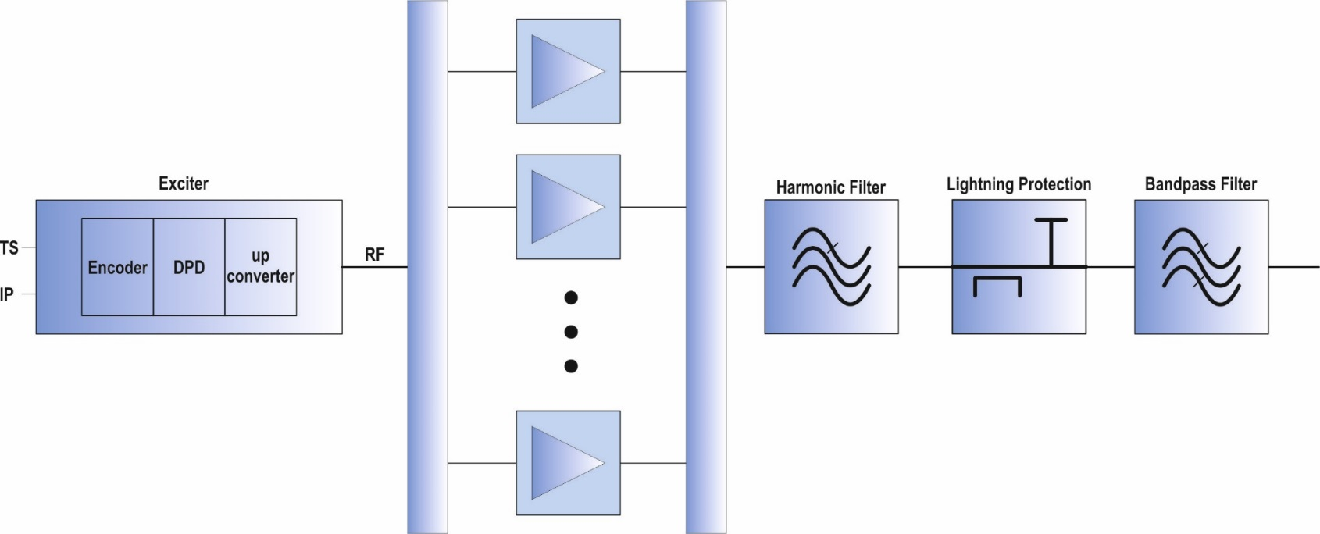
System Architecture – Broadcast Transmitters
Broadband Amplifier
RF
CAN
Ethernet local
Ethernet remote system
Ethernet remote device
Mask filter (typ. 8 MHz, 6 or 8 pole filter)
Display unit
Exciter
Control
Local / Remote
Broadband Splitter/Combiner Architecture
Cooling
system
Rack
Notes:
Ethernet local and remote system
Exciter could be any signal source

Slide 8
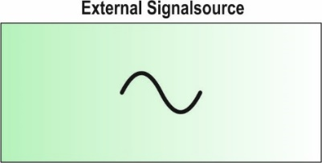
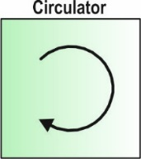
System Architecture – Accelerator
RF
CAN
Ethernet local
Ethernet remote system
Ethernet remote device
Display unit
Exciter
Control
Local / Remote
Cooling
system
Rack
Notes:
Ethernet local and remote system
Exciter could be any signal source

Slide 9
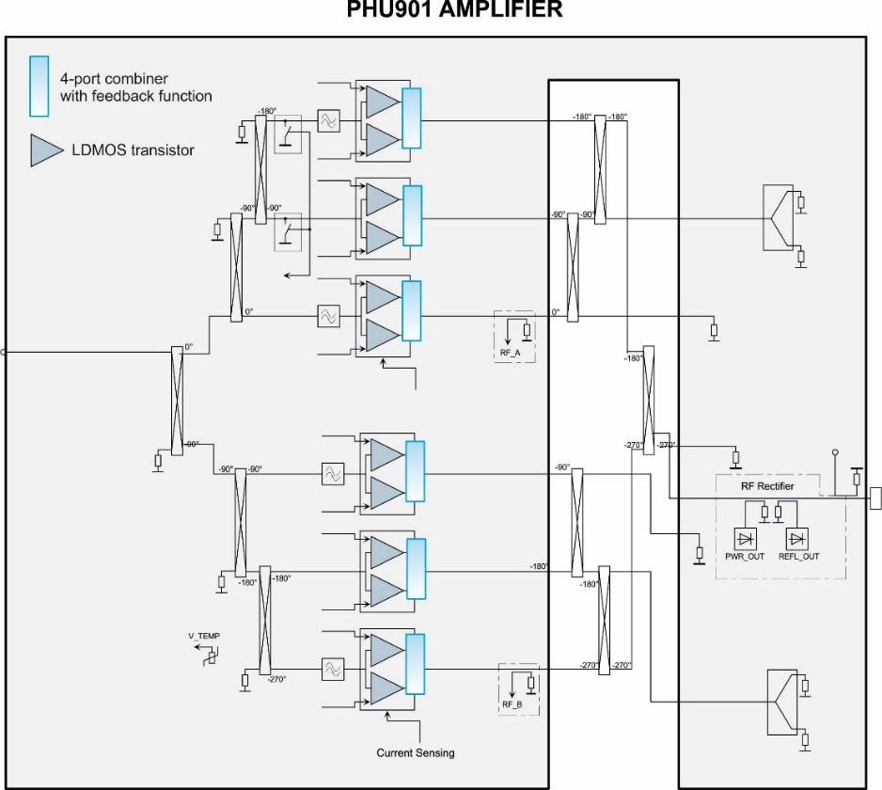
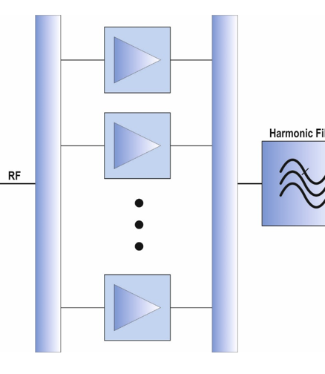
System Architecture – Amplifier Design
LDMOS design
Low junction temperature
Transistors fully decoupled
Signal quality not influenced if transistors fails
Fully broadband design
Power supplies integrated and redundant
Fully liquid cooled → no fans
Feedback combiner can be automatically set for:
- broadband mode class A/B
- Doherty-mode
- CW-mode
Very high MTBF
Notes:
Different matching needed:
Peak power broadband for class A/B (OFDM modulation)
Doherty narrowband matching for highest efficiency – for signals with high crest-factor
CW for outputpower/efficiency (narrowband) – higher impedance needed as for class A/B
Different biasing for the three modes
Field MTBF (over the total number of delivered amplifiers) is >20 years (avoided manual solder joints, etc.)

Slide 10
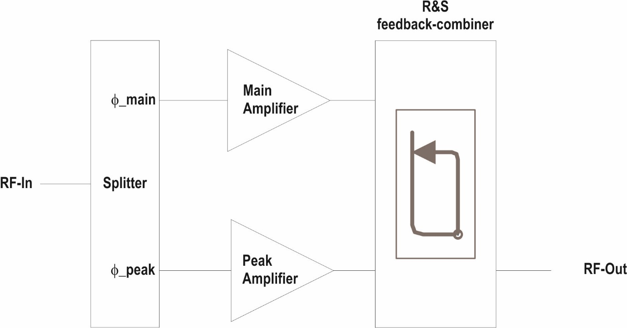
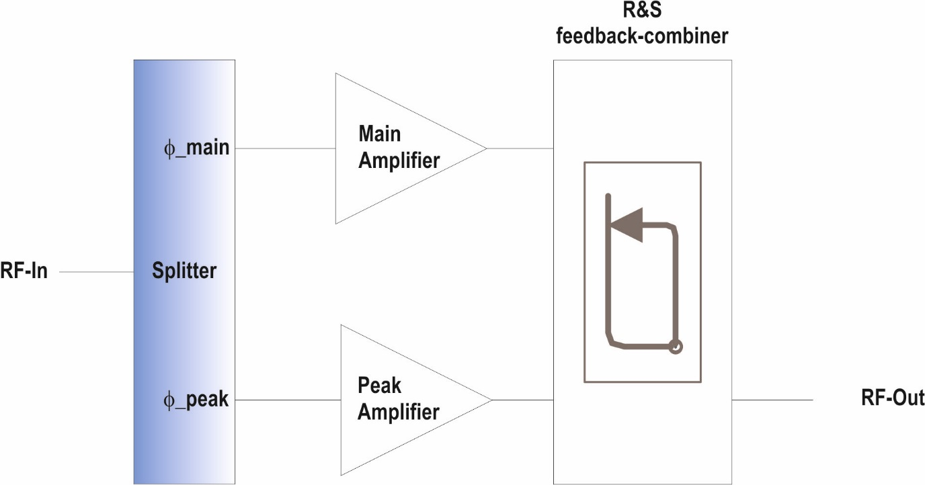
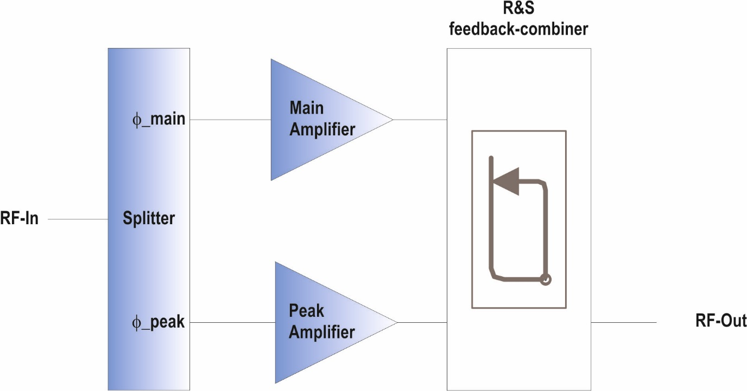
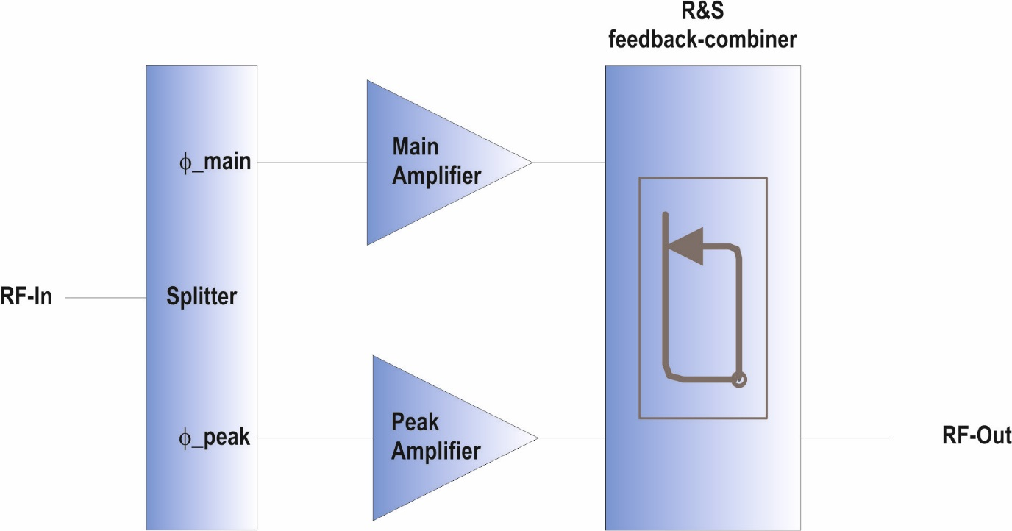
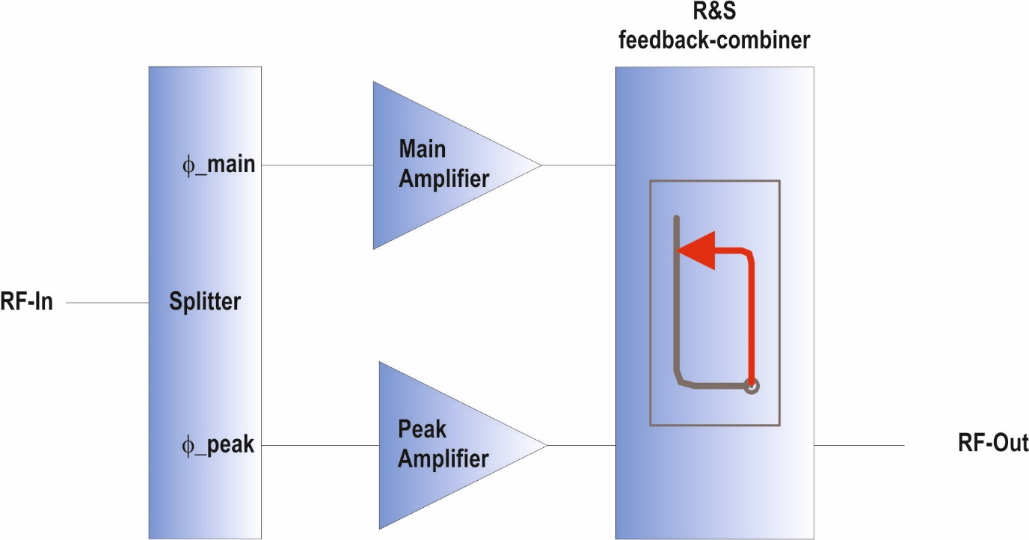
System Architecture – Feedback Combiner
Doherty Amplifier – R&S-Design
  Useable for Broadband-/Doherty-/CW- applications (combiner with feedback function)
Broadband operation in class A/B mode
or
Doherty-operation
narrowband
high efficiency
Or
High efficient CW mode
Broadband
within Bd. III or IV/V
Broadband
within Bd. III or IV/V
Broadband
within Bd. III or IV/V
Notes:
All building blocks are broadband
If feedback is activated → narrowband + dedicated impedance matching

Slide 11
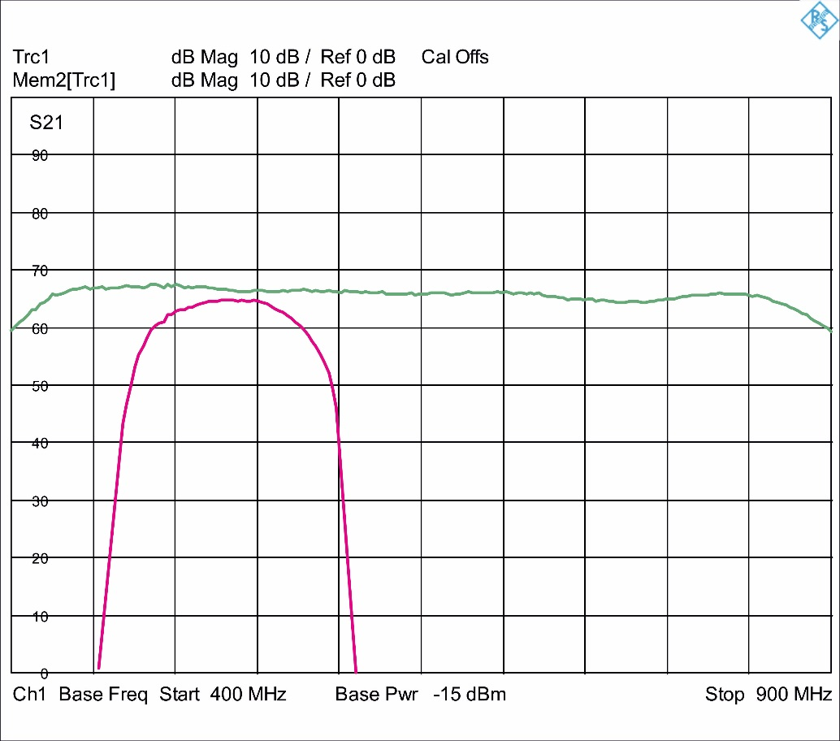
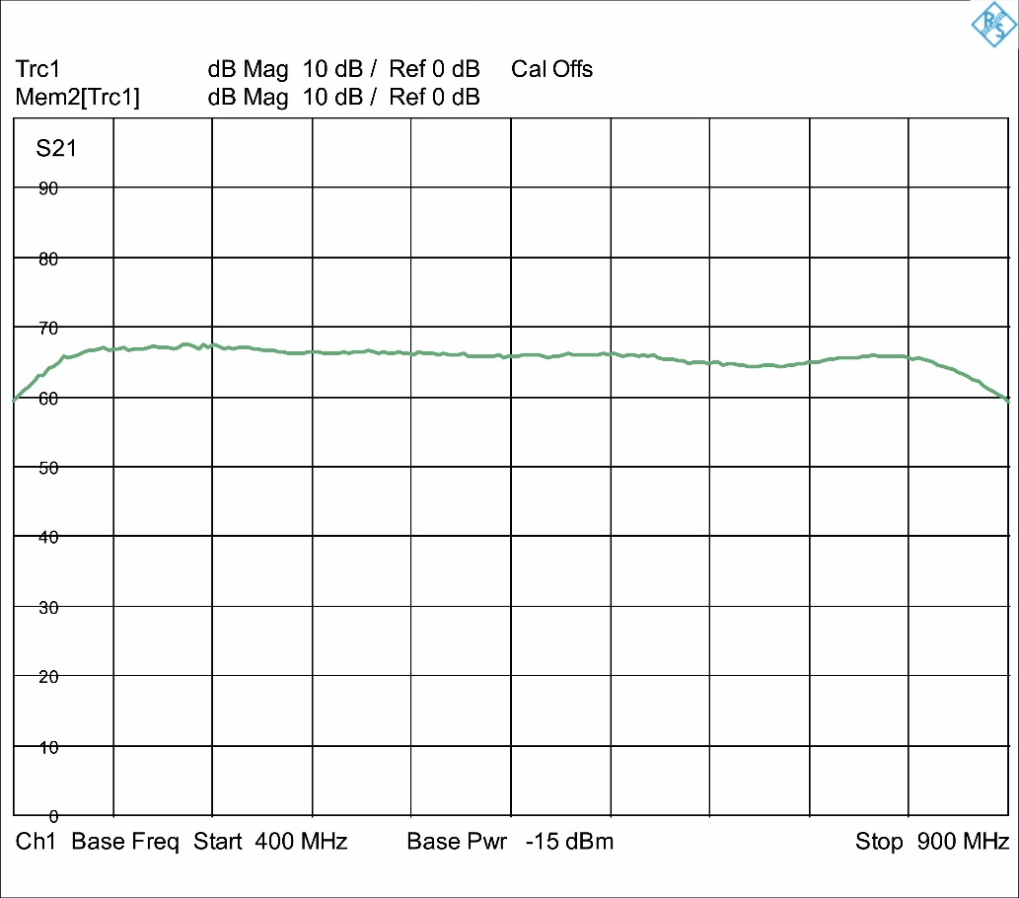
System Architecture – „Multiband Doherty“
Class A/B
broadband from
470 MHz … 862MHz
bandwidth ≥ 400MHz
one amplifier-design for
Band IV/V
usable bandwidth
small signal sweep
Doherty amplifier
narrowband
bandwidth appr. 50MHz
min. 8 … 10 different
amplifiers for Band IV/V
Notes:
green: small signal sweep for class A/B → fully broadband
Red: typical Doherty amplifier with Lambda/4 transformation
i.e. 10 different amplifiers (hardware!)

Slide 12
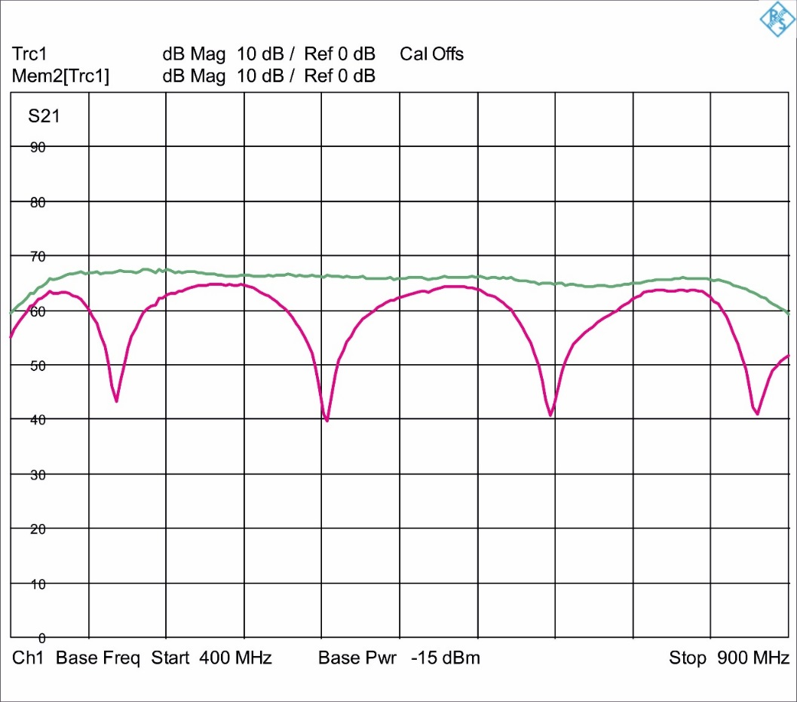
System Architecture – „Multiband Doherty“
Doherty Option
Periodically replication of the
Doherty-region
Less frequency options for broadband use
Architecture gives best efficiency in CW applications
Notes:
max. 4 different Doherty options insted of 10
All 4 frequency options are installed within each amplifier
Can be activated by SW

Slide 13
System Architecture – „Multiband Doherty“
Notes:
- Doherty option can be customized for max. efficiency @ operating frequency

Slide 14
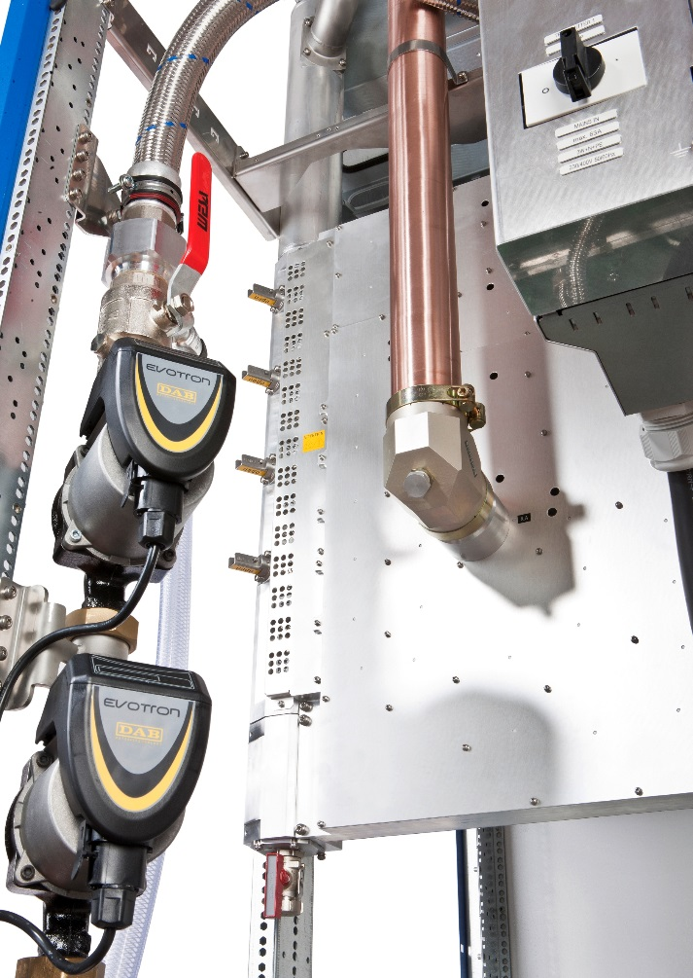
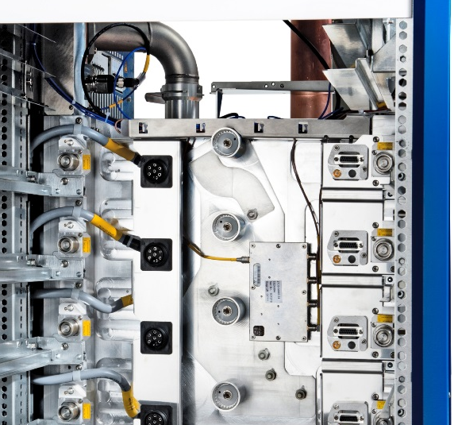
System Architecture – Combiner Design
Example:
4 by 1, Band 2, 20kW
Amplifiers „hot pluggable“
Absorbers located on the liquid hoses of the amplifiers
Fully decoupled inputs
Fully broadband within RF- Band
Notes:
RF combiner from 2:1 up to 8:1 (Band 4/5)
Self closing plugs for liquid/RF/AC/control signals

Slide 15
System Architecture – Combiner Design
decoupling
Input matching
Example:
4 by 1, Band IV/V
Input matching typ. <-32dB
Decoupling typ. >28dB
Insertion loss <0.05dB

Slide 16
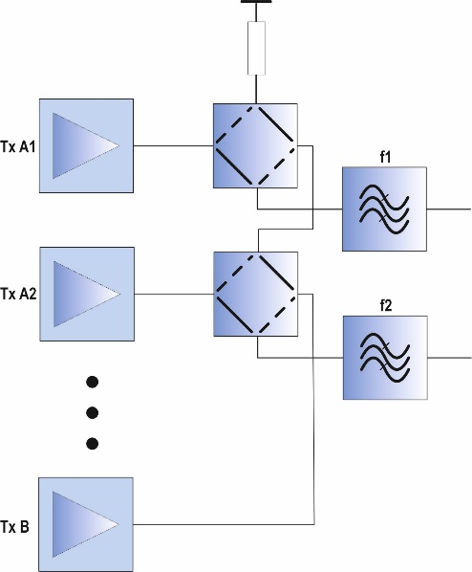
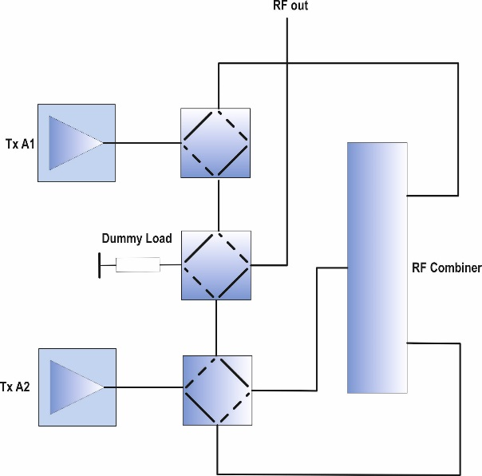
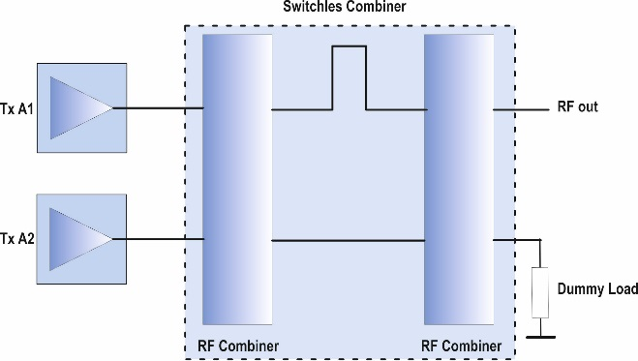
System Architecture – Reserve Systems
N+1 standby
active standby
dynamic reserve
→ Extremely high MTBF and availability
Notes:
Ethernet local and remote system
Power tracking: uses the headroom of intentionally oversized amplifiers to keep the output power constant in case of failures

Slide 17
System Architecture – Reserve Systems
Dynamic power adaption
→ output power tracking in case of failures (transistors/modules/power supplies)
- uses the headroom of the design
Example: 70kW amplifier – 60 amplifier modules Installed power: ~80kW
Faulty device | Output power w/o. power adaption | Power reserve | No. of faulty devices with adaption (70kW)
Amplifier module | 67.69kW | 7.36kW | 4
Power supply | 69.22kW | 9.11kW | 12
Transistor | 69.61kW | 9.56kW | 24
Notes:
Ethernet local and remote system
Power tracking: uses the headroom of intentionally oversized amplifiers to keep the output power constant in case of failures

Slide 18
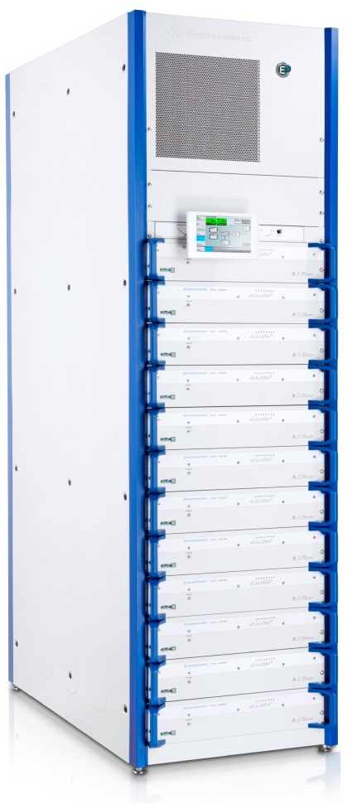
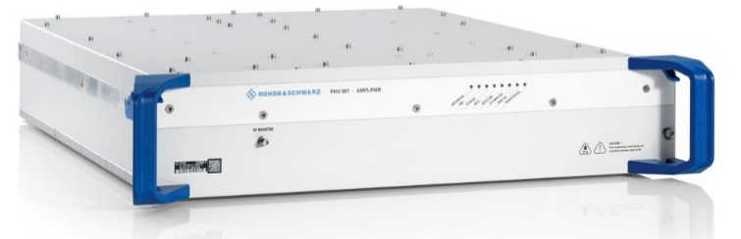
System Architecture – Common Features
High Power liquid cooled Amplifier
Identical mechanical design for
Band II
Band III
Band IV-V
AGC or const. Gain
Fully decoupled RF-structures
Self protection against:
overpower
reflection
overtemperature
mains failures
Interlock
Fast shutdown
Liquid cooled amplifier – hot pluggable
PS included
Fully liquid cooled – no fans
Notes:
1 … 12 amps each rack
Up to 6 racks can be combined with one control
Input AC voltage 208/230/400VAC – single or three/four phases
Pump system integrated in rack (up to … amps)

Slide 19
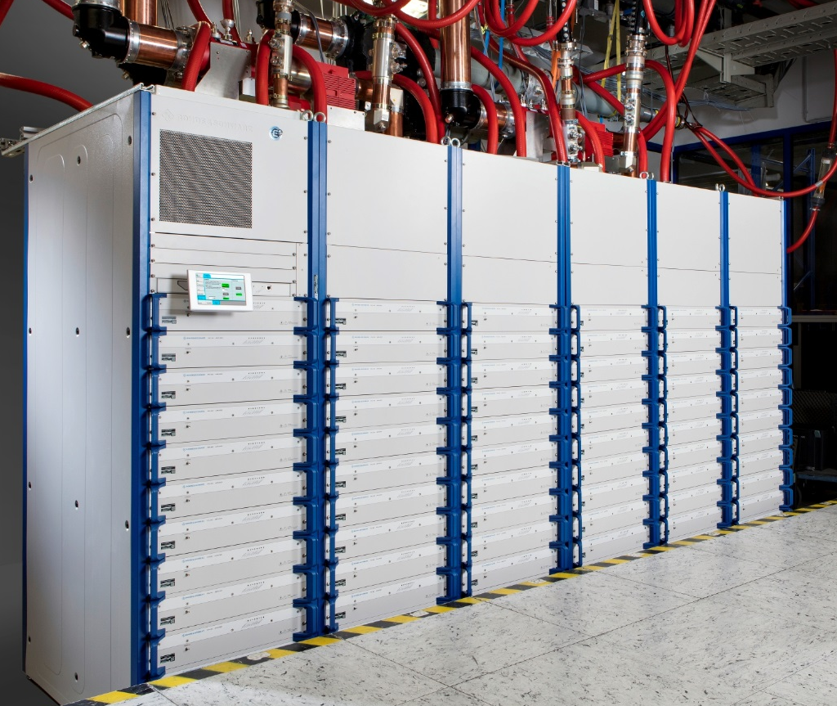
System Architecture – Examples
100kW ATSC Broadcast Tx
(=100kW CW Amplifier)
72 amplifiers
6 racks 19“ / 42 HE
Operating frequency
470MHz … 800MHz

Slide 20
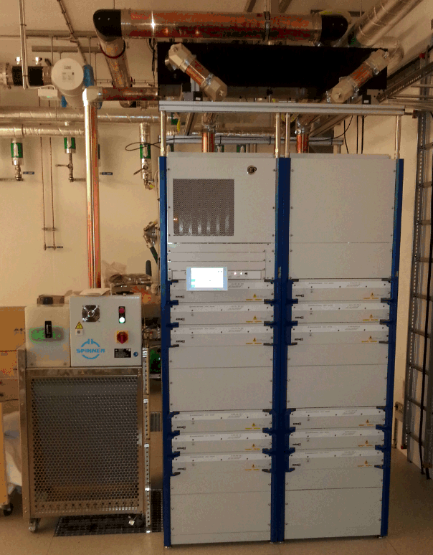
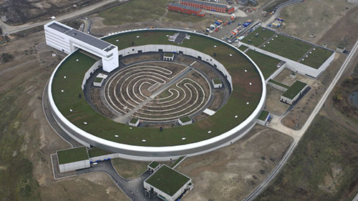
System Architecture – Examples
Accelerator Project:
  Sweden (8 x 60kW) / Poland (2 x 60kW) :
60kW CW Amplifier (=60kW FM Broadcast Transmitter)
12 amplifier modules in 2 racks 19“ / 42 HE
Operating frequency 100MHz

Slide 21
Broadcast Transmitter – An Overview
System Architecture
  Broadcast Transmitter
  Amplifier Design
  Feedback Combiner
  Power Combiner
  Reserve Systems
  Common Features
  Examples
Summary

Slide 22
Summary
Solid State PA‘s for Accelerator use based on Broadcast Tx have the following advantages:
Produced in very high numbers (well engineered and tested)
Fully automated amplifier module production
Efficiency comparable to tube amplifiers
Very robust and high availability
Different Redundancy concepts available
Can be delivered with power levels >100kW CW
… can replace tube amplifiers (as happens already for Broadcast transmitters)

Slide 23
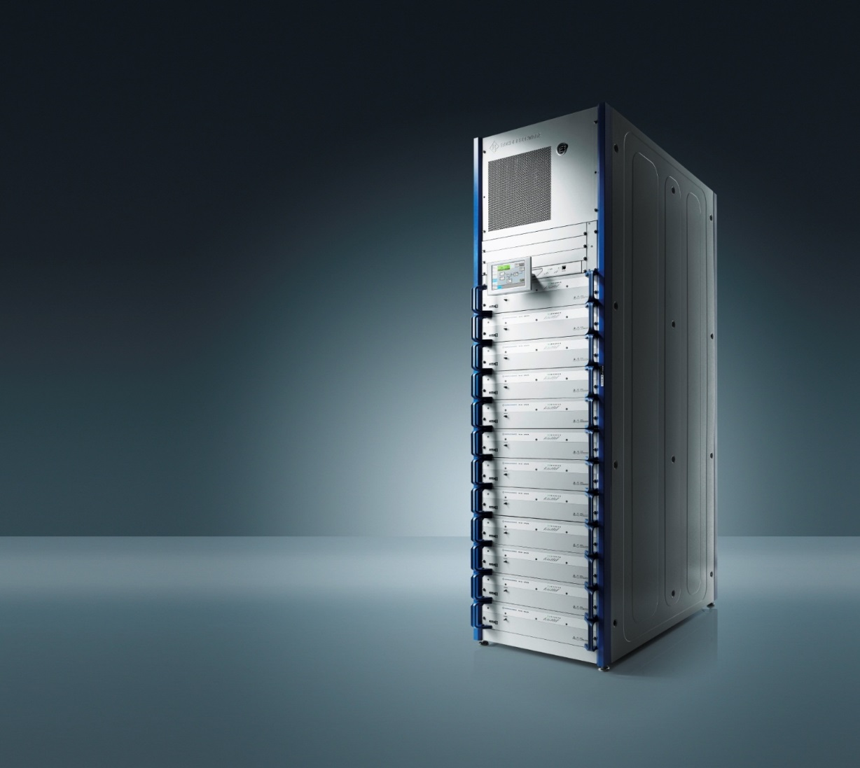
Thank You for
Your Attention!

