Slide 1
ESS-Bilbao Contribution to ESS Warm LINAC High Power RF Systems
Arash Kaftoosian
RF Group
www.essbilbao.org

Slide 2
On behalf of:
Pedro Gonzalez | RF Project Leader
Ibon Bustinduy | MEBT Project Leader
ESS-Bilbao RF Group:
Nagore Garmendia
Tomasso Poggi
Leire Muguira
Oscar Gonzalez
Arash Kaftoosian
And with sincere thanks to the ESS colleagues

Slide 3

ESS - BILBAO
Public Consortium: Funded by Spanish and Basque Country Governments (50/50)
Main Objective: In kind Contribution to ESS (Lund, Sweden)
  Spain participation in ESS: 5%
  In-kind: Some 70 M€ (50% Accelerator/Target and 50% Neutron Instr.)
Staff: ~60 people (researchers, technicians, support)

Slide 4
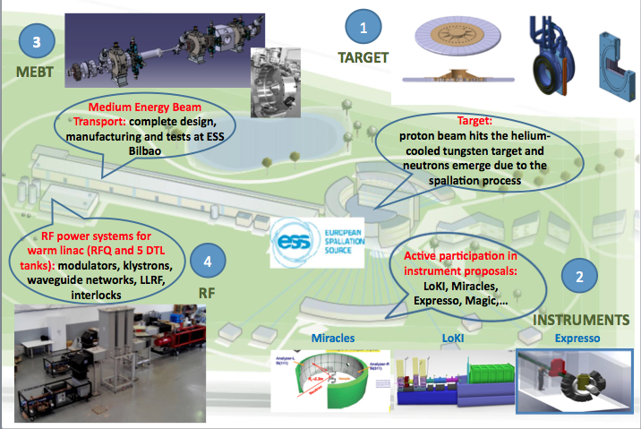
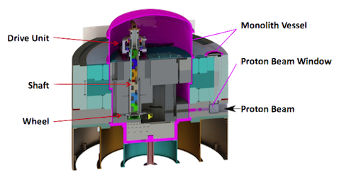
Spanish Contribution to ESS

Slide 5
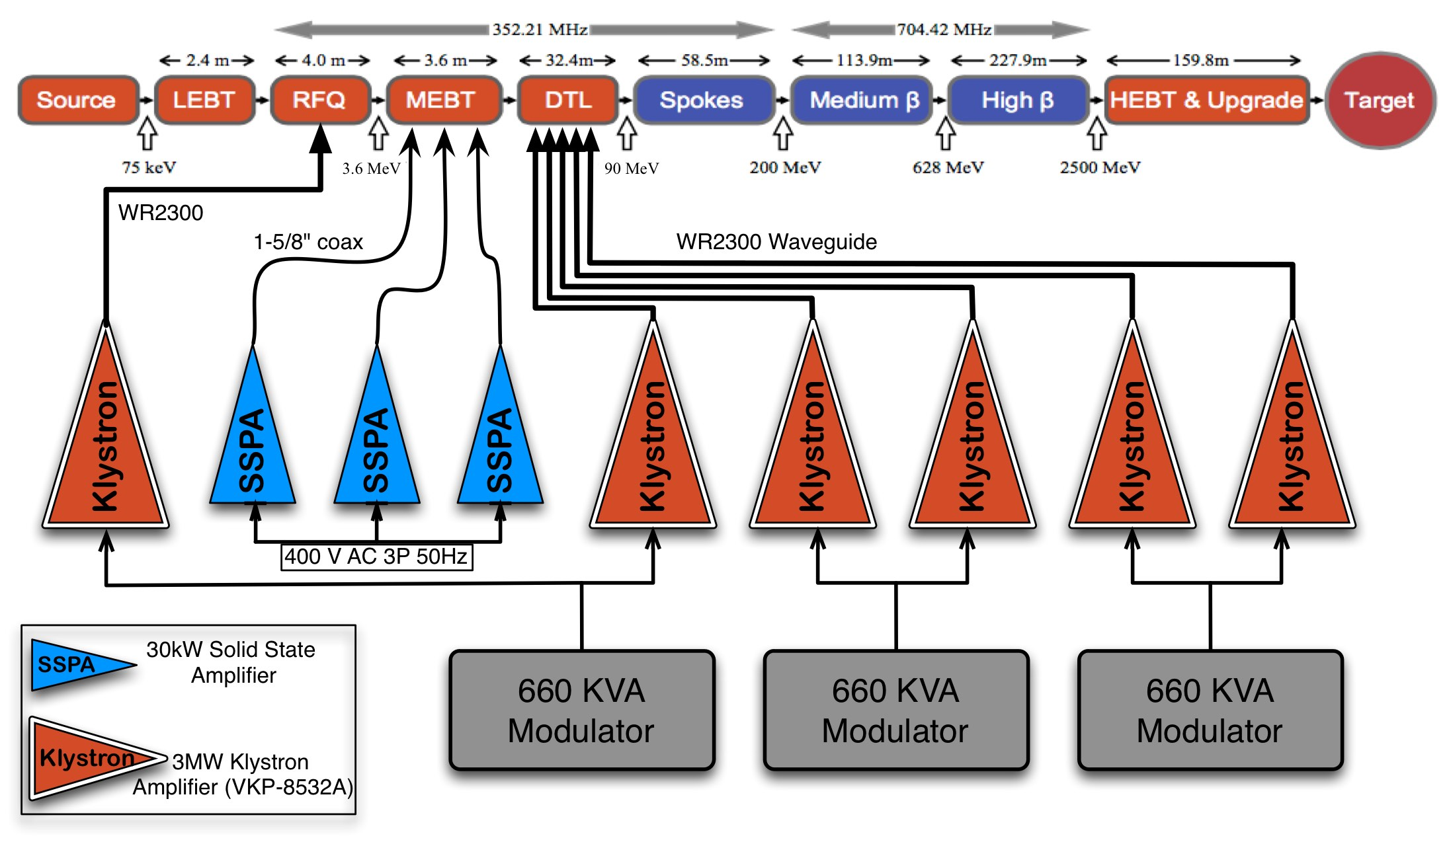
ESS Warm LINAC RF Power System
1700kW
26
36
84
600 MeV
2 GeV
2900kW
30kW
VKP-8352A

Slide 6
ESS-Bilbao RF Contribution
Klystrons: 6x 2.9MW 352MHz Pulsed 3.5ms/14Hz
Modulators: 3x 660 KVA, 120kV, 110A, long pulse (3.5ms)
Solid-State Power Amplifiers: 3x 30 kW for MEBT Buncher Cavities
LLRF: 9+26 DLLRF based on µTCA4
RF Interlock System: Fast and Slow interlock modules (FIM: <10 µs and SIM:<50ms)
RF Distribution System: Circulators, Loads, Directional Couplers, Power Detectors, Splitters, Waveguide components

Slide 7
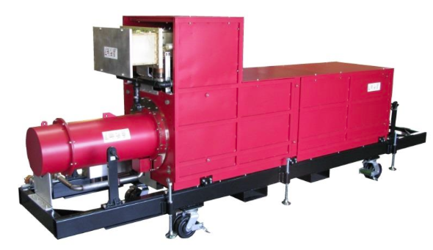
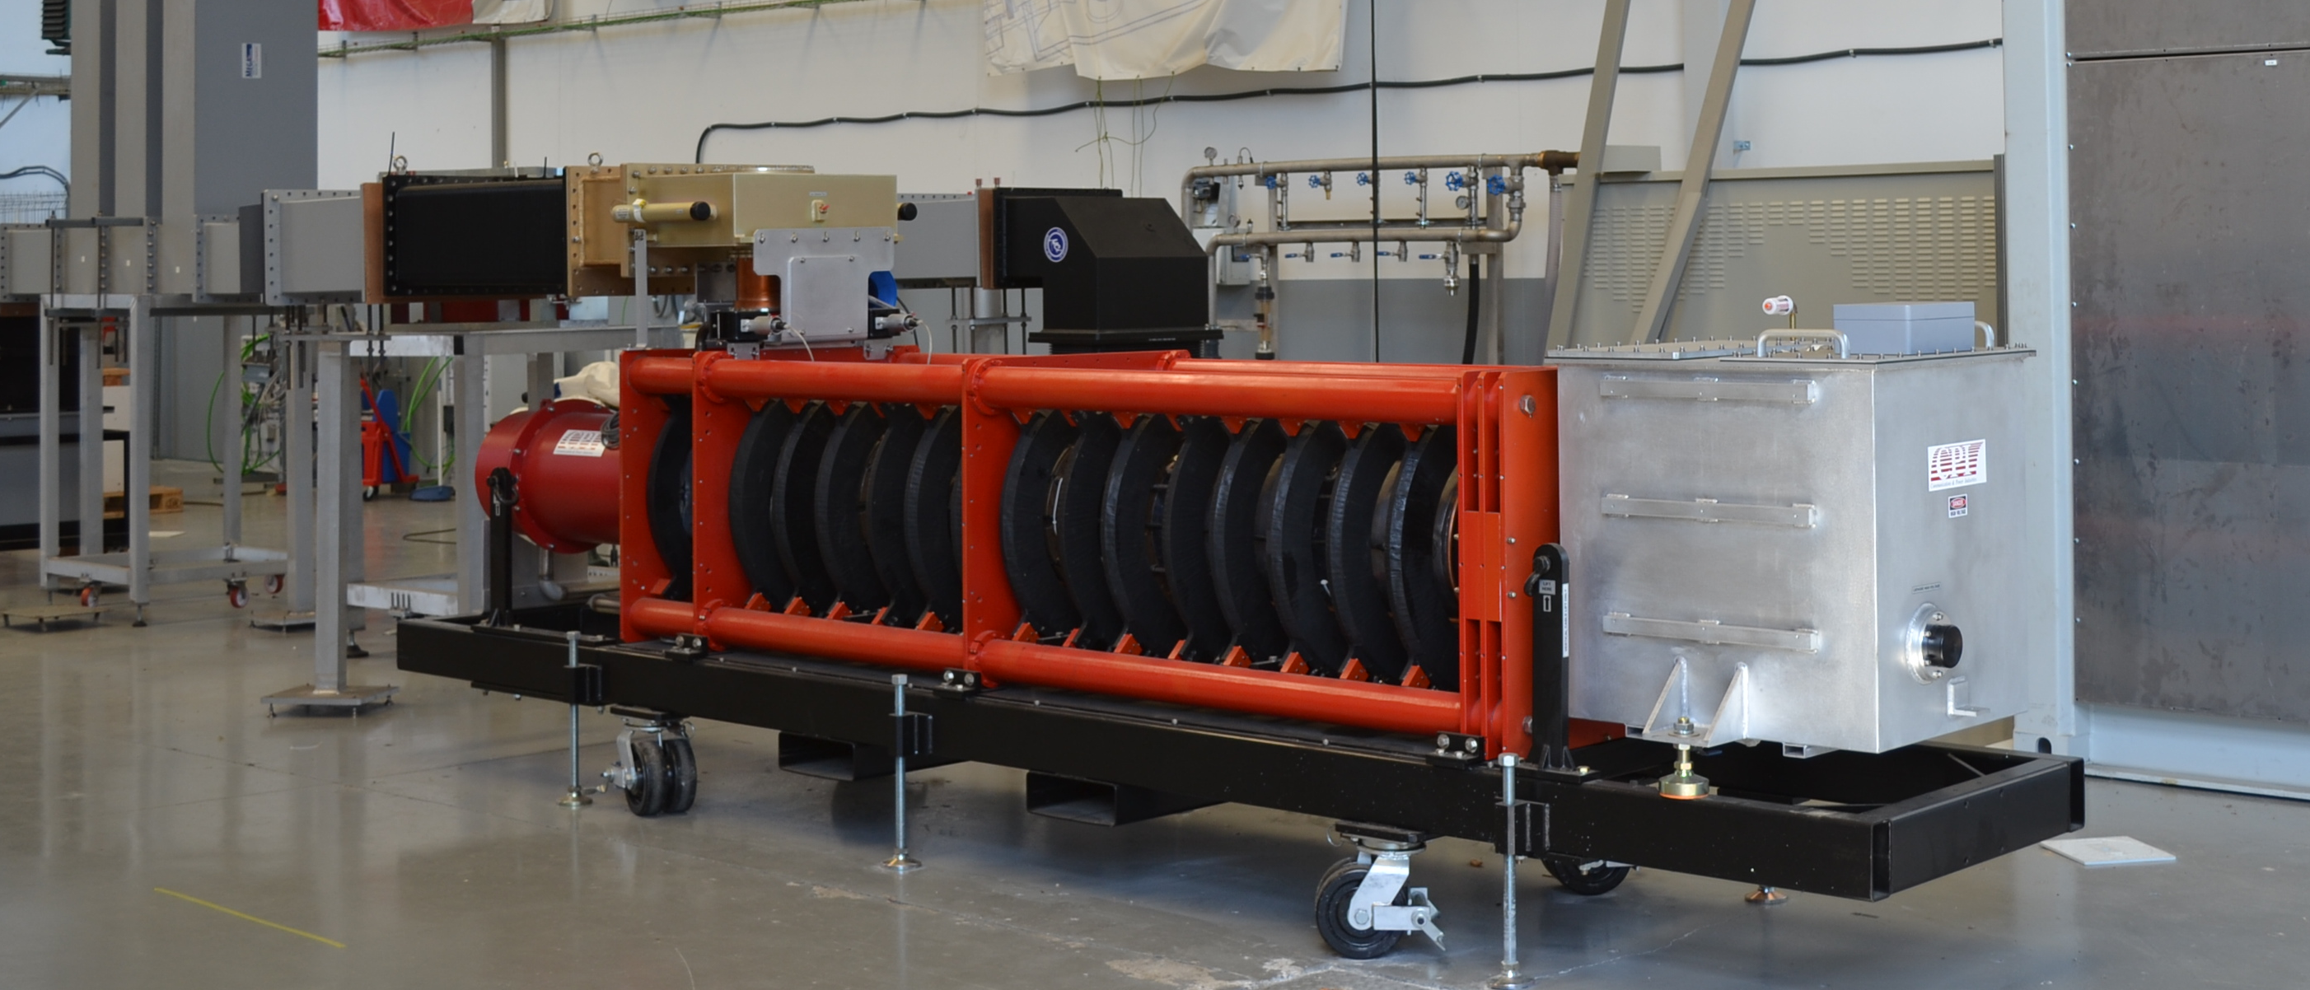
Klystrons
Module | Frequency (MHz) | Peak Power (kW) | Qty. | Amplifier | Transmission Line
RFQ | 352.21 | 1700 | 1 | Klystron | WR2300 (FH/HH)
DTL | 352.21 | 2900 | 5 | Klystron | WR2300 (FH/HH)
Spec | Value | Units
Beam Voltage | 115 | kv
Beam current | 50 | A
Frequency | 352.2 ± 1 | MHz
Peak Power | 3 | MW
Average Power | 150 | kW
Saturation Gain | 42 | dB
Efficiency | 56 | %
Duty | 5 | %
3MW 352MHz Pulsed Klystron
VKP-8352A CPI

Slide 8
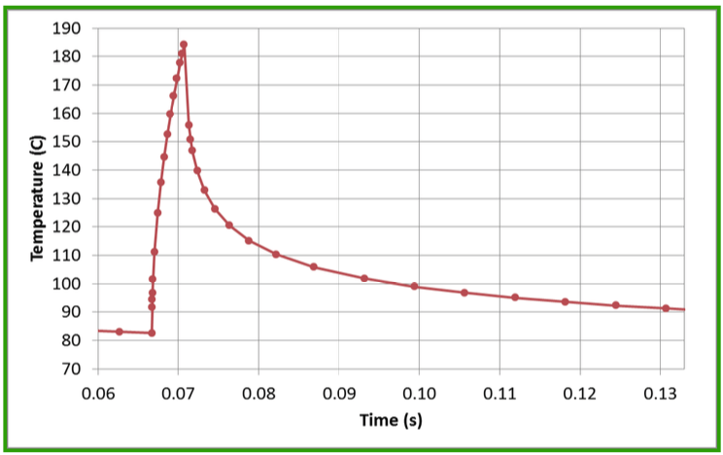
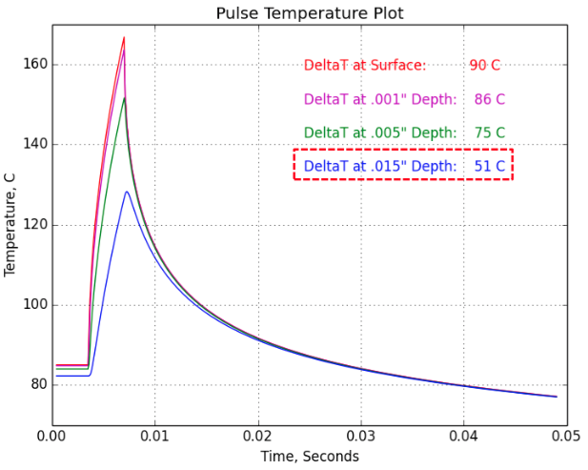
Long Pulse Issue
Four VKP-8352A klystrons already purchased and delivered form CPI
These Klystrons were initially designed and developed for 1.6ms RF pulse width, 30Hz Rep rate
They are going to be utilized for ESS but that requires operation with 3.5ms and 14 Hz repetition rate
A 3-D simulation was performed by CPI to estimate the transient temperature change.
Some concerns raised that due to larger RF pulse width there might be some collector heat cycling fatigue effect which could potentially reduce the klystron lifetime or lead to failure.
After more in-depth simulations and analysis by CPI the result was promising, showing that after a short conditioning, klystrons can work safely with 4ms pulses

Slide 9
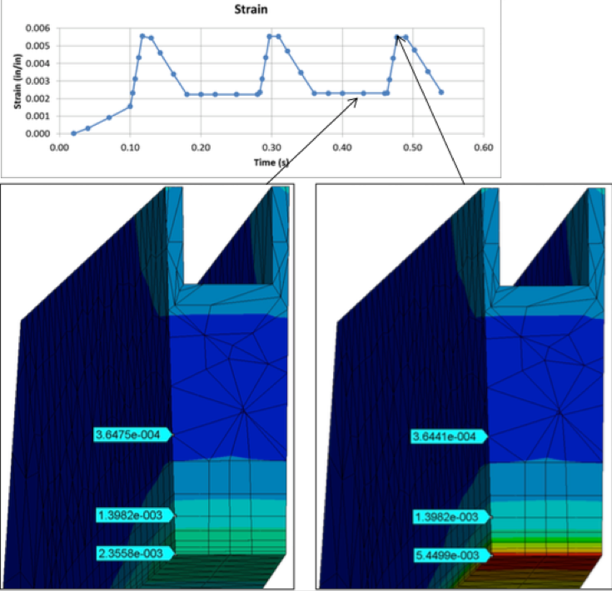
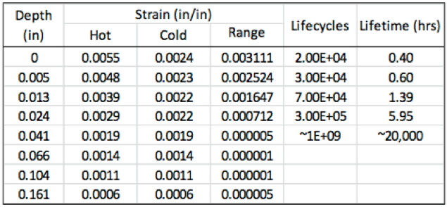
Long Pulse Issue: Simulations by CPI
The temperature cycling induce strain in the material. The variation of this strain (referred to as “strain range”) causes fatigue failure in materials.
The strain range is highest at the surface, 0.003 in/in, and drops to near zero at .040” depth from the surface. Past this depth the fatigue life is beyond material data, greater than 20,000 hours.
This is lifetime in hours of operation with HV only, with no RF.
Surface cracking will occur at depths less than 0.040”. This will be evidenced as “processing” during test with temporarily elevated gas levels.
Verification Plan:
In order to practically verify the analysis, additional testing will be carried out by CPI in Palo Alto, CA on the first VKP-8352A klystron. Subsequent testing of the remaining 3 klystrons will be performed at ESS-Bilbao with technical support from CPI.
Courtesy of CPI

Slide 10
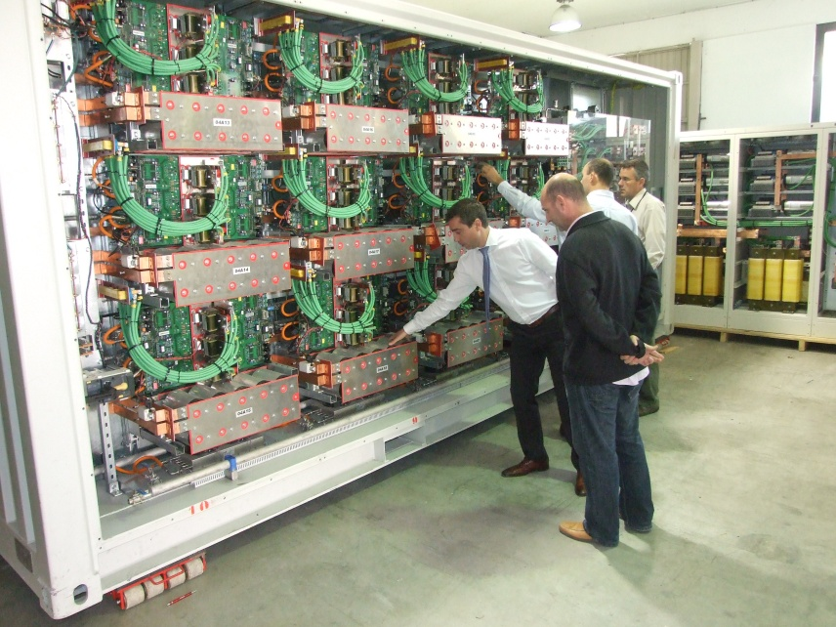
Modulators
ESS BILBAO MODULATOR SPECS (JEMA)
Parameter | Specification
Output Voltage | 120 kV (pulsed)
Output current | 60 A
Pulse Width | 1.81 ms (adjustable)
Pulse Repetition Rate | 2 - 50 Hz
Peak Power | 7.2 MW
Average Power | 648 kW
Duty Cycle (%) | 9%
Input Voltage | 30 kV (50Hz)
Efficiency | > 90%
Main features:
Topology: Mixed between Marx generator –Direct Modulator
Outstanding rise/fall times and pulse flatness characteristics
No oil: Dry Transformers (epoxy insulation)
First test at SNS Q1,2015: Satisfactory
30-day test at full power: soon
3.5ms pulse but low average power test at
ESS-Bilbao: Recently finished successfully

Slide 11
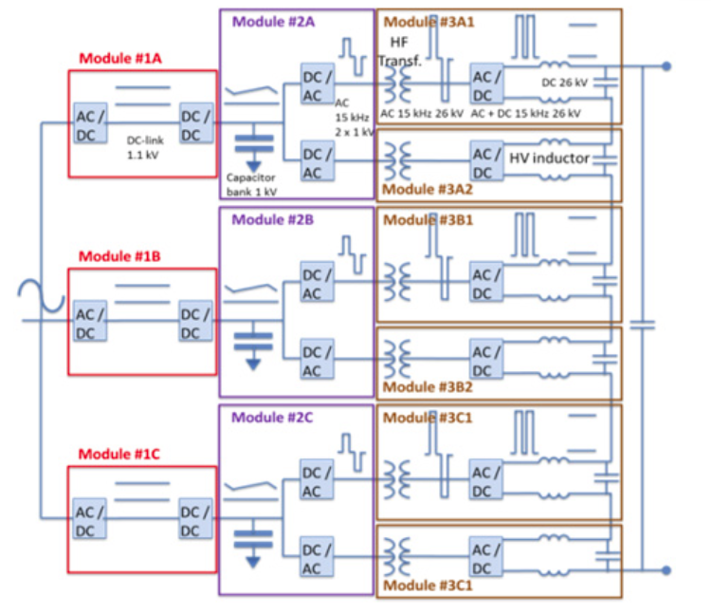
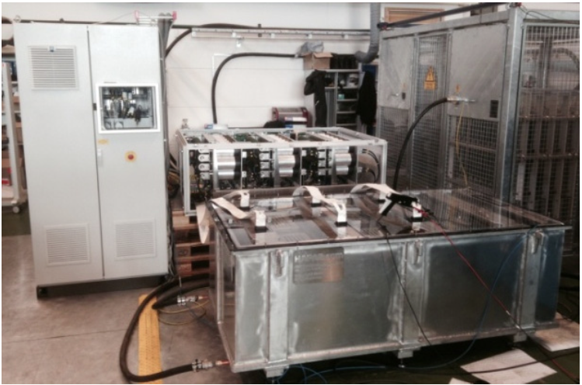
Modulators for ESS
Three 660 KVA Modulators will feed the six klystrons
They will be based on SML (Stacked Multi-Level) topology (ESS design)
A 115kV/20A for 3.5ms/14Hz prototype is under test at Lund University
Last week a 15-minute test with 115kV output done successfully
It is being prepared to do the heat run test
ESS-Bilbao will be in charge of tendering and procurement based on ESS design
LV power electronics
HV tank assembly
Courtesy of ESS
(Carlos A. Martins)

Slide 12
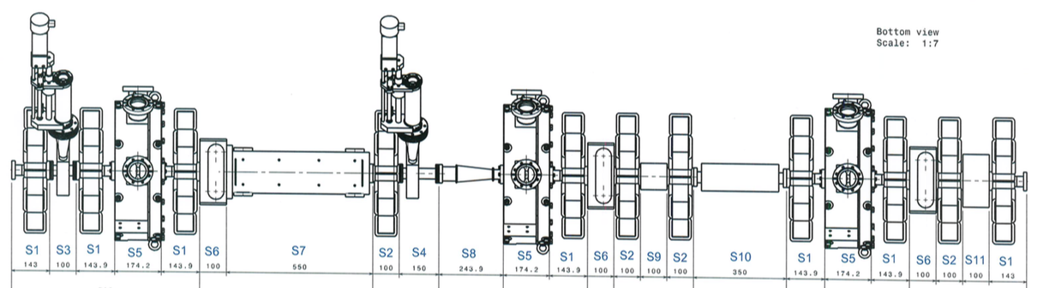
Medium Energy Beam transport
(MEBT)
SSPA
30KW
SSPA
30KW
SSPA
30KW

Slide 13
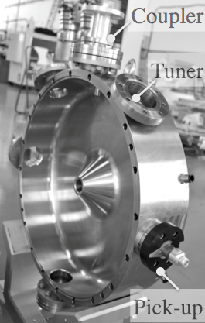
MEBT Buncher Cavities
Power requirements:
  V_{cavity(effective)} = 140 kV
  Cavity shunt Impedance = 1.3 MΩ
  Plus ~2kW for energy adjustment
  between RFQ and DTL if needed
  Plus 25% overhead for LLRF regulation
  Plus 1.5 dB transmission line losses
  Required Power ≅ 30kW

Slide 14
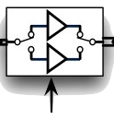
30kW SSPAs for Buncher Cavities
Call for tender for three 30kW peak solid-state power amplifiers is going to be lunched shortly
Reliability and availability for these amplifiers are the key points
The amplifiers should be maintenance-free for at least 8000 hours continues operation (annual running period till the machine shot-down), to achieve that:
  Any internal driver amplifier must be equipped with a redundant amplifier which can be switched automatically to be replaced in case of failure.
  High power amplifier (HPA) modules should be hot-plug to be changed within a few minutes if one module in down
  In case of failure in one HPA, SSPA will continue working but with reduced output power enough not to lose the beam in LINAC due to loss increment in other sections.
  Power supplies or DC/DC converters must be modular and distributed

Slide 15
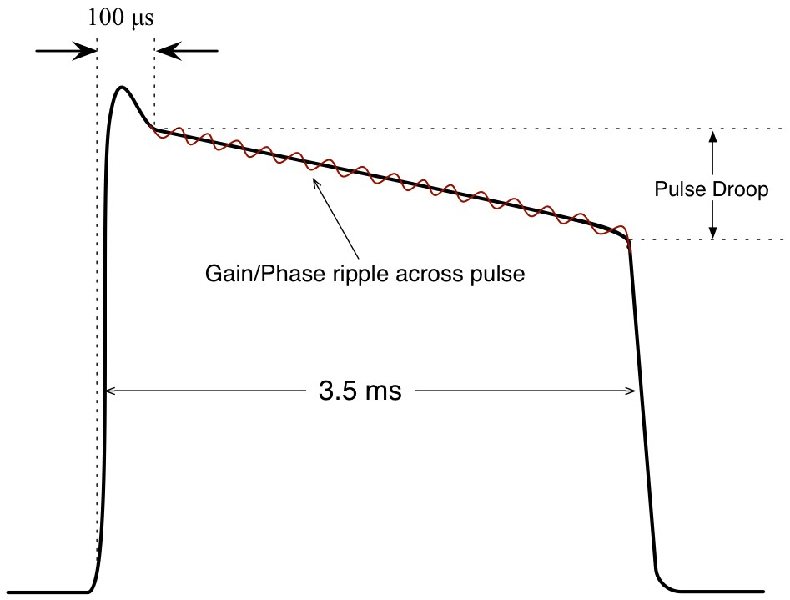
SSPA Technical Specifications
Frequency | 352.21 MHz ± 5MHz
Nominal power | 30 kW peak
Pulsed RF | 3.5ms/14 Hz (5% Duty Cycle)
Gain Linearity | ≤± 0.5dB in 10dB dynamic range
Phase Linearity | ≤ 2˚ in 10 dB dynamic range
Gain ripple within pulse | ≤ 0.25% rms
Phase ripple within pulse | ≤ 0.25˚ rms
RF power droop | ≤ 0.45 dB
Cooling | De-mineralized water

Slide 16
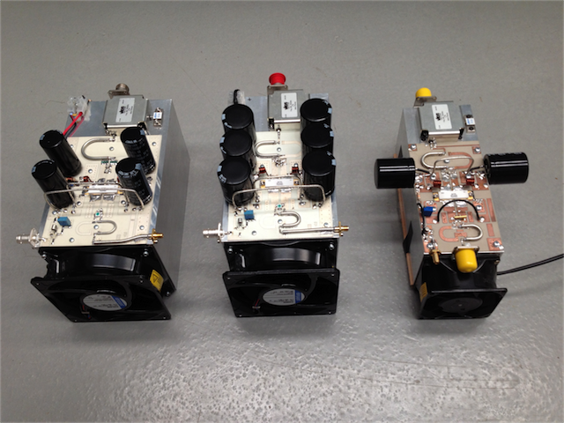
R&D Activities in Amplifiers at ESS-Bilbao
v.3
v.2
v.1
With 25Ω baluns
With 50Ω baluns
1kW Amplifiers

Slide 17
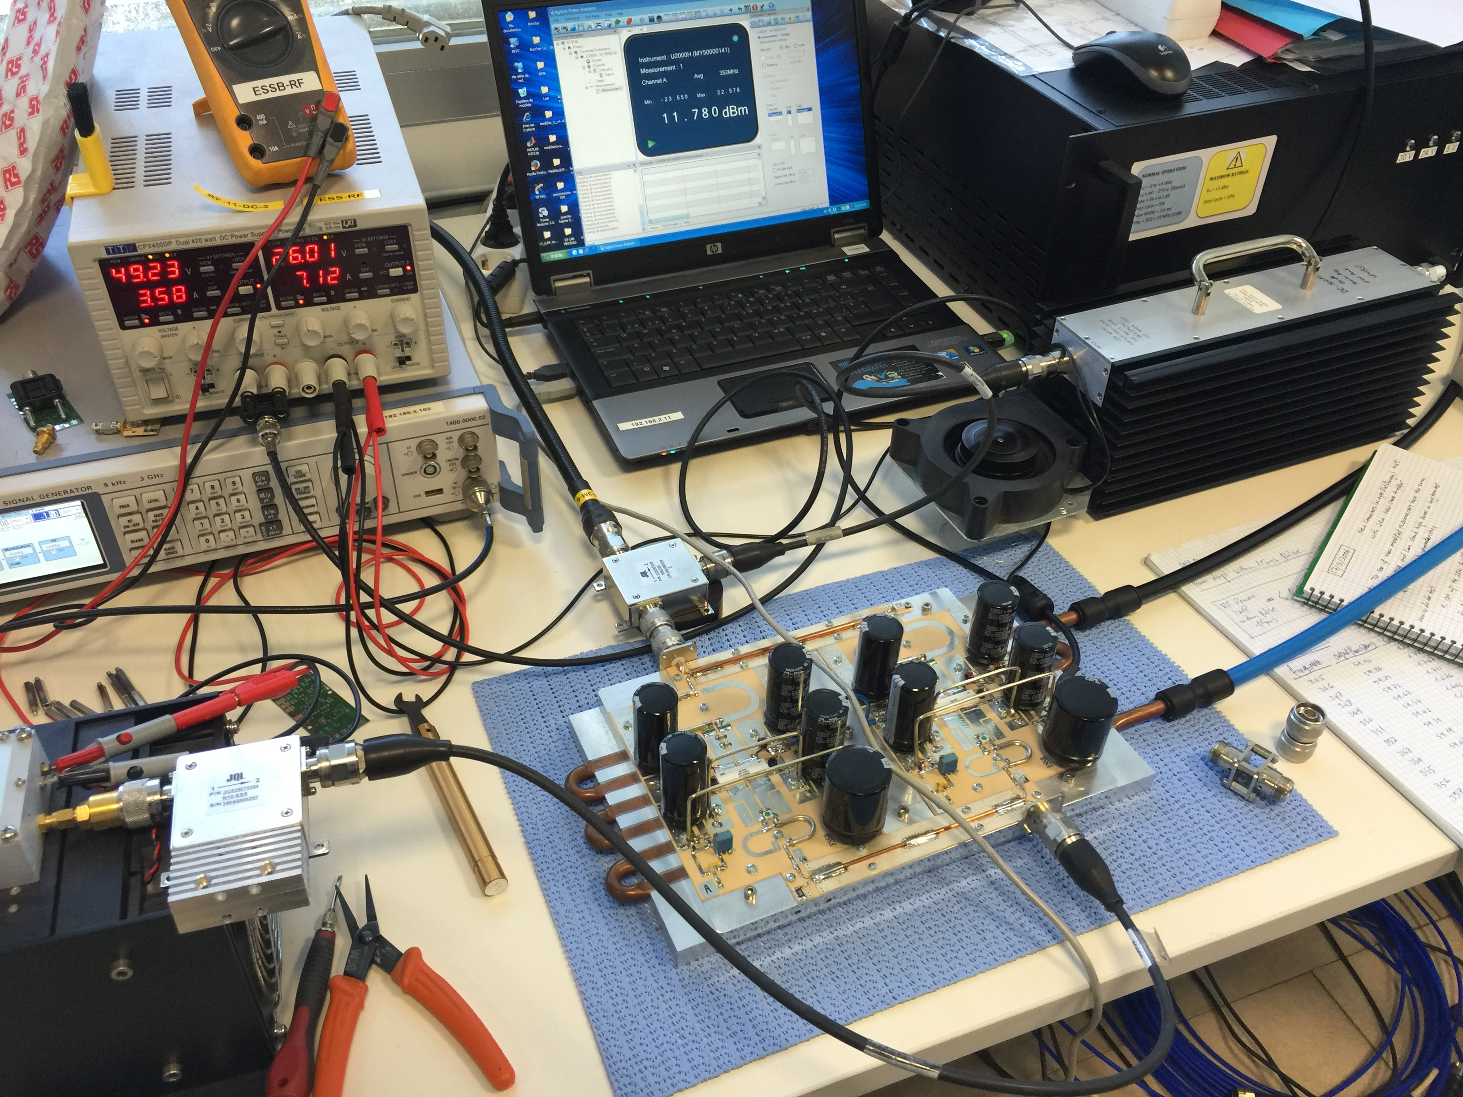
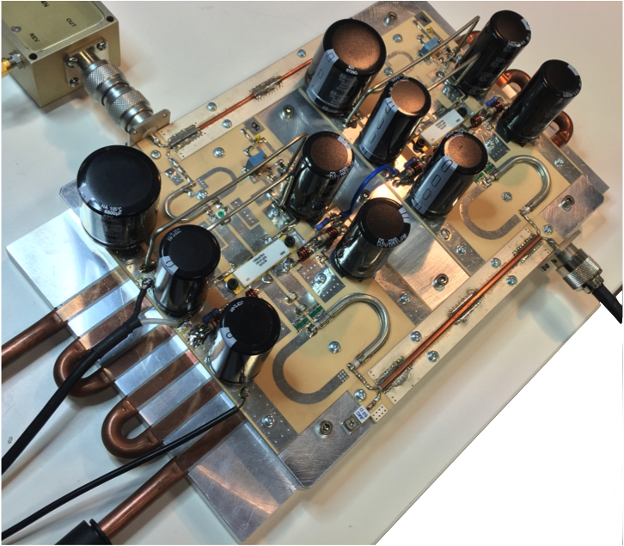
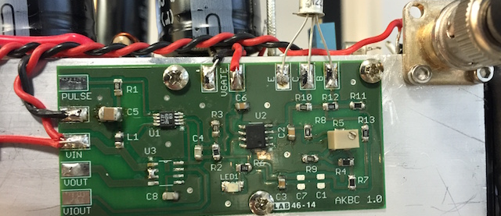
2kW Compact Balanced Amplifier
20x 2kW HPA Modules, each one equipped with Bias circuit, Gate voltage modulation, temperature compensation and current monitoring tools, will be combined to reach 30 to 35 kW Output.
Notes:
Hybridline, 90˚ 3dB hybrid coupler bw<30% Response Microwave

Slide 18
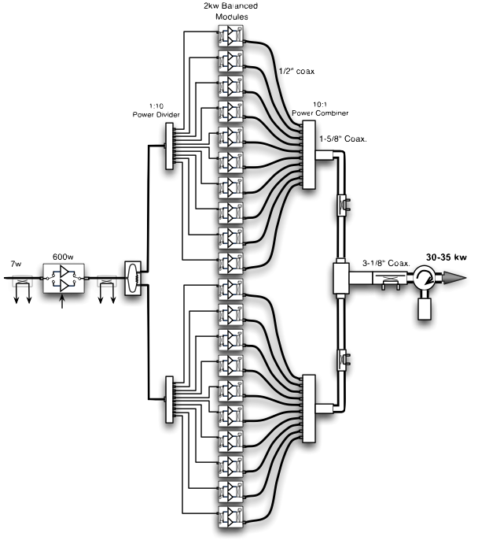
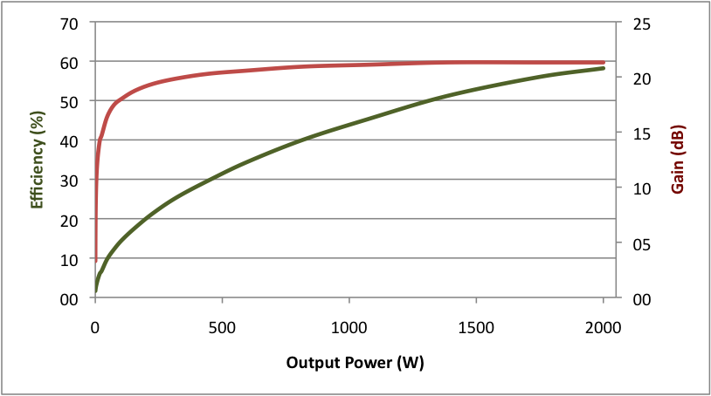
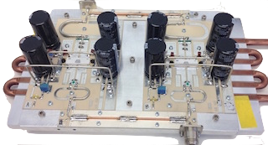
2kW Amplifier Test Results
Parameters | Test Results | Conditions
Frequency | 352.2 MHz
Output Power | 2000 W | 0.5dB Compression
Bandwidth (1dB) | 40 MHz | ± 0.25 dB
Efficiency | 58% | Class AB continued bias
Gain | 21.3 dB | @ full power
Input Return Loss | 29.7 dB | @ 352.2MHz
Duty Cycle | 5% | 3.5ms/14Hz
RF Pulse Droop | 2.7% (Voltage) 0.23 dB (Power) | 1.5ms pulse
 | 5% (Voltage) 0.42 dB (Power) | 3.5ms pulse

Slide 19
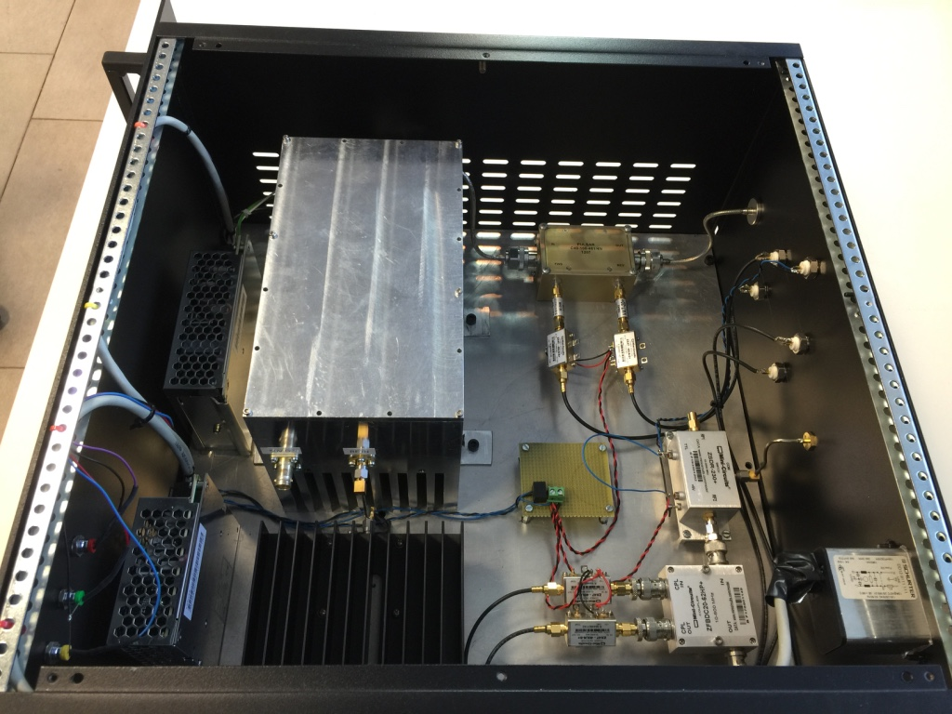
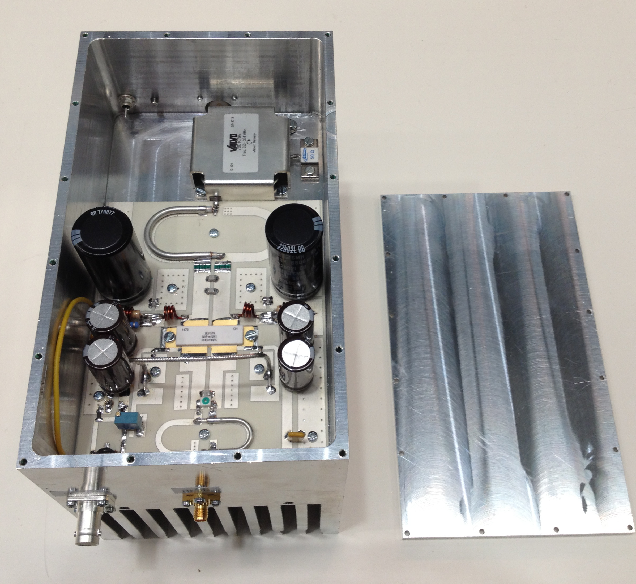
Klystron Driver
Power Detectors
1kW Amplifier
Parameter | Value
Class of Amplifiers | A + AB
Output Power (0.5 dB Compression) | 270 W
Total Gain | 50 dB
Band Width (1dB) | 37 MHz
Overall Efficiency (Including fan, PS, etc.) | 20%
Cooling | Air
Bias | Continues
RF switch Speed (Max) | 4 μs
2W Driver
RF Switch
Directional Couplers
Power Supplies
Six Klystron drivers’ technical specifications are to be ready to call for tender in Q1 2017

Slide 20
Low Level RF
Total 35 Digital LLRF units will be delivered to ESS as our in-kind contribution.
They will be all based on µTCA4 standard
These 35 DLLRFs will be similar but vary slightly depends on amplifier type and number of signals processed by the LLRF system.
Number of signals to LLRF will be from 10 to 34 per cavity
 | No. of Cavities | Power inside cavity | Phase accuracy (RMS) | Amplitude accuracy (RMS) | Temp. | Tuning system
RFQ | 1 | 1600kW | 0.2˚ | 0.2% | ~300K | Water temp
MEBT | 3 | 22kW | 0.2˚ | 0.2% | ~300K | Plunger
DTL | 5 | 2200kW | 0.2˚ | 0.2% | ~300K | Plunger
Spoke | 26 | 330kW | 0.1˚ | 0.1% | ~2K | Deformation + piezo

Slide 21
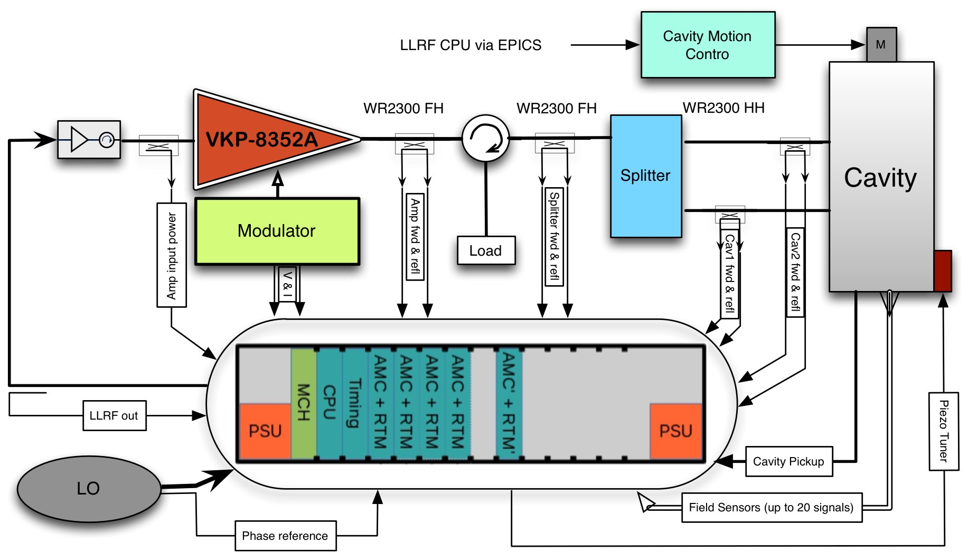
LLRF Signals

Slide 22
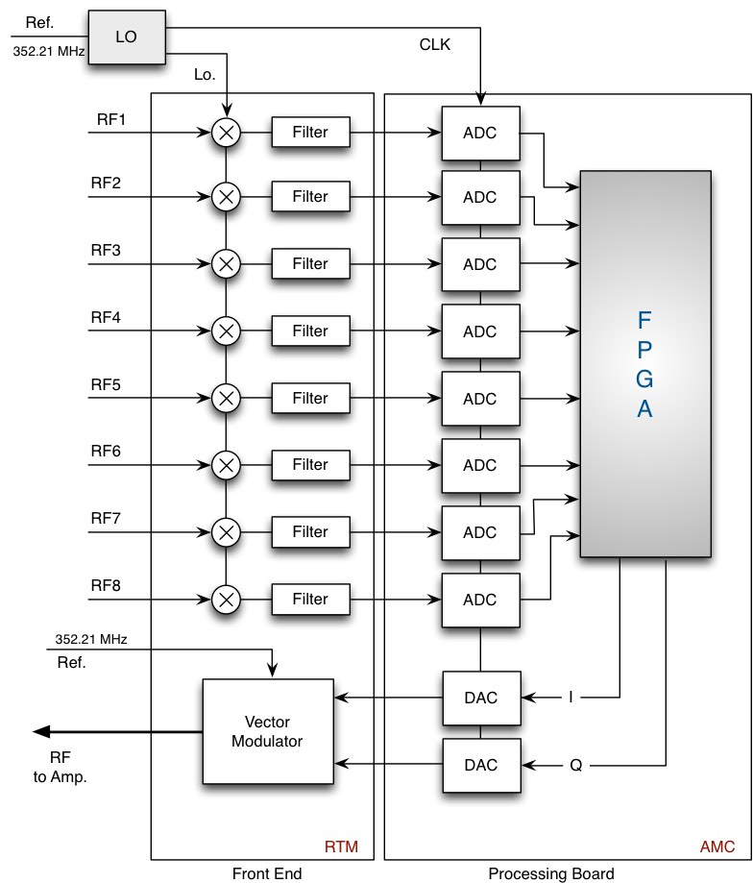
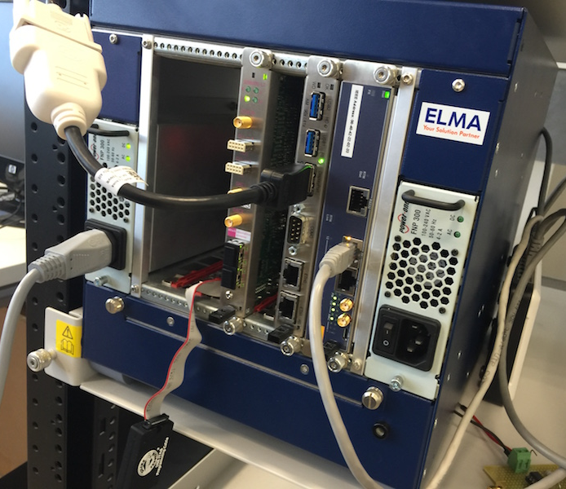
LLRF Block Diagram

Slide 23
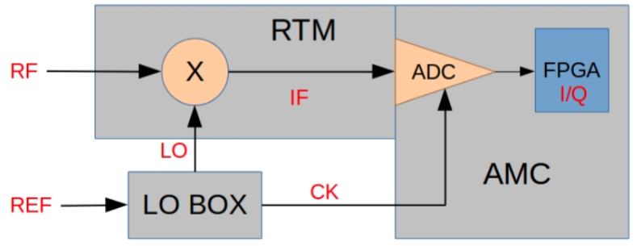
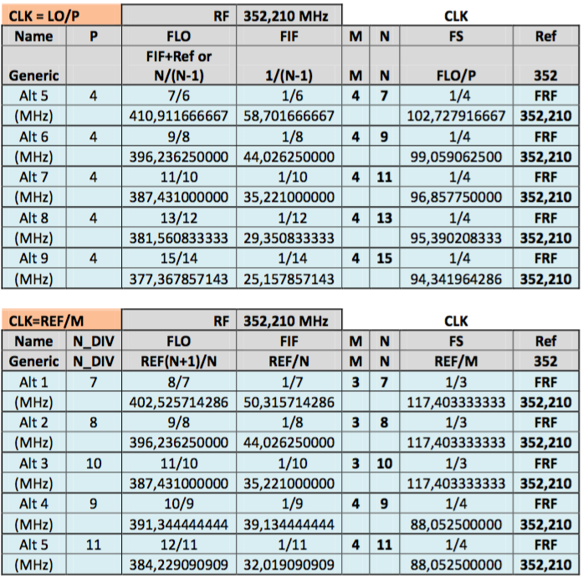
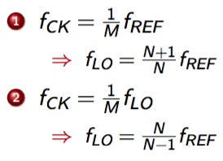
Local Oscillator
 | Freq. range | #outs | Jitter
LO | 377 – 411 MHz | 4 | 200 fs
CLK | 88 – 125 MHz | 4 | 200 fs
RTM will be developed by SLAC
IF to IQ by non-IQ sampling

Slide 24
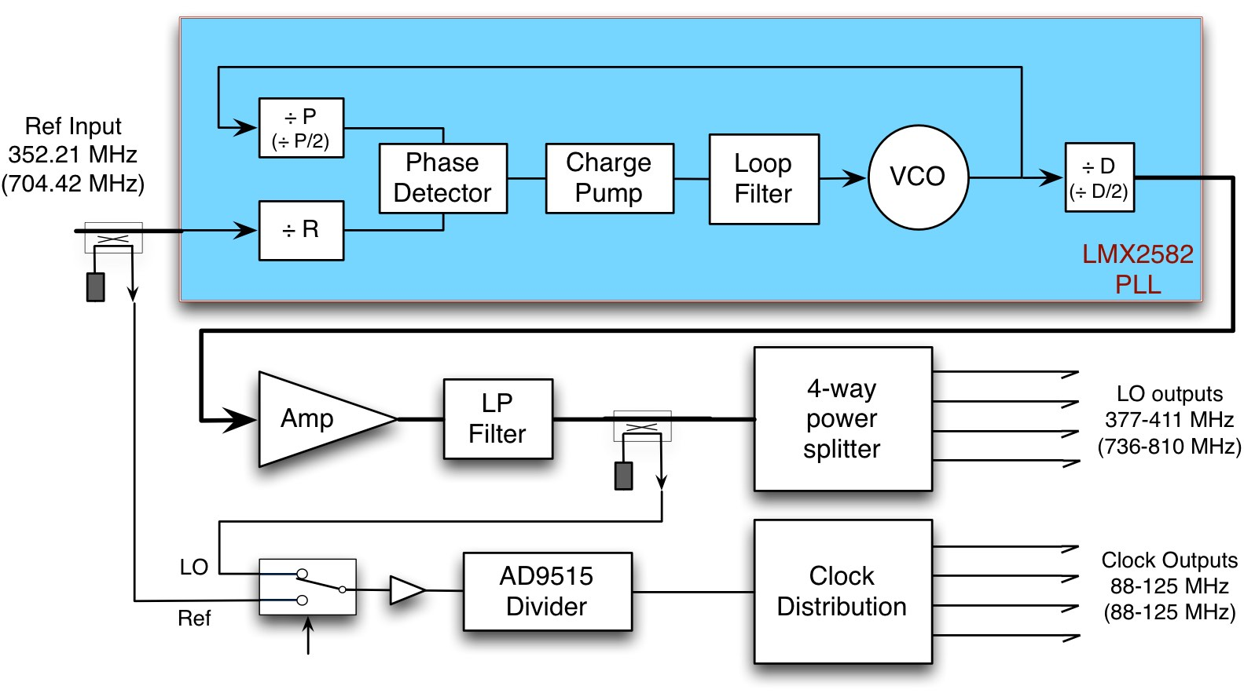
Local Oscillator
Local oscillator tests and validation in collaboration with Santander university

Slide 25
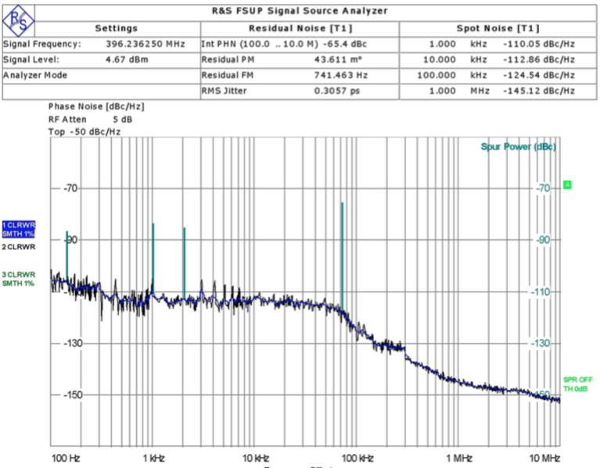
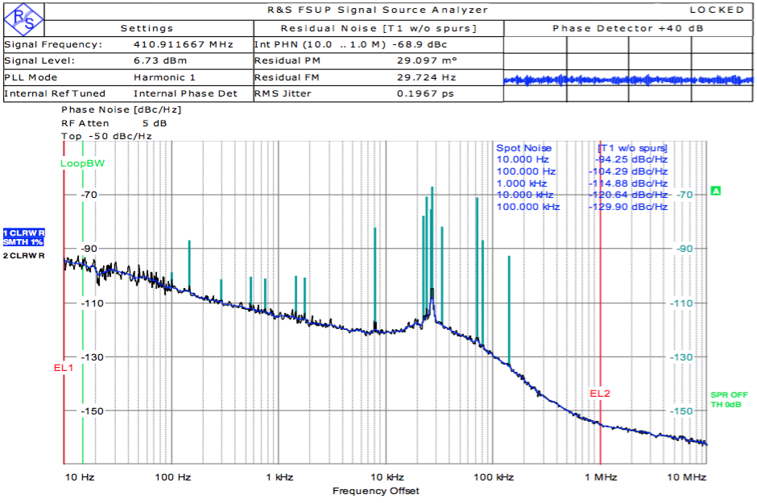
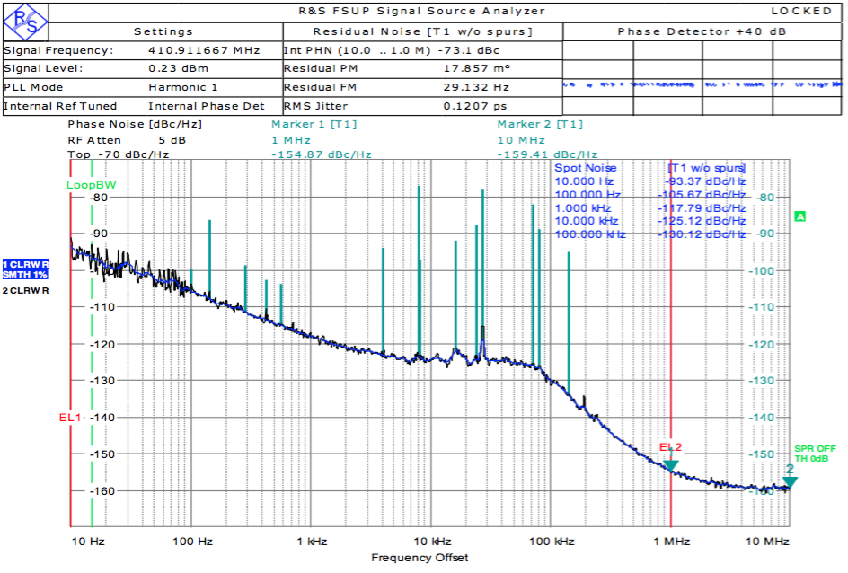
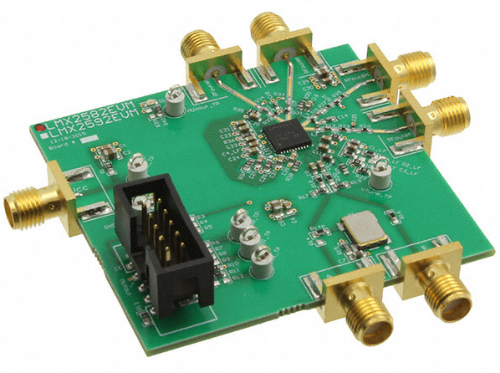
Local Oscillator
LMX2581 with internal VCO
M=4, N=9: Jitter=300fs
LMX2581 with external VCO (Synergy)
M=4, N=7: Jitter=200fs
LMX2582
LMX2582 with internal VCO
M=4, N=7: Jitter=120fs

Slide 26
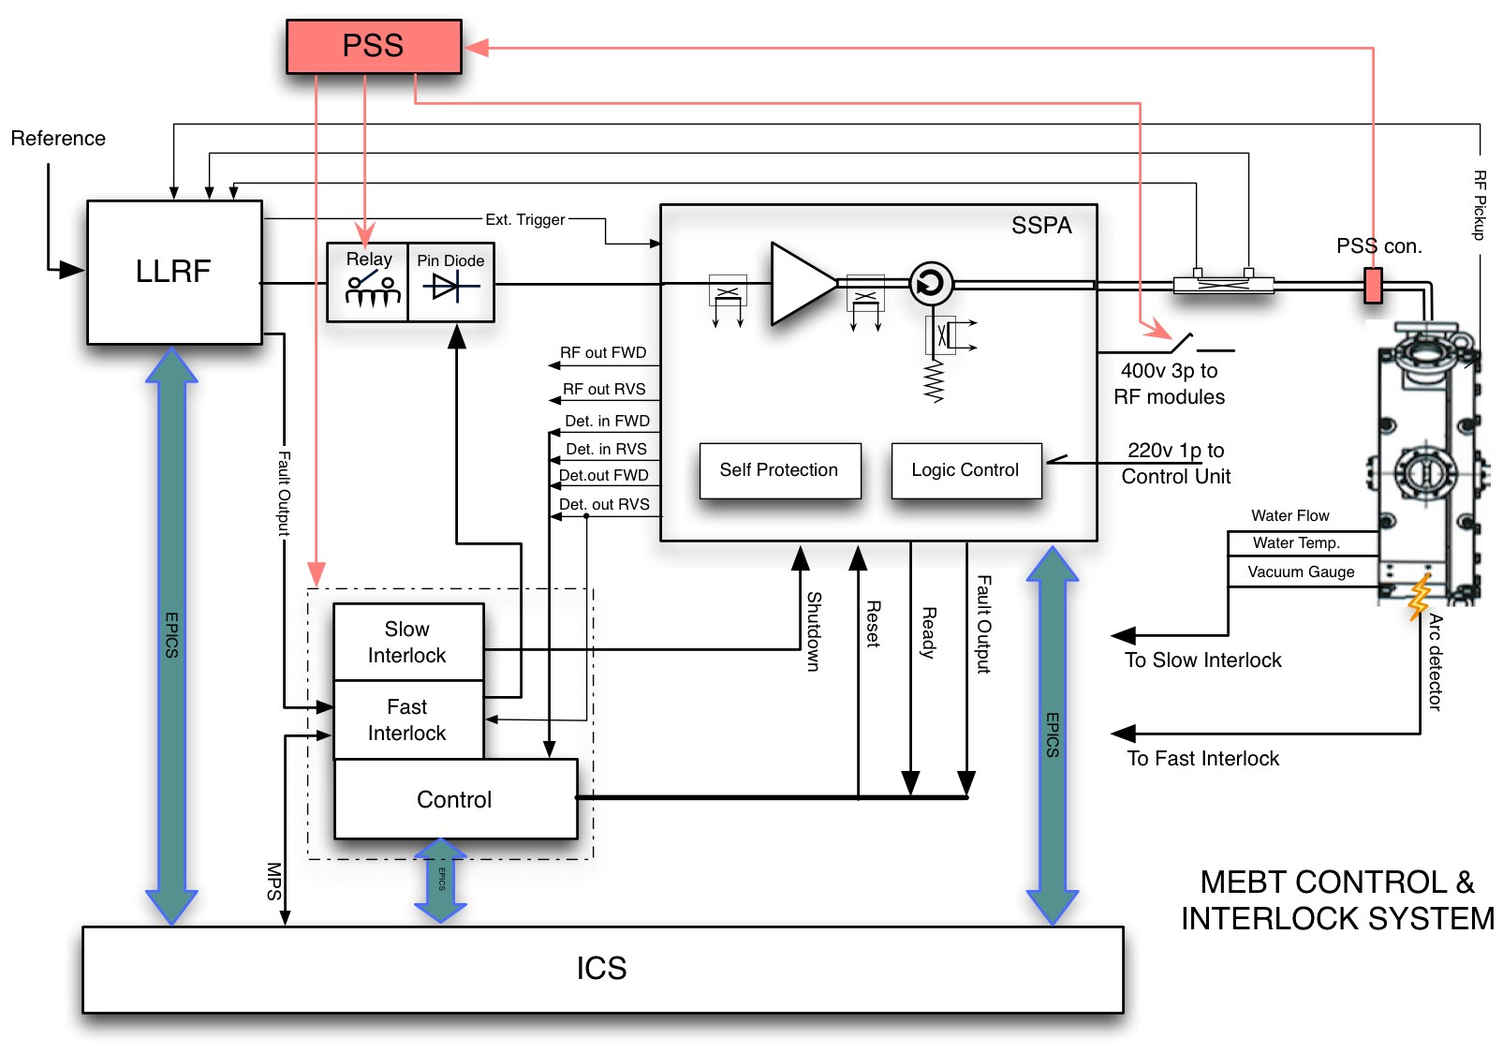
MEBT RF Interlock Diagram

Slide 27
RFQ and DTL RF interlocks
FIM: < 10μs
SIM: < 50ms
Courtesy of ESS

Slide 28
RF Interlocks Hardware
 | ESS-BILBAO | ESS ERIC
 | RF Transmitter System | PROTOTYPE | SOLUTION
Slow Interlock | PLC (Schneider Electric) | PLC (Siemens) S7-1500 S7-300/400 | PLC (Siemens) S7-1500
Fast interlock | Dedicated PCBs (in-house developed) | VME (IOxOS) cRIO-9066 | µTCA (IOxOS)
Control Layer (Machine State) | cRIO-9024 (NI) LabVIEW 2014 | PLC (Siemens) | PLC (Siemens)

Slide 29
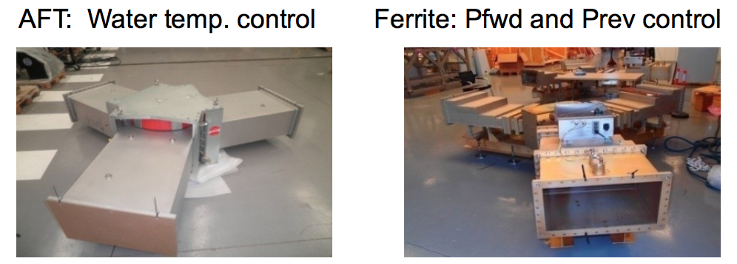
RF Distribution System
Transmission lines: EIA 1-5/8” for Buncher cavities and WR2300 waveguides Full Height (FH) and Half Height (HH) for RFQ and DTL
Circulators and Loads from AFT and Ferrite are under test and validation

Slide 30
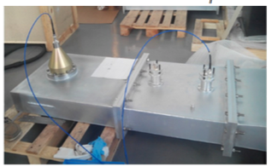
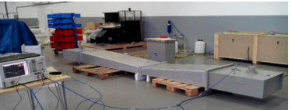
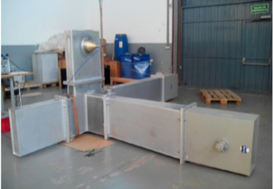
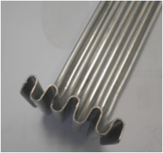
Transmission line components
In-house Designs:
  Straight sections
  Dual directional couplers
  FH to HH tapers
  Power splitters: Magic T and 3dB hybrid coupler
  WR2300 to Coax transition
  Flexible waveguides

Slide 31
Thank you

