Slide 1
Innovative Klystron Modulation Anode Voltage Control System
And
Voltage & Current Measurement System

Slide 2
CERN LHC RF Power Systems
16 RF cavities on the LHC
8 RF cavities per beam
A 300 kW klystron per cavity
1 Modulator tank per klystron
4 klystrons supplied by one HV supply
Crowbar to protect klystrons in case of arcing

Slide 3
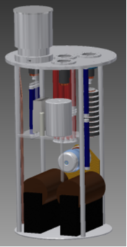
Klystron Modulator Tanks
The modulation anode voltage is generated by adjustable power tetrode.
Tetrode is no longer commercially available
An investigation on a replacement system using current day technologies is being investigated.
Cathode supplied at -58kV
Klystrons 330kW
  Mod Anode Voltage: 35kV max
  Mod Anode Current: 2.5mA max
  Cathode Current: 8.4A

Slide 4
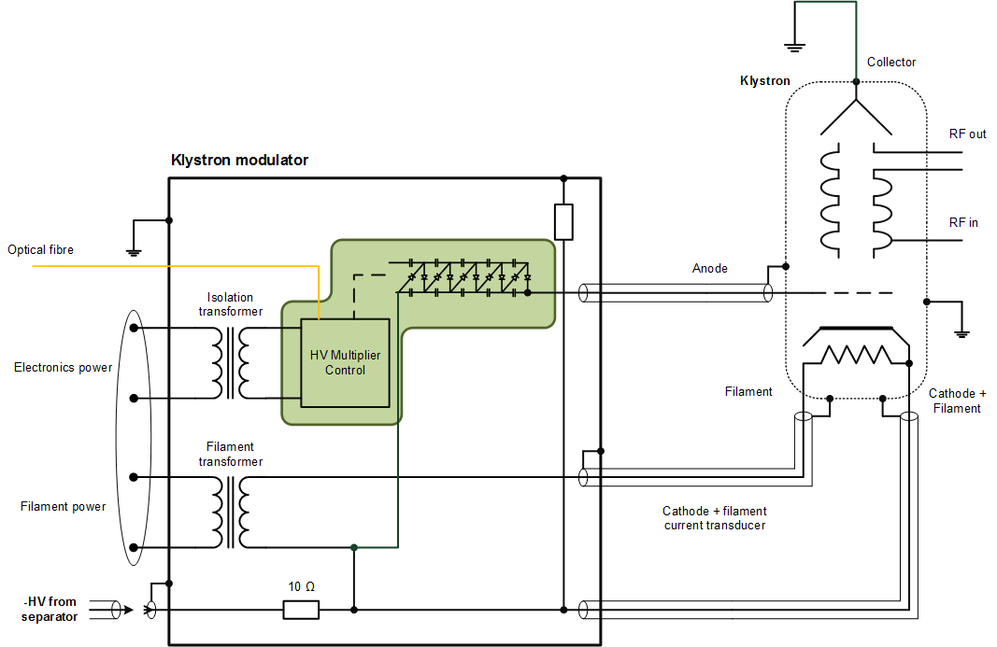
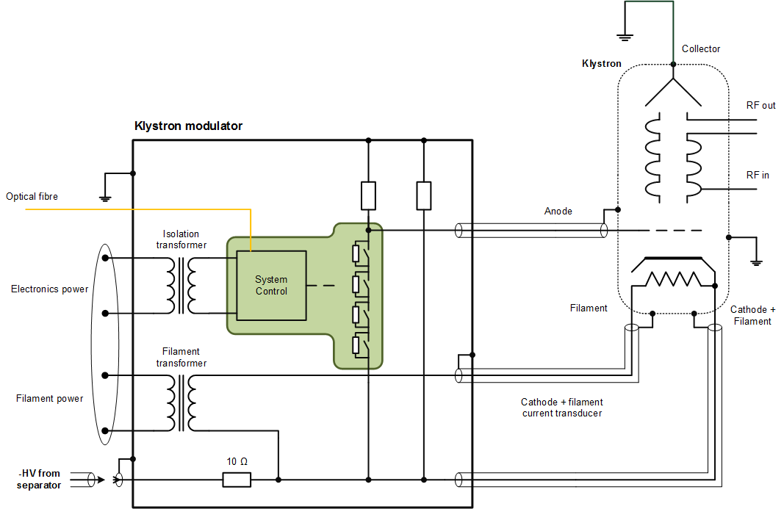
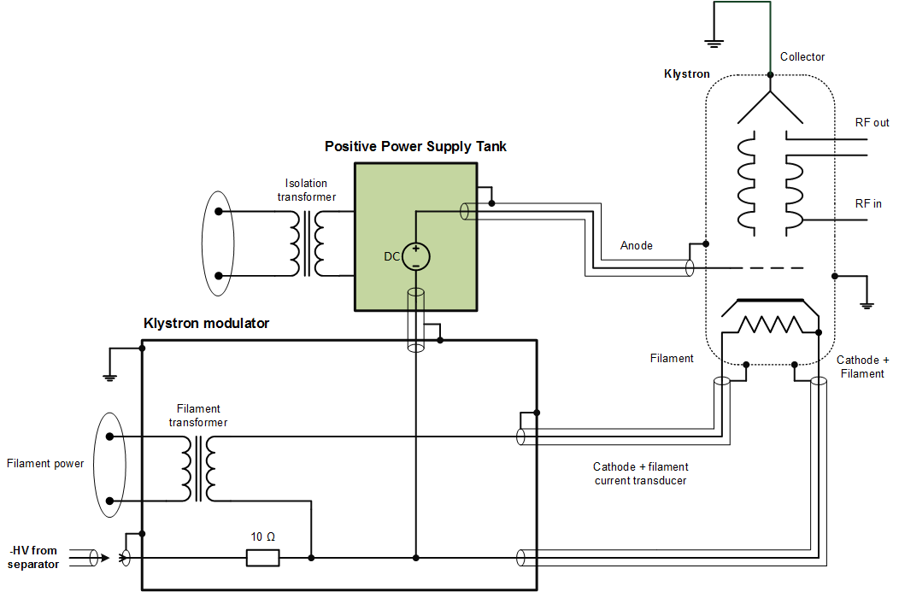
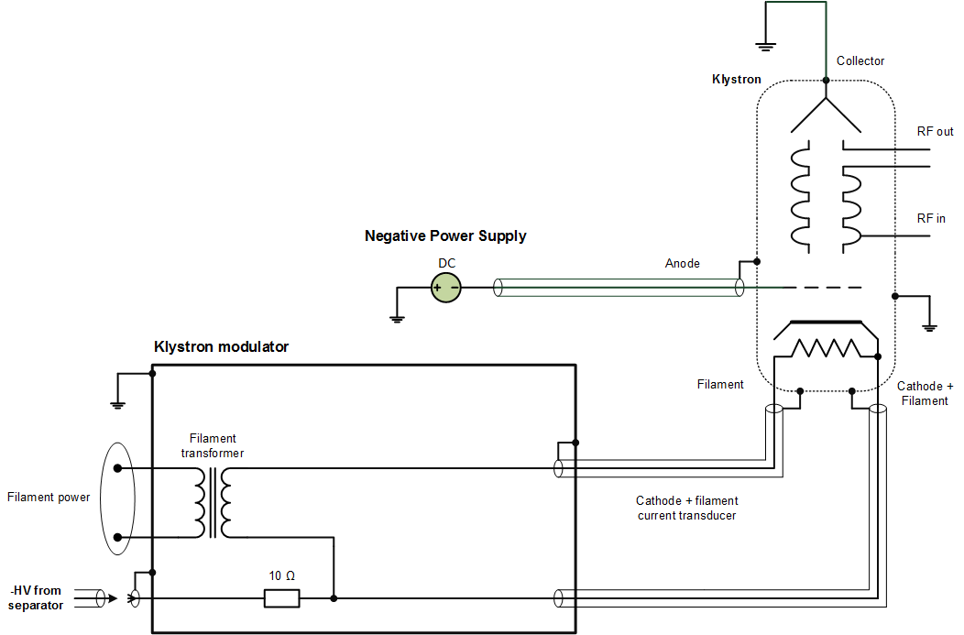
Different Solutions for Tetrode replacement
High Voltage Multiplier
Voltage Divider based on relays
External Positive Power Supply
External Negative Power Supply

Slide 5
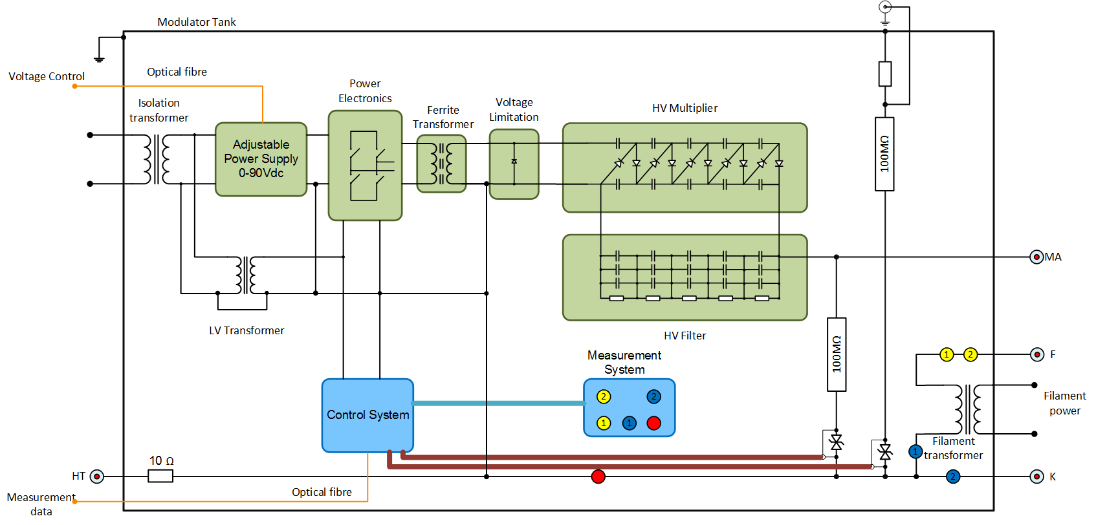
High Voltage Multiplier Solution
Why?
  Only power electronic components, not logic components
  Bunker limited space for extra tanks
  Tetrode removal save space inside Modulator tank
Modulator tank requirements
  Submerged in aggressive oil
  High Voltage at -58kV
  Low ripple
  Adjustable Mod Anode voltage up to 30kV and 2.5mA
  System control via optical fiber to ensure isolation
Goals
  HV Multiplier capable to achieve 40kV and 4mA
  Generate High Voltage from Low Voltage devices
  Low Ripple
HV Multiplier System different parts:
  Power Supply
  Power Electronics
  High Frequency transformer
  Voltage Limitation
  High Voltage Multiplier
  High Voltage Filter
  Power Supply Control System
  Measurement System
High Voltage Multiplier and Measurement System Integration

Slide 6
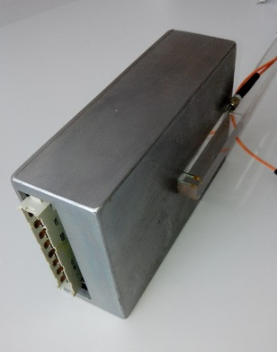
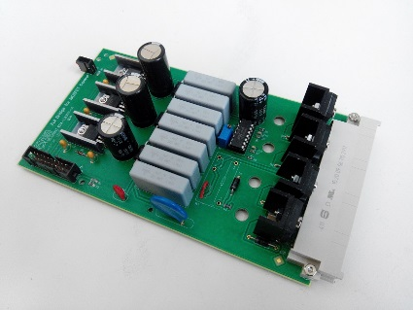
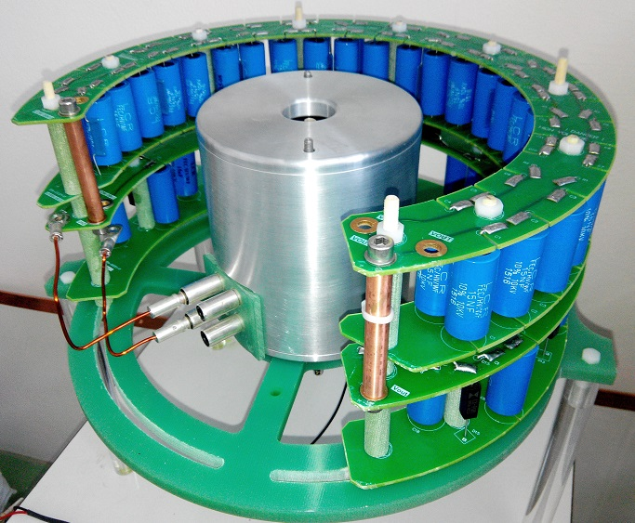
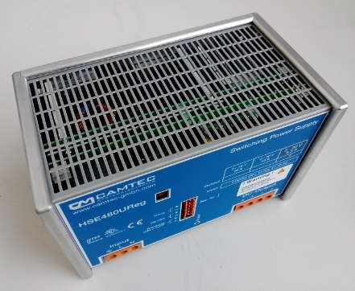
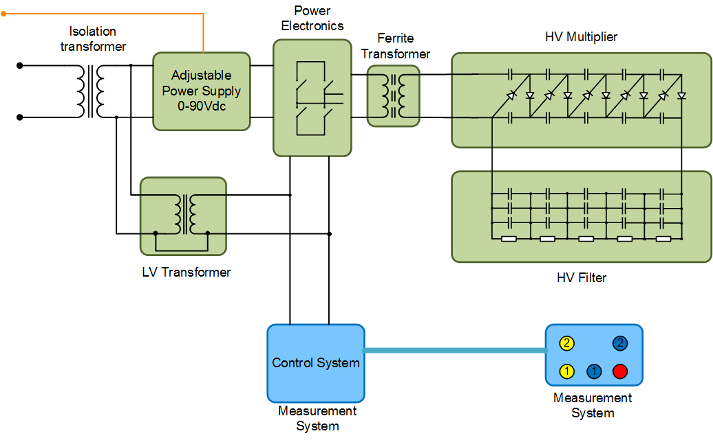
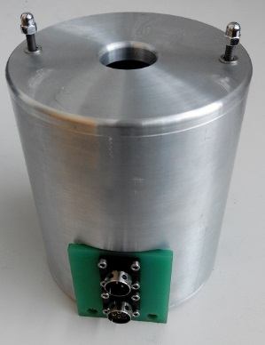
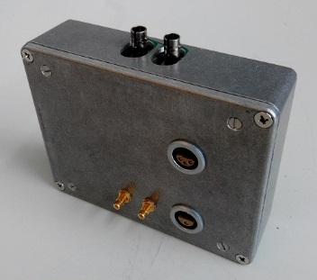
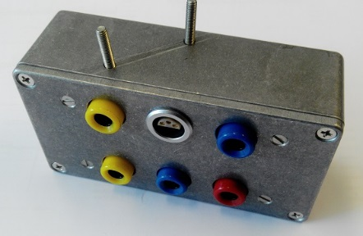
HV Multiplier System Components Design
Covers for sparks and electromagnetic fields
Keep distances for different voltage potential
Reusable components

Slide 7
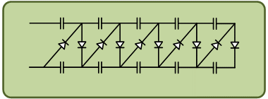




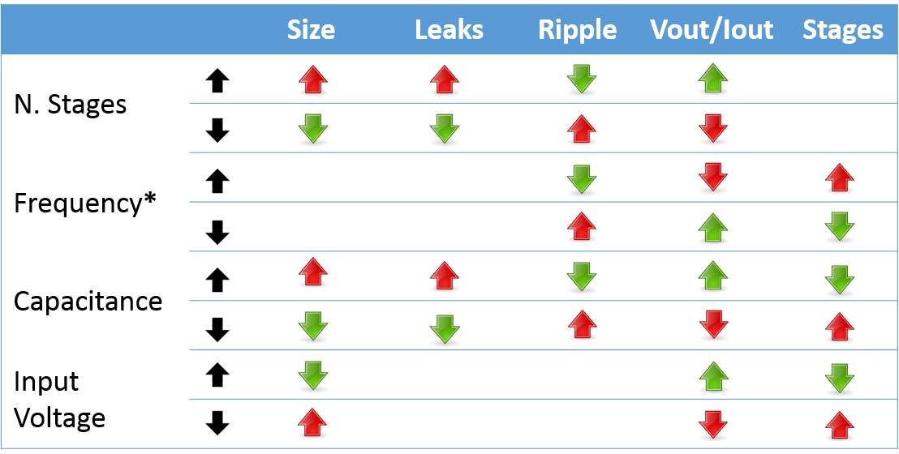


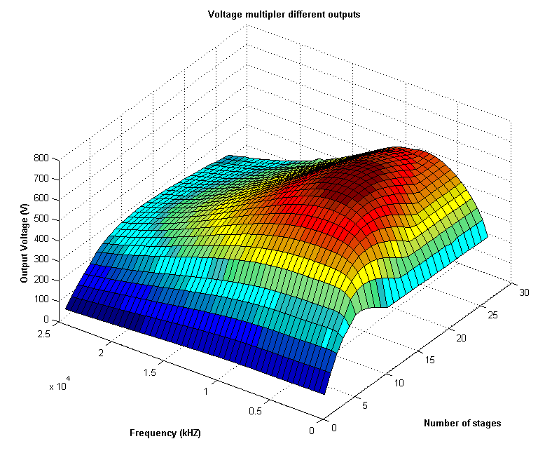


High Voltage Multiplier
 |  | Size | Leaks | Ripple | Vout/Iout | Stages
N. Stages
Frequency*
Capacitance
Input Voltage
Test 200nF capacitors for 30Vp input
Voltage Multiplier Linearity
$V_{out}=N. Stages × v_{inpp}$
*It depends on capacitor value
How start?
  Number of stages
  Frequency
  Capacitors capacitance
  Input Voltage
  8 stages
  30kHz
  15nF/10kV
  70Vp

Slide 8

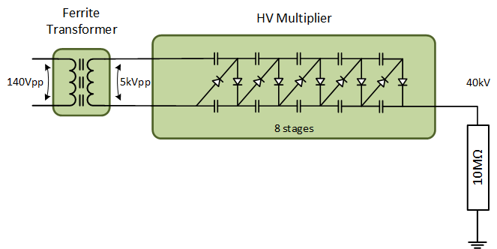

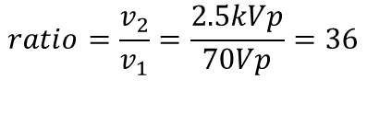



Transformer ratio
IDEAL CASE
No losses on HV Multiplier and transformer
AFTER TESTS
Power Supply consumption is 200W to achieve 160W at the output of the HV Multiplier, there is 40W losses. For the same transformation ratio and same primary voltage.
$$P_{HV Multiplier}=40kV×4mA=160W$$
$$v_{1}=70Vpeak fixed$$
$$i_{1}=\frac{200W}{70V}=2.85A$$
$$i_{1}=\frac{160W}{70V}=2.28A$$
$$ratio=\frac{v_{2}}{v_{1}}=\frac{2.5kVp}{70Vp}=36$$

Slide 9
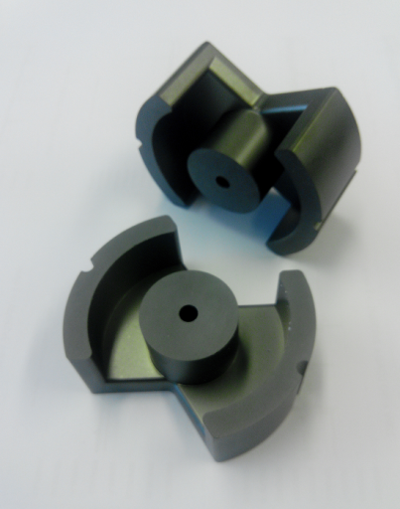
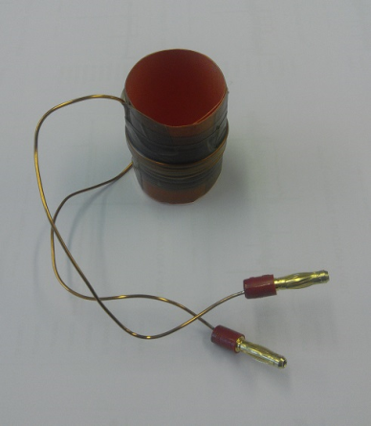
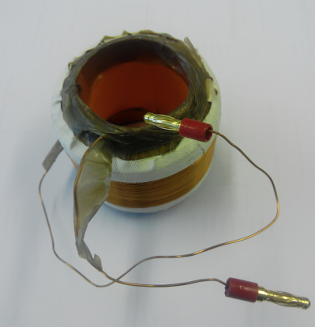
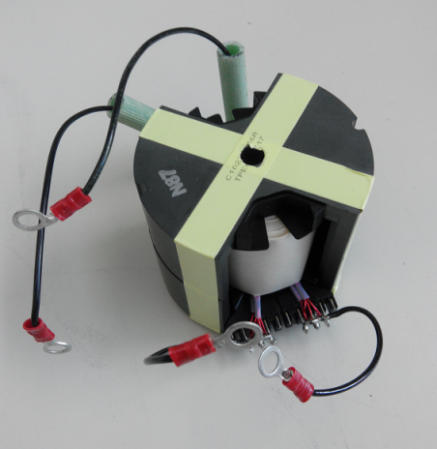
Ferrite core High Frequency transformer & winding
Ferrite cores low losses at high frequencies (30kHz)
Ferrite material 3C94
Transformer characteristics
  70V primary nominal voltage
  Primary from 10 turns
  Secondary 360 turns
  Transformation ratio 36
  Nominal Power 200VA
WINDING
Trial and error
  5 primary turns minimum to magnetize the core
  Turns number limited by the space inside tank and ferrite core size
10 turns hand made primary
Ferrite core
360 turns hand made secondary
Ordered HF Transformer

Slide 10
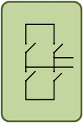
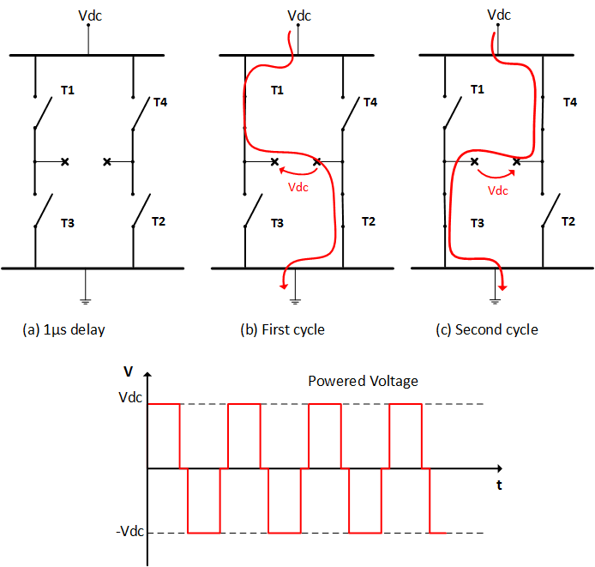

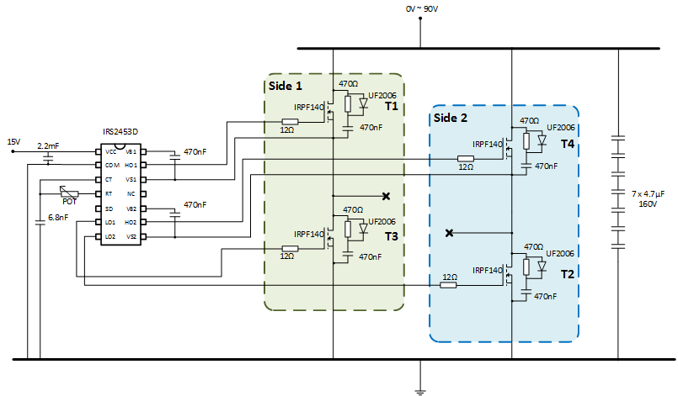
Power Electronics
Bipolar signal using MOSFET full-bridge
MOSFET IRPF140 100V/33A
Snubber circuit to reduce the speaks
IRS2453D full-bridge gate driver
From 100Hz to 100MHz
1µs delay for dead-time

Slide 11
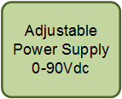
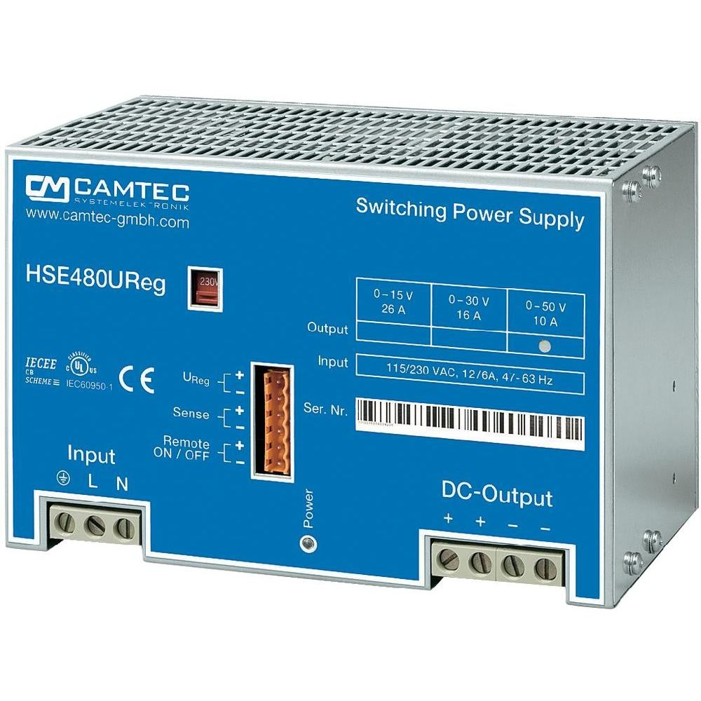
Power Supply
Due to:
Fixed 70Vp
MOSFET 100V/33A
2.85A primary HF Transformer consumption
Power Supply characteristics:
Adjustable from 0 to 90V
5.3A maximum output
480W
Analogue interface
Low ripple

Slide 12
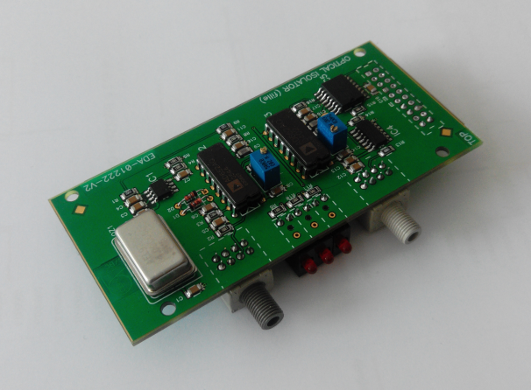
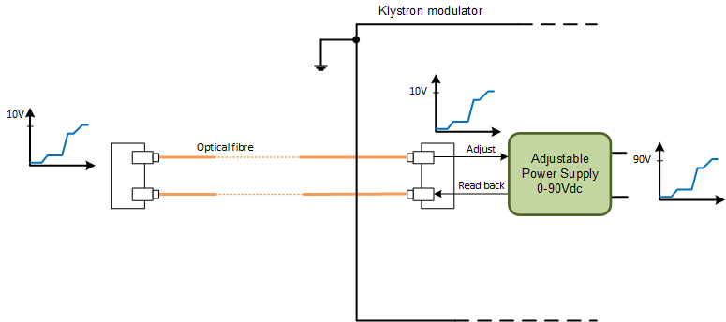
HV Multiplier System Control
Isolation from internal -58kV via Optical Fiber
Control signal from 0 to 10V
AC/frequency converter and vice versa
Read back Power Supply’s adjusted voltage

Slide 13
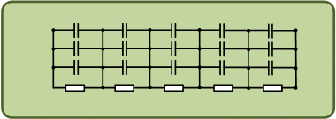
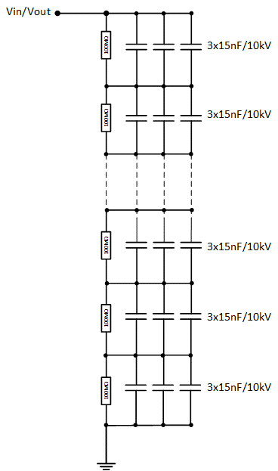
High Voltage Filter
Reduce the ripple
Same capacitors 15nF/10kV
100MΩ resistors
8 stages as HV Multiplier

Slide 14
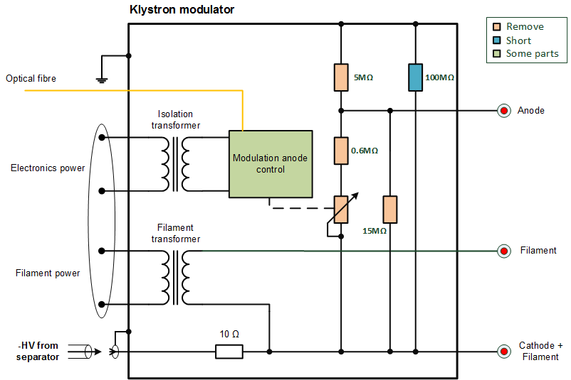
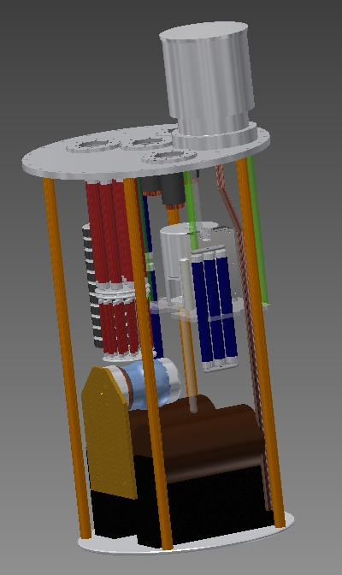
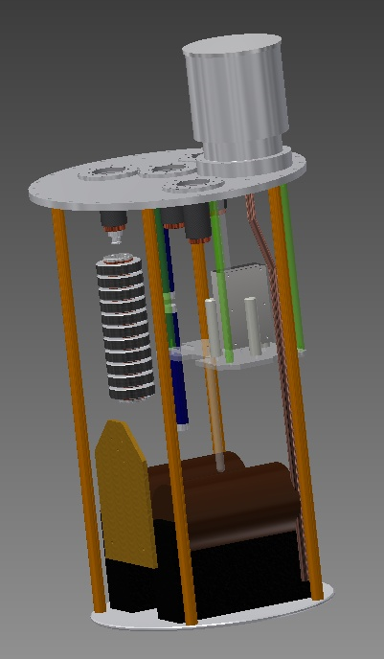
Space inside the Modulator Tank
Remove components not needed
Select shorted components
Reusable components
With Tetrode System
Needed parts for HV Multiplier System

Slide 15
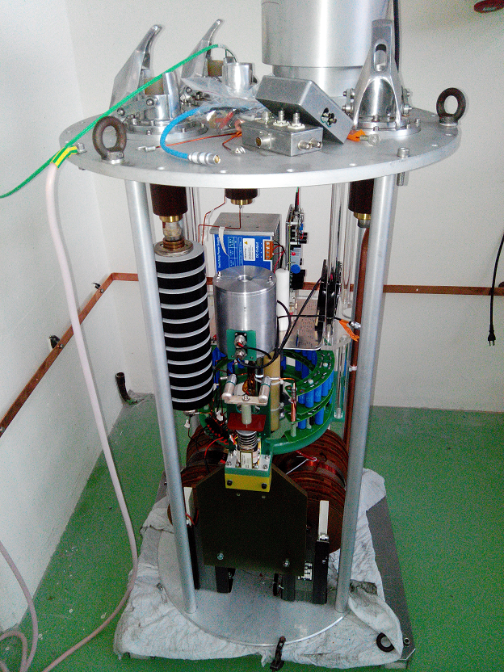
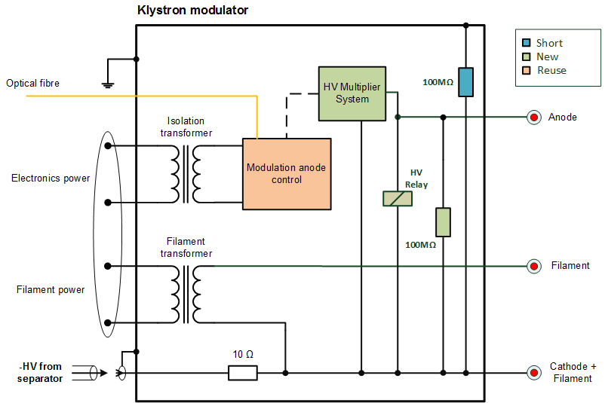
Components Installation
Rigid cabling
40kV Relay to discharge the capacitors
Ensure distances to avoid sparks

Slide 16

Tests & Ripple
TEST
15 days running it at 40kV/4mA
RIPPLE
Current ripple measurement
  HV probe
  Voltage divider
Researching different ripple measurement methods
GLOBAL RIPPLE
HV Multiplier System ripple depends on:
      $$ripple=f\left(Power Supply, Power Electronic, HF Transformer, HV Multiplier\&Filter\right)$$
One installed in the LHC verify the global ripple

Slide 17
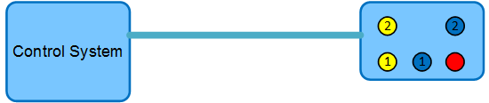
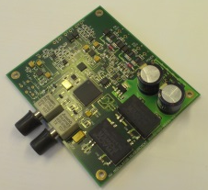
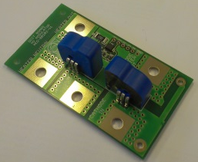
Measurement System
Floating at -58kV
Powered at 36Vac
Optical Fiber used to:
  Data Transmission
  Isolation
Measurement:
  Current -> Transducer
  Voltage -> Voltage Divider
Controlled by a FPGA
7 different measurements
2.5kHz sampling time
12bits ADC resolution
2 PCBs to reduce ground loops from sparks
Measurement Control System
Measured parameter | Nominal value | Range | Resolution
Heater voltage | ±20 V pk | ±50 V pk | 50.2mV/LSB
Heater voltage RMS | 12 V RMS | 50 V RMS | 50.2mV/LSB
Heater current | ±40 A pk | ±50 A pk | 48.8mA/LSB
Heater current RMS | 30 A RMS | 50 A RMS | 48.8mA/LSB
Cathode current | 9 A | 15 A | 9.76mA/LSB
Cathode voltage | -58 kV | -70 kV | 24.41V/LSB
Modulation anode voltage | -35 kV | -70 kV | 24.41V/LSB
Measurement System

Slide 18
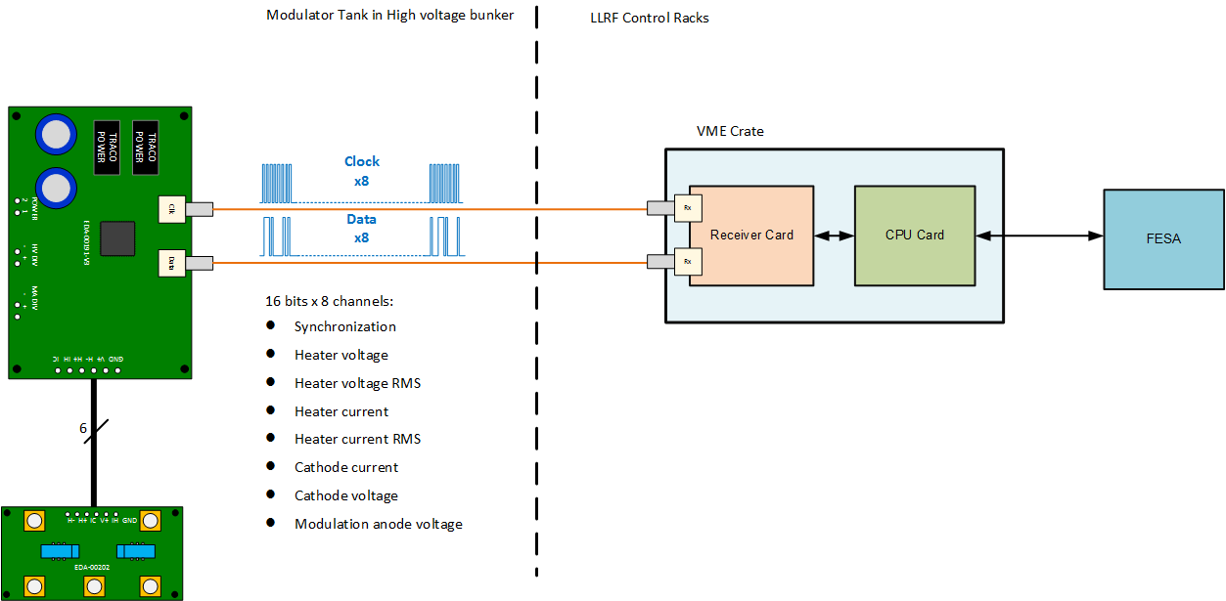
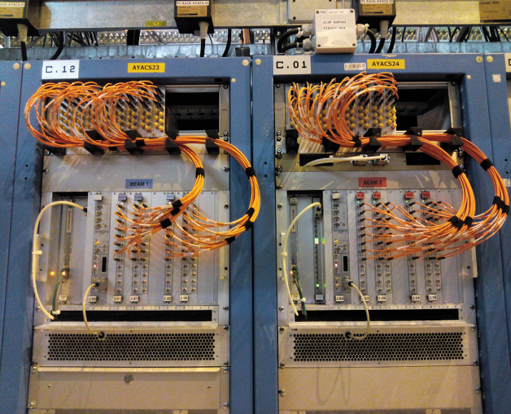
Data transmission
Data is buffered on the CPU until been read
Fibers for B1
Fibers for B2

Slide 19
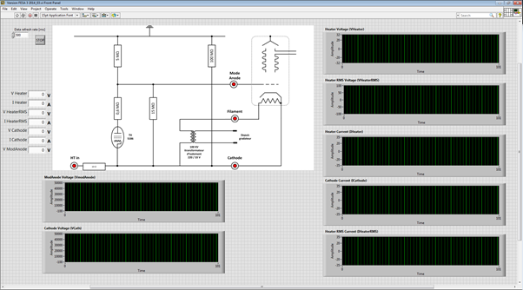
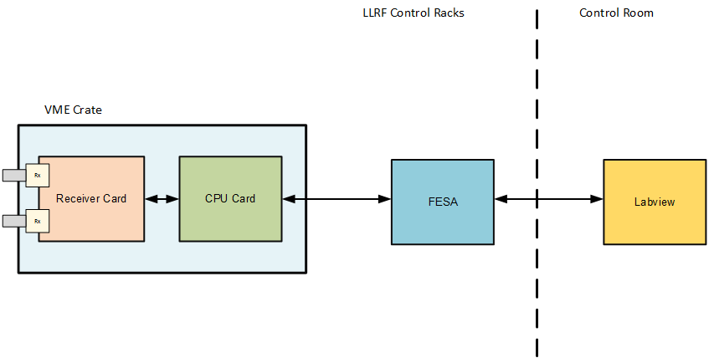
Scale factor & Front-End
FESA is a comprehensive front-end framework
Apply the scale for each measure

Slide 20
Conclusions
Improve HV Multiplier System ripple (from LV part to HV part)
Test HV Multiplier System with a klystron
Install in the LHC and verify the global ripple

