Slide 1
Upgrades to the SNS RF Systems to Support the Second Target Station
Presented to the
Ninth Continuous Wave and High Average Power RF Workshop
Grenoble, France
Thursday, June 23, 2016
Mark E. Middendorf

Slide 2
Upgrades to the SNS RF Systems to Support the Second Target Station
Presented to the
Ninth Continuous Wave and High Average Power RF Workshop
Grenoble, France
Thursday, June 23, 2016
Mark E. Middendorf
(a.k.a. “Swims with Sharks”)

Slide 3
Agenda
Introduction
Proton Power Upgrade
  Timeline
  Parameters
  Scope
    Transmitters
    LLRF
    HVCM
  Challenges
  Schedule
Summary

Slide 4
Acknowledgements
A.V. Aleksandrov | M.P. Howell | R.B. Saethre
D.E. Anderson | Y.W. Kang | J.P Schubert
H.J. Bullman | S.H. Kim | C.C. Smith
M.P. Cardinal | J.S. Kristy | D.J. Solley
M.S. Champion | S.W. Lee | C.M. Stone
M.T. Crofford | J.S. Moss | W.H. Strong
D.E. Curry | S.N. Murray | B.M. Thibadeau
G.W. Durland | T.R. Pennisi | R.F. Welton
J.J. Fazekas | J.P. Price | M.W. Wezensky
J.D. Galambos | F.S. Proffitt | D.C. Williams
D.A. Heidenreich | R.T. Roseberry

Slide 5
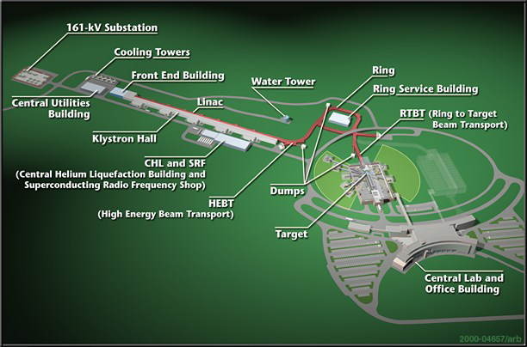
Introduction
 | Design | Routine Operation
Kinetic Energy (GeV) | 1.0 | 0.957
Beam Power (MW) | 1.4 | 0.8-1.4
Energy per pulse (kJ) | 23 | 13 - 23
Target Material | Hg | Hg
Repetition Rate (Hz) | 60 | 60
RF Duty Factor (%) | 8 | 7
Linac pulse length (msec) | 1.0 | 0.975
Peak Linac Current (mA) | 38 | 36
Average Linac Chopping Factor)%) | 32 | 22
SRF Cavities | 81 | 79-80
The SNS accelerator complex provides the world’s highest beam power on target accelerator-based neutron source

Slide 6
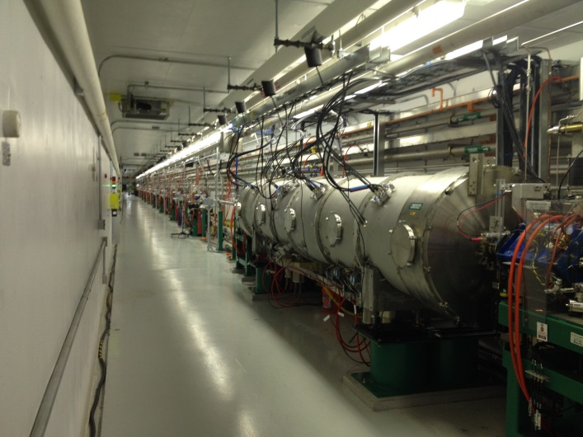
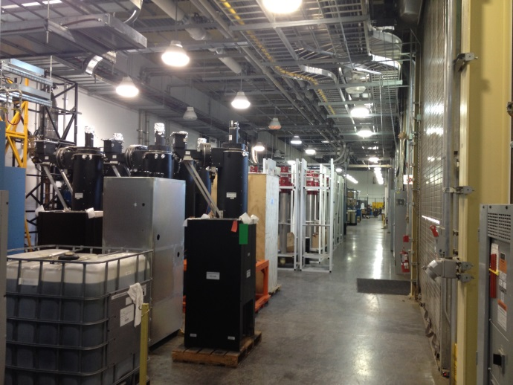
Introduction
Designed from the outset to accomodate two major upgrades
  Second target station
  Power upgrade
9 available
cryomodule slots

Slide 7
Proton Power Upgrade - Timeline
2004 | CD-0 approved for power upgrade (energy only)
2009 | CD-0 approved for STS
2011 | Indefinite postponement
2013 | Started pre-conceptual design effort for STS (included power upgrade)
2015 | Published Technical Design Report
2016 | PPU was split out

Slide 8
Proton Power Upgrade - Parameters
 | Design | Routine Operation | PPU
Kinetic Energy (GeV) | 1.0 | 0.957 | 1.3
Beam Power (MW) | 1.4 | 0.8-1.40 | 2
Energy per pulse (kJ) | 23 | 13 - 23 | 33
Target Material | Hg | Hg | Hg
Repetition Rate (Hz) | 60 | 60 | 60
RF Duty Factor (%) | 8 | 7 | 7
Linac pulse length (msec) | 1.0 | 0.975 | 0.975
Peak Linac Current (mA) | 38 | 36 | 46
Average Linac Chopping Factor)%) | 32 | 22 | 22
SRF Cavities | 81 | 79-80 | 109
Upgrades the SNS accelerator to provide 2MW beam power on target
  Upgrades target to handle 2MW
  Increases energy and current

Slide 9
Proton Power Upgrade - Parameters
 | Routine Operation | PPU | FTS | STS
Kinetic Energy (GeV) | 0.957 | 1.3 | 1.3 | 1.3
Beam Power (MW) | 0.8-1.40 | 2 | 2 | 0.47
Energy per pulse (kJ) | 13 - 23 | 33 | 40 | 47
Target Material | Hg | Hg | Hg | Tungsten
Repetition Rate (Hz) | 60 | 60 | 50 | 10
RF Duty Factor (%) | 7 | 7 | 7 | 7
Linac pulse length (msec) | 0.975 | 0.975 | 0.975 | 0.975
Peak Linac Current (mA) | 36 | 46 | 46 | 46
Average Linac Chopping Factor(%) | 22 | 22 | 33 | 18
SRF Cavities | 79-80 | 109 | 109 | 109
Upgrades the SNS accelerator to provide 2MW beam power on target
  Upgrades target to handle 2MW
  Increases energy and current
Installs all HPRF required for Second Target Station

Slide 10
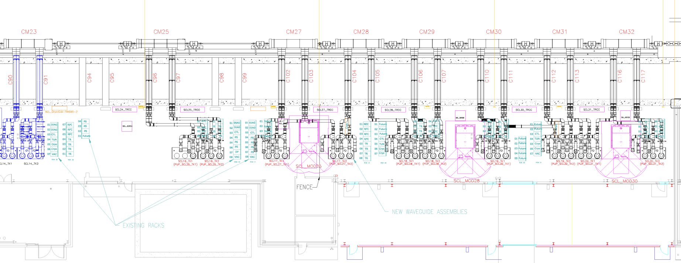
Proton Power Upgrade - Scope
Energy upgrade
  28 high-β cavities in 7 cryomodules
  28 HPRF systems
    5 transmitters
  28 LLRF systems
  3 HVCMs
Current upgrade
  Increasing peak current
  Reducing chopped beam fraction
Upgrade DTL klystrons due to additional beam loading
With the exception of the LLRF, systems will be identical to installed base with noted enhancements

Slide 11
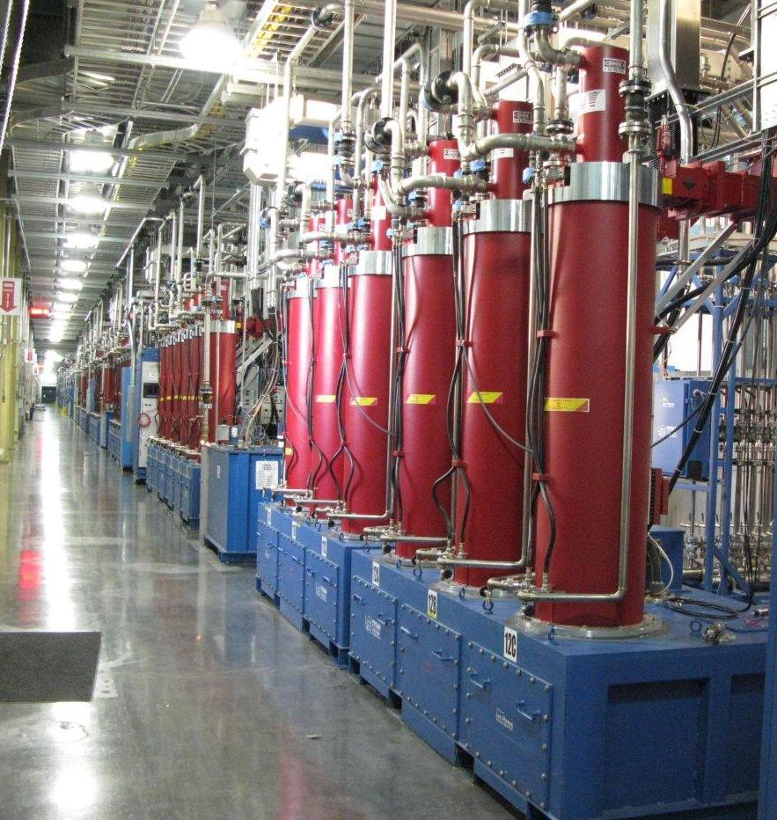
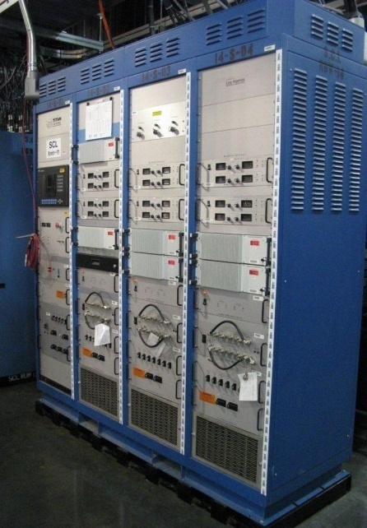
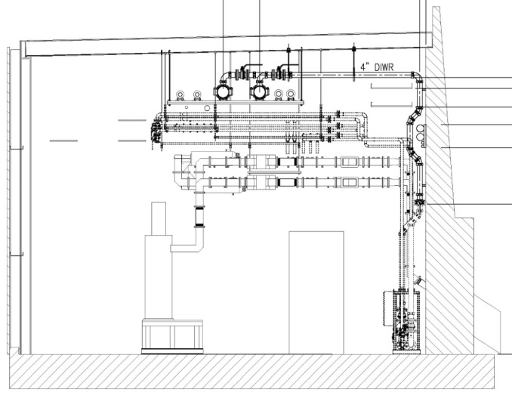
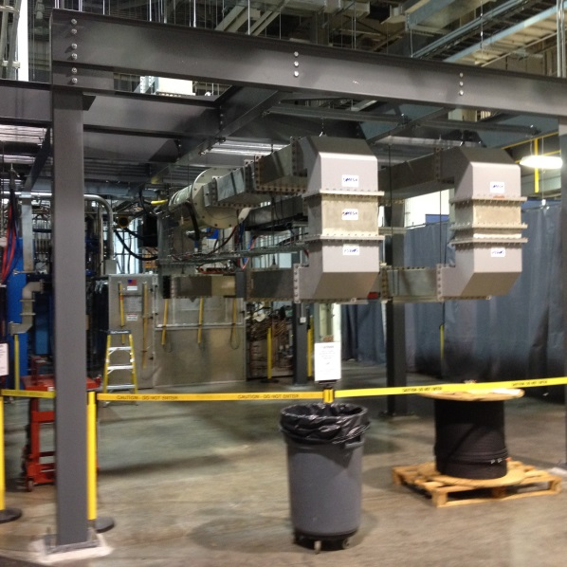
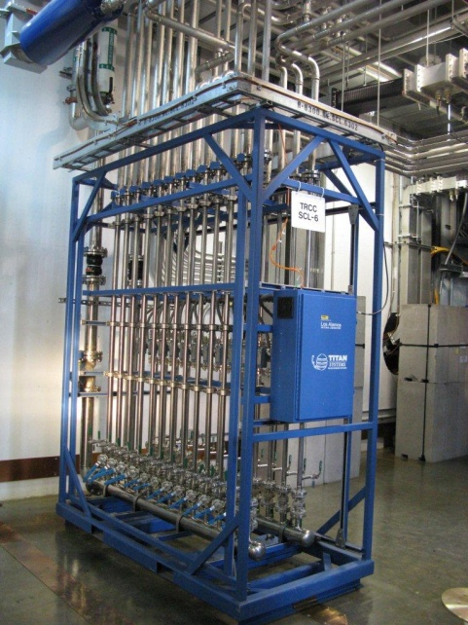
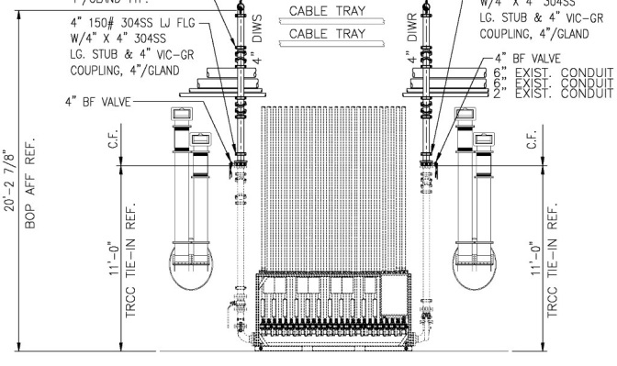
Proton Power Upgrade - Transmitters
Transmitters
  CPI VKP-8291B, 700kW klystrons
  Single magnet power supplies
  Internal chassis temperature measurement
  RHV fiber optic fan-out
  Compact cooling cart
    Ultrasonic flow transducers
  Waveguide support structure

Slide 12
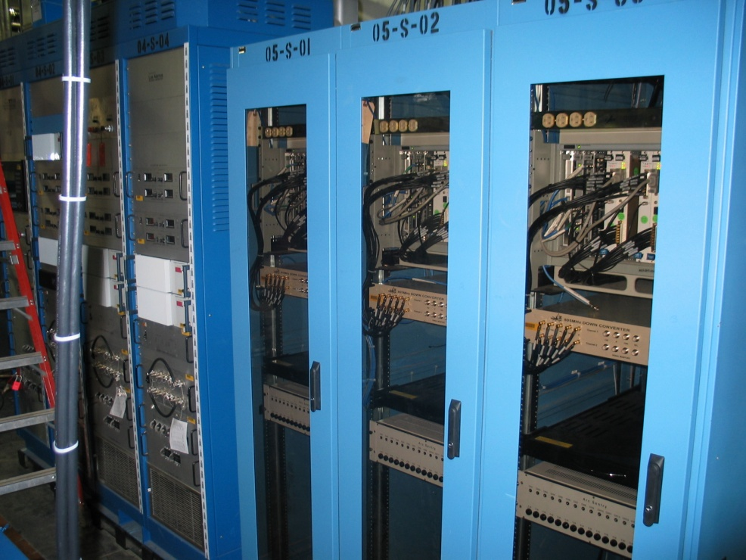
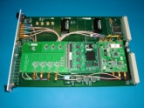
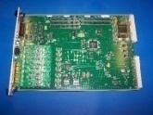
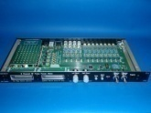
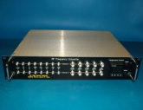
Proton Power Upgrade - LLRF
  The current LLRF systems for the Linac is obsolete.
  There are adequate spares of the Linac LLRF systems to support PPU but the current system cannot meet Second Target Station (STS) requirements.
    No support for more than one style of beam loading
    No pulse-to-pulse AFF correction
    Current system is bus bandwidth limited to 20 Hz
  Utilizing the current Linac LLRF system for PPU is undesirable due to the requirement to replace it for STS.
Standard LLRF Configuration
VXI based
2 LLRF systems per rack (IOC)

Slide 13
Proton Power Upgrade - LLRF
Replacement LLRF system developed on µTCA.4 platform
  Baseline plan currently under investigation
  Allows for use of commercial of the shelf (COTS) hardware where possible
    lowers development effort
  Removes VXI backplane data throughput limitations to allow for full 60 Hz updates
    current system limited to 20 Hz
  Controls Group is adopting µTCA platform for their next generation systems
    ensures support in the future
  Considerable development work will be necessary

Slide 14
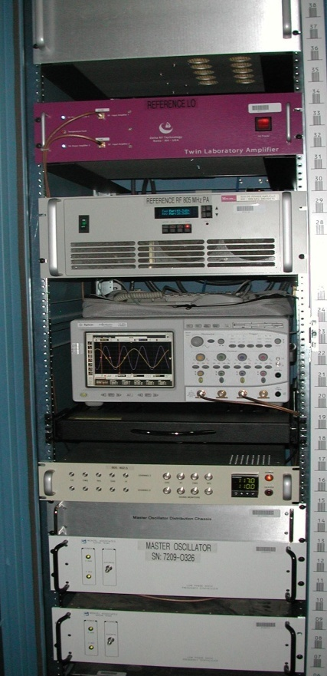
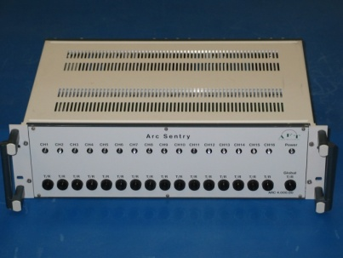
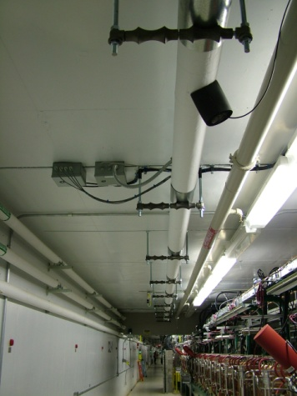
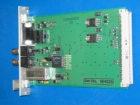
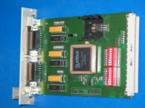
Proton Power Upgrade - LLRF
The installed arc detector system will be reused
RF reference line is in place and will reuse the current LO distribution scheme
AFT Arc Detector System
Reference Line in Tunnel
Master Oscillator Rack

Slide 15
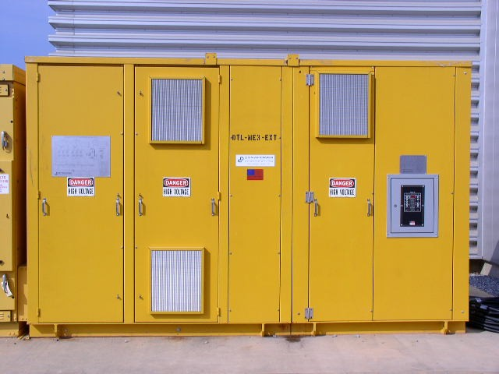
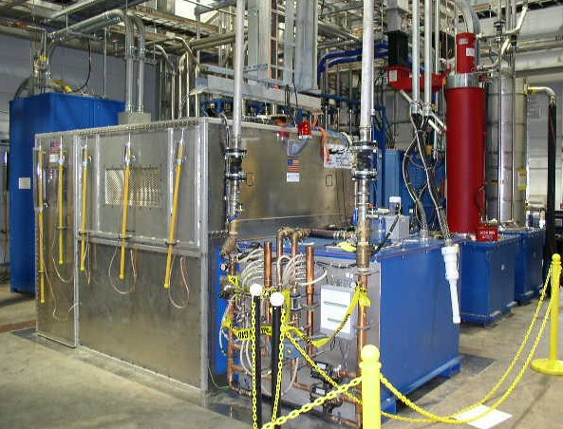
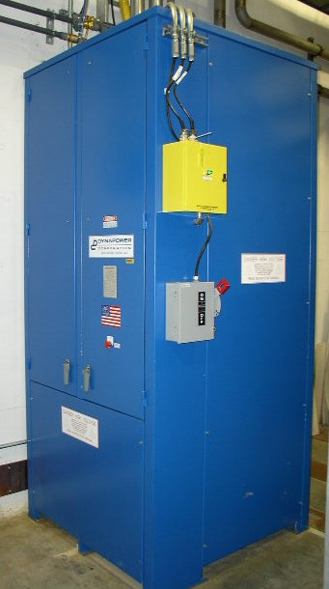
Proton Power Upgrade - HVCM
1.5MVA Transformer
13.8kV/2.1kV 3Φ
High-Voltage Converter Modulator
(Alternate Topology)
SCR Cabinet
To accommodate the modest power increase, an alternate modulator topology is under consideration
  Outputs of the three interleaved full bridge converters are in placed in series, not parallel
    Results in voltage reduction across secondary components
  Boost capacitor across transformer secondary is eliminated
    Eliminates a failure prone device
    The IGBTs turn off losses are minimized
  Topology is load tolerant; can supply one to ten klystrons with minimal output deviation

Slide 16
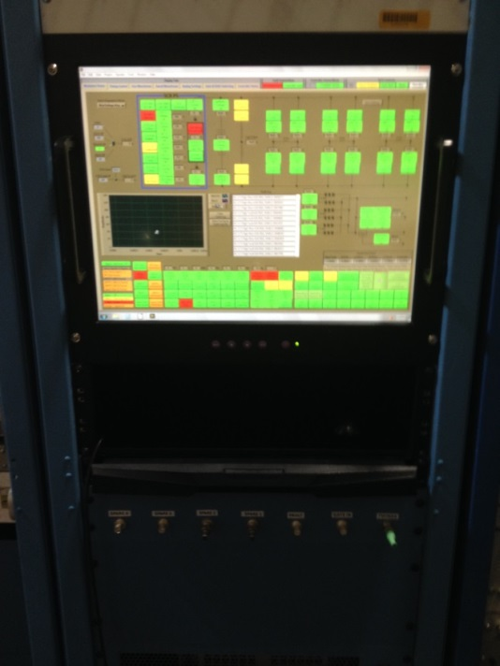
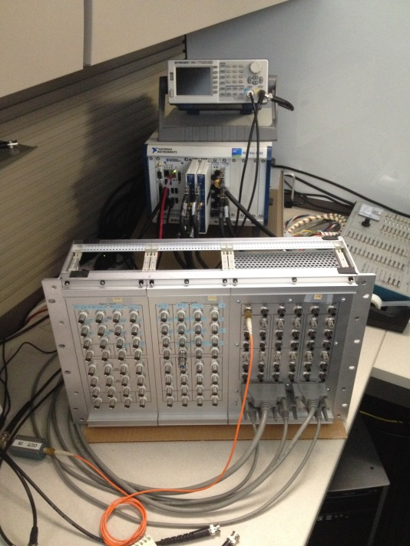
Proton Power Upgrade - HVCM
Next Generation Controller
  Replaces several pieces of obsolete and unreliable equipment
  NI PXI platform with embedded controller using LabView
  32-channel synchronous high speed analog input channels
    Provides synchronized full speed continuous monitoring and data capture
  Multiple digital and low-speed analog channels to monitor and control IGBT gate drivers, interlocks and protection systems
Provides new capabilities
  Ability to perform pulse-flattening
  Phase-shifted pulse width modulation
  Frequency modulation
  Flux compensation
  First fault identification
  Data logging including high speed waveforms
  Faster troubleshooting
Next Generation Controller

Slide 17
Proton Power Upgrade - Challenges
Space
  East end of klystron gallery currently used for storage and shop space
  RF Annex is being re-designated a technical development space
Solution?
  Better use of existing spaces
    Chestnut Ridge Maintenance Facility
    RATS2
    Mezzanines
  Out source construction
    Cryomodules
    HVCMs
  Rent temporary off-site technical space

Slide 18
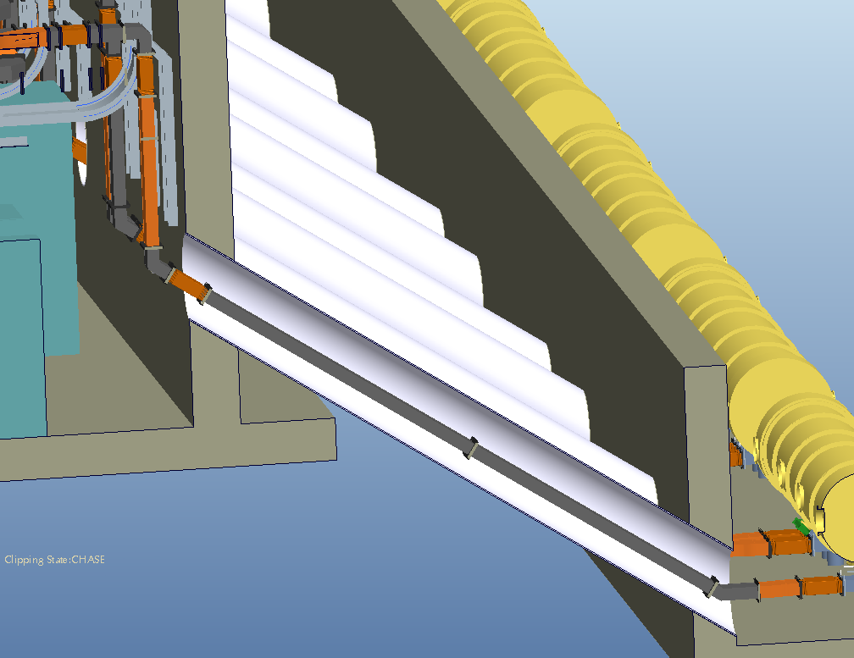
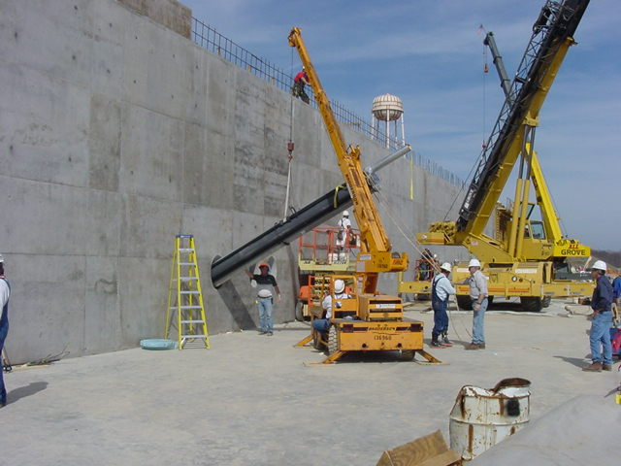
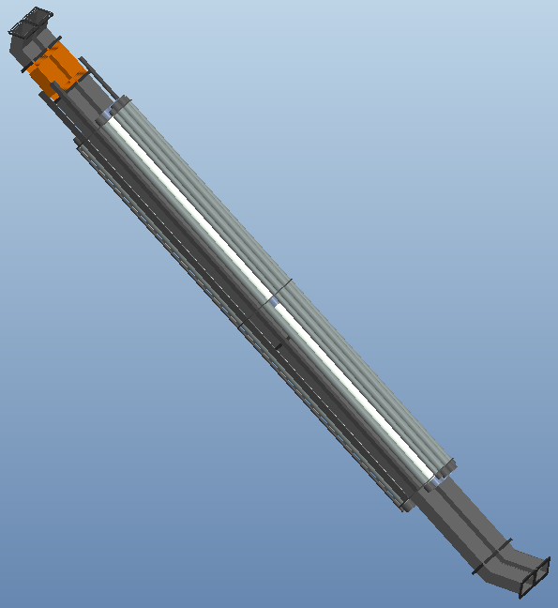
Proton Power Upgrade - Challenges
The penetrations from the klystron gallery to the tunnel have in insert that integrates waveguide and conduit
The inserts were originally installed before the klystron gallery building was constructed.

Slide 19
Proton Power Upgrade - Challenges
During construction, the decision was made to reduce the size of the klystron gallery to save money
  Klystron gallery ended around chase 103
  Required cables for equipment downstream from CM23 were pulled through chases 94, 95, 98, 99, 102, 103, and 117
  Equipment racks were installed in the klystron gallery blocking clear access to chase 94 and 99

Slide 20
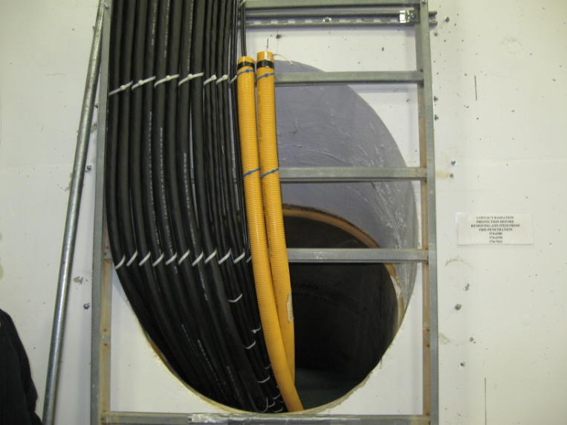
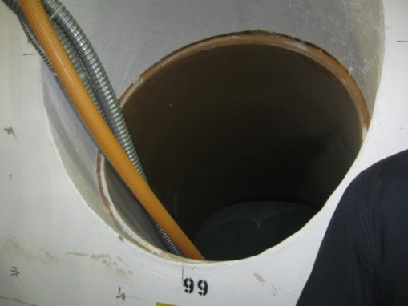
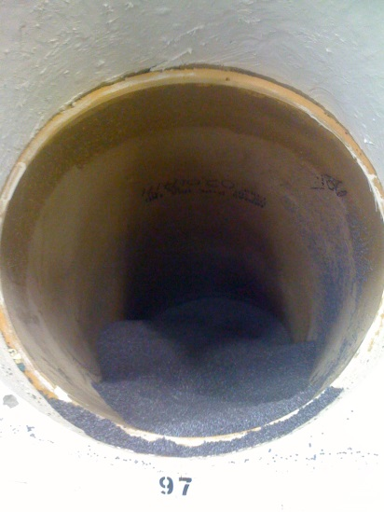
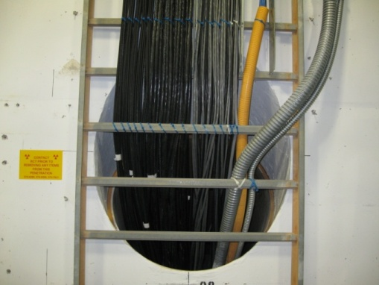
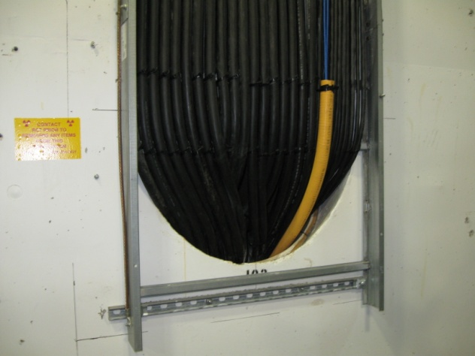
Proton Power Upgrade - Challenges
Chases with cables

Slide 21
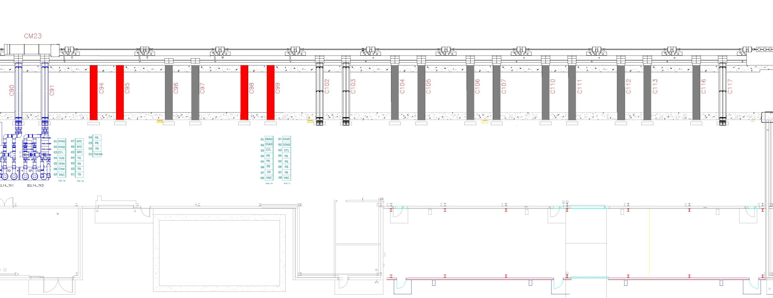
Proton Power Upgrade - Challenges
Clear cables from chases 102 and 103
Re-cable, bringing cables up through chase 99
Install chase inserts and backfill with poly beads

Slide 22
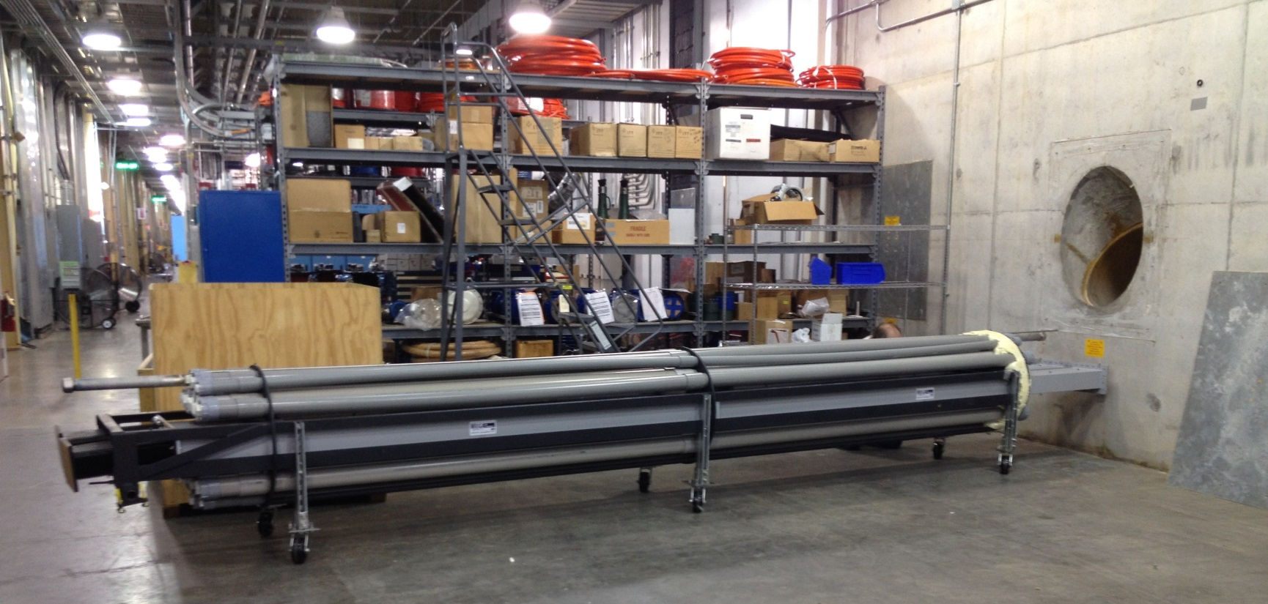
Proton Power Upgrade - Challenges
Clear cables from chases 102 and 103
Re-cable, bringing cables up through chase 99
Install chase inserts and backfill with poly beads

Slide 23
Proton Power Upgrade - Challenges
Clear cables from chases 102 and 103
Re-cable, bringing cables up through chase 99
Install chase inserts and backfill with poly beads
Install remaining inserts and backfill with poly beads

Slide 24
Proton Power Upgrade - Challenges
Clear cables from chases 102 and 103
Re-cable, bringing cables up through chase 99
Install chase inserts and backfill with poly beads
Install remaining inserts and backfill with poly beads
Install equipment in klystron gallery

Slide 25
Proton Power Upgrade - Challenges
Clear cables from chases 102 and 103
Re-cable, bringing cables up through chase 99
Install chase inserts and backfill with poly beads
Install remaining inserts and backfill with poly beads
Install equipment in klystron gallery
Install cryomodules

Slide 26
Proton Power Upgrade - Schedule

Slide 27
Summary
2004 | CD-0 approved for power upgrade (energy only)
2009 | CD-0 approved for STS
2011 | Indefinite postponement
2013 | Started pre-conceptual design effort for STS (included power upgrade)
2015 | Published Technical Design Report
2016 | PPU was split out
2017 | Publish Conceptual Design Report
2017 | CD-1 Approval
2018 | CD 2/3 Funding for advanced procurements
2018 | Conventional facilities complete
2023 | Klystron gallery installation complete
2023 | Last cryomodule installed
2023 | CD-4 Early project finish
STA? | 2MW beam on target

Slide 28
Merci beaucoup de votre attention!

