Slide 1
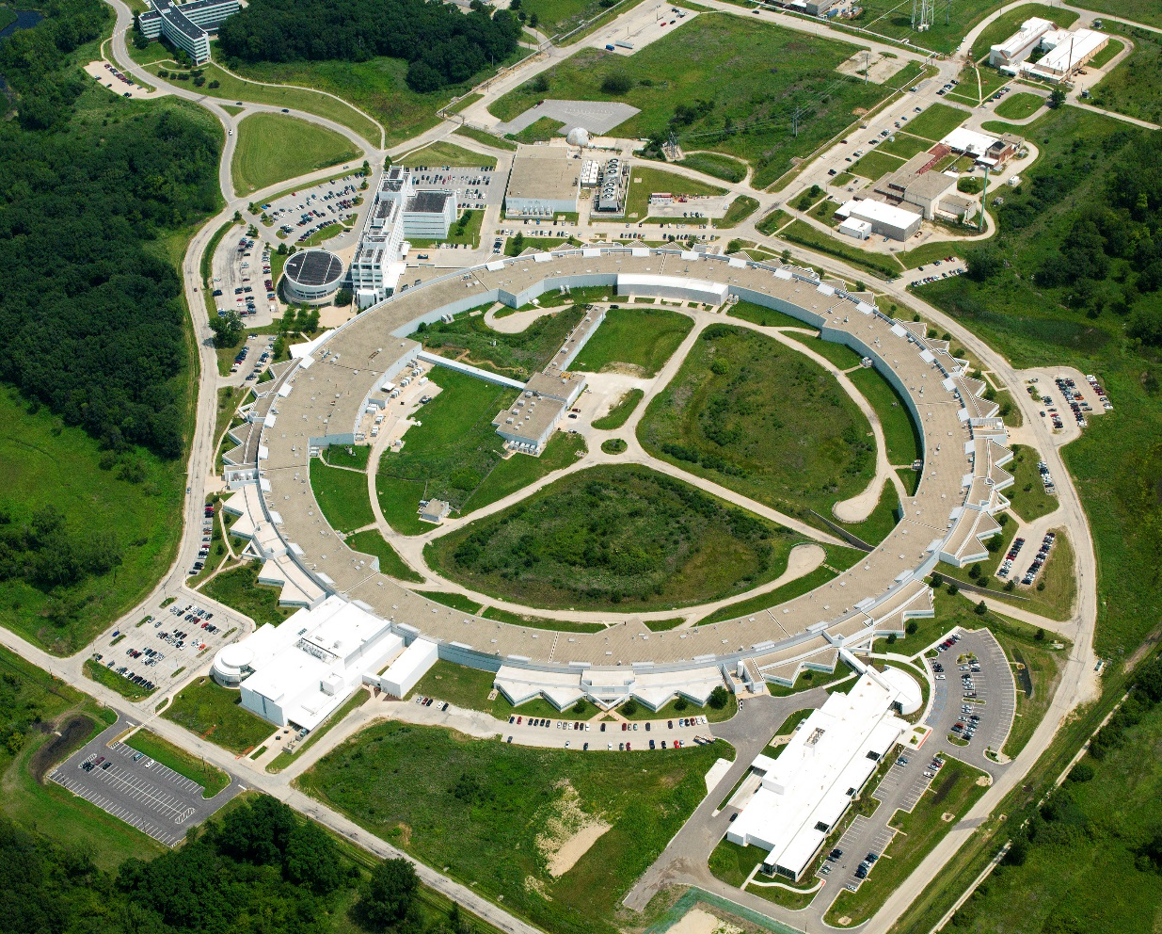
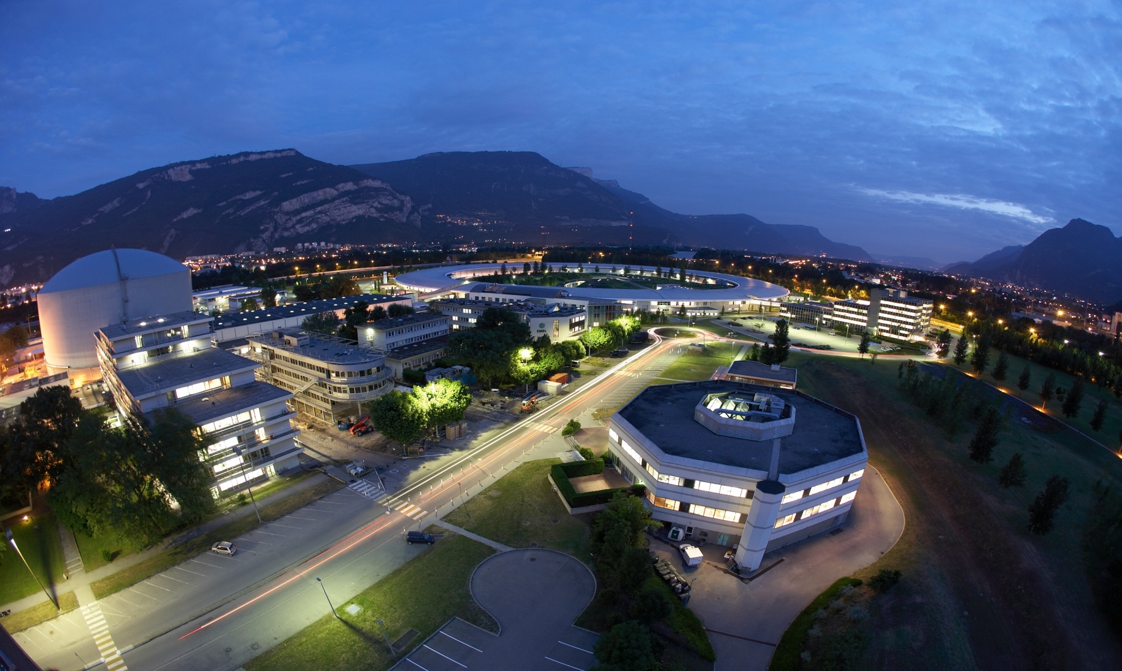
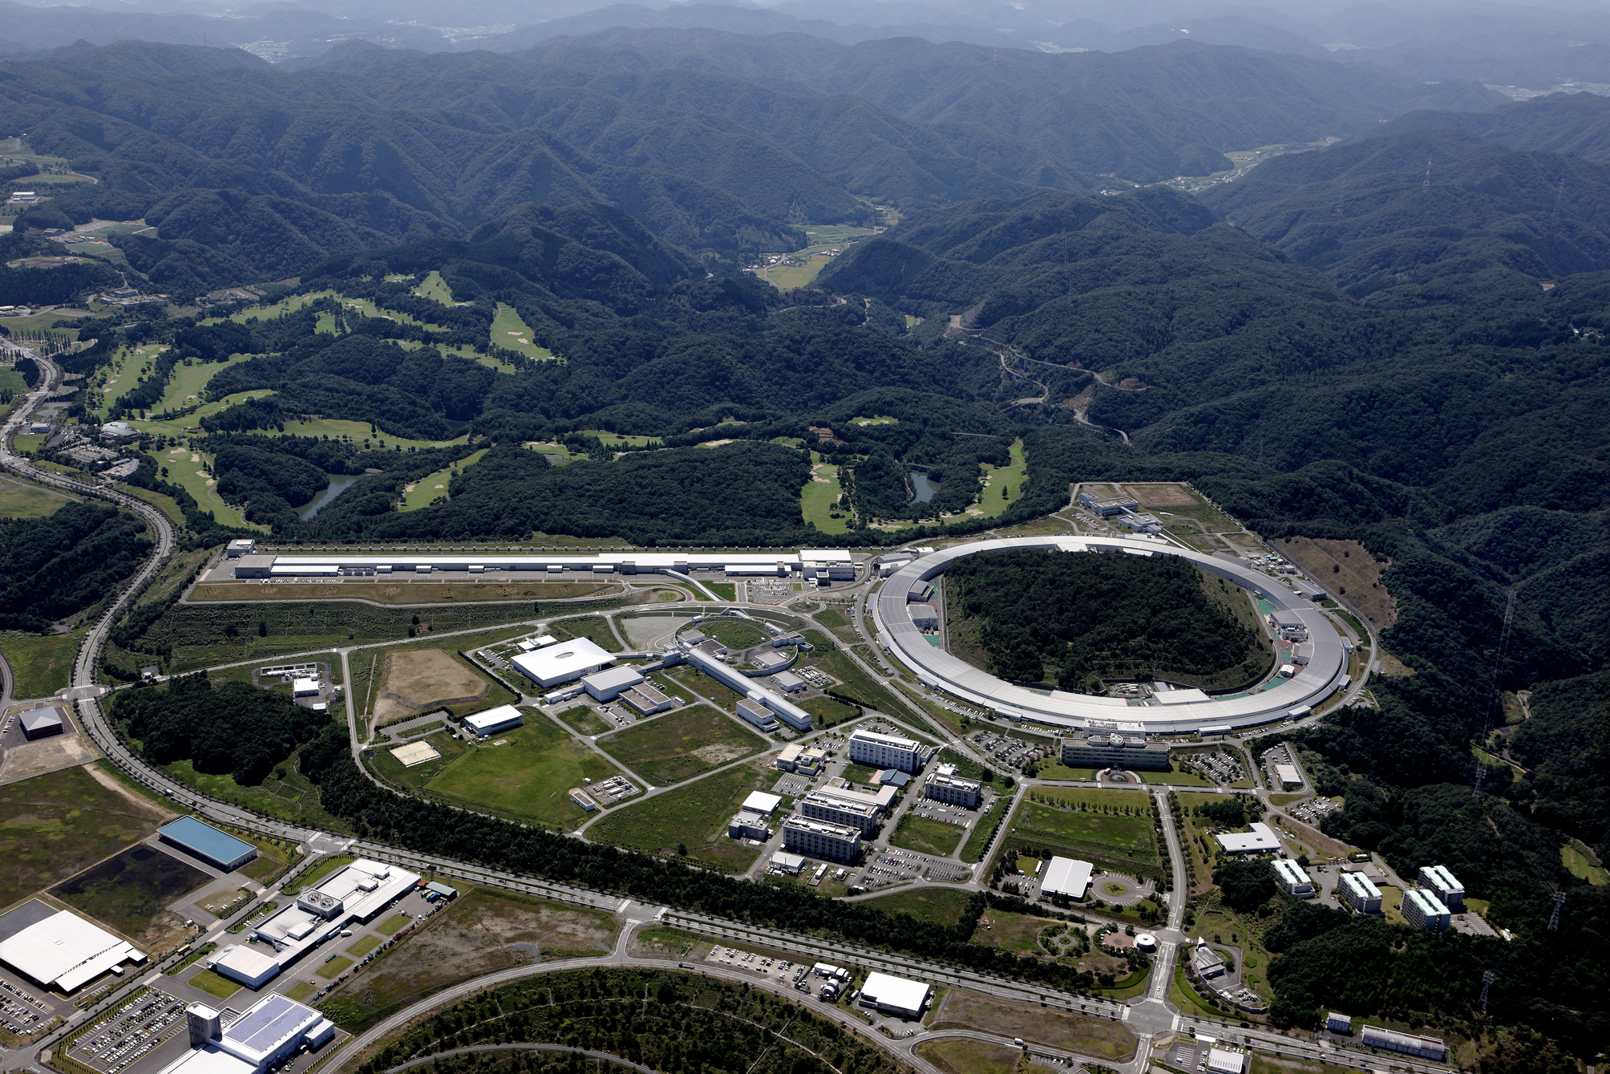
Some Thoughts on Storage Ring RF System for the Advanced Photon Source Upgrade (APS-U)
A. Nassiri
^{Accelerator Systems Division}
^{Advanced Photon Source}
^{Contributions:}
D. Horan, T. Berenc, G. Waldschmidt,
M. Borland, Y. Sun, M. Kelly(PHY),and S-H. Kim(PHY)
22 June 2016
9th CW and High Average Power RF Workshop
21 June – 24 June, 2016
Grenoble, France

Slide 2
Outline
Present APS Storage Ring RF Configuration and Performance
Toward 4th-Gen sources
Motivation for APS-U
APS-U RF systems considerations
Low Frequency RF System Alternative
Summary

Slide 3
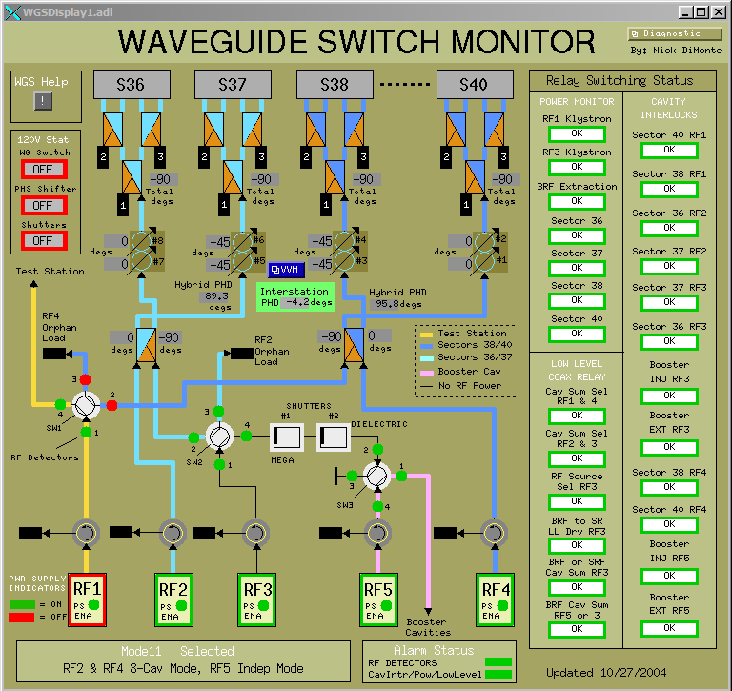
Present configuration and performance - HLRF
Five klystron-based 1.1MW cw rf systems
Four for Storage Ring, one for Booster
Waveguide Switching System provides rf system redundancy
Present Storage Ring operation at 100mA requires two rf systems operating at ≈ 650kW each
Parallel-klystron mode available for stored beam greater than 150mA

Slide 4
Present configuration and performance - Klystrons
In operation
Spares
System | S/N | Filament Hours
RF1 | TH089043 | 38,217
RF2 | TH089033(rebuilt) | 189 ( new install)
RF3 | TH089048 | 13,569
RF4 | TH089030 | 71,276
RF5 (booster) | TH089029 (rebuilt) | 11,030
Type | Quantity | Filament Hours
Thales (new) | 2 | 200
Thales (rebuilt) | 1 | 200
E2V | 2 | LANL

Slide 5
Present configuration and performance - Statistics
SR RF Sub-System Faults (FY2013-present)
Includes rf1 matching transformer failure
25
20
15
Klystron sideband instabilities
Uses downtime (hours)
10
5
Klystron
Waveguide arc
Klystron HVPS system
Cavity vacuum
LLRF
Interlocks

Slide 6
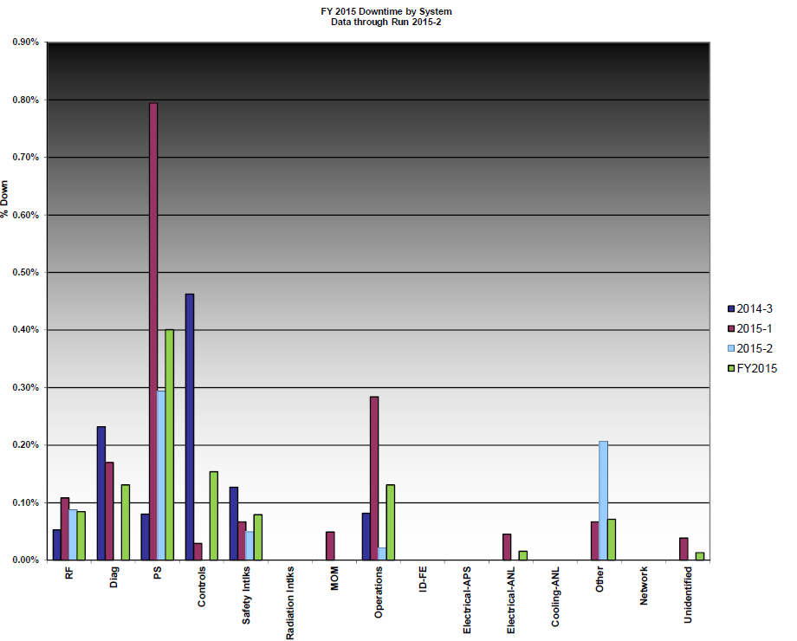
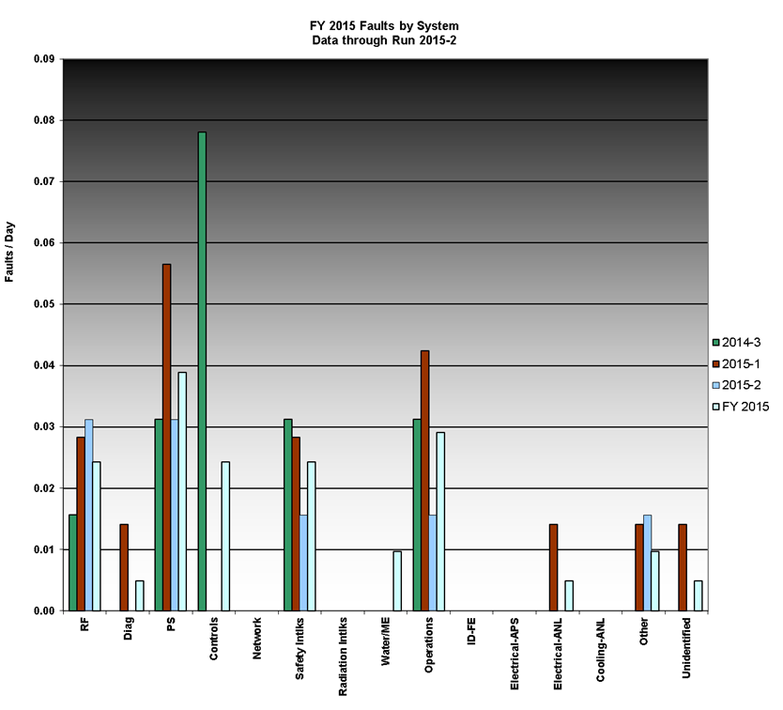
Run Statistics
FY2015 DT by System through run 2015-2
0.1%
FY2015 faults by System through run 2015-2
0.03%

Slide 7
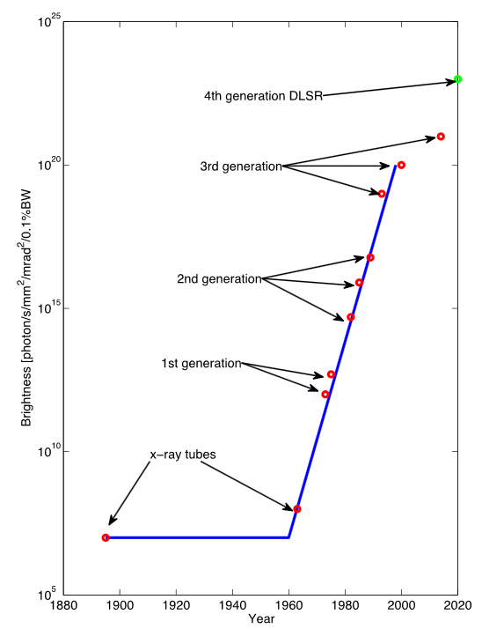
Toward DLSR
Revolutionary increase in storage ring brightness by a factor of 1000 has been proposed and is now being proposed, planned, or under construction at facilities around the world
Lower-energy SR
  Ground-breaking 3 GeV MAX-IV utilizing MBA (7BA) 500 mA, 230 pm x 8 pm
  SIRIUS (Brazil) 3GeV 5BA with super-bend, 500 mA, 280 pm x 8 pm
High-energy SR
  ESRF-EBS ( 1st MBA ring upgrade)
    6 GeV 7BA-EBS
    200 mA, ε_{x}= 135 pm ε_{y}= 3 pm
  APS-U
    6 GeV 7BA
    200 mA, ε_{x}= 67 pm, ε_{x}= 41 pm ε_{y}= 8 pm
  SPring-8-II
    6 GeV 5 BA
    100 mA, ε_{x}= 149 pm

Slide 8
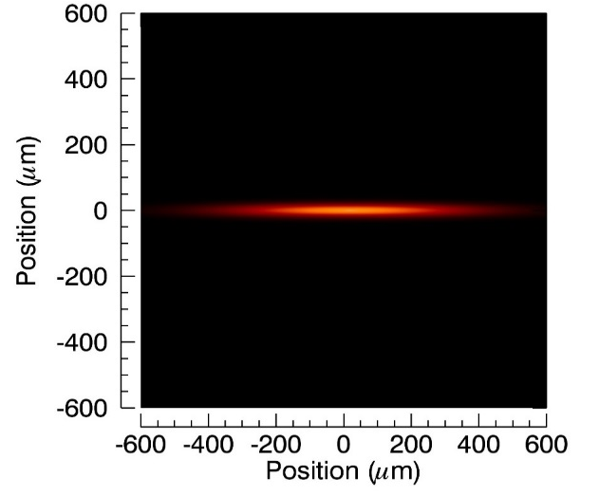
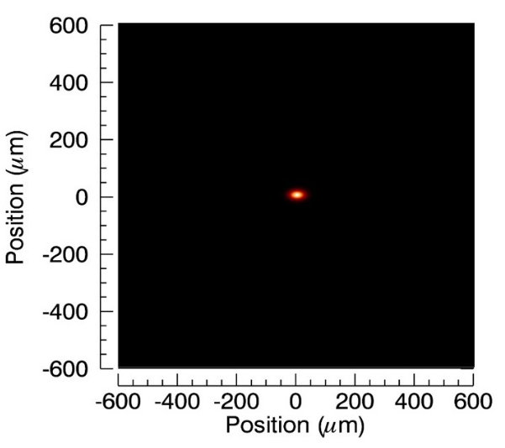
Motivation for APS-U
APS Today
APS Upgrade
Build the world’s leading high-brightness hard x-ray synchrotron facility
The APS Upgrade is a next-generation facility:
  Optimized for hard x-rays
  Incorporating advanced beamlines, optics and detectors
  ‘Round’ source ideal for imaging
APS-U exceeds the capabilities of today’s storage rings by 2 to 3 orders of magnitude in
  Brightness, coherent flux, nano-focused flux
Technical Features
6 GeV storage ring, 200 mA, swap-out injection
Circumference 1100 m
Multi-bend achromat (7 bend) lattice
High-brightness, ultra-low emittance: ε_{x} < 75 pm goal
Diffraction limited vertical emittance to 15 keV, horizontal emittance to 2 keV
35 ID straight sections with >60 operating beamlines
Flexible operation: High-brightness and timing modes, round and flat beams

Slide 9
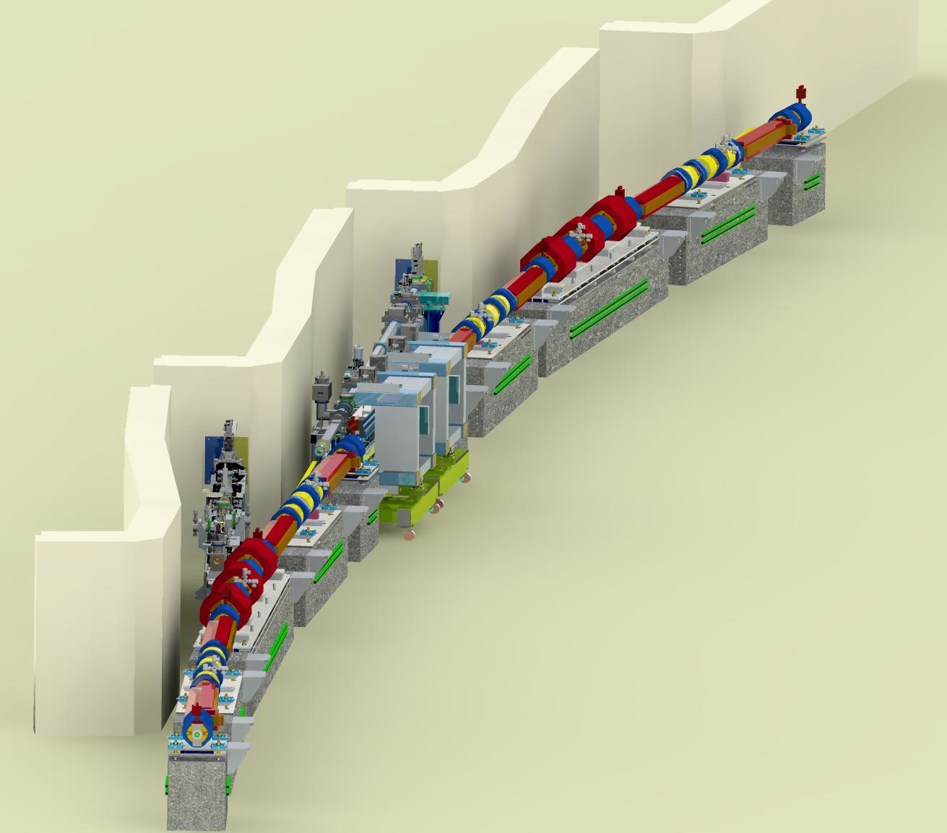
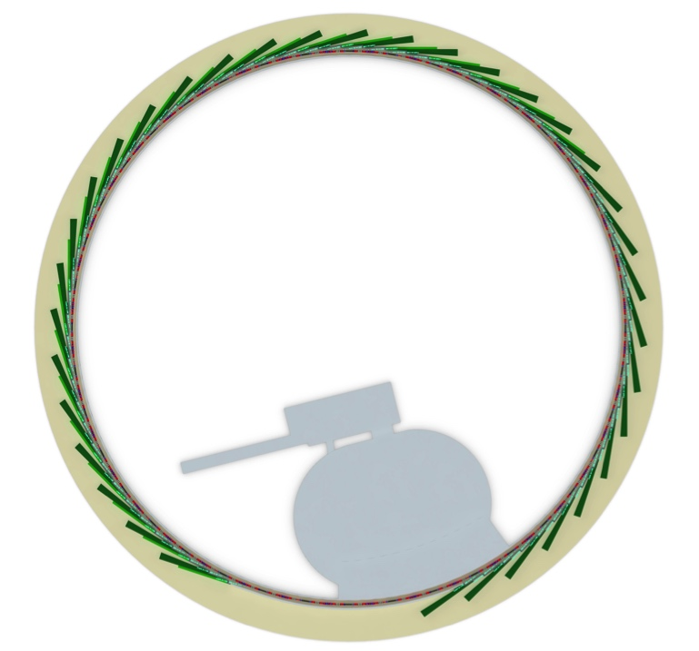
APS-U Scope
SR, IDs, FEs
New Storage Ring
6 GeV MBA lattice
200 mA current
Improved electron/photon stability
New Insertion Devices
Incorporate SCUs on selected beamlines
New/upgraded Front-ends
Common design for maximum flexibility
Injector improvements
Increase performance beyond present capability

Slide 10
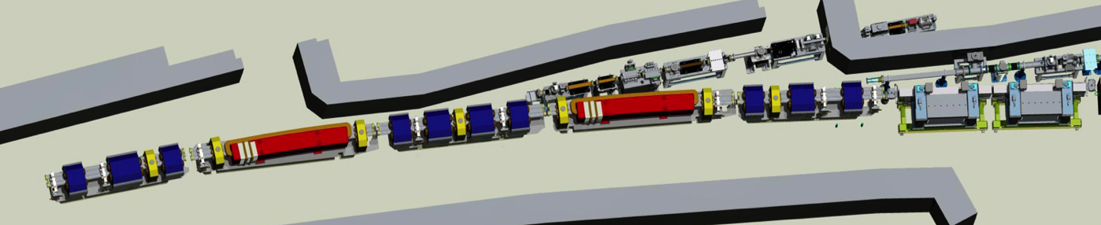

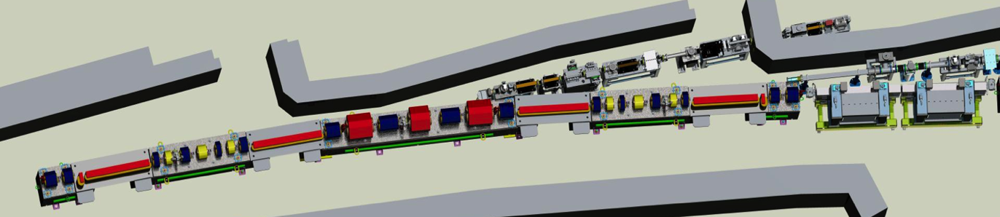
Multi-Bend Achromat Lattice
APS today – Double Bend Lattice
~50-fold reduction in horizontal emittance
Future APS with Multi-Bend Lattice
E = Beam energy (E = 6 GeV for APS MBA)
N_{d} = Number of dipoles per sector (N_{d} = 7 for APS MBA)

Slide 11
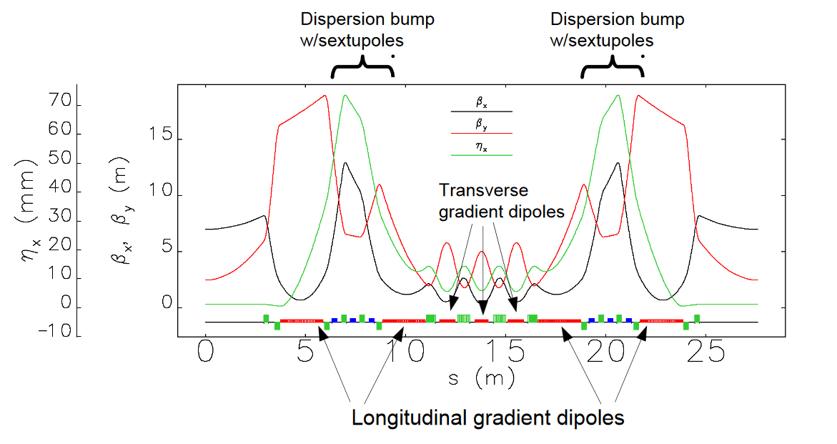
67-pm Hybrid 7BA Lattice Concept
Inspired by ESRF-EBS design*
Phase advance of Δϕ_{x} = 3π and Δϕ_{y} = π between corresponding sextupoles chosen to cancel geometrical sextupole kicks
Thick, interleaved sextupoles:
  Imperfect cancellation
M. Borland/Y. Sun , APS/ANL
*L. Farvacque et al., IPAC13

Slide 12
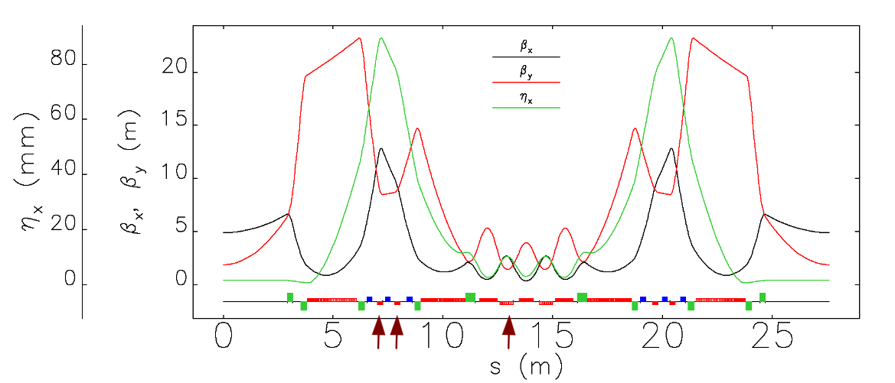
41-pm lattice with reverse bends
Reverse bends in Q4,Q5, and Q8
Emittance reduced from 67 pm to 41 pm
Max η_{x} from 74 mm to 90 mm
Weaker sextupole magnets
M. Borland/Y. Sun , APS/ANL

Slide 13
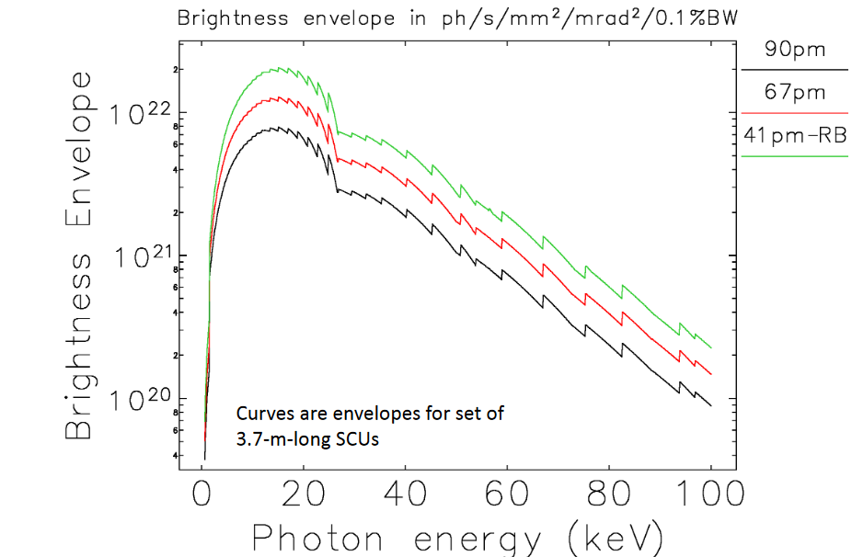
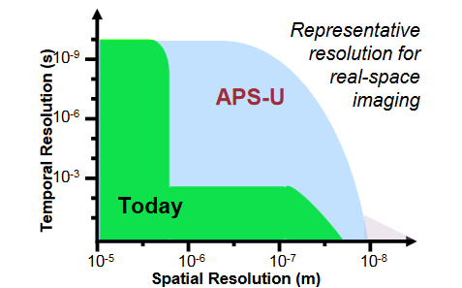
Brightness comparison for 324 bunch mode
Additional improvement (about 2-fold) possible with flat beam (κ=0.1)
90-pm is no longer an option due to lower brightness
M. Borland/Y. Sun , APS/ANL

Slide 14
APS-U Technical Performance Summary
For 67 pm lattice
 | APS-U Timing Mode | APS-U Brightness Mode | APS Now | Units
Beam Energy | 6 | 6 | 7 | GeV
Beam Current | 200 | 200 | 100 | mA
Number of Bunches | 48 | 324 | 24
Effective Emittance | 47 | 68 | 3100 | pm-rad
Emittance Ratio | 1 | 0.1 | 0.13
Horizontal Beam Size (rms) | 18.2 | 21.8 | 274 | μm
Horizontal Divergence (rms) | 2.6 | 3.1 | 11.3 | μrad
Vertical Beam Size (rms) | 10.8 | 4.1 | 10.8 | μm
Vertical Divergence (rms) | 4.4 | 1.7 | 3.7 | μrad
Brightness - 20 keV | 90 | 203 | 0.6 | (*)
Pinhole Flux - 20 keV | 185 | 211 | 20.1 | (#)
Coherent Flux - 20 keV | 87 | 195 | 0.6 | 10¹¹ photons/sec
Single-Bunch brightness - 20 keV | 188 | 63 | 2.6 | (&)
(*) 10²⁰ photons/sec/0.1%BW/mm²/mrad²
(#) 10¹³ photons/sec in 0.5x0.5 mm² pinhole at 30 m
(&) 10¹⁸ photons/sec/0.1%BW/mm²/mrad²

Slide 15
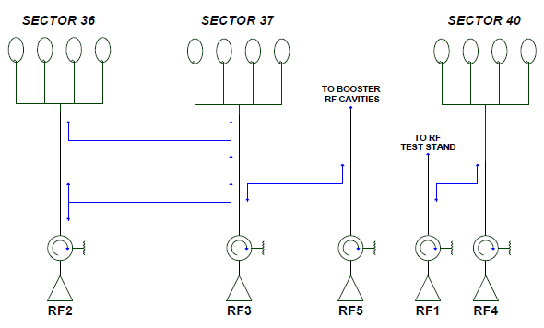
APS-U RF System Considerations
HHC
Sector 38 rf cavities removed -- nominal operation with twelve cavities at
≈ 90kW/cavity to support 200mA stored beam
Operation on eight cavities possible at higher cavity power
“Hot-standby” rf stations preserved
RF3 switchable to power booster

Slide 16
APS-U RF System Considerations- Performance Parameters
Parameter | Unit | 352 MHz RF System
Beam Energy | GeV | 6
Beam current | mA | 200
Momentum compaction |  | 5.66 ×10⁻⁵
Δf_{rf} /f_{rf} |  | - 3.55 × 10⁻⁵
Synchrotron frequency | kHz | 0.7
Accelerating voltage (±4% BHH with HHC) | MV | 5.53
Energy loss per turn with IDs (67 pm) | MeV | 3.57
rf bucket half-height | % | 4
Cavity quality factor unloaded |  | 48,000
Q_{ext} |  | 11.3 × 10³
Q_{L} |  | 9.1 × 10³
3dB ½-BW | KHz | 10.3
R/Q | Ω | 226.7
R_{s} | MΩ | 10.88
E_{p} @1MV | MV/m | 9.7
Cavity nominal accelerating voltage | MV | 0.461
Number of cavities |  | 12
Harmonic number |  | 1296
Beam power/cavity ( includes losses to HHC) | kW | 63.2
Wall power/cavity | kW | 19.5
Gen. power/cavity | kW | 82.7
Total required power ( 15% overhead, 10% loss) | kW | 1240

Slide 17
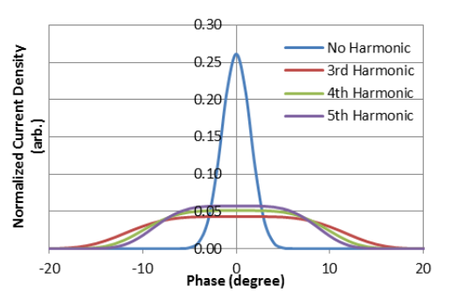
Motivation for Higher Harmonic Cavity*
A number of collective effects foreseen to present challenges to APS-U
  Intra-beam scattering
  Touschek scattering
  Single-bunch collective instabilities
  Multi-bunch collective instabilities
SB effects can be mitigated by lengthening the bunch
  Reduces electron density
  Reduces peak current
  Narrows frequency spectrum
Harmonic cavity allows effective bunch-lengthening
  Bunch-lengthening using a higher harmonic cavity (HHC) can help
  Optimized 4th harmonic HHC increases rms bunch duration from 12.3 to 50 ps
  Naively expect ~4-fold reduction in IBS and Touschek rates
*M. Borland, ANL/APS

Slide 18
HHC Parameters*
 | Parameter | Symbol | Unit | Value
 | Operating Temperature | T | K | 2.1 or 4.3
 | R/Q | r/Q | Ohm | 104
 | Cavity Quality Factor (2.1 K, 4.3K) | Q₀ |  | 1x10¹⁰, 2x10⁸
 | External Q range | Q_{ext} |  | 2x10⁵-2x10⁷
 | Detuning Frequency | Δf_{r} | kHz | 13.5
 | Q_{L} nominal | Q_{L} |  | 6x10⁵
 | Cavity Resonant Frequency | f_{r} | MHz | 1407.8
 | Beam-Induced Voltage | V_{b} | MV | 1.1
 | Detuning angle | ψ_{h} | degrees | 85.0
 | Cavity Loaded Bandwidth | Δf_{BW} | kHz | 2.35
 | Beam Loss Power (nominal Q_{L}=6x10⁵) | P_{b} | kW | 12.8
 | Cavity Wall Loss Power (2.1 K, 4.3K) | P_{wall} | W | 1, 58
 | Peak Surface Electric Field | E_{peak} | MV/m | 21
 | Peak Surface Magnetic Field | B_{peak} | mT | 43
Courtesy of M. Kelly PHY/ANL

Slide 19
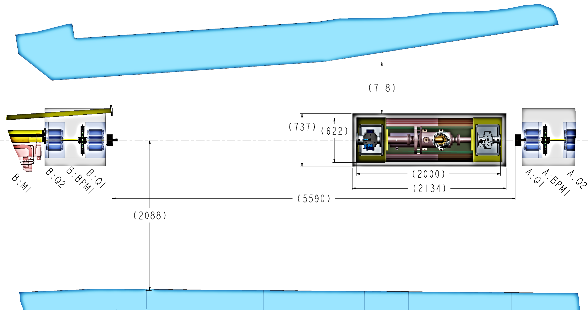
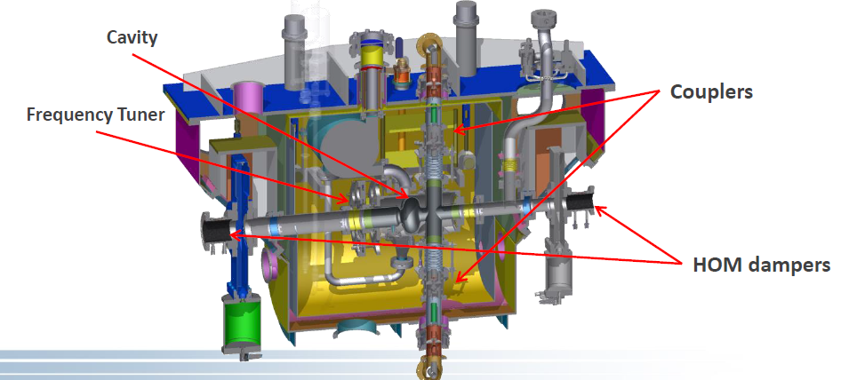
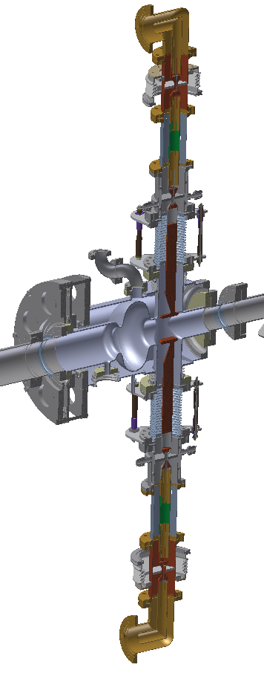
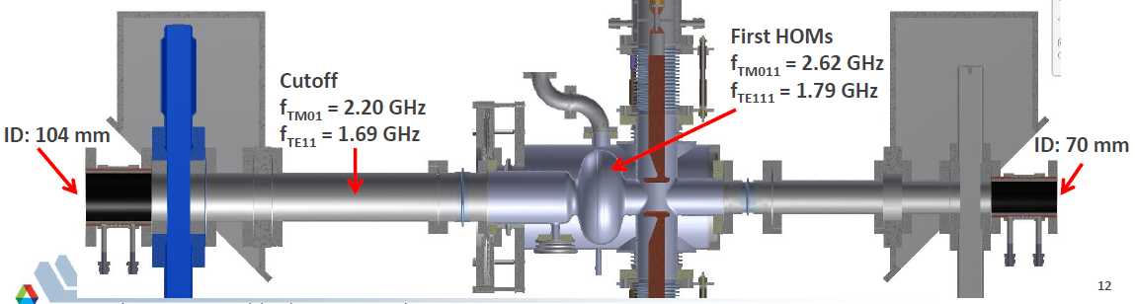
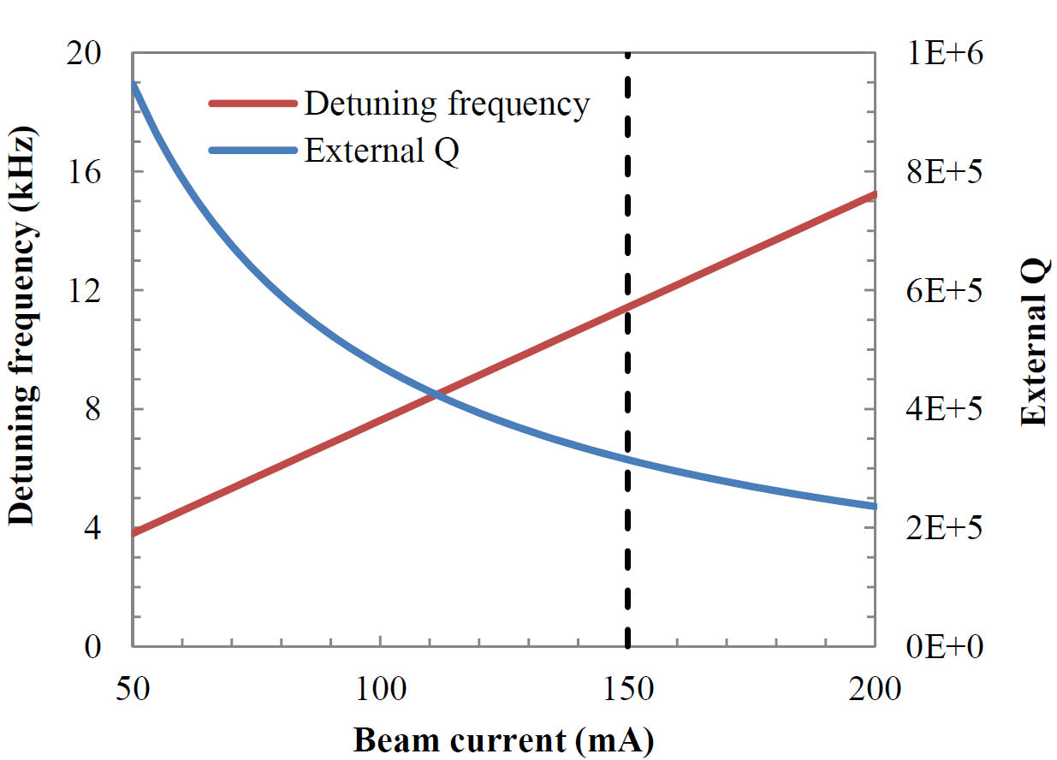
HHC Cryomodule
Harmonic
Cavity
Pneumatic Slow
Tuner
Variable RF
Power Coupler
Courtesy of M. Kelly PHY/ANL
19

Slide 20
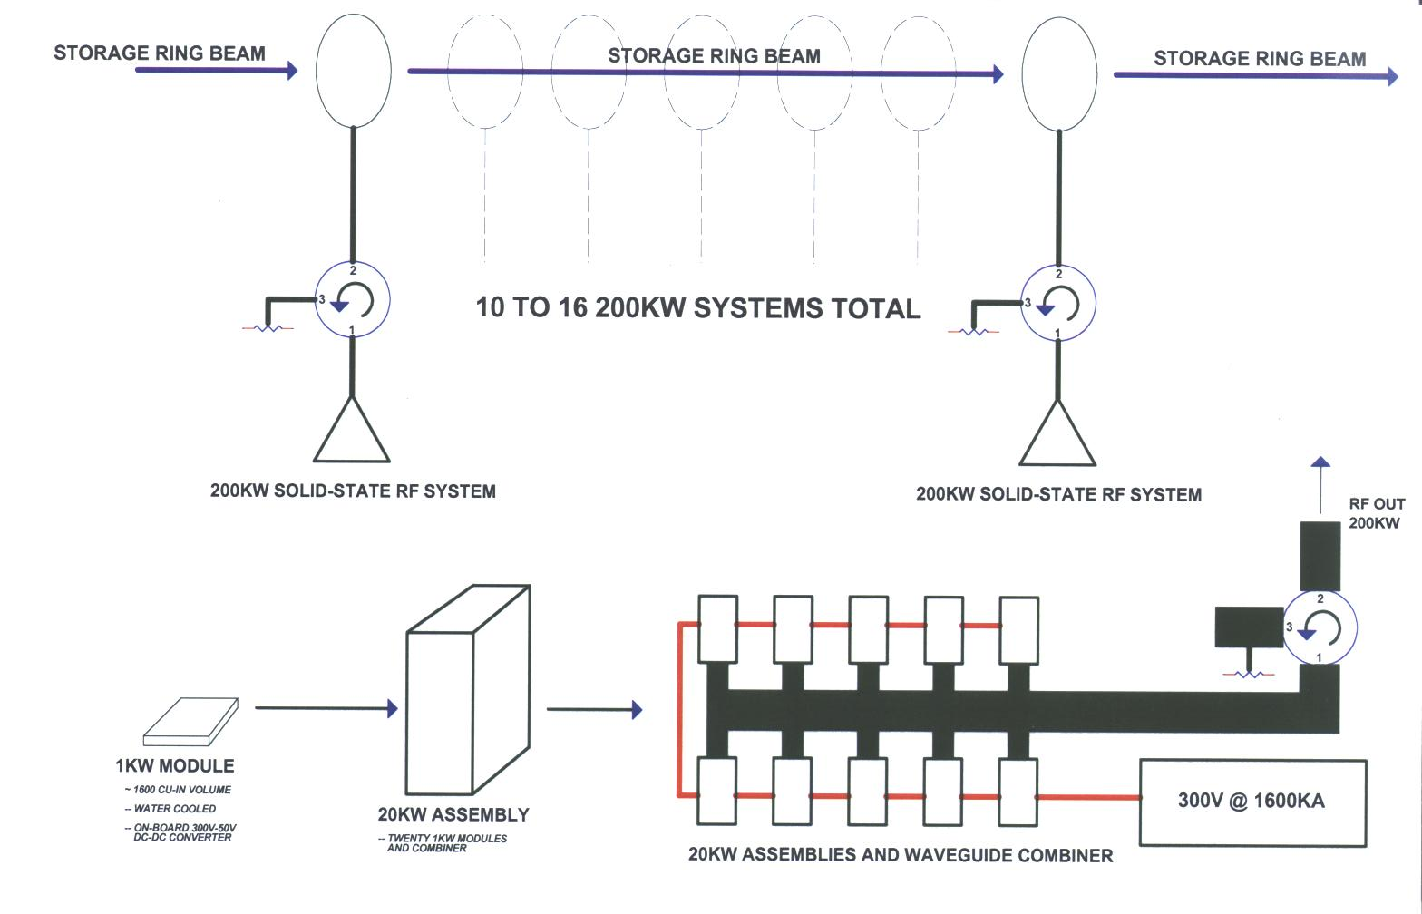
Long-Term APS RF System option
Replace present klystrons with modern solid-state rf amplifier systems
  Eliminates reliance on klystrons and HVPS upgrades

Slide 21
Long-Term APS RF System option, cont.
Implement a flexible digital LLRF system
  Substantial changes in the design are possible by changing program routines without affecting the hardware
  With digital LLRF, amplitude and phase stabilities better that 0.1% and 0.1°areacheivable.
From operation perspectives, we will pursue that digital LLRF in lieu of upgrading our analog electronics
  Address obsolescence issues
  Reduces maintenance cost and repair/maintenance effort
  It is more cost effective
  Would provide more RF control flexibility, better detection, and diagnostics capabilities
  We are evaluating next generation chassis platforms with COTS products
    Flexibility in product choices and expansion over 20+ year lifetime after APS-U
    Flexibility in reconfiguring the system while driving the car (e.g., transitioning from klystron to solid-state)
    Would like to standardize across all our RF systems

Slide 22
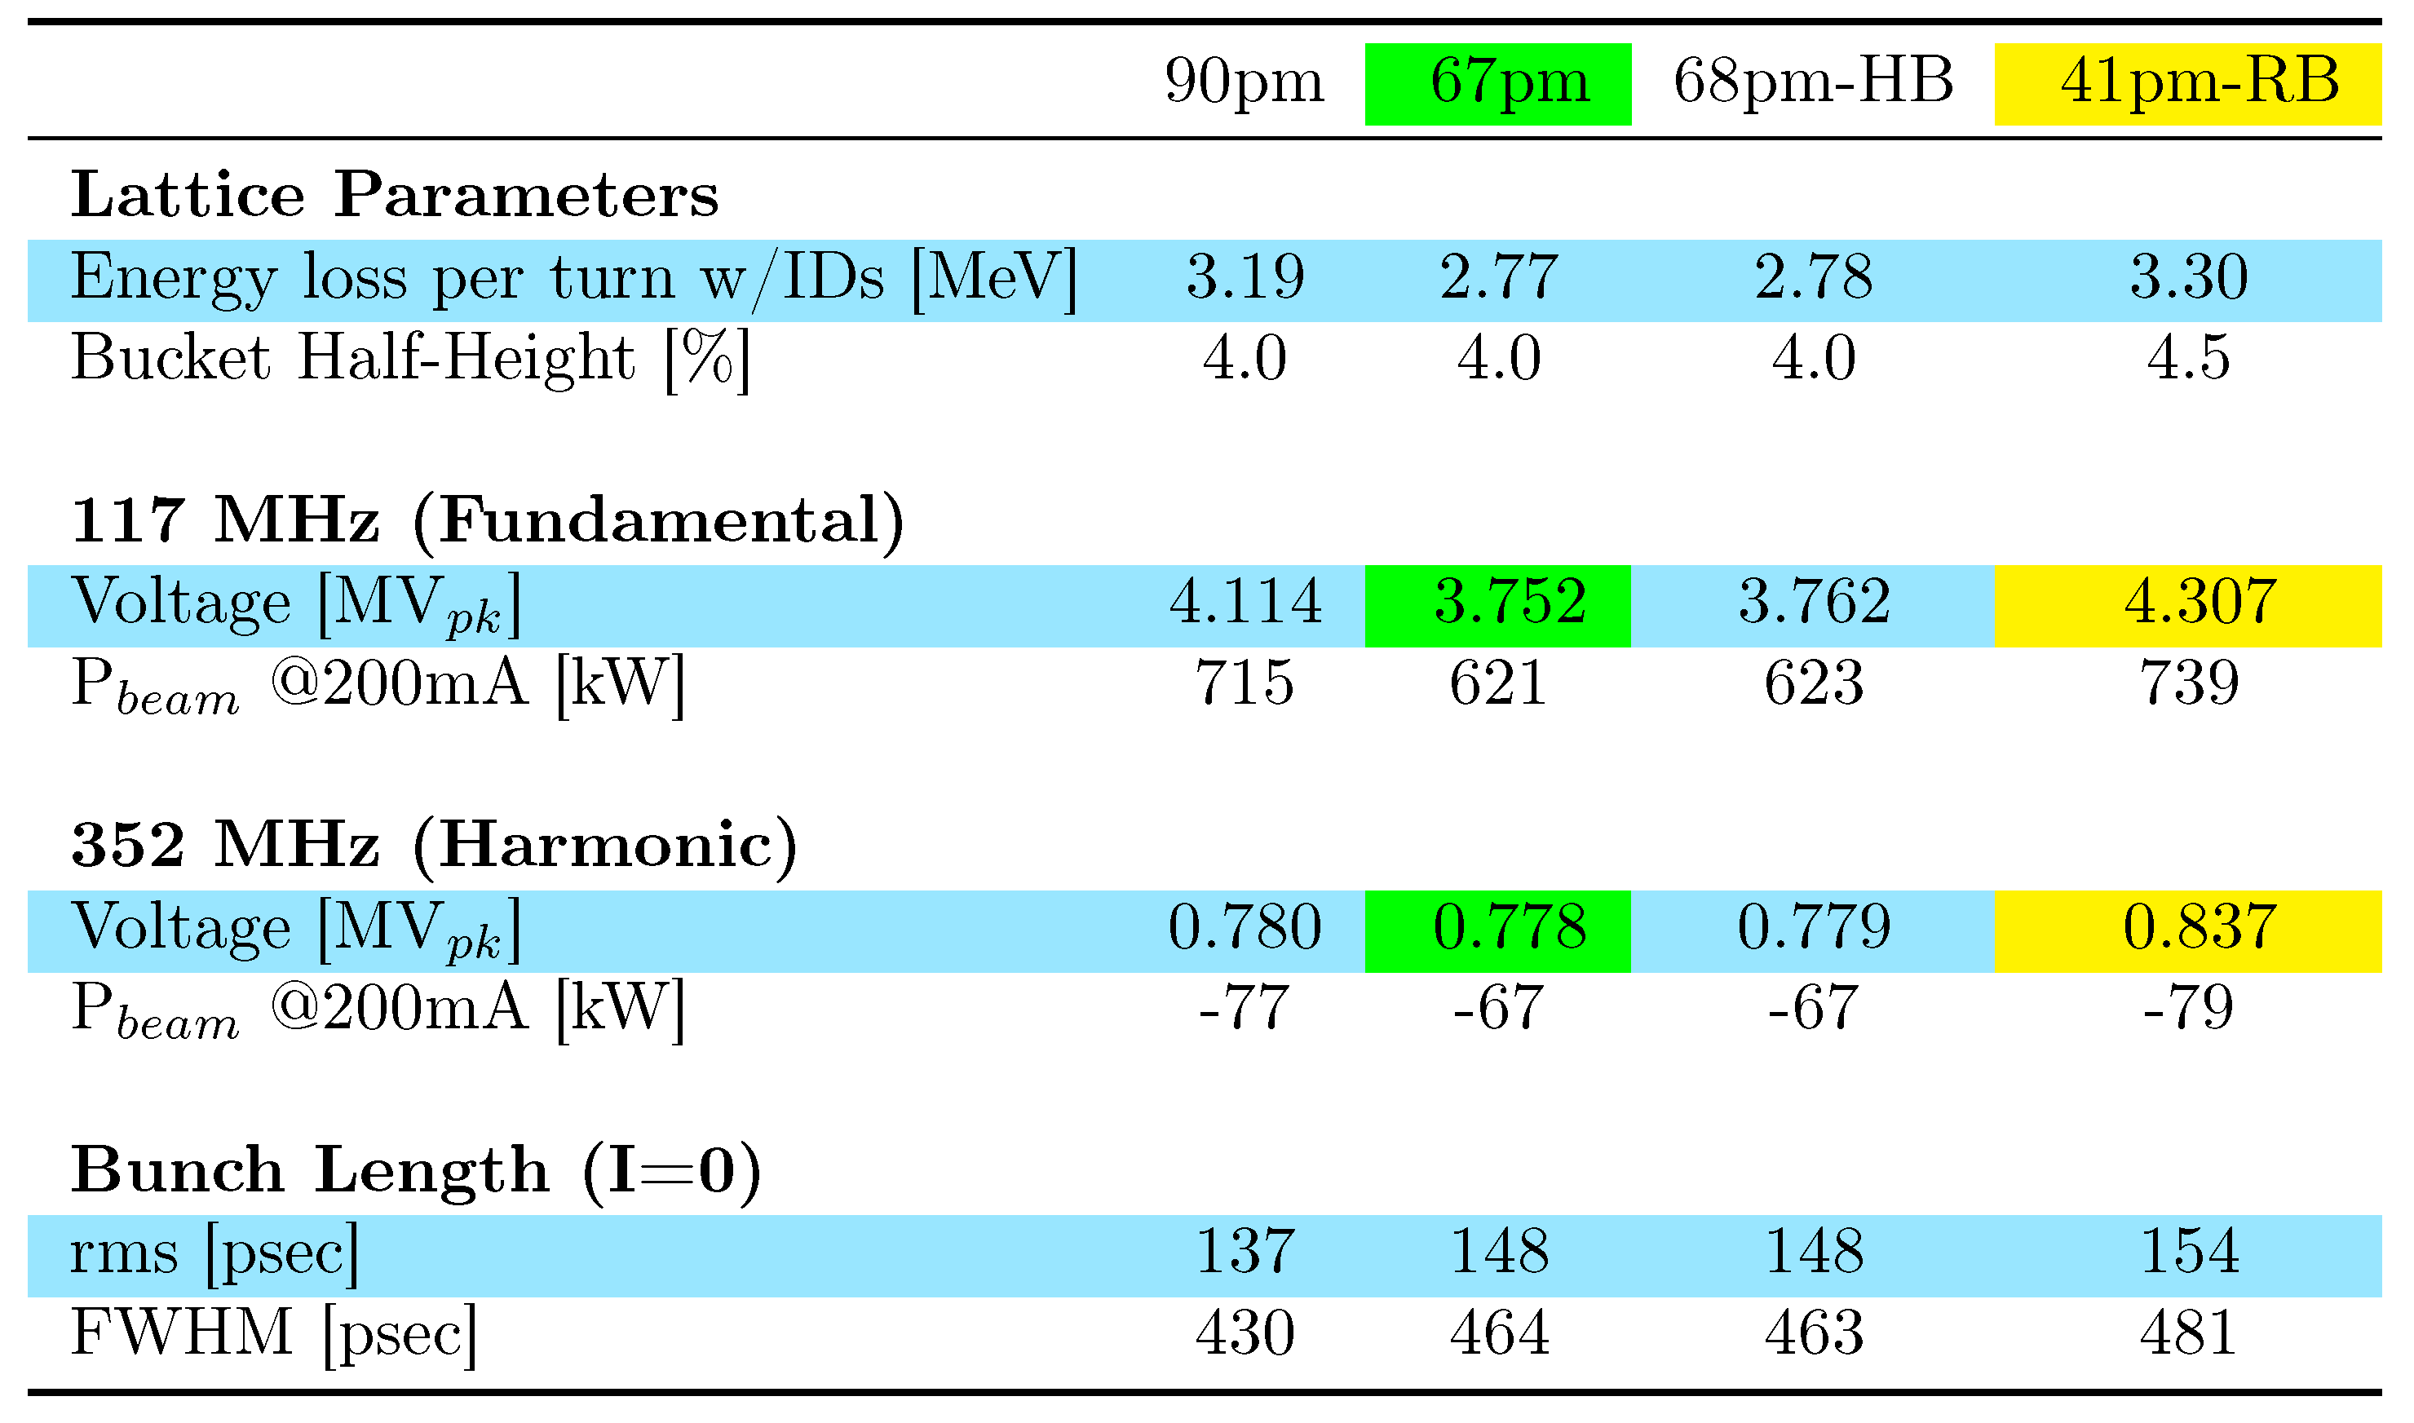
Lower Frequency RF System Alternative
Explored both 88- and 117-MHz RF systems

Slide 23
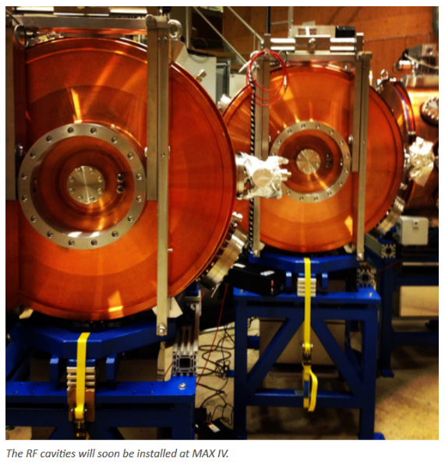
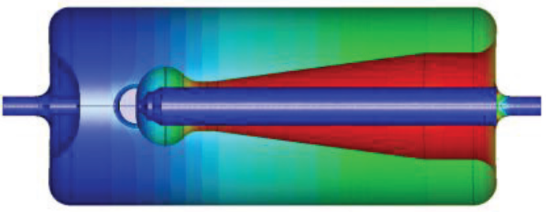
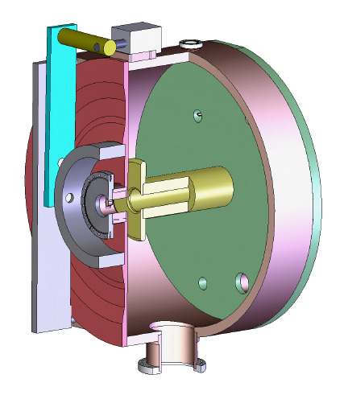
Cavity Options
We reviewed various options ^{[1],[2]} :
  MAX-IV QWR [quarter-wave resonator, normal conducting]
    Voltage limited, but offers an operational design to leverage from
  Symmetric reentrant cavity [normal conducting]
    Improved shunt impedance and peak fields over QWR, but longer cavity
    conceptual design, would require extensive R&D thus is a higher risk
  Superconducting QWR
    Beam power is 620 kW (67pm) to 740 kW (41pm-RB) therefore reduction in number of cavities is limited to input coupler design
    SRF technology increases complexity and risk
    Also only at conceptual design
MAX-IV QWR
Conceptual Reentrant Cavity
Conceptual SRF QWR
[1] AOP-TN-2017-038, Nov. 2015
[2] RF-TN-2016-001, Jan. 2016
Courtesy of P. Tavares, MAX-IV

Slide 24
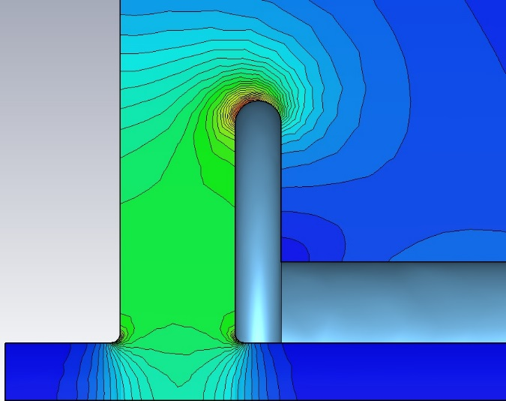
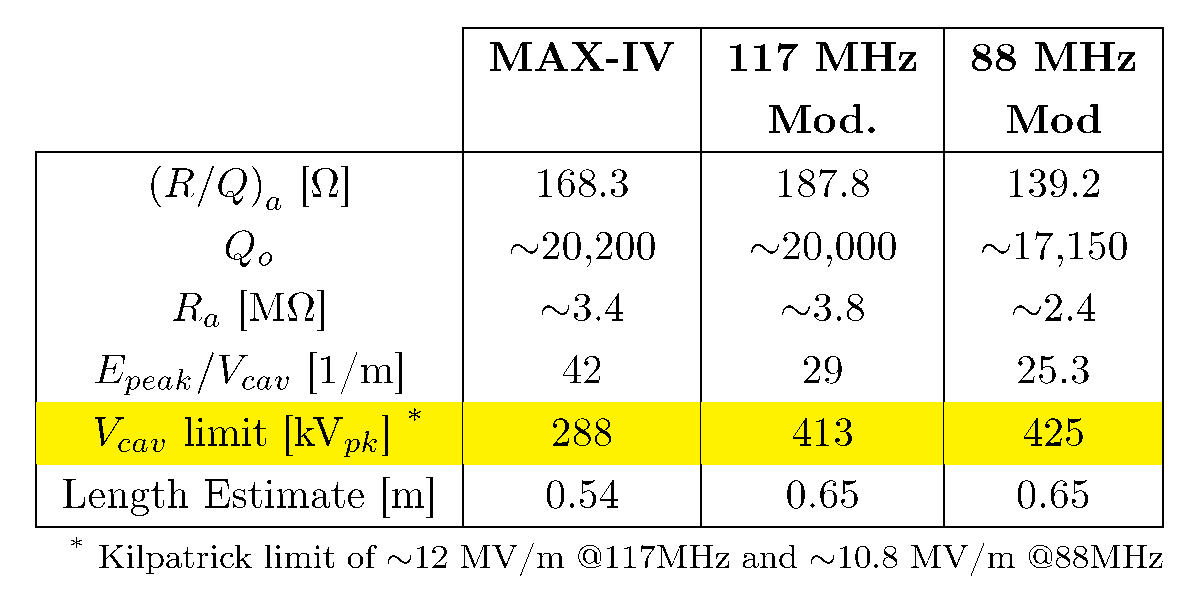
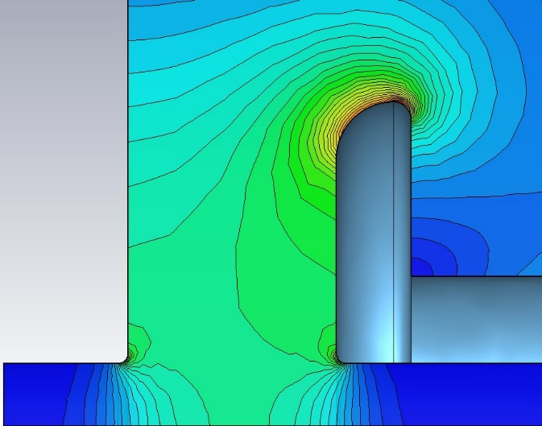
Cavity Options
The wise choice is to leverage off of the MAX-IV design
But need to modify for higher voltage to keep # of cavities reasonable
  Modified electrode shape and gap length
12.6 MV/m
@300kV
MAX-IV Gap
@300kV
8.7 MV/m
MAX-IV uses 6 cavities
  each at ~300kV, ~27kW wall loss
117 MHz Concept by Geoff Waldschmidt

Slide 25
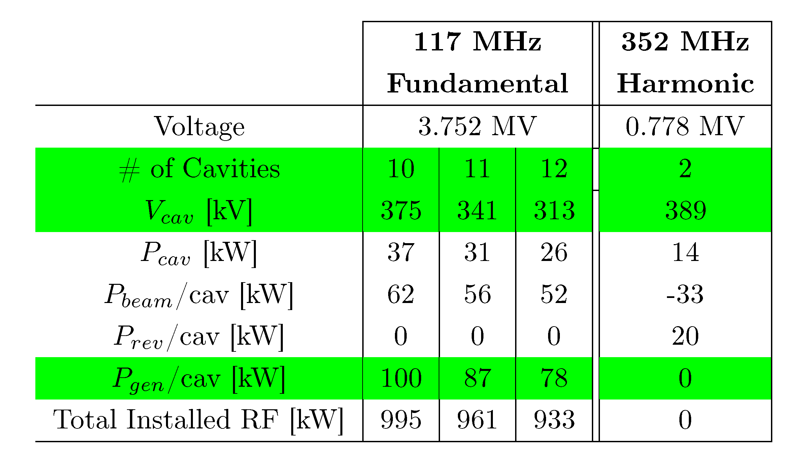
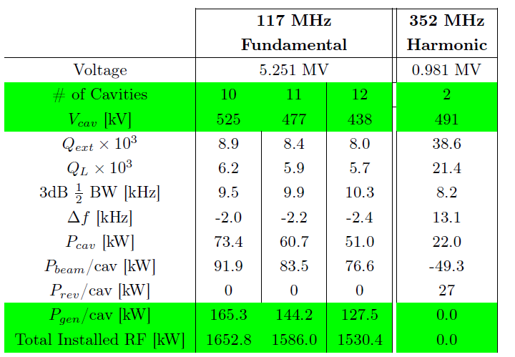
117MHz Power Requirements
67pm
41pm-RB

Slide 26
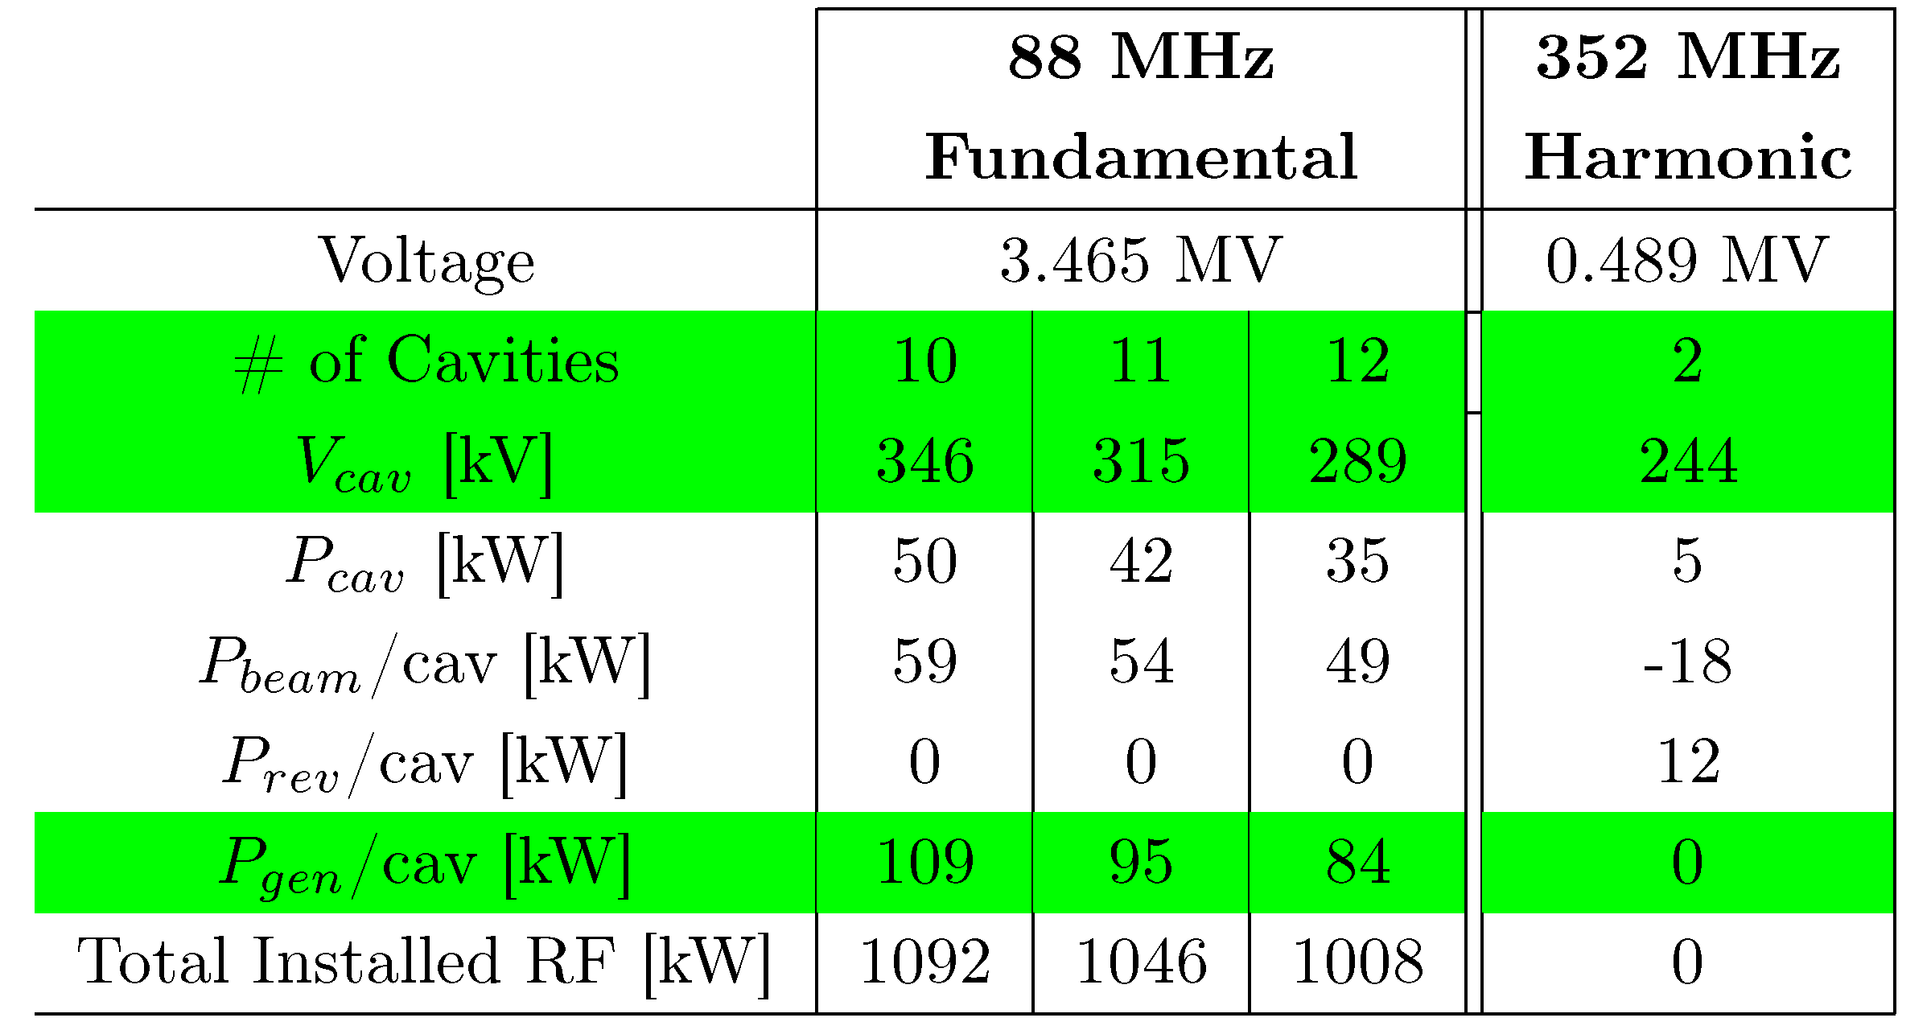
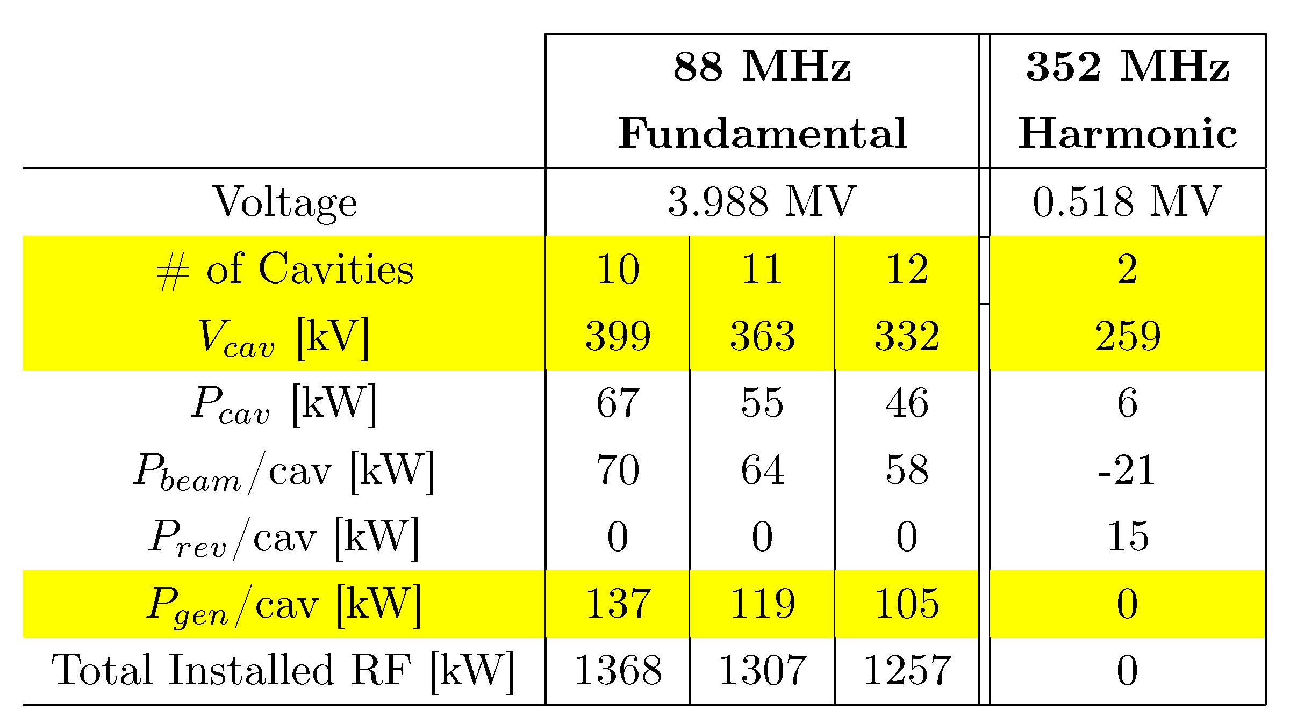
88 MHz Power Requirements
67pm
41pm-RB

Slide 27
Summary
We continue to have excellent operation statistics
  Record operation reliability statistics
    0.08% downtime and 988.0 hours mean-time-to-beam-loss
    Only four beam losses caused by rf over the entire year
  Two 352MHz klystrons reached 66k and 77k hours lifetime
    Nearly double the average expected lifetime
  Proactive maintenance
  Obsolescence issues are addressed
  Hardware improvements and upgrades when possible
For APS-U, 67-pm lattice design delivers ~100-fold increase in brightness for hard x-ray
  6 GeV close to optimal for hard x-ray performance
Passive bunch-lengthening cavity works will for 48- and 324-bunch modes
Several effects show benefit from bunch lengthening
  Intrabeam scattering effects significantly suppressed
  Detailed Touschek lifetime calculations confirm the beneficial effort
  Increase single-bunch instability thresholds
  Reduced energy spread and fluctuations
Long-term goal is to replace klystrons with SSAs

