Slide 1
High Power Model of Isolator
Rutambhara Yogi
www.europeanspallationsource.se
24 June 2016

Slide 2






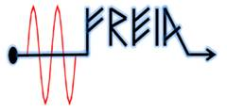


Many thanks to
Suppliers:
Colleagues:
ESS: Mats Lindroos, David McGinnis, Anders Sunnesson, Morten Jensen,
A. Johansson, Carlos Martins, Rihua Zeng, Rafael Montano, Chiara Marrelli,
Stevo Calic, Bruno Lagoguez, Staffan Ekström, Daniel Lundgreen, Carl Johan Hardh
FREIA: Rolf Wedberg, Lars Hermansson, Roger Ruber, Magnus Jobs & other colleagues
CERN: Eric Montesinos, Olivier Bruner
SNS: Crofford Mark

Slide 3
Outline
Brief introduction to ESS RF systems
Circulator
High power model of Isolator
Effect of hot water cooling

Slide 4
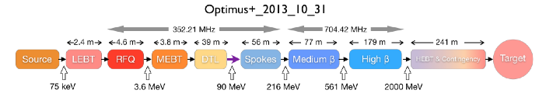
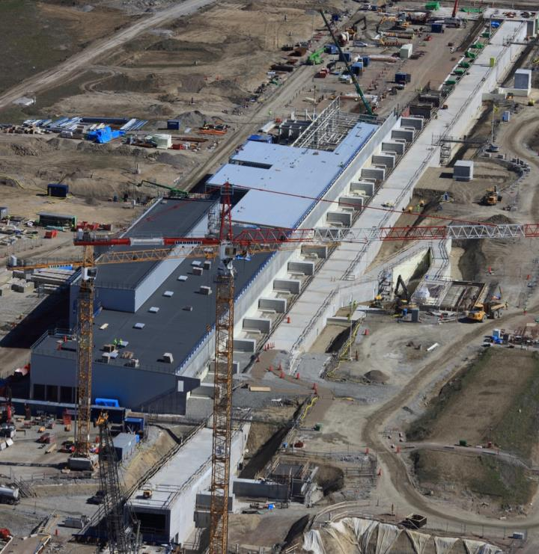
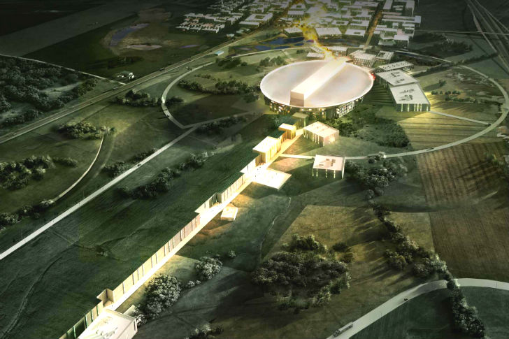
ESS: European Spallation Source
Beam pulse width = 2.86 ms
Pulse repetition rate = 14 Hz
Peak proton beam power to the target = 125MW
Most intense pulsed neutron source in the world : peak beam power larger by factor 5 compared to existing spallation facilities
Europe’s one of the largest infrastructure
Being constructed in Lund, Southern Sweden

Slide 5
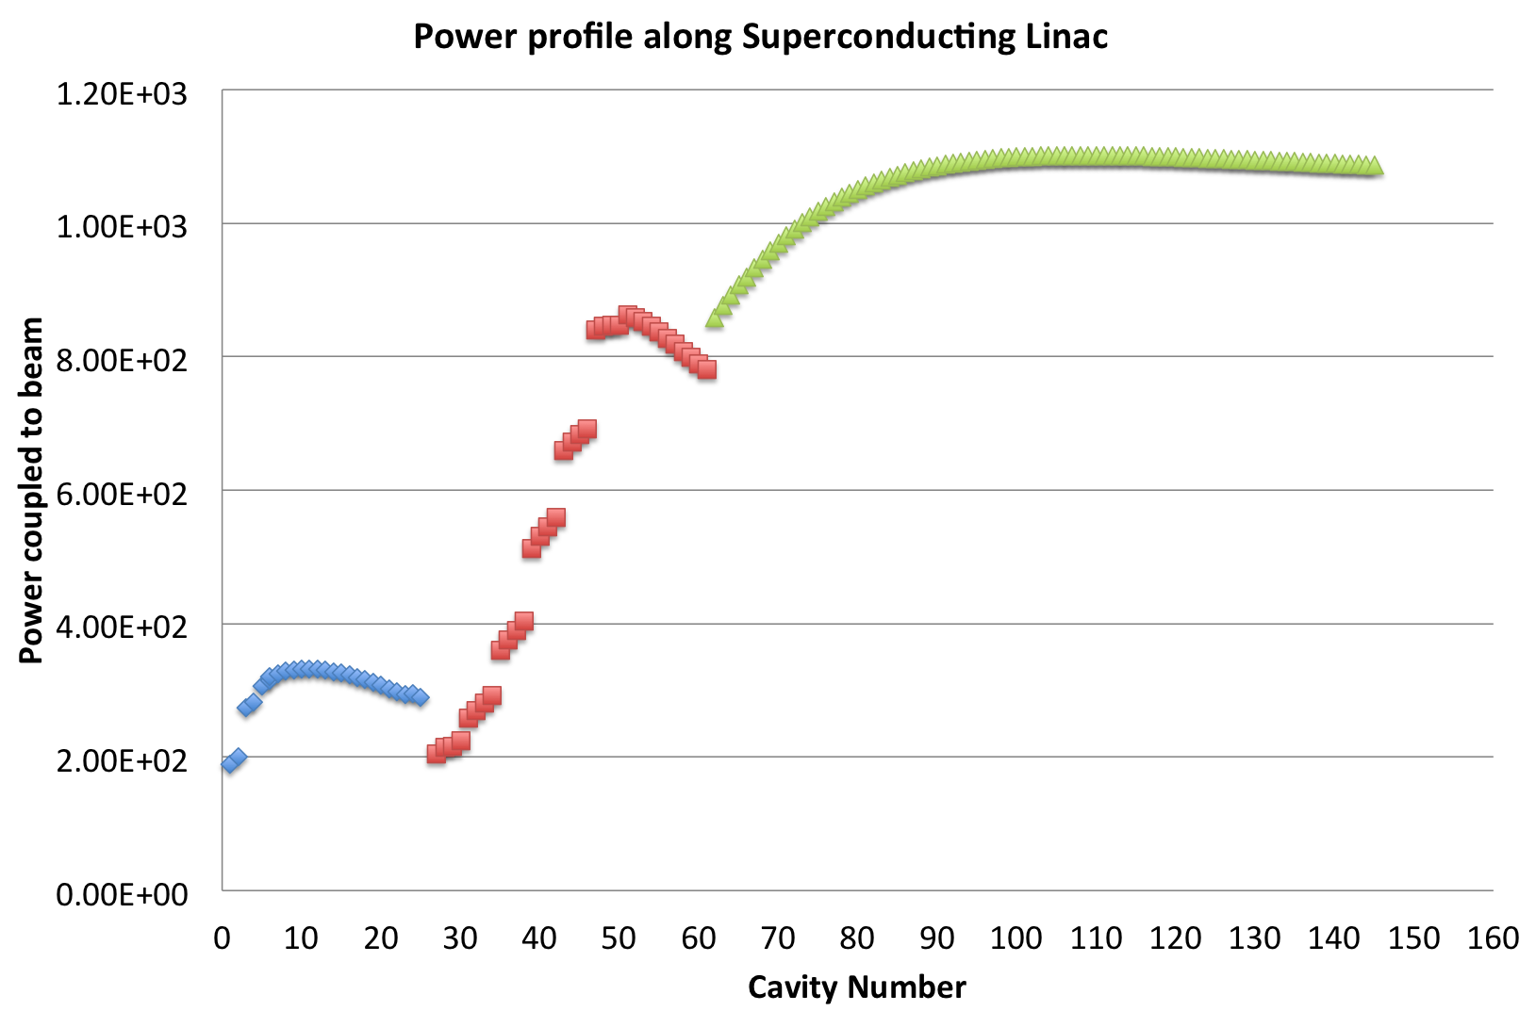
Power profile
1200 kWp*/60 kWavg
1200 kWp*/
60 kWavg
84 High Beta cavities
704 MHz
New development: IOT
Backup solution: Klystron
Coax upto circulator,
WR2300(hh )
26 Spoke Cavities,
352 MHz
400kWp*/20 kWavg
Tetrode
WR1150
36 Medium Beta cavities
704 MHz
1.5MWp Klystron
Warm Linac 352 MHz
-1 RFQ & 5 DTL:
Klystrons
3MWp* / 150 kWavg
WR1150
WR2300 FH,
WR2300 HH
1-5/8 inch
coax
- 3 MEBT
SSA
30kWp* / 1.5kWavg
*- Amplifier power with overhead

Slide 6
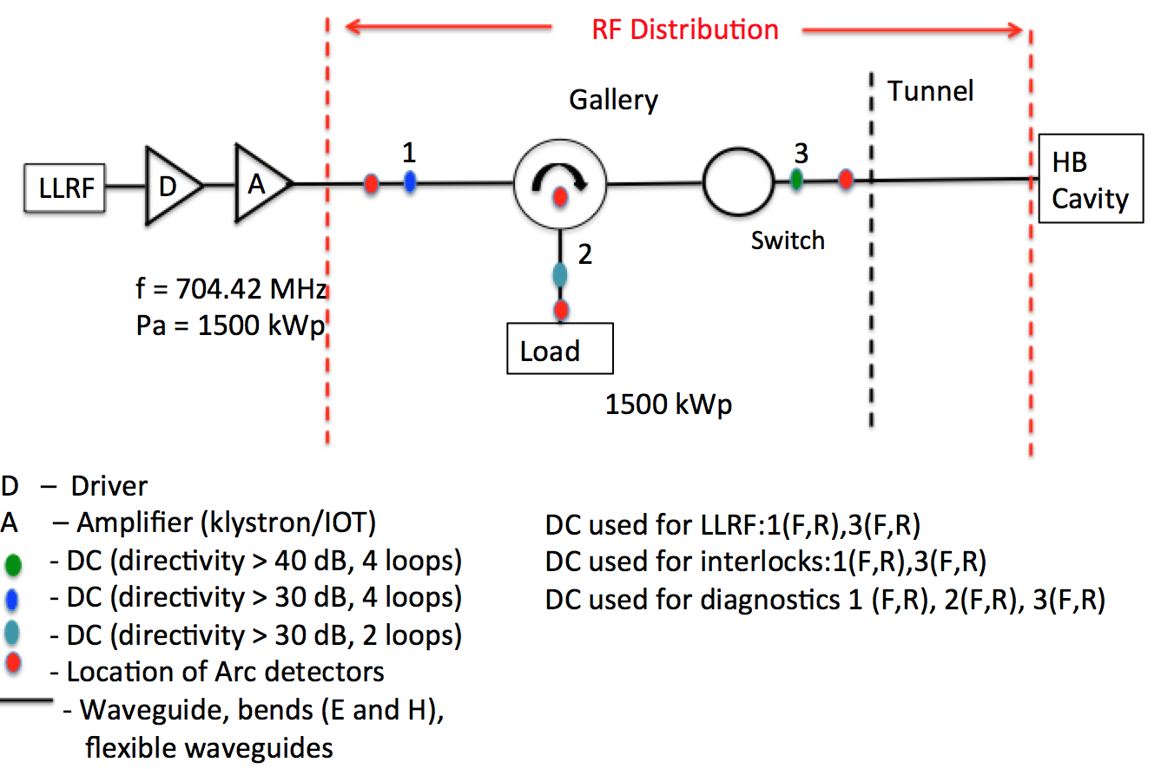
Schematic of RFDS for MB/HB

Slide 7
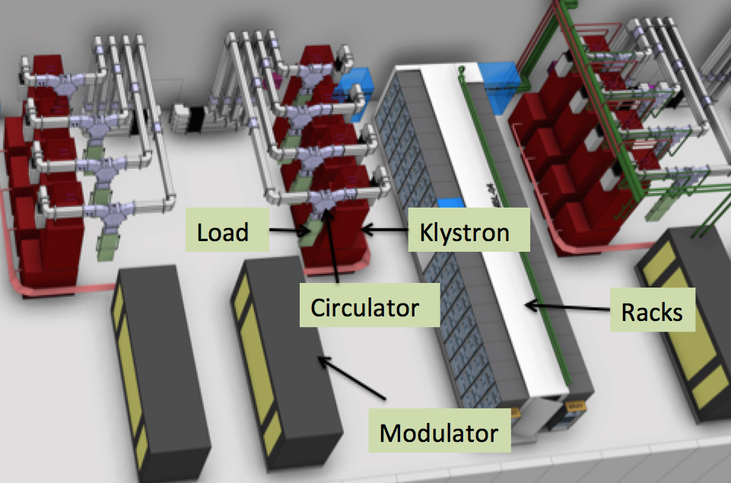
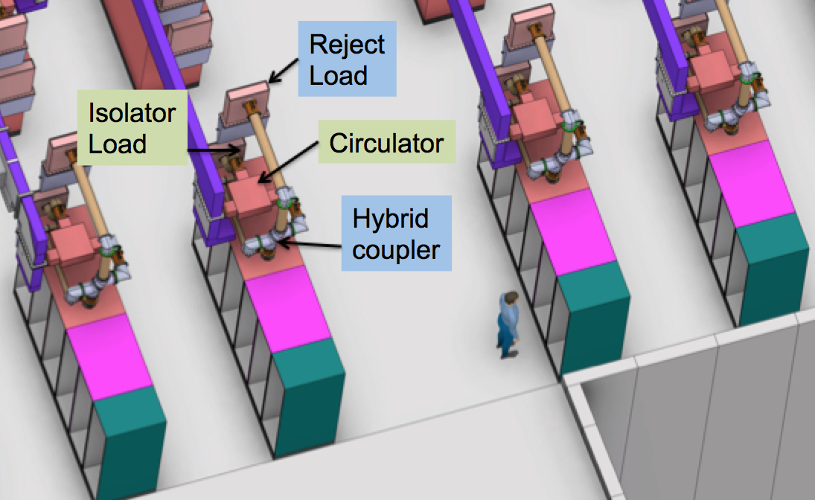
WR1150
Gallery layout MB cell
Racks
Gallery layout for Spokes

Slide 8
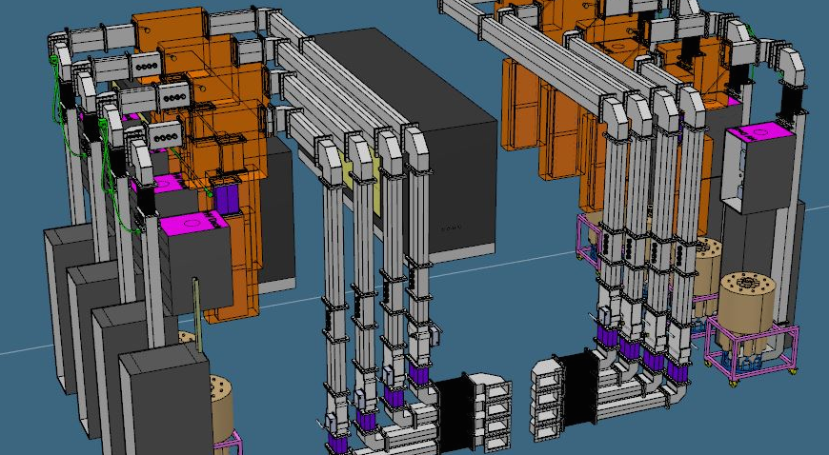
RFDS layout for HB / MB cell
DC-1
Space envelope
For Circulator
RFDS layout
same for
MB/HB upto
this flange
DC-2
DC-3
Space envelope
for Load
Shutter
switch
Removable
wg section for PSS
IOT

Slide 9
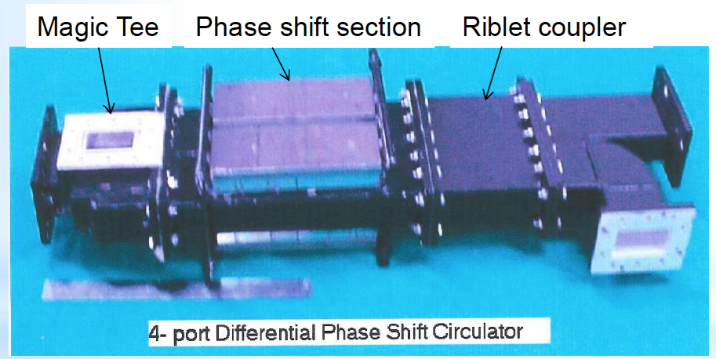
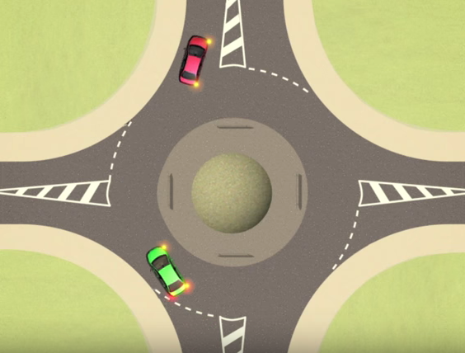

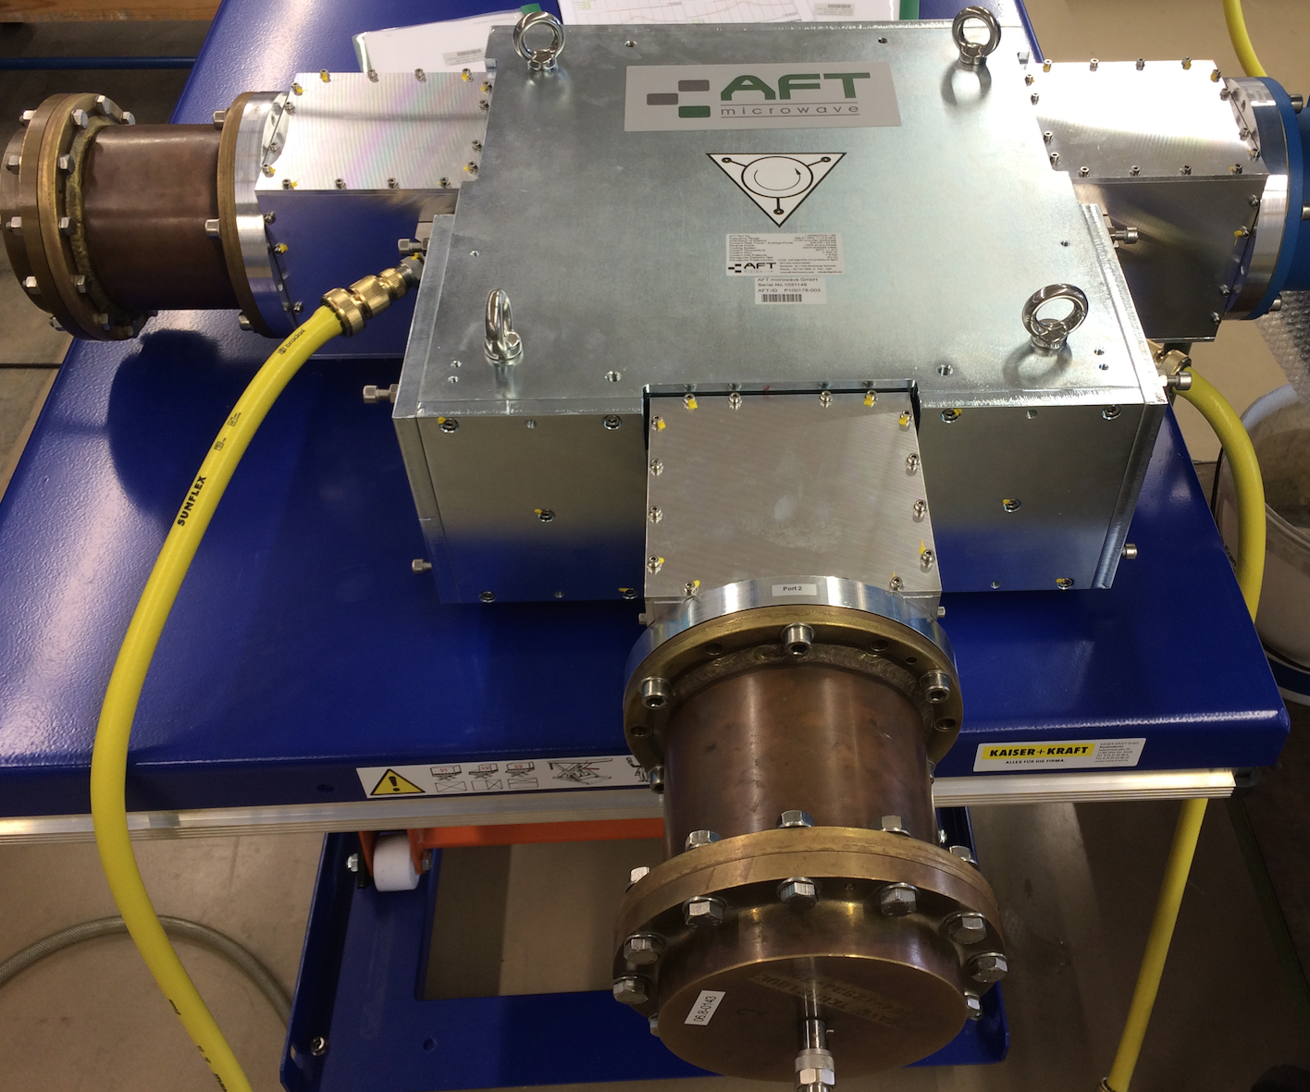
Circulator
Ideal Circulator: Like a round about
2.856 GHz
P = 6 MWp
Pavg = 25 kW
Indigenous development done at SAMEER (India) in 1999. Installed on medical linac.
Can have either 3 ports or 4 ports
Can use coaxial line / waveguide
Direction – clockwise / anti-clockwise
352 MHz
P = 400 kWp
Pavg = 20 kW
Technology demonstrator
for ESS spoke linac
Notes:
After lot of technical negotiations this unpresuruzed cirulator in 6 inch coax was developed.

Slide 10
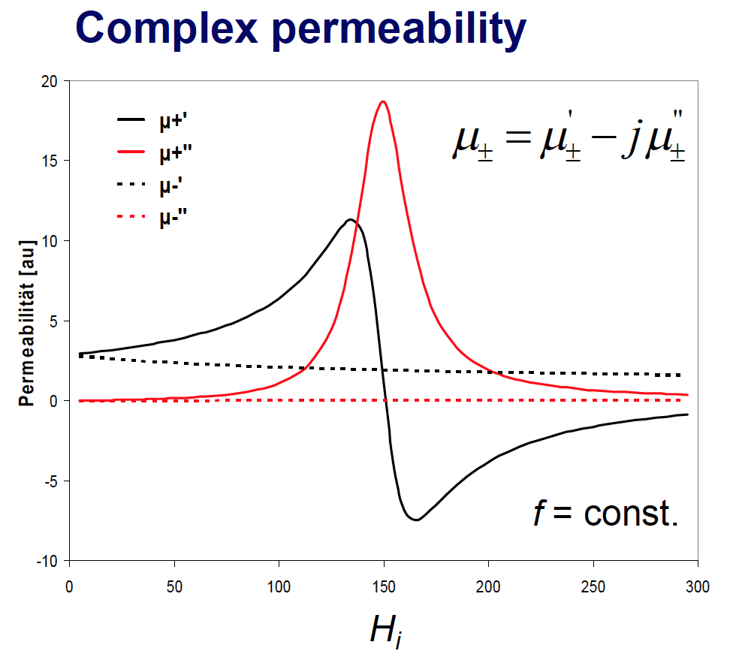
Circulator
Nonreciprocal device
Non-reciprocity is achieved due to ferrite
Generally ferrite discs are used
The discs can be either two discs or the multiples of two. Depends on power and thermal management
Difference in μ₊ and μ₋, leads to non-reciprocity

Slide 11
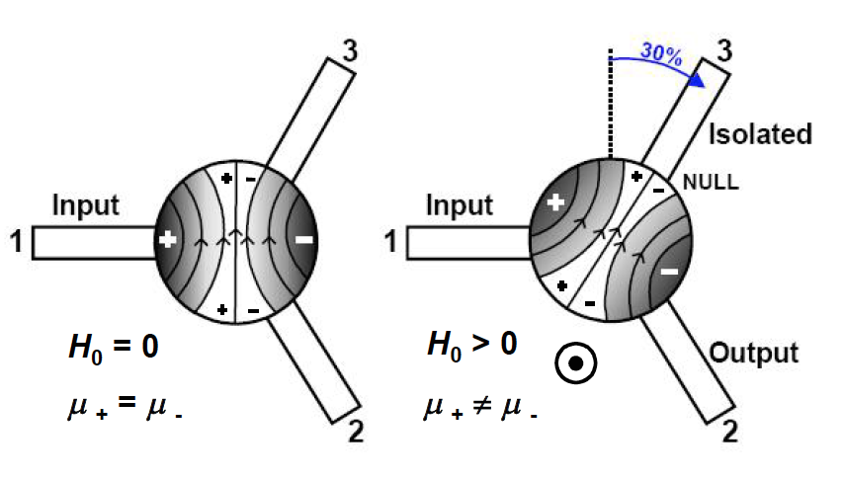
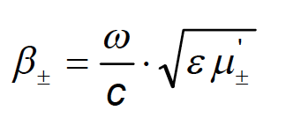


RF signal applied to the ferrite disc will generate two counter rotating waves, velocity dependent on propagation direction.
Transmission
from port 1 to port 2
Isolation
From port 1 to port 3

Slide 12
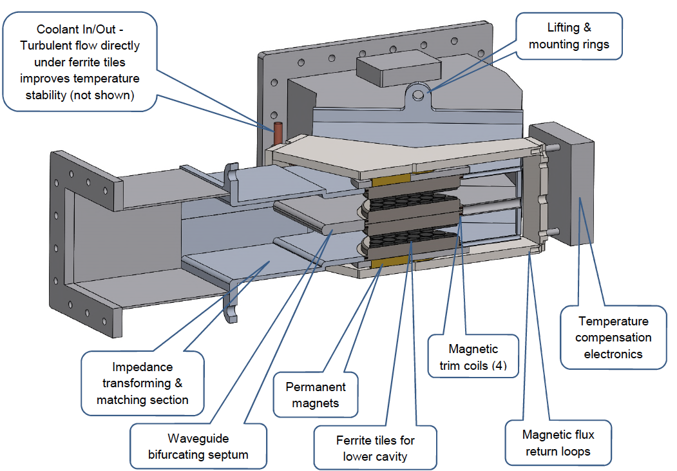
Construction of 3-port Circulator

Slide 13



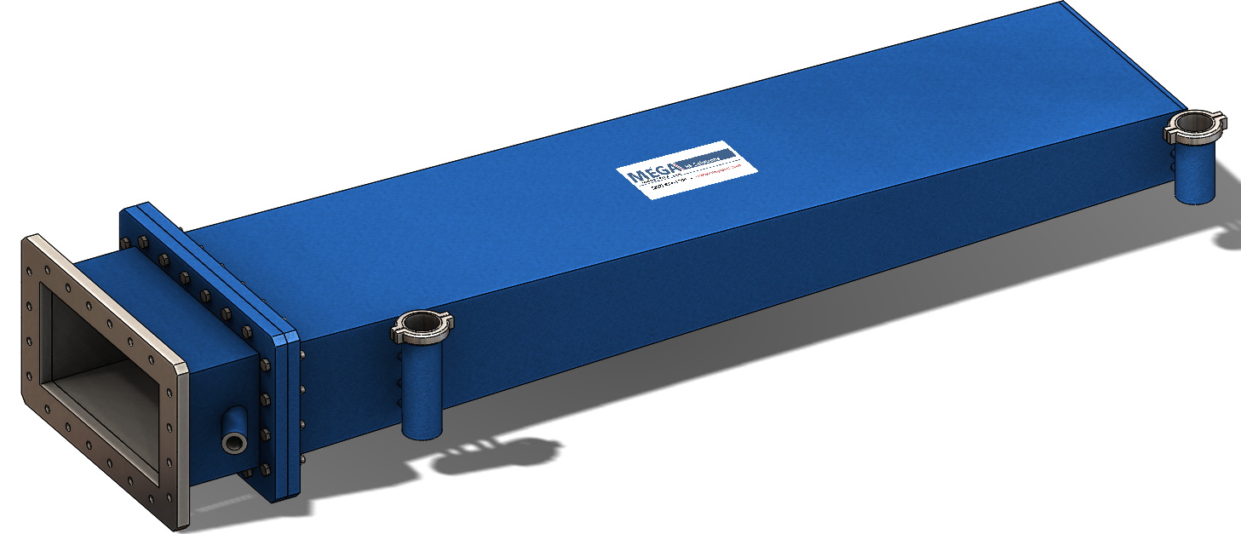
Ideal & Practical Isolator
Isolator = Circulator + load
Ideal: Infinite Isolation
Practical: Finite Isolation
2
Isolation = - 30 dB
1/1000 of
power
1
A
Isolator
3
Load
A
Input power = 1500 kW
Only 1500 W = 1.5 kW
will reach amplifier ?
Load – Dissipate RF power from amplifier
Amplifier is completely isolated from
unwanted reflections

Slide 14
Practical Isolator:
Isolation = 30 dB
Return loss = 30 dB
1500 kW
1.5 kW
Full reflection
from cavity
1.5 kW
A
1
2
Cavity
3
15 kW
15 kW
Load
Load return loss = - 20 dB
So we need a load with good
Return loss

Slide 15
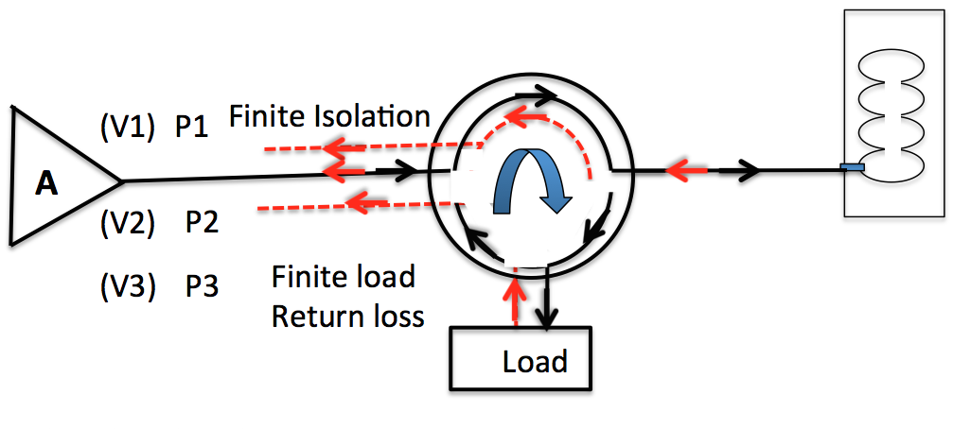
High Power Model of Isolator
Forward power /
Circulation direction
Reflected power
VT = V1 + V2 +V3
A small program is written for effective return loss calculation
(Ref: ESS-0043091)

Slide 16
Assumptions:
Amplifier is perfectly matched.
Higher order harmonics are not considered
Uncertainties in S-parameter measurement not considered
Only first order reflections are considered
Worst case S-parameters and worst phases for S11eff calculations are considered.

Slide 17
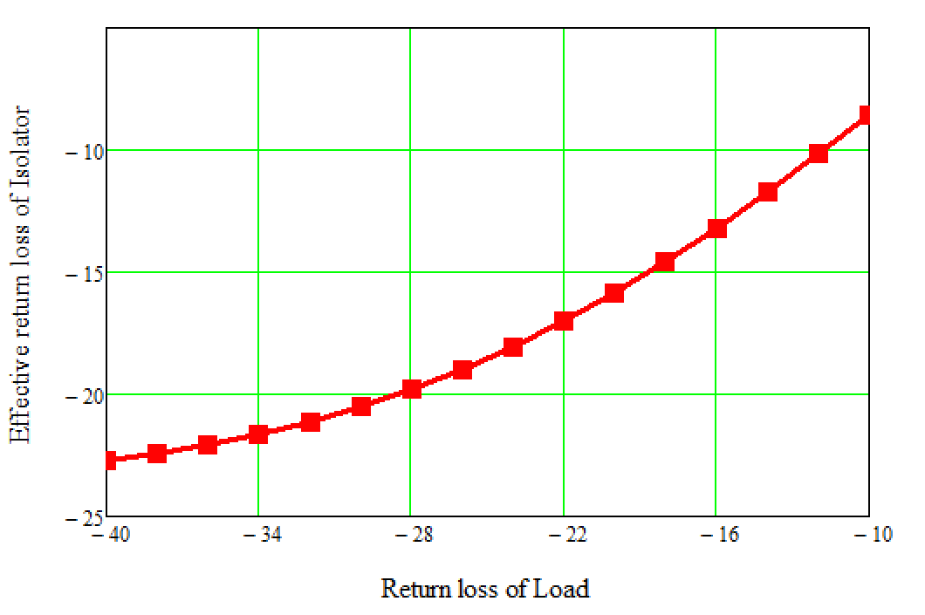
Variation of Effective return loss of Isolator with return loss of load
Parameters of circulator :
S11= -30 dB
S12 = -30 dB
S21 = -0.5 dB
NO higher order harmonics
Amplifier
Specification
We need a GOOD LOAD:
-30

Slide 18
Worst Case Input Return Loss |S_{11eff}| for |S₁₁| = |S₁₂| = 30dB (typical)

Slide 19
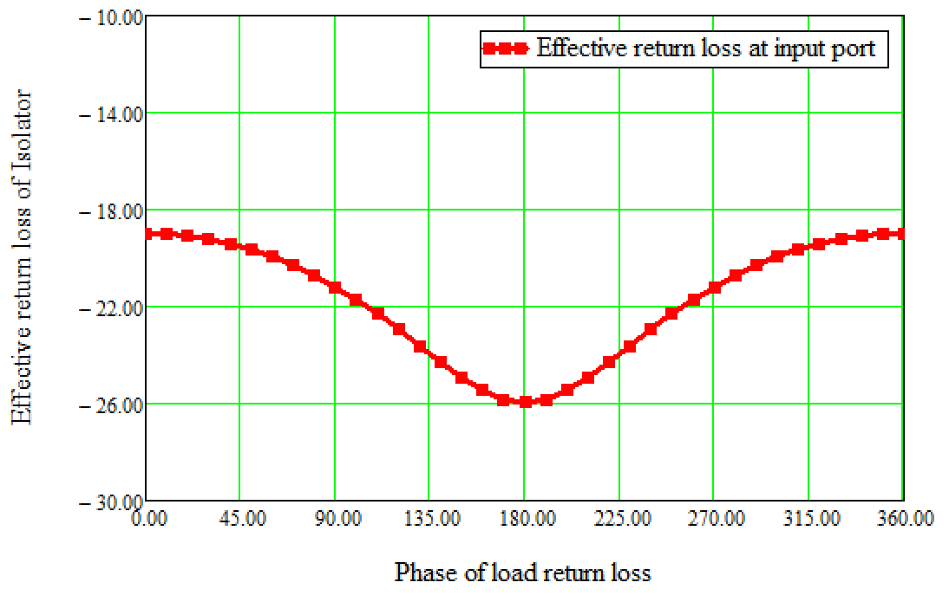
Variation of Effective return loss of Isolator
with Phase of load return loss
Parameters of Circulator:
S11 = -30 dB
S12 = -26 dB
S21= -0.05 dB
Parameters of Load:
S11 = -30 dB
Value is not important.
Phase of load return loss: stable
Waveguide section can be added to get desired phase shift

Slide 20
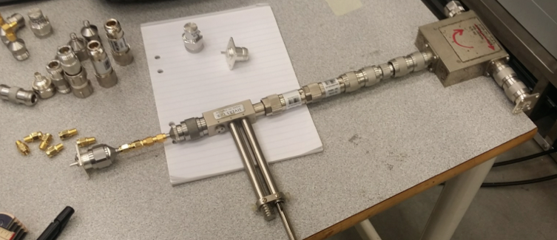
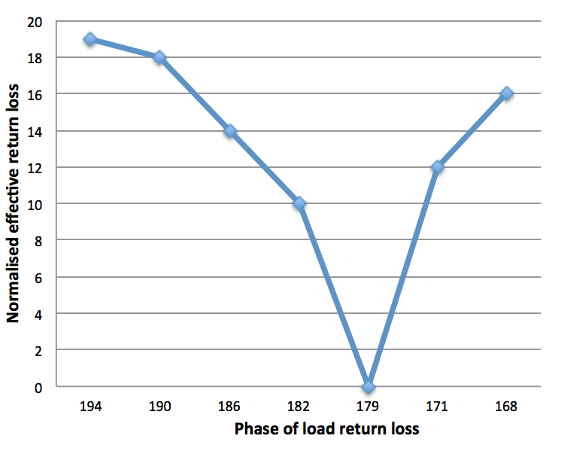
Testing of concept
Towards VNA
Trend of both the curves is same
Good return loss when phase of load return loss at circulator is about 180 º
Load with return loss
variation
Short
Experiment
Further experimentation is planned with high power
Circulator and load at Lund test stand.
Courtesy: Magnus Jobs at FREIA

Slide 21
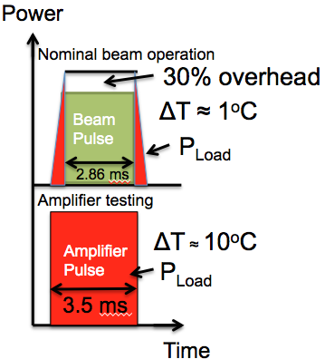
Additional boundary conditions in ESS:
High temperature water cooled loads
Power dissipated across load
Temperature rise due to power dissipation across collector:
Load
With HV on, RF off:
ΔT ~ 10 ºC
With HV on, RF on:
Nominal beam operation,
Klystron testing,
ΔT ~ 5 ºC
Klystron
N Number
Load
Klystron
Inlet temp
50ºC
Initially Outlet temp
Controlled to 60ºC

Slide 22
Effect of unstable phase of load return loss
# Klystron operation will be affected
At same power level, cooling water temperature will vary from 50º C – 80º C depending upon operational scenario.
If phase of load return loss also varies, S11eff seen by amplifier will vary automatically, which may affect klystron stability.
Hence stable phase of load return loss will be preferred.

Slide 23
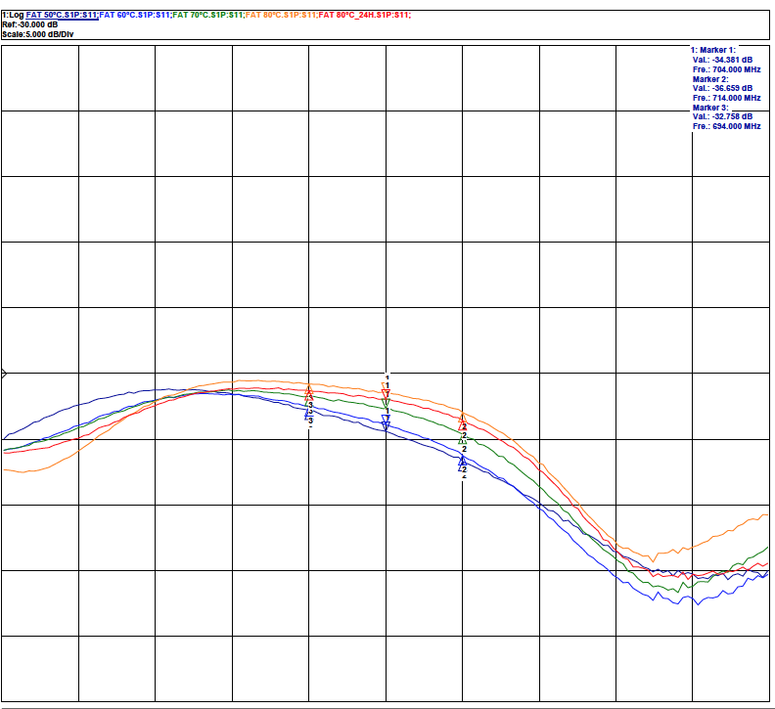
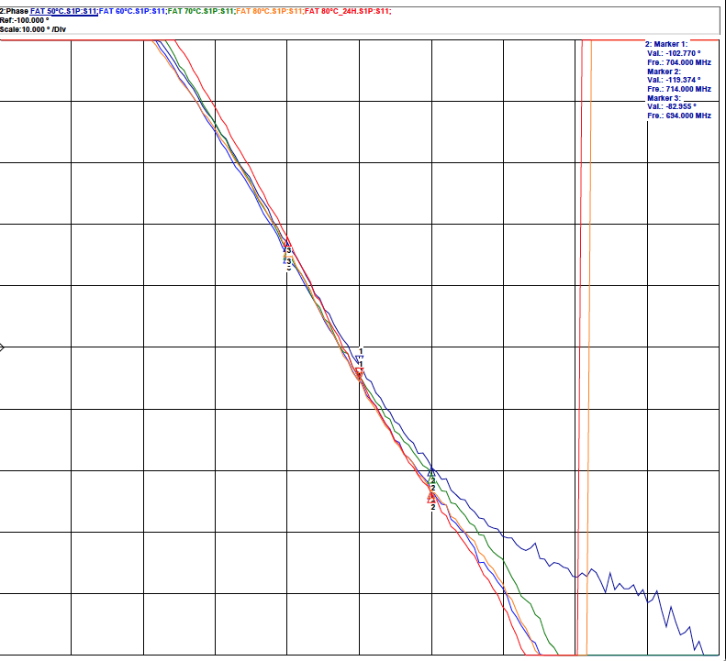
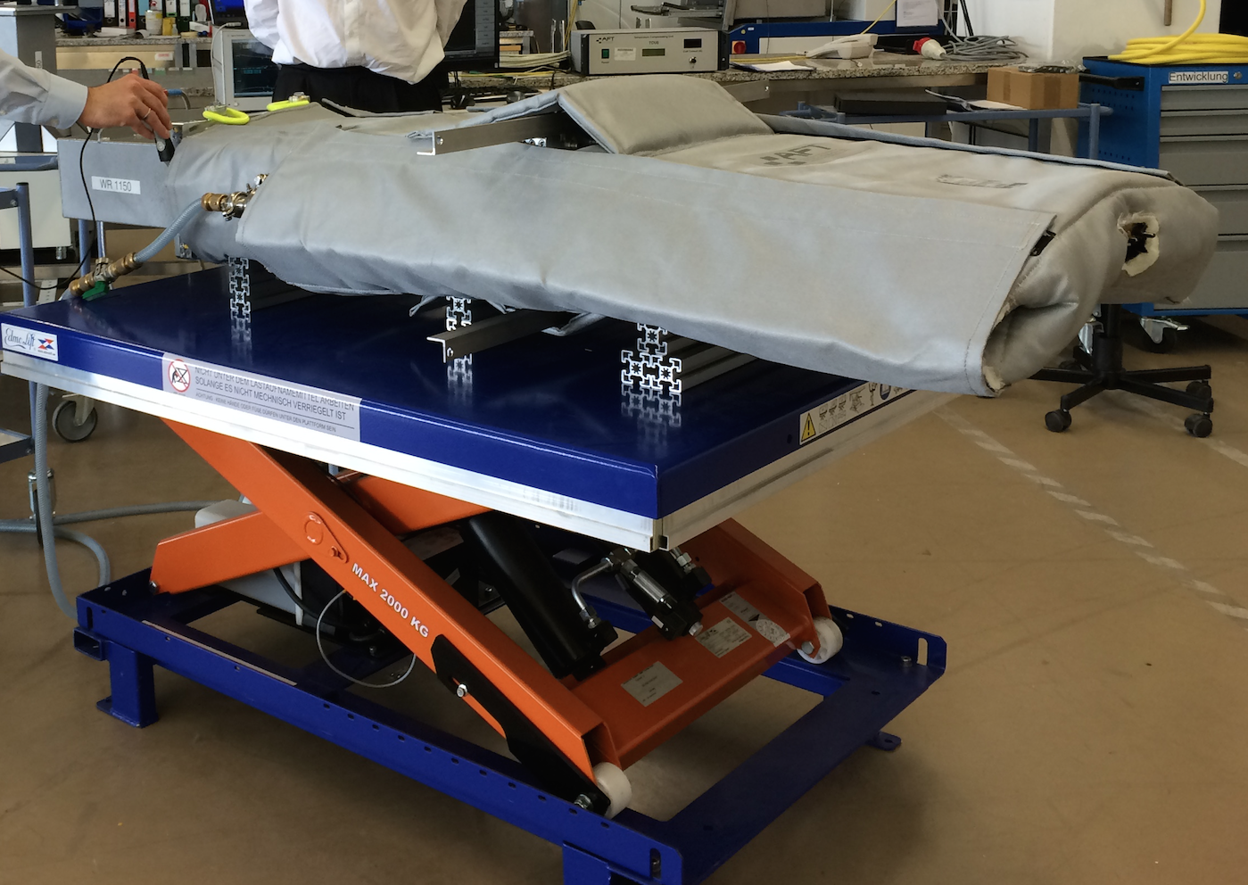
New Load development for ESS
Hot water cooled loads
Frequency = 704 MHz
Power ≥ 1500 kWp
Pulse width = 3.5 ms
Pulse repetition rate = 14 Hz
Inlet water temp ≥ 50º C,
Outlet water temp ≤ 80º C
Return Loss
Phase of Return Loss
Temp: 50ºC, 60ºC, 80ºC,
80ºC: After 24 hours
S11 > 30 dB
BW > ±10 MHz
ΔΦ_{S11}< 10º
Prototypes by MEGA, Thales will be delivered soon.

Slide 24
Thank you !

Slide 25
Functional Requirements of RFDS
Transportation of RF power from amplifier to the cavity coupler with minimum losses
Dissipation of unwanted RF power during different operational scenario - Loads
Protection of amplifier from the unwanted reflections during filling and emptying of cavities or due to sparks – Circulator
To satisfy requirements of personnel safety system (PSS) during different operational scenarios – removable waveguide, PSS flange, switch
Detection of sparks in the RF system and give signal to the local protection system (LPS) – Arc Detectors

Slide 26
Measurement of forward and reflected power from amplifier and cavity with the required accuracy, granularity - Directional couplers
Take care of thermal expansion-contraction, dimensional changes in building layout such as changes in the tunnel length, differential settlement of tunnel with respect to gallery etc – Bellows
Simplification of cooling system design for energy recovery – High temperature water cooled loads
Depending on requirement, to ensure stable klystron operation by changing distance between klystron and circulator – extra flanges

Slide 27
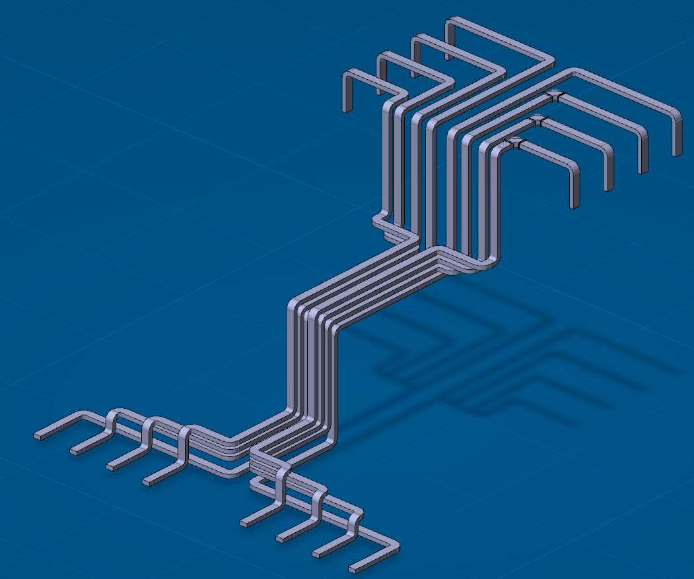
Prototype RFDS at ESS
# Hot water cooled loads – New development for ESS
Being developed by three suppliers: AFT, MEGA and Thales
Received AFT load in Lund test stand,
MEGA and Thales load will be shipped by end of July / August
# Circulators being developed by
three suppliers: AFT, MEGA and FMT
FMT circulator will be shipped in
a few days.
DR for MEGA circulator: 27 June
AFT circulator: Expected delivery
by Aug end.
# High directivity directional
couplers (D > 40 dB)- by MEGA
For MB/HB Linac,
3.8 km Waveguide
E-elbows > 750
H elbow > 550
Huge requirement of
waveguides and elbows !

Slide 28
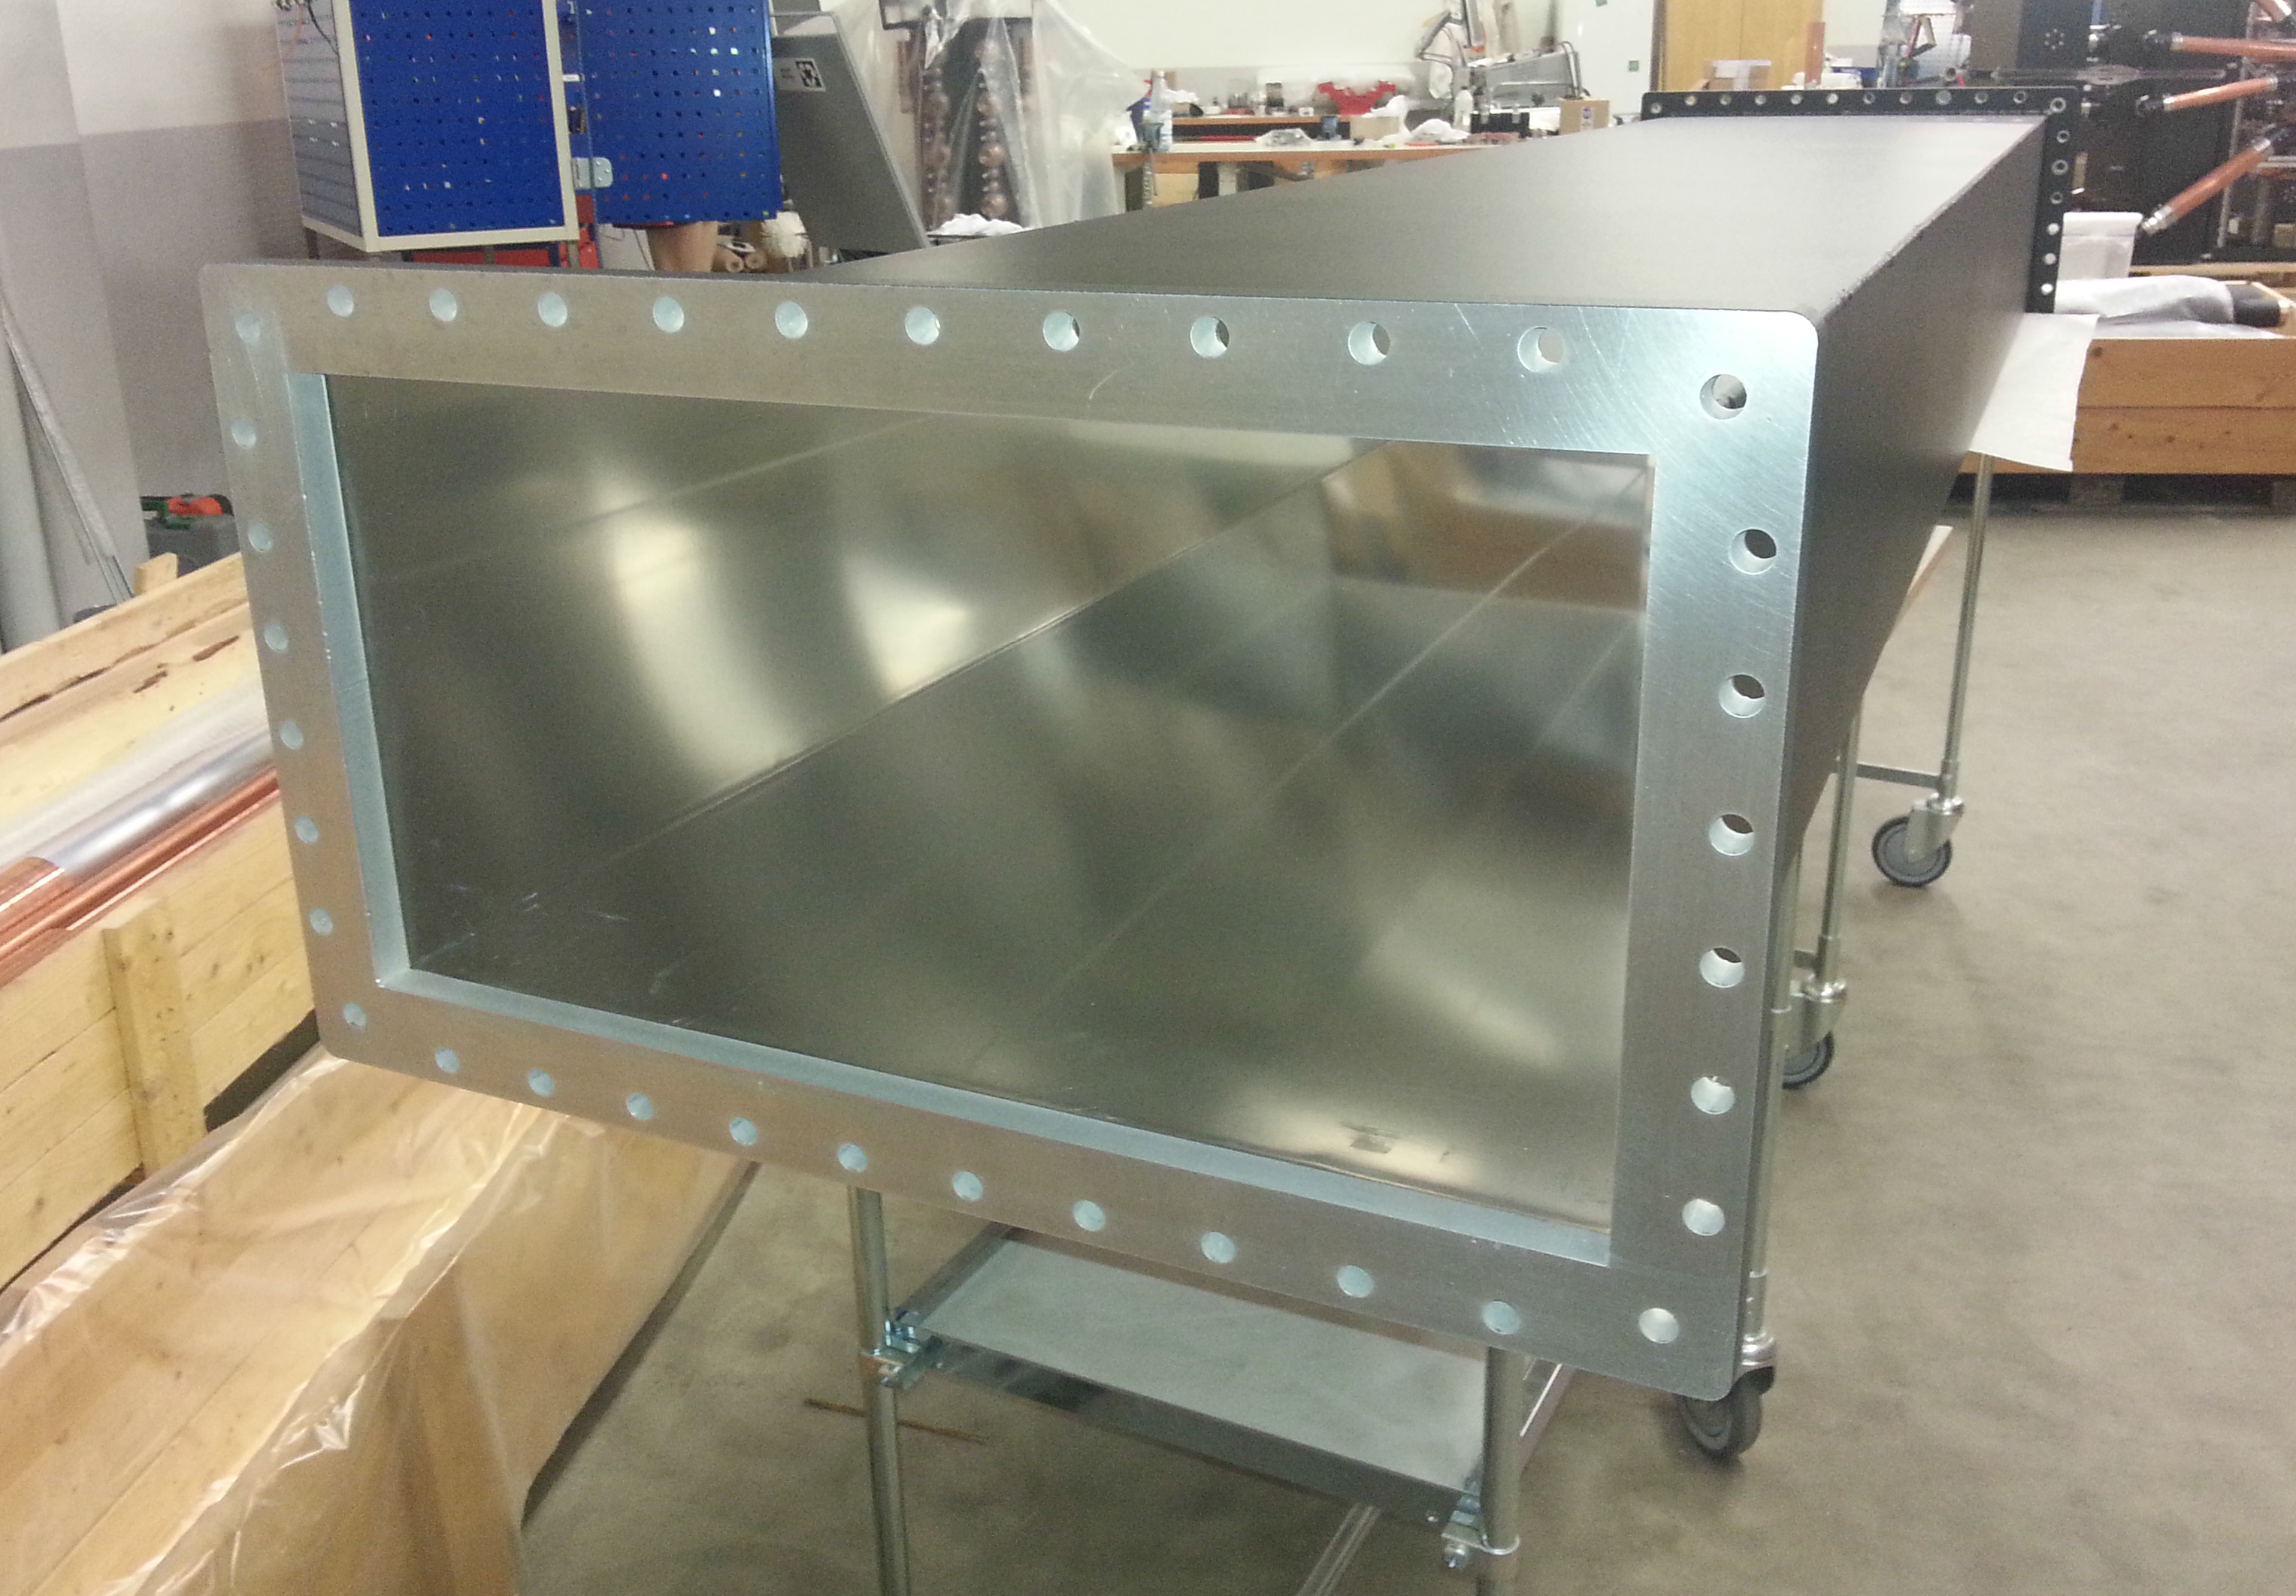
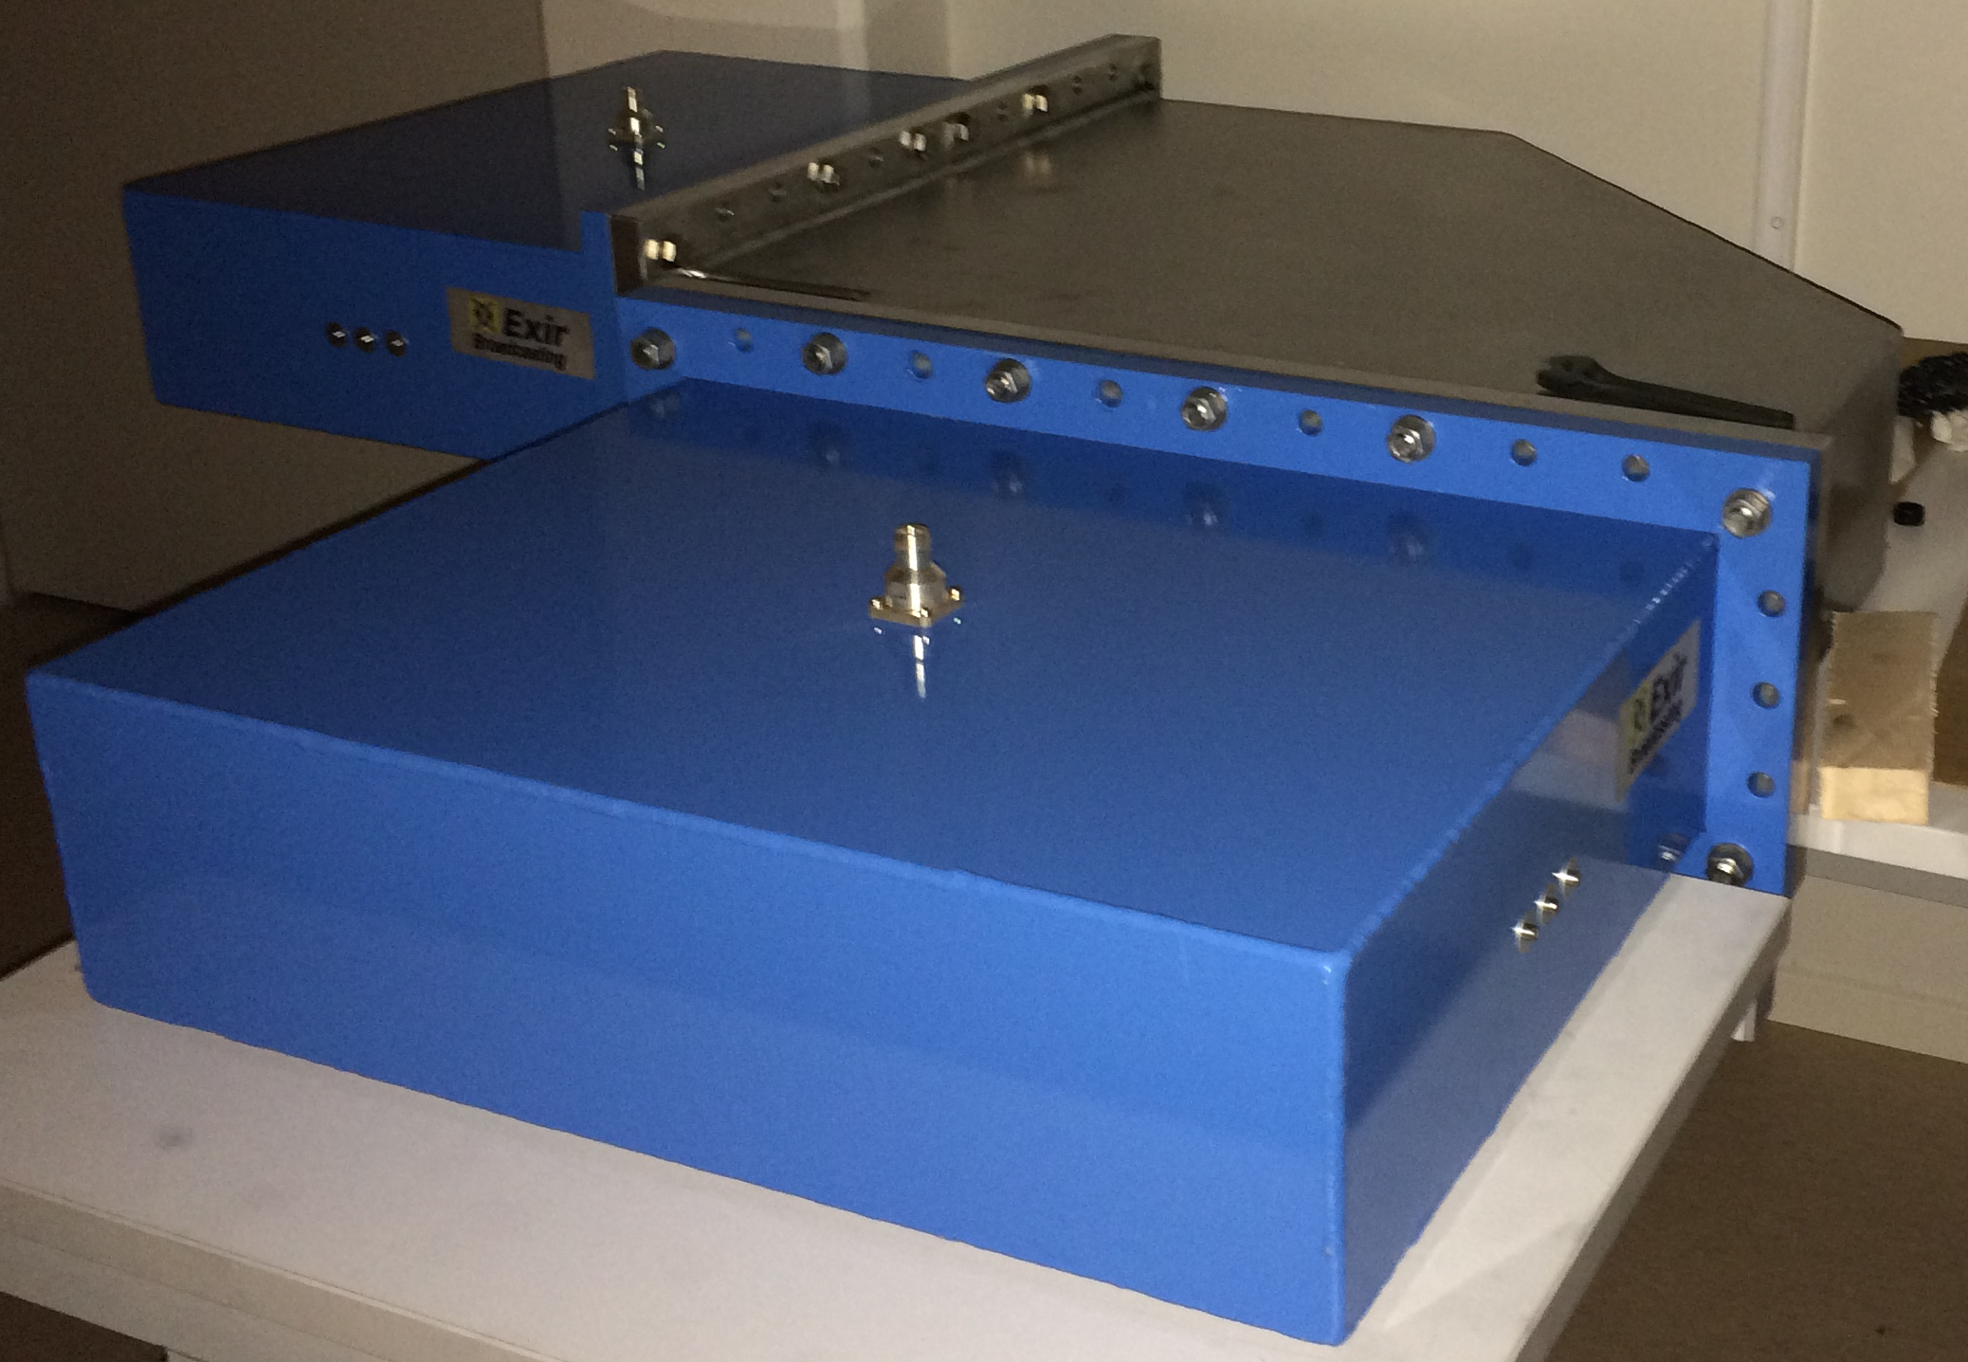
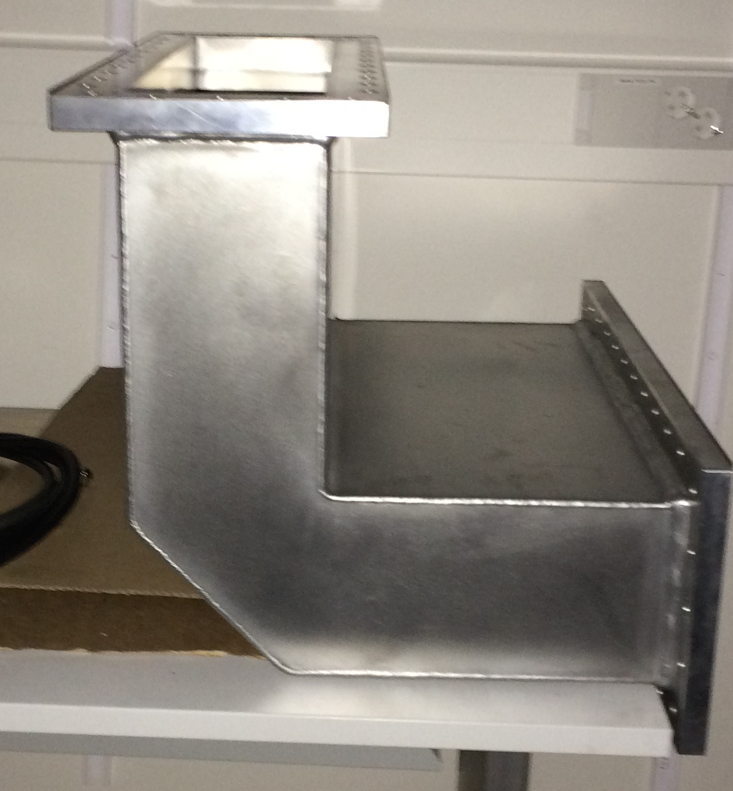
Flange and waveguide design
Waveguide extends through
the flanges
*
*
Fabrication becomes extremely
easy and avoids discontinuities
Flanges will be welded along the
periphery (*)
Surface cut along flange surface to ensure flatness, perpendicularity and parallelity
Flat flanges (without RIM)
Time spent at ESS < 20 hours.
Failed in visual inspection
Costs by metal manufacturers expected to be 20-30% cheaper than RF companies ~ MEUR
Received prototypes from
two companies.

Slide 29
# Arc Detectors (AD)
Procured two types of Arc Detectors
- AFT : uses optical fibre, response time < 10 μs
- Microstep/CERN AD – don’t need optical fibre
* Four redundant photodiodes: to detect spurious arcs
* Two blind photodiodes: to detect radiation induced arcs
Tests will be performed in the Lund test stand and then preferred solution will be selected.

