Slide 1
CERN LIU-SPS
200 MHz RF upgrade
SSPA amplifiers
CERN : European Organisation for Nuclear Research
LIU : LHC Injector Upgrade
SPS : Super Proton Synchrotron accelerator, 1976, 7 km
SSPA : Solid State Power Amplifiers
CWRF workshop 2016
21-24 June
ESRF Grenoble
Eric.Montesinos@cern.ch
Thanks to all CERN BE-RF-PM team members, with special thanks to
Charles Julie, Simon Rains, Gino Cipolla,
Ester Sancho Cabrera, Pilar Parrado Caballero, Philip Hofer, Antoine Boucherie, Sebastien Calvo, FSU-BE03

Slide 2
Outlook
  Brief description of the RF power upgrade project
  RF cycles in the SPS
  New systems
  Purchasing strategy
  BAF3 – New RF building
  IT-3842, Drivers
  IT-3841, Finals
  Transistor power ratings – personal view of future perspective
  Cavity combiners
  IT-3841, Progress report
  Schedule
  Very High Power Cavity Combiner
  Present system upgrade
  Exciting years to come
  See you next CWRF

Slide 3
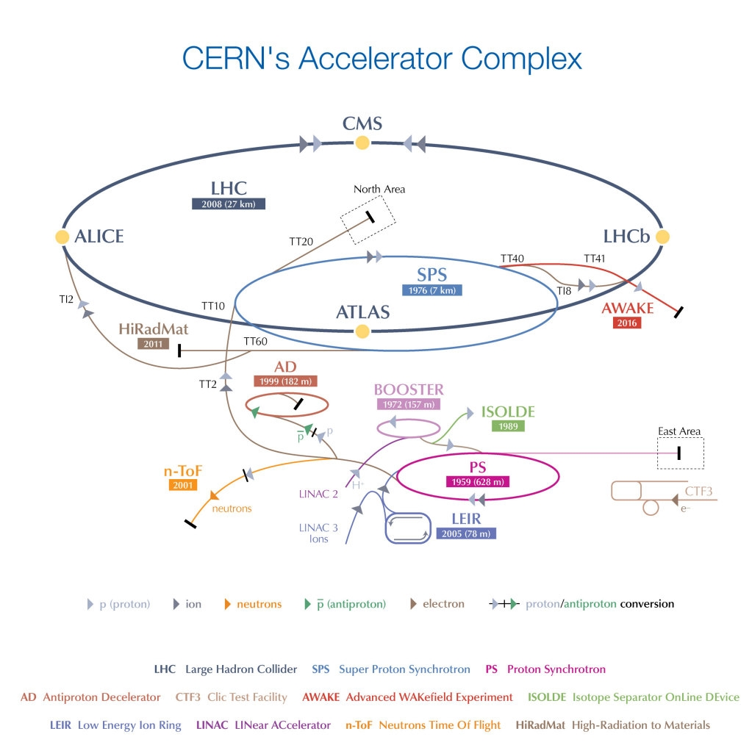
CERN SPS LIU project
The LHC Injectors Upgrade should plan for delivering reliably to the LHC the beams required for reaching the goals of the HL-LHC
Translated to SPS-RF
re-arrangement of the cavities and construction of new RF power stations

Slide 4
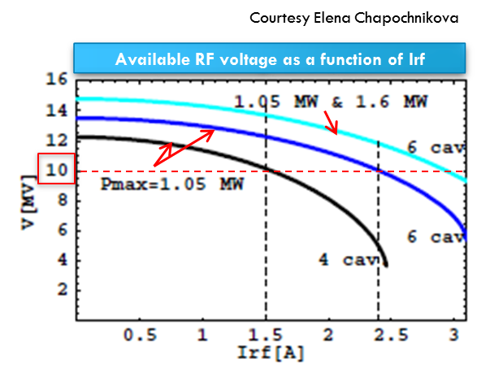
Description of the RF power upgrade project
First definition of the project (2011)
  Four existing amplifiers upgraded to 1.05 MW* feeding four cavities
  Two New power amplifiers delivering 1.6 MW* feeding two additional cavities
  A new RF building
  A new LSS3 distribution (Long Straight Section #3)
  *All RF power levels being peak power operating with a 50% duty cycle at 42 kHz or 172 kHz, CW operation at average power (half peak power) is also requested

Slide 5
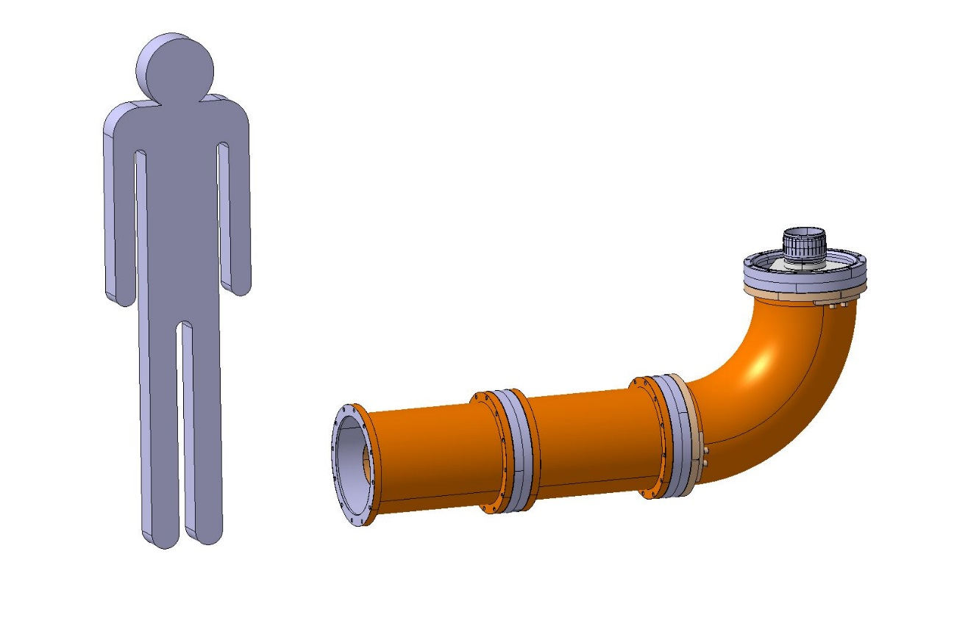
RF cycles in the sps
Average power limited to 750 kW due to 350 mm coaxial lines
2000 kW
750 kW
9.8 μs / 23.04 μs (43.4 kHz) or
2.75 μs / 5.76 μs (173.6 kHz)
10 kW
0
5.0
5.0
3.2
10.8
7.6
1.8
1.2
3.0
2.2
3.2
3.4
9.6
10.0 s
21.6 s
8.2 s
16.2 s
MD
Machine Development
LHC
SHIP
Serach Hidden Particle
FT
Fixed Target

Slide 6
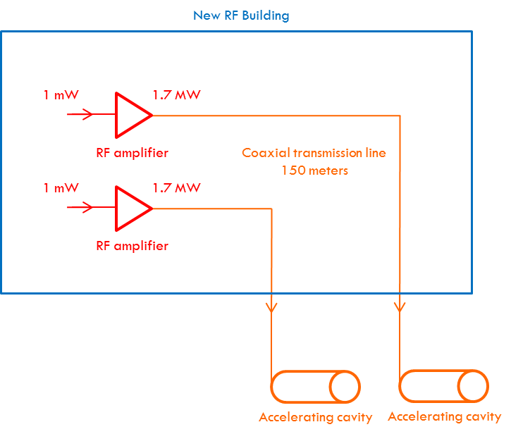
Description of the rf power Upgrade project
Three main sub-tasks
New RF Building project
Cavities re-arrangement project
  LSS3
  Coaxial lines
  Cavities
  Fundamental Power Couplers
RF Power Amplifiers project
  Present amplifiers upgrade
  New amplifiers

Slide 7
New systems 2 x 1.7 MW @ 200 MHz
One line
(input cavity ~120 to 180 m away)
Three topics
Drivers :
  2 x 16 x SSPA
Finals :
  Tetrode : 2 x 16 x 110 kW
  IOT : 2 x 16 x 110 kW
  SSPA : 2 x 16 x (110 x 1 kW)
  Diacrode : 2 x 2 x 850 kW
  No klystron at 200 MHz
Combiners + lines :
  3 dB hybrids
  850 kW power loads
From Beam Control
1/16 splitter
2 x
1.4 MW at cavity input
4 stages of 3 dB combiners = - 0.6 dB
120 to 180 m Coaxial lines = - 0.2 dB
Final Amplifier output = 1.6 MW + 0.8 dB = 1.7 MW / 16 = 110 kW

Slide 8
Purchasing strategy
Thanks to CERN purchasers, with special thanks to Anders Unnervik, Dante Gregorio, Lazslo Abel, Boi-Lan Nguyen Lemoine, Bertrand Nicquevert, Bjorn Jenssen, Ivo Lobmaier
Two contracts
  IT-3842 Drivers
  IT-3841 Finals
A first contract for the Drivers (IT-3842)
  SSPA only (best technology for a few kW amplifier)
  Will be a first input for a predefined cost for the Finals
Combining systems
  Done in house
  Will be a second input for a predefined cost for the Finals
Once Drivers contract adjudicated,
a second contract for the Finals
  Drivers IT-3842 cost
  + Combiner cost (defined by CERN)
  + Finals IT-3841 offer
  _______________________________________
  IT-3841 adjudication to the lowest compliant

Slide 9
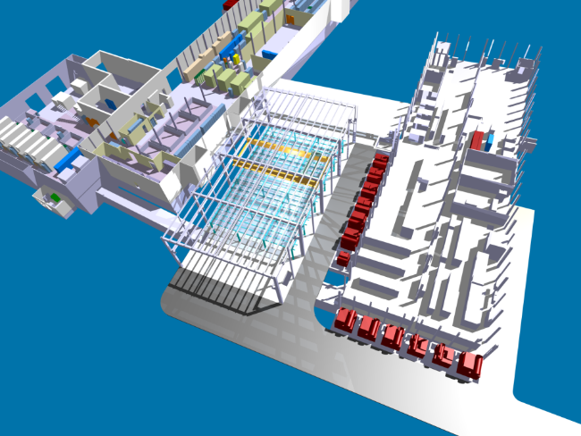
BAF3 – New RF building
Electricity
HVAC
Bare building
Water
2011
2012
2013
2014
2015
2016
2017
2018
2019
2020
2021
Design completed by end of October 2011 to allow Civil engineering studies and authorisation requests to be launched
Goal to have the bare building completed by 2015 (taking advantage of LS1 to minimize accident impacting SPS operation during construction)
Even if we did not know what amplifier technology will be selected !

Slide 10
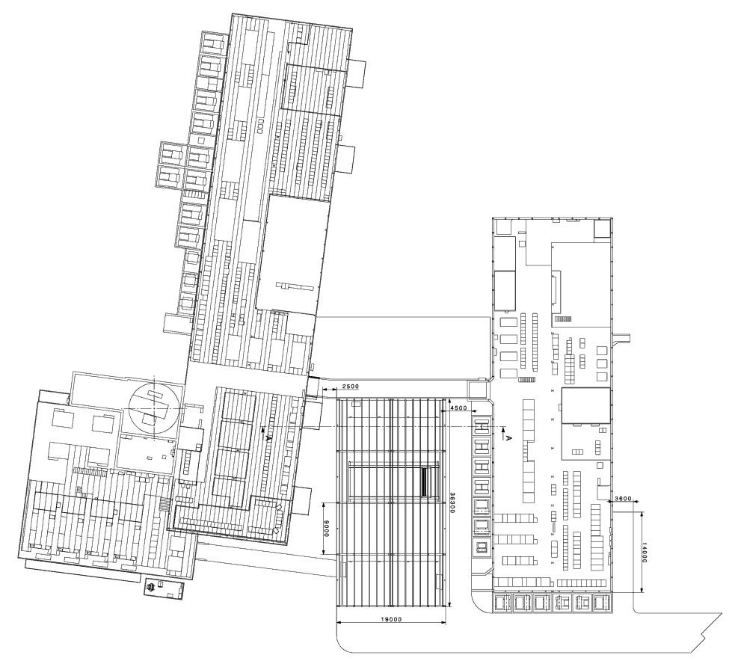
BAF3 – new rf building
Maximum size is restricted by the available land around CERN premises
Total surfaces
  Basement : 17.5 m x 34.5 m = 600 m²
  Mezzanine : 450 m²
  Total = 1050 m²
Total for RF amplifiers
  Basement = 350 m²
  Mezzanine = 350 m²
  Total = 700 m²
34.5 m
17.5 m

Slide 11
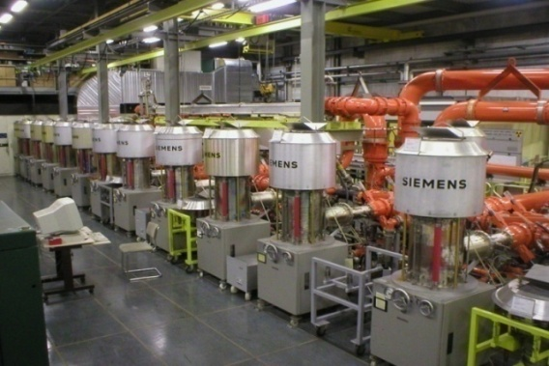
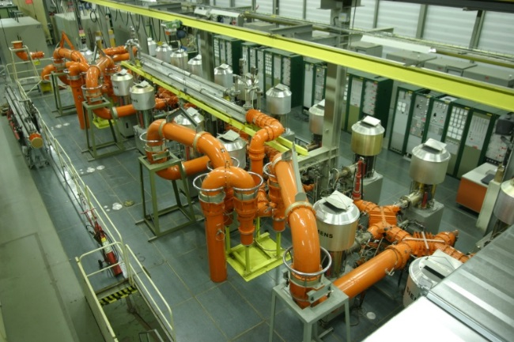
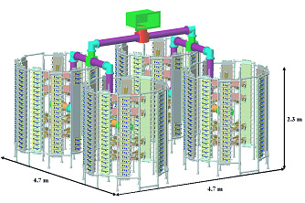
BAF3 – New RF building
BAF3 for RF = 700 m²
Amplifier tendering process opened to several technologies
  2 x 16 tetrodes (well known)
  2 x 2048 SSPA (Solid State Power Amplifiers)
  4 x Diacrodes (new tube)
  4 x IOT (Inductive Output Tube)
Hybrid combiners and coaxial lines will be similar to the ones in use with present systems
1 tube (160 kW) = 4 m²
Total HVPS = 192 m²
Total 32 tubes = 320 m²
2 towers (160 kW) = 15 m²
Total LVPS = 72 m²
total 64 towers = 550 m²
Combiners for 32 = 200 m²
Courtesy
Patrick Marchand
(SOLEIL)
2.3 m
4.7 m
4.7 m

Slide 12
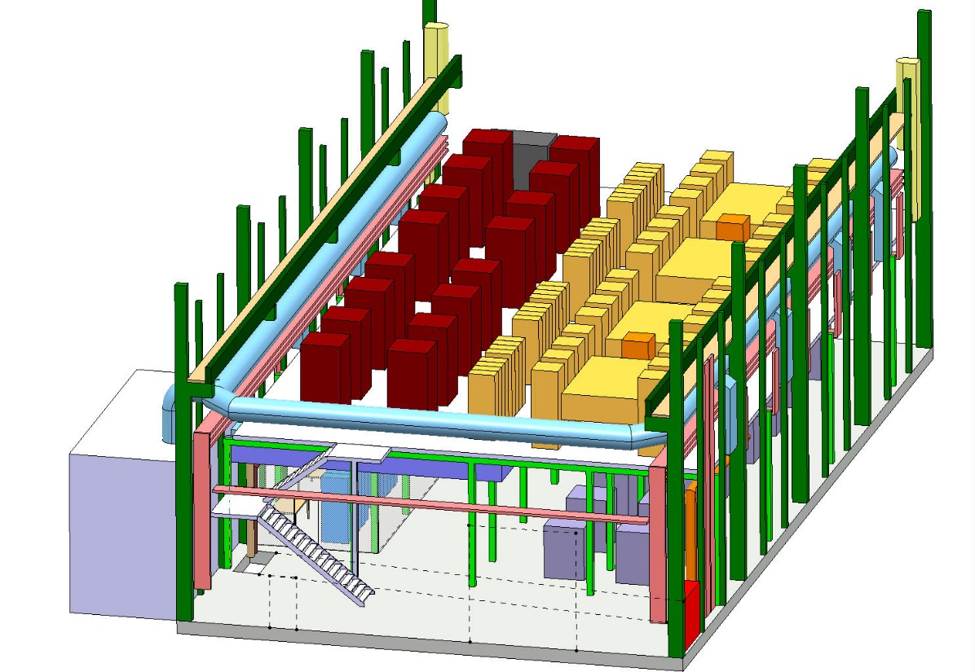
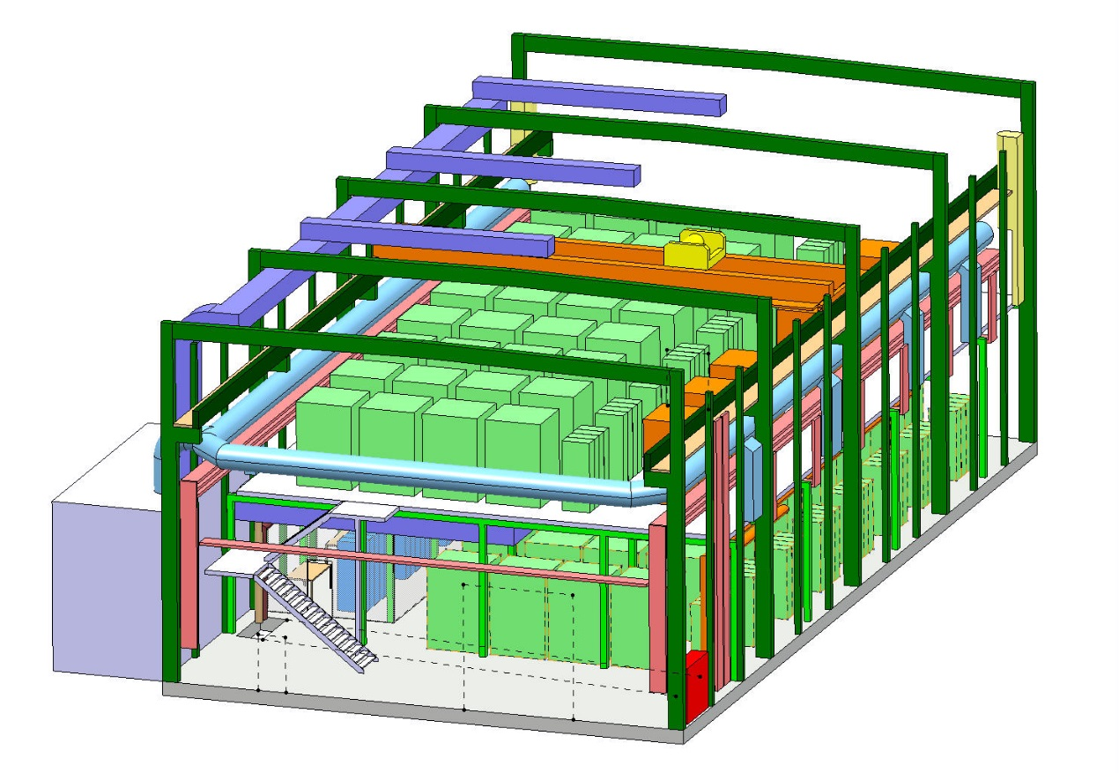
BAF3 – New RF building
BAF3 with Tetrodes
BAF3 with SSPA

Slide 13
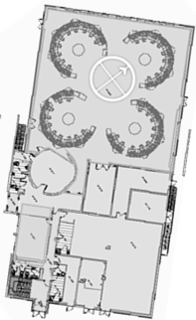
Future power systems in the SPS
BA3
Siemens
2 x 1.1 MW
CCC
BB3
Electrosys
2 x 240 kW
BAE3
Philips
2 x 1.1 MW
BAF3
New
2 x 2.0 MW

Slide 14

IT-3842, DriverS
Consulted
Selected
Pre-series
March 2014
November 2011
Ok for Finals
2011
2012
2013
2014
2015
2016
2017
2018
2019
2020
72 companies consulted
20 selected
10 offers
Defined a 1.25 kW unit
  Compatible with all Finals technologies
    32 for SSPA & IOTS, 256 for Tetrodes, 192 for Diacrodes
  12 pre-series for qualification (end of contract clause in case of any failure without any payment)
  One to six batches of 50 (total 62 to 312) regarding result of future Finals IT-3841
TTI Norte, Spain, awarded the contract (3.7 €/W)
3.7 €/W_{peak}

Slide 15
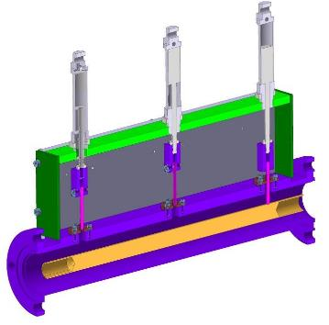
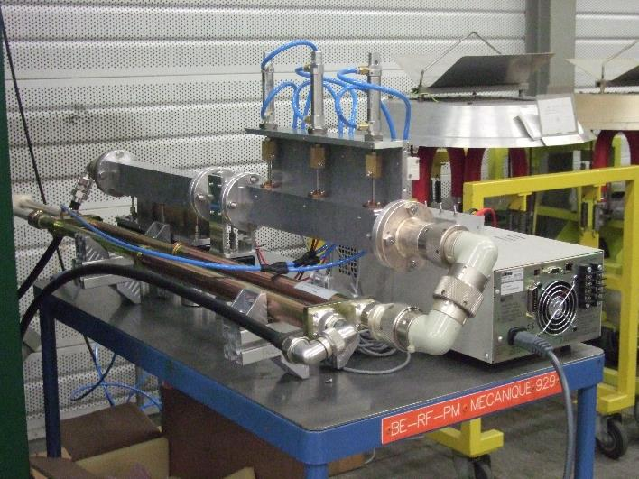
IT-3842, DriverS
November 2011
Series production ok June2016
2011
2012
2013
2014
2015
2016
2017
2018
2019
2020
The 12 pre-series have been qualified
  RF design is impressively robust
    Double circulators !
    Sustained the CERN Fast Short-Circuit test !
  Successfully completed the 1000 hours test with 12 units
  Four units in operation since beginning of March without a single failure
First batch of 100 will be delivered before end 2016

Slide 16
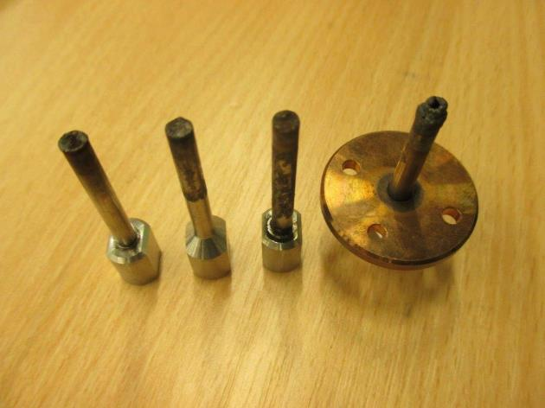
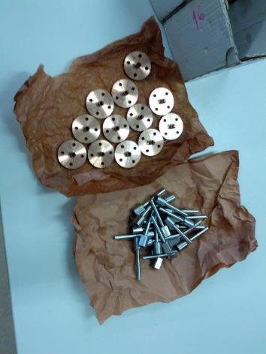
IT-3842, DriverS
November 2011
Series production ok June2016
2011
2012
2013
2014
2015
2016
2017
2018
2019
2020
The 12 pre-series have been qualified
  RF design is impressively robust
    Double circulators !
    Sustained the CERN Fast Short-Circuit test !
  Successfully completed the 1000 hours test with 12 units
  Four units in operation since beginning of March without a single failure
First batch of 100 will be delivered before end 2016

Slide 17
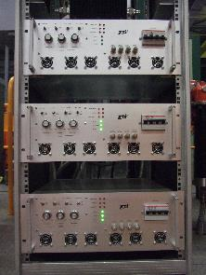
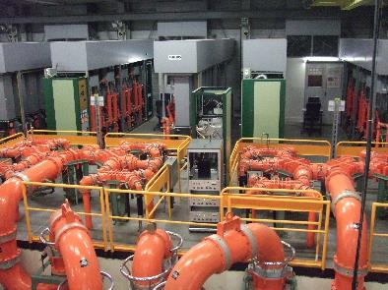
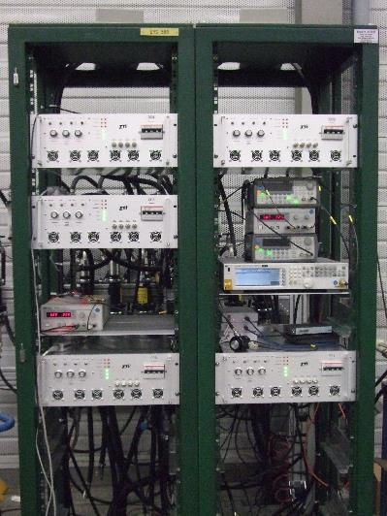
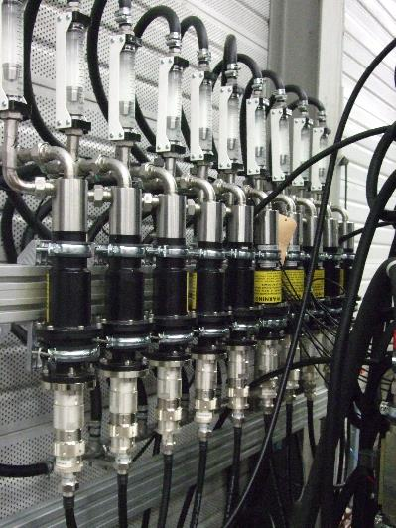
IT-3842, DriverS
November 2011
Series production ok June2016
2011
2012
2013
2014
2015
2016
2017
2018
2019
2020
The 12 pre-series have been qualified
  RF design is impressively robust
    Double circulators !
    Sustained the CERN Fast Short-Circuit test !
  Successfully completed the 1000 hours test with 12 units
  Four units in operation since beginning of March without a single failure
First batch of 100 will be delivered before end 2016

Slide 18
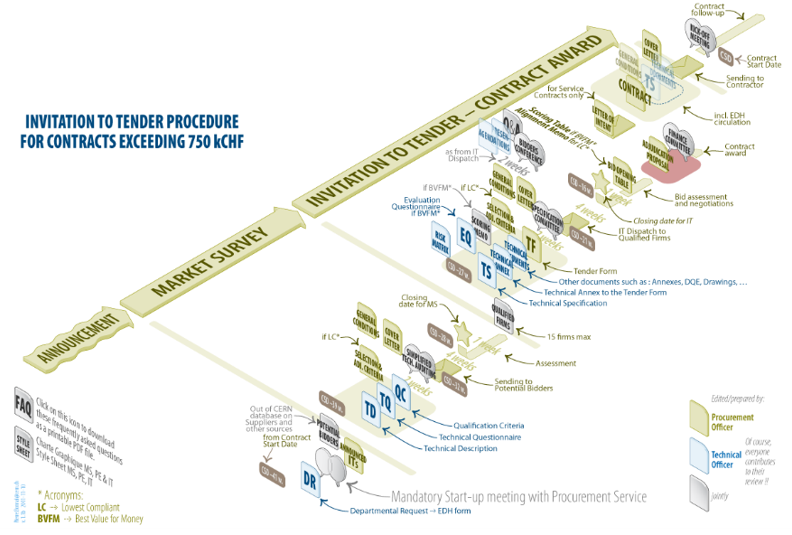
IT-3841, Finals
December 2014
MS
TS
TS
2011
2012
2013
2014
2015
2016
2017
2018
2019
2020
Drivers
Technical Specification to be finalized taking into account Drivers outcome
Power level request increased
  Cavity 1.4 to 1.6 MW
  Amplifier from 1.6 to 2.0 MW !

Slide 19
IT-3841, Finals additional costs
Drivers IT-3842 cost
  5500 CHF per 1.25 kW unit
  SSPA & IOT 176 kCHF
  Tetrodes 1’408 kCHF
  Diacrodes 1’056 kCHF
Combiner cost (defined by CERN)
  SSPA & IOT 2’760 kCHF
  Tetrode 3’160 kCHF
  Diacrode 800 kCHF
Total additional cost per technology
  SSPA & IOT 2’936 kCHF
  Tetrode 4’568 kCHF
  Diacrode 1’856 kCHF

Slide 20
IT-3841, Finals Bidders conference
20 January 2015
2011
2012
2013
2014
2015
2016
2017
2018
2019
2020
Defined the scope of the contract
  being as fair as possible regarding the technology
  Defining a quite costly Demonstrator in order to disqualify ‘non serious’ companies (we do not want to be R&D at low cost)
  Not a single CHF paid in case of failure of the demonstrator
  Taking into account tubes on an as long as possible period (over 5 years, CERN’s rules)
  Including spares in order to operate during 20 years
Answered 102 questions from the suppliers

Slide 21
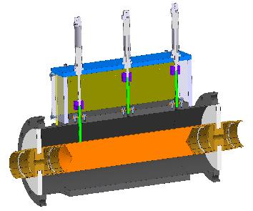
IT-3841, requirements
Requirements
  Integration within the given building
  Repetition rate 0.1 Hz to 500 kHz (require a CW and a pulsed amplifier)
  Full reflection all phases 100 ms (equivalent to 4 time the power level along the lines)
  Non conventional way to measure the BW (required by LLRF and TWC)
  Very good linearity
  Two tone at many power levels
A lot of tests to qualify the Finals
  Supercycle test, short circuit test, BW, linearity, …
  Short duration tests to qualify an Amplifier within one week
  Long duration tests to check reliability over
  1000 hours

Slide 22
IT-3841
Consulted
Selected
13 March 2015, bids opening
2011
2012
2013
2014
2015
2016
2017
2018
2019
2020
74 companies consulted
19 selected
8 declined
7 offered
No discussion about the Drivers neither the combiners costs
Unable to submit a competitive bid due to quantity being beyond our production capacity and we could not provide installation support
Dear all, We are sorry but we are not able to finish every documents within deadline. So we must decline to participate with our offer. Thank you for your opportunity. Best regards
We are not on time with the documents required
We believe that the chances are too low to get the contract by bidding Solid State Amplifier solutions. Additionally, the known dumping price structure of competitors in the field of Solid State Amplifiers, which get development provided free of costs by public institutes (already known due to the preceding call for tender for preamplifiers of the same frequency) also makes the chance to win the bid too small for the required work load for bid preparation

Slide 23
IT-3841
Consulted
Selected
17 September 2015, FC approval
Offered
13 March 2015, bids opening
2011
2012
2013
2014
2015
2016
2017
2018
2019
2020
74 companies consulted
19 selected
8 declined
7 offers
March 2015 lowest bid is Thales Communication & Security
Very careful verification of the offer
(I am (was) a tube guy !)
September 2015 CERN FC approval
2.73 €/W_{peak}

Slide 24
IT-3841
Consulted
Selected
17 September 2015, FC approval
Offered
13 March 2015, bids opening
2011
2012
2013
2014
2015
2016
2017
2018
2019
2020
74 companies consulted
19 selected
8 declined
7 offers
March 2015 lowest bid is Thales Communication & Security
Very careful verification of the offer
(I am (was) a tube guy !)
September 2015 CERN FC approval
2.73 €/W_{peak}

Slide 25

Transistor power ratings – personal view of future perspective
Voltage limits
 | 2002 | 2006
900 MHz | 41 V/m | 3 V/m
1800 MHz | 58 V/m
2100 MHz | 61 V/m
Device | Distance | Power
Phone | 20 km | 2 W
Microcell | 2 km | 10 W
Macrocell | 20 km | 50W
The tendency is to increase the number of smaller cells in order to keep the phone battery autonomy, increase the data bandwidth, and reduce the exposition of population to too high electromagnetic fields

Slide 26
Transistor power ratings – personal view of future perspective
Transistor supplier main business will not be higher power per transistor
Conclusion : below a GHz, 1 kW per transistor (LDMOS) seems to me a very good goal
1482 Million Smartphones in 2015
6.1 Millions Microcell stations 2009
5.9 Millions Macrocell stations 2009
Freescale + NXP Semiconductors revenue in 2015: $10’000 Millions
Assumption (with a lot of simplifications)
  Cost of a LDMOS ~ $120
  Revenue for transistors manufacturers $50 Millions
  Over minimum 5 years $10 Millions per year
RF for accelerators could be 0.1 % of main suppliers revenue
Machine | # RF stations | Peak power | # 500W LDMOS
ESS | 120 | 1.2 MW | 290’000
FCC | 400 | 125 kW | 100’000

Slide 27
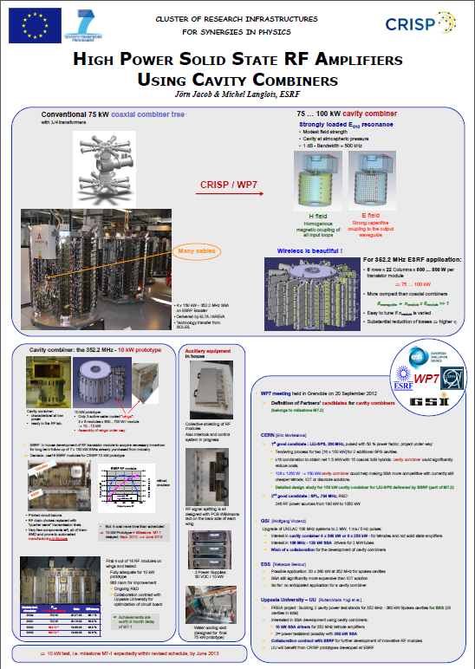
Cavity combiners
CRISP (Sept 2010)
  Jörn Jacob (ESRF) asked for support to the the development of cavity combiners receiving funding from the EU as work package WP7 in the framework of the FP7/ESFRI/CRISP program
  CERN immediately supported it
CRISP, 2nd yearly meeting, PSI 18-19 March 2013
  ESRF cavity combiner
  144:1 Cavity combiner for CERN-LIU-SPS
In addition, please refer to two excellent papers from ESRF at IPAC
  MOPC005-IPAC11, 352.2 MHZ – 150 kW Solid State Amplifiers at the ESRF
  WEPFI004-IPAC13, Commissioning of first 352.2 MHz - 150 kW Solid state amplifiers at the ESRF and status of R&D

Slide 28
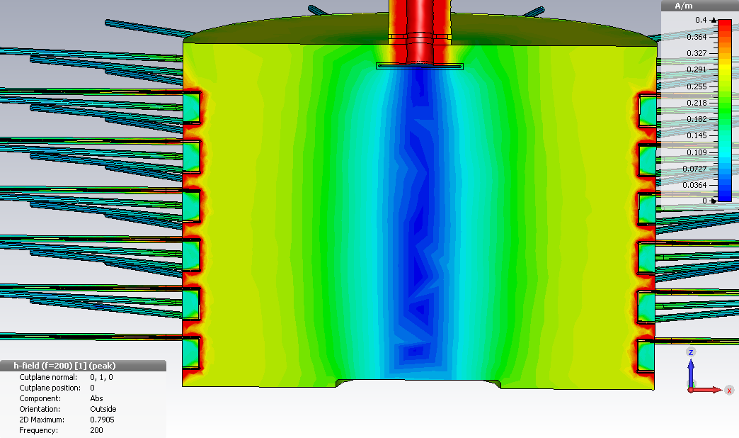
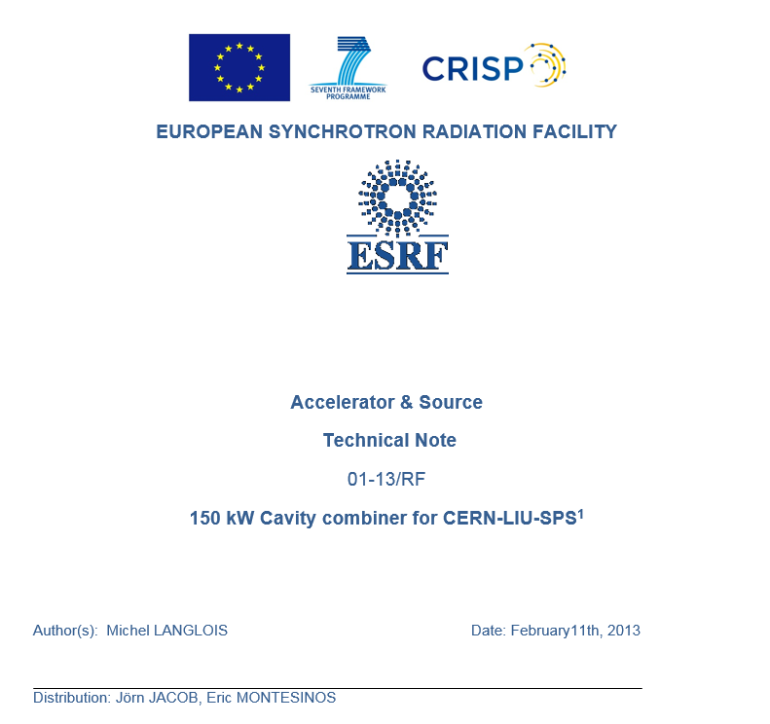
Cavity combiners
Based on ESRF Technical Note for
CERN-LIU-SPS under CRISP in Feb 2013, we built our own 144:1 cavity combiner

Slide 29
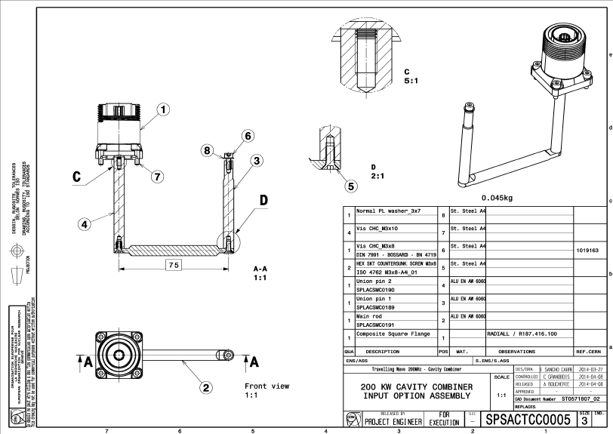
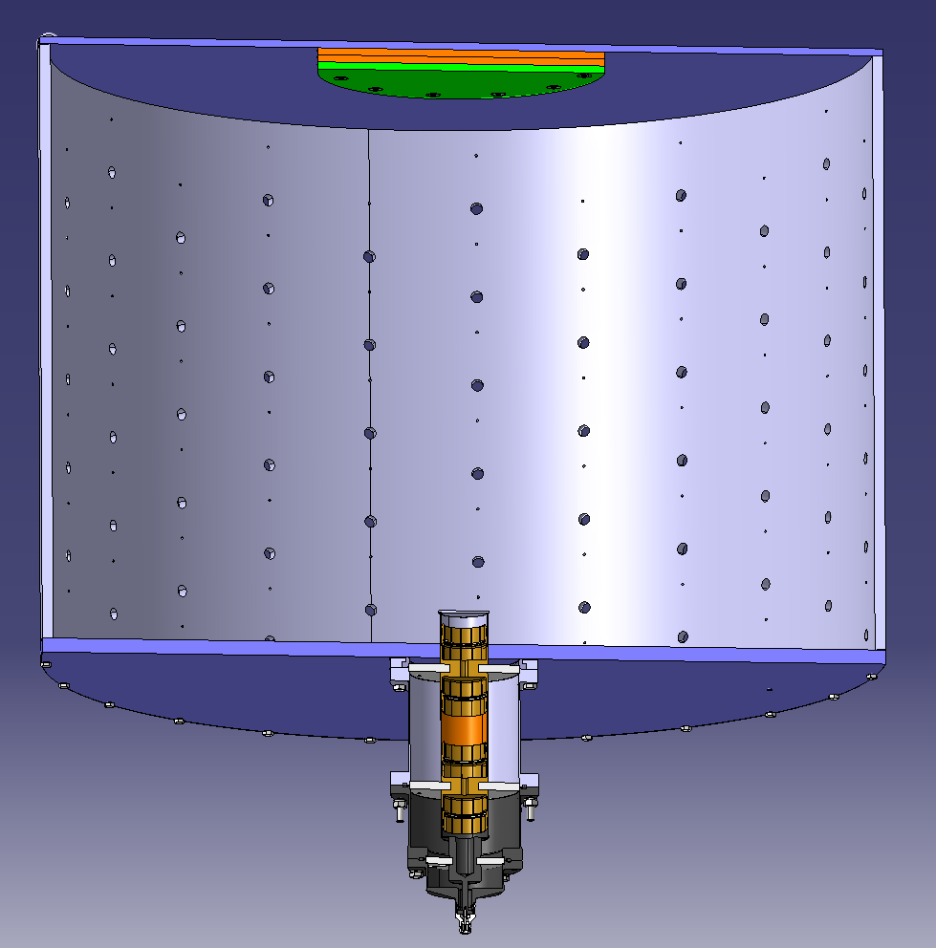
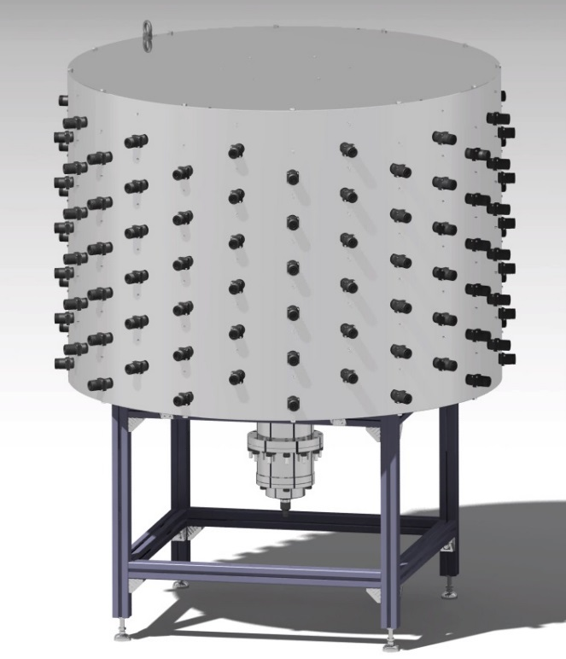
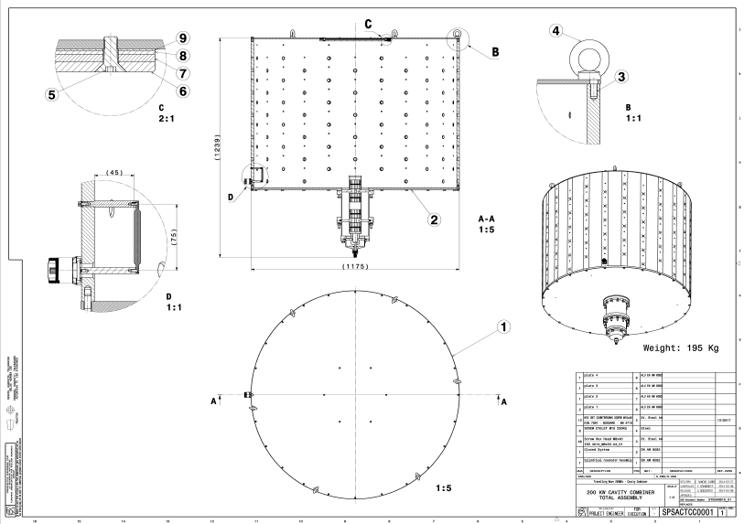
Cavity combiners
Based on ESRF Technical Note for
CERN-LIU-SPS under CRISP in Feb 2013, we built our own 144:1 cavity combiner

Slide 30
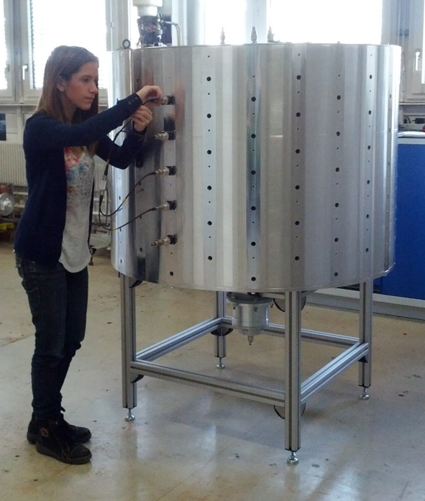
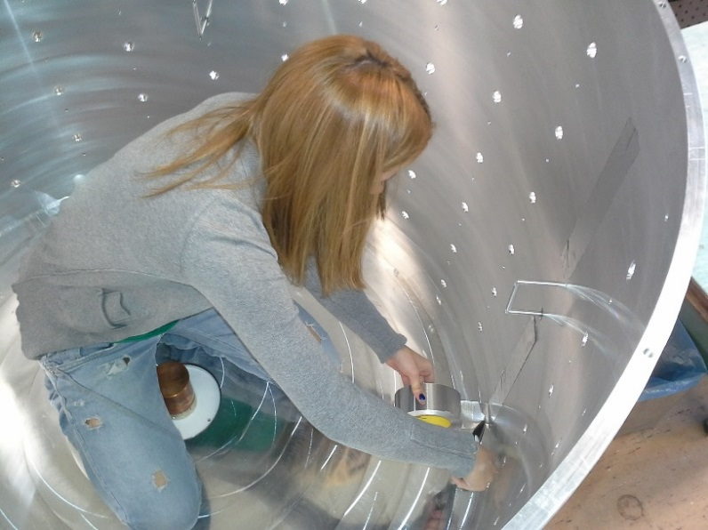
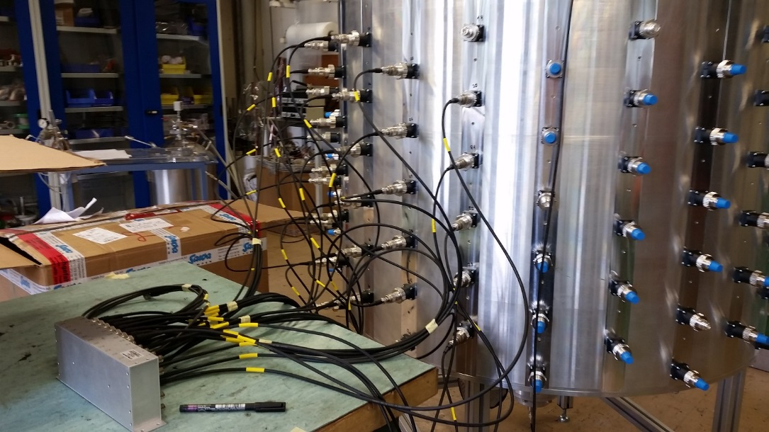
Cavity combiners
Based on ESRF Technical Note for
CERN-LIU-SPS under CRISP in Feb 2013, we built our own 144:1 cavity combiner

Slide 31
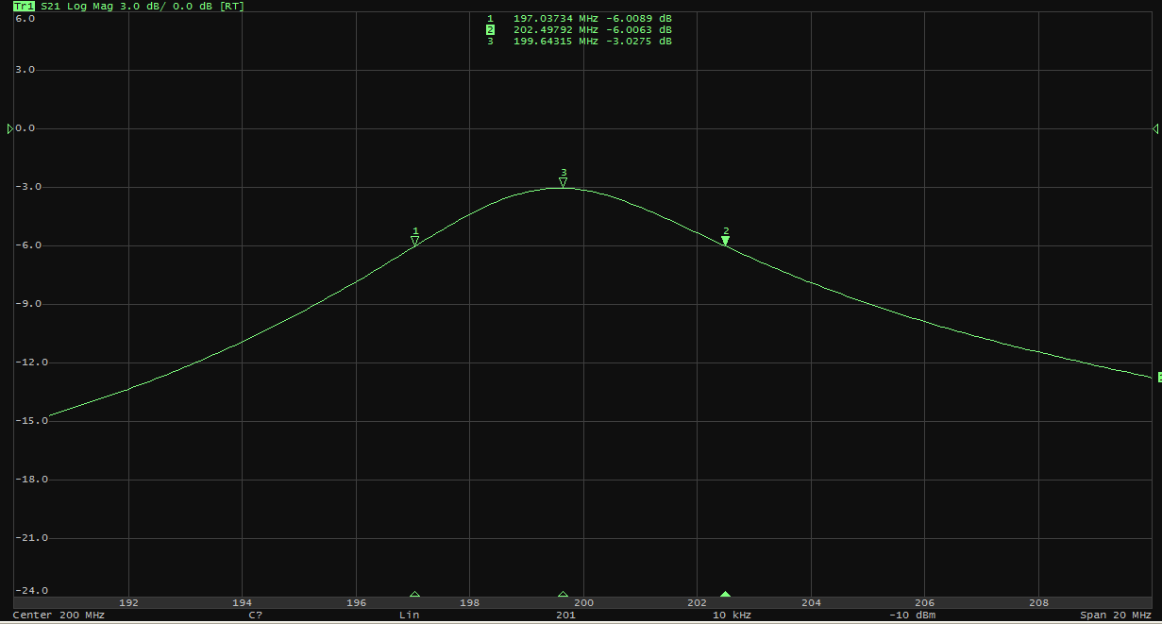
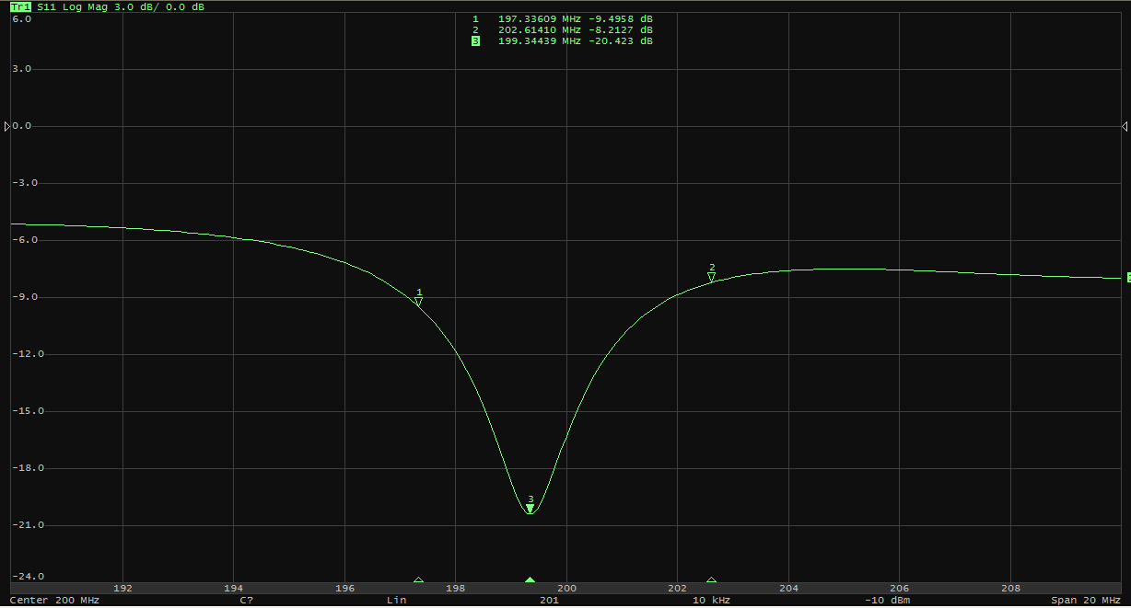
Cavity combiners
Based on ESRF Technical Note for
CERN-LIU-SPS under CRISP in Feb 2013, we built our own 144:1 cavity combiner
BW_{-3dB} 5.5 MHz
S₁₁ -20 dB

Slide 32
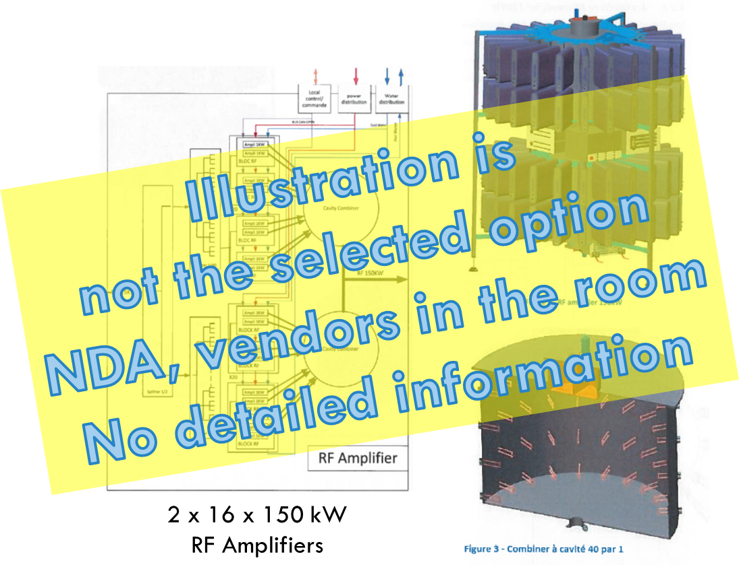
IT-3841, Finals
One Transmitter will be composed of
  16 x 144 kW RF amplifiers
One RF amplifier will be composed of
  80:1 cavity combiner
  80 x 2 kW RF blocs
  160 transistors
In total
  Two transmitters
  32 RF amplifiers
  2560 RF blocs
  5120 transistors
TCS proposal fully in line with our own R&D programs
  Small RF units based on 1 kW LDMOS transistors
  Cavity combiners
  New very interesting features covered by a NDA

Slide 33
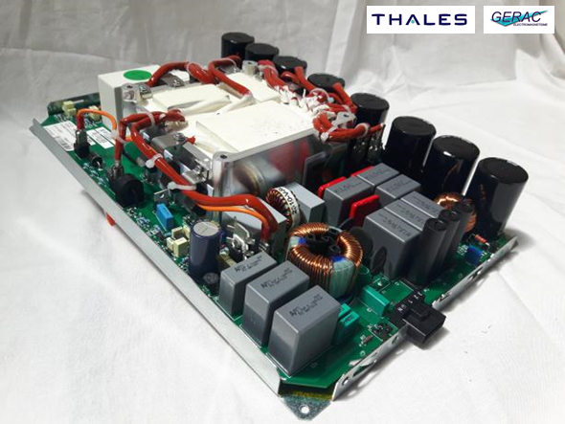

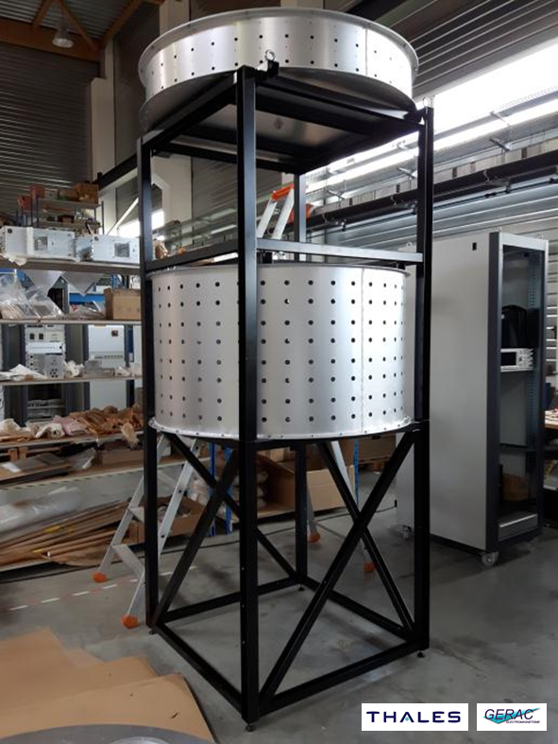

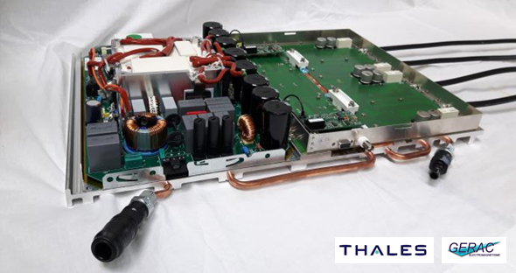

Progress report from last week (June 2016)
Specific Power supplies validated
First RF blocs tested up to 2 kW
First Input cavity splitter and first Output cavity combiner constructed

Slide 34
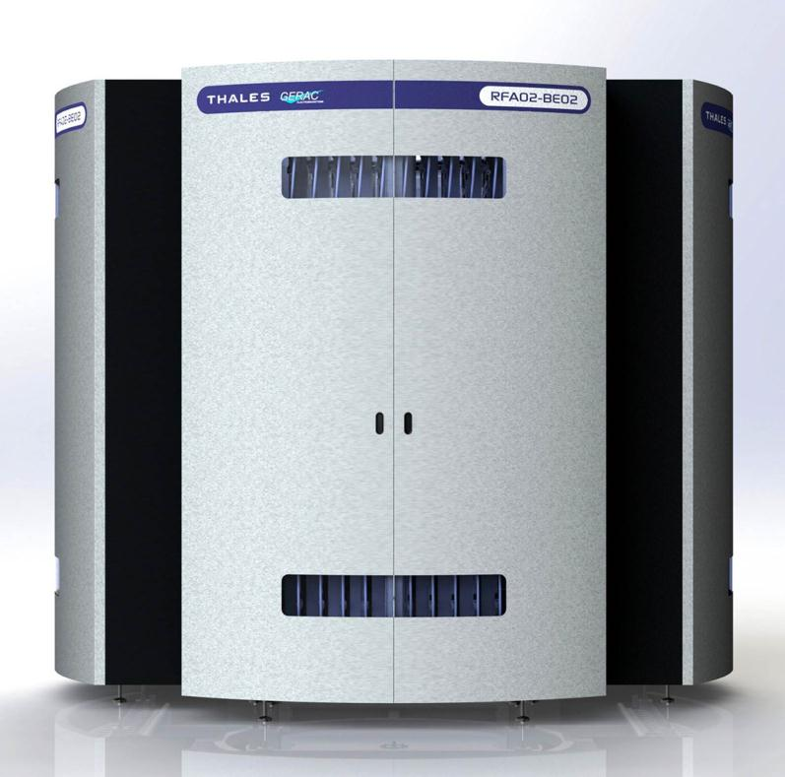
IT-3841, Schedule
Contract
Demonstrator FAT
1st Transmitter
Spares
Ready for LLRF
2016
2017
2018
2019
2020
DR
Demonstrator SAT
2nd Transmitter
End 15 | Contract awarded
Autumn 16 | Demonstrator
Autumn 17 | First transmitter of 16 RF amplifiers
Spring 18 | Second transmitter of 16 RF amplifiers
Summer 18 | All spares delivered
144 kW RF amplifier

Slide 35
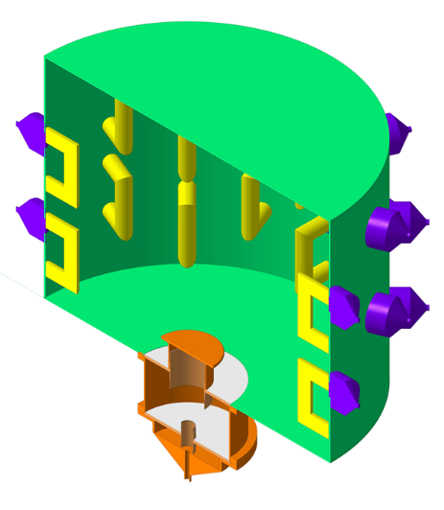
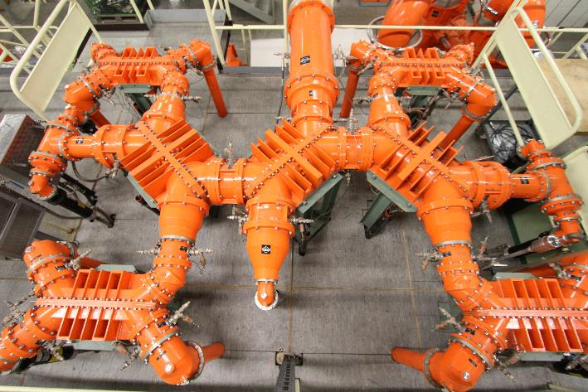
Very high power cavity Combiner
VHPCC (Very High Power Cavity Combiner)
  16:1
  150 kW inputs
  2.5 MW output
Each of our new transmitter will have
  one single VHPCC
  or
  the classical 3 dB combiner as we already have in the Philips plant
Two pictures almost on same scale

Slide 36
Present systems upgrade to 4 x 1.1 MW
Future
‘Siemens’
IT-3842 will also be used to upgrade Siemens and Philips plants
1 kW YL1440 tube & 10 kW YL 1520 tube do not exist anymore
Old relays and CMOS controls upgraded to new PLC controls
HVPS upgraded
100 W 10 kW
2 x 8 x RS 2004
6 spare trolleys
CC 80:1
Thales | 32
Siemens | 160 | Will free 4 x RS 2004 trolleys
Philips | 64 | One Driver to one Final or special CC
Total | 256 | 312 with IT-3842 contract
1 W 1 kW 50 kW
LLRF
To
cav
100 W 10 kW
1 W 1 kW 50 kW
LLRF
80:1
To
cav
Present
‘Siemens’
8 x 125 kW
Cavity Combiner
1 : 80 : 1
Minimize a
single failure effect
(Availability)
2 x 10 x RS 2004
2 spare trolleys
8 x 125 kW

Slide 37
Present systems upgrade to 4 x 1.1 MW
Future
‘Philips’
2 x 32 x TH 335
10 spare trolleys
Present
‘Philips’
IT-3842 will also be used to upgrade Siemens and Philips plants
1 kW YL1440 tube & 10 kW YL 1520 tube do not exist anymore
Old relays and CMOS controls upgraded to new PLC controls
HVPS upgraded
Thales | 32
Siemens | 160 | Will free 4 x RS 2004 trolleys
Philips | 64 | One Driver to one Final or special CC
Total | 256 | 312 with IT-3842 contract
100 W 35 kW
1 W 1 kW
LLRF
To
cav
LLRF
To
cav
100 W 35 kW
1 W 1 kW
2 x 34 x YL 1530
8 spares

Slide 38
Present systems upgrade to 4 x 1.1 MW
Future
‘Philips’
IT-3842 will also be used to upgrade Siemens and Philips plants
1 kW YL1440 tube & 10 kW YL 1520 tube do not exist anymore
Old relays and CMOS controls upgraded to new PLC controls
HVPS upgraded
Thales | 32
Siemens | 160 | Will free 4 x RS 2004 trolleys
Philips | 64 | One Driver to one Final or special CC
Total | 256 | 312 with IT-3842 contract
2 x 32 x TH 335
10 spare trolleys
1:32:1:32
To
cav
LLRF
Cavity Splitter – Combiner – Splitter
1 : 32 : 1 : 32
Minimize a single failure effect
(Availability)
VHPCC
32 : 1

Slide 39
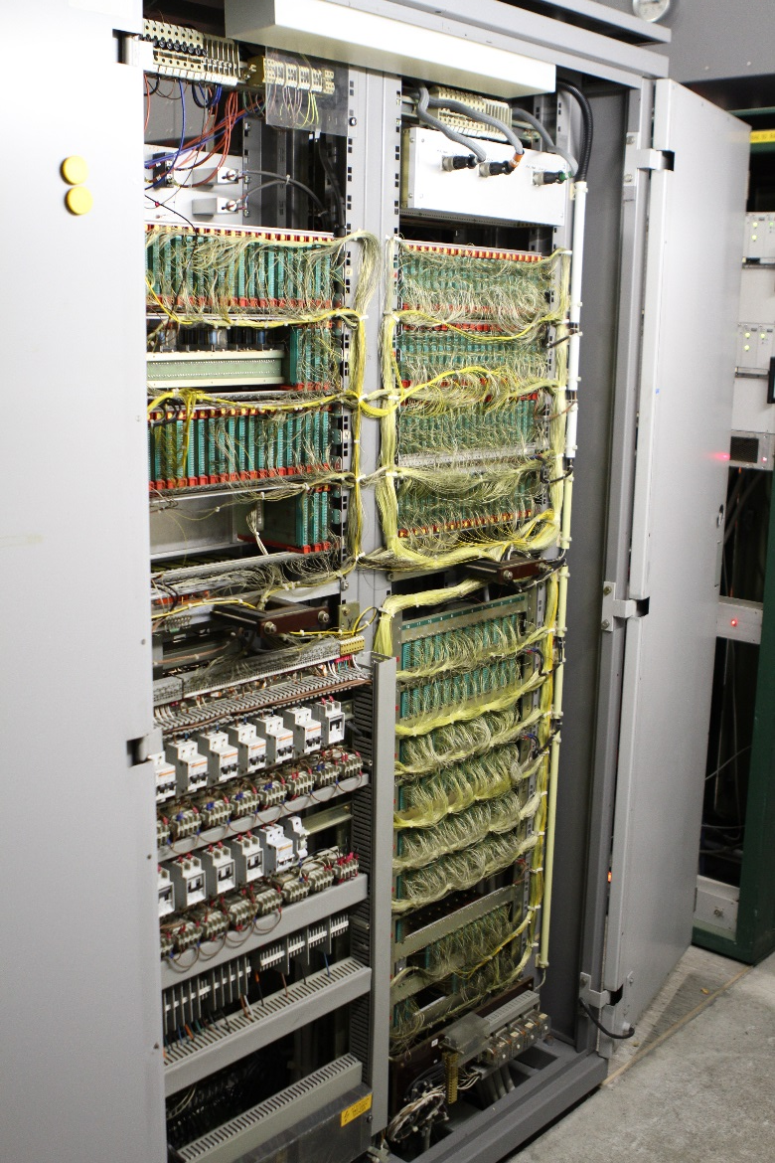
Present systems upgrade to 4 x 1.1 MW
IT-3842 will also be used to upgrade Siemens and Philips plants
1 kW YL1440 tube & 10 kW YL 1520 tube do not exist anymore
Old relays and CMOS controls upgraded to new PLC controls
HVPS upgraded
Thales | 32
Siemens | 160 | Will free 4 x RS 2004 trolleys
Philips | 64 | One Driver to one Final or special CC
Total | 256 | 312 with IT-3842 contract
One of the four wire wrap control system of the ‘Philips’ power plant since 1980
Very reliable controls but wire insulators and connectors are brittle nowadays
Thousands of contacts to be reconnected

Slide 40
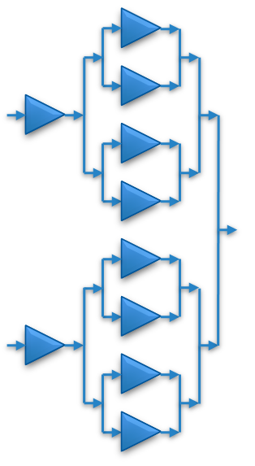
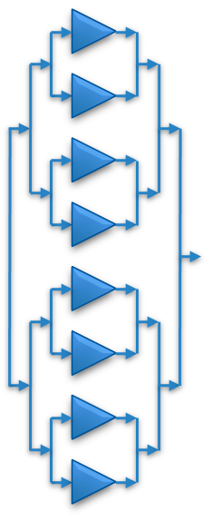
Present systems upgrade to 4 x 1.1 MW
HVPS – Driver
1.1 MVA HVPS
4 Finals
2.2 MVA HVPS
all Finals
Crowbar
Crowbar
Crowbar
HV switches
HV switches
Present
HVPS
Future
HVPS
HVPS 1.1 MVA
4 Finals
HVPS – Driver
Crowbar
Crowbar
HV switches

Slide 41
Exciting years to come
We spent quite some time on
  RF Building BFA3
  Amplifiers, Drivers and Finals
  With this project CERN strongly moved into the SSPA world
Thanks to SOLEIL, with special thanks to
Patrick Marchand and Ti Ruan
Thanks to ESRF, with special thanks to
Jörn Jacob and Michel Langlois
Now we will deeply focus on
  Cavity combiners
  HVPS
  Controls
  Coaxial lines
  Tunnel LSS3
  Cavities
  FPC (WWFPC#2 12-13 July at CERN, if you have any topic you would like us to address, please let me know)

Slide 42



Thank you so much for your attention
See you in two years
to report the (hopefully) good results

