Slide 1

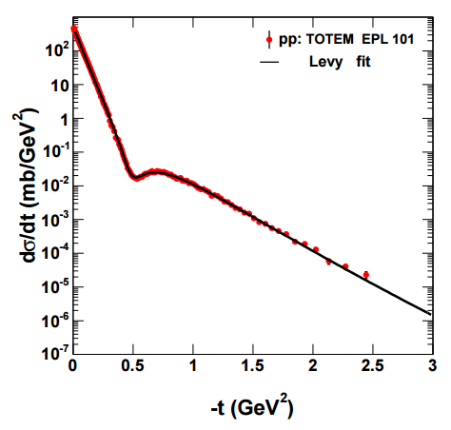
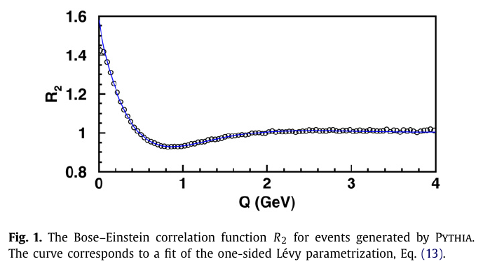
Model independent analysis method for the differential cross-section of elastic pp scattering
T. Novák¹, T. Csörgő^{1,2} and A. Ster²
¹KRF, Gyöngyös, Hungary
²Wigner RCP, Budapest, Hungary
OUTLINE
Model-independent shape analysis:
General introduction
Edgeworth, Laguerre
Levy expansions
Application in elastic pp scattering
Summary

Slide 2
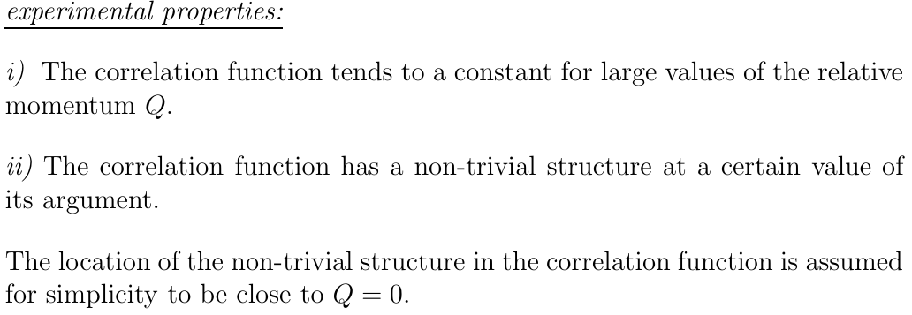
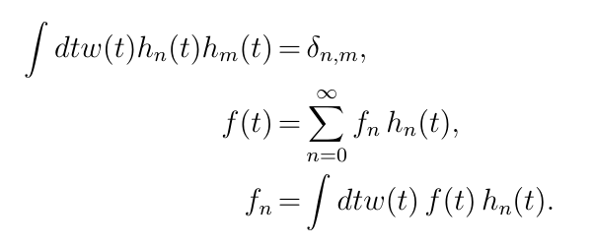

MODEL - INDEPENDENT SHAPE ANALYIS I.
Model-independent but experimentally testable:
w(t) measure in an abstract H-space
approximate form of the correlations
t: dimensionless scale variable

Slide 3
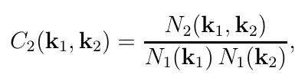

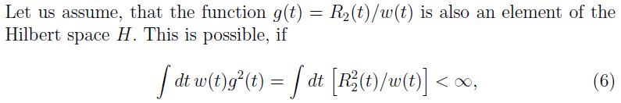
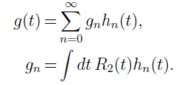

MODEL - INDEPENDENT SHAPE ANALYIS II.
Then the function g can be expanded as
From the completeness of the Hilbert space and from the assumption that g(t) is in the Hilbert space:

Slide 4




MODEL - INDEPENDENT SHAPE ANALYIS III.
Model-independent AND experimentally testable:
method for any approximate shape w(t)
the core-halo intercept parameter of the CF is
coefficients by numerical integration (fits to data)
condition for applicability: experimentally testabe

Slide 5
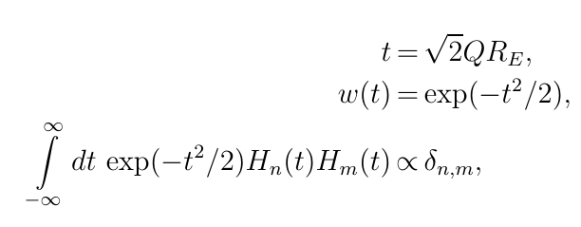
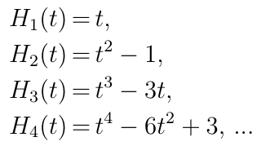
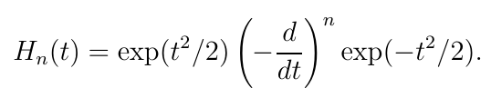
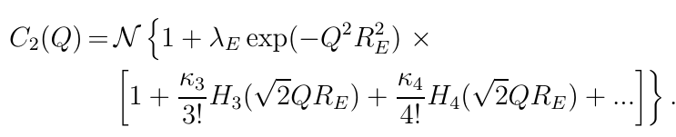
EDGEWORTH EXPANSION: ~ GAUSSIAN
3d generalization straightforward
Applied by NA22, L3, STAR, PHENIX, ALICE, CMS (LHCb?)

Slide 6
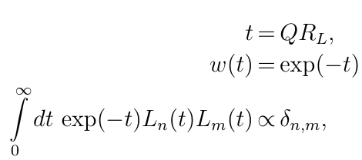


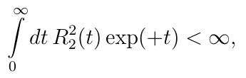

LAGUERRE EXPANSIONS: ~ EXPONENTIAL
Model-independent but experimentally tested:
  w(t) exponential
  t: dimensionless
  Laguerre polynomials
First successful tests
  NA22, UA1 data
  convergence criteria satisfied
  intercept parameter ~ 1

Slide 7
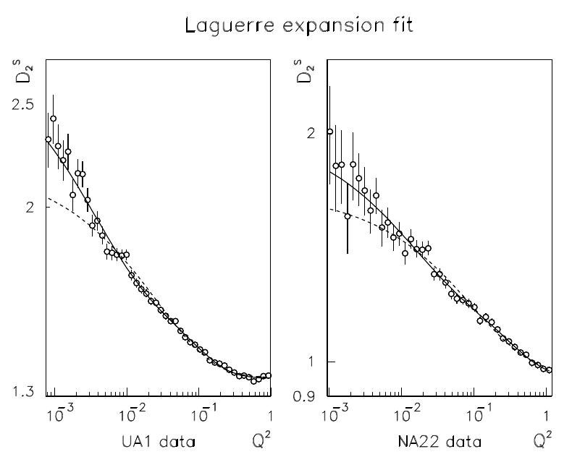
LAGUERRE EXPANSIONS: ~ superEXPONENTIAL
T. Csörgő and S: Hegyi, hep-ph/9912220, T. Csörgő, hep-ph/001233

Slide 8
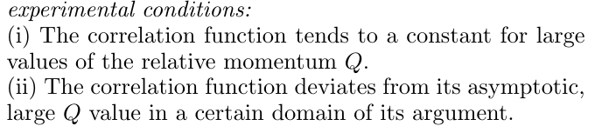




MINIMAL MODEL ASSUMPTION: LEVY
Model-independent but:
  Assumes that Coulomb can be corrected
  No assumptions about analyticity yet
  For simplicity, consider 1d case first
  For simplicity, consider factorizable x k
  Normalizations :
    density
    multiplicity
    single-particle spectra
T. Cs, S. Hegyi, W.A. Zajc, EPJ C36, 67 (2004)

Slide 9



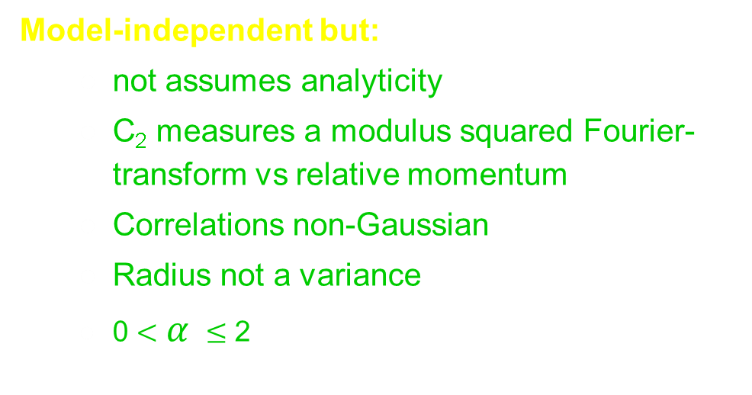
MINIMAL MODEL ASSUMPTION: LEVY
Model-independent but:
  not assumes analyticity
  C₂ measures a modulus squared Fourier-transform vs relative momentum
  Correlations non-Gaussian
  Radius not a variance
  0 $<$ $α$ $≤$ 2
T. Cs, S. Hegyi, W.A. Zajc, EPJ C36, 67 (2004)

Slide 10


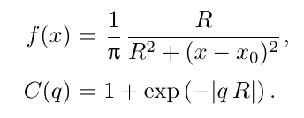
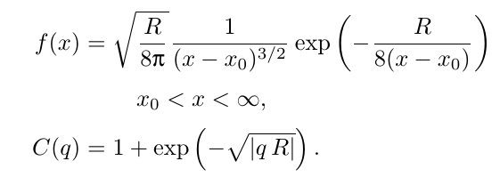
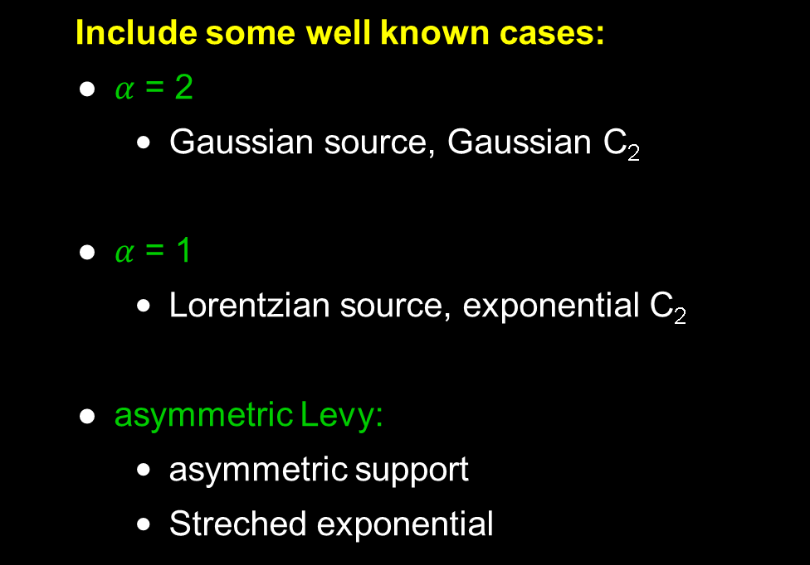
UNIVARIATE LEVY EXAMPLES
Include some well known cases:
  $α$ = 2
    Gaussian source, Gaussian C₂
  $α$ = 1
    Lorentzian source, exponential C₂
  asymmetric Levy:
    asymmetric support
    Streched exponential
T. Cs, hep-ph/0001233, T. Cs, S. Hegyi, W.A. Zajc, EPJ C36, 67 (2004)

Slide 11


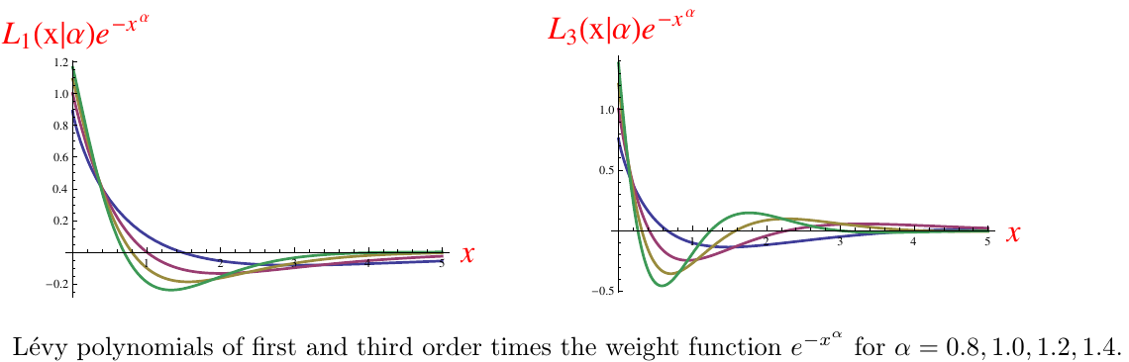

LEVY EXPANSIONS: ~ 1d LEVY
Model-independent but:
  Levy generalizes exponentials and Gaussians
  ubiquoutous in nature
  How far from a Levy?
  Need new set of polynomials orthonormal to a Levy weight
M. de Kock, H. C. Eggers, T. Cs: arXiv:1206.1680v1 [nucl-th]

Slide 12

LEVY EXPANSIONS: ~ 1d LEVY
In case of $α$= 1 Laguerre is ok
These reduce to the
Laguerre expansions and
Laguerre polynomials.

Slide 13
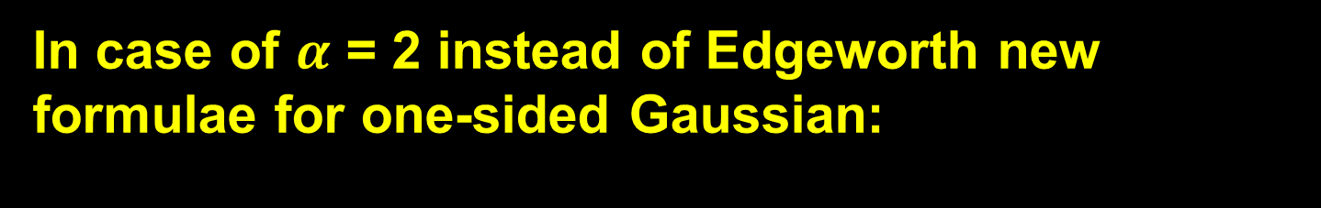
LEVY EXPANSIONS: ~ 1d LEVY
In case of $α$ = 2 instead of Edgeworth new formulae for one-sided Gaussian:
Provides a new expansion around a Gaussian shape
that is defined for the non-negative values of t only.
arXiv:1604.05513 [physics.data-an]

Slide 14
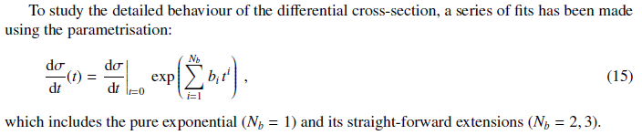
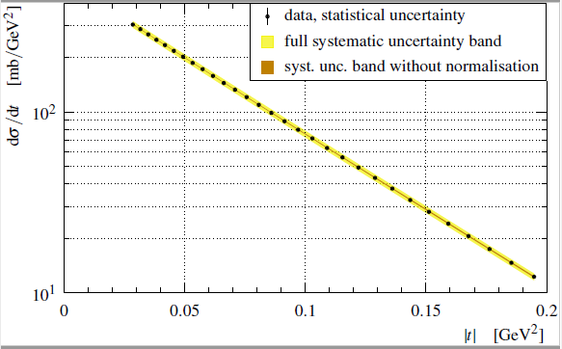
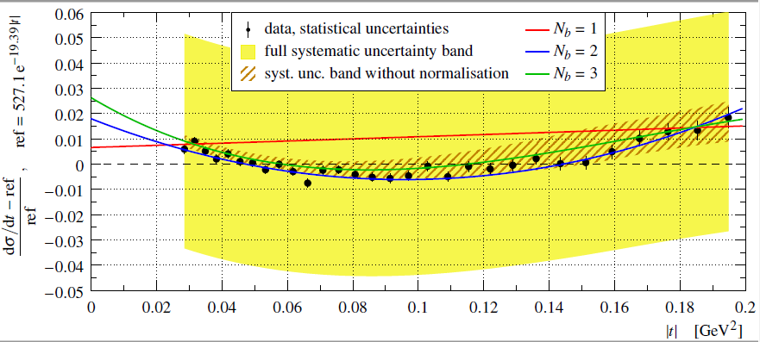
Non-Exponential Differential cross-section

Slide 15
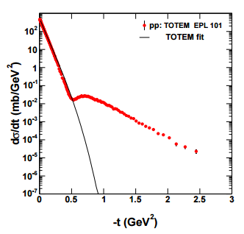
However, this method does not extrapolate well

Slide 16


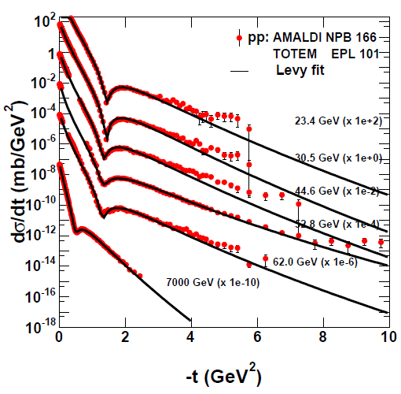
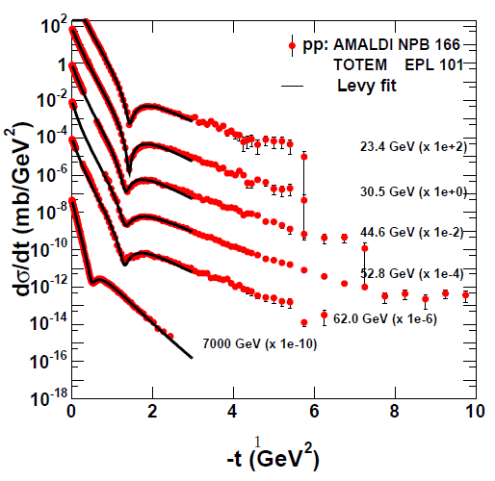
Levy expansion fit

Slide 17
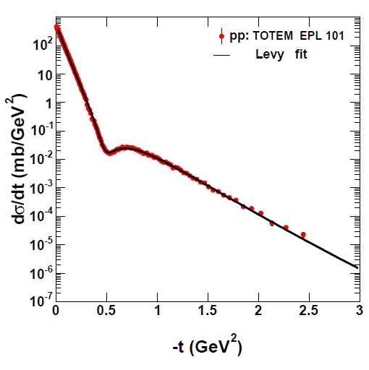

Slide 18
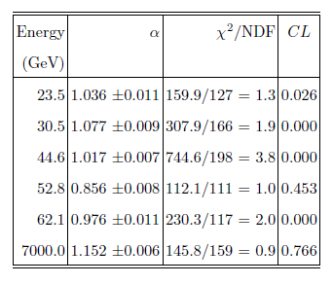
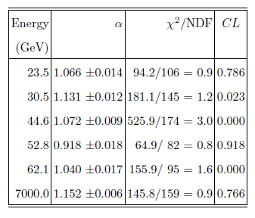
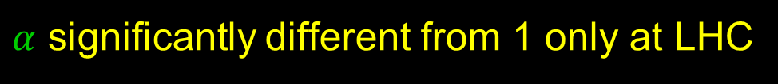
Fit results
Fit range:
Up to –t=10 GeV² Up to –t=3 GeV²
$α$ significantly different from 1 only at LHC

Slide 19
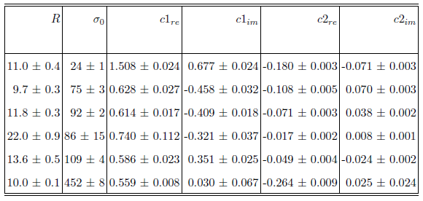
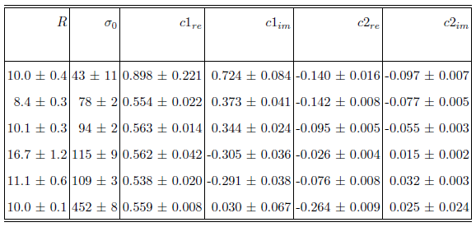
Fit results - parameters
-t<10GeV²
-t<3GeV²

Slide 20
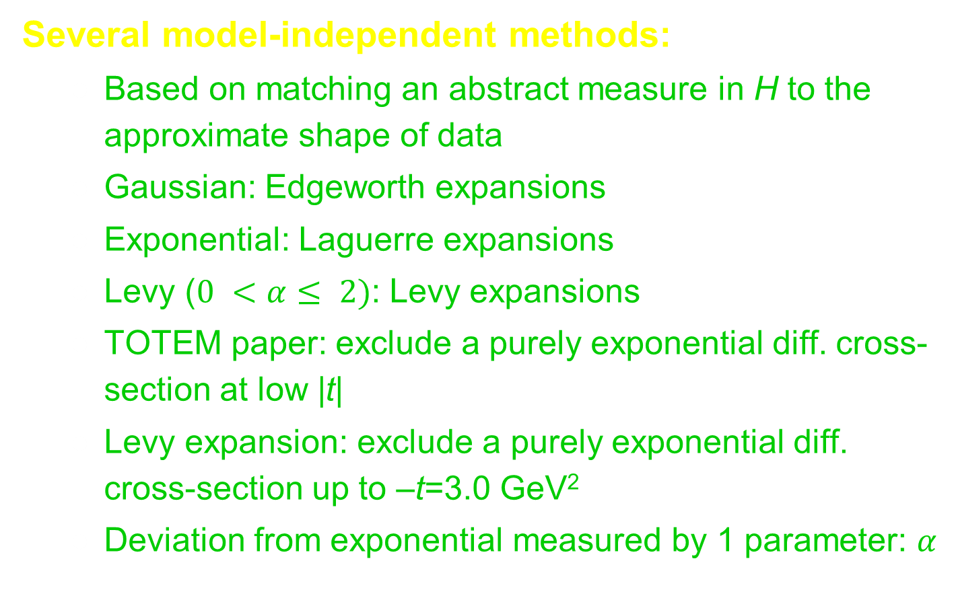
SUMMARY AND CONCLUSIONS
Several model-independent methods:
  Based on matching an abstract measure in H to the approximate shape of data
  Gaussian: Edgeworth expansions
  Exponential: Laguerre expansions
  Levy ($0 <α≤ 2)$: Levy expansions
  TOTEM paper: exclude a purely exponential diff. cross-section at low |t|
  Levy expansion: exclude a purely exponential diff. cross-section up to –t=3.0 GeV²
  Deviation from exponential measured by 1 parameter: $α$

