Slide 1

LHC and its Experiments -
on Rubik’s Void, with a Black Hole
T. Csörgő
MTA Wigner FK, Budapest and KRF, Gyöngyös, Hungary
BerzeTÖK: Science Club of
Berze Secondary and Middle School

Slide 2
PARTICLE GAMES – STUDENT IDEA
2011: Four basic particle card games
by Cs. Török, Judit Csörgő, T. Cs., BerzeTÖK Science Club in Gyöngyös, Hungary
  1. ANTI
  2. Cosmic Showers
  3. Let’s Detect!
4. Quark Matter Card Game
2012: talks, demonstrations and presentations
  5. Memory of Quark Matter arXiv:1303.2798
  Find Your Own Higgs Boson arXiv:1303.2732
  Particle Poker (Academia Europaea, Bergen)
  Particle 66, Machiavelli (CERN Open Days)
2013: talks, demonstrations and presentations
  9. Quark Wars: Summer Camp of Berze Science Club, Visznek
  10. Particle Mahjongg - Mártély, Camp of Science Club Movement
2014: WPCF 2014 conference, KRF, Gyöngyös, Hungary
11. Quark Matter on Rubik’s Cube
12. Particle Hits! – CERN @ Wigner Open Days, Budapest
2016: Low-x 2016, KRF, Gyöngyös, Hungary
13. LHC Experiments Rubik’s Void, with a Black Hole

Slide 3
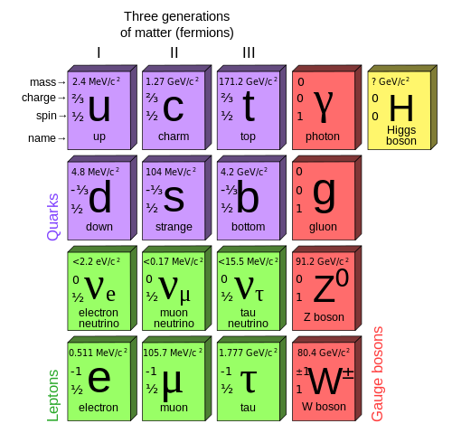
ELEMENTARY PARTICLES

Slide 4





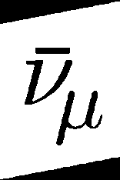
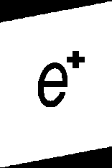
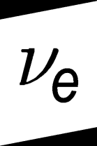
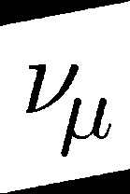
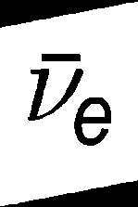

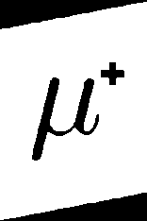
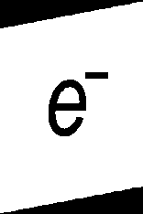
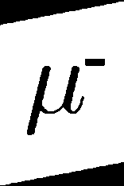
ELEMENTARY PARTICLES
- PLAYFULLY
ANTI-
PARTICLES

Slide 5
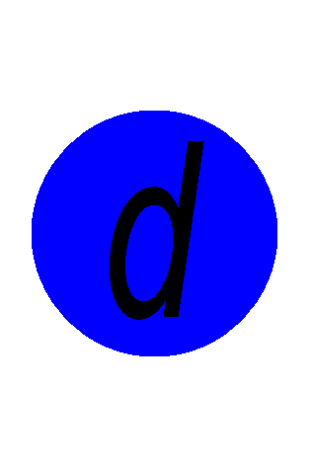




SU(3) COLOR AND OPTICAL COLOR
Mesons
Baryons

Slide 6
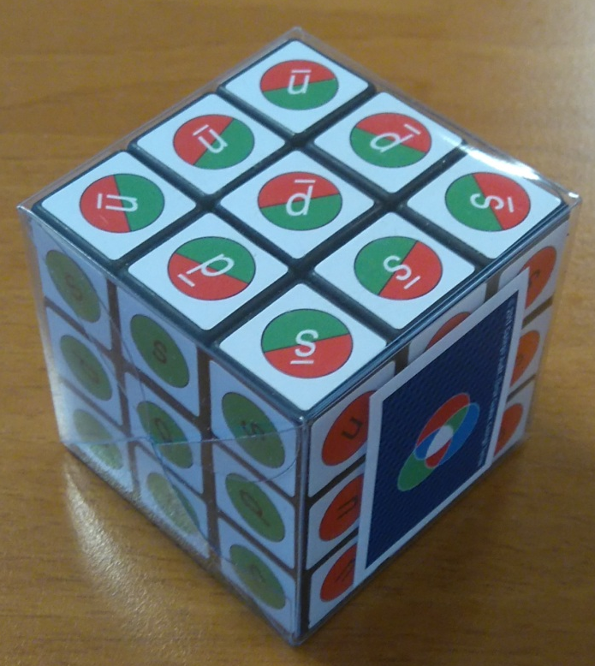
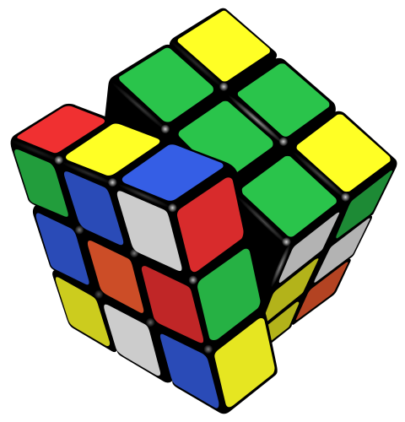
QUARK MATTER – ON RUBIK’S CUBE
Perfect Fluid of Quarks – on Rubik’s Cube
locally, color is deconfined
globally, color neutral
  Red opposite to anti-red (green/blue)
  Green opposite to anti-green (blue/red)
  Blue opposite to anti-blue (red/green)
quarks opposite to anti-quarks
conservation laws
rotates and „expands”
large degree of internal disorder (entropy)
small shear – illustration of perfect fluidity

Slide 7
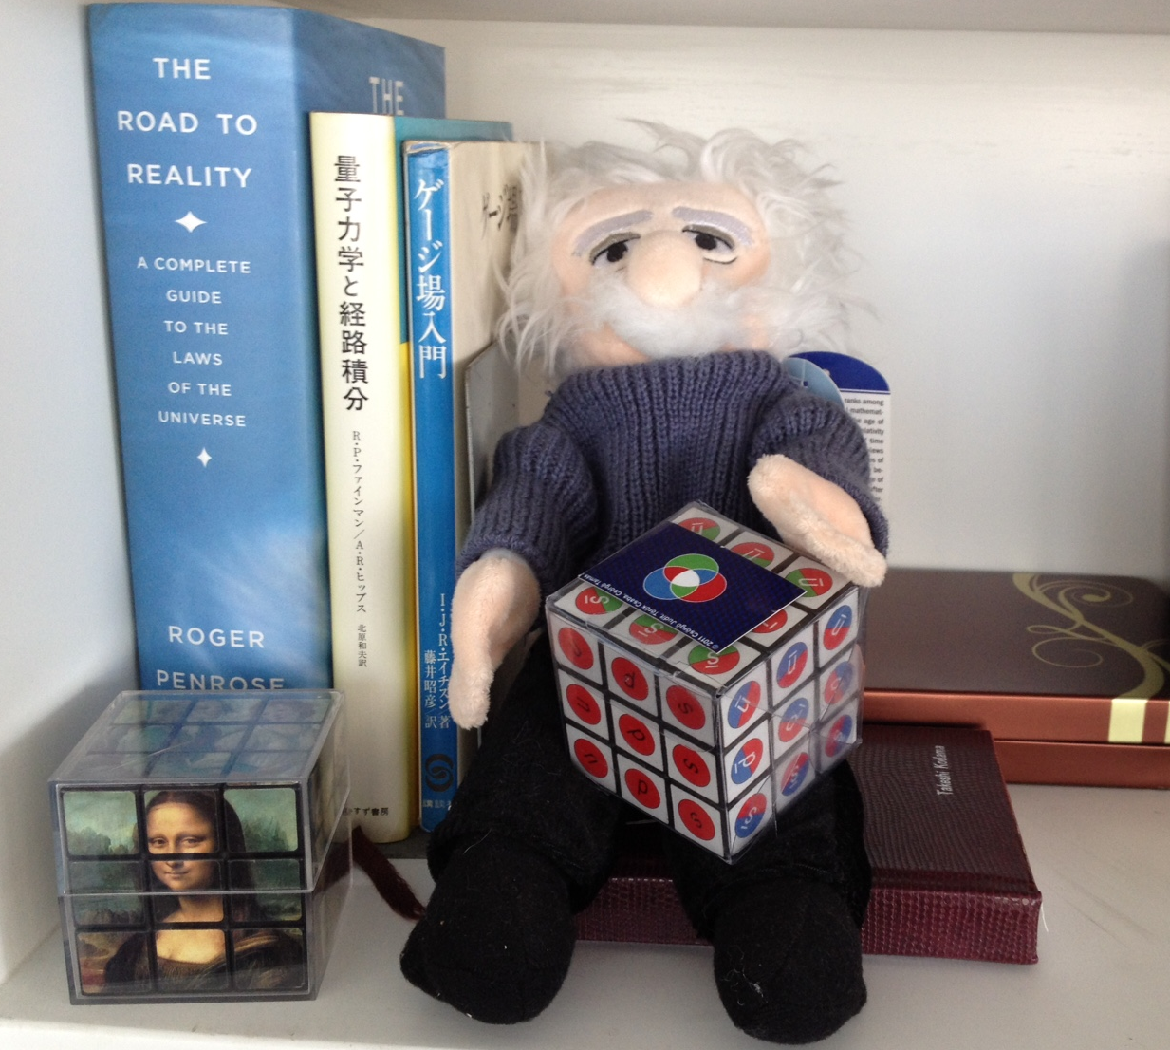
Quark Matter – with a Smile
From Professor T. Kodama (Brazil)
connecting
Albert Einstein,
Mona Lisa Cube,
Quark Matter Cube,
and the Road to Reality:
a Complete Guide to Nature.
Maybe particle games are not so complete,
but their way is certainly
so interesting.

Slide 8

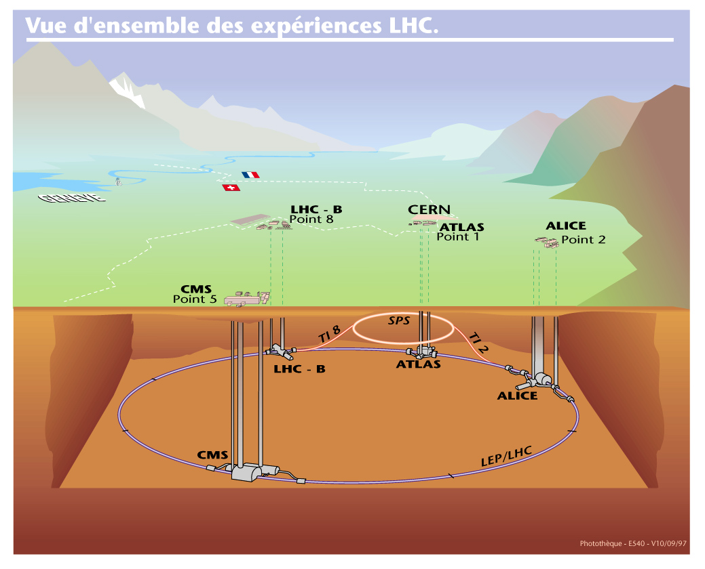
LHC and its Experiments

Slide 9
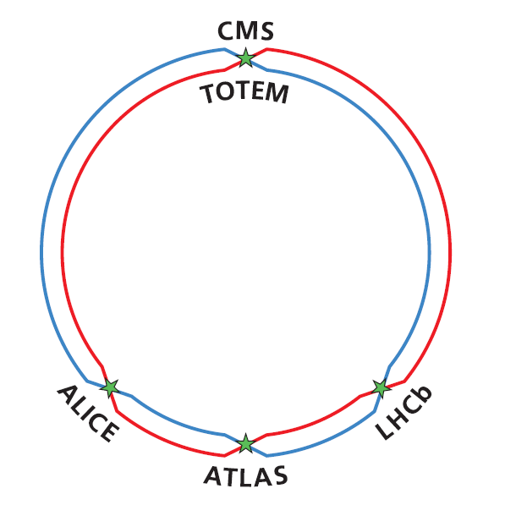
LHC and its 5 major experiments

Slide 10
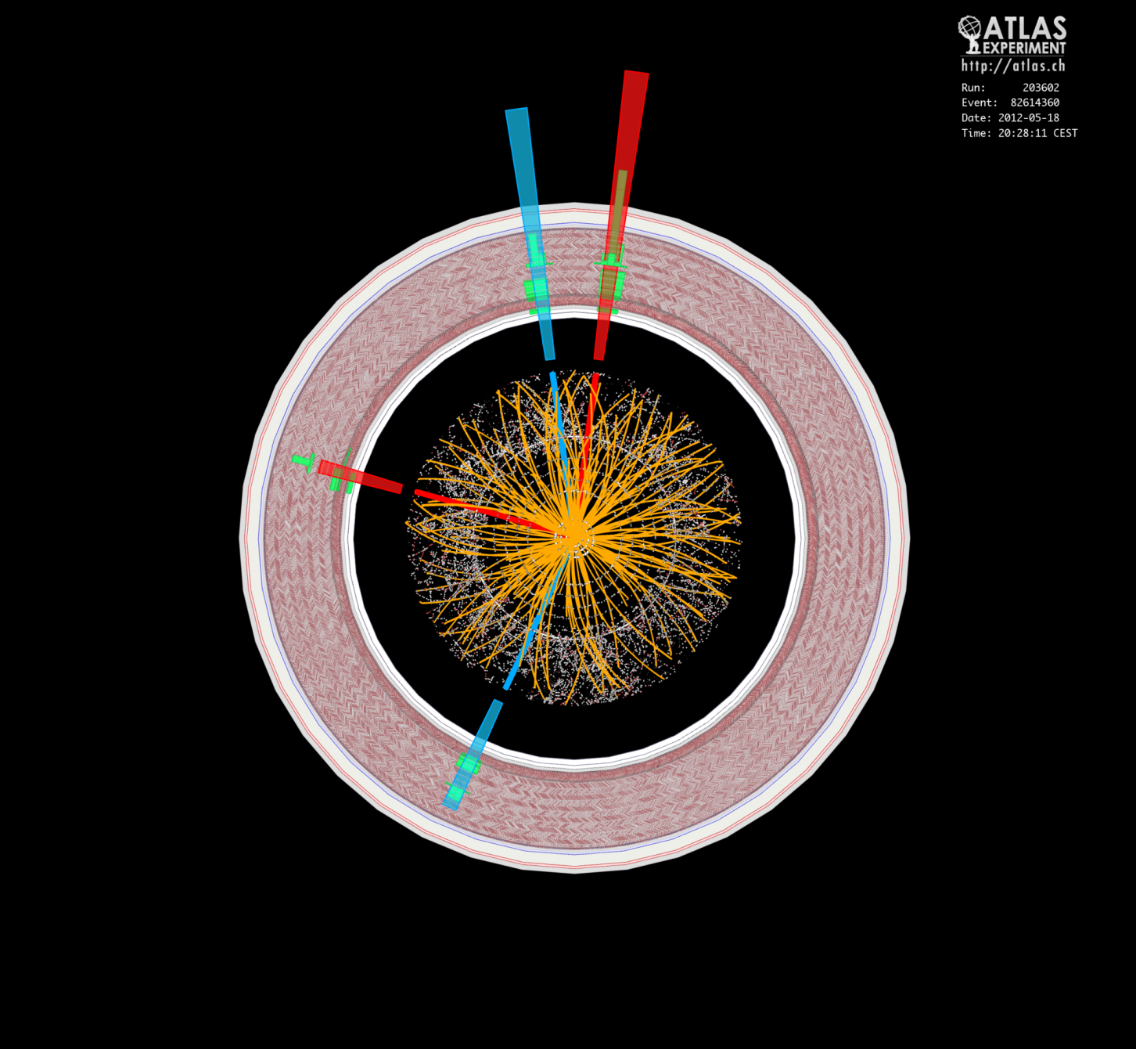
ATLAS

Slide 11
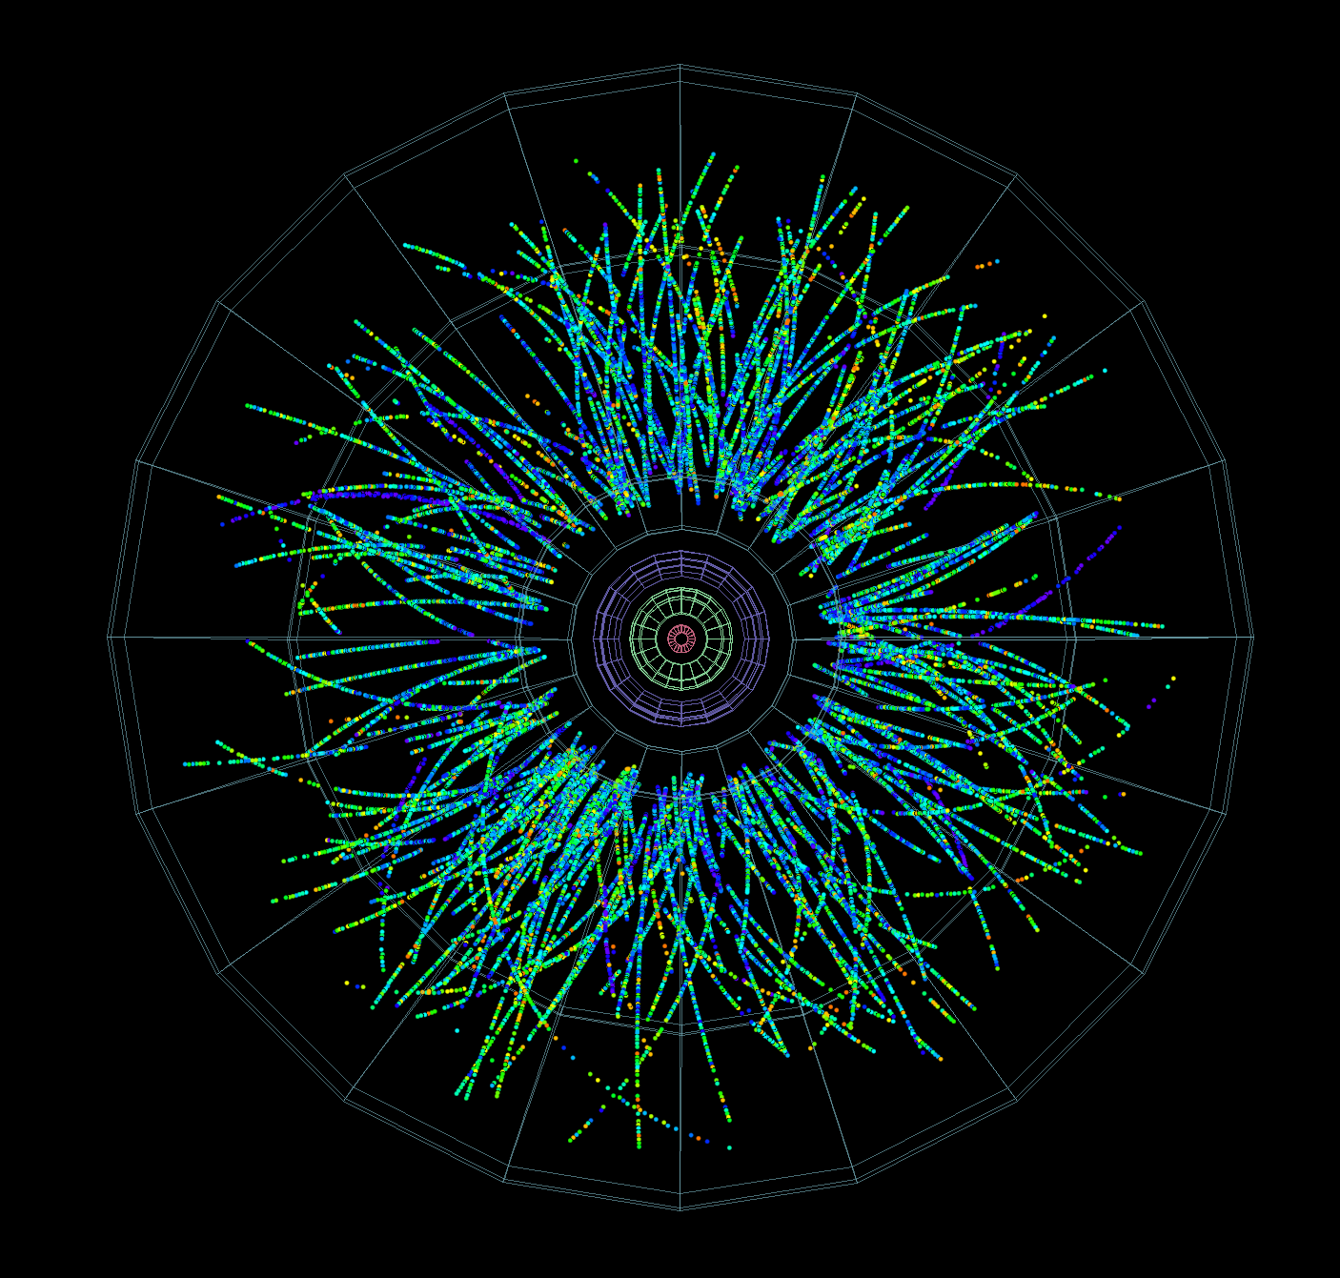
ALICE

Slide 12
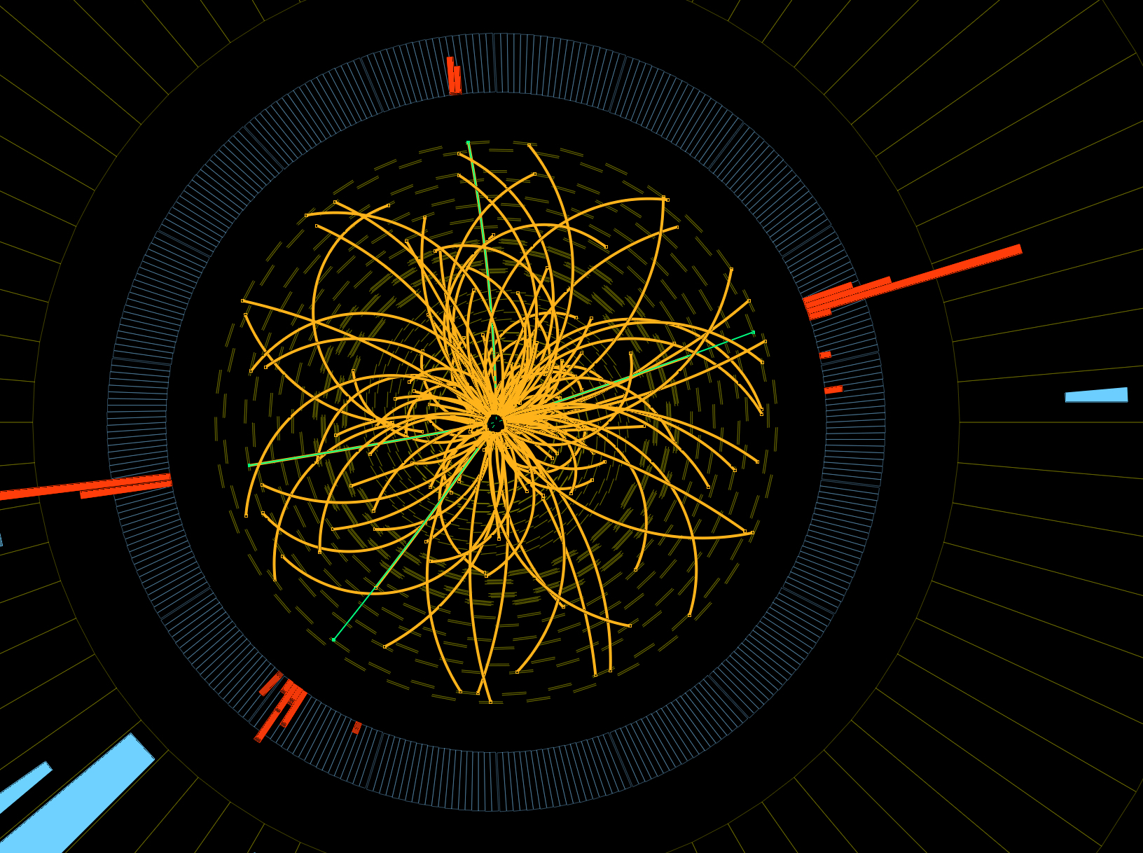
CMS

Slide 13
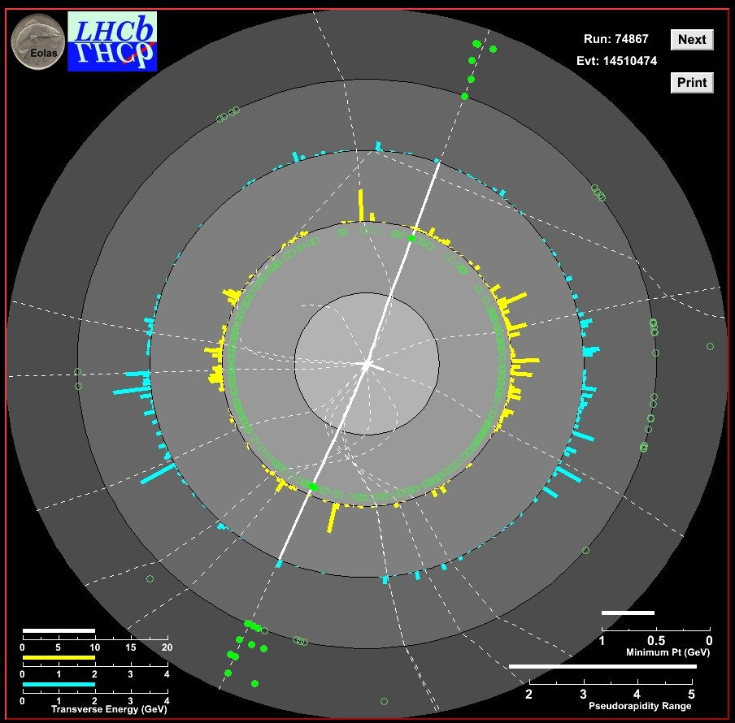
LHCb

Slide 14
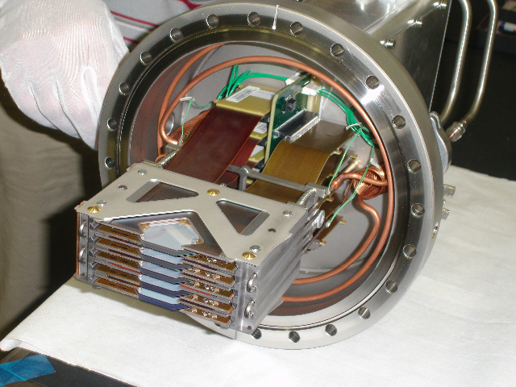
TOTEM

Slide 15
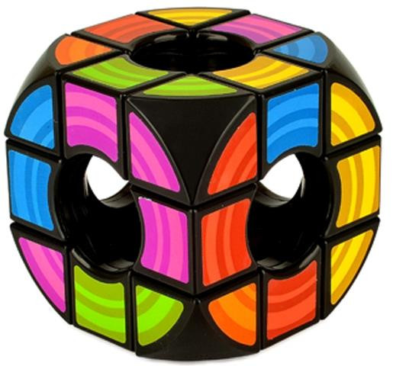
Rubik’s Void Cube

Slide 16
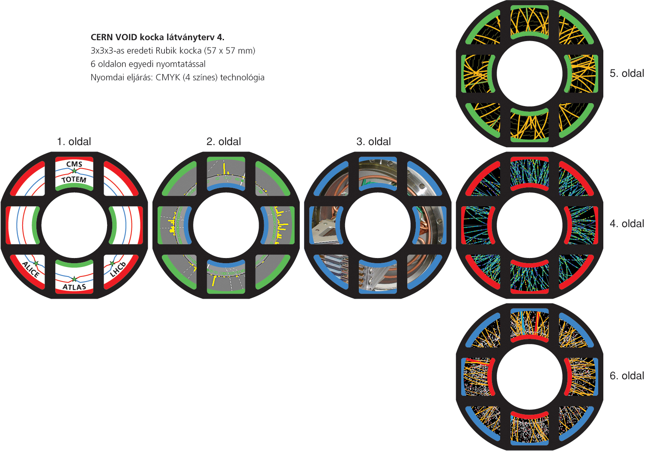
LHC Experiments on Rubik’s Void
CMS
LHC
LHCb
TOTEM
ALICE
ATLAS

Slide 17
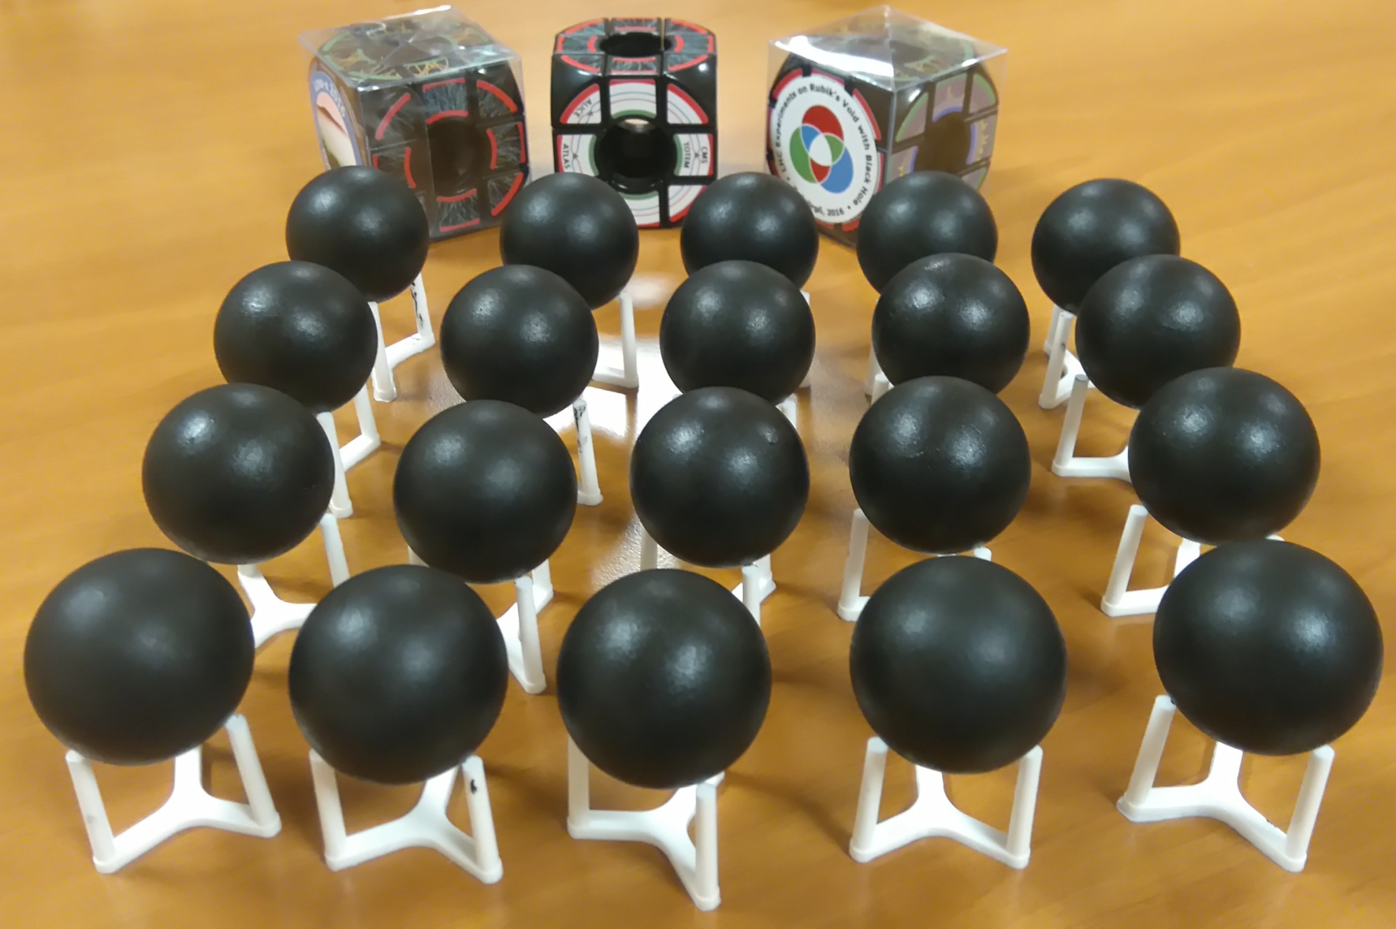
Putting things together: LHC + black hole

Slide 18

Thank you for your attention!

Slide 19
Legal info:
Pictures on the Rubik Void 3x3 and the packing material are derivative works
Rubik company has IP rights for the design and the layout of the Rubik’s Void cube.
The pictures layed out on the faces of the Rubik Void 3x3 cube are CERN material.
T. Csörgő, the author greatfully acknowledges the permission of the CERN Press Office to use these pictures in this educational game, credits CERN as the source of Figures and holds CERN free and harmless in connection with the use of these pictures.
CERN retains copyright of these images, as explained in detail at
http://copyright.web.cern.ch/
Designed © T. Csörgő, presented at Low-x 2016, Gyöngyös, on June 10, 2015.

