Slide 1
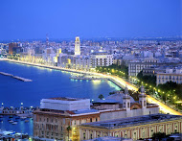
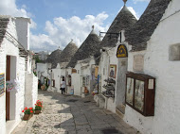
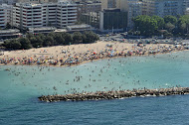
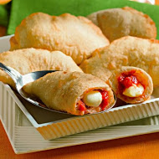

Low x 2017: Region of Bari, Italy
M. Capua
R. Fiore
A. Papa
E. Tassi
N. Minafra
June 2017, exact date/place to be decided

