Slide 1
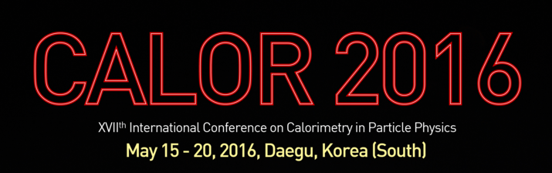
R&D for high resolution calorimetry at the future Electron-ion collider
Carlos Muñoz Camacho
(for the eRD1 calorimetry consortium)
Institut de Physique Nucléaire d’Orsay,
CNRS/IN2P3 (France)
munoz@ipno.in2p3.fr

Slide 2
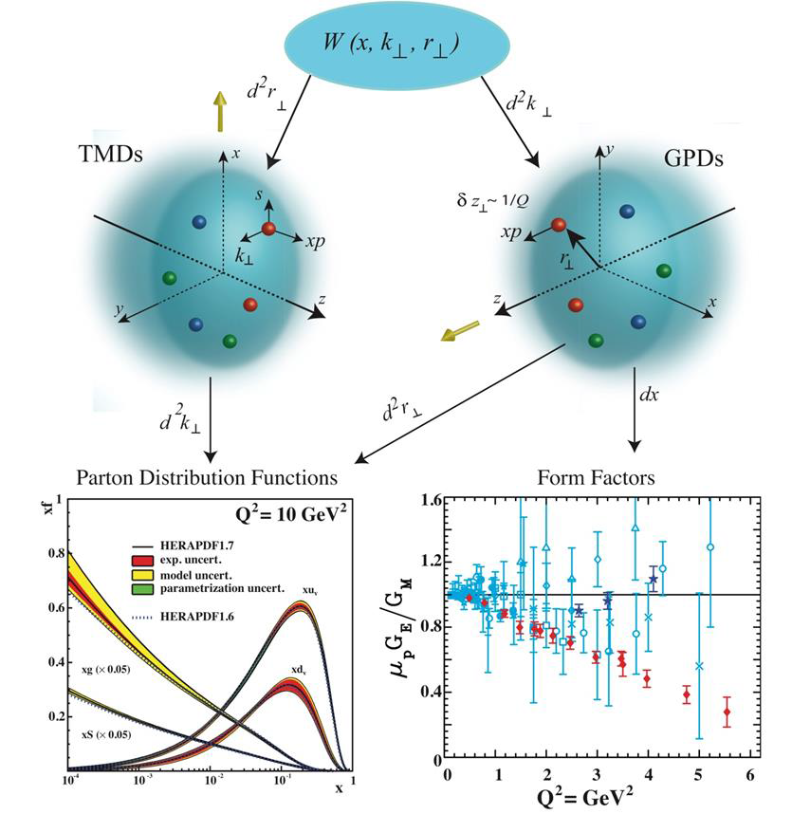
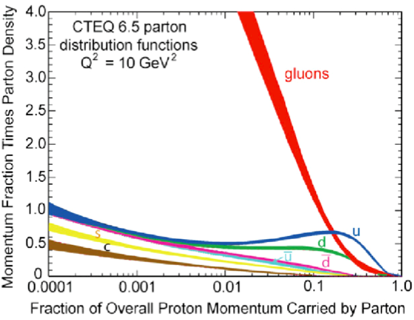
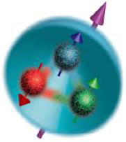
Electron-Ion Collider: physics highlights
3D structure of the nucleon is nontrivial
Far more than the simple valence quark structure
How proton properties arise from the elementary constituents?
How do gluons confine themselves into hadrons?
Gluon dynamics plays a large role in proton spin
Spin=intrinsic (parton spin) + motion (orbital angular momentum)
Dynamical balance between gluon radiation and recombination
Saturation of gluons?

Slide 3
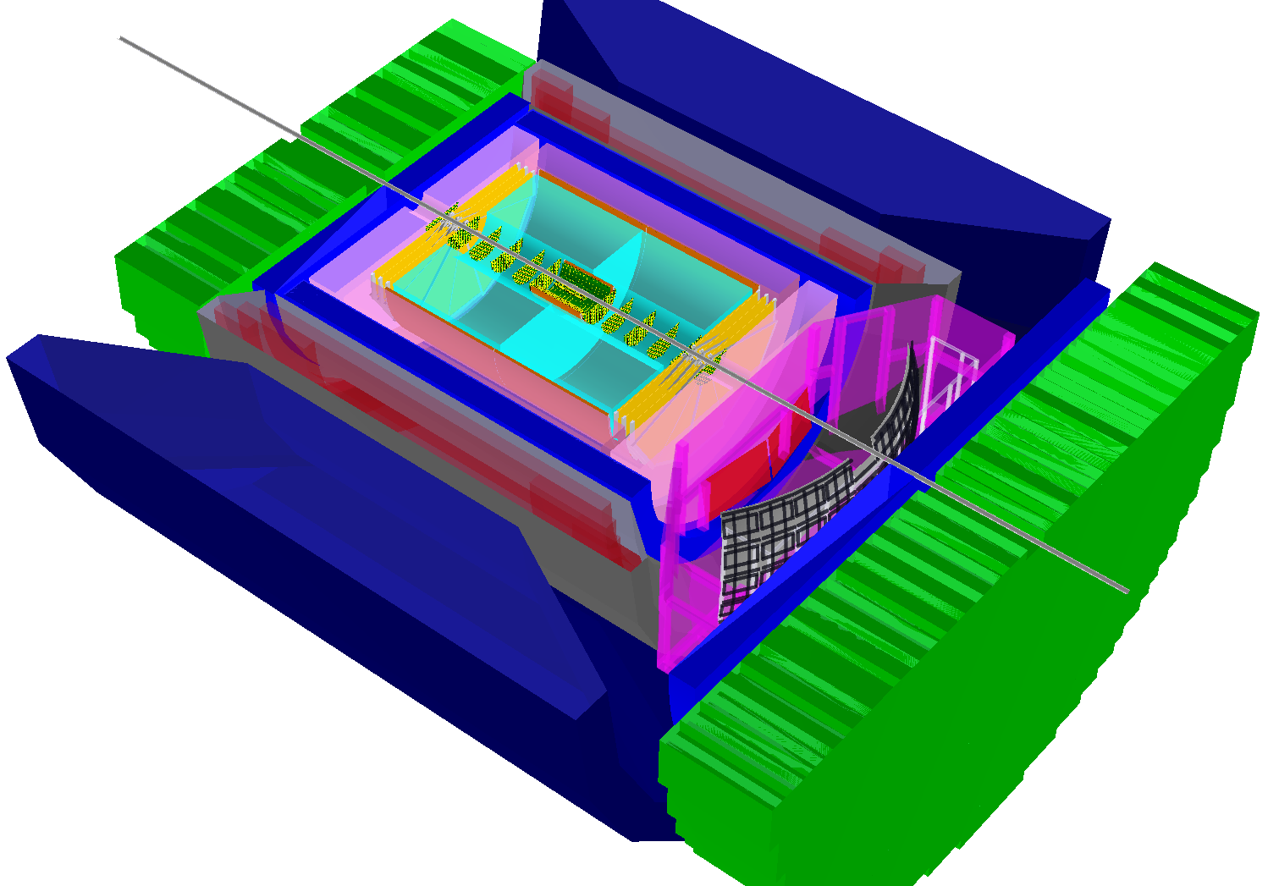
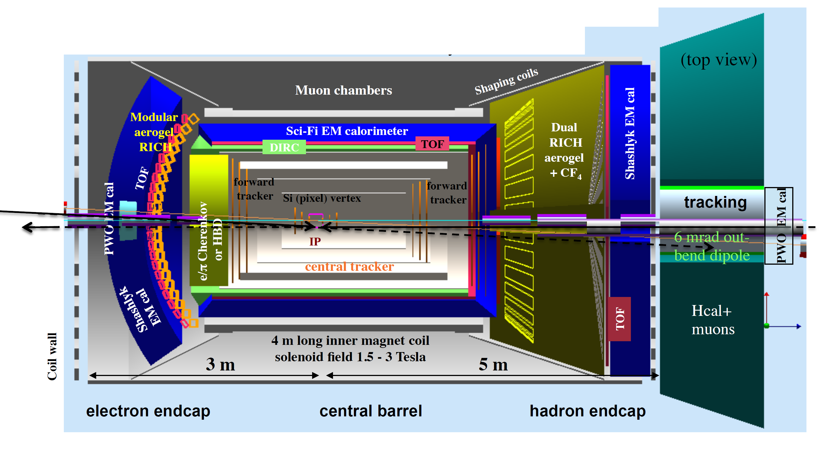
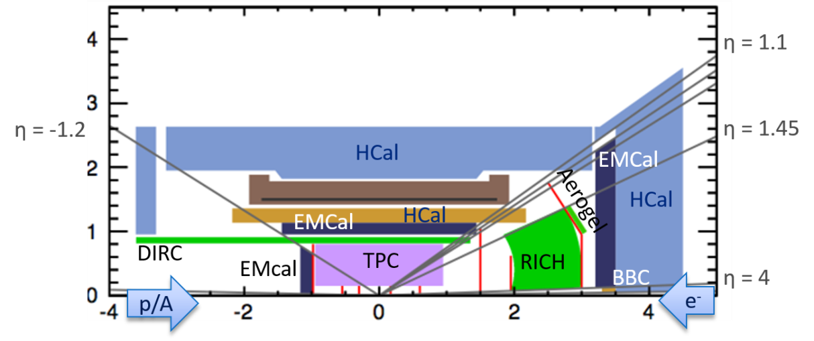
Calorimetry for EIC
Electron identification and triggering
(e-EMC, barrel EMC)
Electron kinematic measurements (e-EMC,
barrel EMC), high resolution needed.
Jet, DIS kinematics and triggering via hadron
final states (barrel EMC/Hcal, h-EMC/Hcal)
Photon ID for DVCS
Diffractive ID via rapidity gap (h-HCal)
High momentum track energy measurement (h-Hcal)
BeAST (Brookhaven eA Solenoidal Tracker)
Jlab EIC detector design
Babar-magnet based detector (RHIC)

Slide 4
Ongoing calorimetry R&D for EIC
Consortium created in 2012, funded by generic EIC detector R&D funds from US DOE
Sci-fiber EM calorimeter (SPACAL)
  Compact W-scifi calorimeter, developed at UCLA
  Investigating high resolution version for e-going endcap
  Investigating large scale production and projectivity, driven by sPHENIX project
Crystal EMCal at small angle: high energy resolution and PID needed
  Option for high resolution e-going endcap calorimeter
Shashlyk EMCal
  Option for h-going endcap calorimeter
HCal
  Prototype development in collaboration with STAR forward upgrade and sPHENIX
Sensor
  SiPM and APDs, radiation studies and support electronics
Simulation
  Full detector simulation and analysis frameworks

Slide 5
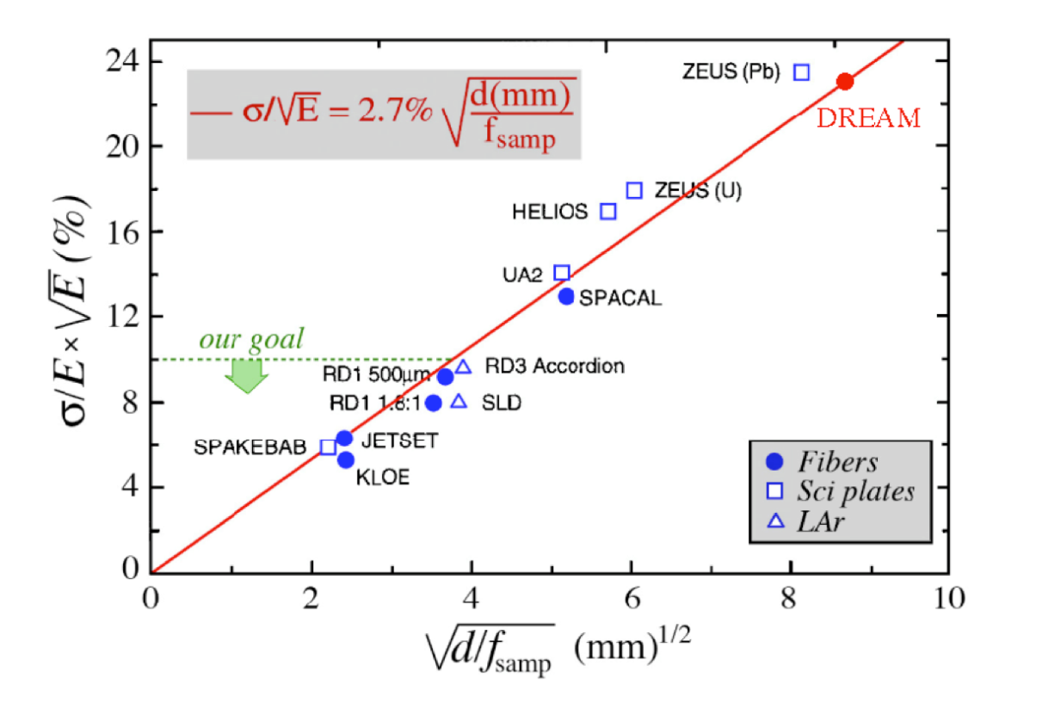
SPACAL: towards high energy resolution
For e-going endcap ECal, high resolution is preferred:
With the SPACAL technology, higher resolution could be achieved with high sampling frequency and fraction
UCLA tested W(75%)/Sb(25%) – SciFi SPACAL with d=0.67mm in 2015, but the light yield is low w.r.t. expectation.
Study on high resolution SPACAL test beam last week!
O. Tsai (UCLA) et al
Central EMC
h-going EMC
e-going EMC
h-going EMC
e-going EMC

Slide 6
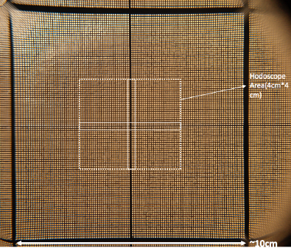
SPACAL beam test at FermiLab (May 4-10, 2016)
Goals:
Is production homogentity of the block sufficient?
(SF kept within +-0.2% from block to block during production)
Is local density/composition variations are under control?
(W/Sn composite absorber during packing)
Is light yield is sufficient to think about compact readout with Si sensors in future?
What is the effect of ‘dead’ area between superblocks.
What are benefits of using square fibers?
Two prototypes:
a) High Frequency.
b) High Sampling Fraction
Results presented for the worst case scenario:
Impact hits selected with sc. Hodoscope centered between four blocks
Impact angle 10 deg (minimal angle for EIC)
Energy scans taken with orientation of ‘wide’ central gap being vertical as shown and horizontal, i.e. for cases when narrow core of EM showers sample or integrate dead area.
O. Tsai

Slide 7
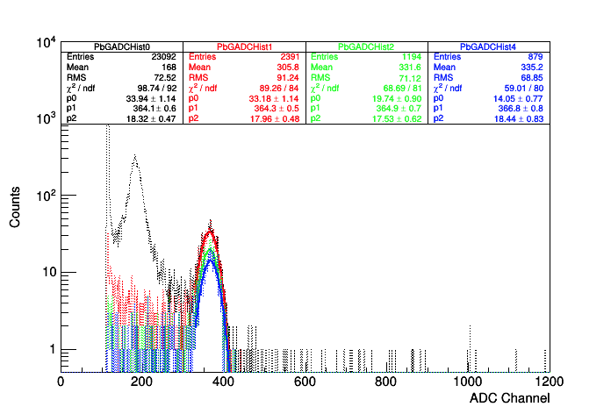

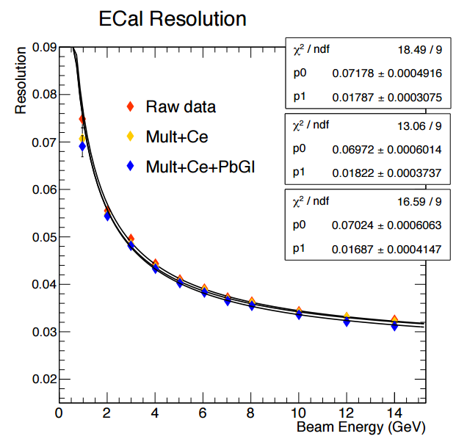
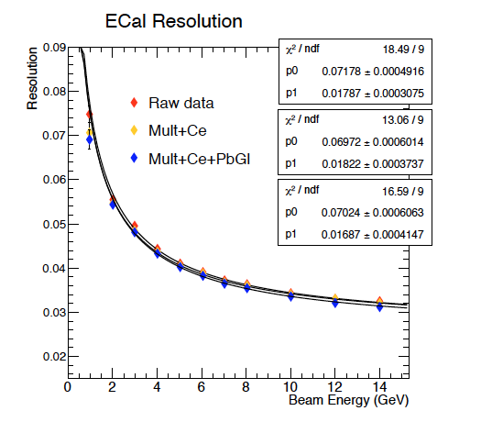
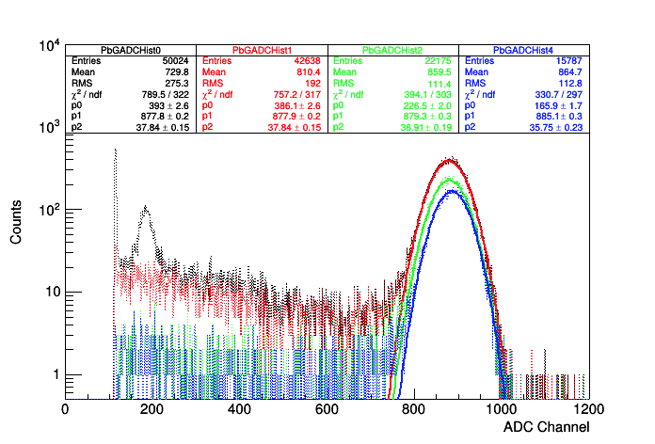
SPACAL beam test: results
1 GeV, EIC Square Fibers
Square fibers meet EIC design goals
3 GeV, EIC Square Fibers
Beam energy spread ~2%
O. Tsai

Slide 8
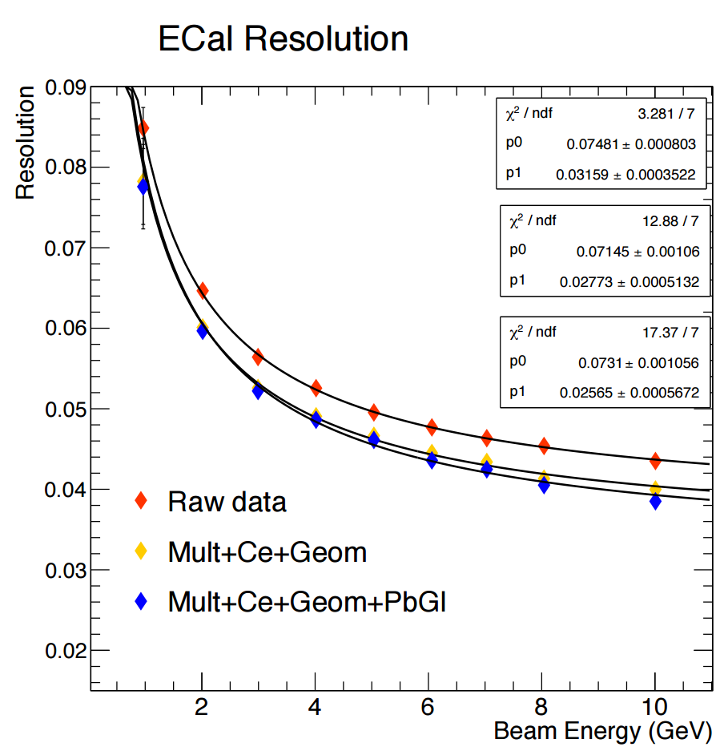
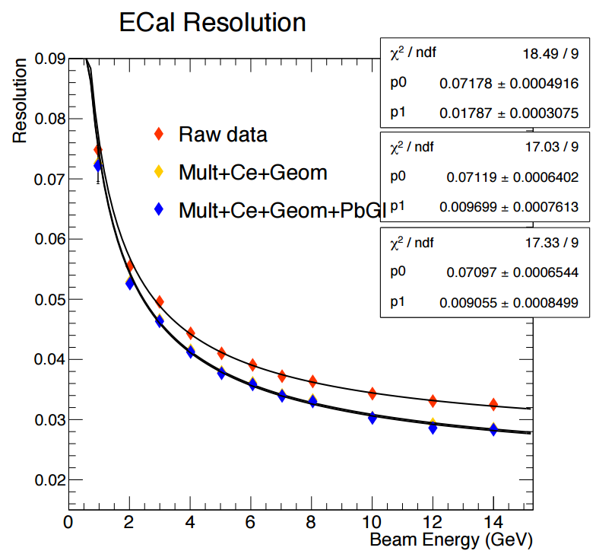
SPACAL beam test: results
Effets of cracks in E resolution
W/Sn composite absorber and thin fibers
‘High Frequency’ prototype:
Combination of composite absorber and thin fibers leads to internal in homogeneities, which increases constant term about factor of three (3%) compare to detector build from square fibers.
Constant term < 1%, when
removing hits +/- 2.5 mm near the cracks.
O. Tsai

Slide 9
SPACAL beam test: conclusions
Is production homogentity of the block sufficient?
Yes, for Square Fiber EM Prototype.
Is local density/composition variations are under control?
Probably No, for composite absorber.
Is light yield is sufficient to think about compact readout with Si sensors in future?
Yes, 5000 p.e./ GeV, Square fibers.
What is the effect of ‘dead’ area between superblocks.
Increased constant term, need to reduce ‘vertical’ crack in future.
What are benefits of using square fibers?
More light, shape may be more suitable for future compact readout.
Very promising results, already better than excellent H1 EMcal.
Clear direction for future developments and improvements.
O. Tsai

Slide 10
High resolution calorimetry for electron endcap
PID requirements in the electron endcap primarily driven by
semi-inclusive and exclusive processes, e.g., DVCS
Detection at very small angle is needed
EM calorimetry has two main functions:
particle identification: important for discriminating single photons from, e.g., DVCS and two photons from p0 decay, and e/p.
particle reconstruction: driven by the need to accurately reconstruct the four-momentum of scattered electrons at small angles, where the angular information is provided by the tracker, but the momentum (or energy) can come from either the tracker or the EM calorimeter.
Requirements:
Good resolution in angle to at least 1 degree to distinguish between clusters
Energy resolution to a few %/sqrt(E ) for measurements of cluster energy
Ability to withstand radiation down to at least 1 degree with respect to the beam line
Collaboration: BNL, Caltech, CUA, IPN-Orsay

Slide 11
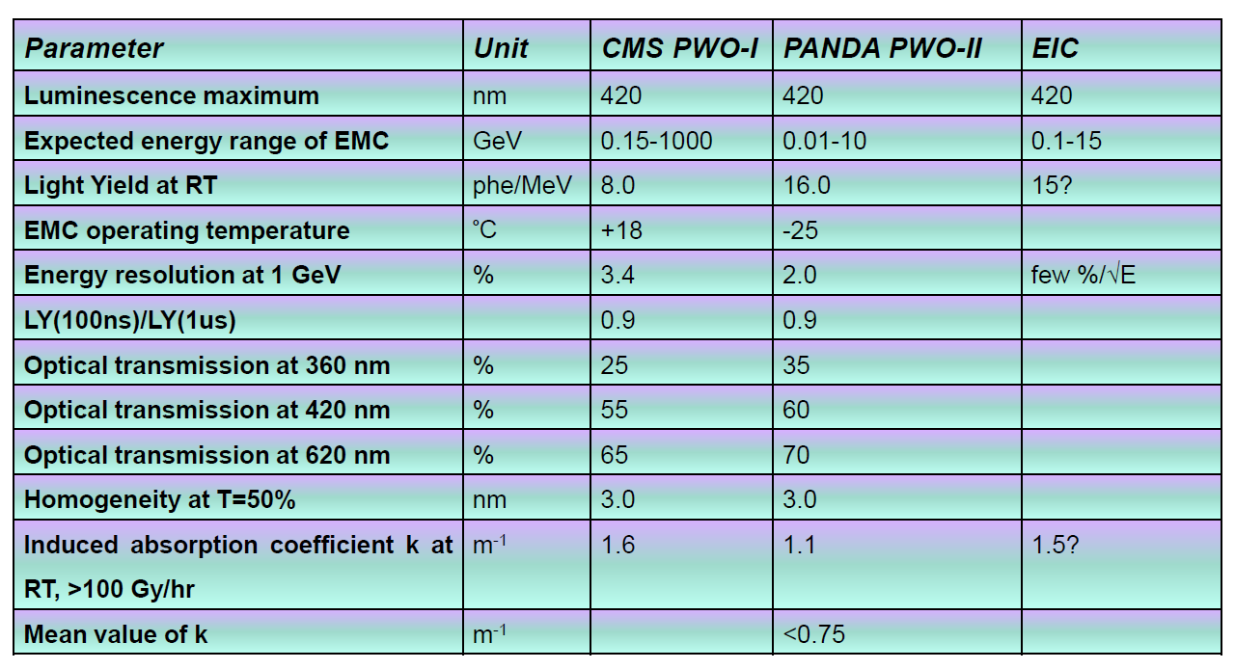
PWO crystal specifications
A key question of ongoing R&D is to determine whether the EIC could use more relaxed crystal specs, also in terms of parameter variation between crystals

Slide 12
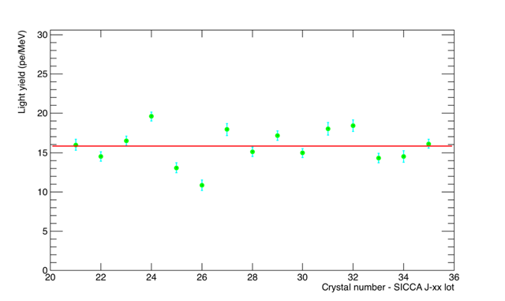
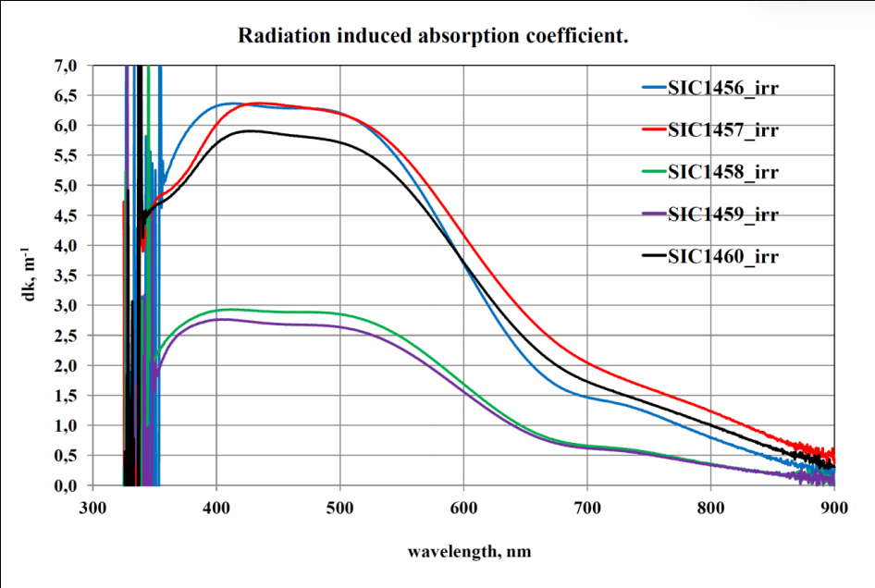
High resolution calorimetry based on PbWO₄ crystals
PbWO₄ has been extensively used for high precision calorimetry (CMS, JLab, PANDA…) because its energy and time resolutions and its radiation hardness.
BTCP (Russia) produced high quality crystals in the past using the Czochralsky growing method, but it’s now out of business.
SICCAS (China) uses the Bridgeman method, but has problems maintaining good crystal quality.
Need to develop an alternate supplier of PbWO₄ in order to ensure worldwide availability of high quality crystals (potential candidate: CRYTUR, Czech Republic).
Light yield: large variations crystal to crystal
CUA measurements of SICCAS crystals
PANDA requirements dk<1.1 after 30Gy
Radiation hardness of recent SICCAS crystals

Slide 13
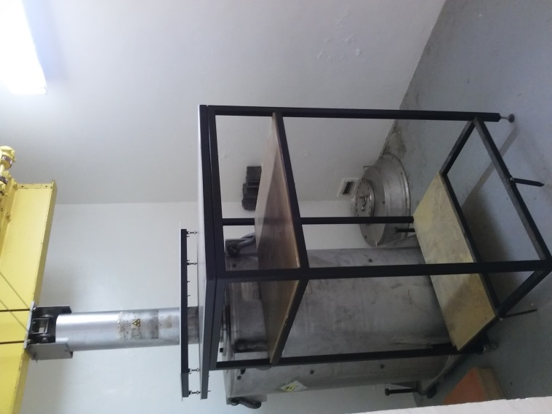
Setting up infrastructure for crystal testing
IPN-Orsay (France)
Optical Transmittance (L/T)
Varian Cary 5000 spectrometer
Setup was commissioned with BTCP crystals on loan from Giessen
To accommodate crystals of lengths greater than 15 cm a more versatile configuration with a fiber-based spectrometer is being commissioned
Crystal light yield and timing
⁶⁰Co (3000 Cu)
A setup is currently being tested with cosmic rays
Radiation Hardness
Panoramic irradiation facility available (⁶⁰Co sources):
5000 Gy/h at 10 cm
300 Gy/h at 35 cm
6 Gy/h at 260 cm
At ~1m 30 Gy in ~30 min
ALTO at IPN-Orsay:
  50 MeV electrons up to 1uA
  Proton beam (Tandem) also available
Laboratoire de Chimie Physique (Orsay)

Slide 14
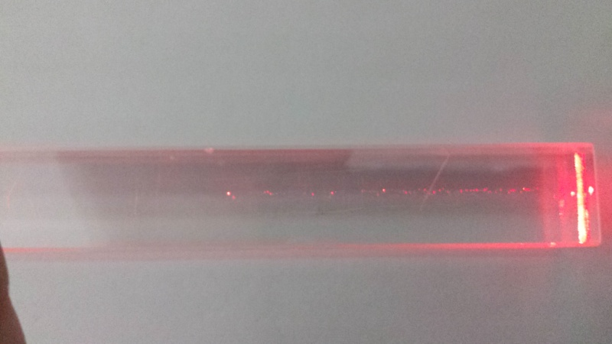
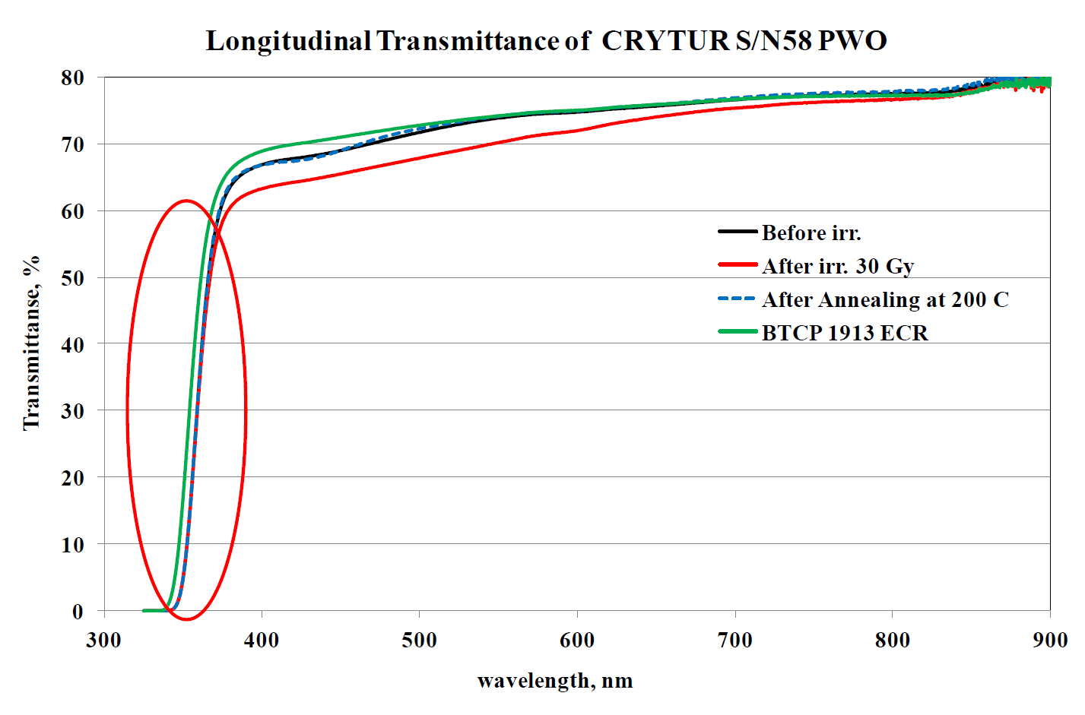
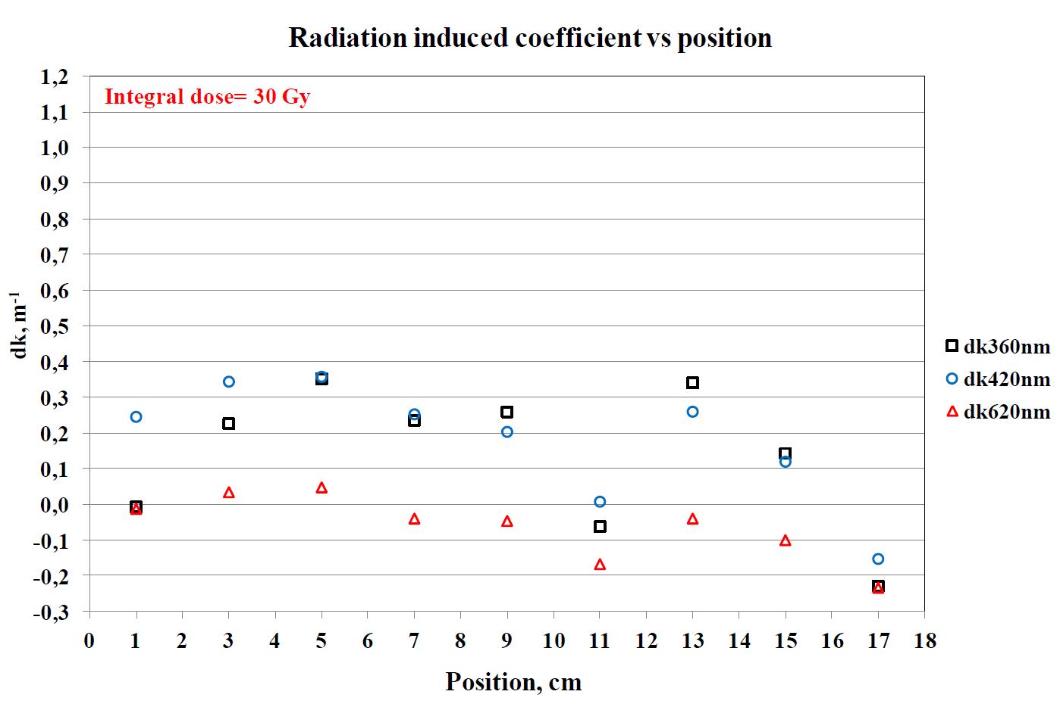
Test of recent CRYTUR crystals
First full size (2x2x20 cm³) crystal produced by CRYTUR (Oct 2015)
Grown in Ar atmosphere & doped with La+Y
3 new (2016) crystal with dimensions: 20x20x18.5 mm³
Low light yield (12-13 pe at 18°), with tolerable non-uniformity (maybe due to high doping)
Acceptable tranmittance. Longitudinal transmittance does not show absorption band in the luminescense range
Crystal similar to CMS quality
(shift of transmittance edge and low radiation induced coefficient)
V. Dormenev

Slide 15
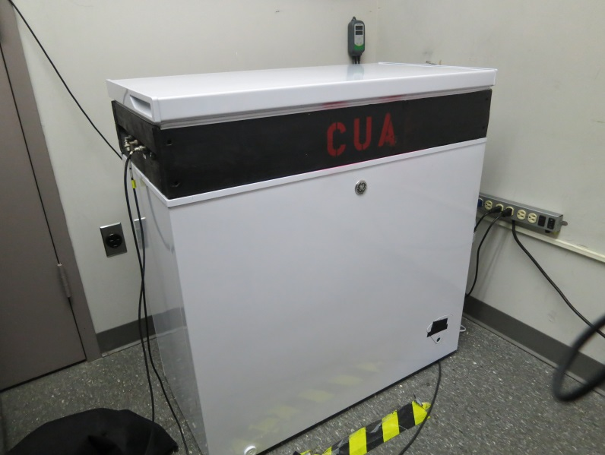
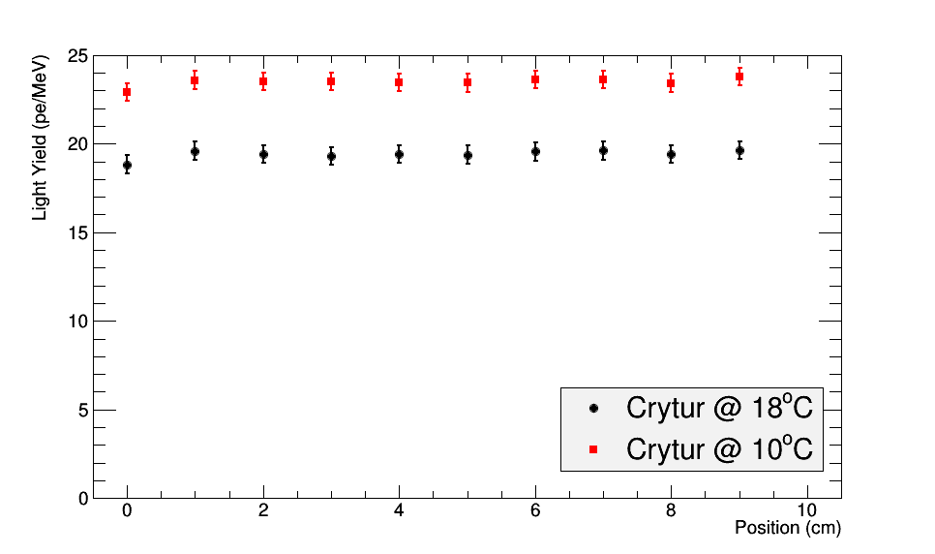
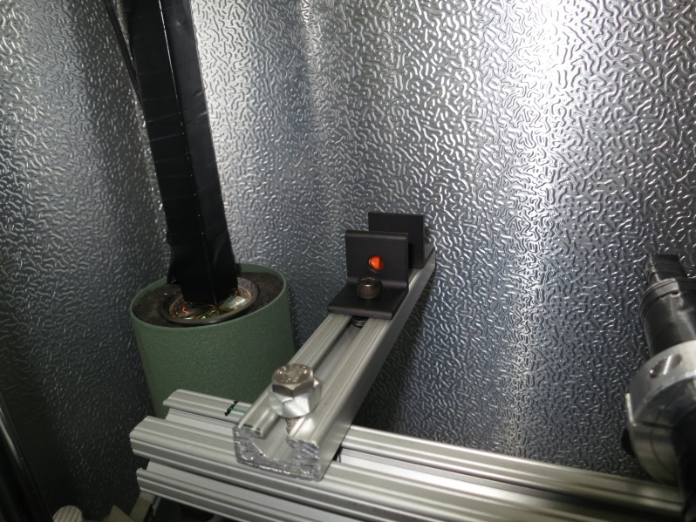
Setting up infrastructure for crystal testing
CUA (USA)
Light yield:
Temperature dependence
Temperature controlled dark box
Source of Na-22 (two 0.511 keV photons back-to-back)
Light yield as a function of transverse position
Comparison with Giessen measurement at 18°:
CUA: 19.4 +/- 0.7 pe/MeV
Giessen: 19.2 pe/MeV
PMT
Warning: PMTs quantum efficiencies are similar, but probably different.
Wrapped crystal
Trigger PMT

Slide 16
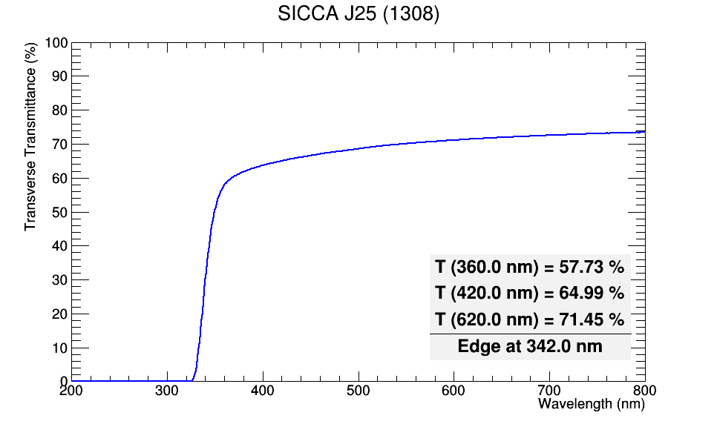
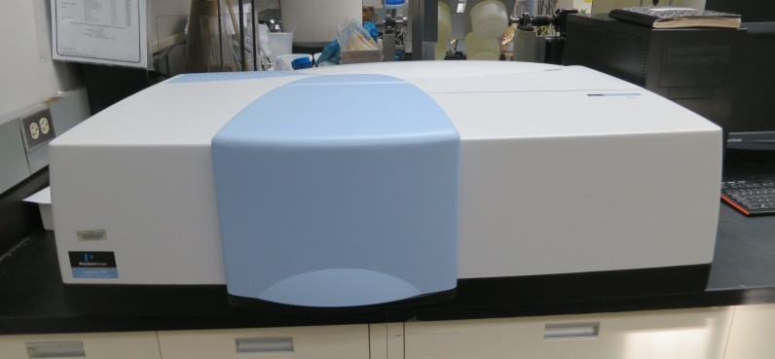
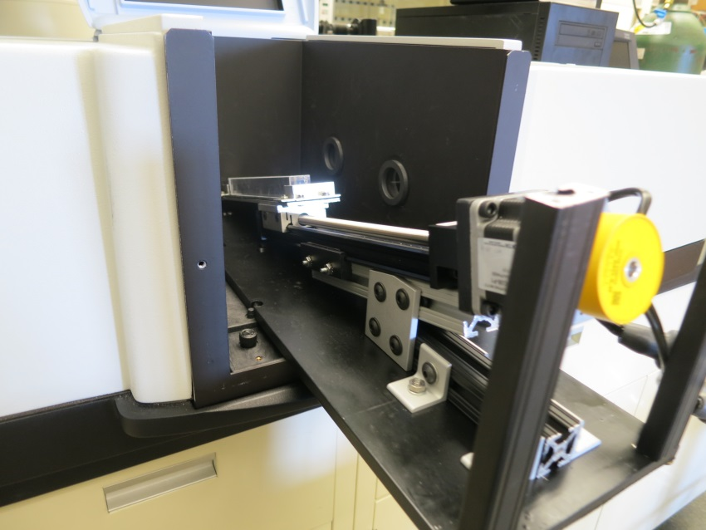
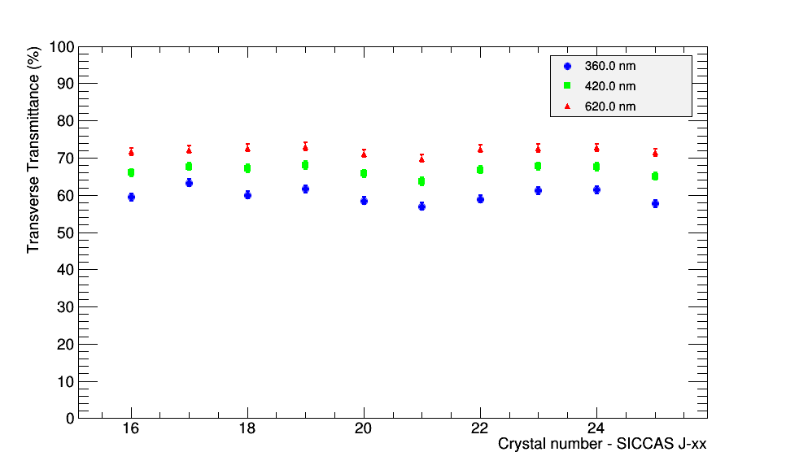
Light transmittance measurements at CUA
Transverse transmittance of individual crystal
Lambda 750 UV/VIS/NIR
Variation of crystals' transverse transmittance in the lot
Stepper motor based setup

Slide 17
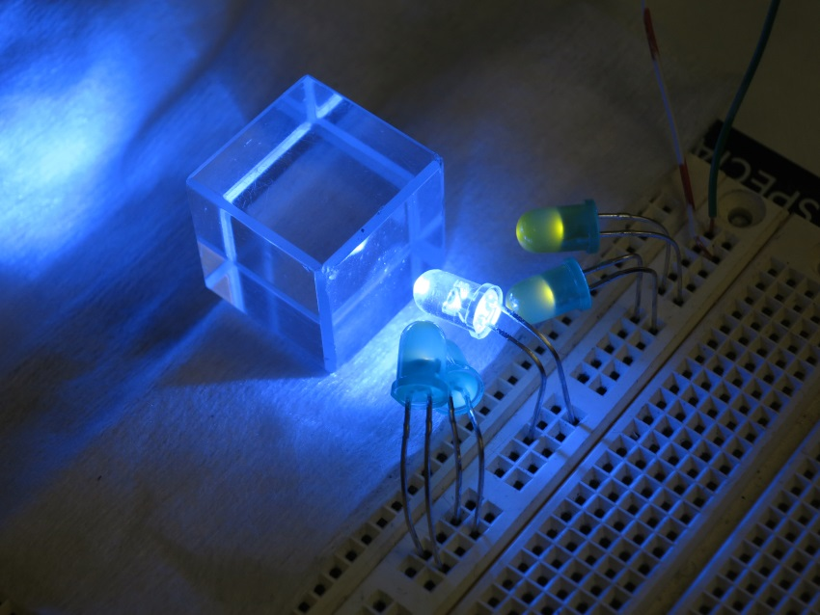
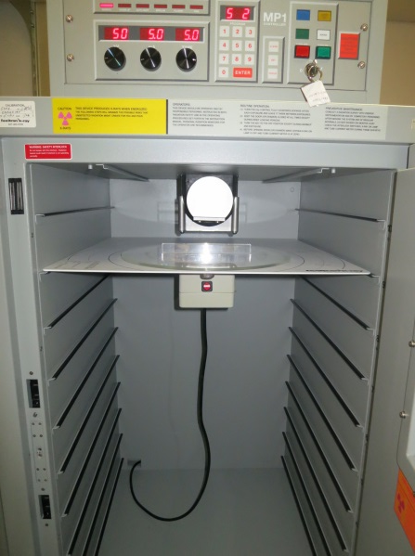
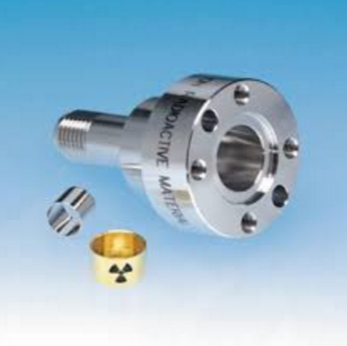
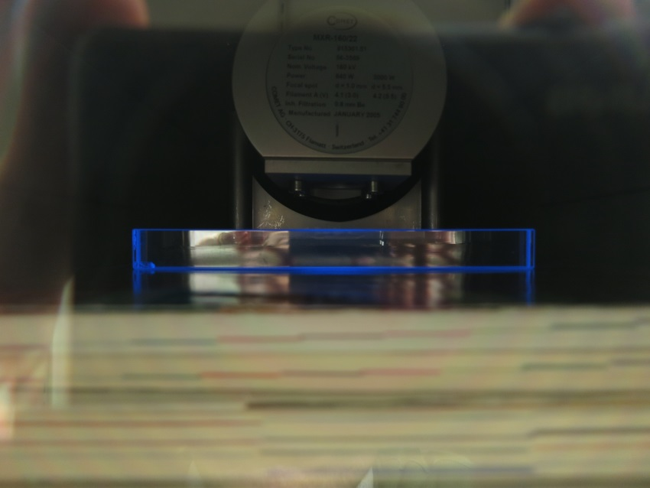
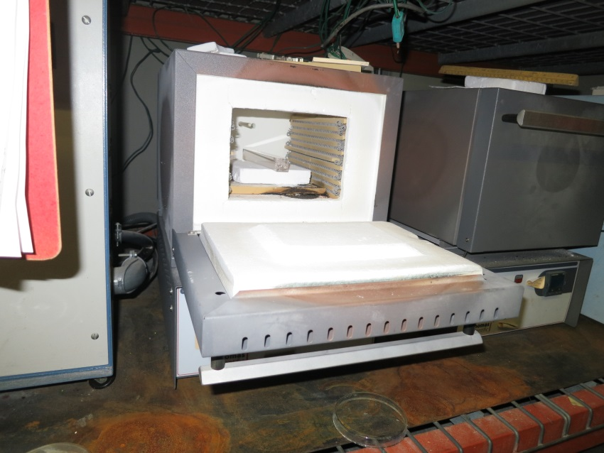
Other activities in progress
Radiation hardness
Light annealing (LED)
Lower energy range
(1-160 keV)
Intermediate energy
(1.17, 1.33 MeV)
X-ray machine
0.5 mCi - Co-60
Thermal annealing (oven)
Scintillating with x-rays

Slide 18
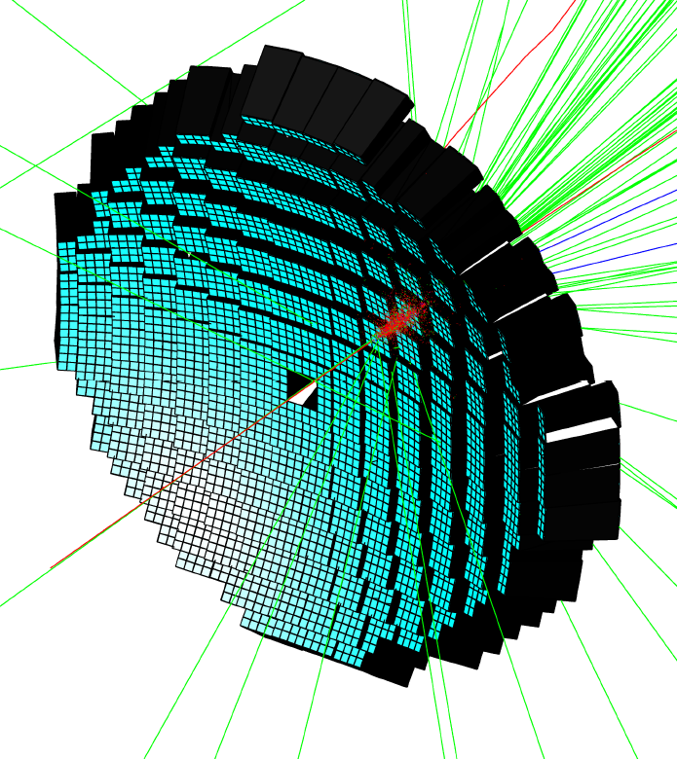
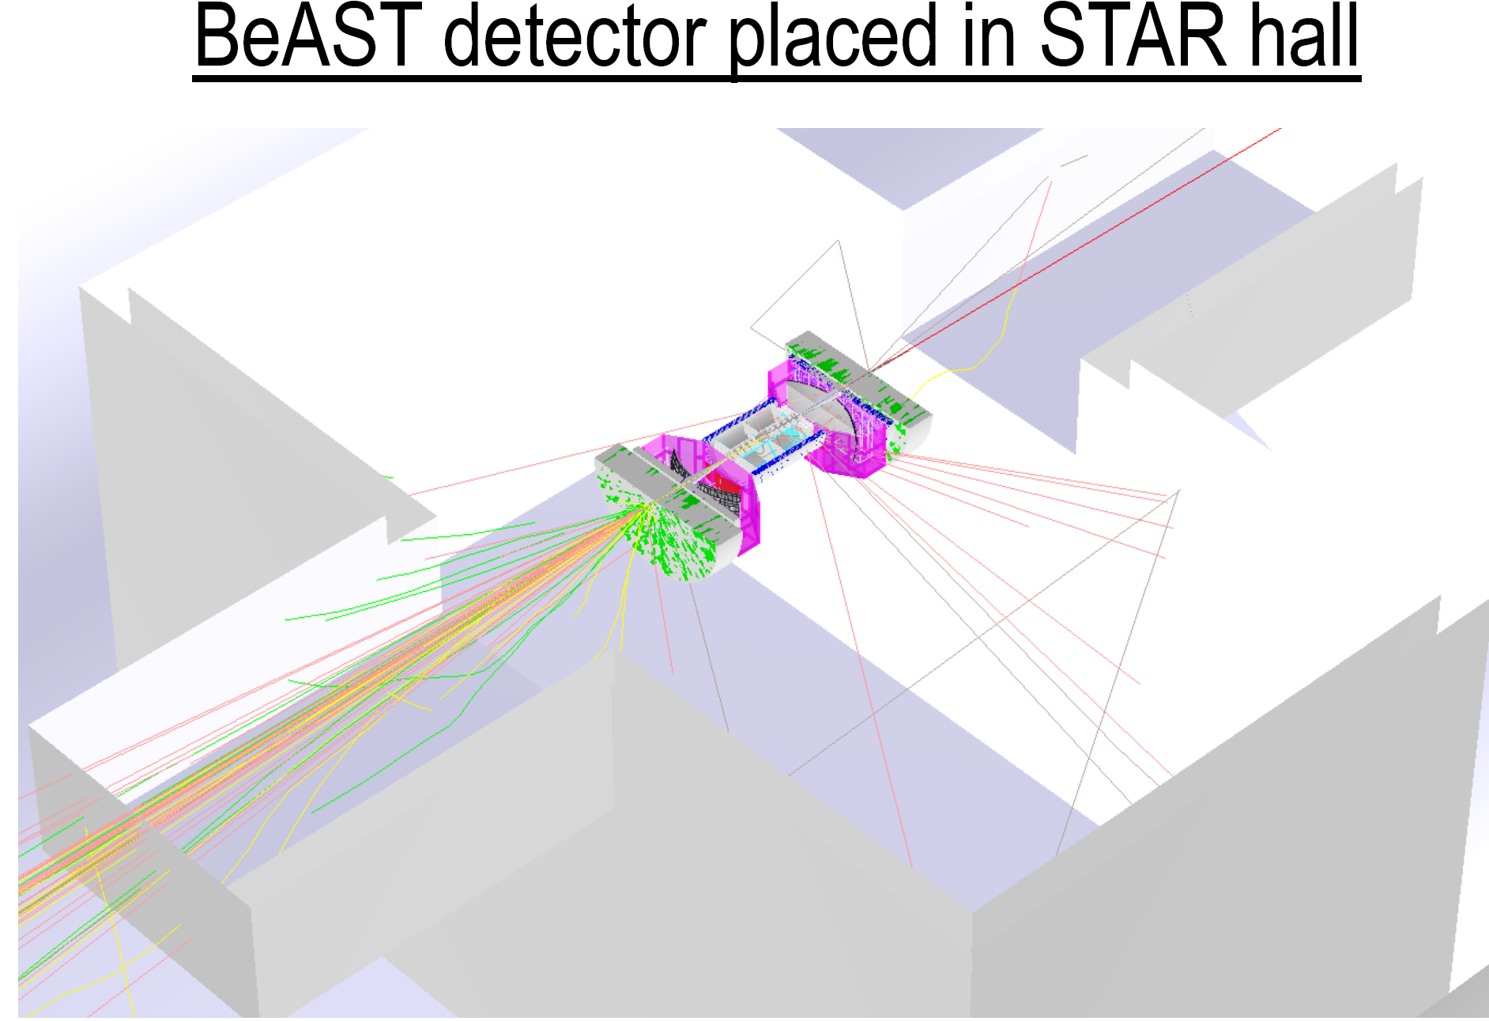
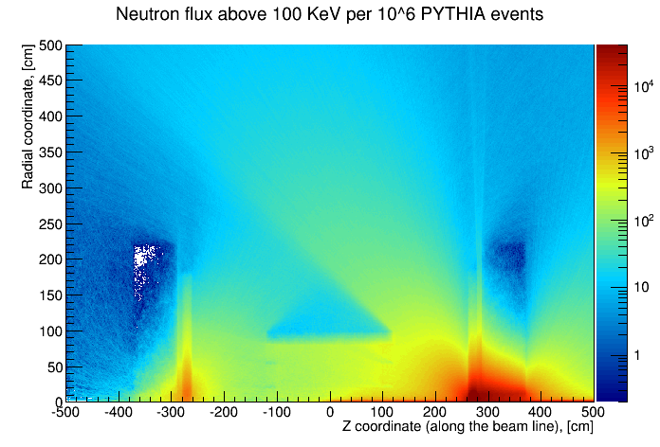
Calorimetry: simulations and radiation dose estimates
eRD1 also plays major roles in maintaining simulation & analysis frameworks, that is open source for full EIC detector simulation
EIC neutron fluence (as BeAST in eRHIC) calibrated to STAR
  Worst region in h-going calorimeter
    1 year EIC run ~ a few 10¹⁰ n_{eq}/cm² ~ 1 RHIC run
    Challenging but possible for SiPM, also considering APD options
  e-going calorimeter and barrel calorimeter
    ~ two order magnitude lower n-flux
    Safe for SiPM operation
A. Kiselev (BNL)
e-going
HCal, EMCal
h-going
EMCal, HCal
Evaluated with EICRoot by A. Kiselev (BNL)
Crosschecked with sim STAR in RHIC

Slide 19
Summary and conclusions
eRD1 explores calorimeter technology for EIC in multiple fronts:
Scintillation fiber calorimeter
  Developed by UCLA group for EIC barrel and endcaps
  Very promising results from recent test run at FermiLab
  On-going R&D focus on higher energy resolution, mass-production capabilities and projectivities
Potentially 2 vendors available for PWO crystals:
  SIC show quality control instabilities
  Crytur making very good progress towards mass production capabilities
Infrastructure being developed at CUA and IPNO for crystal quality control
Prototype being constructed for beam test
SiPM radiation tests, neutron background ≤ RHIC
Full detector simulation environment open to users

