Slide 1

Study of the New Glass and Glass Ceramic
Stoichiometric and Gd³⁺-loaded
BaO*2SiO₂:Ce (DSB:Ce)
Scintillation Material for Future Calorimetry
R. W. Novotnyª, K.-T. Brinkmanª, A. Borisevich^{b}, V. Dormenevª, M. Korjik^{b}, D. Kozlov^{b}, P. Orsich^{b}, H.-G. Zaunickª, and S. Zimmermannª
ªJustus-Liebig-Universität Giessen ,II. Physikalisches Institut, Giessen, Germany
^{b}Institute for Nuclear Problems, Bobruiskaya11, 220030, Minsk, Belarus
and for the Crystal Clear Collaboration
motivation: severe radiation damage due to hadrons
properties of the new material DSB:Ce
characterization of bulk and fiber material
radiation hardness
heavy loading with Gd³⁺
summary and outlook

Slide 2
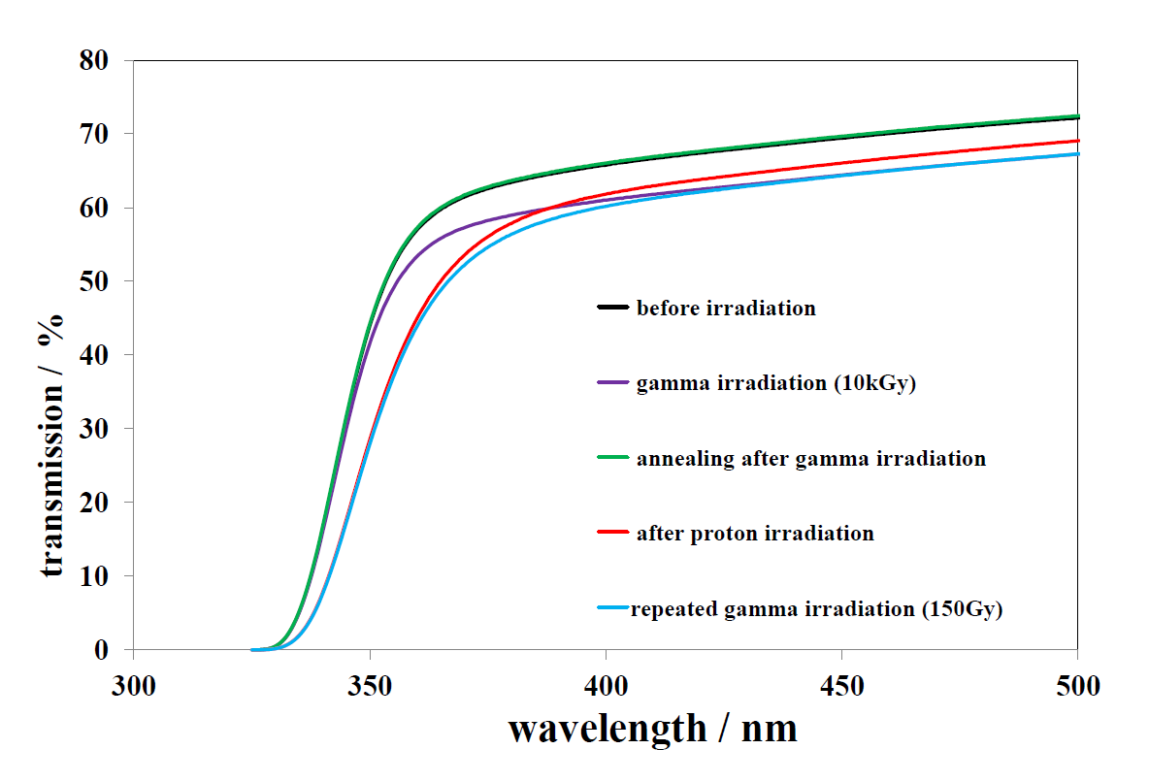
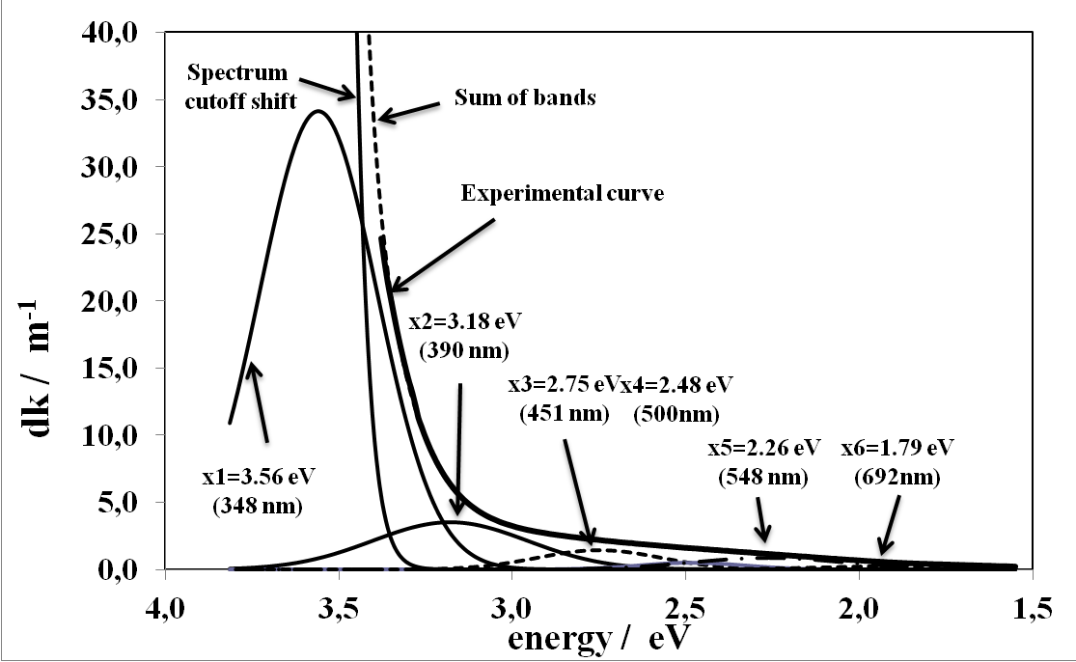
motivation: calorimetry limited by severe hadronic radiation damage
change of optical transmission due to 150MeV protons
1.8 x 10¹³p/cm²
@KVI
24 GeV protons
3.6·10¹³ p/cm²
Francesca Nessi-Tedaldi
(ETH, Zürich, Switzerland)
creation of macro defects
highly ionizing fission products
ion displacements
lower Z material required
sampling calorimetry
cheap for mass production

Slide 3
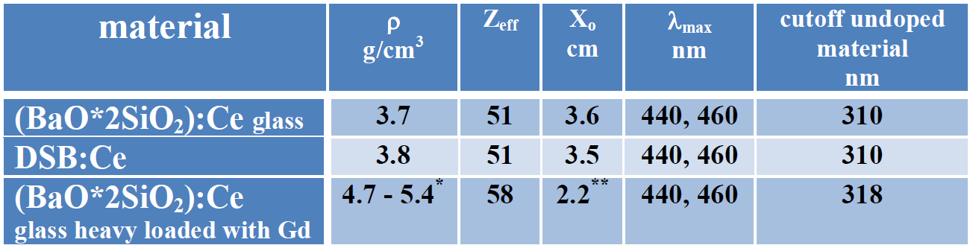
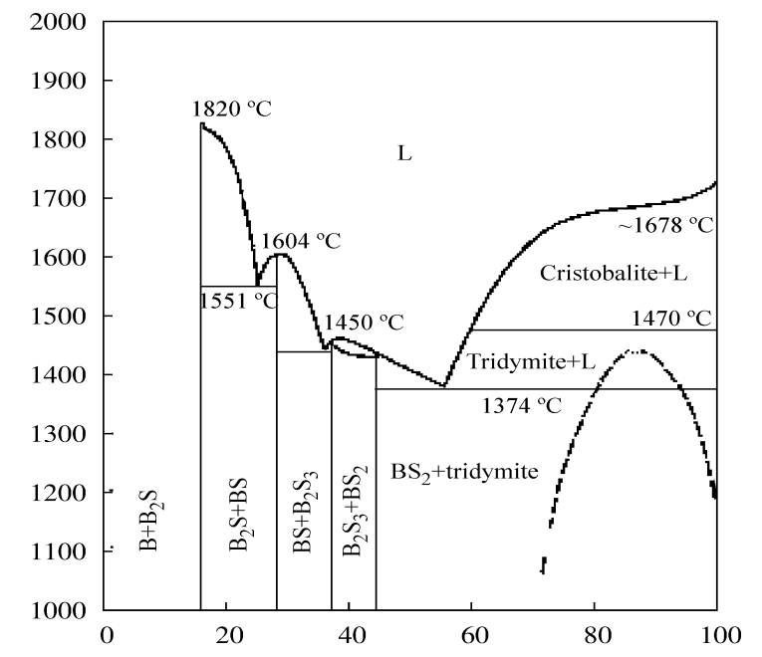
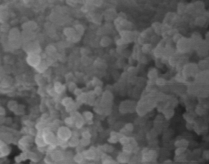
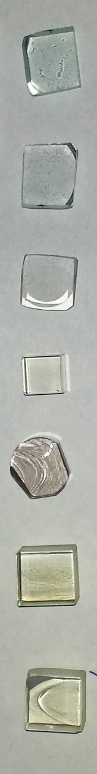
properties
technology: glass production combined with
successive thermal annealing
(800 – 900ºC)
T / ºC
1µm
weight % SiO₂
phase diagram of the BaO*SiO₂ system
SEM image of recrystallized BaO*2SiO₂
at 950ºC
nano-sized particles of Ba₂SiO₅
improve scintillation!
Ba-Si system allows to incorporate
trivalent ions: Lu, Gd, Yb

Slide 4
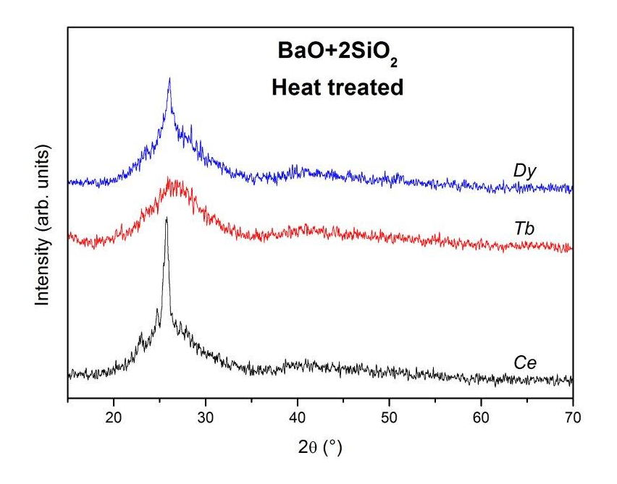
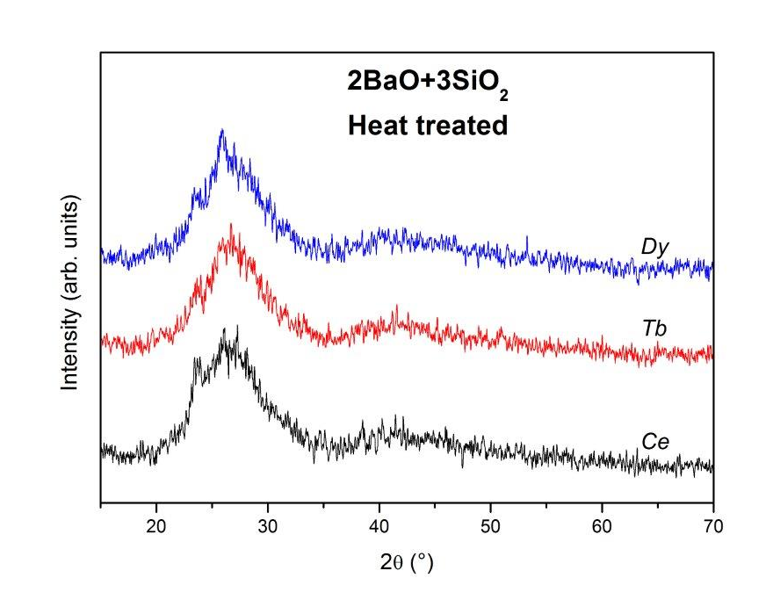
Investigation of the creation of scintillation centers
in collaboration with D. Rinaldi, SIMAU, Ancona
Characterization of doped and un-doped DSB
at different annealing temperatures:
characterization of crystallization
measurement of light yield and radiation hardness
XRD:
samples containing Ce show earlier crystallization
HRSEM: 1.6% Ce 1.93% Ce

Slide 5
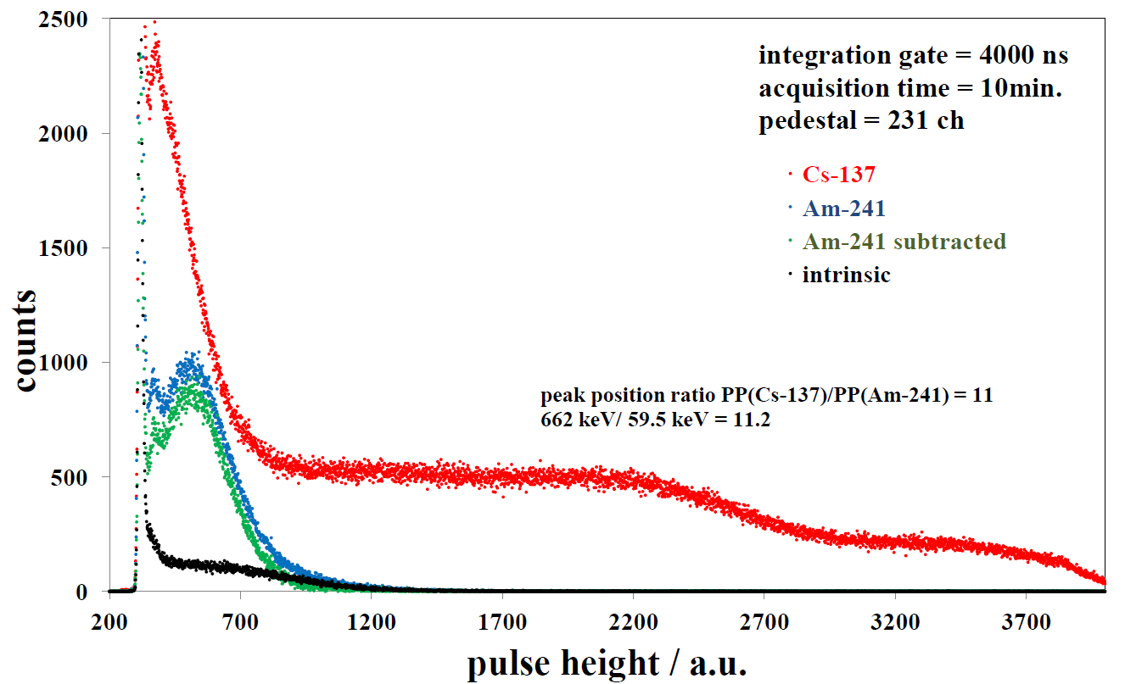
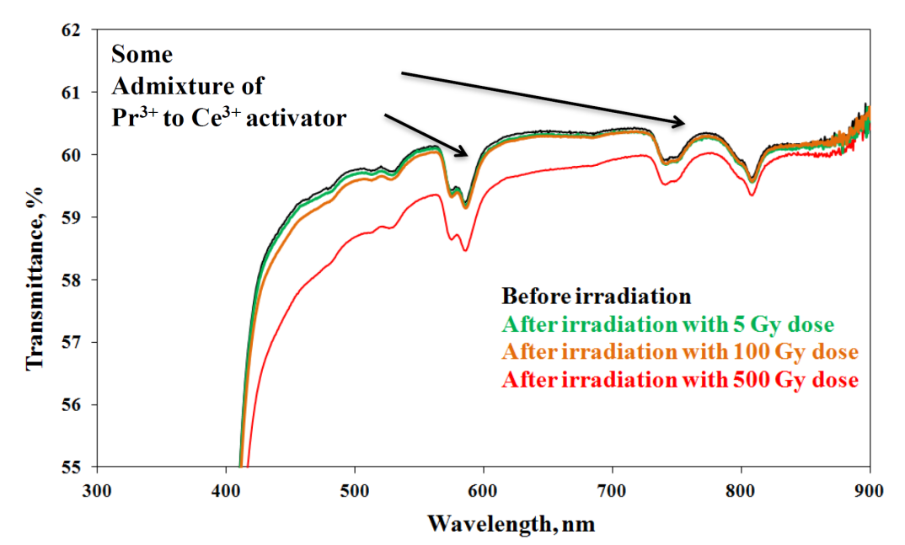
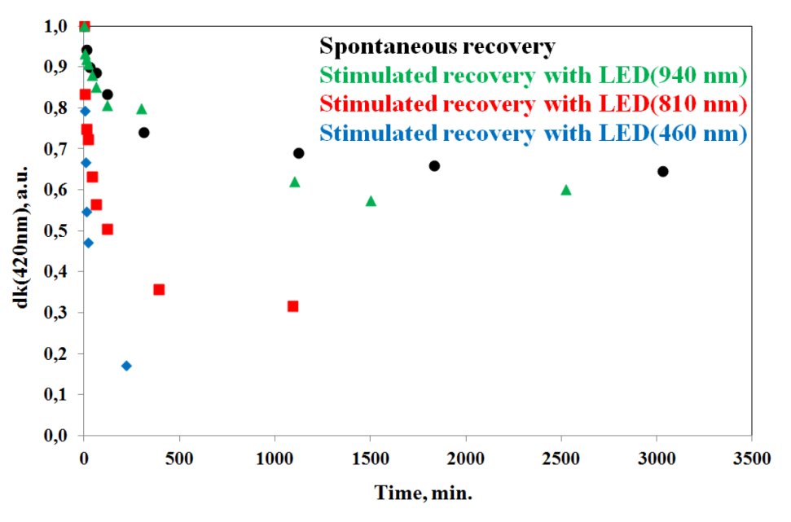
Irradiation and recovery studies:
@RT, integration 4µs
dLY:/dT: +0.05%/ºC
LY @ RT: 110 phe/MeV (4µs)
Quality
of samples:
Spontaneous and
stimulated recovery
Irradiation with ⁶⁰Co, 2Gy/min

Slide 6
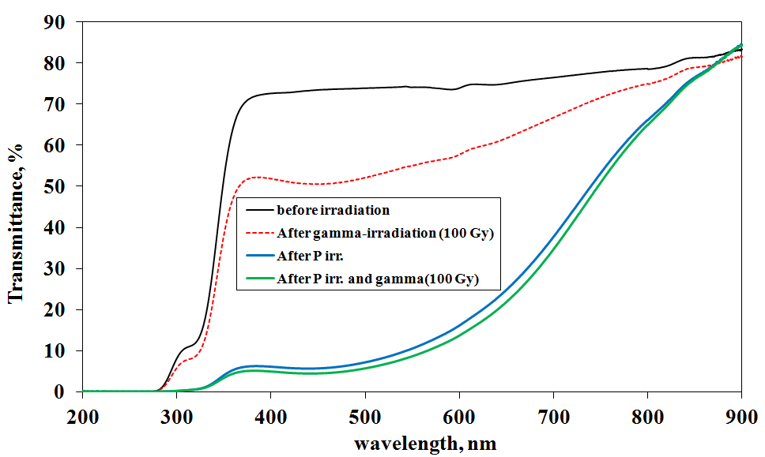
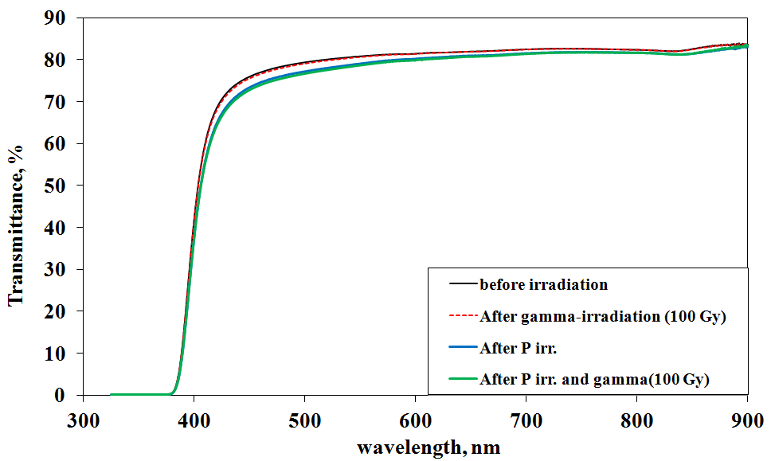
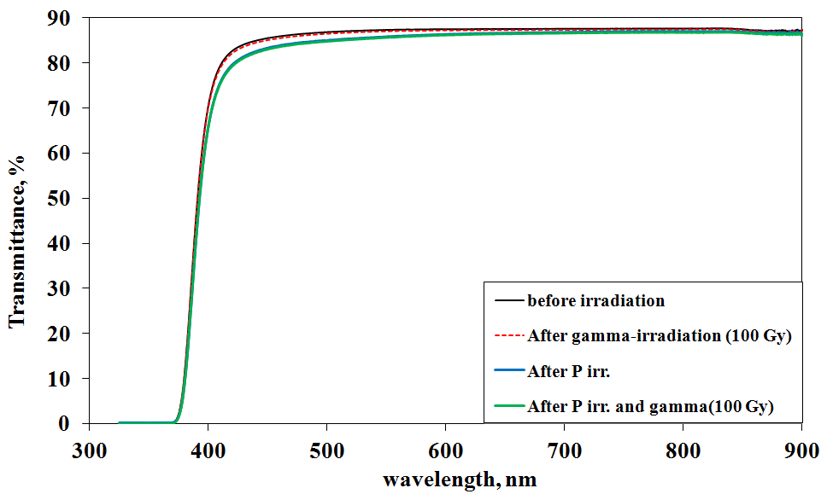
irradiation and recovery studies: with 150MeV protons
flux ≤ 2x10¹¹ p/s cm²
integral fluence = 5x10¹³ p/cm²
BaO x 2SiO₂
(mother glass)
BaO x 2SiO₂ : Ce
(without thermal treatment)
DSB: Ce
(after thermal treatment)

Slide 7
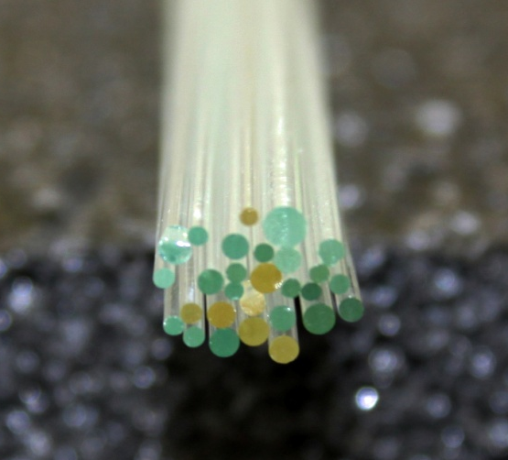
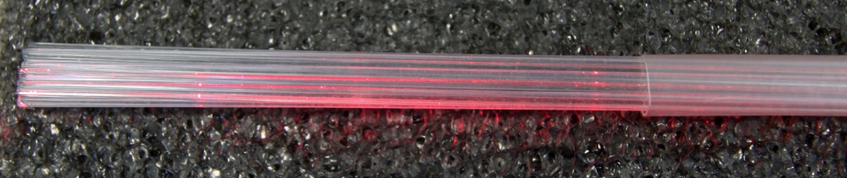
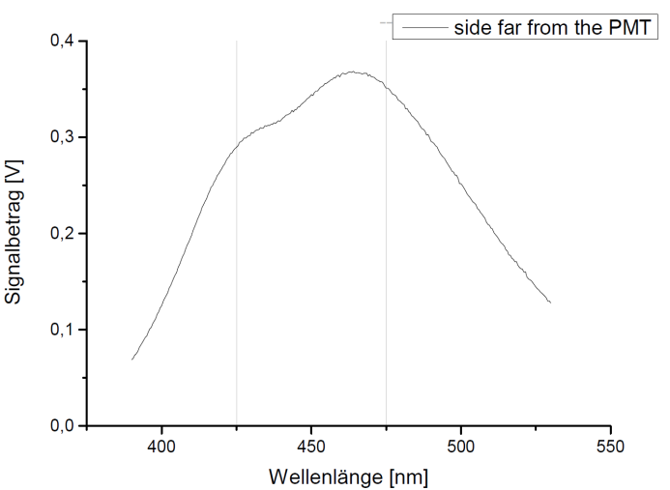
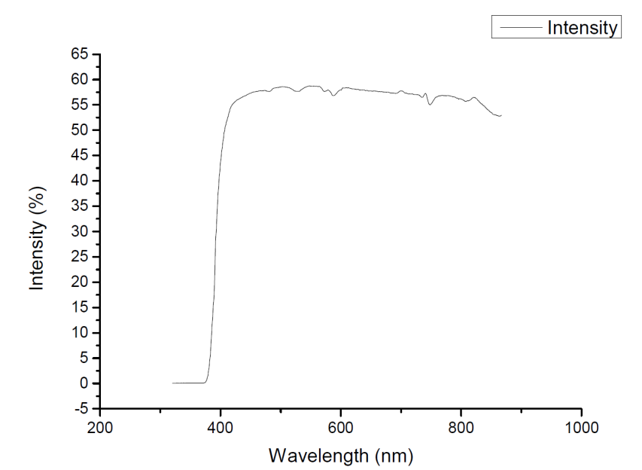
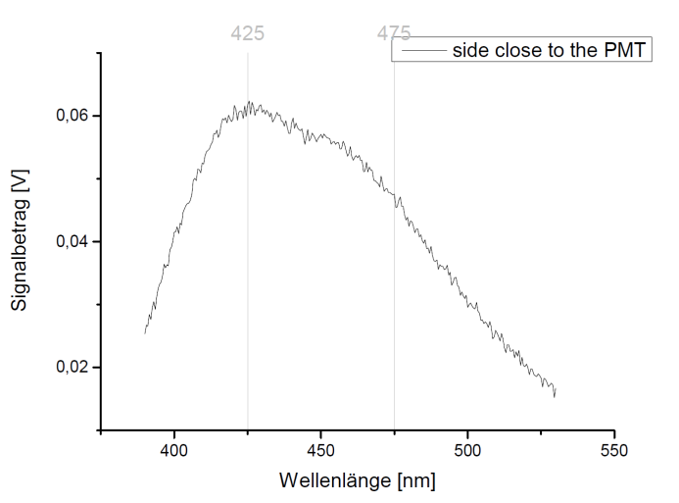
DSB:Ce fibers: 200 mm long
several macro defects
short attenuation length
0.7 < Ø < 1.2 mm
optical transmission
SP
SP
SP
excitation with LASER @ 325nm

Slide 8
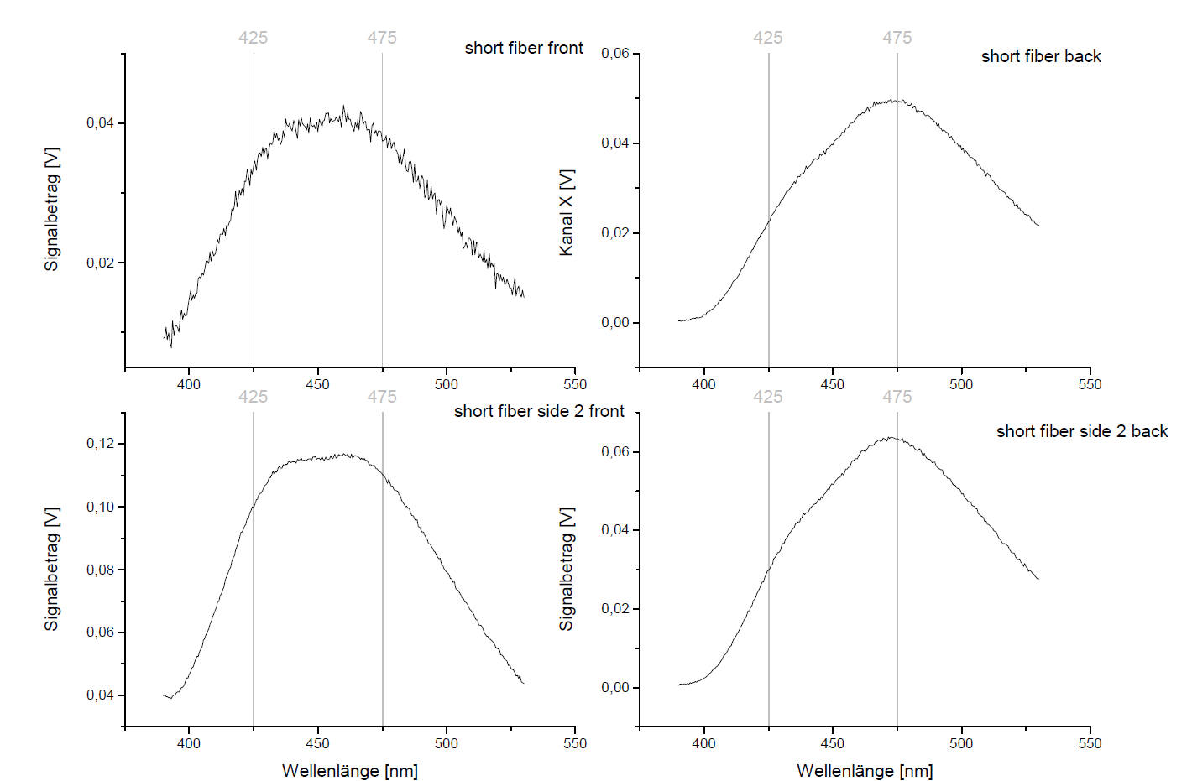
DSB:Ce fiber
excitation with UV-LED @ 365nm
SP
SP

Slide 9
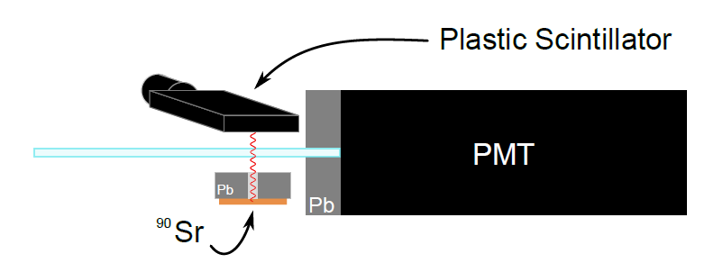
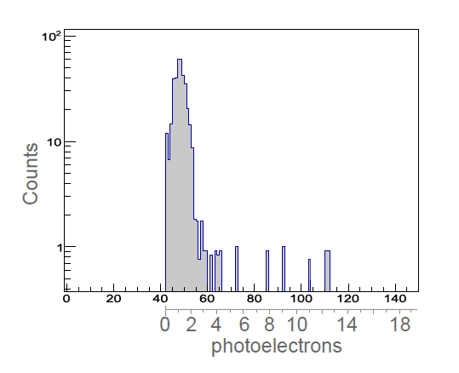
response of a single DSB:Ce fiber to electrons (⁹⁰Sr)
coincidences with
a plastic scintillator
~ 1.5 p.e.

Slide 10
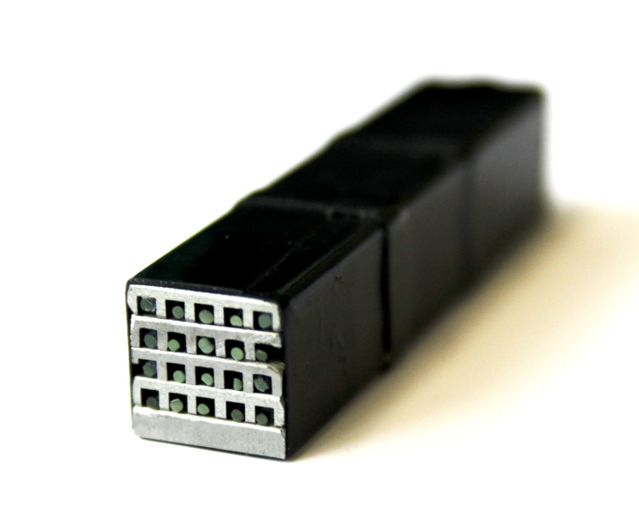
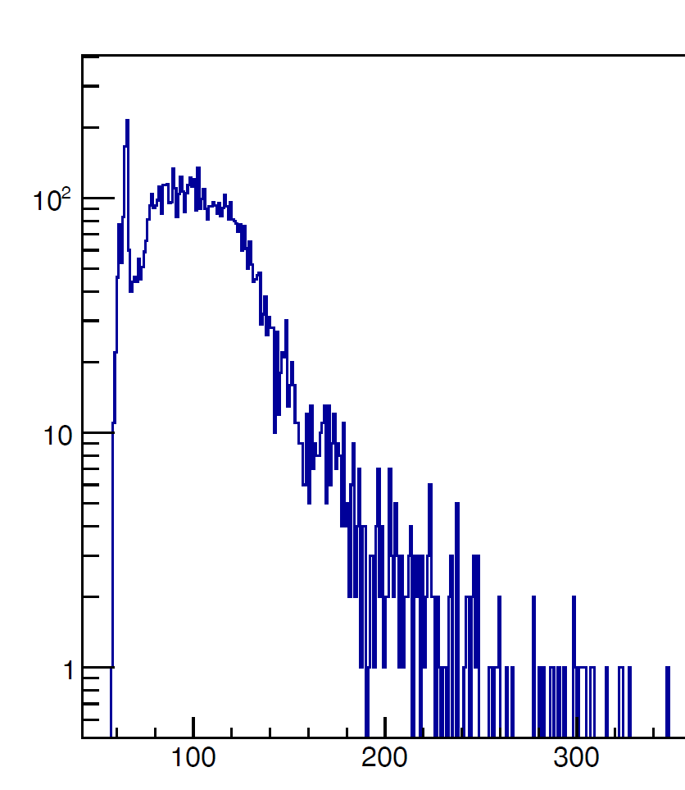
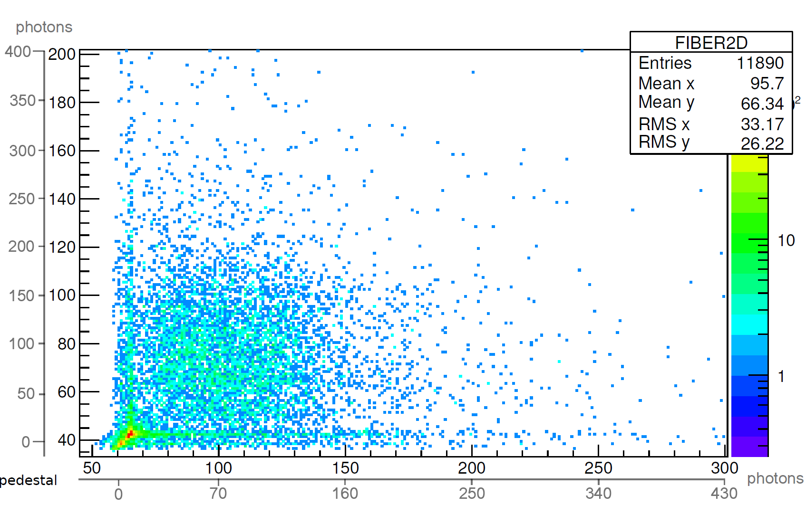
DSB:Ce testmatrix: 4 x 5
composed of: 20 fiber (1mm^{Ø}), 50mm
Mo - structure
matrix
PMT 1
PMT 2
response to cosmics
100 p.e.
200 p.e.
counts
PMT 2
PMT 1
amplitude /a.u.

Slide 11
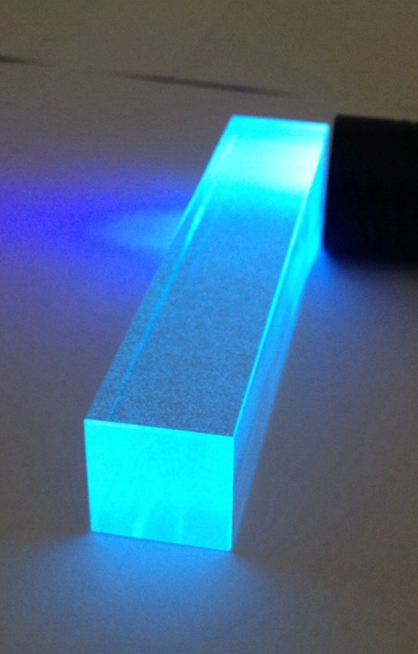
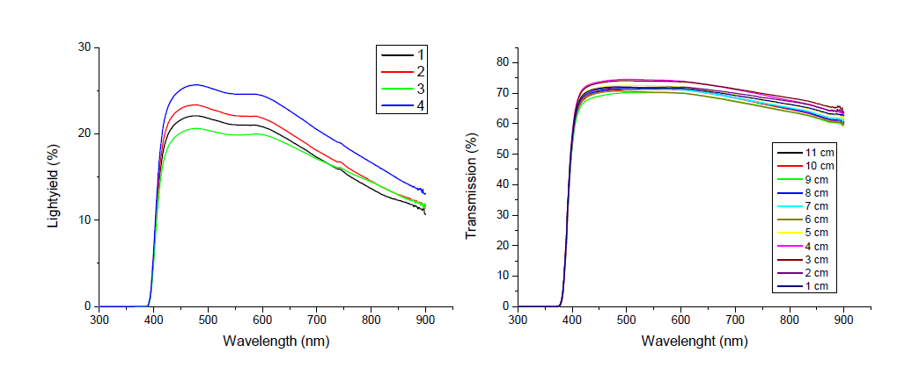
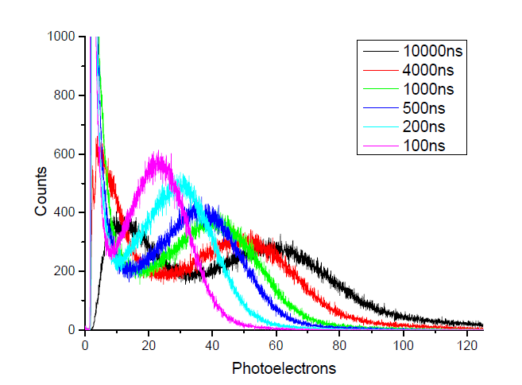
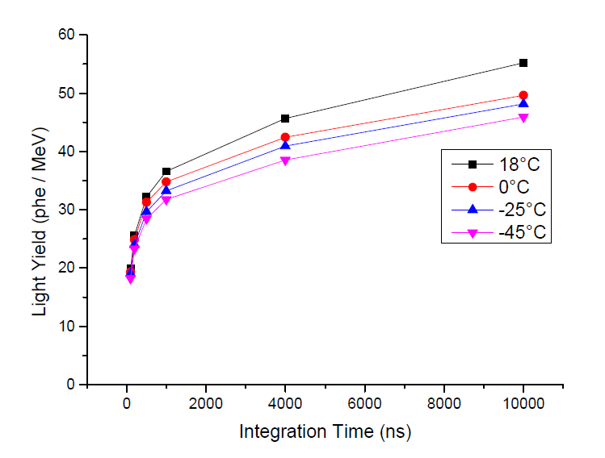
DSB:Ce large volume 23 x 23 x 120 mm³
optical transmission
transmission / %
longitudinal
transversal
light yield
¹³⁷Cs

Slide 12
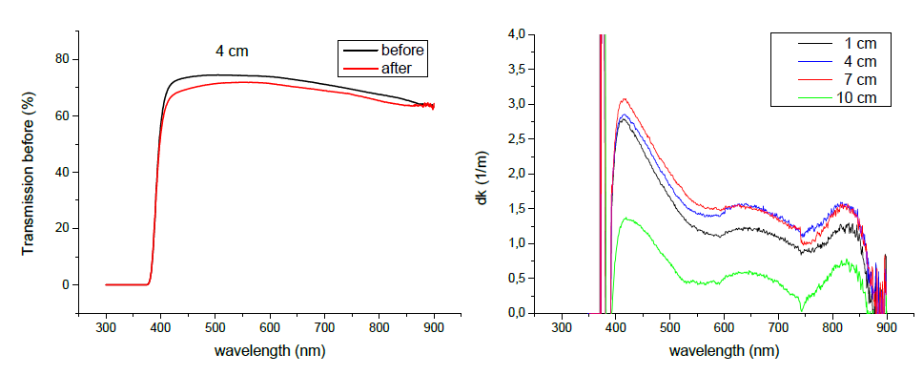
DSB:Ce large volume 23 x 23 x 120 mm³
radiation hardness: 100Gy ⁶⁰Co

Slide 13
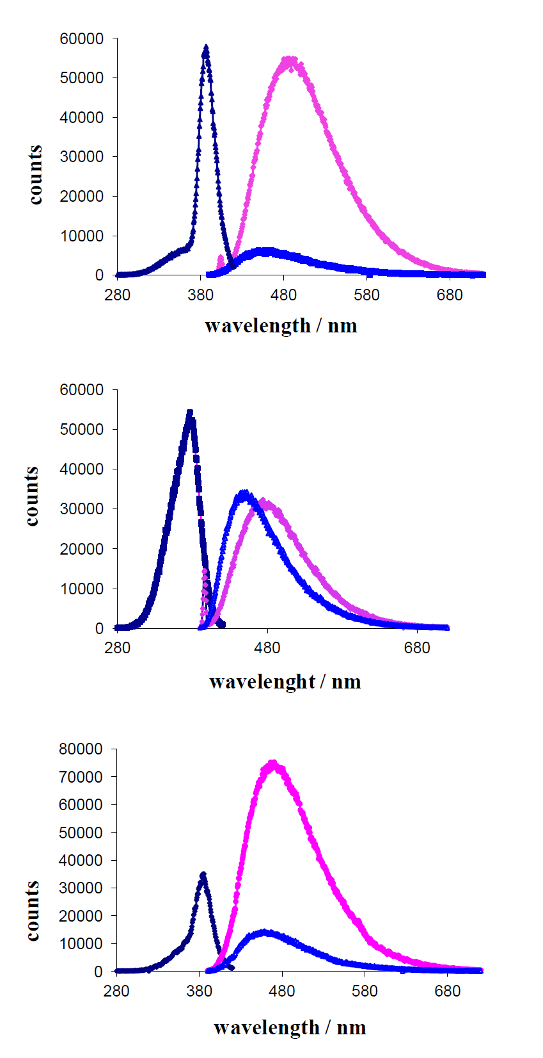
BaO*2SiO₂):Ce
the luminescence
properties
excitation @ 380nm
excitation @ 350nm
DSB:Ce
Gd³⁺-loaded glass appears
not to change the scintillation
created by the Ce³⁺ centers
BaO*2SiO₂):Ce
Gd-loaded

Slide 14
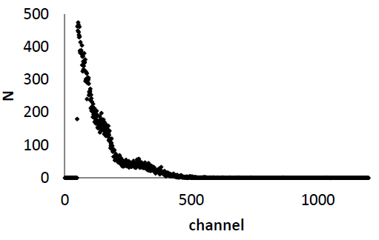
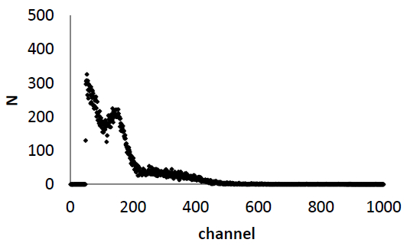
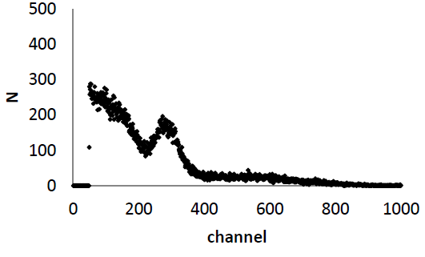
Scintillation properties:
kinetics
Material | Decay constants and their fractions in the kinetics
 | Fast ns (%) | Middfast ns (%) | Slow ns (%)
(BaO*2SiO₂):Ce glass | 22 (12) | 72(50) | 450(38)
(BaO*2SiO₂):Ce glass loaded with 7 weight% of Gd oxide |  | 86(40) | 330(60)
(BaO*2SiO₂):Ce glass loaded with 20 weigth% of Gd oxide | 50(19) | 120(39) | 400(40)
Leads to significant increase of light output measured with a ²²Na γ-source
(BaO*2SiO₂):Ce
glass
(BaO*2SiO₂):Ce
7 weight%
of Gd oxide
(BaO*2SiO₂):Ce
20 weigth%
of Gd oxide

Slide 15
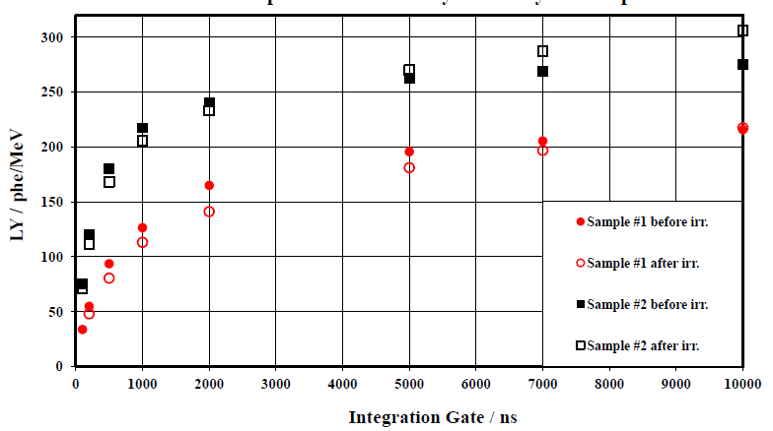
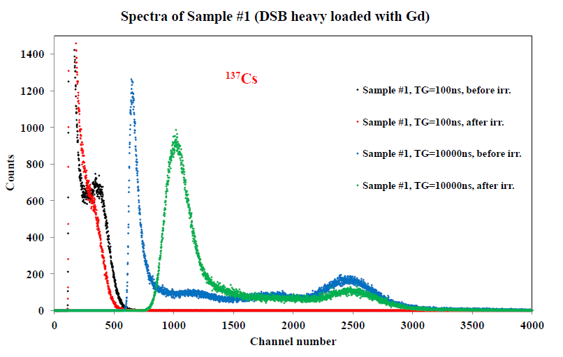
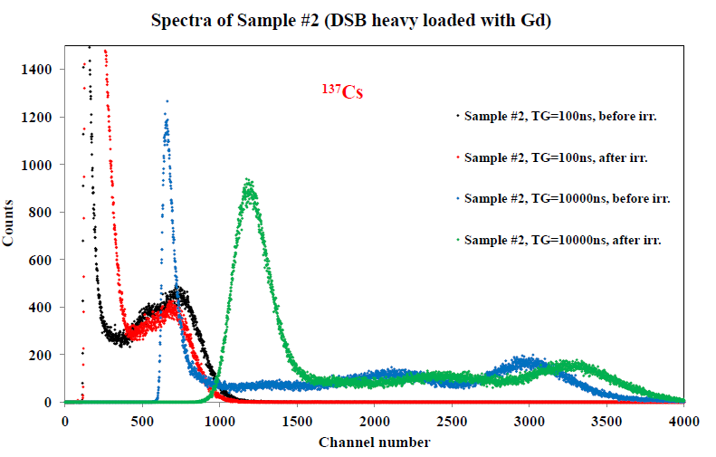
Scintillation property
of 2 selected
Gd-loaded samples
#1: 10 weight% Gd₂O₃
#2: 20 weight% Gd₂O₃
both: 0.5 weight% Ce
Light yield as a function
of gate length
response to ¹³⁷Cs-source (662keV
disturbed stoichiometry leads to additional traps and slows down the scintillation

Slide 16
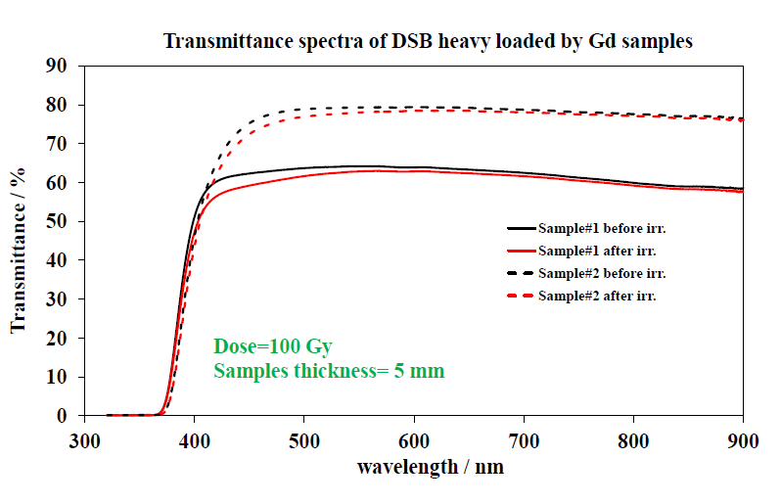
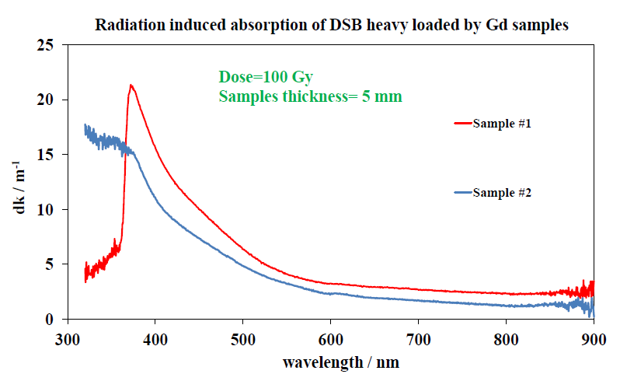
radiation hardness

Slide 17
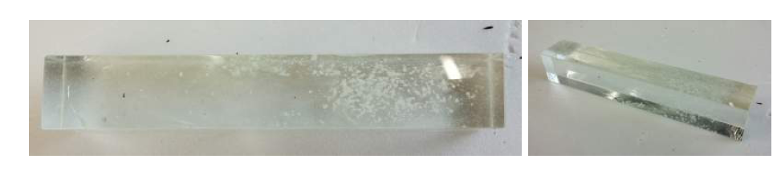
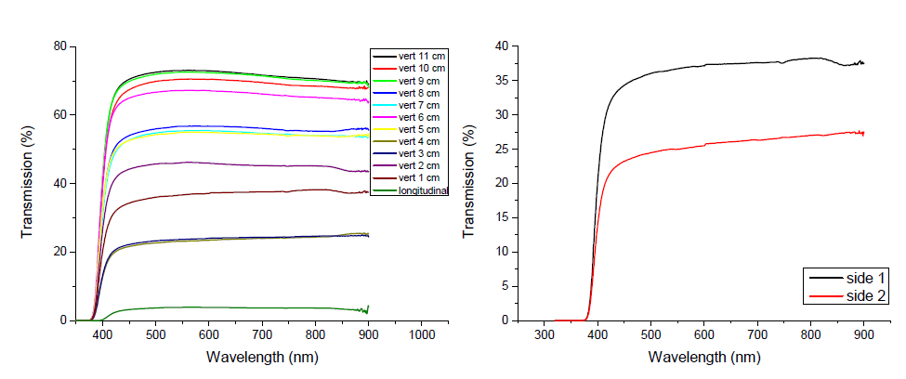
DSB:Ce / Gd loaded large volume 23 x 23 x 120 mm³
macro defects
longitudinal transmission

Slide 18
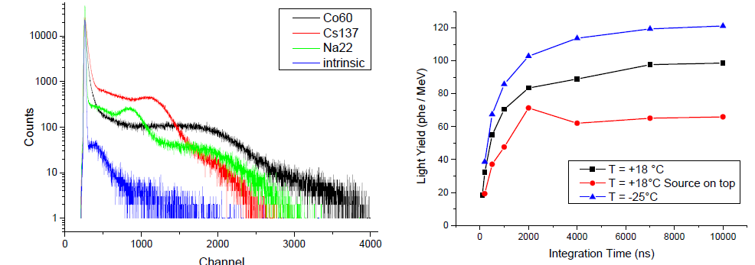
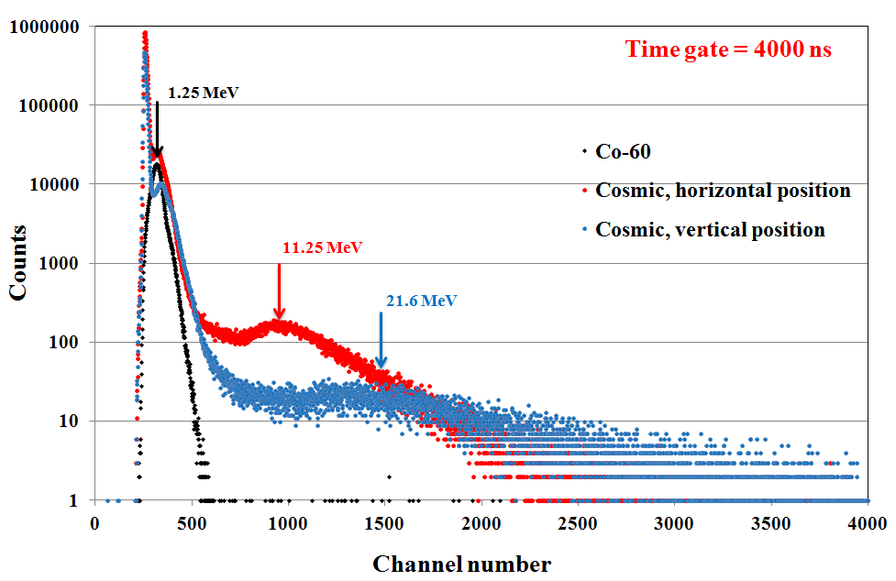
DSB:Ce / Gd loaded large volume 23 x 23 x 120 mm³
response to low energy γ-sources
¹³⁷Cs
response to
cosmic muons

Slide 19
summary and outlook:
DSB:Ce appears to be a promising material
loading with Gd³⁺ helps to increase sensitivity to em probes
wide spectrum of shapes
to do list:
detailed understanding of scintillation centers and the
process of thermal annealing
properties of large volume blocks
need for optimization of Ce³⁺ concentration and Gd/Ce ratio
improvement of fiber production free of cracks
cutting of fibers from blocks

